Slide 1
RIA simulations of ATF fuel in large and WC-SMRs by means of TRANSURANUS
Paul Van Uffelen, Z. Soti, A. Schubert, P. Aragón
IAEA TM on ATF, Vienna, 28-31 October 2025

Slide 2
Contents
Introduction
ATF properties in TRANSURANUS
Case selection
RIA simulation in PWR: Nuscale-like WC-SMR of McSAFER project
RIA simulation in BWR: FK1 case of Fumex-III CRP (IFPE)
Conclusions and perspectives

Slide 3




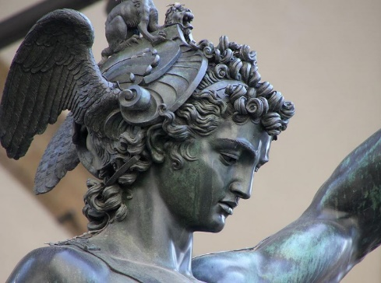
Euratom projects with exp. work on ATF (Prof. K. LAMBRINOU )
H2020 IL TROVATORE Project
(Innovative Cladding Materials for Advanced Accident-Tolerant Energy Systems)
30 partners (Europe, USA, Japan)
BR2 irradiation of global ATF cladding material concepts (i.e., SiC/SiC composites, Cr-coated zircaloys, ODS-FeCrAl alloys)
October 2017 – March 2025
HORIZON SCORPION Project
(SiC Composite Claddings: LWR Performance Optimization for Nominal and Accident Conditions)
16 partners (Europe, USA, Japan, Swiss)
Radical performance optimization of the SiC/SiC composite ATF cladding material concept for Gen-II/III LWRs
September 2022 – February 2026
I-NERI PERSEUS Project
(Advanced PIE of Accident-Tolerant Fuel Claddings Neutron-Irradiated in the BR2 Test Reactor)
7 partners (Europe, USA)
Advanced PIE of BR2-irradiated ATF claddings in H2020 IL TROVATORE
May 2021 – April 2027
I-NERI = International Nuclear Energy Research Initiative
3

Slide 4
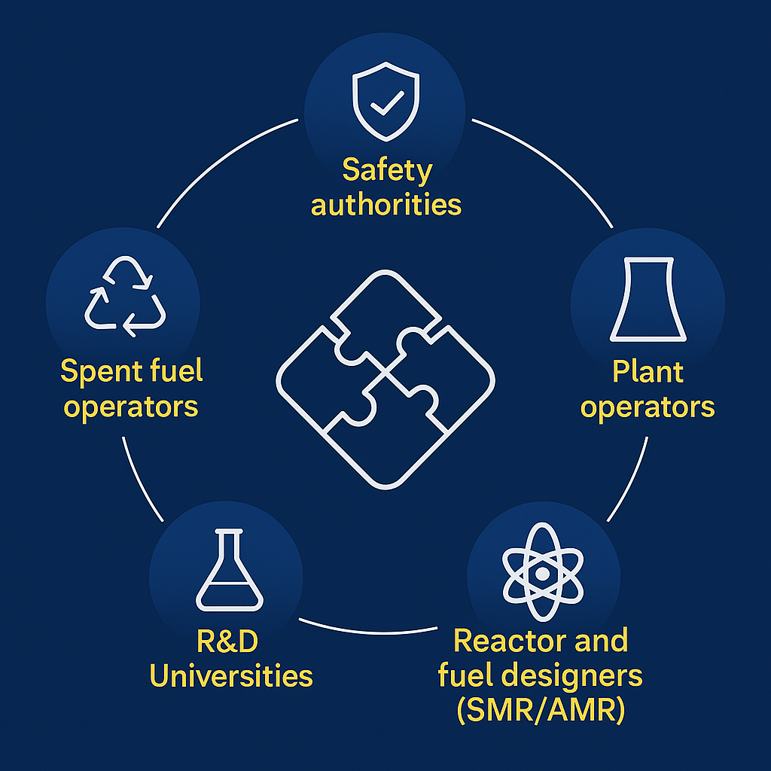
Large user network – Excellent collaboration
Collaborations for ATF
POLIMI, NINE, UPM, NFQ, CIEMAT, IPEN, INRNE, USP, CTU, UCAM
And with support from many
Euratom projects: e.g. Il Trovatore, SCORPION, OperaHPC, APIS, CONNECT-NM

Slide 5
“ATF” in TRANSURANUS
Cladding | Fuel
Zry4 or Zry2 (reference) | UO₂ and Gd-UO₂ (reference)
M5 | U₃Si₂
ZIRLO, optZIRLO | Cr-UO₂ (and ADOPTTM)
Cr-coated Zry | (Th,Pu)O₂, (Th,U)O₂
FeCrAl | MOX(-MA)
SiC | UN, (U,Pu)N
Hastelloy | UC, (U,Pu)C
SS

Slide 6


Preparing for Cr-doped UO₂ fuel
G. Nicodemo et al, Journal of Nuclear Materials 601 (2024) 155301

Slide 7

Fuel phenomena for reference pin and switching to ATF in Rolls-Royce type SMR
A. De Lara et al, Annals of Nuclear Energy 218 (2025) 111355

Slide 8

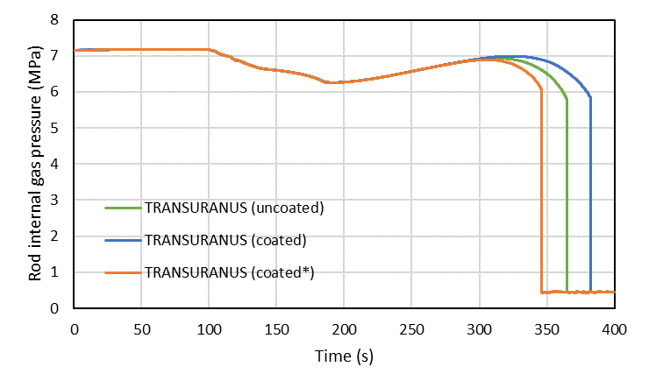

Extend TU(MECH) with Cr-coated Zry
Simulated Halden LOCA test IFA-650.10 simulated using FRAPTRAN + TUmech
P. Aragon et al, Annals of Nuclear Energy 211 (2025) 110950

Slide 9
Contents
Introduction
ATF properties in TRANSURANUS
Case selection
RIA simulation in PWR: Nuscale-like WC-SMR of McSAFER project
RIA simulation in BWR: FK1 case of Fumex-III CRP (IFPE)
Conclusions and perspectives

Slide 10
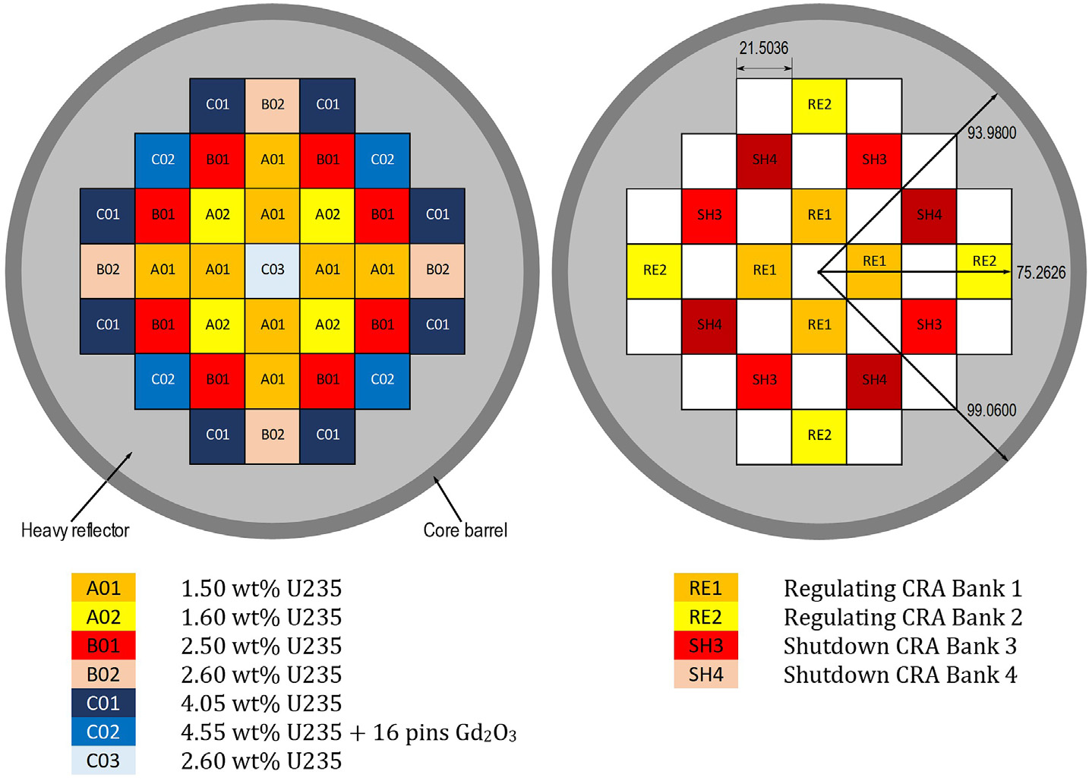
Nuscale-like core

Slide 11
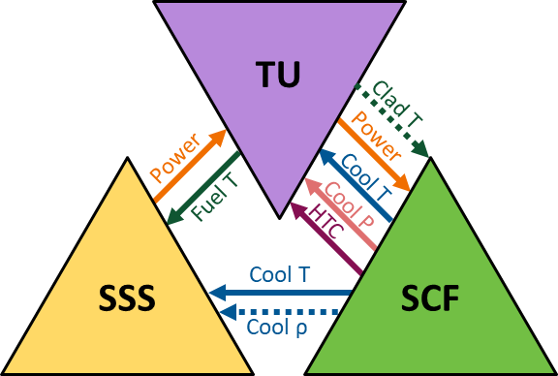
Simulations tools for REA in Nuscale-like core
For the multi-physics calculations we coupled 3 software packages
Serpent2 (SSS): VTT
SUBCHANFLOW (SCF): KIT
TRANSURANUS (TU): JRC
Coupling was done in ICoCo environment of EU Salome platform
We used ICoCo interfaces and supervisor developed in McSAFE project (with HZDR,KIT) and adjusted to needs of RIA
Simulations done on HPCluster of JRC(Petten)
Zsolt et al, Nuclear Engineering and Design 441 (2025) 114183

Slide 12
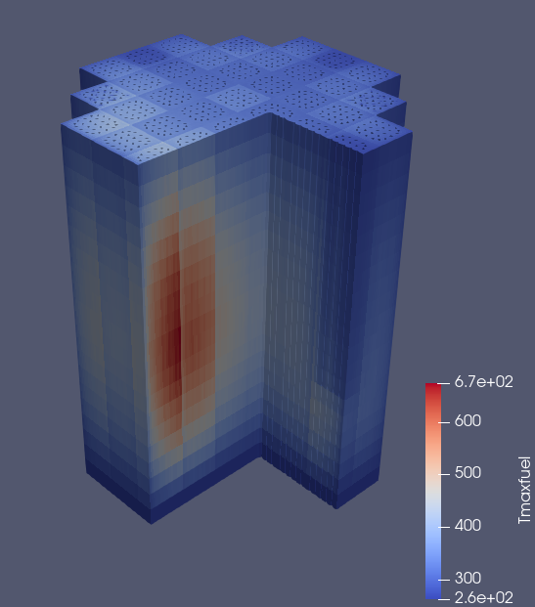
Effect of ATF on fuel temperatures during RIA
Serpent (SSS)
→High-fidelity simulation recommended for ATF in water cooled SMR
TRANSURANUS (TU)

Slide 13
Warning: simulate ATF with same power pulse as UO₂ fuel during a RIA may be misleading (e.g Liu et al with CAMPUS code)
Progress in Nuclear Energy 159 (2023) 104648
Melting in U₃Si₂ fuel in pellet periphery
during RIA may not happen due to lower
power peak in ATF

Slide 14
Contents
Introduction
ATF properties in TRANSURANUS
Case selection
RIA simulation in PWR: Nuscale-like WC-SMR of McSAFER project
RIA simulation in BWR: FK1 case of Fumex-III CRP (IFPE)
Conclusions and perspectives

Slide 15
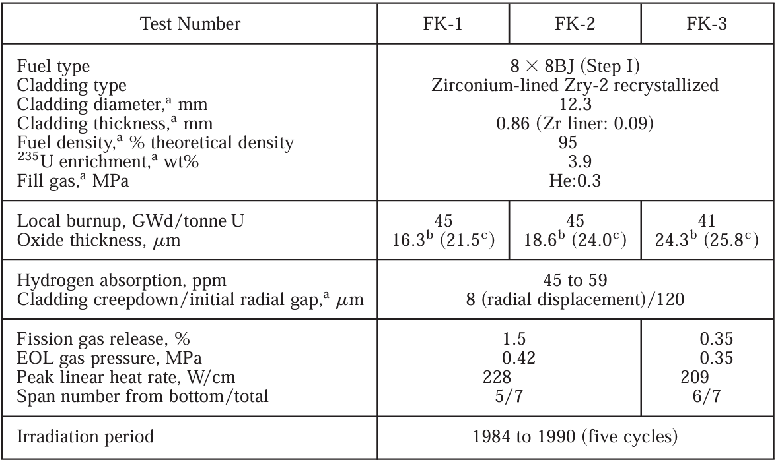
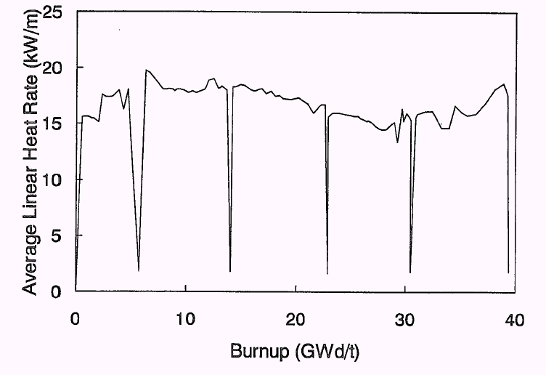
FK1 case of FUMEX-III
Refabricated BWR fuel rods
Base irradiated in Fukushima 1
RIA test in NSSR

Slide 16
Coolant T during RIA

Slide 17
Temperature in standard fuel during RIA

Slide 18
Melting achieved in U₃Si₂ fuel, assuming peak power of oxide fuel

Slide 19
Evolution of radial T in ATF during RIA of FK1

Slide 20
Fuel centre T during RIA

Slide 21
Gap size during RIA (slice 3)

Slide 22
Summary
Implemented and tested successfully a variety of ATF properties in TRANSURANUS in collaboration with the large user community, and support from Euratom projects (Il Trovatore, OperaHPC, APIS, etc.)
Pointed out need for careful safety analysis (e.g. Melting in ATF))
High-fidelity coupling of codes proved useful for SMR/AMR, especially where few data are available

Slide 23
Perspectives Direct support TRANSURANUS for SMR/AMRs
Projects identified so far by IA SMRs
Other advanced reactor projects
EU-SMR-LFR project (Ansaldo Nucleare, SCK-CEN, ENEA, RATEN)
CityHeat project (Calogena, Steady Energy)
Project Quantum (Last Energy)
European LFR AS Project (newcleo)
Nuward (EDF)
European BWRX-300 SMR (OSGE)
Rolls-Royce SMR (Rolls-Royce SMR Ltd)
NuScale VOYGR™ SMR (RoPower Nuclear S.A)
Thorizon One project (Thorizon)
SEALER (Blykalla)
Hexana
Tractebel
SOLO (Terra Innovatum)
MYRRHA (SCK-CEN)
TRANSURANUS license
Under discussion
→JRC directly supports projects and Technical Working groups of IA SMR

Slide 24

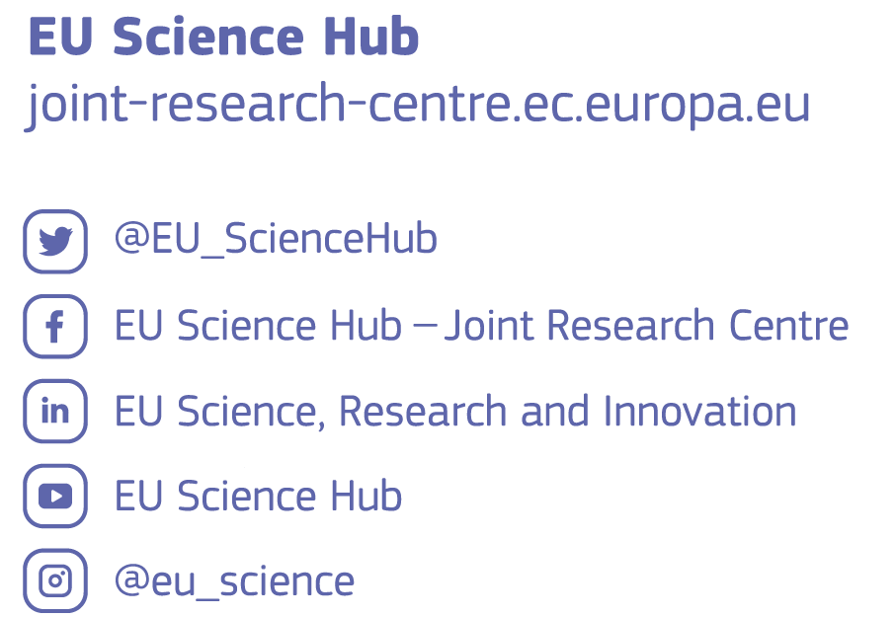
Thank you and keep in touch
© European Union 2024
Unless otherwise noted the reuse of this presentation is authorised under the CC BY 4.0 license. For any use or reproduction of elements that are not owned by the EU, permission may need to be sought directly from the respective right holders.
Notes:
Update/add/delete parts of the copy right notice where appropriate.
More information: https://myintracomm.ec.europa.eu/corp/intellectual-property/Documents/2019_Reuse-guidelines%28CC-BY%29.pdf

Slide 25

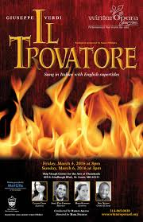

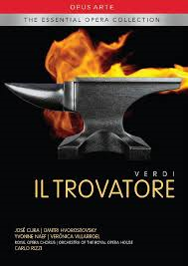

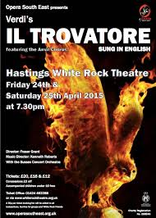

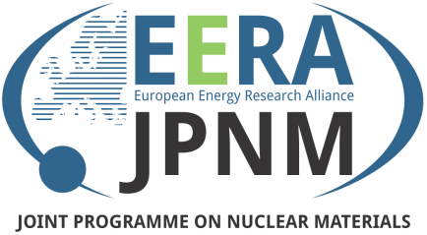
H2020 IL TROVATORE (Innovative Cladding Materials for Advanced Accident-Tolerant Energy Systems)
Prof. Konstantina Lambrinou, University of Huddersfield (UoH), UK
H2020 European Research & Innovation Action (RIA)

Slide 26
H2020 IL TROVATORE
Goal: Help to address the global societal & industrial need for improved nuclear energy safety by optimizing and validating select ATF cladding material concepts in an industrially relevant environment → neutron irradiation in contact with PWR-like water in the BR2 research reactor

Slide 27



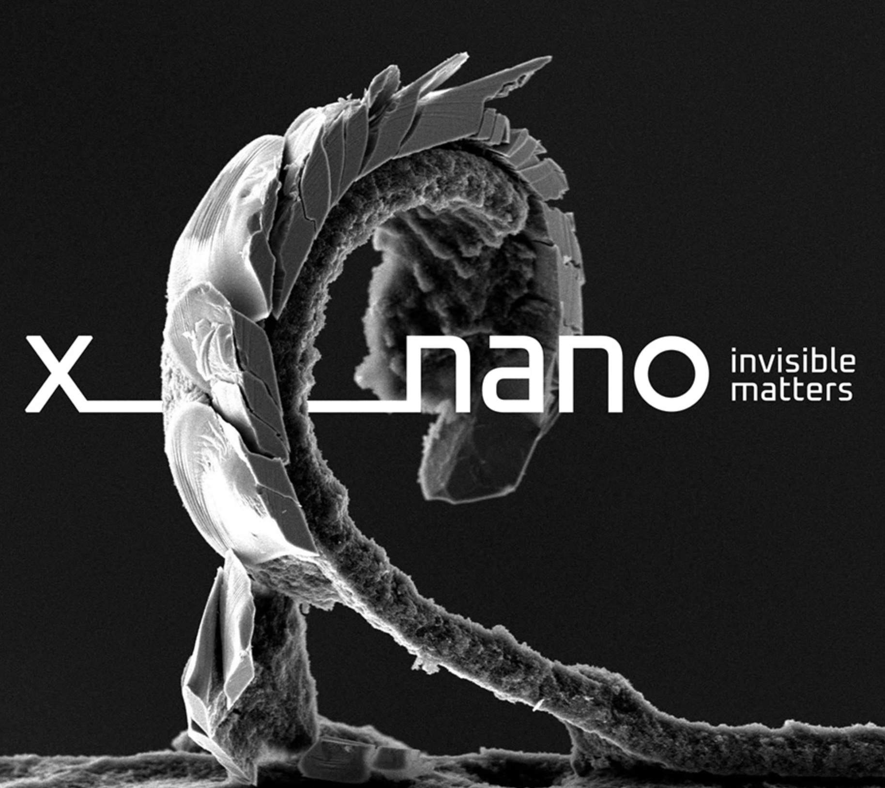









HORIZON SCORPION (SiC Composite Claddings: LWR Performance Optimization for Nominal and Accident Conditions)
Prof. Konstantina Lambrinou, UoH (UK) & IIT (Italy)
HORIZON European Research & Innovation Action (RIA)

Slide 28

HORIZON SCORPION Project – Introduction & Objectives
Modular Material Design Approach:
connecting the nanoscale to the macroscale
Core Objectives: improvement of SiC compatibility with the coolant (water/steam) & resistance to radiation swelling

