Slide 1

SEPARATE EFFECT TESTS WITH ATF CLADDING MATERIALS WITHIN IAEA ATF-TS CRP
Martin Ševeček^{1,2}
¹Czech Technical University in Prague
²UJP PRAHA, a.s.
Technical Meeting on Advanced Technology Fuels 28th of October, 2025 Vienna, IAEA

Slide 2
Outline
ATF-TS Experimental Programme
Ballooning and burst tests
Conclusions and Summary
High-temperature steam oxidation
Autoclave corrosion tests
Mechanical tests

Slide 3
Strategy for SET experimental programme
ATF fabrication
Experimental facilities
Experimental data and correlations
Benchmark exercise = model validation
Database development
ATF LOCA methodology
Participants proposed to provide ATF cladding materials for testing – morning presentation
Other participants proposed testing campaigns using their facilities
Different testing capacities, geometry, test parameters, methodologies, manpower and resources
Test matrix? - Primary objective - to coordinate sample providers and experimentalists to produce valuable data, i.e.:
Not to repeat what was done in the past/complementary testing
Round robin tests if feasible
Support of future benchmarks (fuel performance ballooning/burst, DEGREE tests, QUENCH and CODEX tests)

Slide 4
Strategy for SET experimental programme
ATF fabrication
Experimental facilities
Experimental data and correlations
Benchmark exercise = model validation
Database development
ATF LOCA methodology
SETs provided models for implementation and validation cases for fuel performance and system codes
Collected data and correlations needed for benchmark exercises
WT2.1 – SET benchmark with Cr-coated Zr and FeCrAl
WT2.2 – DEGREE + CODEX bundle tests with correlations from SETs (pre- and post-test calculations)
Data to be stored in a database (MATPRO-like)
Data from the experimental program provided to WT4 for processing and implementation in Open Access MATPRO-like ATF database
IAEA – new Fuels and Materials database available for all member states (EK and CTU data already uploaded)

Slide 5












Experimental facilities
+VTT, BSU, INL that left during the project
12 laboratories/institutes proposing various testing campaigns
CNPE – HT oxidation; Ballooning/burst
CNPRI – axial tensile tests; internal burst tests; internal creep tests; autoclave corrosion tests; HT steam oxidation
CRIEPI – bundle/single rod tests
CTU/UJP – ballooning/burst tests; HT steam oxidation; Autoclave corrosion
EK – HT oxidation; ballooning/burst tests; Mechanical tests; CODEX bundle test
INCT – autoclave corrosion tests; HT air oxidation; NAA
JRC – thermal characterization; mechanical tests
KAERI/SNU – LOCA testing; PQD evaluation; DSC-eutectic study; Micro-mechanics
KIT – HT oxidation tests; single rod tests
NPIC – FeCrAl-thermomechanical tests; SiC – thermal shock tests; irradiation tests
UPM – Autoclave corrosion; Ring compression tests; Cathodic charge; Burst tests

Slide 6
Ballooning/burst tests

Slide 7
TASK 2: HT creep/ballooning/burst
Originally defined for a round robin exercise. But due to different limitations, the tests are not standard RRTs but rather complementary tests of several cladding candidates. However, RRTs was possible in several instances.
HT creep/ballooning/burst
CTU/UJP
Constant pressure-temperature ramp (0.7K/sec and 7K/sec)
Isothermal isobaric creep tests (constant moles of gas vs. infinite volume) at 750 and 950 °C
EK
Constant temperature (750, 850 and 950 °C; 800, 900 and 1000 °C) – pressure ramps (5; 100 kPa/s)
As-received and pre-oxidized samples
UPM
Isothermal pressure ramps (1 bar/s) – 100mm; 600 °C
Autoclave pre-oxidized and as-received
CNPE
Isothermal (800, 840, 900 °C) pressure ramps (6 and 100 kPa/s)
CNPRI
Lower temperature (350 °C) pressure ramps (13.8 MPa/s)
SNU
Single rod LOCA tests with surrogate pellets/fragments; (closed volume, 60–80 °C/s using IR heating)

Slide 8
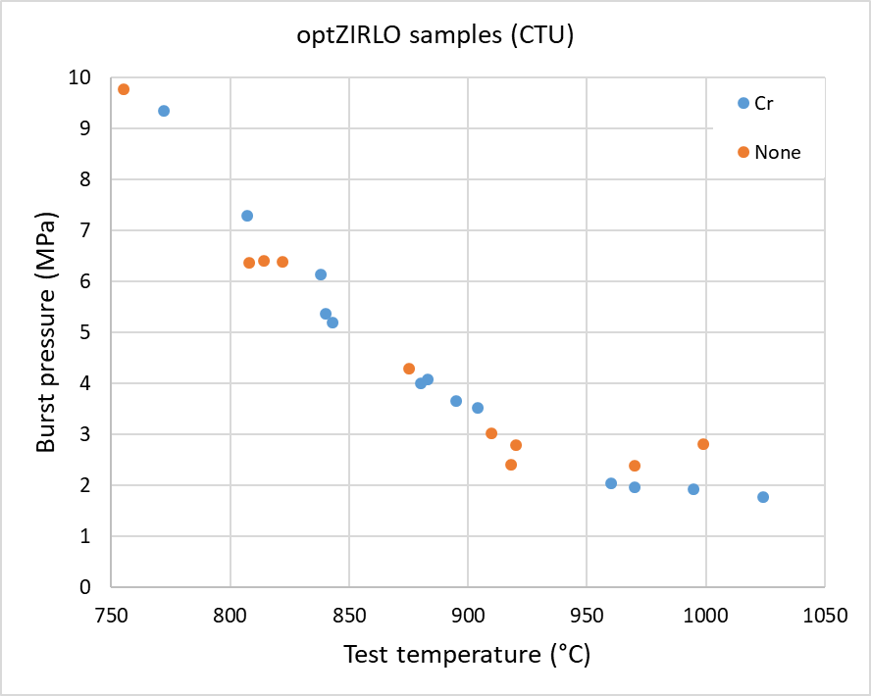
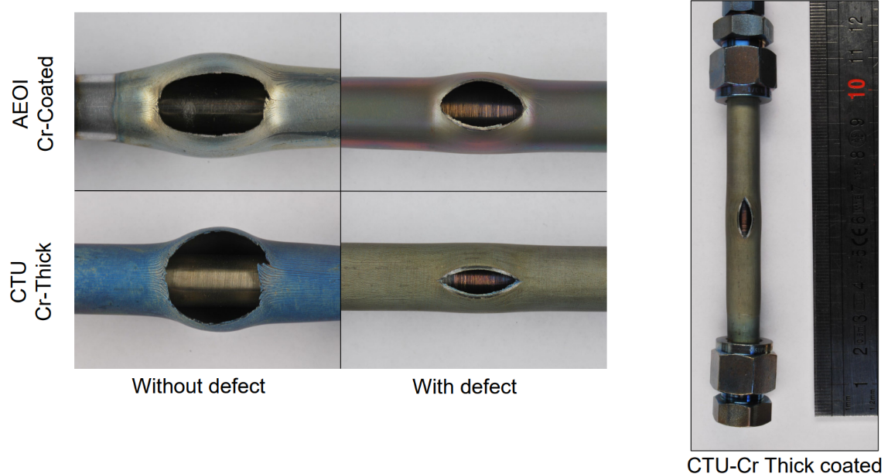
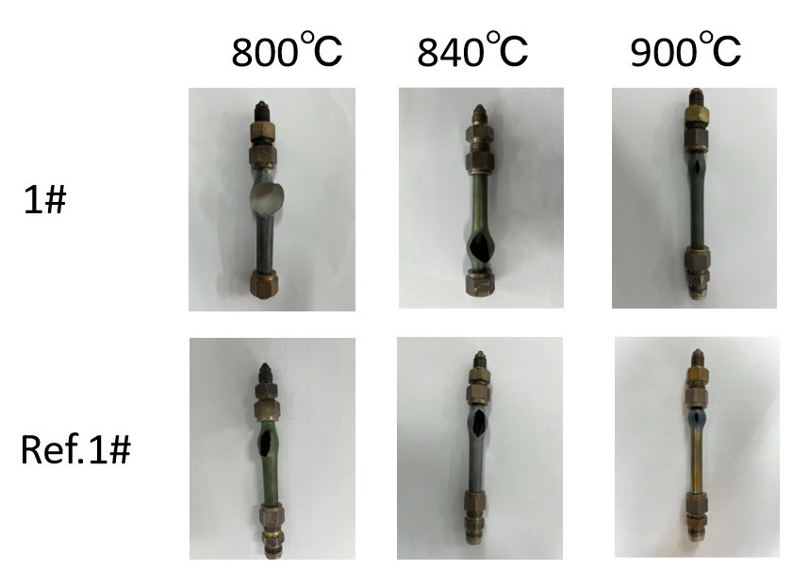
HT creep/ballooning/burst – Main Findings
Coated Zr cladding
Limited benefit of coatings in time-to-burst, generally within the uncertainty range
Ballooning and opening size – coated Zr provide some benefits but the extra margin depends on the specific test conditions and methodology.
New creep correlation and burst criteria derived (both stress- and strain-based for coated cladding) and provided to WT2 for model implementation and validation. Correction coefficients proposed for fuel performance models.
In most cases, reference Zr materials behave similarly to coated Zr given ±20% uncertainty.

Slide 9
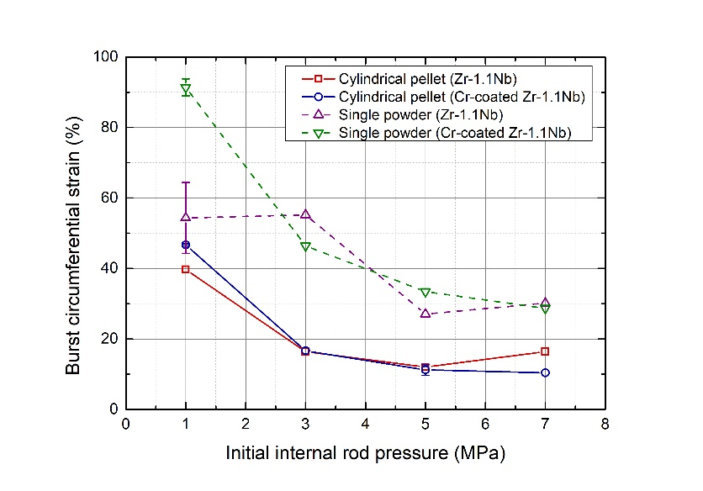
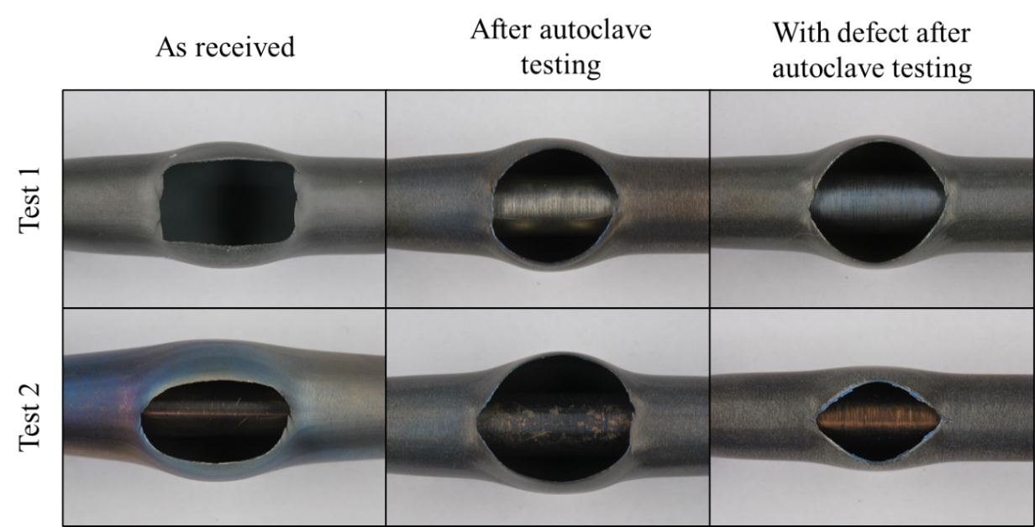
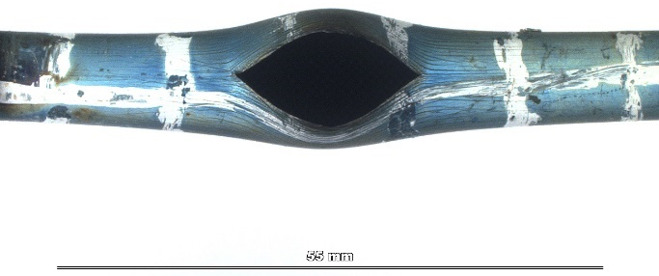
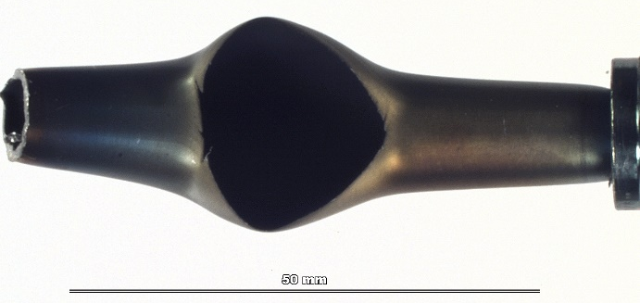
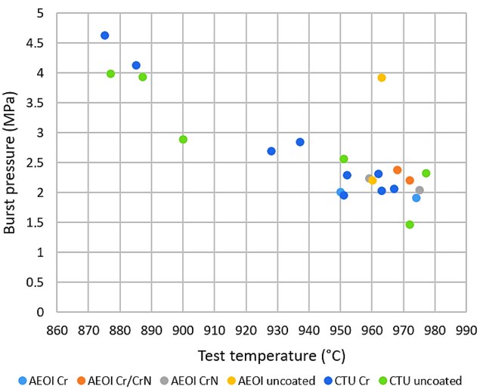
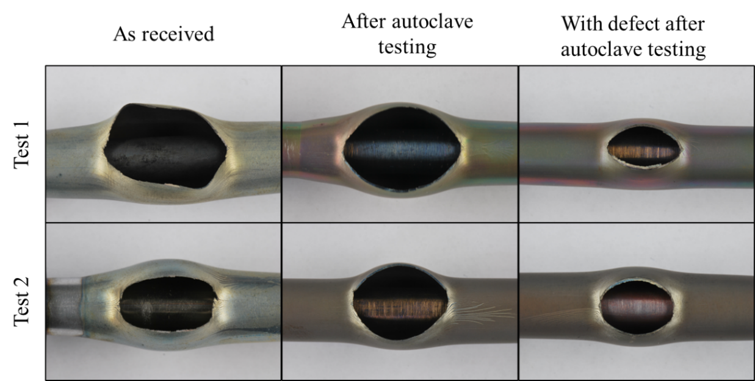
Coating cracking - different patterns and consequences for each type
Ballooning size reduction – closely linked to chosen Zr alloy (more beneficial for softer Zr/Nb alloys)
Strong effect of methodologies – pre-oxidation, geometry of fuel matrix, closed/infinite volume…

Slide 10
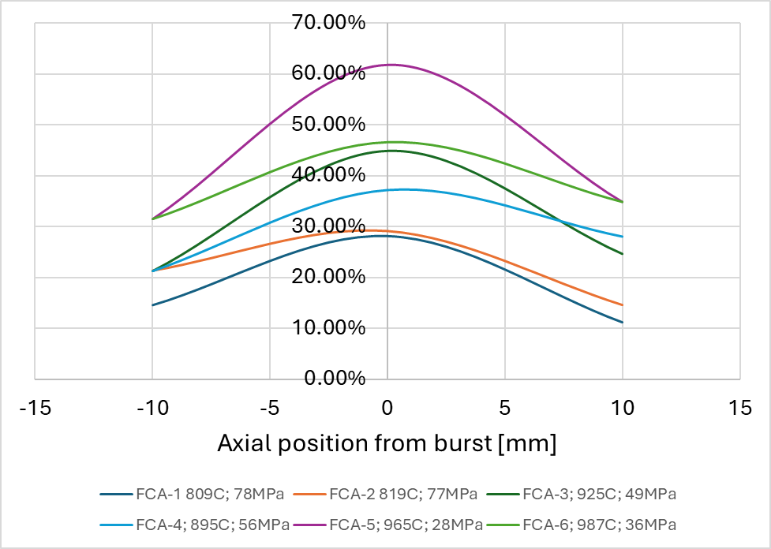
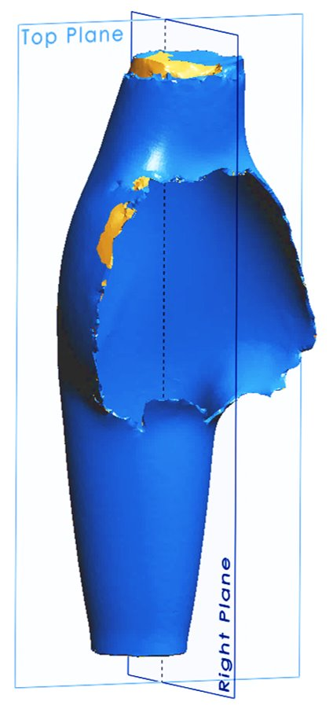
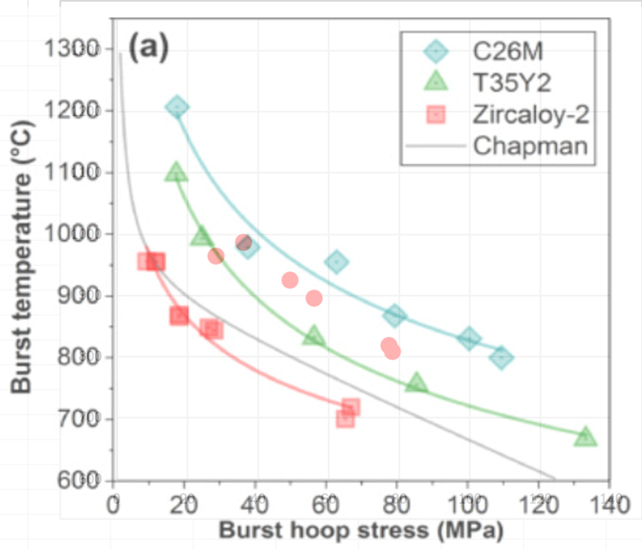
HT creep/ballooning/burst – Main Findings
FeCrAl
Limited volume of material was available but a very different performance was discovered for FeCrAl.
Strengthening effect confirmed but partially eliminated by thinner wall.
Fuel performance codes were not able to predict this behavior because the models were historically developed and tuned for Zr-based materials.
Dozens of experimental datasets were measured and prepared for the new IAEA Fuels and Materials database. Further analysis is foreseen as well as usage of the data for code validation.

Slide 11
High-temperature oxidation

Slide 12
TASK 3: HT oxidation
High-temperature oxidation tests
Small scale SETs (test parameters according to internal methodologies ):
CNPRI – HT double-sided steam oxidation up to 1400 °C
CTU/UJP – double and single-sided steam oxidation + PQD evaluation
EK – steam oxidation tests + RCTs
KAERI/SNU – LOCA testing; PQD evaluation
INCT – Ar annealing test
CNPE – steam oxidation test
KIT , CRIEPI , KAERI/SNU – single rod tests – ramp/isothermal

Slide 13
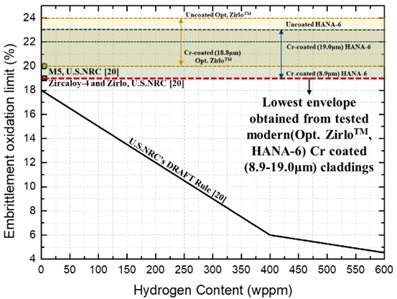
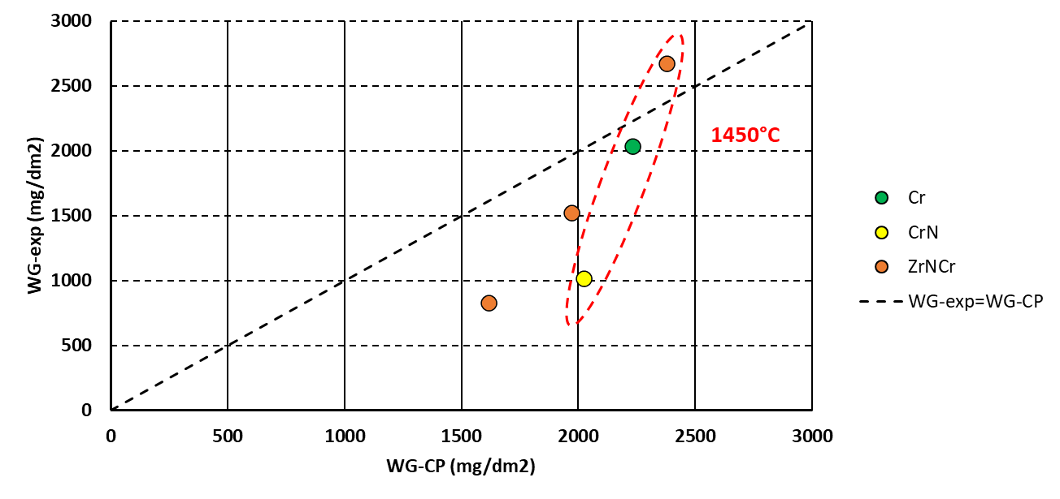
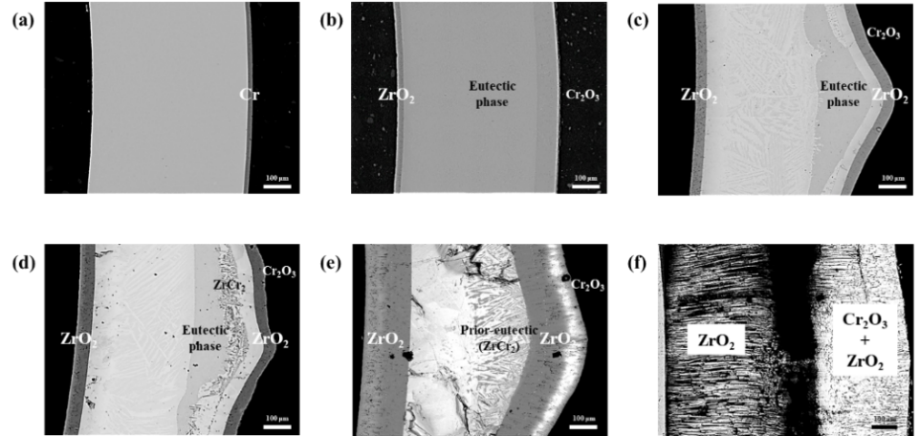
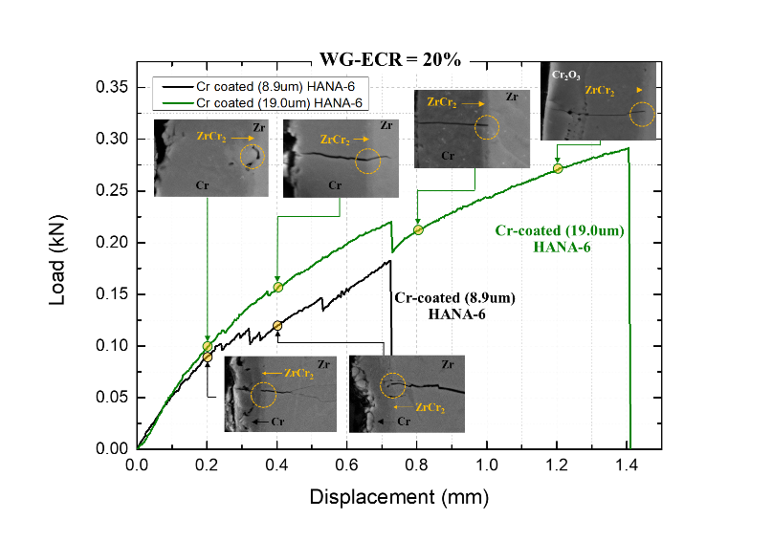
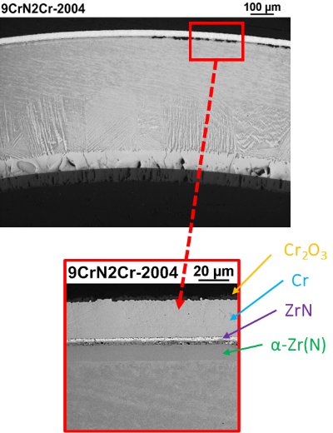
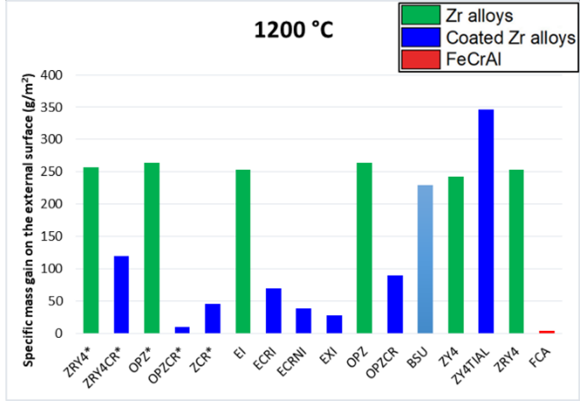
Current ECR a PCT criteria are conservative and can be used for Cr/Zr evaluation. But the degradation mechanisms change significantly.
There are alternative materials/interlayers that can delay degradation observed for Cr/Zr.
Coating quality and defects are very important for evaluation. There’s no generic Cr/Zr cladding.

Slide 14
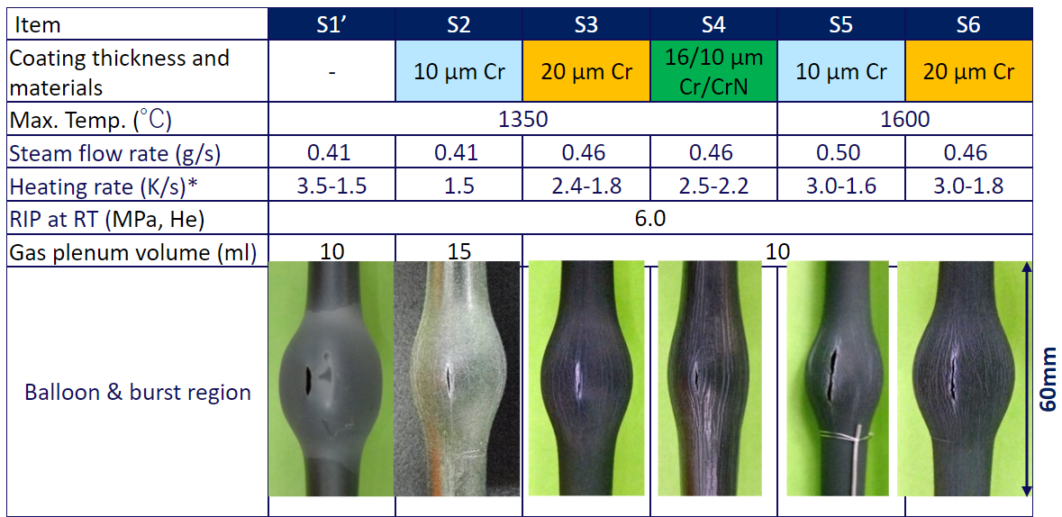
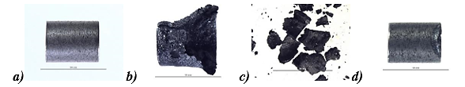
HT oxidation – Main findings
Coated Zr:
Eutectic Cr/Zr – another degradation mechanism (e.g. secondary hydriding, oxygen embrittlement), not hard limit (melting point). Effect of coating thickness observed.
ECR criteria for coated Zr – does not have physical meaning and should be replaced. But it’s conservative and can be used by industry if needed.
CrN/Cr – benefits in BDBA conditions confirmed by CRIEPI, KIT. Open questions remain but it seems like a feasible way to further improve pure Cr coatings.
FeCrAl:
Focus on FeCrAl HT oxidation kinetics:
a) 1350 °C/30 min; b) 1360 °C/5 min; c) 1375 °C/30 min d) 1375 °C/RAMP 900.

Slide 15
Long-term corrosion tests

Slide 16
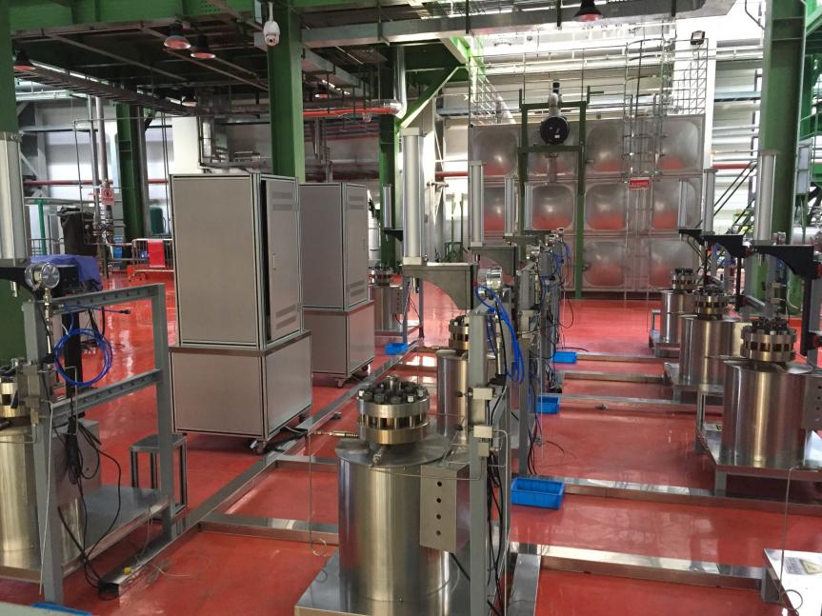
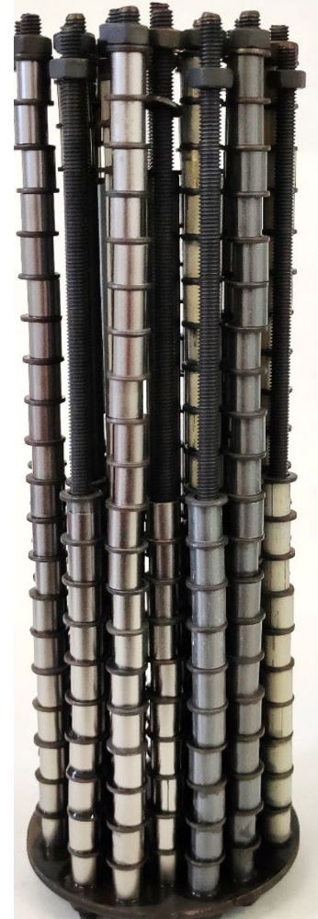
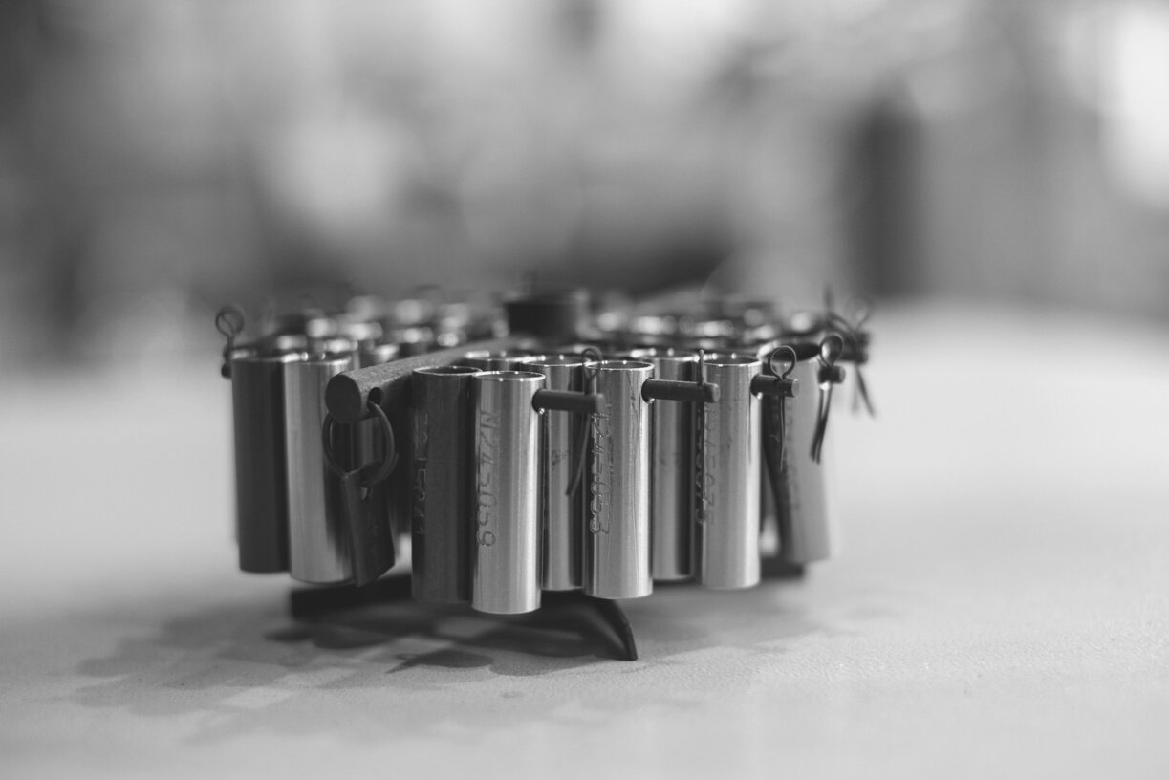
TASK 4: Autoclave corrosion tests
Long-term corrosion tests with available autoclaves – static/dynamic
Various chemistries based on internal methodologies (VVER, PWR, BWR)
At least 200 days with (non)-destructive analysis after specified exposure times
Measurements – weight gain, corrosion kinetics, oxide morphology, thickness, XRD, H-pickup
CTU/UJP, UPM, INCT, CNPRI
Objectives:
long-term corrosion behavior or ATF cladding materials with evaluation of H pickup + RRT test + characterization pre- and post-tests
Evaluation/feasibility of ATF concepts in the simulated primary coolant (ACTOF goal but new materials proposed)

Slide 17
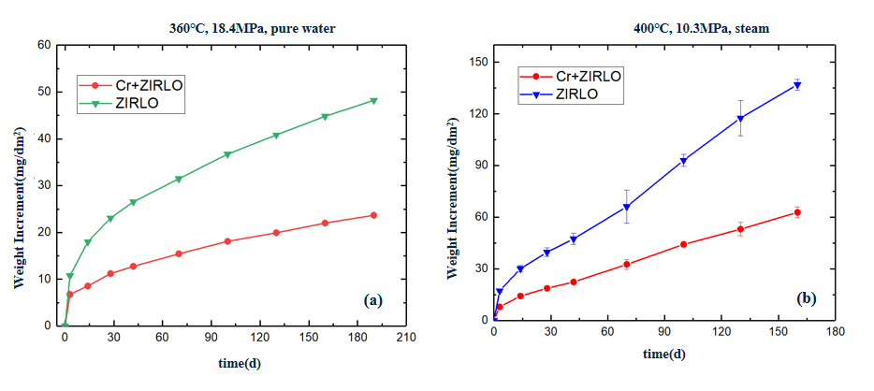
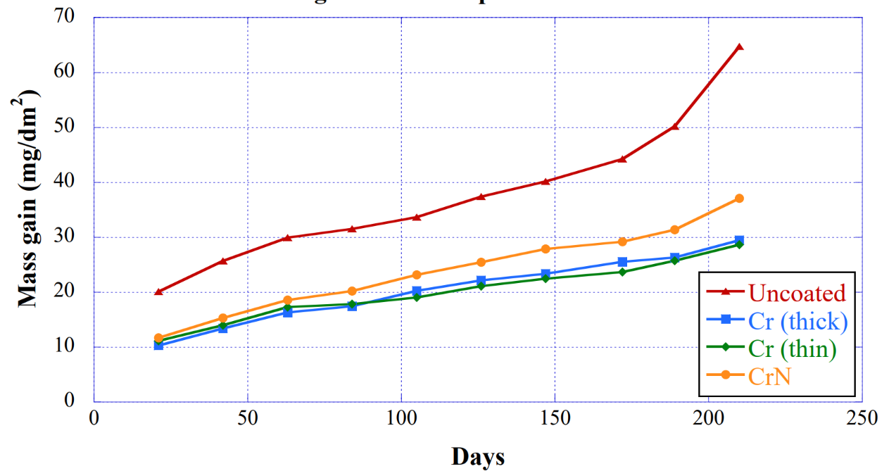
Autoclave corrosion tests
Similar performance of all Cr-based coatings, no effect of coating thickness or substrate found. Excellent behavior confirmed.
Cr plasma treated = poor performance
Hydrogen pickup was reduced with coatings but not as much as the corrosion rate. The mechanisms related to the H-pickup of coated Zr are still not fully understood.
Recommendation – at least 200 days are required to have a general idea about the corrosion behavior. Data shouldn’t be extrapolated and several years are needed for full qualification.

Slide 18
Mechanical tests

Slide 19
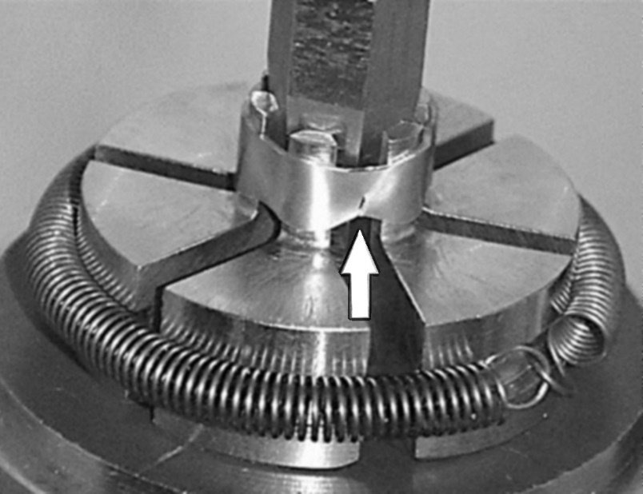
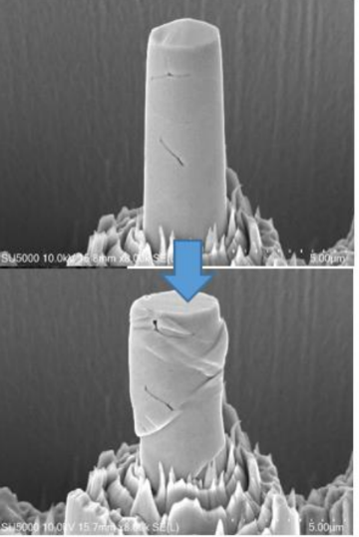
TASK 5: Mechanical tests
EK – Mandrel test, Ring compression tests, tensile tests
CNPRI – axial tensile tests, ring tensile tests
UPM – ring compression tests (as-received, with defects, after corrosion test)
NPIC – coated N36 – axial and ring tensile tests; FeCrAl – tensile test before and after irradiation; SiC/SiC – thermal shock tests
KAERI – Coating micro-compression tests
Objectives – study the mechanical performance of available ATF cladding materials and the applicability of current mechanical models to ATF cladding.

Slide 20
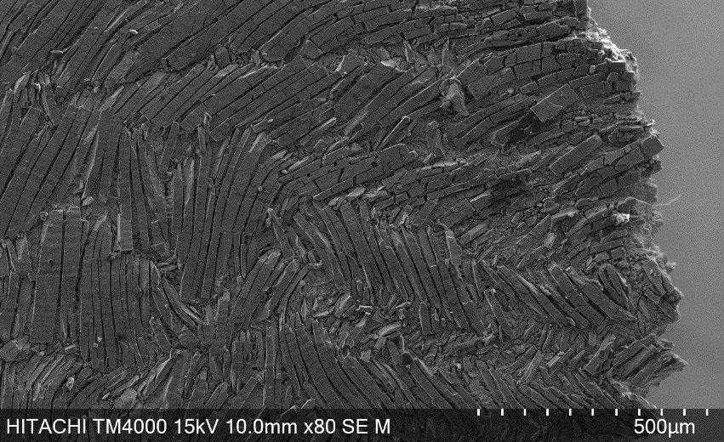
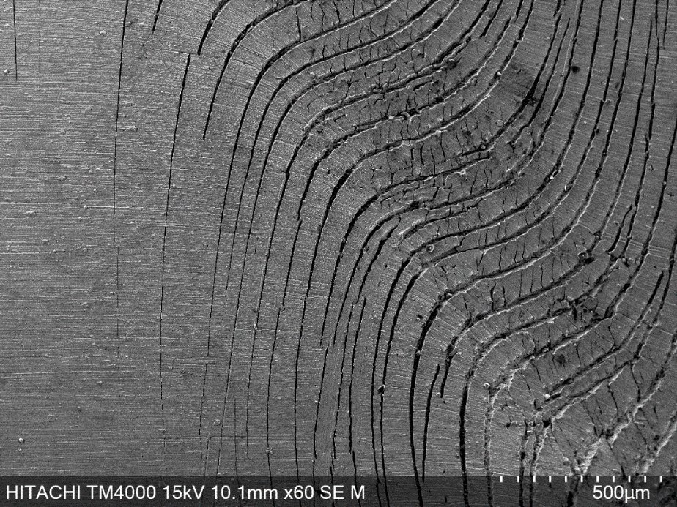
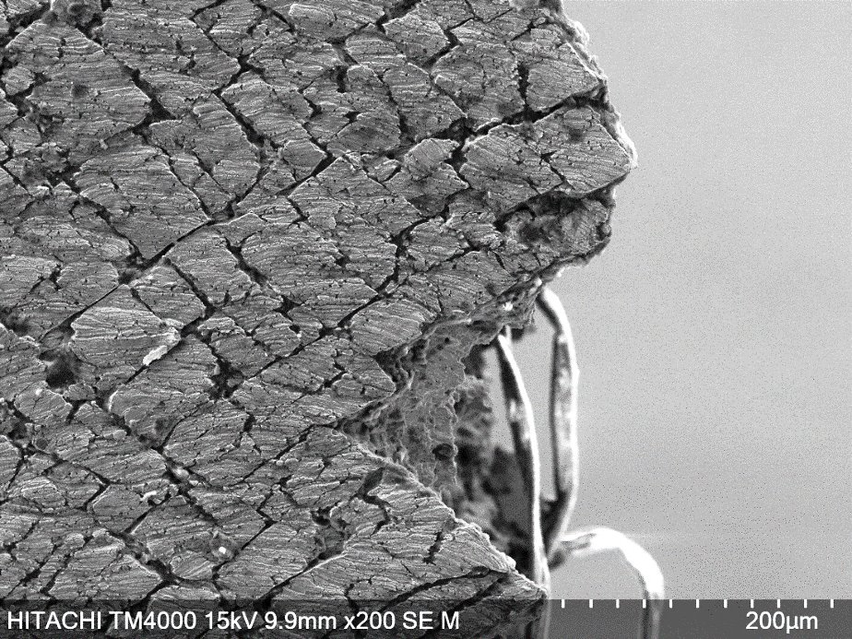
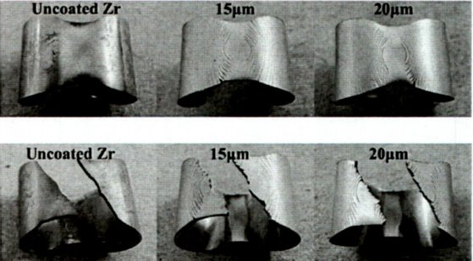
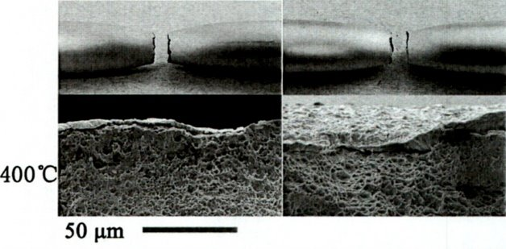
Mechanical tests – Main Findings
Coating fracture mechanics is very complex and differs for all deposition techniques and parameters
Coating increases samples’ stiffness, coated cladding in general show yield and tensile strength but lower elongation
Artificial defects in the coating affect the overall mechanical properties = stress localization and crack initiation site

Slide 21
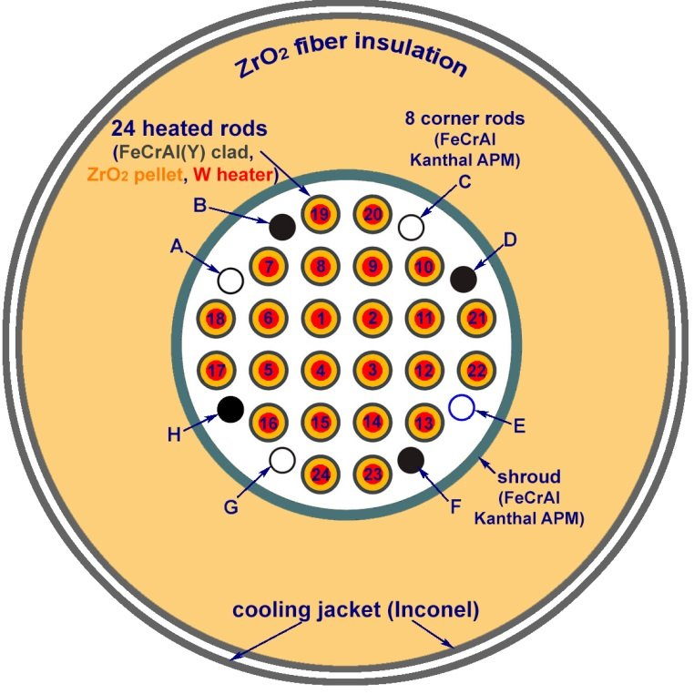
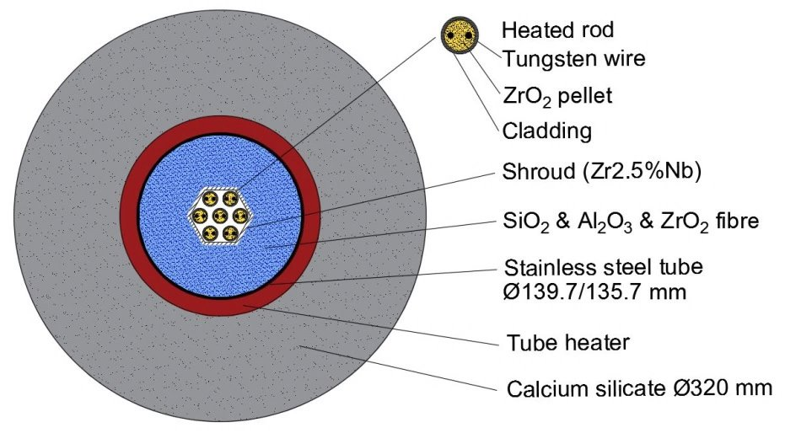
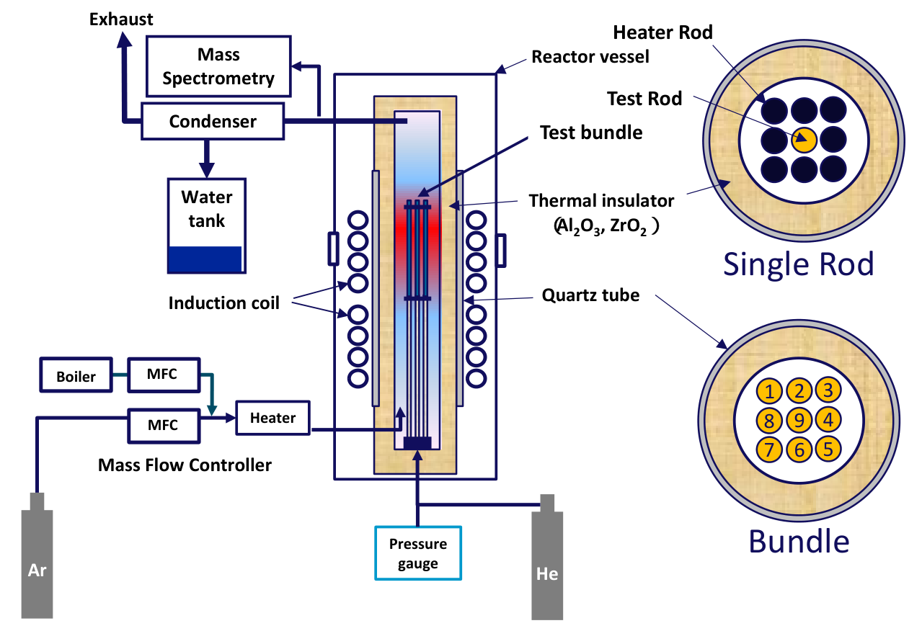
Bundle tests – QUENCH, CODEX, DEGREE
QUENCH-19 – first-ever bundle test with ATF cladding
FeCrAl B136Y investigated within ATF-TS to update material correlations and organize wider benchmark exercise – see Juri’s presentation
“IAEA ATF-TS Benchmark for simulation of bundle tests” – J. Stuckert et al.
CODEX-ATF – PVD Cr coated Opt. ZIRLO in VVER geometry – DEC-A conditions
“CODEX-ATF: integral bundle test with accident tolerant fuel” – Z. Hozer et al
DEGREE – series of bundle tests DBA and BDBA
“BEHAVIOR OF BUNDLES WITH CR COATED CLADDINGS UNDER BDBA CONDITIONS AT THE DEGREE FACILITY” – K. Nakamura et al

Slide 22
Conclusions and Summary
ATF-TS was divided into several work packages with strong interlinks – WPs 2, 3 and 4 relied on experimental results from WP1. WP1 further divided based on the test type.
Ten organizations fabricated and shared their ATF cladding materials, and 14 laboratories performed various experimental investigations
Ballooning and burst – new failure criteria and creep correlations
HT steam oxidation – independent evaluation of all degradation mechanisms for all concepts
Autoclave corrosion – good performance confirmed even with low coating thicknesses and lower quality.
Mechanical performance – complex fracture mechanisms of different coating based on their microstructure (deposition parameters) which will further change with irradiation.
+ many more tests documented in the TECDOC not covered here (hydrogen uptake, microstructure, thermal shock tests, thermophysical properties…)
Two major challenges: 1) COVID pandemic (delays of shipments, closed laboratories) and 2) Political situation in the world (membership and scope of the WP changed significantly during the project)
Despite the challenges, ATF-TS was the most successful and productive CRP in the Fuels&Materials area, especially in the experimental field.
Hundreds of new open datasets, dozens of journal and conference publications, new material correlations and models, validation cases from both, separate effect and integral bundle tests…

Slide 23
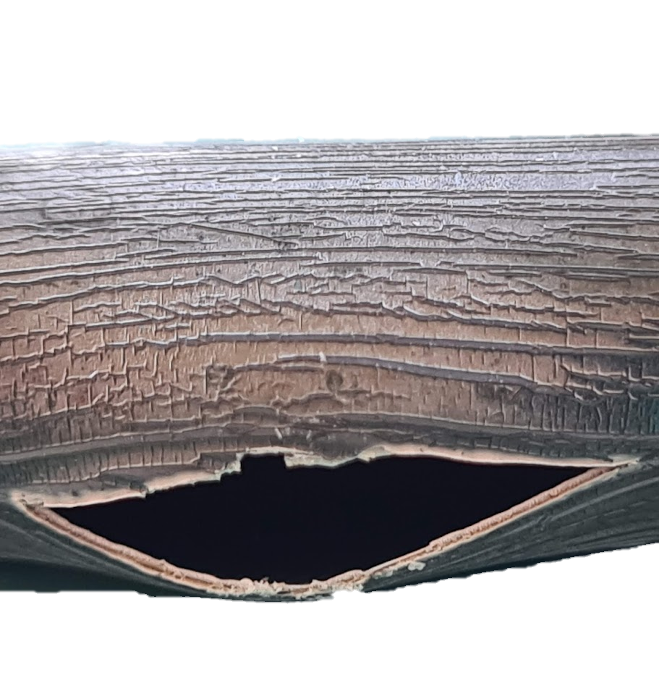




Acknowledgment
Questions?
Special thanks to all participants and partners within ATF-TS CRP.

