Slide 1


IAEA ATF BENCHMARK OF FUEL ROD CODES FOR SIMULATION OF SELECTED SEPARATE EFFECT TESTS
A. Bouloré ¹, M. Cherubini ²
¹ CEA.DES.IRESNE.DEC, Cadarache, F-13108, Saint Paul lez Durance
² N.IN.E. - Nuclear and INdustrial Engineering S.r.l.
Technical Meeting ATF, 28-31 Oct. 2025, Vienna

Slide 2
Introduction
ATF-TS
CRP “ATF-TS” structure
WT2 : benchmark the computer codes used for ATF behavior simulation
Specific developments made to improve modelling of ATF materials
Code “validation” for ATF materials in normal, off-normal and accident conditions
WT2.1: single rod experiments only (WT2.2: bundle tests)
Sci. Secretary: A. Khaperskaya (IAEA)
(former Sci. Secs: K.S.Sim, M.Veschunov)
Co-Chairs: J. Zhang (BEL), M. Sevecek (CZR)
WT 1:
Experimental
Programme
M. Sevecek (CZR)
J. Stuckert (GRF)
WT 2:
Modelling & Benchmark Exercises
A. Bouloré (FRA)
M. Cherubini (ITA)
J. Stuckert (GRF)
Z. Hozer (HUN)
WT 3:
LOCA Evaluation Methodology
J. Zhang (BEL)
WT 4:
Material Properties Database for ATF
Ch. Allison (USA)

Slide 3
Introduction
ATF concepts
Chromia doped UO₂ pellets in irradiation
Steady state
Transient
FeCrAl claddings
Separate effect tests (burst tests)
Cr-coated Zircaloy claddings
Separate effect tests (burst tests)
Single rod test (DEGREE facility)

Slide 4
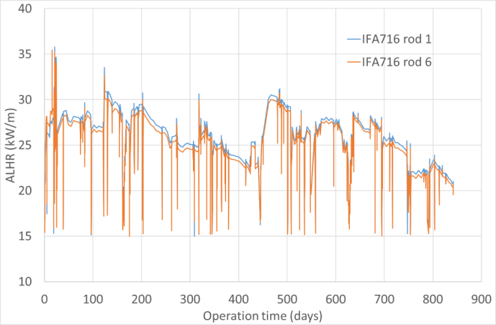
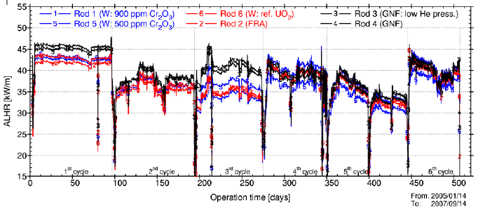
Cases (Chromia doped UO₂ fuel)
Mandatory: Steady state, IFA716 rods 1 and 6
AREVA UO₂+Cr₂O₃ pellets
Thermocouple
Internal pressure (FGR)
Fuel elongation (swelling)
Optional: High initial rating, IFA677 rods 1 and 5
Westinghouse UO₂+Al₂O₃+Cr₂O₃
TCs
Internal pressure (FGR)
PIE

Slide 5
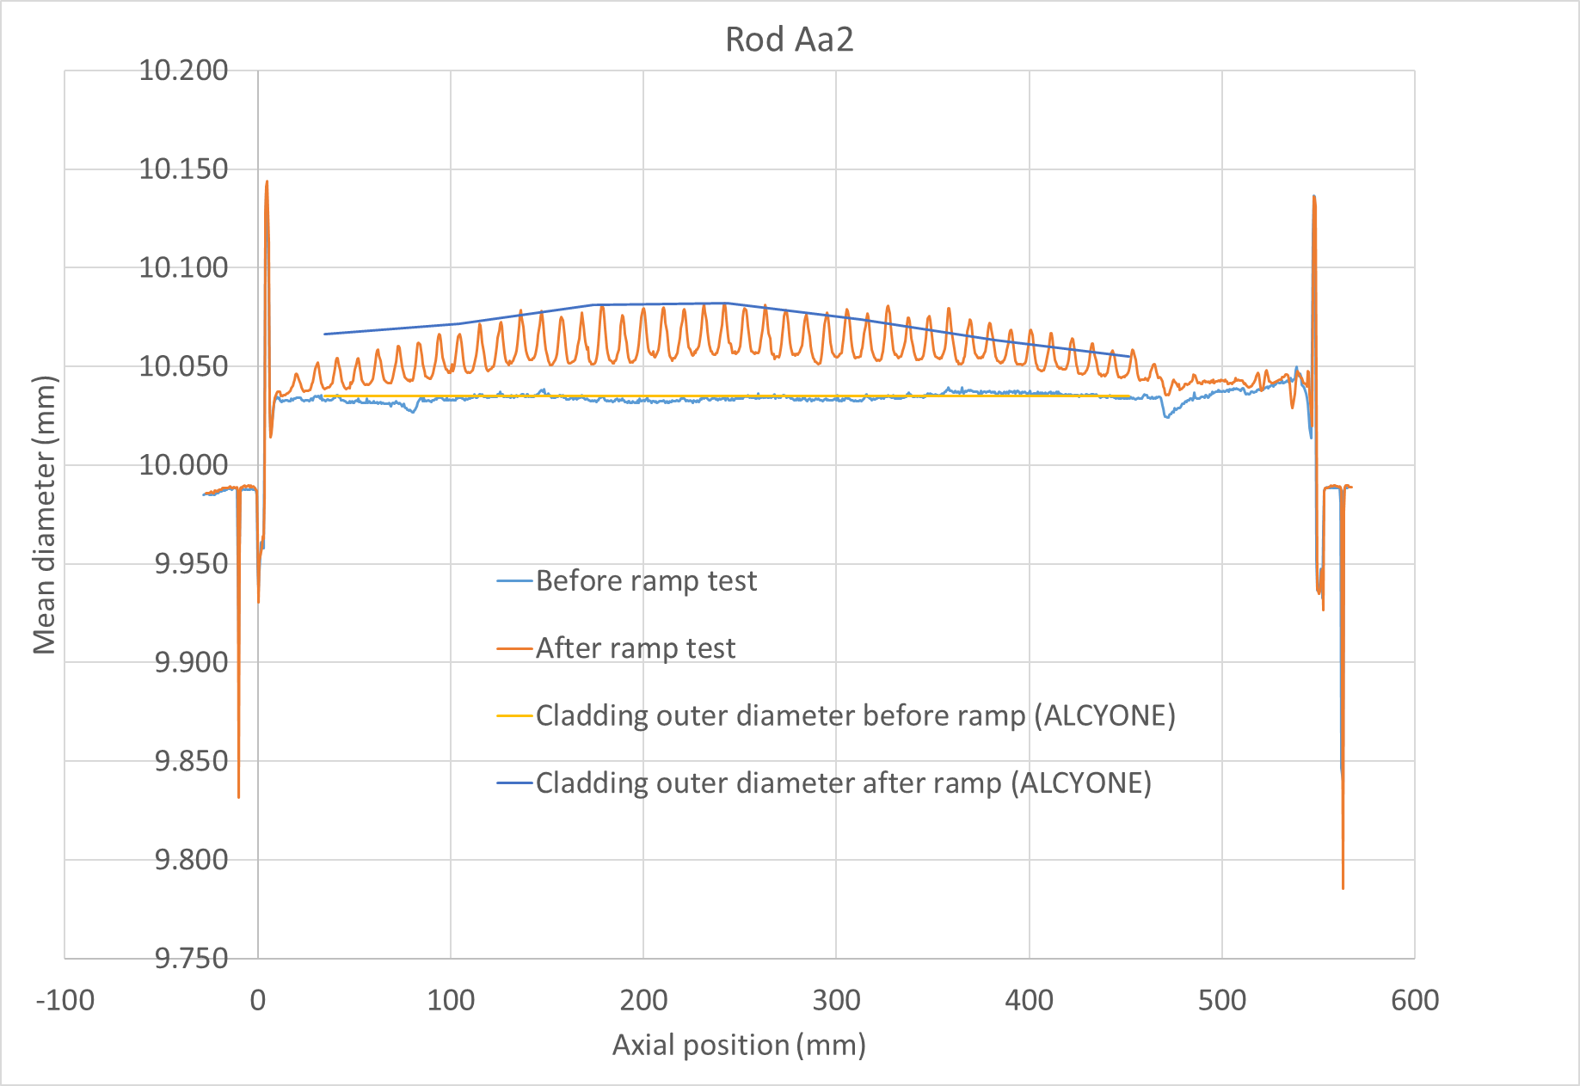
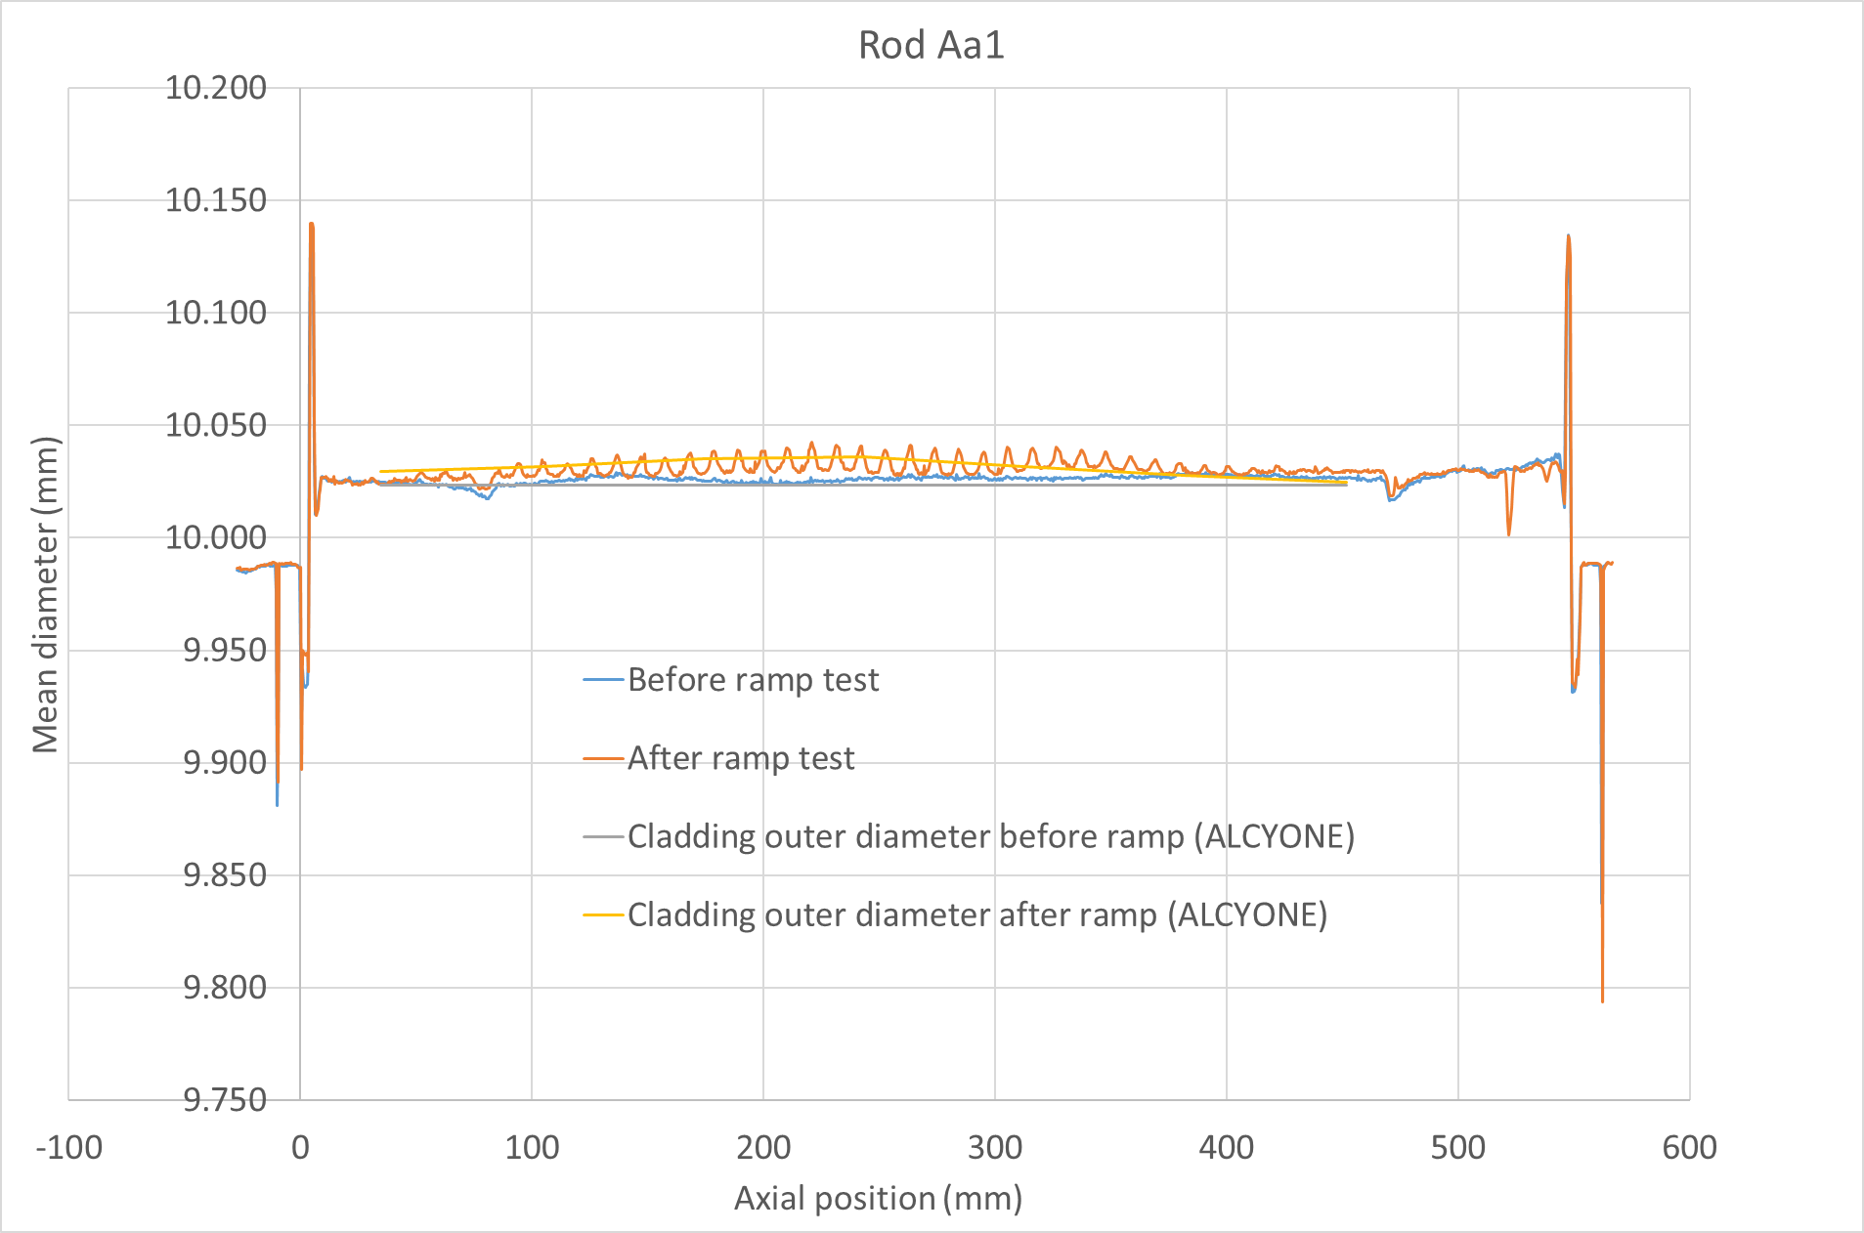
Cases (Chromia doped UO₂ fuel)
Off-normal conditions: SCIP II power ramps
Cr-doped UO₂ fuel (AREVA) irradiated in Oskarshamn-2 (BWR)
Zy-2 cladding with Zr liner
Ramp up to 450 W/cm
Mandatory: Aa2, 12h holding time
Optional: Aa1, no holding time
PIE: puncturing and profilometry
Rod number | Aa2 | Aa1
Burnup (GWd/tM) | 28 | 26
Conditioning Power Level (CPL) (kW/m) | 10 | 10
CPL duration (h) | 12 | 12
Ramp Terminal Level (kW/m) | 45 | 45
Holding time | 12 h | 15-30 s
Experimental fission gas release (%) | 1.7 | 0.02

Slide 6
Cases (ATF claddings)
SET FeCrAl claddings (similar to ACTOF CRP)
“Virtual” burst tests from PUZRY (EK lab., Hungary)
adapted to FeCrAl
@controlled temperature (800-1200°C)
Priority tests #8, 18 and 30
Geometrical data and exp. conditions provided to participants
Burst tests performed at HUN-REN EK (Hungary)
FeCrAl cladding provided by KIT
@controlled T (800-925°C) and Pressure rate
SET Cr-coated claddings
Burst tests (CTU, Czech Rep.)
Cr-coated Optimized ZIRLO
Temperature range 800-915°C
Pressurization rate range 5-106 kPa/s
Sample | Temperature (°C) | Pressurization rate (kPa/s) | Burst pressure (MPa)
OPZCR-1 | 804-807 | 105 | 7.29
OPZCR-4 | 835-814 | 105 | 6.13
OPZCR-5 | 902-905 | 94 | 3.53
OPZCR-8 | 902-905 | 6 | 2
Material properties/correlations provided
ACTOF → FeCrAl
ATF-TS WT1 → Cr-coated cladding

Slide 7
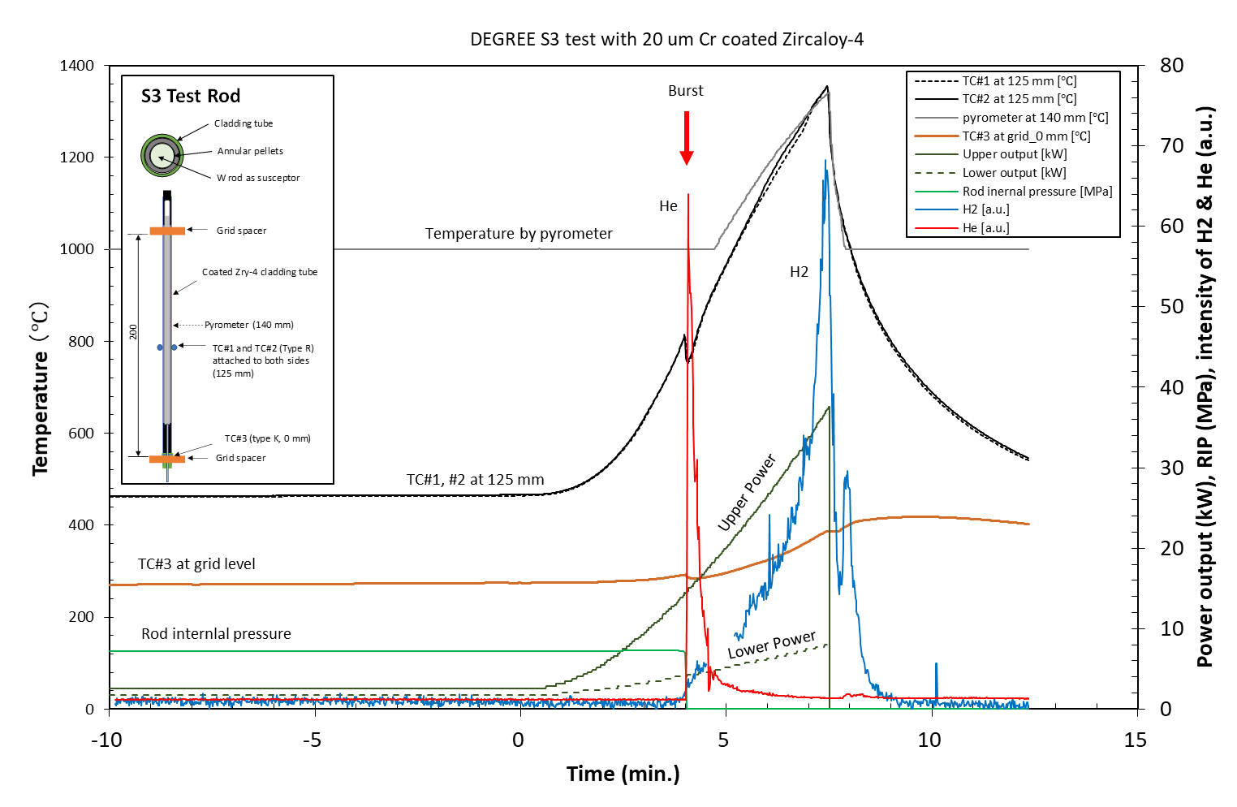
Cases (ATF claddings)
DEGREE single rod test S3
SET on Cr-coated Zy-4 cladding
LOCA heating and cooling phase
Experimental conditions
Heating power
Steam flow rate
Cladding outer temperature (3 locations)
Internal pressure (detect balloon./burst)
Post-tests examinations
Profilometry
H pickup
Chemical analysis (Cr diffusion)

Slide 8
List of participants
Country | Participant | Code | UO₂ Cr doped |  |  | FeCrAl | Coated Zy claddings | Coated Zy claddings
 |  |  | IFA716 | IFA677 | SCIP II power ramps | ACTOF cases + ATF-TS SET | ATF-TS SET | DEGREE Single rod test S3
Argentina | CNEA | DIONISIO | x | x | x | x | x | x
Belgium | Tractebel | FRAPCON/FRAPTRAN |  |  |  |  | x
Brazil | IPEN | TRANSURANUS |  |  |  | x
Bulgaria | INRNE-BAS | TRANSURANUS |  |  |  | x
China | CNPRI | JASMINE | x | x |  | x | x
China | CNPE | FRAPCON/FRAPTRAN |  |  |  | x
China | NPIC | FUPAC | x | x |  | x | x
Czech Republic | CTU | FRAPCON/FRAPTRAN, TRANSURANUS | x |  | x |  | x
France | CEA | ALCYONE | x | x | x
Germany | GRS | TESPA-ROD |  |  |  | x
Iran | ANCC | PARS/PART | x | x | x |  | x
Italy | NINE | TRANSURANUS | x | x | x | x
Japan | CRIEPI | FRAPCON |  |  |  |  |  | x
Korea | KAERI | FRAPCON/MERCURY | x |  |  | x | x | x
Russia | IBRAE | SOCRAT |  |  |  |  | x | x
Slovakia | B&J | FEMAXI | x | x | x
Spain | UPM | TRANSURANUS |  |  |  | x
Spain | CIEMAT | FRAPCON/FRAPTRAN | x | x | x | x
USA | UTK | BISON | x | x | x | x
19 organizations
16 countries

Slide 9
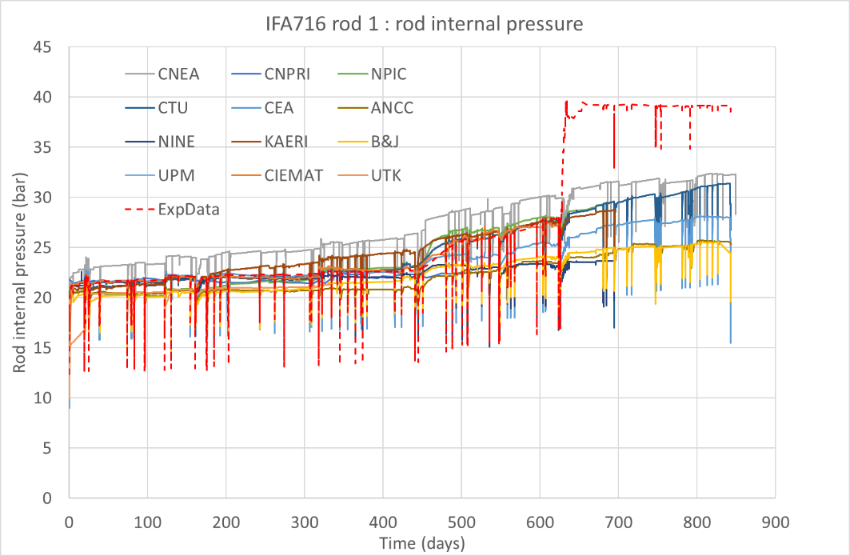
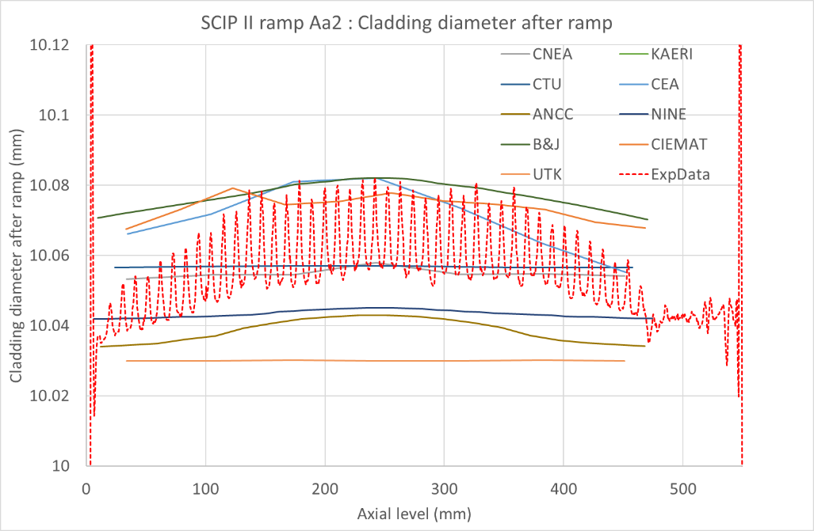
Selected results
Cr-doped UO₂ fuel
Exhaustive comparison of calculated quantities with experimental data to be done in TECDOC
Fuel temperature
Pressure evolution
Fuel stack elongation
…
Results in a reasonably good agreement with experiments
Importance of uncertainty knowledge (experimental conditions)

Slide 10
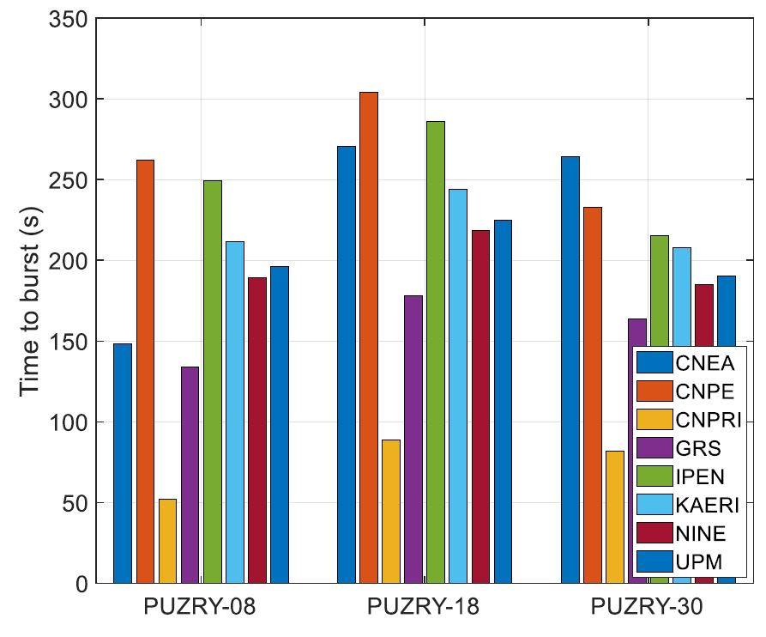
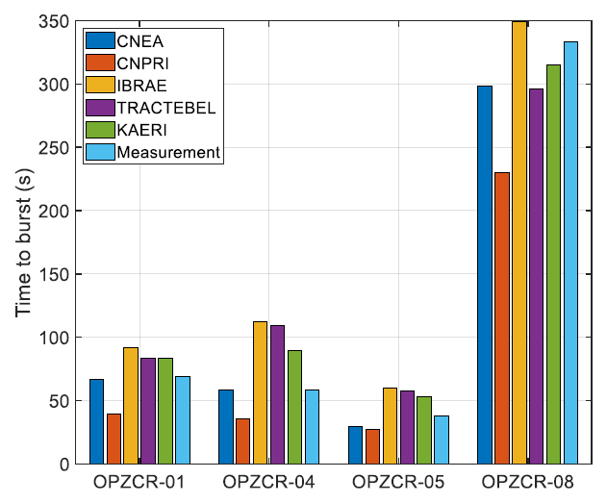
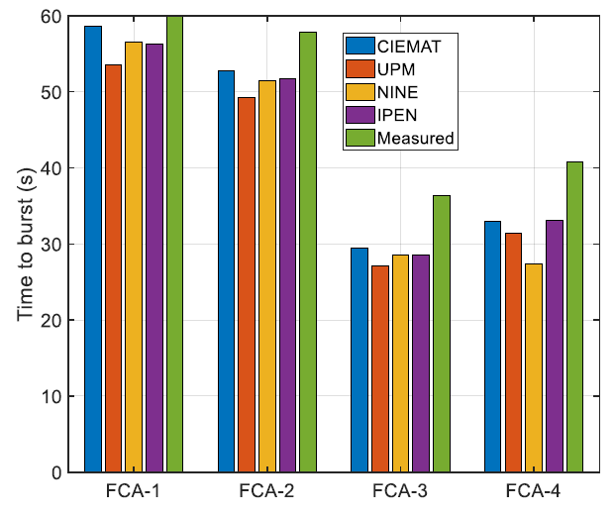
Selected results
Burst tests
Exhaustive comparison of calculated quantities with experimental data to be done in TECDOC
Time to burst
Burst pressure
Case (rod #) | Exp (s) | CNEA | CNPRI | IBRAE | KAERI | Tractebel | CIEMAT | UPM | IPEN | NINE
OPZCR-1 | 83.5 | 67 | 39.5 | 92 | 83 | 83,4
OPZCR-4 | 108 | 58 | 35.5 | 112 | 90 | 109,3
OPZCR-5 | 53.5 | 29 | 27.5 | 60 | 53 | 57.6
OPZCR-8 | 323 | 299 | 230 | 349 | 315 | 296
FCA-1 | 62.7 |  |  |  |  |  | 58.6 | 53.6 | 56.3 | 56.6
FCA-2 | 59.7 |  |  |  |  |  | 52.8 | 49.2 | 51.8 | 51.4
FCA-3 | 38.2 |  |  |  |  |  | 29.4 | 27.1 | 28.6 | 28.6
FCA-4 | 41.7 |  |  |  |  |  | 33 | 31.4 | 33.1 | 27.4

Slide 11
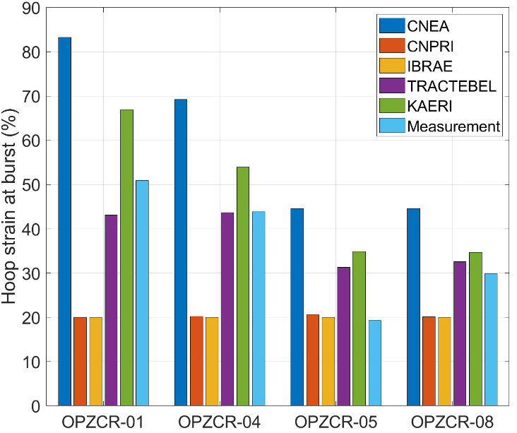
Selected results
Burst tests
Exhaustive comparison of calculated quantities with experimental data to be done in TECDOC
Hoop strain at # axial level
FeCrAl : some properties of the materials (e.g. surface treatment) is not taken into account in the analytical models and may play a role in the deformation behaviour.

Slide 12
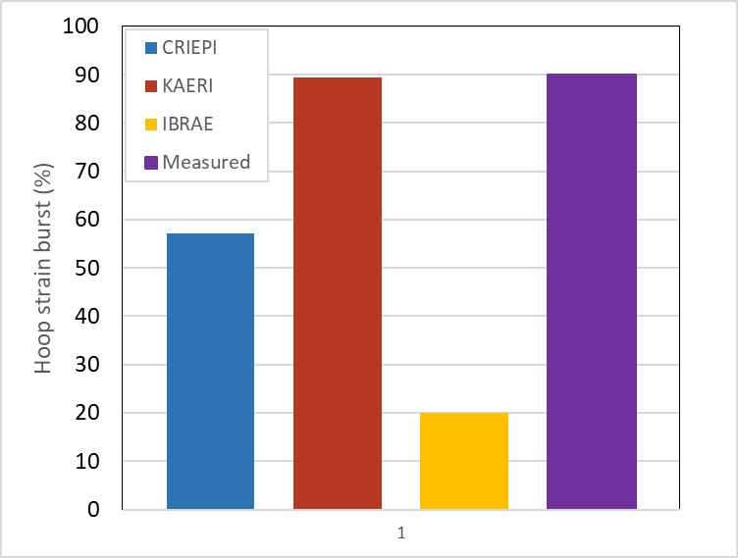
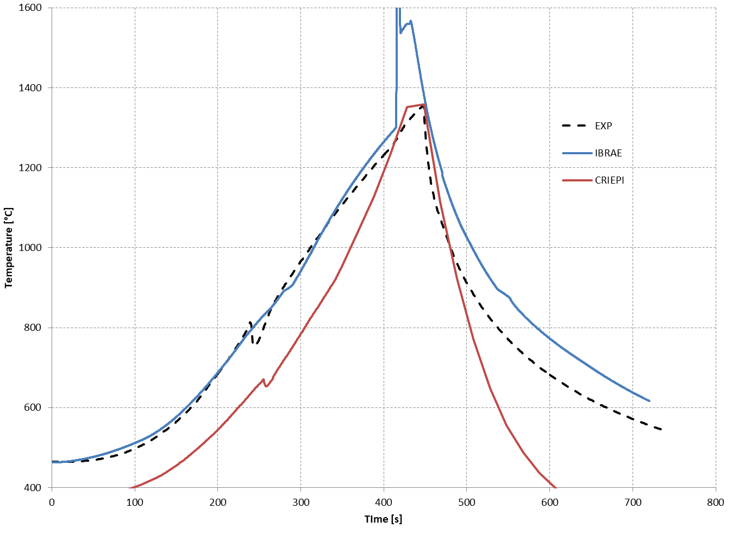
Selected results
DEGREE single rod test
Exhaustive comparison of calculated quantities with experimental data to be done in TECDOC
Cladding temperature at # axial position
Hoop strain
Time to burst
Burst pressure
Oxidation layer thickness (no exp.)
Cladding temperature @TC level (DEGREE single rod test S3)

Slide 13
Conclusion
WT2.1 of ATF-TS CRP
Code improvement for ATF materials
Code “validation” for ATF materials (claddings, pellets)
Pre-requisite for participation to WT3 (development of a methodology for ATF assessment)
Chromia-doped fuel irradiations
Benchmark results aligned well with experimental data, highlighting the importance of uncertainty analysis in fuel performance code validation
ATF claddings separate effects tests
Burst pressure predictions were accurate with available data, though hoop strain predictions varied
Discussions suggested improvements in code predictions and the need for further work on material properties and deformation behavior

Slide 14
Conclusion
General conclusion and subjects for next CRP (future work)
Validation
current benchmarks are based on non-irradiated separate effect tests
Future projects should include integral or semi-integral irradiation tests for comprehensive validation
LOCA Tests
No fueled ATF LOCA tests were provided
Future projects should address this gap
If no experimental data available, “theoretical cases” could be considered (e.g. boundary conditions provided by system codes corresponding to LOCA scenario)
Emphasize uncertainty analysis, material property verification, and inclusion of irradiated data for improved code validation

Slide 15
Thank you for your attention
Antoine Bouloré
antoine.boulore@cea.fr
Marco Cherubini
m.cherubini@nineeng.com

