Slide 1



Technical Meeting on Advanced Technology Fuels: Progress on their Design, Manufacturing, Experimentation, Irradiation, and Case Studies for their Industrialization, Safety Evaluation, and Future Prospects
(EVT2404561)
28 –31 October 2025

Slide 2
IPEN/CNEN (Brazil) Contribution to the ATF-TS CRP and Bridging Activities for ATF Development
Alfredo Abe – IPEN/CNEN
Antônio Teixeira e Silva – IPEN/CNEN
Claudia Giovedi – USP (University of São Paulo)
Caio Melo – USP (University of São Paulo)

Slide 3
SUMMARY
Introduction
ATF-TS CRP SCOPE
IPEN/CNEN Contribution
Work Tasks and Outcomes
Bridging Activities for ATF Development
Final Remarks
3

Slide 4
Introduction
Previous background
Both institutions (IPEN and USP) had been participated in previous CRP dedicated to ATF: FUMAC and ACTOF.
The activities developed in the framework of both CRP (FUMAC and ACTOF) were directly related to ATF fuel performance codes assessment (FRAPCON/FRAPTRAN and TRANSURANUS), codes modification to address different ATF cladding materials, simulations of experimental benchmark, as well as experiments to evaluate the behavior of ATF materials under accident scenarios.
4

Slide 5
ATF-TS CRP Scope
CRP ATF-TS was created and started in April 2020 and ended in December 2024 with 22 member states participation aiming to support their efforts to design and development an accident tolerant for light water reactors in order to increase the safety and reliability
This CRP consists of four different groups and objectives:
Work task 1: was dedicated to conducting single rod and bundle experimental tests using potential candidates for Accident Tolerant Fuels. These tests aimed to evaluate the performance and behavior of ATF materials under various conditions, helping to identify promising candidates for further development, as well as obtain material properties data useful for fuel performance codes.
5

Slide 6
ATF-TS CRP Scope
Work task 2: was focused to benchmark fuel performance codes by considering experiments conducted in Work task 1, as well as existing tests and data on advanced fuel, including cladding materials. By comparing simulation results with experimental data, this work task aimed to improve the accuracy and reliability of fuel performance predictions.
Work task 3: was aimed to evaluate Loss-Of-Coolant Accident (LOCA) methodologies using a best estimate plus uncertainty approach for nuclear power applications in order to enhance safety assessments for reactor operation and design.
6

Slide 7
ATF-TS CRP Scope
Work task 4: was dedicated to compiling a comprehensive database of available material data, properties, and correlations for ATF materials.
Moreover, aimed to create a valuable open-source resource for researchers and engineers. By centralizing relevant information will facilitates access to critical data needed for ATF development and implementation.
7

Slide 8
IPEN contribution for ATF-TS CRP
Work Task 2: Benchmark exercise (FeCrAl cladding)
Work Task 3: LOCA evaluation methodology
WT 3.1 - Simulation of Halden LOCA integral tests with TRANSURANUS considering FeCrAl as cladding
WT 3.2 - Simulation of NPP LOCA scenarios and prediction with TRANSURANUS considering FeCrAl as cladding
Work Task4: some data of iron alloy corrosion experiment under accident condition
8

Slide 9
Work Tasks and Outcomes
WT-2 Benchmark Exercise
TRANSURANUS fuel performance code (version 2019 and 2022) *
Code capability assessment for FeCrAl cladding aiming to ensure applicability of code for WT2 and WT3
Opportunity to address and verify existing FeCrAl model and data already implemented (version 2022), assessment and review some available open data (e.g. ORNL/SPR-2018/905 Rev. 1 - Handbook on the Material Properties of FeCrAl Alloys for Nuclear Power)
* The authors acknowledge and are grateful to European Commission, Joint Research Centre, Directorate for Nuclear Safety and Security (Karlsruhe, Germany) for the TRANSURANUS code license, which made it possible to perform the ATF-TS CRP activities
9

Slide 10
Work Tasks and Outcomes
WT-2 Benchmark Exercise
Experimental cases for benchmark (TECDOC 1921 Sec. 5)
6 LOCA cases taken from PUZRY benchmark
3 priority (case 8, 18 and 30) and 3 optional (case 10, 12 and 26)
4 Selected FOMs: hoop strain at axial peak position (%), time to burst (s), burst pressure (MPa), hoop strain at burst (%)
4 Burst experiment with FeCrAl performed in Work Task 1
10

Slide 11
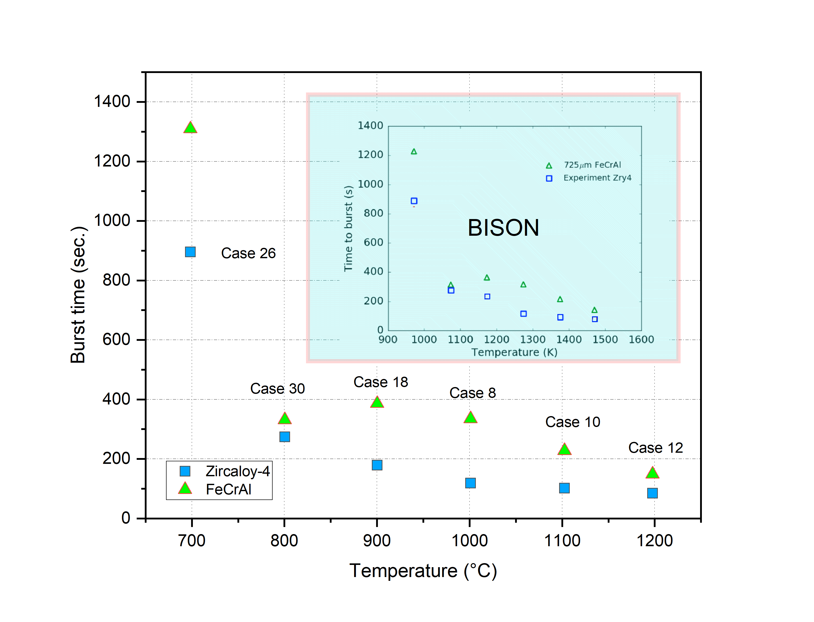
Work Tasks and Outcomes
WT-2 Benchmark Exercise
Burst (6 cases of PUZRY – comparison FeCrAl and Zircaloy )
11

Slide 12
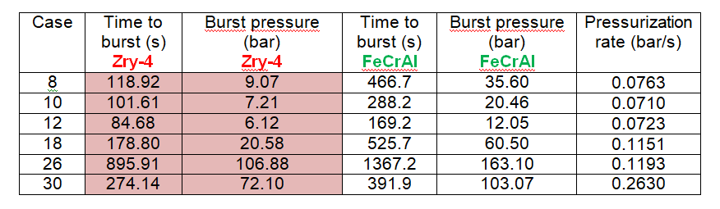
Work Tasks and Outcomes
WT-2 Benchmark Exercise
Burst (6 cases of PUZRY – comparison FeCrAl and Zircaloy )
*FeCrAl alloy known as B136Y
12

Slide 13
Work Tasks and Outcomes
WT-2 Benchmark Exercise
FeCrAl alloy* burst experiment performed in Work Task 1
Case | Experimental time (s) | Calculated time of cladding burst failure (s)
 |  | Modified TRANSURANUS | TRANSURANUS (v1m3j22)
FCA1 | 62.50 | 56.27 | 56.88
FCA2 | 59.25 | 51.76 | 52.20
FCA3 | 37.75 | 28.60 | 28.80
FCA4 | 41.25 | 33.09 | 33.48
*FeCrAl alloy known as B136Y
13

Slide 14
Work Tasks and Outcomes
WT-2 Benchmark Exercise
FeCrAl burst experiment performed in Work Task 1
14

Slide 15
ATF-TS CRP Outcomes/results and Analysis
All participants outcomes/results of “Testing and Simulation for Advanced Technology and Accident Tolerant Fuels (ATF-TS)” will available in TECDOC Report of a Coordinated Research Project, (3 volumes):
Vol. 1: Experimental Programme of Accident Tolerant and Advanced Technology Fuels (ATFs)
Vol. 2: Fuel Modelling and Computer Codes’ Benchmark Exercise for Accident Tolerant and Advanced Technology Fuels (ATFs)
Vol. 3: LOCA Fuel Safety Evaluation for Accident Tolerant and Advanced Technology Fuels (ATFs)
15

Slide 16
Bridging Activities for ATF Development
The IAEA coordinated research projects on light water reactors, focusing on advanced technology fuel testing and simulation have become crucial sources of experimental data
Fuel rod
Cladding
Modified
Advanced
Fuel
Advanced
Modified
Dopped or modified UO₂
Higher U235 enrichment
Higher burnup
Higher U235 density(UN, U₃Si₂, etc)
FeCrAl
SiC based
Coated Zr alloy
Different maturity level
16

Slide 17
Bridging Activities for ATF Development
Bridging activities between research and commercial licensing involves addressing key challenges and providing robust data to regulators
The licensing of a new fuel system like FeCrAl cladding requires demonstrating that it meets or exceeds existing safety criteria
NRC approach based on licensing topical reports (LTRs), this approach to licensing the use of a new cladding alloy can be used as a reference guide for the FeCrAl cladding and others ATF´s system (reference: PNNL-30445).
17

Slide 18
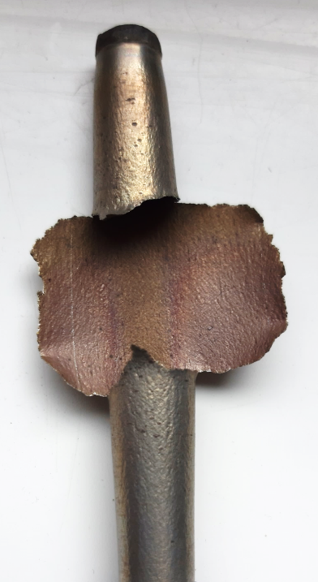
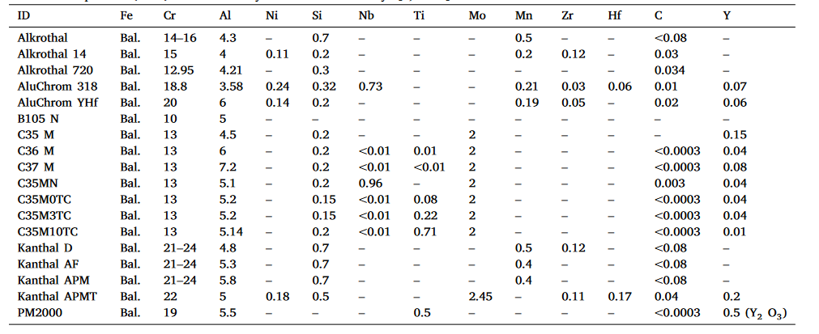
Bridging Activities for ATF Development
SAFDL (Specified Acceptable Fuel Design Limit) Limits for New Cladding
Identifies several general phenomena that should be considered for fuel system (fuel + cladding) to avoid damage and fuel rod failure and to ensuring fuel coolability
Different composition (FeCrAl alloys)
Burst experiment conduct under ATF-TS CRP
18

Slide 19
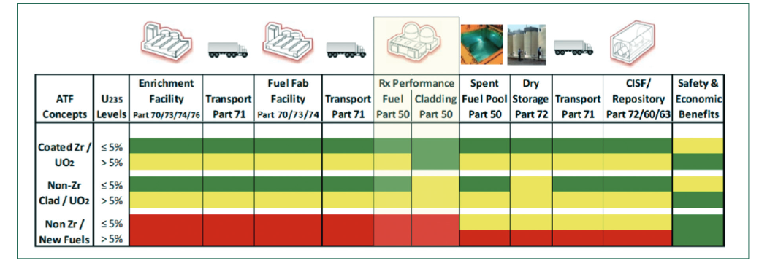

Bridging Activities for ATF Development
SAFDL (Specified Acceptable Fuel Design Limit) Limits for New Cladding
(1)
Systematic, comprehensive and consistent methodology
Identifying functional requirements for the fuel system (e.g. load follow)
Identifying the limits for each functional requirement (e.g. power rate change)
Identifying the codes or other approach to assess performance and verify against functional requirement.
(1) Accident Tolerant Fuel Technical Update - Valuation 1.0, Gap Analysis, and Valuation 2.0
19

Slide 20
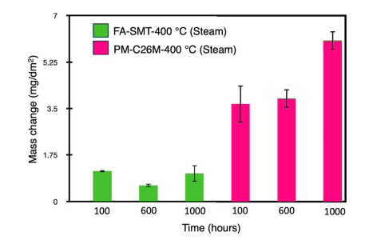
Bridging Activities for ATF Development
SAFDL (Specified Acceptable Fuel Design Limit) Limits for New Cladding
One of the critical part is code verification and validation (V&V), and shall at least address SAFDLs requirements:
Fuel temperature
Fission gas release
Rod internal pressure and internal void volume
Cladding oxide thickness
Cladding permanent hoop strain (power ramp)
Critical Heat Flux (CHF)
Reference: Synergistic roles of Cr and Mo in low temperature steam oxidation of FeCrAl alloys - Corrosion Science 255 (2025) 113107
20

Slide 21
FINAL REMARKS
The ATF-TS CRP activities performed and outcomes are very important for ATF development.
The second most likely ATF cladding to be adopted will be FeCrAl alloy, therefore are many subject to be investigated associated to thermo-mechanical properties of FeCrAl (e.g. burst behavior, resistance to neutron irradiation)
The framework of next CRP could address an specific task to develop an approach on licensing new fuel (ATF)
21

Slide 22
Thank you for your kind attention!

