Slide 1
Technical Meeting on Advanced Technology Fuels
IAEA ACTIVITIES ON FUEL SAFETY AREA
Surik Bznuni – Nuclear Safety Officer (NSNI/SAS)
28 October – 31 October 2025
International Atomic Energy Agency, Vienna, Austria

Slide 2

Outline
Revision of design safety and safety assessment requirements
Revision of design safety and safety assessment safety guides
Conclusions

Slide 3
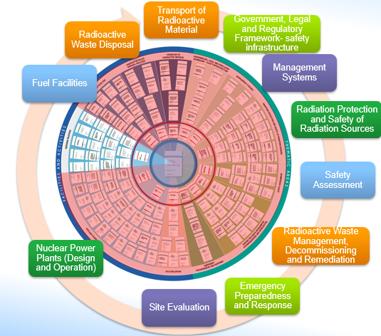
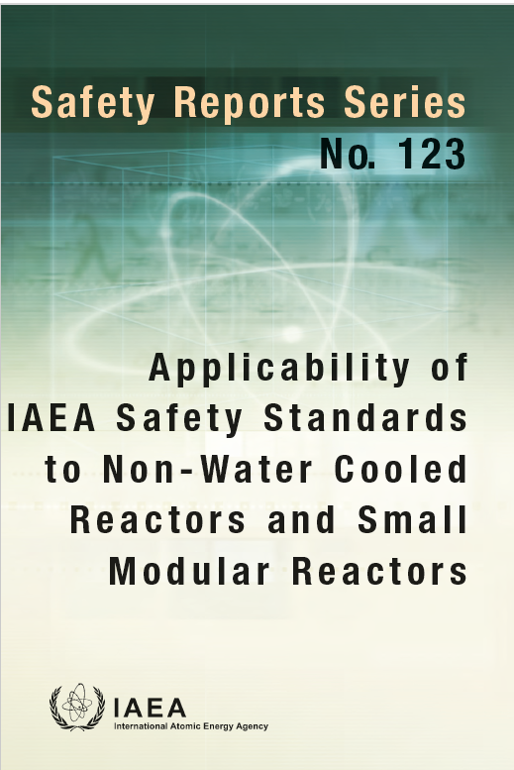
Applicability of Safety Standards
https://wwwpub.iaea.org/MTCD/Publications/PDF/PUB2027_Web.pdf

Slide 4
Review Approach
Identification of areas of novelty compared to operating land-based LWRs
Identification of gaps in the applicability of the safety standards and areas for further consideration, based on the areas of novelty identified
Identification of areas where the safety standards may not be applicable or could be adapted for a better application, based on the areas of novelty identified

Slide 5
Review Outcomes
Siting
Design and Const.
Com. and Operation
EPR
Legal and Reg.
Transport
Fuel Cycle Facilities
Radiation Protection and Safety
Manag. of Waste and Spent Fuel
LMfS
Decom.
SSR-1
SSG-35
SSG-9
SSG-18
SSG-21
NS-G-3.6
NS-G-3.1
NS-G-3.2
SSG-30
SSR2/1
SSG-64
SSG-34
SSG-39
SSG-62
SSG-38
SSG-51
SSG-52
SSG-56
SSG-53
SSG-63
SSG-68
SSG-67
SSG-69
DS524
SSR2/2
SSG-54
SSG-70
SSG-71
SSG-72
SSG-73
SSG-74
SSG-75
SSG-76
SSG-77
SSG-13
SSG-28
SSG-48
SSG-50
GSR- Part2
GS-G-3.5
SSR4
SSG-5
SSG-6
SSG-7
SSG-42
SSG-27
SSG-43
GSR- Part3
GSG-8
RS-G-1.7
GSG-7
GSG-9
GSG-10
GSR-Part 5
GSG-1
WS-G-6.1
SSR-5
SSG-14
SSG-40
SSG-29
SSG-41
SSG-15
GSR-Part6
SSG-47
WS-G-5.1
W-G-5.2
GSR-Part7
GSG-2
GSG-11
SSG-14
GS-G-2.1
SSG-65
GSR-Part1
SSG-12
GSG-13
GSG-9
SSG-16
GSG-6
SSR-6
GSG-16
SSG-45
GSG-3
DS512
SSG-31
SSG-23
Safety Assess.
GSR-Part4
SSG-25
NS-G-2.13
SSG-2
SSG-3
SSG-4
No applicability considerations (areas of non applicability, gaps, areas for further consideration) | Small number of applicability considerations/ very small impact on safety standard | Some applicability considerations/ small impact on safety standard | Numerous applicability considerations/ more than a third of the safety standard impacted

Slide 6
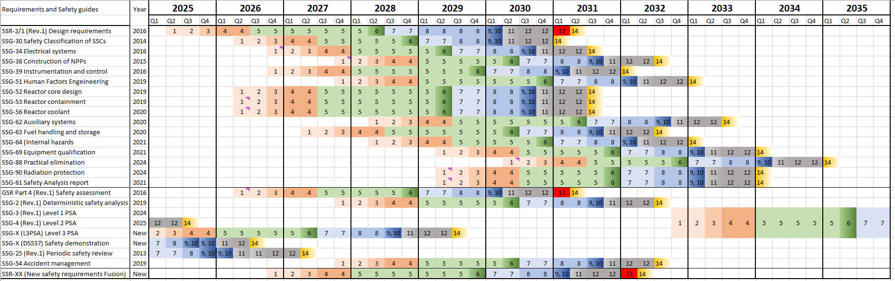
IAEA Safety Standards update 10years vision

Slide 7
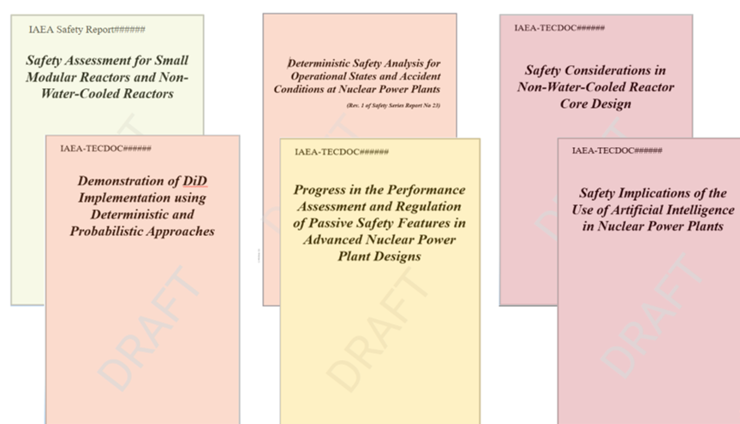
Safety of Advanced Technologies

Slide 8
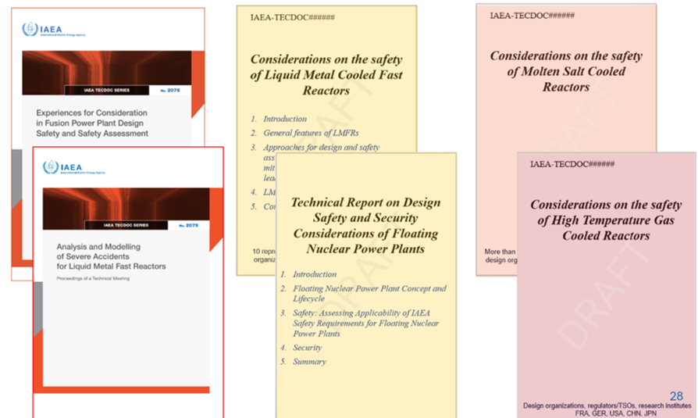
Safety of Advanced Technologies

Slide 9
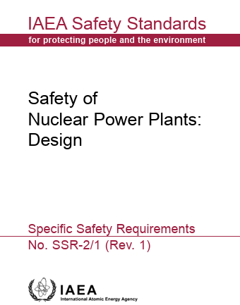
Design Safety Standards Update
The reactor core
(SSG-52)
The containment and associated systems
(SSG-53)
The reactor coolant system and associated systems
(SSG-56)
The fuel handling and storage systems
(SSG-63)
The design of electrical power systems (SSG-34)
Instrumentation and control systems
(SSG-39)
The application of the HFE in the design (SSG-51)
Auxiliary and Supporting Systems
(SSG-62)
Internal Hazards
(SSG-64)
Radiation Protection aspects
(DS524)
Equipment Qualification (SSG-69)
Safety Classification of SSCs in NPPs (SSG-30)
No applicability considerations (areas of non applicability, gaps, areas for further consideration) | Small number of applicability considerations/ very small impact on safety standard | Some applicability considerations/ small impact on safety standard | Numerous applicability considerations/ more than a third of the safety standard impacted

Slide 10
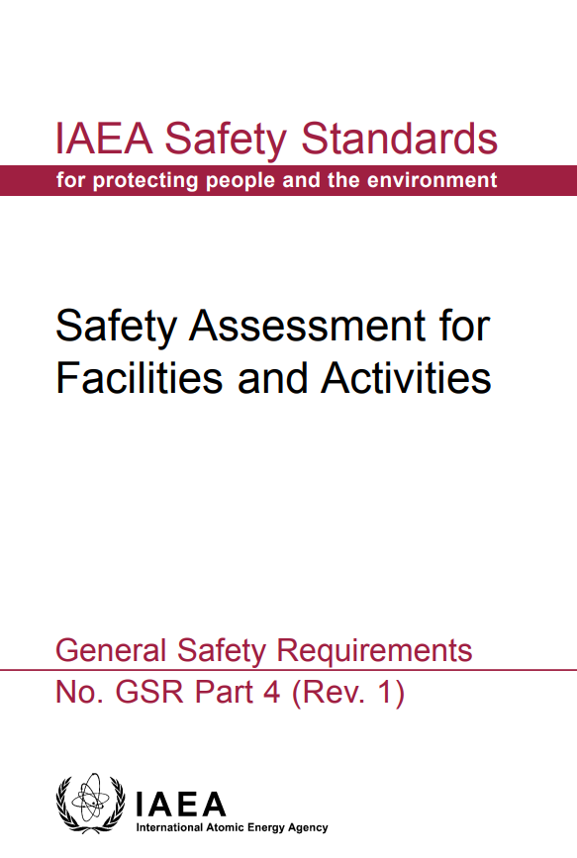
Safety Assessment Standards Update
Development and Application of Level 2 Probabilistic Safety Assessment for Nuclear Power Plants
(SSG-4)
Deterministic Safety Analysis for Nuclear Power Plants
(SSG-2)
Development and Application of Level 1 Probabilistic Safety Assessment for Nuclear Power Plants
(SSG-3)
Periodic Safety Review for Nuclear Power Plants
(SSG-25)
No applicability considerations (areas of non applicability, gaps, areas for further consideration) | Small number of applicability considerations/ very small impact on safety standard | Some applicability considerations/ small impact on safety standard | Numerous applicability considerations/ more than a third of the safety standard impacted

Slide 11
Conclusions
IAEA safety standards in the field of design safety and safety assessment, including nuclear fuel safety aspects are in the process of update for NWCR and SMRs
Formal process of update of key design safety standard SSR 2/1(Rev.1) already started (DPP approval in the Safety Standard Committees)
TecDocs for each of advanced reactor technologies are in progress to accumulate necessary systematic knowledge and experience for update of relevant safety guides
Source: IAEA/NENP/NPTDS/SMR/MHS/14Jan22

Slide 12
THANK YOU

Slide 13
SSG-4
Some Core damage concept is not applicable to all reactor types
Accident progression analysis are not always applicable to non-WCRs
The discussion on source terms for severe accidents is not applicable to non-WCRs
Source: IAEA/NENP/NPTDS/SMR/MHS/14Jan22

Slide 14
SSG-2
DECs with core melting is not relevant for some SMRs (HTGR, MSR)
recommendations on the analysis of core melt accidents are not applicable to HTGRs
The descriptions of the analysis in support of severe accident management guidelines are not applicable to HTGRs
Low level, derived acceptance criteria are not included for NWCR that would reflect differences in barriers, associated phenomena and damaging mechanisms of barriers
Guidance on analysis of functional containment is lacking

Slide 15
SSG-3
The end states of accidents at some SMRs and AMRs are different from the traditional core damage in WCRs
PSA Level 1 metrics (i.e. core damage frequency) are not applicable to SMRs for which core damage may not be meaningful, such as HTGRs, MSRs

Slide 16
SSR 2/1
Specific plant system design requirement needs to be adapted for design
references to fuel damage, core damage and core melting and severe accident in various requirements may not be directly applicable for NWC SMRs
mechanical and thermomechanical deign requirements of fuel, core, control rods needs to reflect design features
functional containment for TRISO fuelled SMRs
components (e.g. tank, pipe) that are likely to contain fuel and fission products generating decay heat
possibility that the content of fissile material and fission products in the fuel salt could modify the salt’s chemical properties, leading to safety concerns
possible overcooling of an MSR and its fuel (freezing, change of physicochemical properties)
highly heterogeneous transport reactor fuel

Slide 17
SSG-52
‘Fuel rods’, ‘Fuel assemblies’ and ‘Fuel pellets’, may not be applicable to some reactors (HTGR, MSR)
The critical heat flux limits and the critical heat flux correlation concept may not be applicable to some non-water reactor designs, such as HTGRs, SFRs and LFRs.
The concept of the reload fuel cycle and some aspects of core design — such as specification of loading and shuffle patterns of fuel assemblies to provide optimum fuel burnup and desired neutron flux distributions — may not be applicable to some designs
pebble bed HTGR with on-line continuous fuel loading and discharging of fuel pebbles
the discussion of mechanical effects in fuel rods and of reactor operation with leaking fuel rods may not be applicable for some designs
For an HTGR, a design limit is associated with the failure fraction of the fuel particles
Some recommendations related to cladding may not be applicable to non-pellet fuels or fuels without cladding, such as those for fuel pellet–cladding interaction.

Slide 18
SSG-52
Cladding ballooning is a phenomenon that is specific to fuel rod geometry. For non-pellet fuels, there is no risk of the internal pressure of the fuel rods increasing to cause cladding deformations that would negatively affect the heat transfer between the fuel pellets and the coolant
Radial gap closure and fuel pellet cracking are not relevant for non-pellet fuel designs
Fuel–cladding mechanical interaction is not applicable to some fuel designs, such as the HTGR fuel design
In general, some cladding materials may not be susceptible to hydriding and corrosion (HTGR, SFR and LFR )
Hydrogen pick-up correlations are not applicable to cladding materials that are not susceptible to hydrogen pick-up and degradation or adversely affected by corrosion
new cladding materials (ATF cladding) or new fuel designs (e.g. cermet material considerations) are not addressed
the specificities of metallic fuel for SFRs (such as degradation mechanisms) are not included

Slide 19
SSG-63
apply mainly to wet storage of spent fuel
fuel disassembly and reassembly is not relevant for HTGR and MSR designs
Specific aspects of the fuel handling and storage system of a pebble bed HTGR are not covered
burnup measurement of irradiated fuel elements
on-line refuelling of fuel elements that have not reached the target burnup
specifics of fuel element identification regarding inspection, transportation and storage
detection, separation and storage of damaged fuel elements
Considerations associated to the fuel storage for HALEU are not covered
The on-power refuelling, as well as the associated considerations to ensure the integrity of the pressure boundary and the fuel cooling functions during loading and unloading in pebble bed HTGRs, are not covered

