Slide 1





Università di Pisa & HUN-REN Centre for Energy Research
FINITE ELEMENT SIMULATION OF MANDREL TEST WITH ATF CLADDING IAEA Technical Meeting on Advanced Technology Fuels, Vienna, October 2025
Hamidreza Yousefi, Rosa Lo Frano, Márton Király, Zoltán Hózer, Levente Tatár, Francesco D’Auria, Daniel Antok, Nicola Forgione
h.yousefi@studenti.unipi.it
This work was supported by the OFFERR-SNETP project (GA n. 101060008) and ENEN2plus project (GA 10161677) founded by the European Union.

Slide 2
Content
INTRODUCTION
MANDREL TEST
NUMERICAL MODELING
MODEL VALIDATION
PROFILOMETRY
THROUGH THICKNESS ANALYSIS
CODE COUPLING STRATEGY & ANALYSIS
CONCLUSION
FUTURE NEEDS

Slide 3
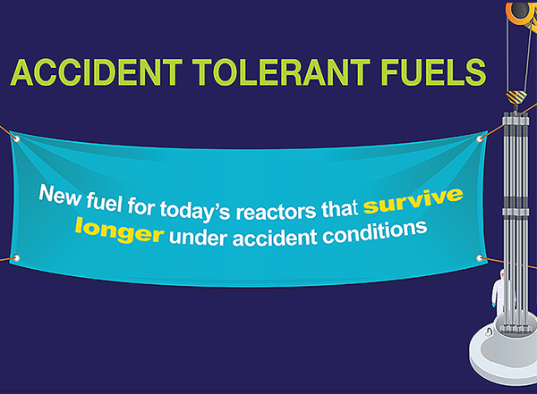
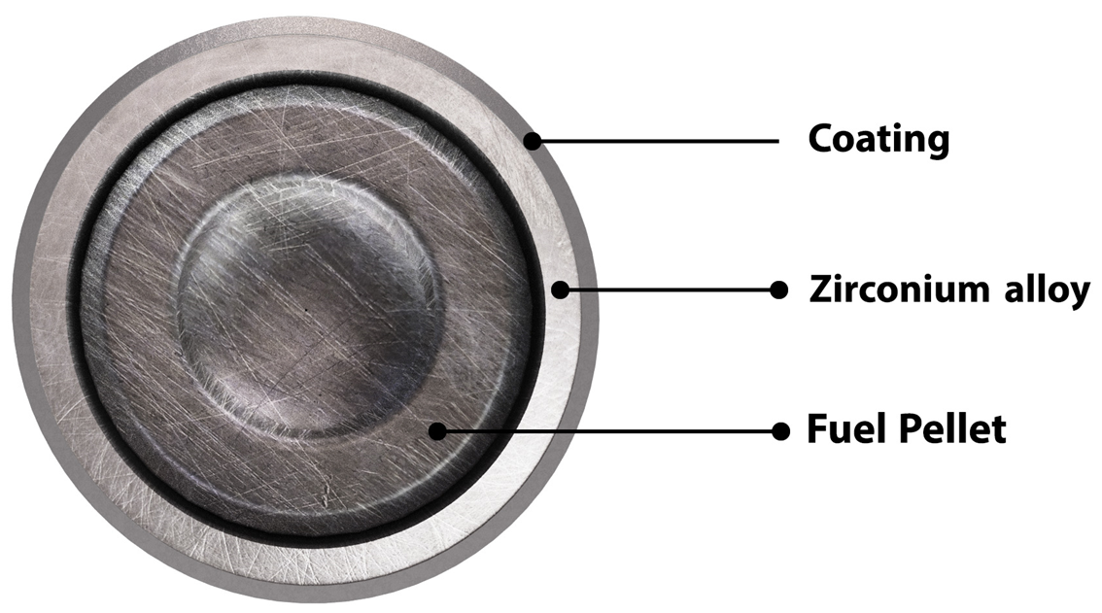
INTRODUCTION
ATF claddings with FLEX strategies may provide enough coping time [1-4].
Most R&D programs on Cr coated ATF claddings have focused on the mechanical integrity of the unirradiated coating (as-fabricated) under accidental conditions, while for Normal Operation (NO), numerical predictions (theoretical basis) were used [2].
Under NO, Pellet Cladding Mechanical Interaction (PCMI) is unavoidable [2].
Need to investigate the coating behaviour under NO-PCMI by
Prototype testing (Modified mandrel ductility test)
Numerical modeling
Scheme of Chromium (Cr) coated Zr-alloy [2]

Slide 4
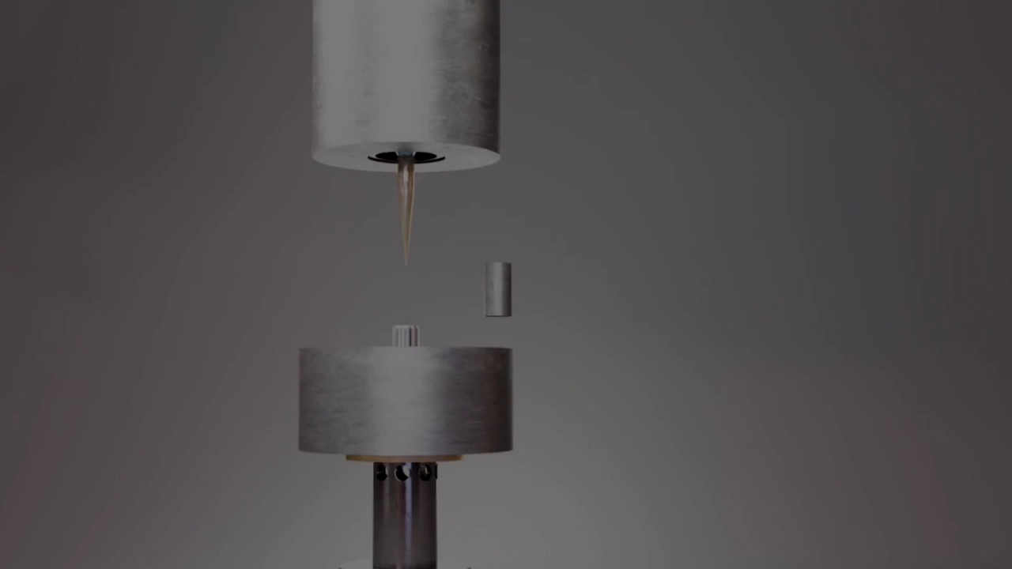
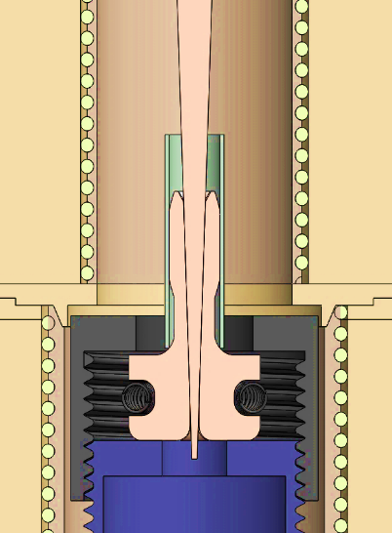
DESCRIPTION OF MODIFIED MANDREL TEST
Mandrel tests were performed using a rigid hexagonal spike mounted on a tensile machine. The spike gets into contact with the mandrel segment, which in turn was in contact with the tube, over an active height corresponding approximately of single fuel pellet [2].
Mandrel Test Setup [2]

Slide 5
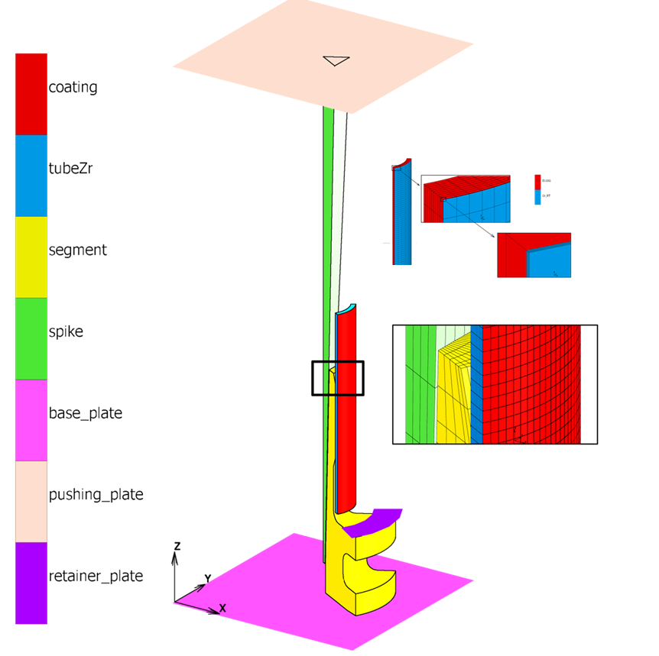
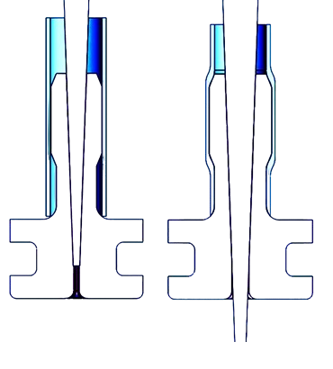
NUMERICAL MODELING (1/5)
- Contact nonlinear analyses by Marc© FE code
- Strain > 3% (large strains assumption)
- E110opt @Room Temperature material properties used to model the Zr substrate of the Cr coated Iranian Zr1%Nb sample (ECRI-51).
cladding-coating detail
Component | Young’s Modulus [GPa] | Yield Stress [MPa] | Ultimate Tensile Stress [MPa] | Poisson’s Ratio [-]
Zr1% Nb [2] | 93.85 | ≈270 MPa | 380 MPa | 0.35
Bulk Cr [2] | 240 ± 30 | 264.2 MPa | 270.5 ± 20 MPa | 0.22
K360 Isodur Steel (Tool) [2] | 212 | 630 MPa | 834.5 MPa | 0.30
Validation (numerical vs experimental data) and Verification of modelling (influence of mesh size) were performed to assure the reliability of the simulation
max. plastic deforamtion
FE model of 1/6 mandrel test (ECRI-51B) [2]

Slide 6
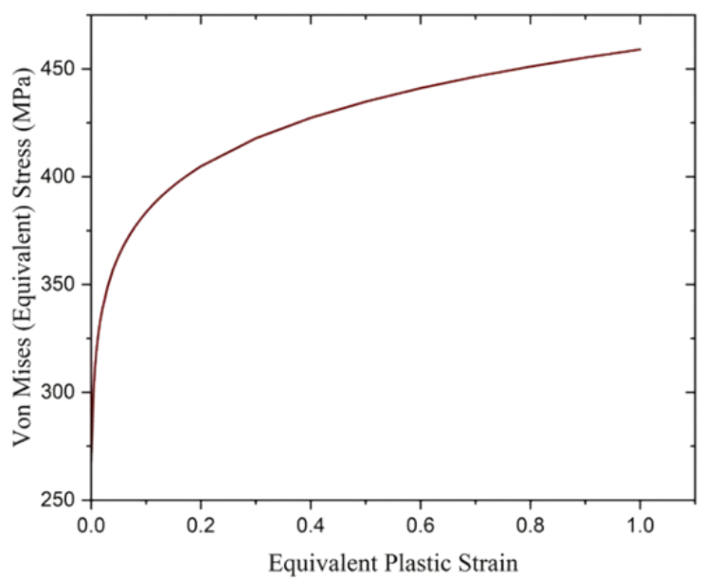
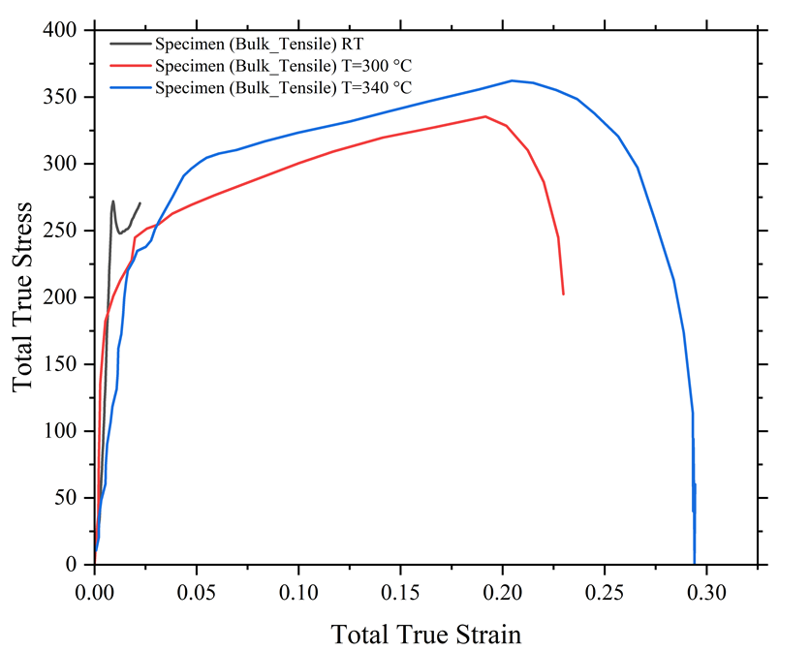
NUMERICAL MODELING (2/5)
Acceptable curve extension as the Zr substrate shows no cracks.
Material property used for Zr-substrate at RT [2]
True stress–strain for bulk chromium [2]
Lower yield criteria for Cr [2]
The Von Mises plasticity model was implemented, converting anisotropic properties with a single stress–strain curve (unavailable anisotropy factors for the Iranian samples) [2].
For the Cr coating, bulk material properties were used
Chromium has a BCC crystal structure (compression results may not accurately represent its behaviour under tensile regime); 2) data availability

Slide 7
NUMERICAL MODELING (3/5)
Material property used for Spike-Segment [2]
The tool flow curve shows higher S_{y} and S_{UTS} for the mandrel and spike relative to the Zr alloy and the chromium coating: they remain in the elastic field for the test load condition [2].

Slide 8
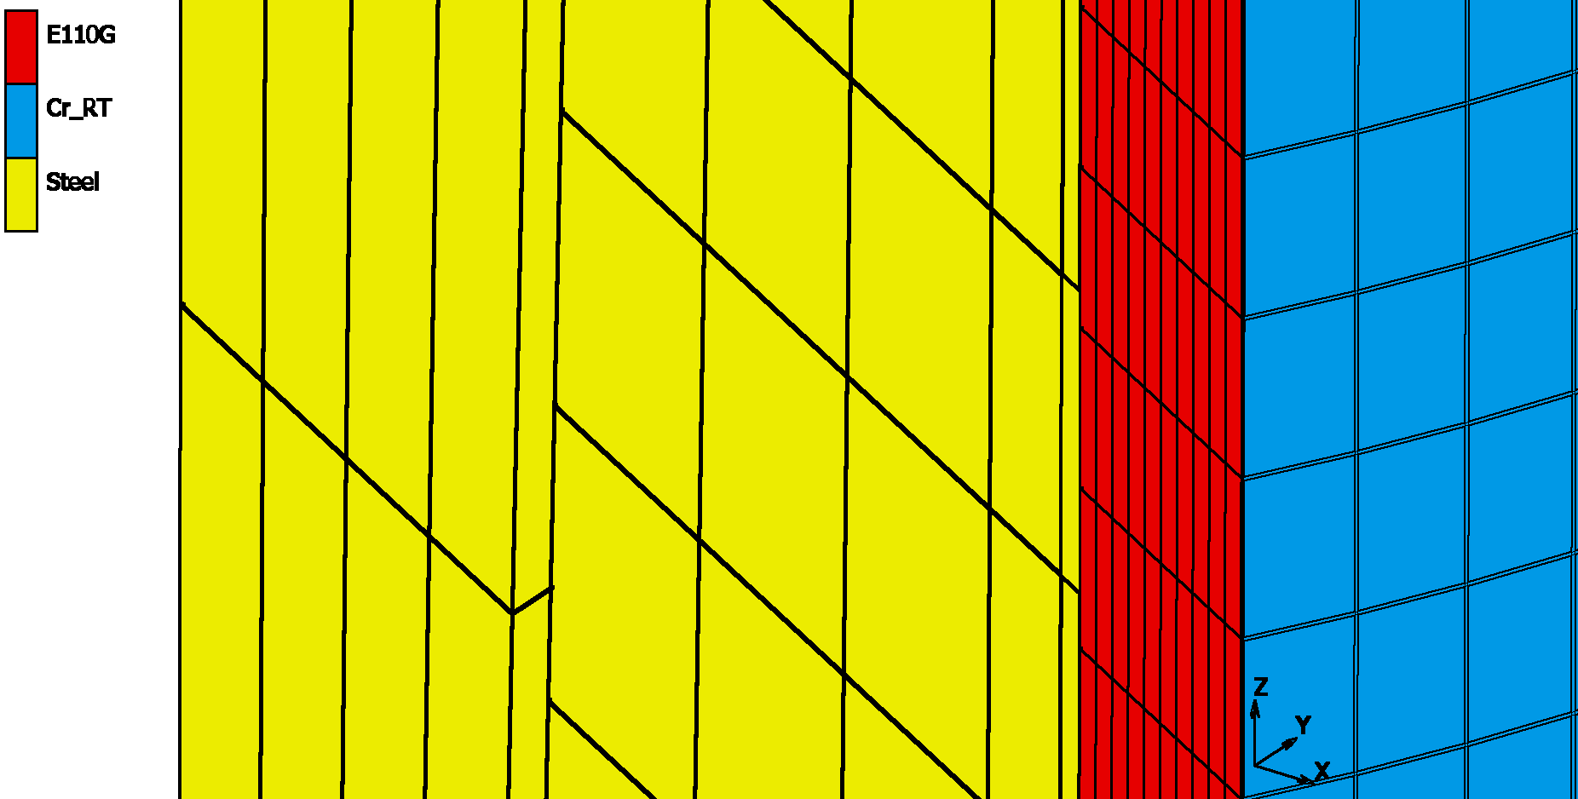
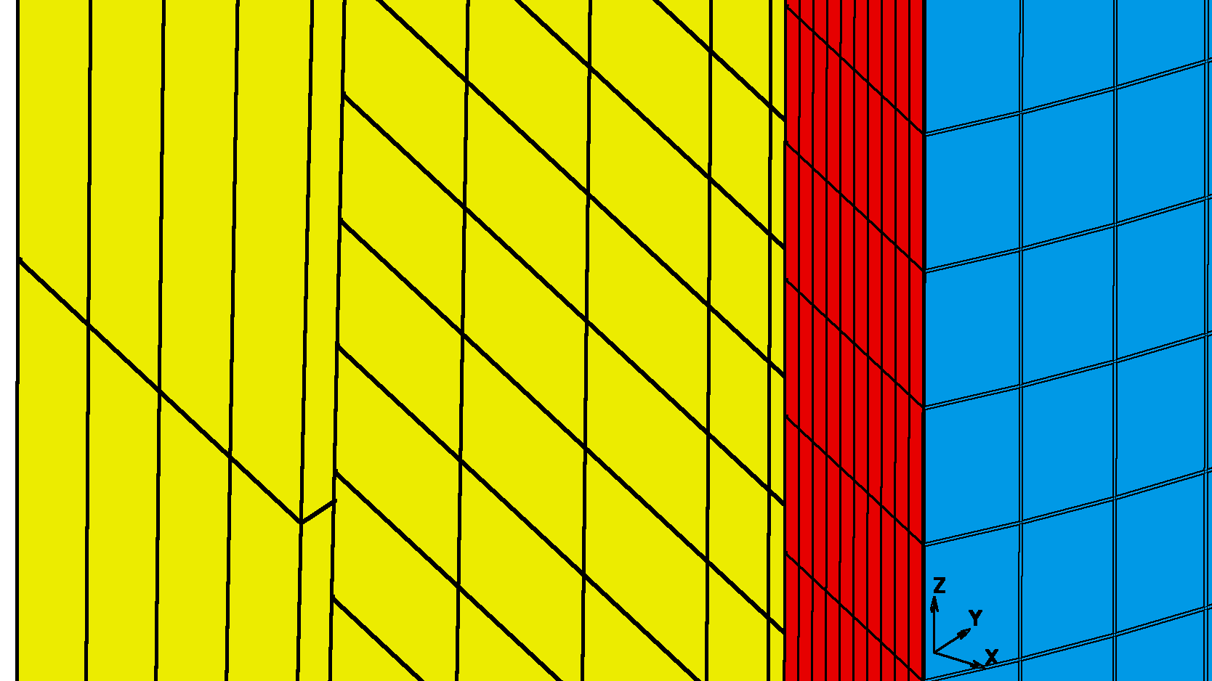
NUMERICAL MODELING (4/5)
The segment mesh size was refined to achieve a 1:1 ratio with the cladding (one segment element matching one cladding element-ECRI-51B2-M2).
ECRI-51B2
ECRI-51B2-M2 [1]

Slide 9
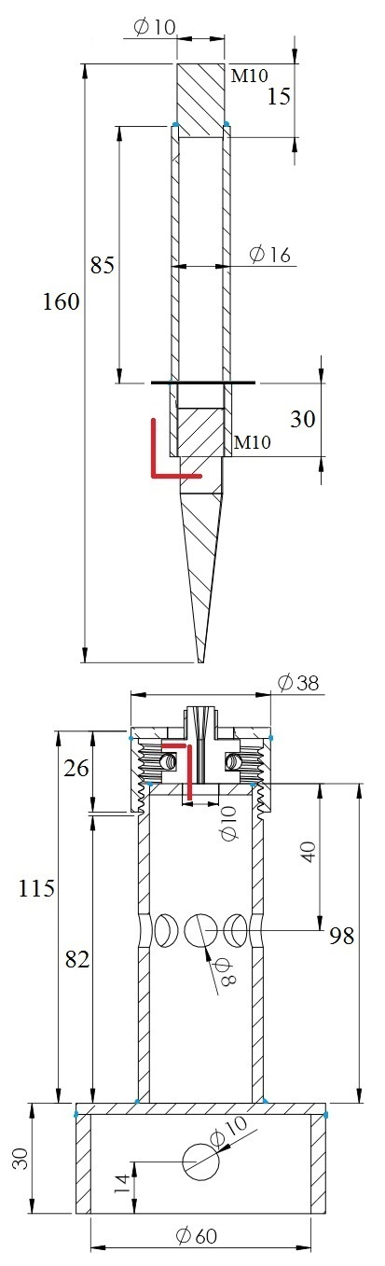
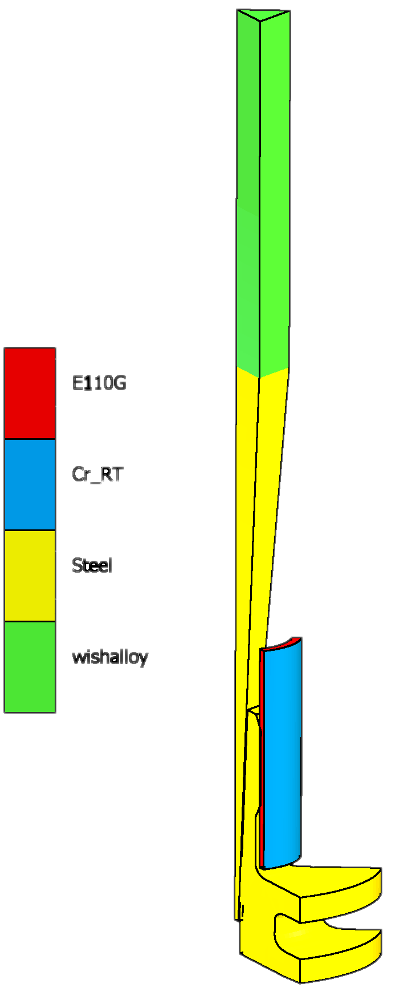
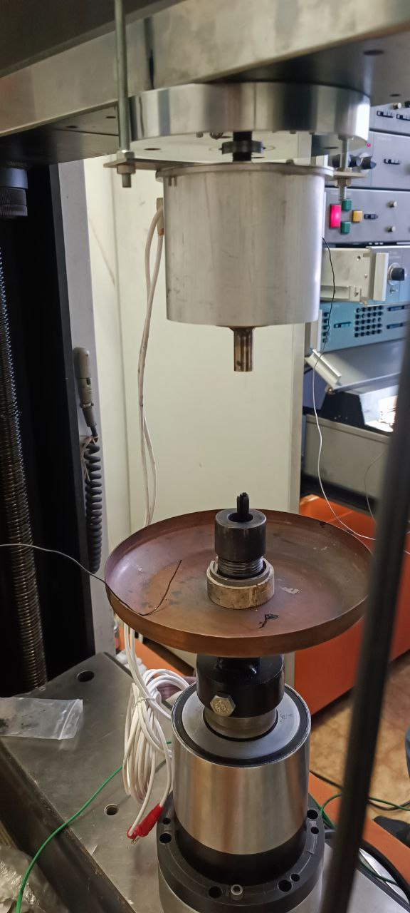
NUMERICAL MODELING (5/5)
The FE model was improved by inputting non-linear elastic behaviour as per UTM components, to ensure that the coating response is independent of this effect (ECRI-51B6-2).
ECRI-51B6-2[1]
Parts of UTM not modelled previously

Slide 10
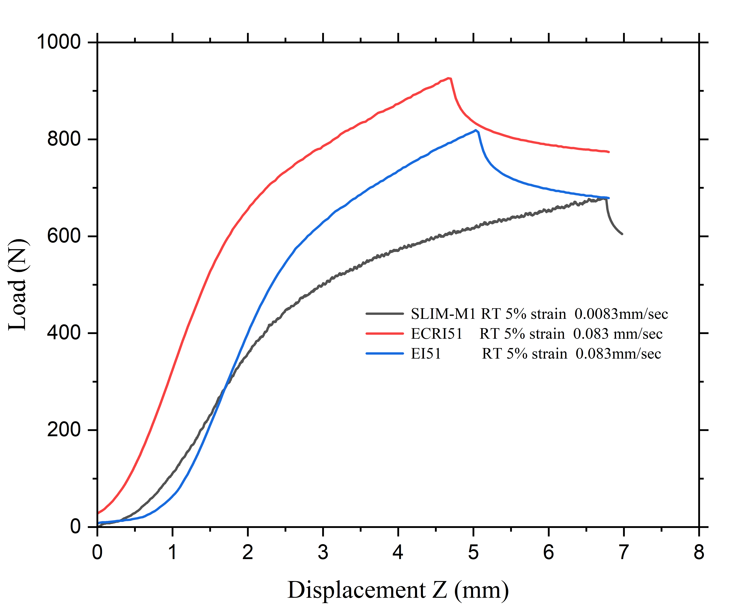
MODEL VALIDATION (1/3)
Validation steps:
Determine the Effective Friction Coefficient (EFC), based on UTM data (F- d plot)
Comparison of permanent radial deformation of the samples with model, from the Profilometry results
Cladding | OD (mm) | ID (mm) | Wall (mm)
E110opt SLIM | 8.9 | 7.8 | 0.55
Iranian Zr1%Nb | 9.057 | 7.705 | 0.676
Iranian Zr1%Nb + Cr | 9.08 | 7.682 | 0.699
Force vs spike displacement (experimental data) [2]

Slide 11
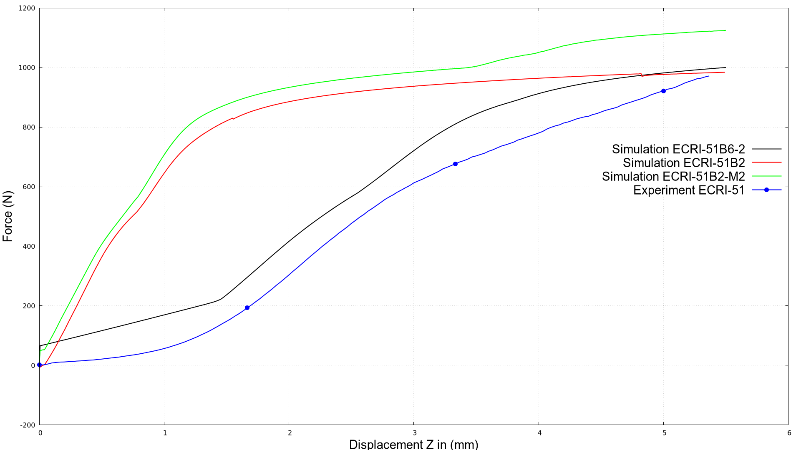
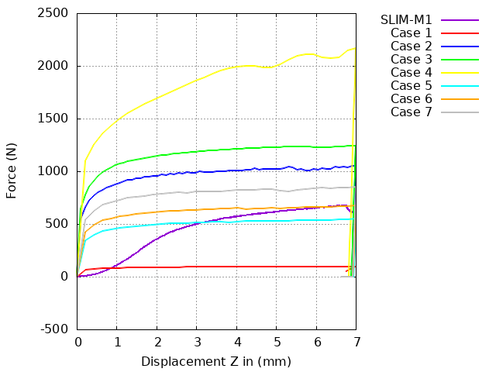
MODEL VALIDATION (2/3)
Case ID | EFC1 | EFC2 | EFC3
Case 1(b) | 0.3 | 0.001 | 0.3
Case 2(c) | 0.3 | 0.3 | 0.3
Case 3(d) | 0.4 | 0.4 | 0.01
Case 4(e) | 0.4 | 0.57 | 0.2
Case 5(f) | 0.16 | 0.16 | 0.16
Case 6(g) | 0.2 | 0.2 | 0.2
Case 7(h) | 0.25 | 0.25 | 0.25
EFC trial-error
Cladding | EFC samples
E110opt SLIM | 0.2
Iranian Zr1%Nb + Cr | 0.25
FC ID | EFC1 | EFC2 | EFC3
Type | Kinematic | Static | Kinematic
Acting on | Spike-Segment | Tube-Segment | Segment-base plate
Effect of thickness + Cr
simulated vs experimental data [1]
EFC description
Assessment of EFC on SLIM-M1[2]

Slide 12
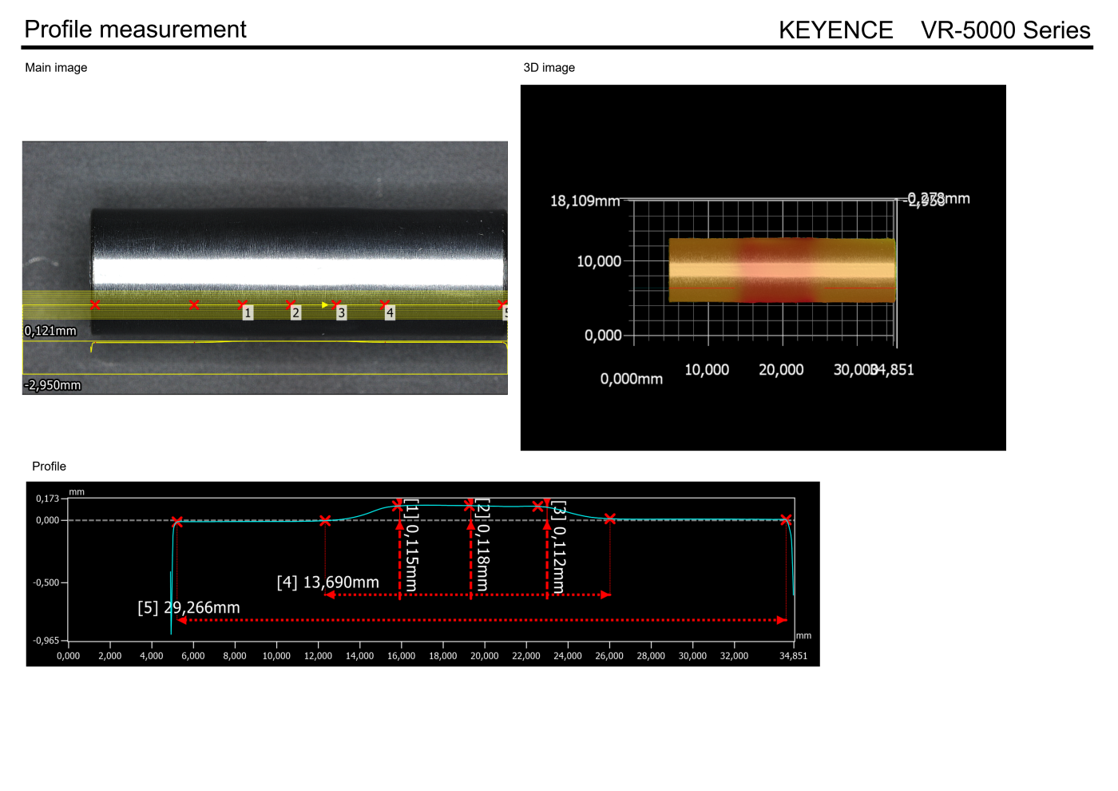
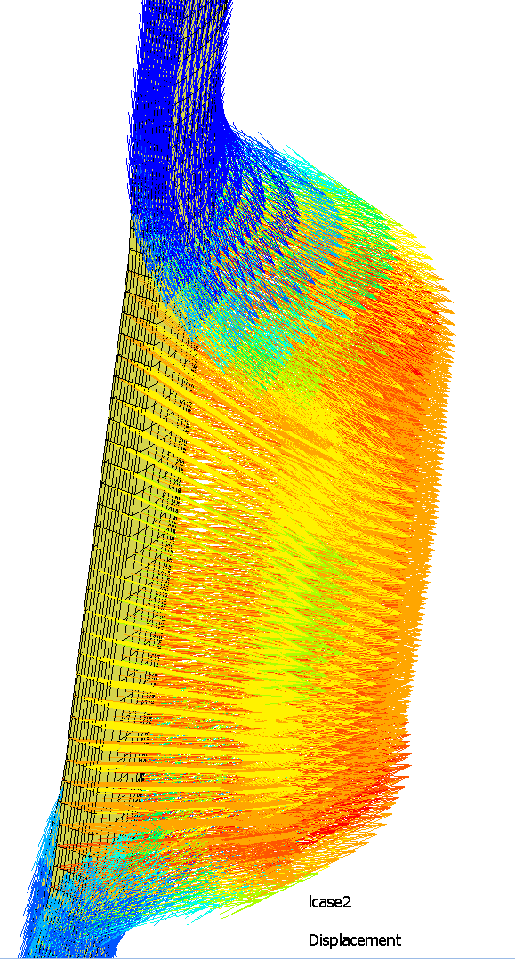
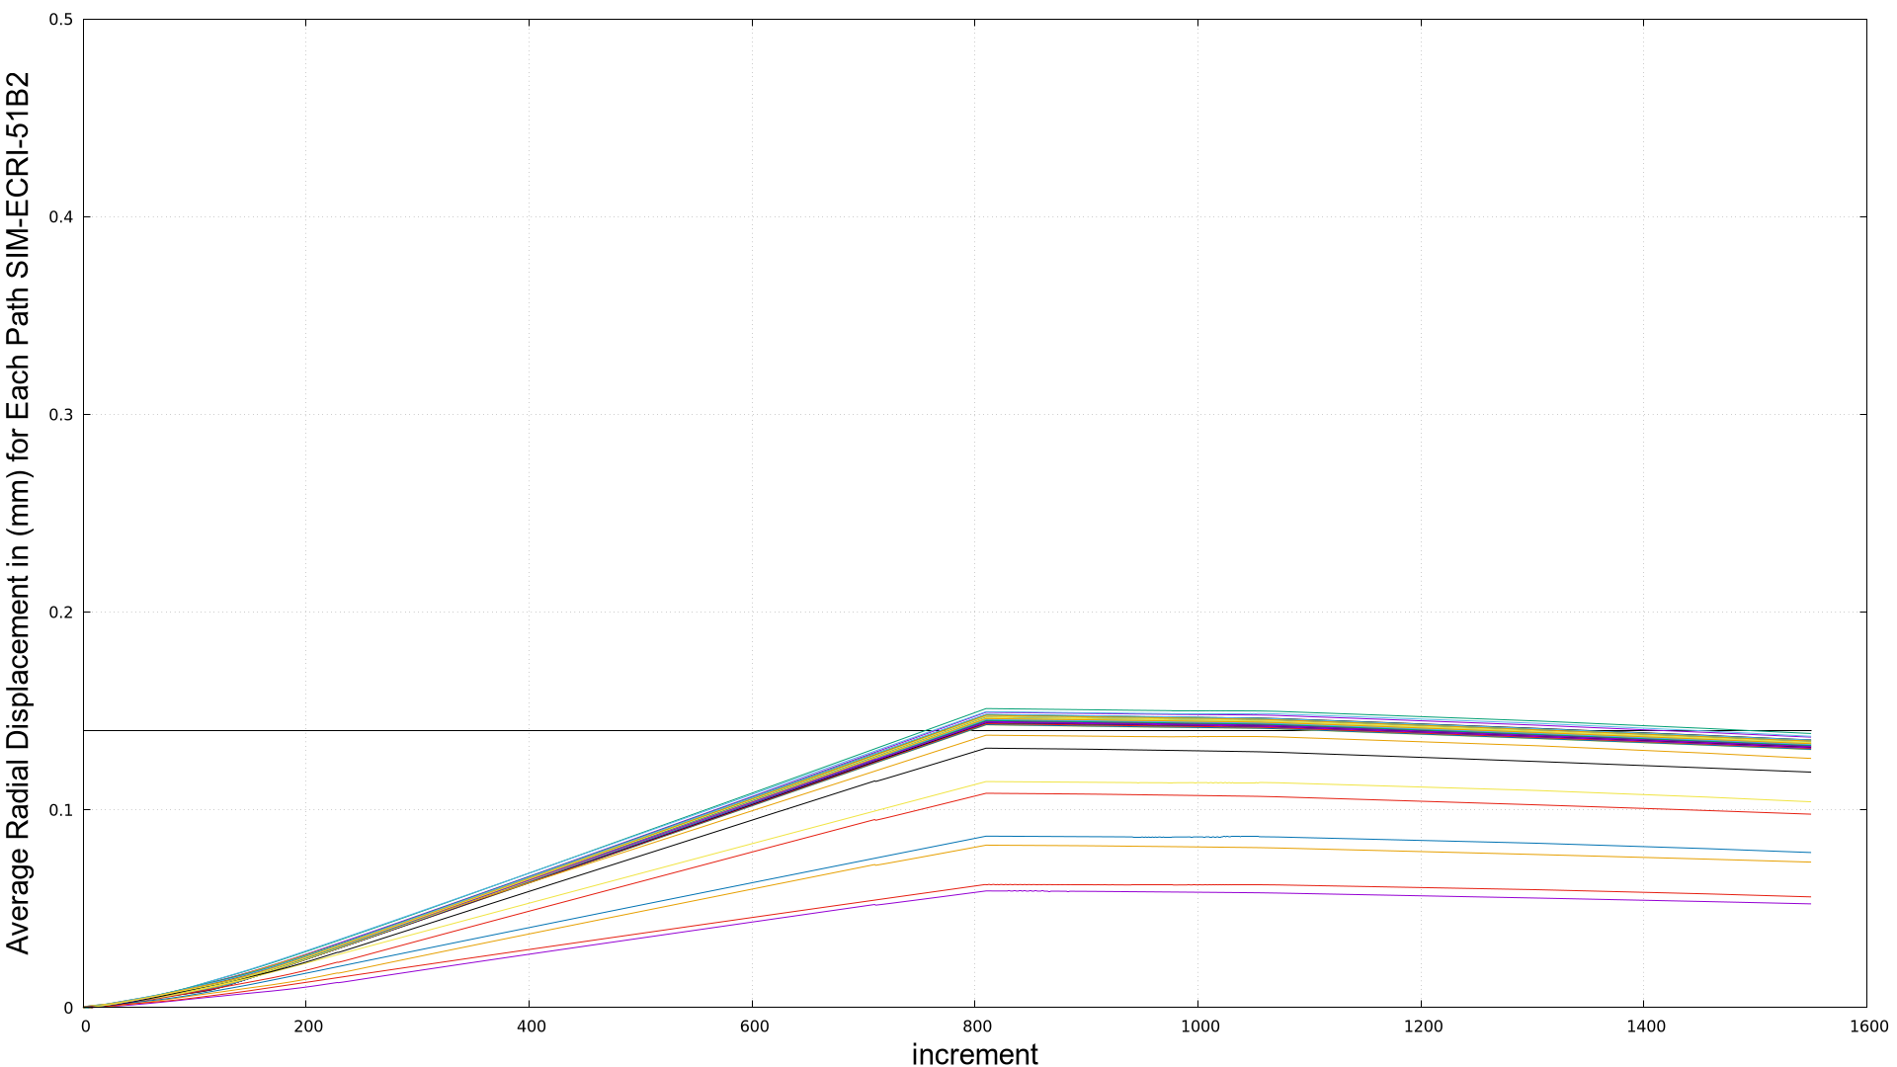

PROFILOMETRY (3/3)
Simulation ID | Avg Plastic radial displacement | Convergence Tolerance (displacement)
ECRI-51B2 | 0.115 mm | 0.05
Outer Nodal Path
3D surface profilometry of ECRI-51 (VR-5000 series device) [2]
Average radial displacement in each path case ECRI-51B2 after unloading
Deformed height > 10 mm (active section of segment)
Error_abs=4.64%
Profilometry data were used to obtain the permanent radial displacement (used for model validation).
Error=$\frac{(Experimental−Simulation)}{Experimental}$×100

Slide 13
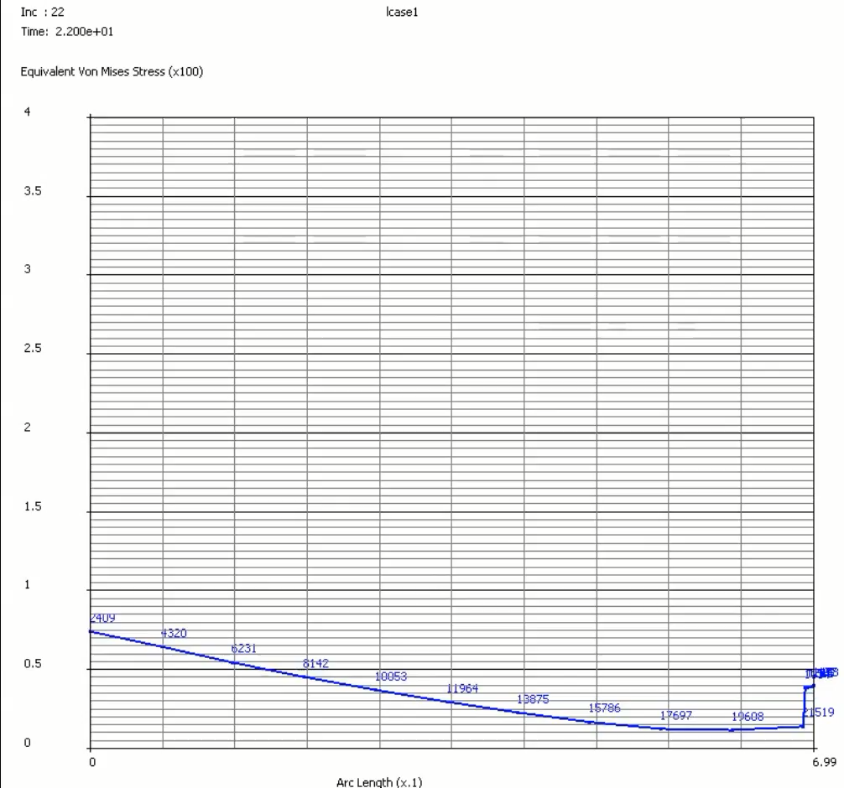
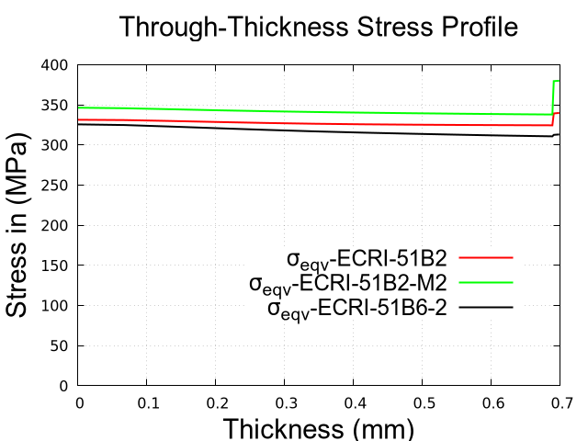
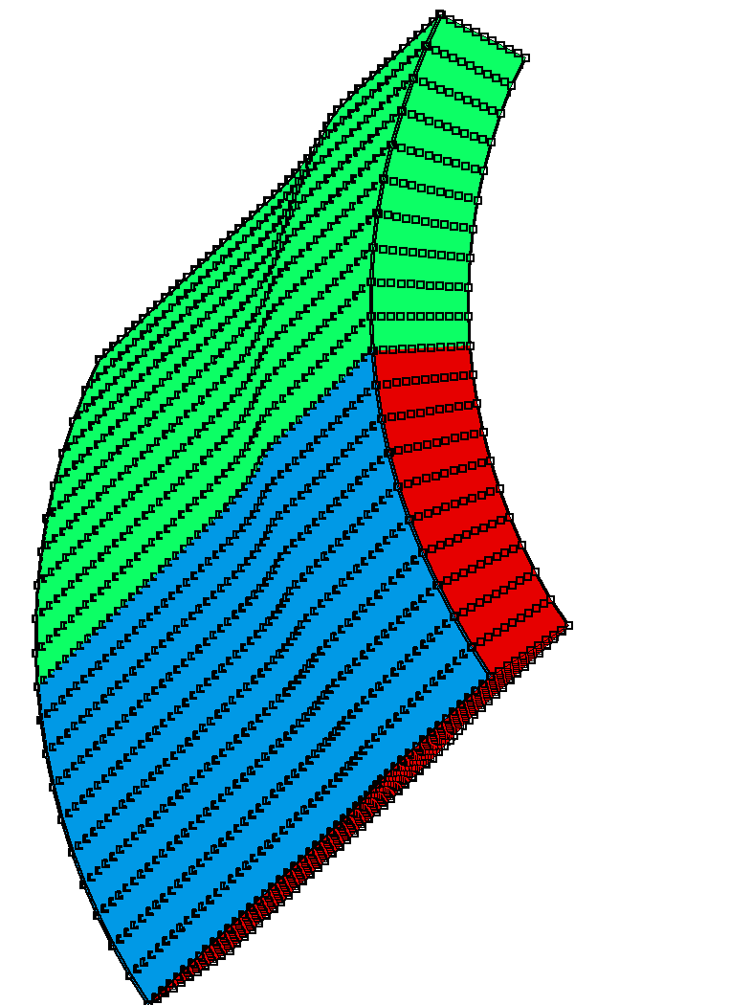
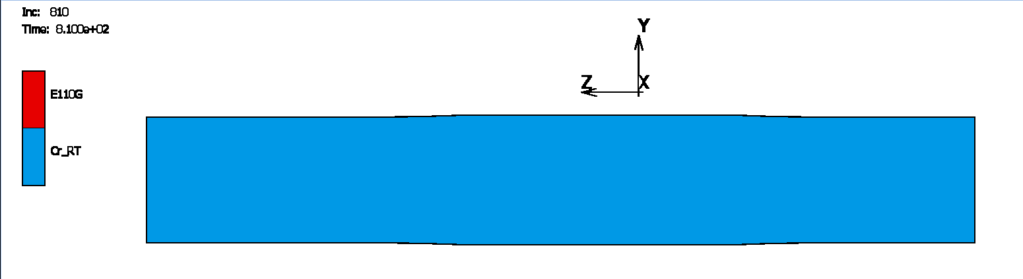
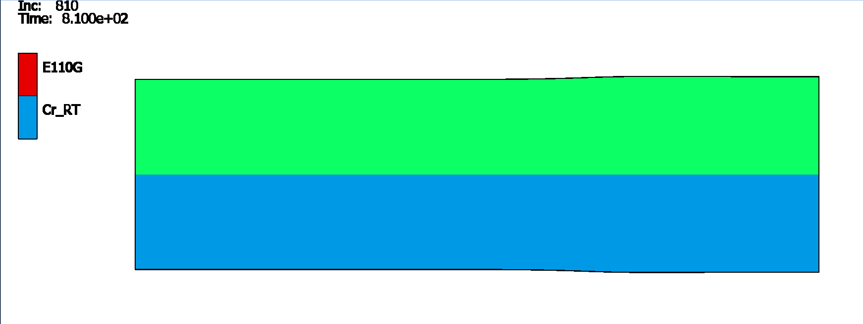
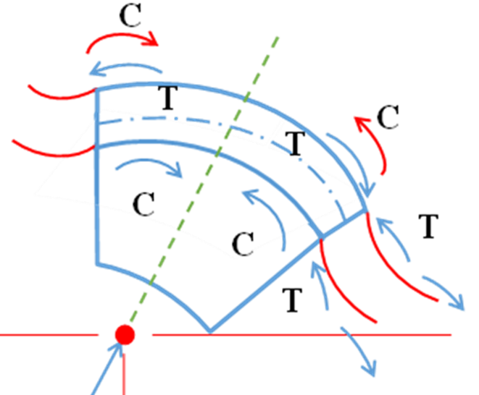
THROUGH-THICKNESS ANALYSIS (1/2)
Through-thickness analysis was performed for ECRI-51B2 case (spike at maximum depth and loading) to evaluate σ-ε changes at the coating–substrate interface → this may govern delamination and cracking behaviour [1].
-The interface strength ensures firm adhesion of the Cr coating to the Zr substrate (importance of study).
-The apparent jump in σ at the interface reflects the stress concentration near this location.
-The sudden stress reduction (inc. 117) is due to the bending moment originating from the different diameters of the mandrel and cladding (contact establishment).
mid-section of deformed area [1]
Comparison of models- showing consistency of results [1]
4.22 s starts the reduction of stress

Slide 14
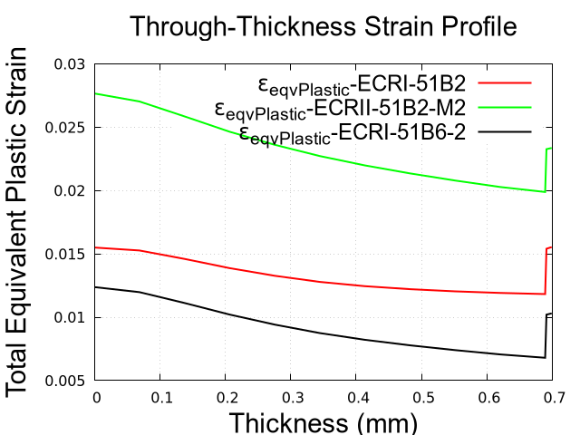
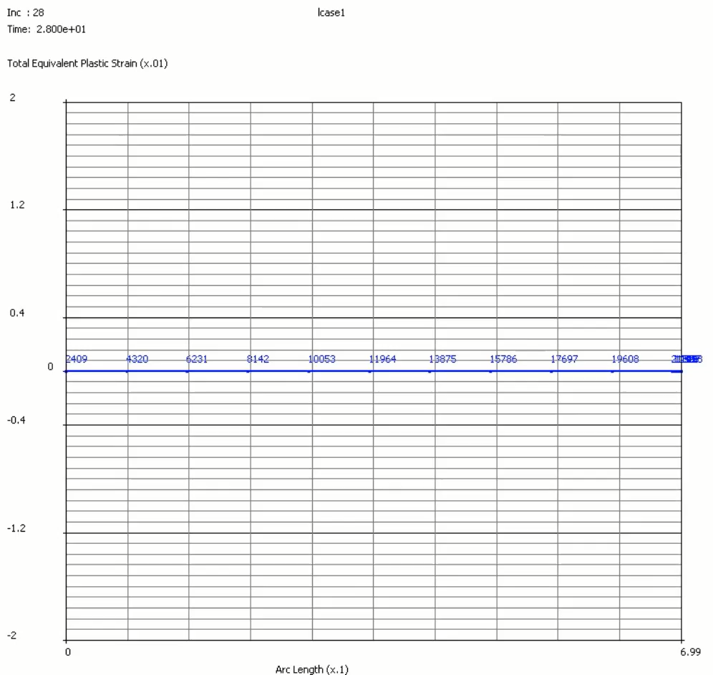
THROUGH-THICKNESS ANALYSIS (2/2)
The through-thickness strain analysis verifies the localized plastic strain at the interface of the coating-substrate.
Comparison of models [1]
For an elastic strain of 2%, all FE models indicate Cr failure based on the bulk properties before reaching the 5% maximum strain (test parameter), with ECRI-51B2-M2 reaching failure at a higher rate [1].

Slide 15
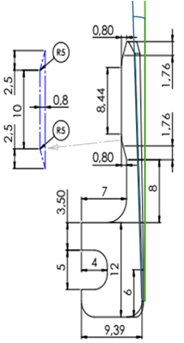
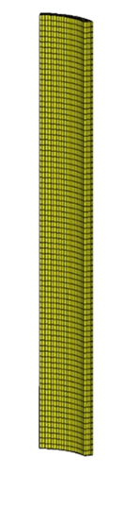
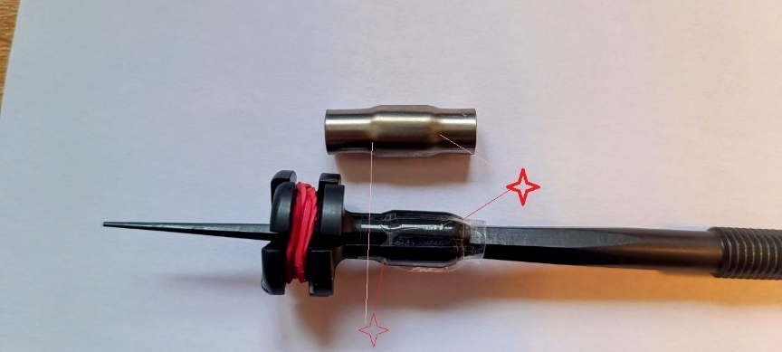
CODE COUPLING STRATEGY & ANALYSIS (1/3)
The code coupling approach with aim of prediction of coating failure, was based on the premise that cladding deformation observed in the mandrel test can be replicated using an equivalent gas, as the contact pressure during NO-PCMI can be approximated by an increase of the rod internal pressure [2].
Methodology to extract pressure
Raw data (geometry, material, experimental data)
FE code
TU (fuel performance) code
Concentrated
Uniform

Slide 16
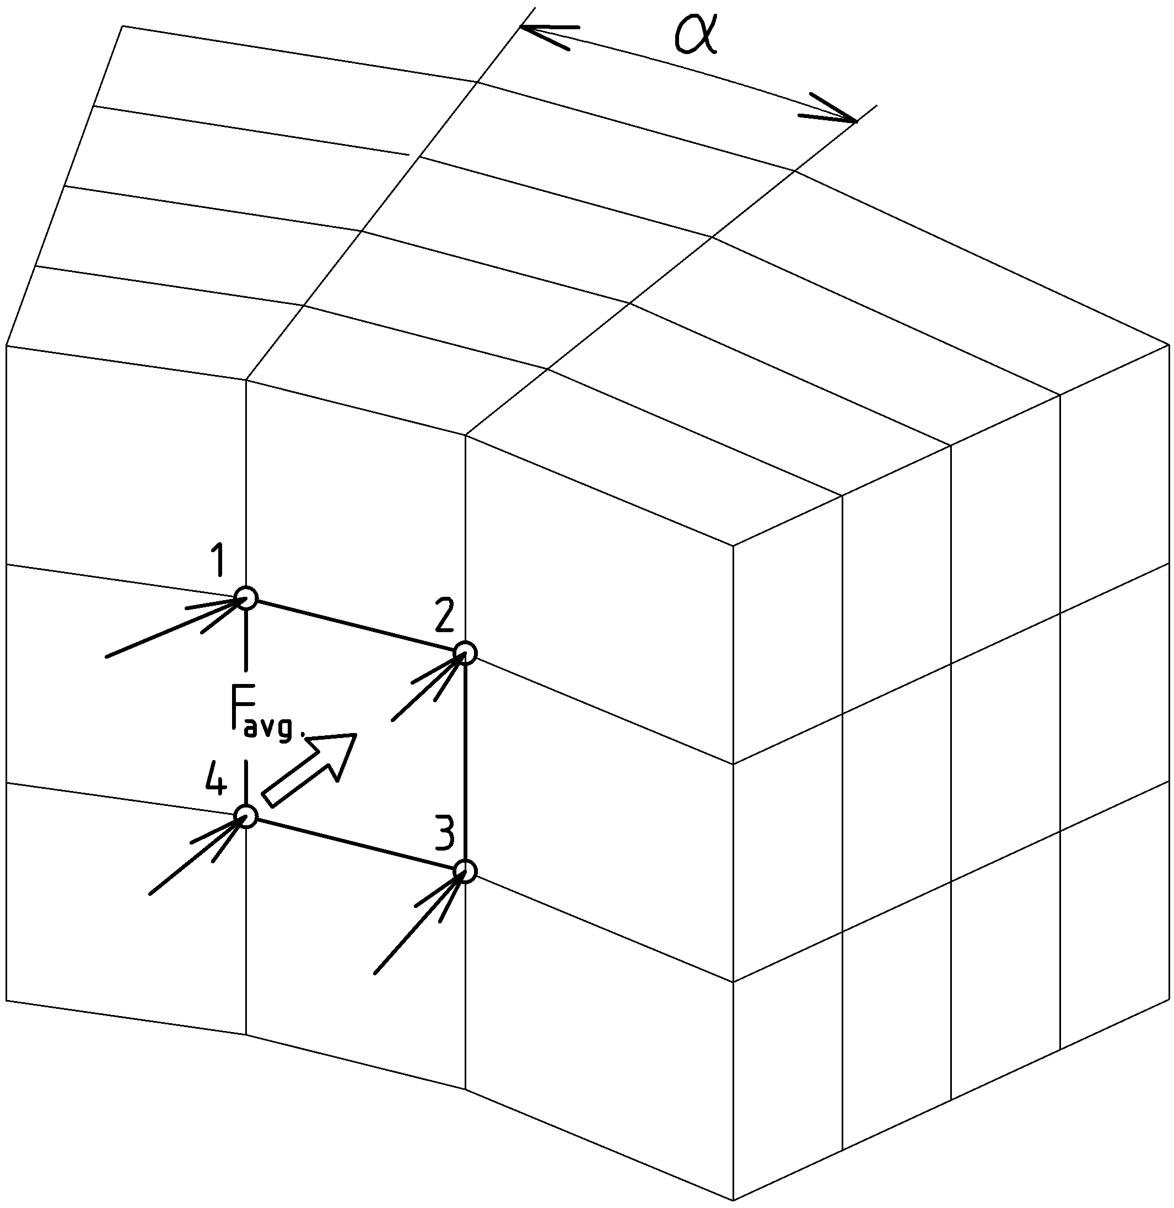
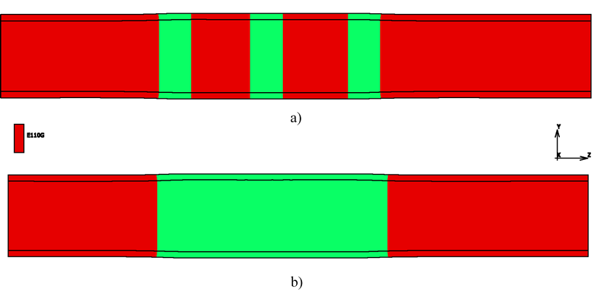
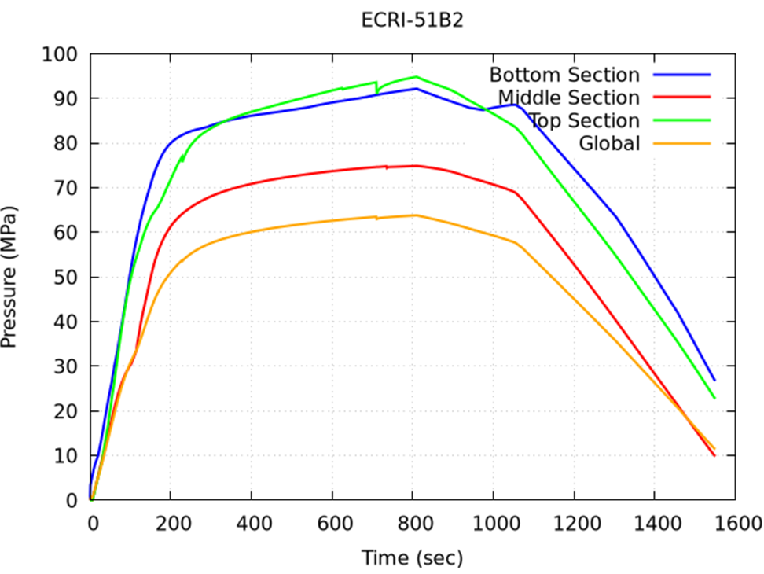
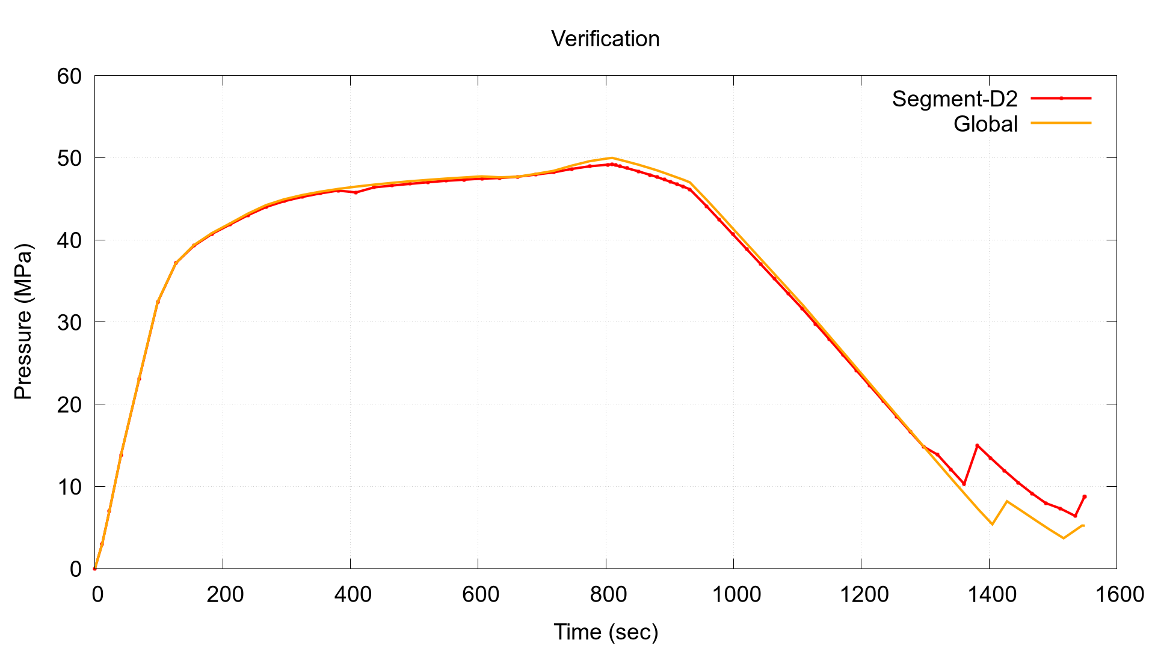
CODE COUPLING STRATEGY & ANALYSIS (2/3)
Local values: along the 5 paths at the top, middle, and bottom of the mandrel contact length, local P caused localized deformation.
Global value: along all the contact area, mean average resultant pressure.
Contact area calculated from profilometry results (deformed area).
Methodology to obtain contact force (pressure history) [2]
Selected portion of the tube (local and global) [2]
Verification of pressure history by the principle of equilibrium in static condition and rigidity of the segment [2]
Pressure history [2]
These pressure values were then inputted to burst test model….

Slide 17
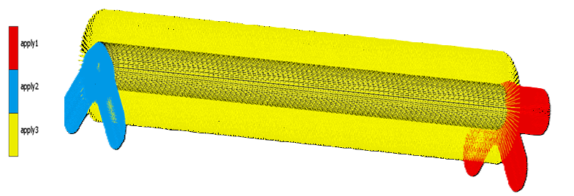
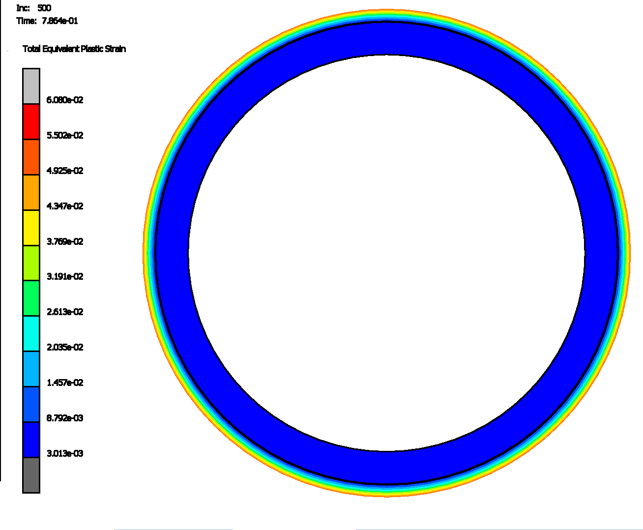
CODE COUPLING STRATEGY & ANALYSIS (3/3)
To verify the applicability of the equivalent pressure model, a separate FE model was developed.
Linear increase of pressure up to P_{max} (at the middle section pressure history-70MPa)→ Case= t05
L=150mm
Burst model [2]
Although in the equivalent gas expansion model, the strain concentration due to the fillets can not be seen, yet the plastic deformation of the cladding verifies the capability of the model to predict the failure of the coating.
Case: coated sample

Slide 18
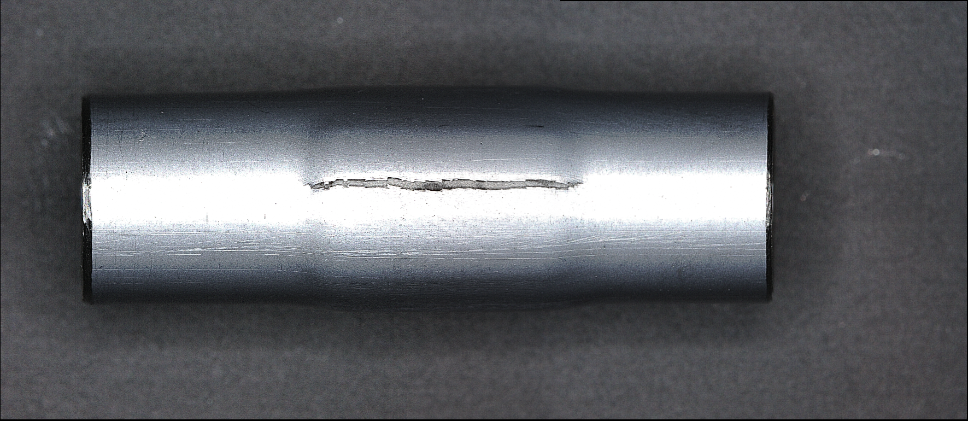
FUTURE NEEDS
Fractography study on OPZCr-48 sample (15% strain) [2]

Slide 19
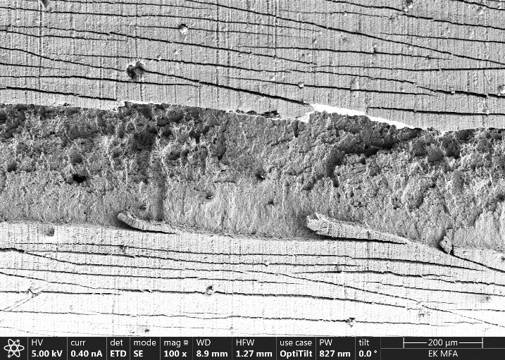
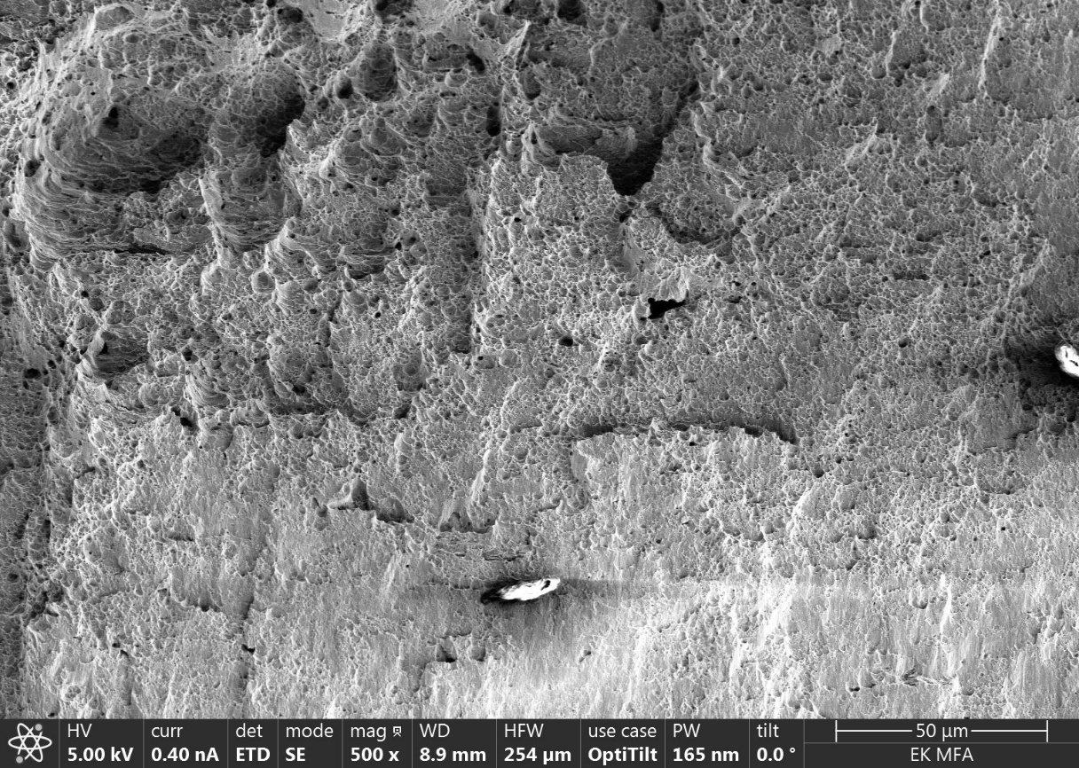
FUTURE NEEDS
Fractography study on OPZCr-48 sample (15% strain) [2]

Slide 20
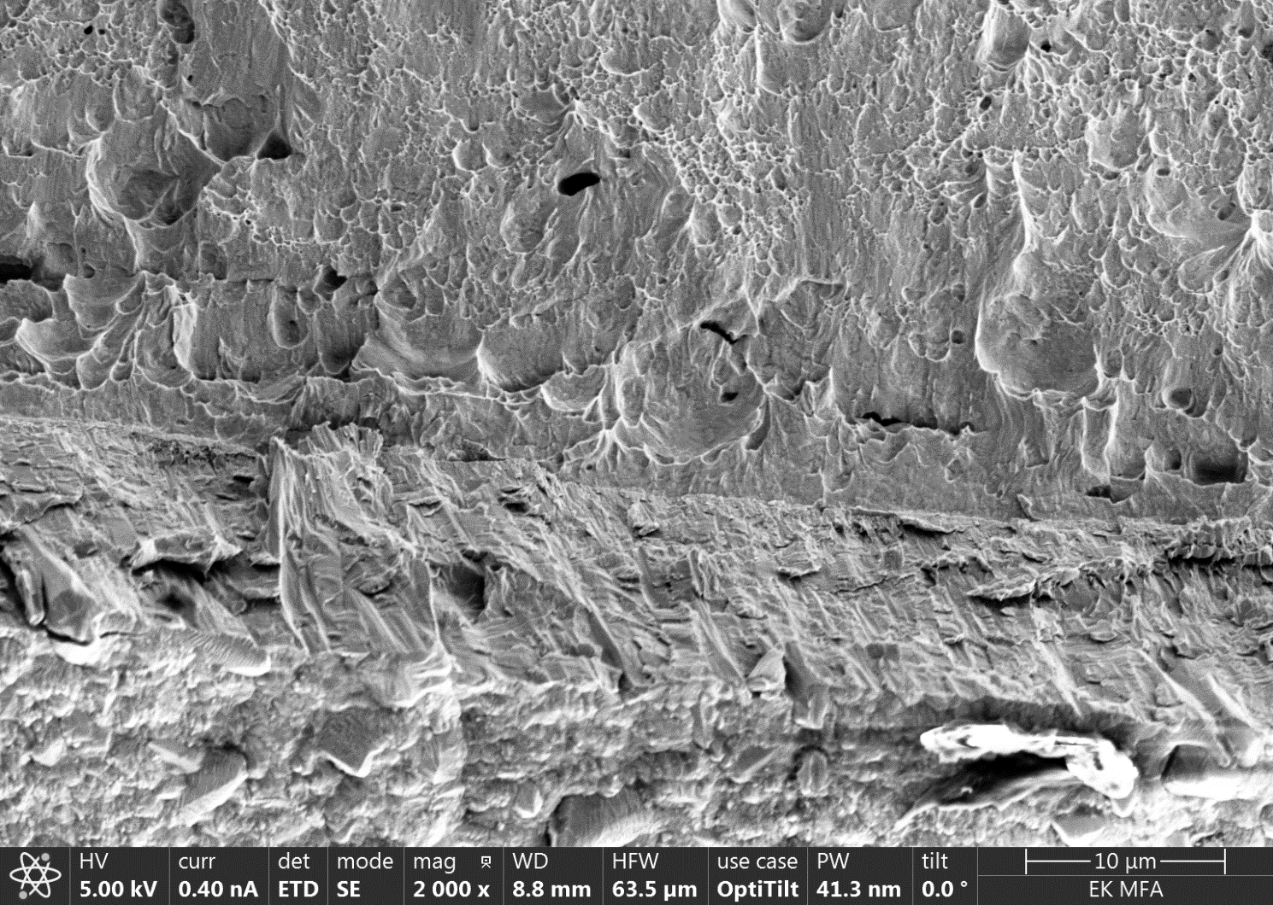
FUTURE NEEDS
Intergranular failure of Cr layer under tensile stress [2]

Slide 21
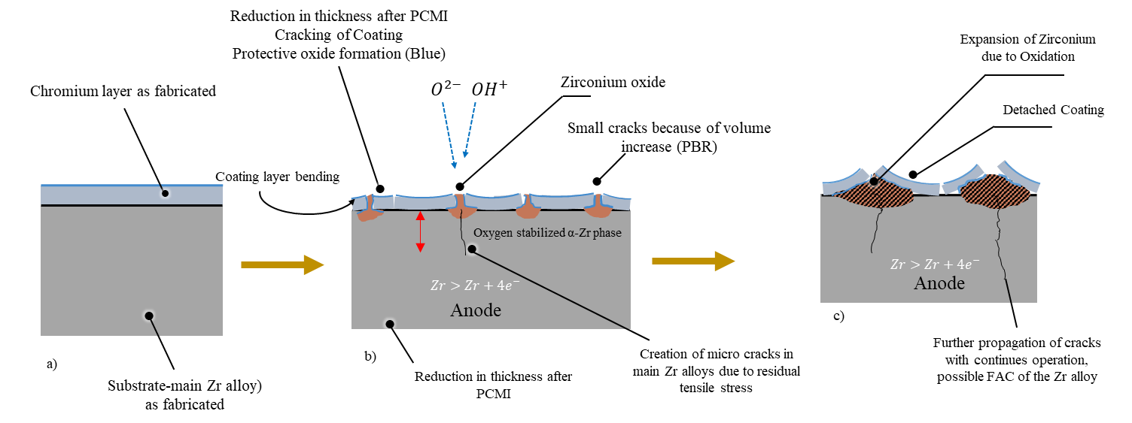
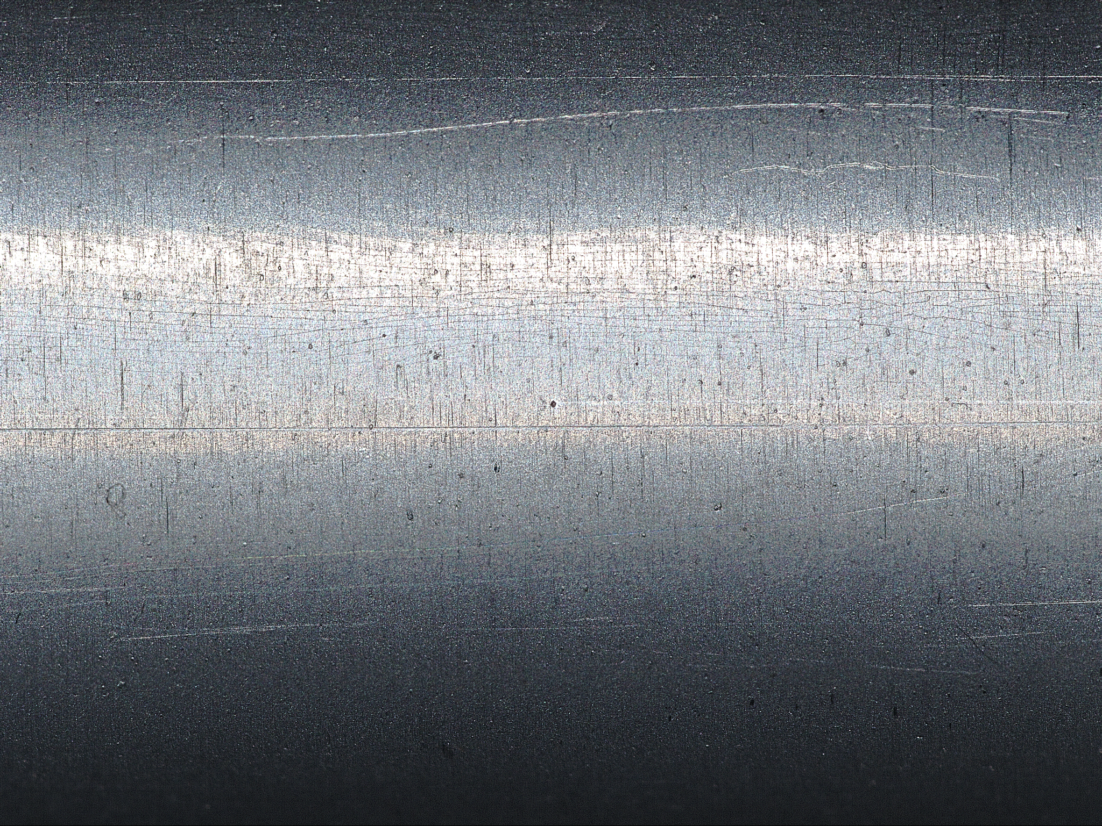
FUTURE NEEDS/ IMPORTANCE OF AVOIDING COATING CRACKING
σ_{t}>S_{y} or ε>ε_{y} of Chromium (Brittle) at both RT and 300 °C
If σ_{t}<S_{UTS} or ε<ε_{f} of Chromium (Ductile)
Possible effect of cracking on coating response [2]

Slide 22
CONCLUSION
-The coating integrity under PCMI conditions, along with other phenomena causing radial loading at NO, like fission gas (especially when no lift-off criterion is applied), needs to be verified on unirradiated and irradiated claddings using prototype testing combined with simulation.
-The segmented-mandrel test demonstrated to be a reliable technique to characterize the coating failure condition under postulated PCMI scenario.
-FE simulation is a powerful method for simulating cladding (thermo-mechanical) behaviour. When combined with FPCs, it can further improve the accuracy of fuel system predictions. The code coupling (preliminary results of equivalent gas expansion model) shows to be a reliable approach to enable FPCs to assess and validate their mechanical sub-model.
-Despite inducing stress discontinuities and local plastic strain at the interface, the material mismatch has demonstrated a beneficial impact on dimensional stability, as evidenced by the results of the ATF-TS separate effects burst tests. Consequently, this phenomenon should be carefully engineered to maximize its advantages.
-Future mechanical tests are required to determine the tensile properties of coating and interface material if PVD is used (since no cracks for Zr was observed).
-The addition of Cr shall not reduce the ductility limit of the Zr substrate.

Slide 23

ACKNOWLEDGEMENTS
The authors gratefully acknowledge the Czech Technical University and the Atomic Energy Organization of Iran for providing the materials used in the present testing.
“Funded by the European Union. Views and opinions expressed are however those of the author(s) only and do not necessarily reflect those of the European Union or the European Commission. Neither the European Union nor the European Commission can be held responsible for them.”

Slide 24
Thanks for your attention Any questions?

Slide 25
DEDICATION
I would like to dedicate this presentation to my parents, their unwavering love, guidance, and support throughout my journey made me the person I am today.
I also want to express my gratitude to my professors, in particular to dear Dr. Zoltán Hózer and Dr. Márton Király (HUN-REN EK), and to Professors D’Auria, Lo Frano, and Forgione (University of Pisa) and dear Dr. Paul Van Uffelen (JRC).
Their kindness, wisdom, and dedication have deeply inspired me.
This is just the beginning of my journey…

Slide 26
REFERENCES
[1] Yousefi, H. (2025). Simulation of pellet–cladding mechanical interaction with ATF claddings [Unpublished master’s thesis]. Università di Pisa. Supervisors: Z. Hózer, F. S. D’Auria, & N. Forgione; Mentors: R. Lo Frano & M. Király.
[2] Yousefi, H., Király, M., Hózer, Z., Vér, N., Novotny, T., Perez-Feró, E., Horváth, M., Tatár, L., Aragón, P., Schubert, A., & Van Uffelen, P. (2025, July). Mandrel ductility tests with ATF cladding. OFFERR Project report, HUN-REN Centre for Energy Research, Budapest.
[3] International Atomic Energy Agency. (2024, May 13). Experimental programme of accident tolerant and advanced technology fuel: Final report of a coordinated research program ATF-TS [Unpublished TECDOC report].
[4] Karoutas, Z., Luangdilok, W., Shockling, M., Schneider, R., Lahoda, E., & Xu, P. (2018). Update on Westinghouse benefits of EnCore® fuel (TopFuel 2018-A0163). Westinghouse Electric Company LLC. https://www.euronuclear.org/archiv/topfuel2018/fullpapers/TopFuel2018-A0163-fullpaper.pdf
[5] Hong, J., Ahn, D., Jang, D., Oh, H., Kim, J., Kim, H., & Ševeček, M. (2023). Measurement of local mechanical properties for Cr-coated accident tolerant fuel cladding. Journal of Nuclear Materials, 579, 154407. https://doi.org/10.1016/j.jnucmat.2023.154407

