Slide 1
Testing-simulation of pellet-cladding mechanical interaction with ATF claddings Hamidreza Yousefi, Márton Király, Zoltán Hózer, Márta Horváth, Erzsébet Perez-Feró, Tamás Novotny, Nóra Vér IAEA Technical Meeting on Advanced Technology Fuels, October 2025

Slide 2

Overview
OFFERR project
Mandrel test
SEM examinations
Post-test oxidation
Metallography
Summary

Slide 3













SNETP OFFERR
Nuclear Research Group of San Piero a Grado
HUN-REN EK
“This work has been supported by the OFFERR-SNETP project founded by the Euratom-European Union”.
“This work (mobility) has been supported by the ENEN2plus project (HORIZON-EURATOM-2021-NRT-01-13 101061677) founded by the European Union”.

Slide 4
Project timeline
Phase 1: (2024.10.21.-2024.12.06.)
• Kick-off meeting in October
• selection of test conditions (crosshead speed of the universal
testing machine, testing temperature, maximum deformation limit)
• selection of the materials for the tests
Phase 2: (2024.12.06.-2025.02.28.)
• execution of the mandrel test series, distribution of raw data
• numerical simulation of the mandrel tests
• oxidation in high-temperature steam
Phase 3: (2025.02.28.-2025.05.30.)
• Project meeting in March
• surface analysis of the samples by SEM
• metallography of the oxidized samples
• release of the final report

Slide 5
Test parameters
The test parameters were decided together with the User Team
Testing temperature | 300 °C in air (reference at room temperature)
Maximum radial displacement | 5% average inner diameter increase (0.19 mm average radial displacement)
Rate of displacement | 0.0175 mm/min radial displacement (0.5 mm/min crosshead speed, 11 minutes)
Optional: Step-loading | two samples were step-loaded in 0.45% increments eleven times to reach the 5% total
Post-test characterization methods | SEM, 3D profilometry, metallography (after oxidation)
Post-test oxidation parameters | Steam + argon, 1000 °C (isothermal), 1800 s

Slide 6
Cladding geometry
These ATF and uncoated reference materials were available for the tests. The geometry of the cladding materials was measured.
Sample code | Supplier | Base material | Coating | OD (mm) | ID (mm)
OPZ | CTU | Opt. ZIRLO | - | 9.075 | 7.939
OPZCR | CTU | Opt. ZIRLO | Cr | 9.085 | 7.933
EI | AEOI | Zr1%Nb | - | 9.057 | 7.705
ECRI | AEOI | Zr1%Nb | Cr | 9.08 | 7.682
ECRNI | AEOI | Zr1%Nb | CrN | 9.05 | 7.68
EXI | AEOI | Zr1%Nb | Cr/CrN | 9.08 | 7.672
SLIM | HUN-REN EK | E110opt | - | 8.89 | 7.76
E110 | HUN-REN EK | E110 | - | 9.09 | 7.76

Slide 7
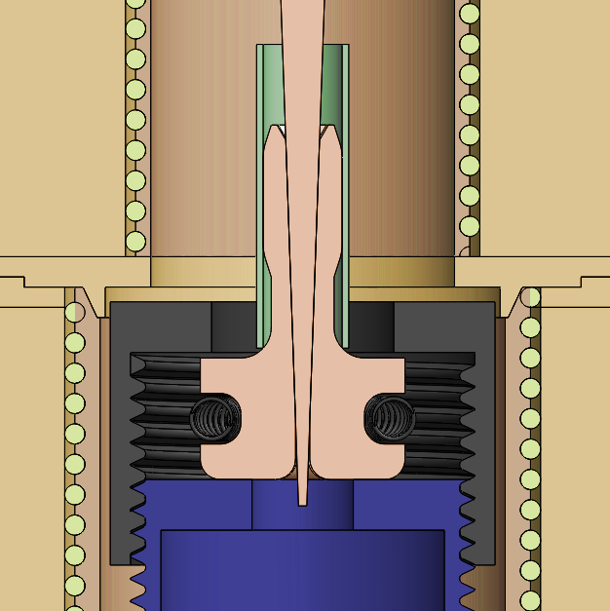
Mandrel test geometry
The mandrel segments used in the test were designed to load only the middle 13 mm of the 30 mm long samples in order to reproduce the axial cracking that is expected in PCMI conditions.
Fillets were added to the sections in contact with the sample in order to reduce the stress concentration.

Slide 8
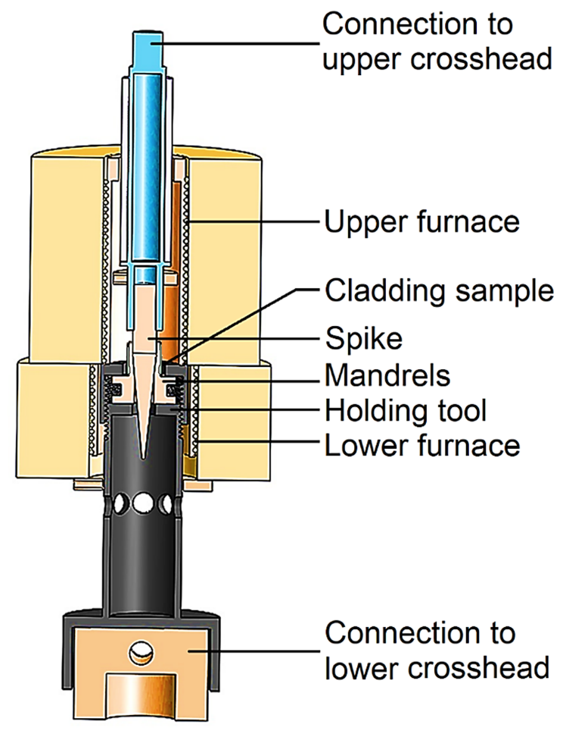
Mandrel test geometry
A two-part furnace was previously constructed around the test in order to perform mandrel tests at higher temperatures (up to 350 °C).
This required extension to be added, like a holding tool for the mandrels and an extension tube for the spike.
The heating of the two halves was controlled by adding a thermocouple to the holding tool beside the sample, and another was fixed to the spike to control the upper part

Slide 9
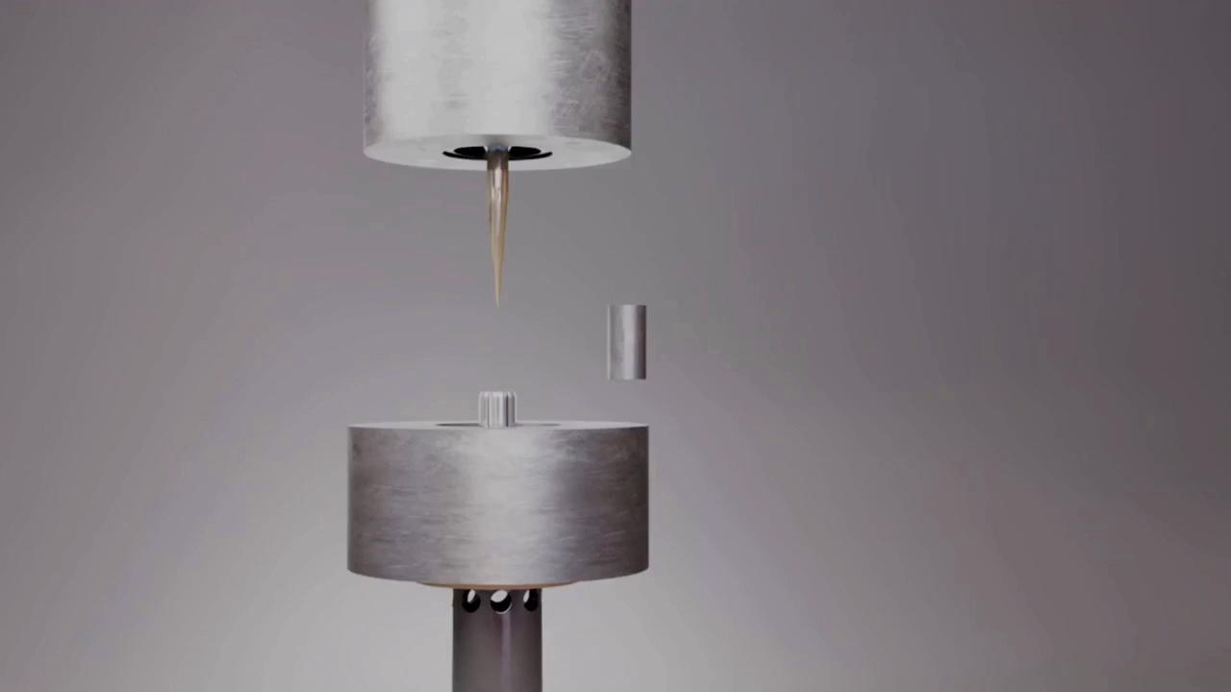
Mandrel test simulation
Considering the nature of PCMI (strain-controlled), the mandrel test is the closest test that can resemble the real PCMI.

Slide 10
Mandrel test conditions
The test procedure was the following:
The INSTRON 1195 type universal testing machine was started and the load cell was calibrated (50 kN)
The mandrels were assembled and tied together with a spring
The extensions were fixed to the crosshead and the load cell
The furnaces were assembled and fixed to these extensions, the thermocouples were fixed and connected
The mandrels and the spike were fixed to the extensions and a high temperature graphite-based grease was applied
The first sample was put on the mandrels and the spike was lowered to achieve contact at zero force, the corrent alignment of the mandrels and the spike was checked

Slide 11
Mandrel test conditions
The test procedure was the following:
The furnace was closed and the controllers were set to 300 °C
The power supply units were turned on, the heating started
The testing machine was set to the measurement range (0-10 kN) and the crosshead speed (0.5 mm/min),
After reaching 300 °C, a hold time of 10 minutes before each test ensured that the whole apparatus and the samples reached the equilibrium temperature (< ±5 °C)
The length and diameter of each sample was measured, the name of the sample was registered in the data acquisition
The test started by enabling the crosshead and the acquisition

Slide 12
Mandrel test conditions
The test procedure was the following:
At low force the mandrel segments and the sample could move and align, the timer was only started after reaching 300 N (1000 N for the room temperature reference tests)
11 minutes corresponded to the 5% total average inner diameter increase, elastic and plastic deformation (11x1 min)
At the end the crosshead was stopped and the direction was reversed, the spike was pulled out from the interconnected mandrels, then it moved out of the furnace
The furnace was opened and the samples were changed
There were timer switches attached to the furnace controllers that stopped them while the furnace was open (overshoot)

Slide 13
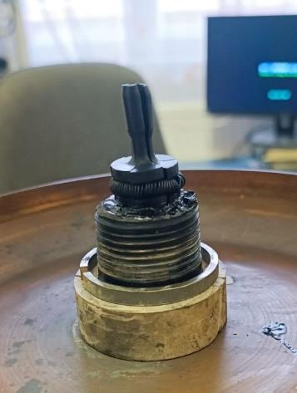
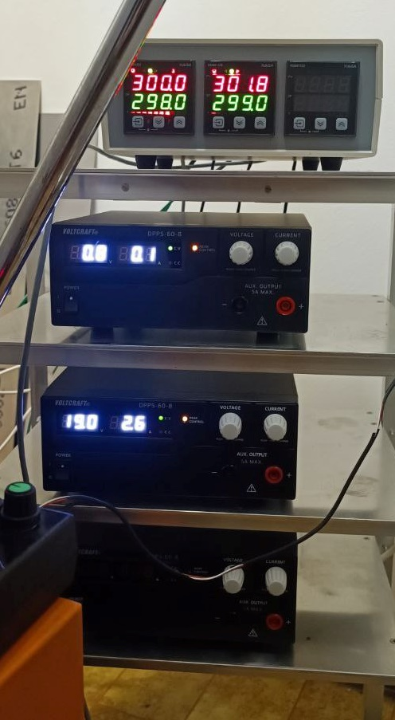
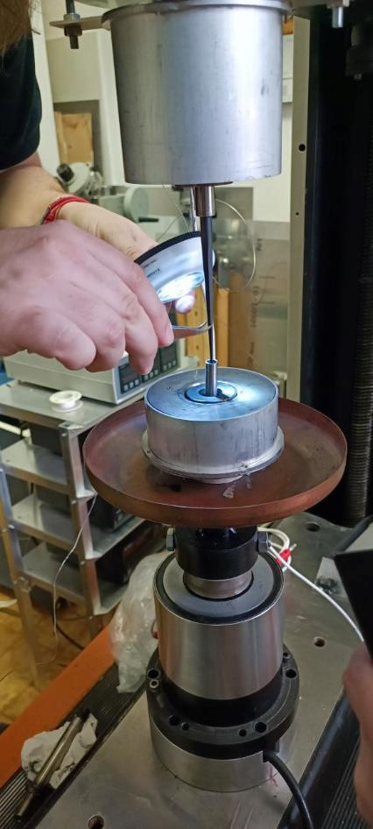
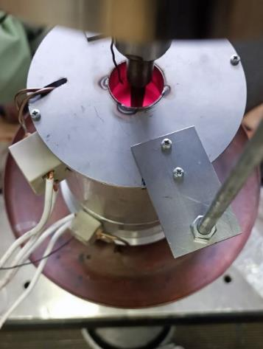
Mandrel test conditions
The grease was reapplied at the start of each day
All samples were tested successfully
One mandrel segment broke while pulling out the spike

Slide 14
Mandrel test matrix
15 tests were completed with the available materials
Only two samples were tested with stepwise loading as there was limited materials available
The tested samples were sent to post-test measurements
Sample No. | Supplier | Base material | Coating | Temperature (°C) | Comments
OPZ-M3 | CTU | Opt. ZIRLO | - | 300
OPZ-M4 | CTU | Opt. ZIRLO | - | 300
OPZCR-M1 | CTU | Opt. ZIRLO | Cr | 300
OPZCR-M7 | CTU | Opt. ZIRLO | Cr | 300
OPZCR-M8 | CTU | Opt. ZIRLO | Cr | 300
OPZCR-M9 | CTU | Opt. ZIRLO | Cr | 20 | stepwise loading
OPZCR-M10 | CTU | Opt. ZIRLO | Cr | 300 | stepwise loading
EI-M1 | AEOI | Zr1%Nb | - | 300
EI-M2 | AEOI | Zr1%Nb | - | 300
ECRI-M1 | AEOI | Zr1%Nb | Cr | 300
ECRI-M2 | AEOI | Zr1%Nb | Cr | 300
ECRNI-M1 | AEOI | Zr1%Nb | CrN | 300
ECRNI-M2 | AEOI | Zr1%Nb | CrN | 300
EXI-M1 | AEOI | Zr1%Nb | Cr/CrN | 300
EXI-M2 | AEOI | Zr1%Nb | Cr/CrN | 300

Slide 15
Mandrel test matrix
These were conducted to test the behavior of the ATF materials at room temperature and to give additional information on the reference cladding substrate materials
10 additional „reference tests” were also completed to ease the post-test finite element calculations
Sample No. | Supplier | Base material | Coating | Temperature (°C) | Comments
SLIM-M1 | HUN-REN EK | E110G | - | 20 | reference test
SLIM-M2 | HUN-REN EK | E110G | - | 300 | reference test
E110-M1 | HUN-REN EK | E110 | - | 300 | reference test
E110-M2 | HUN-REN EK | E110 | - | 300 | reference test
EI-51 | AEOI | Zr1%Nb | - | 20 | reference test
ECRI-51 | AEOI | Zr1%Nb | Cr | 20 | reference test
ECRNI-51 | AEOI | Zr1%Nb | CrN | 20 | reference test
EXI-51 | AEOI | Zr1%Nb | Cr/CrN | 20 | reference test
OPZCR-47 | CTU | Opt. ZIRLO | Cr | 20 | reference test
OPZCR-48 | CTU | Opt. ZIRLO | Cr | 20 | reference test

Slide 16
Mandrel test results
The forces of the Iranian Zr1%Nb and the E110 and SLIM materials was remarkably close, so the direct comparison between these two materials could be drawn. It was important for the modelling, as the detailed materials properties like anisotropy and stress-strain relationship were only available for the E110 material.
The Optimized ZIRLO cladding has higher yield strength compared to the Zr1%Nb claddings. This accounts for the measured difference of consistently higher maximum forces for the Optimized ZIRLO materials compared to the Zr1%Nb materials.
The step-loaded Optimized ZIRLO has reached similar maximum force compared to the regular mandrel-tested sample, which confirms the repeatability of the test results in different configurations.

Slide 17
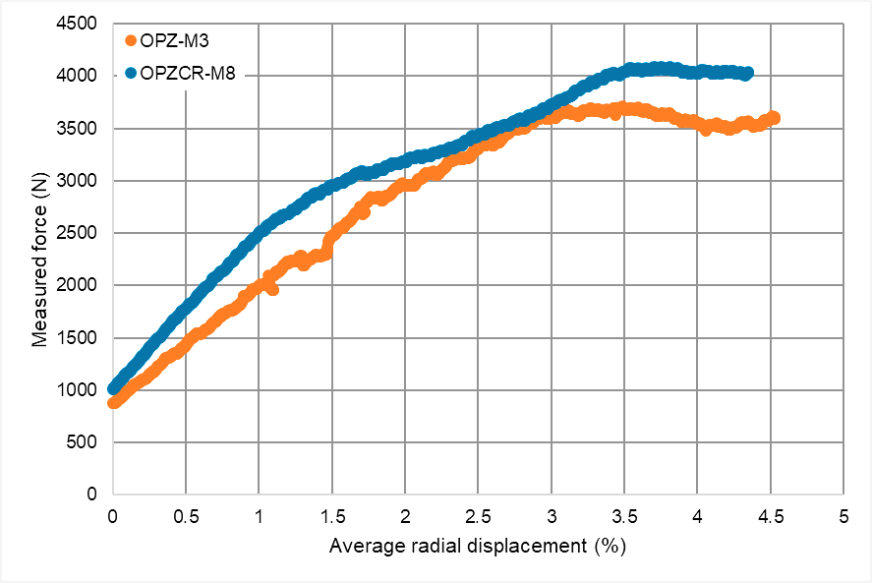
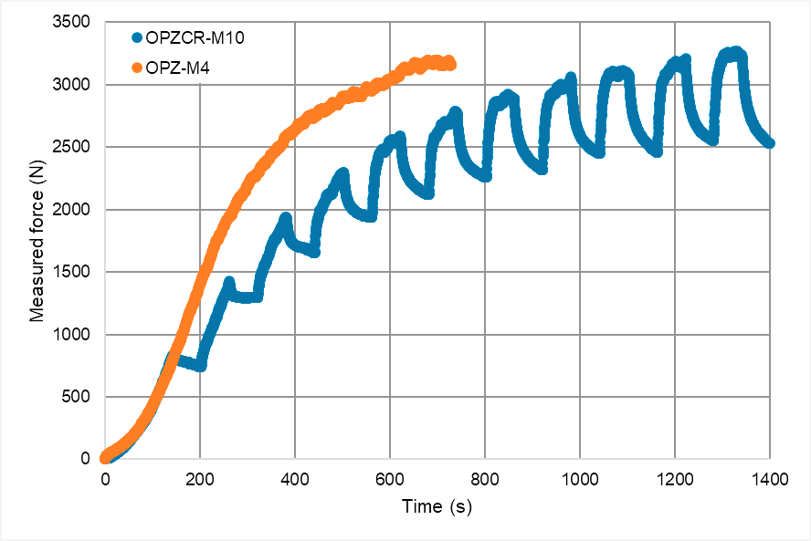
Mandrel test results
The results of the tests were the force and the time, which corresponds to the crosshead and the spike displacement
The raw measured data was distributed to the User Team
Figure 33: The comparison of the force-radial displacement of an uncoated Optimized ZIRLO sample (OPZ-M3) and a Cr-coated Optimized ZIRLO sample (OPZCR-M7).
Figure 34: The comparison of the force-time graph of an uncoated Optimized ZIRLO sample (OPZ-M4) and a Cr-coated step-loaded Optimized ZIRLO sample (OPZCR-M10).

Slide 18
Objectives
Need to evaluate the behavior of the coating in a simulated PCMI transient:
Will the chromium coating on the zirconium cladding alloy surface flexibly follow the strain of the cladding tube in a simulated PCMI transient with little deformation?
OR
Will the coating would break up into stripes of coated/uncoated segments?
What will be the consequences of this?
Preliminary samples were prepared and mandrel tested at room temperature
Cr Zr

Slide 19
SEM of the coatings
Iranian Zr1%Nb + Cr
5% average strain, 20 °C
optZIRLO + Cr
LEO 1540XB type SEM, 5 kV

Slide 20
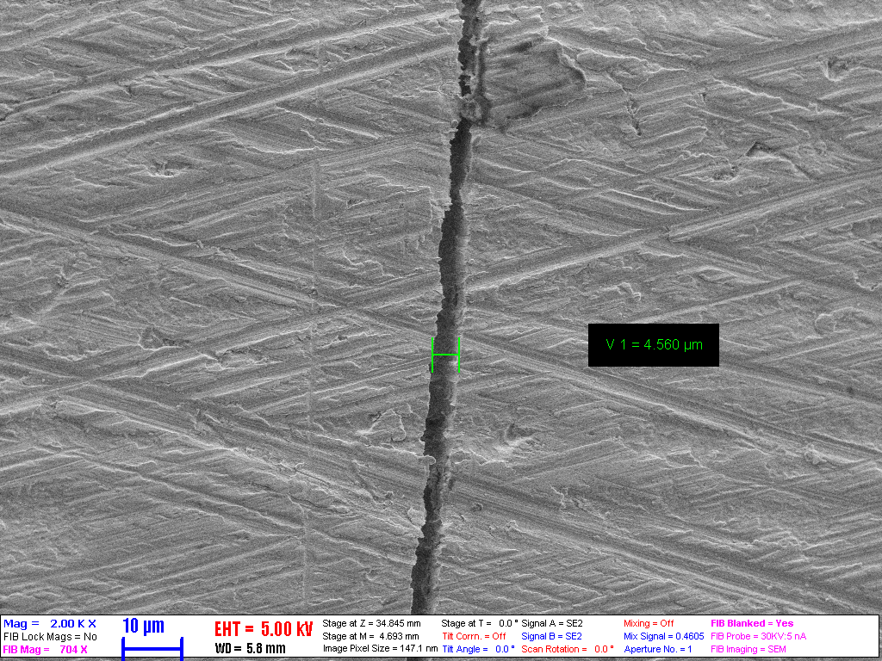
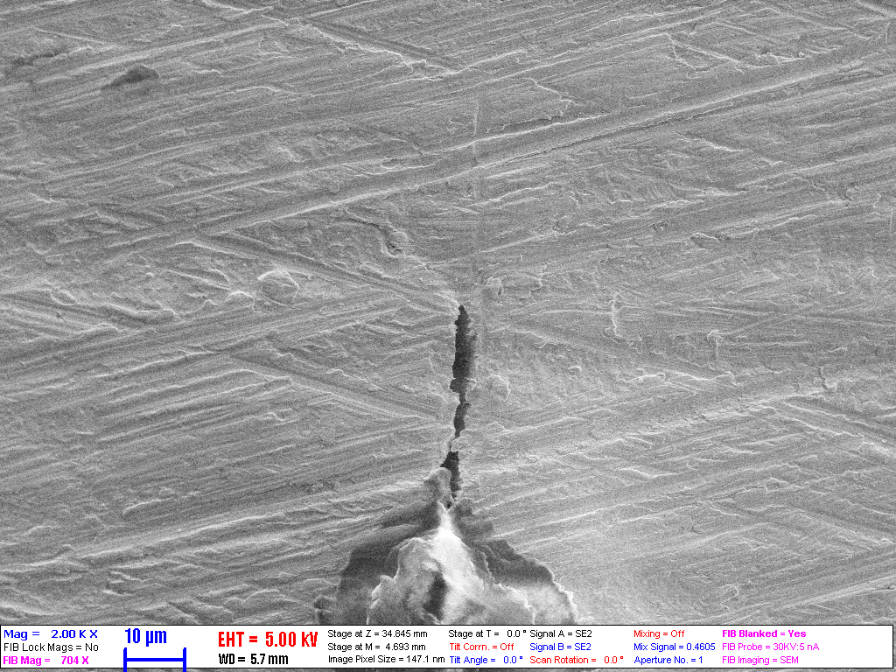
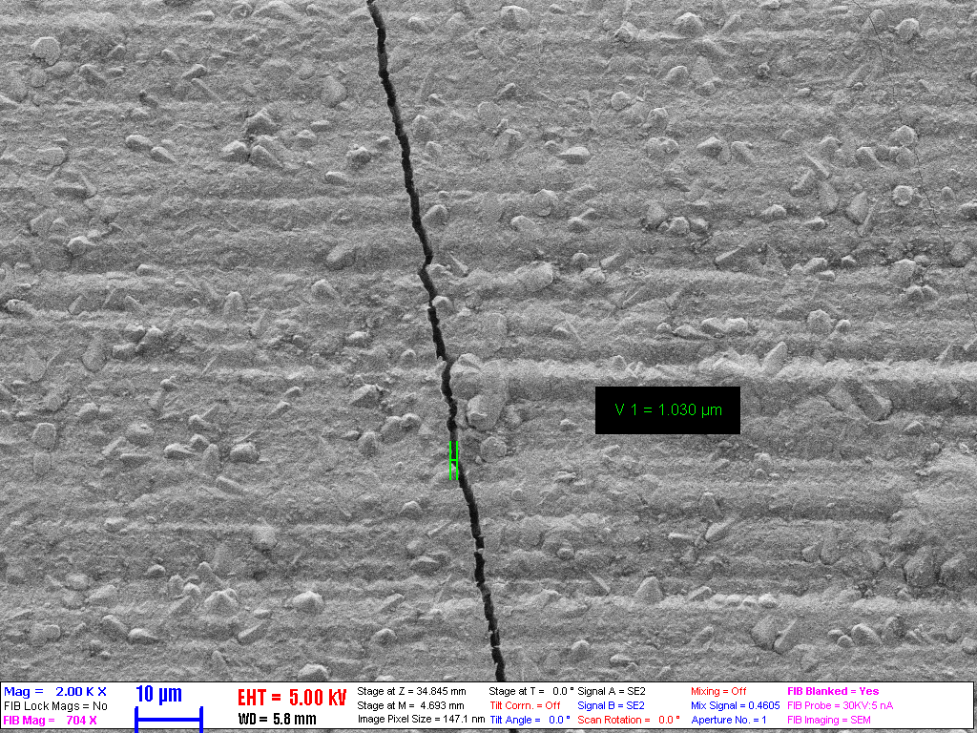
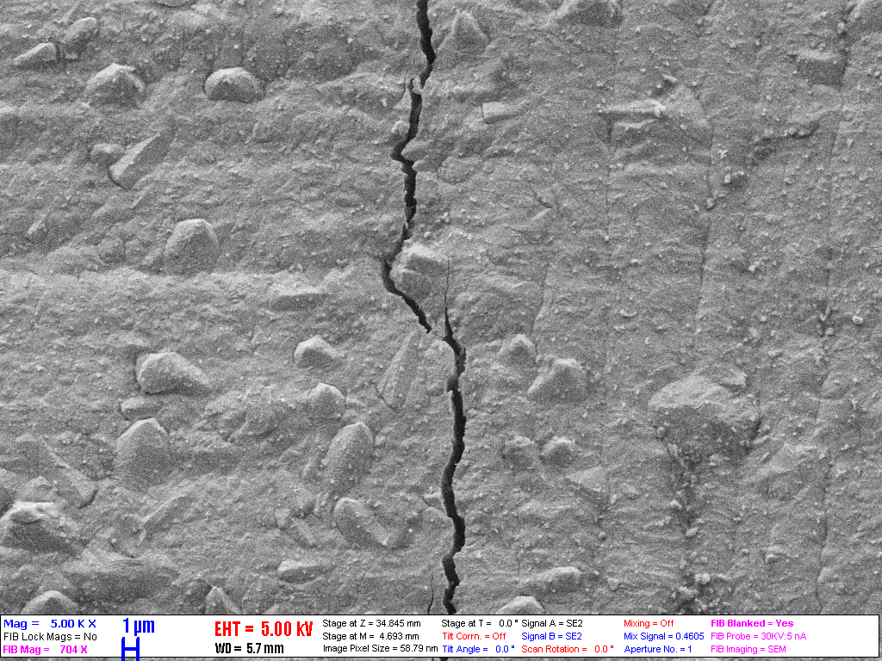
SEM of the coatings
Iranian Zr1%Nb + Cr
5% average strain, 300 °C
optZIRLO + Cr
LEO 1540XB type SEM, 5 kV

Slide 21
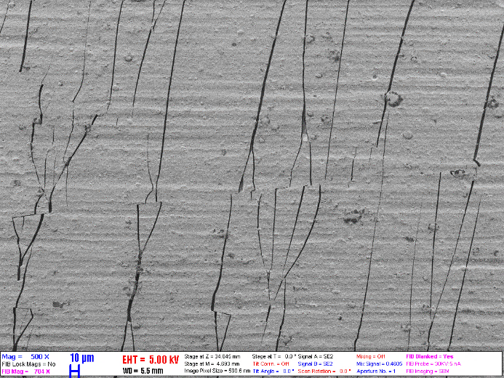
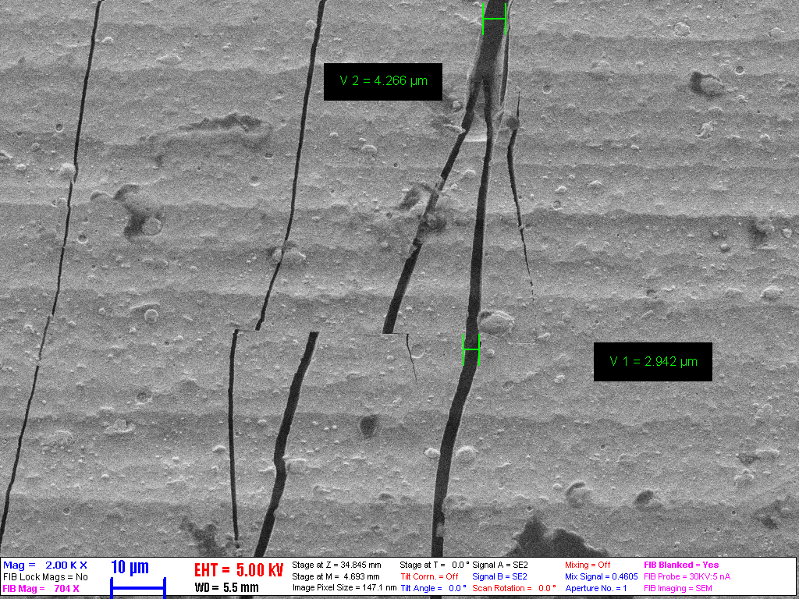
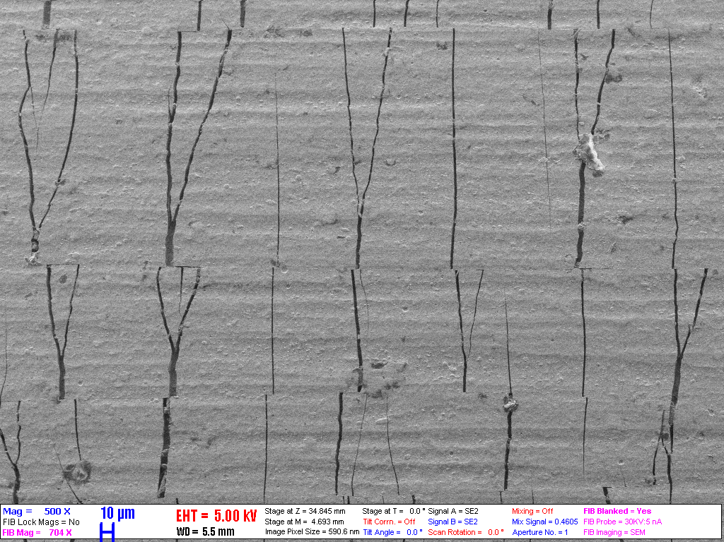
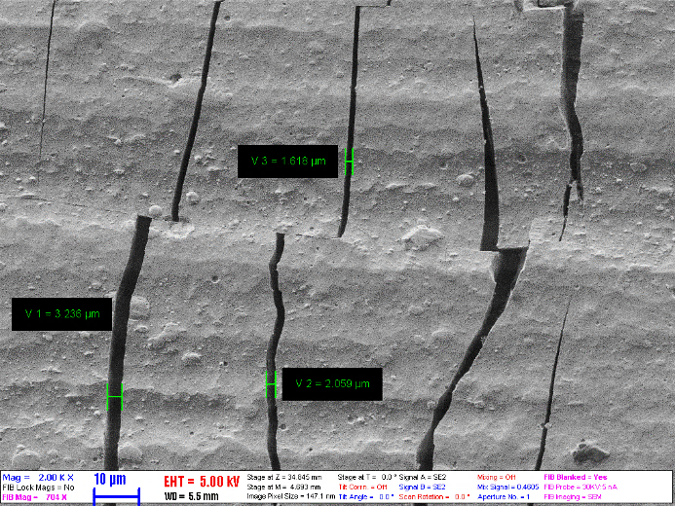
SEM of the coatings
Iranian Zr1%Nb + CrN
5% average strain, 300 °C
Iranian Zr1%Nb + Cr/CrN
LEO 1540XB type SEM, 5 kV

Slide 22
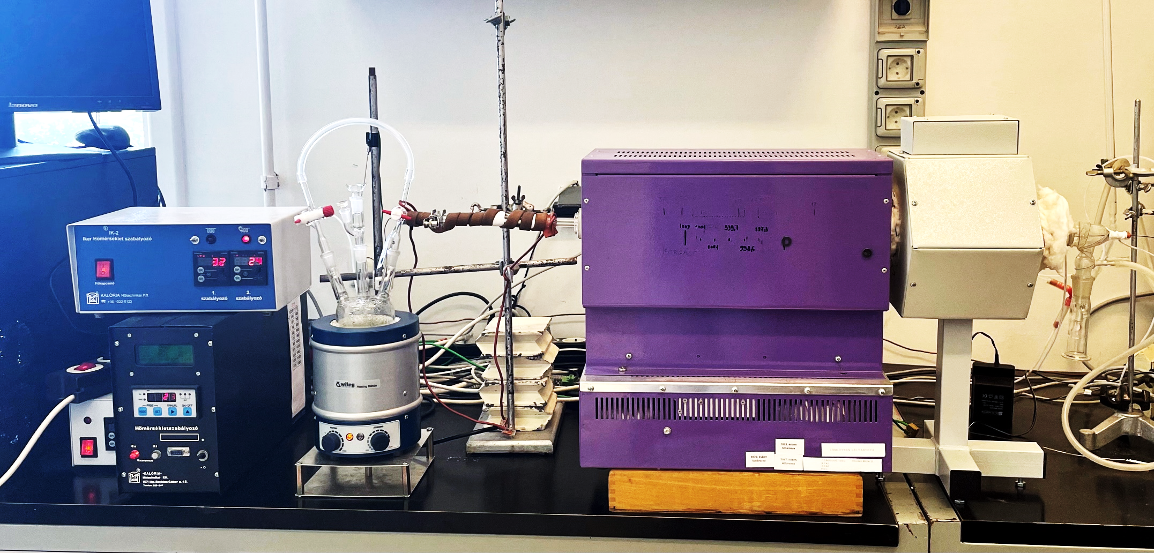
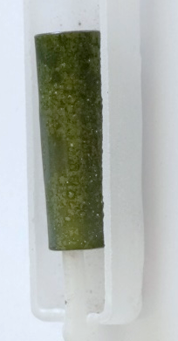
Oxidation of the cracked coating
The some samples were oxidized in steam-argon atmosphere for 1800 s at 1000 °C to see if the cracks in the coating could lead to the loss of protection and possibly even delamination.

Slide 23
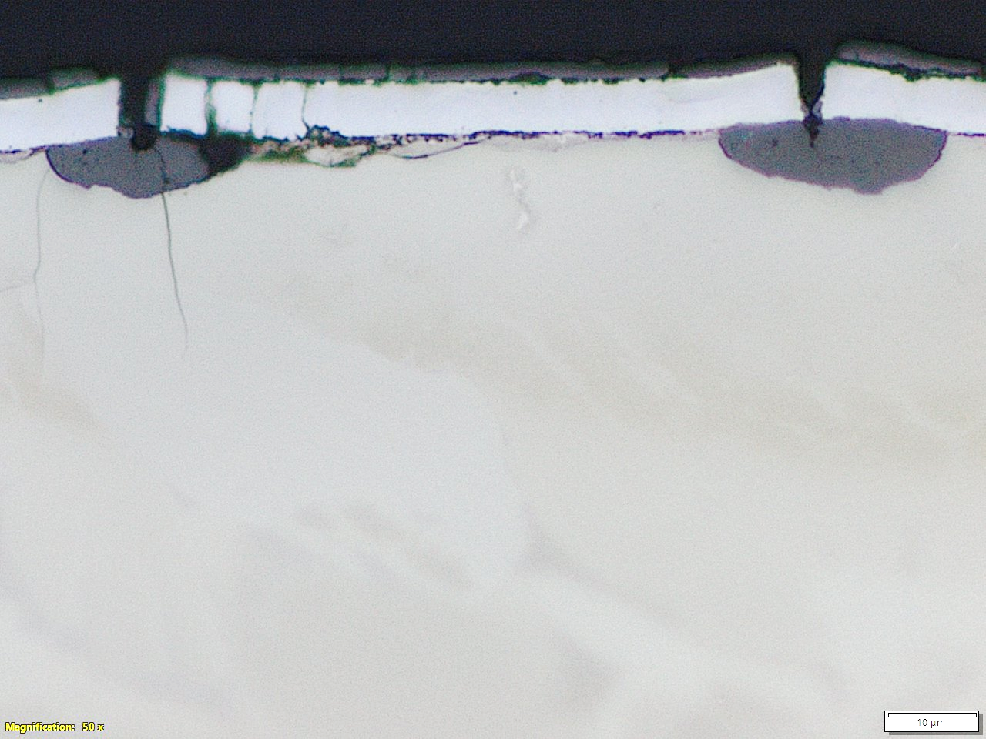
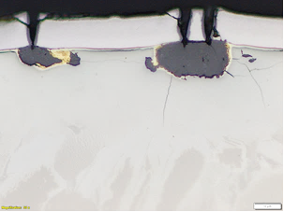
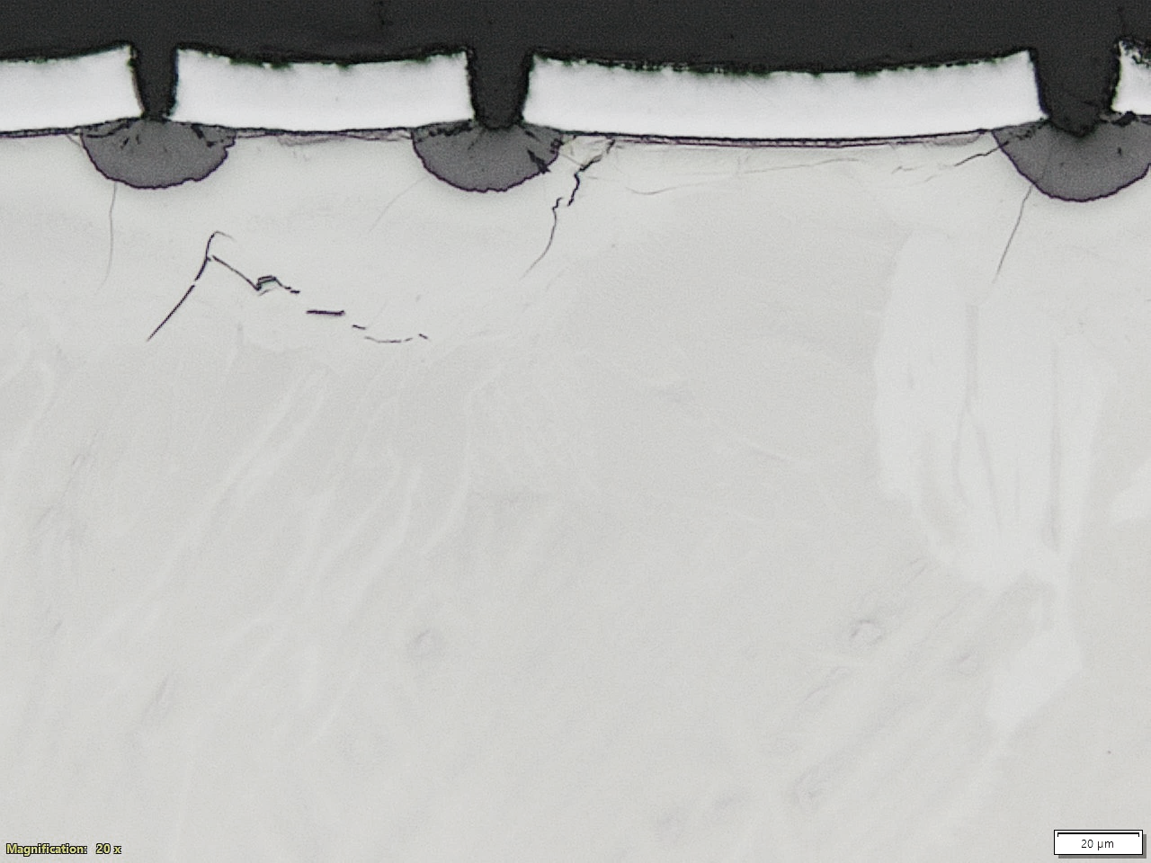
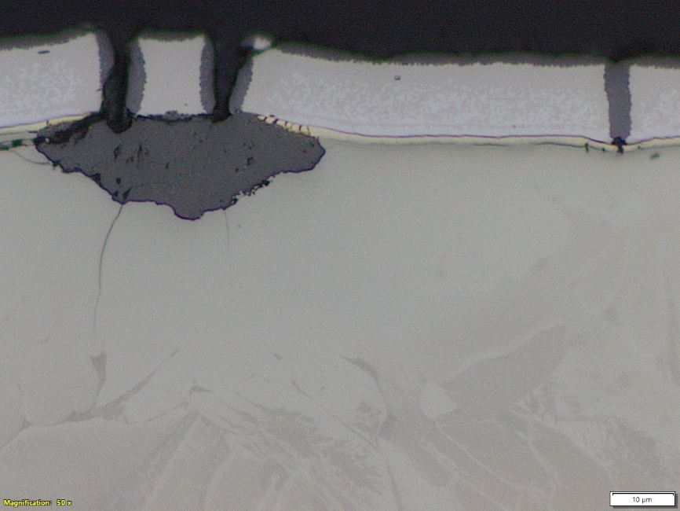
Metallography after oxidation
Iranian Zr1%Nb + Cr
Mandrel test at 300 °C
5% average strain,
1000 °C steam 1800 s
Opt-ZIRLO + Cr
(300 °C)
Iranian Zr1%Nb + CrN
Mandrel test at 300 °C
5% average strain,
1000 °C steam 1800 s
Iranian Zr1%Nb + Cr/CrN

Slide 24
Metallography
The metallography of the samples shows that the cracks in the protective coating leads to significant oxidation of the zirconium-based cladding substrate. It is clear that in all cases the cracking of the protective chromium layer led to local ZrO₂ oxide nodules forming under the coating and α-Zr(O) has penetrated deep into the cladding substrate.
However, the coatings have not delaminated and remained mostly protective, compared to the heavily-oxidized uncoated inner side (about 25-30 µm oxide thickness).
The samples that were mandrel tested at 20 °C and 300 °C show no difference in cracking and post-oxidation behaviour.

Slide 25
Summary
The OFFERR ATF mandrel ductility testing project successfully assessed the mechanical behaviour of several ATF cladding candidates under representative postulated-PCMI conditions
The coatings showed strong adhesion and good oxidation resistance, no spalling occurred, and the coatings remained adherent even under extended LOCA oxidation conditions.
The coatings were prone to brittle cracking even at 300 °C, near the operating temperature. The interdiffusion of both Cr and N into the Zr at high temerature remain critical factors.
Post-test evaluations revealed the coating’s complex mechanical behaviour under varying conditions, underscoring the need for further experimental studies.

Slide 26
Thank you for your attention!

