Slide 1
IAEA FUEL DATABASE
Technical Meeting on Advanced Technology Fuels: Progress on their Design, Manufacturing, Experimentation, Irradiation, and Case Studies for their Industrialization, Safety Evaluation, and Future Prospects
IAEA Headquarters, Vienna, Austria
28 – 31 October 2025
Anzhelika Khaperskaia, Technical Lead NFCMS /NEFW, IAEA

Slide 2
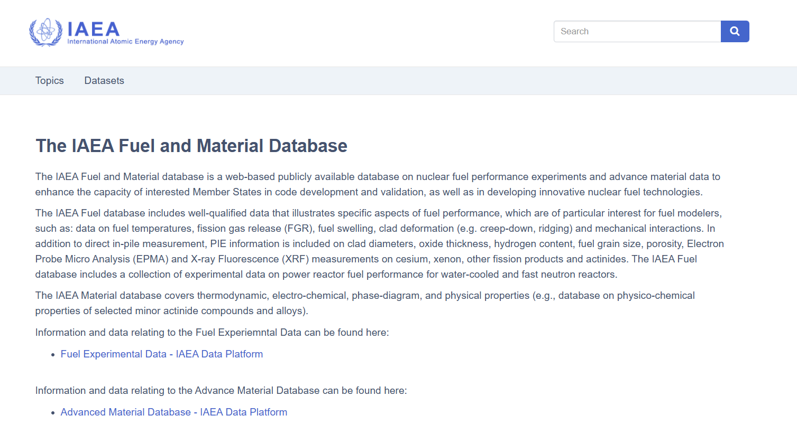
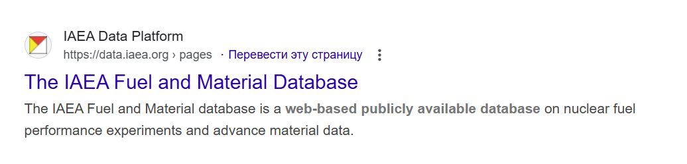

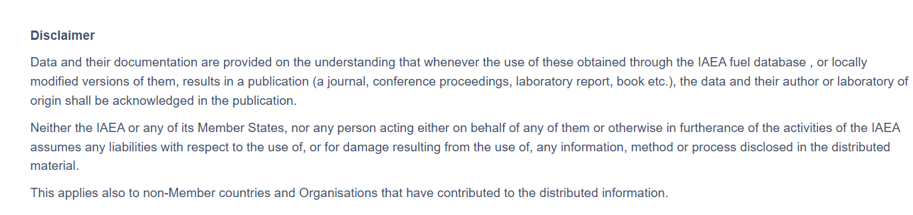
IAEA Fuel and material database
Terms of Use | International Atomic Energy Agency
The data in the IAEA digital repositories and databases is provided free of charge for educational and informational use.
The IAEA Fuel and Material Database - IAEA Data Platform;
2

Slide 3
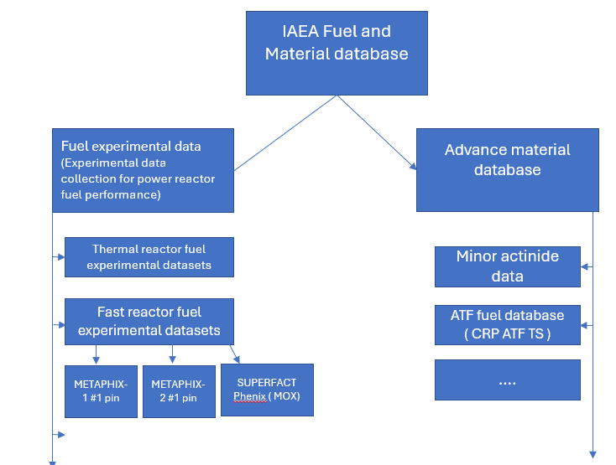
IAEA Fuel and material database. Structure
The IAEA Fuel database includes a collection of experimental data on power reactor fuel performance (water-cooled and fast neutron reactors)
Well-qualified data that illustrates specific aspects of fuel performance, which are of particular interest for fuel modelers, such as:
Data on fuel temperatures
Fission gas release (FGR)
Fuel swelling
Clad deformation (e.g., creep-down, ridging)
Mechanical interactions
PIE information is included on clad diameters, oxide thickness, hydrogen content, fuel grain size, porosity, Electron Probe Micro Analysis (EPMA) and X-ray Fluorescence (XRF) measurements on cesium, xenon, other fission products and actinides
The IAEA Material database covers thermodynamic, electro-chemical, phase-diagram, and physical properties (e.g., database on physico-chemical properties of selected minor actinide compounds and alloys)
3

Slide 4
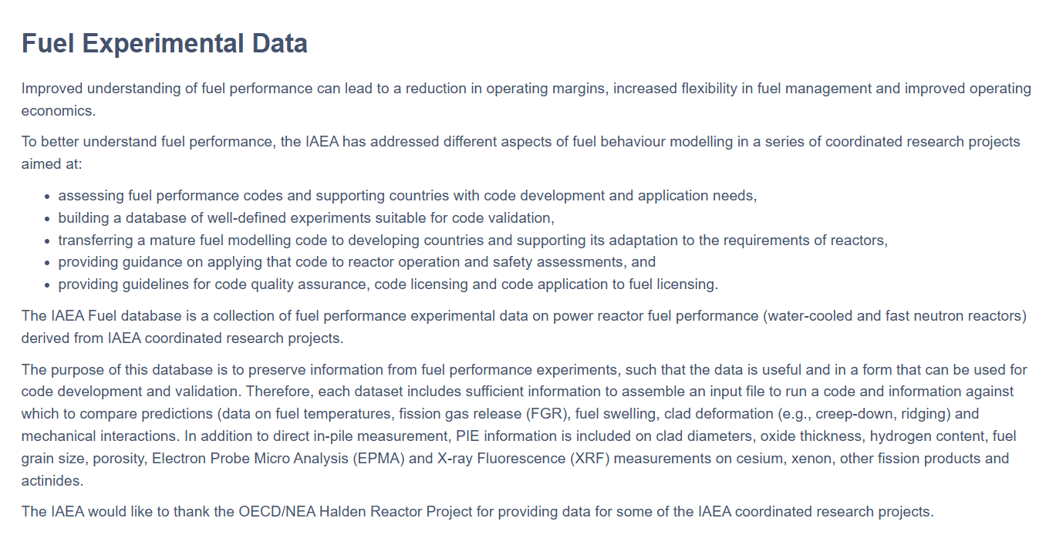
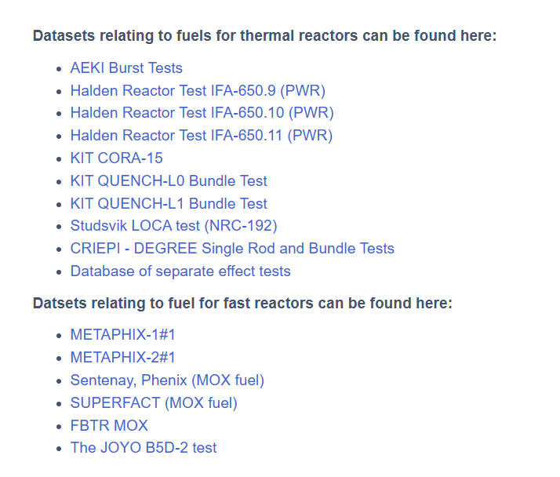
IAEA fuel experimental database.
Fuel Experimental Data - IAEA Data Platform
Picture of the burst area of sample ZCR-2

Slide 5
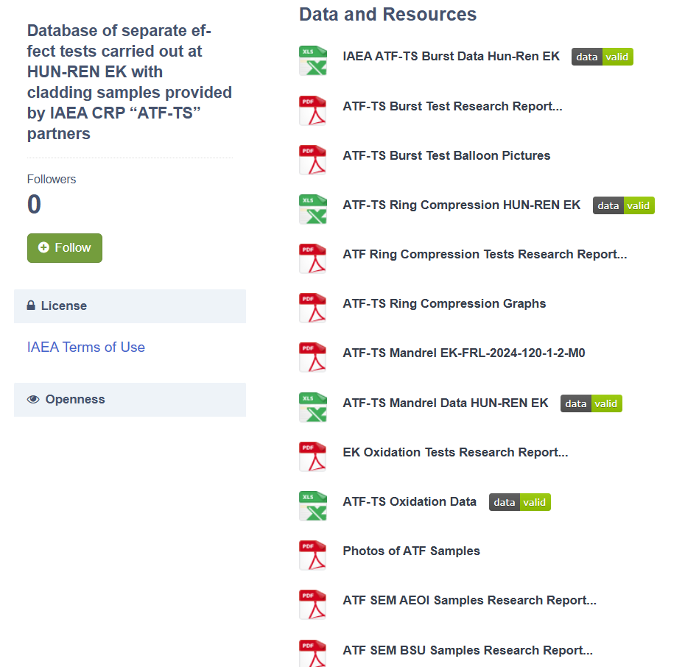
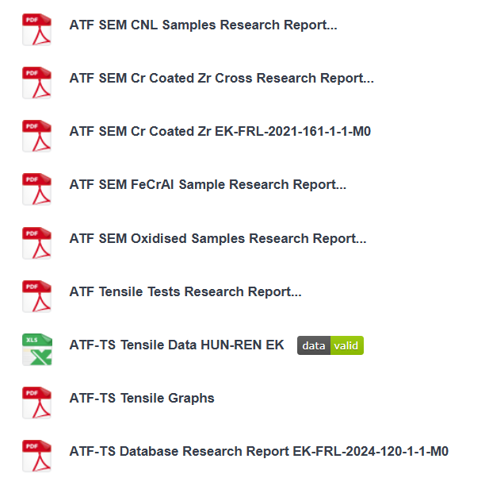
ATF-TS experimental datasets. ATF Database HUN-REN_EK
At HUN-REN EK, extensive work has been carried out to characterize the behaviour of candidate materials for ATFs and to compare newly measured data with the parameters of traditional cladding alloys
The database includes the main characteristics and results of the separate effect tests: ballooning and burst tests, oxidation tests in high-temperature steam, tensile testing using ring samples, ring compression tests, mandrel tests, scanning Electron Microscopy (SEM) examinations
13 cladding types were tested:
Reference Claddings: Zircaloy-4, ZIRLO™, Optimized ZIRLO™ (optZIRLO™), Zr-1%Nb alloy
Coated Claddings (Zr alloy base): Cr coating, CrN coating, CrN/Cr multilayer coating, TiAl coating
Alternative Alloy: FeCrAl alloy
Database of separate effect tests carried out at HUN-REN EK with cladding samples provided by IAEA CRP “ATF-TS” partners - Database of separate effect tests carried out at HUN-REN EK with cladding samples provided by IAEA CRP “ATF-TS” partners - Datasets - IAEA Data Platform
5

Slide 6
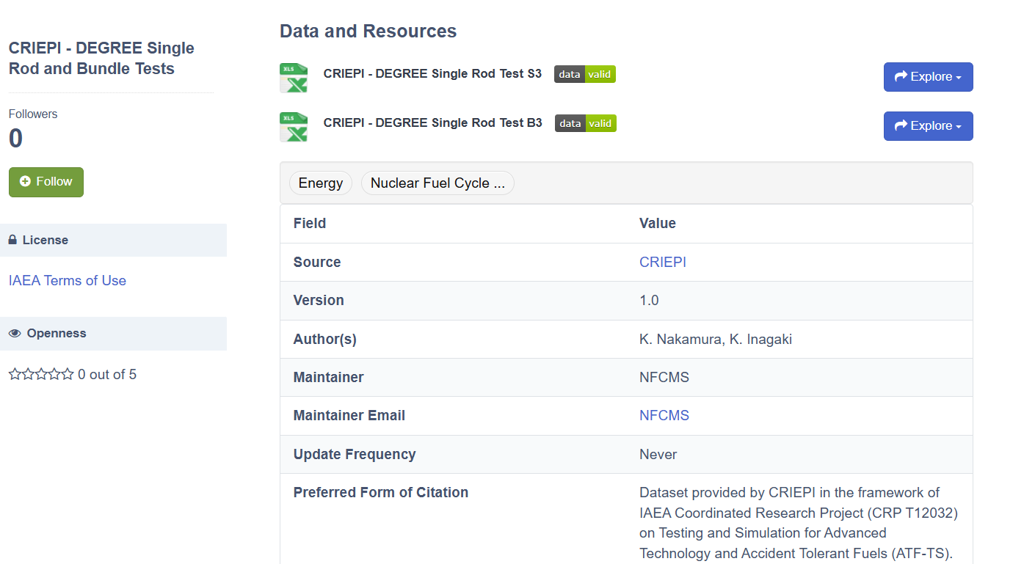
ATF-TS experimental datasets. CRIEPI - DEGREE Single Rod and Bundle Tests
Series of single rod tests (S1–S13) and 3x3 bundle tests (B1–B7) were performed at the DEGREE facility, CRIEPI (Japan) for simulation Design Extension Conditions (DEC) LOCA scenarios using an induction heating furnace.
Cladding types tested: Zircaloy-4, Optimized ZIRLO, E110 , all coated with either chromium (Cr) or Cr/CrN.
Heating conditions: Peak temperatures: 1350°C, 1500°C, 1600°C; heating rate: 3–5 K/s, atmosphere: Steam/Ar mixture
Test phases: Pre-heating to 500°C, conditioning at 500°C; heat-up to target temperature, cool-down in Ar atmosphere
CRIEPI - DEGREE Single Rod and Bundle Tests - CRIEPI - DEGREE Single Rod and Bundle Tests - Datasets - IAEA Data Platform
6

Slide 7
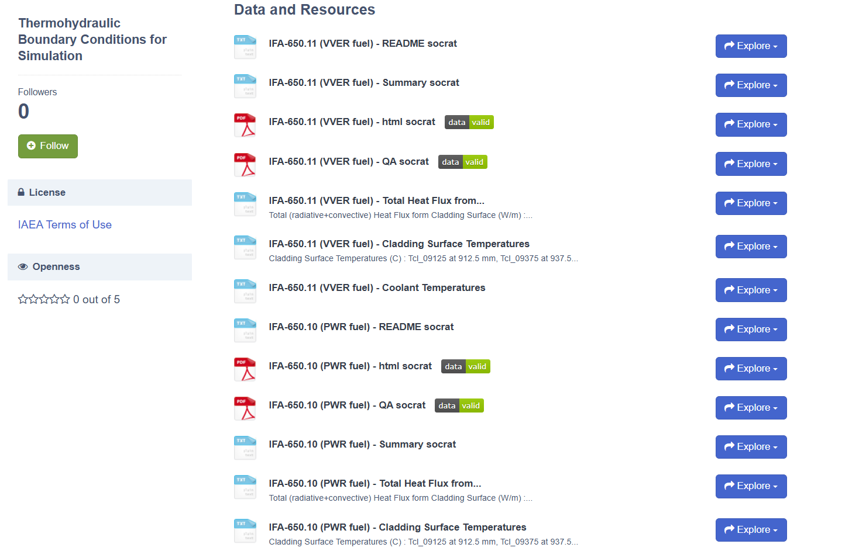
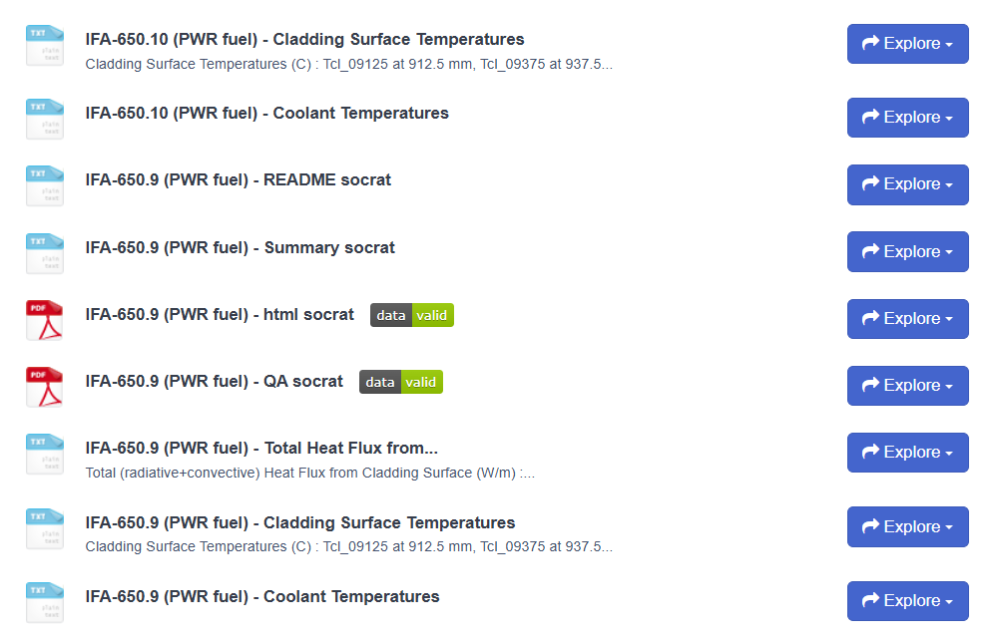
Thermohydraulic Boundary Conditions for Simulation
Thermohydraulic Boundary Conditions for Simulation were developed in the framework of
IAEA CRP “Fuel Modelling in Accident Conditions” (FUMAC, IAEA-TECDOC-1889)
project partner for three Halden LOCA tests:
• IFA-650.9 (PWR fuel)
• IFA-650.10 (PWR fuel)
• IFA-650.11 (VVER fuel)
and calculated by the integral code SOCRAT/V3
Thermohydraulic Boundary Conditions for Simulation - Thermohydraulic Boundary Conditions for Simulation - Datasets - IAEA Data Platform

Slide 8
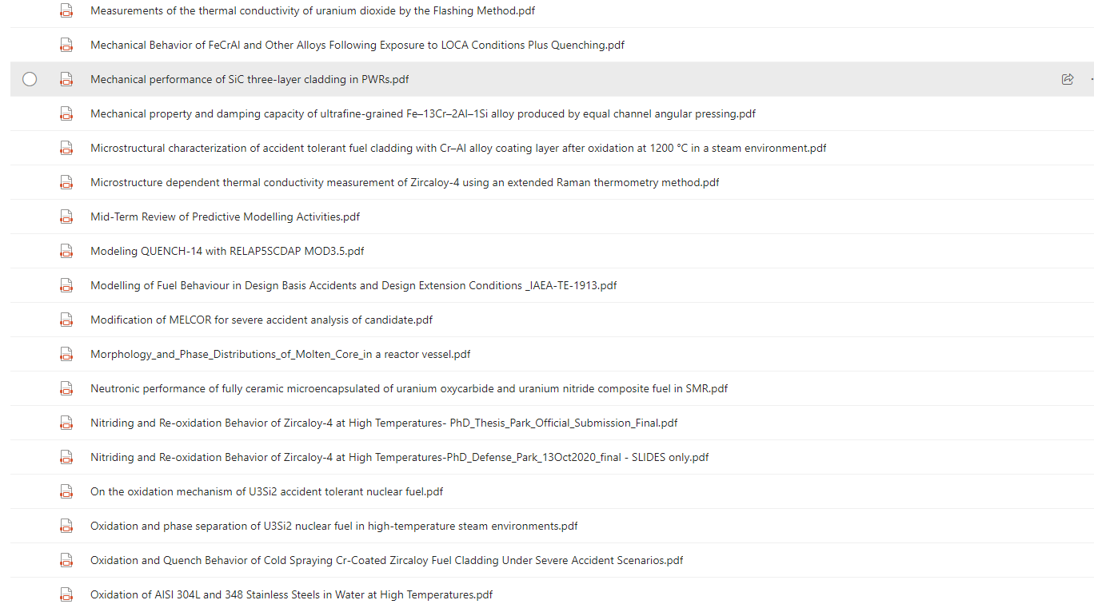
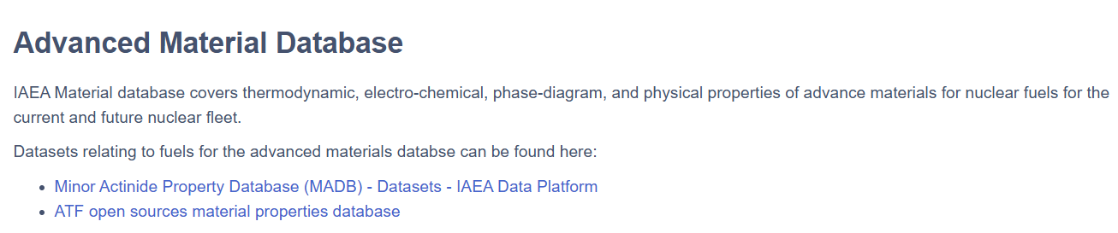
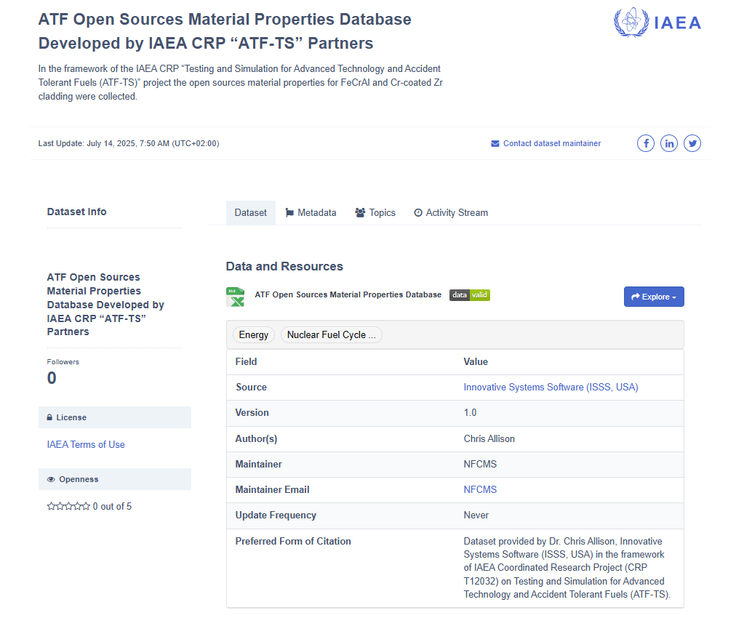
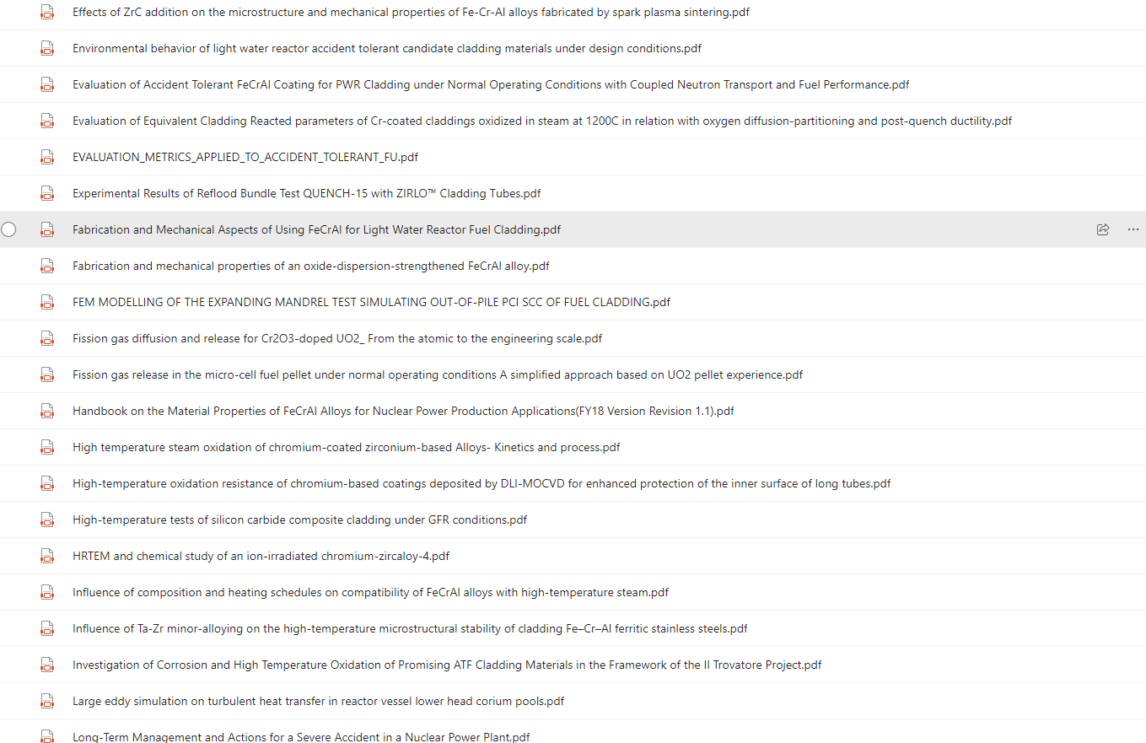
Open-source ATF material properties database
ATF Open Sources Material Properties Database Developed by IAEA CRP “ATF-TS” Partners - ATF Open Sources Material Properties Database Developed by IAEA CRP “ATF-TS” Partners - Datasets - IAEA Data Platform
8

Slide 9
Conclusion
The IAEA Fuel Database compiles experimental data on fuel performance in water-cooled and fast reactors, collected through IAEA Coordinated Research Projects.
It aims to preserve and share high-quality data for fuel performance code development and validation.
The IAEA acknowledges the OECD/NEA Halden Reactor Project for contributing data to several CRPs.
9

Slide 10
A.Khaperskaia@iaea.org

