Slide 1


CORROSION KINETICS OF AUSTENITIC
STAINLESS STEEL UNDER WATER
NORMAL OPERATION PWR CONDITION
VANESSA SANCHES and FABIO DE CAMARGO | 29/10/2025
IAEA – Technical Meeting on Advanced Technology Fuels | 28th – 31st October – Vienna 2025
National Technology for the Benefit of Society

Slide 2
Summary
Introduction
Objectives
Materials & Methods
Results
Visual & XRD
Weight Gain (Corrosion Model)
Estimated Oxide Thickness
Discussion/Conclusions
Notes:
2
2
2
2

Slide 3
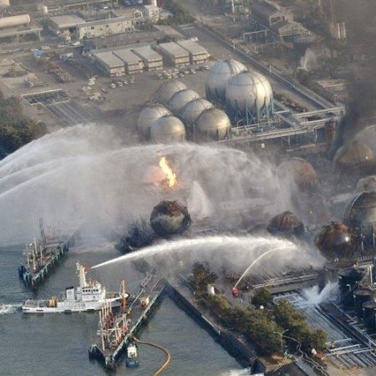
INTRODUCTION
Post-Fukushima demand for safer, more reliable fuels
Advanced Technology and Accident Tolerant Fuels (ATFs) as priority
Nb-stabilized austenitic stainless steel (Nb-ASS) selected
Notes:
3
3
3
3

Slide 4
OBJECTIVES
• Investigate corrosion behavior of Nb-ASS under PWR normal operation
• Determine corrosion kinetics and oxide thickness formed onto Nb-ASS
• Compare with literature data for Zr-, Fe- and Ni-based alloys
Notes:
4
4
4
4

Slide 5
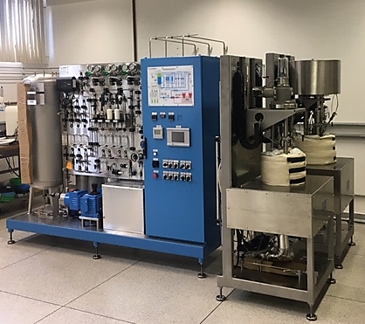
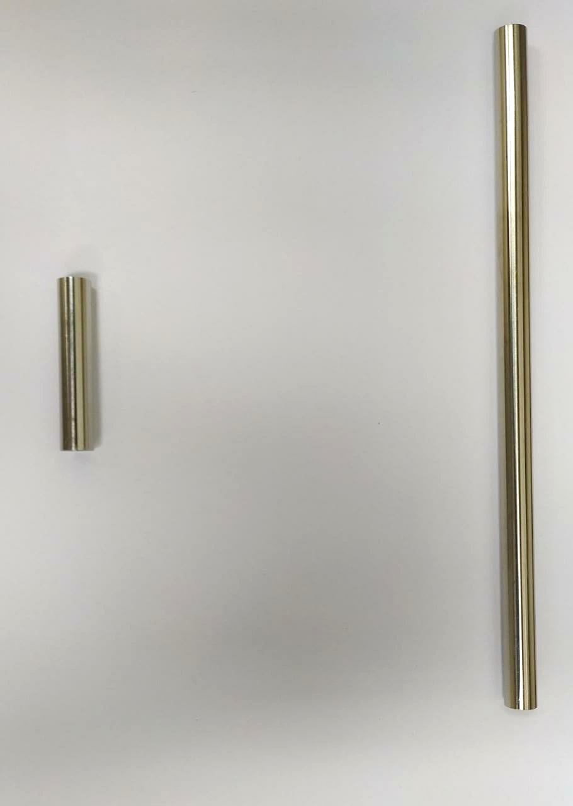
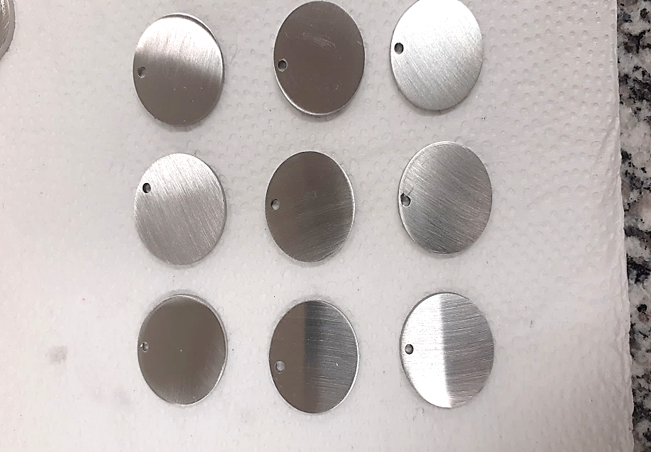
MATERIALS & METHODS
• Two rounds of long-term corrosion tests
(360 °C, 20 Mpa, dynamic mode)
• Autoclaves with recirculating ultrapure, deoxygenated water
• Specimens: tubes & plates (~ 84 days) – Test 1
plates (~ 84 days) – Test 2
• Characterization: visual inspection, mass gain, XRD, oxide thickness estimation.
Notes:
5
5
5
5

Slide 6

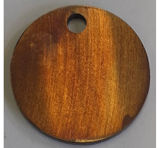
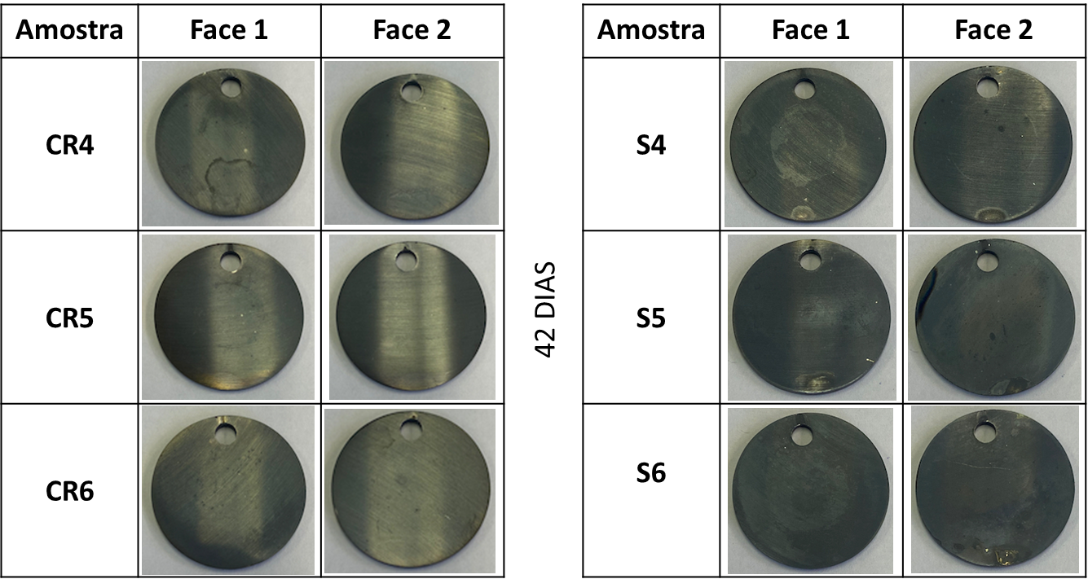
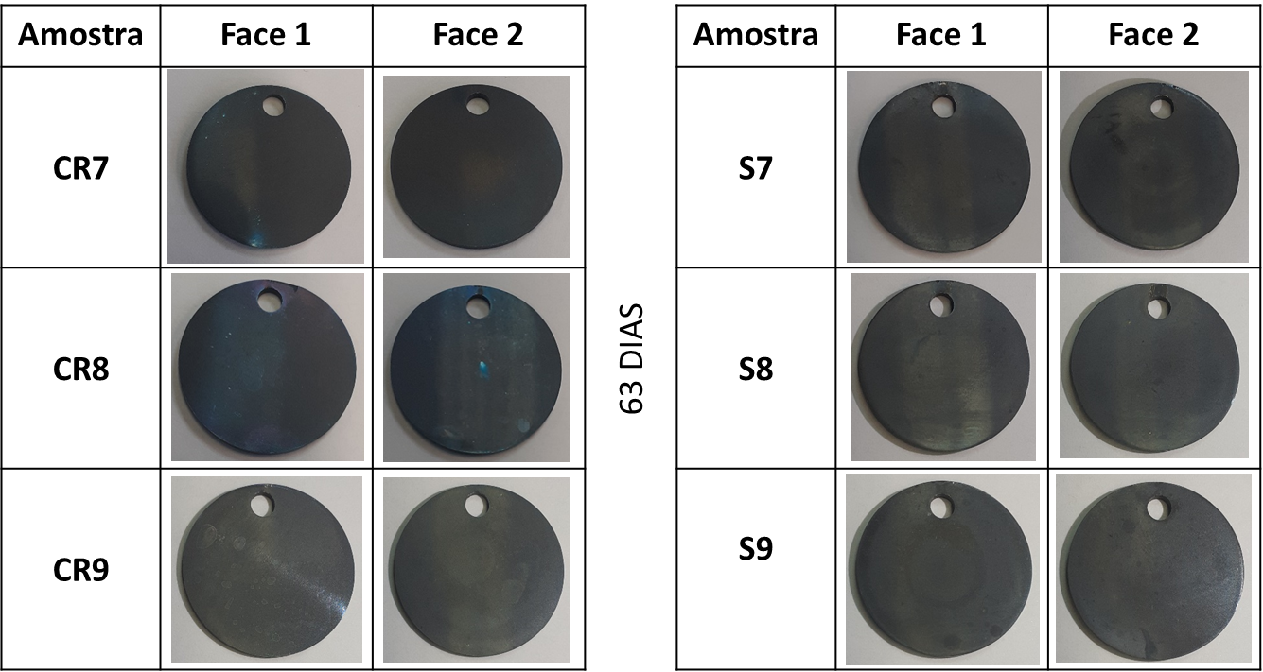
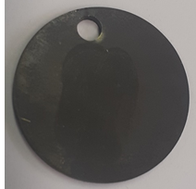
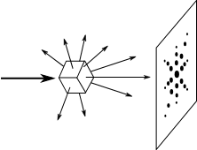
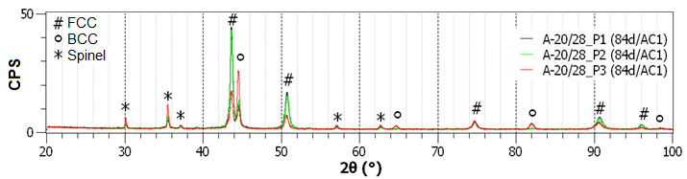
RESULTS – VISUAL OBSERVATION & XRD
21 days 42 days 63 days 84 days
• Magnetite (Fe₃O₄) / Spinel (M₃O₄) detected;
• FCC austenite (matrix) + BCC martensite identified;
Notes:
6
6
6
6

Slide 7
RESULTS – WEIGHT GAIN
• Tubes showed higher mass gain than plates – Test 1
• Autoclave differences (AC1 vs AC2) - Test 2
Test | Coupon | Exposure time (Autoclave) | Weight gain (mg/dm²) | Oxide thickness estimated (µm)
1 | Plates | 21.0 d (both) | 1.64 ± 0.51 | 0.117 ± 0.037
 |  | 63.5 d (both) | 2.81 ± 0.78 | 0.201 ± 0.056
 |  | 84.5 d (both) | 3.60 ± 0.44 | 0.257 ± 0.033
 | Tubes | 21.0 d (both) | 3.22 ± 0.15 | 0.230 ± 0.014
 |  | 63.5 d (both) | 4.06 ± 0.48 | 0.290 ± 0.036
 |  | 84.5 d (both) | 5.00 ± 0.39 | 0.357 ± 0.031
2 | Plates | 34 d (AC1) | 0.98 ± 0.36 | 0.070 ± 0.026
 |  | 42 d (AC1) | 1.02 ± 0.37 | 0.073 ± 0.027
 |  | 63 d (AC1) | 1.09 ± 0.51 | 0.078 ± 0.037
 |  | 84 d (AC1) | 1.56 ± 0.56 | 0.111 ± 0.040
 |  | 21 d (AC2) | 1.38 ± 0.37 | 0.099 ± 0.027
 |  | 34 d (AC2) | 3.60 ± 0.49 | 0.257 ± 0.036
 |  | 42 d (AC2) | 3.72 ± 0.47 | 0.266 ± 0.035
 |  | 63 d (AC2) | 4.26 ± 0.47 | 0.304 ± 0.035
Notes:
7
7
7
7

Slide 8
RESULTS – CORROSION MODEL
water
M₃O₄
Oxide
bilayer
SOLID STATE DIFFUSION MODEL
Stainless Steel
Fe₃O₄
Stainless Steel
íons
Nanopores
Grain boundaires
Diffusion of metal ions across the inner layer oxide limits the corrosion rate.
Parabolic kinect: Wg² = k_{p}.t
Spinel oxides (M₃O₄) are expected over chromia (Cr₂O₃), when diffusion constant to form Chromia and corrosion rates are compared (k_{p} = 2D).
J. Robertson [1]
Notes:
8
8
8
8

Slide 9
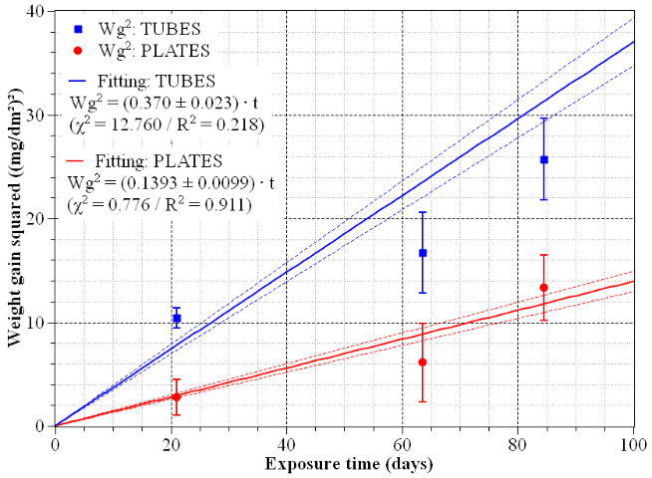
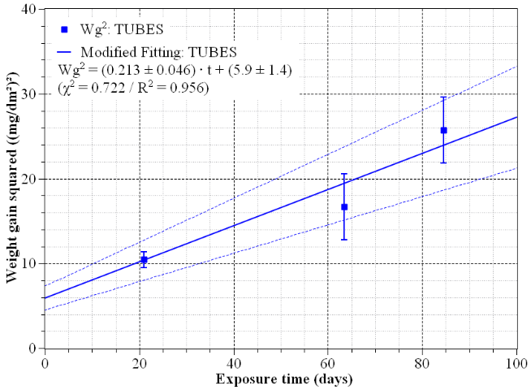
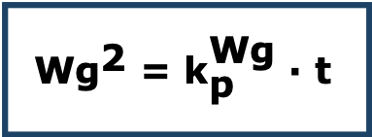
RESULTS – PARABOLIC FITTING
• Parabolic kinetics confirmed;
a)
b)
Fittings used to obtain parabolic weight gain kinetic constant (slope) in (mg/dm²)²/d for a) plates and tubes specimens tested on round 1 according to J. Robertson, 1991 [1] and b) tubes according to B. Pierragi, 1987[2].
$$\text{W}{\text{g}}^{\text{2}}\text{ = }{\text{k}}_{\text{p}}^{\text{Wg}}\text{ ∙ }\text{t}$$
Notes:
9
9
9
9

Slide 10

RESULTS – PARABOLIC FITTING
Test 1:
• ${\text{k}}_{\text{p}\text{, }\text{tubes}}^{\text{Wg}}$= 0.370 ± 0.023(mg/dm²)²/d) > ${\text{k}}_{\text{p}\text{, }\text{Plates}}^{\text{Wg}}$= 0.1393 ± 0.0099 (mg/dm²)²/d
Test 2:
• ${\text{k}}_{\text{p}\text{, }\text{AC}\text{1}}^{\text{Wg}}$= 0.0424 ± 0.0038(mg/dm²)²/d) < ${\text{k}}_{\text{p}\text{, }\text{AC}\text{2}}^{\text{Wg}}$= 0.231 ± 0.015 (mg/dm²)²/d
Repeatability:
${\text{k}}_{\text{p}\text{,}\text{Test}\text{ 2 }}^{\text{Wg}}$ = 0.1367 ± 0.0077 (mg/dm²)²/d
${\text{k}}_{\text{p}\text{, }\text{Test}\text{ 1 − }\text{Plates}}^{\text{Wg}}$= 0.1393 ± 0.0099 (mg/dm²)²/d
Notes:
10
10
10
10

Slide 11
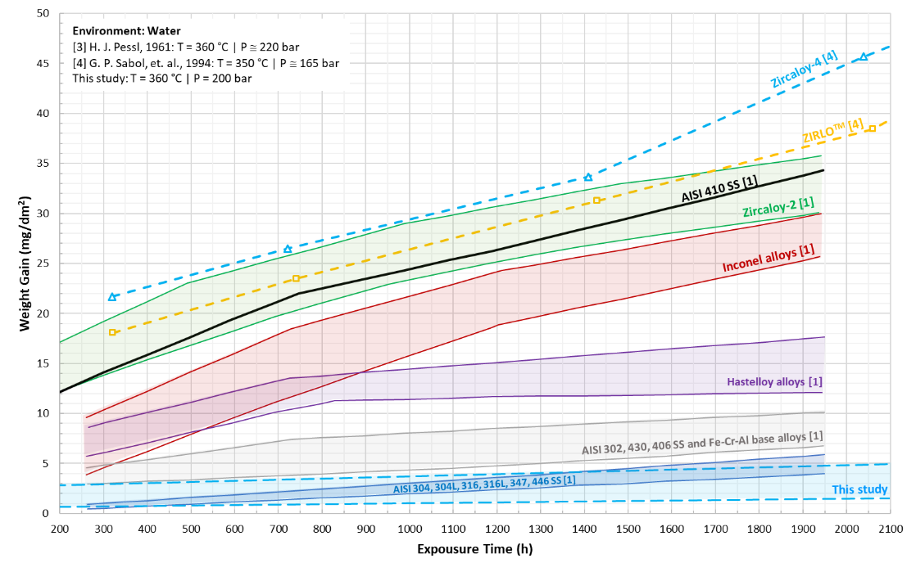
RESULTS – Wg COMPARISON
3
3
3
3
3
3

Slide 12
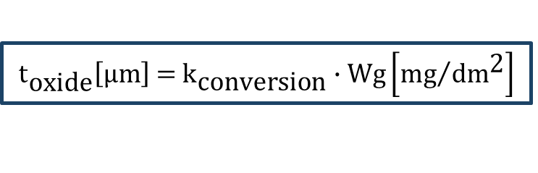
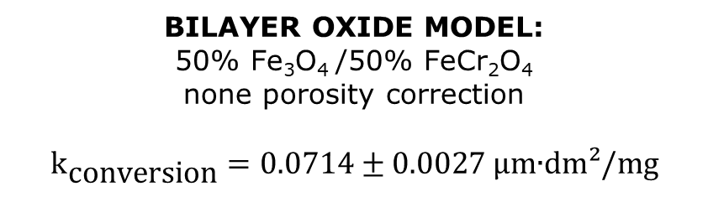
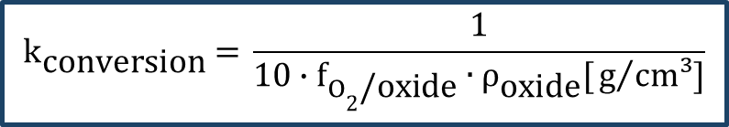
RESULTS – OXIDE THICKNESS
• Oxide thickness were estimated from mass gain data.
$${\text{t}}_{\text{oxide}}\left[\text{μm}\right]\text{ = }{\text{k}}_{\text{conversion} }\text{∙ }\text{Wg}\left[{\text{mg}}/{\text{d}{\text{m}}^{\text{2}}}\right]$$
$${\text{k}}_{\text{conversion}} \text{= }\frac{\text{1}}{\text{10 ∙ }{\text{f}}_{O_{\text{2}}\text{/}\text{oxide}}\text{ ∙}{ \text{ρ}}_{\text{oxide}}\text{[}{\text{g}}/{\text{cm}\text{³]}}}$$
BILAYER OXIDE MODEL:
50% Fe₃O₄ /50% FeCr₂O₄
none porosity correction
$${\text{k}}_{\text{conversion}}=\text{0.0714 ± 0.0027 µ}\text{m}\text{∙}\text{dm}\text{²/}\text{mg}$$
Notes:
12
12
12
12

Slide 13
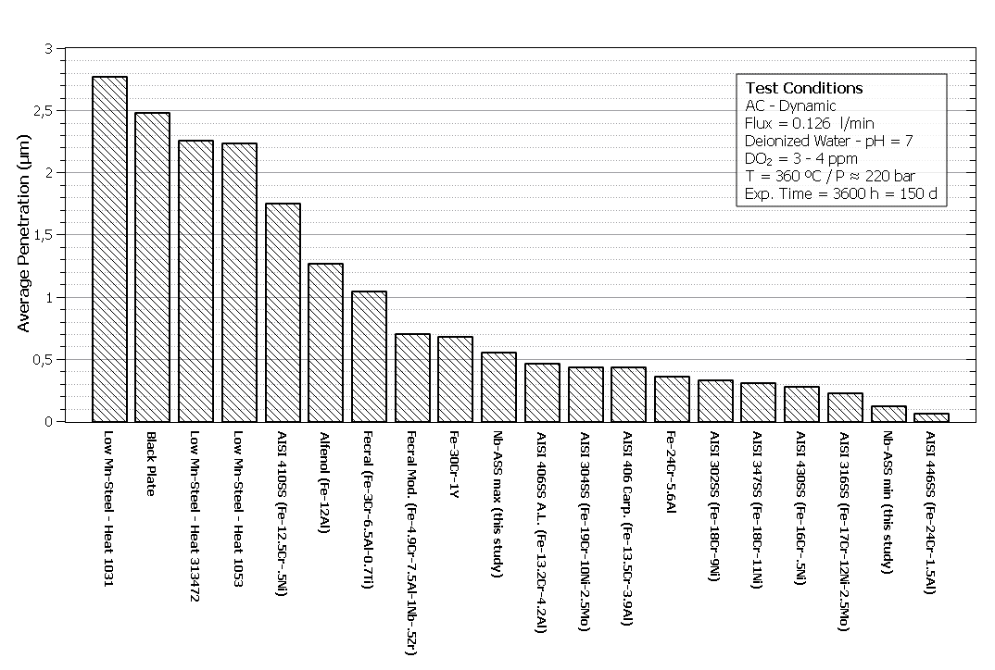
RESULTS – OXIDE THICKNESS – LITERATURE COMPARISON
Parabolic kinetic parameter for thickness $\left({\text{k}}_{\text{p}\text{,}\text{plates} }^{Thickness}\right)$allowed estimation of oxide growth for 150 days in similar conditions to compare with H. J. Pessl, 1961 [3], results.
Notes:
13
13
13
13

Slide 14
DISCUSSION/CONCLUSIONS
• Repeatability confirmed across tests;
• Nb-ASS oxidation resistance comparable to 300-series SS;
• Nb-ASS shows high corrosion resistance under PWR conditions (superior to Zr-based alloys)
• Parabolic kinetic & bilayer oxide (magnetite + spinel) model validated
• Reliable methodology for oxide thickness estimation
• Promising ATFs cladding candidate
Notes:
14
14
14
14

Slide 15
REFERENCES
[1] J. Robertson, "The Mechanism of High Temperature Aqueous Corrosion of Stainless Steels," Corrosion Science, vol. 32, no. 4, pp. 443-465, 1991.
[2] B. Pieraggi, "Calculations of Parabolic Reaction Rate Constants," Oxidation of Metals, vol. 27, pp. 177-185, 1987.
[3] H. J. Pessl, "Evaluation of iron- and nickel-base alloys for medium and high temperature reactor applications. Part I. HW-67715," Washington, 1961.
[4] G. P. Sabol, R. J. Comstock, R. A.Weiner, E. Larouere, and R. N. Stanutz, In-Reactor Corrosion Performance of ZIRLO and Zircaloy-4, Zirconium in the Nuclear Industry: 10th International Symposium, ASTM STP1245, A. M. Garde and E. R. Bradley, Eds., American Society for Testing and Materials, Philadelphia, 1994, pp. 724-744
Notes:
15
15
15
15

Slide 16

Thank you!
QR Code com contatos
Vanessa Sanches Pereira | vsanchesp@gmail.com

