Slide 1


Research on the interdiffusion performance of Cr-Zr under high temperature in Cr-Coated Cladding
Liang He¹, Chunyu Yin¹, Kun Zhang¹, Moyijie Huang ¹
Yuxin Zhong ², Jijun Yang ²
1.Nuclear Power Institute of China, CNNC
2.Sichuan University

Slide 2
01
Background
02
Diffusion experimental research
CONTENTS
03
Diffusion coefficient research
04
Summary & Follow-up plan

Slide 3

1
Background

Slide 4
1.Background
Cr-coated cladding is one of the primary research directions for accident-tolerant fuel cladding technologies now.
Cr-coated cladding is obtained by applying a thin Cr coating onto the surface of mature zirconium alloy cladding, with the following characteristics:
Retain the advantages properties of zirconium alloy cladding
Improve the corrosion resistance under normal operating conditions
Slow down the zirconium-water reaction
Enhance resistance to high-temperature oxidation during accident conditions
Cr-coated cladding has become the closest to engineering application in ATF materials.

Slide 5
1.Background
Since the Cr coating and the matrix zirconium alloy are two different metallic materials, the intermetallic compounds formed at their interface through interdiffusion at high temperature may affect the performance of the Cr-coated cladding.
The interdiffusion behavior between Cr and Zr at high temperature will reduce the Cr coating thickness.
The intermetallic phase formed at the Cr-Zr interface due to high-temperature interdiffusion may lead to coating cracks or other defects.
To promote the subsequent application of Cr-coated cladding, it is necessary to research the interdiffusion behavior of Cr and Zr at high temperature.

Slide 6
2
Diffusion experimental research

Slide 7
2.Diffusion experimental research
Experimental sample：Cr-coated N36 cladding by multi-arc ion plating.
High-temperature annealing was employed to research Cr-Zr diffusion.
After the annealing experiments, the microstructure and depth of the diffusion layers in the samples annealed at different temperatures were analyzed.
Finally, a preliminary analysis and calculation were conducted on the diffusion coefficient of Cr in Zr at different temperatures based on the measurement data.

Slide 8
2.Diffusion experimental research
Experimental matrix
No. | Temp | Time | Sampling frequency | Total Number of Samples | Annealing environment | Remarks
1 | 360℃ | 30d | 10d | ≥10 | Vacuum* （＜10⁻³Pa） | Normal operating temperature
2 | 831℃ | 10d | 2d | ≥10 |  | Zirconium alloy phase transformation temperature
3 | 1000℃ | 4h | 1h | ≥10 |  | /
4 | 1204℃ | 4h | 1h | ≥10 | Argon atmosphere** | LOCA limit temperature
5 | 1332℃ | 4h | 1h | ≥10 |  | Eutectic temperature
*The purpose of vacuum is to prevent oxidation of the coating
**To avoid the loss of Cr coating due to volatilization in a vacuum environment at high temperature, an argon protective atmosphere is adopted instead.

Slide 9
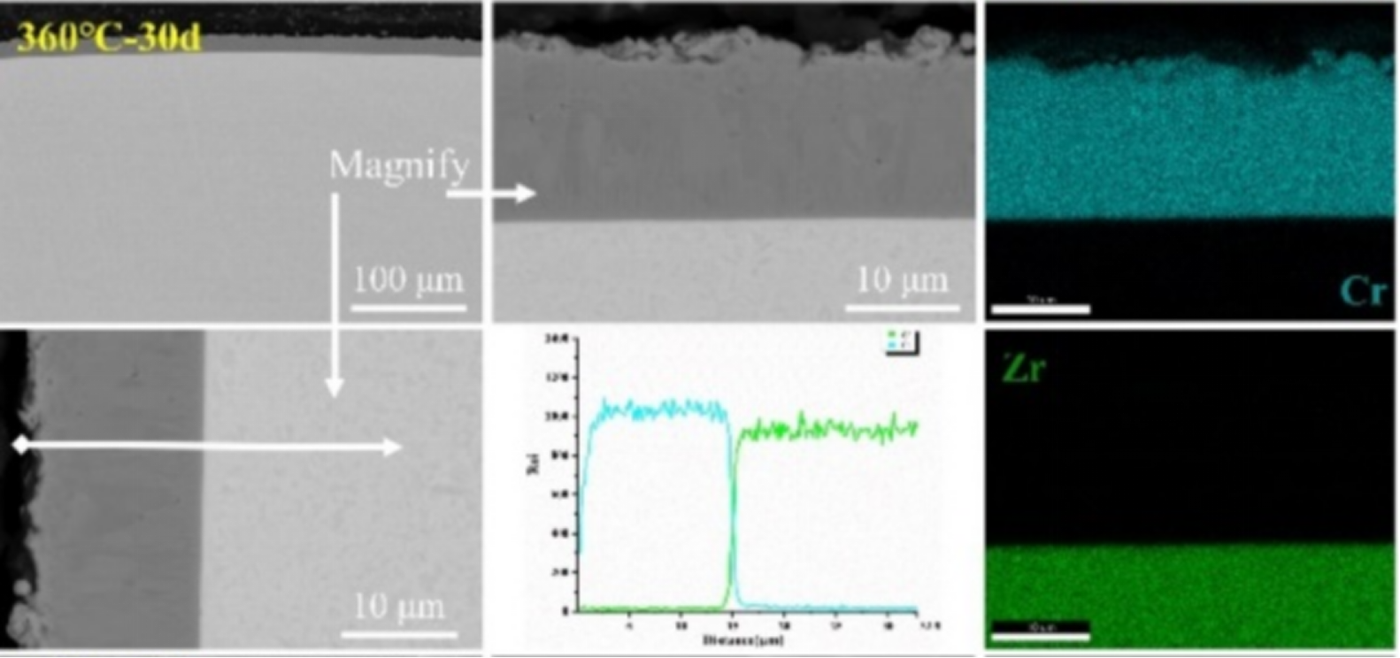
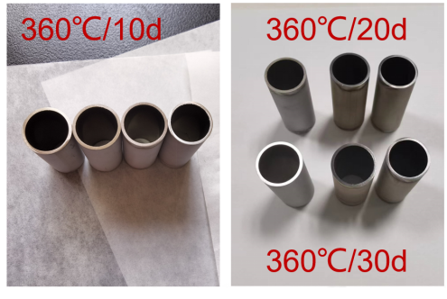
2.Diffusion experimental research
360℃ annealing in vacuum
After annealing at 360°C for 30 days, the microstructures of zirconium alloy claddings are α-Zr.
the interface on the sample cross-section remained clear, with no diffusion observed.
Appearance of Samples
Microstructure of samples after 30 days of vacuum annealing at 360°C

Slide 10
2.Diffusion experimental research
360℃ annealing in vacuum
Characterized using TEM, no distinct Cr-Zr compounds were observed at the interface, indicating that intermetallic phases are unlikely to form at 360°C for 30 days.
Microstructure of samples after 30 days of vacuum annealing at 360°C

Slide 11
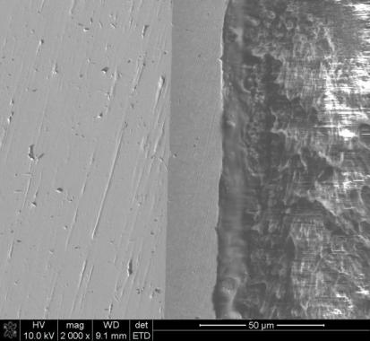

2.Diffusion experimental research
360℃/18.6MPa corrosion（composition of NPP water）
The Cr-coated samples after 300 days of corrosion were examined.
No Cr-Zr interdiffusion layer was observed under SEM at 2000× magnification.
Combined with 360℃ annealing experiment, the Cr-Zr diffusion is difficult to occur under normal operating conditions.
Cross-sectional morphology of Cr-coated N36 cladding sample after 300 days of corrosion

Slide 12
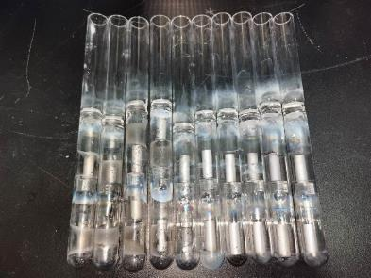
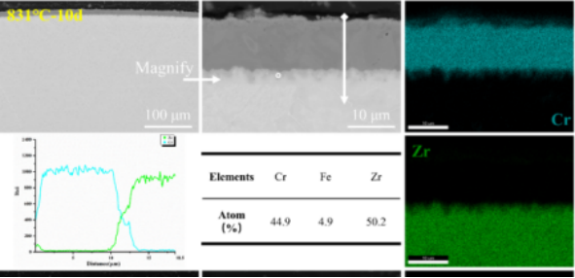
2.Diffusion experimental research
831℃ annealing in vacuum
After holding at 831°C for 10 days, The cross-sectional microstructure of the sample exhibits both α-Zr and β-Zr phases.
Cr-Zr interdiffusion occurred at the interface, and the thickness of the intermediate layer increased with prolonged holding time.
There is a small amount of Fe element in the diffusion layer, resulting from the segregation of trace Fe elements inherently present in the zirconium alloy matrix into the intermediate diffusion layer.
Appearance of Samples
Microstructure of samples after 10 days of vacuum annealing at 831°C

Slide 13
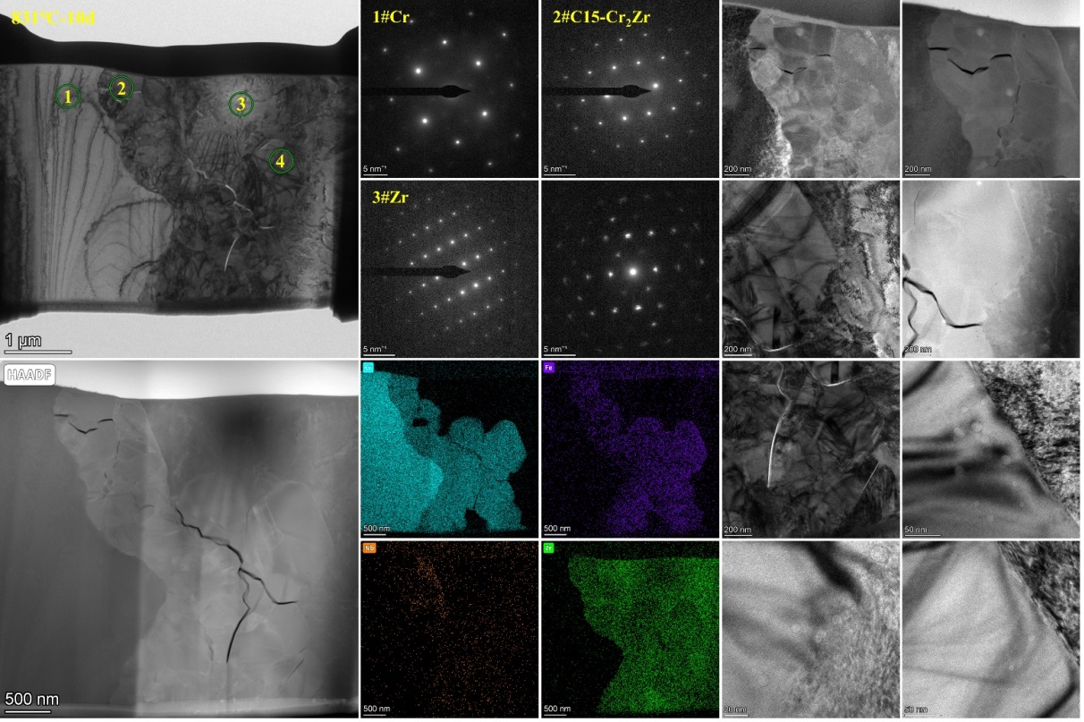
2.Diffusion experimental research
831℃ annealing in vacuum
The phase distribution from the Cr coating toward the matrix in the radial direction is Cr , C15-Cr₂Zr (FCC) and Zr.
The diffusion layer formed at the interface is the brittle Cr₂Zr phase, which is prone to cracking under stress, and cracks can be observed in the microstructure of the diffusion layer.
Microstructure of samples after 10 days of vacuum annealing at 831°C

Slide 14
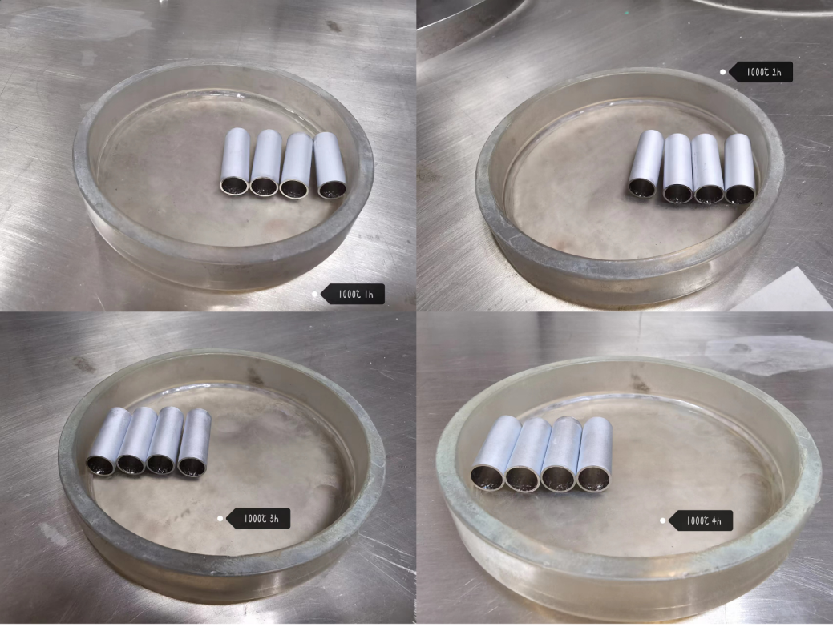
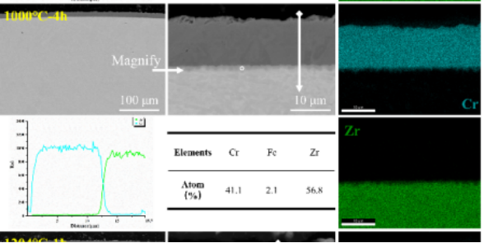
2.Diffusion experimental research
1000℃ annealing in vacuum
After holding at 1000°C for 4 hours, The sample cross-sectional microstructure is almost entirely composed of β-Zr phase.
Cr-Zr interdiffusion occurred to varying degrees at the Cr-Zr interface, and the intermediate layer thickness increasing with prolonged holding time.
Appearance of Samples
Microstructure of samples after 4 hours of vacuum annealing at 1000°C

Slide 15
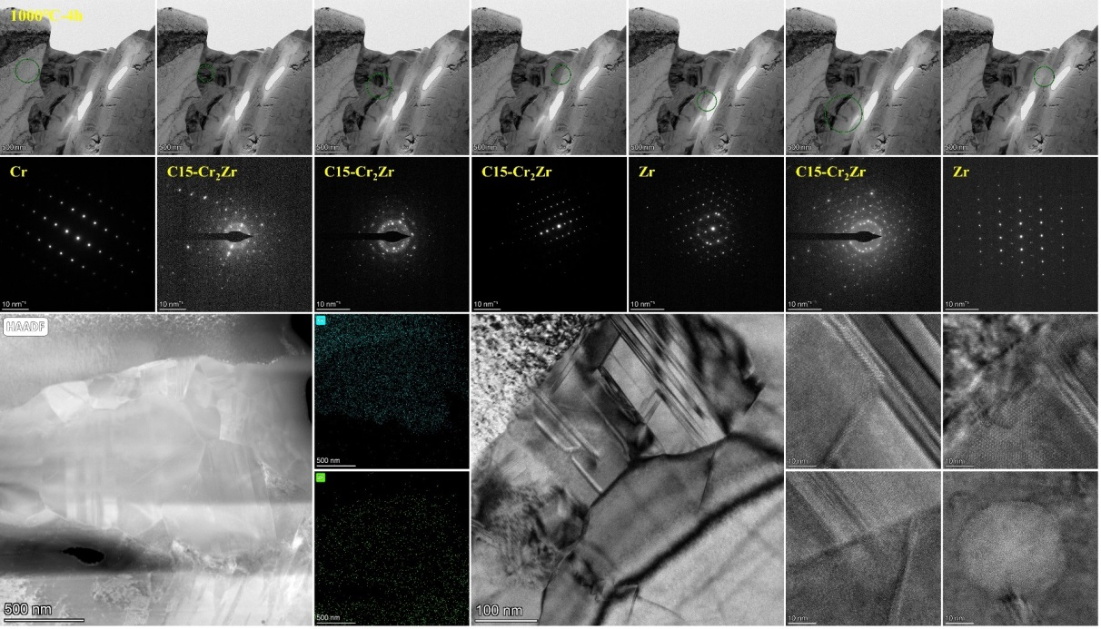
2.Diffusion experimental research
1000℃ annealing in vacuum
Similar to the condition at 831°C, the phase distribution from the Cr coating toward the matrix in the radial direction is Cr , C15-Cr₂Zr (FCC) and Zr.
The diffusion layer formed at the interface is the Cr₂Zr brittle phase. Although no cracks were observed, micro-pores were found in the matrix, which are Kirkendall pores formed by thermal diffusion.
Microstructure of samples after 4 hours of vacuum annealing at 1000°C

Slide 16
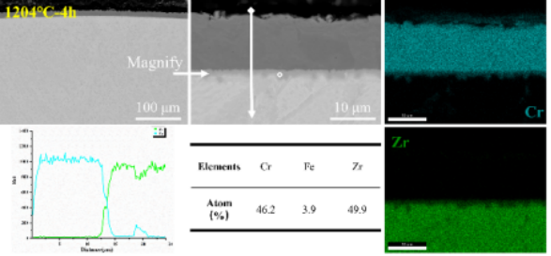
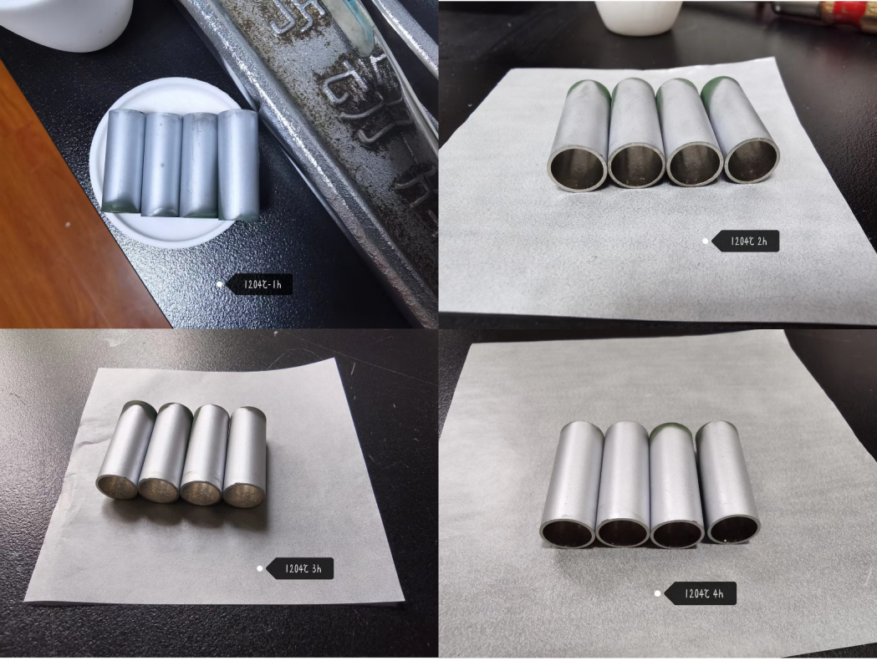
2.Diffusion experimental research
1204℃ annealing in argon atmosphere
After annealing at 1204°C for 4 hours, The sample cross-sectional microstructure is almost entirely composed of β-Zr phase.
The diffusion layer formed at the interface remains the brittle Cr₂Zr phase, It is prone to cracking under stress and its thickness is not uniform, which may be related to the presence of Cr diffusion channels at the grain boundaries.
Appearance of Samples
Microstructure of samples after 4 hours of annealing at 1204°C

Slide 17
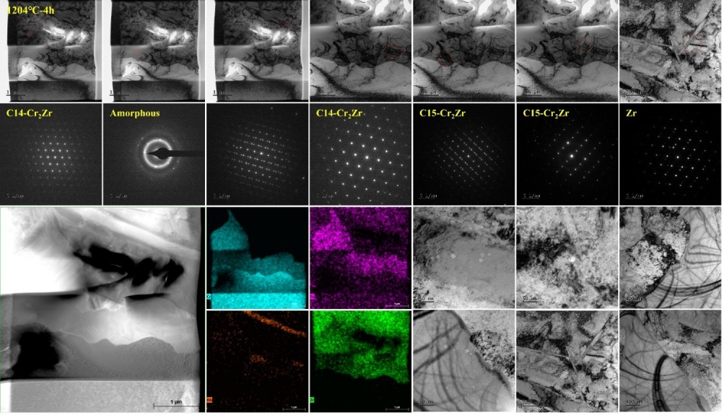
2.Diffusion experimental research
1204℃ annealing in argon atmosphere
The phase distribution from the Cr coating toward the matrix in the radial direction is Cr , Cr₂Zr and Zr. At this temperature, the intermediate diffusion layer contains C15-Cr₂Zr (FCC) and C14-Cr₂Zr(HCP).
Similar to the experiment conducted at 1000℃, some tiny pores were observed at the interface between the matrix (Zr) and the diffusion layer (Zr₂Cr）
Microstructure of samples after 4 hours of annealing at 1204°C

Slide 18
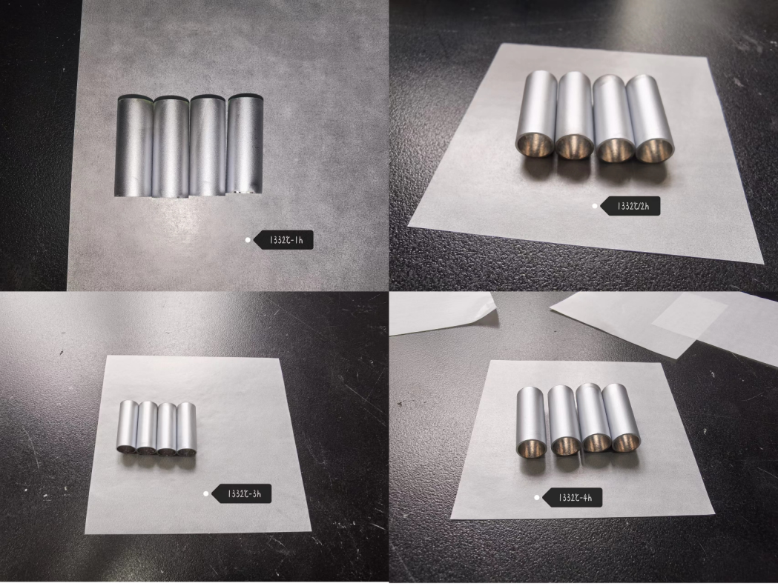
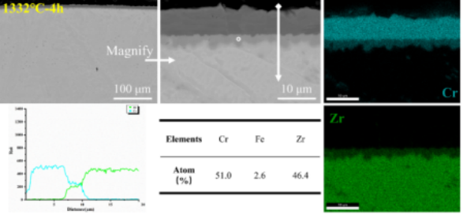
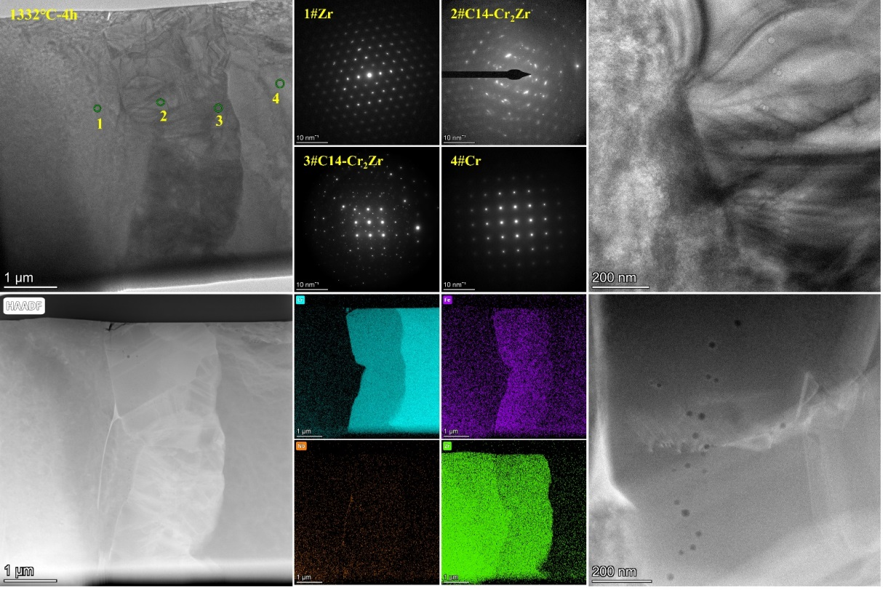
2.Diffusion experimental research
1332℃ annealing in argon atmosphere
The experimental results are similar to 1204°C, with the diffusion layer consisting of brittle Cr₂Zr phase. Both exhibit pores (at the interface between the matrix and the diffusion layer) and cracks (within the diffusion layer).
The main difference is that the diffusion layer at 1332°C is thicker, and the Cr₂Zr is almostly C14-Cr₂Zr(HCP).
Appearance of Samples
Microstructure of samples after 4 hours of annealing at 1332°C

Slide 19
3
Diffusion coefficient research

Slide 20
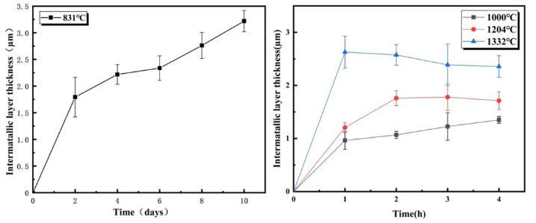
3.Diffusion coefficient research
After annealing, the thickness of the diffusion layer was measured at various diffusion temperatures and holding times.
Overall, the thickness of the Cr-Zr interface diffusion layer increases with extended holding time at the same temperature, and also increases with rising temperature at the same holding time.
However, at 1332°C, the diffusion layer thickness decreases with increasing time, possibly due to Cr-Zr eutectic behavior.

Slide 21
3.Diffusion coefficient research
During the interdiffusion, in the absence of coating volatilization under vacuum conditions, the consumption of the Cr coating primarily results from two factors: formation of the ZrCr₂ intermediate layer and dissolution into the Zr alloy.
The diffusion coefficients of Crat different temperatures were calculated by measuring the residual Cr coating thickness, intermediate layer thickness, and the extent of Cr diffusion into the Zr alloy matrix after annealing at various temperatures and holding times.

Slide 22

3.Diffusion coefficient research
The remaining thickness of Cr coating thickness can be calculated as follow
$$X=X0\sqrt{1−Kt}$$
X, the remaining Cr coating thickness
X₀ , the initial Cr coating thickness
K, diffusion coefficient of the Cr, m²/s
t, the holding time, s

Slide 23

3.Diffusion coefficient research
At the same temperature, assuming the diffusion coefficient K does not change with the holding time,
By combining diffusion coefficients at different temperatures, the activation energy and pre-exponential factor are calculated using the Arrhenius equation.
The diffusion coefficient of the Cr can be calculated by the Arrhenius equationas as follow:
$$K=K0e^{−\frac{Q}{RT}}$$
K, diffusion coefficient of the Cr, m²/s
K₀, pre-factor, m²/s
Q, activation energy,J/mol;
R, gas molar constant, 8.314 J/(mol·K)
T, holding temperature, K

Slide 24
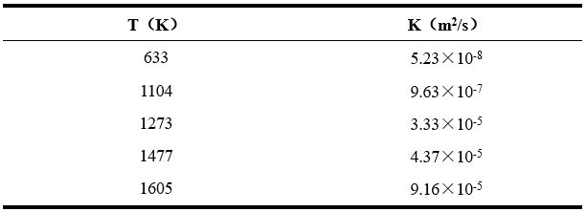
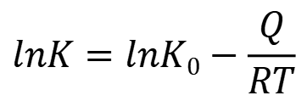
3.Diffusion coefficient research
Ideally, the diffusion coefficient is taken as a constant at the same holding temperature.
Plot the reciprocal of the holding temperature (T⁻¹) against the natural logarithm of the diffusion coefficient (lnK) as follow, and obtain the slope and intercept through linear fitting.
The activation energy(Q) and pre-factor(K₀) can be obtained based on the slope and intercept respectively, and the diffusion coefficient (K) can be calculated as follow
$$lnK=lnK0−\frac{Q}{RT}$$

Slide 25
4
Summary & Follow-up plan

Slide 26
4.Summary & Future research
Summary
Cr-Zr diffusion behavior is unlikely to occur under normal operating conditions.
At annealing temperatures of 831°C and above, Cr-Zr diffusion will occur, and the thickness of the diffusion layer is generally positively correlated with the annealing temperature and holding time.
The diffusion layer is primarily composed of Cr2Zr phase, and cracks can be observed in some microstructures within the diffusion layer.
The diffusion coefficient can be fitted based on experimental results to estimate the diffusion amount of Cr.

Slide 27
4.Summary & Follow-up plan
Follow-up plan
Observe the microstructure of irradiated Cr-coated cladding to verify the difficulty of diffusion under normal operating conditions.
By preparing diffusion layers of different thicknesses, research the influence of diffusion layer thickness on the mechanical properties of Cr-coated cladding.

Slide 28
Thanks for your attention

