Slide 1









Investigation of the temperature-dependent failure processes in a PVD Cr-coated ZIRLO nuclear fuel cladding material using real-time X-ray micro-tomography imaging
Guanjie Yuan, Martin Ševeček & Dong Liu
Technical Meeting on Advanced Technology Fuels (EVT2404561)
pl19178@bristol.ac.uk
Oct 2025

Slide 2
Outline
Introduction
Background
Materials and experiments
Results
Key messages
Other research area
Materials information
In situ high-temperature C-ring compression tests
Microstructures and local properties of as-received and post-tested materials
Mechanical behaviour at elevated temperatures: RT, 345°C, 650°C and 950°C
Real-time failure processes at elevated temperatures: RT, 345°C, 650°C and 950°C
Crack patterns of post-tested at elevated temperatures: RT, 345°C, 650°C and 950°C
Summary and comparison of failure processes at elevated temperatures
Guanjie Yuan
pl19178@bristol.ac.uk

Slide 3
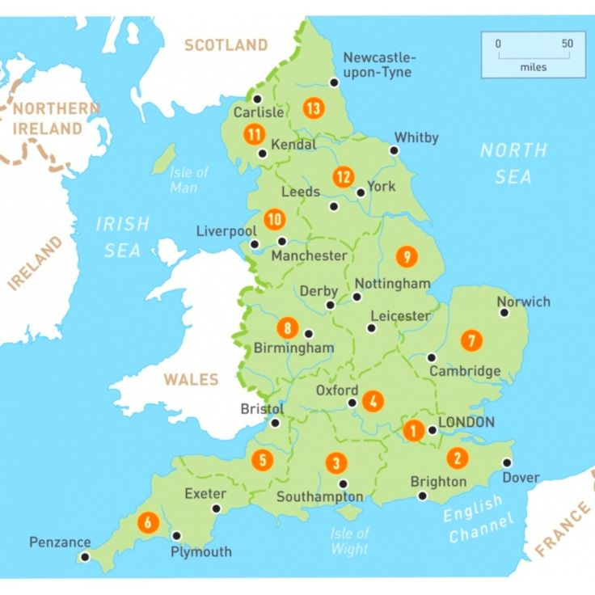
Introduction
About me
Postdoctoral research associate in University of Bristol (2025.02-present)
Visiting scholar in University of Oxford (2025.02-present)
Postdoctoral research assistant in University of Oxford (2024.02-2025.02)
PhD in Physics in University of Bristol (2019.09-2024.06)
Master degree in Materials Science and Engineering in University of Science and Technology Beijing (2016.09-2019.06)
Double Bachelor degree in Materials Science and Engineering/English Culture in University of Science and Technology Beijing (2012.09-2016.06)
Guanjie Yuan
pl19178@bristol.ac.uk
[1] https://www.pinterest.com/pin/405816616425706034/

Slide 4


Background
Conventional fuel-cladding system in LWRs
Challenges:
Zircaloy
Fuel
pallets
Oxidation of Zircaloy in high-temperature steam
Lose structural integrity
Release combustible H₂
Accident tolerant fuel (ATF) cladding
Improvement the oxidation and corrosion resistance in loss-of-coolant accident (LOCA) and beyond-design-basis (DBA) conditions
Modification of current Zircaloy cladding, i.e. Cr-coating
Replacement of Zircaloy cladding
Fukushima accident (boiling water reactor) happened in 2011^{[1]}
Guanjie Yuan
pl19178@bristol.ac.uk
[1] https://world.people.com.cn/n/2014/0826/c1002-25540196.html

Slide 5
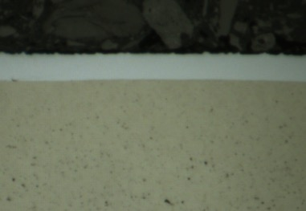
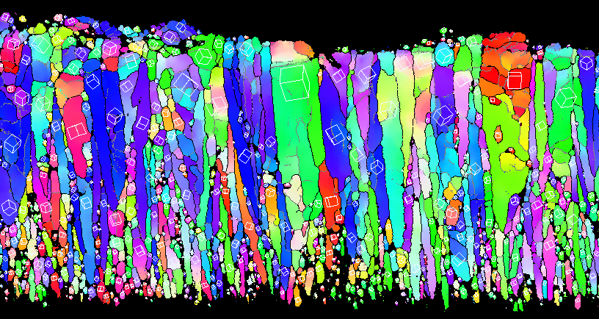
Background
Cr-coated Zircaloy cladding
Cr coating
Cr
Zircaloy
25 μm
Cr coating produced by physical vapor deposition (PVD) method^{[1]}
5 μm
PVD Cr grains are primarily columnar in shape
Smaller grains are clustered at the interface
No obvious porosity between large columnar grains
No obvious plastic deformation of underlying substrate
Guanjie Yuan
pl19178@bristol.ac.uk
[1] Guanjie Yuan et al. Materials & Design, 2023, 234: 112373.

Slide 6
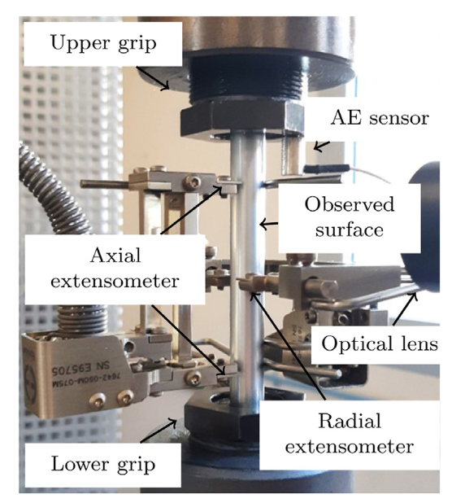
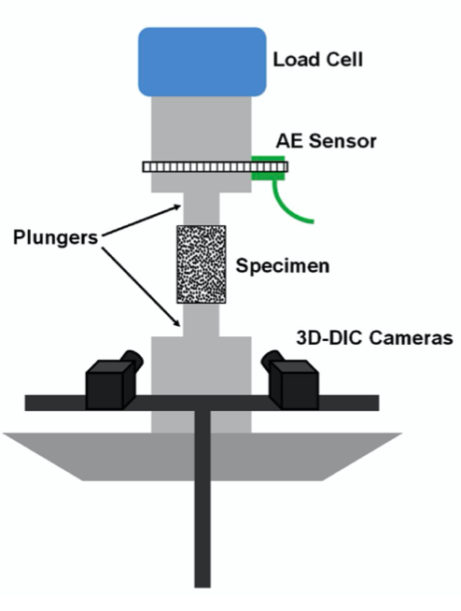
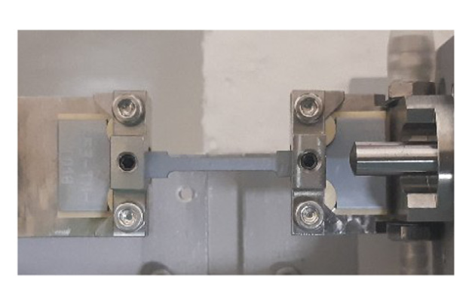
Background
Mechanical testing from open literature
Ring tensile tests on tube samples: RT by Korean (2005, 2023)
In situ plug expansion tests (AE and DIC) on tube samples: RT by USA (2020)
In situ tensile tests (SEM) on coated sheet samples: RT and 400°C by China (2021)
In situ biaxial tensile tests (AE and DIC) on tube samples: RT by France (2022)
In situ tensile tests (SEM) on coated sheet samples: RT by France (2022)
In situ plug expansion tests (DIC) on tube samples: 315°C by USA (2020)
In situ C-ring compression tests (XCT) on C-ring samples : RT and 345°C by UK (2023)
Plug-expansion test
Biaxial tensile test
In situ high-temperature (over 345°C) X-ray micro-tomography test is needed to monitor the formation and evolution of the 3D deformation and fracture
Tensile test
Guanjie Yuan
pl19178@bristol.ac.uk

Slide 7
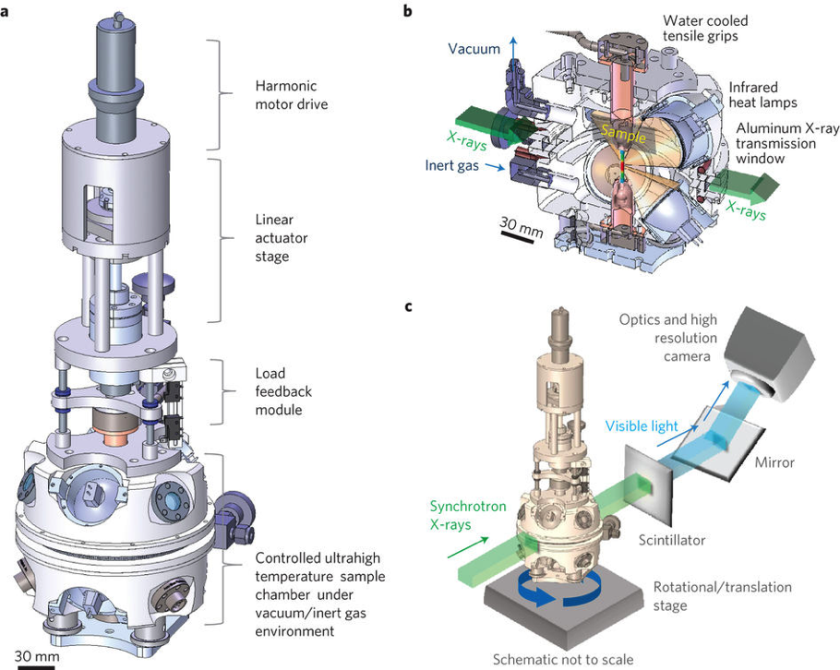
In situ high temperature mechanical tests with XCT imaging
Device used
High temperature in situ hot cell allow heating up to 1600°C; maximum loading (3.2 kN)
Rotation of the stage allows the radiography projection taken at each angle around the sample
Attenuation based tomography and phase contrast tomography
High temperature device^{[1]}
[1] Bale H A, Haboub A, MacDowell A A, et al. Nature materials, 2013, 12(1): 40-46.
Guanjie Yuan
pl19178@bristol.ac.uk

Slide 8
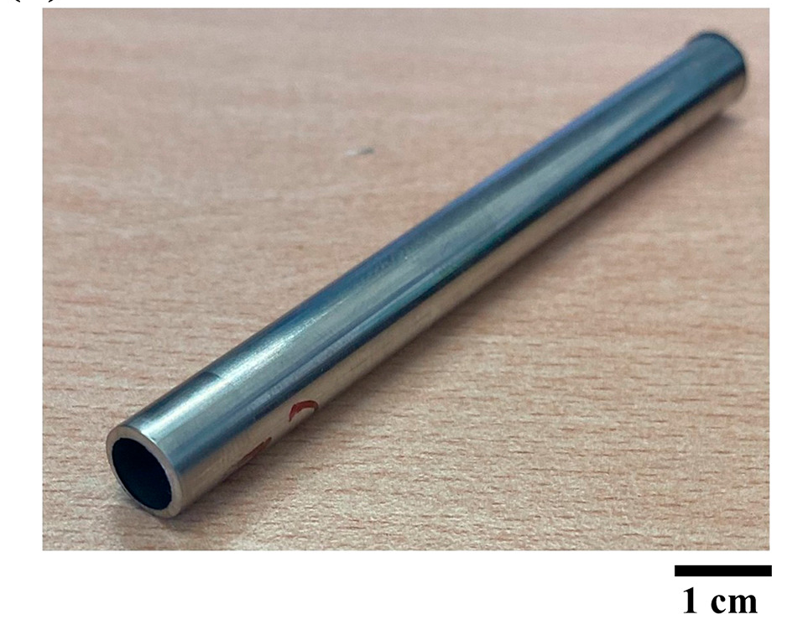
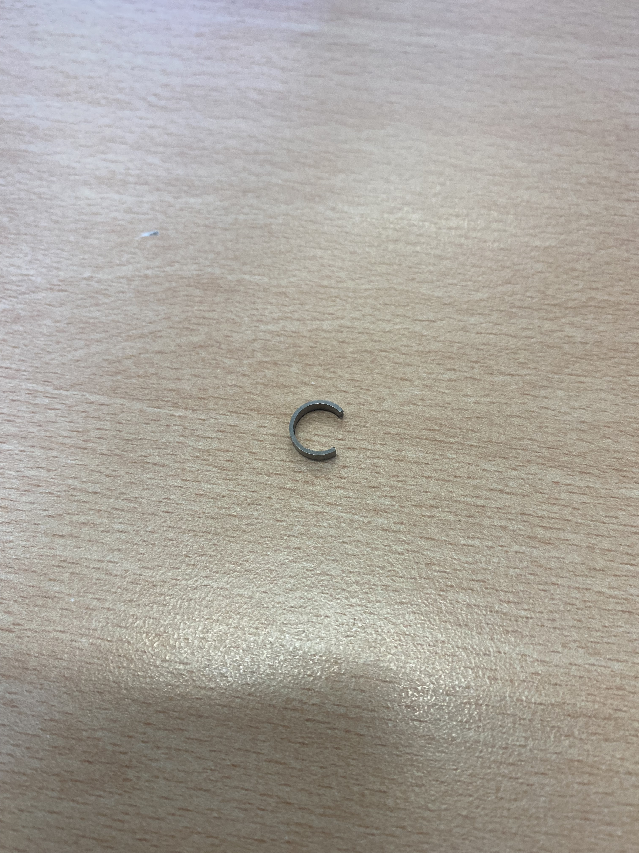






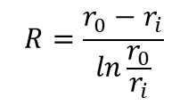



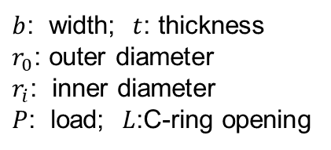

Materials and experiments
Sample geometry
C-ring sample
Outer radius (mm) | Inner radius (mm) | Wall-thickness (mm)
4.57 ± 0.021 | 4.00 ± 0.016 | 0.57 ± 0.017
1 cm
C-ring compression test
$$P$$
Maximum tensile hoop stress:
$$σ_{θmax}=\frac{P_{U}R}{btr_{0}}[\frac{r_{0}−r_{a}}{r_{a}−R}]$$
$$r_{0}$$
where:
$$L$$
$$R=\frac{r_{0}−r_{i}}{ln\frac{r_{0}}{r_{i}}}$$
$$\left. r_{a}=(\frac{r_{0}+r_{i}}{2}\right)$$
$$1≤\frac{b}{t}≤2$$
$$σ_{θmax}$$
$$r_{i}$$
$b$: width; $t$: thickness
$r_{0}$: outer diameter
$r_{i}$: inner diameter
$P$: load; $L$:C-ring opening
$$b$$
$$P$$
C-Ring Test Geometry ^{[1]}
Guanjie Yuan
pl19178@bristol.ac.uk
[1] ASTM C1323, ASTM International, West Conshohocken, 2013

Slide 9
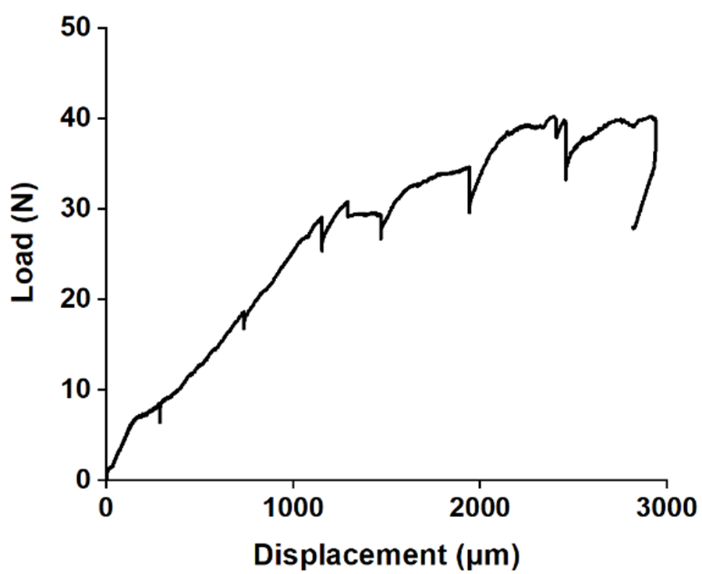
In situ C-ring compression tests
Testing conditions
Peak load
Four temperatures: RT, 345°C, 650°C and 950°C
Two samples tested at each tempeature
Environment: Ar
Four to eight XCT scans for each sample
At least 1 hour duration for each sample
Tomography scans
Guanjie Yuan
pl19178@bristol.ac.uk

Slide 10
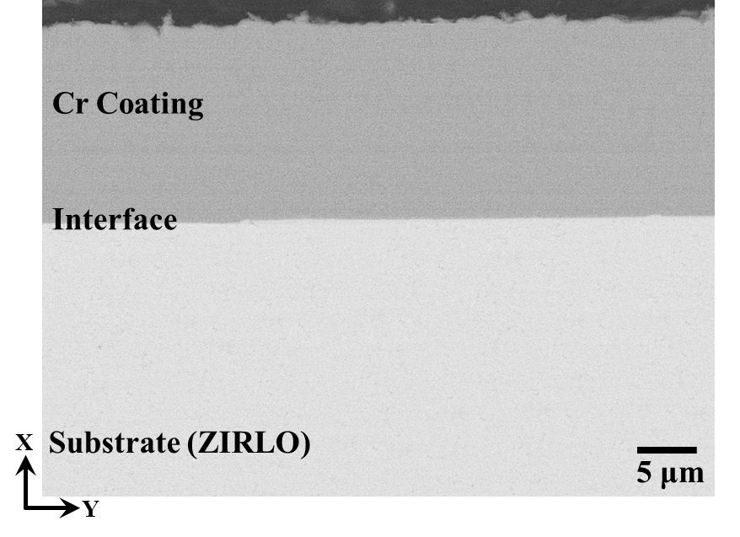
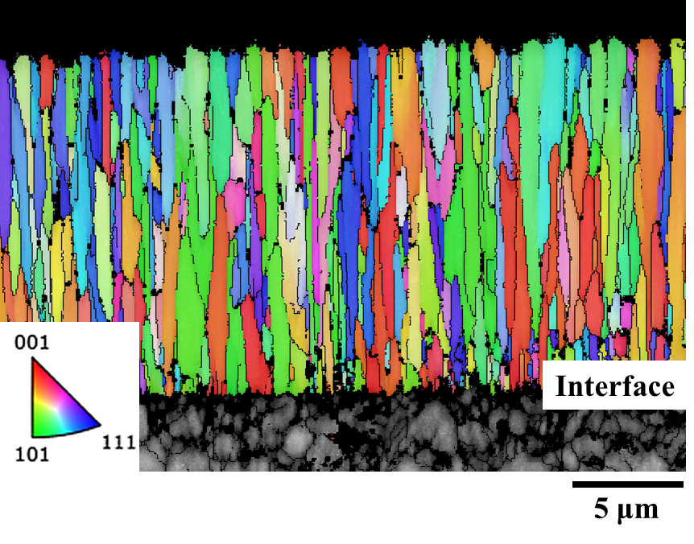
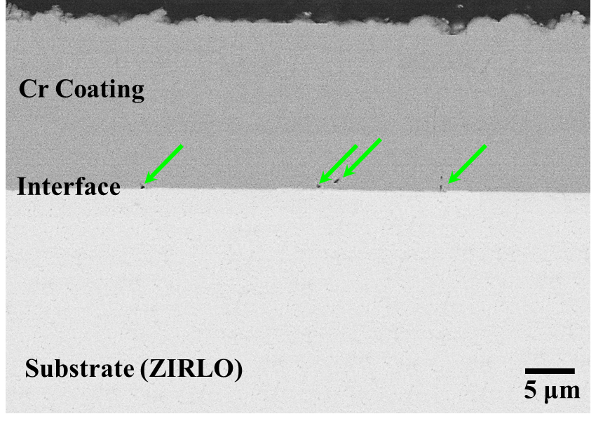
Results: Microstructures
As-received material
Post-tested at 950°C
For post-tested samples at RT, 345°C and 650°C, no obvious pores were found
At 950°C, pores were found at the interface, and in the Cr coating near the interface
Cr coating thickness: 14.36 ± 0.19 μm
No obvious pores in the Cr coating, or at the interface
Average area of the Cr grains: 1.1 ± 0.8 μm²
Guanjie Yuan
pl19178@bristol.ac.uk

Slide 11

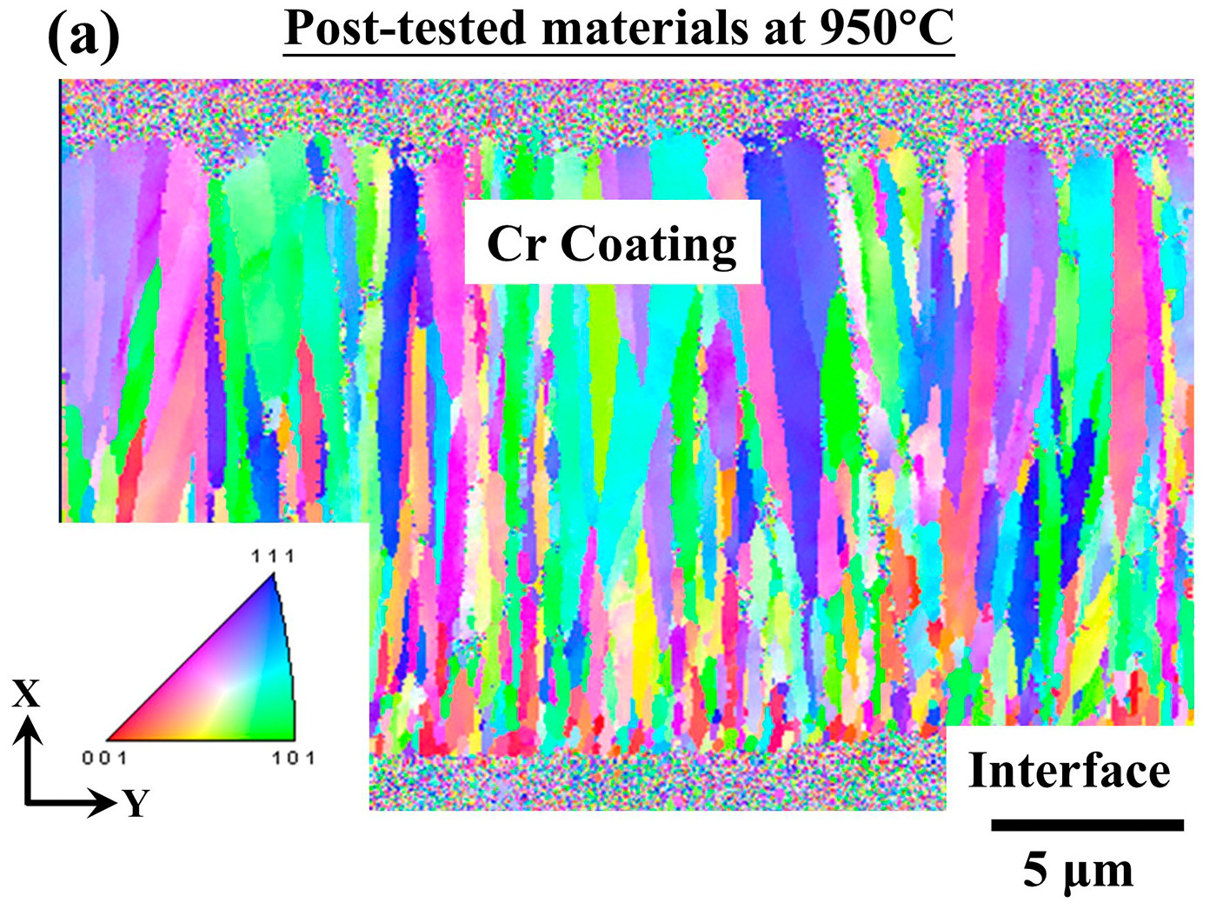
Results: Potential reasons for the formation of pores
Interdiffusion of Cr into the ZIRLO substrate
Recrystallisation of Cr grains
At the same temperature, the diffusion coefficient of Cr diffusing into Zr is greatly higher than Zr into Cr
At 748°C to 1197°C, Cr into Zr is 8.7 × 10⁻¹³ to 5.5 × 10⁻¹² m²/s, but Zr into Cr is much lower 10⁻¹⁵ to 10⁻¹⁶ m²/s ^{[1,2]}
At the same temperature, maximum solubility of Cr in Zr is higher than Zr in Cr
At 1300 °C, the maximum solubility of Cr in Zr is ∼8 at.%, and it is significantly higher than Zr in Cr which is ∼0.6 at.% ^{[3]}
After testing at 950°C, the average area of the Cr grains increased to: ~5.7 μm²
[1] DJ Kim, et al. Surface and Coatings Technology, 2023, 468: 129698.
[2] Li, Bo, et al. Tungsten 6.2 (2024): 333-341.
[3] Yang, Jianqiao, et al. Journal of Nuclear Materials 547 (2021): 152806.

Slide 12
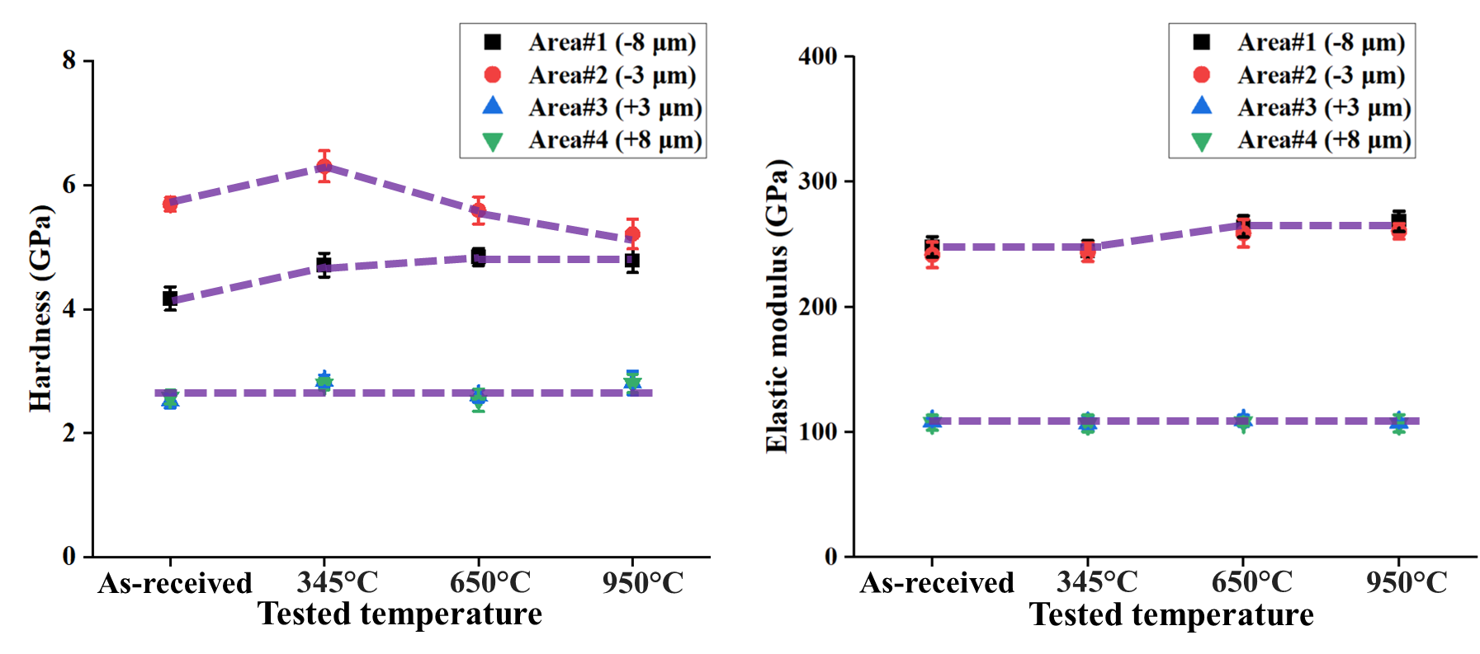
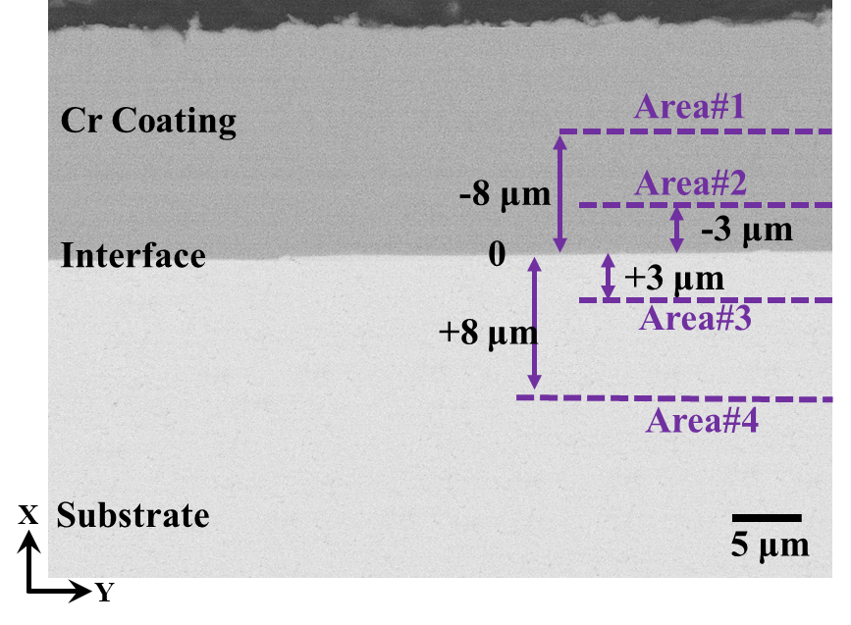
Results: Local properties of as-received materials
Locations of nanoindentation tests
Hardness
Elastic modulus
Hardness in Area#1 (∼4.17 GPa) is lower than Area#2 (∼5.69 GPa), and elastic modulus remains similar (∼241.65 GPa)
Caused by the smaller grains clustered at the interface^{[1]}
In Area#3 and Area#4, similar hardness (2.51 to 2.58 GPa) and elastic modulus (107 to 108 GPa) were found
Indicates PVD process has minimum impact on the underlying substrate^{[1]}
Coating
Area#1: at −8 μm away from the interface
Area#2: at −3 μm away from the interface
Area#3: at +3 μm away from the interface
Area#4: at +8 μm away from the interface
Substrate
Guanjie Yuan
pl19178@bristol.ac.uk
[1] Guanjie Yuan et al. Materials & Design, 2023, 234: 112373.

Slide 13
Results: Local properties of post-tested materials
Locations of nanoindentation tests
Hardness
Elastic modulus
Area#1
Area#2
Increase in the hardness was found: ∼4.71 GPa at 345°C (11.8 % increasing), ∼4.84 GPa at 650°C (16.1 % increasing) and ∼ 4.78 GPa at 950°C (14.6 % increasing)
For the elastic modulus, it remains constant after testing at 345°C (∼244.72 GPa), a 7.4 % increase after testing at 650°C and 950°C (∼264.27 GPa and ∼ 268.46 GPa, respectively)
Hardness (after testing at 345°C) increased to ∼6.30 GPa (11.1 % higher), and then decreased to 5.49 GPa (3.5 % lower) and 5.21 GPa (8.4 % lower) after testing at 650°C and 950°C, respectively
Areas#3 and 4
Hardness increases by 12.2 % after testing at 345°C, be similar to as-received materials after testing at 650°C, and then increases by 12.2 % after testing at 950°C
Guanjie Yuan
pl19178@bristol.ac.uk
[1] Guanjie Yuan et al. Materials & Design, 2023, 234: 112373.

Slide 14

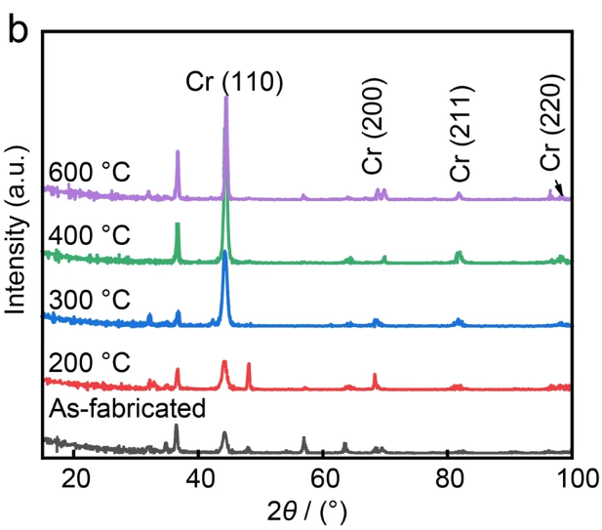
Results: Potential reasons for the variation of local properties
Area#1 (in the middle of Cr coating)
Area#2 (in the coating but close to the interface)
Recrystallization caused microstructural variation in the columnar Cr grains at elevated temperatures
Variation of residual stress in the PVD Cr coating at high temperatures ^{[1]}
Under annealing at high temperatures, such amorphous Cr could transform into crystalline Cr ^{[1]}
Areas#3,4 (Substrate, ZIRLO)
Precipitate of Nb from the substrate at elevated temperatures ^{[2]}
For the ZIRLO materials being annealed below 700 °C, the coalescence of α-grain could reduce its hardness.
For the materials tested at 950°C, the increased hardness could be caused by the refinement of the equiaxed α-grain ^{[3]}
XRD results of as-fabricated and specimens PVD Cr coating^{[1]}
[1] Li, Bo, et al. Tungsten 6.2 (2024): 333-341.
[2] Yi P. Journal of Physics: Conference Series, 2020, 1676(1): 012176.
[3] Jiang Y,et al. Transactions of Nonferrous Metals Society of China, 2018, 28(4): 651-661.

Slide 15
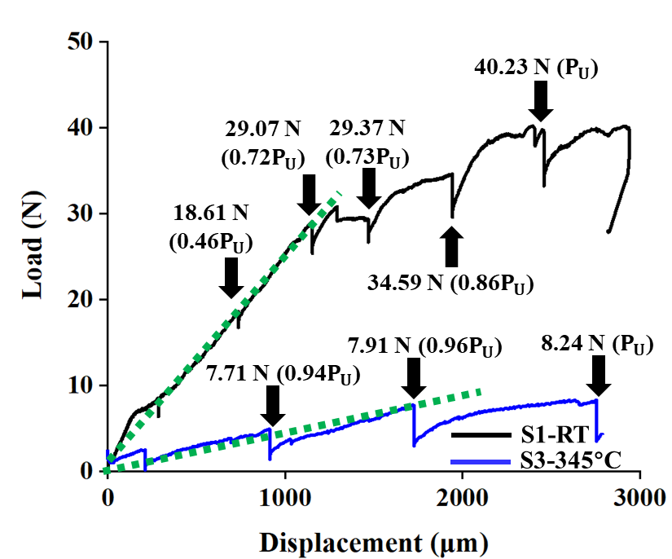

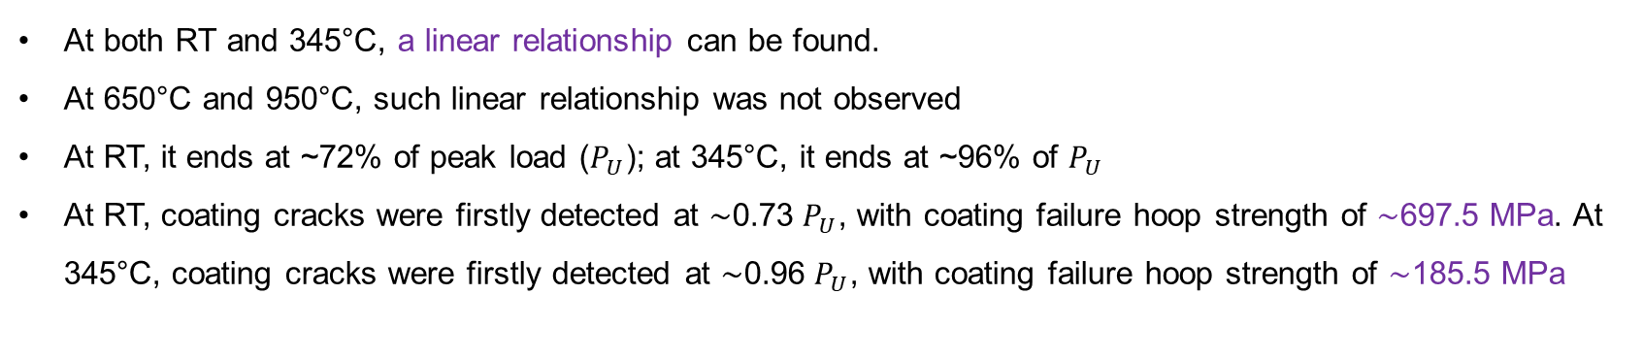
Results: Mechanical behaviour at elevated temperatures
RT and 345°C
650°C and 950°C
At both RT and 345°C, a linear relationship can be found.
At 650°C and 950°C, such linear relationship was not observed
At RT, it ends at ~72% of peak load ($P_{U}$); at 345°C, it ends at ~96% of $P_{U}$
At RT, coating cracks were firstly detected at ∼0.73 $P_{U}$, with coating failure hoop strength of ∼697.5 MPa. At 345°C, coating cracks were firstly detected at ∼0.96 $P_{U}$, with coating failure hoop strength of ∼185.5 MPa
Guanjie Yuan
pl19178@bristol.ac.uk

Slide 16
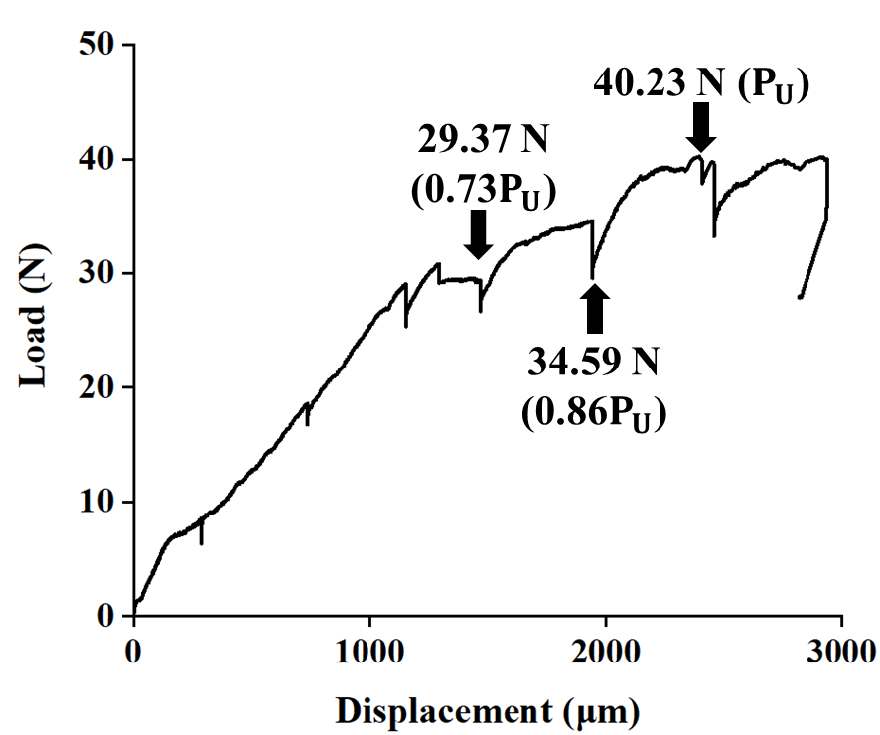
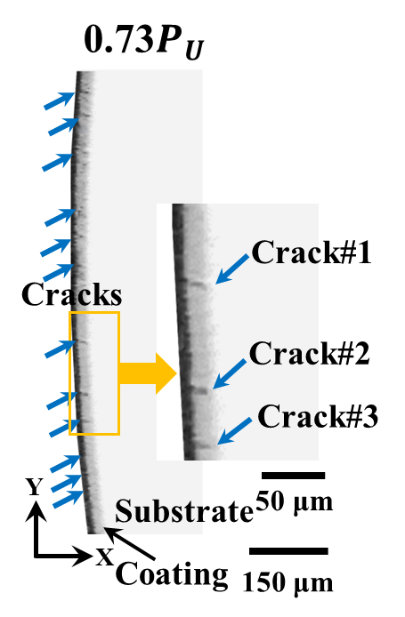
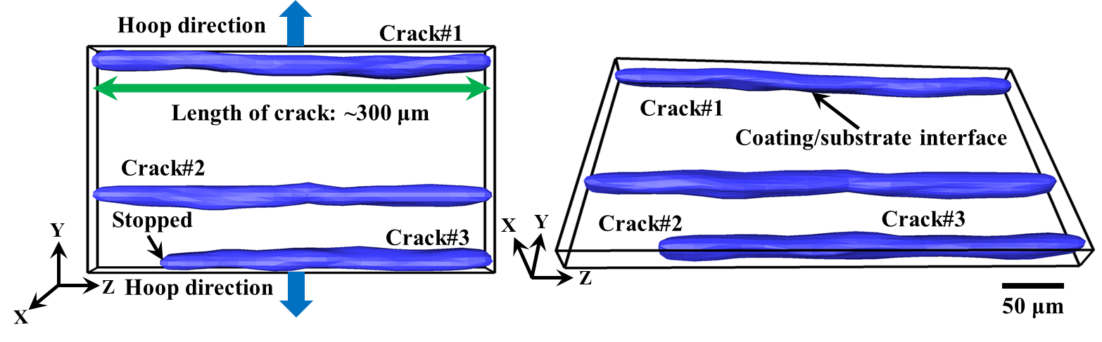
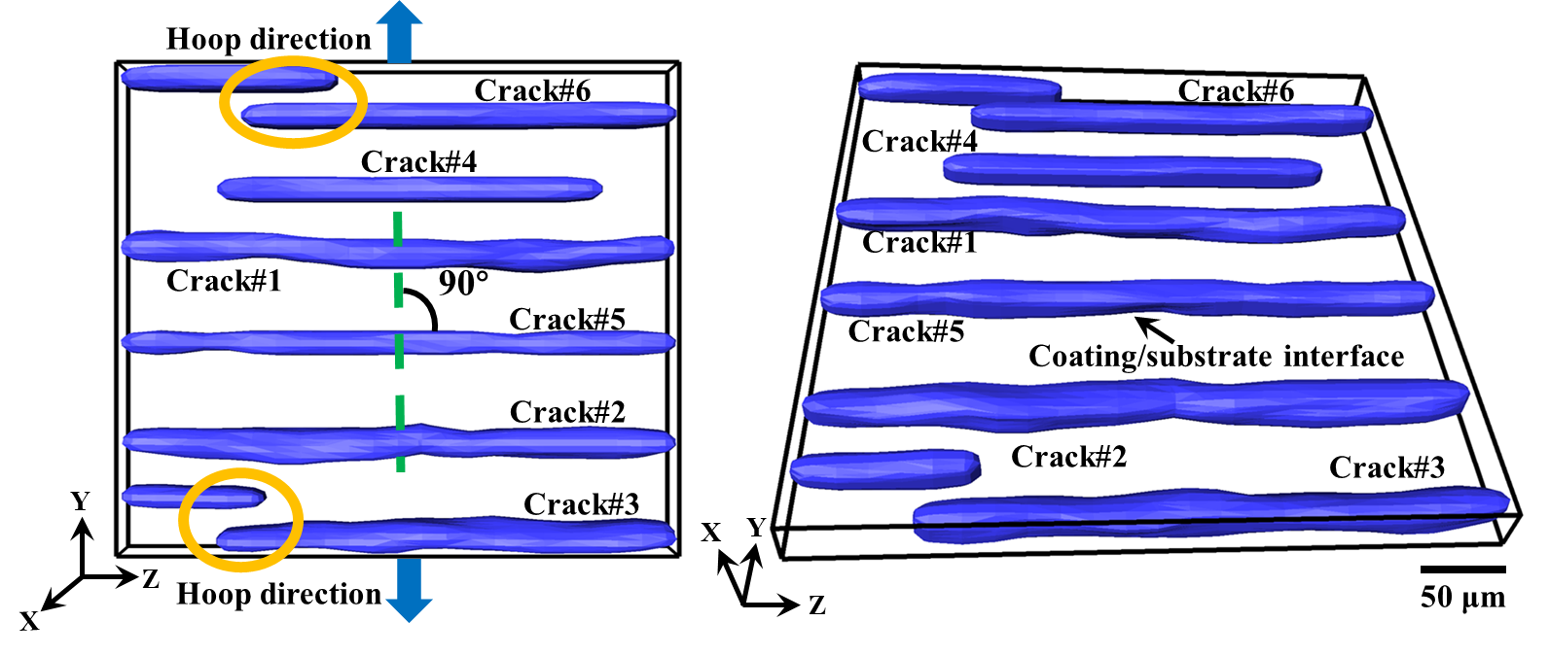
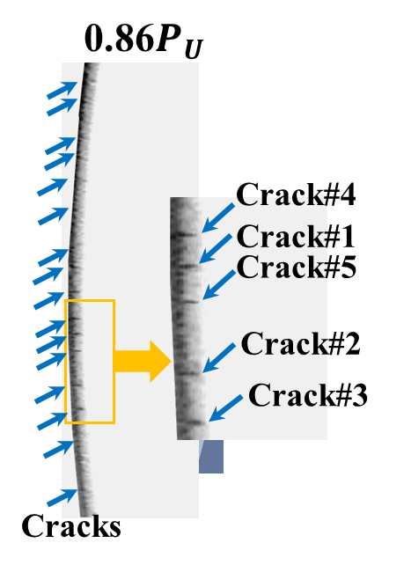
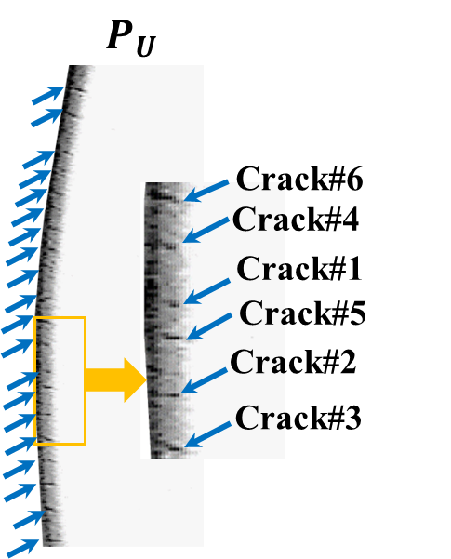
Results: Real-time failure process at RT
Guanjie Yuan
pl19178@bristol.ac.uk

Slide 17
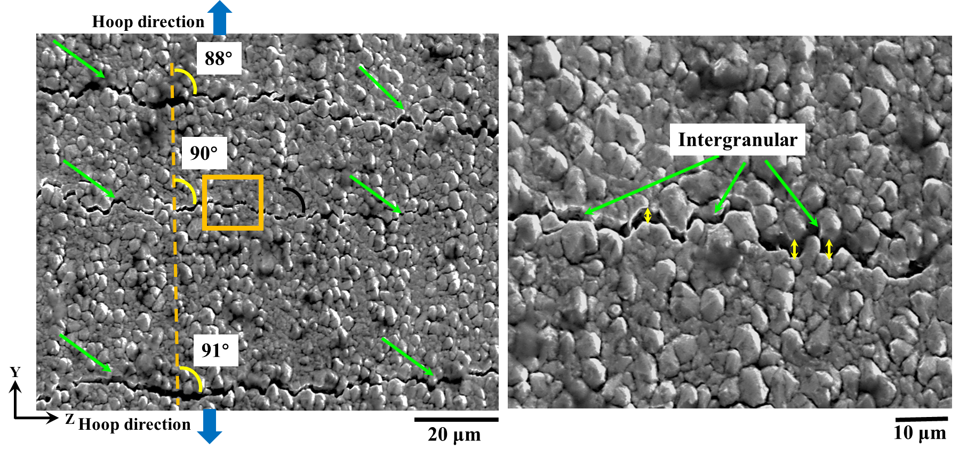
Results: Crack patterns of post-tested materials at RT
At RT, the average distance between the coating cracks is measured to be 36.1 ± 9.8 μm.
Cracks propagated almost perpendicular to the hoop loading direction (angle range of 88° to 91°)
Cracks propagated mostly in an intergranular mode (deflected along the Cr grain boundaries)
Guanjie Yuan
pl19178@bristol.ac.uk

Slide 18
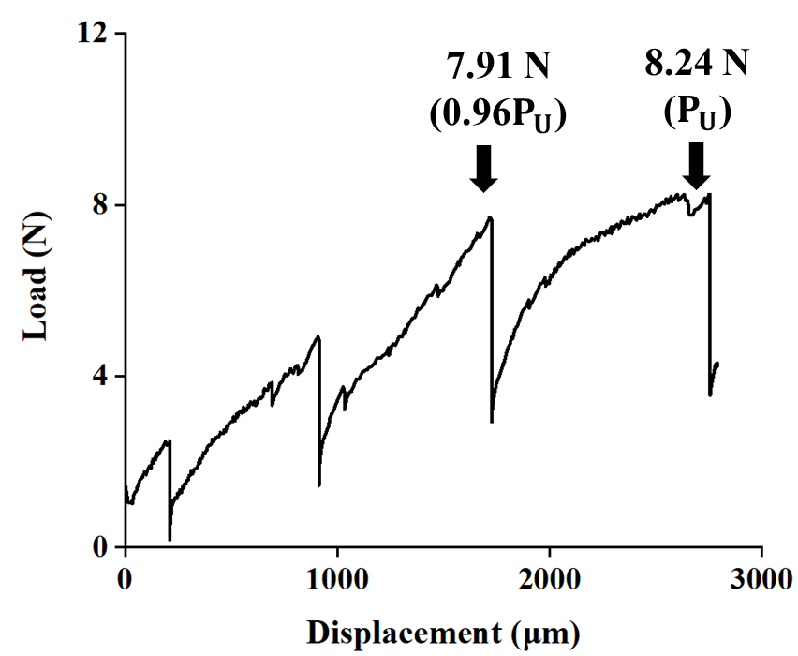
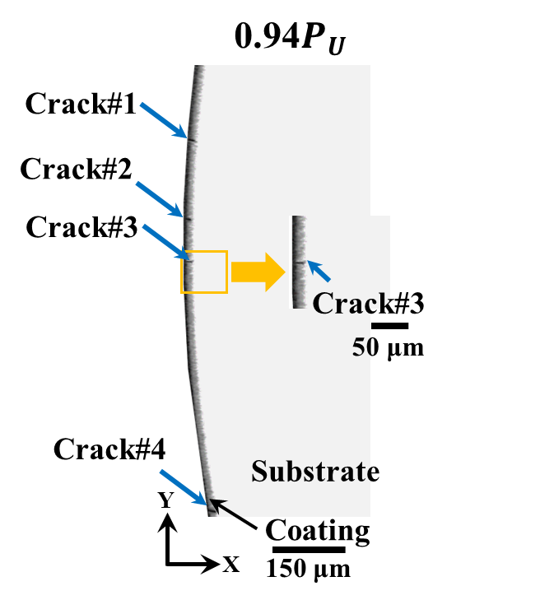
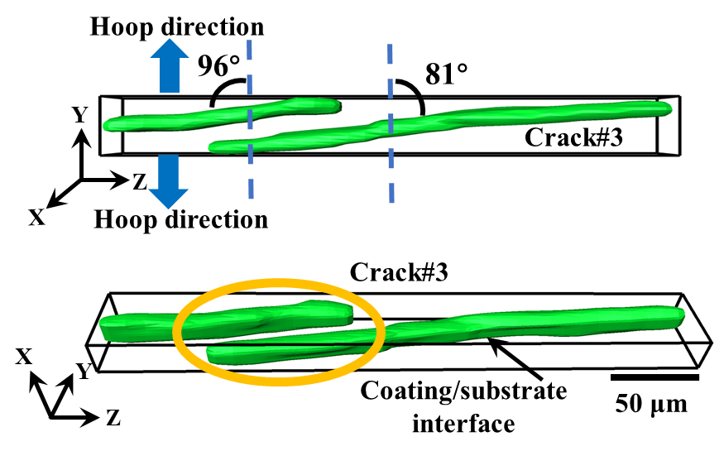
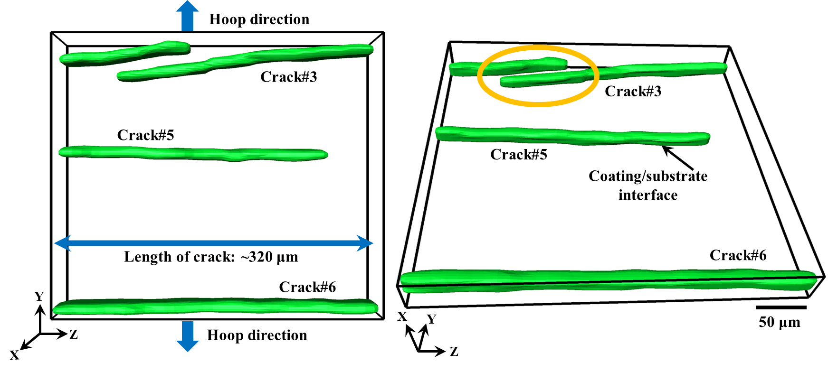
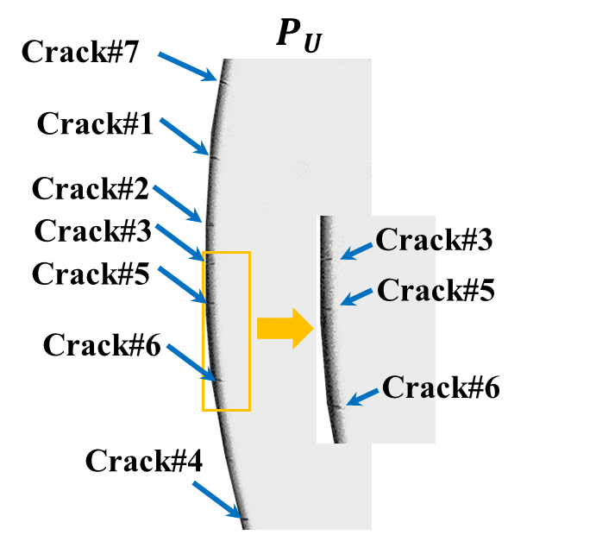
Results: Real-time failure process at 345°C
Guanjie Yuan
pl19178@bristol.ac.uk

Slide 19
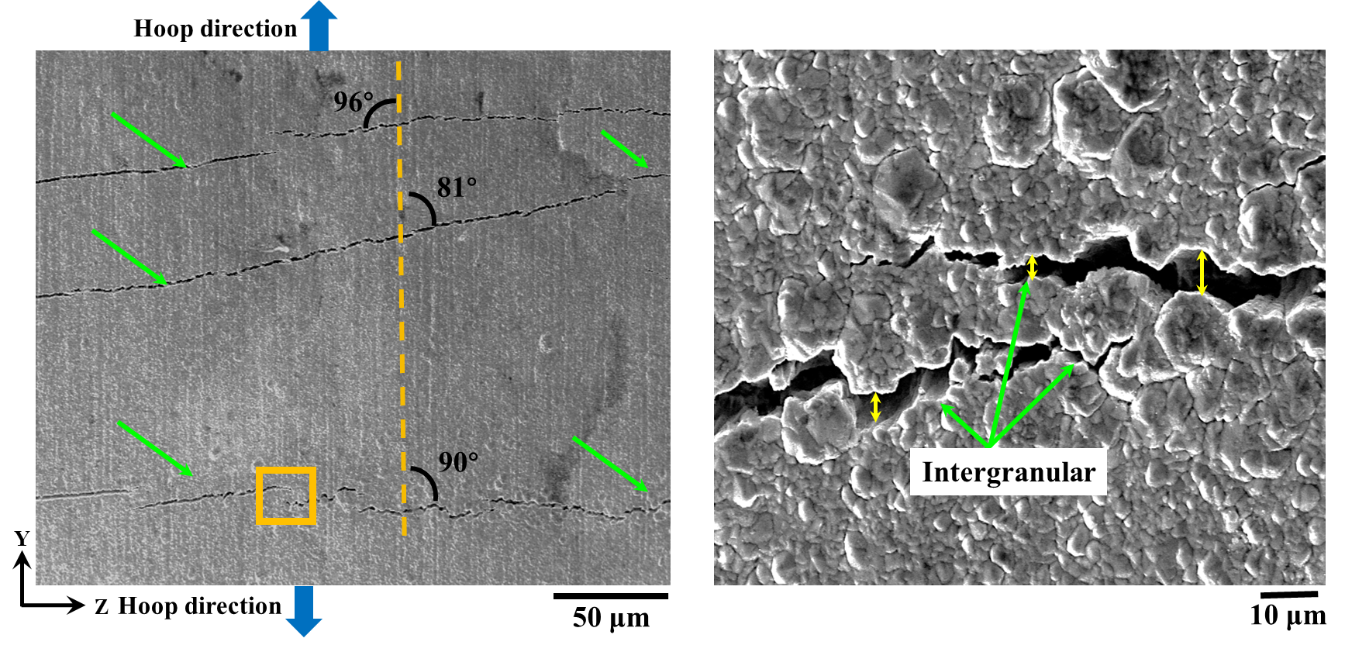
Results: Crack patterns of post-tested materials at 345°C
At 345°C, the average distance between the coating cracks is measured to be 112.9 ± 49.1 μm (much higher than that at RT: 36.1 ± 9.8 μm).
Cracks propagated almost perpendicular to the hoop loading direction (angle range of 81° to 96°, higher than that at RT: 88° to 91°)
Cracks propagated mostly in an intergranular mode (deflected along the Cr grain boundaries)
Guanjie Yuan
pl19178@bristol.ac.uk

Slide 20
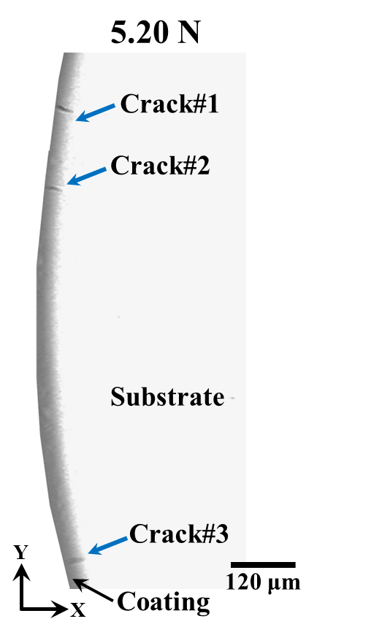
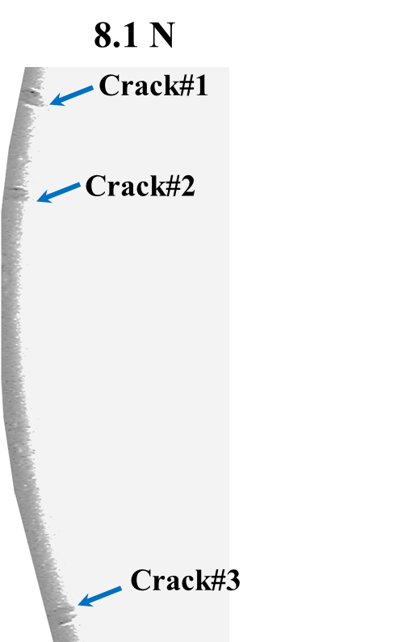
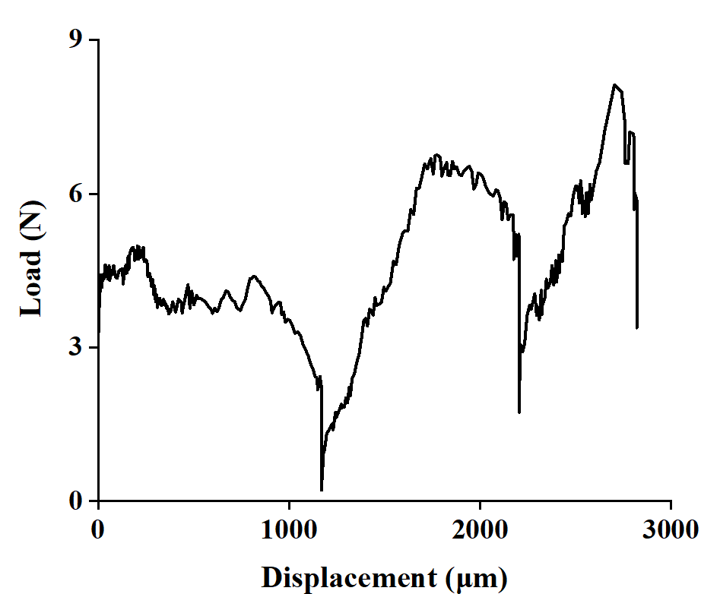
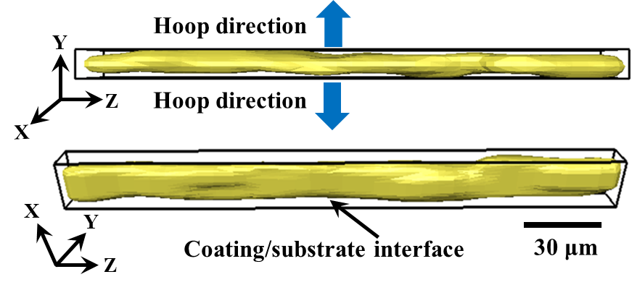
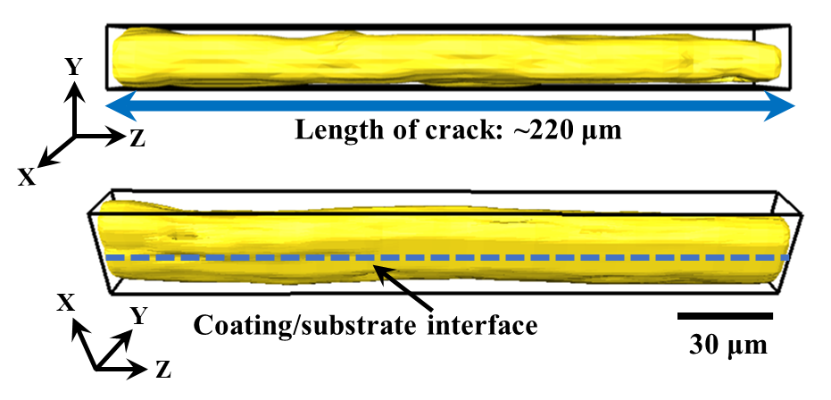
Results: Real-time failure process at 650°C
8.12 N
5.20 N
Guanjie Yuan
pl19178@bristol.ac.uk

Slide 21
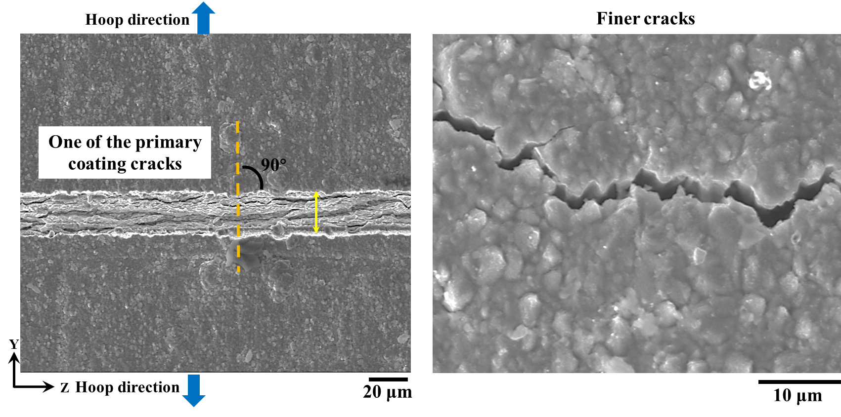
Results: Crack patterns of post-tested materials at 650°C
At 650°C, the average distance between the primary coating cracks is measured to be 342.9 ± 201.7 μm.
Primary cracks propagated almost perpendicular to the hoop loading direction
Finer cracks have a width less than 3 μm, which is below the detection resolution (3.25 μm/pixel)
Guanjie Yuan
pl19178@bristol.ac.uk

Slide 22
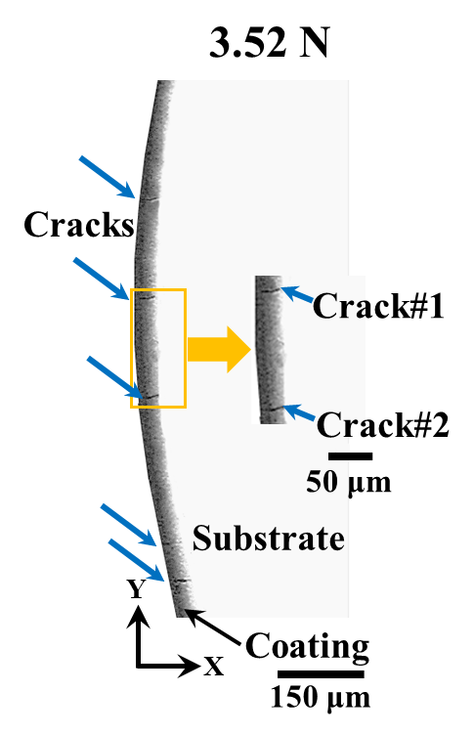
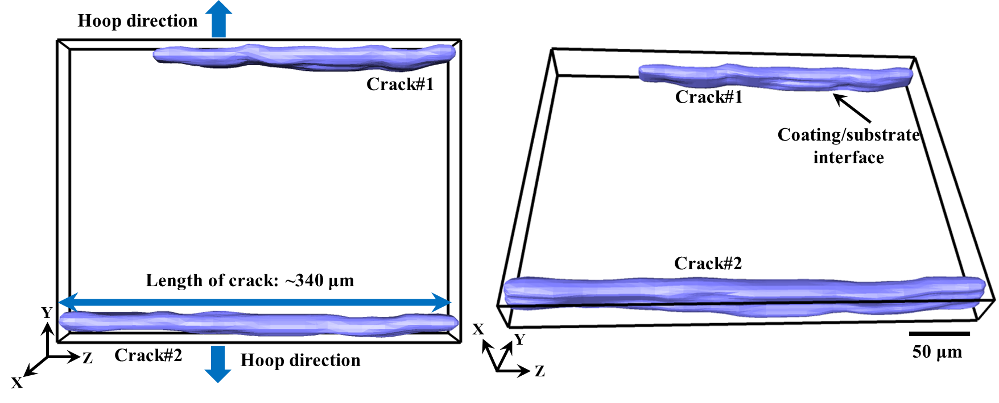
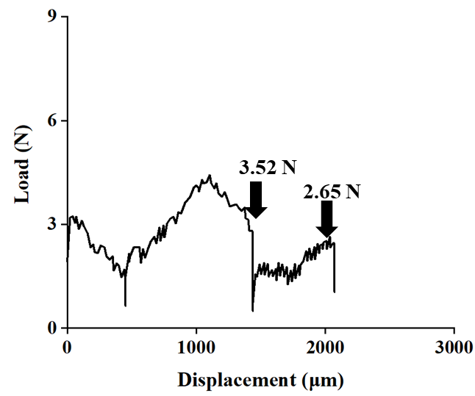
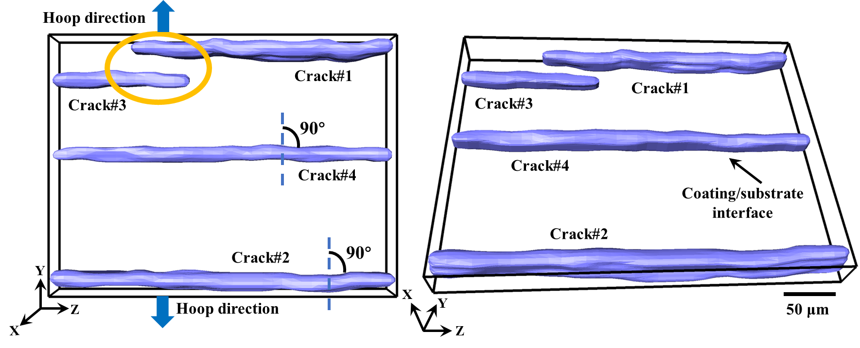
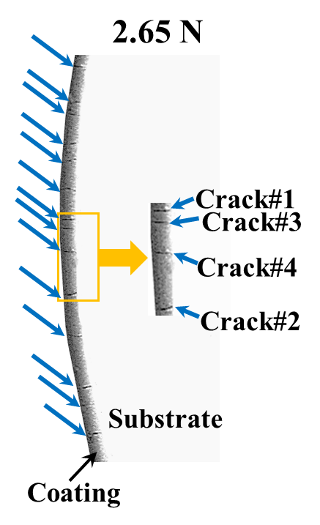
Results: Real-time failure process at 950°C
Guanjie Yuan
pl19178@bristol.ac.uk

Slide 23
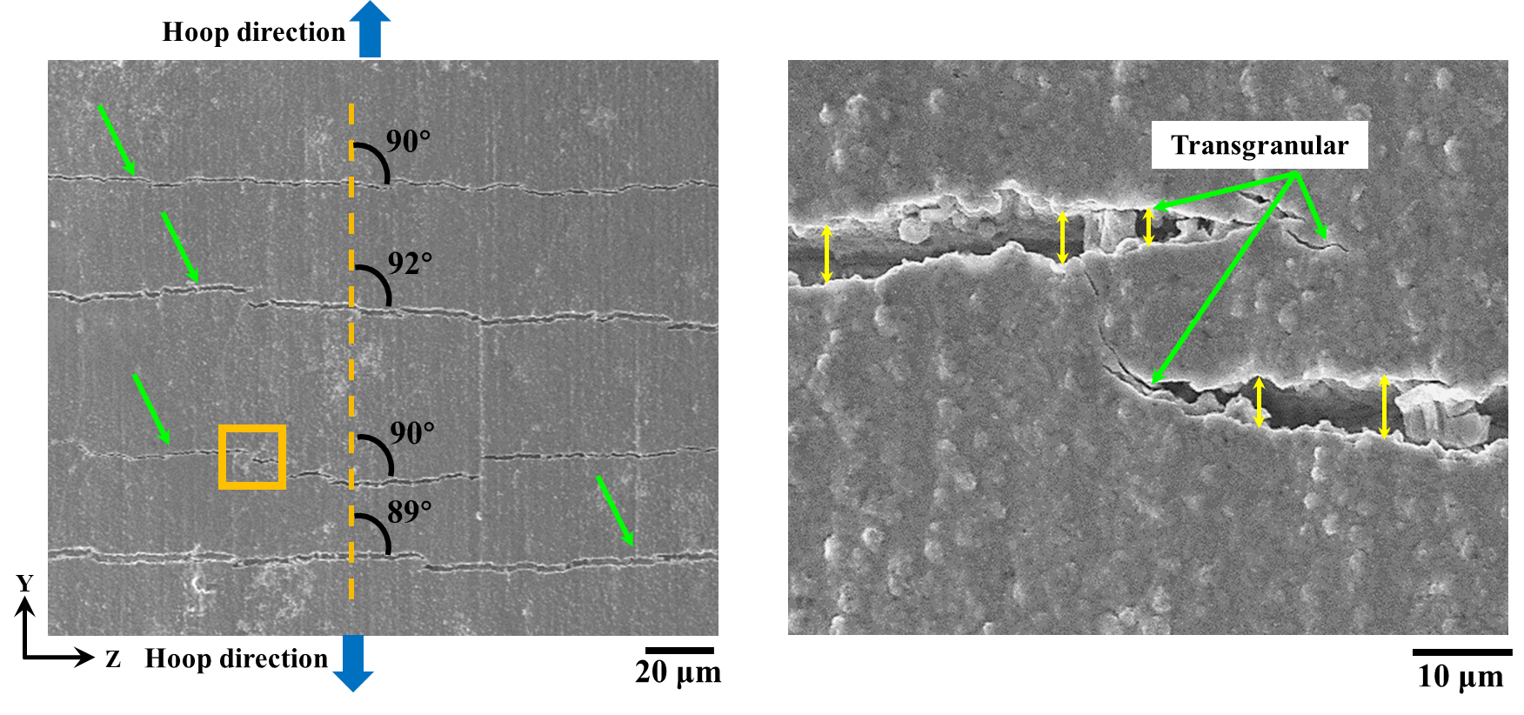
Results: Crack patterns of post-tested materials at 950°C
At 950°C, the average distance between the coating cracks is measured to be 83.7 ± 23.4 μm.
Cracks propagated almost perpendicular to the hoop loading direction (angle range of 89° to 92°)
Transgranular failure mode was found at the crack tips at 950°C
Guanjie Yuan
pl19178@bristol.ac.uk

Slide 24

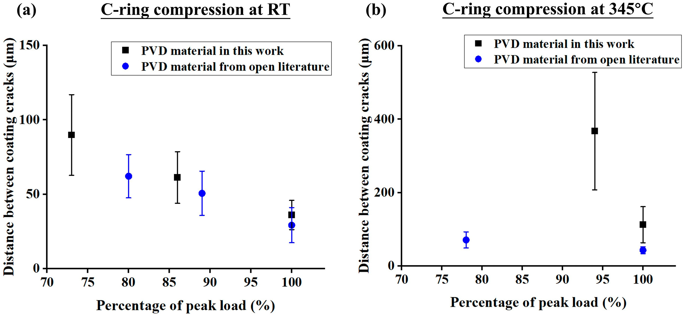
Results: Summary of failure processes at RT and 345°C
At RT and 345°C: brittle failure mode
(i) Initial deformation without formation of coating cracks
(ii) Simultaneous formation of multiple coating cracks, where lower number of cracks formed at 345°C
(iii) Number of coating crack increases with increasing of load, until reaches to saturation at peak load; cracks open up further after peak load but no formation of new cracks.
At 345°C, the increasing of atomic mobility could enhance the ductility of Cr coating, which consequently results in larger crack width and a reduced crack density at peak load ^{[1,2]}
Guanjie Yuan
pl19178@bristol.ac.uk
[1] Guanjie Yuan et al. Materials & Design, 2023, 234: 112373.
[2] Jiang J et al. Surface and Coatings Technology, 2021, 427: 127815.

Slide 25
Results: Summary of failure processes at 650°C and 950°C
At 650°C: ductile failure mode
Once the three coating cracks formed, further loading did not induce the formation of more coating cracks, but increased the width of the existing coating cracks
Brittle-to-ductile transition temperature (BDTT) in the range of 345°C to 650°C
At 950°C: brittle failure mode
At 950°C, recrystallisation of PVD Cr grains could occur, which resulted in the growth of Cr grains
This could caused concentrated stress in each grain, and eventually caused the transgranular cracks and brittle behaviour of the coating ^{[1]}
Guanjie Yuan
pl19178@bristol.ac.uk
[1] Li, Bo, et al. Tungsten 6.2 (2024): 333-341.

Slide 26
Key messages
Local property variations in coating and substrate were potentially attributed to high-temperature recrystallisation, which enlarged grain size and caused coalescence of finer grains, affecting mechanical behaviour
Relaxation of residual stresses at elevated temperatures also likely contributed
Coating failure strain/stress was influenced by microstructure, local properties, and residual stress distributions. Significant strength degradation of the cladding materials was observed at 650°C and 950°C
Temperature-dependent failure processes were investigated at elevated temperatures. At 345°C, coating fractured in a more ductile behaviour, with lower number of cracks (compared with RT).
However, a ductile fracture mode was observed at 650°C, with cracks growing in width rather than number, indicating a brittle-to-ductile transition between 345°C and 650°C.
Coatings fractured brittlely again at 950°C. This could be caused by the increasing of Cr grain sizes during recrystallisation, which concentrated stress in each grain and ultimately led to the brittle behaviour of the coating
Guanjie Yuan
pl19178@bristol.ac.uk

Slide 27
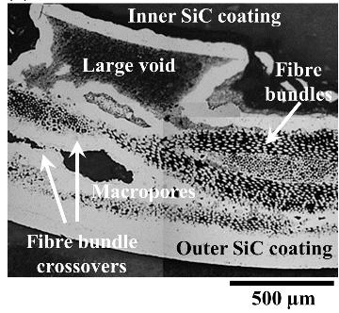
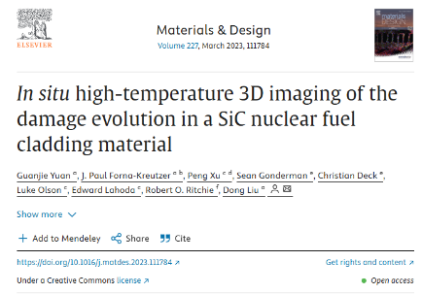
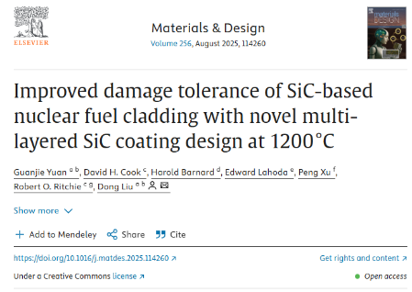
Other research area
SiC CMCs nuclear cladding
Guanjie Yuan
pl19178@bristol.ac.uk

Slide 28



Other research area
Cr-coated Zircaloy nuclear cladding
Guanjie Yuan
pl19178@bristol.ac.uk

Slide 29
Thank you!
Guanjie Yuan
pl19178@bristol.ac.uk
HH Wills Physics Laboratory
Tyndall Ave., Bristol
BS8 1TL
United Kingdom
Technical Meeting on Advanced Technology Fuels (EVT2404561)
Oct 2025

Slide 30
Guanjie Yuan
pl19178@bristol.ac.uk

