Slide 1

Behaviour of Bundles with Cr and Cr/CrN Coated Zirconium Alloy Cladding under Simulating Design Extension Conditions at the DEGREE Facility
CRIEPI
KIT
CTU
Kinya Nakamura, Kenta Inagaki
Juri Stuckert
Martin Ševeček
Technical Meeting on Advanced Technology Fuels: Progress on their Design, Manufacturing, Experimentation,
Irradiation, and Case Studies for their Industrialization, Safety Evaluation, and Future Prospects
28 - 31 October 2025
IAEA Headquater, Vienna, Austria

Slide 2
Outline
  1. Motivation
  2. Contribution to CRP ATF-TS
      A series of SINGLE ROD tests under DEC
      A series of BUNDLE tests under DEC
3. Comparison of degradation behavior
    Specifications of coated Zr-based cladding
    Single rod vs Bundle
4. Conclusions

Slide 3
Motivation
To improve safety, economics, and reliability of LWRs, long-cycle reactor operation is being promoted by combining HBU, IE, and ATFs.
Full-core accident tolerance requires a combination of AT fuel & components such as CR, CB, and GS.
Validation of the accident behavior model in the SA analysis code requires test data of the fuel bundles composed of core structural materials under adiabatic accident conditions.
Potential more intense temperature runaway has been pointed out in fuel bundle systems. ^{*1}
To address these issues, including the still lack of knowledge on degradation behavior, an international collaborative research projects on ATF bundle behavior under DEC is being carried out.
^{*1} M. Steinbrück, et al., JNM 559 (2022) 153470.
International Research Projects on ATF Bundle Behaviors under DEC
FeCrAl | Coated Zr-based alloy
QUECH-19 (2018) | OECD NEA QUENCH-ATF (2021-2026) | IAEA CRP ATF-TS (2021-2024) | EU OFFERR CODEX-ATF-AIT (2024-2025)
First ATF bundle test @QUENCH Ref. QUENCH-15 | Three bundle tests under extended DBA and DEC @QUENCH | Bundle tests and simulation @CODEX and DEGREE | Bundle tests under air @CODEX Ref. CODEX-AIT-3
3

Slide 4
  Significance of Bundle Test in Accident Conditions
Advantages
To provide validation data for SA analysis codes, which can predict degradation behavior taking into account interactions between fuel rods, CR, CB, and GS
Performance evaluation of FA under accident conditions and feedback to FA design and operation guidelines
Technical basis for regulatory authorities and utilities for safety assessment and licensing
Challenges
Reproducibility of degradation behavior and real-time data acquisition using a high-precision-manufactured ATF test bundle under high-temperature and high-pressure thermal-hydraulic conditions
International standardization of test methods and evaluation criteria

Slide 5
  Contribution to CRP ATF-TS from CRIEPI
    To improve knowledge of the degradation behavior of bundles with unirradiated coated Zr-based cladding materials
    A series of SINGLE ROD tests (WT1.1)
    Different types of coating material, its thickness, and cladding substrates
    Heated to 1350-1600˚C
    A series of BUNDLE tests (WT1.2)
      Different types of coating material
      Heated to 1350-1500˚C
      WT2.1 : Benchmark exercise for the DEGREE S3 test
      WT2.2 : Benchmark exercise for the DEGREE B3 test

Slide 6
Test Rod with Coated Zr-based Cladding
Coated Cladding
Structure of the Test Rod
Item | Zircaloy-4 | Opt. ZIRLO | E110
OD / Thickness (mm) | 10.75 / 0.725 | 9.13 / 0.65 | 9.15 / 0.70
Length (mm) | 225 | 225 | 225
Coating material and its thickness (provider) | 10 µm Cr (KIT) 20 µm Cr (CTU) | 20 µm Cr (CTU)
 | 26 µm Cr/CrN double-layer (CTU) |  | 6 µm Cr/CrN multi-layer (AEOI)
Coating method | PVD | PVD | PVD
Coated Zr-based alloy cladding
Annular pellet, Al₂O₃ (1350˚C)
ZrO₂ (1500-1600˚C)
Tungsten rod as susceptor
Gas plenum (He, about 10 cc)
Grid spacer, Al₂O₃
Coated Zr-based alloy cladding
KIT : Karlsruhe Institute of Technology
CTU : Czech Technical University in Prague
AEOI: Atomic Energy Organization of Iran
225 mm
Max. Temperature level
Cross-Sectional Microstructure
16µm Cr
20µm Cr
10µm CrN
End plug
Grid Spacer, Al₂O₃
10µm
      No pre-oxidation
      No pre-hydrogenation
Zry-4
Zry-4
10µm
20 µm Cr (CTU)
26 µm Cr/CrN double-layer (CTU)
Pressure gauge

Slide 7


Bundle Test Facility (DEGREE)
Test Scenario
Experimental Setup
Exhaust
Pre-heating
Conditioning
Heat-up
Cooling
Mass Spectrometry
Reactor vessel
Heater Rod
Test Rod
Condenser
Test bundle
1350 to 1600˚C
Temperature and power output
Water tank
Thermal insulator
(Al₂O₃, ZrO₂)
2-5˚C/s
Single Rod
Furnace cooling without water quenching
Quartz tube
＜600˚C
Induction coil
Boiler
MFC
Induction power output (controlled)
1
2
3
MFC
Heater
8
9
4
7
6
5
Flow rate
Ar 10 L/min
Mass Flow Controller
Steam 0.4 g/s
Ar 2 L/min
Pressure gauge
Bundle
Ar
Time
He
The low-insulation DEGREE facility, applying induction heating technology, allows single rod and bundle testing under DEC.
K. Nakamura, K. Inagaki, Proc. TOP FUEL 2021, Santander, Spain, Oct. 24-28, 2021.

Slide 8
Test Matrix
Single Rod | S1 | S2 | S3 | S4 | S5 | S6
Cladding materials | Zircaloy-4
Coating materials | Uncoated | 10 µm Cr | 20 µm Cr | 26 µm Cr/CrN | 10 µm Cr | 20 µm Cr
Max. temperature | 1350 ˚C |  |  |  | 1600 ˚C
Rod inter. Pressure | 6 MPa
Single Rod | S8 | S9 | S10 | S11 | S12 | S13
Cladding materials | Opt. ZIRLO |  |  | E110
Coating materials | Uncoated | 20 µm Cr | 20 µm Cr | 6 μm Cr/CrN multi-layer |  | Uncoated
Max. temperature | 1350 ˚C |  | 1500 ˚C | 1350 ˚C | 1500 ˚C | 1350 ˚C
Rod inter. Pressure | 6 MPa |  | 0.1 MPa | 6 MPa | 0.1 MPa | 6 MPa
Bundle | B1 | B2 | B3 | B5 | B6 | B7
Cladding materials | Zircaloy-4
Coating materials | Uncoated | 10 µm Cr | 20 µm Cr | 20 µm Cr | 26 µm Cr/CrN | 20 µm Cr
Max. temperature | 1350 ˚C |  |  |  |  | 1500 ˚C
Rod inter. pressure | 6 MPa | 0.1 MPa | 6 MPa | Two rods with 6 MPa & the rest with 0.1 MPa
      Fuel pitch: 14.5 mm for Zry-4 and 12.6 mm for OZ & E110

Slide 9
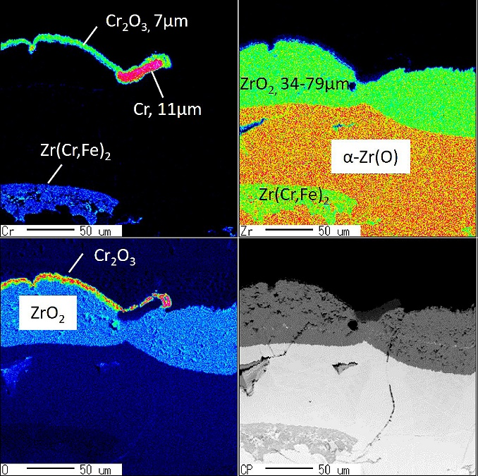
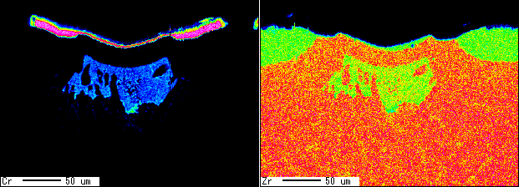
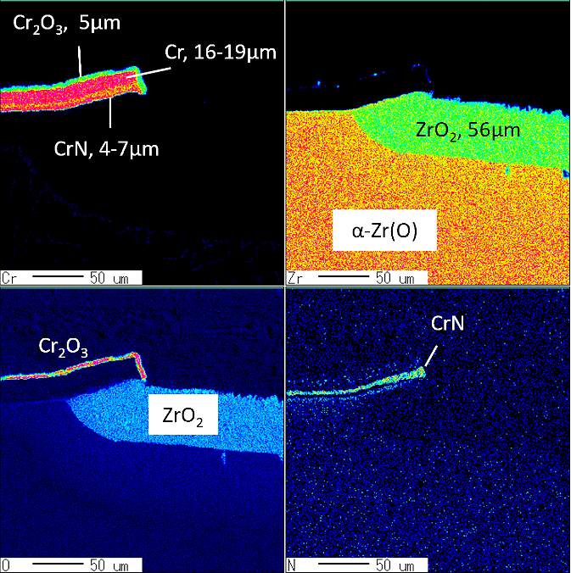
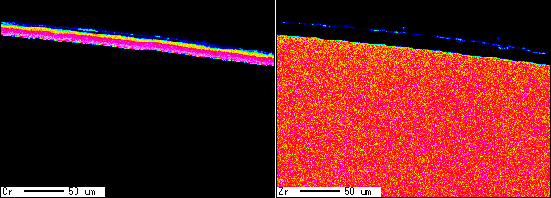
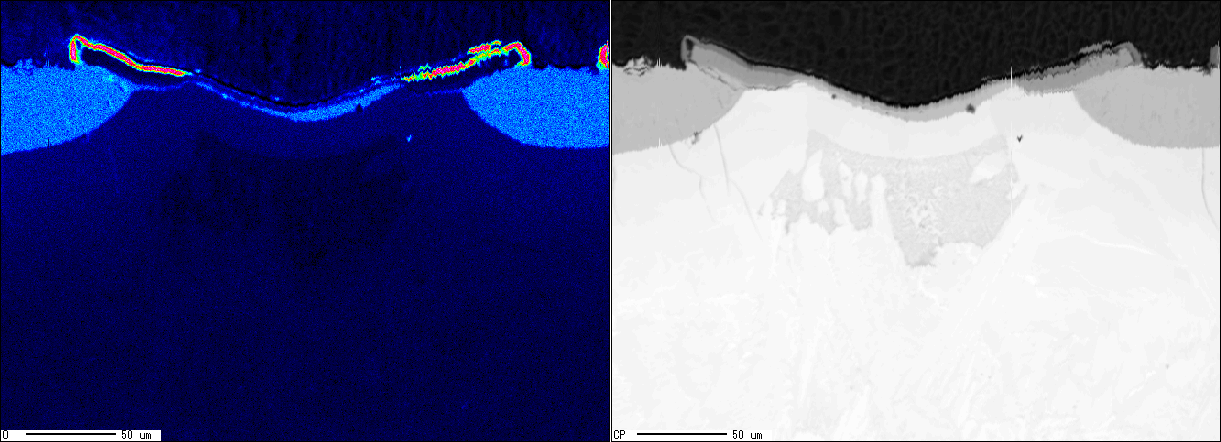
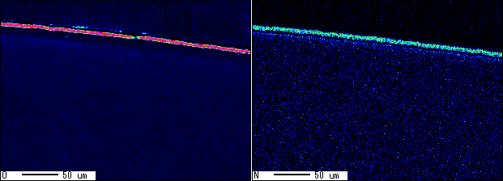
  Comparison of Degradation Behavior
  Microstructure Heated to 1350˚C
Observation Region
Circumferential cross sections
0 - 6 mm above burst opening
Single Rod
  Zircaloy-4
  Opt. ZIRLO
  Zircaloy-4
  E110
20 µm Cr (S3)
20 µm Cr (S9)
26 µm Cr/CrN (S4)
6 µm Cr/CrN (S11)
Cr
Zr
Cr
Cr₂O₃
Zr
Cr
Zr
Cr
Zr
Cr
ZrO₂
Zr(Cr,Fe)₂
Zr(Cr,Fe)₂
O
Cr₂O₃
BSE
O
N
ZrO₂
O
BSE
O
N
along the burst side
90 degree circumferential direction from the burst
along the burst side
90 degree circumferential direction from the burst
Cr coating Formation of ZrCr₂ at the α-Zr(O)/β-Zr interface and disappearance of Cr layer
Cr/CrN coating No formation of ZrCr₂ and remaining both Cr and CrN layers
Suggest that Inner CrN layer suppresses Cr & O inward diffusion and Zr outward diffusion

Slide 10
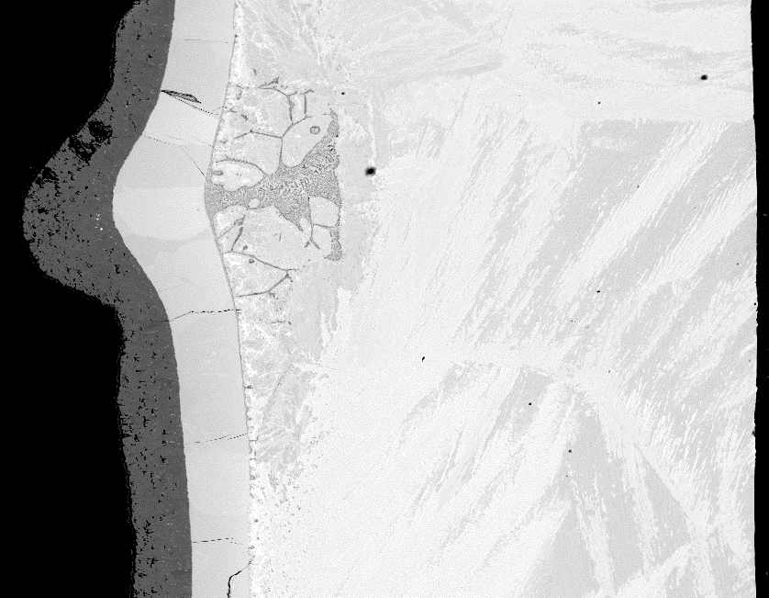
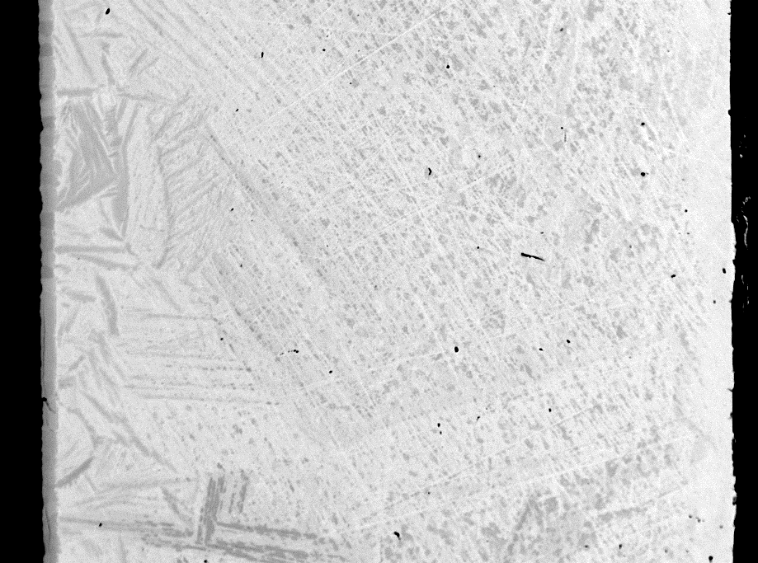
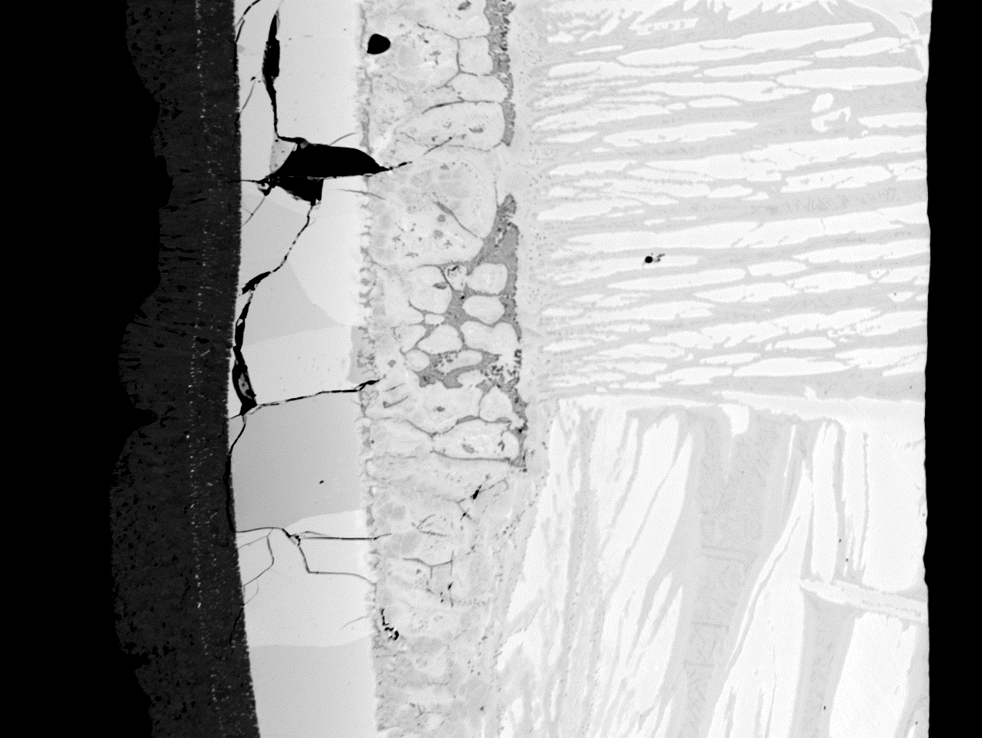
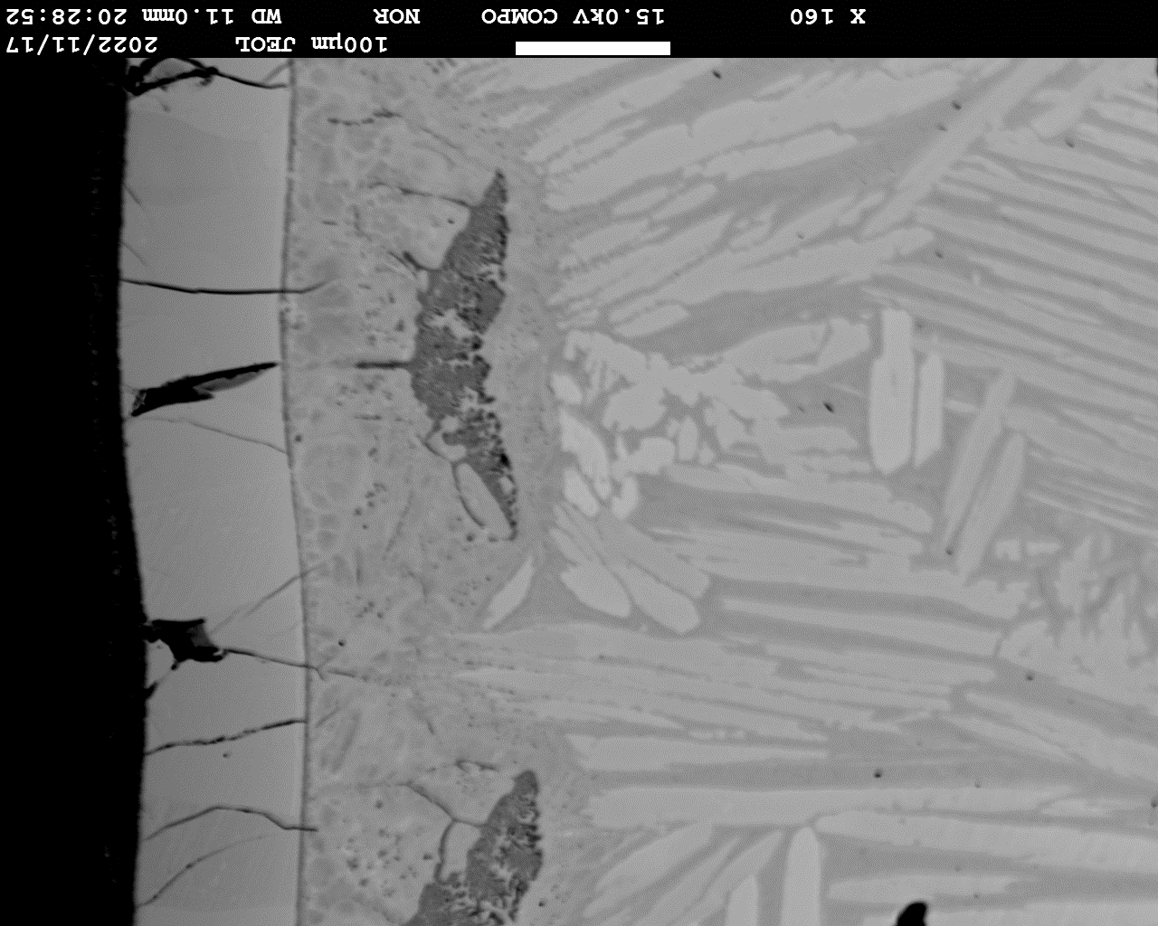
  Comparison of Degradation Behavior
  Microstructure Heated to 1500˚C or 1600˚C
Observation Region
longitudinal cross sections
24 mm above the burst
Single Rod
  Zircaloy-4
  (RIP = 6 MPa, 1600˚C)
  Opt. ZIRLO
  (RIP = 0.1 MPa, 1500˚C)
  E110
  (RIP = 0.1 MPa, 1500˚C)
10 µm Cr (S5)
20 µm Cr (S6)
20 µm Cr (S10)
6 µm Cr/CrN (S12)
Cr/Cr₂O₃
α-Zr(O)
Cr diffusion zone
Cr₂O₃/Cr
Cr diffusion zone
Cr₂O₃/Cr
Cr diffusion zone
ZrO_{2-x}
ZrO_{2-x}
α-Zr(O)
ZrO_{2-x}
α-Zr(O)
prior β-Zr
prior β-Zr
prior β-Zr
prior β-Zr
728 HV
391 HV
438～261 HV
435 HV
Invisible due to high contrast
Invisible due to high contrast
External
External
External
External
Sn-rich region
Liquid→ZrCr₂+ β-Zr
Upward
Upward
Upward
Upward
100 µm
100 µm
100 µm
100 µm
Localized large strain due to formation of Cr-diffusion zone and liquefaction at the α-Zr(O)/prior β-Zr interface regardless of RIP
Significant inward diffusion of Cr & O and outward diffusion of Zr resulting in formation of interdiffusion structures including Cr-Zr eutectic melt
Increasing trend of microhardness in the outward direction ( in BSE image of S6)
Negligible inward diffusion of Cr & O leading to no formation of Cr diffusion zone

Slide 11
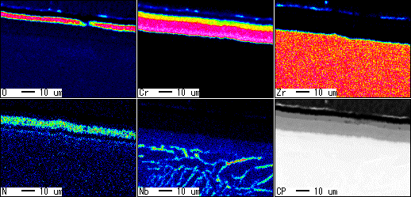
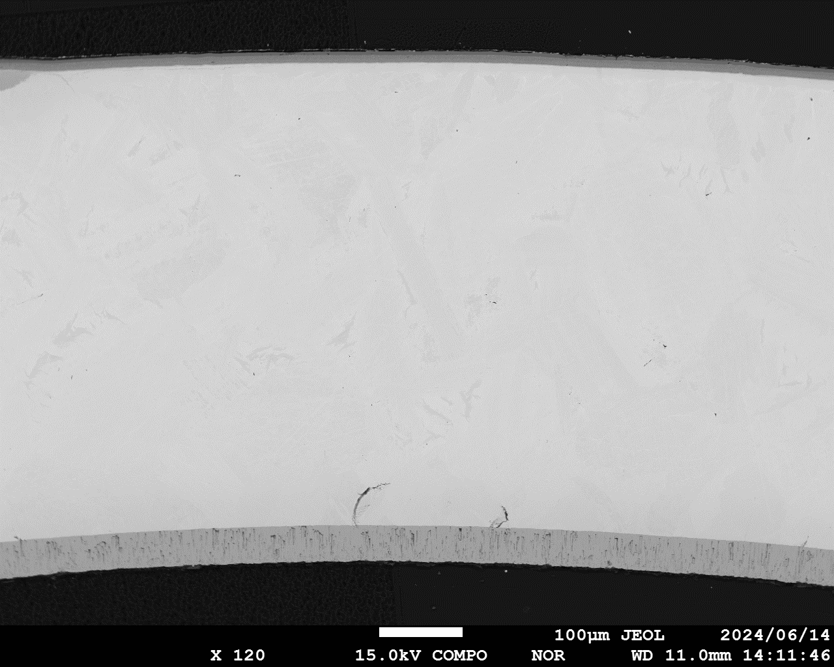
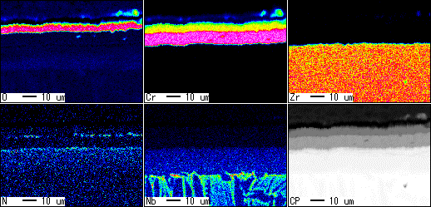
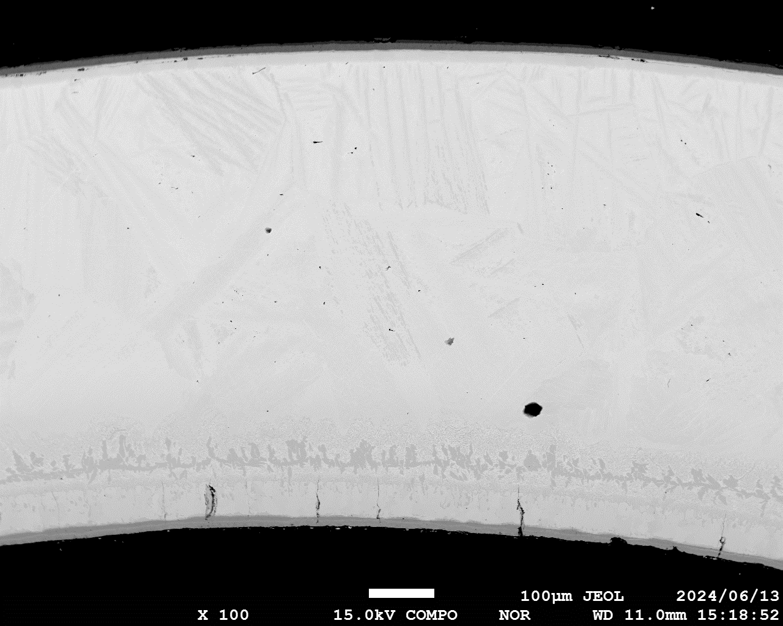
  Comparison of Degradation Behavior
  Microstructure of Multi-layer Cr/CrN Coated E110
Single Rod
  1350˚C
  RIP 6 MPa (S11)
Cr₂O₃
Cr₂O₃
Observation Region
  Burst level
  90 degrees circumferentially from the burst opening
CrN
Cr metal
CrN
  Initially, 20 nm each of Cr and CrN alternately deposited to form a multi-layer Cr/CrN with a total 6 μm
  Transformed into another three layers: Cr₂O₃/CrN/Cr below 1350˚C
  The CrN layer, which is likely to retard the inward diffusion of oxygen, reduces in thickness at HT to form Cr metal.
  Parts of nitrogen diffuses inward to form nitrogen/oxygen-stabilized α-Zr(N,O), which is likely to retard the inward diffusion of Cr and the outward diffusion of Zr.
α-Zr(N,O)
Nitrogen band
α-Zr(N,O)
Prior β-Zr
  1500˚C
  RIP 0.1 MPa (S12)
Cr₂O₃
Cr₂O₃
CrN
CrN
Cr metal
Nitrogen band
CrN
α-Zr(N,O) to α-Zr(O) inward
α-Zr(N,O)
Prior β-Zr

Slide 12
  Comparison of Degradation Behavior
  Hydrogen Concentration Distribution in Cladding
Single Rod
Vertical Distribution of Hydrogen Concentration Absorbed in the Cladding
Radial Distribution of Hydrogen Concentration at 24 mm above the Burst Opening (S6)
Hydrogen concentration (ppm)
Hydrogen concentrates in the Cr diffusion zone and in the α-Zr layer that has transformed from the prior β-Zr layer.
Distance from the burst opening (mm)
obtained by ToF-SIMS

Slide 13
Comparison of Degradation Behavior
3×3 Bundle Tests
Bundle
Time history of the B6 test (Cr/CrN coated Zry-4, T_{max} 1350˚C )
Layout of Bundle
1
2
3
RIP 6 MPa No. 4 and No.8
8
9
4
RIP 0.1 MPa others
7
6
5
Identical test conditions for bundle tests B5, B6, and B7
  Pressurized/non-pressurized fuel rod layout
  12 Thermocouple mounting positions (8 R-type and 4 K-type)
  T_{max} 1350 or 1500˚C

Slide 14
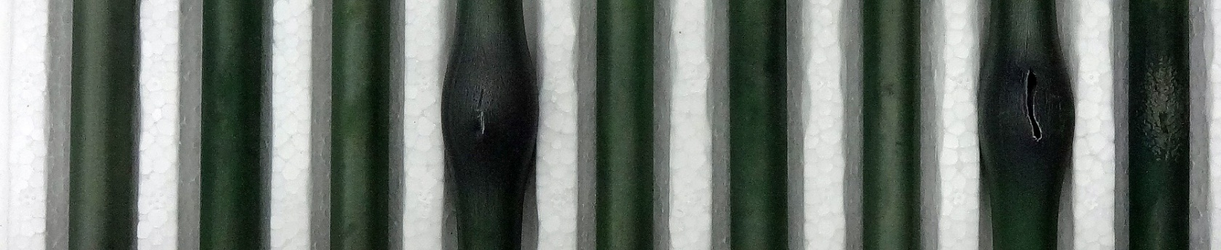
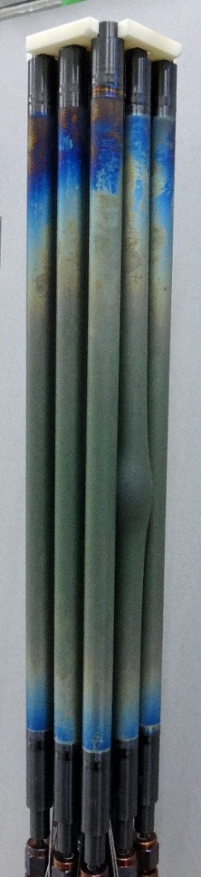
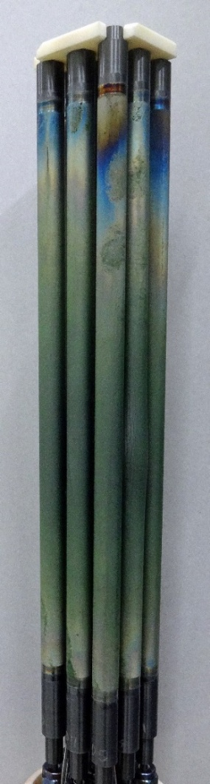
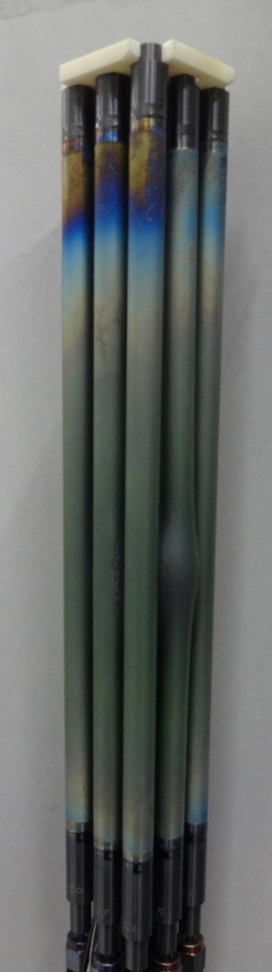
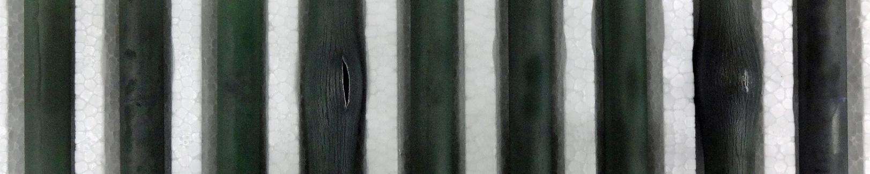
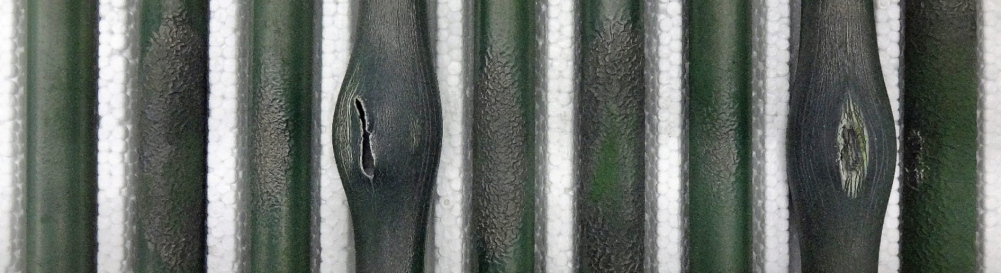
Comparison of Degradation Behavior
Overview of Post-Tested Bundle
Bundle
Pressurized Rods
B5
20µm Cr
1350˚C
B6
Cr/CrN
1350˚C
B7
20µm Cr
1500˚C
1
2
3
4
5
6
7
8
9
B5
B6
B7

Slide 15
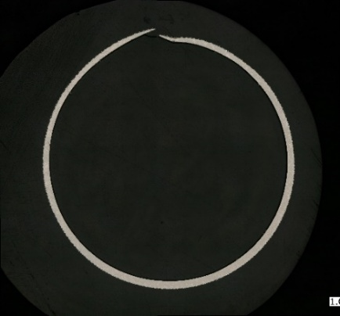
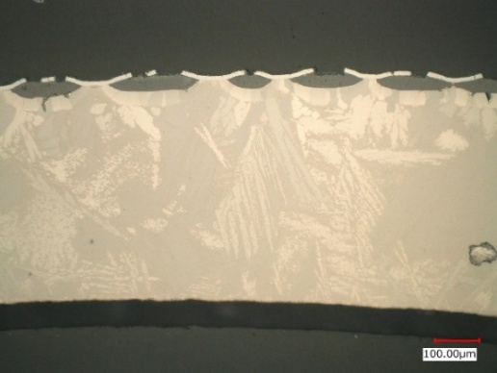
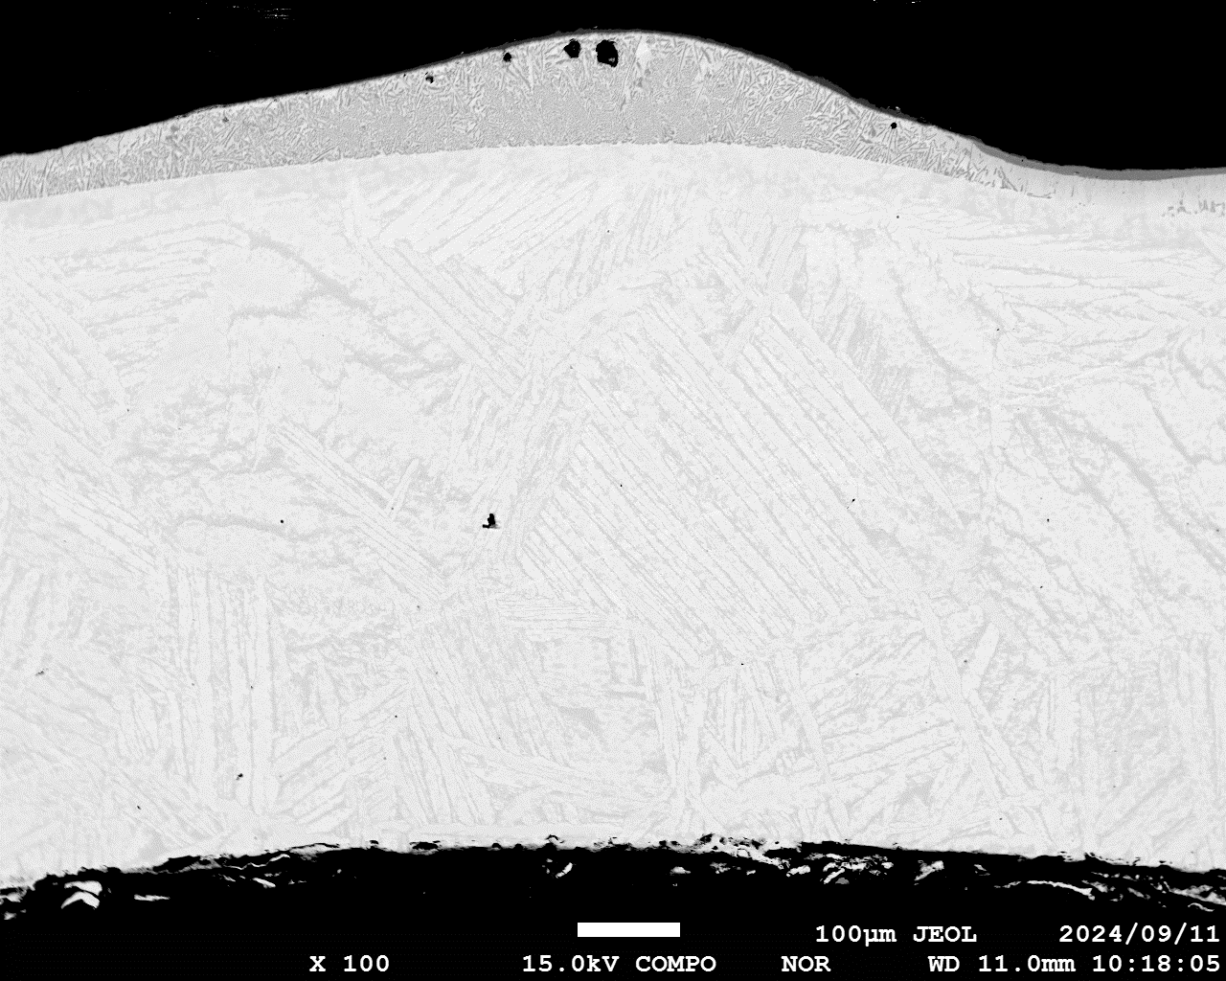
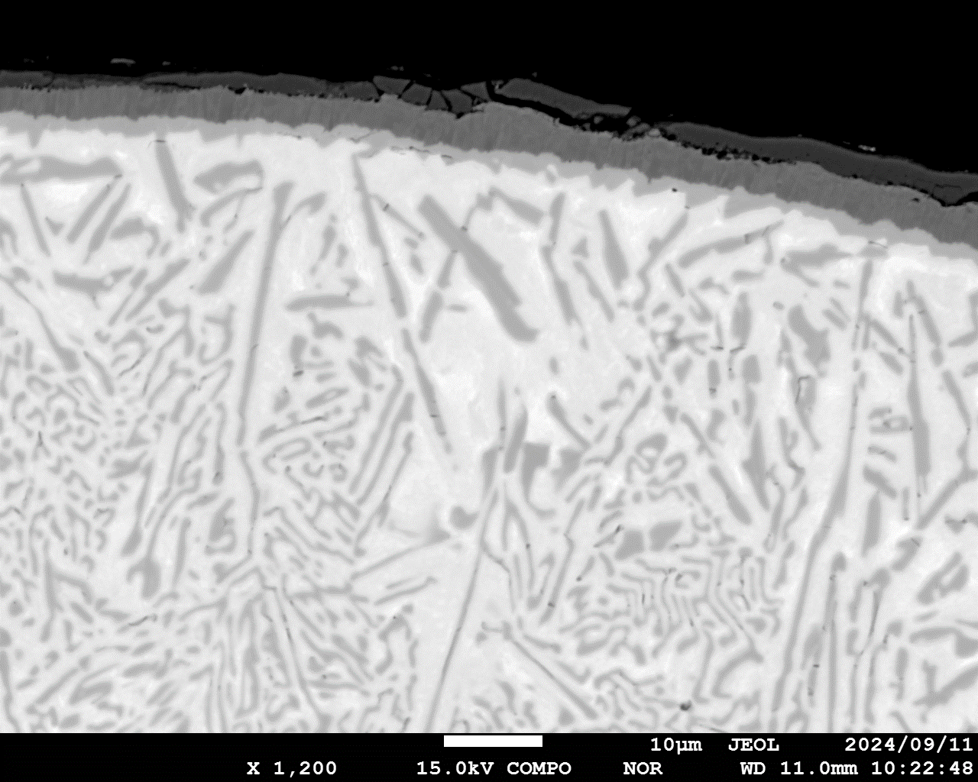
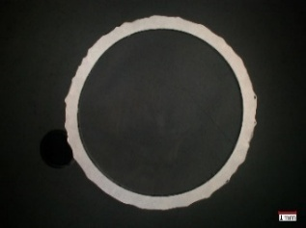
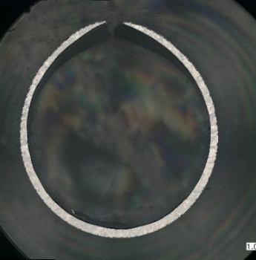
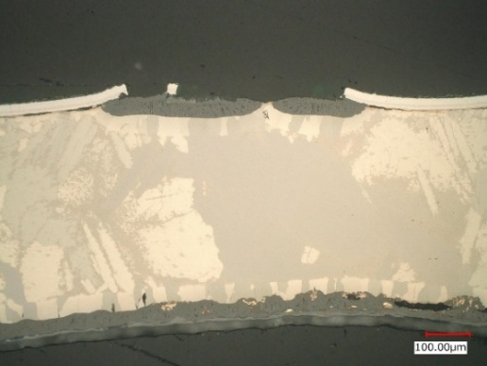
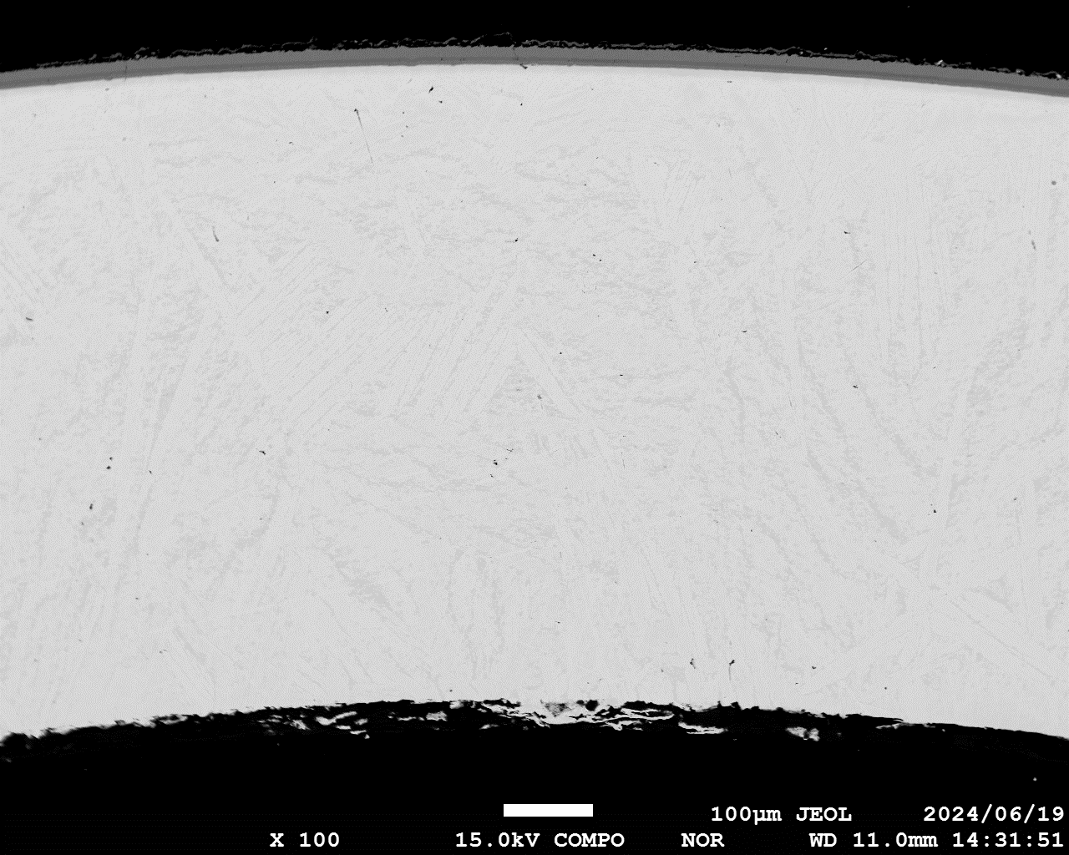
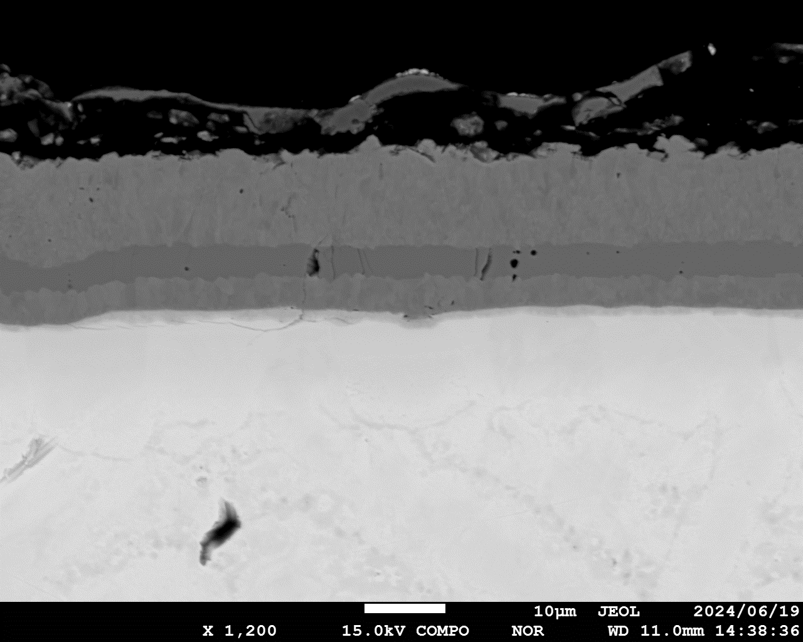
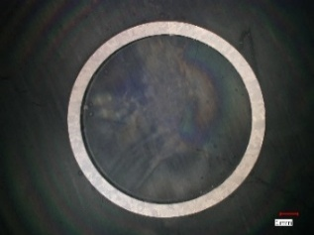
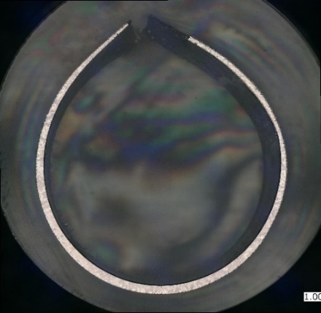
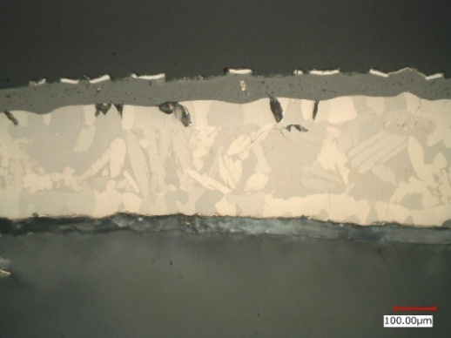
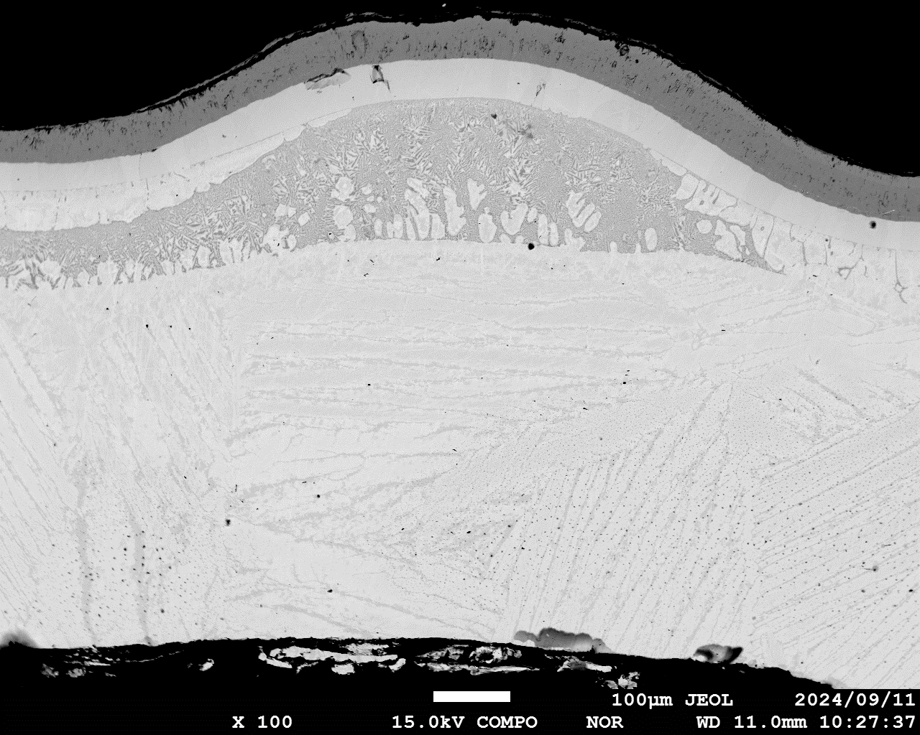
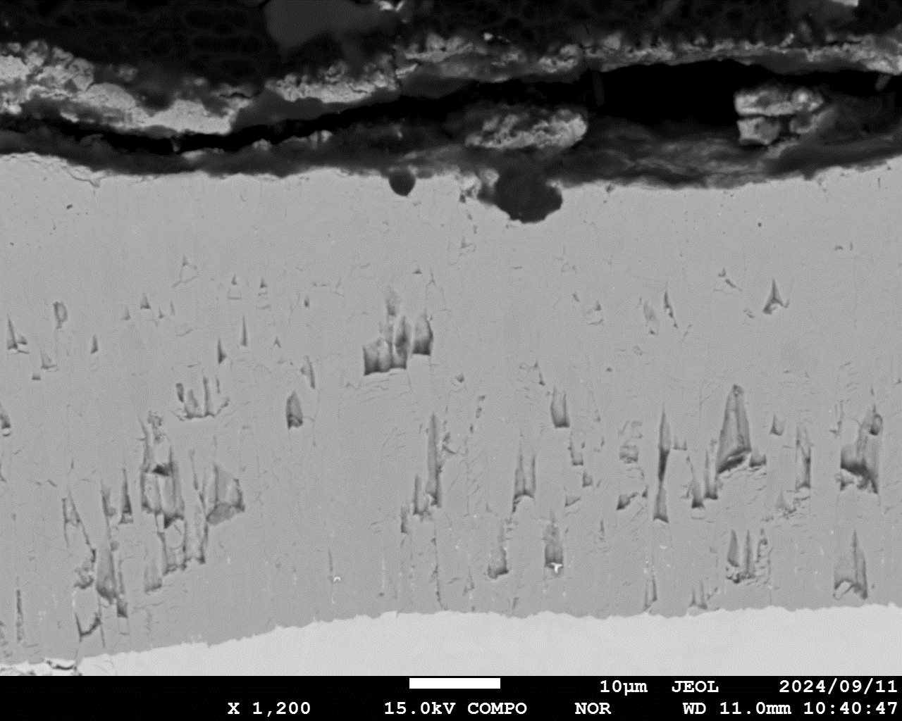
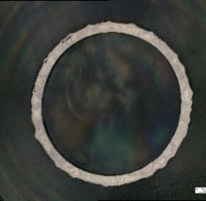
Comparison of Degradation Behavior
Cross Section at Burst Level
Bundle
Pressurized Rods (No. 4, RIP 6 MPa)
Unpressurized Rods (No. 9, RIP 0.1 MPa)
void
Cr₂O₃
B5
20µm Cr
1350˚C
Cracking of Cr₂O₃/Cr layer
Cr
ZrCr₂
B5
α-Zｒ(O)
ZrO₂
α-Zｒ(O)
Large hoop strain
Cr diffusion zone
(Liquid at HT)
prior β-Zr
prior β-Zr
B6
Cracking of Cr₂O₃/Cr layer
B6
Cr/CrN
1350˚C
Relatively large hoop strain
ZrO₂
α-Zｒ(O)
Next slide
prior β-Zr
prior β-Zr
Prior β-Zr
B7
20µm Cr
1500˚C
B7
Cracking of Cr₂O₃/Cr layer
Cr₂O₃
ZrO₂
α-Zｒ(O)
ZrO₂
α-Zｒ(O)
Large hoop strain
prior β-Zr
Cr diffusion zone (Liquid at HT)
prior β-Zr
ZrO₂
ZrO₂ layers connected in the circumferential direction
α-Zｒ(O)

Slide 16
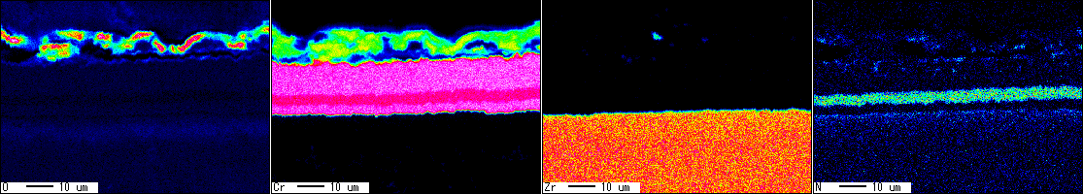
Comparison of Degradation Behavior
Cross Section of Double-Layer Cr/CrN Coated Zry-4, 1350˚C
Bundle
Central Rod No. 9 at Burst Level (B6)
BSE Image
Elemental Map
O
Cr₂(O,N)₃
Cr
Cr₂(O,N) ₃
Zr
N
Nitrogen band
Cr
CrN
CrN
Cr
α-Zr(N,O) to
α-Zr(O,N) inward
Oxygen band
prior β-Zr (substrate)
The double-layer Cr/CrN was transformed into a four-layer structure Cr₂O₃/Cr/CrN/Cr.
The CrN layer was thinned from the original 10 µm to 4 µm.
Formation of nitrogen-dissolved layers: likely Cr₂(O,N)₃ outward and α-Zr(N,O) inward.
These layers appears to suppress the inward diffusion of Cr and O, and the outward diffusion of Zr.
Similar microstructures are seen in the region at least 18 mm above the burst level.
Expected properties of double-layer and multi-layer Cr/CrN coatings
  Suppressing circumferential strain,
  Reducing the oxidation kinetics, and
  Retarding liquefaction due to the Cr-Zr eutectic.

Slide 17
Comparison of Degradation Behavior
Single Rod vs Bundle
Single Rod
Bundle
Burst Temp. and Hoop Strain
Burst Opening Size
Zircaloy-4
OZ
E110
Zircaloy-4
1
2
3
Zircaloy-4
OZ
E110
Zircaloy-4
8
9
4
uncoated
10 µm Cr
20 µm Cr
Cr/CrN
uncoated
10 µm Cr
10 µm Cr
20 µm Cr
Cr/CrN
10 µm Cr
20 µm Cr
uncoated
20 µm Cr
Cr/CrN
uncoated
20 µm Cr
20 µm Cr
Cr/CrN
Cr/CrN
20 µm Cr
20 µm Cr
20 µm Cr
uncoated
20 µm Cr
Cr/CrN
uncoated
20 µm Cr
20 µm Cr
Cr/CrN
Cr/CrN
20 µm Cr
20 µm Cr
7
6
5
Single Rod
Bundle
Single Rod
Bundle

Slide 18
  Conclusions
  In the IAEA CRP ATF-TS, series of single rod and bundle tests were successfully carried out using the DEGREE facility, where three types of fuel claddings coated with Cr or Cr/CrN, were heated up to 1600˚C in a steam-Ar mixed atmosphere under simulated DEC.
  The interdiffusion layer structure formed at the interface between coating and Zr alloy substrate, the radial and vertical redistribution of the constituent elements, the radial profile of the microhardness, and the ballooning and bursting behaviour were clarified.
  The accident behaviours of the different coating materials, their thicknesses, and cladding substrates, as well as between single rod and bundle tests, were also discussed.
For the Cr coating, the Cr₂O₃ diffusion barrier effect is deteriorated at high temperatures due to cracking in the coating layer, interdiffusion of the components, liquefaction due to Cr/Zr eutectic etc.
For the Cr/CrN coating, regardless of whether it was a double- or multi-layer, the hoop strain was relatively small, and the CrN layer might suppress the interdiffusion of the components, and the diffusion barrier effect was likely to be improved at high temperatures compared with the Cr coating.
Some experimental data were provided for benchmark exercise and uploaded to the ‘IAEA Fuel and Materials Database’.
No temperature runaway was observed under the DEGREE’s low-insulation conditions.

Slide 19
  Outlook for Future CRP on ATF
Expansion of ATF Bundle Test Data under DEC Based on Internationally Standardized Test Methods and Evaluation Criteria
    Reproducibility and repeatability
    High-precision-manufactured ATF test bundle
    Acquisition of lots of experimental data in real time under high-temperature and high-pressure thermal-hydraulic conditions
    Universal test data independent of test equipment
    Limitations of simulating real accident environmental conditions
Improvement of SA analysis code through benchmarking exercises using new or existing ATF bundle test data
19

Slide 20


Acknowledgment
Thank you for your attention!

