Slide 1
Scientific Secretary’s introduction
Technical Meeting on Advanced Technology Fuels: Progress on their Design, Manufacturing, Experimentation, Irradiation, and Case Studies for their Industrialization, Safety Evaluation, and Future Prospects
IAEA Headquarters, Vienna, Austria
28 – 31 October 2025
Anzhelika Khaperskaia, Technical Lead NFCMS /NEFW, IAEA

Slide 2
Technical Meeting on Advanced Technology Fuels, 28 – 31 October 2025
108 experts
40 MSs
2 IOs (OECD Nuclear Energy Agency NEA and EU: JRC)
China
Czech Republic
Egypt
France
Germany
Iran
Italy
Korea
Pakistan
Russian Federation
Slovakia
United Kingdom
United States of America
Algeria
Argentina
Armenia
Bangladesh
Belarus
Belgium
Brazil
Bulgaria
Ethiopia
Finland
Hungary
Japan
Jordan
Kazakhstan
Nigeria
Poland
Romania
Slovenia
Spain
Switzerland
Thailand
Türkiye
Ukraine
Uzbekistan
Viet Nam
Zimbabwe
2

Slide 3

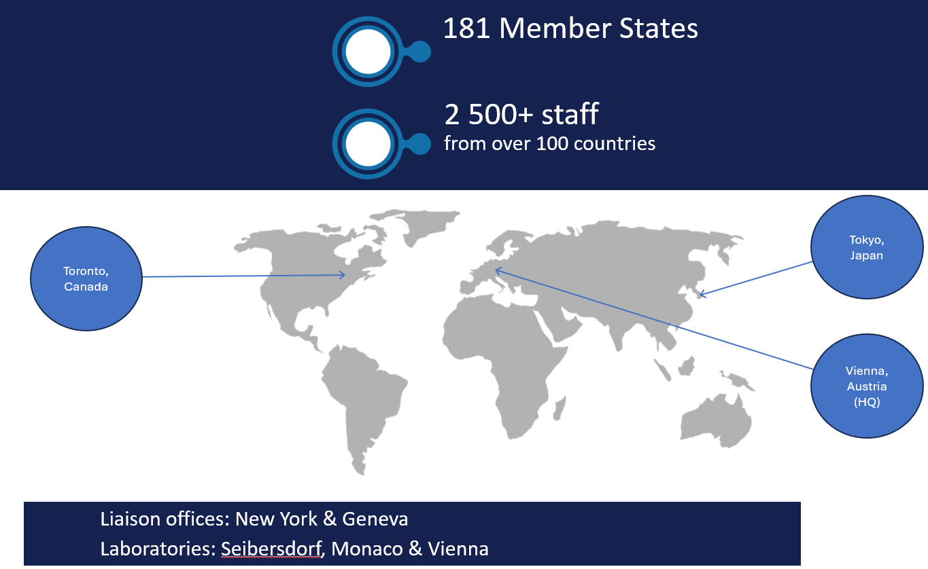
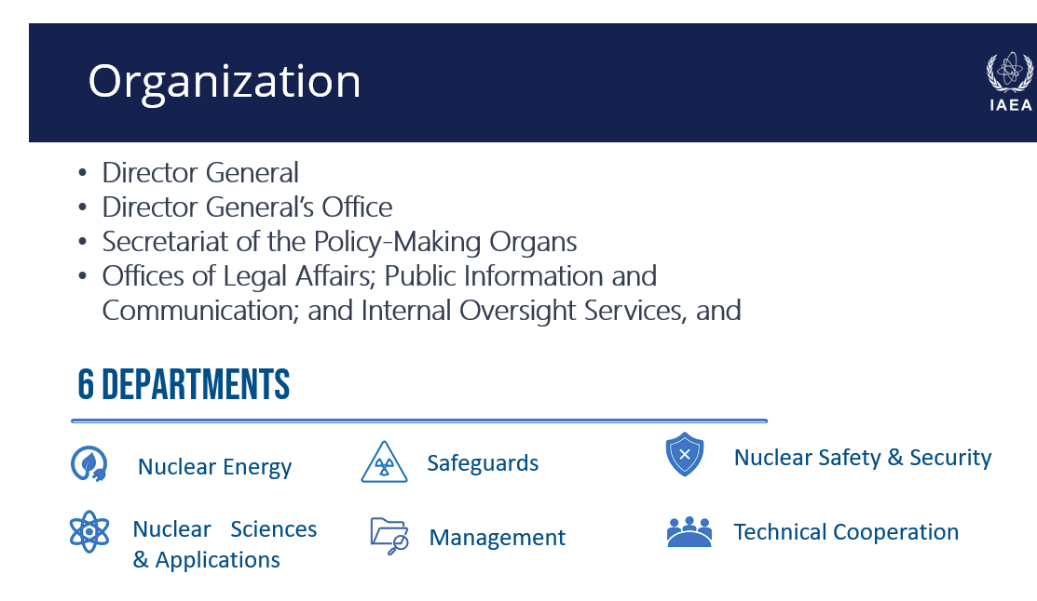
IAEA at a Glance

Slide 4
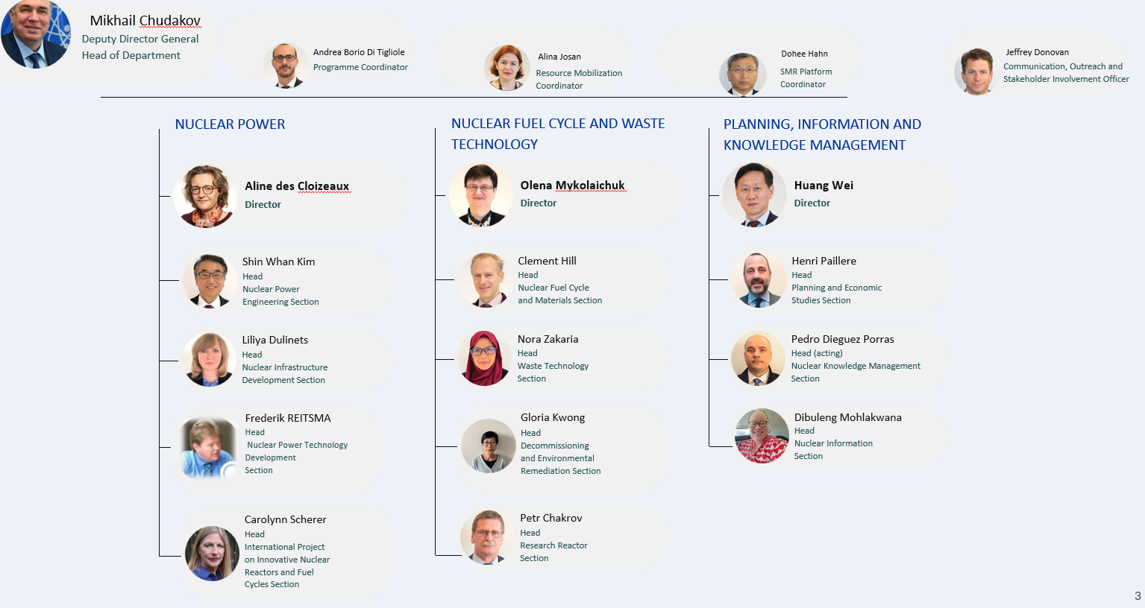
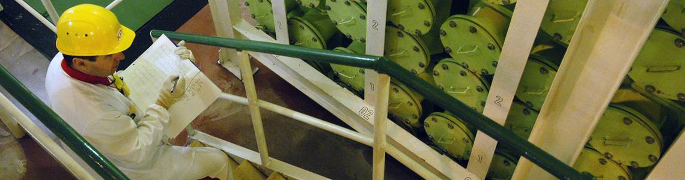
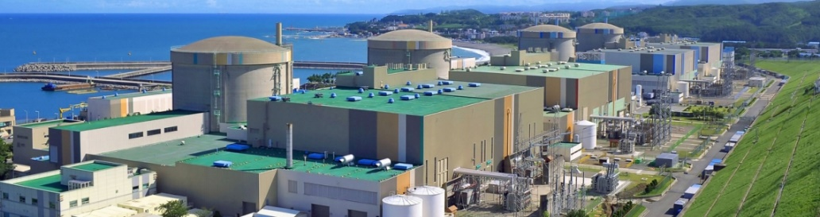
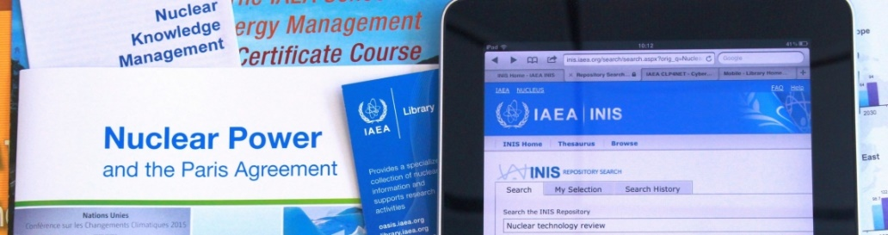
Department of Nuclear Energy (NE)
Nuclear Fuel Cycle and Waste Management
Nuclear Power
Planning, Information and Knowledge Management
Fosters sustainable nuclear energy development by supporting existing and new nuclear programmes around the world.
Provides technical support on the nuclear fuel cycle and the life cycle of nuclear facilities, and builds indigenous capability in energy planning, analysis, and nuclear information and knowledge management.
4

Slide 5
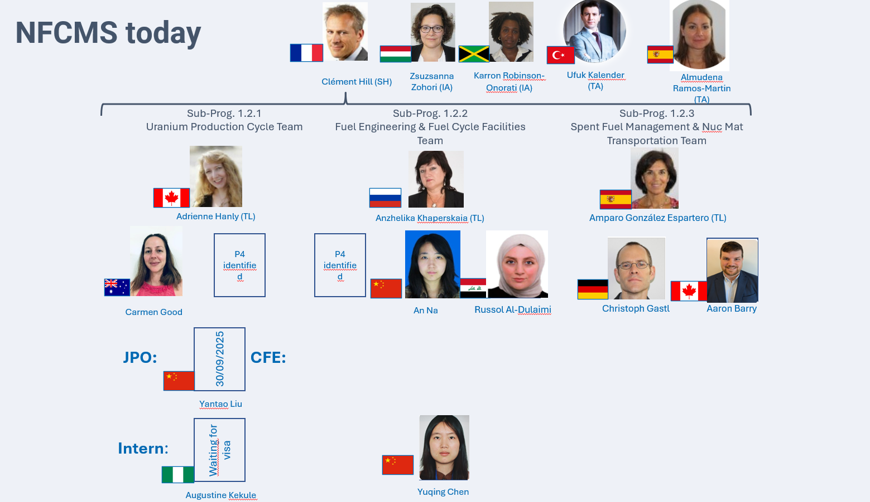
Nuclear Fuel Cycle and Materials Section (NFCMS)
Division of Nuclear Fuel Cycle and Waste Technology (NEFW)
NE
NS
NA
TC
SG
MT
RRS
WTS
UPC Team
Project 1.2.2.001 Nuclear Power Reactor Fuel Engineering and Operation: Support Member States (MSs) to understand and address factors affecting the design, fabrication and in-pile behaviour of currently operating and innovative nuclear fuels and materials for power reactors.
NFCMS
NFE Team
Project 1.2.2.002 Fuel Cycle Facilities Operation and Life Management : Support MSs to technically implement IAEA Safety Standards when operating or upgrading existing nuclear fuel cycle facilities, and to understand and address factors affecting the ageing of these facilities
DERS
SFM Team
5

Slide 6
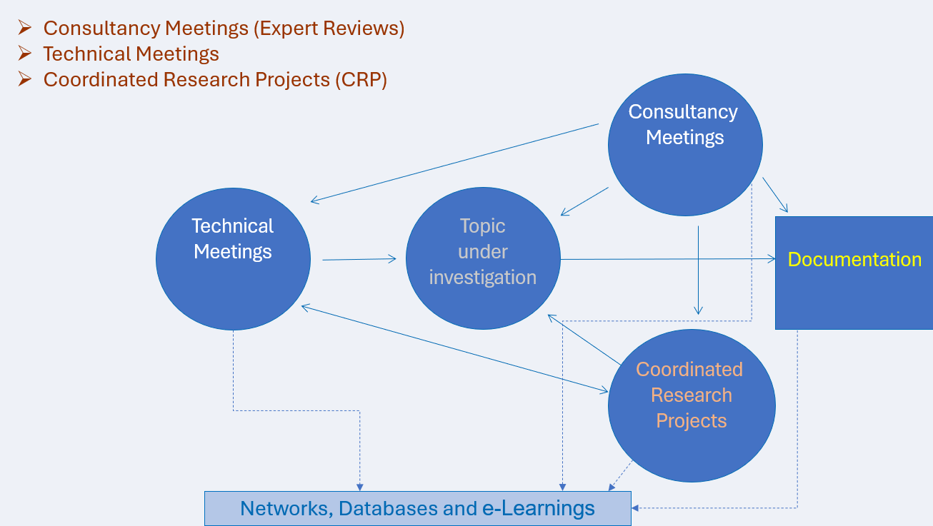
IAEA Sub-Programme 1.2.2:
Nuclear Power Reactor Fuel and Fuel Cycle Facilities
  Organizing IAEA meetings and developing IAEA publications
  Coordinating research activities (CRPs)
  Maintaining databases (NFCFs, PIE: Integrated Nuclear Fuel Cycle Information System - IAEA INFCIS), IAEA Fuel and material database (The IAEA Fuel and Material Database - IAEA Data Platform) and NFC simulation tools (NFCSS: Nuclear Fuel Cycle Simulation System (NFCSS))
  Developing e-Learning Materials on nuclear fuel and PIE: OPEN-LMS: All courses
  Building up Networks among experts (NFE-Net): Pages - NFE Net
  Supporting the IAEA Technical Cooperation Programme
To foster collaboration and information exchange, provide reference data, preserve knowledge, and capacity building
6

Slide 7
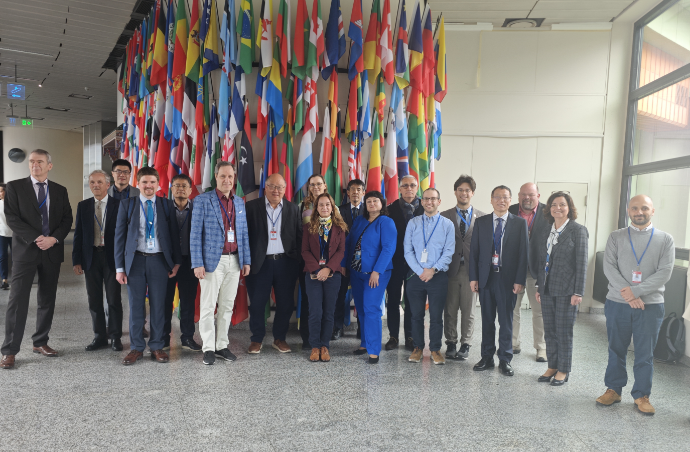
Technical Working Group on Fuel Performance and Technology (TWG-FPT)
TWG FPT is a group of recognized experts from MSs providing advice to DDG-NE and supporting programme implementation, reflecting a global network of excellence and expertise in nuclear power reactor fuel engineering
20 Member States (Argentina , Belgium, Brazil, Canada, China, Finland, France, Hungary, India, Japan, Pakistan , RoK, Romania, Russia, South Africa , Spain, Sweden, UK, Ukraine, USA).
TWG-FPT Meeting, 15–17 April 2025
TWG-FPT focuses on nuclear fuel and materials technologies with an emphasis on:
- Status and trends in nuclear power reactor fuel technology and performance
- Nuclear core materials research and development, including fuel design, manufacturing, and quality assurance issues, fuel utilization, coolant chemistry, and fuel performance analysis
with consideration for: Safety, Economy, Management systems, Nuclear science, Nuclear power plant operations

Slide 8
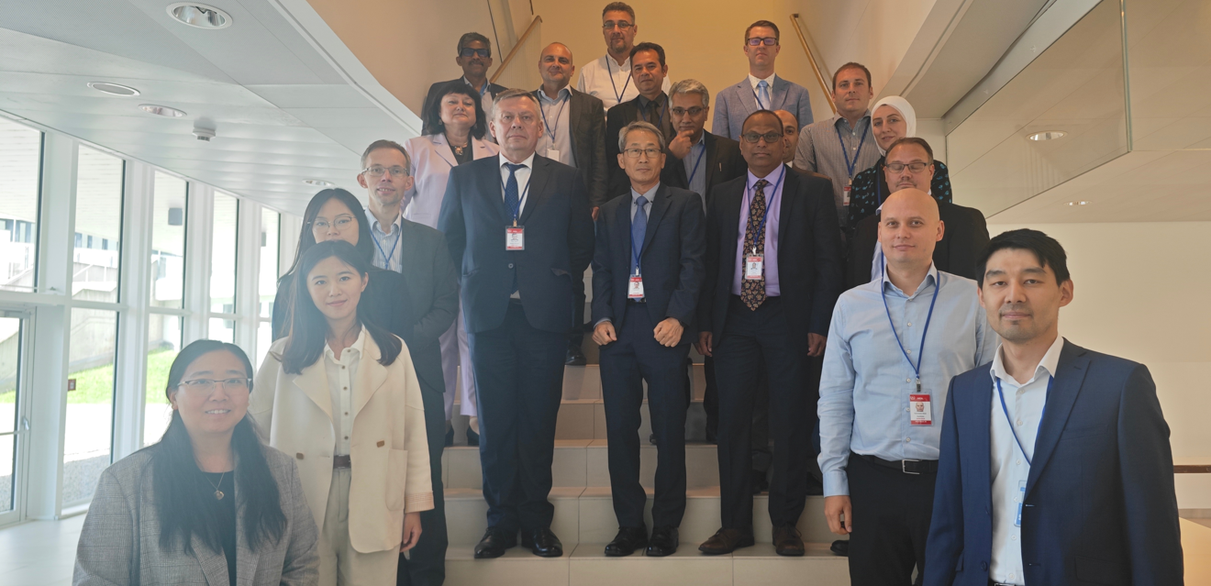
Technical Working Group on Fuel Cycle Facilities (TWG-FCF)
TWG FCF is a group of recognized experts from MSs providing advice to DDG-NE and DDG-NS and supporting programme implementation, reflecting a global network of excellence and expertise in NFCFs operation areas
20 Member States (Argentina , Belgium, Brazil, Canada, Egypt , France, Germany , India, Japan, Kazakhstan, Netherlands, RoK, Russia, South Africa , Spain, Sweden, UK, Ukraine, USA).
TWG-FCFs focuses on:
- status and trends in nuclear fuel cycle facilities (NFCFs) operation areas, including operating experience, optimization, ageing management, long term operation, refurbishment, modernization, and use for capacity building.
- covers fuel cycle facilities from milling to fuel fabrication, through conversion, enrichment, and re-conversion, as well as nuclear research and development (R&D) related fuel cycle facilities (such as research laboratories, Post Irradiation Examination facilities, etc.).
- with consideration for: Safety, Economy, Management systems
TWG-FCF Meeting, 17-20 June 2025

Slide 9
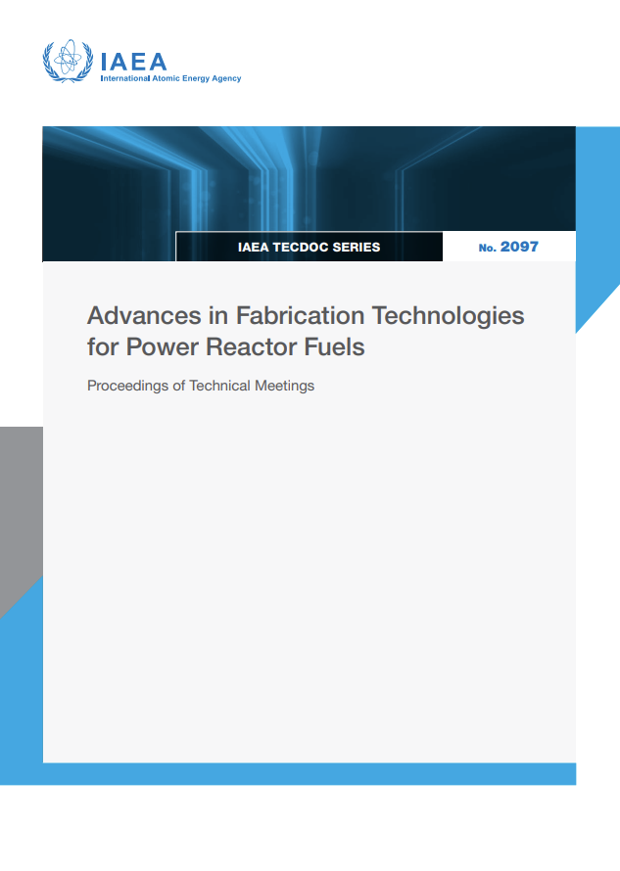
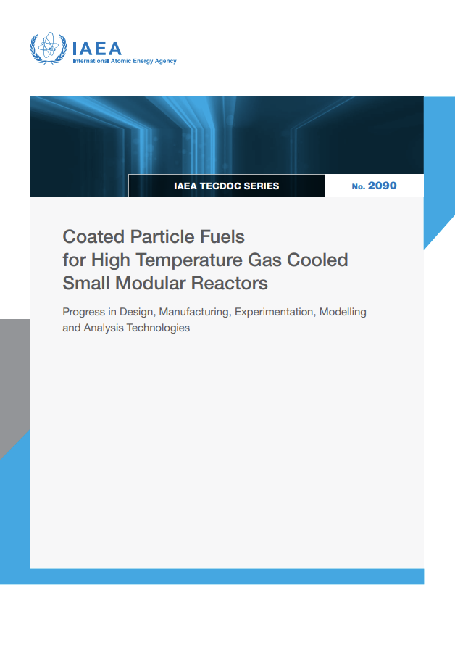
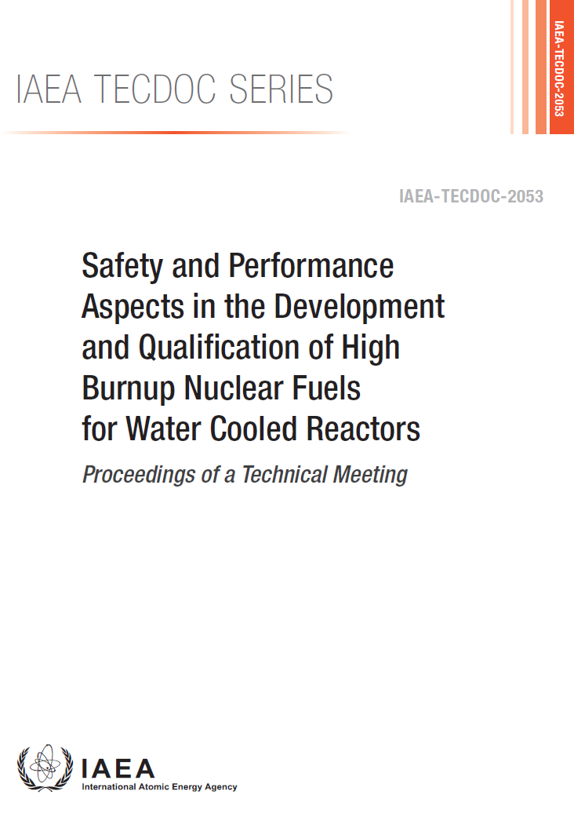
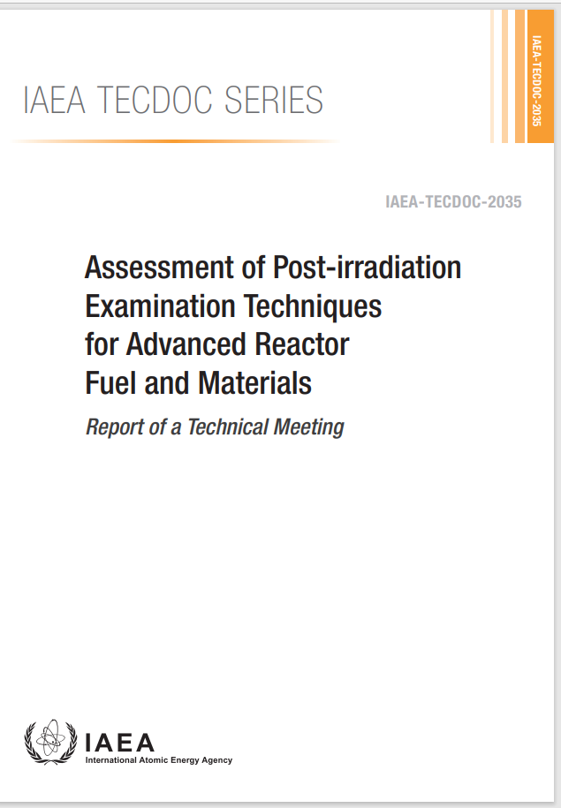
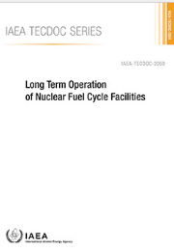
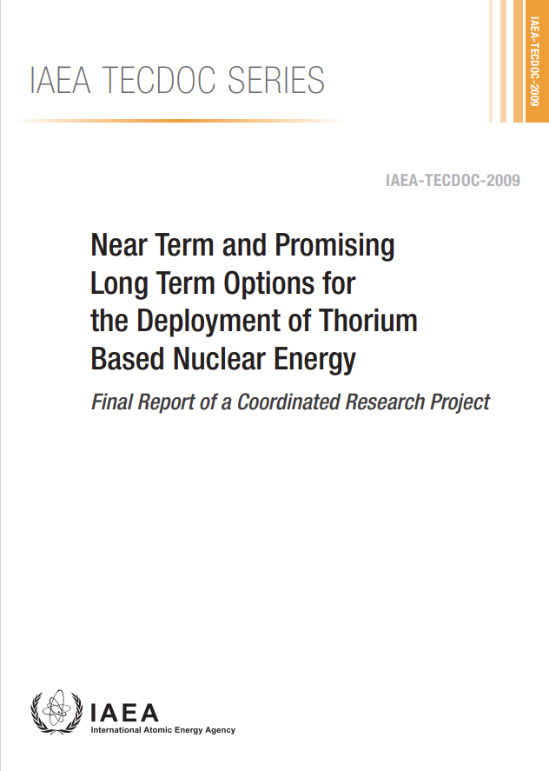
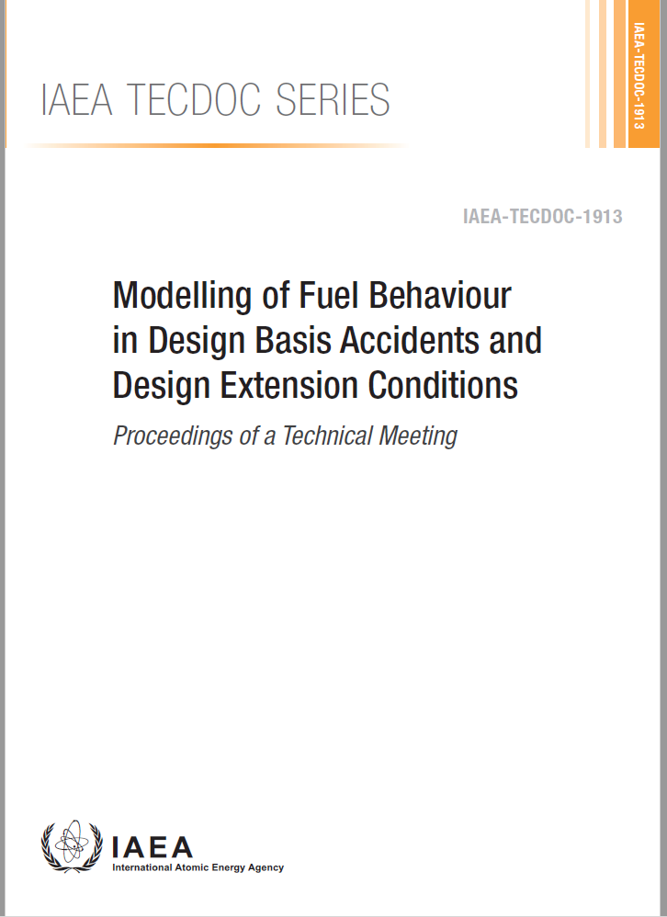
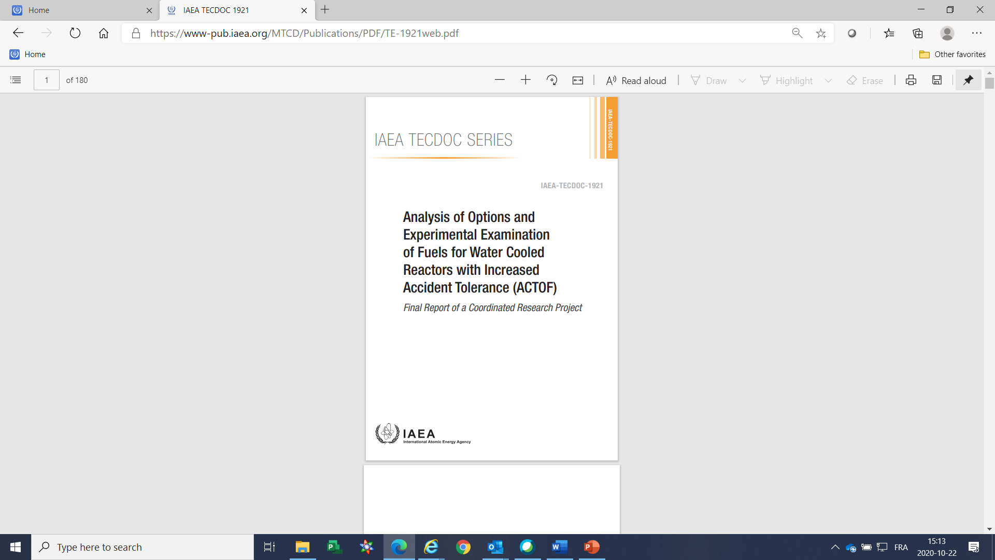
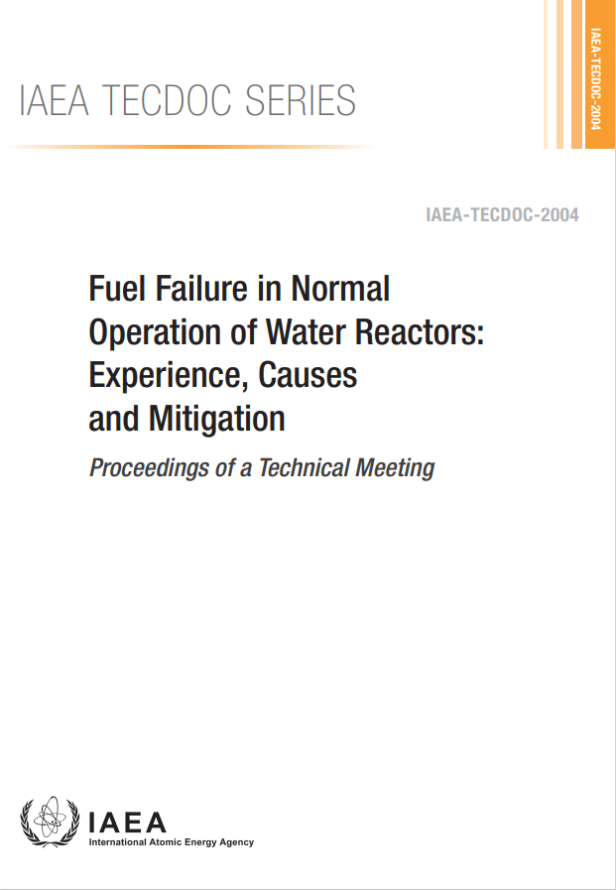
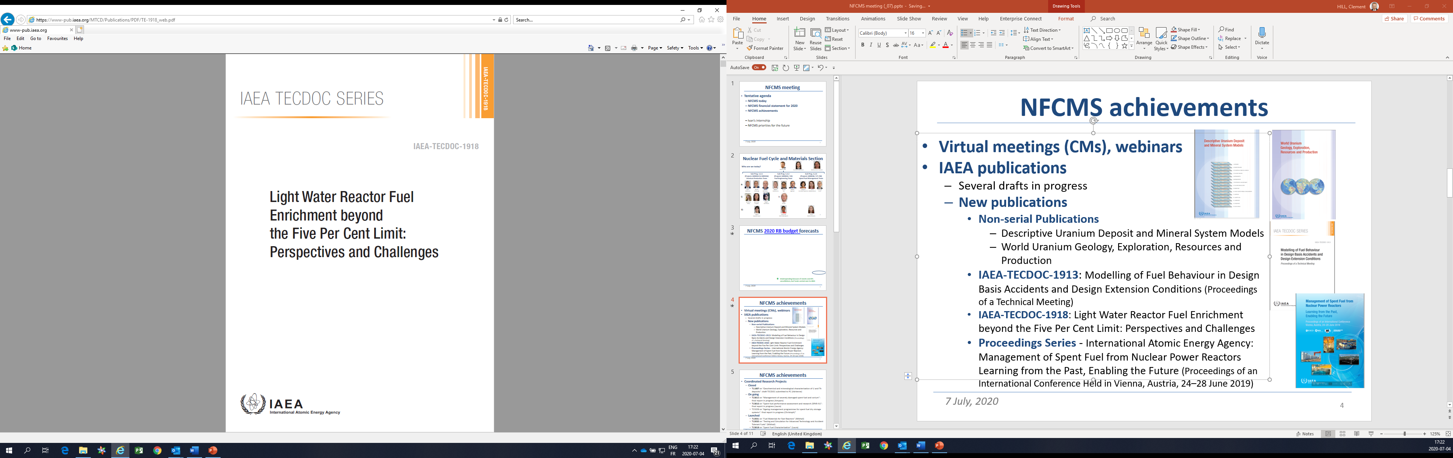
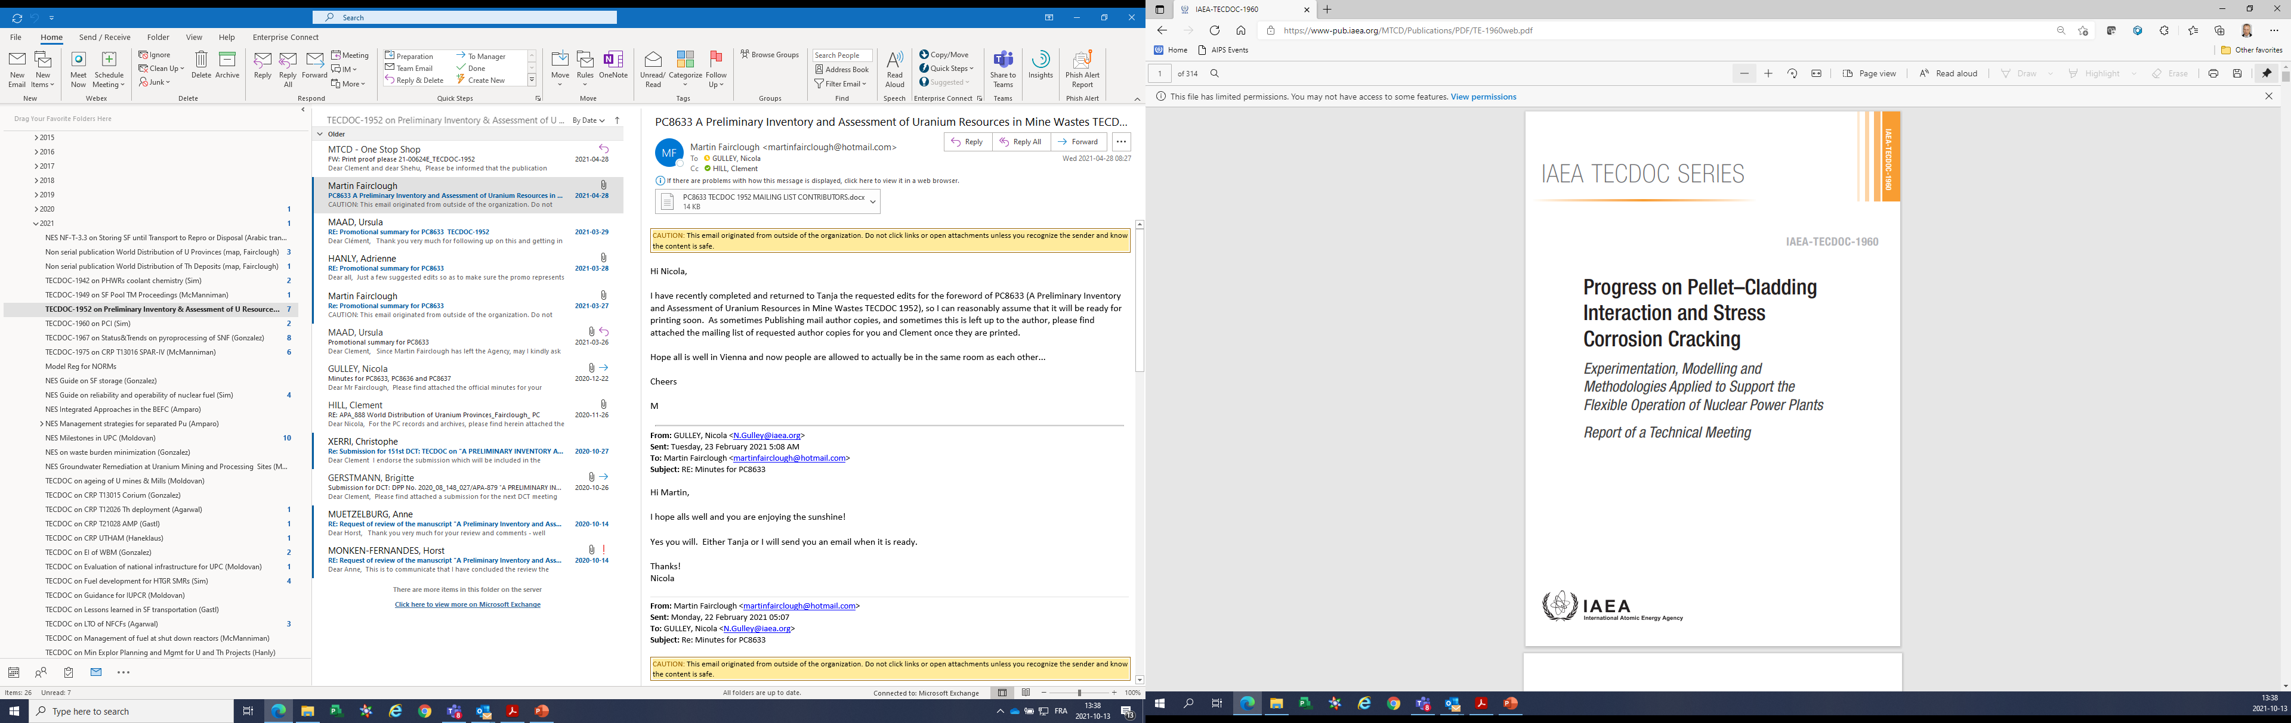
Publications on Fuel Engineering & FCF (2020-2025)
IAEA Book on the Metallurgy of Zirconium
IAEA-TECDOC-2097 Advances in Fabrication Technologies for Power Reactor Fuels: Proceedings of Technical Meetings held in 2021 and 2023 (2025)
IAEA-TECDOC-2090 Coated Particle Fuels for High Temperature Gas Cooled Small Modular Reactors ( 2025)
IAEA-TECDOC-2059 Long Term Operation of nuclear fuel cycle facilities (2024)
IAEA-TECDOC-2053 : Safety and Performance Aspects in the Development and Qualification of High Burnup Nuclear Fuels for Water Cooled Reactors (2024)
IAEA NES No NF-G-2.1: Quality and Reliability Aspects in Nuclear Power Reactor Fuel Engineering (2024)
IAEA-TECDOC-2035: Assessment of Post-irradiation Examination Techniques for Advanced Reactor Fuel and Materials
IAEA-TECDOC-2009: Near Term and Promising Long-Term Options for the Deployment of Thorium Based Nuclear Energy - Final Report of a Coordinated Research Project
NES NF-T-2.5: Review of Fuel Failures in Water Cooled Reactors in 2006-2015
IAEA-TECDOC-1889: Fuel Modelling in Accident Conditions - Final Report of a Coordinated Research Project on Fuel Modelling in Accident Conditions – FUMAC, 2014–2018
IAEA-TECDOC-1918: Light Water Reactor Fuel Enrichment beyond the 5% Limit: Perspectives and Challenges
IAEA-TECDOC-1942: Coolant Chemistry Control and Effects on Fuel Reliability in Pressurized Heavy Water Reactors
IAEA-TECDOC-1960: Progress on Pellet–Cladding Interaction and Stress Corrosion Cracking: Experimentation, Modelling and Methodologies Applied to Support the Flexible Operation of Nuclear Power Plants
IAEA-TECDOC-2004: Fuel Failure in Normal Operation of Water Reactors: Experience, Causes and Mitigation. Proceedings of a Technical meeting
IAEA-TECDOC-1921: Analysis of Options and Experimental Examination of Fuels for Water-Cooled Reactors with Increased Accident Tolerance (ACTOF). Report of a Coordinated Research Project 2015–2019
IAEA Book on the Metallurgy of Zirconium (3 Volumes)
9

Slide 10
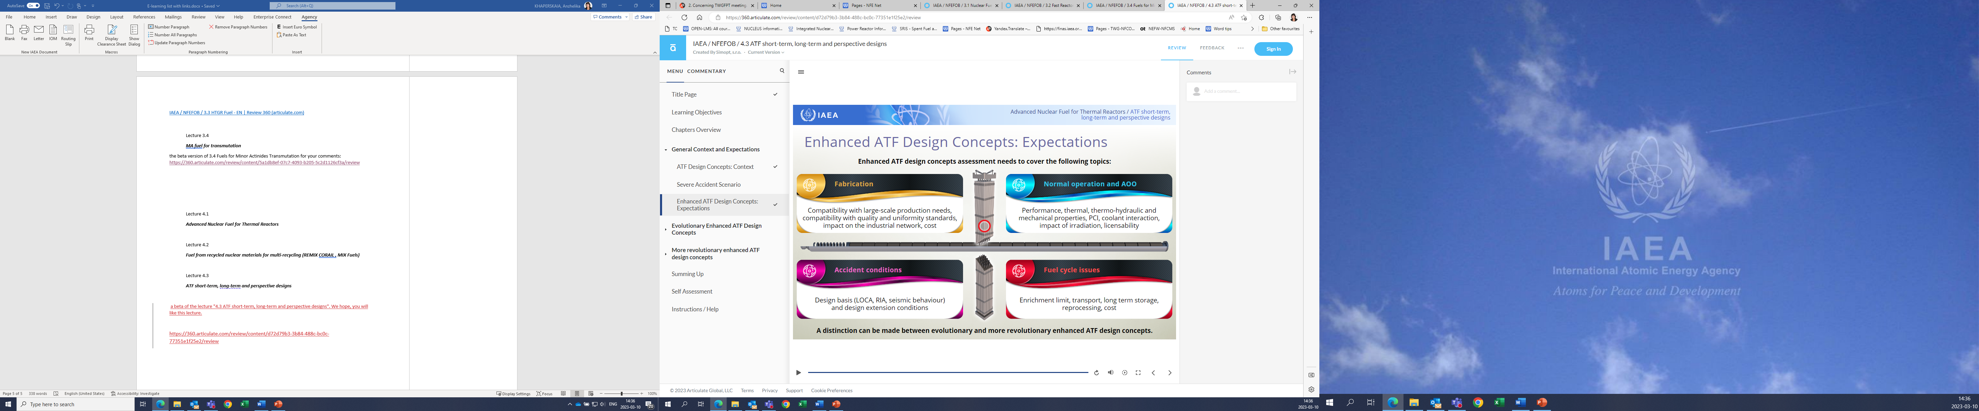
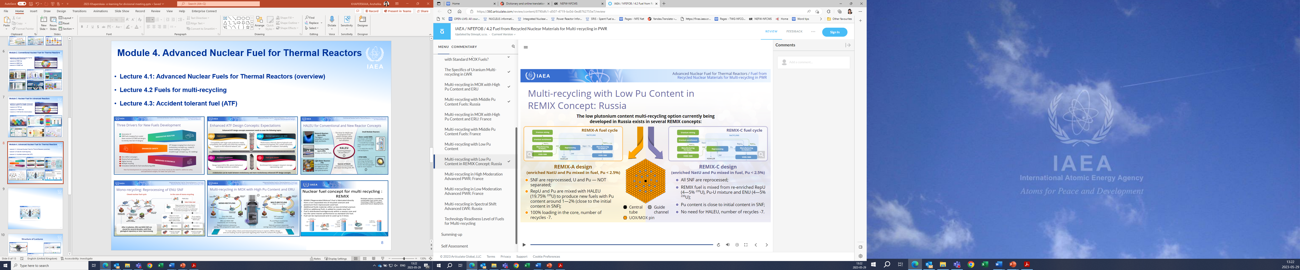
IAEA ongoing activity to support current generation of nuclear power reactors fuels
Fuel engineering and operation for current generation of nuclear power reactors
Accident Tolerant Fuels
1. TECDOC on “Mixed Oxide Fuels Design, Operation and Management” (in preparation to publishing)
2.TECDOC on “Structural Behaviour of Fuel Assemblies in Water Cooled Reactors” (in publishing)
3. TM on “Advances in Fuel Design, Manufacturing and Examinations for Pressurized Heavy Water Reactors” (November 2024, Argentina)
2. TM on “Advanced Technology Fuels: Progress on their Design, Manufacturing, Experimentation, Irradiation, and Case Studies for their Industrialization, Safety Evaluation, and Future Prospects” (28-31 October 2025)
2. IAEA publications on “Challenges and Opportunities in Reprocessed Uranium Fuels” (TECDOC in progress)
3. Proposed new CRP on “Testing and performance simulation of Advanced Technology Fuels (ATF- HBU) (2026 -?)
4.TM on “Digitalization and the Use of Artificial Intelligence in Advanced Nuclear Fuel Manufacturing and Quality Control”, June 2026
Fuels for recycling/multi-recycling
1. NES on “Review of Fuel Failures in Water Cooled Reactors (2016–2020) Rev.1” (preparation for publication)
1. CRP T12032 on “Testing and Simulation of Advanced Technology and Accident Tolerant Fuels (ATF-TS)” (2020-2024)
Conventional Water-Cooled Reactor fuels
10

Slide 11
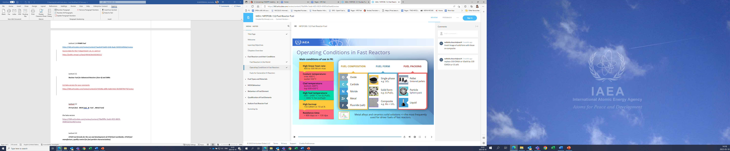
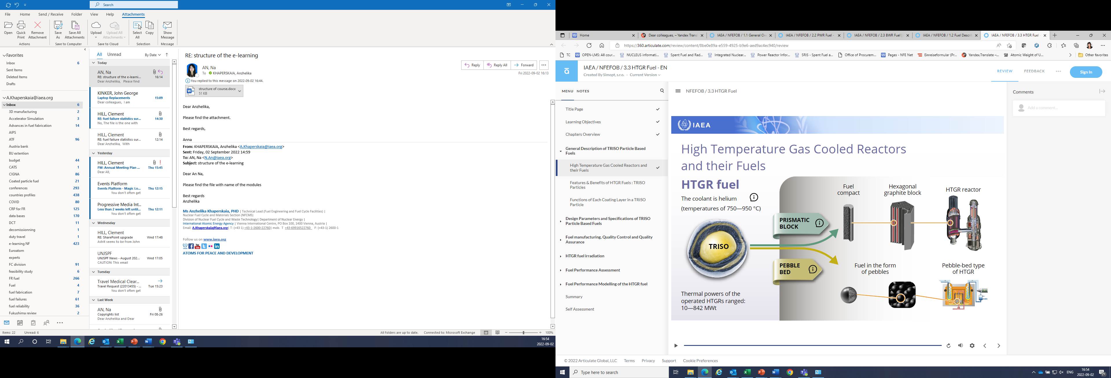
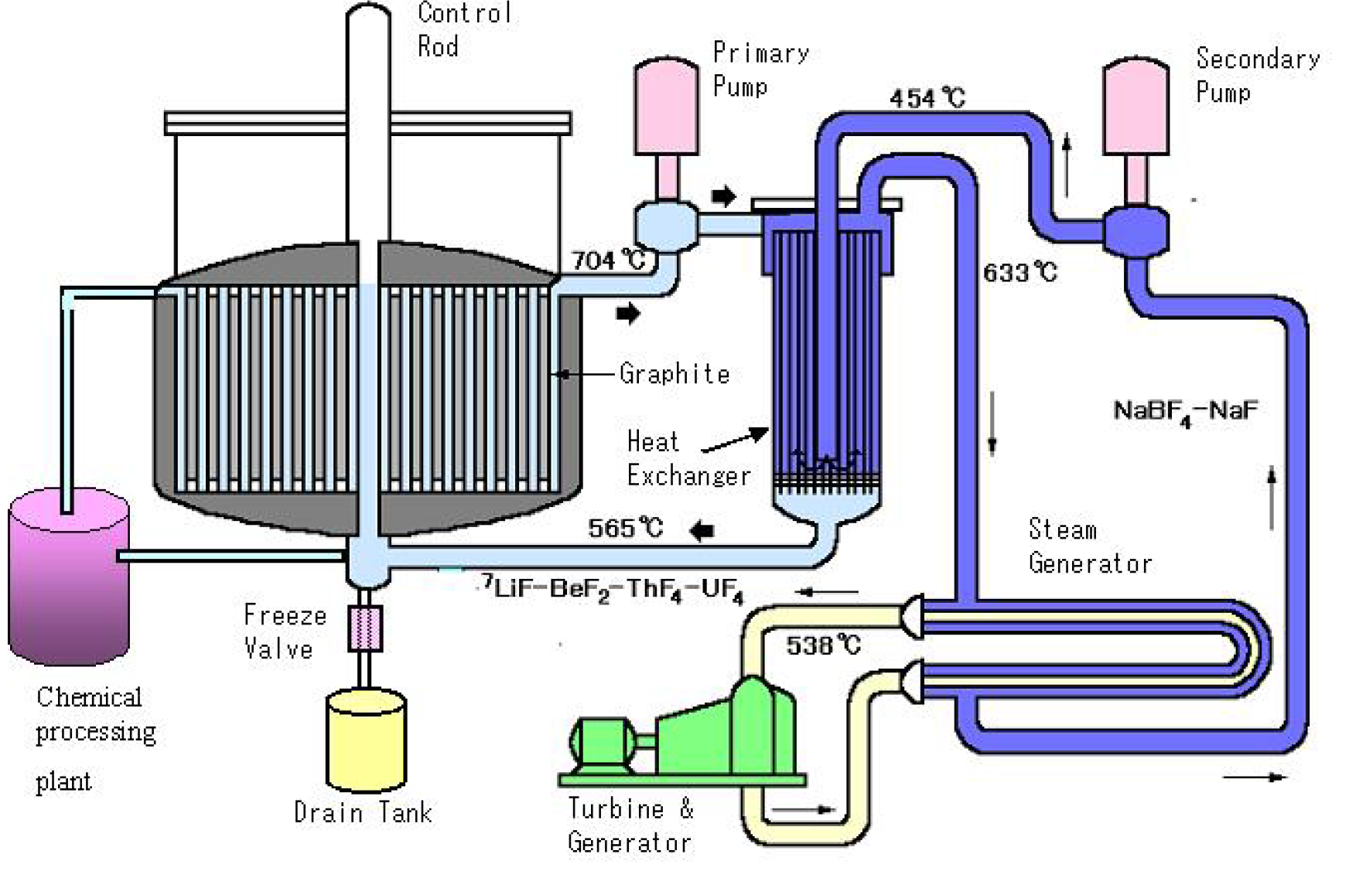
IAEA ongoing activities to support advanced reactors fuels development
Water-cooled SMR fuels
Fast reactor fuels
HTRs SMR fuels
1. TECDOC on “Core and Plant Simulation with an Emphasis on Fuel Behaviour in Light Water Reactor Based Small Modular Reactors” ( based on Workshop 27-29 February 2024, TECDOC in progress)
2. NES Technical Report on “Nuclear Fuel Technologies for Liquid Metal Cooled Fast Reactors (LMFRs)” (in preparation to publishing)
3. Workshop on the “Behaviour of Liquid Metal Cooled Fast Reactors Fuels” (30 June – 04 July 2025)
1. CRP T12034 on “Fuel Modelling Exercises for Coated Particle Fuel for advanced reactors including SMR”(2024-2029)
1. New Simulation tool module development for MSR with relevant fuel cycle
2. Workshop on “Molten Salt Reactor Fuel: Recent Development and Future Challenges” (21-25 July 2025)
1. CRP T12033 on “Standardization of Subsized Specimens for Post-Irradiation Examination and Advanced Characterization of Fuel and Structural Materials for Small Modular Reactor and Advanced Reactor Applications (PIE for SMR)”(2024-2028)
1. CRP T12031 on “Fuel Materials for Fast Reactors (FMFR)” (2019-2023: Final Report in preparation to publishing)
Molten salt SMR fuels
4. Proposed new CRP on “Benchmark Exercises on Testing and Performance Simulation of Advanced Fuels for Liquid Metal-Cooled Fast Reactors” (2026-…)
PIE for SMR fuels
3. Workshop on “Current Status of Structural Material Development for Molten Salt Reactors and Related Challenges” (July 2026)
HALEU fuel
1. Workshop on “Operational Aspects of Manufacturing High Assay Low Enriched Uranium Advanced Fuels” (August 2026)
Fuel engineering and operation for SMRs and future generations of nuclear power reactors
11

Slide 12
NFE Network Task forces on specific areas
Recognizing the importance of advancements in nuclear fuel technologies and the renewed interest among Member States (MSs), the IAEA aims to effectively support MSs by leveraging a broader range of expertise and experiences. The TWG-FPT members have recommended the establishment of dedicated Task Forces (TFs) in specific technical areas:
Light Water Reactor (LWR) Fuels: Pressurized Water Reactor (PWR), Water-Water Energetic Reactor (WWER), Boiling Water Reactor (BWR).Chair: Jinzhao Zhang (TRACTEBEL)
Heavy Water Reactor (HWR) Fuels: Pressurized Heavy Water Reactor (PHWR), CANada Deuterium Uranium (CANDU). Chair: Noel Harrison (CNL)
Fast Reactor (FR) Fuels: Lead-cooled Fast Reactor (LFR), Sodium-cooled Fast Reactor (SFR). Chair: Valerie Vandenberghe (CEA)
Artificial Intelligence/Machine Learning (AI/ML) in Nuclear Fuel Engineering . Chair: Aiden Peakman (Amentum)
Fuel Manufacturing and Quality Management. Chair: Nuria Doncel (ENUSA)
Molten Salt Reactor (MSR) Fuel.
Task Force activities are carried out through online working meetings (via Webex or MS Teams), or dedicated IAEA events such as Consultancy Meetings, Technical Meetings, and Workshops, and through the Nuclear Fuel Engineering (NFE) Network platform to enhance information exchange and collaboration.
12

Slide 13
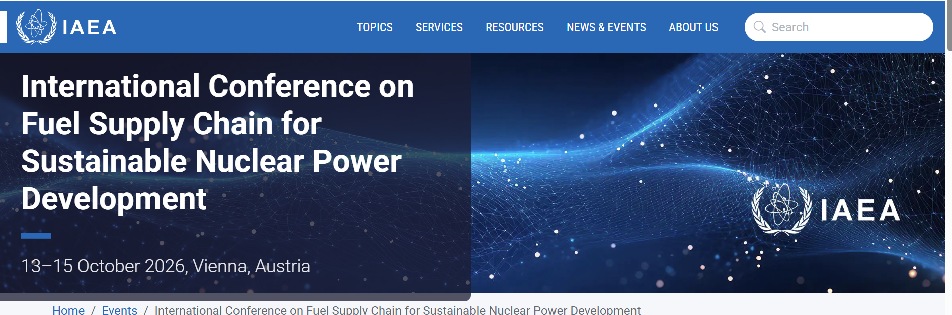
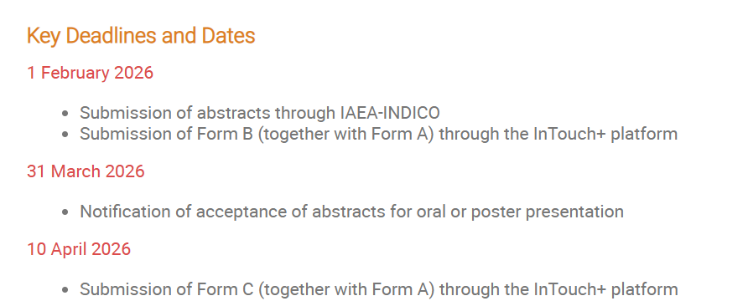
International Conference on Fuel Supply Chain for Sustainable Nuclear Power Development, Vienna, from 13 to 15 October 2026
International Conference on Fuel Supply Chain for Sustainable Nuclear Power Development | IAEA
Topic 1. Industry Prospects and Challenges Facing Raising Fuel Supply Demand:
Challenges in supply and front-end services to meet the increasing infrastructure requirements for conversion, enrichment and fuel fabrication
Topic 2. Supply and demand for raw materials for nuclear fuel supply:
Innovations in the front end of the nuclear fuel cycle, from exploration to mining: (new uranium exploration and mining projects, Innovative advancements in uranium exploration and mining, Uranium and thorium resources, processing and mining and the circular economy
Topic 3. Advanced nuclear fuels for innovative reactor technologies:
Advanced technology fuels and fuels for advanced reactors: design, qualification and operation of ATFs, LEU+ and HALEU fuels, TRISO fuels, fuels for Fast Reactors, MSRs and multiple recycling in all types of reactors, advances in nuclear fuel fabrication processes and quality control (automation, additive manufacturing and use of artificial intelligence)
Topic 4. Industrial and Innovative technologies for recycling nuclear materials
Industrial operating experience and lessons learned in reprocessing for recycling
13

Slide 14
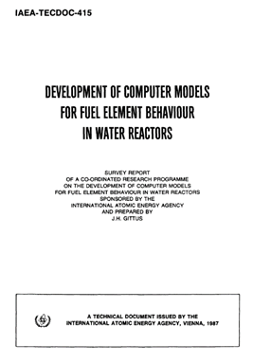
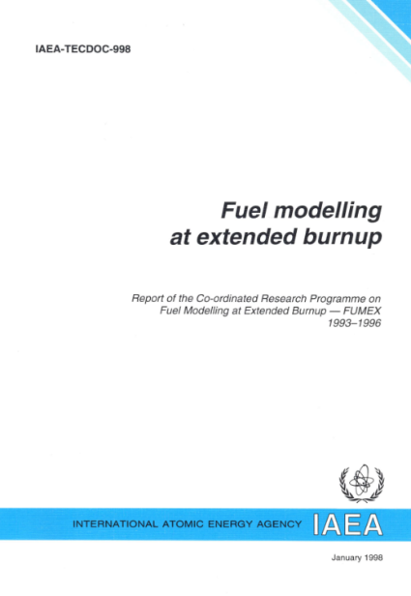
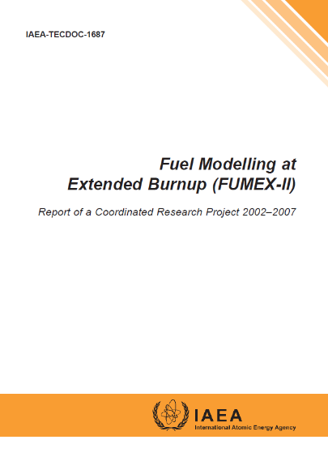
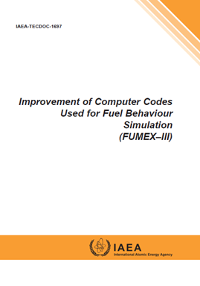
IAEA CRP Series on Fuel Behavior Modelling since 1982
CRP D-COM
1982-1984
published in 1987
CRP FUMEX
1993-1996
published in 1998
CRP FUMEX-2
2002-2007
published in 2012
CRP FUMEX-3
2008-2012
published in 2013
IAEA support to ATF development
CRP FUMAC
focused on modeling of fuel behaviors during LOCA (DBAs and DECs)
Better understanding of fuel behaviour during LOCA
24 organizations (18 countries),
10 computer codes
CRP ACTOF
focused on testing of candidate ATF materials (Cr-coatings, FeCrAl, AISI 348 SS), fuel rod code benchmark on FeCrAl and simulation of QUENCH-19
Better understanding of ATF cladding behaviour during normal operation and under accident conditions
5 organizations, 5 computer codes
CRP FUMAC
2014-2018
published in 2019
CRP ACTOF
2015-2019
published in 2020
14

Slide 15
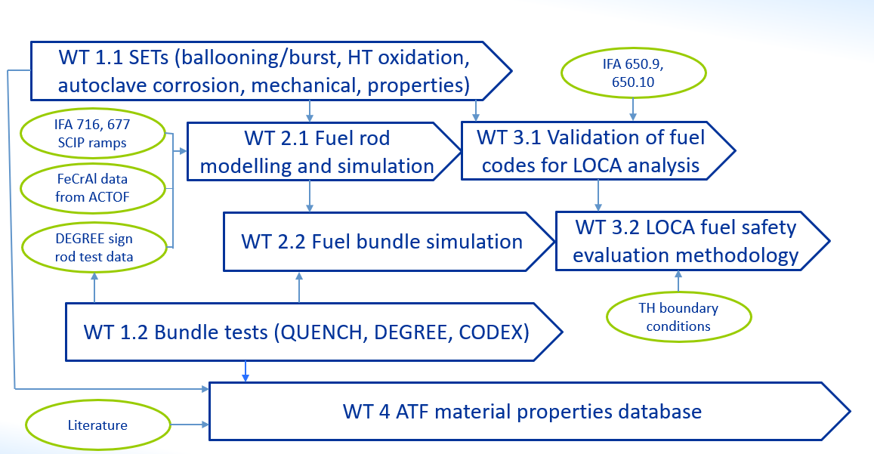
CRP T12032 “Testing and Simulation of Accident Tolerant and Advanced Technology Fuels (ATF-TS)” (2020-2024)
Objectives of the CRP
To perform experimental tests including SET and bundle tests on ATFs' performance under normal, DB and DE conditions
To benchmark fuel codes against new test data either obtained during the CRP or from existing data relevant to advanced fuel and cladding concepts from Member States' experimental Programmes
To develop LOCA evaluation methodology for ATF performance with a view for NPP applications
To support Member States in their efforts to design and develop ATFs for LWRs, to enhance their computer code capabilities to predict nuclear fuel behaviour under normal, DB and DE conditions, and to increase the technology readiness level for candidate ATF materials.
CRP ATF TS aimed to provide comprehensive understanding of ATF (cladding, rod, assembly) behaviour for all applicable plant conditions
Mainly focused on near-term ATF concepts like coated Zircaloy claddings, FeCrAl
Participants: 29 organizations from 22 Member States
Argentina (CNEA), Belgium (Tractebel), Belarus (BSU), Brazil (IPEN/CNEN), Bulgaria (INRNE), Canada (CNL), China (CNPRI, CNPE, NPIC), Czech Republic (CTU), France (CEA), Germany (KIT, GRS), EC (JRC), Hungary (EK), Iran (AEOI), Italy (NINE), Japan (CRIEPI), Korea (KAERI), Poland (IChTj), Russia (IBRAE RAS), Spain (UPM, CIEMAT, Slovakia (B&J NUCLEAR ltd.), UK (NNL), USA (ISSS, UTK)
15

Slide 16
CRP T12032 “ATF-TS” structure
ATF-TS
Sci. Secretary: A. Khaperskaya (IAEA) (former Sci. Secs : K.S.Sim, M.Veschunov)
Co-Chairs: J. Zhang (BEL), M. Sevecek (CZR)
WT 1:
Experimental
Programme
M. Sevecek (CZR)
J. Stuckert (GRF)
WT 2:
Modelling & Benchmark Exercises
A. Boulore (FRA)
M. Cherubin (ITA)
J. Stuckert (GRF)
Z. Hozer (HUN)
WT 3:
LOCA Evaluation Methodology
J. Zhang (BEL)
WT 4:
Material Properties Database for ATF
Ch. Allison (USA)

Slide 17
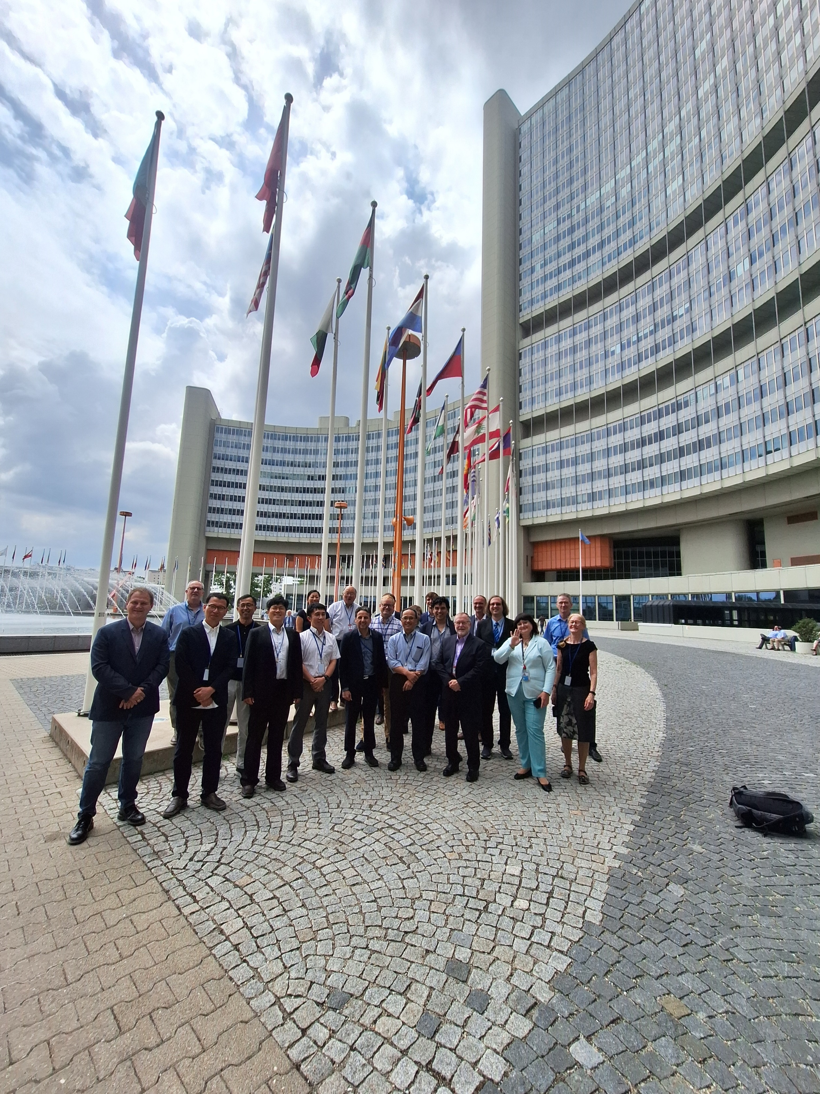
CRP T12032 “Testing and Simulation of Accident Tolerant and Advanced Technology Fuels (ATF-TS) (2020-2024)
Results achieved
Various ATF options were analyzed resulting in improved understanding of ATFs’ behaviors and developments of ATF technologies in MSs.
Several coated cladding materials (coated Zircaloy claddings, FeCrAl) were manufactured, tested, characterized and analyzed.
Fuel performance codes and severe accident codes from participating organizations were extended to the analysis of several ATF concepts.
The qualified fuel rod codes to develop a hot rod LOCA fuel safety evaluation methodology were applied to assess the performance of ATFs.
The open-source ATF material properties and experimental datasets have been prepared and uploaded the IAEA fuel database
The TECDOC “Testing and Simulation for Advanced Technology and Accident Tolerant Fuels (ATF-TS). Final Report of a Coordinated Research Project” with 3 volumes:
    Vol. 1; Experimental Programme of Accident Tolerant and Advanced Technology Fuels (ATFs);
    Vol. 2: Fuel Modelling and Computer Codes’ Benchmark Exercise for Accident Tolerant and Advanced Technology Fuels (ATFs);
    Vol. 3: LOCA Fuel Safety Evaluation for Accident Tolerant and Advanced Technology Fuels (ATFs).
Under preparation to publication
17

Slide 18
The IAEA extends its gratitude to the significant contributors
  to the Coordinated Research Project on “Testing and Simulation for Advanced Technology and Accident Tolerant Fuels (CRP ATF-TS).
  CRP Chairs/Coordinators :
  Jinzhao ZHANG (Tractebel , Belgium), Martin SEVECEK (Czech Republic), Antoine BOULORÉ (CEA, France), Marco Cherubini (NINE, Italy), Juri Stuckert (KIT, Germany), Zoltan Hozer (Centre for Energy Research, Hungary)
CSIs:
  P. M. E Loza(CNEA, Argentina), A. Abe (IPEN-CNEN/SP, Brazil), M. Manolova (INRNE BAS, Bulgaria), E. Onder (CNL, Canada), W. Li (NPIC, China), X. Jiang (CNPE, China), M. Chen (CNPTRI, China), T. Hollands (GRS, Germany), J. Peltonen (VTT, Finland), L. Vlahovic (JRC, EC), A. Riahi (AEOI, Iran), K. Inagaki (CRIEPI, Japan), H. C. Kim (KAERI , Korea), L. H. Hernandez (ININ, Mexico), B. Sartowska (PINCT, Poland), K. Dolganov (IBRAE, Russia), J. Luley ( SUT, Slovakia), S. J. C. Queral (PUM, Spain), P. L. E. Herranz (CIEMAT, Spain), H. J. Ruíz (UPM, Spain), G. Rossiter (NNL, UK), C. M. Allison ( ISS LLC, USA), B. Wirth (UT, USA)
  ex. IAEA Sci. Secretaries:
  Mikhail Veschunov, Ki-Seob Sim
18
Notes:
If your facility doesn’t have a strategic plan, why not?

Slide 19
TWG FPT recommendation : new CRP on ATF fuel proposed:
Testing and performance simulation of Advanced Technology Fuels (ATF- HBU)
The new CRP is proposed to enhance Member States’ capabilities in testing and modelling Advanced Technology Fuels (ATFs) to improve reactor performance, safety, and fuel-cycle economics.
The CRP will focus on the testing and modelling of ATF concepts—such as Cr-coated, FeCrAl, and SiC claddings, as well as high-density and high-energy fuels—under both operational and accident conditions.
Proposed activities include benchmarking of fuel performance codes; investigation of key phenomena such as cladding integrity, fuel fragmentation, relocation, and dispersal; and the development of methodologies to quantify the economic and safety benefits of ATF implementation. Feasibility assessments for the near-term use of ATFs in water-cooled small modular reactors (SMRs) will also be considered.
This CRP will complement the completed T12032 by addressing high-burnup applications and supporting advanced testing and simulation frameworks for innovative fuel technologies.
The scope of the future CRP will be discussed during the upcoming Technical Meeting

Slide 20
Technical Meeting on Advanced Technology Fuels: Progress on their Design, Manufacturing, Experimentation, Irradiation, and Case Studies for their Industrialization, Safety Evaluation, and Future Prospects, 28 - 31 October 2025
1. Advances in ATF Materials and Manufacturing (ATF cladding and fuel fabrication; Coating designs and optimization; Industrialization of ATFs and associated challenges
2. Experimental Testing of ATF Materials and Validation Database ( Bundle Tests – Bundle tests with ATFs simulating DBA, DEC-A and DEC-B conditions including tests with air ingress; Separate Effect Tests (SETs) – SETs focused on nominal operating conditions and anticipated occupational occurrences (long-term corrosion testing, mechanical tests, coating defects), accidental scenarios (HT steam/air oxidation, LOCA- and RIA-related SETs) ; In-pile Testing– Irradiation testing of candidate ATF materials both in research reactors or accelerators and commercial power plants (e.g. LTRs, LTAs)
3. ATF Modelling (Verification, Validation, and Uncertainty Quantification of fuel performance codes ; Multi-physics and Multi-scale Modelling; Benchmarking of fuel performance codes for ATF materials in operational and accident conditions; Data-driven and artificial intelligence (AI) applications)
4. ATF Safety Analysis and Licensing Practices (New Safety Criteria for ATFs, Innovative Qualification & Licensing Approaches for DBA and DEC scenarios; Risk-Informed Approaches; Margin Quantification and Management
5. Future prospects of ATF (Effect of ATFs on occurrence and consequences of Fuel Fragmentation, Relocation, and Dispersal (FFRD), Definition of Post- Critical Heat Flux (CHF) Time at Temperature Limits; Improved ATF designs; Use of LEU+ with ATFs for High Burnup (HBU); Deployment of ATFs in Small Modular Reactors (SMRs)
39 presentations in total
20

Slide 21
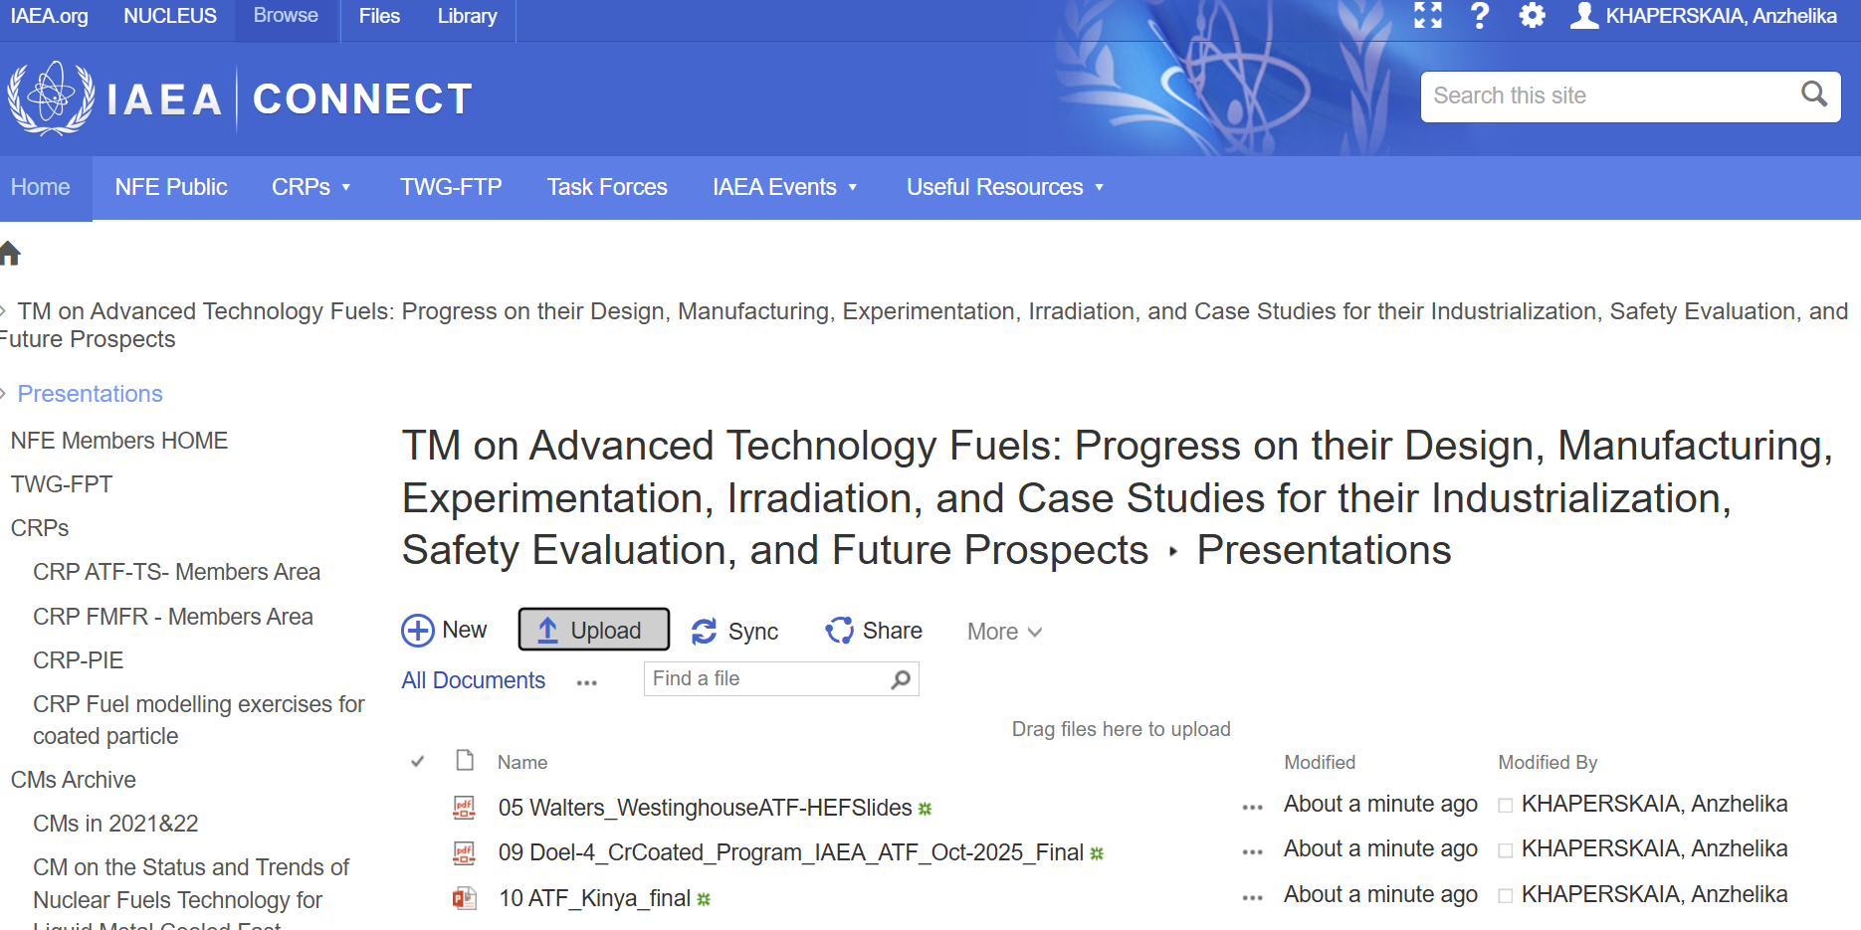
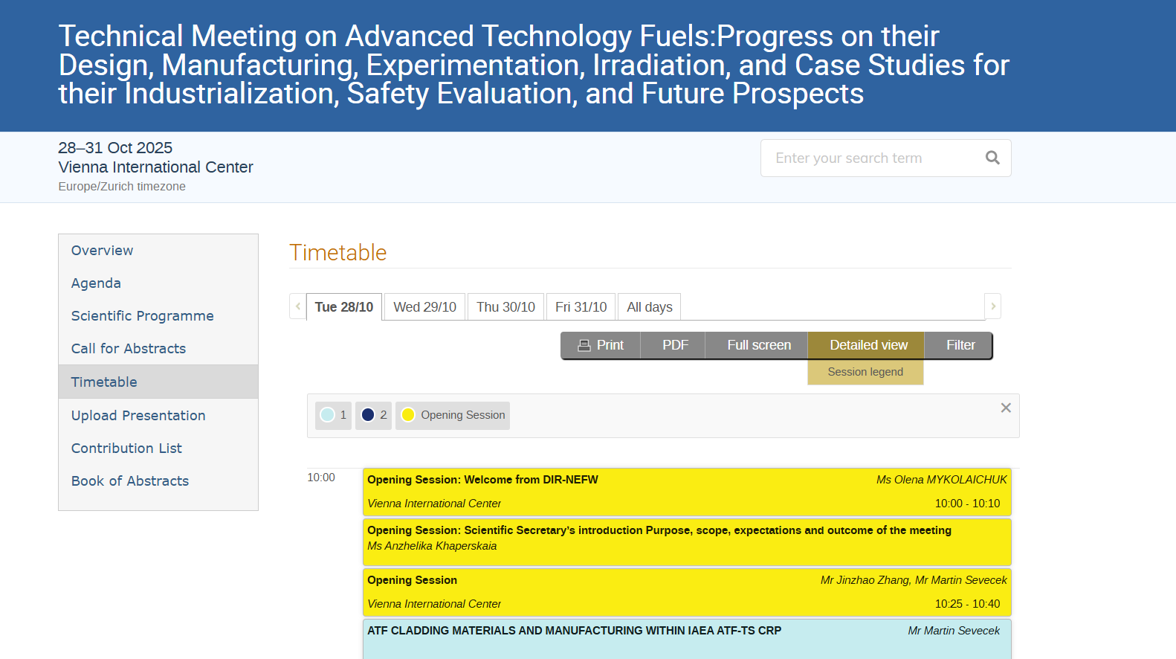
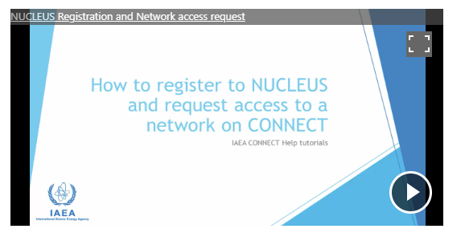
Sharing the Presentations and Documents : INDICO and NFE dedicated webpages
NFE webpage
INDICO webpage
Presentations - All Documents
Technical Meeting on Advanced Technology Fuels:Progress on their Design, Manufacturing, Experimentation, Irradiation, and Case Studies for their Industrialization, Safety Evaluation, and Future Prospects (28-31 October 2025): Timetable · Indico for IAEA Conferences
Registration

Slide 22
During the meeting
We are a large group of people participating from various geographical places ⇨ We need your cooperation
Please:
Stay muted unless speaking
Turn off video except speakers (for online participants)
Let us know your name and country before you ask a question
Raise your hand or use the chat for Q&As (for online participants)
22

Slide 23
The conference clerk for the meeting
Mr Torkel Elsin
Please contact him for any technical questions
- via the WEBEX chat (for online participants)
- or by email:
IAEA-CONFFOUR <Iaea-Conffour@iaea.org>
23

Slide 24

Dr. Jinzhao Zhang
Global Expert and Technical Director at Tractebel (ENGIE)
Ph.D. from UCLouvain (1993).
40+ years in nuclear reactor R&D, engineering, and consulting.
Leads nuclear fuel design and safety analysis at Tractebel.
Active member or chair in international working groups on fuel performance and safety at IAEA (TWGFPT) and OECD/NEA (EGRFP, WGFS, WGAMA).
Co-chair and coordinator of the CRP ATF-TS.
24

Slide 25
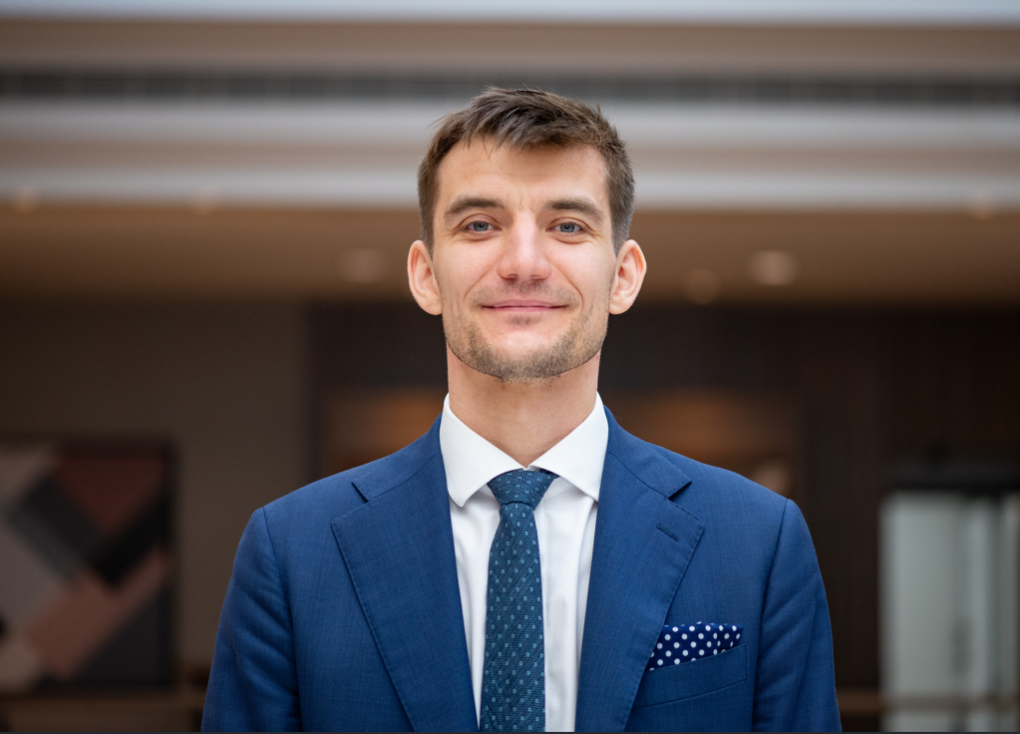
Dr. Martin Ševeček
Czech Technical University and UJP Praha
Dr. Martin Ševeček is a nuclear engineer educated at the Czech Technical University in Prague, National Tsing Hua University, and Massachusetts Institute of Technology.
He has broad international professional experience in nuclear fuel development, testing, qualification, and licensing from academia, industry, and national regulator.
In his position at Czech Technical University and UJP Praha, he leads several national and international nuclear materials-related projects and teaches fuel performance- and heat transfer-related Master and Bachelor courses.
He is also active in IAEA and OECD/NEA expert groups, he’s been a vice chair of the Working Group on Fuel Safety at OECD/NEA since 2021.
25

Slide 26
I wish all of us a productive and successful meeting
A.Khaperskaia@iaea.org

