Slide 1
INTEGRAL TESTING OF ATF FUEL UNDER HIGH TEMPERATURE ACCIDENT CONDITIONS IN THE CODEX FACILITY Zoltán Hózer, Róbert Farkas, Nóra Vér, Berta Bürger, Anna Pintér-Csordás, Márton Király, Péter Szabó, Seif Eddine Habbachi, Tamás Novotny, Erzsébet Perez-Feró, Martin Ševeček, Martin Steinbrück, Juri Stuckert, Mirco Grosse Technical Meeting on Advanced Technology Fuels: Progress on their Design, Manufacturing, Experimentation, Irradiation, and Case Studies for their Industrialization, Safety Evaluation, and Future Prospects, 28–31 October 2025, IAEA, Vienna

Slide 2
INTRODUCTION

Slide 3
Introduction
Development and testing of Accident Tolerant Fuels:
Positive effects seen in several areas (moderate oxidation, reduced hydrogen production, less heat from chemical reactions, delayed embrittlement if any, …)
Which effects will dominate fuel degradation in NPP accident scenarios?
Small scale separate effect tests
Integral tests with fuel bundles

Slide 4
CODEX-ATF and CODEX-ATF-AIT
Comparison of ATF and traditional Zr claddings
CODEX-ATF (IAEA ATF-TS):
Bundle contained both Cr coated and uncoated Zr cladding tubes
Main information on differences in the post-test examinations
CODEX-ATF-AIT (EU OFFERR):
Only Cr coated components in the bundle, comparison with the reference tests (CODEX-AIT-3) carried out with uncotaed Zr components
Possibility for the comparison of on-line measured data

Slide 5
CODEX-ATF and CODEX-ATF-AIT
Atmosphere
steam
steam+air

Slide 6
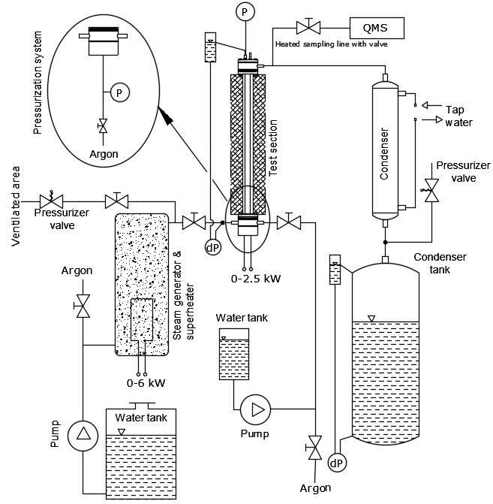
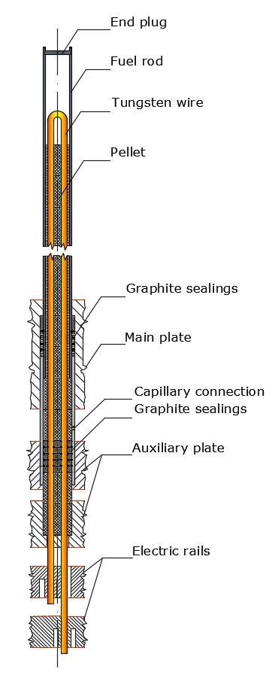
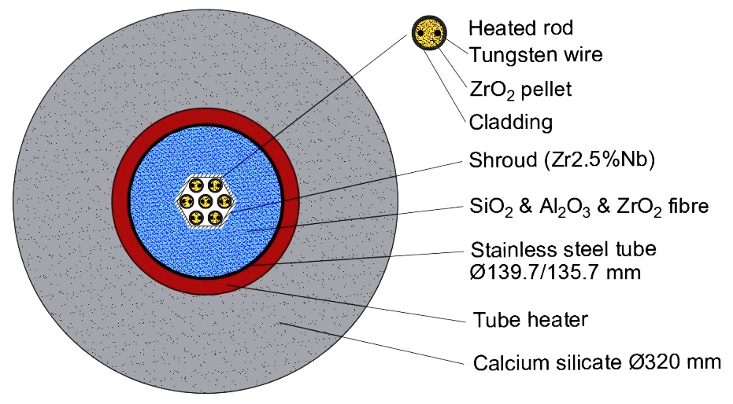
The CODEX facility
Electrically heated 7-rod bundle in hexagonal geometry

Slide 7
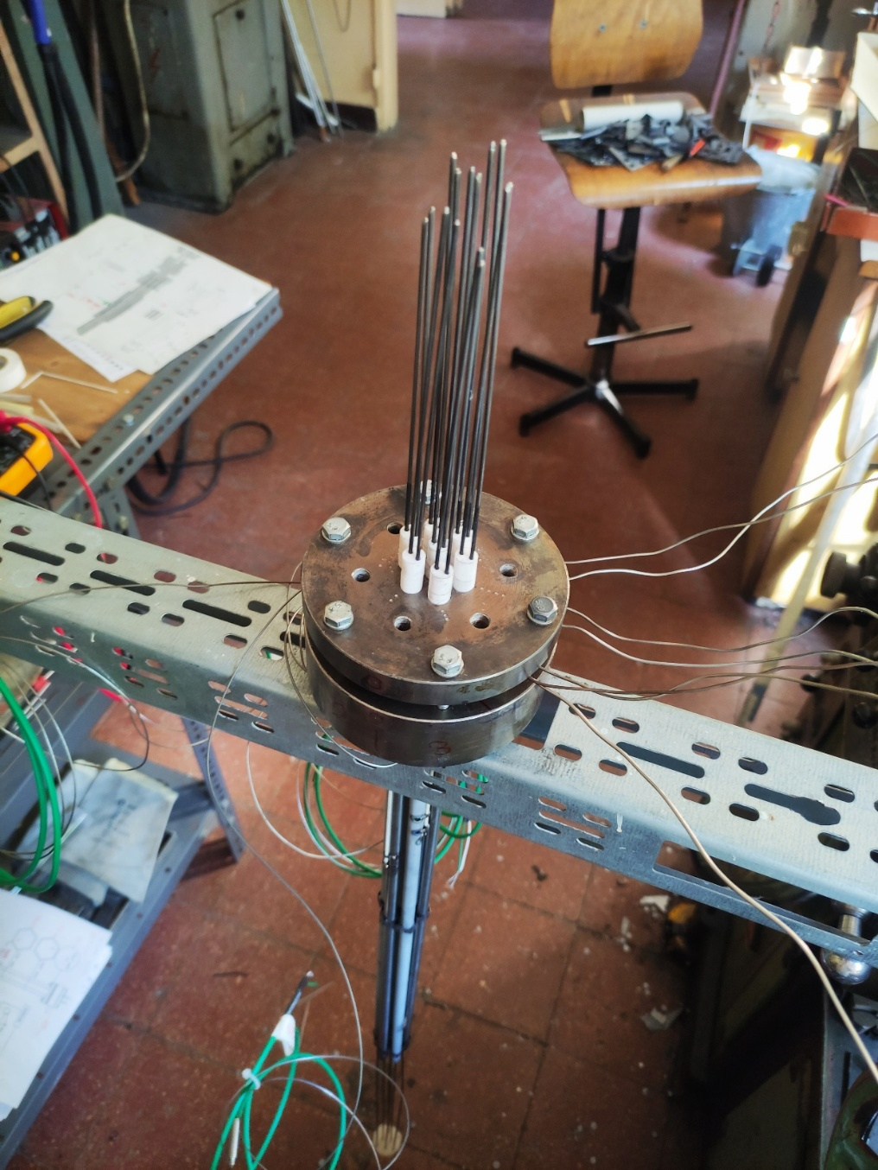
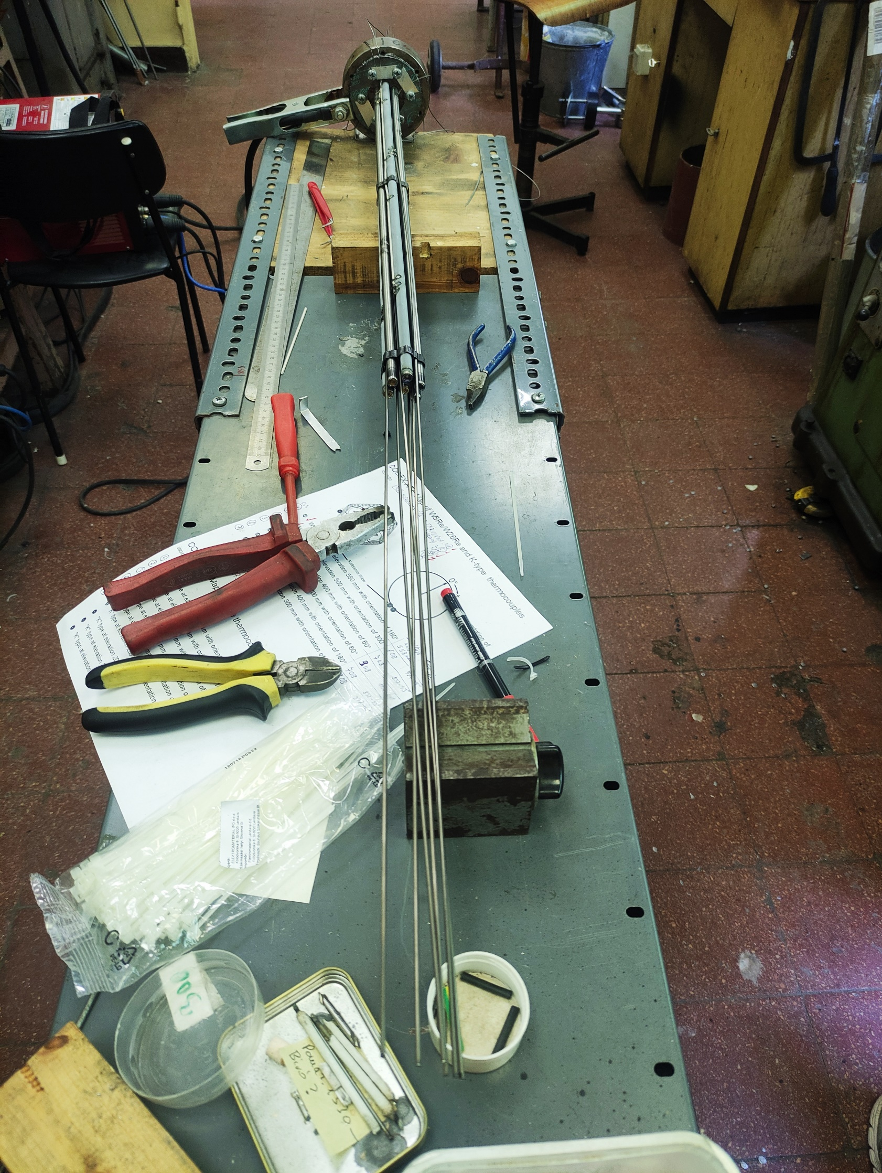
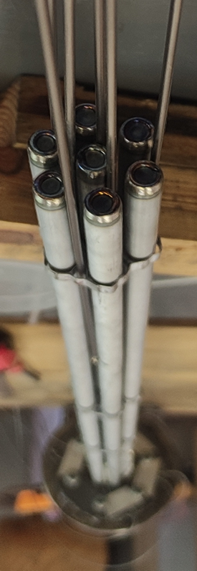
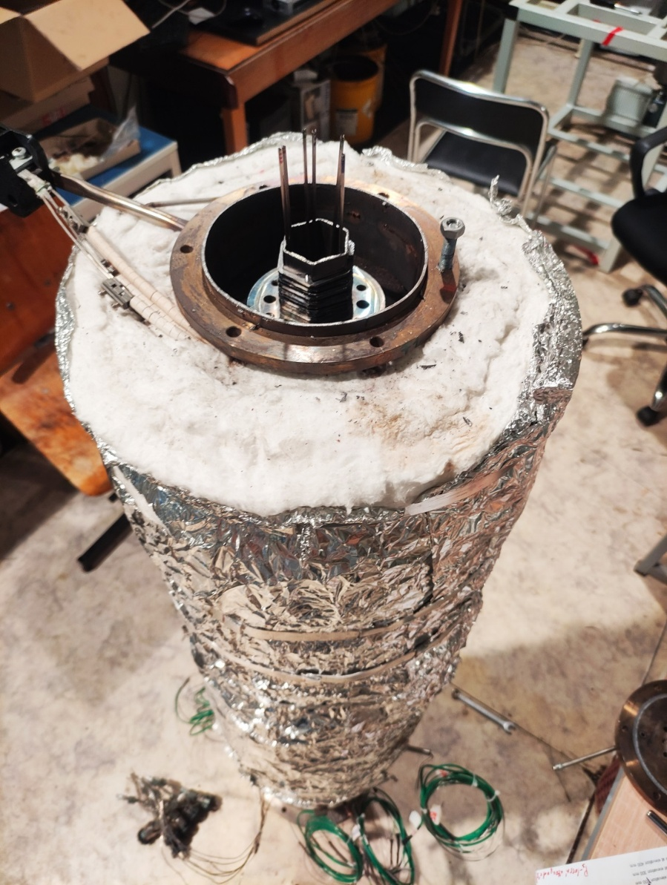
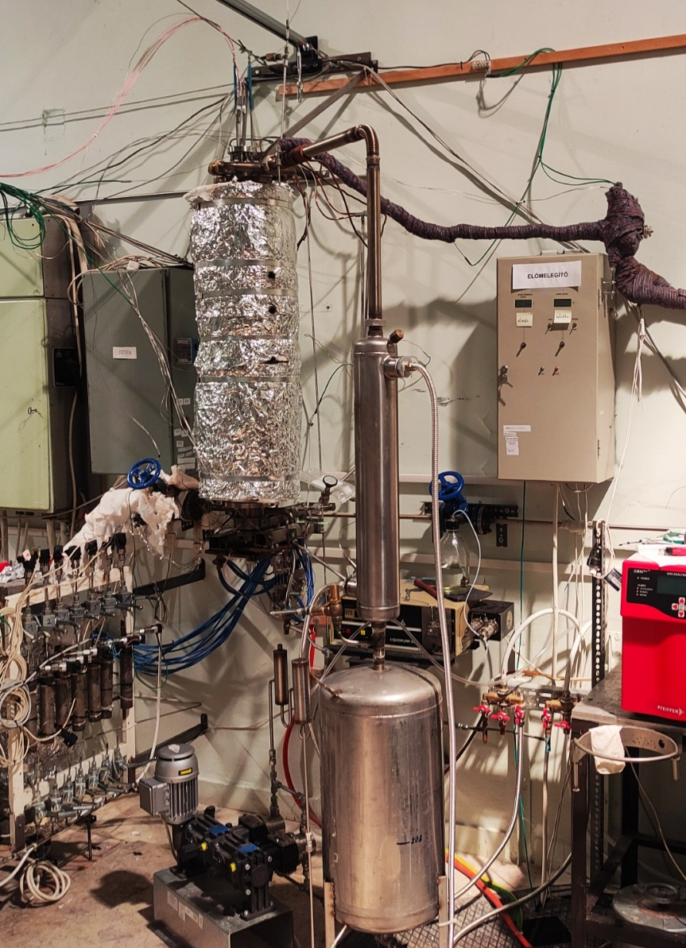
The CODEX facility
CODEX-ATF CODEX-ATF-AIT

Slide 8
CODEX-ATF

Slide 9
CODEX-ATF planned scenario
further heat-up with increased power, target temperature of 1400 °C
technological heat-up of the facility, initiation of steam supply, moderate power and target temperature of 600 °C
Heat-up phase I
Heat-up phase II
Preparatory phase
Quench
1400 °C
Burst
800-900 °C
1000 °C
Max. cladding temp.
injection of water, switching off power and steam supply
further heat-up with increased power, pressurization of fuel rods to reach burst, target temperature of 1000 °C
600 °C
500 s
1000 s
Power (+800 W external heaters)
2000 W
1000 W
600 W
0 W
Argon
0.2 g/s
0 g/s
Steam
0.2 g/s
0 g/s
10 g/s
Water

Slide 10
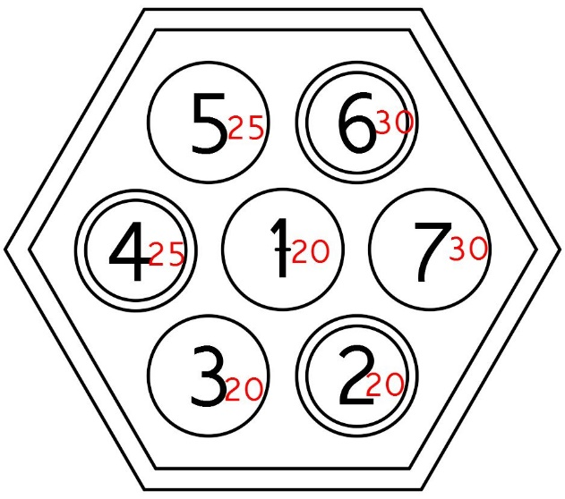
CODEX-ATF planned scenario
Ballooning and burst
Oxidation of cladding external surface
Oxidation of inner cladding surface and secondary hydriding
Eutectic formation
SBO like scenario with recovery of ECCS
optZIRLOTM
Cr-coated optZIRLOTM

Slide 11
CODEX-ATF power, flowrates, temperatures
Heat-up
ph.
Heat-up
ph.
Quench
Quench
Maximum rod temperature
T1_550mm, 1655 °C
Preparatory ph.
Preparatory ph.

Slide 12
CODEX-ATF pressures

Slide 13
CODEX-ATF hydrogen production
Total H₂ generation 2.9 g

Slide 14
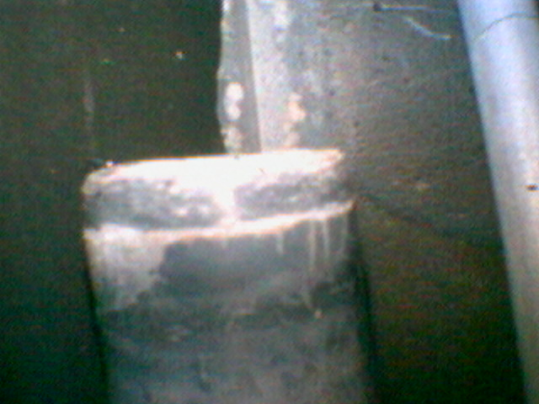
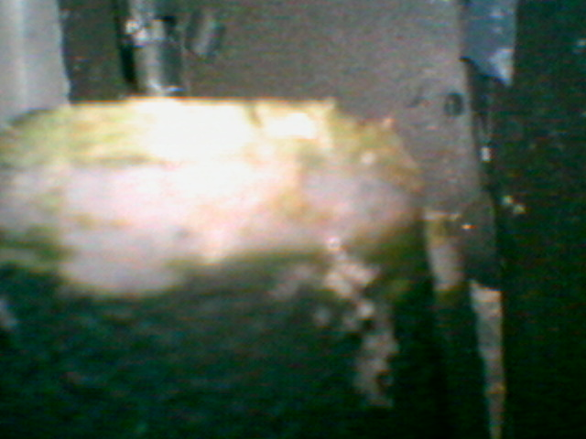
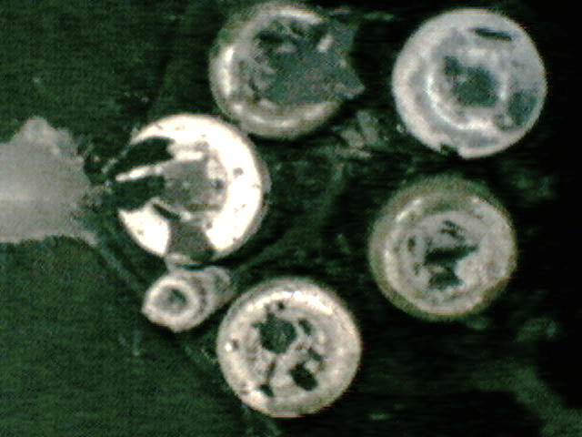
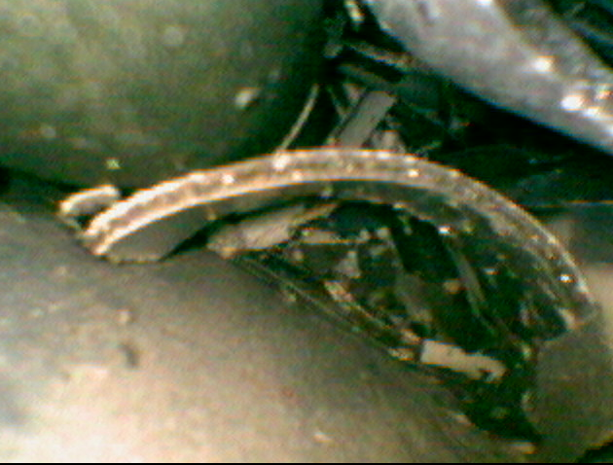
CODEX-ATF endoscopic images from the top
Uncoated rod
Coated rod
Top of the bundle
Debris

Slide 15
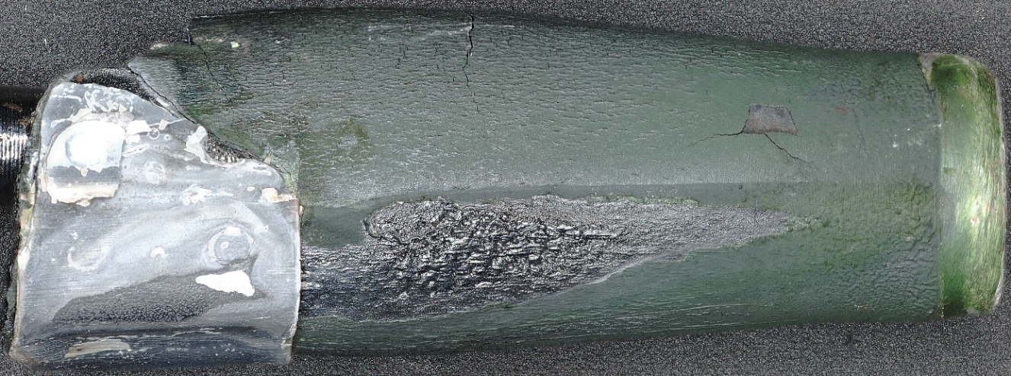
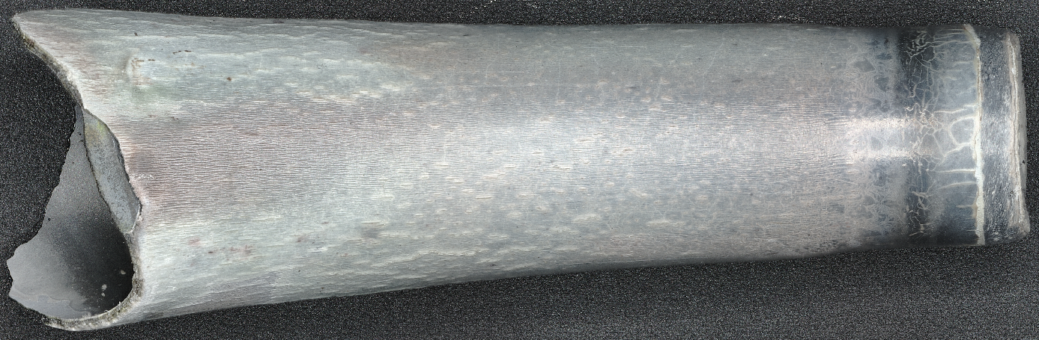
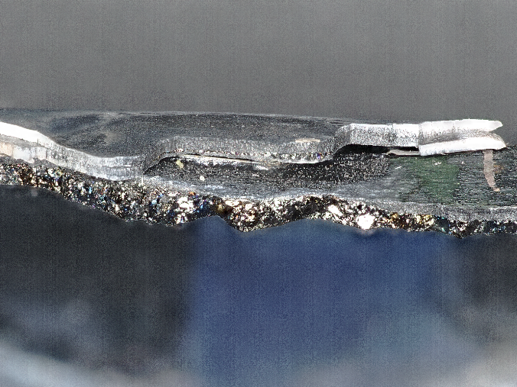
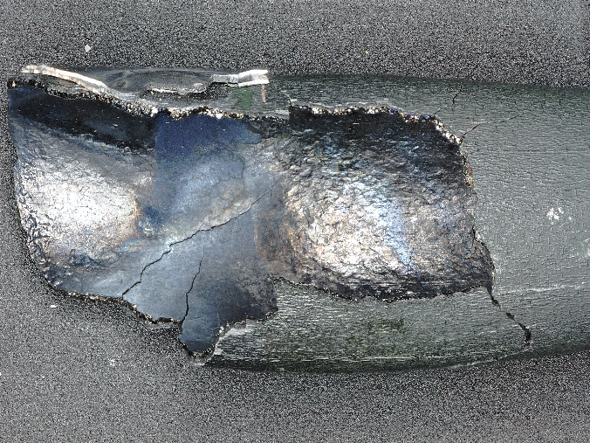
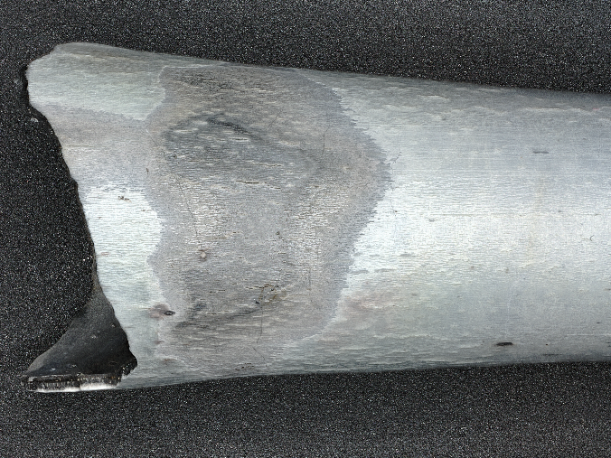
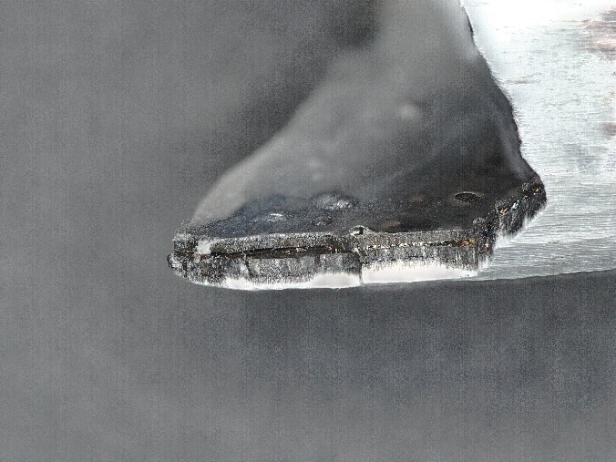

CODEX-ATF broken-off pieces from the top
$≈$elevation 590-630 mm, T_{max}>1350 °C
Rod No. 3 - Cr-coated optZIRLOTM
Cr₂O₃
Rod No. 4 - optZIRLOTM
ZrO₂
spacer grid
“crocodile skin” (Zr-Cr eutectic )
inner oxidation
393 ppm H
150 ppm H
inner oxidation
mark of spacer grid

Slide 16
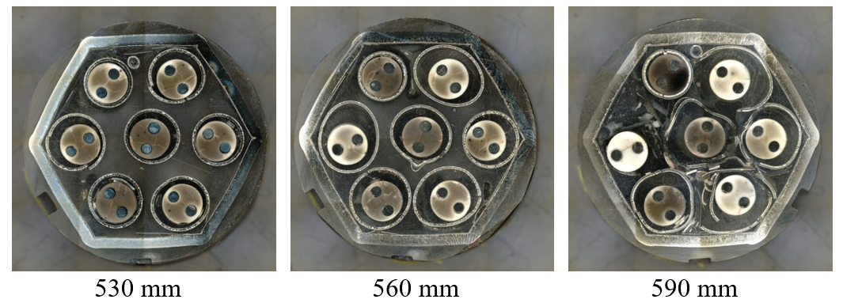
CODEX-ATF bundle cross sections
Ballooning, burst and brittle failure

Slide 17
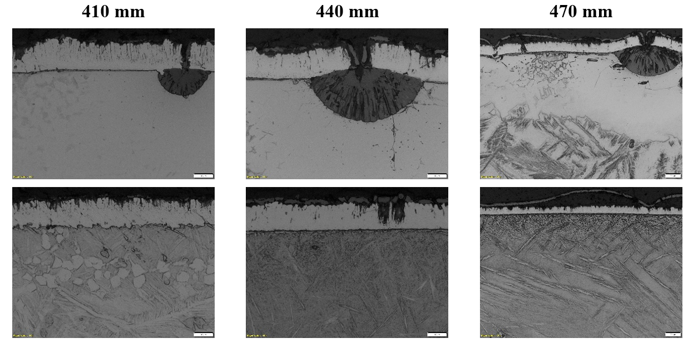
CODEX-ATF oxidation of Cr coated claddings
Cracked Cr-layer on the ballooned tubes => start of Zr oxidation
Ballooned
Non- ballooned

Slide 18
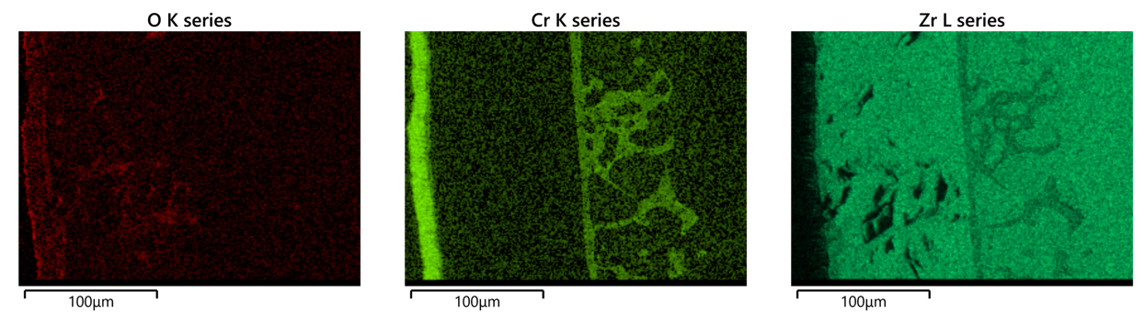
CODEX-ATF Cr diffusion into Zr
500 – 560 mm (maximum cladding temperature ≈1400 – 1650 °C)
Still significant metal phase
Largest Cr-Zr eutectic formation at rod No. 5. (undamaged Cr coating)
Cr diffusion => accumulation at the α-Zr(O)/β-Zr phase boundary

Slide 19
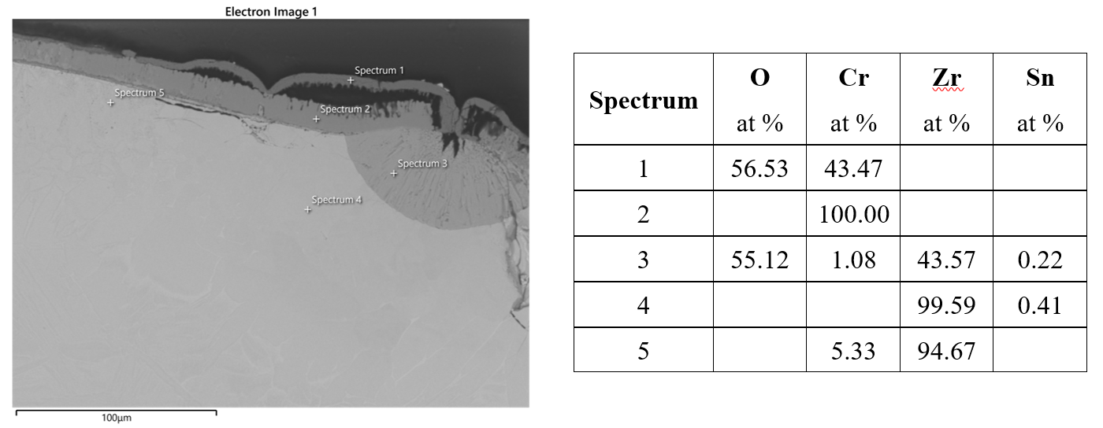
CODEX-ATF spalling Cr₂O₃ layer
Cr₂O₃
Cr
Zr
ZrO₂

Slide 20
CODEX-ATF-AIT

Slide 21
CODEX-ATF-AIT planned scenario
Air ingress after preoxidation in steam
Steam and oxygen starvation

Slide 22
CODEX-ATF-AIT planned scenario
The main objective of the proposed test was to check if Cr coating would have a protective role in case of NPP accidents with air ingress.
The proposed scenario was focused on covering several phenomena of fuel behavior during accidents
burst,
oxidation,
nitriding,
eutectic formation.
CODEX-AIT-3 experiment was chosen for reference test which was an air ingress test conducted with traditional Zr materials.

Slide 23
CODEX-ATF-AIT – coating on Zr components
Cr coating: Czech Technical University in Prague, PVD technique
CODEX-AIT-3
CODEX-ATF-AIT
Number of fuel rods | 7
Cladding of fuel rods | E110G
Length of fuel rods | 1000 mm
External diameter of fuel rods | 9.1 mm
Cladding wall thickness | 0.69 mm
Pellet material | ZrO₂
Pellet material in the bottom of the rods | Al₂O₃
Height of pellet | 10 mm
Diameter of pellet | 7.65 mm
Hole diameter in the pellet | 2 mm
Spacer grid material | Zr1%Nb
Height of spacer grid | 10 mm
Thickness of spacer grid | 0.4 mm
Number of spacer grids | 3
Shroud material | Zr2.5%Nb
Shroud thickness | 2 mm
Length of shroud | 1000 mm
Number of fuel rods | 7
Cladding of fuel rods | Cr-coated optZIRLOTM
Length of fuel rods | 900 mm
External diameter of fuel rods | 9.1 mm
Cladding wall thickness | 0.57 mm
Pellet material | ZrO₂
Pellet material in the bottom of the rods | Al₂O₃
Height of pellet | 10 mm
Diameter of pellet | 7.65 mm
Hole diameter in the pellet | 2 mm
Spacer grid material | Cr-coated Zr1%Nb
Height of spacer grid | 10 mm
Thickness of spacer grid | 0.4 mm
Number of spacer grids | 3
Shroud material | Cr-coated Zr2.5%Nb
Shroud thickness | 2 mm
Length of shroud | 1000 mm
Uniform Cr coating layer around the circumference of the cladding ≈15.5 µm
Thickness of the Cr layer on spacer grid
at the straight sections almost uniform ≈ 10 – 12 µm
at the curved parts ≈ 2 – 3 µm

Slide 24
Power and temperatures
CODEX-AIT-3
CODEX-ATF-AIT

Slide 25
CODEX-ATF-AIT results – Temperatures
CODEX-AIT-3
CODEX-ATF-AIT
Extra power was needed with Cr coating to accelerate temperature increase
Half hour delay in escalation

Slide 26
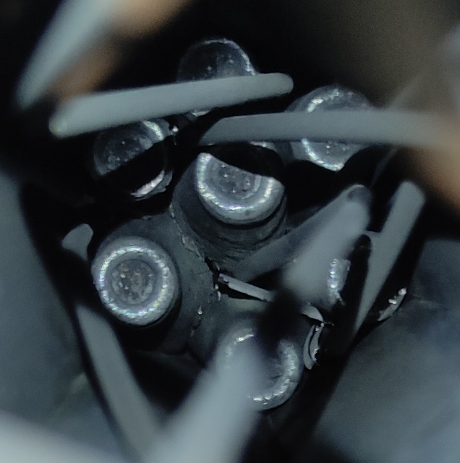
CODEX-ATF-AIT results – Pressures
CODEX-ATF-AIT
Top view of the CODEX-ATF-AIT bundle after experiment

Slide 27
CODEX-ATF-AIT results – Outlet gas composition
CODEX-AIT-3
CODEX-ATF-AIT
Total H₂ generation:
Pre-oxidation phase: ≈ 3.8 g
Air-ingress phase: ≈ 1.4 g
Total H₂ generation:
Pre-oxidation phase: ≈ 1.4 g
Air-ingress phase: -
Extra air-ingress phase: ≈ 3.3 g

Slide 28
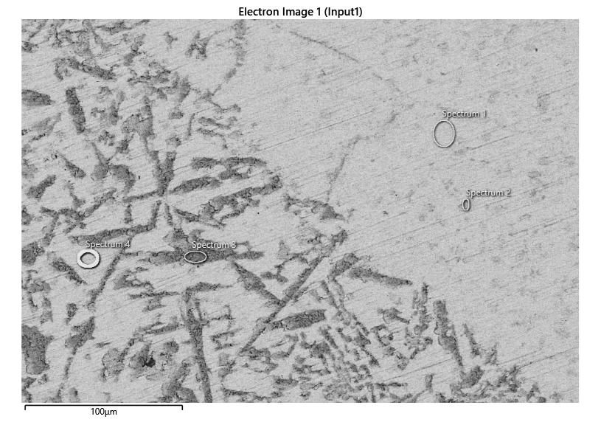
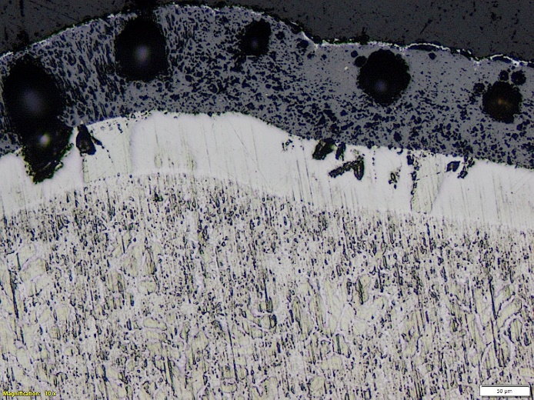
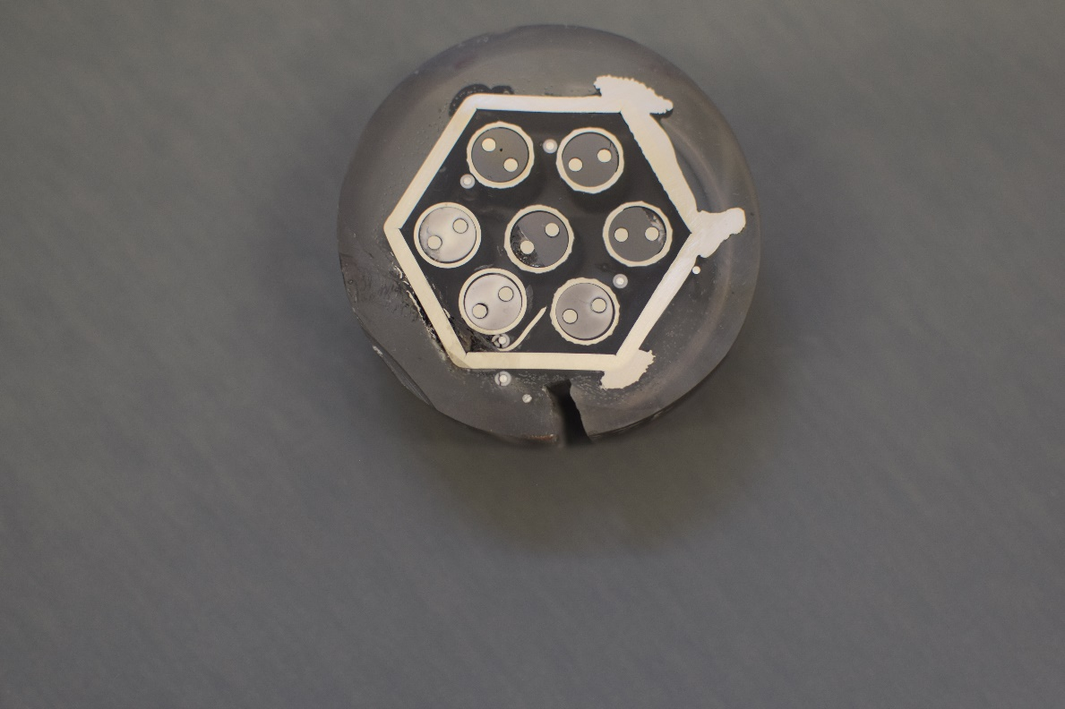
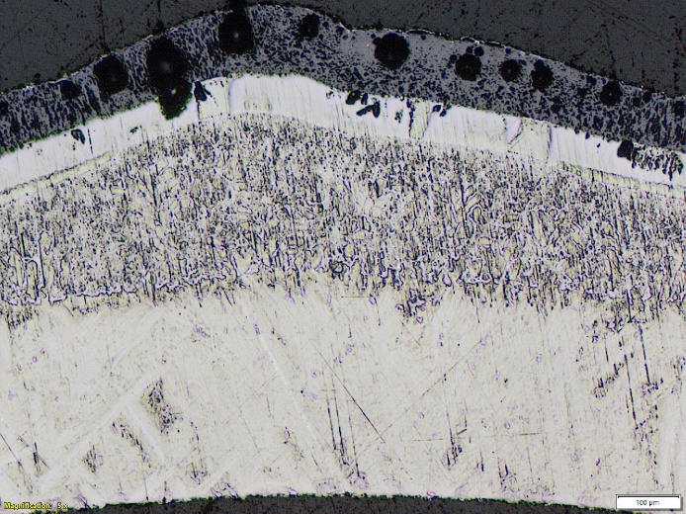
Cross section of rods at 125 mm
pre-oxidation phase: no balloning, no oxidation (T < 600 °C)
extended air ingress phase: eutectic melt formation (T_{max} ≈ 1400 °C)
α-Zr(O) (60-80 at. % Zr – 15-30 at. % O) and thin Cr-rich features (2-5 at. % Cr )
96 at. % Zr
2 at. % Cr
2 at. % Fe
64 at. % Cr
30 at. % Zr
3 at. % Fe
Cr coating
≈100 μm ZrO₂ layer
50-60 μm α-Zr(O) layer
150-250 μm eutectic region
≈350 μm β-Zr layer
125 mm

Slide 29
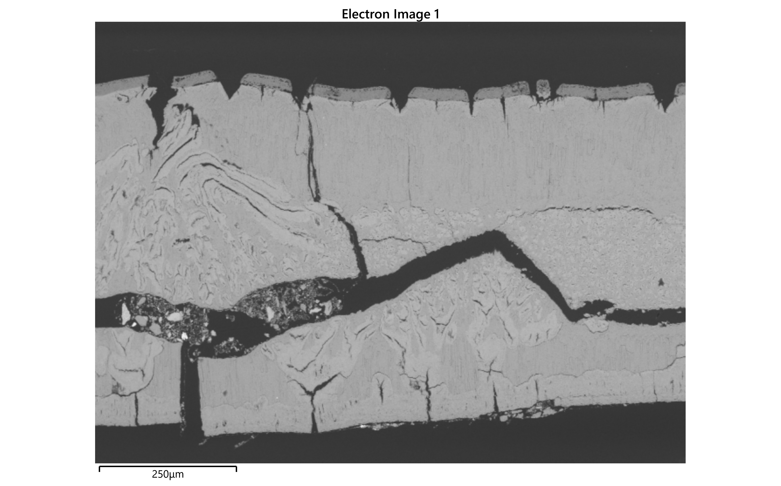
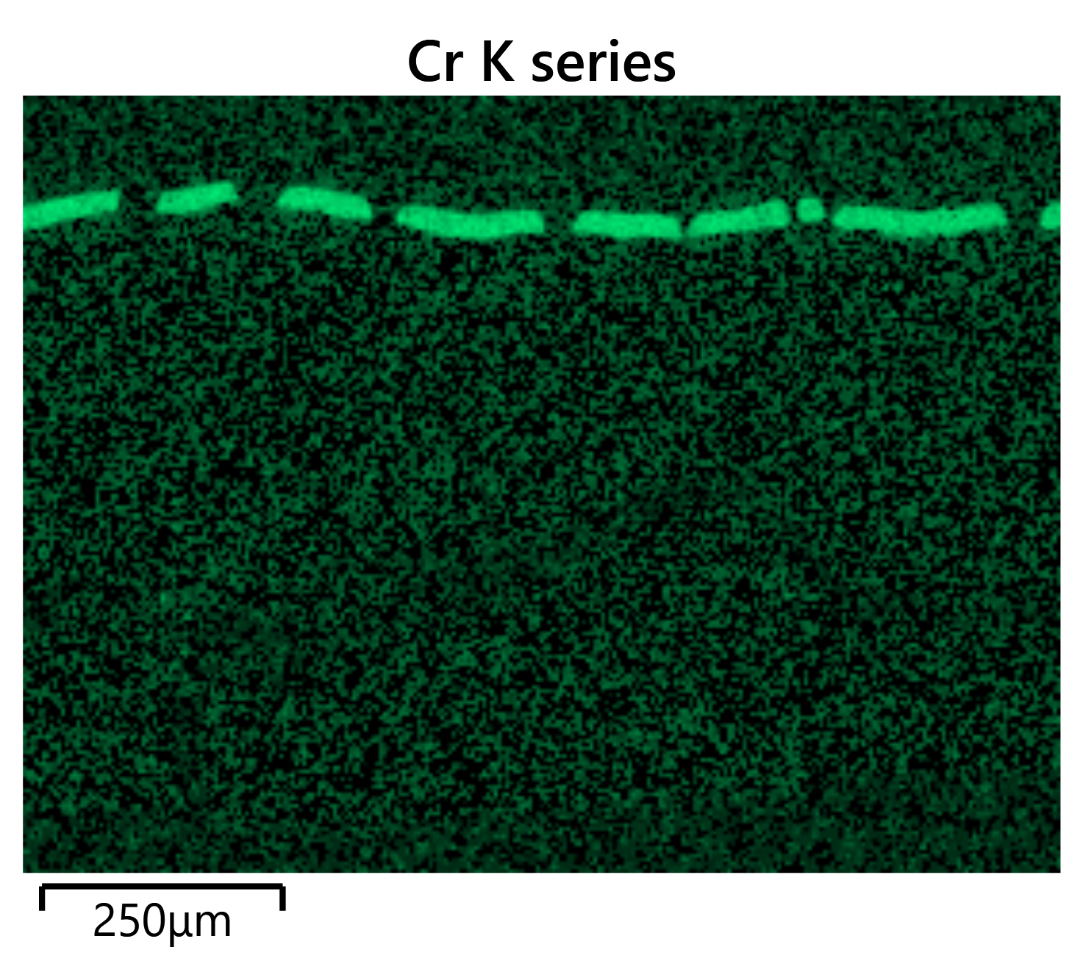
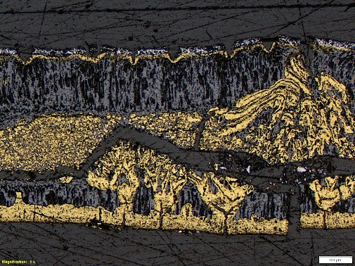
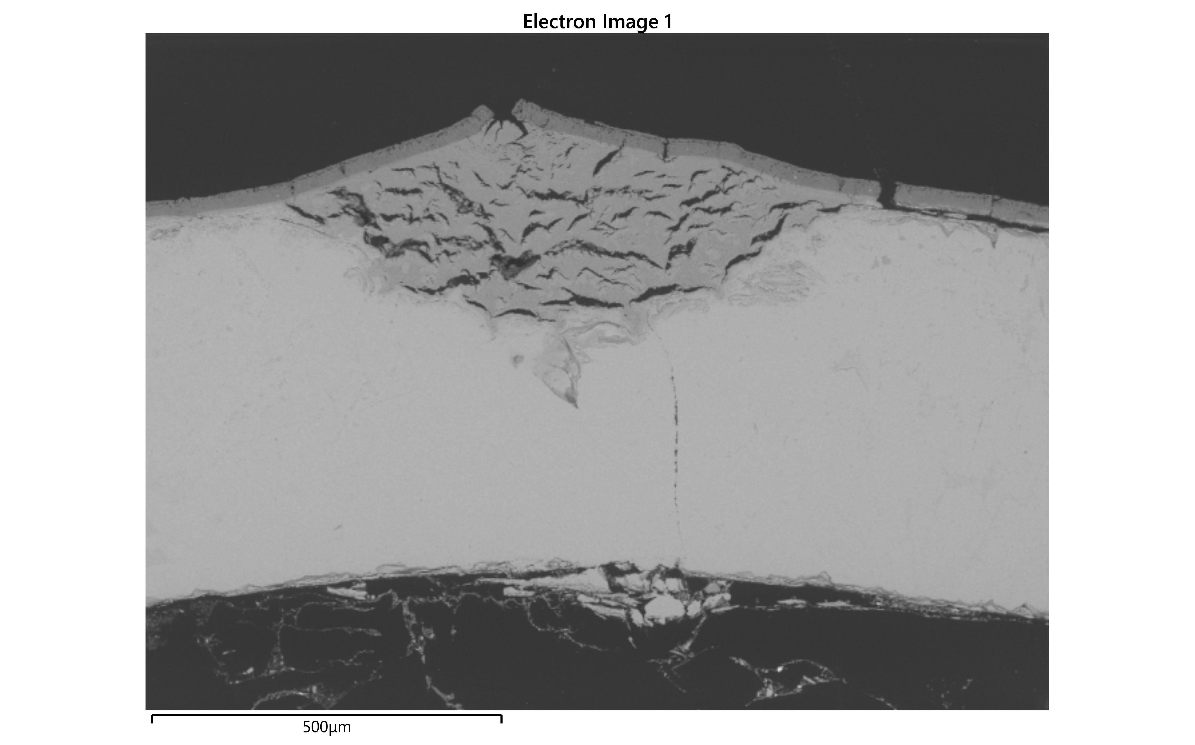
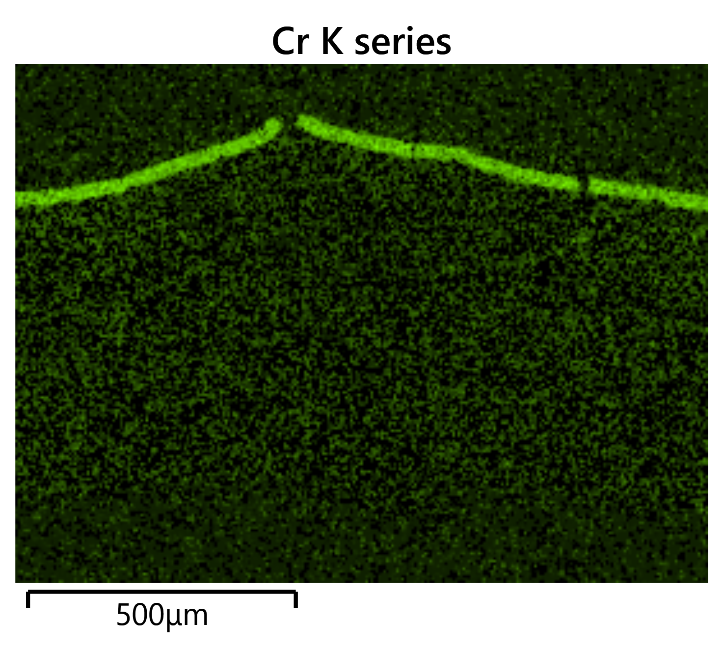
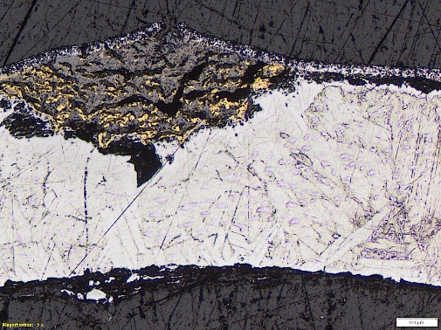
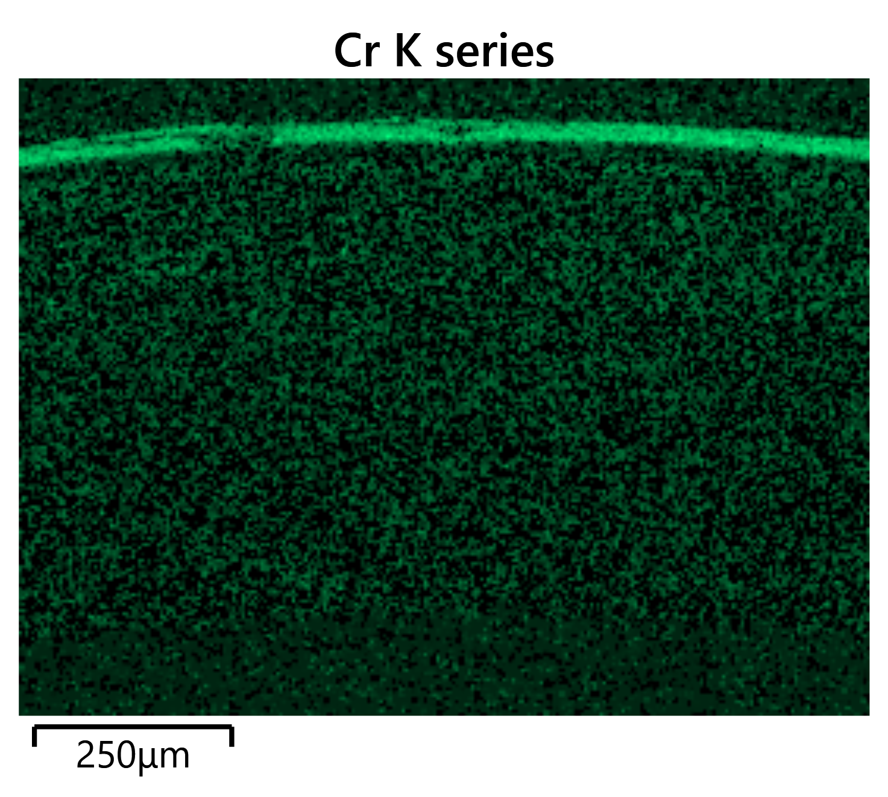
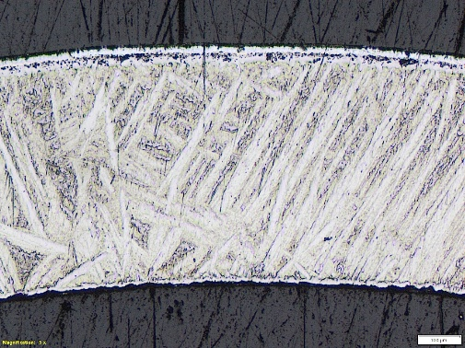
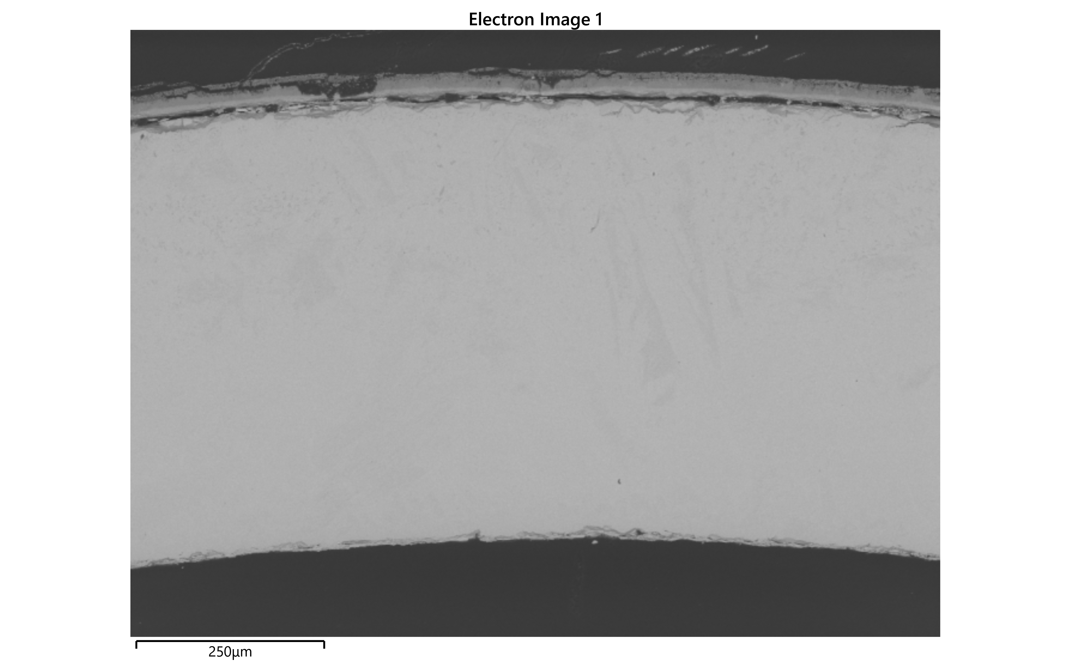
Cross sections of rods at 800 mm
No. 2.
ballooned and burst
No. 3.
ballooned and non-burst
No. 6.
non-ballooned

Slide 30
SUMMARY AND CONCLUSIONS

Slide 31
Summary
Two integral tests with ATF cladding materials were conducted in the CODEX facility in steam and steam+air atmospheres
 | CODEX-ATF | CODEX-ATF-AIT
Max. temperature | 1655 °C | 1545 °C
Steam atmosphere | Yes | Yes
Steam+air atmosphere | No | Yes
Oxidation | Yes | Yes
Nitriding | No | Yes
Cr-Zr eutectic | Yes | Yes
Quench | Yes | No

Slide 32
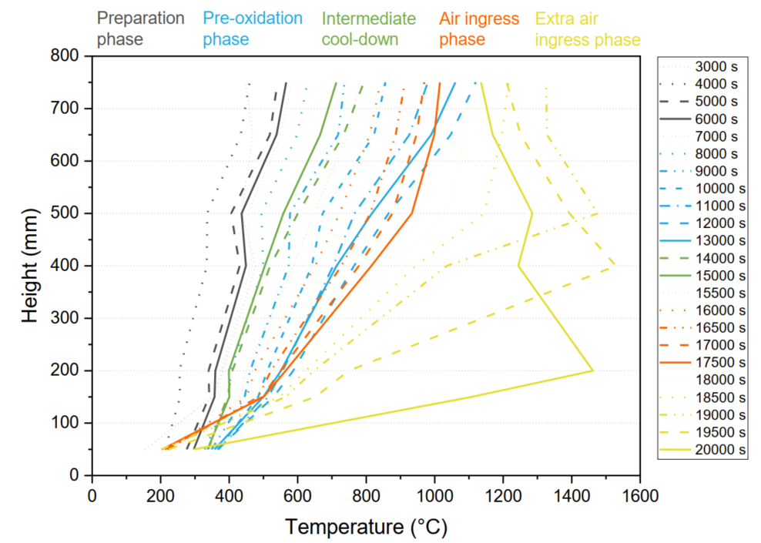
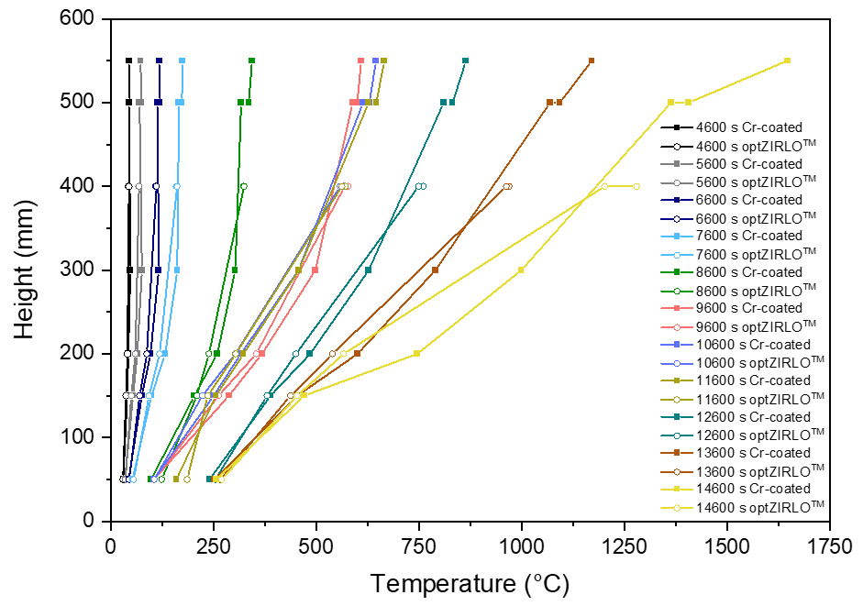
Summary – axial temperature profiles
CODEX-ATF CODEX-ATF-AIT
No steam starvation
Steam and oxygen starvation

Slide 33
Conclusions
CODEX-ATF CODEX-ATF-AIT
Ballooning of Cr coated claddings resulted in crackings of Cr-layer, which lead to local oxidation of Zr at the crack positions.
Cr-Zr eutectic formation and Cr diffusion took place at ≈1400 – 1650 °C.
Similar degree of degradation of Cr coated and uncoated claddings was observed after reaching 1655 °C temperature.
The comparison of results from the CODEX-AIT-3 and CODEX-ATF-AIT tests suggests that ATF materials can increase the coping time in the event of air ingress type reactor accidents.
The ATF cladding reacted significantly less with high-temperature steam below 1200 °C than traditional Zr cladding material.
In the reference test, air ingress led to a temperature excursion, with cladding temperatures reaching 1625 °C within 40 minutes. Under the same conditions in the CODEX-ATF-AIT test, the cladding temperature increased only to 1030 °C over the same period.

Slide 34
Conclusions
The Cr coating provided significant protection against oxidation in both steam and air atmospheres as long as the coating remained intact.
Ballooning: after cracking of the Cr layer, local oxidation of Zr began. The local oxidation spots could facilitate full cross-sectional fracture of the cladding tube wall.
Cr-Zr eutectic melt formation: can take place if Cr diffuses into the Zr cladding wall to a large extent and the temperature reach the Cr-Zr eutectic melt formation temperature. Fast oxidation/nitriding of the metallic Cr-Zr eutectic melt could start.
The final state of the Cr-coated and uncoated fuel rods after reaching 1500–1600 °C was similar.
The degradation of the ATF fuel occurred more slowly in the integral tests compared to traditional fuel.

Slide 35
Thank you for your attention!

