Slide 1
Framatome Programs to Support U.S. PWR Optimization
Lisa Gerken
Senior Technical Advisor
Framatome Inc.
October 2025
Notes:
Lisa Gerken — Senior Technical Advisor, Framatome Inc.
talk objective: to show how AFM (Advanced Fuel Management) plus PROtect Cr (E‑ATF) enable US PWR optimization—economics, safety, and deployment path.

Slide 2
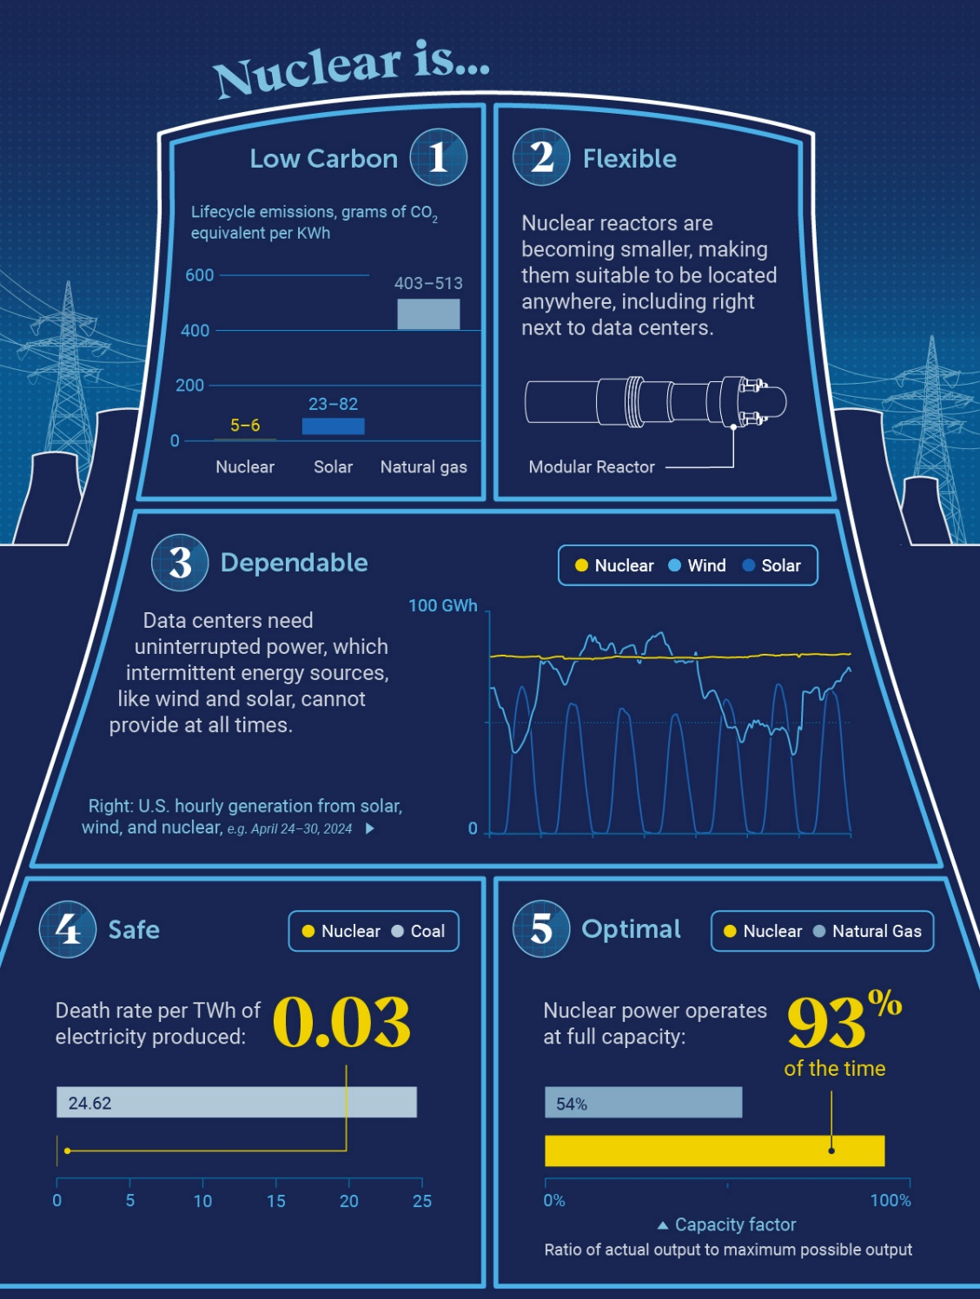
Rising electricity demand and decarbonization increase interest in fleet optimization
Vastly different story today
Government funded initiatives
2010’s
Prominent industry leaders and technology company support
Fukushima, focusing on enhanced safety performance
↑ Nuclear Fuel Research
Growth of AI and data centers
Economics and negative public perception
↓ Nuclear Market
Change in public perception
US plants have been maintaining status quo or shutting down
Visual Capitalist. (2025). 5 Ways Nuclear Can Power the Future [Infographic]. https://www.visualcapitalist.com/sp/5-ways-nuclear-can-power-the-future/

Slide 3
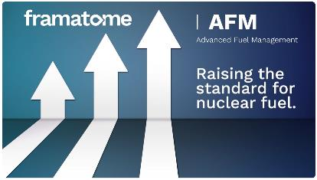


Framatome’s Advanced Fuel Management (AFM) Program: Coordinated effort to implement higher enrichment and burnup using proven components and upgraded supply chain
Framatome’s Support Strategy
Framatome’s PROtect Cr: Evolutionary E‑ATF fuel product combining Cr‑coated M5‑cladding with Cr₂O₃‑doped UO₂ pellets for improved accident performance
Common Foundation: M5_{Framatome} cladding performance, GALILEO fuel performance code, and ARCADIA 3D neutronics platform
Notes:
Key initiatives: enrichment >5 wt% U‑235 (LEU+), rod average burnup >62 GWd/MTU, and ATF deployment.
Goals: enable 24‑month cycles, reduce batch sizes, support power uprates while maintaining regulatory compliance.

Slide 4
1
Framatome’s AFM Program

Slide 5
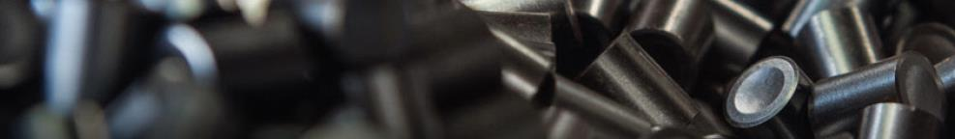
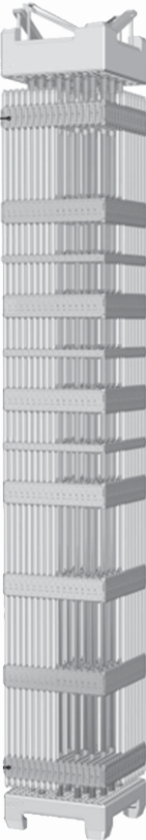
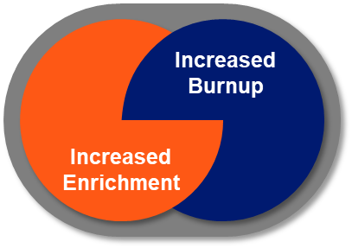
AFM Program
Goal: Improve economics while maintain performance and safety
Increased enrichment and increased burnup enable:
More energy to be loaded into each fuel assembly
Higher energy production from each fuel assembly
AFM Approach
AFM = Framatome’s Advanced Fuel Management program
Streamline site upgrades with a plan that maintains flexibility and efficiency
Employ fuel components with a service record of robust performance
Build up foundation of advanced code and methods that provide the features and flexibility to support AFM core designs

Slide 6

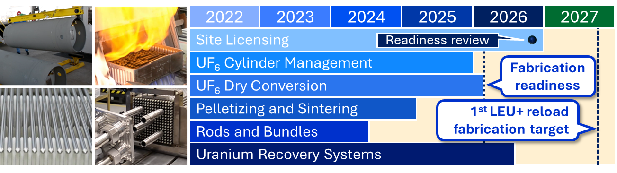
Increased Enrichment
✓
- first line upgraded
Disciplined implementation and use of operating experience
Carefully coordinated with concurrent reloads and other plant investments
Existing reload orders maintain priority
Project schedule included substantial flexibility relative to first LEU+ reload
Early procurement assured major new components were onsite when needed
Design and procurement were largely finished by 2024

Slide 7
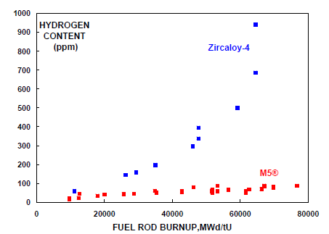
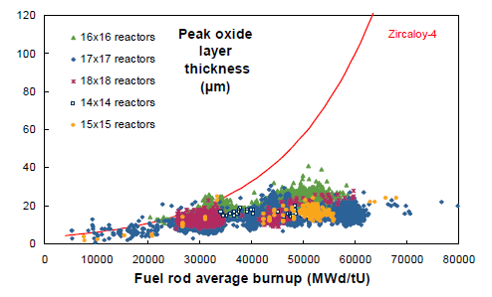
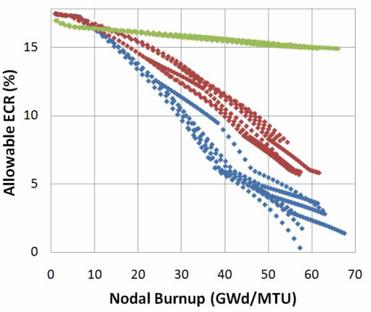

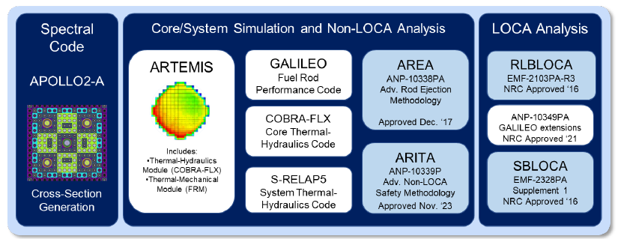
Hydrogen
Content
(wppm)
Increased Burnup
Proven fuel designs that maintain their performance through irradiation are essential
With over 20 years of operation, M5_{Framatome} cladding remains the gold standard
Deployed in over 7 million fuel rods worldwide
Recognized for its mechanical properties, superior corrosion resistance, and very low hydrogen pickup
Increased Burnup for PWRs
Extension to high burnup
Increased Enrichment for PWRs
Extension to >5 wt% U-235
Innovative codes and methods solution needed to unleash the full value of AFM
Advanced Non-LOCA
ARITA
Advanced REA
AREA
Upgraded FPC
LOCA GAL
ARCADIA Code System
HBU Approved
GALILEO FPC
HBU Approved
Q12
M5Framatome Cladding
HBU Approved
Assembly Designs and Materials
Established Performance

Slide 8
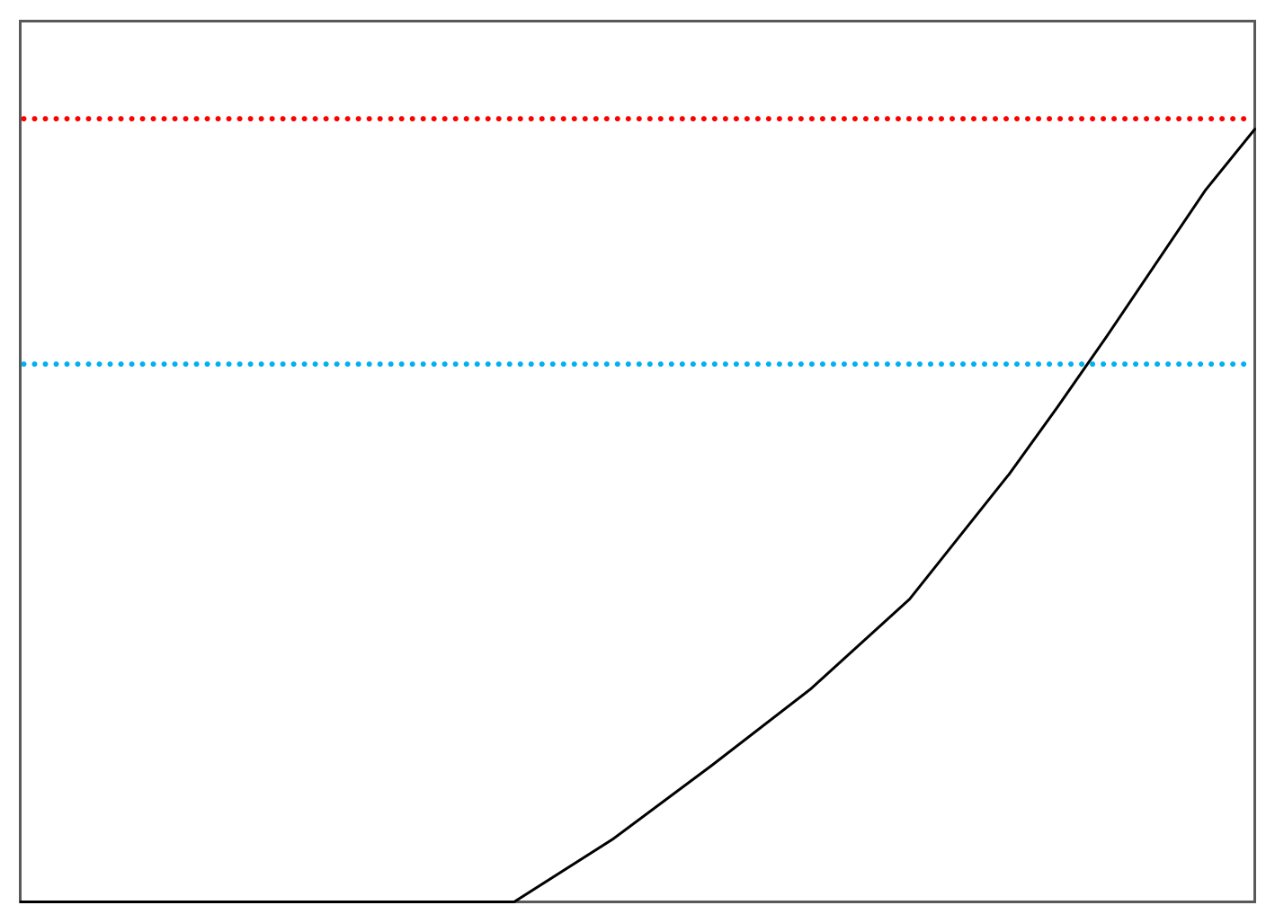
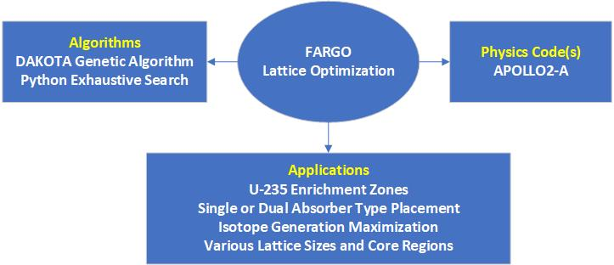
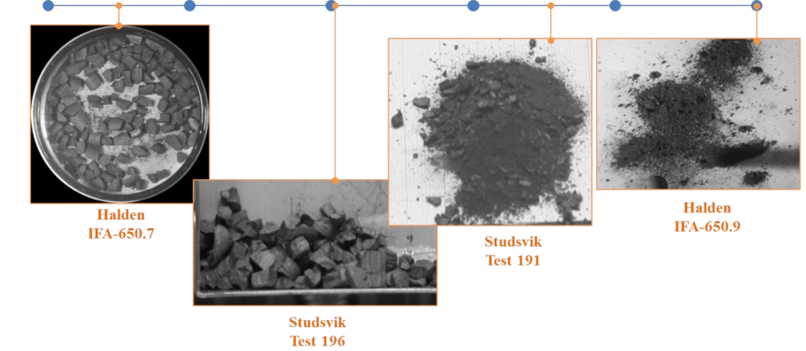
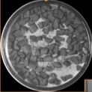
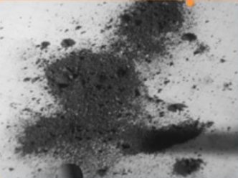
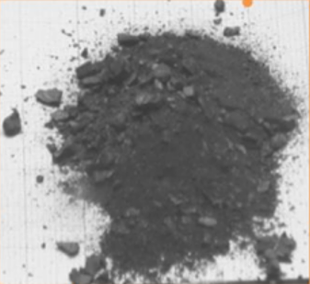
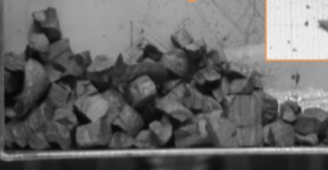
Increased Burnup
Increased Rod Internal Pressure Limit
M5_{Framatome} rod over pressure limit
Core Design Optimization
Rod Over Pressure
Historical rod over pressure
HBU Limitation
62 GWd/mTU
Rod Average Burnup
HBU Challenge
Increased likelihood of fuel dispersal during a LOCA
Framatome Solution to FFRD
Phenomena-driven
Risk-informed and performance-based
Addresses all LOCA break sizes
Remains within the existing 10 CFR 50.46 rule, i.e., no rule change required
Increasing Fragmentation with Burnup

Slide 9
2
Framatome’s PROtect Cr

Slide 10
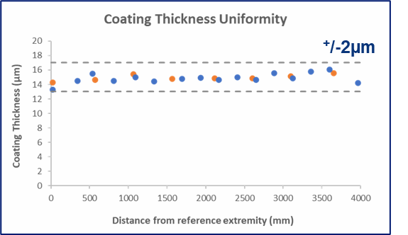
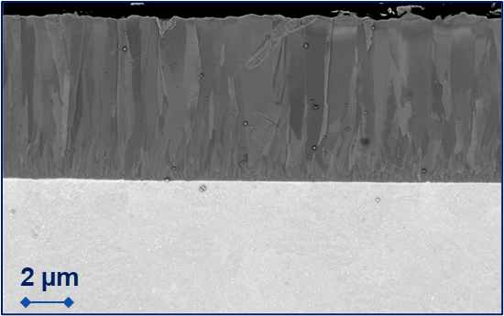
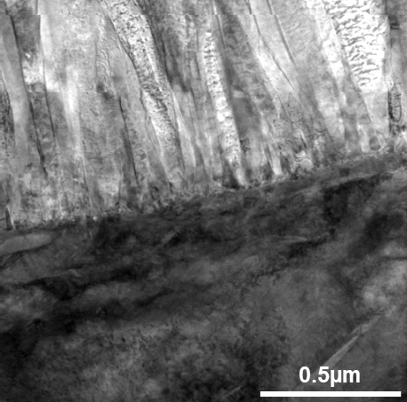
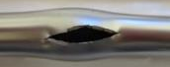
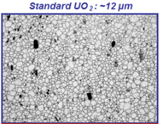
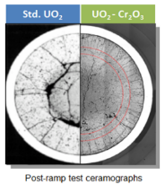
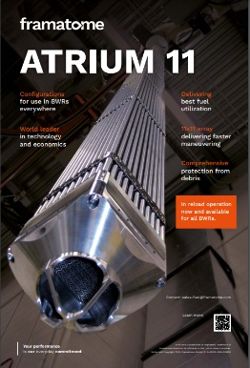
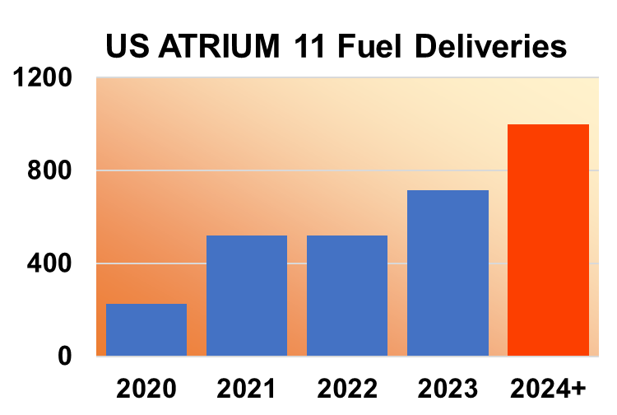
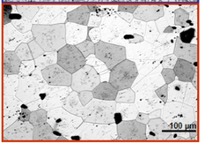
PROtect Cr Fuel & Cladding
Dense & uniform coating
Roughness equivalent to uncoated cladding
Cr
Excellent adherence
No significant modification of cladding microstructure
M5_{Framatome}
PVD produces a highly protective and adherent coating while retaining key M5_{Framatome} cladding properties
Enhanced viscoplasticity
for improved PCI performance
100µm
Cr-doped pellets are already commercialized and available in reload volume production
Large grain microstructure for improved fission gas retention

Slide 11
US Deployment
 | 2016 | 2017 | 2018 | 2019 | 2020 | 2021 | 2022 | 2023 | 2024 | 2025 | 2026 | 2027 | 2028
Lab scale
Coated Clad
Manufacturing
Full-length small-scale industrial
Large scale industrial
Reload
Ready
Base properties out of pile characterization
Coating
Qualification
Test reactor irradiation testing
Accidental properties out of pile characterization
Commercial reactor irradiation testing
US
PROtect Cr
Licensing
Cr-Doped Licensing
BWR
PWR
Cr-Coating Licensing

Slide 12
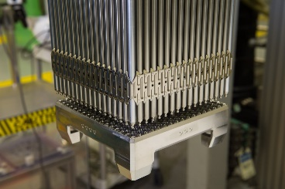
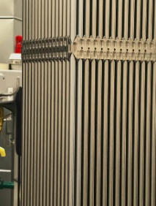
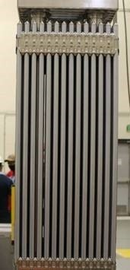
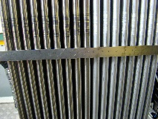

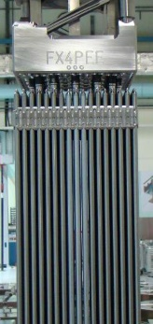

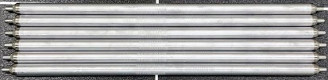
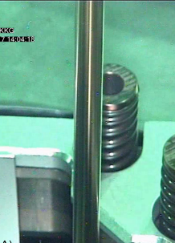
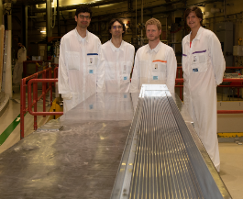

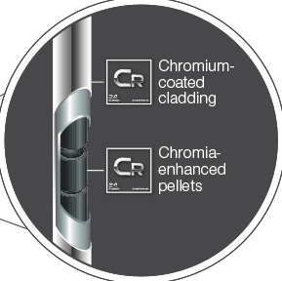
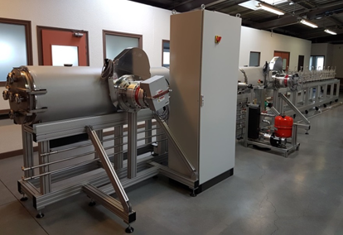
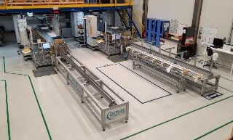
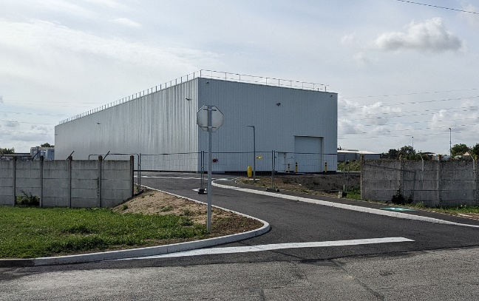
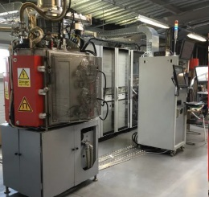

Production Qualification
Halden 2017
Vogtle 2019
ANO 2019
Blayais 2023
OSIRIS 2015
Hermès-P/Seismic test assemblies 2021
ATR 2025
2016: Cr-coating of small samples mastered
2018: Cr-coating of full-length cladding begins
2026: Installation of industrial pilot line at Framatome Paimboeuf (100,000 tubes/year)
2020: Full-length Cr-coating begins at Framatome Paimboeuf
Calvert Cliffs 2021
ATR 2018
Gösgen 2019
IMAGO 2016
Lab-scale coater
Full-length Prototype (FLP) Machine
Coating PROtect Prototype (CPP) Machines
PROtect Industrial Pilot Facility

Slide 13
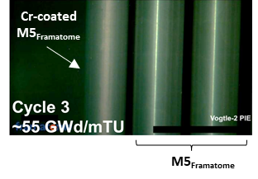
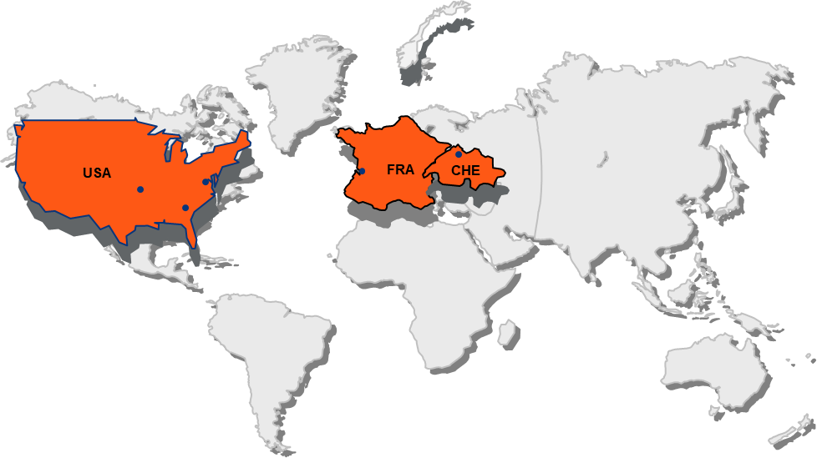
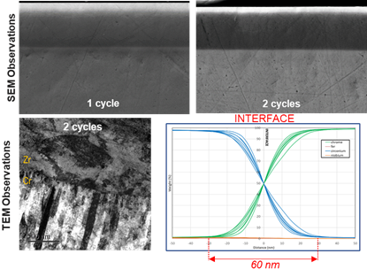
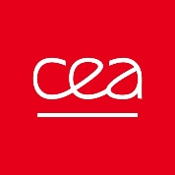
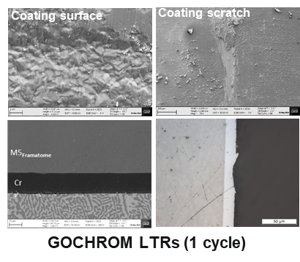
Worldwide Irradiation
Gösgen
IMAGO–MTR: Six 12-mo cycles Equivalent burnup of ~90GWd/tU
GOCHROM–LTR: Five 12-month cycles Burnup of ~73GWd/tU
Vogtle - LTR
Three 18-month cycles of irradiation
Arkansas Nuclear One - LTR
Three 18-month cycles of irradiation
Calvert Cliffs 2 - LTA
First fully-coated fuel assembly completed its 2nd 24-month cycle
3rd cycle in progress!
Blayais - LTR
First cycle in an EDF reactor completed
Excellent performance during full lifecycles confirmed by PIE Irradiation Examinations (PIE) in reactor and in hot-cells up to very high burnups

Slide 14
3
Takeaway

Slide 15
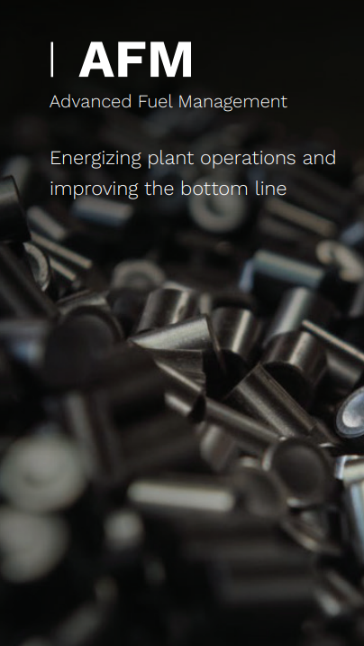
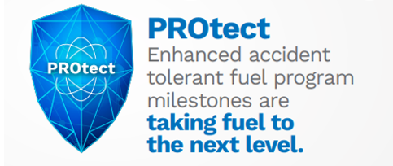
Conclusions
Industry initiatives support continued and consistent power production from the operating fleet
Framatome’s comprehensive approach to AFM and ATF leverages manufacturing upgrades, an advanced cladding (M5_{Framatome}), state-of-the-art analytical tools, and a robust development and licensing framework
Enables utilities to achieve longer cycles, greater efficiency, and enhanced safety with proven products and capabilities
Provides a pathway for the adoption of next-generation accident tolerant fuels
Notes:
Minimize rais

