Slide 1
Research Progress & Prospects of the Cr-coated claddings and Large-grain fuel pellets
JIAO Yongjun, YIN Chunyu, HONG Zhenhan
Nuclear Power Institute of China
Notes:
1
1

Slide 2
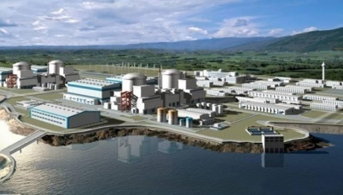

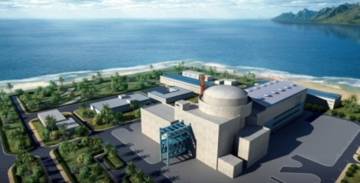
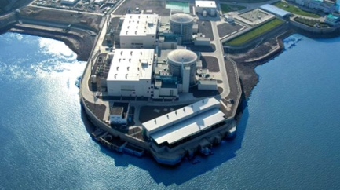
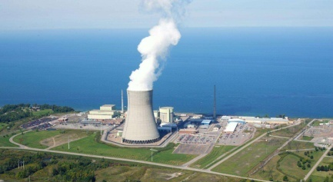
Content
1
Introduction
2
Progress of the Cr-coated claddings
3
Progress of the Large-grain pellets
4
Future activities and discussions
5
Conclusion

Slide 3

PART 1
Introduction
Notes:
3

Slide 4
Introduction | Current trends
Current trends of the PWR fuel developing:
improve nuclear safety and reliability
increase maximum burnup
extend refueling cycles
Conventional nuclear fuel
ATF
Burnup of the fuel assembly （MWd/tU） | ＜33,000 | 42,000 | 52,000 | 57,000 | 62000
Refueling cycles（month） | ＜12 | 12 or more | 18 | 18 or more | 24 or more
Failure rate | —— | 10⁻⁵ | 10⁻⁵ | 10⁻⁶ | 10⁻⁶
Accident Tolerant Fuel (ATF) has been the research hotspot for more than ten years

Slide 5
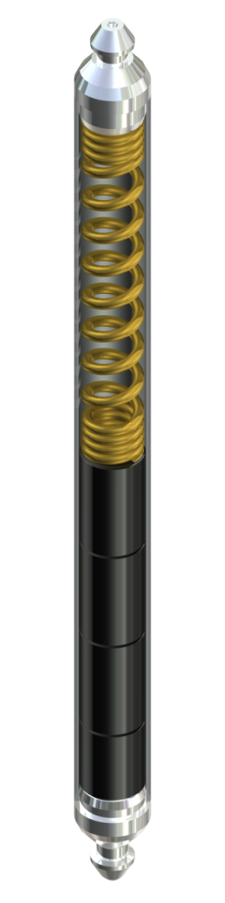
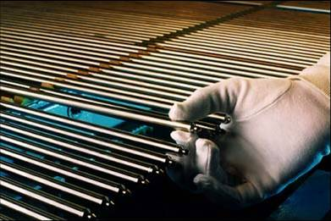
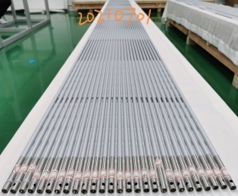
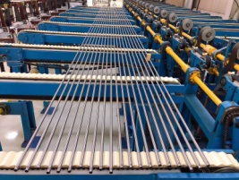
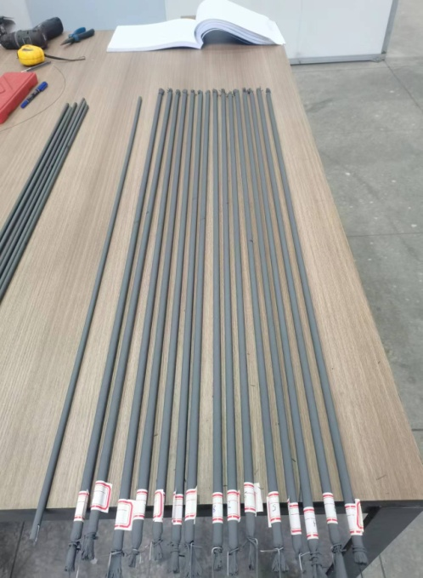
Introduction | Cr coating
Good corrosion resistance
Proper strength and hardness
Good machinability
Zr-water reaction generates H₂
Conventional Zr alloy claddings
ATF cladding
Cr-coated cladding
FeCrAl cladding
SiC cladding
Cr-coated zircoloy cladding is considered the most likely ATF technology to achieve engineering aplication in near future.

Slide 6
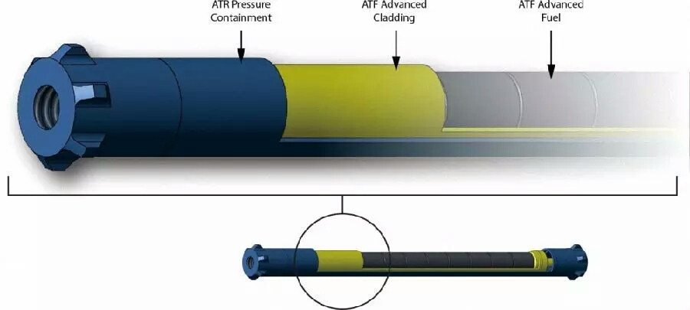
Introduction of the Cr-coated claddings
The Cr-coated cladding is obtained by applying a Cr layer on the outer surface of the zircaloy cladding.
Significantly enhance corrosion resistance of the cladding, potential to increase maximum fuel burnup, and further improve the economic of NPPs .
Significantly reduce hydrogen production and improve high-temperature oxidation resistance of the cladding, increase the safety margin of fuel assemblies under LOCA conditions.
Currently the most commercially promising ATF cladding technology in the near term.
Cr coating
zirconium alloy cladding
pellets
Coating: improve the high-temperature oxidation resistance
Retain advantageous properties of zirconium alloys
Zirconium: Small neutron absorption cross-section
60 years of application experience
Notes:
NPP:nuclear power plants

Slide 7
Introduction | Large-grain fuel pellet
The Large-grain fuel pellet is one of the technical approaches to improve rod performance in operation.
The mainstream process for large-grain pellets is grain growth achieved by adding trace additives (typically less than 1 wt%), which effectively improves their performance without changing more.
Some common processes for large-grain UO₂ pellets are the doping approach (Cr₂O₃ or Cr₂O₃-Al₂O_{3,} SiO2）

Slide 8
Introduction
To improve fuel reliability and safety, along with counterparts and the CRPs platform from IAEA, NPIC has been working on Cr-coated cladding and large-grain UO2 pellets in recent years.
Out-of-pile tests have been conducted for both coating cladding and large grain pellets.
Cr-coated cladding has completed full-cycle irradiation in commercial reactors

Slide 9
PART 2
Progress of the Cr-coated claddings
Notes:
9

Slide 10
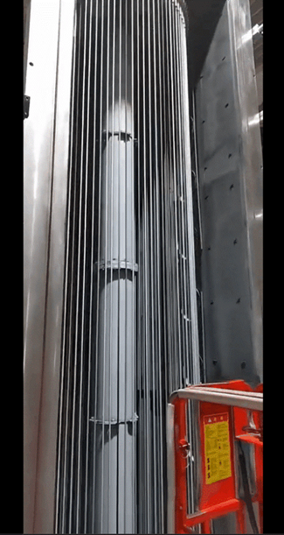
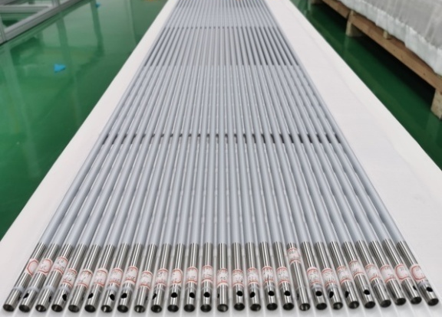
2.1 Fabrication
Fabrication
Cr coating is prepared on the surface of zirconium alloy cladding using the multi-arc ion plating process
Excellent coating-substrate adhesion, high deposition rate, low heating temperature, and high target material utilization.
Full-size coating fabrication equipment
Small-batch full-size coated cladding

Slide 11
2.2 Out-of-pile performance
Investigations are conducted on the out-of-pile properties or performance.
Test item | Cr-coated zircaloy cladding | comparation with zircaloy cladding or item effect
Thermal physical properties of Cr | √ | /
Corrosion | √ | Better
High-temperature steam oxidation | √ | Better
Thermal shock | √ | No significant effect
Friction and Wear | √ | Better
Tensile properties | √ | No significant difference
Creep | √ | Better
Burst | √ | Slightly better
Fatigue | √ | Slightly worse
Electrochemical corrosion | √ | No significant effect
Micro-crack analysis of Cr-coated cladding | √ | No significant effect
Cladding Scratch Analysis | √ | No significant effect
High-temperature burst test | √ | Slightly better
High-temperature plastic deformation test | √ | Better

Slide 12
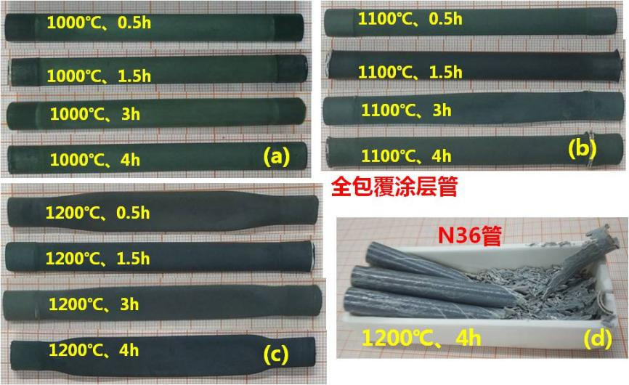
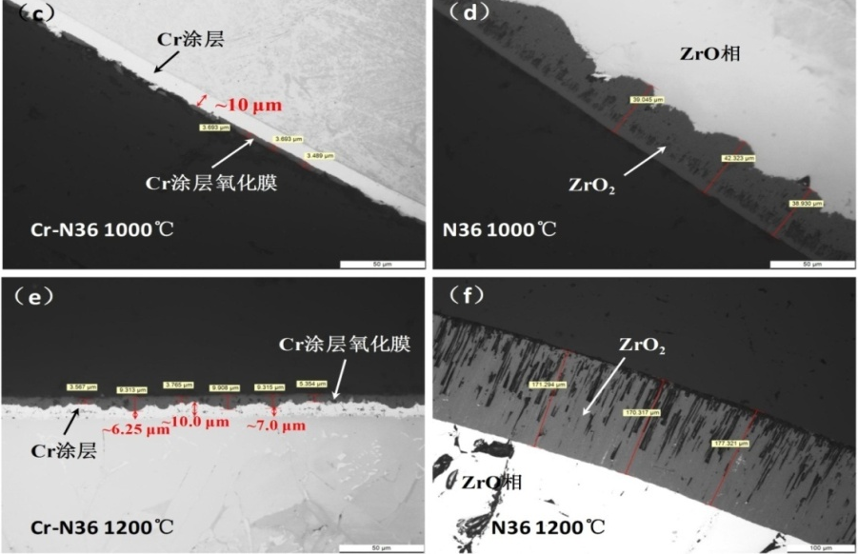
2.2 Out-of-pile performance
High-temperature oxidation
The Cr coating does not spall from the Zr substrate under high-temperature oxidation conditions, demonstrating excellent adhesion.
The high-temperature oxidation rate of the Cr coating in steam environment is significantly lower than that of zirconium alloy, effectively suppressing the reaction between the zirconium alloy and steam, thus maintaining the structural integrity of the zirconium alloy samples under such conditions.

Slide 13
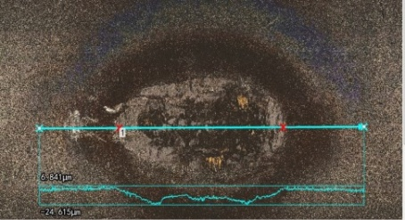
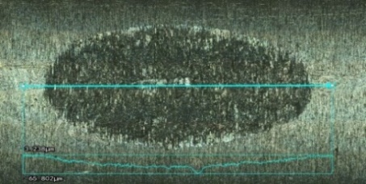
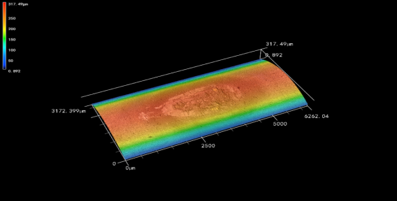
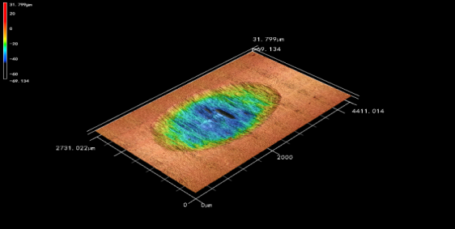
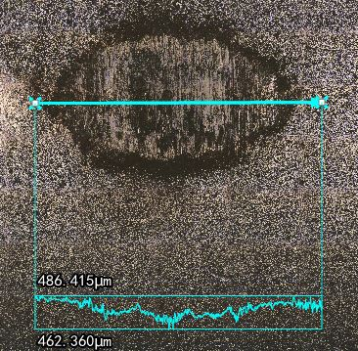
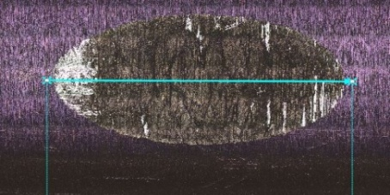
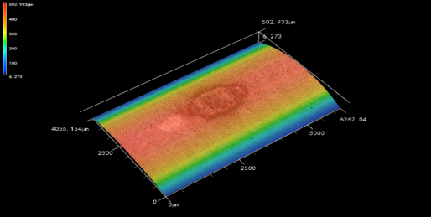
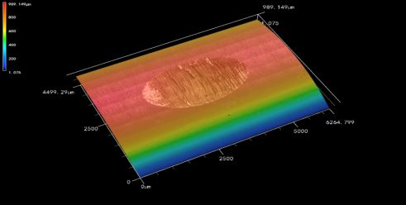
2.2 Out-of-pile performance
Friction and wear
Under high-temperature and high-pressure water conditions of 300°C/15 MPa, the volumetric wear rate of the Cr coating is less than 30% of that of uncoated zirconium alloy.
No coating cracking or spalling observed around the wear track after friction and wear testing.
4h
4h
4h
3D topogra-phy measure-ment
Wear morph-ology
Cr
zircaloy
4h
4h
4h
Cr
Zircaloy

Slide 14
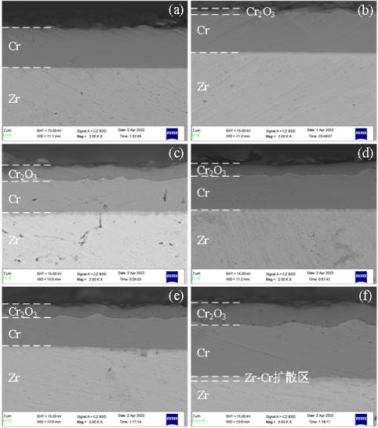
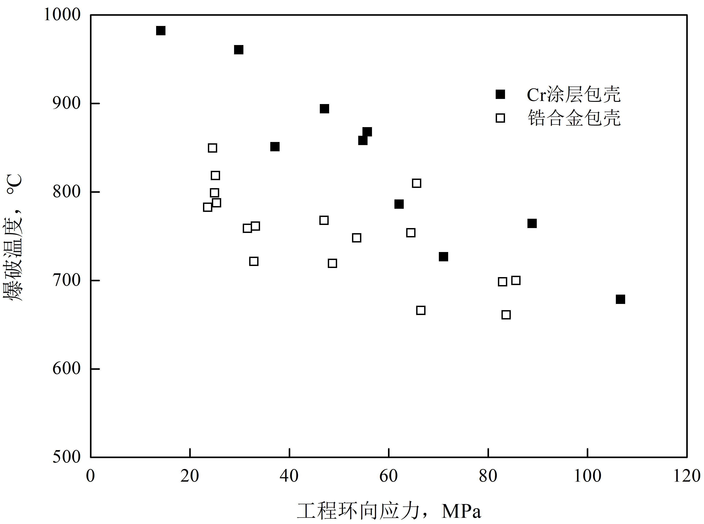
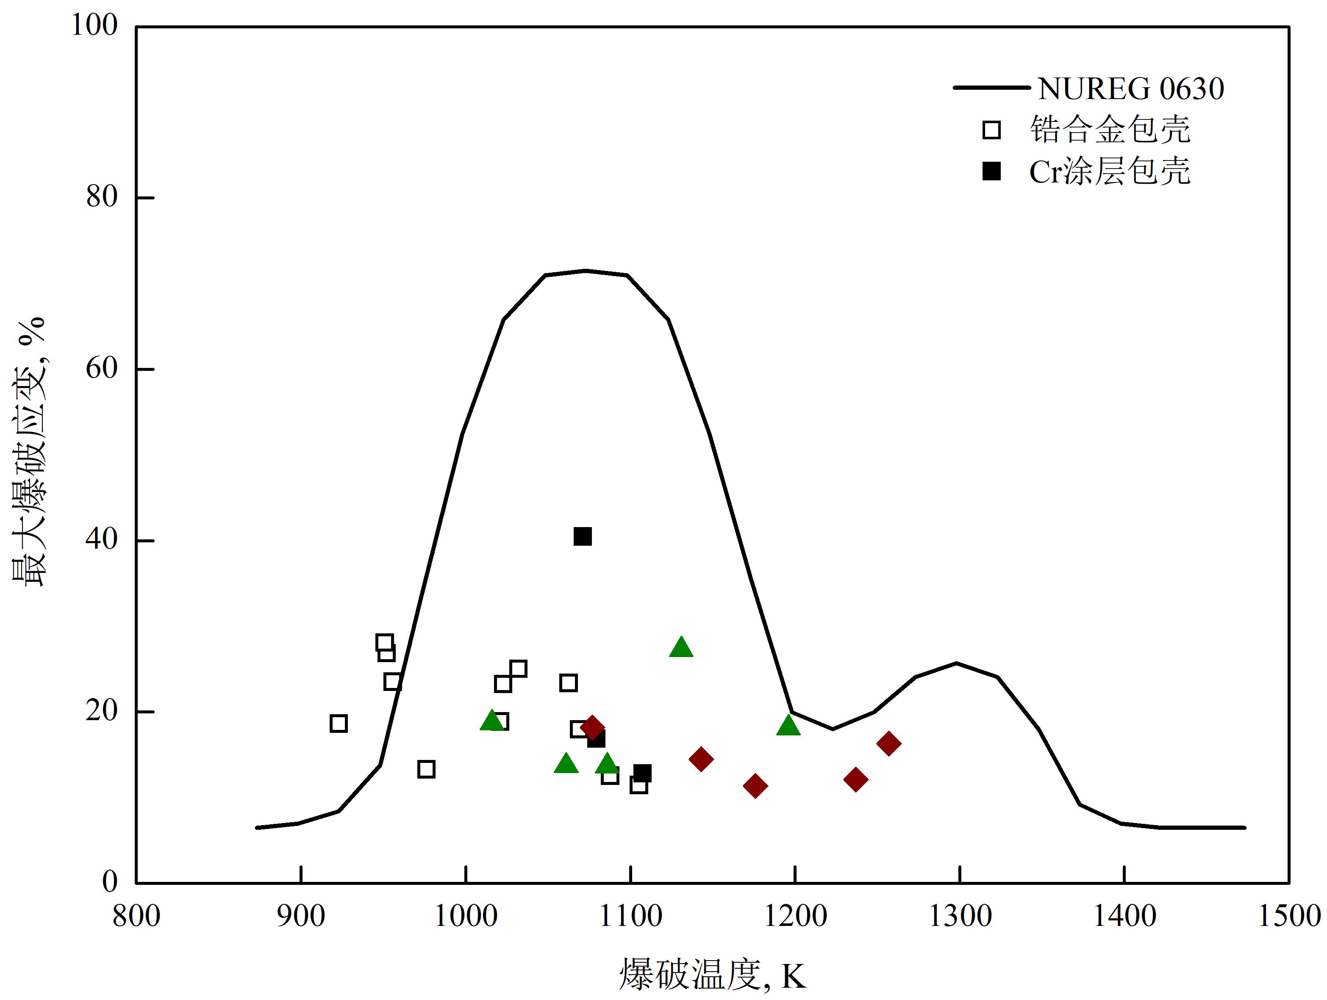
2.2 Out-of-pile performance
High-temperature burst test
No separation or delamination of the Cr coating was observed after test.
The Cr-coated cladding exhibits a slightly higher burst temperature and slightly lower burst strain compared to zirconium alloy cladding under high-temperature conditions
In the oxidation quenching test, the Cr coating provided effective protection, no significant loss of plasticity or toughness was observed in the Cr-coated cladding after the test.
Cross-sectional morphology after oxidation quenching tests
Burst temperature veusus hoop stress
Burst strain veusus burst temperature

Slide 15
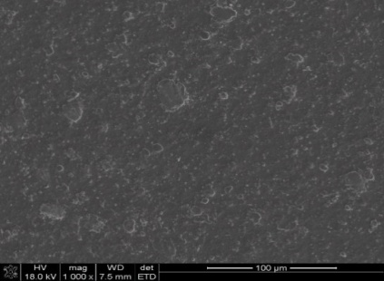
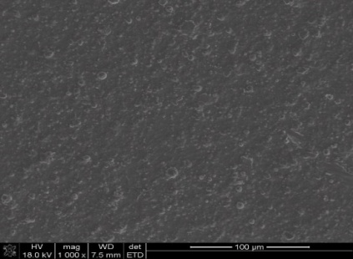
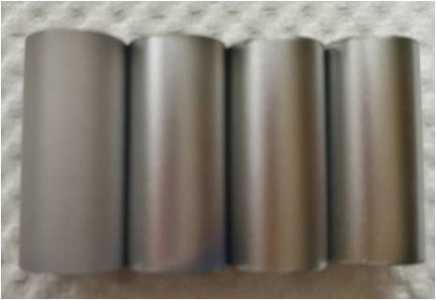
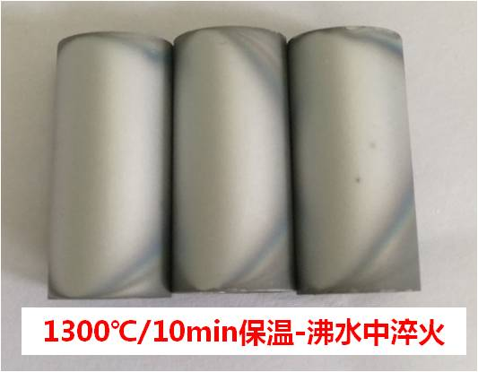
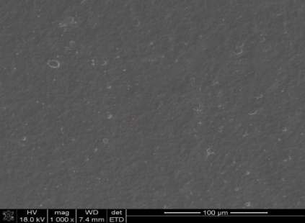
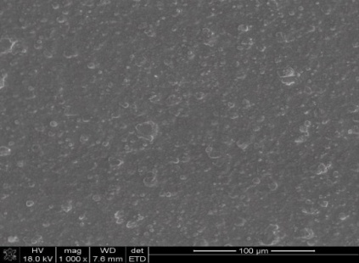
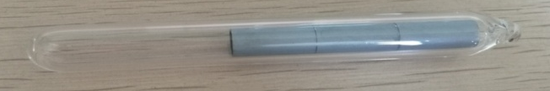
2. Out-of-pile performance
Thermal shock
After annealing in a vacuum quartz tube at temperatures ranging from 700°C to 1300°C for 10 minutes, the coated tubes were rapidly quenched to 100°C (boiling water). The samples remained intact, with no cracking or spalling observed in the coating.
Annealing temperatures From left to right: 700℃、 900℃、1100℃、1300℃
700℃ →100℃
900℃ →100℃
All 1300℃ annealing
1100℃ →100℃
1300℃ →100℃
Surface microstructure of coated tube specimens after thermal shock
Vacuum sealing with quartz tube

Slide 16
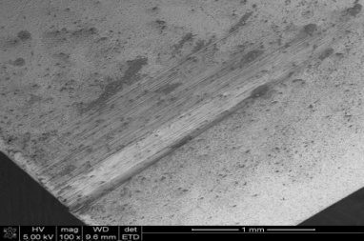
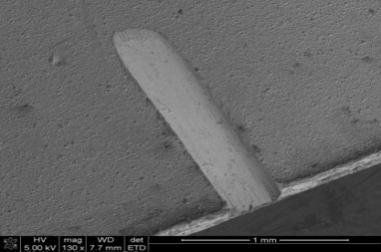
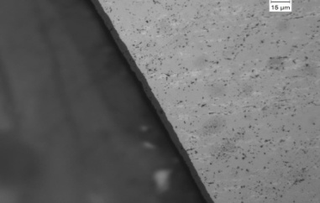
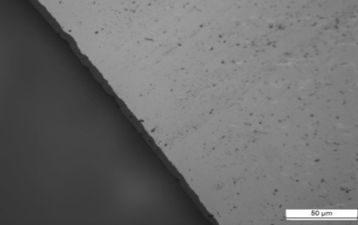
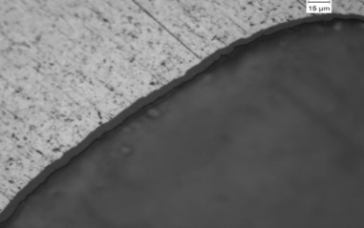
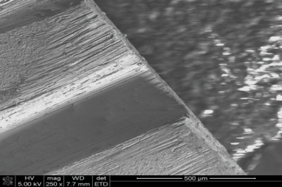
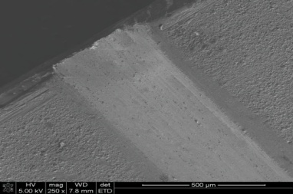
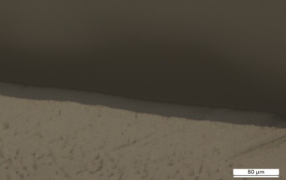

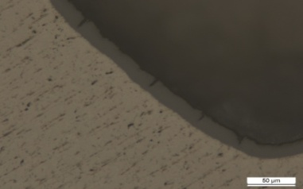
2. Out-of-pile performance
Influence of Cladding Scratch on Corrosion
The presence of the coating has no significant effect on the corrosion rate of the bare zirconium substrate.
Pre-fabricated scratches on the coating show no coating delamination after corrosion, and the bare zirconium substrate at the scratch bottom exhibits no accelerated corrosion.
360℃ 300 d
inner side of the coated sample
360℃ 300 d
inner side of the bare zirconium
360℃ 300 d
Bottom of the coating scratch
360℃ 30 d
360℃ 30 d
400℃ 300 d
inner side of the coated sample
400℃ 300 d
inner side of the bare zirconium
400℃ 300 d
Bottom of the coating scratch
400℃ 30 d
400℃ 30 d

Slide 17
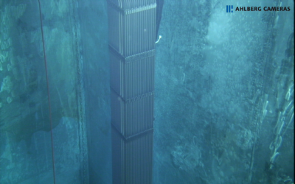
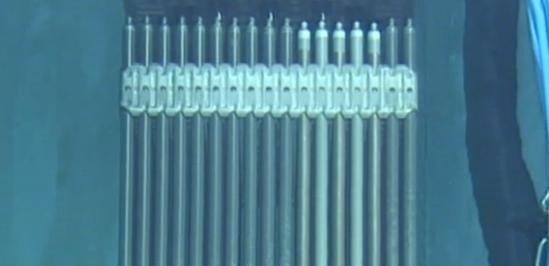
2.3 In-pile irradiation tests
Cr-coated leading rods in commercial reactors
2021: Cr-coated leading rods were irradiated in a commercial reactor in China for the first time.
2024: Cr-coated leading rods completed its full-cycle operation and was discharged from the reactor.
The Cr-coated rods exhibit a light metallic luster with uniform color.
The coating surface is intact, with no cracks, blisters, or delamination observed.
The corrosion resistance is significantly improved compared to uncoated cladding.
Cr-coated rod
Notes:
17

Slide 18
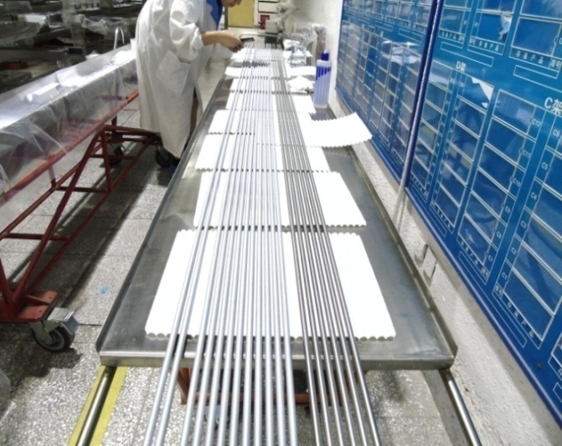
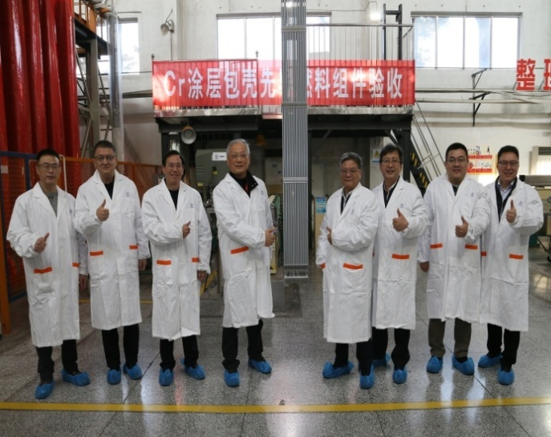
2.3 In-pile irradiation tests
Future plans – In-pile irradiation of Cr-coated leading fuel assembly
Currently, the manufacturing of the Cr-coated leading fuel assembly has been completed, and the in-pile irradiation testing of Cr-coated leading fuel assembly is in plan.
Cr-coated fuel rods of leading fuel assembly
Cr-coated leading fuel assembly

Slide 19
2.4 Summary
Cr coating is fabricated using the multi-arc ion plating process
Systematic investigations are conducted on the out-of-pile performance of the Cr-coated claddings, and show advanced performance compared with bare Zr claddings
Completed full-cycle irradiation in commercial reactors and the IFAs irradiation are in plan
Test item | Cr-coated N36 cladding
Thermal physical properties of Cr | √
Corrosion | √
High-temperature steam oxidation | √
Thermal shock | √
Friction and Wear | √
Tensile properties | √
Creep | √
Burst | √
Fatigue | √
Electrochemical corrosion | √
Micro-crack analysis of Cr-coated cladding | √
Cladding Scratch Analysis | √
High-temperature burst test | √
High-temperature plastic deformation test | √

Slide 20
PART 3
Progress of the Large-grain pellets
Notes:
20

Slide 21
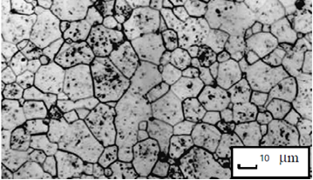
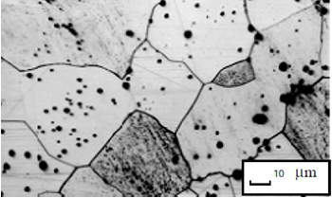
3.1 Introduction of the Large-grain pellets
Large-grain UO₂ pellets are UO₂ pellets with grain sizes larger than those of conventional pellets (10–25 μm), typically ranging from 30 to 60 μm.
The benefits of Large-grain UO₂ pellets are ：
improving fission gas retention and creep resistance
reducing fission gas release
enhancing PCI resistance
and thus contributes to higher fuel rod burnup
Conventional UO₂ pellets
Large-grain UO₂ pellets

Slide 22
3.1 Fabrication | Early studies
NPIC has conducted exploration to the manufacturing process of large-grain pellets and has essentially established industrial-scale production capability for large-grain UO₂ pellets.
trace amounts of Al₂O₃ and SiO₂ powders are added. All other process steps remain consistent.
UO₂ pellets with grain sizes ≥ 25 μm were produced.

Slide 23
3.1 Fabrication | Recent work
The industrial-scale manufacturing process were established for large-grain UO2 pellets with grain sizes ≥ 25 μm
Recently, research has focused on pellets with grain size greater than 40um.
Through series of process trials, large-grain UO₂ pellets with grain sizes of 40–50 μm were successfully fabricated. The optimal addition process and range of grain growth promoters were determined, and the product passed qualification tests.

Slide 24
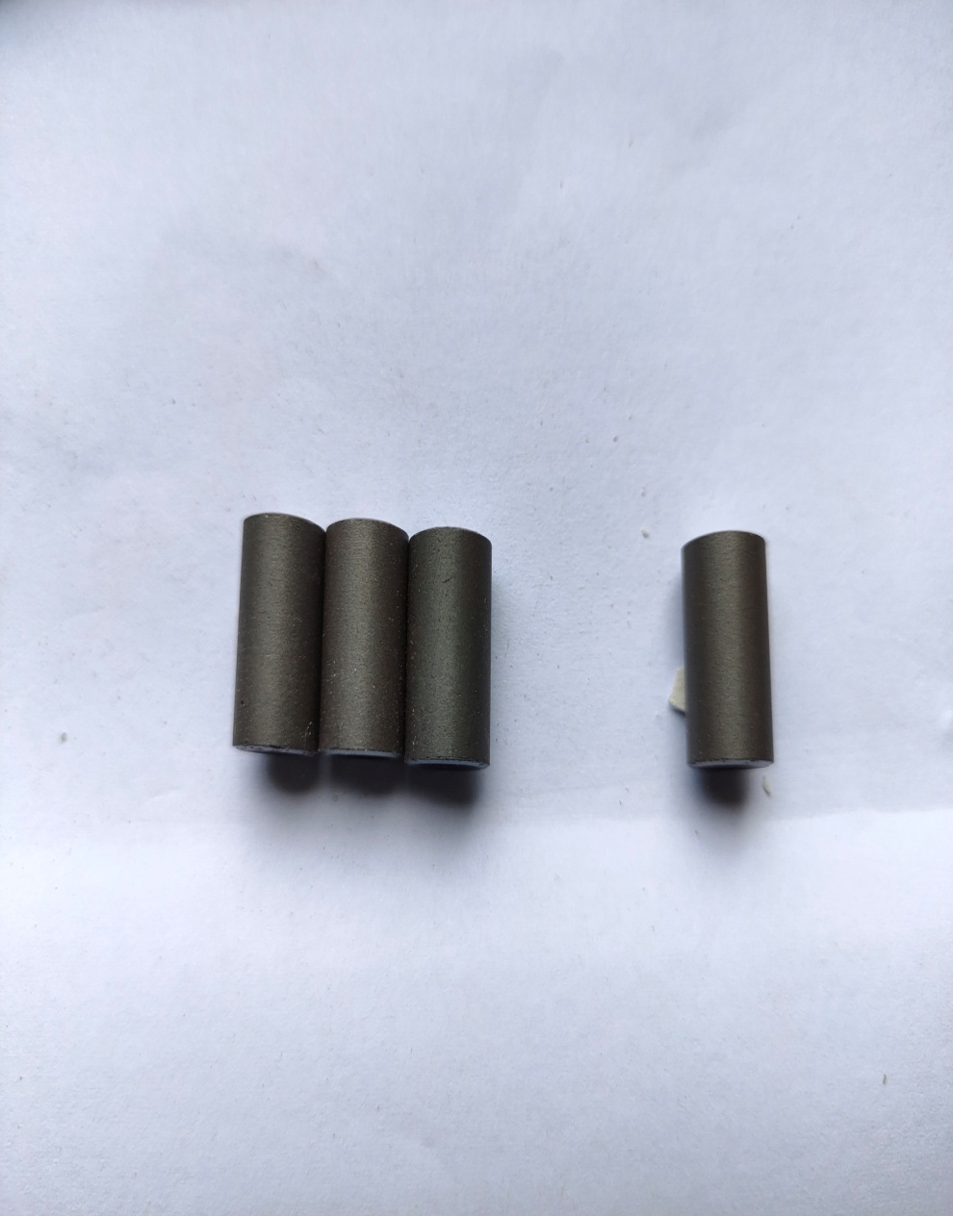
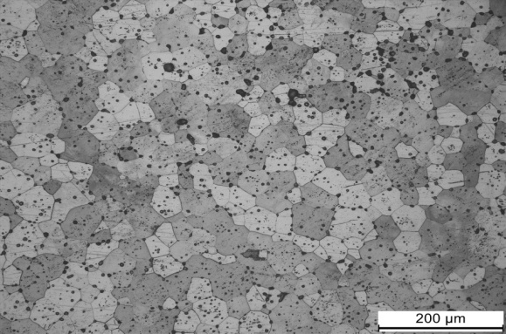
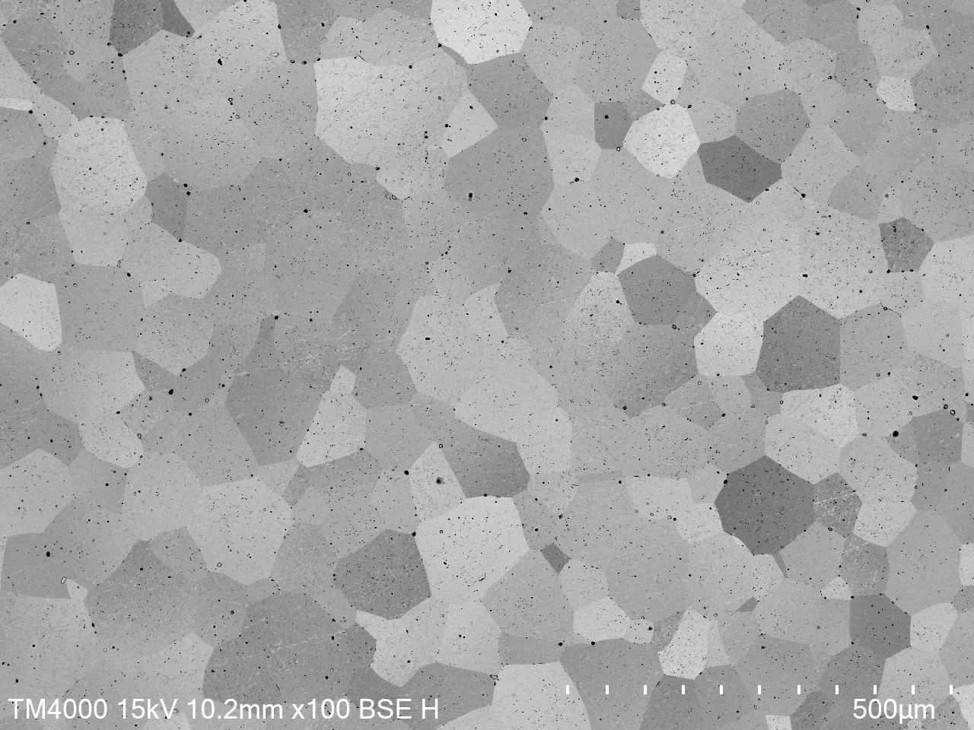
3.1 Fabrication
Except for the additives addition during the mixing stage, the rest of the fabrication process for large-grain UO2 pellets remains same with that of conventional UO₂ pellets.
Specifically，UO₂ powder → batching and mixing → rolling granulation → spherical granulation with waxing → pressing → sintering → grinding → external inspection → finished product
Large-grain UO₂ pellets after sintering
doped large-grain UO₂ pellets， 25um
doped large-grain UO₂ pellets，40um

Slide 25
3.2 Out-of-pile performance
Systematic investigations are conducted on the out-of-pile performance.
Test item | Large-grain UO₂ pellets | Results & Difference with conventional UO₂ pellets
Chemical composition | √ | No significant difference
Density | √ | No significant difference
Thermal stability | √ | Superior
Pore size and distribution | √ | No significant difference
Lattice constant | √ | No significant difference
Phase analysis | √ | No significant difference
Agglomeration of dopants | √ | No agglomeration
Chemical compatibility with cladding | √ | Good compatibility
Melting point | √ | No significant difference
Thermal expansion | √ | No significant difference
Thermal diffusivity and thermal conductivity | √ | No significant difference
Specific heat | √ | No significant difference
Creep | √ | No significant difference
Elastic modulus | √ | No significant difference
Poisson's ratio | √ | No significant difference
Corrosion resistance | √ | No significant difference

Slide 26
3.2 Out-of-pile performance
Chemical composition
All impurity element contents meet the technical requirements：
only a slightly higher residual Cr content (~300 ppm) compared to conventional UO₂ pellets.
it still satisfies the technical requirements for conventional UO₂ pellets
Residual Cr content also meets the requirement for the equivalent boron content of pellet impurity elements
Residual Al content after sintering is not significantly different from that of conventional UO₂ pellets.
The uranium content and stoichiometric ratio of large-grain UO₂ pellets are indistinguishable from those of conventional UO₂ pellets.
Notes:
各项杂质元素含量均满足技术条件要求，与常规UO₂芯块相比仅Cr元素残留量偏多（~300ppm），但仍满足常规UO₂芯块技术条件的要求（Cr+Mo+Fe+Ni≤500ppm）
Al元素经烧结后残留量与常规UO₂芯块无明显差异
Cr元素的残留也满足芯块杂质元素当量硼含量的要求
大晶粒UO₂芯块的铀含量及化学计量比与常规UO₂芯块无差异

Slide 27
3.2 Out-of-pile performance
The density of large-grain UO₂ pellets is slightly higher than that of conventional UO₂ pellets, but the difference is not significant.
The thermal stability of large-grain UO₂ pellets is superior to that of conventional UO₂ pellets, exhibiting better resistance to densification under in-reactor conditions.
Apart from the difference in grain size, the pore size and distribution of large-grain UO₂ pellets are indistinguishable from those of conventional UO₂ pellets.

Slide 28
3.2 Out-of-pile performance
Microstructure
XRD measured lattice constant of large-grain UO₂ pellets is 0.547037 nm, showing no significant difference compared to the 0.547098 nm measured for conventional UO₂ pellets.
Phase analysis shows no difference between large-grain UO₂ pellets and conventional UO₂ pellets, indicating that the addition of Cr does not affect the intrinsic structure of the material and does not introduce any new phases.
Conventional UO₂ pellets
Large-grain UO₂ pellets

Slide 29

3.2 Out-of-pile performance
Distribution and redistribution of dopants
Chemical composition analysis was performed using EDS on pellet samples to obtain the distribution of U, O, and dopant elements.
To simulate the pellet's state under load, a redistribution research of dopants was conducted under 100 hours of 1000°C and 100 MPa compressive stress.
The pellet's chemical composition before and after the test primarily consists of U and O elements, with no agglomeration of dopants observed.
Before load
After load

Slide 30
3.2 Out-of-pile performance
Chemical compatibility with cladding
Using SEM and EDS analysis, the elemental distribution in the substrate and at the interface of the zirconium alloy/fuel pellet sample was obtained.
The large-grain UO₂ pellets and conventional UO₂ fuel pellets exhibit good compatibility with zirconium alloys, with no obvious UO₂/Zr diffusion layer observed at the interface.

Slide 31
Study on gas behavior in large-grain UO₂
As grain size increases, the diffusion path for gas atoms from the grain interior to the grain boundary becomes longer, reducing the rate of bubble connectivity at grain boundaries and lowering porosity, thereby slowing down fission gas release.
Xe diffusion rate significantly affects gas release; The additive elements increase the diffusion rate of fission gases in grain. The gas release and swelling behavior of doped large-grain UO₂ are jointly influenced by the diffusion rate of gas atoms and grain size.
Bubbles also serve as nucleation sites for recrystallized grains, accelerating their formation. Meanwhile, the formation of recrystallized grains increases the number of grain boundaries, further promoting bubble formation and growth. Under the same burnup, the proportion of high-burnup structures with larger UO₂ grain sizes is smaller.
Notes:
对比了不同晶粒尺寸UO2的气泡联通和气体释放行为，起始阶段气泡优先在晶界处形核，而后不断粗化并形成连通区域，并扩散到自由表面，晶粒尺寸增大后，晶面气泡的联通速度变慢，联通区域的体积占比更小，从而减缓了裂变气体的释放

Slide 32
3.2 Out-of-pile performance
Other tests and results
Test item | Large-grain UO₂ pellets | Results & Difference with conventional UO₂ pellets
Melting point | √ | 2803~2849 ℃, no significant difference
Thermal expansion | √ | No significant difference (100 ℃~1600 ℃ test results)
Thermal diffusivity and thermal conductivity | √ | No significant difference
Specific heat | √ | No significant difference
Creep | √ | No significant difference (1000 ℃, 40MPa & 60MPa, no creep )
Elastic modulus | √ | No significant difference (By theoretical calculation)
Poisson's ratio | √ | No significant difference (By theoretical calculation)
Corrosion resistance | √ | No significant difference

Slide 33
3.3 Summary
Test item | Large-grain UO₂ pellets
Chemical composition | √
Density | √
Thermal stability | √
Pore size and distribution | √
Lattice constant | √
Phase analysis | √
Agglomeration of dopants | √
Chemical compatibility with cladding | √
Melting point | √
Thermal expansion | √
Thermal diffusivity and thermal conductivity | √
Specific heat | √
Creep | √
Elastic modulus | √
Poisson's ratio | √
Corrosion resistance | √
The manufacturing process for large-grain UO₂ pellets is the same as the existing pellet manufacturing process.
The out-of-pile performance of large-grain UO₂ pellets show no significant difference from those of conventional UO₂ pellets.
The out-of-pile tests are fully covered.

Slide 34
PART 4
Future activities and discussions
Notes:
34

Slide 35
4.1 future activities---Cr-coated claddings
1、Hot cell inspection of the discharged ATF leading rods are prepared.
To investigate structure after irradiation, coating defects, morphology of secondary phases, and Cr-Zr interdiffusion, mechanical properties and so on.
2 Extending burnup irradiations are in planning for the irradiated lead rod.
3、Research on the Cr-Zr interfacial layer are on going
Cr-Zr interdiffusion
Cr-Zr eutectic reaction
4、Research to decrease the interface reactions are in the plan.
5 How to accelerate the approval from Safety authorities?

Slide 36
4.1 Future activities---- Large-grain pellets
1、Simulation study on the in-reactor behavior:
Cross-scale simulation and mechanism modeling of gas behavior
Cross-scale simulation and mechanism modeling of creep behavior
2 The optimization of grain size, additives and their propotions
What is the opitimization grain size for pellets? There are a few of elements to add for pellets size increasing, which is the best? What kind of combination and proportion are favaroble?
3、In-pile performance testing
4、Experimental characterization for large grain size effect
The effect of large grain size pellets should be described or measured in irradiation test explicitly and precisely.

Slide 37
4.2 Discussionss for CRPs
1、 Simulation study on the in-reactor behavior of large grain pellets:
Cross-scale simulation and mechanism modeling of gas behavior
Cross-scale simulation and mechanism modeling of creep behavior
2、Benchmark of effect of large grain pellets between codes and experimental results
3、Is it possible to improve cladding behaviors beyond LOCA by coating ?
,

Slide 38
PART 5
Conclusion
Notes:
38

Slide 39
Conclusion
PWR nuclear fuel is evolving toward higher burnup and ATF technologies, continuously improving in-reactor performance and economy characteristics.
The systematic out-of-pile performance studies and completed full-cycle irradiation in commercial reactors demonstrate great properties and performance of Cr-coated rods.
The out-of-pile test on large-grain UO₂ pellets are carried out and the results show no significant difference compared to conventional UO₂ pellets.
Some further research are in preparation or in plan.

Slide 40
Thank you
Notes:
40

