Slide 1

ATF CLADDING MATERIALS AND
MANUFACTURING WITHIN IAEA ATF-TS CRP
Martin Ševeček^{1,2}
¹Czech Technical University in Prague
²UJP PRAHA, a.s.
Technical Meeting on Advanced Technology Fuels
28th of October, 2025
Vienna, IAEA

Slide 2
Outline
ATF-TS Experimental Programme
Overview of tested materials
Conclusions and Summary
Cr coated Zr-based Alloys
Zr-Based Alloys with Alternative Coatings
FeCrAl

Slide 3
ATF-TS Experimental Programme - SETs
ATF fabrication
Experimental facilities
Experimental data and correlations
Benchmark exercise = model validation
Database development
ATF LOCA methodology
Participants proposed to provide ATF cladding materials for testing
  Quantity and geometry limitations – e.g. tubes vs. coupons
  Limited volume of materials – e.g. FeCrAl B136Y
  Priorities of sample suppliers
Other participants proposed testing campaigns using their facilities
  Different testing capacities, geometry, test parameters, methodologies, manpower, and resources
In the previous IAEA’s CRP ACTOF, many low TRL concepts were investigated. In ATF-TS, suppliers were asked to provide optimized high TRL products. The optimization was not part of the project, and the fabrication parameters were selected solely by material providers.

Slide 4
ATF Cladding Fabrication

Slide 5
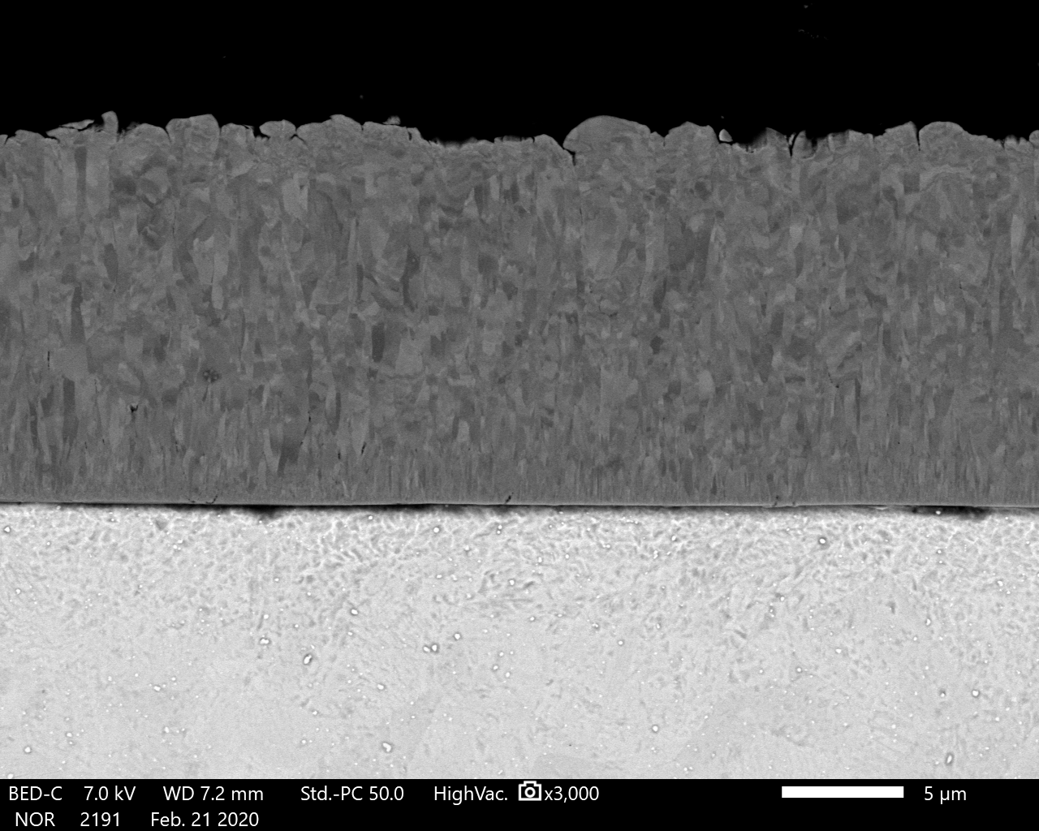
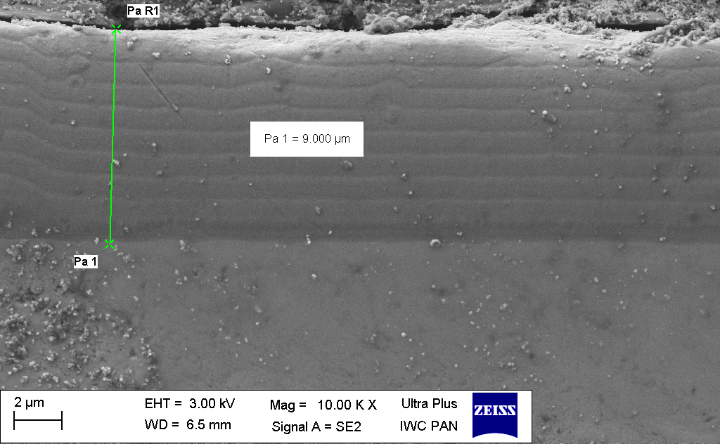







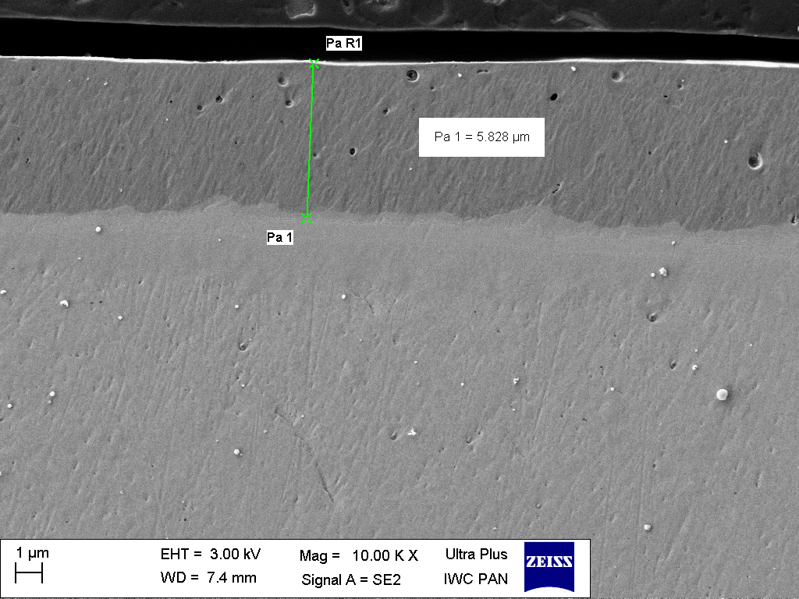

ATF concepts fabricated within ATF-TS
Cr
Opt. ZIRLOTM
9 institutes fabricated ATF cladding materials for testing
Six reference uncoated Zr-based alloys to be used as a reference (Zircaloy-4, Opt. Zirlo, Zr1Nb, HANA6, M5, E110)
Coated commercial Zr-based alloys
  Cr – KIT (7 microns MS), CTU (18 microns MS), AEOI (arc ion plating 10 microns), BSU (PVD with plasma treatment), NPIC (Cr coated N36), CNPE (PVD 15 microns Zry-4), KNF (Cr coated HANA6)
  CrN/Cr (CrN) – AEOI , CTU
  TiAl – CNL
  SiC/YAG– INCT (Zr1Nb plates from AEOI)
FeCrAl, SiC
  KIT FeCrAl B136Y (ORNL)
  NPIC FeCrAl, SiC/SiC
In total, more than 160 meters of reference and ATF tubes and several m² of reference and ATF plates were shared and tested.
Cr/CrN
Zr1Nb
E110
Martin Sevecek, 12/5/2022 Page 5

Slide 6
Cr Coated Zr-Based Alloy

Slide 7

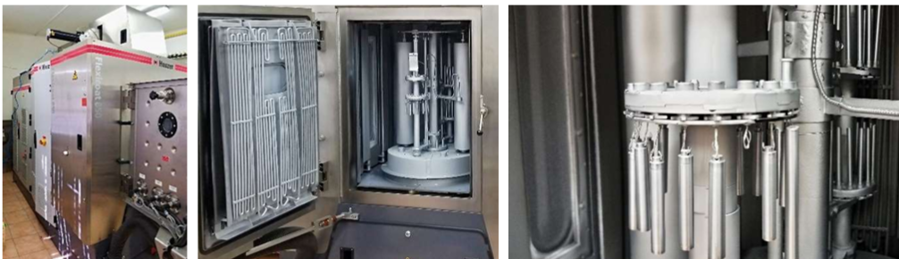
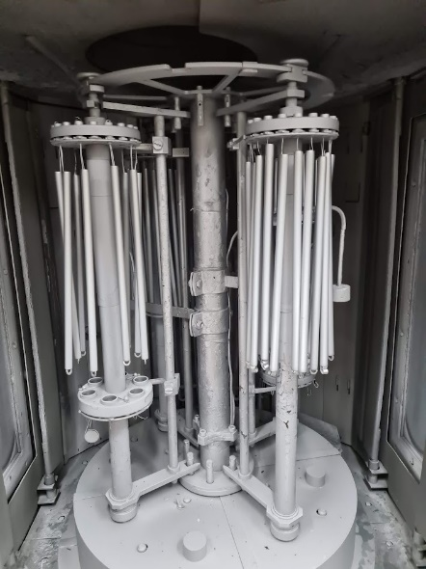
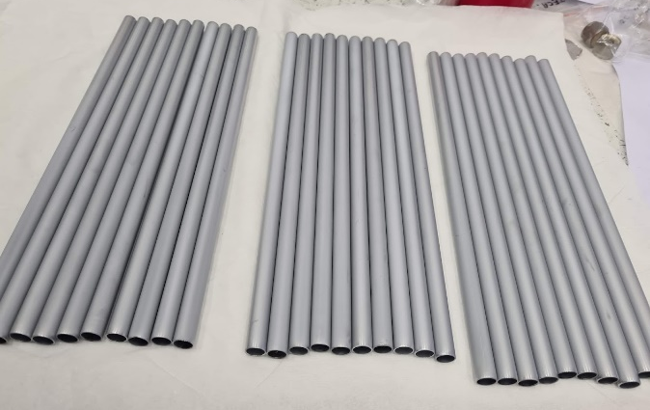
CTU - Cr-coated Opt. ZIRLOTM
Opt. ZIRLO (OD=9.144mm), kindly provided by Westinghouse Electric Company for the ATF-TS CRP project
Two coating machines/chambers, optimized power sources and deposition parameters:
Semi-industrial - Hauzer Flexicoat 850
Industrial – Hauzer Flexicoat 1500
Three coating types:
Cr thick ~ 17-20 microns (Flexicoat 850 and 1500)
Cr thin ~ 7 microns
CrN (6 microns) + Cr coating (12 microns)

Slide 8
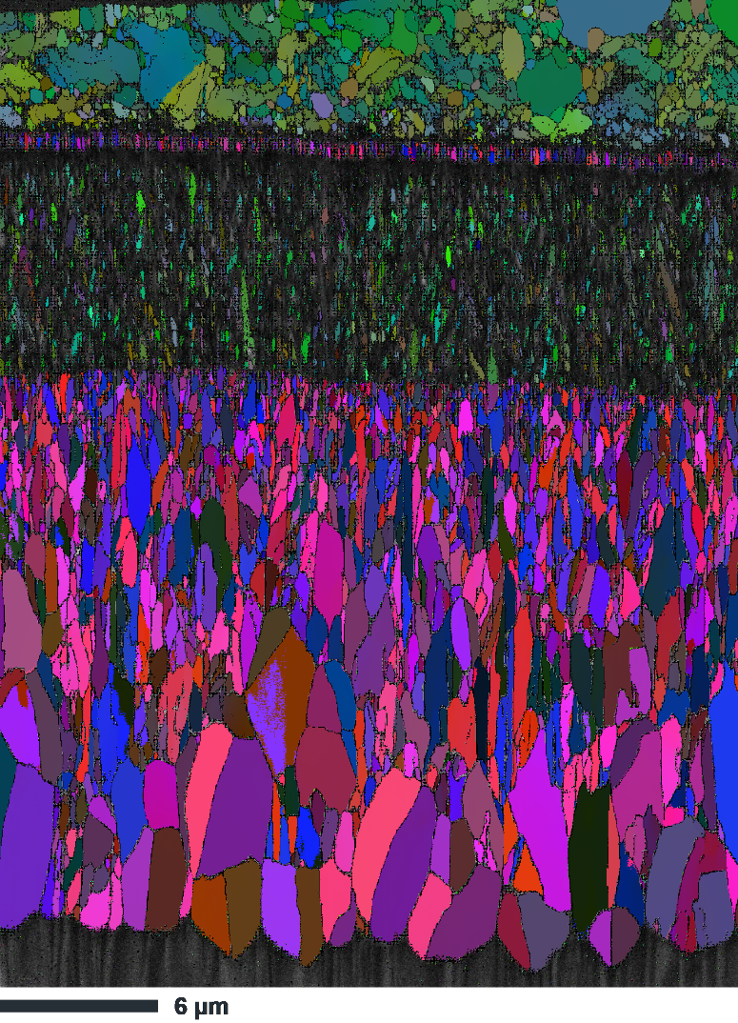
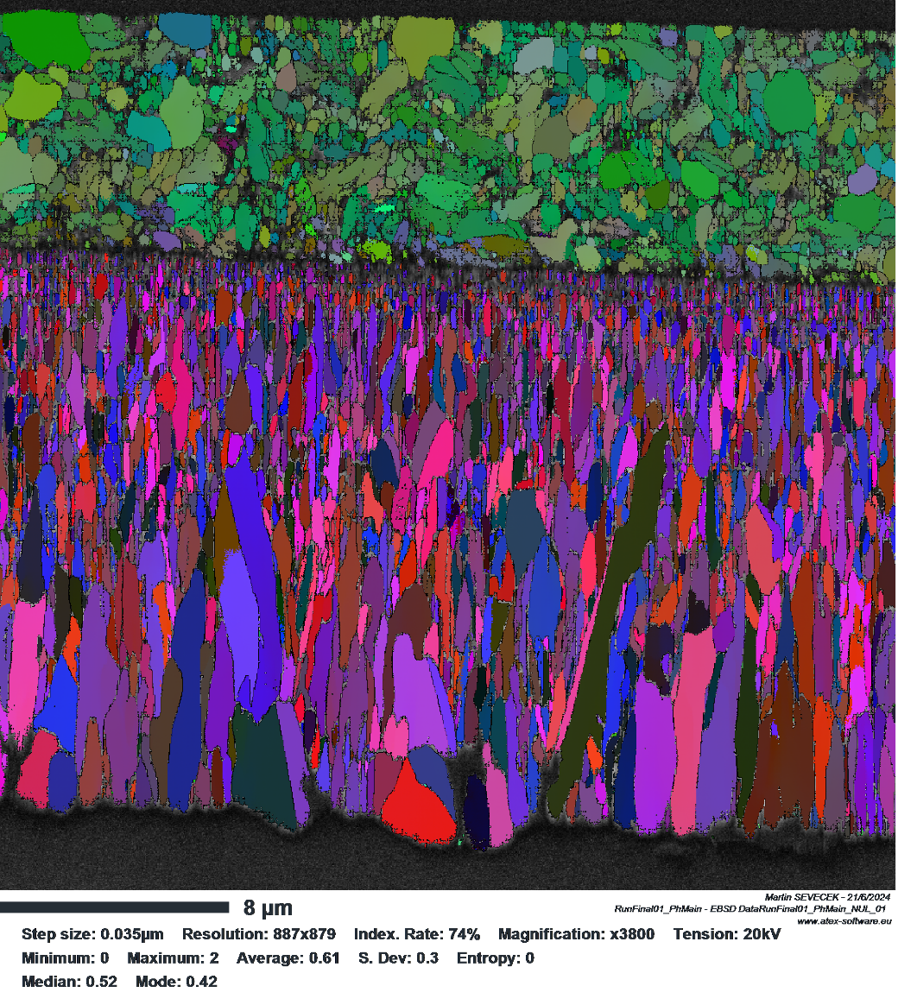
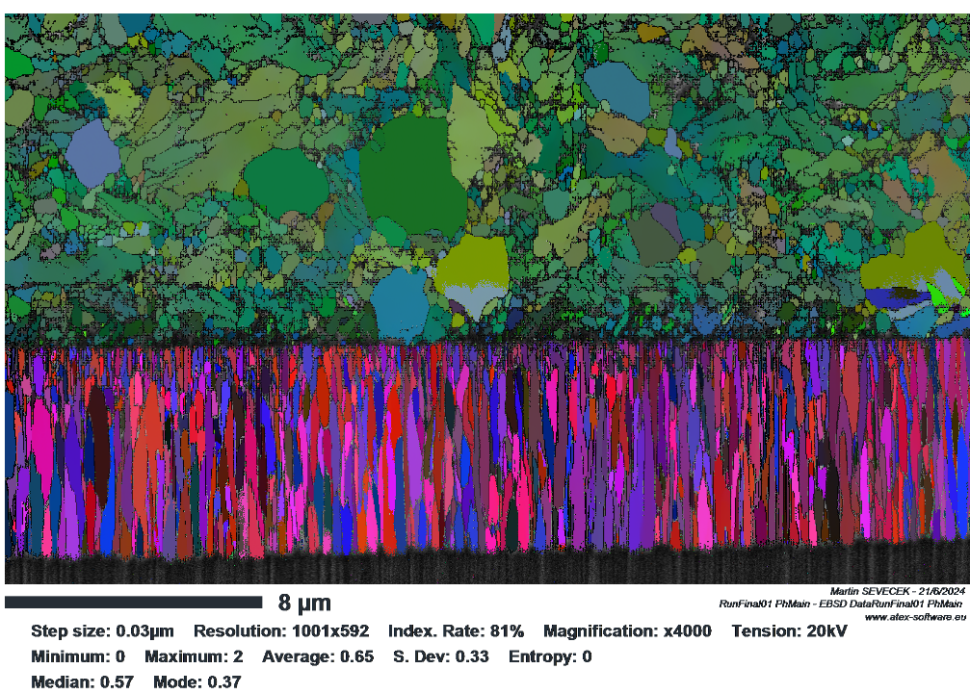
Opt. ZIRLOTM
Opt. ZIRLOTM
Opt. ZIRLOTM
Opt. ZIRLOTM
CrN
Cr thin
Cr
Cr thick

Slide 9
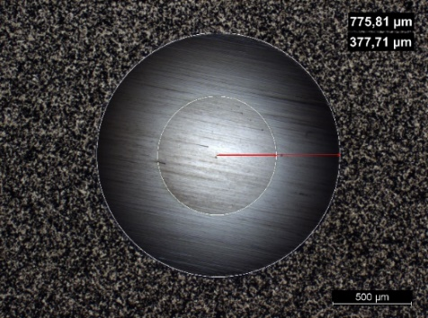
Experimental investigation with CTU’s samples
EK – several batches of material from both machines. Industrial machine used for CODEX-ATF materials due to required length. The same parameters as with the semi-industrial machine were used but at higher temperature.
CRIEPI – single rod tests as part of the DEGREE test series
KIT – high-temperature single rod Cr and CrN coated
JRC Petten – mechanical testing in PWR and VVER autoclaves and characterization
JRC Karlsruhe – thermal characterization
UPM – mechanical testing, burst, cathodic charge, corrosion; additional samples provided in fall 2022
INCT – corrosion testing, NAA, air oxidation
KAERI/SNU – LOCA testing PQD evaluation; eutectic study; microstructure evaluation; single rod semi-integral tests; four separate deliveries from both machines
CNPRI – shipment problems + COVID delays in 2022/23
CNPE – shipment problems + COVID delays in 2022/23
VTT - Coated Opt. ZIRLO samples - biaxial creep, autoclave corrosion, HT oxidation (also older coatings such as CrAl or TiN)
INL – mechanical testing, NDT evaluation

Slide 10
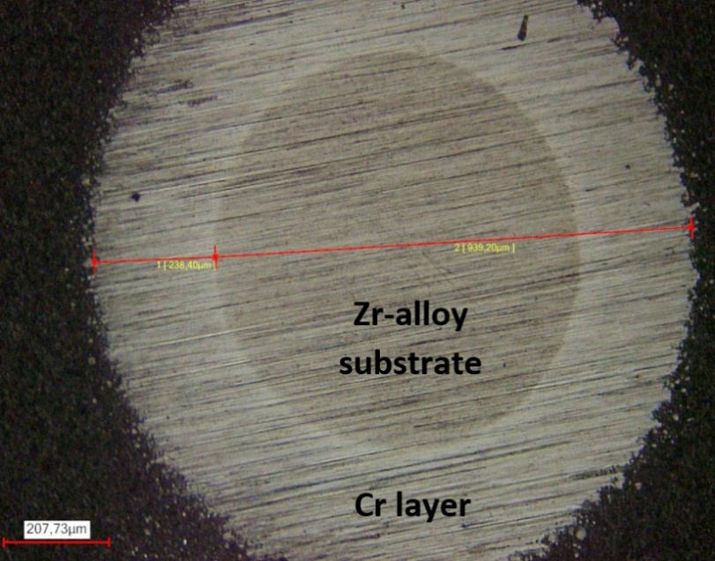
KIT - Cr-coated ZIRLO, M5 and Zircaloy-4
External company - Oerlikon Balzers coating company GmbH
Tubes provided by KIT, proprietary deposition parameters (deposition temperature ~270 °C)
Coating thicknesses – 7.5 and 10.5 microns
Investigations:
CRIEPI (single rod and bundle tests)
EK (HT steam oxidation, Mandrel tests)
CTU/UJP (long-term corrosion and HT steam oxidation)
KIT

Slide 11
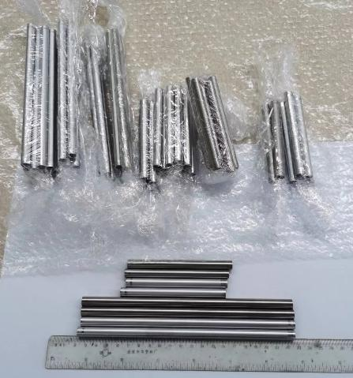
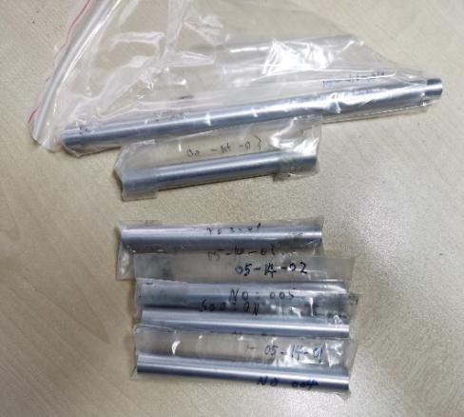
CNPE – Cr coated Zr
Type 1 – Zr-Sn-Nb alloy – MS Cr
Type 2 – Zircaloy-4 – arc ion plated Cr
Substrate preparation - ultrasonic cleaning and rinsing using alcohol and ultrapure water; drying; wiping several times with a lint-free cloth soaked in anhydrous ethanol; air gun is used to blow off any dust particles.
The substrate is then inserted into the chamber, evacuated, and the deposition process begins

Slide 12
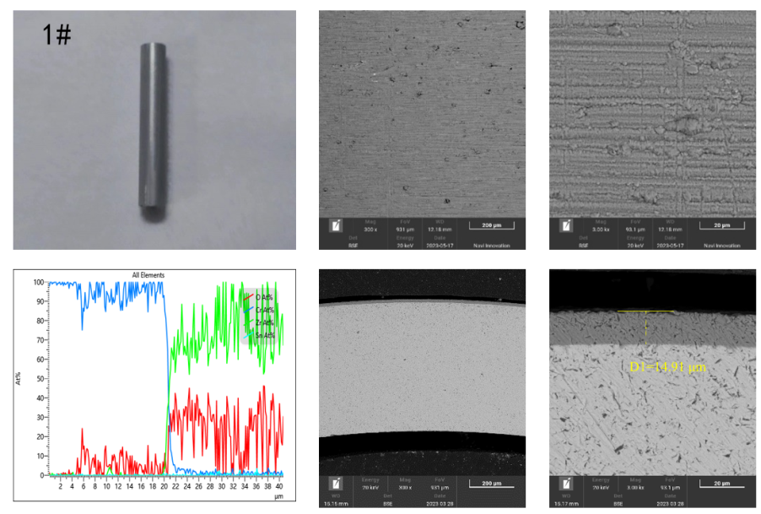
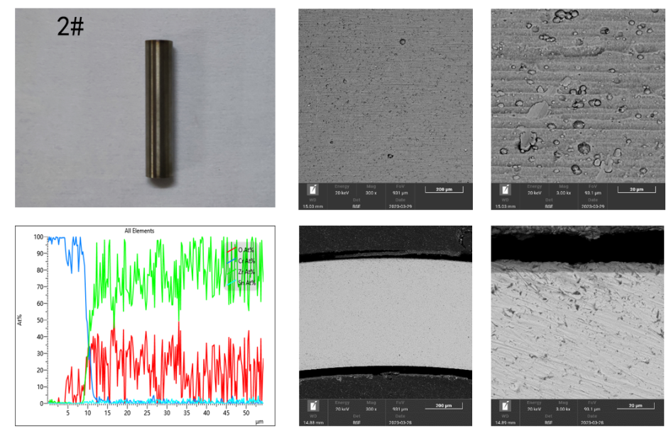
CNPE – Cr coated Zr

Slide 13
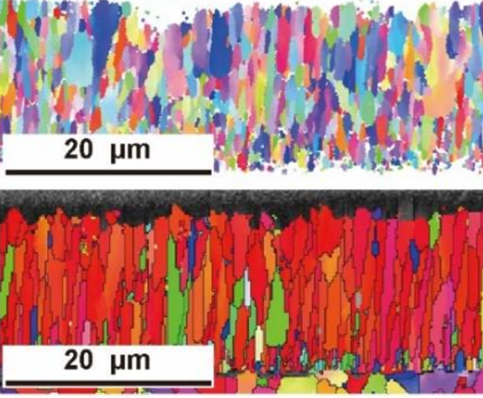
NPIC – Cr coated Zircaloy-4
Zircaloy-4 (Zr-1.5Sn-0.2Fe-0.1Cr), outer diameter 9.5 mm, wall thickness 0.57 mm
Multi-arc ion plating technology (15–17 μm)
substrate was mechanically polished and does not require surface treatment
multiple ultrasonic cleaning and rinsing using environmentally friendly metal cleaners and ultrapure water, and finally dried with compressed air.
Before loading into the chamber, a lint-free cloth dipped in absolute ethanol was used to wipe the surface of the substrate, and floating dust on the surface was removed with compressed air.
Loading into the chamber - evacuation, heating, and deposition
  Deposition parameters: negative bias voltage 120 V, current 120 A, chamber pressure 1.2 Pa, deposition temperature 350°C

Slide 14
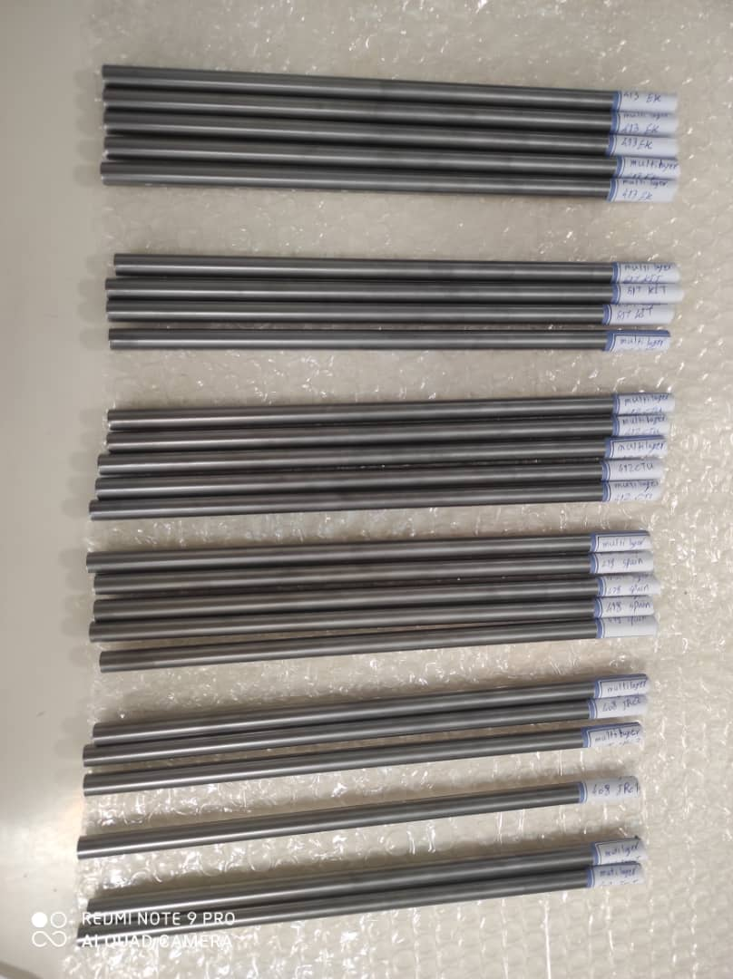
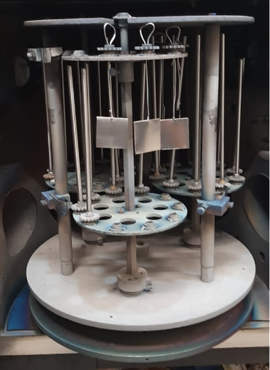
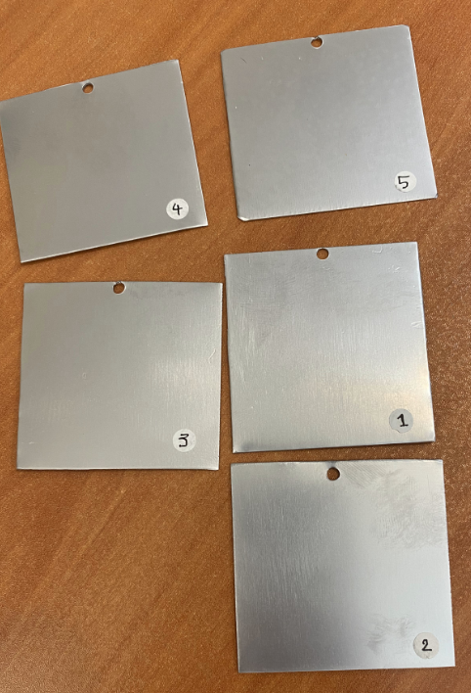
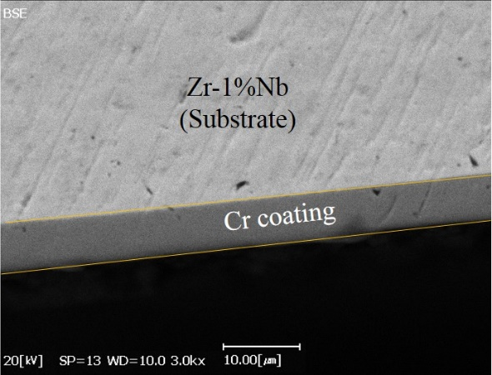
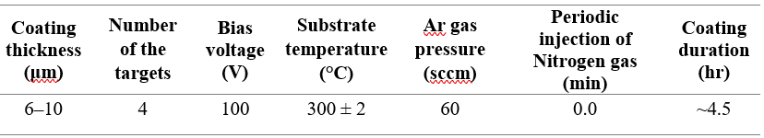
AEOI – Cr coated Zr1Nb
Substrate - Zr-1%Nb alloy manufactured by AEOI (tubes and plates)
Cleaning in acetone and ethanol using an ultrasonic bath for at least 15 minutes, followed by rinsing with distilled water outside the chamber
Argon ion sputtering inside the chamber for 20 minutes at the bias voltage of 700V
Cathodic Arc Evaporation or Arc-PVD -

Slide 15
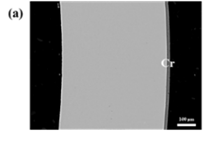
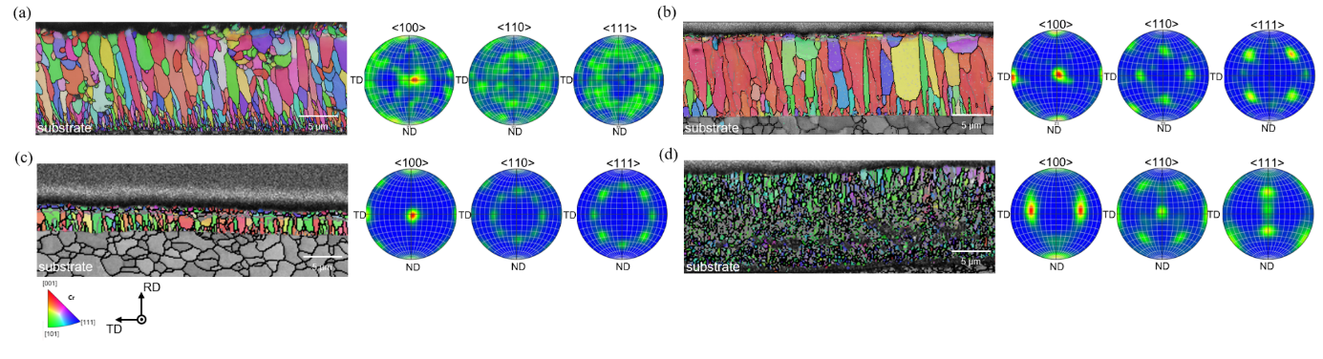
KNF – Cr coated HANA6
HANA-6 manufactured by KNF used as a substrate
ultrasonic cleaning, drying, and then loading into the coating chamber
plasma etching in an argon atmosphere to remove the thin oxide layer
Cr ions are generated by applying various high currents to the Cr target and deposited onto the cladding by applying different voltages for a set duration (Arc Ion Plating – 9 and 19 microns)
outer surfaces of the cladding are polished and cleaned. Finally, non-destructive, visual, and material testing inspections ensure quality coating and manufacturing

Slide 16
Zr-Based Alloys with Alternative Coatings

Slide 17
CTU – CrN+Cr coated Zr
Opt. ZIRLOTM
Issues linked to Cr/Zr alloys:
Cr enhanced embrittlement (Cr is beta-Zr stabilizer+increases oxygen diffusion in Zr)
Cr/Zr eutectic – at around 1330 °C – not typical melting, but rather another degradation mechanism
Cr ductility and coating failures at low strains
Various designs proposed in the literature, CrN/Cr shown to eliminate some of the issues.
Coatings deposited using Hauser Flexicoat 850, CrN using reactive MS + thin Cr layer to improve adhesion.
CrN
Cr

Slide 18
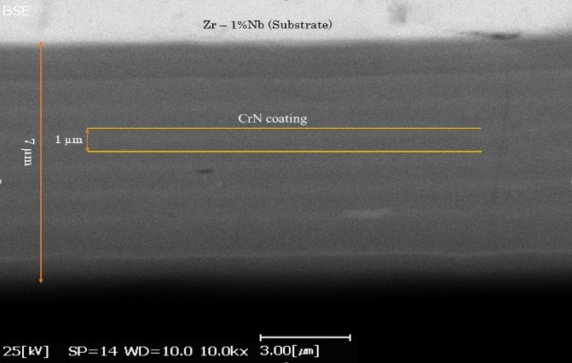
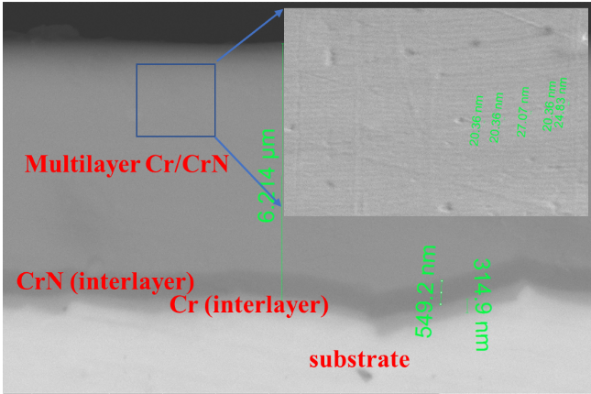
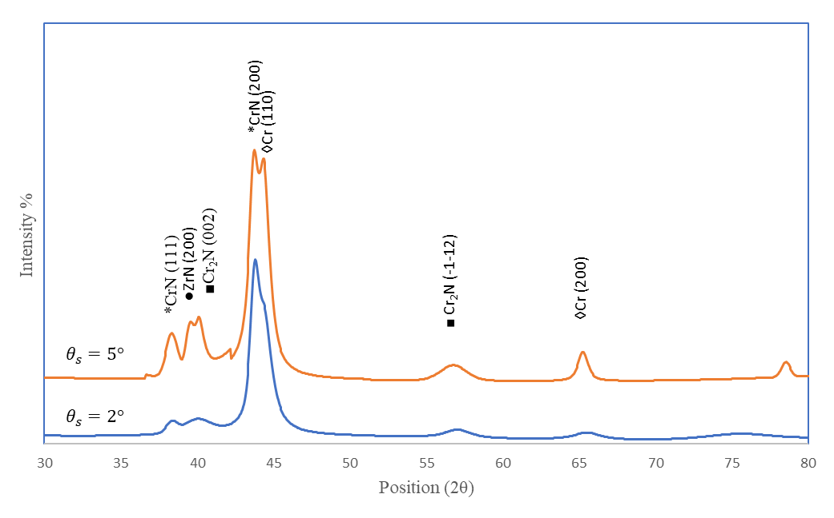
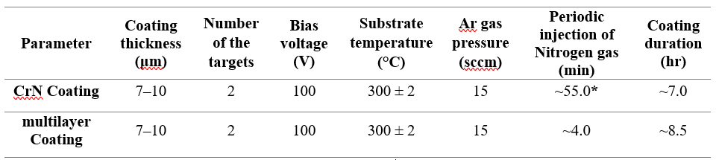
AEOI – CrN and multilayer CrN/Cr
CrN, and Cr/CrN multilayer coatings deposited on AEOI’s Zr-1%Nb by AIP
Zr-1%Nb samples cleaned in acetone and ethanol using an ultrasonic bath for at least 15 minutes, rinsed with distilled water outside the chamber
Argon ion sputtering inside the chamber for 20 minutes at the bias voltage of 700 V

Slide 19

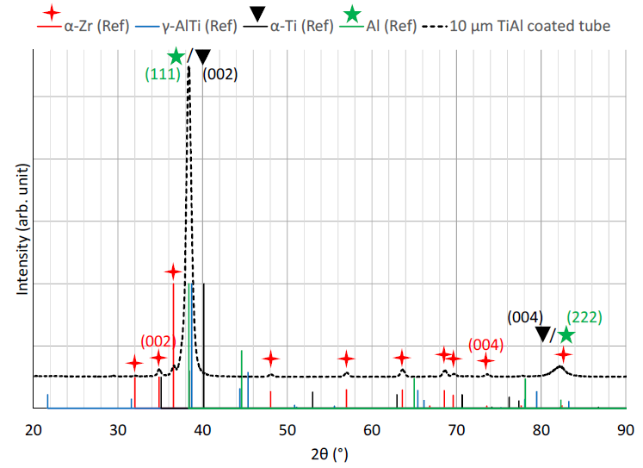
CNL – TiAl coated Zry-4
Focus on CANDU – two dimensions – OD= 5.3 and 13.08 mm
TiAl magnetron sputtering with a target thickness of 10 µm and a composition of 45–50 at.% Ti to 55–50 at.% Al on the tubes
Unbalanced closed field UMS-PVD coater (Teer 650) using two Ti and two Al targets, with argon as the working gas.
The deposition chamber was pumped down to less than 5 × 10⁻⁵ Torr before introducing Ar. The specimens were cleaned in isopropanol solution prior to being loaded into the chamber on the planetary, and rotated in three axes during coating deposition to yield a uniform surface coating coverage.

Slide 20

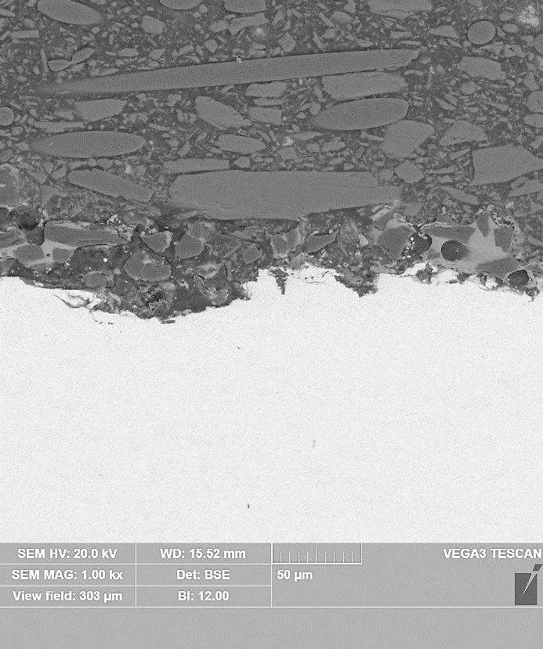
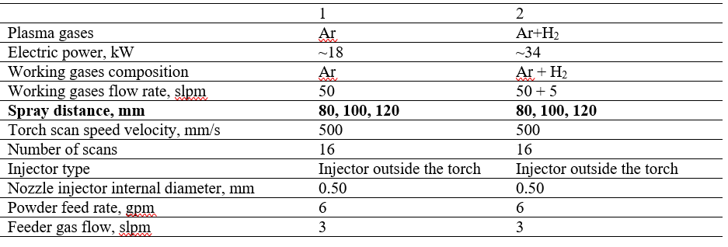
INCT – SiC/YAG coated Zr1Nb
Zr1Nb plates provided by AEOI (deposition possible only on planar geometry)
- YAG (yttrium aluminum garnet) + SiC – to avoid decomposition of SiC
- suspension plasma spraying - plasma torch SG-100 (Praxair, U.S.). The prepared powder (sol-gel) was delivered to plasma torch by GTV PF11WM powder feeder and sprayed.

Slide 21
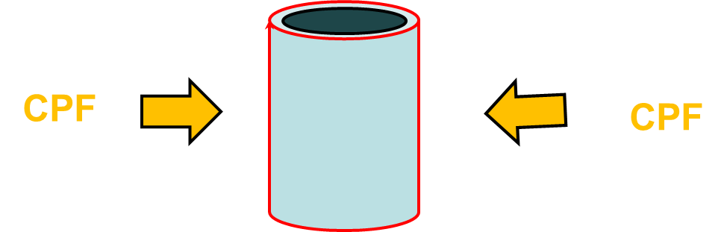

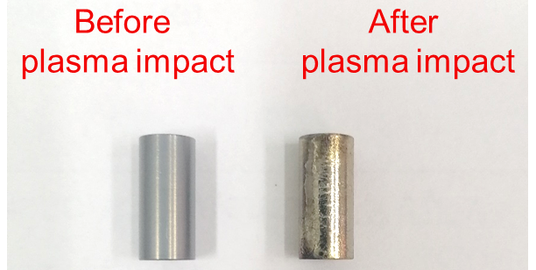
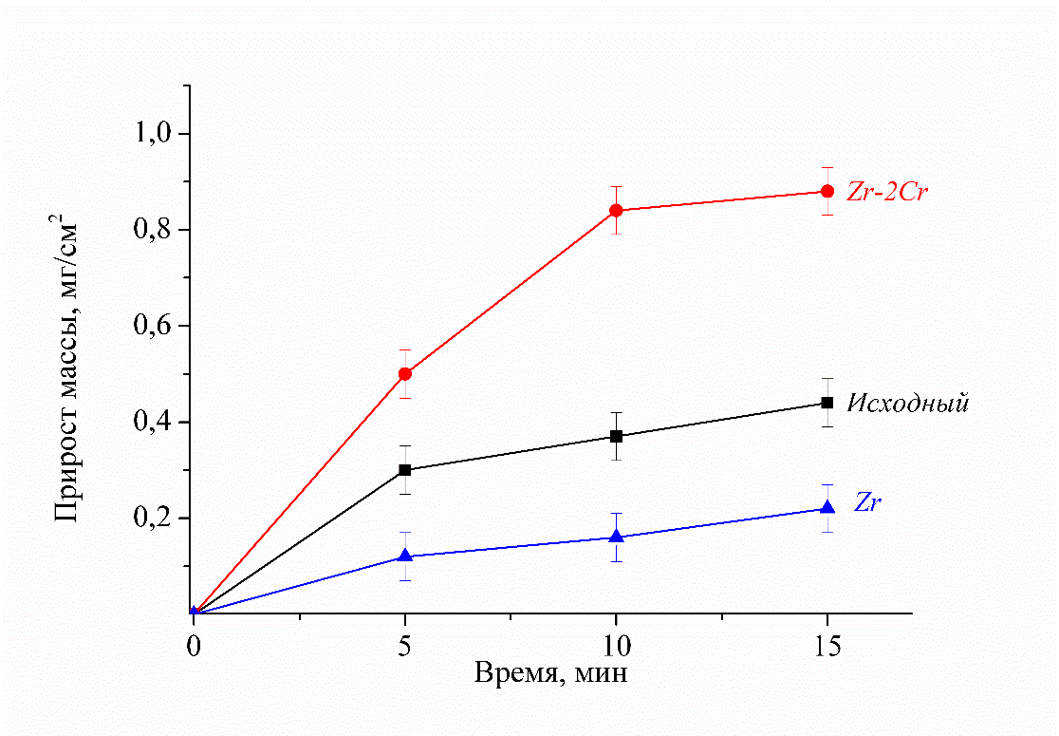
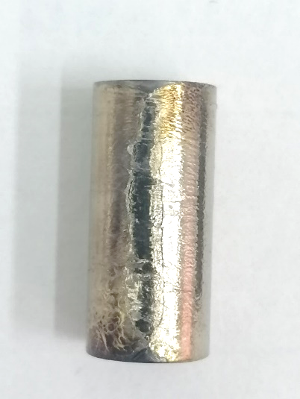
BSU – Cr coated plasma treated Zr
Zr1Nb (E110 ) – 20mm used as a substrate
1st step – Cr deposition
2nd step - compression plasma flow treatment
Compression plasma flow length — 10 – 12 cm diameter — 1 – 2 cm
Plasma parameters:
discharge duration — 100 μs
peak current — 50 ÷ 120 kA
plasma velocity — 30 ÷ 70 km/s
electron density — 10¹⁶ ÷ 10¹⁸ cm⁻³
nitrogen atmosphere – pressure 400 Pa
absorbed energy density – 20-30 J/cm²

Slide 22
FeCrAl

Slide 23

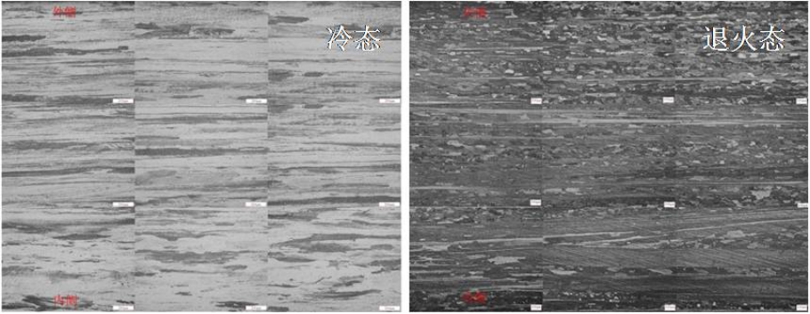
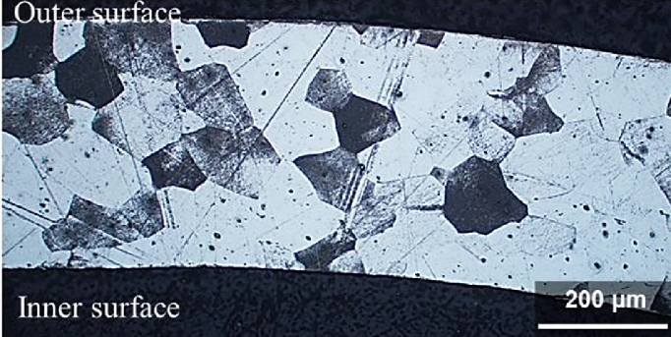
FeCrAl NPIC
13Cr-4.5Al-2Mo-1Nb-0.4Ta-0.05Y (wt.%)
Vacuum induction melting → homogenization → red feeding forging → extrusion → warm rolling (three passes) → cold rolling (seven passes) → recrystallization annealing → final product.
The final geometry of the cold pilgered thin-wall tube are 9.5 mm in outer diameter and 0.38 mm in wall thickness
FeCrAl B136Y3 (KIT/ORNL)
- 13Cr-6.2Al-0.03Y-0.01C (wt.%)
- Produced by ORNL – B-type alloy
-Used in the QUENCH-19 bundle test = link to Q19 benchmark exercise + support with SETs
- Limited quantity used for HT oxidation tests, ballooning/burst and long-term autoclave testing

Slide 24
Conclusions and Summary
Coordinated Research Project ATF-TS – organized by IAEA between 2019 and 2024.
ATF-TS was divided into several work packages with strong interlinks – WPs 2, 3 and 4 relied on experimental results from WP1.
Ten organizations fabricated and shared their ATF cladding materials, and 12 laboratories performed various experimental investigations. Variations in quantities, geometries and preferred partnerships.
Optimization of fabrication parameters was out of the scope of the project – it was done previously by CRP participants = focus on higher TRLs. Material providers shared the materials based on their preferences and needs.
Focus mostly on Cr coated Zr – but many different variations produced (substrates, deposition technologies, coating thicknesses, pre- and post-treatment).
Alternative coating materials proposed and provided to eliminate the drawbacks of Cr/Zr ATF concept. Two types of FeCrAl and one type of SiC were also investigated.
Detailed fabrication parameters are presented in the TECDOC. The material fabrication parameters should be linked to their performance = see my next presentation.

Slide 25
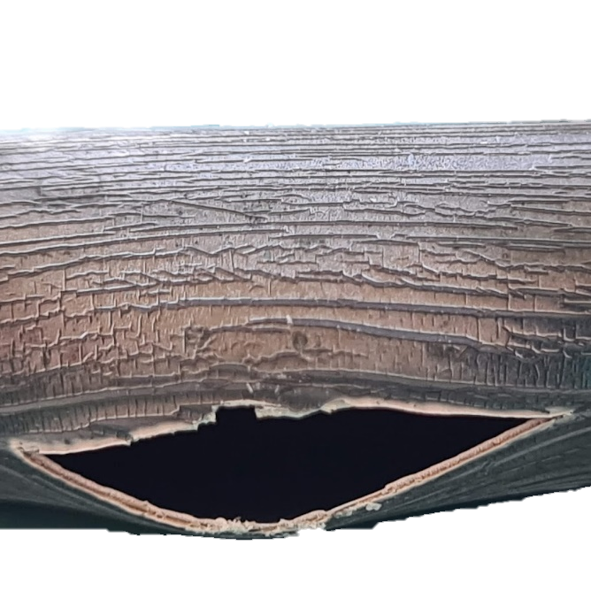



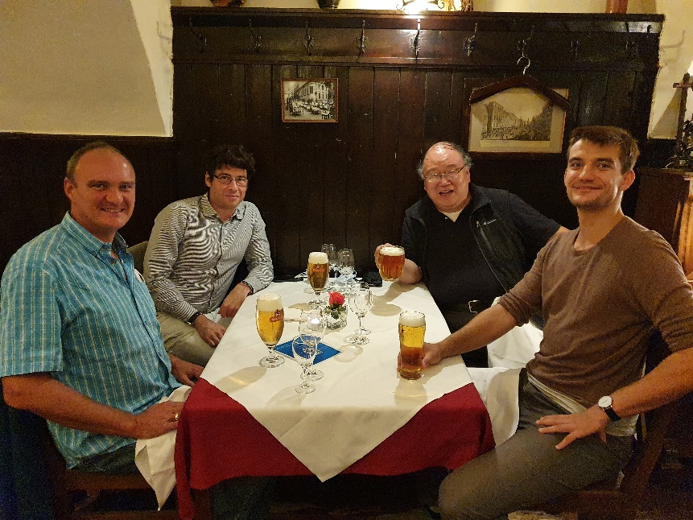
Questions?
Special thanks to all participants and partners within ATF-TS CRP.
We dedicate the CRP outcomes to the memory of Dr. Giovanni Pastore, who has made a significant contribution to this IAEA CRP and the fuel performance community in general.

