Slide 1























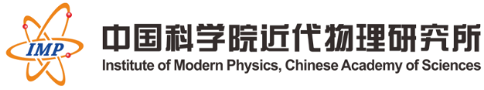




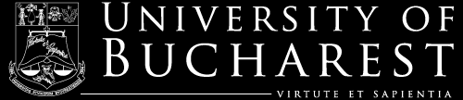


Capture cross section using integral data
(MACS are integral data)
R. Capote (IAEA) on behalf of the INDEN collaboration
https://www-nds.iaea.org/INDEN

Slide 2
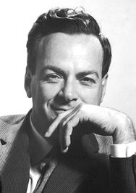
Outlook
Definition of integral data: Anything measured in a neutron spectrum (eg MACS).
-> Requires a knowledge of the neutron spectrum
“It doesn't matter how beautiful your theory is,
it doesn't matter how smart you are.
If it doesn't agree with experiment, it's wrong.”
Richard Philips Feynman,
Nobel Prize in Physics 1965

Slide 3
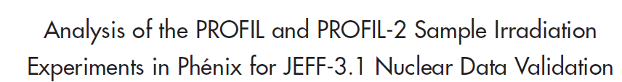
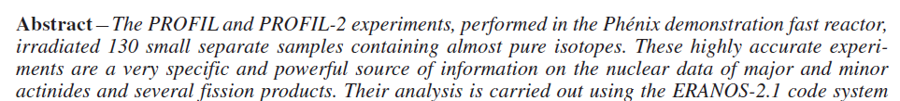
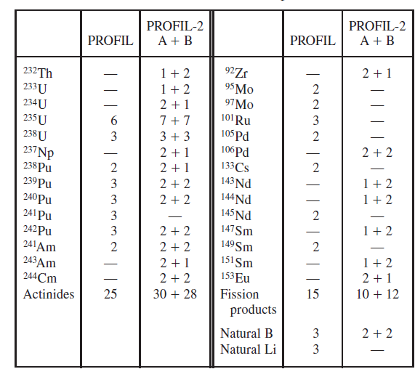
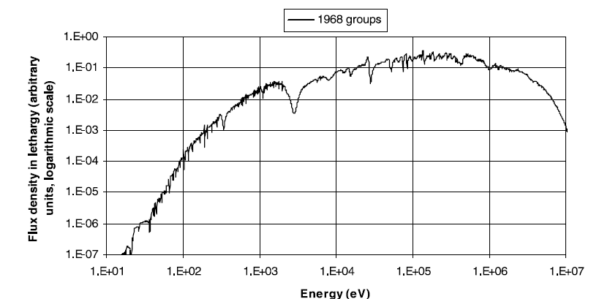
J. Tommasi, G. Noguere, Nucl. Sci. Eng. 160, 232 (2008) - PROFIL
Very sensitive to capture
PHENIX spectrum
JEFF-3.1 reference library

Slide 4
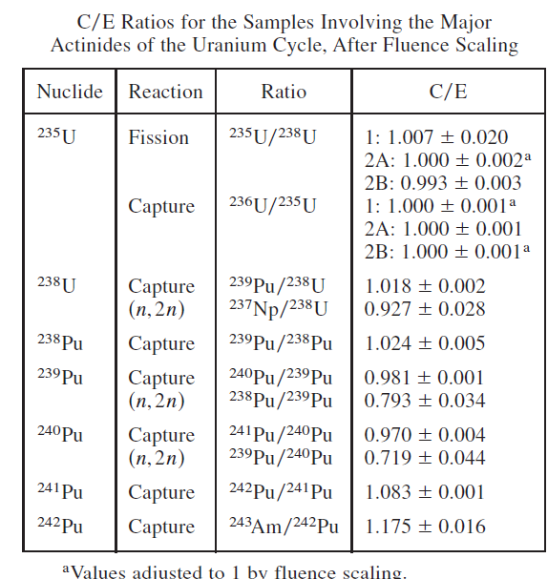
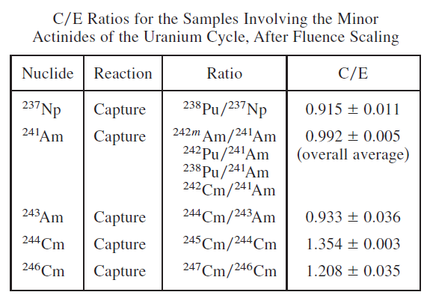
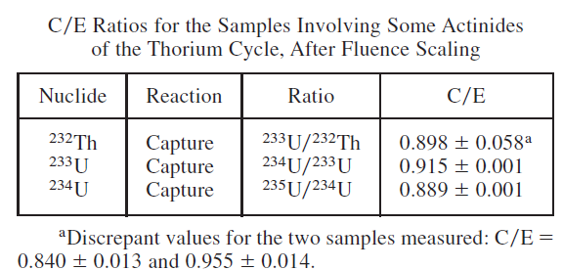
J. Tommasi, G. Noguere, Nucl. Sci. Eng. 160, 232 (2008) - PROFIL

Slide 5
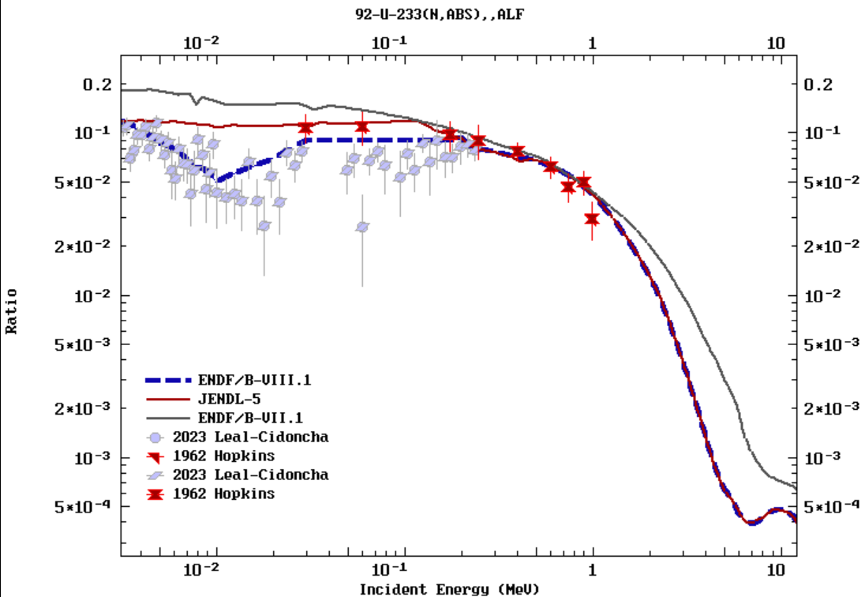
U-233 capture (10-30 keV region)
PROFIL-2 data : see table XI (C/E)
JENDL-5: 0.97(2)
JEFF-4.0: 0.983
ENDF/B-VIII.1 = 0.913 (low)
ENDF/B-VII.1 (JEFF-3.3): 1.31 (high)
Near 10-20 keV
α=σ_{γ}/σ_{f}
(adopted by JEFF-3.3)
J. Tommasi and G. Noguere, Nucl. Sci. Eng. 160, 232 (2008) - PROFIL
JENDL-5 eval (URR) agrees with CEA PROFIL data
JEFF-3.3 (B71) and B81 in disagreement with PROFIL

Slide 6
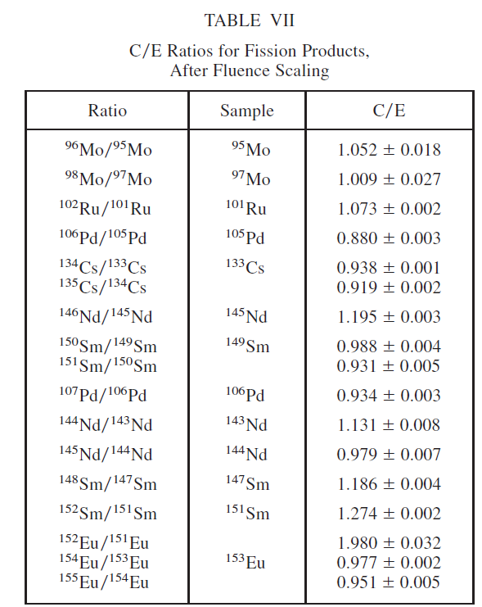
J. Tommasi, G. Noguere, Nucl. Sci. Eng. 160, 232 (2008) - PROFIL
These C/E can be used to test any capture XS
PHENIX spectrum
JEFF-3.1 reference library

Slide 7
Summary
We need to use integral data (eg PROFIL capture reaction rates) measured in reactors to improve our knowledge of FP and actinide capture XS
“It doesn't matter how beautiful your theory is,
it doesn't matter how smart you are.
If it doesn't agree with experiment, it's wrong.”
Richard Philips Feynman, Nobel Prize in Physics 1965

