Slide 1






  Surrogate reactions in inverse kinematics at heavy-ion storage rings
B. Jurado¹, M. Sguazzin¹, C. Berthelot¹, G. Leckenby¹, B. Wloch¹, J. Pibernat¹, J. A. Swartz¹, M. Grieser², J. Glorius³, Y. A. Litvinov³,
R. Reifarth⁴, K. Blaum², P. Alfaurt¹, P. Ascher¹, L. Audouin⁵, B. Blank¹, B. Bruckner⁴, S. Dellmann⁴, I. Dillmann⁶, C. Domingo-Pardo⁷,
M. Dupuis⁸, P. Erbacher⁴, M. Flayol¹, O. Forstner³, D. Freire-Fernandez², M. Gerbaux¹, J. Giovinazzo¹, S. Grevy¹, C. Griffin⁶,
A. Gumberidze³, S. Heil⁴, A. Heinz⁹, D. Kurtulgil⁴, S. Litvinov³, B. Lorentz³, V. Meot⁸, J. Michaud¹, S. Perard¹, U. Popp³,
M. Roche¹, M.S. Sanjari³, R.S. Sidhu¹⁰, U. Spillmann³, M. Steck³, Th. Stöhlker³, B. Thomas¹, L. Thulliez⁸, M. Versteegen¹, L. Begue-Guillou¹¹, D. Ramos¹¹, A. Cobo¹¹, A. Francheteau¹¹, M. Fukutome¹², A. Henriques¹³, I. Jangid¹¹, A. Kalinin³, W. Korten⁸, T. Yamaguchi¹²
1- LP2I (ex-CENBG), Bordeaux, France
2- MPIK, Heidelberg, Germany
3-GSI, Darmstadt, Germany
4-University of Frankfurt, Germany
5-IJCLAB, Orsay, France
6-Triumf, Vancouver, Canada
7-IFIC, Valencia, Spain
8-CEA, France
9-University of Chalmers, Sweden
10-University of Edinburgh, UK
11-GANIL, France
12-University of Osaka, Japan
13-FRIB, USA

Slide 2

Motivation:
Need for neutron-induced reaction cross sections of radioactive nuclei,
essential for astrophysics and applications!
γ-ray emission
(A+1)*
Neutron emission
n + A
Fission
→Very difficult or even impossible to measure with standard techniques because of the radioactivity of the targets.
→Complicated to calculate due to the difficulty to describe the de-excitation process (level densities, γ-ray strength functions, fission barriers…). Calculations can be wrong by several orders of magnitude!

Slide 3
Surrogate-reaction method
Neutron-induced reaction
Surrogate (alternative) reaction
w
n + A
(A+1)*
X + Y
P_{f}
P_{n}
P_{γ}
Decay probabilities as a function of excitation energy are precious observables to constrain model parameters (level densities, γ-ray strength functions, fission barriers…) and provide much more accurate predictions for neutron-induced cross-sections of nuclei far from stability.

Slide 4
Setup for the study of surrogate reactions in
direct kinematics
Fission
Detector
Gamma detectors
Fission Fragment
Light projectile
Heavy target nucleus
Si Telescope
Beam-like residues
ΔE
Limits:
Unavailability of targets (radioactive samples)
Target contaminants and target support
P_{γ} : rather low detection efficiency, background
P_{n}: measurement of low-energy neutrons and neutron efficiency,
background, never measured!
E

Slide 5
Advantages of Inverse kinematics:
-Access to very short-lived nuclei
-Detection of heavy residues
P’
A + p
(A)*
BUT!
Required E* resolution ~ few 100 keV, E*=f(E_{beam}, E_{target_like}, θ)
Target contaminants and target windows have to be avoided
STORAGE RINGS!

Slide 6
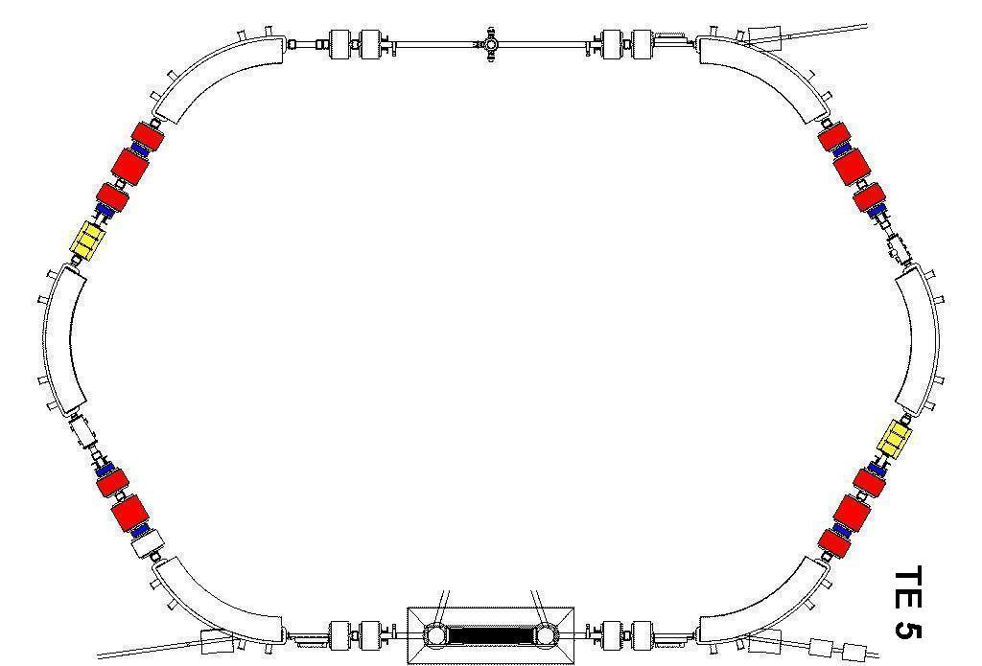
Advantages of heavy-ion storage rings
The ESR at GSI/FAIR
Beam cooling → Excellent energy and position resolution of the beam, maintained after each passage through the target, negligible, E-loss & straggling effects
Use of ultra-low density in-ring gas-jet targets ~10¹³/cm².
Effective target thickness increased by ~10⁶ due to
revolution frequency (at 10 A MeV)
High-quality, pure, fully-stripped beams and pure, ultra-thin, windowless targets→ unique!
Gas target
Revolving ions
~10 A MeV
~1 MHz
See talks by Yuri Litvinov and Iris Dillman
SIS
e- cooler
Challenge: Detectors in Ultra-High Vacuum (10⁻¹¹-10⁻¹² mbar)!

Slide 7

First surrogate reaction experiment at the ESR, 20-27 June 2022
208Pb+p→208Pb*+p’ <-> n+ 207Pb
H₂ gas-jet Target,
~6·10¹³ atoms/cm²
Beam
²⁰⁸Pb⁸²⁺
30 A MeV
5·10⁷ ions
Dipole
Target-like
detector
Gas target
Beam-like
detector
Revolving ions
Unreacted
beam
SIS

Slide 8
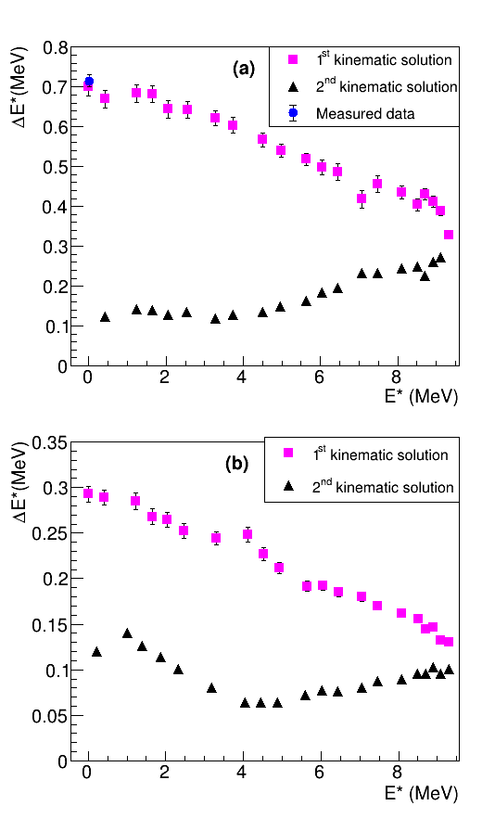
Excitation energy resolution
Target radius 2.5 mm
Target radius 0.5 mm
Simulations
SS
ΔE*dominated by the angular uncertainty due to target radius of ~2.5 mm.
M. Sguazzin et al., Phys. Rev. C 111 (2025) 024614

Slide 9
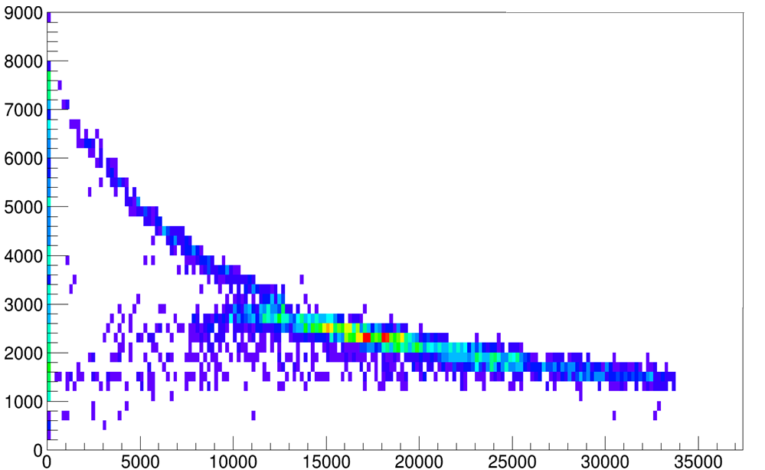
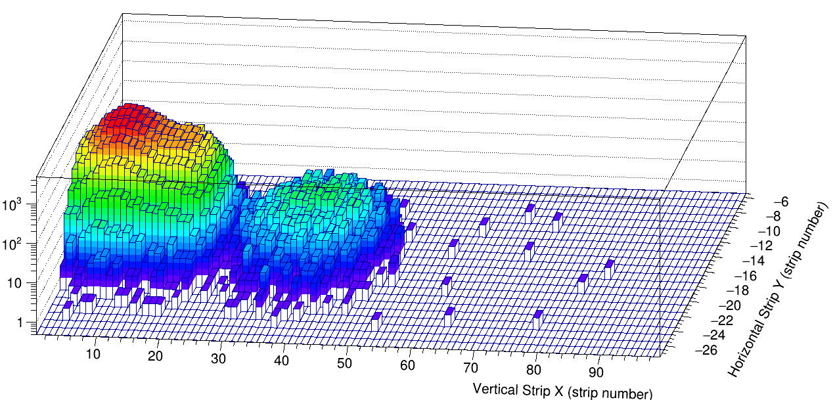
Detection of beam-like residues
Position of detected beam residues
in coincidence with protons
Detected protons
Eloss (keV)
²⁰⁸Pb⁸²⁺ after
γ emission
Full separation!!
²⁰⁷Pb⁸²⁺
n emission
Vertical position (mm)
Eresidual (keV)
Efficiency ~33-100%!
≈ Max 20 % in direct kinematics
Horizontal position (mm)
Efficiency 100%!
0% in direct kinematics…
M. Sguazzin et al., Phys. Rev. Lett. 134 (2025) 072501
M. Sguazzin et al., Phys. Rev. C 111 (2025) 024614

Slide 10
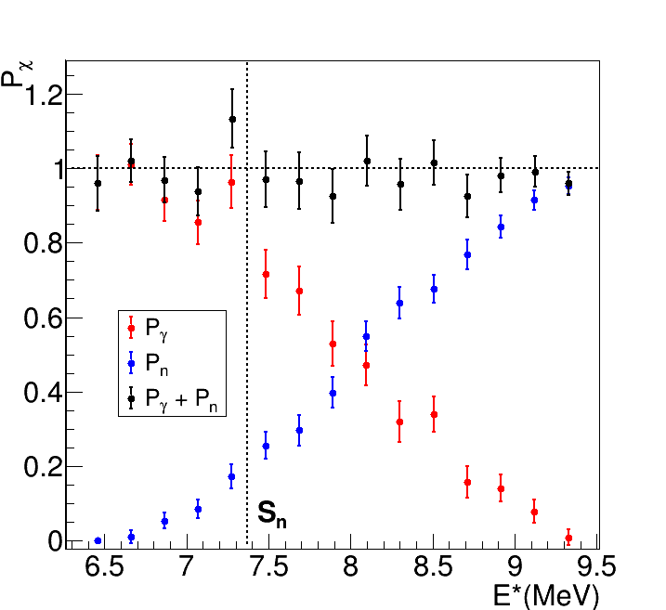
Results
Pn+Pγ≈1!
Validation of experimental technique!
M. Sguazzin et al., Phys. Rev. C 111 (2025) 024614

Slide 11
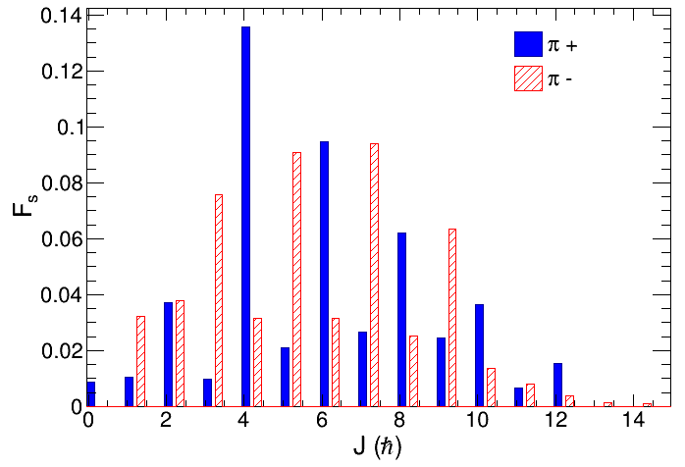
Comparison with model calculations
Hauser-Feshbach calculation with TALYS
Calculation of F_{s} populated in
p+208Pb→p’+208Pb*
Marc Dupuis (CEA-DAM)
E*
<J>~6-7
G_{n}
E*=9 MeV
13/2+
See talk by Marc Dupuis
G_{γ}
3/2-
S_{n}=7.37 MeV
5/2-
½-
²⁰⁷Pb
Decay rulled by level
densities and
γ-ray strength functions
of 208Pb!
γ
0
0+
²⁰⁸Pb*

Slide 12
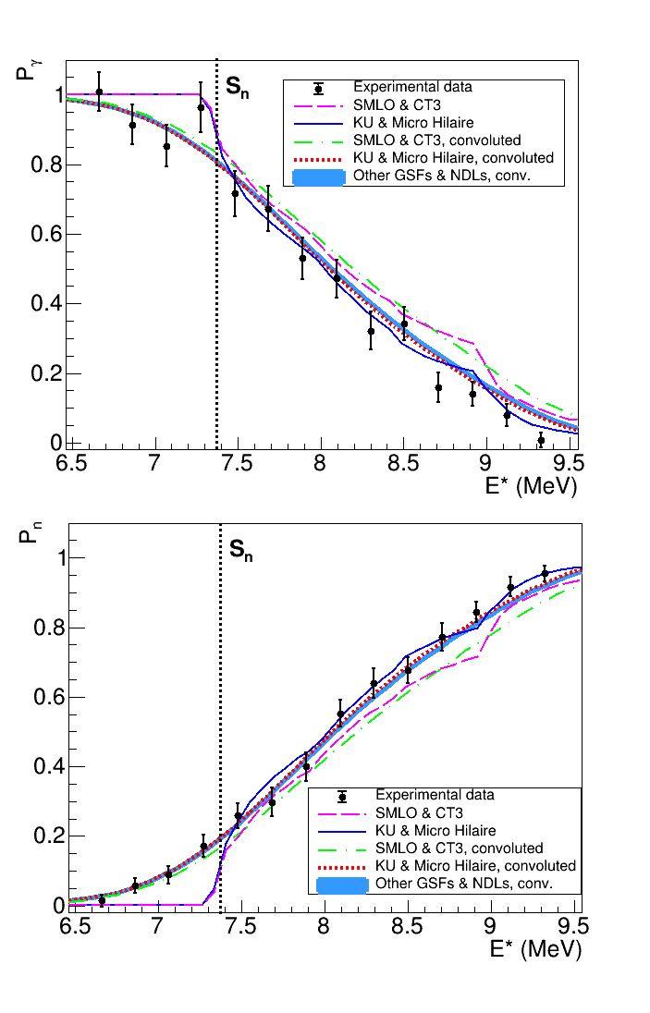
Comparison with TALYS calculations
Effect of E* resolution at the neutron
separation
energy!
Largest level density description based on CT3 model is ruled out by our data!
M. Sguazzin et al., Phys. Rev. Lett. 134 (2025) 072501
M. Sguazzin et al., Phys. Rev. C 111 (2025) 024614

Slide 13
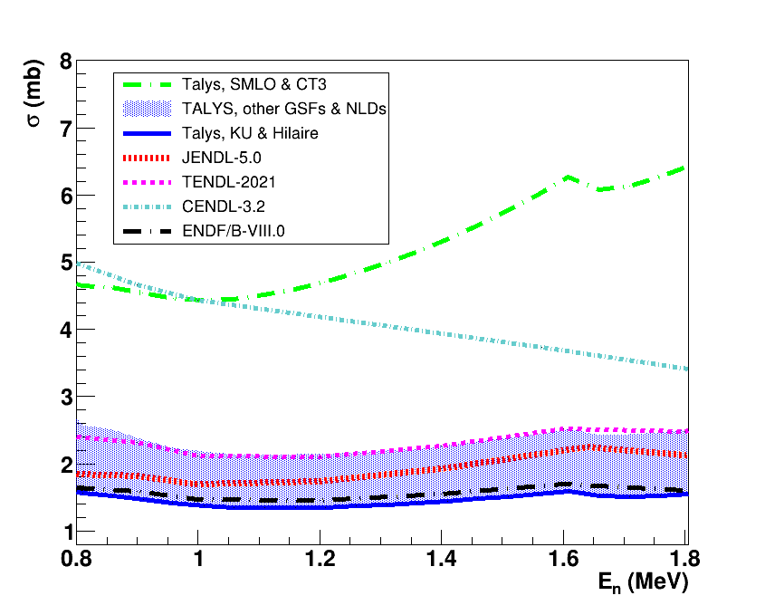
²⁰⁷Pb(n, γ) cross section
Good agreement with all evaluations except CENDL-3.2!
M. Sguazzin et al., Phys. Rev. Lett. 134 (2025) 072501
Notes:
In this slide we see in blue the result of TALYS for the radiative capture cross section of 207Pb when using the NDL and GSF descriptions that best describe our data. The shaded area in blue includes all the other descriptions which are in good agrement with our data. In black and red we have the results for the evaluations. For the 207Pb(n,gamma) cross section there are data in the resonance region but not in the region shown in the figure. However, we can consider that the evaluations are reliable because of the existence of the data on 207Pb(n,gamma) cross section at low energies, the existing data for other cross sections like (n,tot), (n,n) and the very well known structure of 208Pb. We can see that our data in blue agree well with the evaluations. However, when we use the NLD of JENDL 4.0, we can see that the cross section is clearly overestimated. This overestimation was expected, since with this level density the gamma-emission probability is over predicted.
Therefore, these results show the usefulness of our data. Indeed, when a calculation describes our data on Pn well, then the (n,gamma) cross section is correct, but if there is not a good agreement the (n,gamma) cross section is not well reproduced, e.g. if the Pn is underpredictied (i.e. Pgamma overpredicted) the radiative capture cross section is also overpredicted.

Slide 14

Second surrogate reaction experiment at the ESR, 20-27 June 2024
Fission detectors
Added fission detectors. First time that fission is studied in a storage ring!
Studied 238U(d,d’) and 238U(d,p) reactions
Deuteron breakup issue
D₂ target
Beam
²³⁸U⁹²⁺
17 A MeV
Dipole
Target-like
detector
P_{f}
(A+1)*
P_{n}
Gas target
P_{γ}
Beam-like
detector
A + d
p
Revolving ions
Unreacted
beam
A
Injection
SIS
A + d
p
n
e- cooler
Notes:
The goal of our new proposal is to add a fission detection system to the setup shown in slide 3 and to demonstrate the feasiblity of measuring for the first time simultanously P_f, P_g and P_n. It will be the very first time that fission is studied in a storage ring! Using a D2 target it will be possible to study the 238U(d,p) and the 238U(d,d’) surrogate reactions. The measured probabilities will allow us to determine several neutron induced cross sections for 238U and 237U. Note that the 237U has only a half-life of 6.75 days, so its cross sections are very difficult to measure with standard experiments! The beamtime required is highlighted as well as the fact that this experiment will be part of the PhD Thesis of Camille Berthelot.

Slide 15
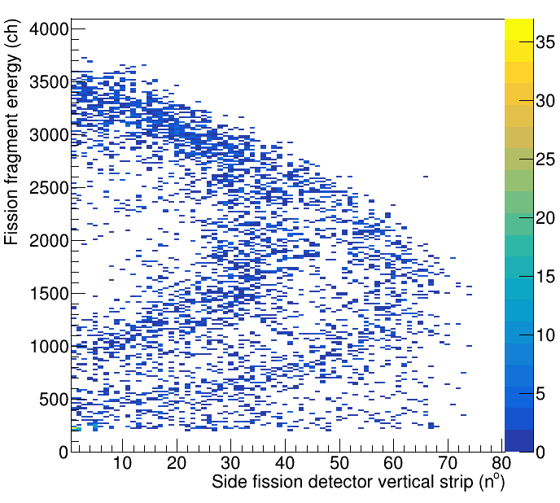
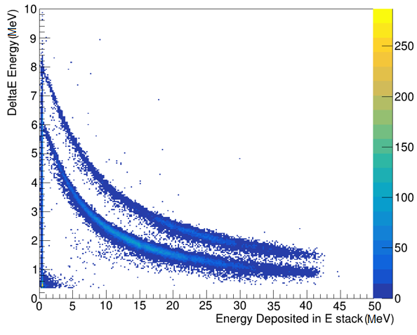
Preliminary results, 238U(d,p)
Telescope
Fission detector
ΔE (Ch)
Heavy fragment
Light fragment
d
p
Residual energy (Ch)
Fission fragment horizontal position (mm)
Beam
Analysis by Camille Berthelot & Boguslaw Wloch

Slide 16
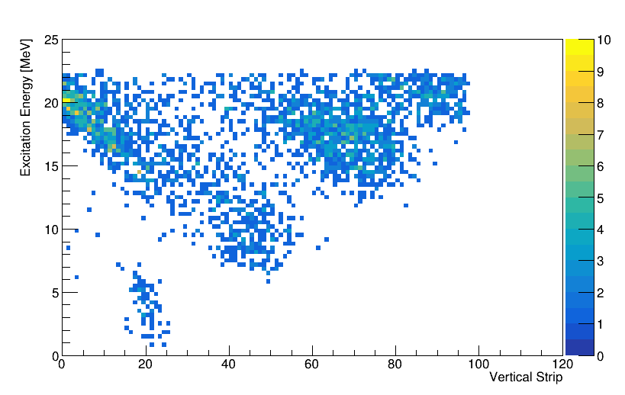
Preliminary results for heavy-residue detection
238U(d,p)
ΔE (Ch)
Telescope
Beamlike residue detector
Excitation energy
d
p
Horizontal position (mm)
Residual energy (Ch)
Analysis by Camille Berthelot & Boguslaw Wloch

Slide 17
Preliminary results for heavy-residue detection
²³⁸U⁹²⁺ residues from deuteron breakup
3n-emission!
²³⁶U⁹²⁺
Excitation energy
S_{2n}
2n-emission ²³⁷U⁹²⁺
100% efficiency!
S_{n}
1n-emission ²³⁸U⁹²⁺
100% efficiency
γ-emission ²³⁹U⁹²⁺
100% efficiency!
Beam
Horizontal position of heavy residues (mm)

Slide 18
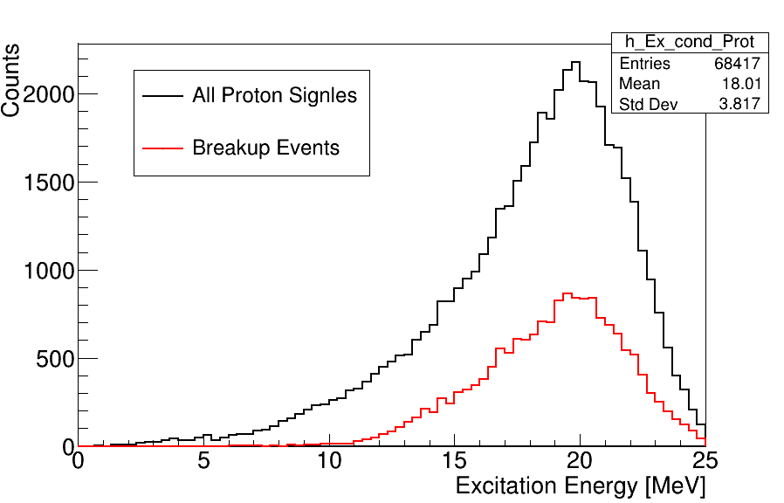
Correction of deuteron breakup events
²³⁸U⁹²⁺ residues from deuteron breakup

Slide 19
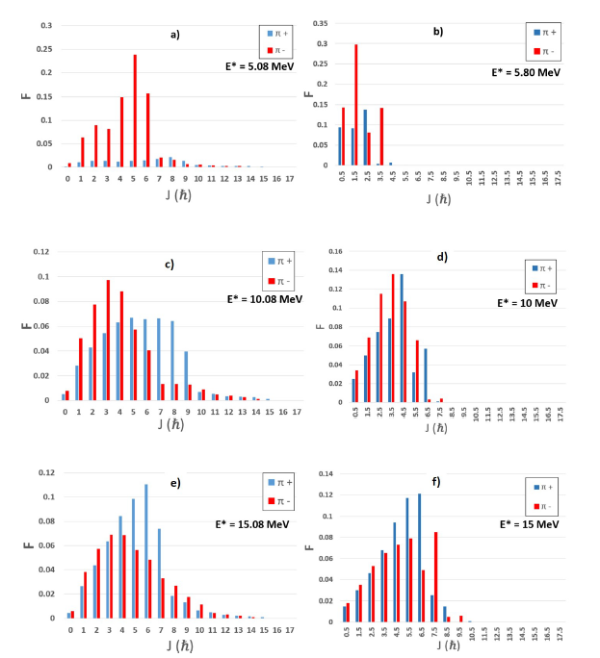
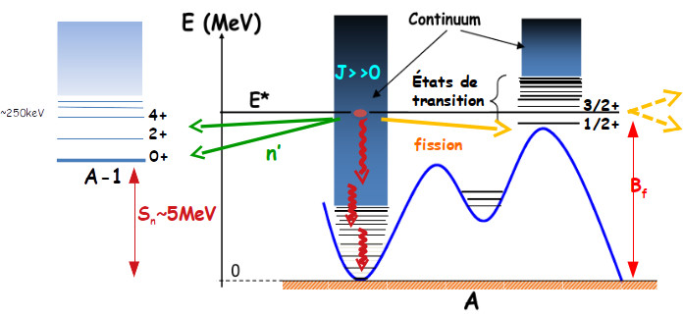
Spin/parity differences between neutron capture and (d,p)
238U(d,p)
Gregory Potel
n+238U
Talys
E*
?
^{A-1}
Sn
At higher E*, spin/parity distributions get closer and level densities increase.

Slide 20
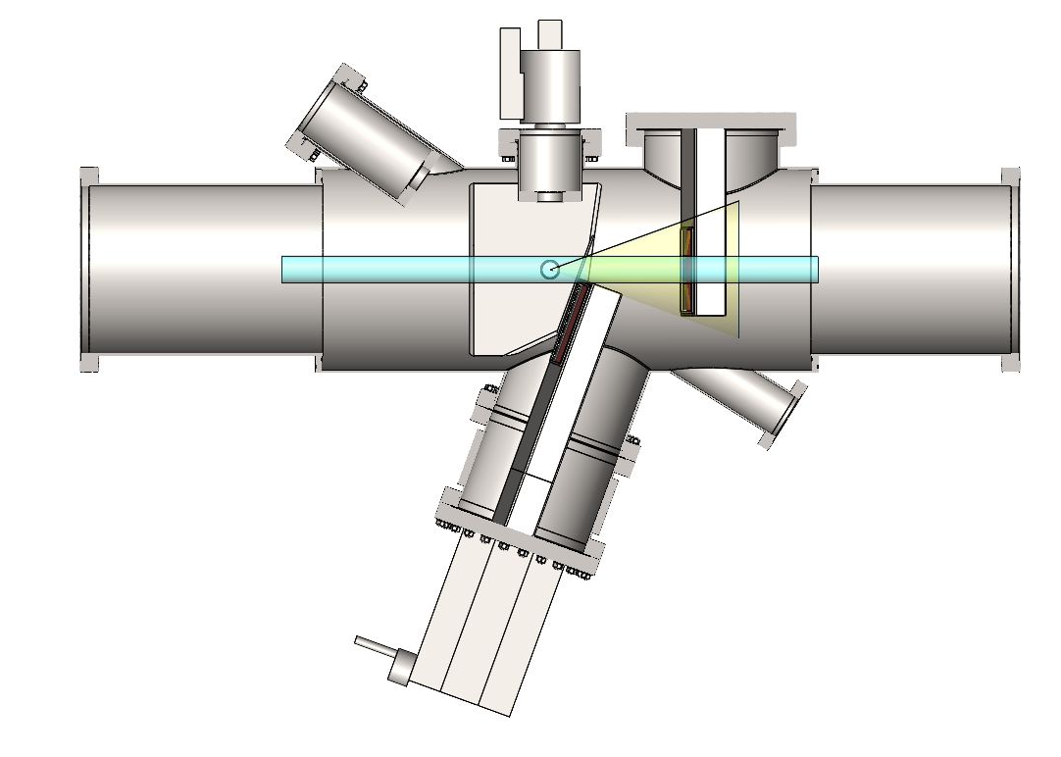
Experimental perspectives
New dedicated reaction chamber for the ESR
Significant increase of solid angle for detection of target residues
Optimised for the use with radioactive beams
Next experiment in 2027 with 206Pb and 205Pb beams
Beam
Design by Guy Leckenby, Jerome Pibernat and Ruben Kankanyan

Slide 21







Conclusions
Storage rings offer the ideal conditions to investigate the fission threshold, surrogate
reactions and more largely, nuclear reactions!
In the ESR, high-quality radioactive beams of bare ions at few 10 MeV/nucleon repeatedly
interact with an ultra-low density, pure gas-jet targets enabling us to measure simultaneously
for the first time the fission, gamma, one, two and three neutron-emission probabilities!
Perspectives
Bayesian analysis, to extract 238U(n,g), (n,f), (n,n’), (n,2n) and (n,3n) cross sections
Upgrade setup to make experiments with radioactive beams
Next experiment, infer neutron-induced reaction cross sections of ²⁰⁵Pb
M. Sguazzin
PhD student,
Bordeaux
C. Berthelot
PhD student,
Bordeaux
G. Leckenby
Post-doc,
Bordeaux
B. Wloch
Post-doc,
Bordeaux
J. Pibernat
Engineer,
Bordeaux
M. Grieser
MPIK
Heidelberg
J. Glorius
GSI
Darmstadt

Slide 22



Acknowledgements
This work is supported by the European Research Council (ERC) under the European Union’s Horizon 2020 research and innovation programme (ERC-Advanced grant NECTAR, grant agreement No 884715).
NECTAR: Nuclear rEaCTions At storage Rings
Prime 80 program from CNRS, PhD thesis of M. Sguazzin
Accord de collaboration 19-80 GSI/IN2P3
The results presented here are based on the experiments E146 and G0028, which were performed at the GSI Helmholtzzentrum fuer Schwerionenforschung, Darmstadt (Germany) in the context of FAIR Phase-0
This project has received funding from the European Union’s Horizon Europe Research and Innovation programme under Grant Agreement No 101057511.

Slide 23
BACK-UP SLIDES

