Slide 1
TALYS and TENDL for the future of FENDL
Arjan Koning, IAEA, Vienna

Slide 2
Contents
TENDL approach
Some examples
Summary

Slide 3
TENDL: TALYS Evaluated Nuclear Data Library
General purpose nuclear reaction data library
Simultaneous focus on
Reproducibility ✓
Completeness ✓
Quality (ongoing, never enough)
Heavily based on the TALYS nuclear model code
Extent:
Neutrons, photons, protons, deuterons, tritons, Helium-3, alpha-particles
2853 nuclides (all stable or with half-life > 1 sec.)
0-200 MeV
All cross sections and secondary distributions (particle and gamma spectra)
UQ with covariance matrices or random distributions
A variety of data formats
TENDL ranges from global TALYS calculations to detailed isotopic evaluations
TENDL-2025 to be released in December 2025

Slide 4
Building blocks of TENDL: horizontal nuclear data evaluation
Complete automated Resonance Parameter system including covariance data:
TARES-1.6 (Dimitri Rochman)
Regularly updated with latest recommendations for best resonance parameters
Tested for format and basic physics errors and declared correct (AK)
EXFOR database
Entire database renormalized to the latest standard and monitor reactions
Based on Viktor Zerkin’s XC5 database and Shin Okumura’s EXFOR_JSON database
11 500 experimental cross section sets validated, 2050 data sets declared outlier (needed for automatic optimisation): Essential for automated TALYS model parameter optimisation
Latest version of TALYS, version 2.1 (right now GitHub only)
Contains new ‘best’ model parameter database from automated fitting with TASMAN
Czendes global optimization based on Boender-Rinnooy Kan-Timmer-Stougie stochastic method
Dimension reduction, only optimize the most sensitive model parameters (“Occam’s razor”)
“Best” nuclear model parameters for reactions up to 30 MeV
One superscript: autotalys -element Sn -mass 117 -Ltarget 000 -Liso 000 -proj n -bins 60 -high -endf -njoy -residual -isomer -levels -recoil -covar -binsrand 60 -plot -subfission -nomcnp -tasmanfile /Users/koning/tasman/misc/tasman.tendl2023 -tarwork -best -ntalys 100 -sdefault -s20 -s60 -acf -eaf -mt
……which produces the TENDL file for n + Sn117, up to 200 MeV, including all secondary distributions and covariance data, i.e. from MF1 - MF40. All adjustment to experimental data is in underlying databases.

Slide 5
Example: Upcoming JEFF-4.0 neutron library
Consist for 80% of isotopes from the TENDL-2025 beta version, which at least guarantees true general purpose application (MF1-40)
106 nuclides, or 34 materials, not from TENDL: H, He, Li, Be, B, C, N, O, F, Al, Si, Cl, Cr, Mn, Fe, Cu, Rh, Sn, Gd, Hf, Ta, W, Au, Pb, Th, Pa, U, Np, Pu, Am, Cm, Bk, Cf, Es, Fm
Non-TENDL isotopes for the right reasons:
No reproducible system (anywhere) for light nuclides
TALYS failure for structural nuclides (Cr, Fe, Cu etc.) up to a few MeV, need Gaussian Processes for model defects. Systematic approach can not yet outperform the manual evaluation of nuclides with strong sensitivity to crit-safety or some other applications. INDEN evaluations are better.
Consistent approach for actinides not yet ready
In total, current JEFF-4 pre-release tests looking good (in part thanks to TENDL)

Slide 6
Global use of TALYS (~ 7000 papers)

Slide 7
TALYS applications
TEFAL processes the output of TALYS, and data from other sources, into an ENDF-6 data library
TAGNDS
Other processing software
Automated plotting
EXFOR outlier detection
Astrophysical databases
Medical isotope data
AI/ML
TALYS event generator
etc.
Input
TALYS
But also:
Output
TALYS input file
‘endf y’
TALYS output files
Input
TEFAL
Output
gam13 y
eswitch 30.
adopt 3 1
11023.0000 22.7920000 0 0 0 01125 3 1
0.0 0.0 0 0 1 16331125 3 1
1633 2 1125 3 1
1.00000E-5 30.01000001.090516E-5 28.88378281.176413E-5 27.93758371125 3 1
1.257105E-5 27.13857751.332237E-5 26.46086031.474673E-5 25.32124481125 3 1
1.591407E-5 24.50371641.684983E-5 23.91068111.835751E-5 23.05234531125 3 1
2.00000E-5 22.23004902.181024E-5 21.4336445 2.35281E-5 20.76452741125 3 1
2.514186E-5 20.19948982.664444E-5 19.72021662.949314E-5 18.91424921125 3 1
3.182781E-5 18.33605613.369931E-5 17.91662593.671479E-5 17.30952461125 3 1
4.00000E-5 16.72787884.362039E-5 16.16458234.705604E-5 15.69129701125 3 1
5.028349E-5 15.29161415.328858E-5 14.95258445.898596E-5 14.38241631125 3 1
6.365529E-5 13.97335646.739828E-5 13.67660147.342935E-5 13.24703021125 3 1
8.00000E-5 12.83542868.724079E-5 12.4367866 9.41123E-5 12.10179941125 3 1
1.005679E-4 11.81885951.065787E-4 11.57883431.179737E-4 11.17514101125 3 1
1.273126E-4 10.88546451.347988E-4 10.67528531.468603E-4 10.37100291125 3 1
1.60000E-4 10.07939391.744821E-4 9.796840691.882251E-4 9.559341041125 3 1
2.011354E-4 9.358695902.131561E-4 9.188433632.359458E-4 8.901941581125 3 1
2.546232E-4 8.696257792.695952E-4 8.546955432.937188E-4 8.330684881125 3 1
3.20000E-4 8.123269843.489633E-4 7.922156003.764486E-4 7.752966031125 3 1
4.022684E-4 7.609911274.263093E-4 7.488420994.718883E-4 7.283756031125 3 1
5.09243E-4 7.13660721 5.39187E-4 7.029664965.874353E-4 6.874528761125 3 1
6.40000E-4 6.725454556.767185E-4 6.631531297.461161E-4 6.472807891125 3 1
8.02796E-4 6.358266288.481141E-4 6.274777049.209316E-4 6.153261151125 3 1
.001000000 6.03600000.0010905086 5.92308619.0011763986 5.828188921125 3 1
.0012570838 5.74802770.0013322101 5.68001327.0014746442 5.565584741125 3 1
.0015913772 5.48345048 .001684952 5.42384184.0018357303 5.337512701125 3 1
.002000000 5.25474099.0021810163 5.17451983.0023527956 5.107057261125 3 1
.0025141652 5.05003618.0026644172 5.00162729.0029492852 4.920115391125 3 1
.0031827511 4.86154670.0033699007 4.81900328.0036714583 4.757324471125 3 1
.004000000 4.69810390.0043620318 4.64061662.0047055896 4.592189681125 3 1
.0050283281 4.55118966.0053288314 4.51632611.0058985672 4.457487391125 3 1
.0063654989 4.41508851 .006739798 4.38421641.0073429143 4.339330731125 3 1
.008000000 4.29606921.0084589708 4.26873941.0091972669 4.228908191125 3 1
.010000000 4.19040000.0109050782 4.15292906.0117639715 4.121243991125 3 1
.0125708168 4.09431934.0133220739 4.07134362.0147464132 4.032373621125 3 1
.0159137422 4.00411715.0168494898 3.98343622.0183572823 3.953185001125 3 1
.020000000 3.92379338.0212105848 3.90409888.0231652286 3.875199481125 3 1
.025300000 3.84700000 .026790941 3.83119247.0296146078 3.804404691125 3 1
.0319259991 3.78500433.0337771793 3.77081994.0367571382 3.750097951125 3 1
.040000000 3.73000000.0436203101 3.71065148.0470558813 3.694226761125 3 1
.0502832602 3.68021721.0532882864 3.66821961 .058985643 3.647767701125 3 1
.0636549587 3.63284665.0673979492 3.62187048.0734291223 3.605720251125 3 1
TEFAL input file
~ 60 keywords (all optional)
ENDF file

Slide 8
Some recent and upcoming TENDL versions
TENDL-2023: Missing several 10s of isomers (JCS, FISPACT), for isomers above 10th discrete level, solved
TENDL-2023: For several nuclides MF9/MT102 branching ratio for neutron capture to isomer, extrapolation error at low energies: 1.e-22 below 10 eV (discovered by ANL and ORNL), mostly solved
TENDL-2023: (n,α) generally too high above 14 MeV due to bug in implementation of knock-out mechanism, solved
TENDL-2025 (in development): Reproduction of exp. with horizontal nuclear data evaluation:
Towards global agreement for exp./evaluated ‘one-point values’ : thermal c.s. , RI, MACS etc.
Fully automated parameter optimisation below 30 MeV for cross sections, including isomers
In the range from F - Bi: ~ 80 individual reaction channels still unsatisfactory due to model defects. The rest is competitive with or better than the other NDL’s.
Recommendation, also for FENDL: wait for TENDL-2025
For possible adoption of missing isotopes in “transport” library (FENDL-3.2c++)
Activation library
Having TENDL in standard validation schemes (JADE, FISPACT, etc.) would be beneficial for development…thank you!!!

Slide 9
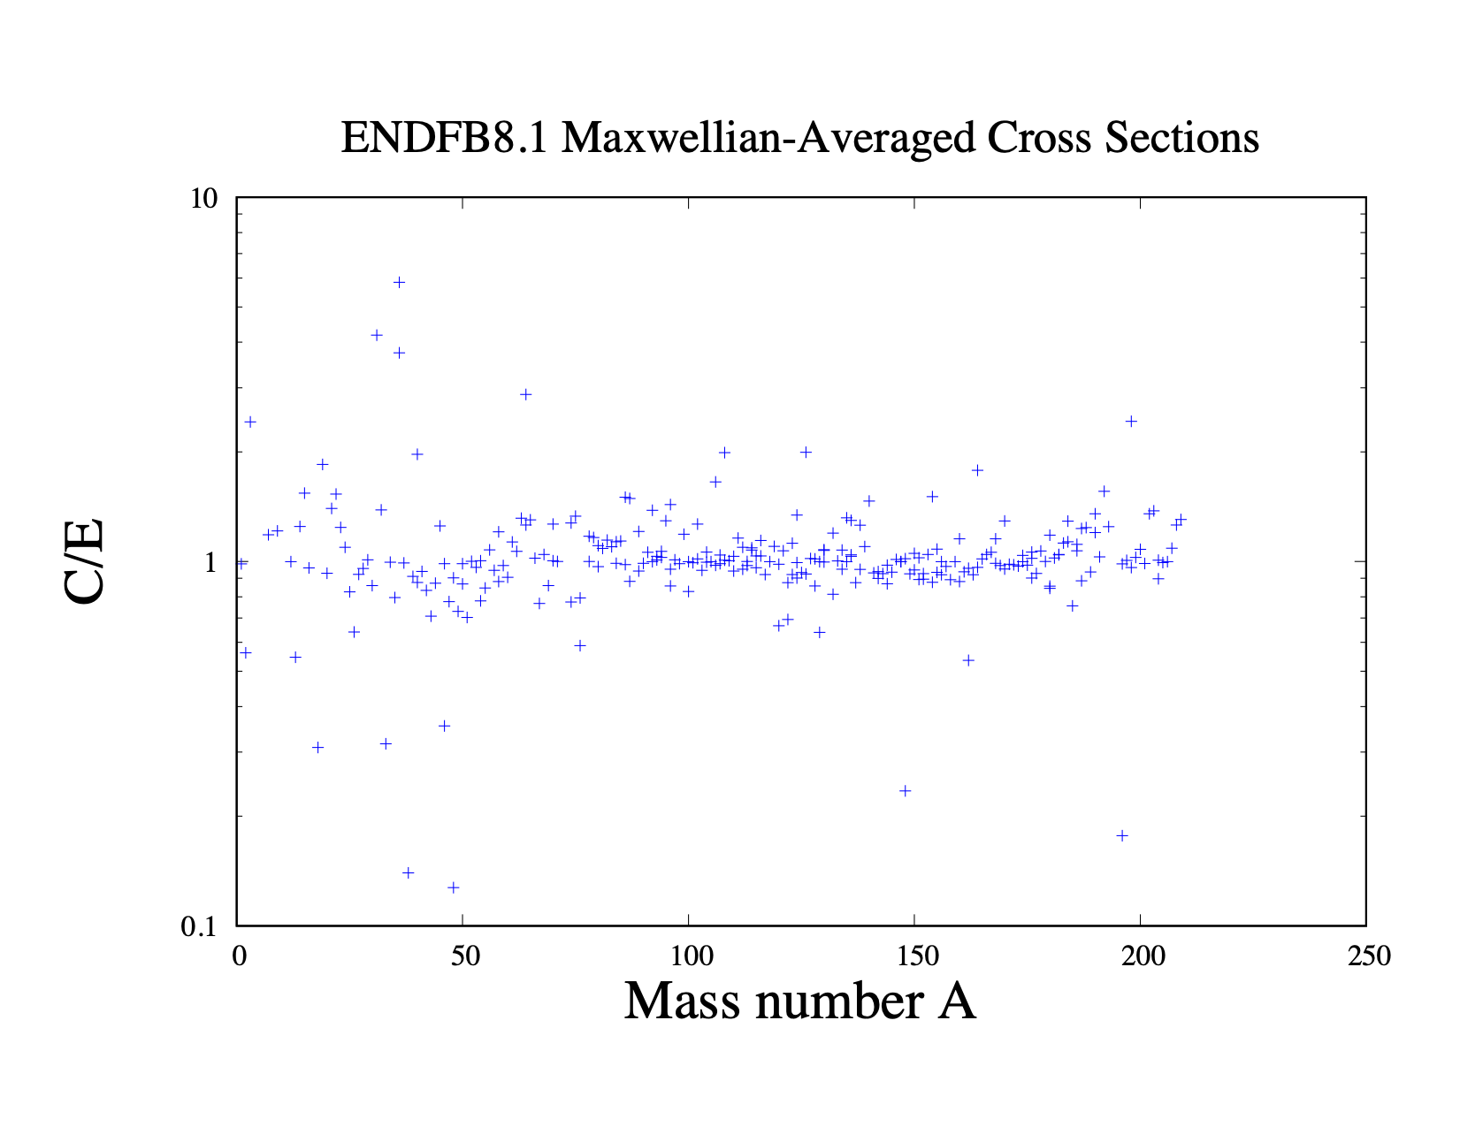
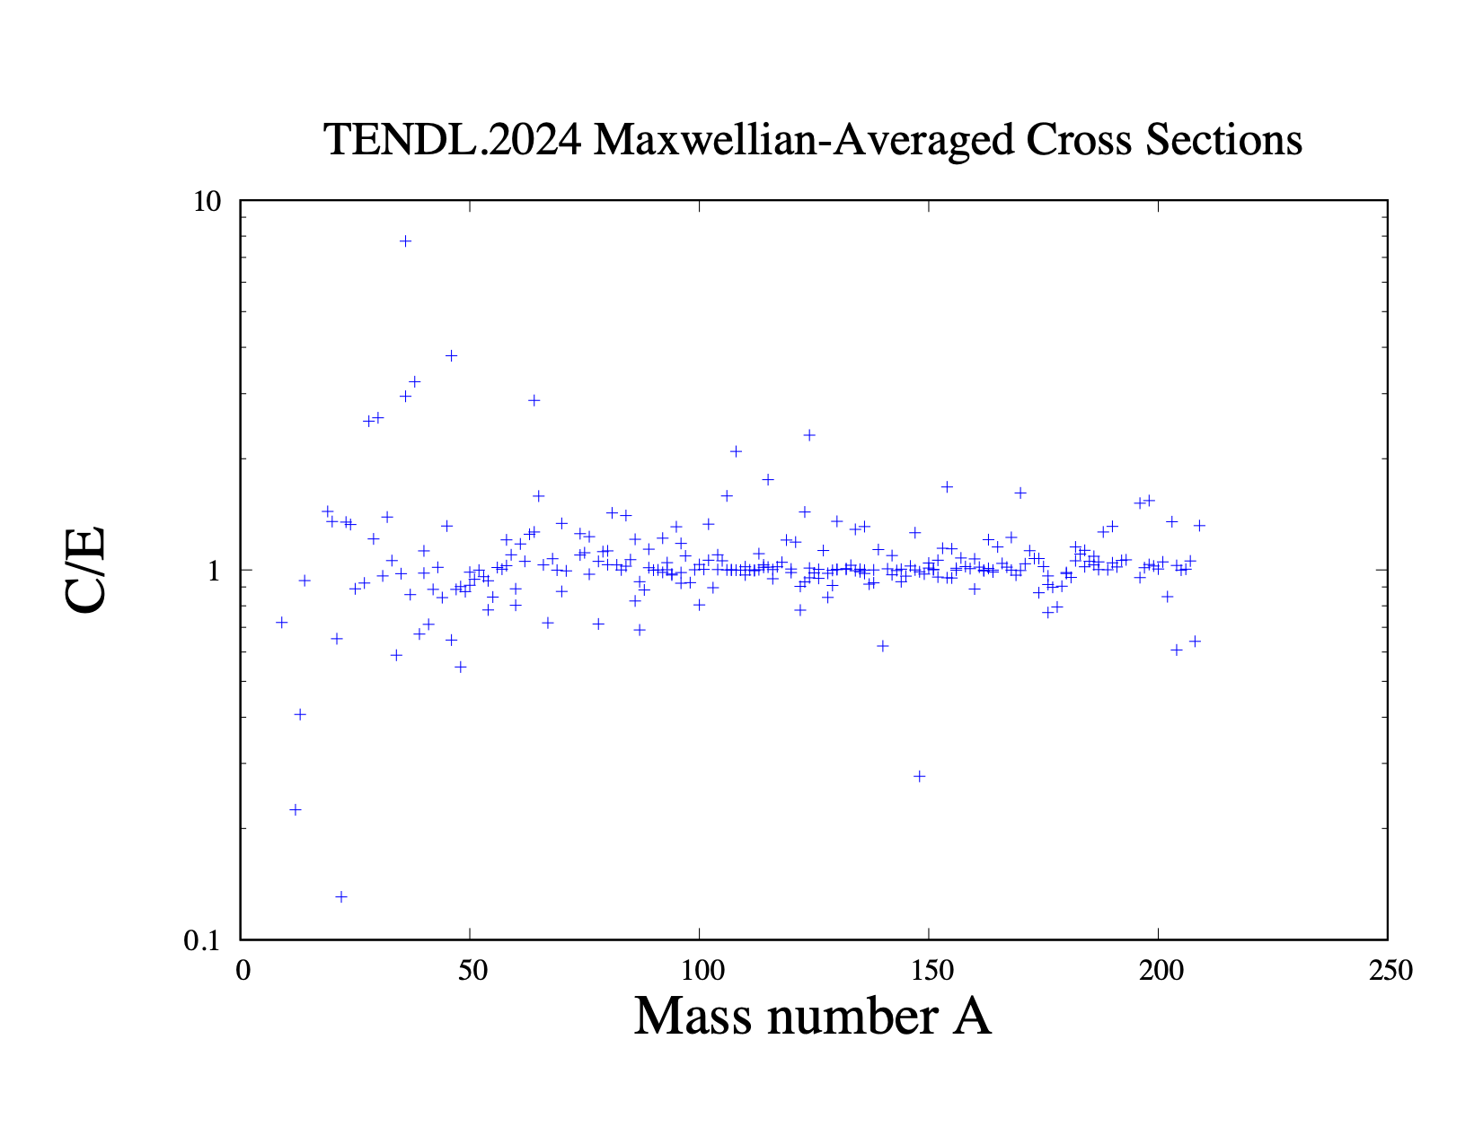
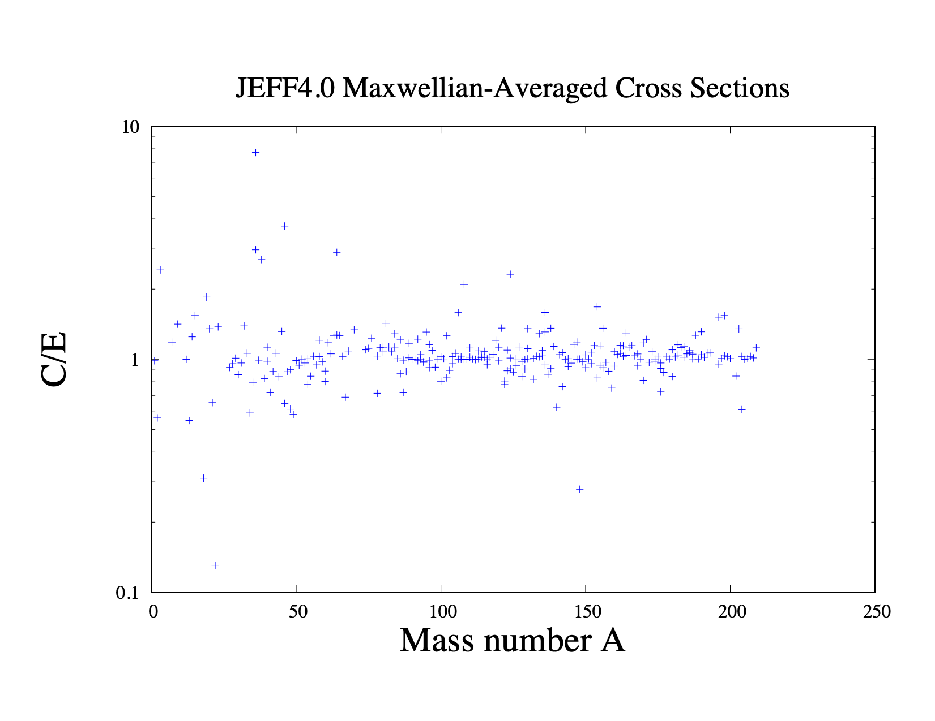
NDL’s (n,γ) versus Astral/Kadonis exp. MACS at 30 keV
Frms
CENDL-3.2: 1.069
JENDL-5.0: 1.064
ENDF/B8.1: 1.064
TENDL-2025: 1.052
JEFF-3.3: 1.076
JEFF-4.0: 1.062

Slide 10
Parameter optimisation in fast range
Use TASMAN for parameter optimisation
Multi-dimensional parameter landscape not too wild
20 TALYS runs per parameter
(n,γ):
Photon strength function: wtable(0,0) of compound nucleus
(n,n’), (n,2n), (n,p) and (n,np):
Optical model: rvadjust p
Pre-equilibrium: gadjust(0,0), gadjust(1,0), gadjust(0,1)
(n,α):
Optical model: rvadjust a
Pre-equilibrium: cstrip a
Isomer versus ground state:
Discrete levels: Risomer of the final nuclide
Level density s2adjust (level density spin distribution) of final nuclide

Slide 11
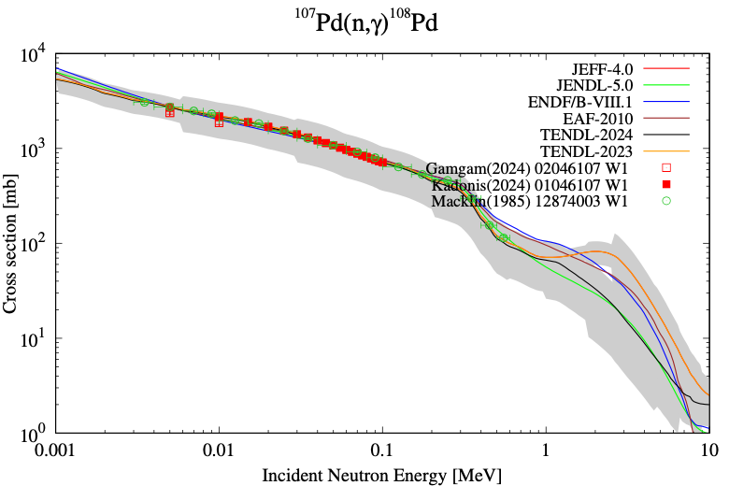
Typical case
In general: uncertainties require
some attention (this one seems to wide)

Slide 12
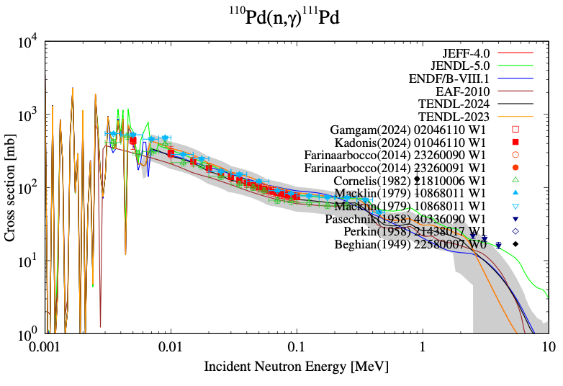
Usually: (n,γ) cross sections, MACS and Γγ are consistent

Slide 13
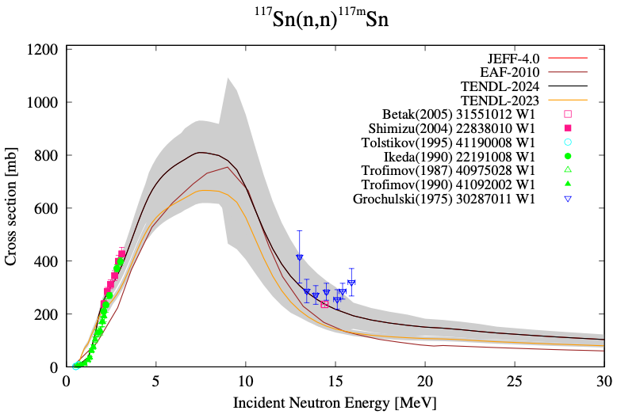
Malec, Trkov: important dosimetry reaction

Slide 14
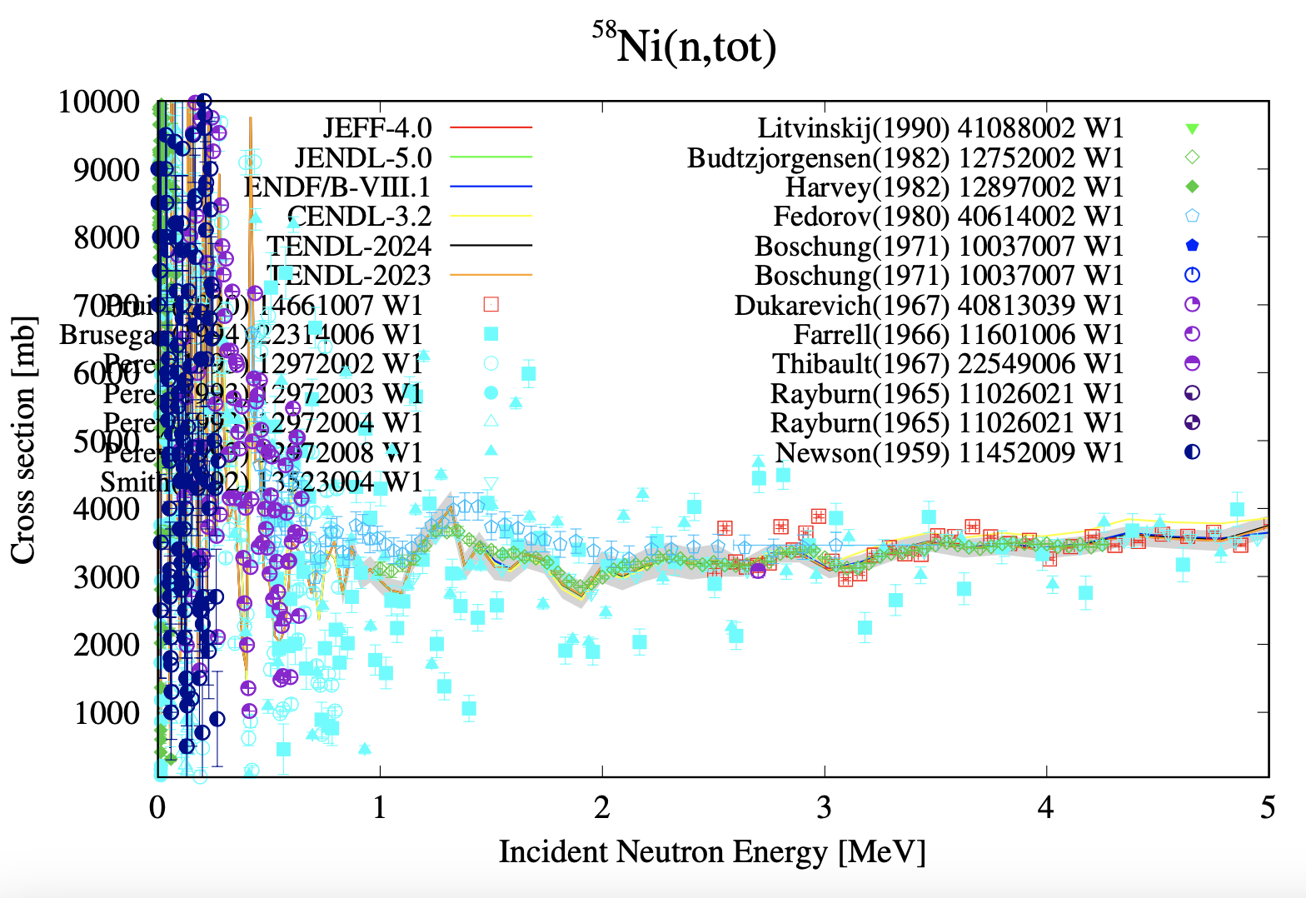
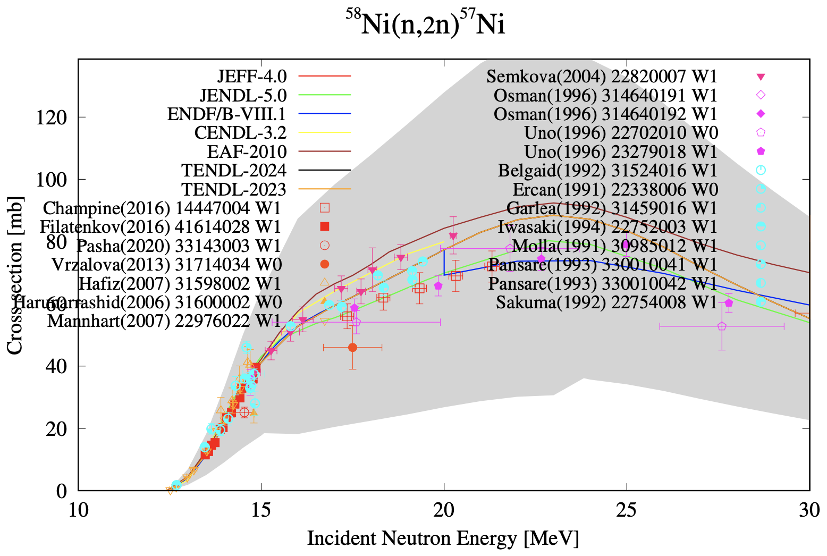
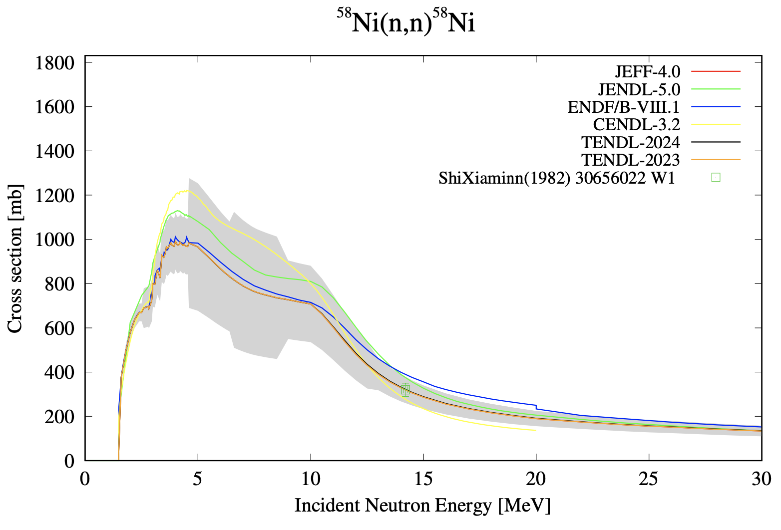
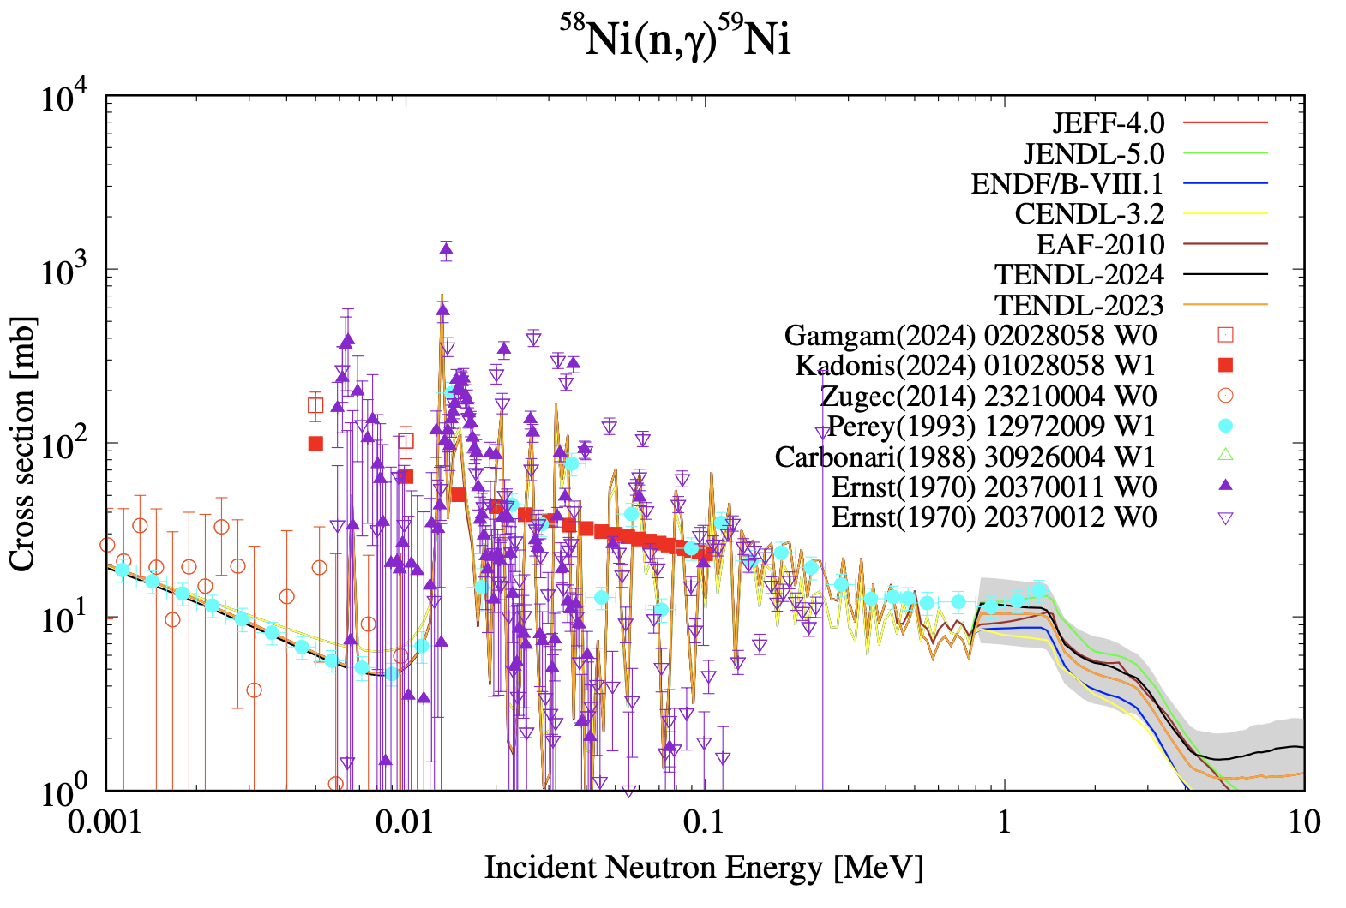

Slide 15
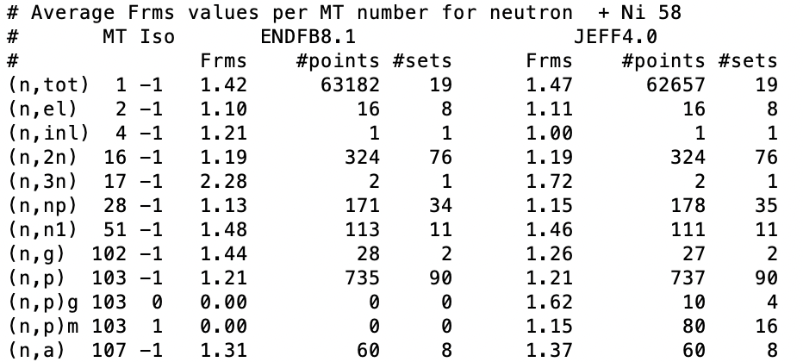
EXFORtables: Frms values per nuclide, reaction channel and NDL
Only makes sense when EXFOR outliers are removed
Available for all nuclides, reaction channels and NDL’s
Statistics available in all kinds of different forms (summed over nuclides, channels etc.)

Slide 16
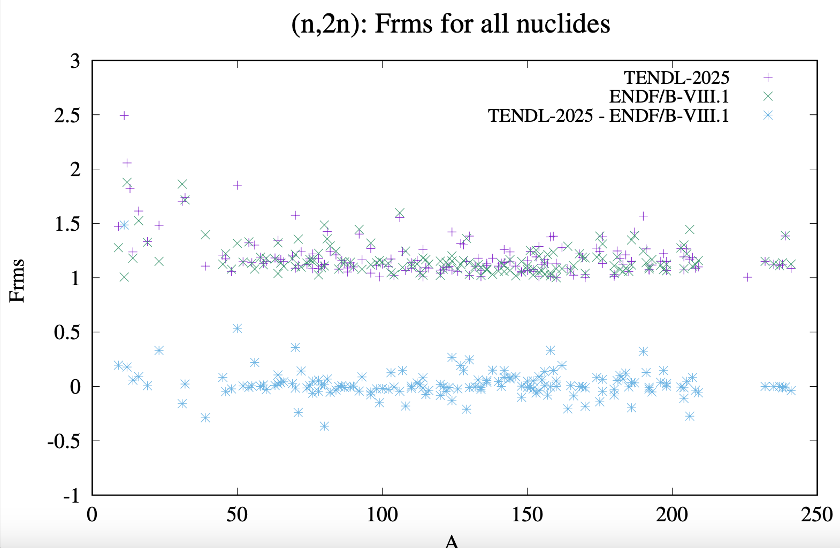

Slide 17
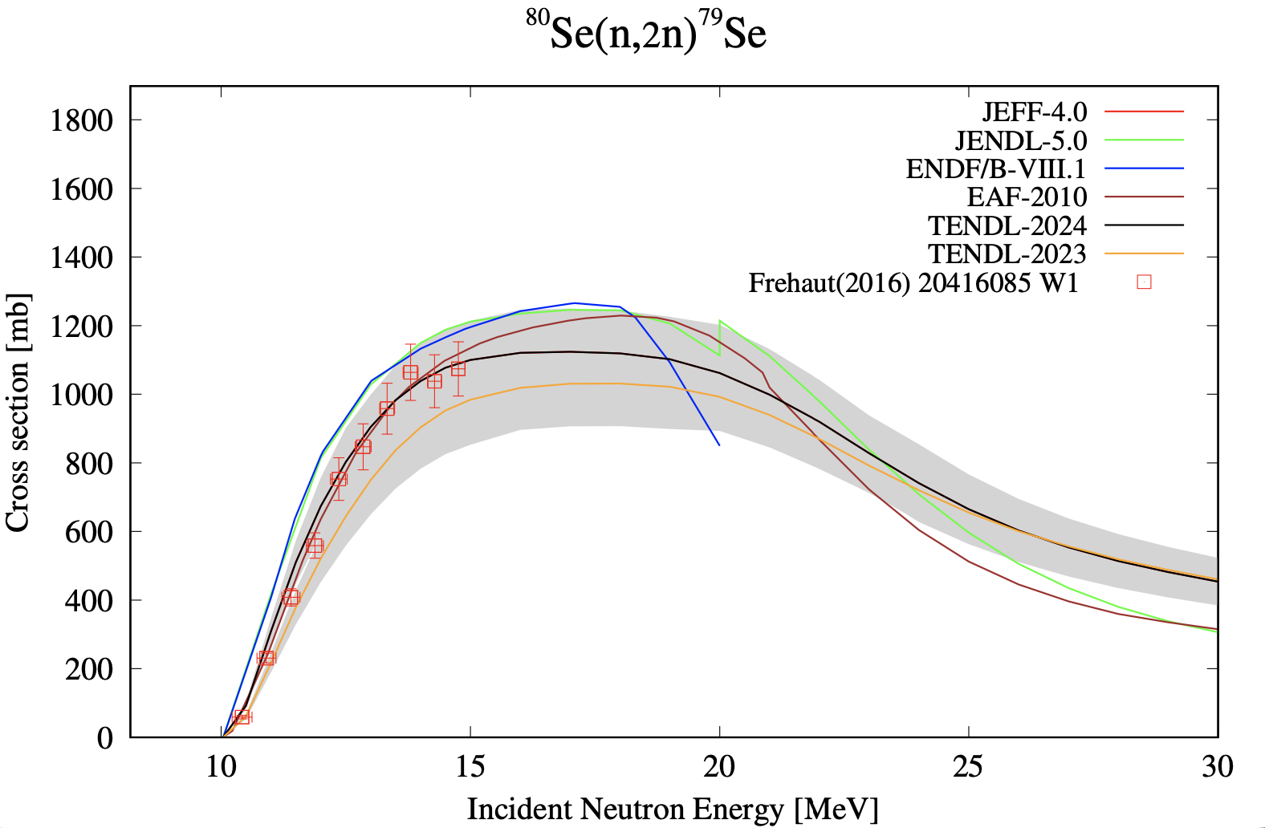
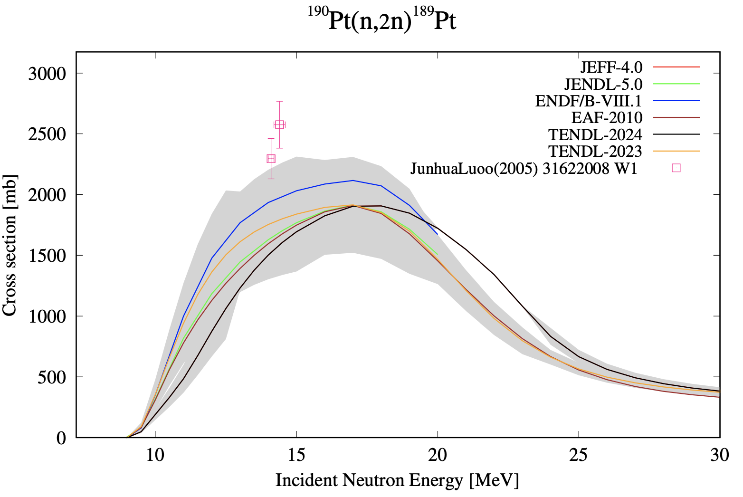
Good enough for the moment
Work to be done on weights,
other channels etc.

Slide 18
YANDF (Yet Another Nuclear Data Format)
Zen of Python: Explicit is better than implicit
Key - value approach: allow ‘easy’ parsing into JSON, YAML, GNDS/XML etc.
Not as non-descriptive as ENDF
Not as heavy as GNDS
Not as extensive and abbreviated as EXFOR
More metadata than in the previous TALYS output files
Human-readable
Same schema for TALYS, EXFOR and ENDF
From the point of view of a nuclear physicist, not from EXFOR or ENDF
Would make ALL nuclear reaction data programmatically available at the same time: good for TENDL, other large data projects, AI/ML

Slide 19
TALYS output file: rp039090.L02
‘#’ for direct use in
various software, e.g.
Gnuplot
Without ‘#’: YAMLesque
2 space indentation per
level
Parsing to JSON should
be easy
Only 5 main attributes for
nuclear reactions
TALYS: 2 more main
attributes: ‘parameters’
and ‘observables’
EXFOR: All specific
metadata may follow
after the datablock

Slide 20
TALYS
JENDL5.0
EXFOR
(One file per data set)

Slide 21
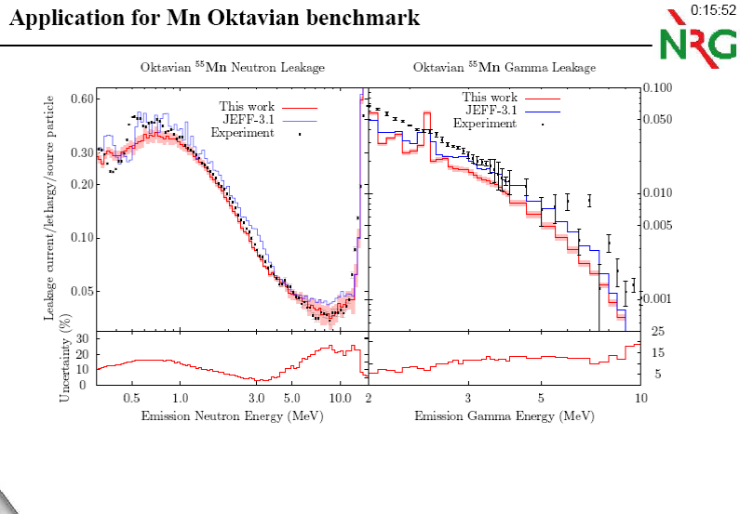
2010 FENDL meeting, IAEA: Total Monte Carlo with MCNP
Why did this data file work so well?
Can integral data be translated back to differential data (with uncertainties)
to which we can fit TALYS?

Slide 22
What next
Establish new evaluated databases of thermal cross sections, RI, MACS, Γγ, D0, etc.
Data mining of all existing compilations and EXFOR
New level density CRP
Give all resonance parameter databases in human/modern readable format: Atlases, all NDL’s (TARES code)
Finalising EXFOR outlier collection
Translate negative feedback for JEFF-4, FENDL etc into next automated TENDL scheme
TENDL-2025 in development:
Clean up remaining ENDF-6 format glitches
Apply automated optimisation to improve agreement with differential data
Applied for neutrons up to 30 MeV with ~10 parameters
Improved description of isomeric data
Further improvement of all photon and charged particle induced libraries (untouched since 2021)
Do more completeness tests and integral tests before release
After 2025:
more efficient integral validation
More focus on angular distributions and (double-differential) emission spectra
TALYS event generator
Skipping ENDF and cross sections altogether, true nuclear reaction simulator with all correlations included
Fully populated by probability tables
Direct input to next generation transport codes

Slide 23
Thank you!
Notes:
Thank you!

Slide 24
