Slide 1































INDEN activities for FENDL: Fe, Ni, W, F
R. Capote (IAEA) on behalf of the INDEN collaboration
https://www-nds.iaea.org/INDEN

Slide 2
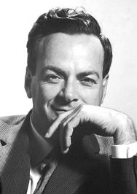
Outlook
CIAE DT benchmarks: Graphite, Be, Fe, SiC, W
Comments on “differential” and “integral” benchmarks W
CIAEA and Rez benchmarks, comments
“It doesn't matter how beautiful your theory is,
it doesn't matter how smart you are.
If it doesn't agree with experiment, it's wrong.”
Richard Philips Feynman,
Nobel Prize in Physics 1965

Slide 3
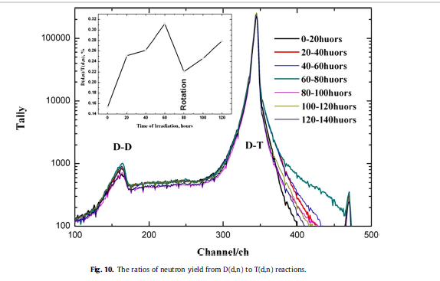
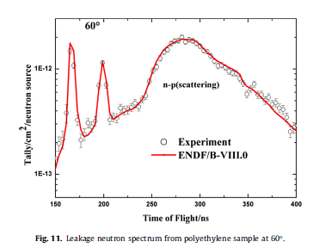
CIAE testing & setup
Y. Nie et al. Annals of Nuclear Energy 136 (2020) 107040
https://doi.org/10.1016/j.anucene.2019.107040

Slide 4
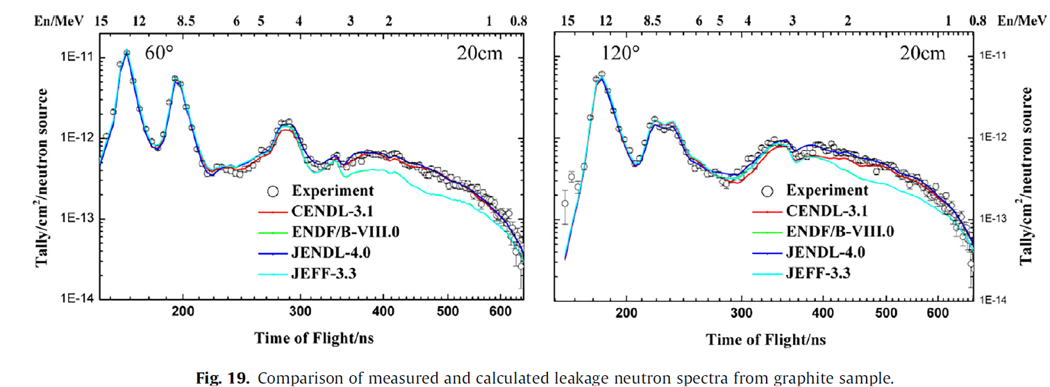
Graphite (Carbon) DT testing @ CIAE
Y. Nie et al. Annals of Nuclear Energy 136 (2020) 107040
https://doi.org/10.1016/j.anucene.2019.107040

Slide 5
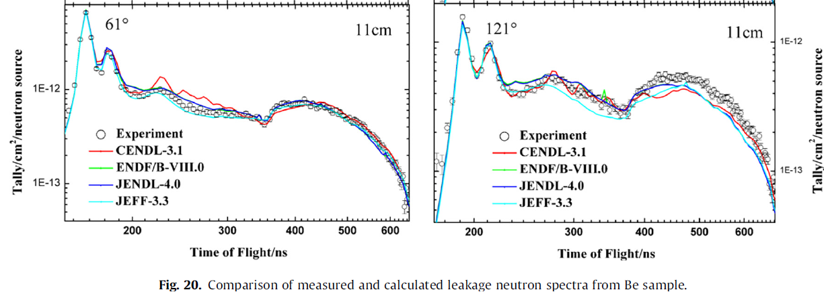
Be DT testing @ CIAE, 11 cm
Y. Nie et al. Annals of Nuclear Energy 136 (2020) 107040
https://doi.org/10.1016/j.anucene.2019.107040

Slide 6
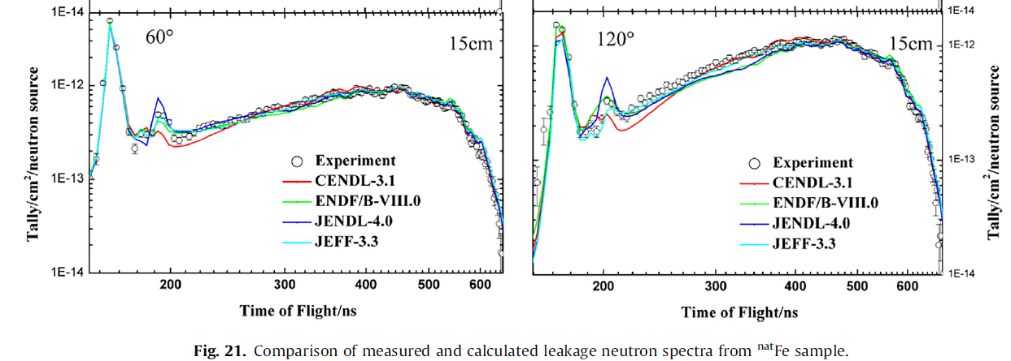
Fe-nat DT testing @ CIAE, 15 cm
Y. Nie et al. Annals of Nuclear Energy 136 (2020) 107040
https://doi.org/10.1016/j.anucene.2019.107040

Slide 7
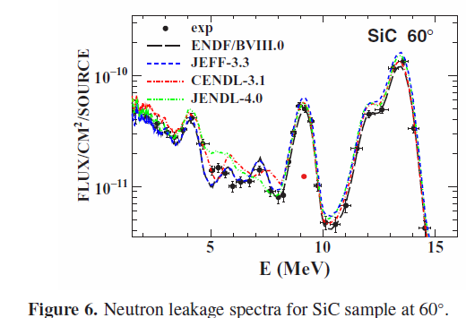
SiC DT testing @ CIAE, 60 deg
R. Han et al, EPJ Web of Conferences 239, 18009 (2020)
https://doi.org/10.1051/epjconf/202023918009

Slide 8
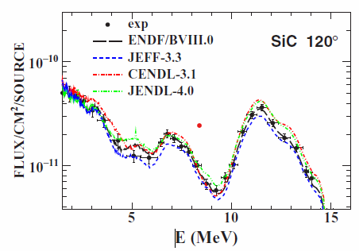
SiC DT testing @ CIAE, 120 deg
R. Han et al, EPJ Web of Conferences 239, 18009 (2020)
https://doi.org/10.1051/epjconf/202023918009

Slide 9
TUNGSTEN
Evaluations:
1) JENDL-5=JENDL-4
2) * fast region: IAEA eval from 2007
ENDF/B-VIII.1 (JEFF-4)=
ENDF/B-VIII.0=ENDF/B-VII.1
* RRR: ENDF/B-VIII.0 new evaluation (adopted for B81 and JEFF-4)

Slide 10
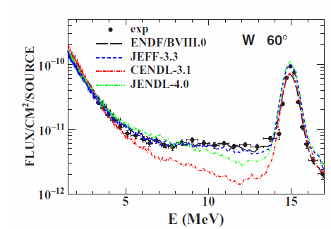
W DT testing @ CIAE, 60 deg
R. Han et al, EPJ Web of Conferences 239, 18009 (2020)
https://doi.org/10.1051/epjconf/202023918009

Slide 11
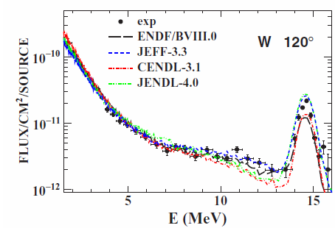
W DT testing @ CIAE, 120 deg
R. Han et al, EPJ Web of Conferences 239, 18009 (2020)
https://doi.org/10.1051/epjconf/202023918009

Slide 12
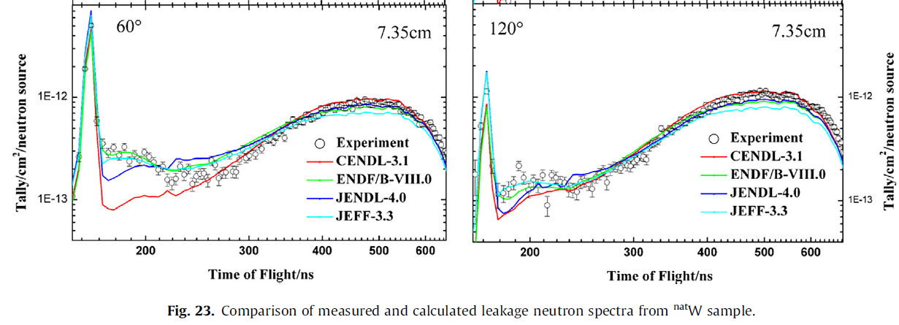
W-nat DT testing @ CIAE, 15 cm
Y. Nie et al. Annals of Nuclear Energy 136 (2020) 107040
https://doi.org/10.1016/j.anucene.2019.107040

Slide 13
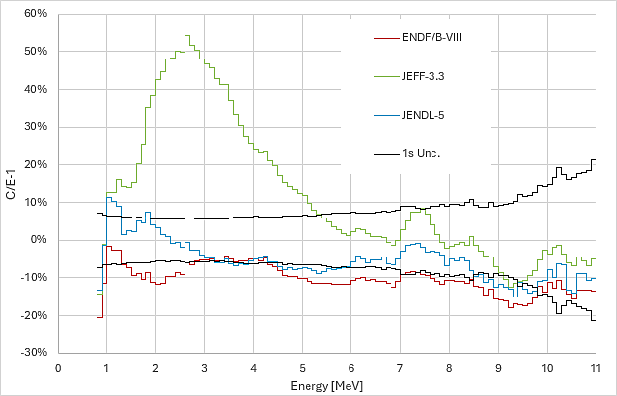
W-nat Rez broomstick, 20 cm thick
ENDF/B-VIII.0
JEFF-3.3
JENDL-5
uncertainty
JEFF-3.3 very poor performance

Slide 14
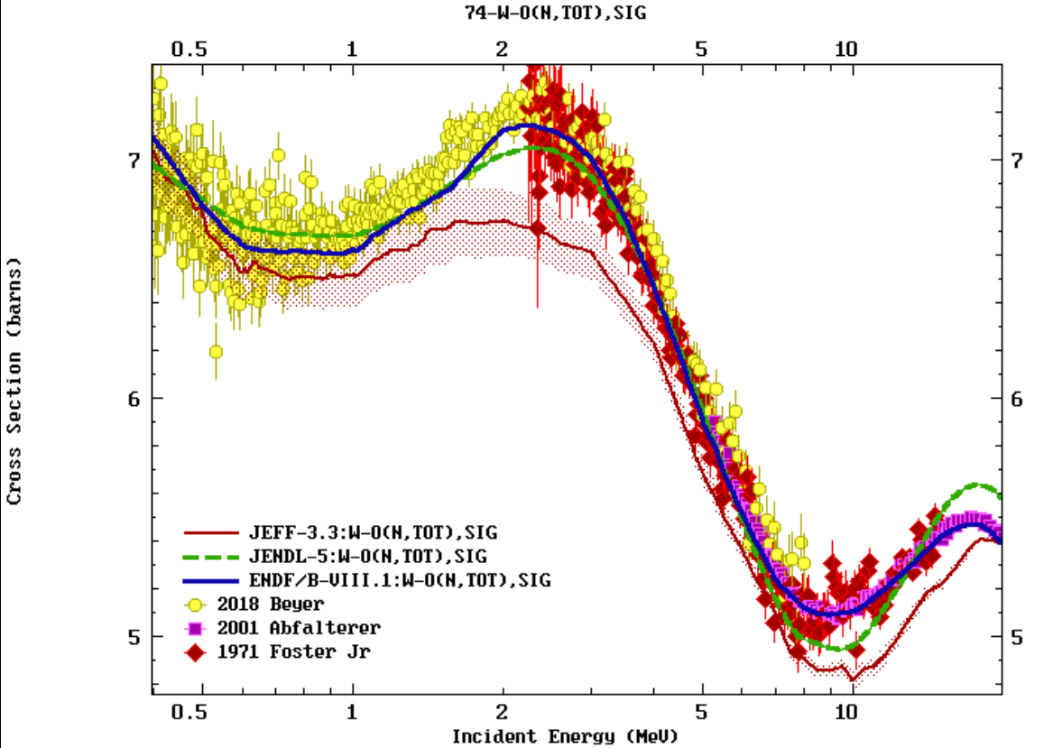
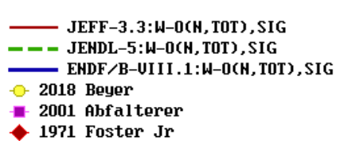
W total cross section

Slide 15
Summary and Conclusions
INDEN collaboration is addressing data issues with the following strategy:
Identify data problems through integral validation and feedback
Identify underlying data issues in differential data evaluation
Assess available experimental differential data to find alternative solutions to improve integral benchmarks
Update selected experimental data to the latest standards/references
A GLSQ fit of available comprehensive datasets is the preferred solution
If model is available, use model including correlations as prior
INDEN developed files for Fe and Cu isotopes and F-19 adopted
for ENDF/B-VIII.1 and JEFF-4
“It doesn't matter how beautiful your theory is,
it doesn't matter how smart you are.
If it doesn't agree with experiment, it's wrong.”
Richard Philips Feynman, Nobel Prize in Physics 1965

