Slide 1
Benchmark experiment for large angle scattering cross section of 14 MeV neutrons
Yamato Fujii
Graduate School of Engineering,
the University of Osaka
Notes:
Thank you for the introduction, and giving me this opportunity to speak today.
My name is Yamato Fujii.
I’m a graduate student at the University of Osaka in Japan, and currently, I’m working as an intern for three months in the Nuclear Data Section at the IAEA.
Today, I’m going to talk about a study in Japan, Benchmark experiment for large angle scattering cross section of 14 MeV neutrons.

Slide 2
Outline
Benchmark experimental method and results
・Our benchmark experimental method for large angle scattering cross section
・results of iron and tungsten
Research we are currently undertaking
・Selection of activation foil for statistical error reduction of benchmark
experiment of lithium
Notes:
This is the outline.
First, I will introduce our benchmark experimental method for large angle scattering cross section, and show you the results of iron and tungsten.
Second, I will explain a research we are currently undertaking.
This is about selection of activation foil for statistical error reduction.

Slide 3
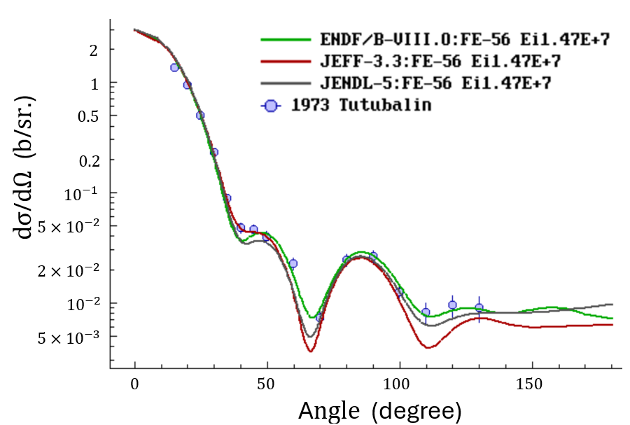
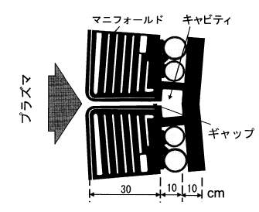


Introduction
Large angle scattering cross section
  Neutron backward scattering
  Smaller than forward scattering cross
  section by 2 - 3 orders of magnitude
  Not Negligible in neutronics design
  of fusion reactor because of gap
  streaming phenomenon
Gap streaming phenomenon
Fig. 1 Elastic scattering cross section of ²⁶Fe ^{[1-4]}.
  Neutrons leak out through gaps in the blanket of a fusion reactor
  Significant impact on the neutron shielding design
  Affected by large angle scattering
Plasma
Fig. 2 Blanket gap in fusion reactor ^{[5]}.
[1] O. Iwamoto, et al J. Nucl. Sci. Technol., 60(1), 1-60 (2023). [2] D.A. Brown, et al., Nuclear Data Sheets, 148, 1-142, (2018).
[3] A. J. M. Plompen, et al., The European Physical Journal A, 56(7), (2020). [4] A.I.Tutubalin, et al., C,73KIEV,3,62,(1973).
[5] K. Ochiai, et al., Journal of Plasma and Fusion Research, 84(9), 594-599, (2008).
Notes:
First, I’d like to explain the background of this study.
Please look at figure 1 above. This figure shows the angular distribution of the neutron elastic scattering cross section of iron at 14 MeV. As you can see, the cross section varies with the nuclear data at large angles.
This cross section is 2 or 3 orders of magnitude smaller than the forward scattering cross section. However, we can’t ignore its impact on neutronics design for fusion reactors because of the gap streaming phenomenon by the blanket.
So, we need to examine large angle scattering cross sections.

Slide 4
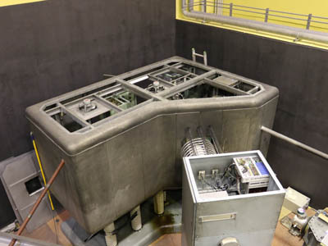
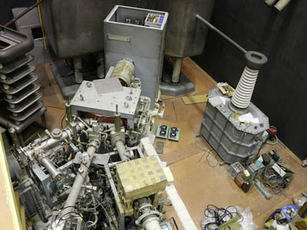
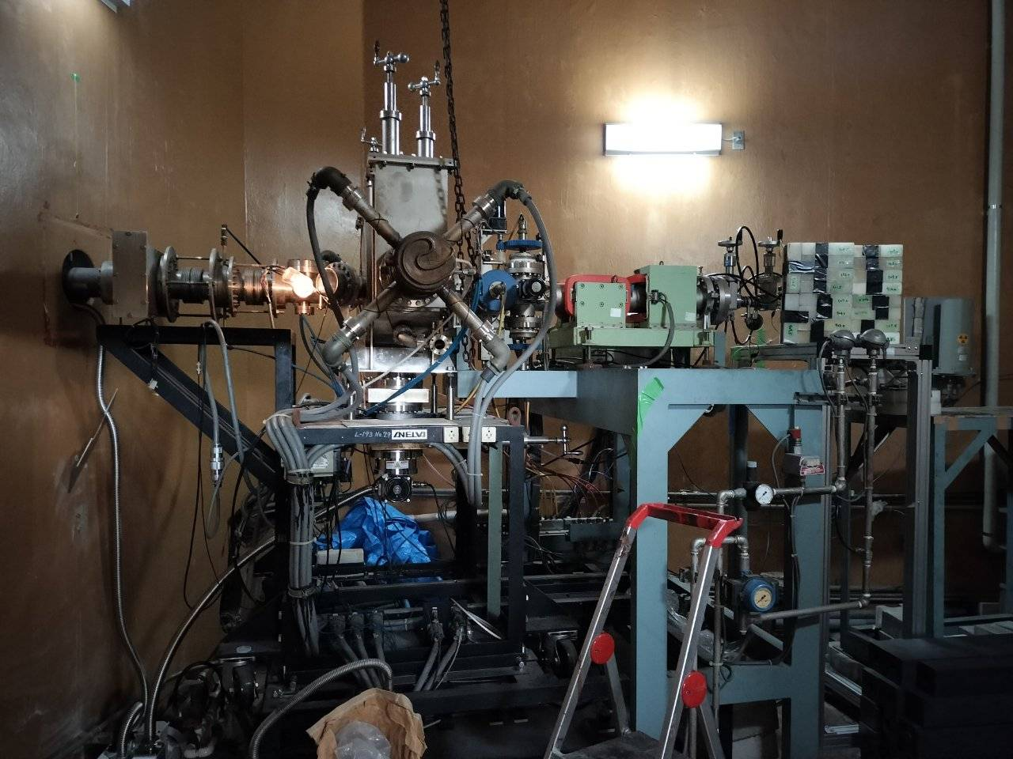
Experimental Facility: OKTAVIAN
We are using 14 MeV neutron engineering experimental apparatus (OKTAVIAN) of the University of Osaka
Deuterium ions are accelerated by a Cockcroft-Walton accelerator
Neutrons are produced by the D-T reaction
Duoplasmatron ion sources
Accelerator
Neutron irradiation room
30 mA, D⁺ beam : 300 keV
300 kV - 80 mA
4.2×4.6×4.2 m³
Fig. 3 Experimental facility of OKTAVIAN of the University of Osaka.
Notes:
Here, I will explain OKTAVIAN, an experimental facility at the University of Osaka.
At this facility, Deuterium ions are accelerated by a Cockcroft-Walton accelerator,
and irradiated to a Tritium target attached to the end of the beamline to produce 14 MeV neutrons by the D-T reaction.

Slide 5
Experimental System
Designed experiments to measure large angle scattering neutrons ^{[6]}
55 cm
50 cm
1 cm
1 – 2 mean free path
Large angle scattering neutron
D-T neutron source
shadow bar
(Iron)
Activation foil
Target
Fig. 4 Schematic experimental arrangement in previous study.
To extract the contribution of large angle scattering neutrons,
an iron shadow bar is used in front of a D-T neutron source
[6] N. Hayashi, et al., Plasma and Fusion Research, 13(0), (2018), 2405002.
Notes:
Next, let me explain the experimental system.
Please look at this figure. This shows an experimental setup for measuring only large angle scattering neutrons.
The neutrons emitted from the source irradiate the target, and the scattered neutrons are detected using the foil activation method.
Our group has employed an iron shadow bar to prevent incident neutrons from entering the activation foil directly and we can detect large angle scattering neutrons.

Slide 6
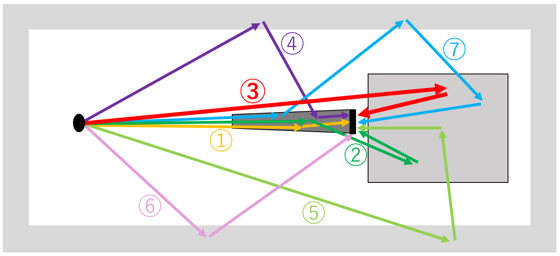
Experimental System
How to extract the contribution of large angle scattering neutrons
  There are 3 components in the system (shadow bar, target sample, and wall)
  Therefore, there are 7 combinations of components that neutrons can pass through in the entire particle history ( ³C₁ + ³C₂ + ³C₃ = 7 pathways )
Fig. 5 Seven pathways of neutrons entering the activation foil.
Notes:
There are mainly 3 components in the experimental system, shadow bar, target sample, and wall.
Therefore, the number of combinations of 3 components is; 3 choose 1 plus 3 choose 2 plus 3 choose 3, which equals 7 pathways.
This figure shows these 7 pathways. This path 3 marked by the red line is the path for large angle scattering neutrons.
So, we need to remove the other 6 pathways.

Slide 7
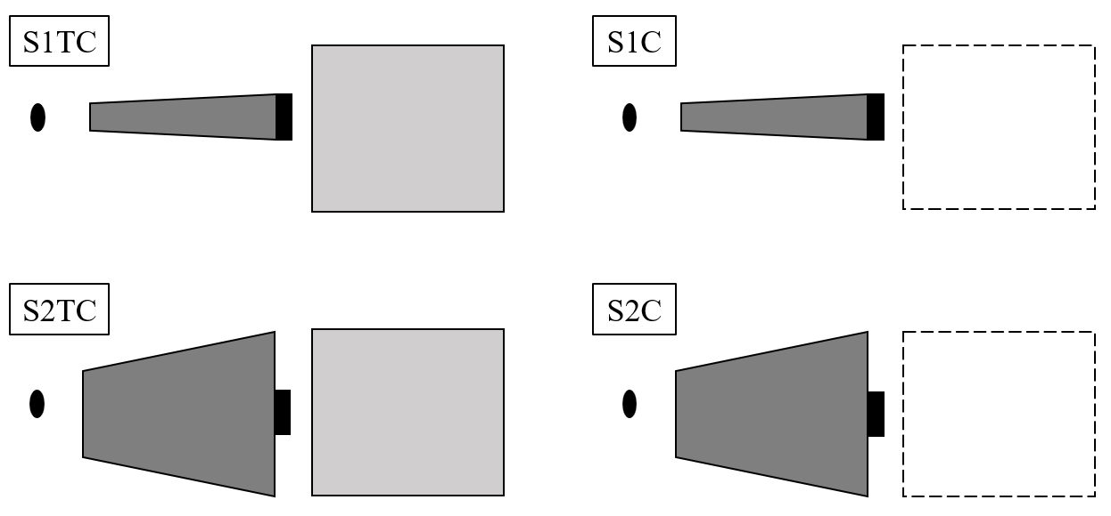
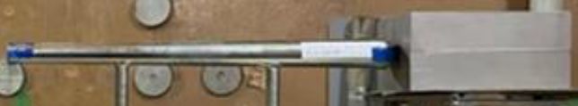
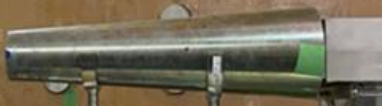

Experimental System
We carry out four experiments with different types of shadow bar (S1, S2) and with or without a target to remove 6 pathways
S1:
Thin shadow bar, incident neutrons CAN enter the target without passing through the shadow bar
S2:
Thick shadow bar, incident neutrons CANNOT enter the target without passing through the shadow bar
Fig. 6 Four experimental systems.
We can largely remove other contributions via 6 pathways by the equation (1), and evaluate large angle scattering neutrons
$$R_{net}=(R_{S1TC}−R_{S1C})−(R_{S2TC}−R_{S2C}) (1)$$
$R$ : Reaction rate of activation foil
Notes:
To achieve this, we prepared two types of shadow bar, S1 and S2.
S1 is a thin shadow bar and incident neutrons CAN enter the target without passing through the shadow bar.
On the other hand, S2 is a thick shadow bar and incident neutrons CANNOT enter the target without passing through the shadow bar.
We carried out four experiments, using S1 with target, S1 without target, S2 with target, and S2 without target.
Then, using the equation (1), we can largely remove 6 pathways, and evaluate large angle scattering neutrons.

Slide 8
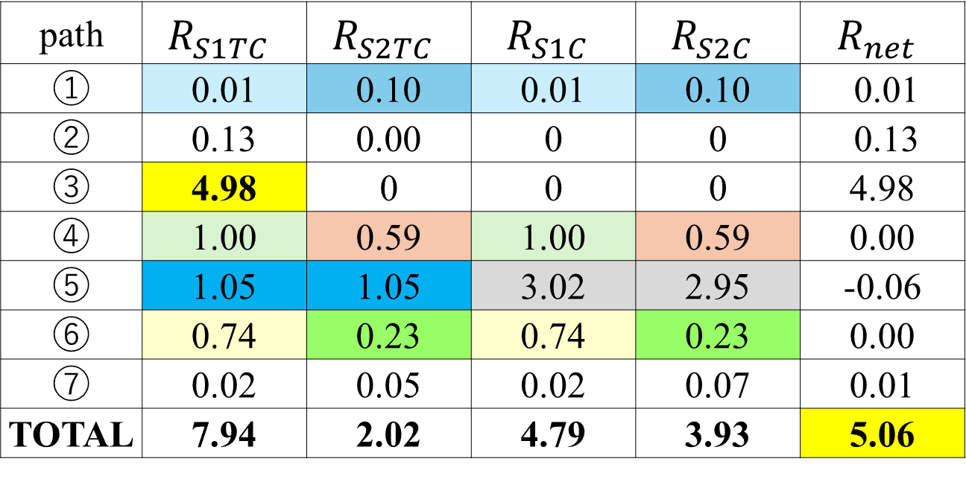
Subtracting 6 pathways
$$R_{net}=(R_{S1TC}−R_{S1C})−(R_{S2TC}−R_{S2C})$$
Table 1 Reaction rate of neutrons passing through all paths
using Fe target. [10⁻⁹ reaction/source neutron/cm³]
Notes:
Next, I will explain how we eliminate the contributions from the six different paths.
This table shows the activation reaction rate of Nb foil using an iron target.
These values are the reaction rates of neutrons passing through each paths.
For example, Path ① represents neutrons that reach the activation foil only through the shadow bar.
In this case, the number of neutrons detected by S1TC and S1C will be the same.
Similarly, the counts from S2TC and S2C will also match.
Therefore, when we subtract the corresponding values using this equation, R_net becomes nearly zero.
Path ⑤ represents neutrons that reach the activation foil through the wall and the target.
This mainly depends on whether the target is present or not.
So the values of S1TC and S2TC are almost the same, and likewise S1C and S2C are almost the same.
Although a few paths cannot be completely eliminated, we can subtract almost all contributions.
As a result, the value corresponding to Path ③, which represents large-angle scattered neutrons, becomes approximately equal to the value calculated by the equation.

Slide 9
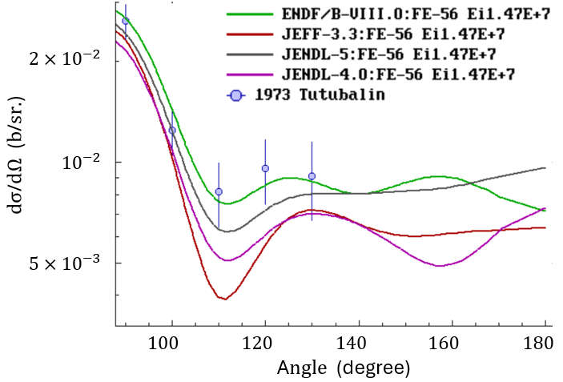
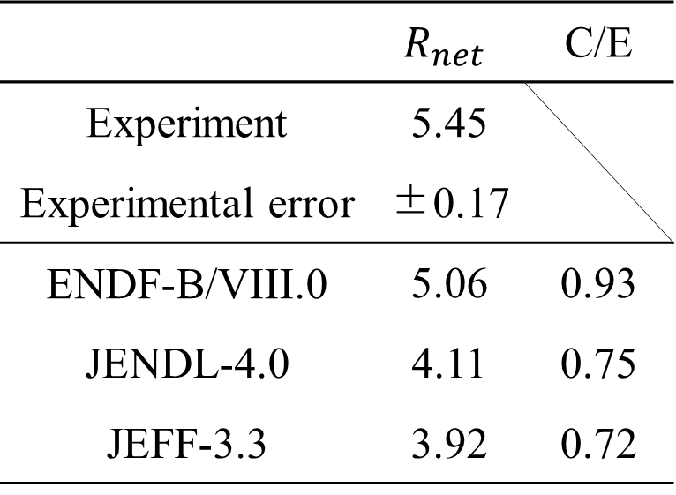
Result of Fe target (2020)
Table 2 Activation reaction rates in Nb foil with Fe target. [10⁻⁹ reaction /source neutron /cm³]
Fig. 7 Elastic scattering cross section of ²⁶Fe
(Previous study ^{[1-4,7]}).
ENDF/B-VIII.0 showed good agreement
with the experimental data.
[1] O. Iwamoto, et al J. Nucl. Sci. Technol., 60(1), 1-60 (2023). [2] D.A. Brown, et al., Nuclear Data Sheets, 148, 1-142, (2018).
[3] A. J. M. Plompen, et al., The European Physical Journal A, 56(7), (2020). [4] A.I.Tutubalin, et al., C,73KIEV,3,62,(1973).
[7] K. Shibata, et al., J. Nucl. Sci. Technol.. 48(1), 1-30 (2011).
Notes:
Here’s the result.
First, I will show you the result using iron as a target.
We carried out 4 experiments and This table shows the subtracted reaction rates.
We also performed Monte Carlo simulations using MCNP5, applying three different evaluated nuclear data libraries for an iron target.
And compered the calculated results with the experimental data.
I apologize that these results are a little old and don’t reflect the most recent nuclear data libraries.
The value of FENDL is nearly the same as the ENDF data.
As a result, the calculation based on the ENDF showed the best agreement with the experimental data.

Slide 10
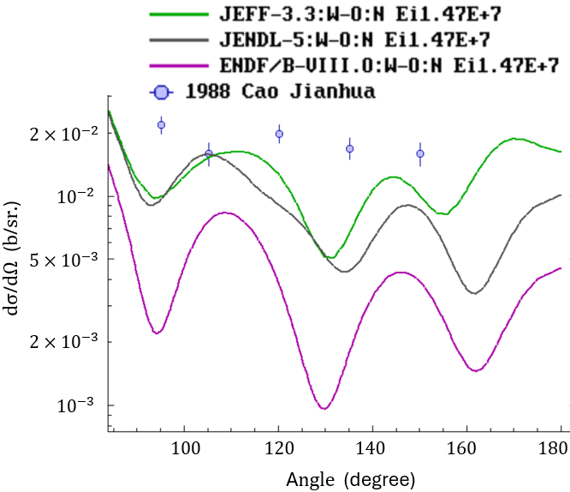
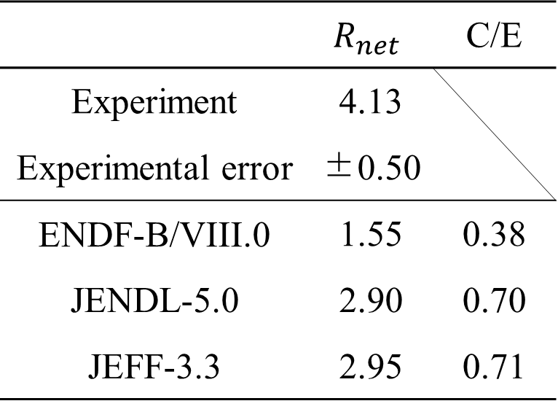
Result of tungsten target (2022)
Table 3 Activation reaction rates in Nb foil with W target. [10⁻⁹ reaction /source neutron /cm³]
Fig. 8 Elastic scattering cross section of ^{nat}W
(Previous study ^{[1,2,3,8]}).
  JENDL-5.0 and JEFF-3.3 showed better agreement
  with the experimental data
  All nuclear data are underestimated
[1] O. Iwamoto, et al J. Nucl. Sci. Technol., 60(1), 1-60 (2023). [2] D.A. Brown, et al., Nuclear Data Sheets, 148, 1-142, (2018).
[3] A. J. M. Plompen, et al., The European Physical Journal A, 56(7), (2020). [8] C. Jianhua, et al., R,INDC(CPR)-011,125,(1988).
Notes:
Next, here’s the result using tungsten as a target.
We carried out experiments and simulations.
The value of FENDL is also the same as ENDF.
As a result, the calculation based on the JENDL and JEFF showed the better agreement with the experimental data.
However, It was found that all three data libraries may underestimate the experimental results.

Slide 11
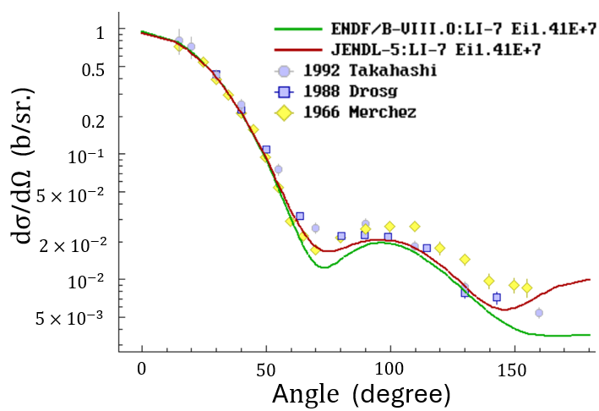
Present Study
We are now focusing on lithium
  Discrepancies are observed in the
  large angle range
  Lithium is used for the blanket of
  fusion reactor to breed tritium
Fig. 9 Elastic scattering cross section of ⁷Li ^{[1,2,9-11]}.
Challenging Points
  Mass of Li is low → The energy of large angle scattered neutrons gose down
  → Difficult to detect the neutrons
  Detect a lot of neutrons scattered from walls and other surrounding materials
  → The statistical error increases
[1] O. Iwamoto, et al J. Nucl. Sci. Technol., 60(1), 1-60 (2023). [2] D.A. Brown, et al., Nuclear Data Sheets, 148, 1-142, (2018).
[9] A. Takahashi, et al., R,OKTAV-A-92-01,(Li-6),(1992). [10] M.Drosg, et al., R,LA-11367-MS,(1988).
[11] F.Merchez, et al., C,66PARIS,1,393,(1966).
Notes:
Next, I will talk about present study.
Now, I’m focusing on lithium and researching it.
Please look at this figure.
This figure shows the angular distribution of the neutron elastic scattering cross section of lithium-7 at 14 MeV. the cross section varies with the nuclear data at large angles, just like with iron and tungsten.
We are trying to carry out benchmark experiment for lithium, but it has some challenging points to evaluate large angle scattering cross sections.
Because the mass of lithium is small, the energy of neutrons scattered by lithium also becomes small.
This makes it challenging to detect the neutrons.
To detect low-energy neutrons, we need to use activation foils with low threshold energies.
However, in this case, a large number of scattered neutrons from surrounding materials are also detected,
so the statistical error increases.

Slide 12
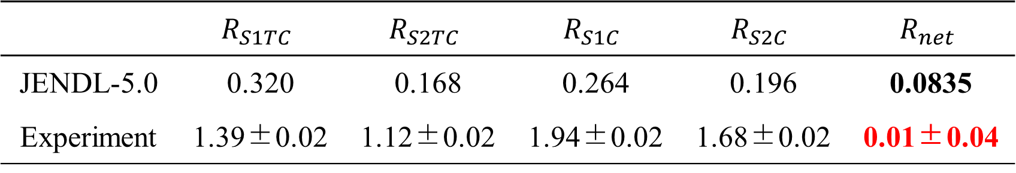
Previous Study / Objectives
Our group has performed benchmark experiments for Li as the target using Hf as the activation foil.
However, the statistical error was large.
Table 4 Activation reaction rates in Hf foil with Li target in the previous study. ^{[12]}
[${10}^{−9}$ reaction/source neutron/${cm}^{3}$]
Objectives
  Select a new activation foil with smaller statistical error
  Optimize the materials and configurations of surrounding components to reduce statistical error
[12] S. Araki, master’s thesis, Osaka University, (2023).
Notes:
In previous study, our group performed benchmark experiments for Li using Hf as the activation foil.
However, the statistical error was too large.
Please look at the right-most experimental result in this table.
We found that large angle scattering cross section of Li may be smaller than evaluated data.
But the error was 4 times as large as the result. So, we need to reduce the error.
So, in this study, we aimed to consider a new activation foil with smaller statistical error, and optimize the materials and configurations of surrounding materials to reduce the error.

Slide 13
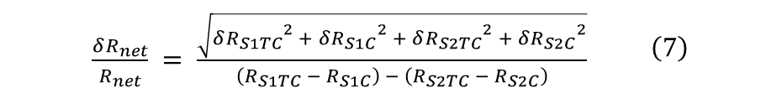





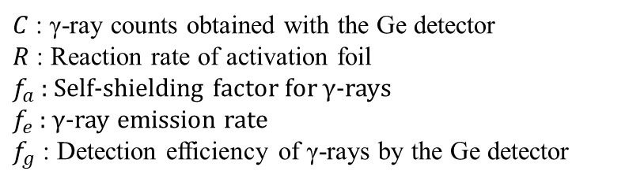
Calculation Method
1. Selected candidate activation foils based on factors such as isotope abundance,
activation cross section, threshold value, and half-life
2. Calculated reaction rate of activation foil using MCNP5
3. Estimated the γ-ray counts obtained with the Ge detector by using equation (2)
$$\begin{aligned}&C=\frac{R}{λ}{f_{a}f_{e}f_{g}\left(1−e^{−λt_{i}}\right)e}^{−λt_{c}}\left(1 − e^{−λt_{m}}\right)+bt_{m}\#\end{aligned} \left(2\right)$$
$C$ : γ-ray counts obtained with the Ge detector
$R$ : Reaction rate of activation foil
$f_{a}$ : Self-shielding factor for γ-rays
$f_{e}$ : γ-ray emission rate
$f_{g}$ : Detection efficiency of γ-rays by the Ge detector
$λ$ : Decay constant
$t_{i}$ : Irradiation time of neutron
$t_{c}$ : Cooling time
$t_{m}$ : Measurement time
$b$ : Background γ-ray counts per second
4. Determined statistical error by using equation (3) - (7)
$$\frac{δR_{S1TC}}{R_{S1TC}} = \sqrt{\frac{C_{S1TC} +bt_{m}}{{\left(C_{S1TC} −bt_{m}\right)}^{2}}} \left(3\right)$$
$$\frac{δR_{S1C}}{R_{S1C}} = \sqrt{\frac{C_{S1C} +bt_{m}}{{\left(C_{S1C} −bt_{m}\right)}^{2}}} \left(4\right)$$
$$\frac{δR_{S2TC}}{R_{S2TC}} = \sqrt{\frac{C_{S2TC} +bt_{m}}{{\left(C_{S2TC} −bt_{m}\right)}^{2}}} \left(5\right)$$
$$\frac{δR_{S2C}}{R_{S2C}} = \sqrt{\frac{C_{S2C} +bt_{m}}{{\left(C_{S2C} −bt_{m}\right)}^{2}}} \left(6\right)$$
$\begin{aligned}&\frac{δR_{net}}{R_{net}} = \frac{\sqrt{{δR_{S1TC}}^{2} + {δR_{S1C}}^{2} + {δR_{S2TC}}^{2} + {δR_{S2C}}^{2}}}{\left(R_{S1TC} − R_{S1C}\right) − \left(R_{S2TC} − R_{S2C}\right)}\#\end{aligned}$ $\left(7\right)$
Notes:
In this slide, let me explain the calculation method to select a new activation foil.
First, we selected candidate activation foils based on isotope abundance, activation cross section, threshold value, and half-life.
Second, we calculated the reaction rate of the activation foils using MCNP5.
Next, we estimated the γ-ray counts of the Ge detector using this equation (2).
Finally, we determined statistical error by using these equations (3) to (7).

Slide 14
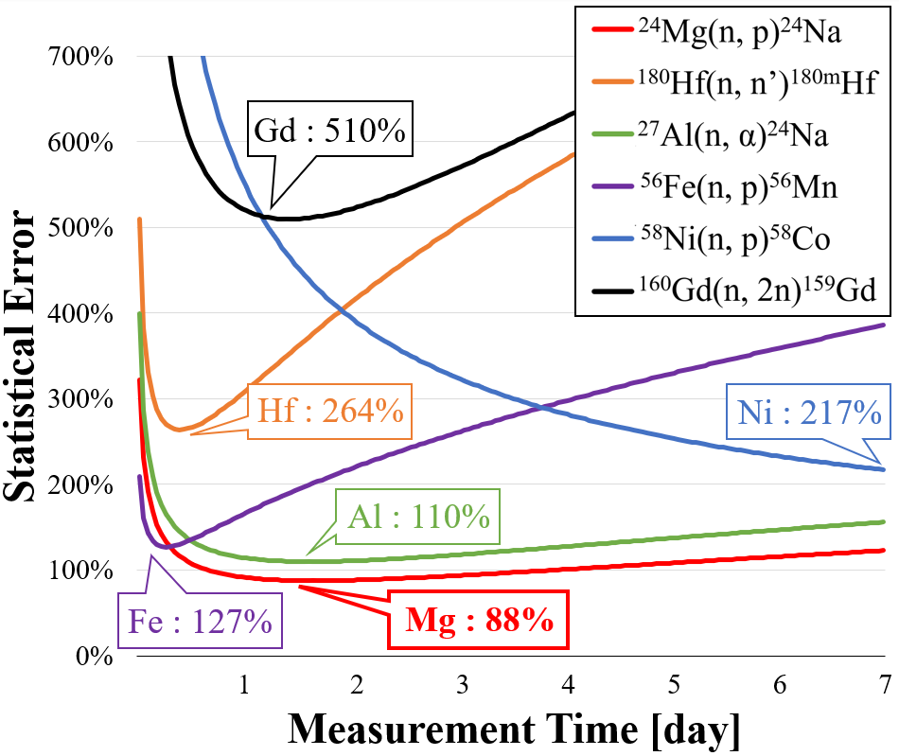

Results
Activation foils
  Six isotopes were selected based on isotope abundance, activation cross section, threshold value, and half-life
  The measurement time was divided into hourly intervals, with the statistical error calculated for each hour
Incident neutron : 4$×{10}^{9}$, Cooling time : 1 hour
Using the ²⁴Mg(n, p)²⁴Na reaction produced the lowest statistical error, approximately one-third of that obtained when using hafnium as shown in Fig. 10
Fig. 10 Statistical Errors in activation foils.
Notes:
Here’s the result.
I have considered a new activation foil .
Please look at this figure. This shows each statistical error of six selected foils.
The horizontal axis represents the measurement time of the γ ray.
As you can see in this figure, Mg is the most effective at reducing error, with a reduction of approximately one-third compared to Hf.
So, we concluded that using Mg as the activation foil is the best way to perform benchmark experiment with high accuracy.

Slide 15
Sammary / Future work
Sammary
  We developed a benchmark experimental system to validate the large angle scattering reaction cross sections and carried experiment for several elements such as iron and tungsten.
  In the case of iron, ENDF/B-VIII.0 showed good agreement
  In the case of tungsten, JENDL-5 and JEFF-3.3 show better agreement
  We are now trying to reduce the statistical error of benchmark experiment for lithium
  Mg is the optimal activation foil for reducing the error in benchmark experiments on large angle scattering cross section of Li, although this is still insufficient for conducting precise benchmarking experiments
Future Work
  Develop an experimental system that further minimizes statistical errors
  by optimizing the materials and configurations of surrounding components
  Carry out benchmark experiments for Li using the optimized system
Notes:
Finally, I’d like to summarize our study.
The cross section varies with the nuclear data at large angles,
so we developed a benchmark experimental system to validate the large angle scattering cross sections and carried out experiment for several elements such as iron and tungsten.
In the case of iron, ENDF showed good agreement with the experimental data.
On the other hand, in the case of tungsten, JENDL and JEFF show better agreement, but all data may be underestimating.
Now I’m trying to reduce the statistical error for benchmark experiment of lithium.
To achieve this, we selected a new activation foil.
As a result, Mg is the optimal activation foil for reducing the error, but it is still insufficient for conducting precise benchmarking experiments.
In the future, we will develop an experimental system that further minimizes statistical errors by optimizing the materials and configurations of surrounding components and conduct benchmark experiments for Li using the optimized experimental system.

Slide 16
Appendix

Slide 17
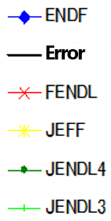
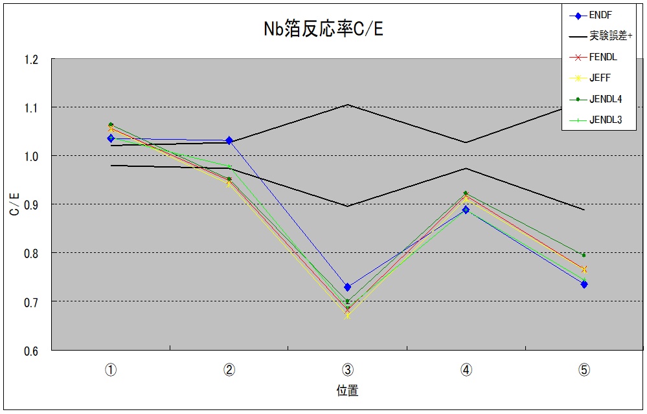
Scattering cross section verification experiment
Benchmark experiment using D-T neutron beam
Unit: cm
①
②
③
④
⑤
⑥
60
Differences between experimental and calculated values in regions
far from the neutron source and
away from the beam axis (③, ⑤)
15
15
15
15
1.2
15
20
40
Error
1.1
It has been pointed that
the large angle elastic scattering reaction cross section could be uncertain.
1.0
0.9
C / E
0.8
0.7
0.6
①
②
③
④
⑤
Fig Experimental scheme of the benchmark (top) and
its results (bottom) in previous studies^{[13]}.
[13] Seiki Ohnishi et al., “New integral experiments for large angle scattering cross section data benchmarking with DT neutron beam at JAEA/FNS,” Fusion Engineering and Design, 87, (2012), pp. 695-699.

Slide 18
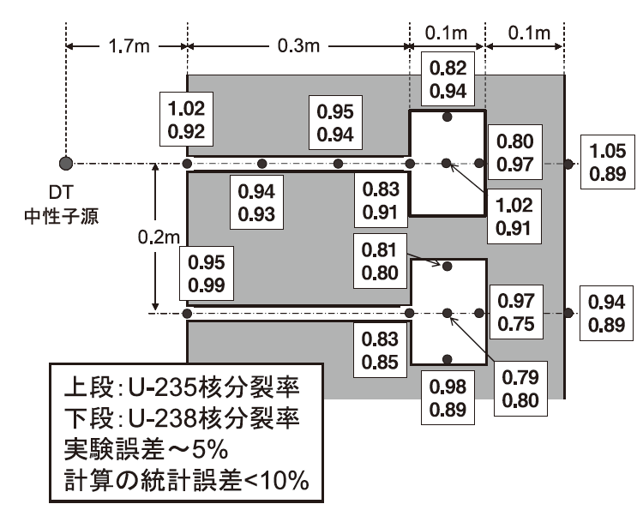
Gap streaming phenomenon
Calculation / Experiment ratio
Calculation : MCNP-4A, FENDL/E-1.0
D-T
neutron source
Upper : 235U nuclear fission rate
Lower : 238U nuclear fission rate
Experimental error : ~ 5%
Statistical error in calculation : < 10%
Fig. Example of FNS shielding blanket gap streaming experimental analysis results ^{[5]}.
[5] K. Ochiai, et al., Journal of Plasma and Fusion Research, 84(9), 594-599, (2008).
Notes:
日本原子力研究開発機構FNS : 重水素イオンビームをトリチウムターゲットに照射し，DT 中性子を発生させる加速器型DT中性子発生装置

Slide 19
Appendix
Heavy Irradiation Room
Target Sample
Wall
Detection Foil (Au)
Shadow Bar
T Target
Beam Line
D＋

Slide 20
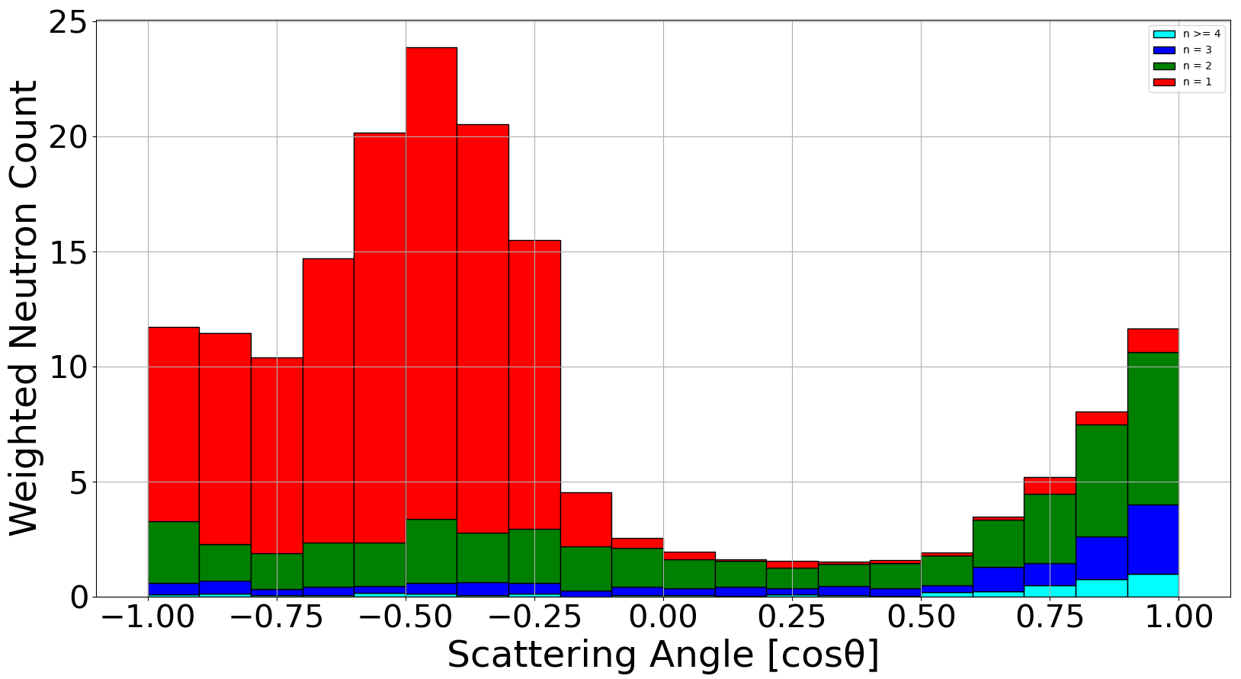
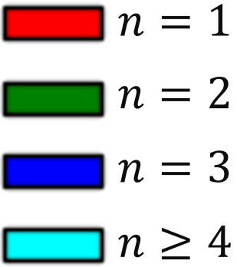
Scattering Angle and Multiple Scattering
Target: Li, Foil: Mg (5 mm)
Fig. Neutron scattering angle distribution and scattering count.

Slide 21
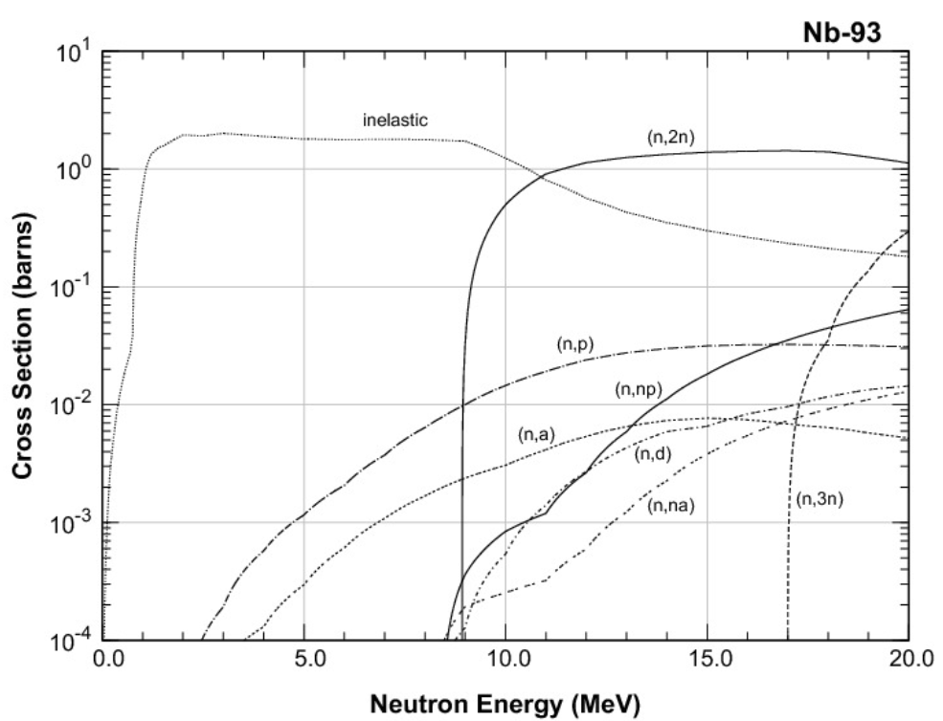
Cross section of ⁹³Nb
Fig Cross Section of ⁹³Nb ^{[1]}.
[1] O. Iwamoto, et al J. Nucl. Sci. Technol., 60(1), 1-60 (2023). .

Slide 22
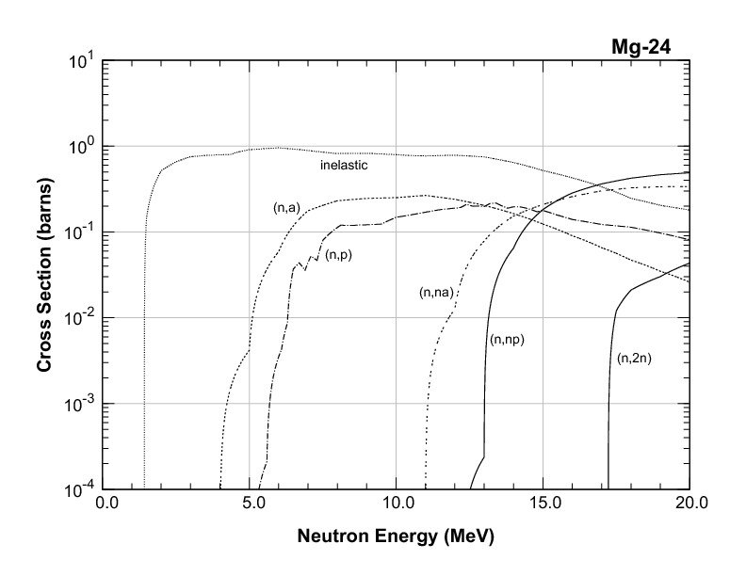
Cross section of ²⁴Mg
The energy of D-T neutron elastically scattered at 180° in Li is 7.85 MeV
Neutrons can be detected using ²⁴Mg foil
Fig Cross Section of ²⁴Mg ^{[1]}.
[1] O. Iwamoto, et al J. Nucl. Sci. Technol., 60(1), 1-60 (2023). .

Slide 23
Cross section of ¹⁸⁰Hf (n,n’) ^{180m}Hf
Fig Cross section of ¹⁸⁰Hf (n,n’) ^{180m}Hf ^{[1, 14-17]}.
[1] O. Iwamoto, et al J. Nucl. Sci. Technol., 60(1), 1-60 (2023). .
[14] M. Hillman, E. Shikata, Journal of Inorganic and Nuclear Chemistry, 31(4), 909-913, (1969).
[15] C. Konno, et al., JAERI Reports, 1329, (1993).
[16] T. Shimizu,, et al., Annals of Nuclear Energy, 31(16), 1883-1900, (2004).
[17] Yu. N. Trofimov, Vop.At.Nauki i Tekhn., Ser.Yaderno-Reak.Konstanty, (4), 10, (1987).

Slide 24
13 candidate activation foils ^{[1]}
Reaction | Isotope abundance | γ ray (Energy, Intensity) | Half-life
¹⁸⁰Hf(n,n’)^{180m}Hf | 35.08% | 215.43 keV, 81.32% 332.27 keV, 94.12% 443.16 keV, 81.88% | 5.47 h
²⁴Mg(n,p)²⁴Na | 78.99% | 1368.63 keV, 99.99% | 14.997 h
²⁷Al(n,α)²⁴Na | 100% | 1368.63 keV, 99.99% | 14.997 h
²⁸Si(n,p)²⁸Al | 92.223% | 1778.85 keV, 100% | 2.245 m
³¹P(n,α)²⁸Al | 100% | 1778.85 keV, 100% | 2.245 m
⁵⁶Fe(n,p)⁵⁶Mn | 91.754% | 846.75 keV, 98.87% 1810.72 keV, 27.19% 2113.05 keV, 14.34% | 2.5789 h
⁵⁸Ni(n,p)⁵⁸Co | 68.007% | 810.76 keV, 99.45% | 70.86 d
⁶⁴Zn(n,p)⁶⁴Cu | 49.17% | 1345.77 keV, 0.48% | 12.701 h
⁹²Mo(n,np)⁹¹Nb | 14.53% | 1204.67 keV, 2.02% | 60.86 d
¹⁶⁰Gd(n,2n)¹⁵⁹Gd | 21.86% | 58.00 keV, 2.49% 348.28 keV, 0.24% 363.54keV, 11.78% | 18.479 h
¹⁶⁹Tm(n,2n)¹⁶⁸Tm | 100% | 198.25 keV, 54.49% 447.51 keV, 23.98% 815.99 keV, 50.95% | 93.1 d
¹⁷⁰Er(n,2n)¹⁶⁹Er | 14.91% | 8.41 keV, 0.17% | 9.392 d
¹⁷⁶Yb(n,2n)¹⁷⁵Yb | 12.996% | 113.81 keV, 3.87% 282.52 keV, 6.13% 396.33 keV, 13.15% | 4.185 d
[1] O. Iwamoto, et al J. Nucl. Sci. Technol., 60(1), 1-60 (2023). .

Slide 25
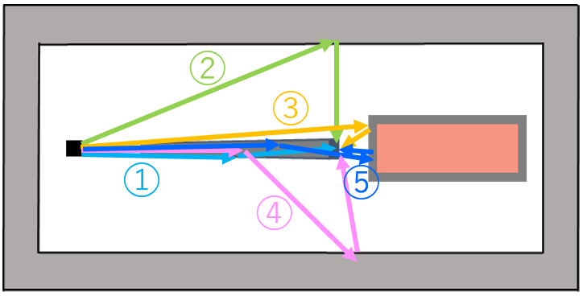
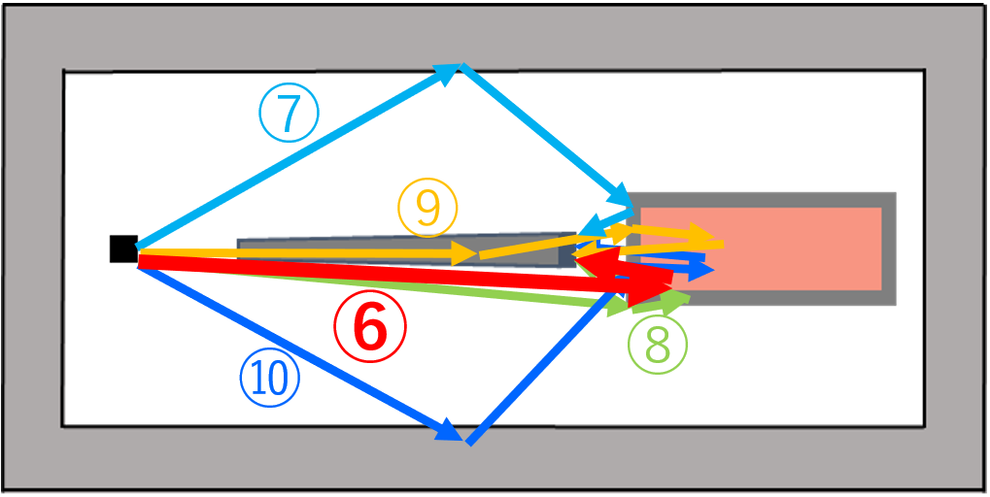
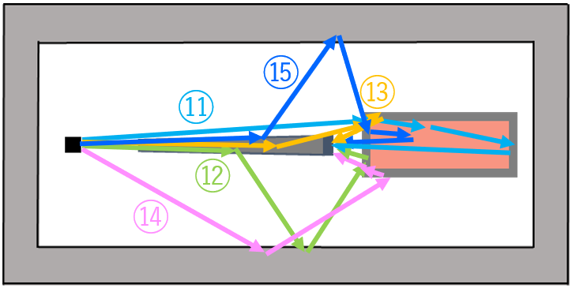
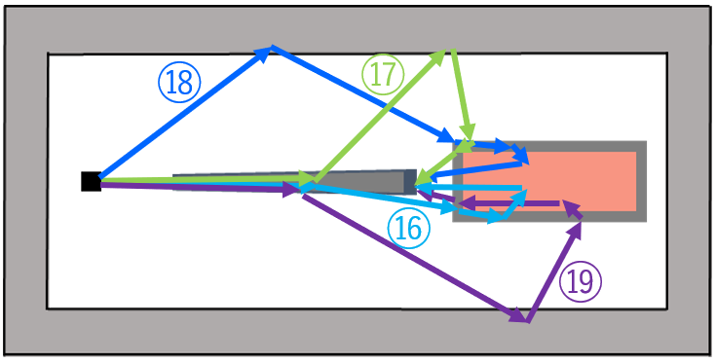
Experimental System
How to extract the contribution of large angle scattering neutrons
  There are 5 components in the system (shadow bar, lithium sample, front of stainless container, other surfaces of the container, and wall)
  Therefore, there are 31 combinations of components that neutrons can pass through in the entire particle history
  ( ₅C₁ + ₅C₂ + ₅C₃ + ₅C₄ + ₅C₅ = 31 pathways )
  Excluding pathways that do not physically exist, 19 pathways remain
Fig. Nineteen Pathways of neutrons entering the activation foil.
Notes:
There are 5 components in the experimental system, shadow bar, lithium sample, front of stainless container, other surfaces of the container, and wall.
Therefore, the number of combinations of five components is (5 choose 1 plus 5 choose 2 plus 5 choose 3 plus 5 choose 4 plus 5 choose 5 equals) 31 pathways.
We can exclude 12 pathways that don’t physically exist, so 19 pathways remain.
This figure shows these 19 pathways. This path 6 marked by the red line is the path for large angle scattering neutrons. So, we need to remove the other 18 pathways.

Slide 26
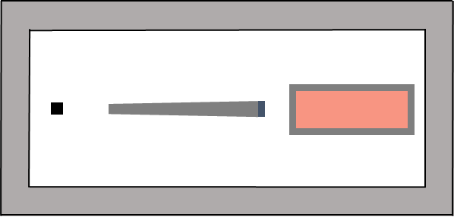
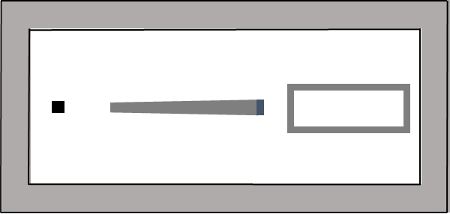
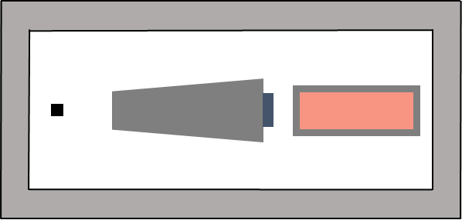
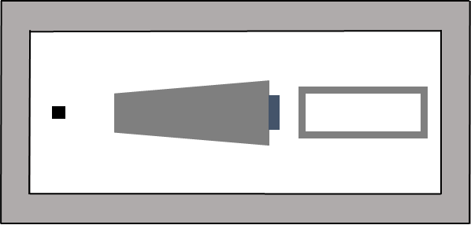
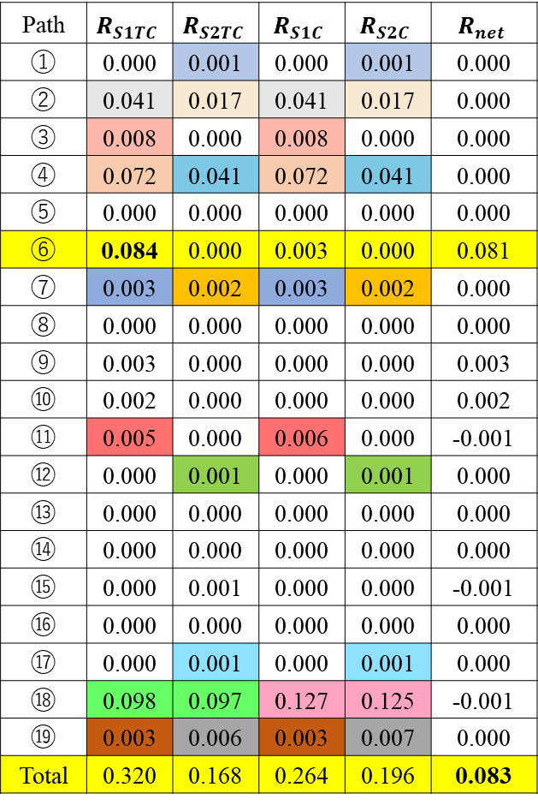
Subtracting 18 pathways
Table Reaction rate of neutrons passing through all paths using Li target.
Path⑥
Path | $$R_{S1TC}$$ | $$R_{S2TC}$$ | $$R_{S1C}$$ | $$R_{S2C}$$ | $$R_{net}$$
① | 0.000 | 0.001 | 0.000 | 0.001 | 0.000
② | 0.041 | 0.017 | 0.041 | 0.017 | 0.000
③ | 0.008 | 0.000 | 0.008 | 0.000 | 0.000
④ | 0.072 | 0.041 | 0.072 | 0.041 | 0.000
⑤ | 0.000 | 0.000 | 0.000 | 0.000 | 0.000
⑥ | 0.084 | 0.000 | 0.003 | 0.000 | 0.081
⑦ | 0.003 | 0.002 | 0.003 | 0.002 | 0.000
⑧ | 0.000 | 0.000 | 0.000 | 0.000 | 0.000
⑨ | 0.003 | 0.000 | 0.000 | 0.000 | 0.003
⑩ | 0.002 | 0.000 | 0.000 | 0.000 | 0.002
⑪ | 0.005 | 0.000 | 0.006 | 0.000 | -0.001
⑫ | 0.000 | 0.001 | 0.000 | 0.001 | 0.000
⑬ | 0.000 | 0.000 | 0.000 | 0.000 | 0.000
⑭ | 0.000 | 0.000 | 0.000 | 0.000 | 0.000
⑮ | 0.000 | 0.001 | 0.000 | 0.000 | -0.001
⑯ | 0.000 | 0.000 | 0.000 | 0.000 | 0.000
⑰ | 0.000 | 0.001 | 0.000 | 0.001 | 0.000
⑱ | 0.098 | 0.097 | 0.127 | 0.125 | -0.001
⑲ | 0.003 | 0.006 | 0.003 | 0.007 | 0.000
Total | 0.320 | 0.168 | 0.264 | 0.196 | 0.083
S1TC
S1C
S2TC
S2C
We can largely remove 18 pathways by the equation (1), and evaluate large angle scattering neutrons
$$R_{net}=(R_{S1TC}−R_{S1C})−(R_{S2TC}−R_{S2C}) (1)$$

Slide 27
19 Pathways
Table Elements that neutrons pass through in each of the 19 paths.
Path | Shadow bar | Target | Wall | Front of container | Other surfaces of container
① | 〇
② |  |  | 〇
③ |  |  |  | 〇
④ | 〇 |  | 〇
⑤ | 〇 |  |  | 〇
⑥ |  | 〇 |  | 〇
⑦ |  |  | 〇 | 〇
⑧ |  |  |  | 〇 | 〇
⑨ | 〇 | 〇 |  | 〇
⑩ |  | 〇 | 〇 | 〇
⑪ |  | 〇 |  | 〇 | 〇
⑫ | 〇 |  | 〇 | 〇
⑬ | 〇 |  |  | 〇 | 〇
⑭ |  |  | 〇 | 〇 | 〇
⑮ | 〇 | 〇 | 〇 | 〇
⑯ | 〇 | 〇 |  | 〇 | 〇
⑰ | 〇 |  | 〇 | 〇 | 〇
⑱ |  | 〇 | 〇 | 〇 | 〇
⑲ | 〇 | 〇 | 〇 | 〇 | 〇

Slide 28
Design of two shadow bars
S1
2.66 cm Φ
4 cm Φ
S2
8.36 cm Φ
15 cm Φ
50 cm
Fig. Design of two shadow bars.

Slide 29
Results
Thickness of Mg foil
  The systematic error and statistical error were calculated for each different thickness of Mg foil
  Systematic error is the difference between the reaction rate subtracted by equation (1) and that of large angle scattered neutrons.
Incident neutron : 4$×{10}^{9}$, Cooling time : 1 hour
48%
$$R_{net}=(R_{S1TC}−R_{S1C})−(R_{S2TC}−R_{S2C}) (1)$$
13 mm - 16 mm was found to be the best thickness as shown in Fig.7
Fig. Errors in the thickness of Mg foil.
Notes:
Next, we optimized the thickness of Mg foil.
This figure shows the systematic error, statistical error, and total error for each thickness.
Systematic error refers to the difference between the reaction rate calculated by equation (1) and that of large angle scattered neutrons.
I mentioned that we could remove the contributions of room-return neutrons and shadow bar scattering neutrons with 4 experiments. However, we can’t subtract all the neutrons. So, subtracted value obtained by equation (1) differs slightly from that of large angle scattering neutrons. This gap is the systematic error.
As you can see in this figure, the Mg foil from 13 to 16 mm is optimal to reduce the error.

