Slide 1
Application of the TUD-W Benchmark for Nuclear Data and code Validation
Marta Campos Fornés
Marco Fabbri*, Luigino Petrizzi,
Aljaz Kolsek, Davide Laghi
14th May 2025, IAEA HQ

Slide 2
Outline
Introduction and presentation of the TUD-W SINBAD benchmark
Analysis of the neutron spectra results
Analysis of the gamma spectra results
Investigation of discrepancies in high-energy photons
Conclusions and possible future work

Slide 3
Introduction and presentation of the TUD-W SINBAD benchmark
Objective:
Validation study of tungsten nuclear data across 2 different transport codes.
Description:
Use of the TUD-W SINBAD benchmark, which consists of a thick tungsten alloy block (DENSIMET).
Source employed: almost isotropic emitting around $14 MeV$ neutrons.
Computation and comparison of spectral neutron and photon flux at four positions in depth: $5, 15, 25$and $35 cm$.
Experimental results (NE 213 scintillation spectrometer) + transport codes (MCNP 6.2, OpenMC 0.15.0).
Weight windows applied for the simulations in positions 2, 3 and 4 ($15, 25$and $35 cm$ in depth).
$$49 cm$$
$$47 cm$$
$$z$$
$$y$$
$$x$$
Neutron source
$$46.85 cm$$
$$35 cm$$
$$25 cm$$
$$15 cm$$
$$5 cm$$
DENSIMET-176
DENSIMET-180
Notes:
Tungsten (W) is a key material in fusion reactor designs, particularly for plasma-facing components. Accurate nuclear data for tungsten are essential for reliable neutronic simulations, impacting reactor safety, shielding, and operational performance. Moreover, the 2023 ITER rebaselining exercise led to the replacement of the beryllium (Be) First Wall (FW) with tungsten (W), further increasing interest in this material and the accuracy of computed responses. This work presents a validation study of tungsten nuclear data using the TUD-W SINBAD benchmark, ranked as the highest-quality benchmark for this purpose. The study employs MCNP6.2 and OpenMCv0.15 to compute and compare spectral neutron flux and spectral photon flux at four positions (5, 15, 25, and 35 cm) within a thick tungsten alloy block (DENSIMET) irradiated by 14 MeV neutrons. The experimental results, obtained using an NE 213 scintillation spectrometer, serve as a reference for validation.

Slide 4
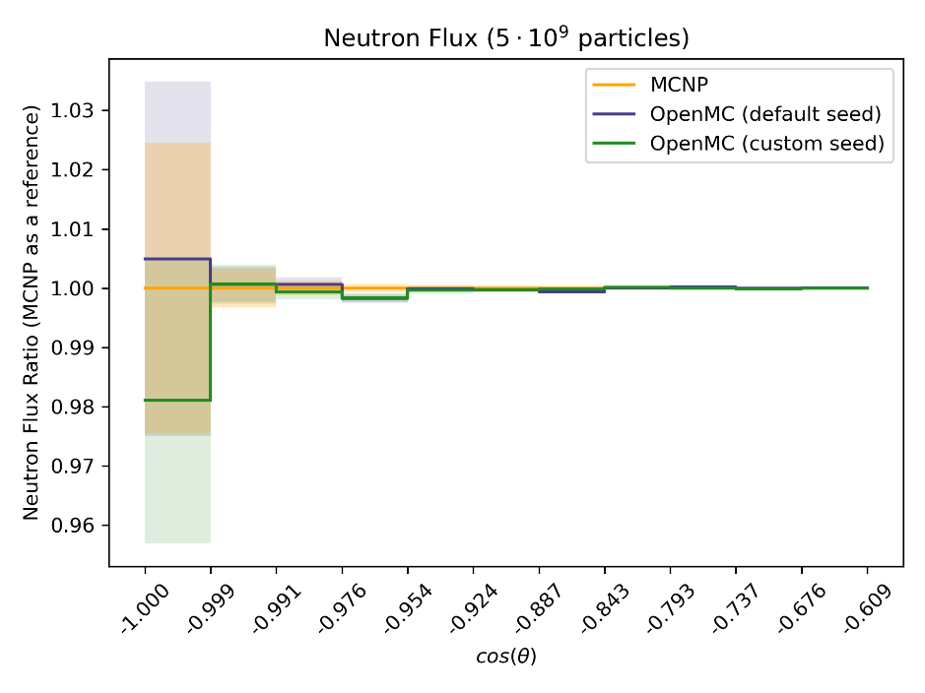
Conversion of the benchmark model: MCNP $→$ OpenMC
$$49 cm$$
$$47 cm$$
$$z$$
$$y$$
Translation of geometry and materials using csg2csg.
Definition of tallies according to the benchmark documentation.
Translation of source using the models uploaded to the openmc_fusion_benchmarks github repository (MIT) as a reference and studying source angular and energy distribution equivalences between MCNP and OpenMC (angular distribution with a specific energy distribution defined for each angular position).
Short scoping study for weight windows performance in OpenMC.
$$x$$
Neutron source
$$46.85 cm$$
$$35 cm$$
$$25 cm$$
$$15 cm$$
$$5 cm$$
DENSIMET-176
DENSIMET-180
OpenMC verification for a point source collimated into a cone of directions.

Slide 5
Analysis of the neutron spectra results I
Clear agreement between MCNP and OpenMC results for all 4 positions $⇒$ OpenMC validation.
General agreement between experimental and simulated results, with discrepancies mostly appearing above $6 MeV$.
Notes:
Statistical optimization techniques were applied, including weight window generators and customized Python-based scripts to refine various cell parameters. The weight window generator was iteratively used to improve statistical accuracy in deeper regions. Additionally, a geometry error caused by a small undefined volume was corrected, and the corresponding patch was communicated to the NEA Data Bank.
While a general agreement was observed among the libraries, discrepancies appeared above 6 MeV, with FENDL3.2c performing the best but with a behaviour extremely similar to ENDF-VIII.0. Further comparisons were performed using OpenMC, requiring the conversion of geometry, tallies, and source definitions. These comparisons confirmed that discrepancies were likely driven by the nuclear data itself rather than differences between Monte Carlo codes.

Slide 6
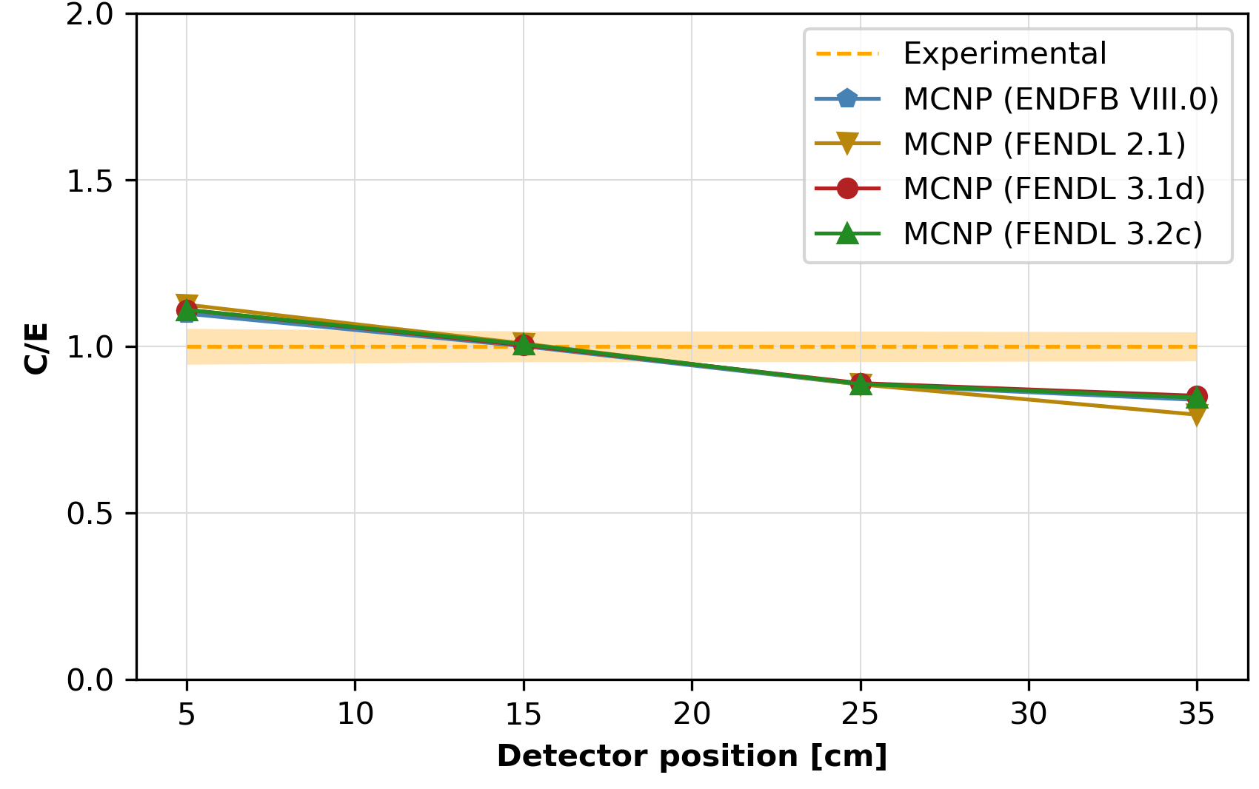
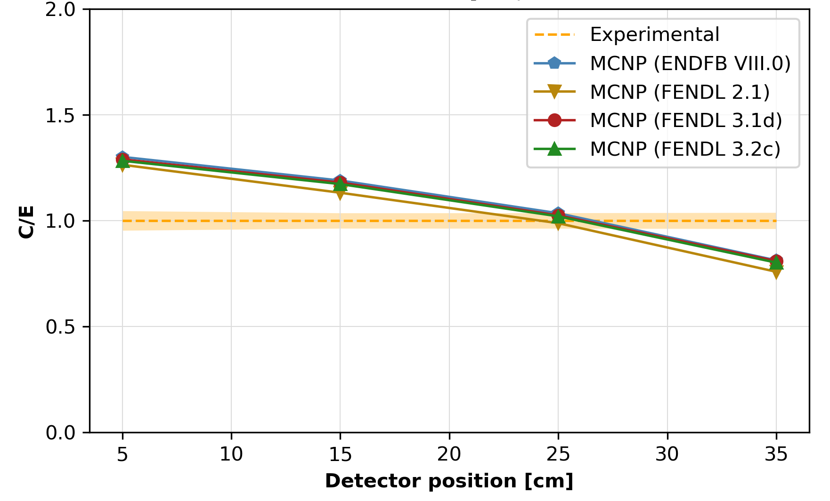
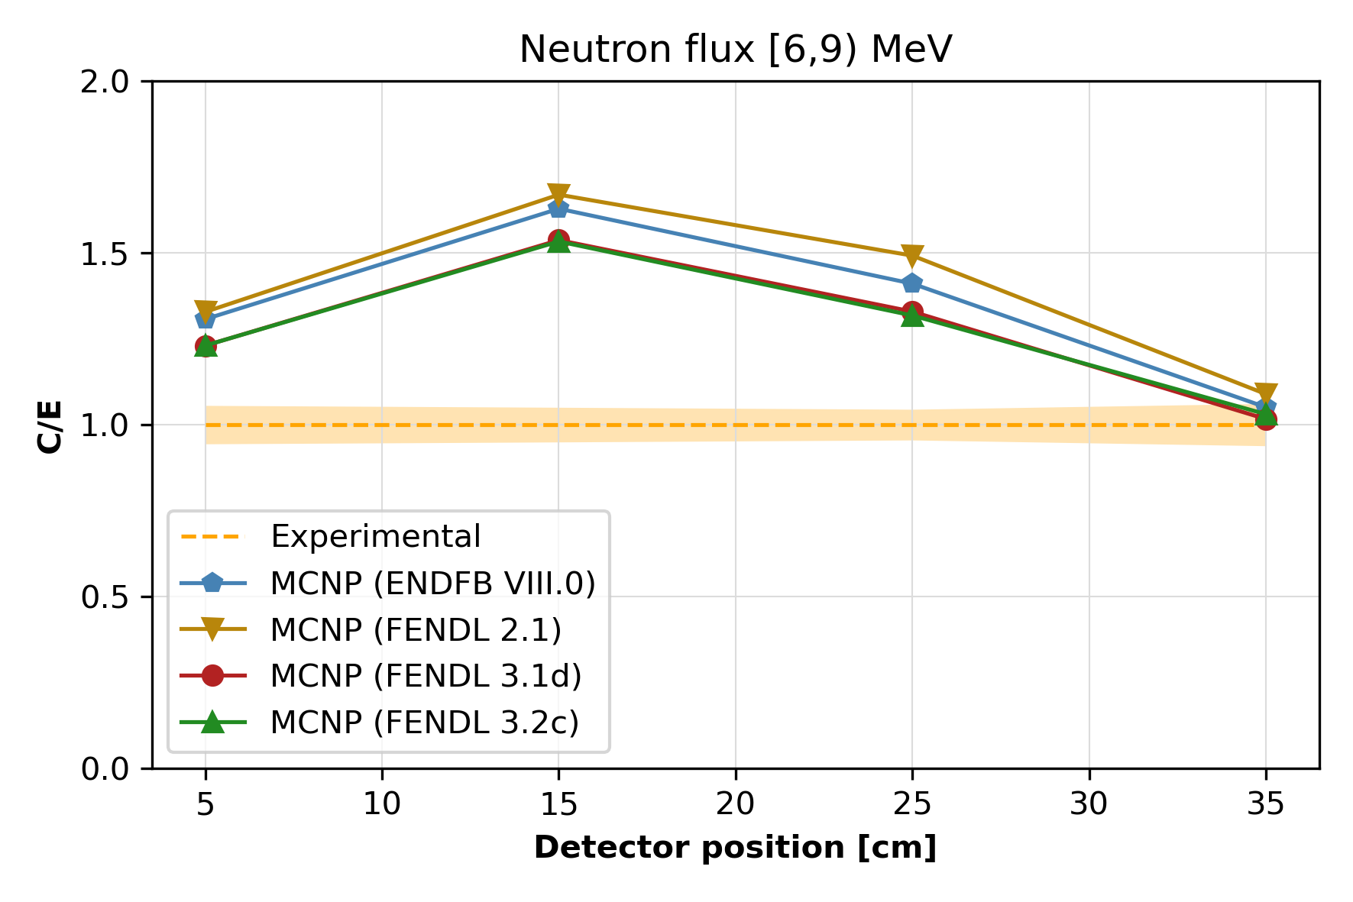
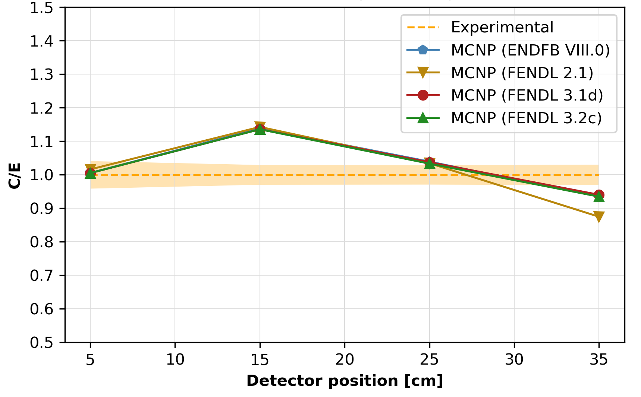
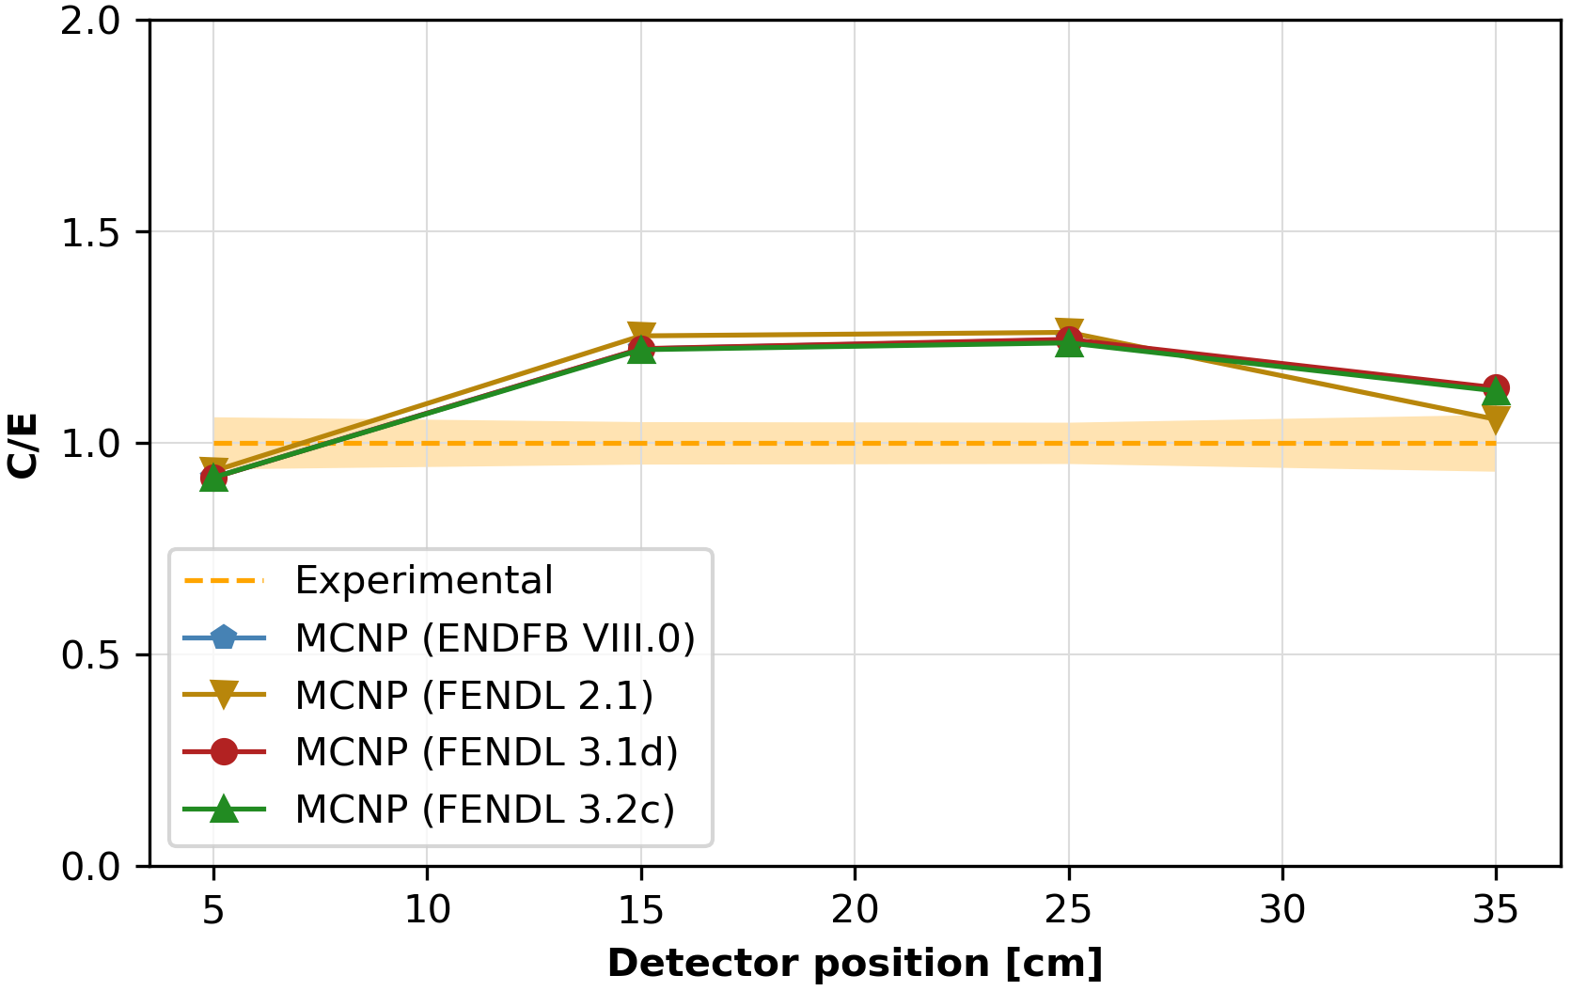
Analysis of the neutron spectra results II
Exp vs MCNP (FENDL 3.2c, FENDL 3.1d, ENDFB VIII.0)
Notes:
Best performing nuclear data library tested: FENDL 3.2c.

Slide 7
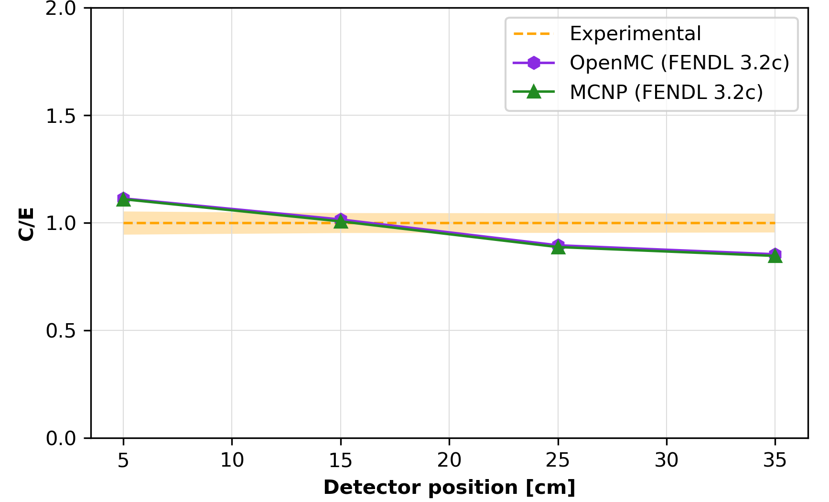
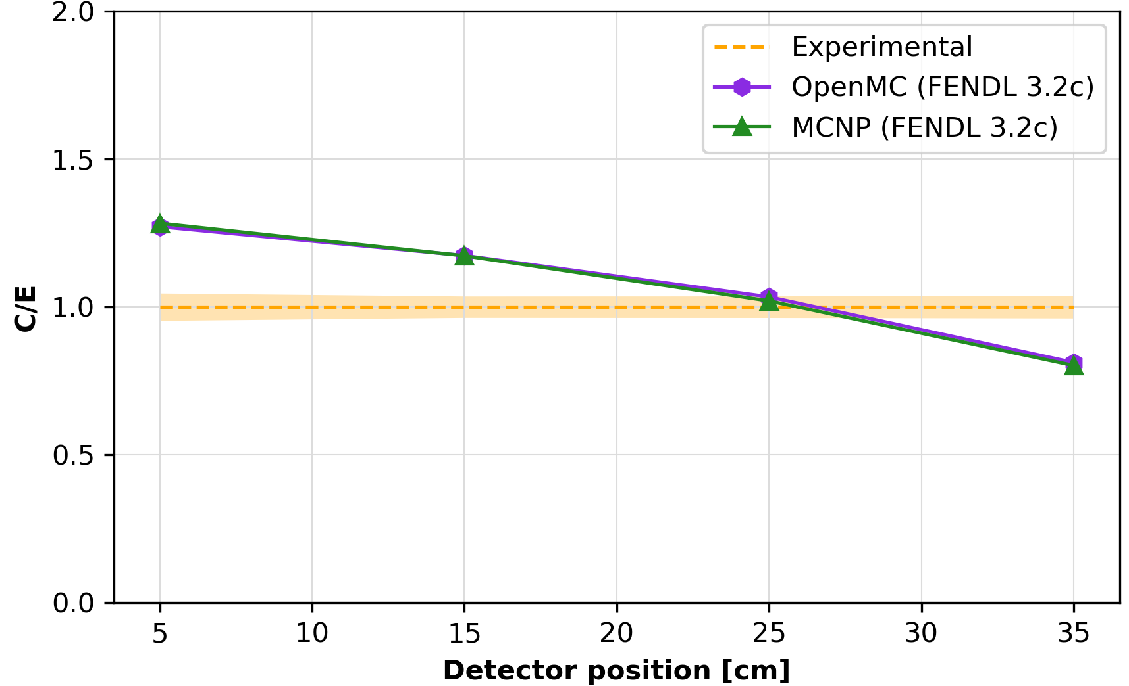
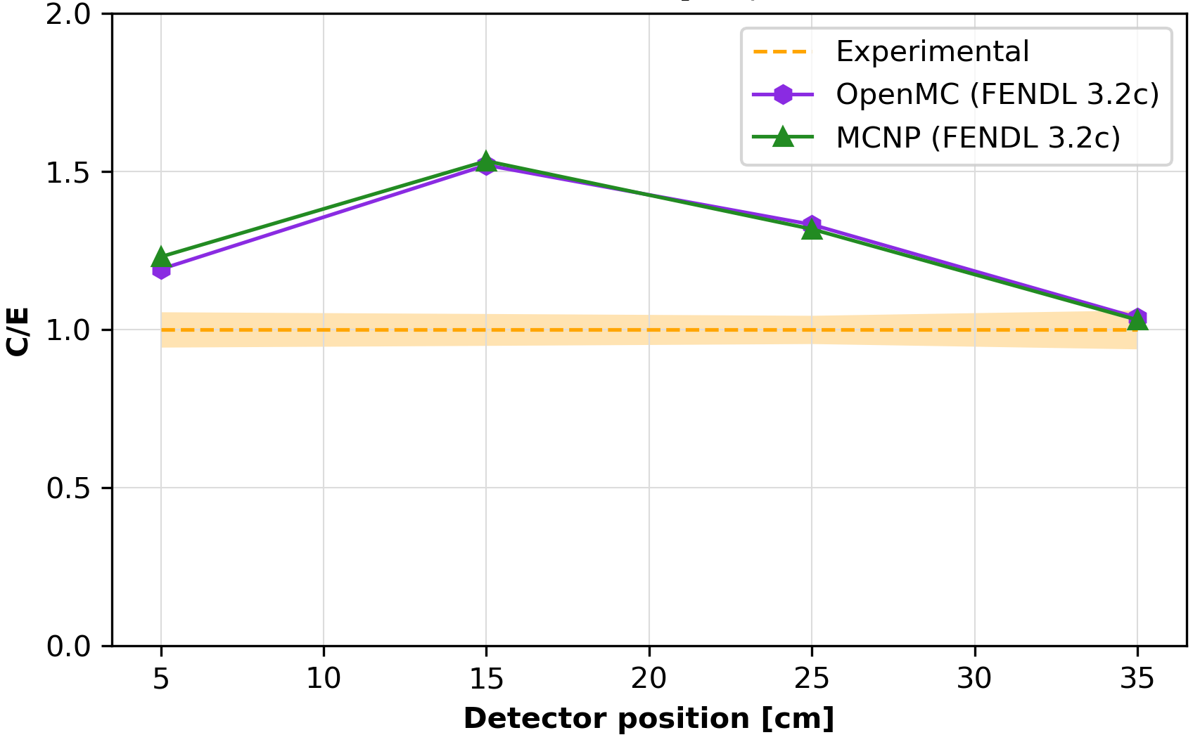
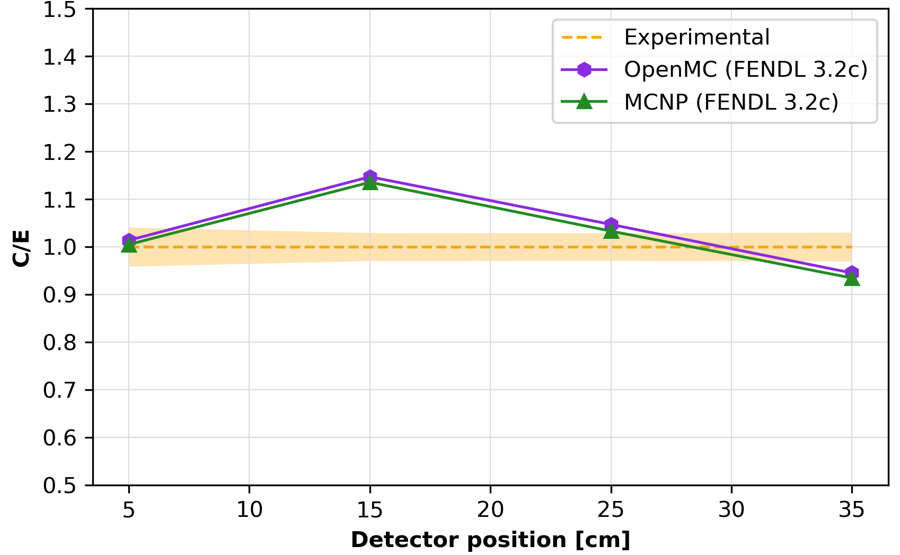
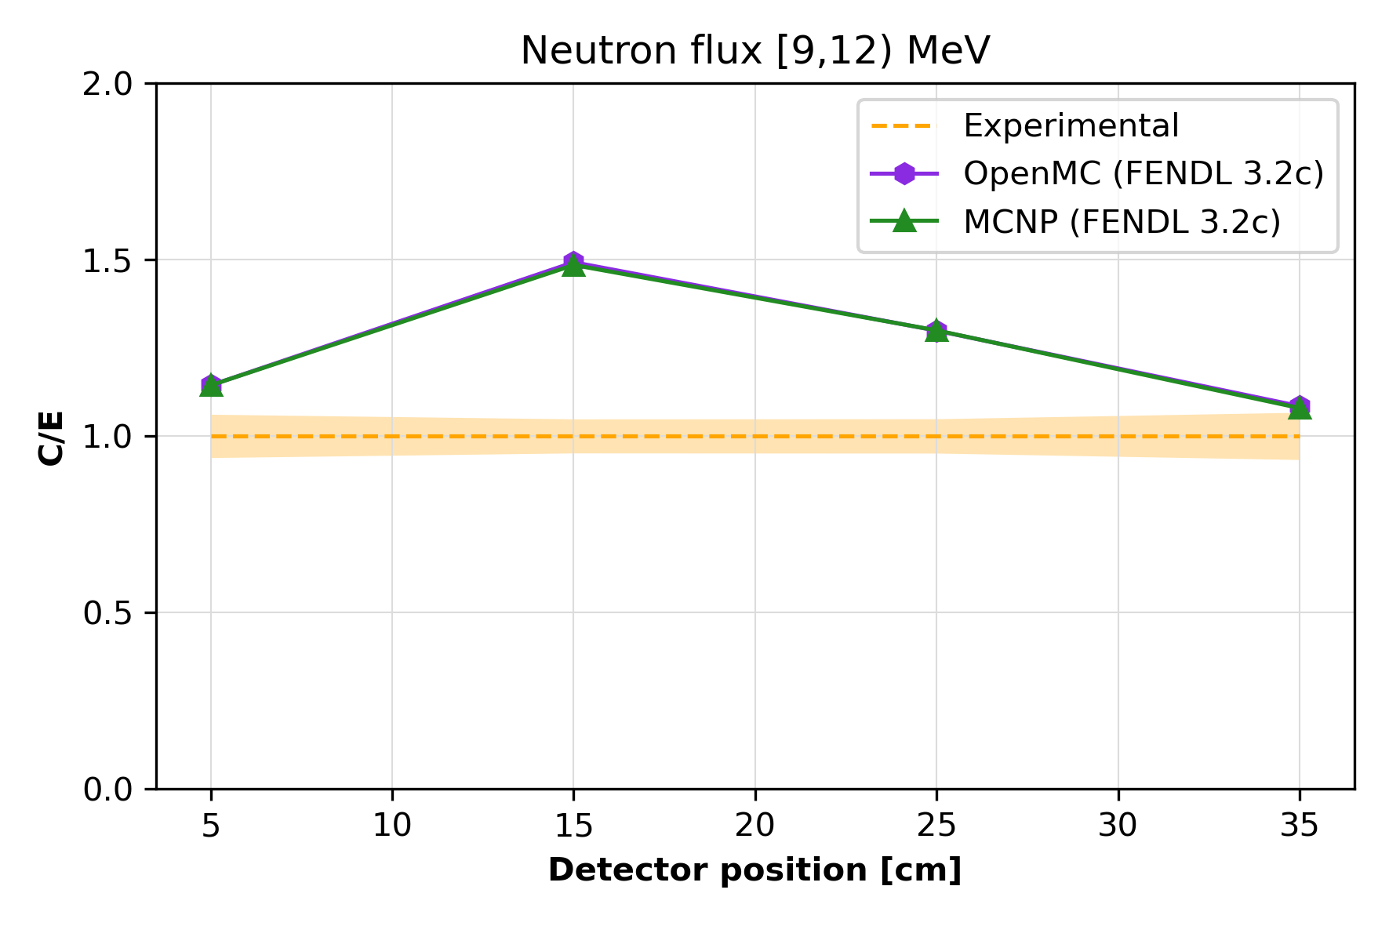
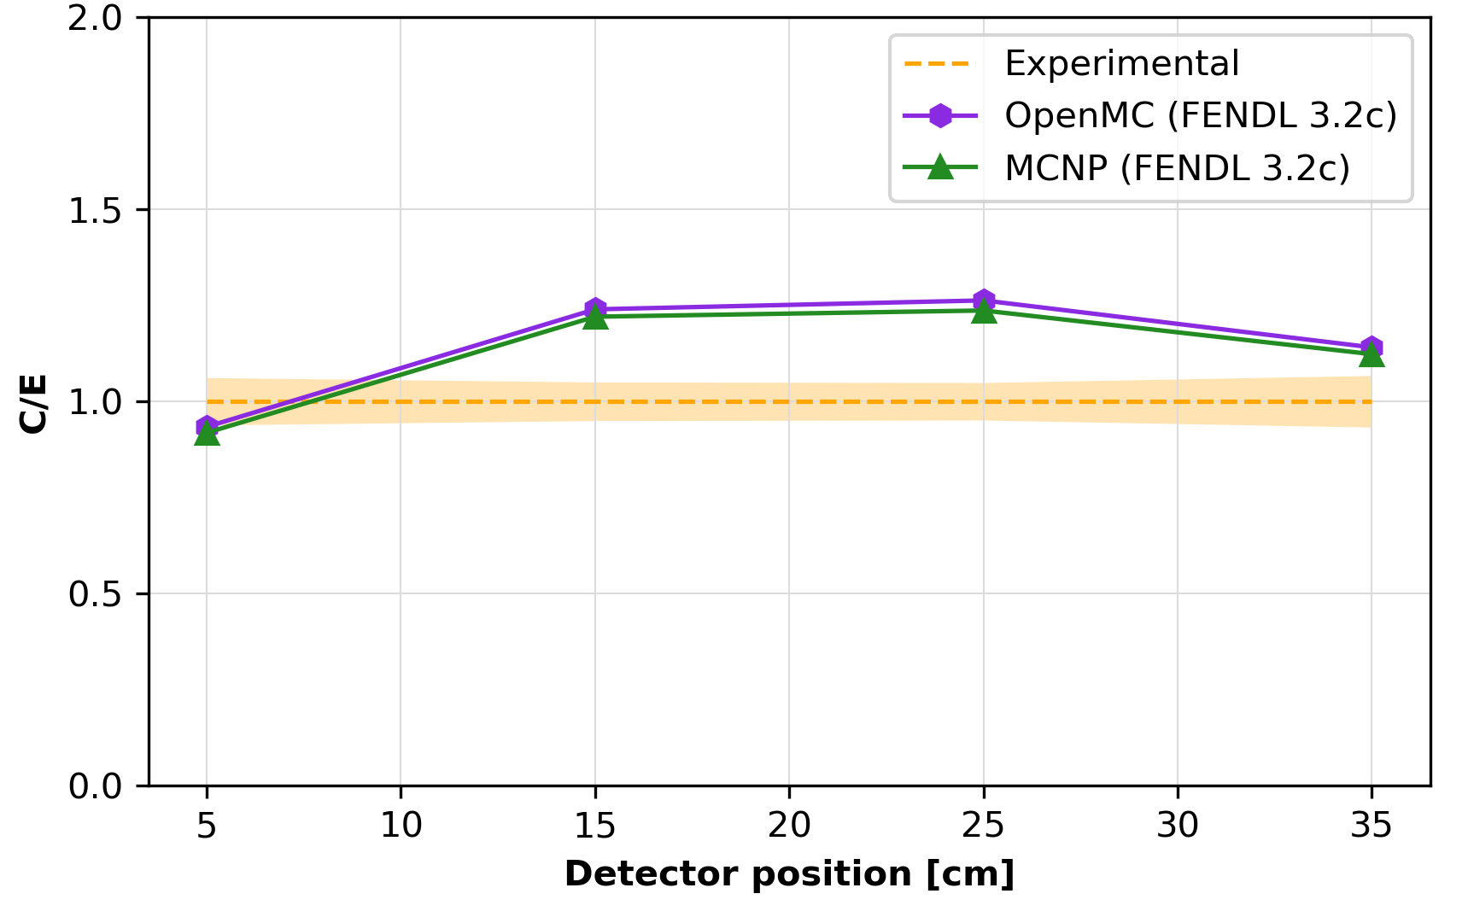
Analysis of the neutron spectra results III
Exp vs MCNP (FENDL 3.2c) vs OpenMC (FENDL 3.2c)
Notes:
Agreement between different transport codes $⇒$ discrepancies driven by the nuclear data.

Slide 8
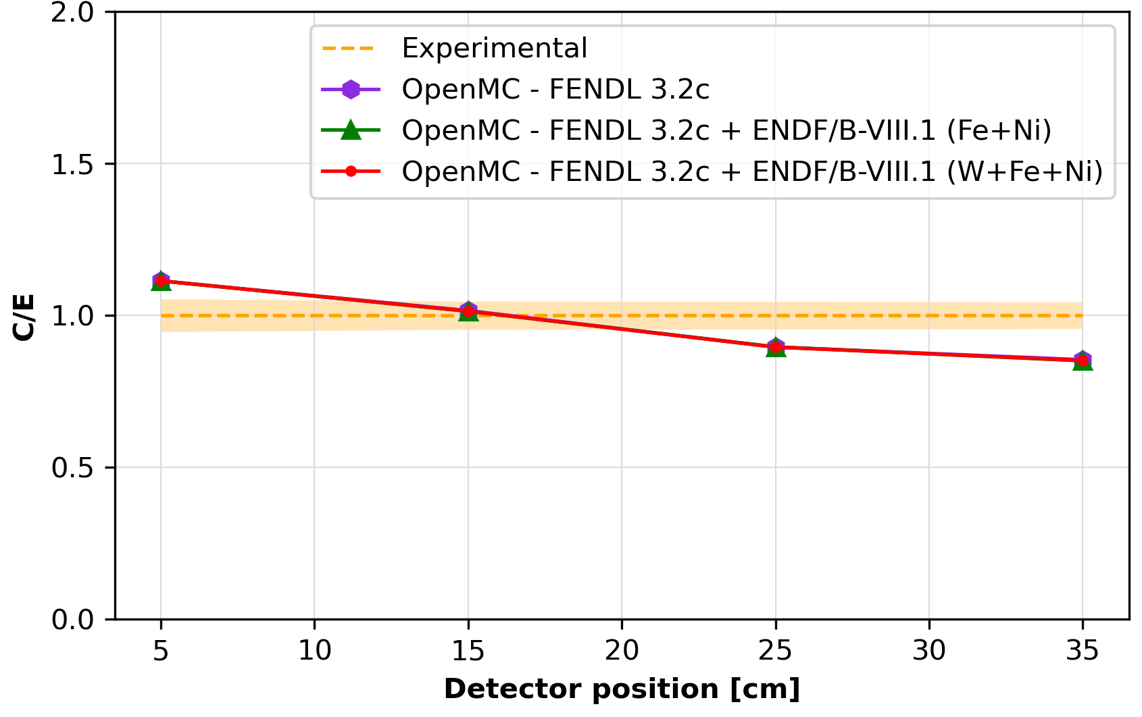
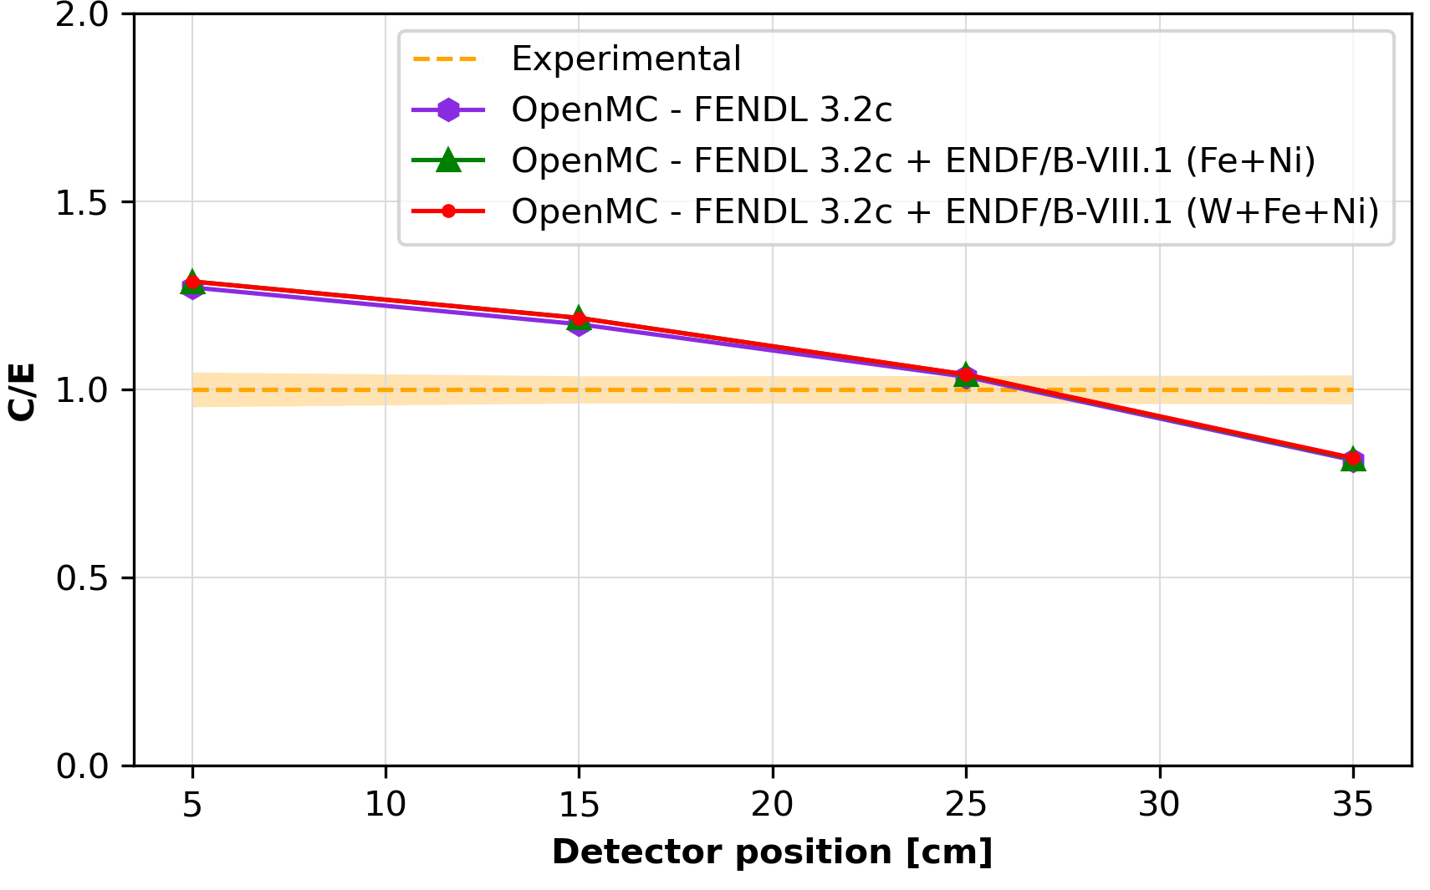
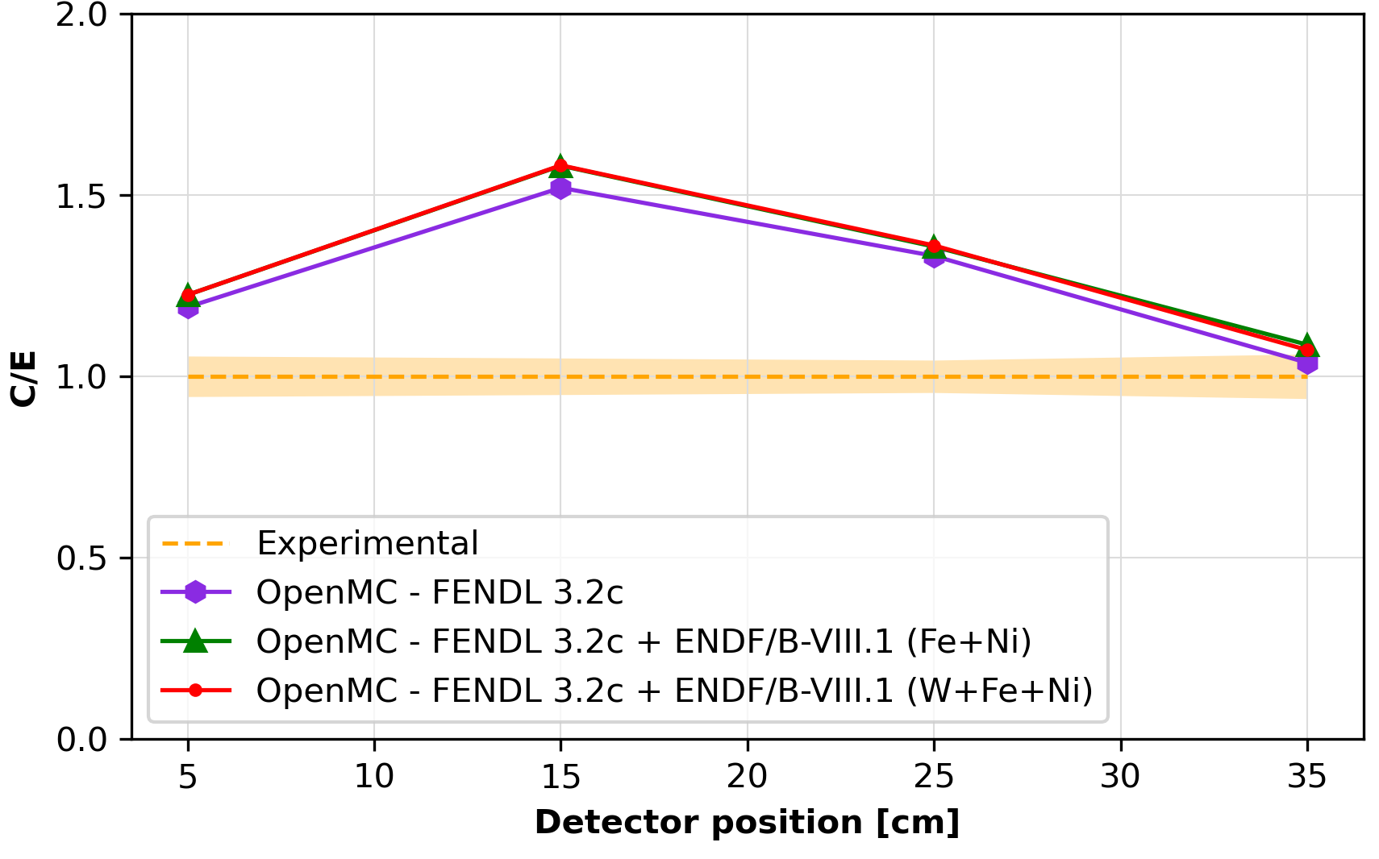
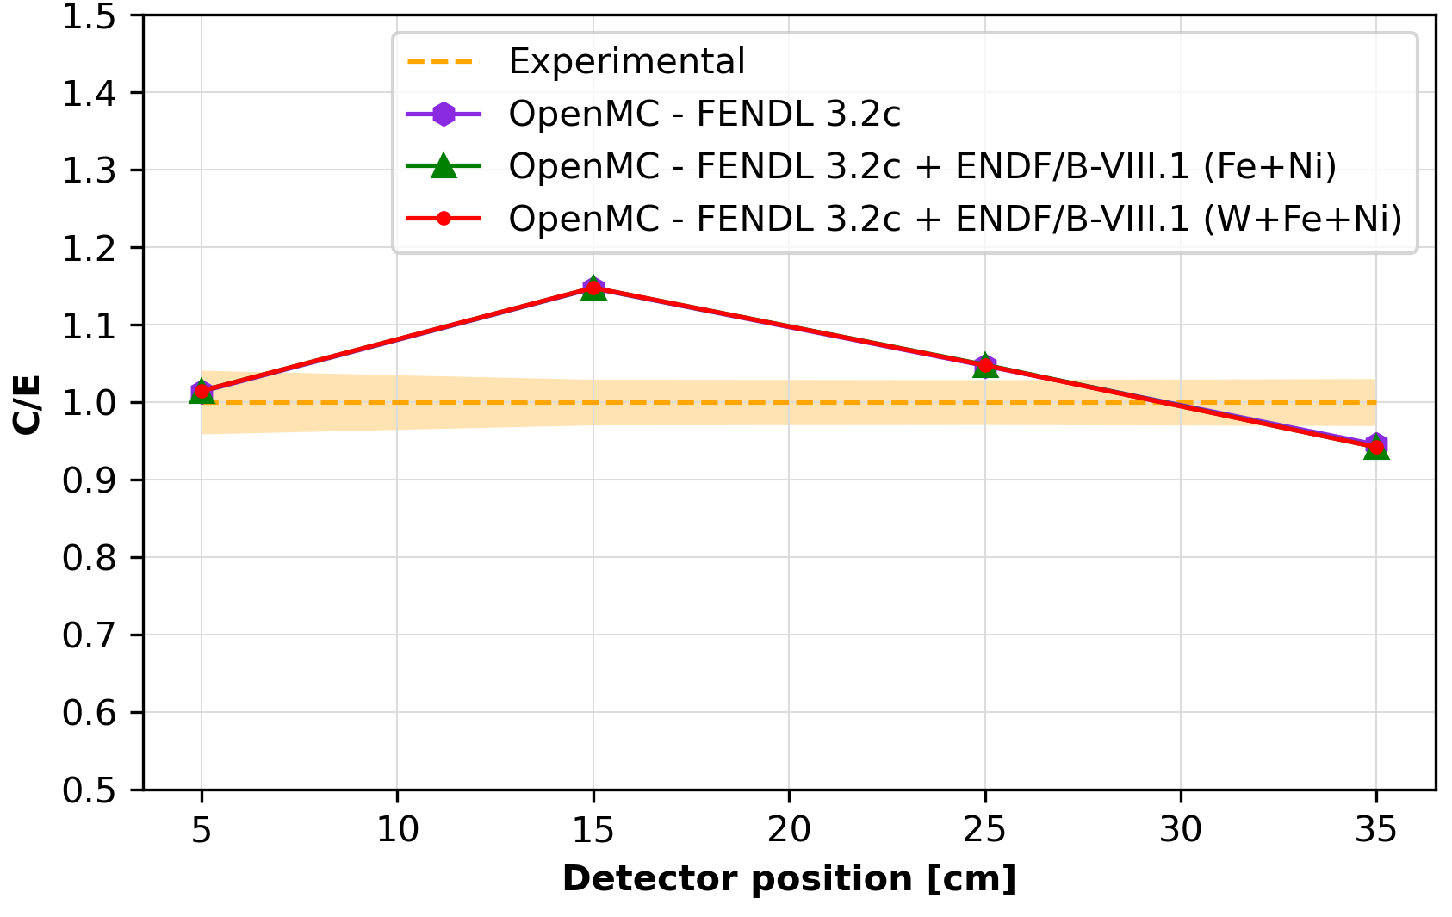
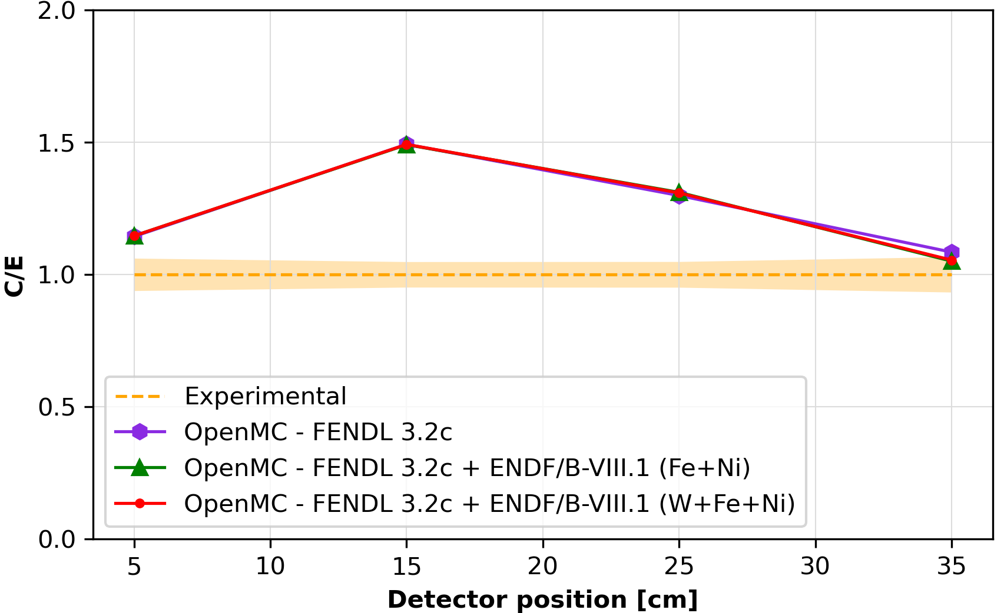
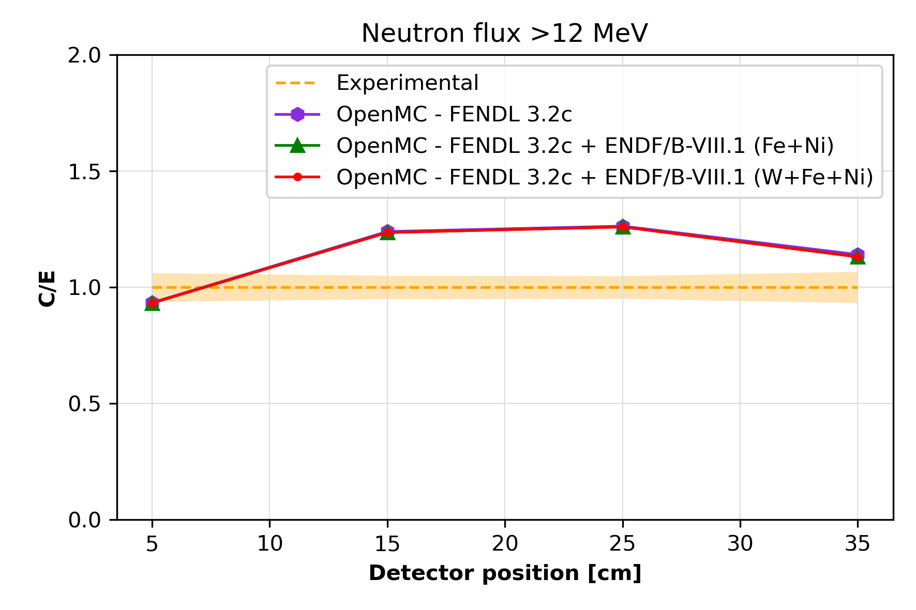
Analysis of the neutron spectra results IV
Exp vs OpenMC - FENDL 3.2c, FENDL 3.2c + ENDF/B-VIII.1 (Fe+Ni), FENDL 3.2c + ENDF/B-VIII.1 (W+Fe+Ni)
8
Notes:
Agreement between different transport codes $⇒$ discrepancies driven by the nuclear data.

Slide 9
Analysis of the photon spectra results I
Clear agreement between MCNP and OpenMC results for all 4 positions $⇒$ OpenMC validation.
Significant deviations in several peaks above $6 MeV$. Posterior investigation on the origin of these peaks and the cause of the deviation.
Notes:
A similar trend was noted for gamma spectra, although significant deviations were observed in several peaks above 6 MeV compared to experimental data. Further comparisons were performed using OpenMC, requiring the conversion of geometry, tallies, and source definitions. These comparisons confirmed that discrepancies were likely driven by the nuclear data itself rather than differences between Monte Carlo codes.

Slide 10
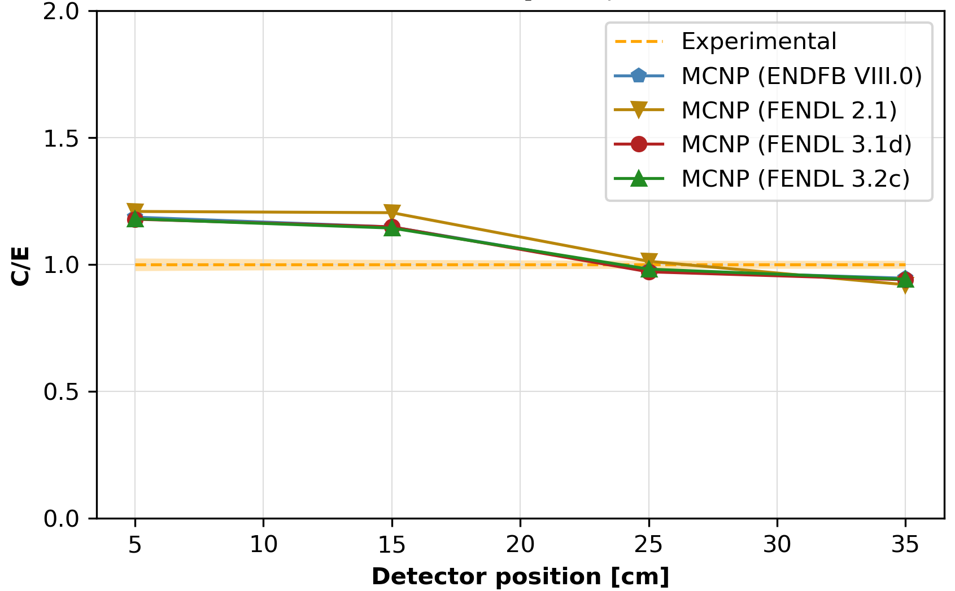
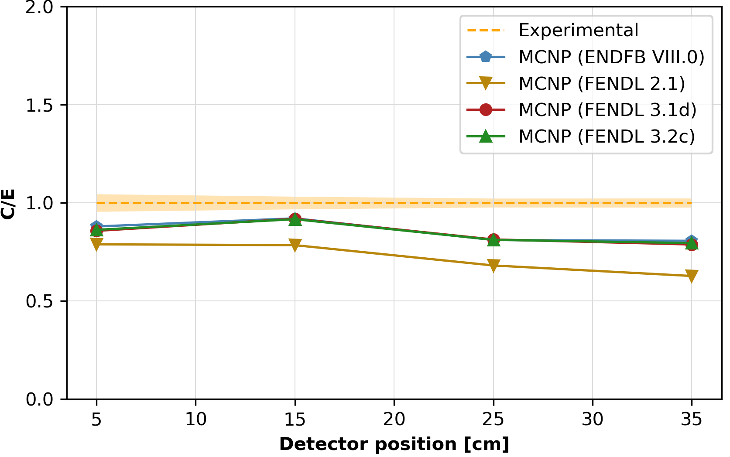
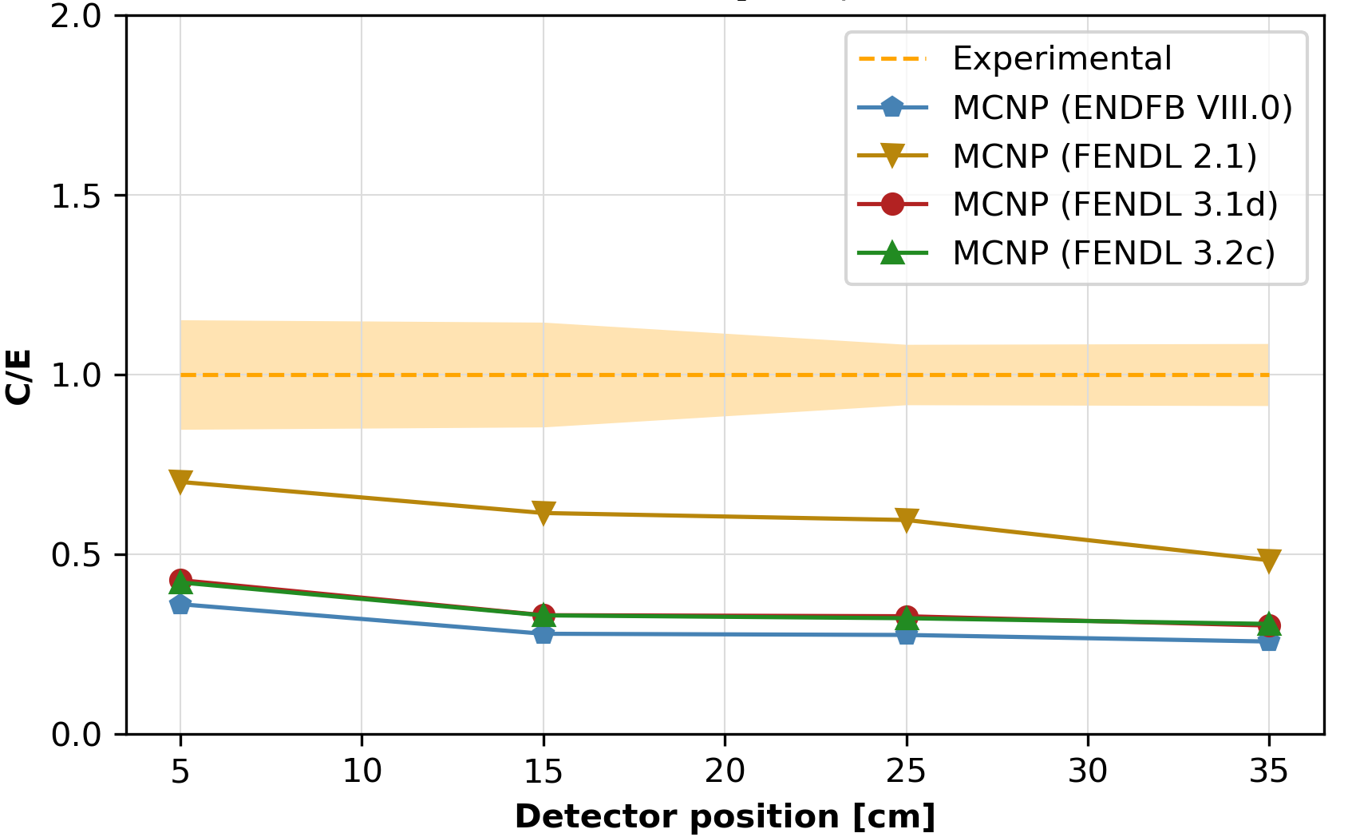
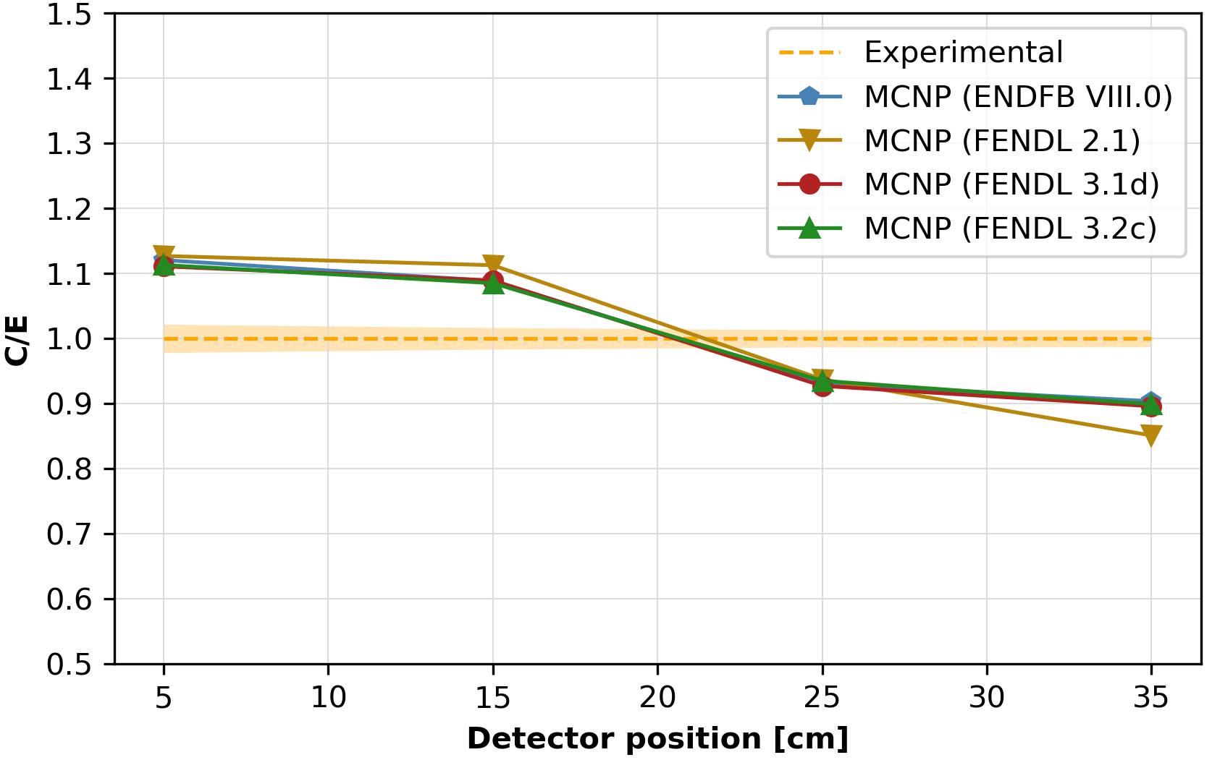
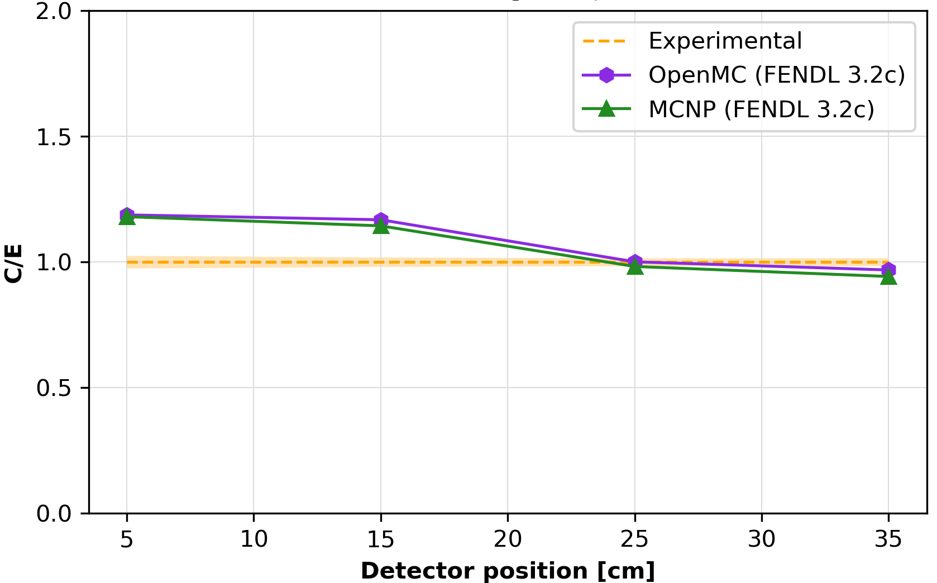
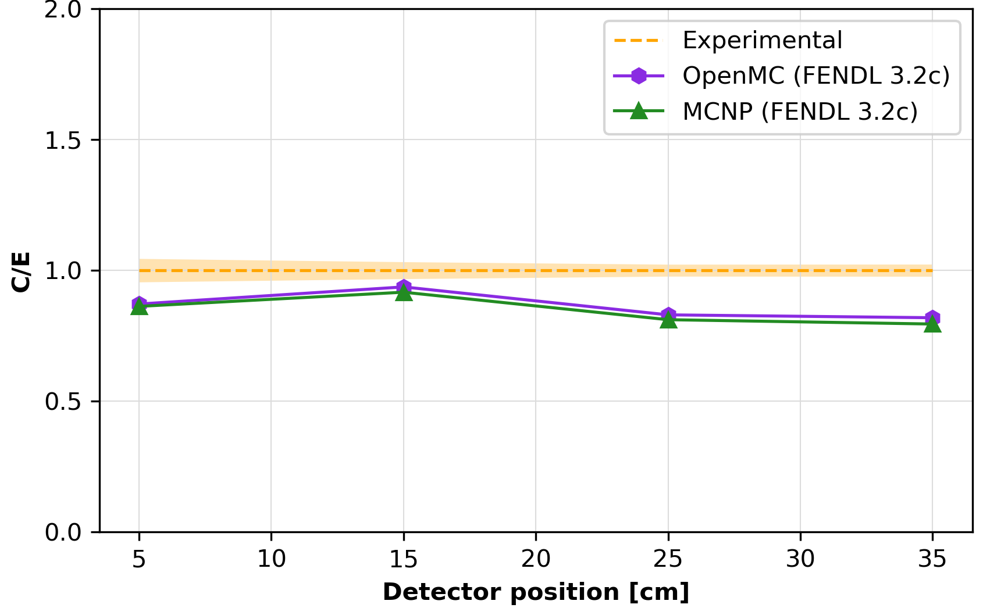
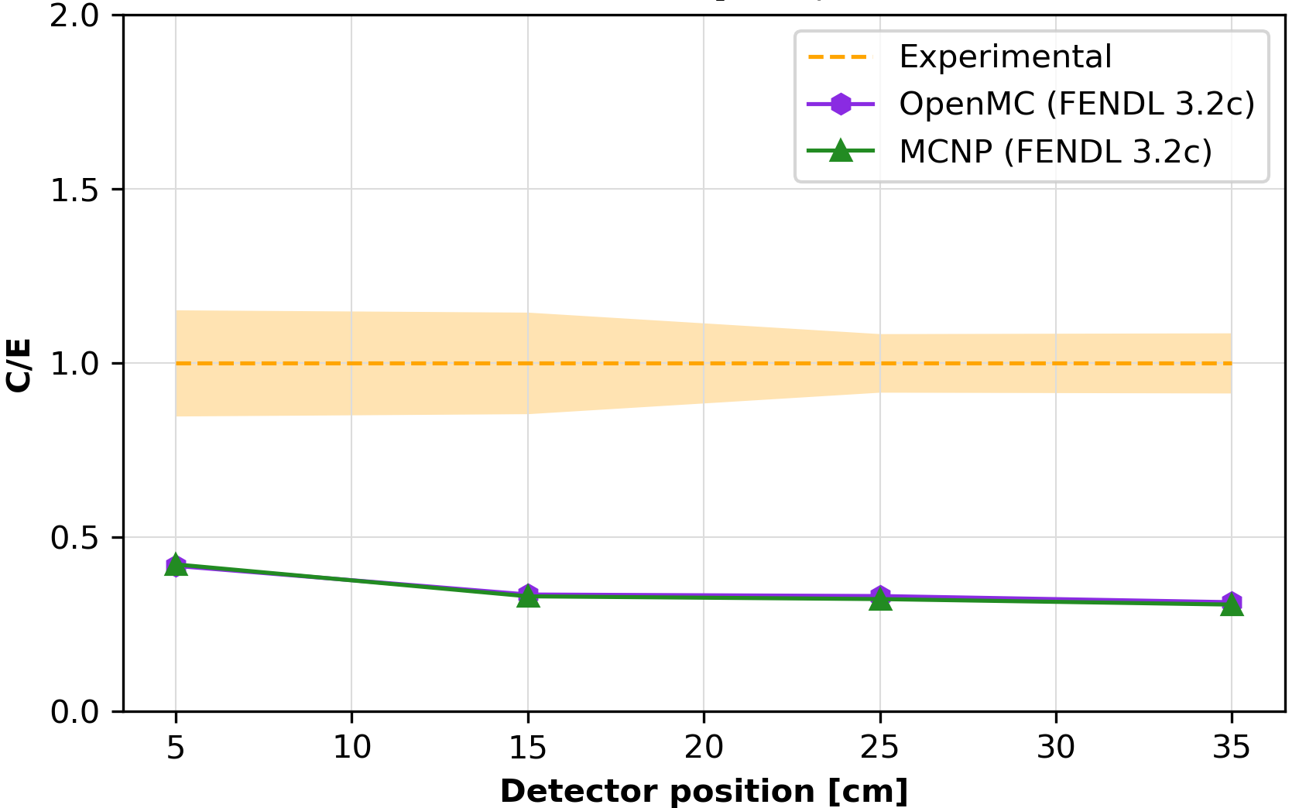
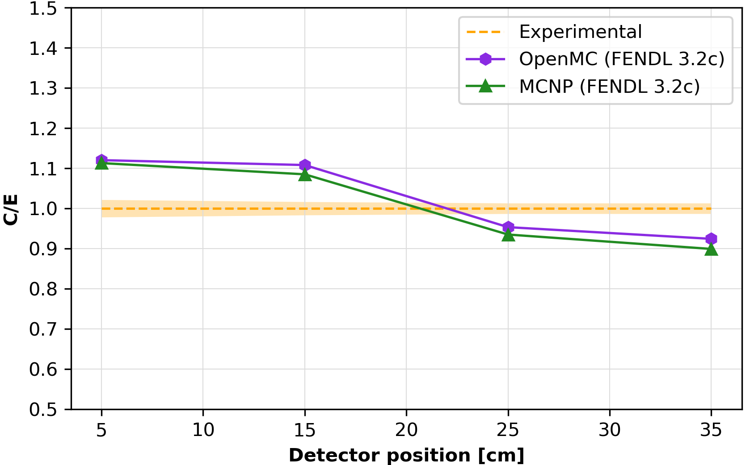
Analysis of the photon spectra results II
Exp vs MCNP (FENDL 3.2c, FENDL 3.1d, ENDFB VIII.0)
Exp vs MCNP (FENDL 3.2c) vs OpenMC (FENDL 3.2c)

Slide 11
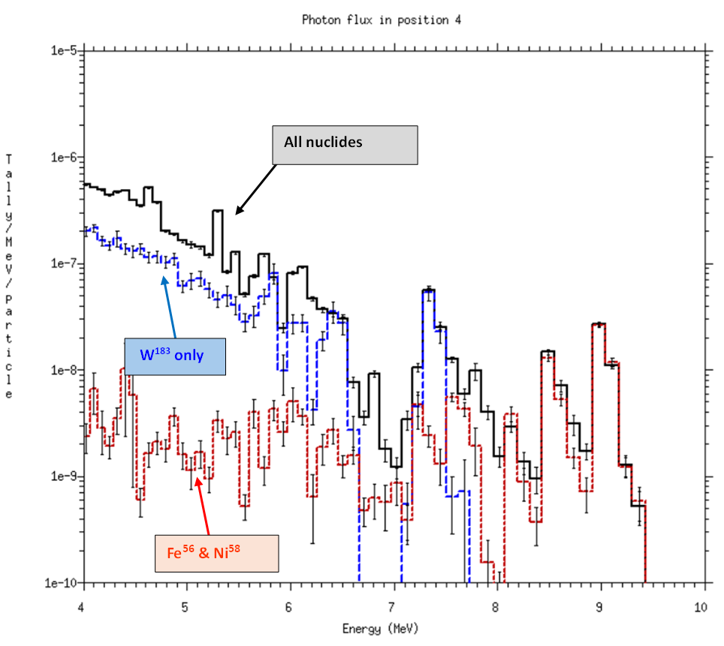
Investigation of discrepancies in high-energy photons
MCNP PKMT card employed to enable gamma production for different elements.
~$7 MeV$ line originated from ${}_{}^{183}W$ reactions.
Highest energy peaks resulting from ${}_{}^{56}{Fe}$ and ${}_{}^{58}{Ni}$, impurities present in DENSIMET.
Critical role of impurities in prompt radiation transport, not only in activation studies.
Clear need to characterize and certificate materials to ensure accurate response predictions.
$$⟹$$
Further studies of impact of impurities using ENDF-VIII.1 Fe, Ni and W isotopes provided by Daniel L.A.
Notes:
To investigate the origin of high-energy photon discrepancies, the MCNP PKMT card was used to selectively enable or disable secondary gamma production for different elements. This analysis revealed that the 7 MeV photon line originates from W-183 (n,γ) reactions, while the higher-energy peaks result from inelastic scattering in Fe-56 and Ni-58, impurities present in DENSIMET. This finding underscores the critical role of impurities not only in activation studies but also in prompt radiation transport. It highlights the necessity for thorough material characterization and certification to ensure accurate response predictions.

Slide 12
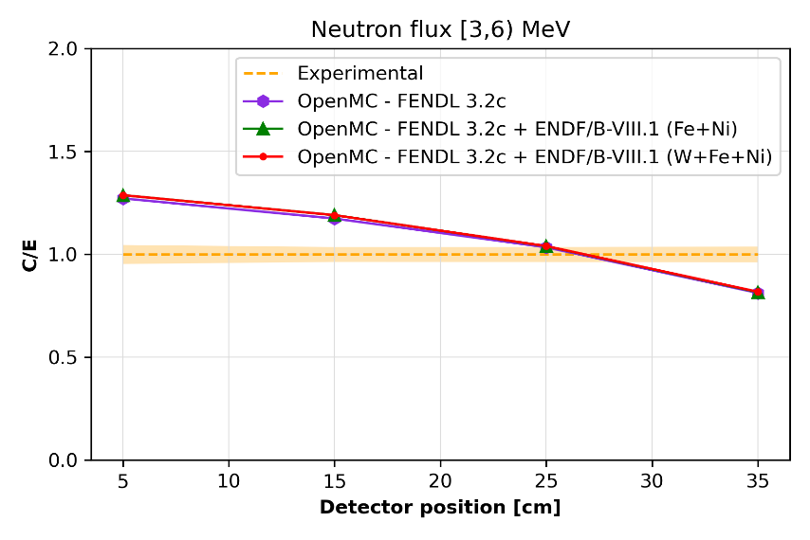
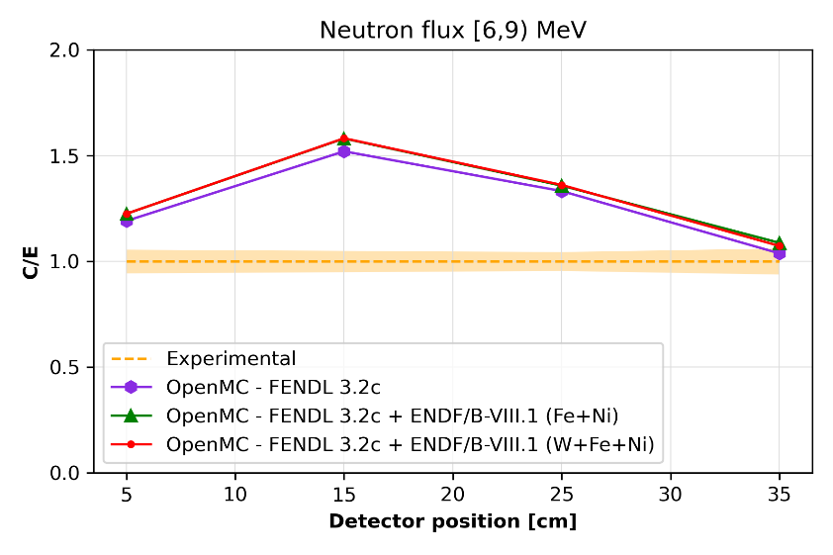
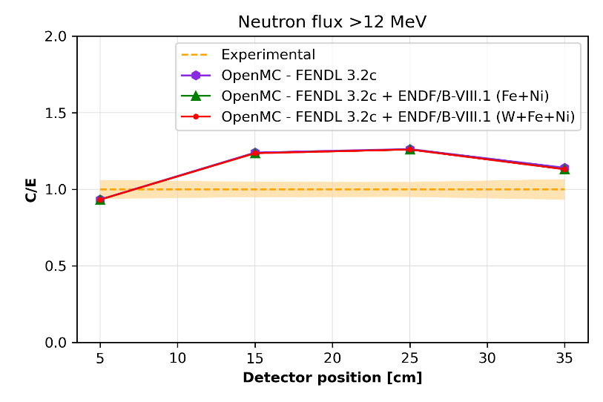
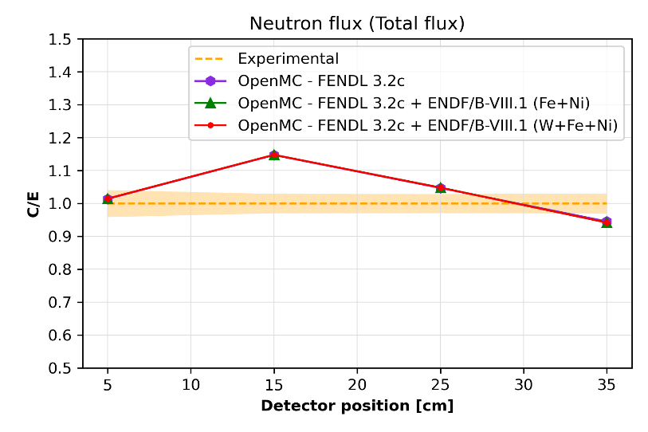
Analysis of the neutron spectra results III
Almost no impact of Neutron transport

Slide 13
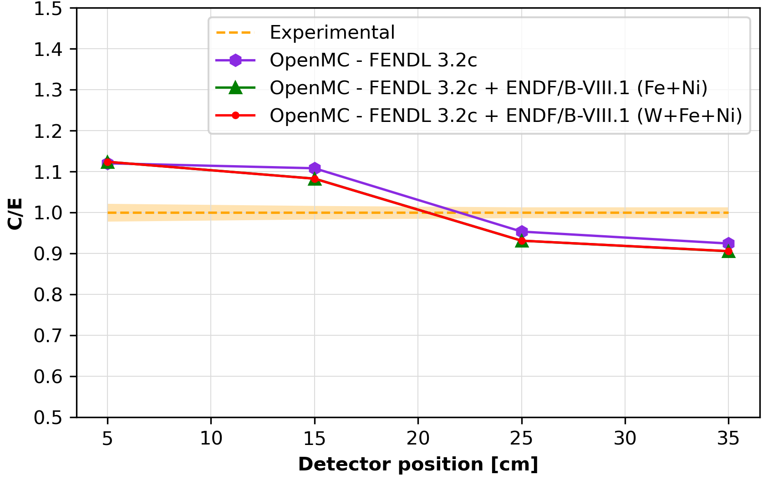
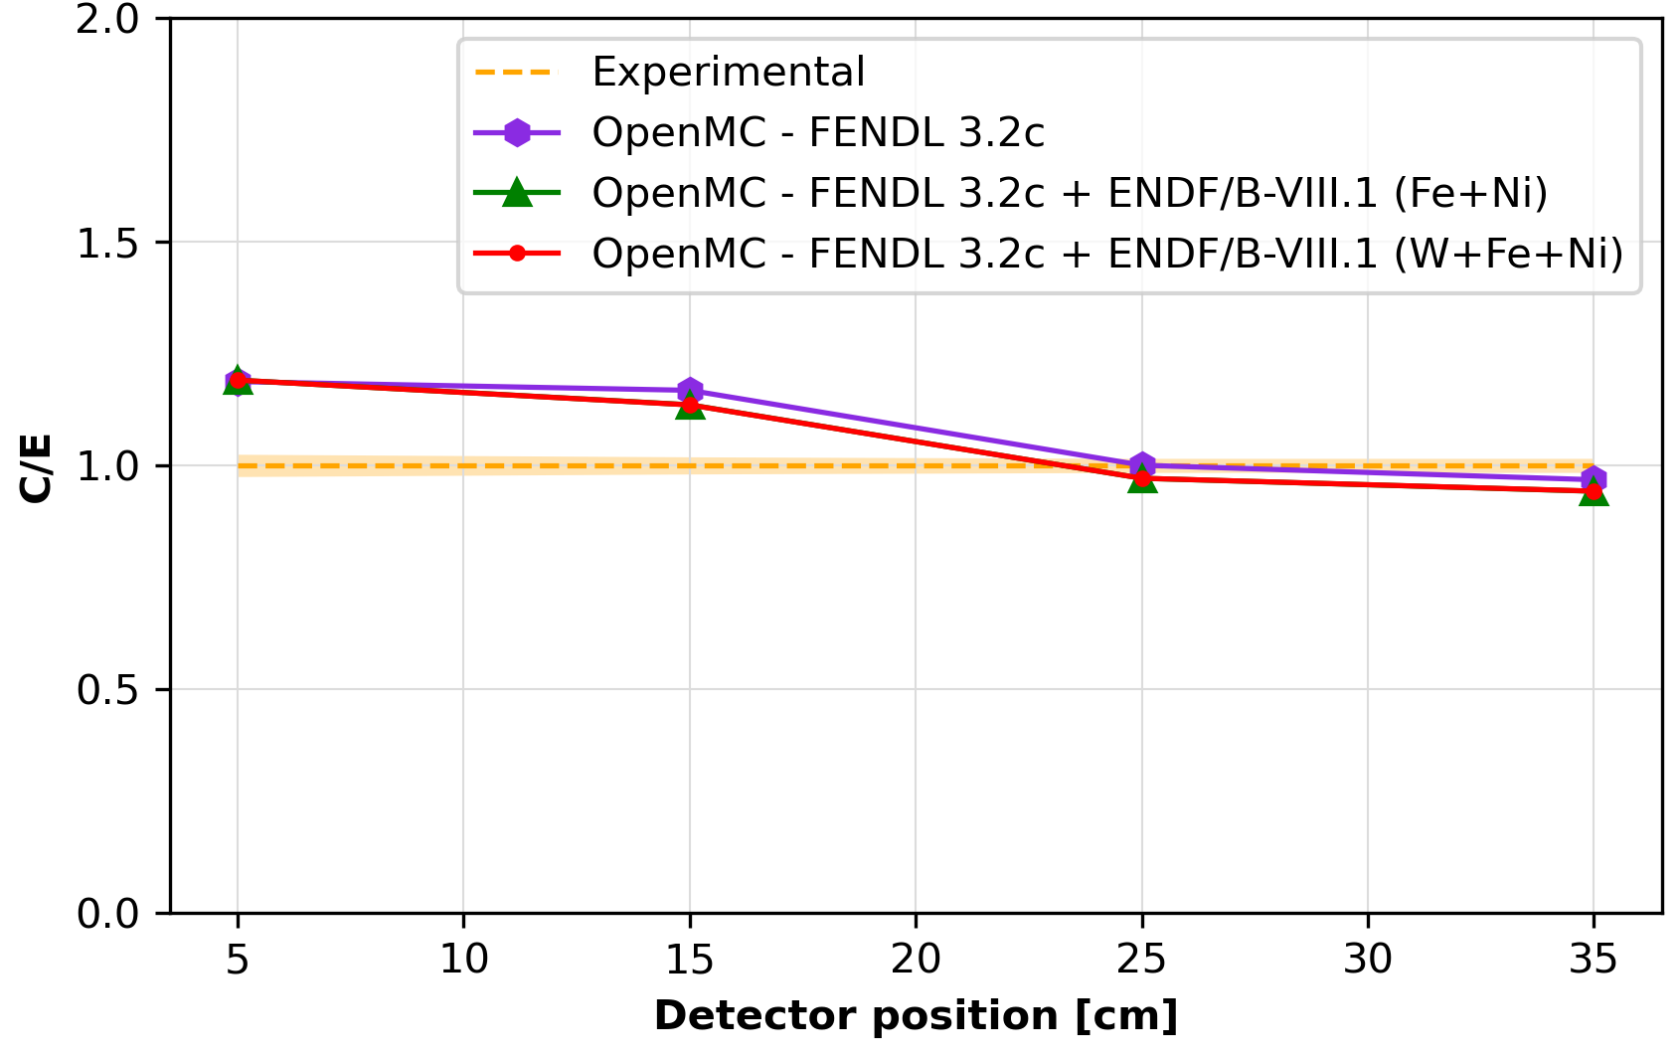
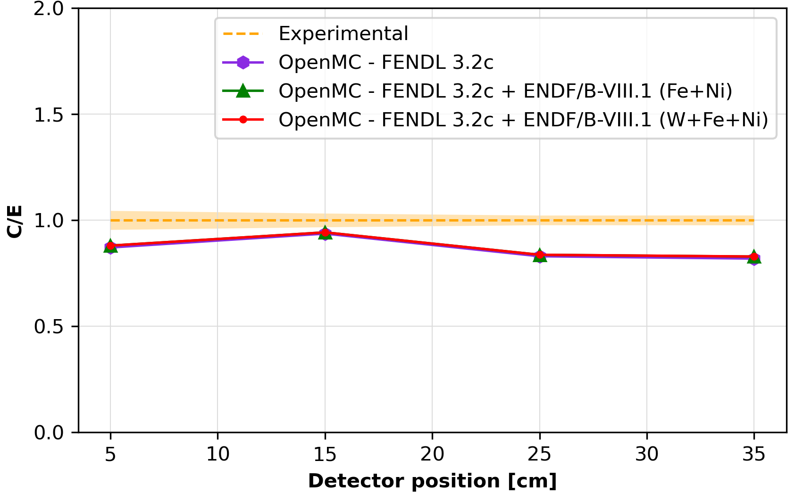
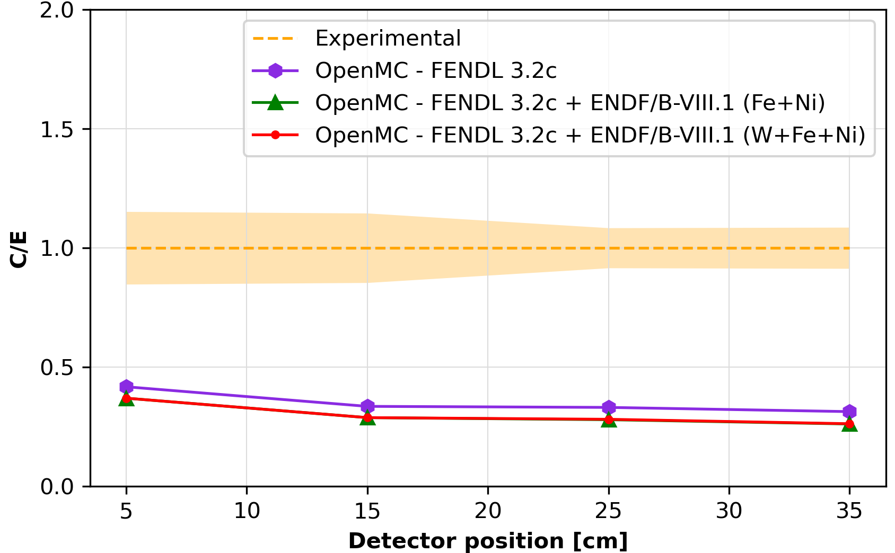
Analysis of the photon spectra results III
Exp vs OpenMC - FENDL 3.2c, FENDL 3.2c + ENDF/B-VIII.1 (Fe+Ni), FENDL 3.2c + ENDF/B-VIII.1 (W+Fe+Ni)

Slide 14
Conclusions and possible future work
Key outcomes:
Validation of the tungsten nuclear data using the TUD-W SINBAD experiment and 2 different transport codes (MCNP 6.2 & OpenMC 0.15.0).
General underestimation for high-energy photons responses.
Conversion of the TUD-W experimental benchmark model to OpenMC format with a special focus on the source transformation.
Validation of the OpenMC transport code for this case.
Better understanding of OpenMC weight windows efficacy.
Benchmark added to JADE
Possible future work:
Scoping studies to assess whether impurity levels are consistent with the material certificate.
Understand the importance of the different reaction channels.
$$49 cm$$
$$47 cm$$
$$z$$
$$y$$
$$x$$
Neutron source
$$46.85 cm$$
$$35 cm$$
$$25 cm$$
$$15 cm$$
$$5 cm$$
DENSIMET-176
DENSIMET-180

Slide 15
Thank you for your attention
Follow us on:
www.f4e.europa.eu
www.twitter.com/fusionforenergy
www.youtube.com/fusionforenergy
www.linkedin.com/company/fusion-for-energy www.flickr.com/photos/fusionforenergy

