Slide 1

Recent and future benchmark experiments at the Frascati Neutron Generator (FNG)
Rosaria Villari
D. Flammini, F. Andreoli, P. Batistoni, A. Colangeli, M. Damiano, N. Fonnesu, S. Loreti, M. Lungaroni, F. Moro, S. Noce, G. Pagano, A. Pietropaolo, A. Previti
Consultancy Meeting on the Preparation of a Major Release of the Fusion Evaluated Nuclear Data Library (FENDL)
– 13-16 May 2025 – IAEA, Vienna
Rosaria.villari@enea.it

Slide 2
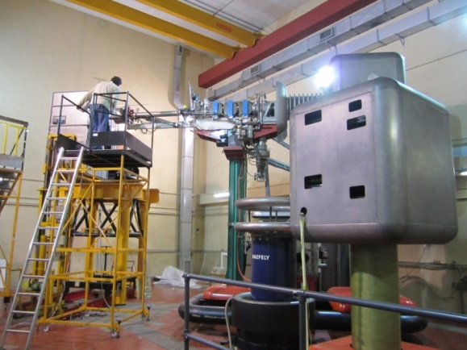
Introduction
Frascati Neutron Generator (FNG)
DEMO oriented experiments within EUROfusion WP BB
14 MeV neutron irradiation at FNG
2022-2023 Tungsten shielding experiment aimed at studying the neutron transport in a reactor-like DEMO relevant shielding element made of tungsten, stainless steel (SS) and water.
2025-2026 Concrete shielding experiment aimed at demonstrating the shielding capability of concrete and the accuracy of computational tools& nuclear data for deep penetration assemblies (about 1 m).
Application of FENDL 3.2 to post-analysis of W shielding exp & pre-analysis of Concrete

Slide 3
W-Shielding experiment

Slide 4
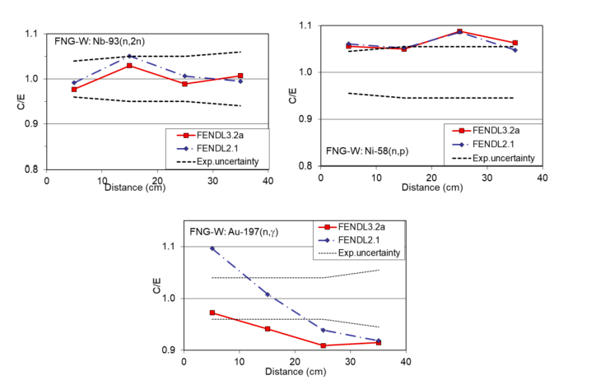
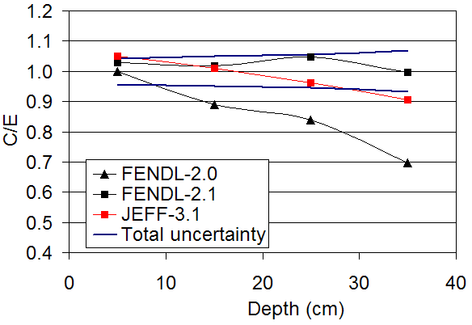

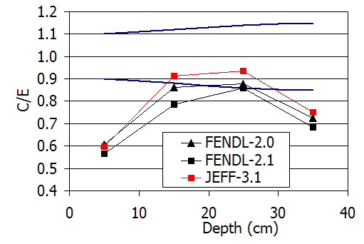
Tungsten experiment at FNG (2002)
Tungsten: armour material for high heat flux components
Fast N flux
Zr-90(n,2n)
P. Batistoni, Jour. Nuc. Mat., 329-333, 683 (2004)
Nuclear Heating
G. Schnabel, NDS, 193, 1 (2024)
Neutron fluxes
Significant improvement of the calculation of fast neutron flux from FENDL-2.0 to 2.1
FENDL 3.2 same as FENDL 2.1 for fast – lower results for thermal
Neutron flux predicted within ± 10% by FENDL-2.1/3.2
Nuclear heating Underestimation of γ heating up to 40%
-Issues also in FENDL3.2 evaluation

Slide 5

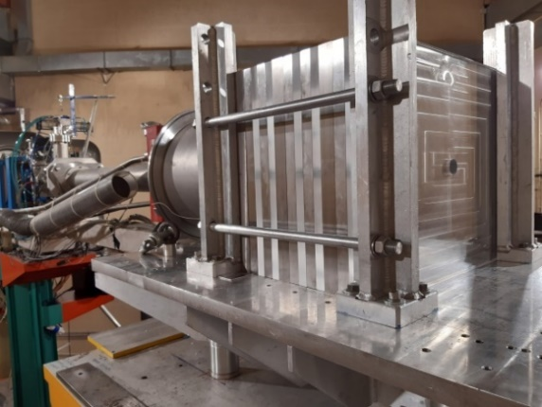
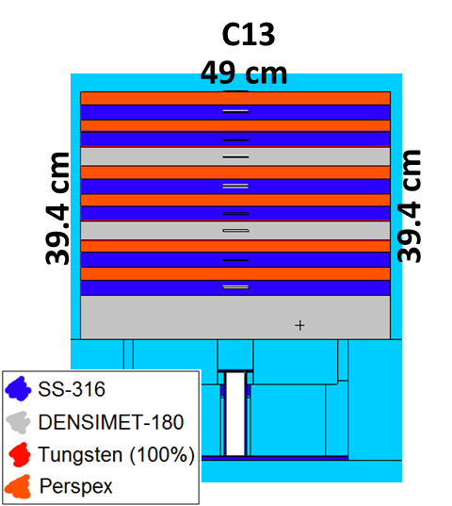




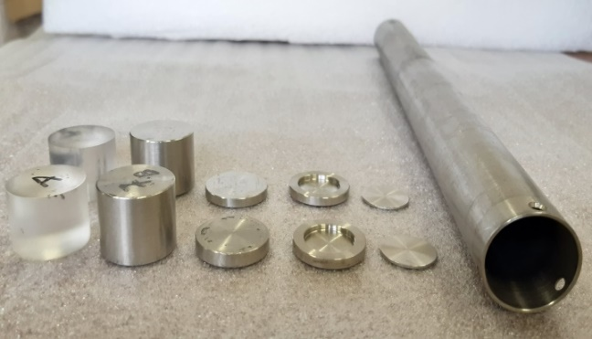
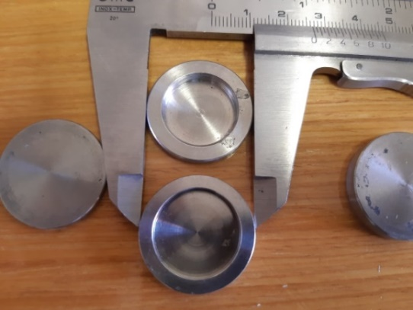
Tungsten Shielding experiment at FNG
DEMO oriented Tungsten shielding experiment
Alternated slabs of Tungsten, SS and Perspex
DENSIMET 180 :
  95% W
  3.4% Ni
  1.6% Fe
Activation Foils
Material | Reaction | Half-live | Energy threshold (MeV) | Thickness (mm)
Au | ¹⁹⁷Au(n,γ)¹⁹⁸Au | 2.696 d | - | 0.05
W | ¹⁸⁶W(n, γ)¹⁸⁷W | 23.9 h | - | 0.15
In | ¹¹⁵In(n,n’)^{115m}In | 4.49 h | 0.5 | 1, 2.5, 5
Ni | ⁵⁸Ni(n,p)⁵⁸Co | 70.82 d | 1 | 1
Al | ²⁷Al(n,α)²⁴Na | 14.96 h | 4.2 | 1
Nb | ⁹³Nb(n,2n)^{92m}Nb | 10.15 d | 8.9 | 1
D. Flammini, submitted to FED
EUROFusion WP BB

Slide 6
Irradiations & Reaction Rates measurements
Irradiation # | Irradiation Time (s) | 14 MeV Neutron Yield (n/s) | Err. % | Foils
1 | 15625 | 4.54E+10 | 4.2 | Au, Ni, Al, VERDI
2 | 10430 | 4.49E+10 | 4.3 | In
3 | 14997 | 4.08E+10 | 4.2 | Nb, W
DENSIMET - 180
DENSIMET - 180
Absolutely calibrated HPGe detector at FNG lab
Clear decrease of the two thermal RR, ¹⁹⁷Au(n,γ) and ¹⁸⁶W(n,γ), inside the two Densimet-180 slabs

Slide 7
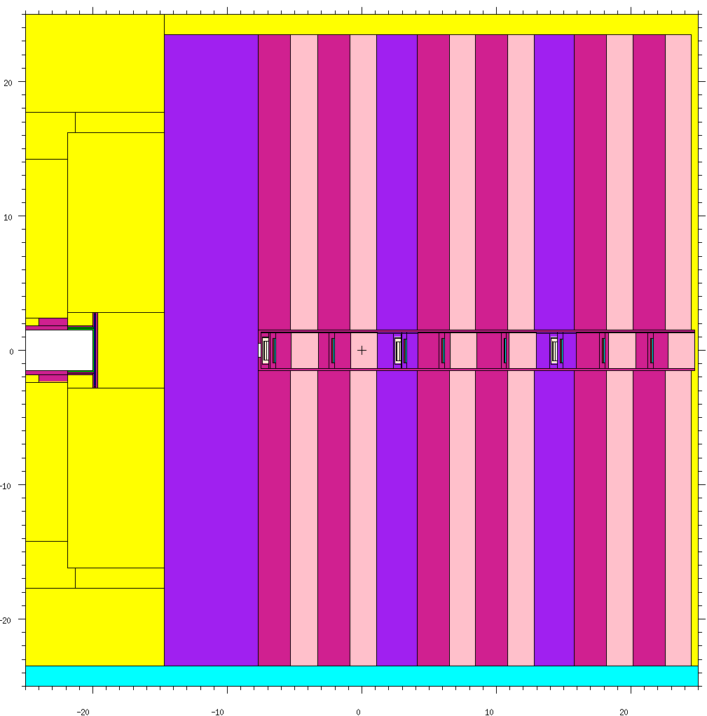
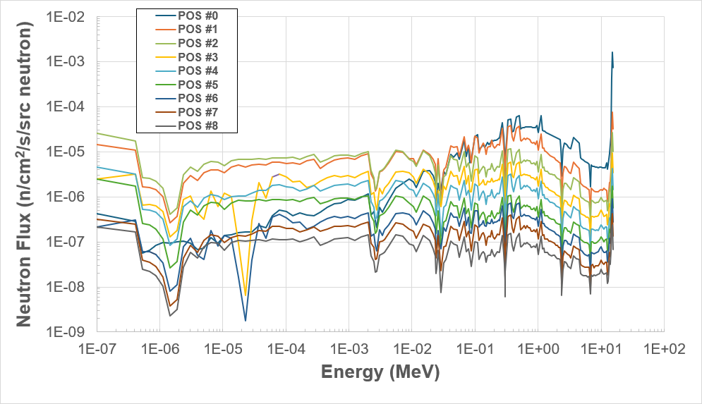
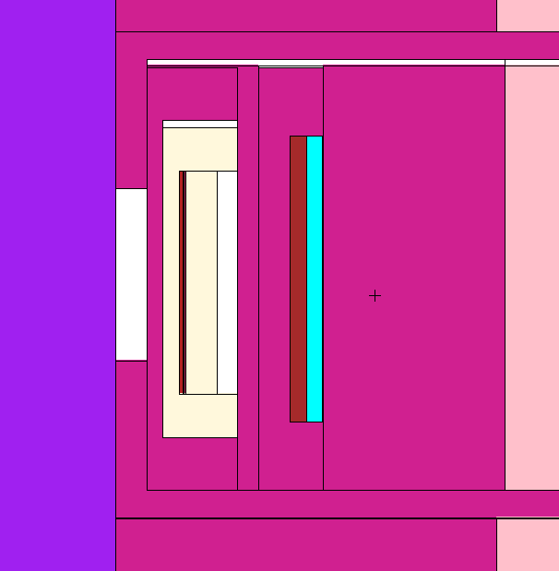
MCNP model and calculations
MCNP 5 v1.6 with FNG subroutine
JEFF 3.3,JEFF 4T2 and FENDL 3.2 (transport) IRDFF-II (dosimetry)
ADVANTG generated wwinp
3 MCNP models corresponding to each irradiation
5x10⁹ source particles in each run
Neutron energy spectra in exp positions
Gap
ENEA foils
VERDI

Slide 8
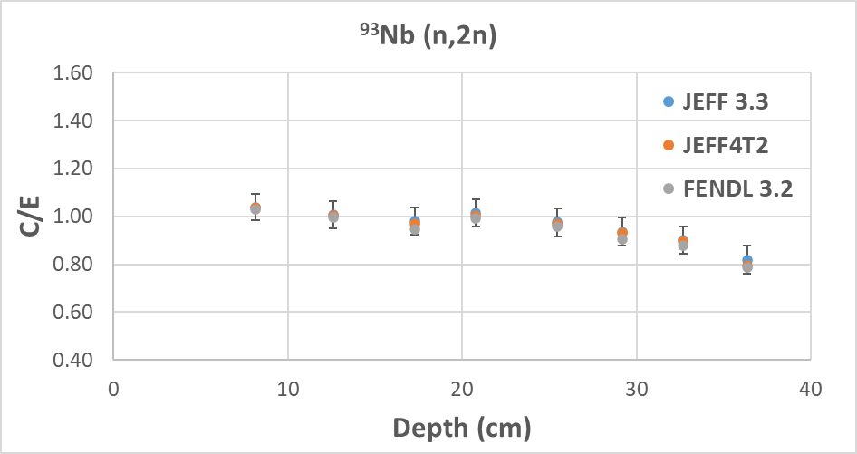
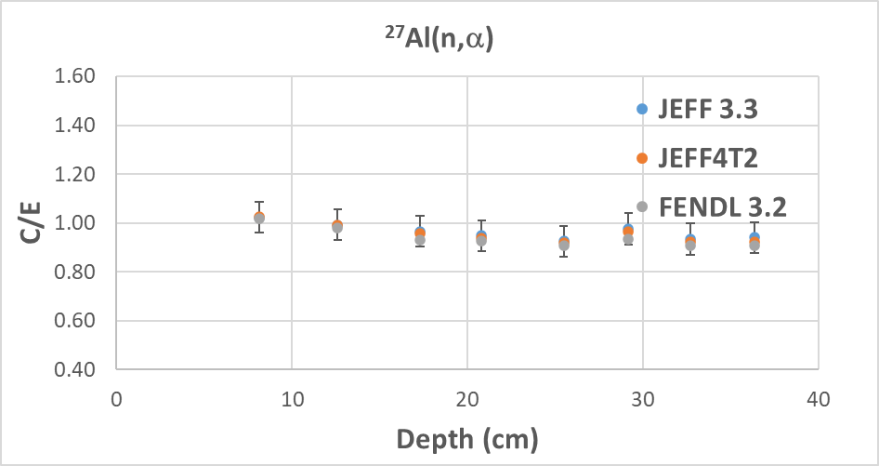
C/E for ⁹³Nb (n,2n) and ²⁷Al (n,α)
Same trend with all libs
FENDL3.2 slightly lower than JEFF 3.3 -3-4% in last position
²⁷Al(n,a): Good agreement with all libs in all positions
⁹³Nb(n,2n): good agreement< 25 cm- understimation up to 20% in rear part

Slide 9
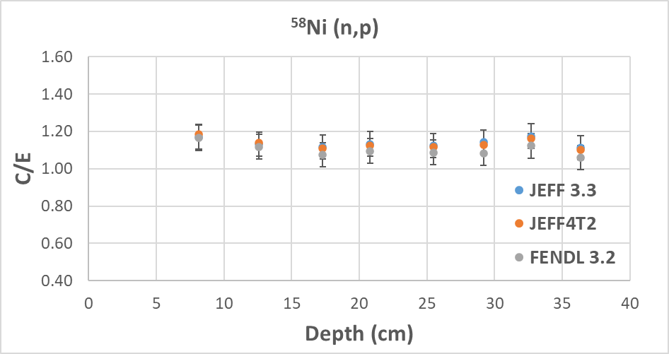
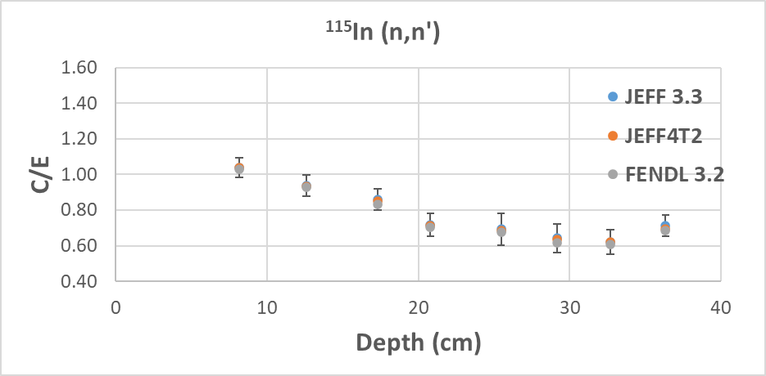
C/E for ⁵⁸Ni (n,p) and ¹¹⁵In (n,n’)
Same trend with all libs
FENDL3.2 slightly lower than JEFF 3.3 -4-5% in last position
⁵⁸Ni(n,p): Overestimation up to 20% with all libs in all positions- better agreement with FENDL3.2
¹¹⁵In(n,n‘): good agreement in first & second positions- understimation up to 40% at about 30 cm depth

Slide 10
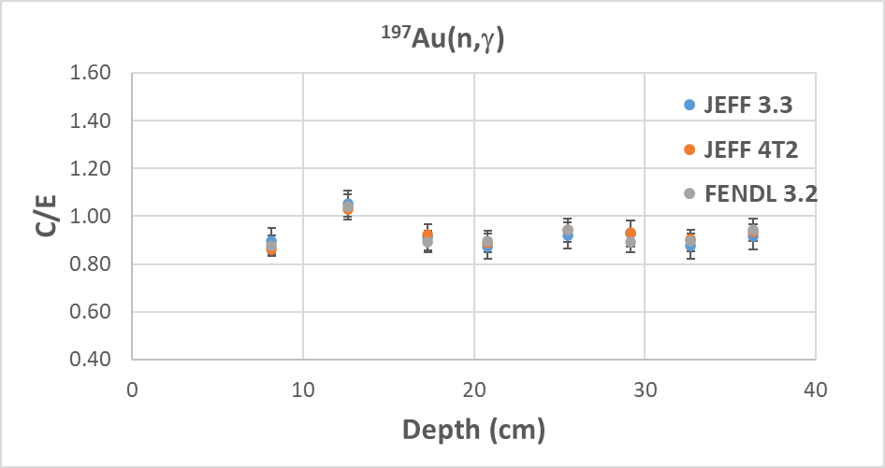
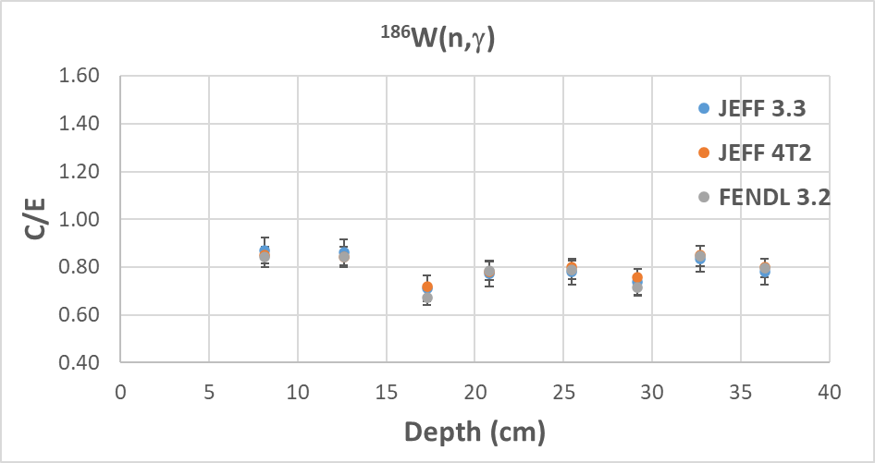
C/E for ¹⁹⁷Au(n,γ) and ¹⁸⁶ W(n,γ)
Same trend with all libs
FENDL3.2 /JEFF 3.3 0.95-1.03
FENDL3.2 ¹⁹⁷Au(n,γ): underestimation in all positions except 2nd pos (+4%- within error)- min -12%
FENDL3.2 ¹⁸⁶W(n,γ): understimation 0.67<C/E<0.85 - min at the 3rd pos

Slide 11
Pre-analysis of Concrete experiment

Slide 12
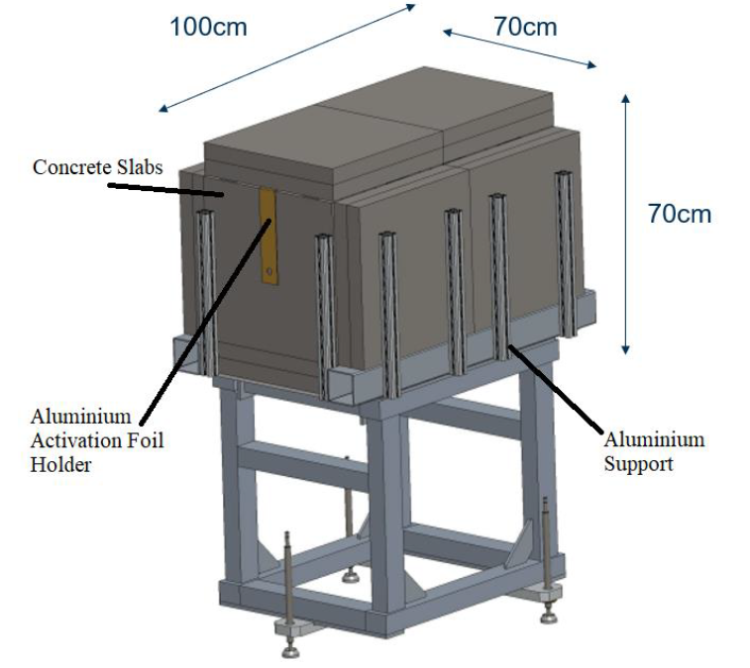
Concrete experiment at FNG 2025-2026
The concrete shielding benchmark experiment at FNG will use the same concrete slabs (50x50x5 cm³) as in the experiment performed within WP-ENS at the CAS Nuclear Physics Institute (NPI) U120M cyclotron for IFMIF-DONES [EFDA_D_2RKKG3]
Two kinds of concrete: ordinary and heavy concrete
El. | Weight (%)
 | Ordinary Concrete | Heavy Concrete
H | 0.35 | 0.3
C | 10.29 | -
O | 49.66 | 28.6
Na | - | 0.18
Mg | 9.87 | 0.27
Al | 0.75 | 0.69
Si | 1.99 | 2.57
P | - | 0.45
S | 1.07 | 0.13
Cl | 0.02 | 0.01
K | 0.06 | 0.17
Ca | 24.16 | 4.7
Ti | 0.05 | 0.03
Fe | 1.73 | 61.9
ρ [g/cm³] | 2.55 | 3.94
Pre-analysis performed to:
demonstrate the feasibility of the experiment
  Select suitable detectors and calculate the expected quantities to have measurable signals in the experiment
set up a clean experimental configurations
  Reduce the background effect
EUROfusion WP BB

Slide 13
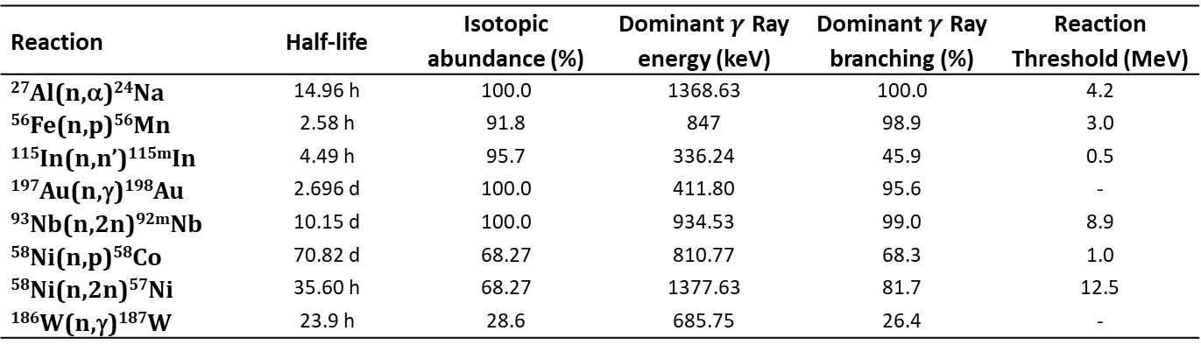
Codes, libraries and methodology
Codes
MCNP5 v1.60 with FNG source subroutine
ADVANTG for weight windows
Libraries
JEFF3.3 (ref), FENDL3.2 used for transport
IRDFF-II for dosimetry
Methodology
Reaction rates in activation foils (2 mm thick void cells)
Neutron flux distribution for different energy intervals (1eV, 1 keV, 1 MeV, 20 MeV)
Reaction | Half-life | Isotopic abundance (%) | Dominant $γ$ Ray energy (keV) | Dominant $γ$ Ray branching (%) | Reaction Threshold (MeV)
²⁷Al(n,α)²⁴Na | 14.96 h | 100.0 | 1368.63 | 100.0 | 4.2
⁵⁶Fe(n,p)⁵⁶Mn | 2.58 h | 91.8 | 847 | 98.9 | 3.0
¹¹⁵In(n,n’)^{115m}In | 4.49 h | 95.7 | 336.24 | 45.9 | 0.5
¹⁹⁷Au(n,γ)¹⁹⁸Au | 2.696 d | 100.0 | 411.80 | 95.6 | -
⁹³Nb(n,2n)^{92m}Nb | 10.15 d | 100.0 | 934.53 | 99.0 | 8.9
⁵⁸Ni(n,p)⁵⁸Co | 70.82 d | 68.27 | 810.77 | 68.3 | 1.0
⁵⁸Ni(n,2n)⁵⁷Ni | 35.60 h | 68.27 | 1377.63 | 81.7 | 12.5
¹⁸⁶W(n,γ)¹⁸⁷W | 23.9 h | 28.6 | 685.75 | 26.4 | -

Slide 14
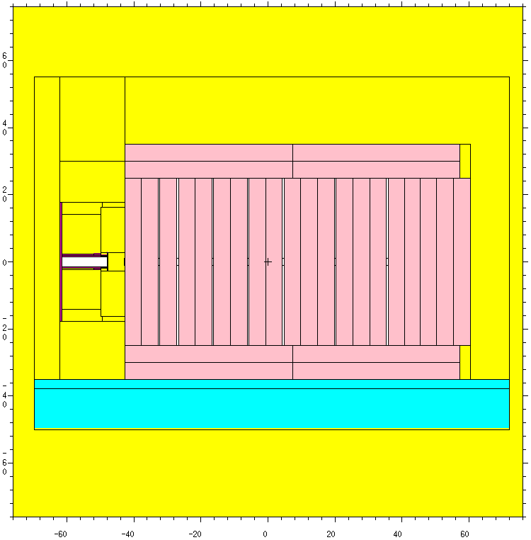
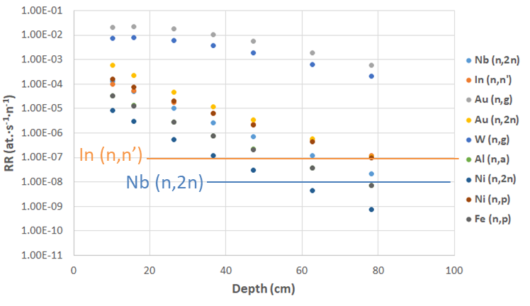







Pre-analysis of Concrete experiment
#3
Several configurations analysed
Optimal configuration: #3
  Measureable RRs level up to 80 cm under FNG conditions
  Max 7% background in the last position on total N-flux

Slide 15
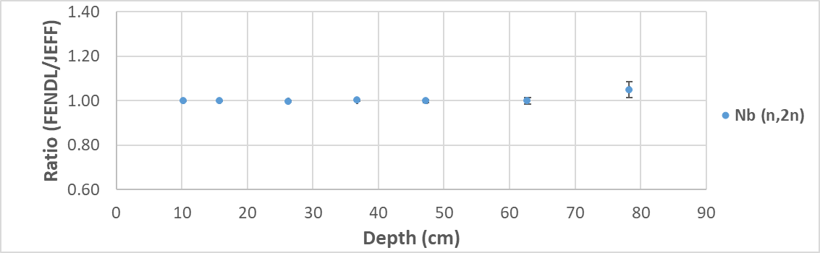
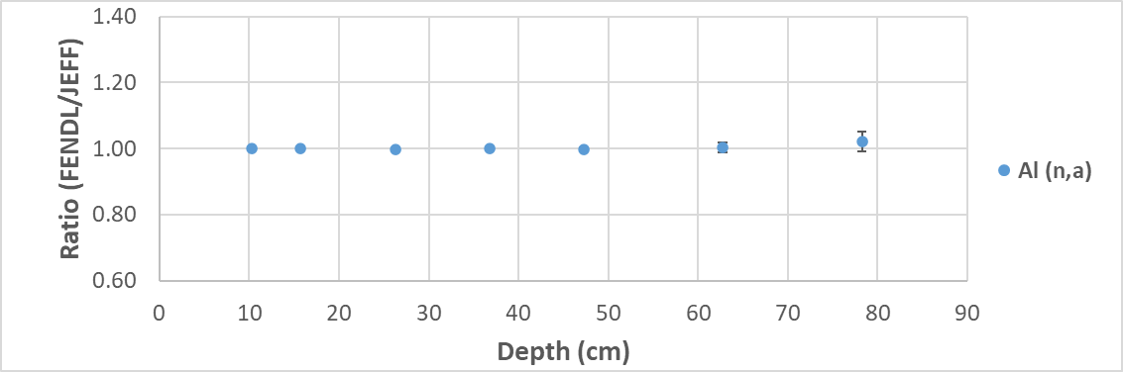
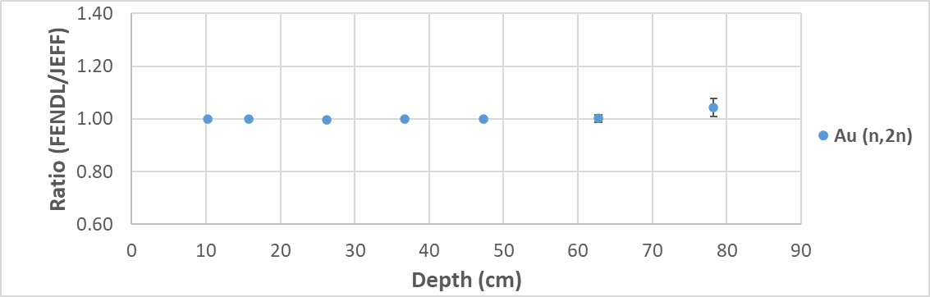
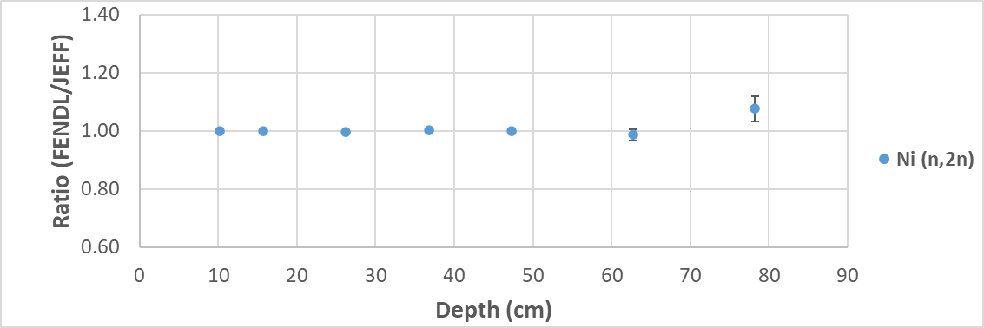
Ordinary Concrete
Comparison RR FENDL 3.2 /JEFF 3.3 high threshold reactions
Same results within statistical error except for last position- max FENDL/JEFF ratio 1.08 in Ni(n,2n) (4.4 % error)

Slide 16

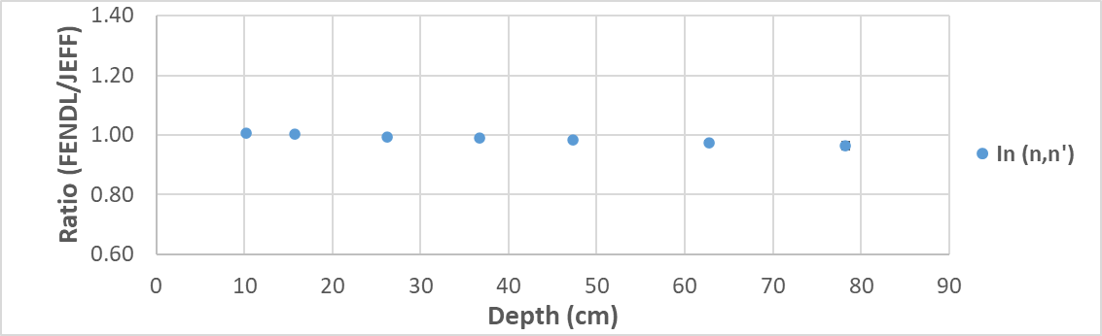
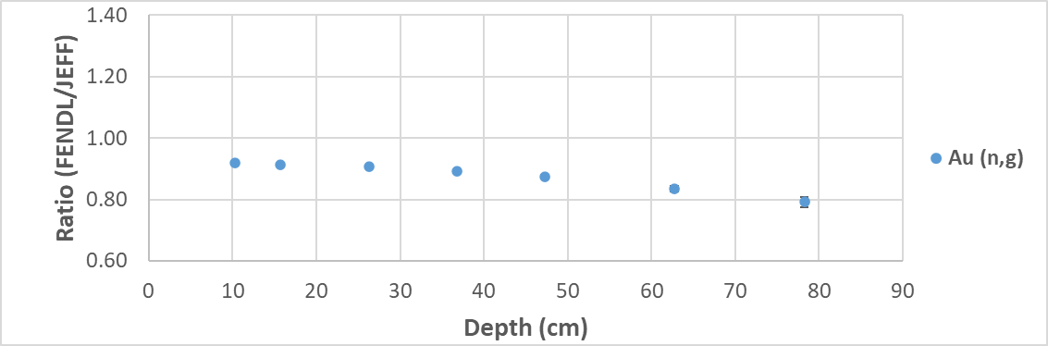
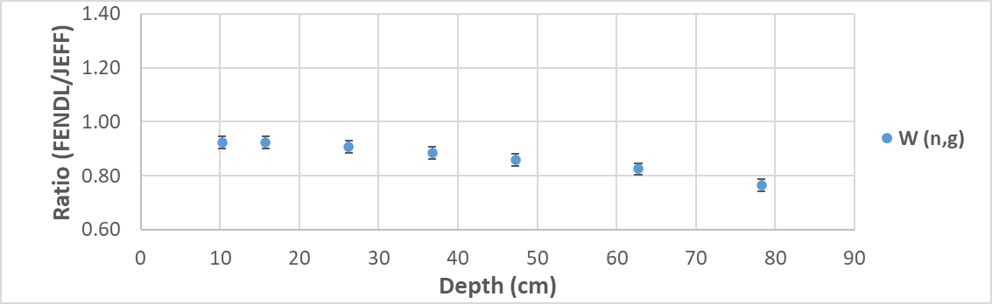
Ordinary Concrete
Comparison RR FENDL 3.2 /JEFF 3.3
low threshold & thermal reactions
Ni(n,p) & In (n, n‘) FENDL/JEFF ratios decrease along depth from 1.00 to 0.95 (Ni) and 0.96 (In)
FENDL 3.2 results show lower values than JEFF 3.3 in thermal reaction rates
  Au(n,g) FENDL/JEFF ratio from 0.94 to 0.79 (error 1.6%) decreases along depth
  W(n,g) FENDL/JEFF ratio from 0.93 to 0.77 (error 1.9%) decreases along depth

Slide 17


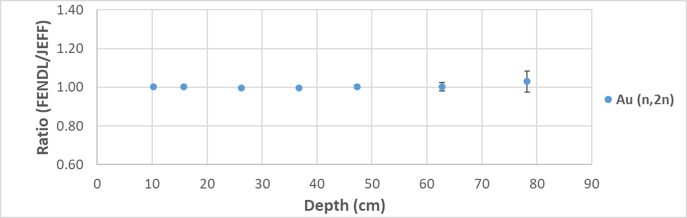
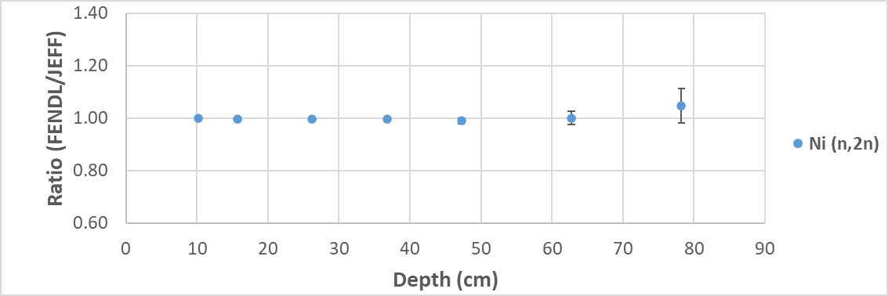
Heavy Concrete
Comparison FENDL 3.2 /JEFF 3.3
High threshold reactions
Same results within statistical error

Slide 18
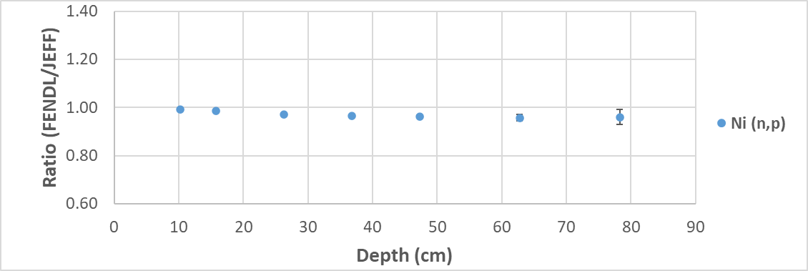
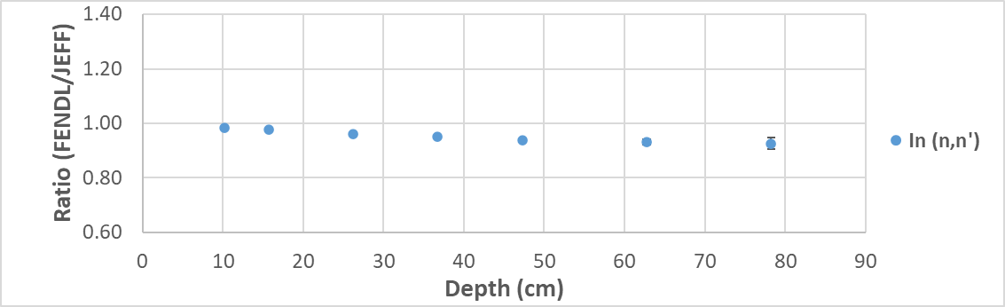
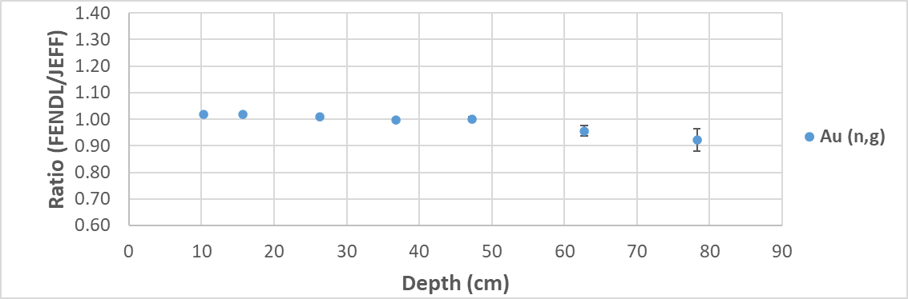
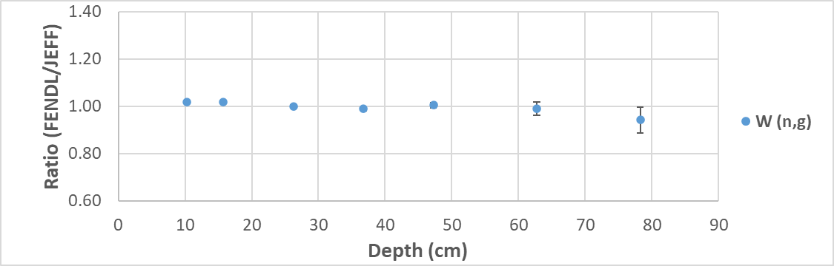
Heavy Concrete
Comparison RR FENDL 3.2 /JEFF 3.3
low threshold & thermal reactions
Ni(n,p) & In (n, n‘) FENDL/JEFF ratios decrease along depth from 1.00 to 0.96 (Ni) and 0.93 (In)
Au(n,g) FENDL/JEFF ratio decreases along depth from 1.02 to 0.92 (error 4%)
W(n,g) FENDL/JEFF ratio decreases along depth from 1.04 to 0.94 (error 5.3%)
Not like ordinary concrete

Slide 19
Summary
W shielding exp C/E
Concrete pre-analysis FENDL vs JEFF
Ordinary Concrete
⁹³Nb(n,2n), ²⁷Al(n,α): Same within error/ max FENDL/JEFF = 1.08 (Ni)
⁵⁸Ni(n,p), ¹¹⁵In(n,n′): Ratios drop with depth: Ni 1.00→0.95, In 1.00→0.96
FENDL 3.2 < JEFF 3.3 for thermal RR
  ¹⁹⁷Au(n,γ): Ratio 0.94→0.79 with depth
  ¹⁸⁶W(n,γ): Ratio 0.93→0.77 with depth
Heavy Concrete
⁹³Nb(n,2n), ²⁷Al(n,α): Same within error
⁵⁸Ni(n,p), ¹¹⁵In(n,n′): Ratios drop with depth: Ni 1.00→0.96, In 1.00→0.93
Minor difference for thermal RR compared to ordinary concrete
  ¹⁹⁷Au(n,γ): Ratio 1.02→0.92
  ¹⁸⁶ W(n,γ): Ratio 1.04→0.94
General: same trend as JEFF
⁹³Nb(n,2n), ²⁷Al(n,α): Good agreement overall / Underestimation up to 20% in rear positions (Nb)
⁵⁸Ni(n,p): Overestimation up to 20% in all positions/Better results than JEFF
¹¹⁵In(n,n′): Good agreement in 1st & 2nd pos. / Underestimation up to 40% at ~30 cm depth
Thermal RR
¹⁹⁷Au(n,γ) Underestimation in all pos except 2nd up to −12%
^{186 W}(n,γ):Underestimation 0.67 < C/E < 0.85 -Lowest at 3rd position

Slide 20
Future FNG experiments

Slide 21
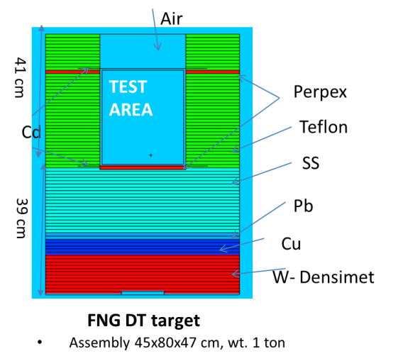
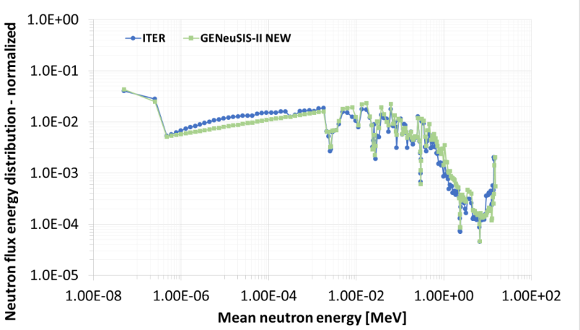
Future experiments
DEMO oriented benchmark experiment (WP-BB)
2026 Heavy Concrete
2027 (?) Chromium (TBD)
  - Cr is the most abundant element in EUROFER after Fe
  - Difficult to find on the market & high cost
GENeuSIS
ITER oriented experiments (WP-PrIO)
2025 ACP FNG experiment
2025 GENeuSIS tests for SEE effects on electronics
Additional proposal
WLCB blanket mockup + repeat TBR measurements in WCLL
Divertor mock-up experiment W-Cu-Water
Shielding and activation experiments
Novel shielding mock-up for Streaming/Shutdown dose rate experiment
FNG-burn: DT neutron irradiations at high temperature for testing diagnostics and electronics in harsh environment and for breeding blanket studies
….Other suggestions?

Slide 22
Conclusions
FENDL-3.2 was applied for post-analysis of the W shielding experiment & pre-analysis of the concrete benchmark at FNG.
Reaction rate (RR) trends in the W shielding experiment are similar to those observed with JEFF-3.3, with only minor differences- Underestimation of exp observed mainly in the low/thermal energy range.
In the concrete pre-analysis, the FENDL-3.2/JEFF-3.3 RR ratios decrease with depth.
The most significant discrepancy is found in the thermal reaction rates for ordinary concrete, while the impact is minor in heavy concrete. Investigations are ongoing.
New experiments are currently in preparation at FNG, and novel experiments are proposed.
This meeting offers a valuable opportunity to identify which future experiments & types of measurement at FNG could provide the most significant support for the next FENDL data library release.

Slide 23
Thank you!!

Slide 24
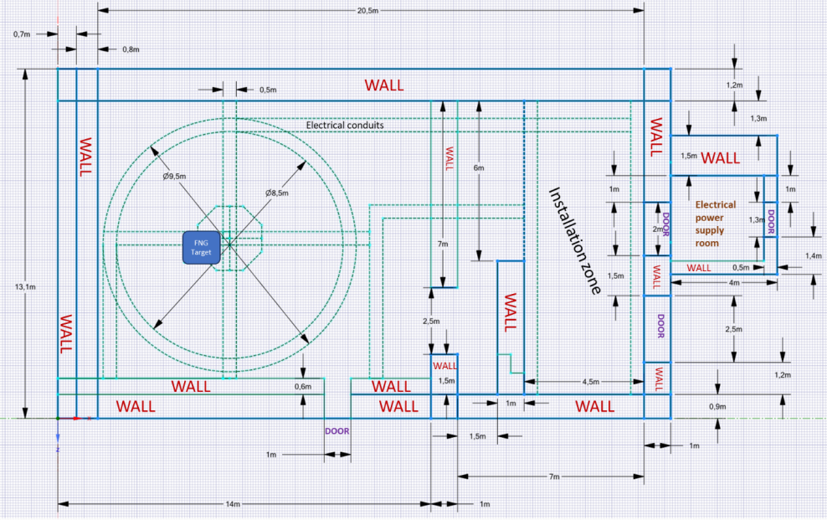
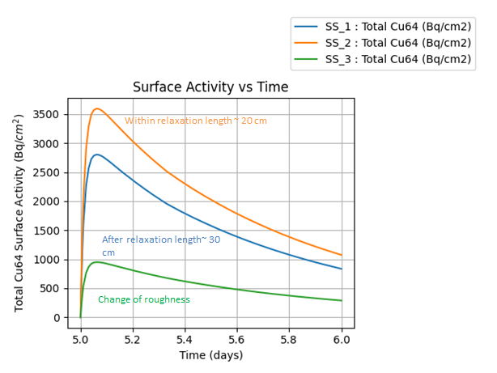
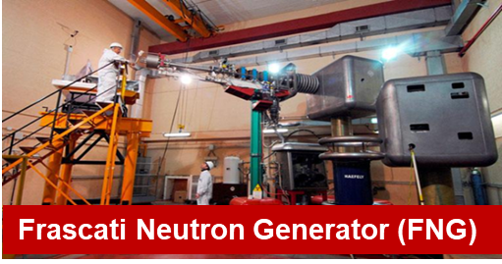
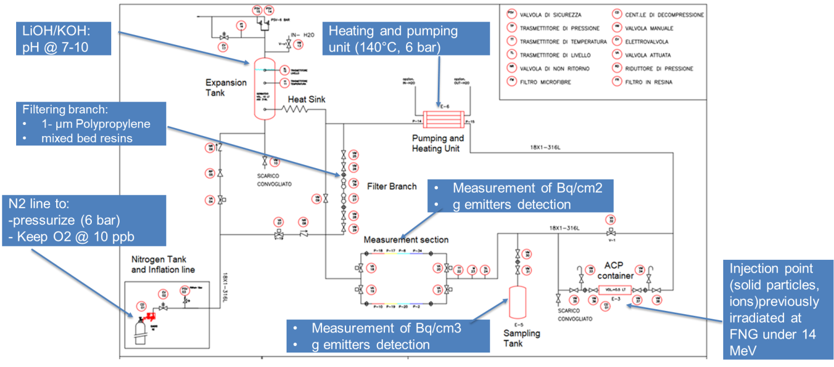
FNG ACP experiment
Dedicated experimental water loop at FNG facility to support the study & validation of Activated Corrosion Products (ACP) in fusion reactor environment.
Main goals of this experiment:
Testing fundamental water chemistry & fluid transport contamination mechanisms for ITER ACP assessment
Supporting the development & experimental validation of ACP simulation codes & tools (e.g., OSCAR-Fusion).
Unicity
14 MeV neutron irradiation
FNG Building planimetry
Procurement in progress
Mechanisms: deposition, dissolution-precipitation
Activity Measurements
Oscar-Fusion simulations &vValidation
FNG ACP water cooling loop P& ID
Activity included in ITER ACP roadmap

Slide 25

GENeuSIS assembly for testing electronics
Tests of electronics in ITER-like environment
  Development of test bed assembly replicating ITER neutron energy spectra- GENeuSIS at FNG
GENeuSIS at FNG
GENeuSIS
General
Experimental
Neutron
Systems
Irradiation
Station
Same N flux & energy spectra as in ITER Port Cell!
R. Villari| Neutronics R&D Supporting ITER Nuclear Operations |Madrid| April, 6th 2025

