Slide 1
Application of JADE as a complete tool for automated nuclear data and particle transport code verification and validation
FENDL meeting, 05.2025
Alex Valentine, Steven Bradnam, Davide Laghi, Alberto Bittesnich, Marco Fabbri, Marta Campos, Priti Kanth, Greg Bailey, David Foster, Mark Gilbert

Slide 2
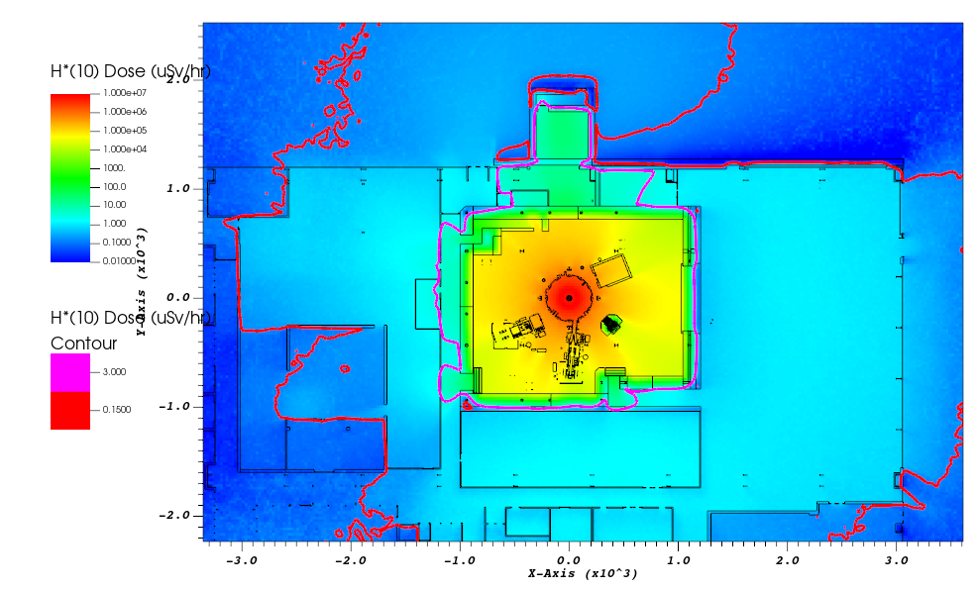
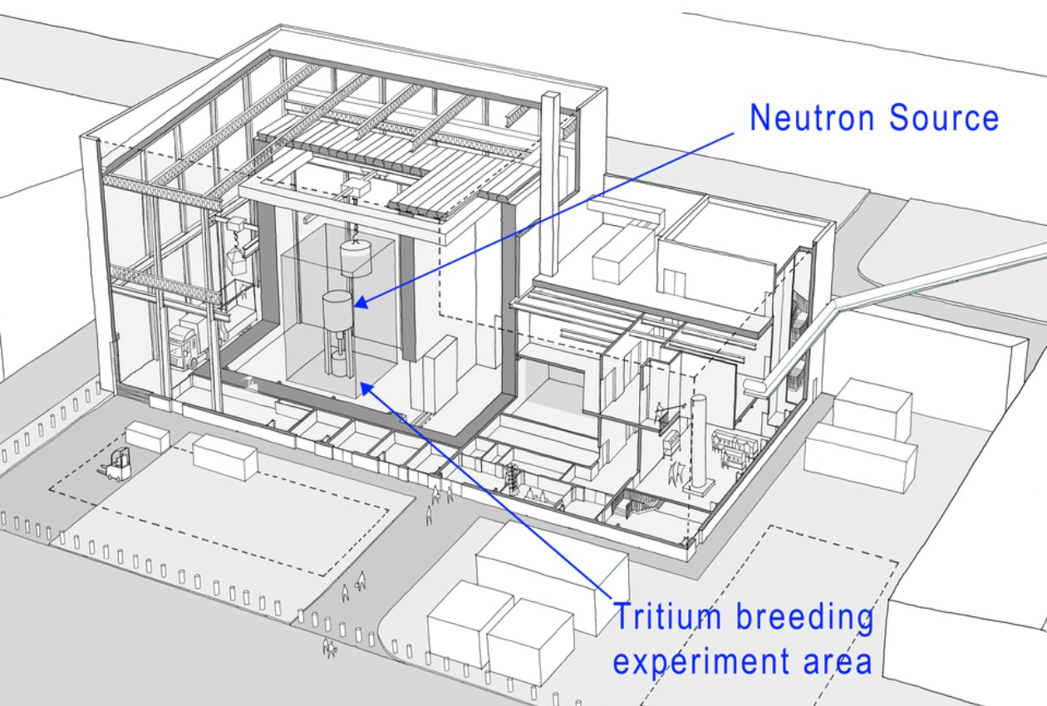
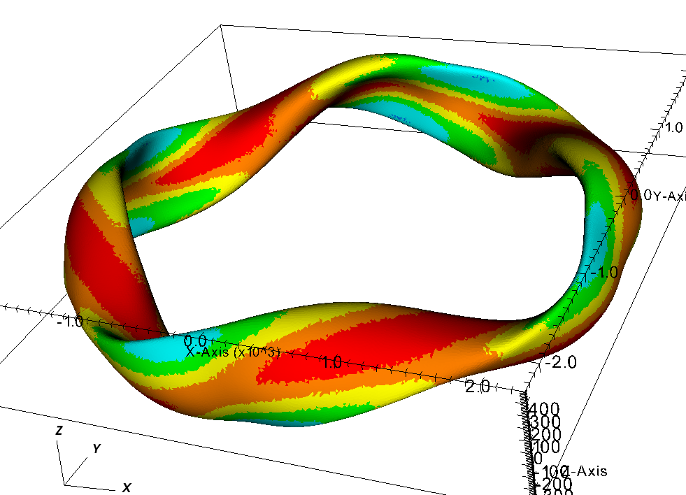
Neutronics and nuclear data at UKAEA
Applied Radiation Group at UKAEA has ~20 experts in neutronics and radiometrics areas. Currently two seconded staff at the IAEA.
Key interfaces with:
Fusion Materials Interface group: Nuclear data experts and FISPACT development team
Advanced Computing: Experts in multi-physics
Current activities in neutronics: JET decommissioning, IFMIF-DONES, ITER, STEP, MAST-U, EUROfusion VNS & DEMO, LIBRTI, private fusion consultancy (Gauss Fusion, General Fusion, Commonwealth Fusion), code development (GEOUNED, Fluid activation, ACP modelling, N1S, JADE)
All have adopted the FENDL library
LIBRTI

Slide 3
Applications of JADE with OpenMC

Slide 4
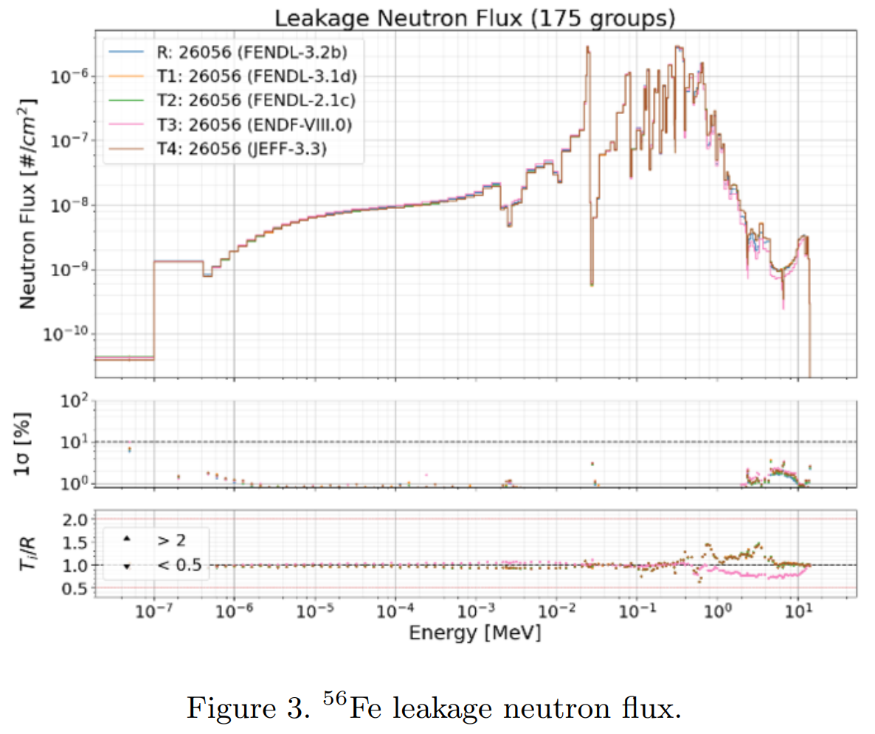
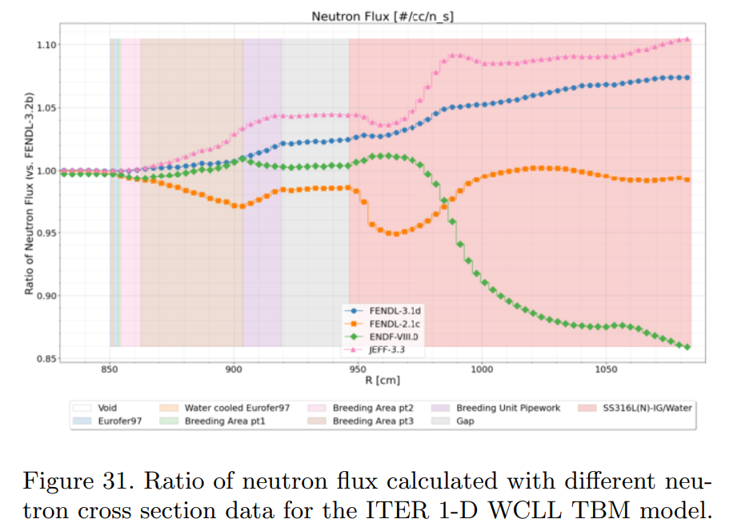
JADE V&V tool
JADE has been applied extensively in the verification and validation efforts for nuclear data libraries.
JADE automates the simulation of computational and experimental fusion relevant benchmarks providing a concise set of graphical and tabulated outputs
JADE is adopted as the official tool for validation and verification of the FENDL library and features prominently in the major journal article on the library published in Feb 2024¹.
Major re-write of the code for future sustainability in JADE v4, released 01.04.2025 [see D. Laghi presentation]
Open source and maintained on GitHub: https://github.com/JADE-V-V/JADE
¹https://doi.org/10.1016/j.nds.2024.01.001

Slide 5
JADE V&V tool
UKAEA got involved with the JADE project ~2022. Two primary motives for this:
Identifying the potential to expand JADE for V&V of particle transport codes as well as nuclear data libraries. Clear uptake in the community of alternatives to MCNP.
Users of data libraries and transport codes for array of applications.
First major revisions led to release v3.0.0, 03.2024
Develop a Linux compatible version of JADE capable of running benchmarks using jobs for parallel submission
Establish framework and demonstrate isolated running of OpenMC in JADE.
Prepare OpenMC inputs for simulation and experimental benchmarks in JADE.
Begin preliminary work for inclusion of Serpent.
Contributions in 2024 and 2025 are through EUROfusion WPBB – in-kind UK contribution.
UKAEA collaborate closely with F4E on the tool – periodic progress meetings and to date 3 in-person hackathons held in the UK and in Barcelona.

Slide 6
OpenMC in JADE
To use OpenMC in JADE, the user must have the OpenMC python package installed in the same environment as JADE and a version of the code installed in order to be able to run the benchmarks.
JADE uses the python API of OpenMC for all input and output handling including all post processing necessary to prepare JADE raw data files.
JADE is already helping to identify differences compared to MCNP and identify gaps requiring further development e.g. source definitions, tally definitions, variance reduction + computational performance – engagement with developers ongoing/required.
openmc.py is a separate module in JADE so all transport code specific code is isolated. Layers of abstraction mean that addition of further transport codes is as straightforward as possible. No code is required to be changed.

Slide 7
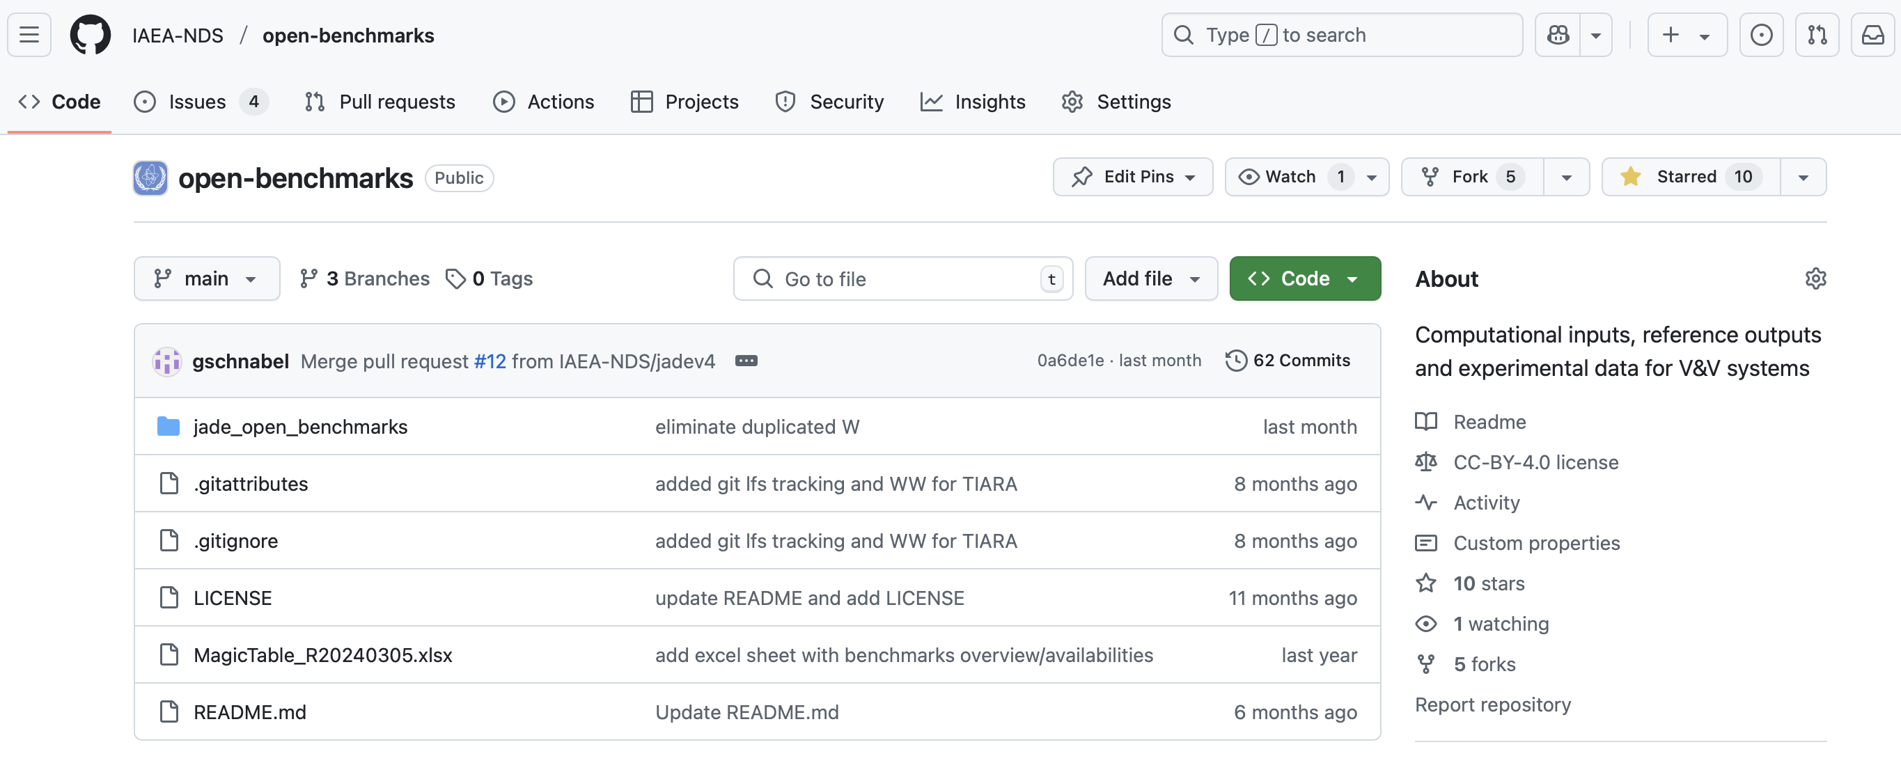
IAEA open benchmarks repository
All benchmarks are hosted externally to JADE in one of three locations: IAEA open benchmarks GitHub [open source], NEA GitLab [SINBAD], F4E GitLab [other] . Benchmark models version controlled with metadata.
Contributions and visibility of these repositories encouraged – we have made great strides in avoiding duplicated inputs/effort.
Address validation of benchmarks in this repository and documentation on benchmarks.

Slide 8
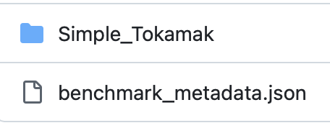
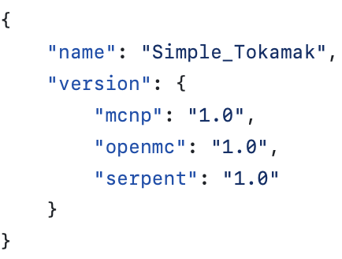
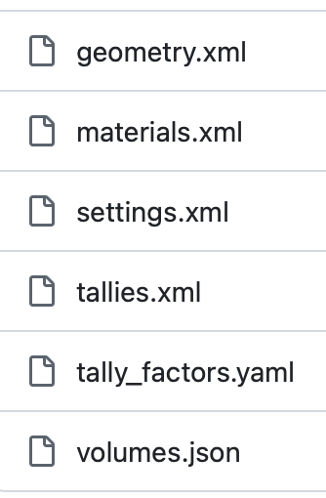
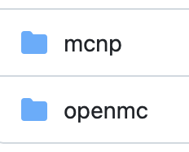
IAEA open benchmarks repository
All benchmarks are hosted externally to JADE in one of three locations: IAEA open benchmarks GitHub [open source], NEA GitLab [SINBAD], F4E GitLab [other] . Benchmark models version controlled with metadata.
Contributions and visibility of these repositories encouraged – we have made great strides in avoiding duplicated inputs/effort.
Address validation of benchmarks in this repository and documentation on benchmarks.
Revisions of existing benchmarks / the addition of new benchmarks can be completed via creating a pull request
Metadata for the benchmark is updated
Additional control over code specifics: Tally_factors.yaml and volumes.json currently unique to OpenMC to capture necessary normalisations

Slide 9
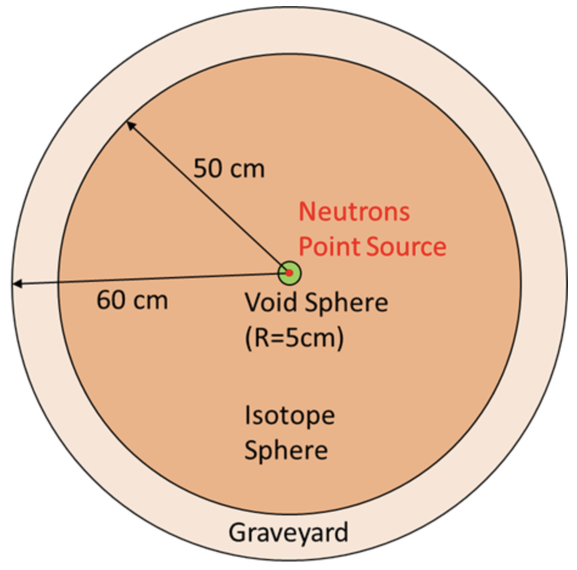
Sphere leakage benchmark
Sphere leakage benchmark is a simple yet highly useful benchmark in JADE. The material of the spherical shell is set as each isotope of a library and a set of ‘standard materials’.
MCNP with FENDL 3.2c ran previously by F4E.
Here the sphere benchmark is run with OpenMC with the complete set of isotopes in FENDL 3.2c and ENDFVIII.0 and the JADE ‘standard materials’.
Job submission was utilised - total 212 simulations – each ran on 32 CPU cores on single node of UKAEA HPC cluster. Longest simulation: 21 minutes for 10⁷ particles – results are illustration of capability and preliminary.
50.001 cm
MCNP
OpenMC

Slide 10
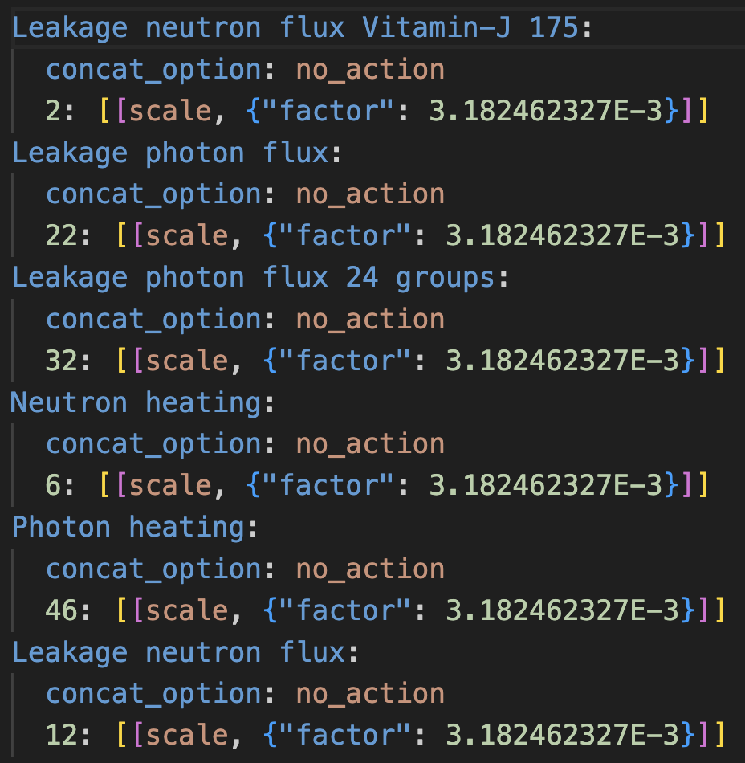
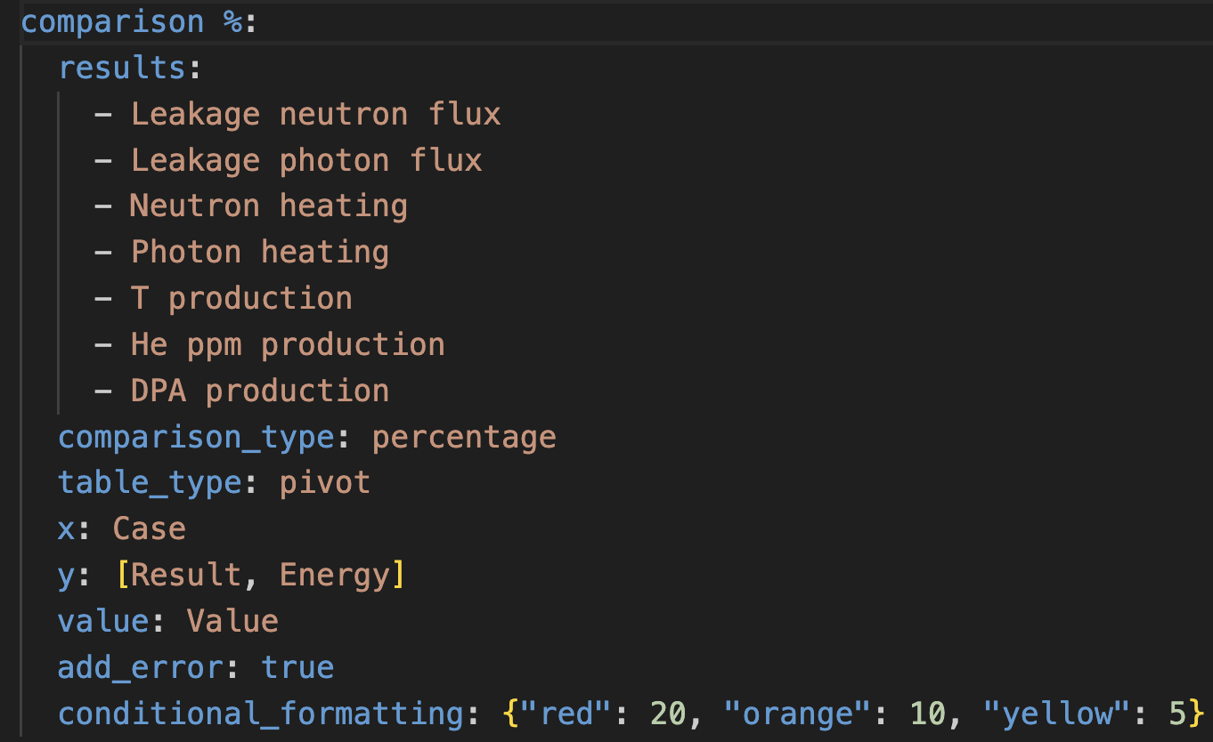
Sphere leakage benchmark
Addition in JADE requires addition of YAML files controlling the processing. See documentation
Excel config file
Raw config file

Slide 11
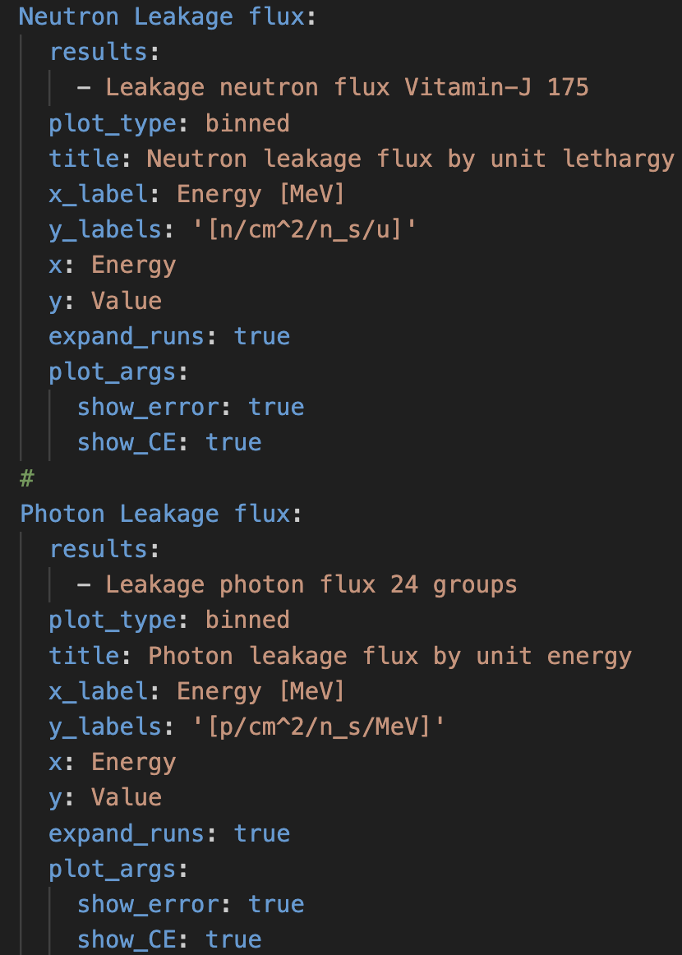
Sphere leakage benchmark
Atlas config file

Slide 12
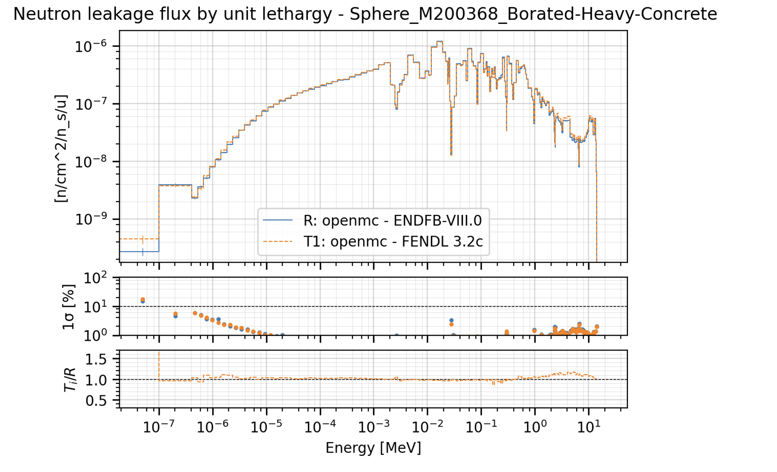
Sphere leakage results

Slide 13
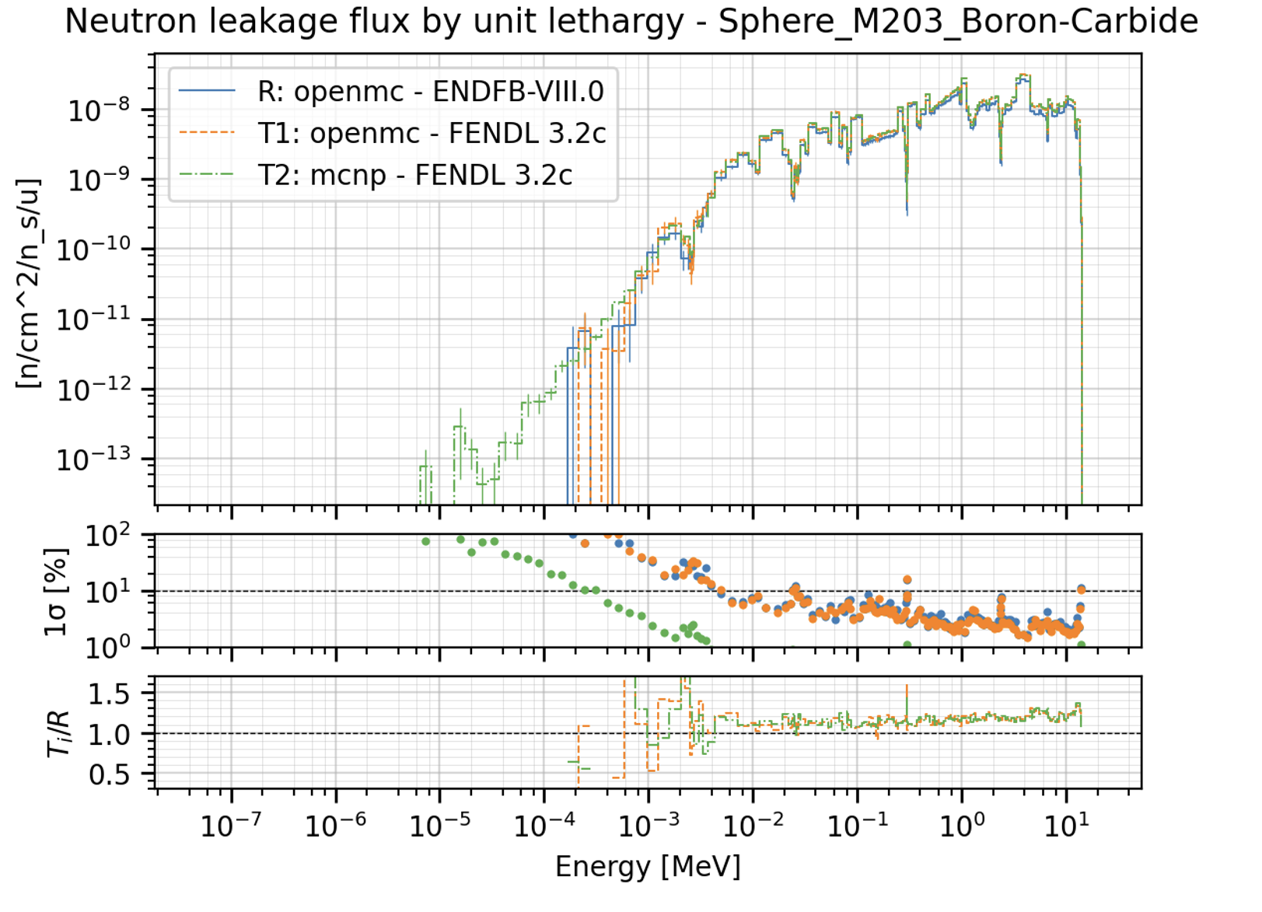
Sphere leakage results

Slide 14
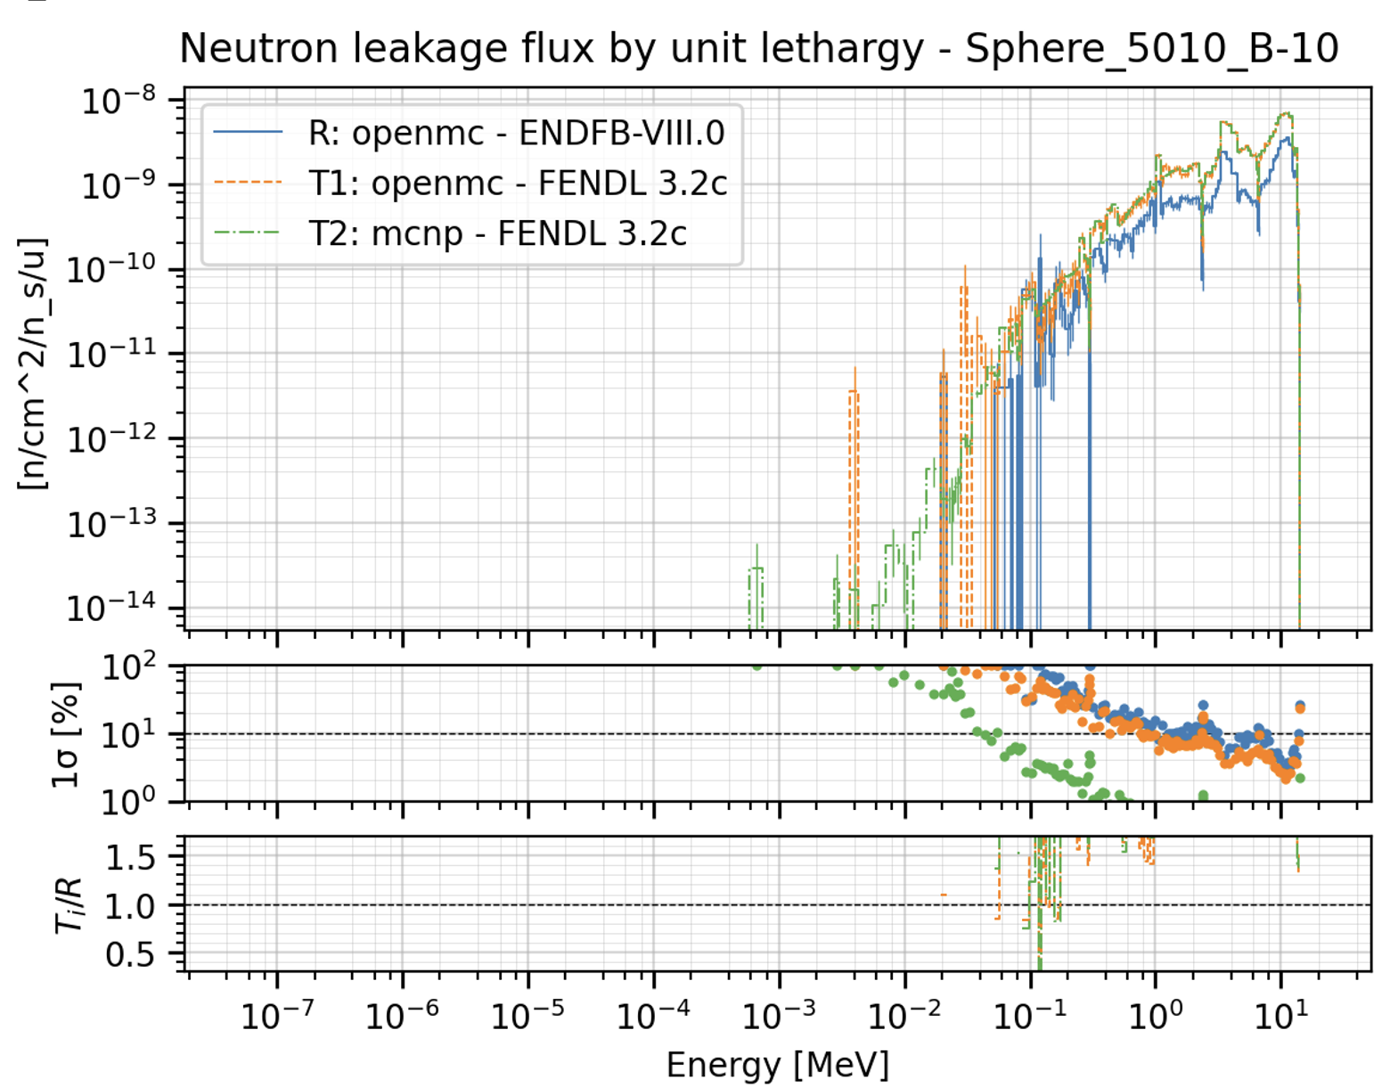
Sphere leakage results

Slide 15
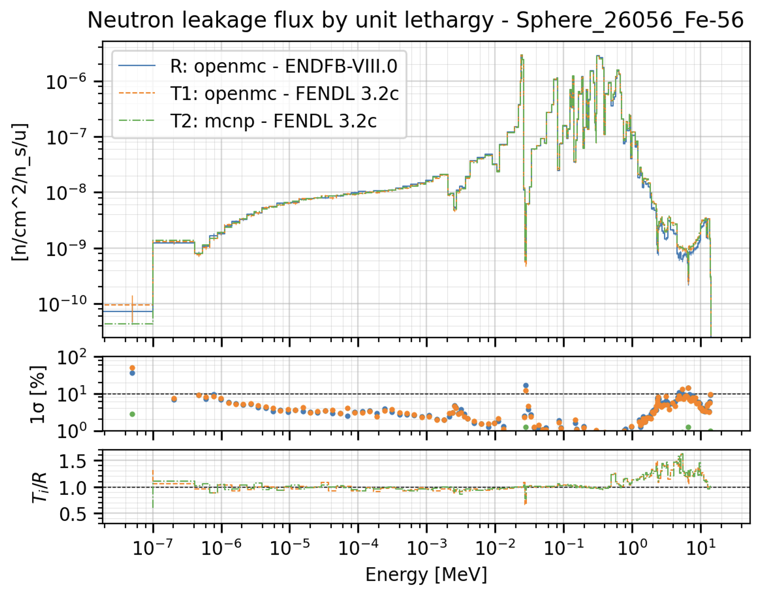
Sphere leakage results

Slide 16
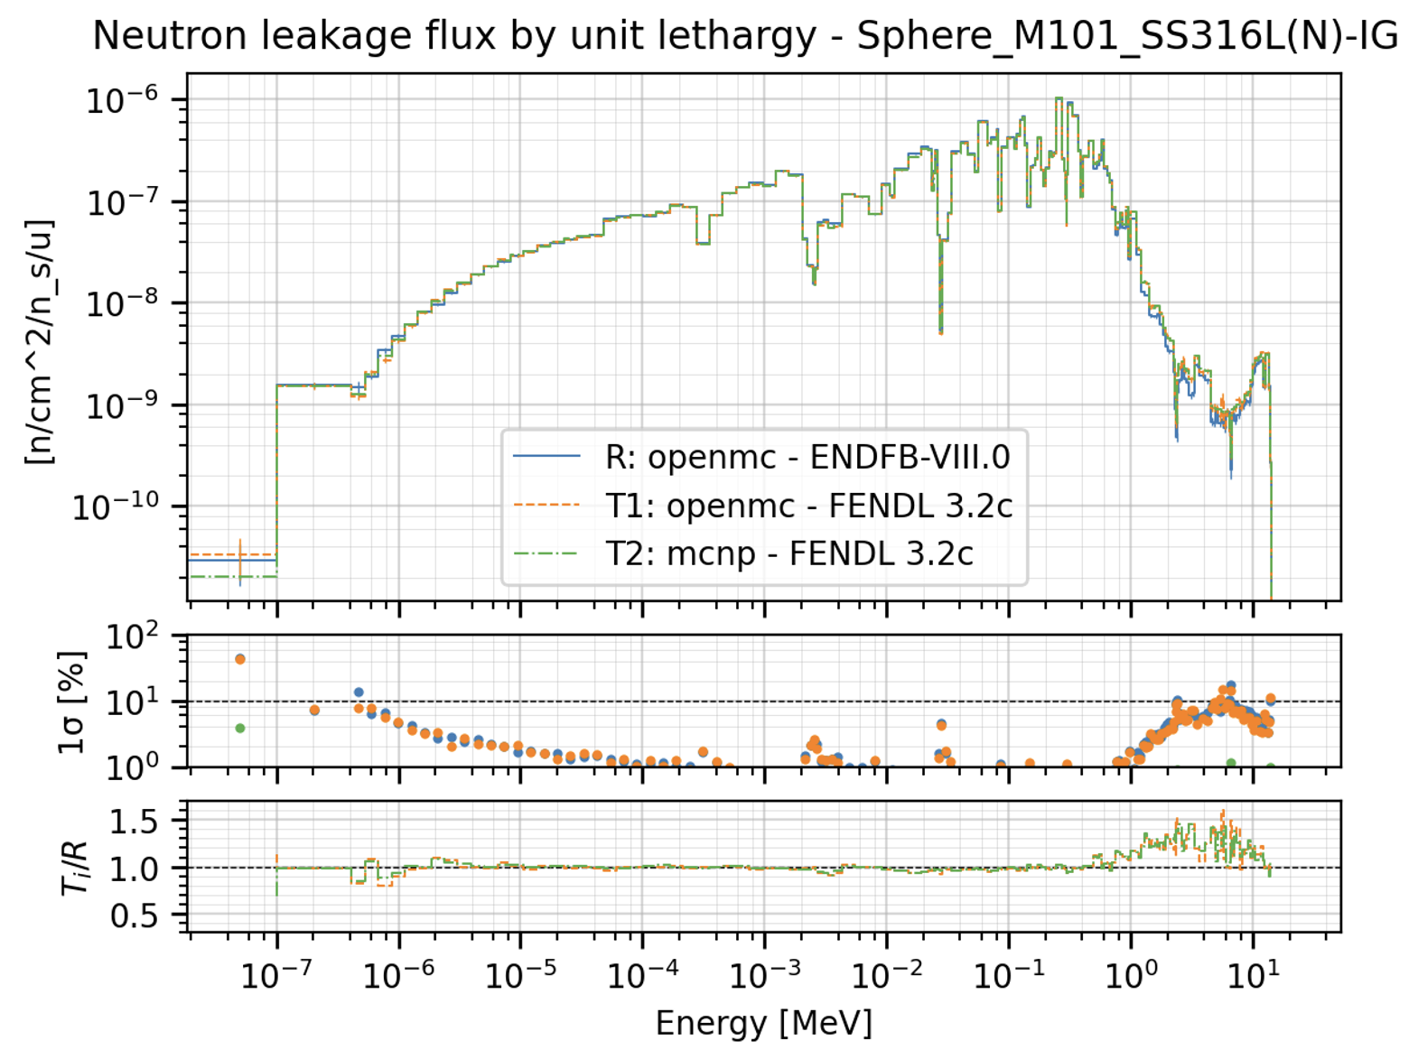
Sphere leakage results

Slide 17
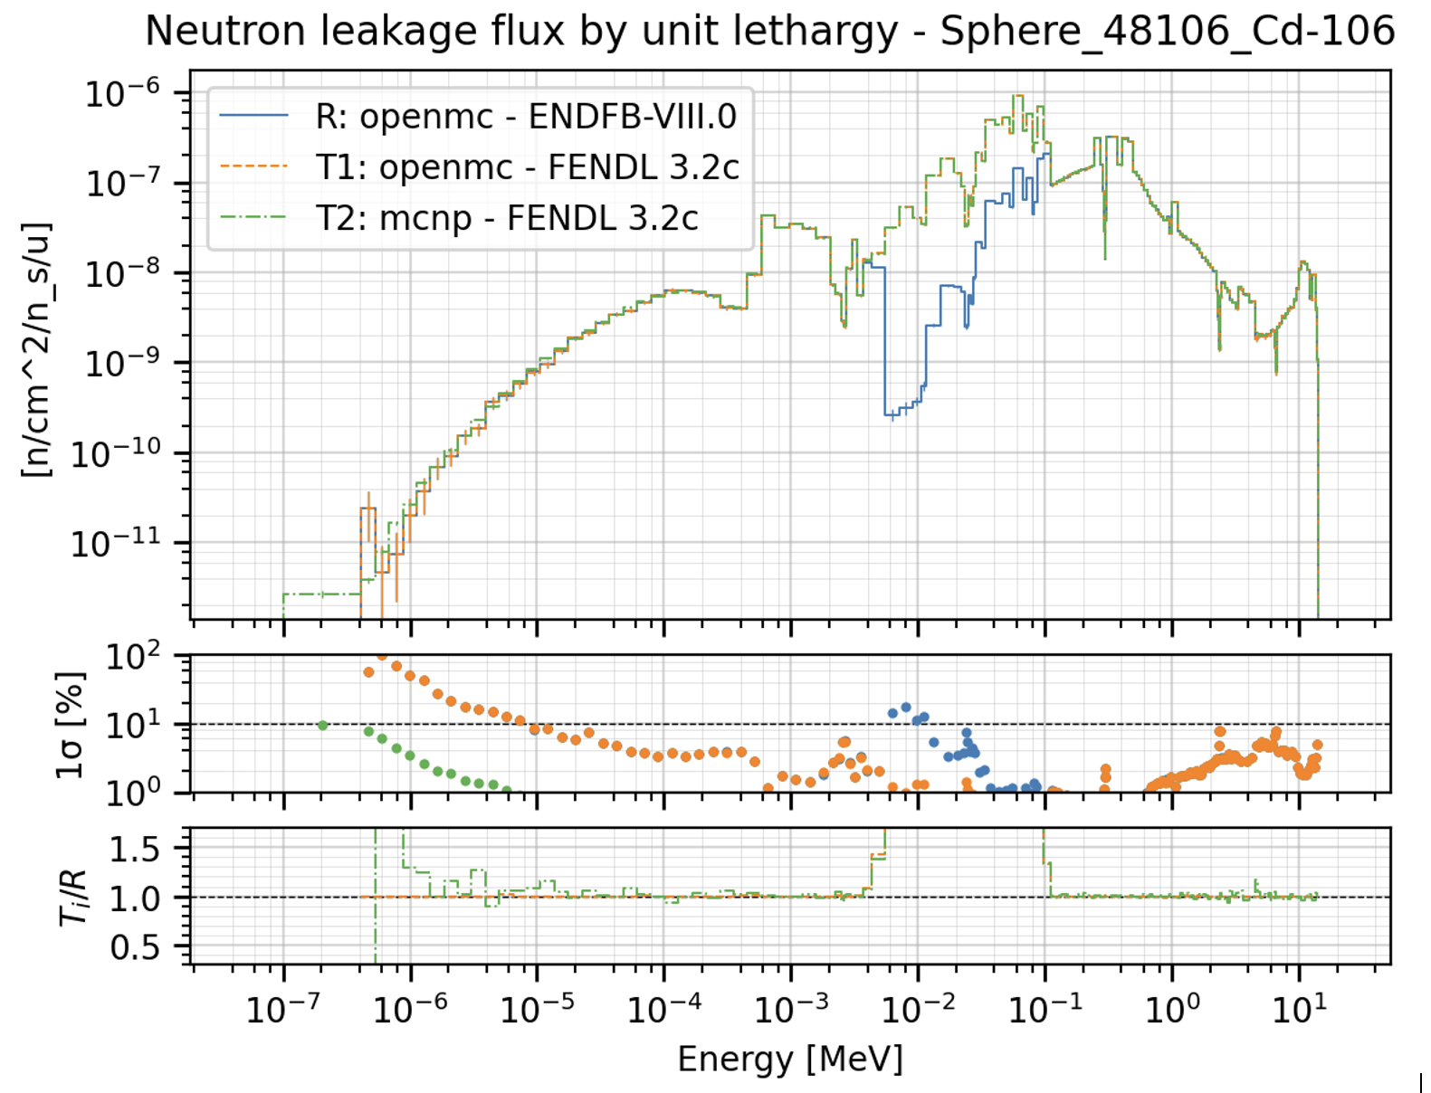
Sphere leakage results
Notes:
for Cd-106, the inclusion of probability tables in the unresolved resonance range in FENDL-
3.2c—enabled by modifications to the NJOY module PURR—enhances the treatment of self-
shielding effects in this energy region, resulting in improved neutron transport and reaction
rate calculations in materials containing cadmium. Similar improvements are observed for
Re-185 and Re-187.

Slide 18
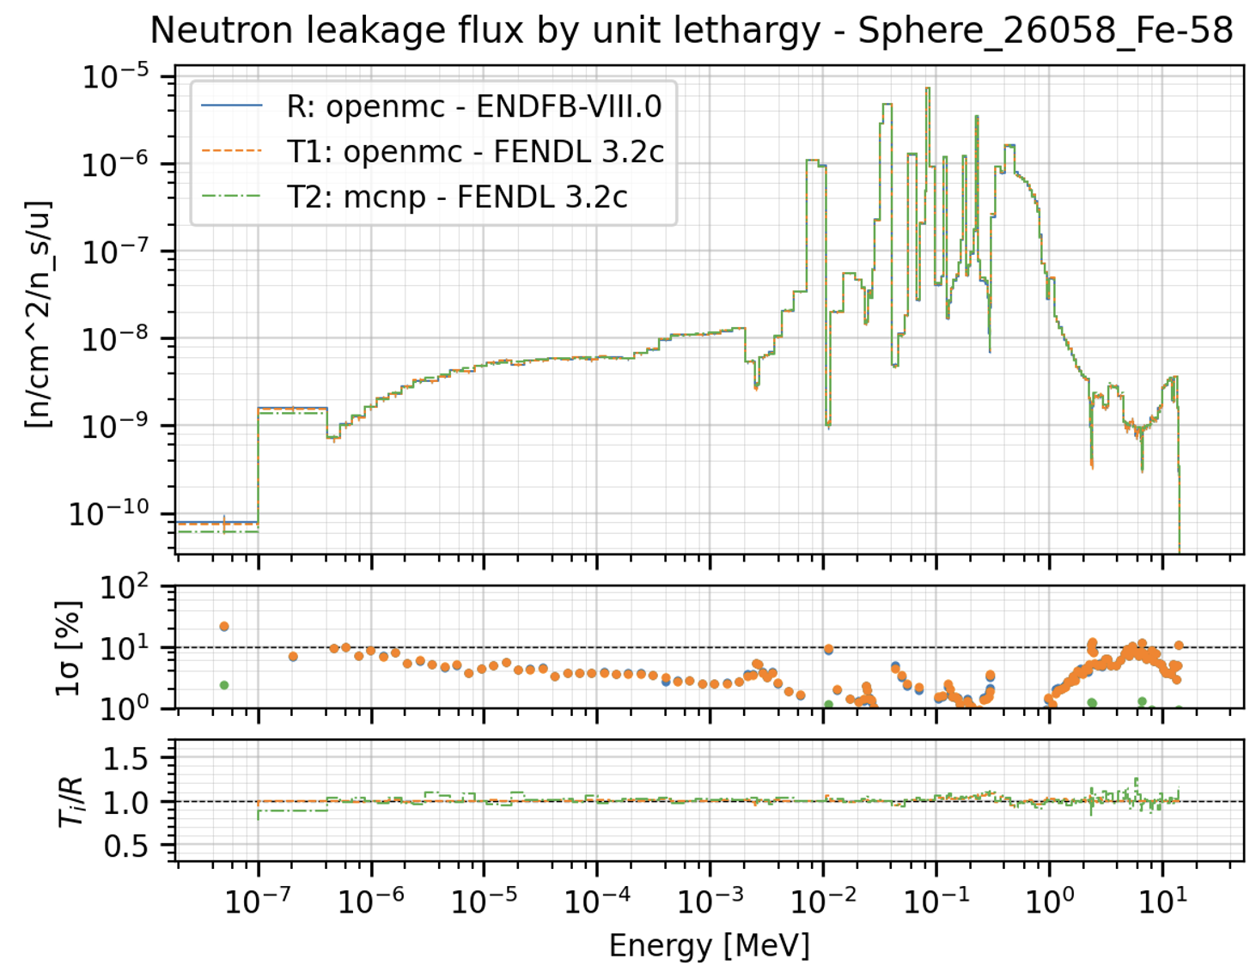
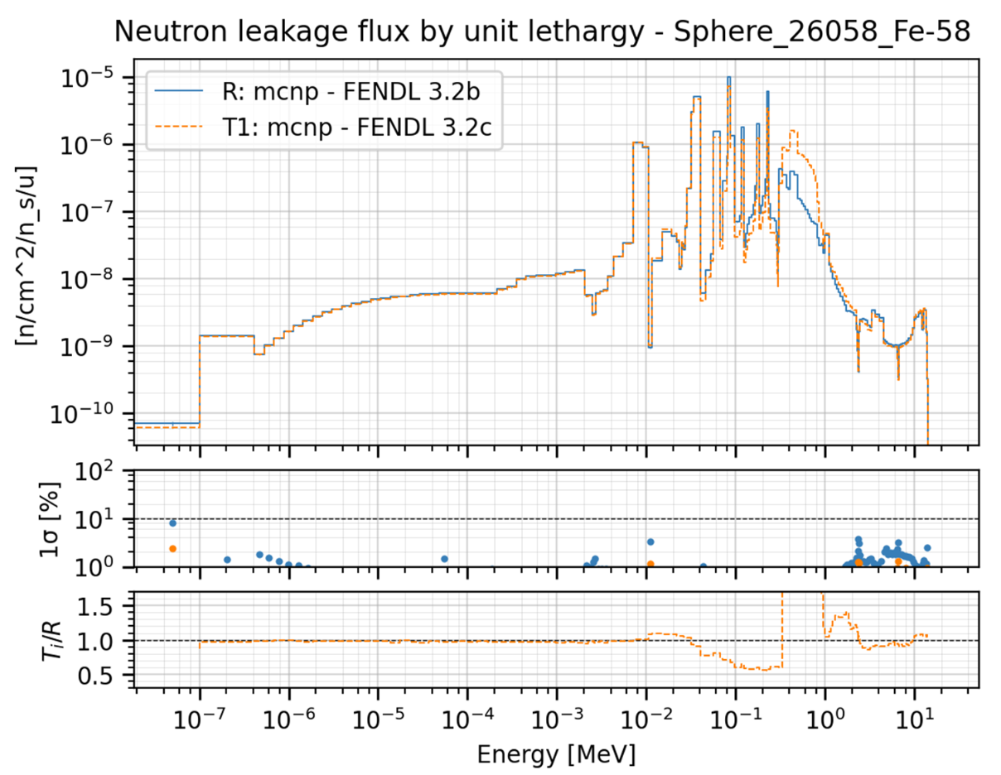
Sphere leakage results
Notes:
Differences observed for Fe-58 and Hf isotopes are attributed to corrections introduced in
the NJOY module PURR for treating small sampled values of the total cross section. In the
case of FENDL-3.2c, a reduced minimum cross-section threshold was employed, resulting in
a higher self-shielding effect, which means smaller shielded cross sections in the unresolved
resonance region and higher neutron flux.

Slide 19
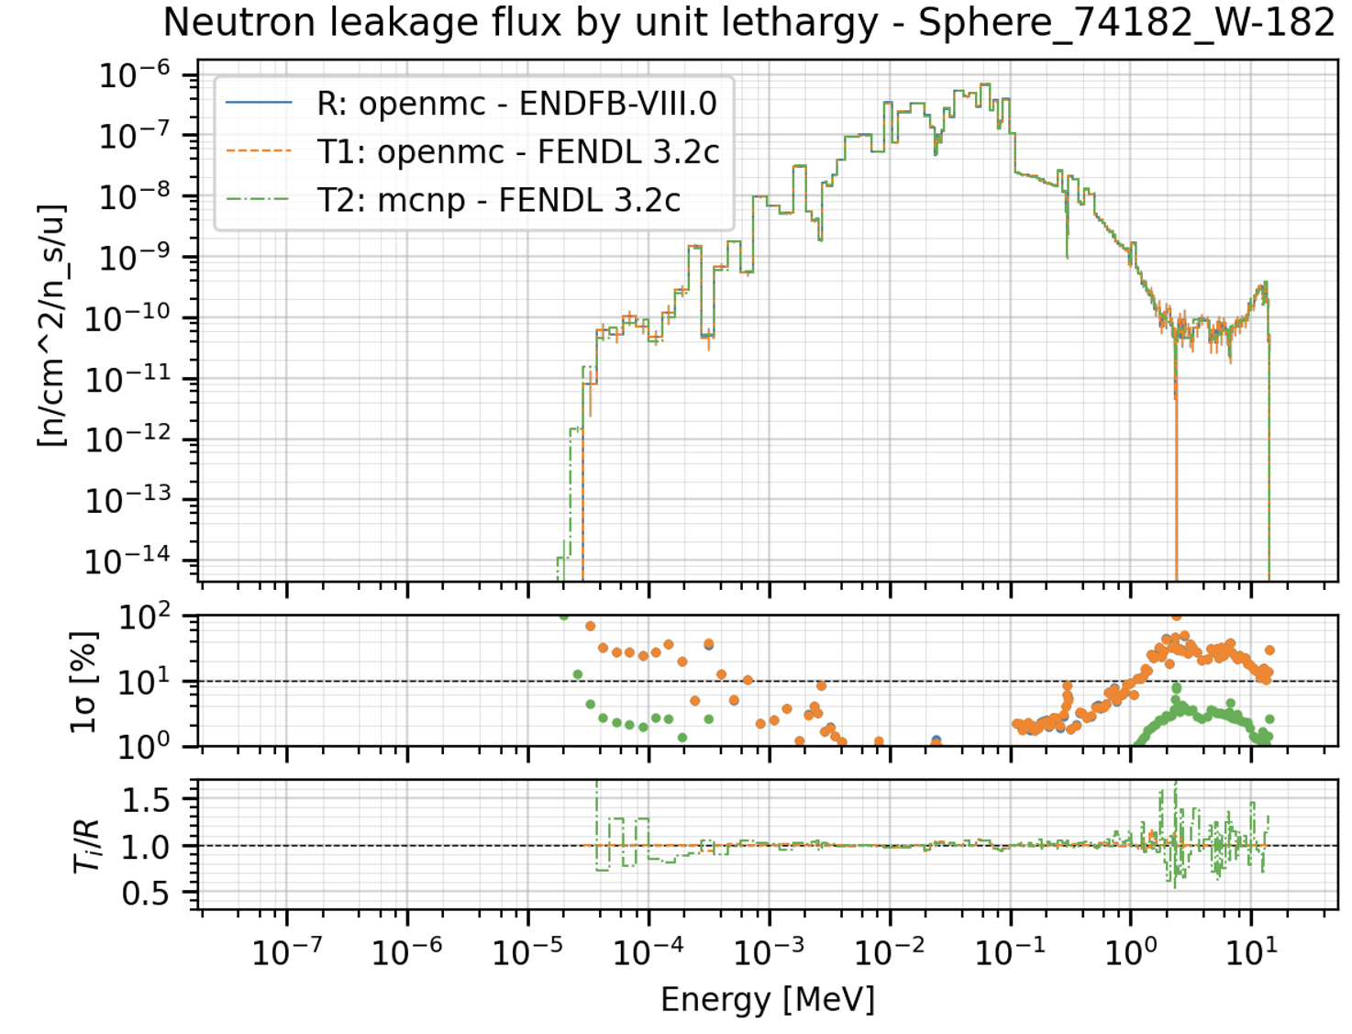
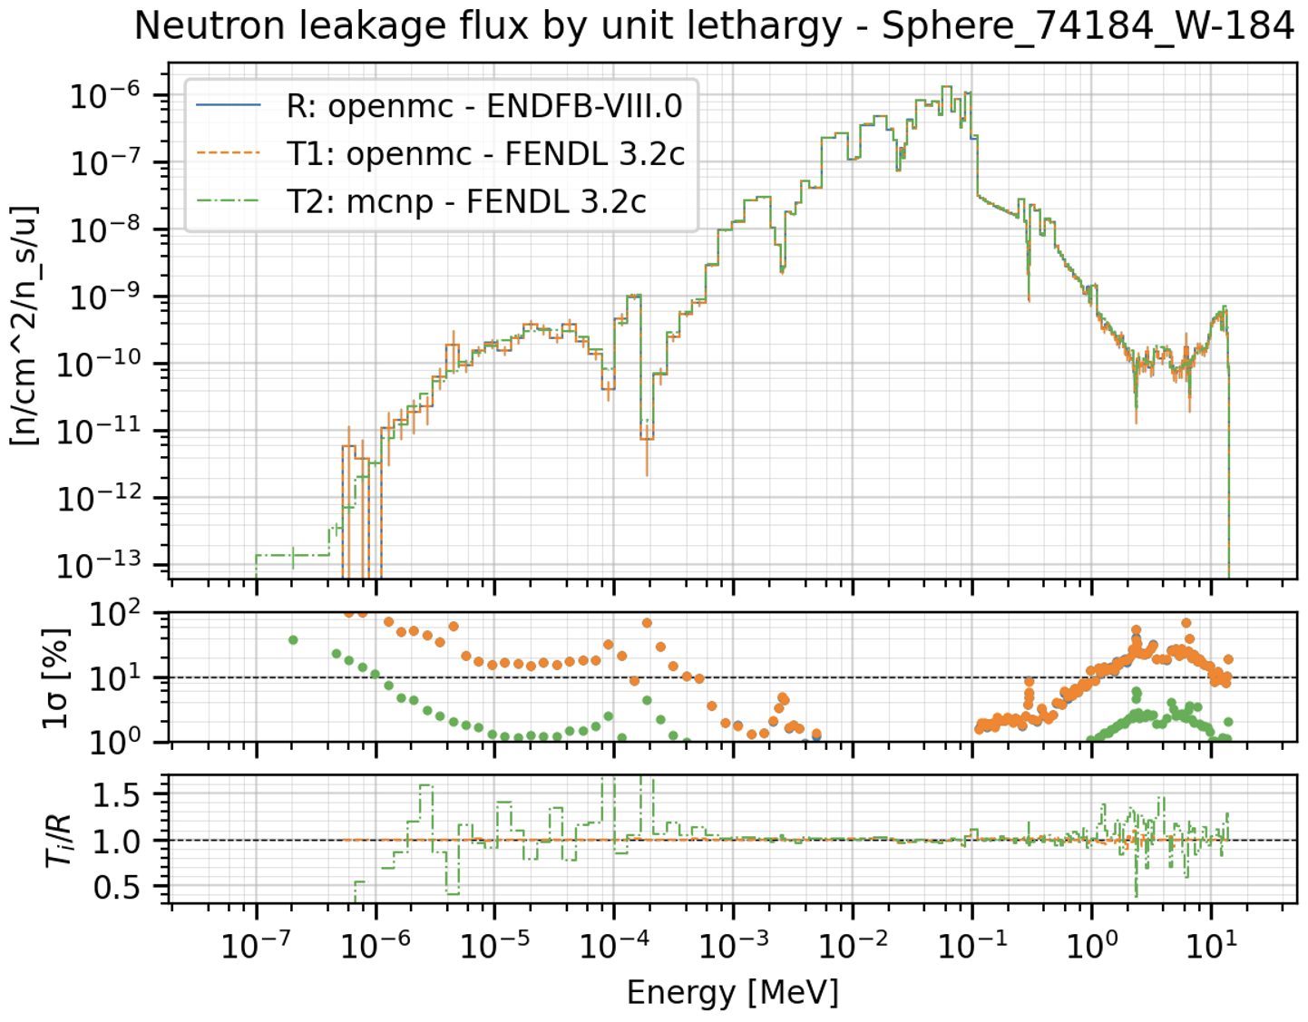
Sphere leakage results
Notes:
The neutron flux for W isotopes was slightly different due to the changes implemented in the
resonance region, where ENDF-VIII.0 parameters were adopted.

Slide 20
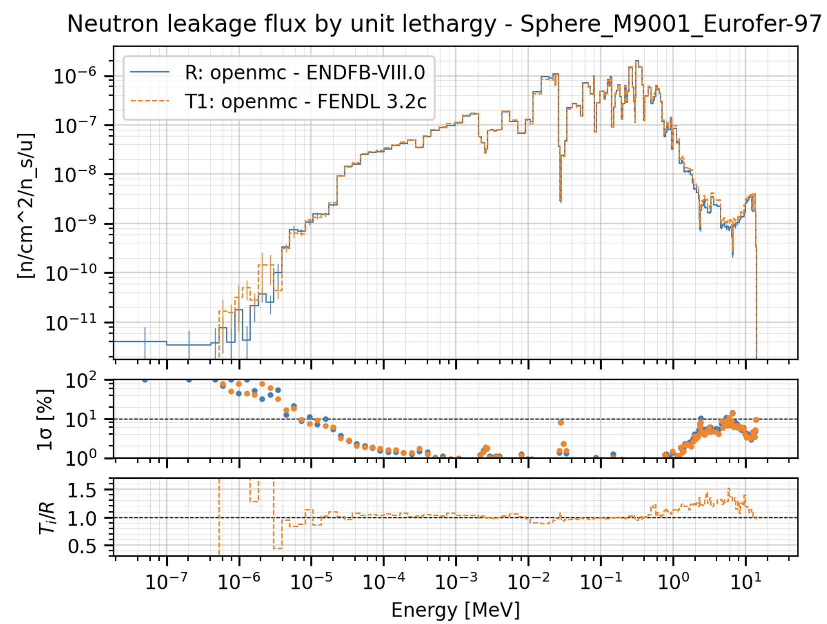
Sphere leakage results

Slide 21
UKAEA future plans
Under 2025 WPBB project on JADE, UKAEA will focus on the following:
Running JADE for sphere benchmark and analysis of results [ongoing] (code comparisons)
Preparation of OpenMC input files (outside of JADE) for current JADE benchmarks [ongoing]
Possible modifications to JADE required for running OpenMC benchmarks (e.g. custom sources)
Addition of OpenMC benchmarks in to JADE (preparation of YAML files etc.)
Running JADE for added benchmarks (+ perform code comparisons)
Perform production runs of JADE (JEFF-4, ENDFVIII.1, JENDL-5 etc …)
General code maintenance and addressing issues in the repository [ongoing/ JADE hackathon]
Write a paper on these activities aiming for submission in October/November

Slide 22
Conclusions
JADE v4 now available with significant revisions to the code architecture. Usability and development now much more straightforward.
OpenMC now fully integrated – we have several benchmarks that can be ran in OpenMC.
This year the list of benchmarks will grow and analysis will be performed providing useful input to the development of OpenMC.
Additions of benchmarks/transport codes always welcomed.

Slide 24
PATHFINDER: A tool for creating and plotting pathways
Priti Kanth, Greg Bailey, Dave Foster, Mark Gilbert, Alex Valentine
priti.kanth@ukaea.uk

Slide 25
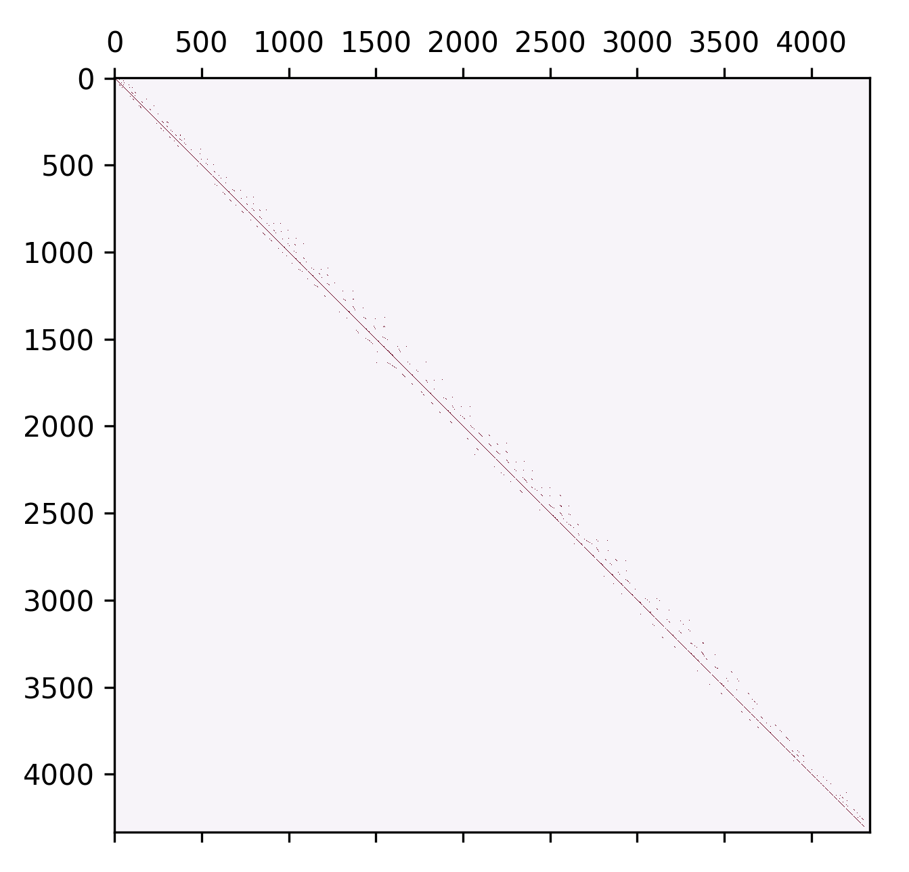
PATHFINDER - Intro
The evolution of the inventory of nuclides in a target material that is irradiated by a time-dependent projectile ﬂux is given by the set ordinary differential equations.
The coefficient matrix contains all the paths between any two isotopes for a given neutron spectrum.
It can be used to construct the directed graphs and the pathways.
Each edge corresponds to a nuclear reaction or radioactive decay between the parent and daughter isotope (vertices).
$$\frac{dN_{1}}{dt}=−λ_{1}N_{1}(t)$$
$$\frac{dN_{2}}{dt}={−λ}_{2}N_{2}\left(t\right)+λ_{1}N_{1}\left(t\right)$$
$$⋮$$
$$\frac{dN_{n}}{dt}={−λ}_{n}N_{n}\left(t\right)+\sum_{j}{λ_{ji}N_{j}\left(t\right)}$$
$$\frac{dN}{dt}=ΛN$$
Coefficient matrix
$$Λ_{ij}=σ_{ij}φ+λ_{ij}$$
PATHFINDER is a Python script that reads the nuclear data libraries, constructs the adjacency matrix and then generates a directed graph for the requested isotope.
Notes:
The coefficient matrix is very sparse, because only kinematically possible reactions/decays exist. The red dots indicate locations with non-zero values. The background is pink with zero values.
We also plot the adjacency matrix which is just a set of 1 or 0. If a pathway exists it is a 1 – this directs what to plot.

Slide 26
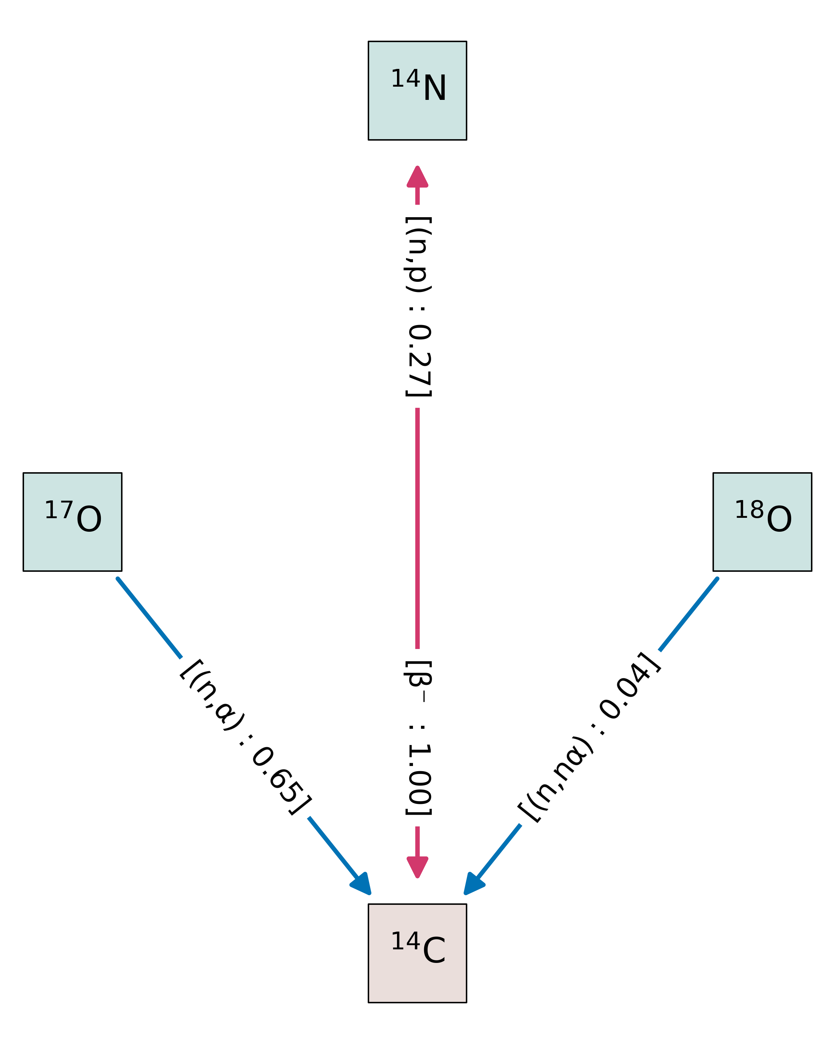
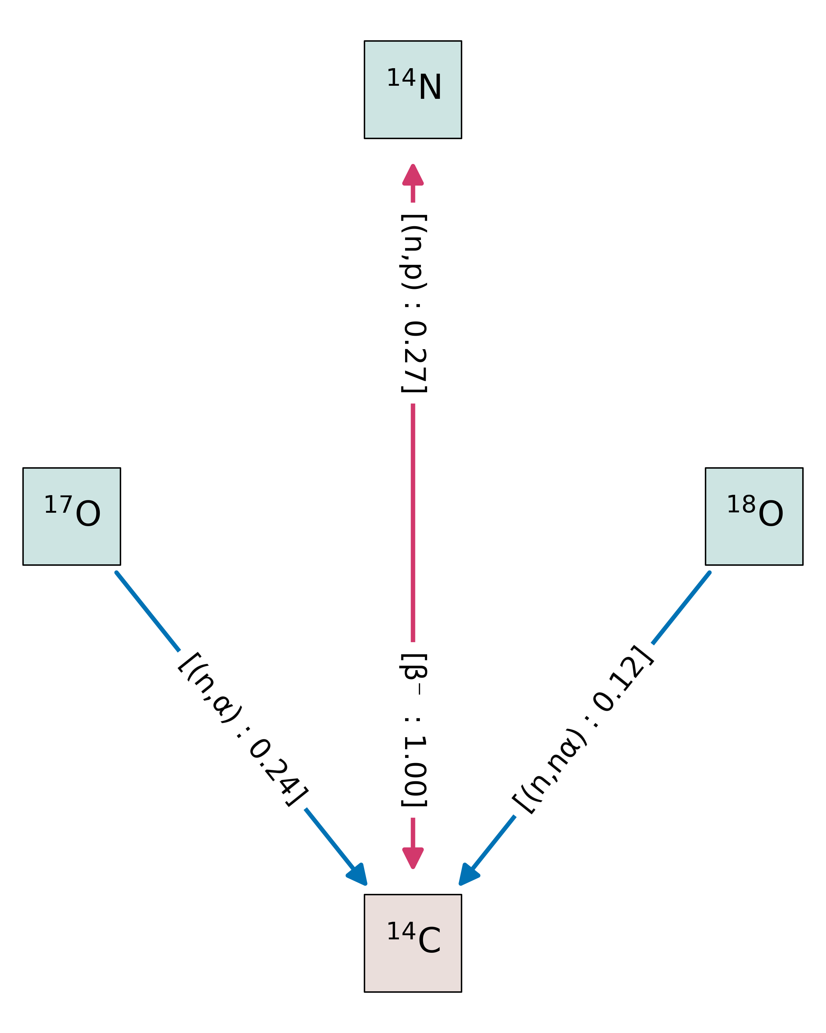
PATHFINDER - Applications
Graphs between isotopes
Comparison of data libraries
ENDFB/VIII.0
The difference in the probability for ¹⁴C production from ¹⁷O(n,α)¹⁴C reaction is due to the difference in ¹⁷O(n,2n′)¹⁶O reaction cross-section in the two data libraries*. The ¹⁷O(n,2n′)¹⁶O reaction has different threshold energies, 4.36 MeV in the case of JEFF-3.3 and 7.58 MeV in the case ENDF/B-VIII.0.
JEFF 3.3
Notes:
The red double-headed arrow means a loop. Blue single-headed arrow is a straight path between parent and daughter.
Pathfinder can print pathways and draw the graphs for all the parents of an isotope, all the daughters of an isotope or paths between two isotopes.
60Ni, 59Co specified as daughter and parent. - plot all pathways.
Ar

