Slide 1
Recent updates to the evaluated nuclear data files of structural materials
Andrej Trkov, Jožef Stefan Institute, Ljubljana, Slovenia
(on behalf of the INDEN Collaboration)

Slide 2
Background
ENDF/B-VIII.1 Library has been released
JEFF-4.0 Library is about to be released
Extensive benchmarking of the libraries has been done
The need for covariance information was expressed by the fusion community
Question:
  Can we take advantage of the improved evaluations?
  Focus on Fe, Cu, Cr, Si isotopes

Slide 3
Iron isotopes
The neutron emission spectra at high energies agree well with measured data.
However, some problems were identified:
  Excessive spectrum contribution is observed at low energies in integral experiments (observed by B. Jansky).
  The low-energy tail of neutron emission spectra do not go to zero (pointed out by S. Kwon, e.g. Fe-56(n,2n). With 14 MeV neutrons incident on thin slabs the spectra at lower energies are affected).
  Other minor corrections were done in the evaluations for consistency.
Recommendation
  Adopt JEFF-4t5, which includes all corrections for all isotopes from the INDEN contribution

Slide 4
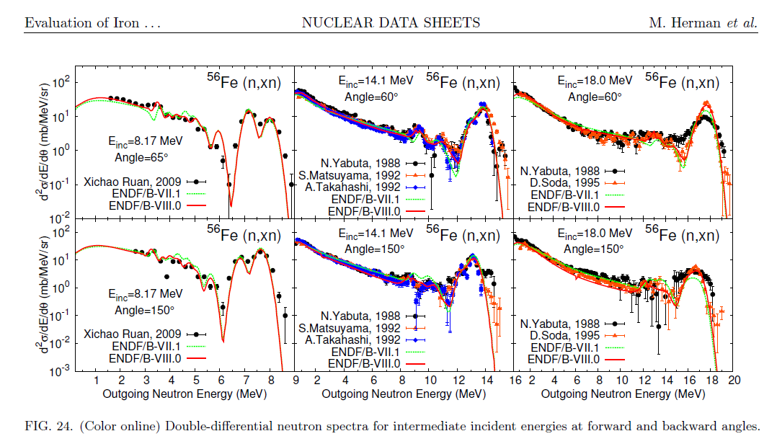
Neutron emission spectra

Slide 5
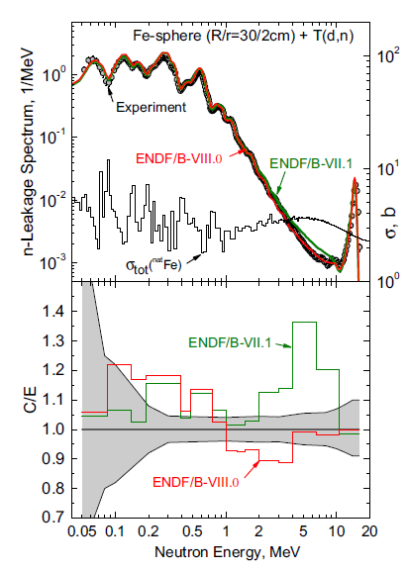
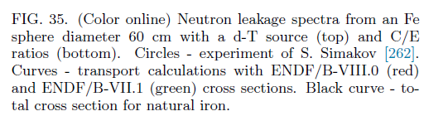
Issues with neutron leakage in Fe CIELO

Slide 6
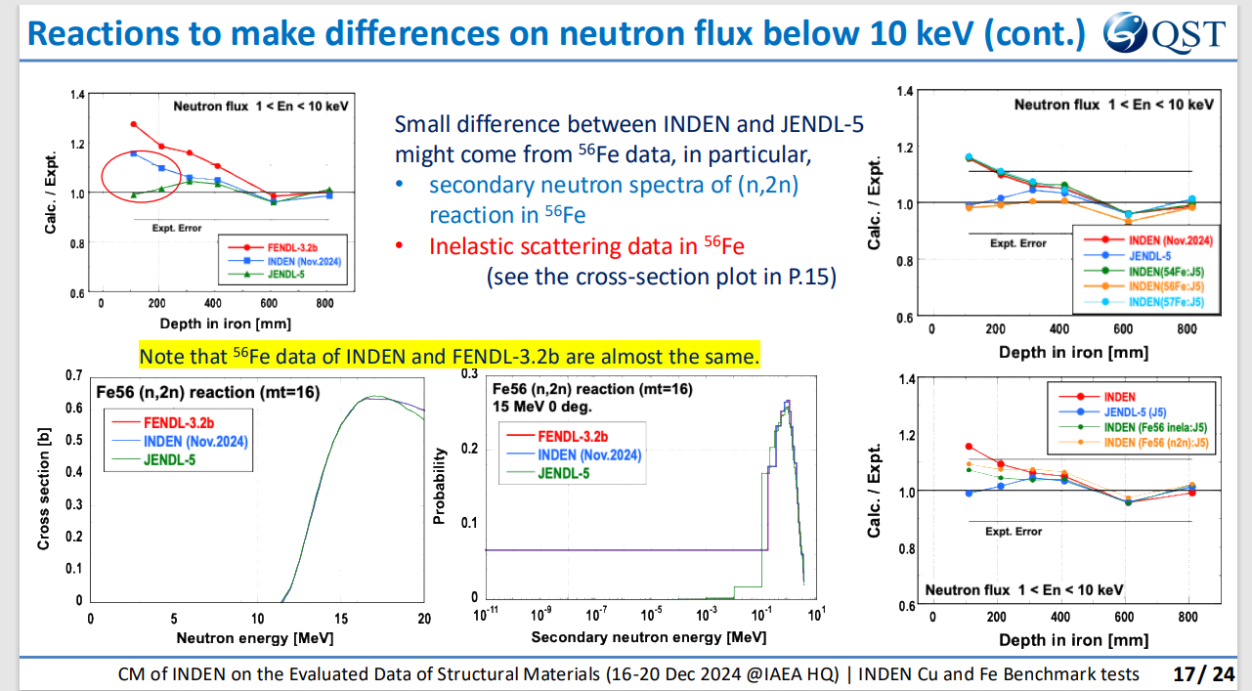
Iron isotopes – Validation (presentation by S. Kwon) KwonCapote)

Slide 7
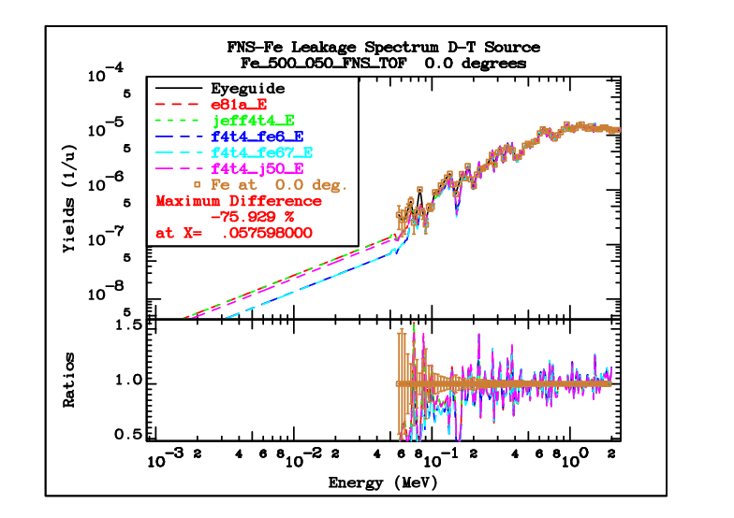
Iron isotopes - Validation

Slide 8
Copper isotopes
Significant improvements to Cu-63 and Cu-65 were made
The key point for validation is the bulk transmission experiment from Rez
Improvements to both isotopes are included in ENDF/B-VIII.1:
  New resolved resonance parameters, including MF32
  Improved elastic angular distributions in the energy range 1.0-2.5 MeV
  Interpolation flags in MF6/MT5 switched to 22
  Minor corrections for consistency
  Improvements show the elimination of 800pcm bias in new CERBERUS critical experiment (hmf106)
In addition (INDEN contribution):
  Addition of covariances from JEFF-3.3 above the resonance range
Recommendation:
  Adopt ENDF/B-VIII.1 with addition of covariances by INDEN

Slide 9
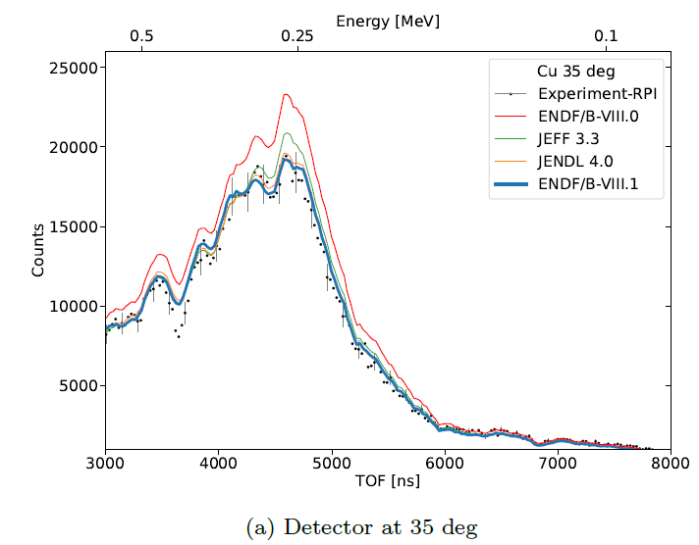
RPI quasi-differential experiment (2021)
Copper isotopes - Validation
Y. Danon, ENDF/B-VIII.1 paper (submitted)

Slide 10
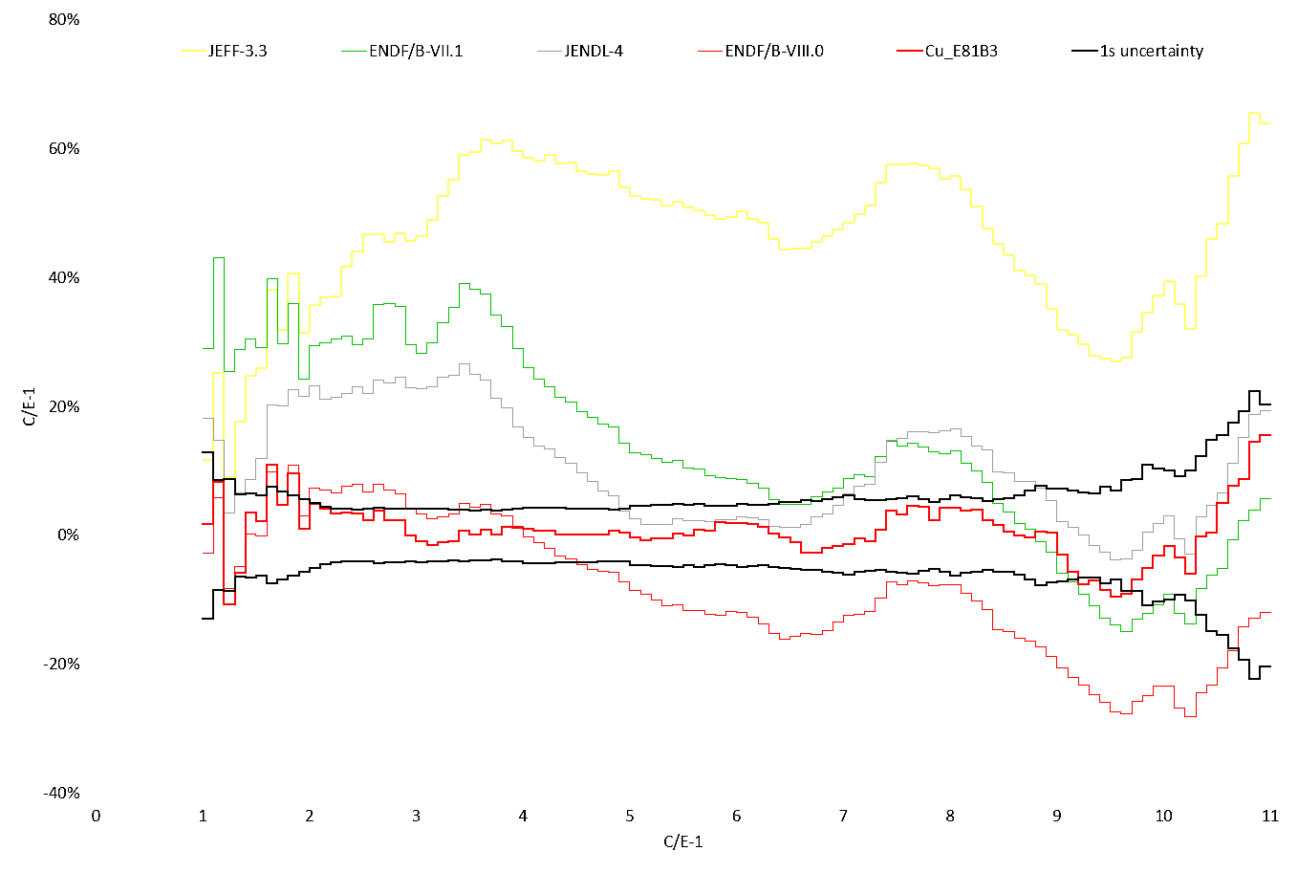
Copper isotopes - Validation
nds.iaea.org/INDEN/data/ALARM-CF-CU-SHIELD-001
INDEN-2024 (B81)
ENDF/B-VIII.0
Cu isotopes, ORNL/IAEA/JSI
n,γ
discr.
Schulc et al, Rad.Phys.Chem. 2021
Cu cube, neutron leakage (Rez, CZ)

Slide 11
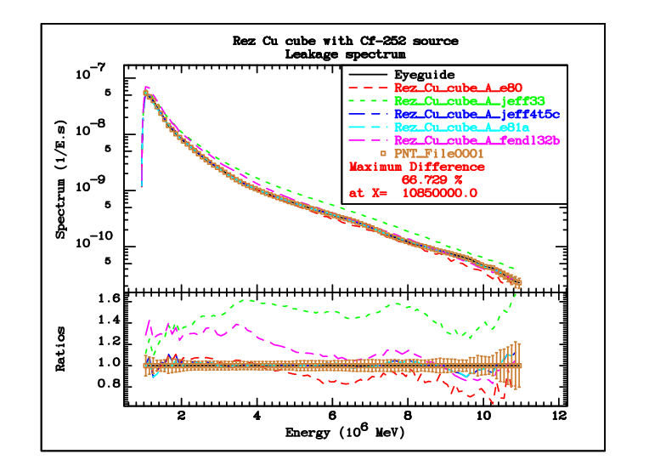
Copper Isotopes Validation (Rez cube)

Slide 12
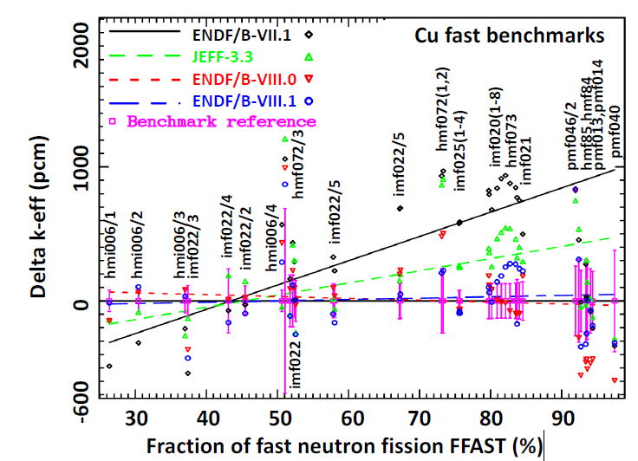
Fast neutron benchmarks - Cu

Slide 13
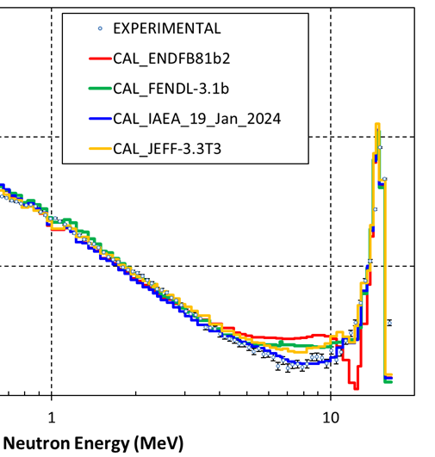

Oktavian shielding 14 MeV benchmark
INDEN latest
shows excellent
fusion performance

Slide 14
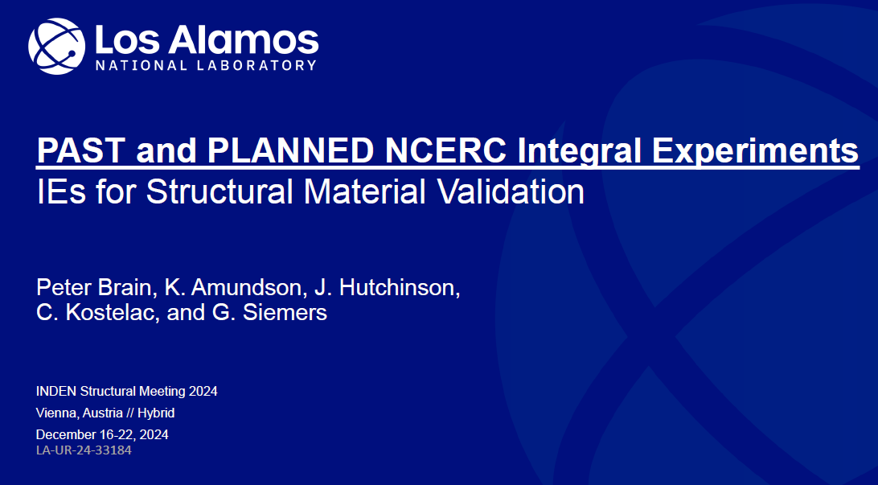

Slide 15
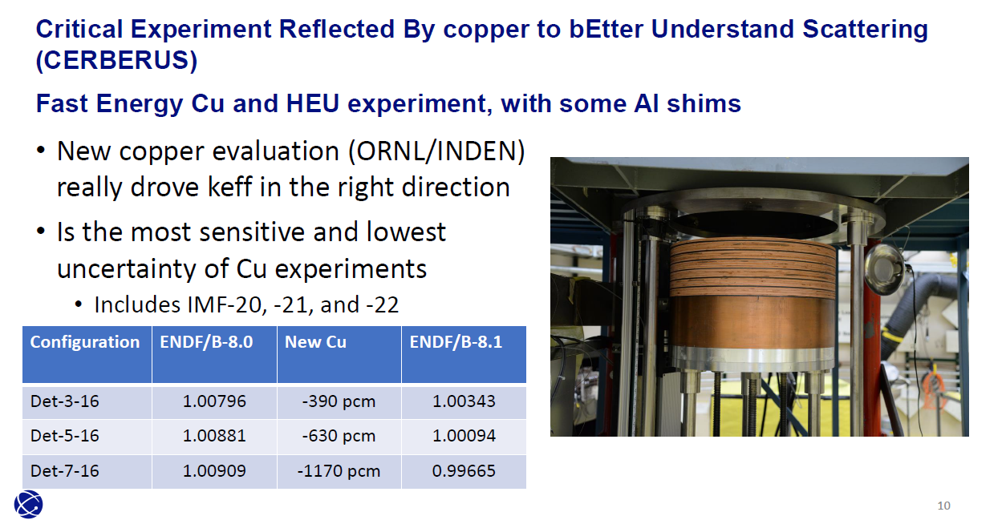
New Cu benchmark (CERBERUS)
INDEN Cu (B81) improved ENDF/B-VIII.0 by -800pcm

Slide 16
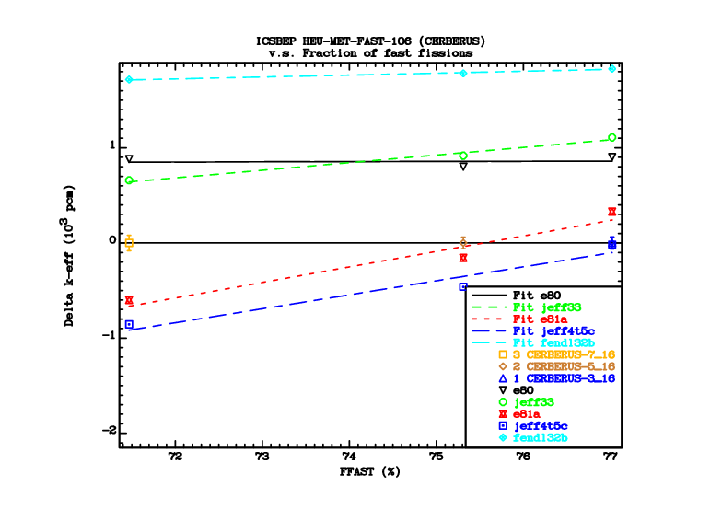
CERBERUS (HMF106) Benchmark

Slide 17
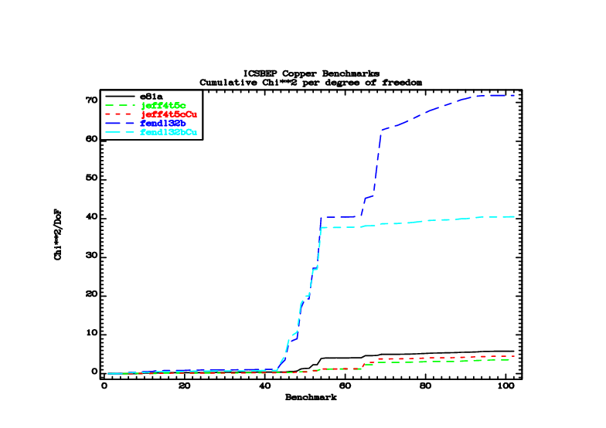
Copper isotopes – Bulk Criticality Validation

Slide 18
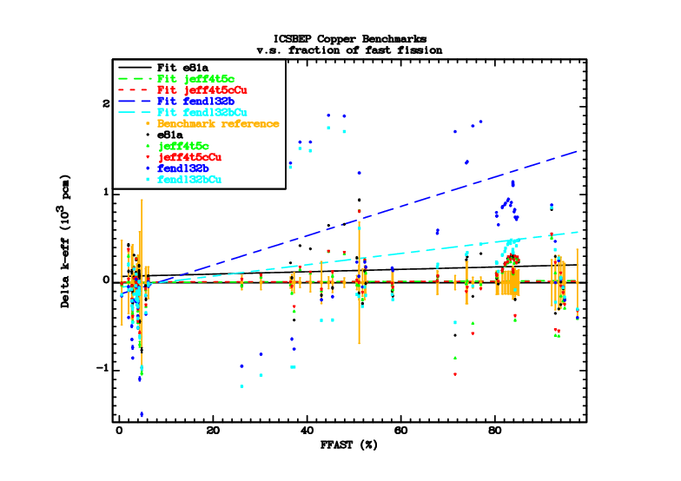
Copper isotopes - Validation
CURIE
Zeus

Slide 19
Copper Isotopes Validation - Comments
Insertion of Cu from ENDF/B-VIII.1 significantly reduces the Chi^2/DoF
Certain benchmark sets remain strongly discrepant, but these are most likely NOT related to copper data (e.g. CURIE benchmarks with a copper reflector are sensitive to fluorine in teflon)

Slide 20
Conclusions - Cu
INDEN 2024 file performs well both in shielding and criticality experiments.
^{nat}Cu(n,el) angular distributions reviewed vs existing experimental data up to 15 MeV: Popov 86 data below 300 keV consistent with evaluation
Excellent performance achieved, much better than ENDF/B-VIII.0 (do not harm). New Cu evaluations adopted by ENDF/B-VIII.1 and proposed for JEFF-4.
New experiment CERBERUS shows big improvement with new INDEN EVAL
INDEN files available from https://nds.iaea.org/INDEN

Slide 21
Silicon Isotopes
Status
  The comments in ENDF/B-VIII.1 are more descriptive.
  The (n,p) cross sections in INDEN “iaea_E" are higher by more than 20 % compared to ENDF/B-VIII.1.
  The change in the (n,p) cross section is propagated to the non-elastic cross section.
  The ENDF/B-VIII.1 (n,p) reaction agrees with IRDFF-II.
  The elastic cross sections in INDEN "iaea_E" are lower to preserve the total.
  Deuteron emission spectra were added in ENDF/B-VIII.1.
  Some changes in the energy grid of the double-differential cross sections were done in ENDF/B-VIII.1
  The JEFF-4t4 file is equal to INDEN "iaea_E".
  Cross sections in ENDF/B-VIII.1 have a big impact on criticality, especially in
Recommendation:
  Adopt ENDF/B-VIII.1 for all isotopes

Slide 22
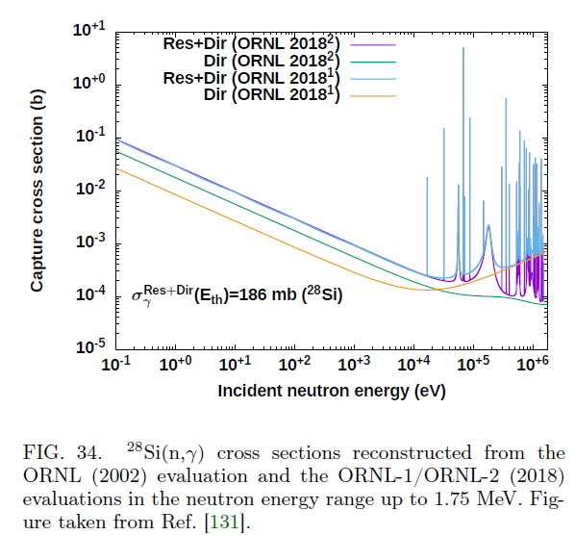
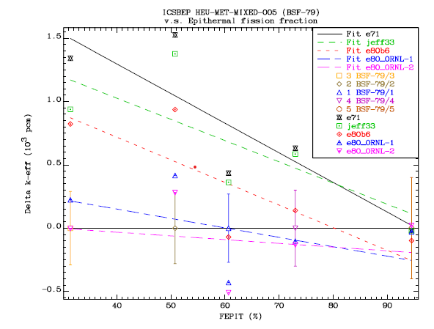

Slide 23
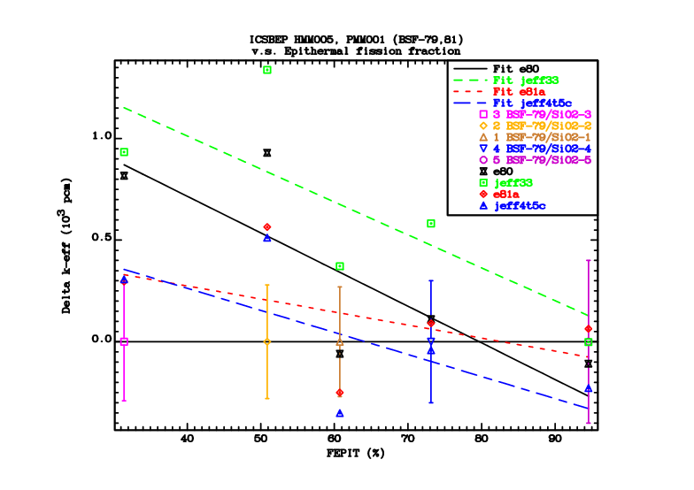
Silicon Isotope validation

Slide 24
Fluorine
Status
  Poor performance in criticality benchmarks, particularly in assemblies containing Teflon
  Poor performance in shielding benchmarks

Slide 25
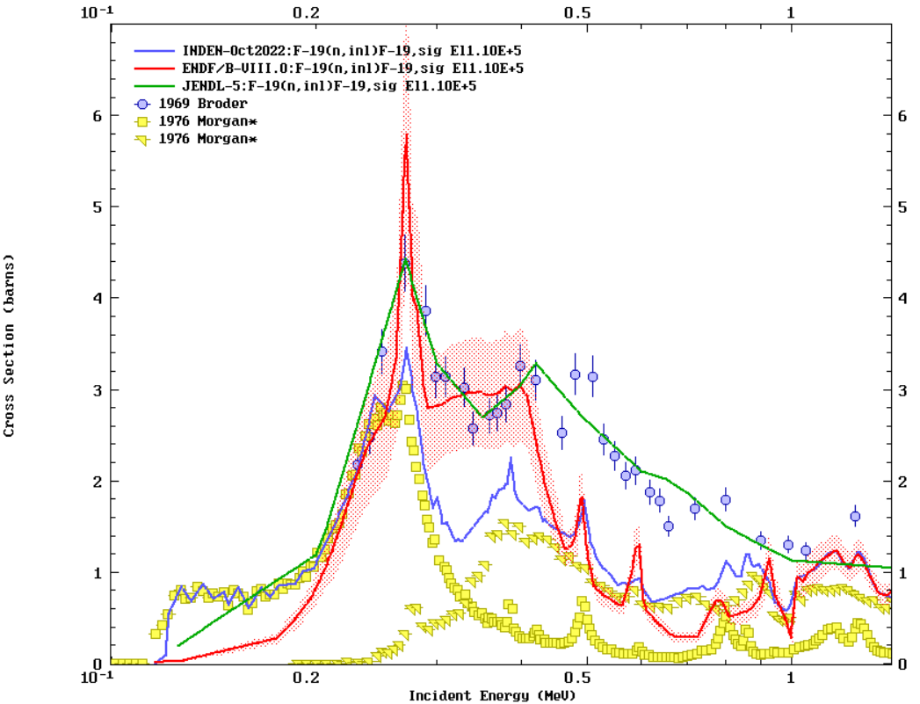
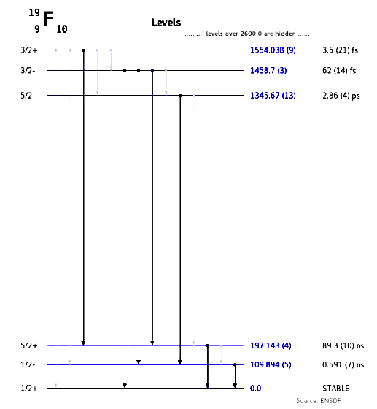
Morgan 76 data adopted << Broder data
B8 & JENDL-5
followed Broder
with REF Fe !
By using Morgan derived INL data (nng x 4pi)
F-19(n,inl) reduced by ~40% from 300 keV

Slide 26
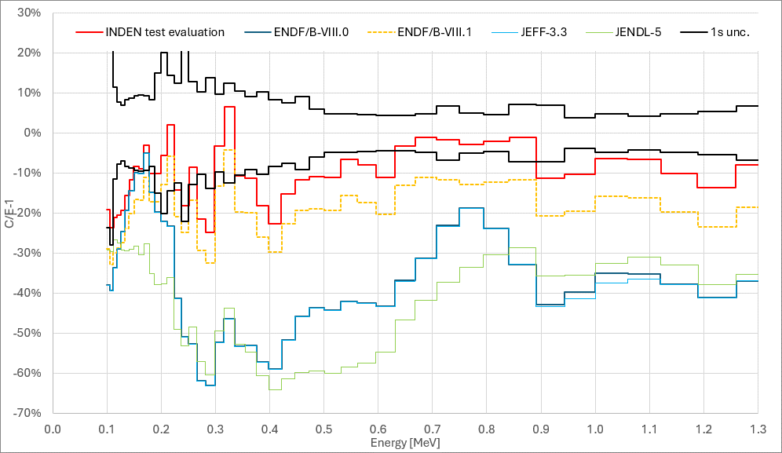
Teflon neutron leakage (HPD) - NEW
(JEFF4t5)
(JEFF4t5)

Slide 27
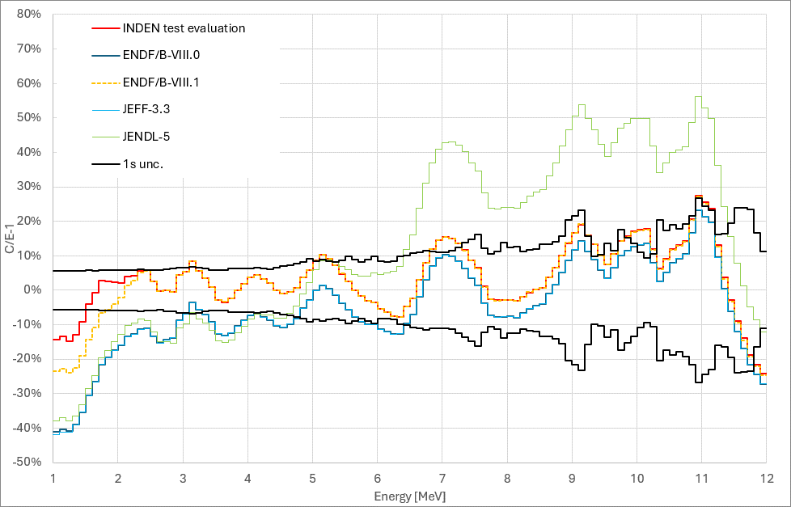
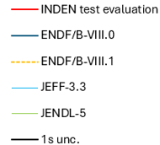
Teflon neutron leakage (stilbene) - NEW
(JEFF4t5)
Neutron leakage drop below 2 MeV
confirmed in broomstick experiments

Slide 28
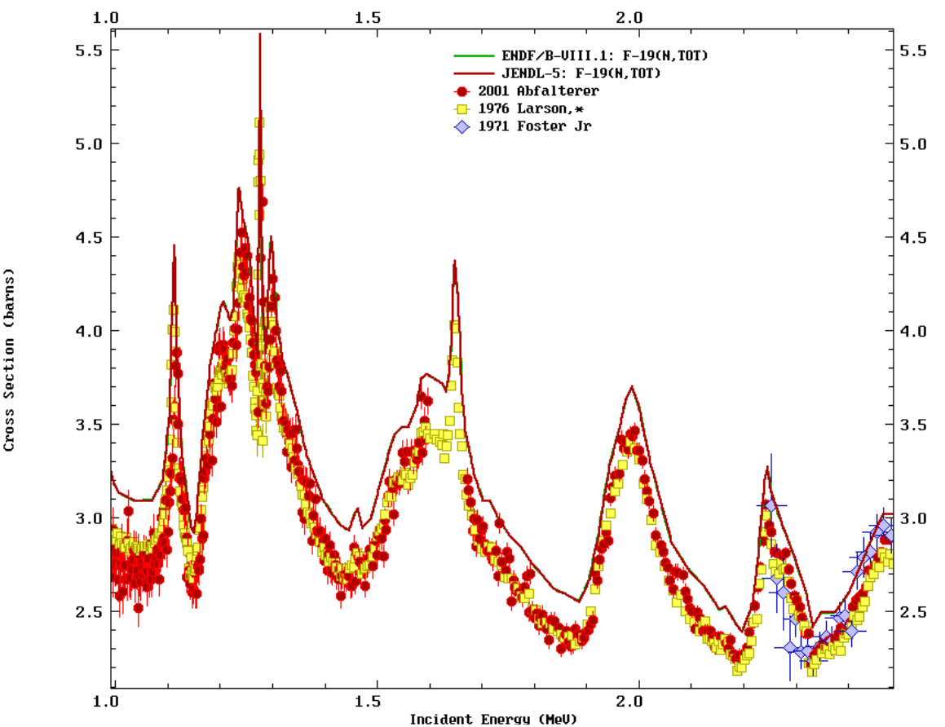

F-19: (n,tot) below 2 MeV
All evaluations based on Larson 76 data
Larson 76 x 0.92
consistent !! with Foster Jr 71
& Abfalterer 2000
Larson x 0.92

Slide 29
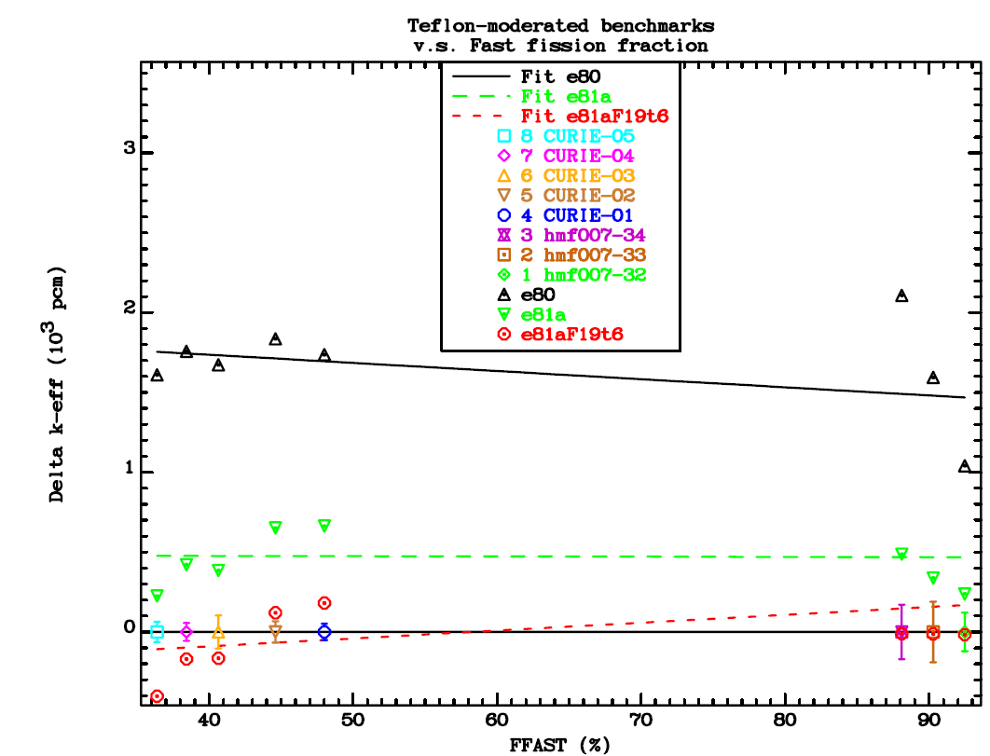
New ¹⁹F Criticality impact ≅ -400pcm
hmf007
cases 32-34
hmi011
(CURIE)
New INDEN F19 shows poor performance for JEFF-4t5

Slide 30
Conclusions – F-19
A new full evaluation using Morgan/Dickens inelastic data and Elwyn elastic DA data needed
ENDF/B-VIII.1 (INDEN) dramatically improved the performance
Neutron leakage experiments showed a ND deficiency below 2 MeV (post – ENDF/B-VIII.1)
A possible problem with Larson 76 total cross section data
Larson rescaled by 0.92 to match Abfalterer 2000 and Foster Jr 71 data
Neutron leakage improved below 2 MeV
ICSBEP benchmark agreement for hmi011 & hmf007/32-34 improved
(about -400 pcm impact !!!)
INDEN files available from https://nds.iaea.org/INDEN

Slide 31
Chromium Isotopes
Status
  Overall, there is more to be desired !
  MACS of Cr-50,53 are too high
  New resonance analysis is needed
  There are no consistent covariance data available
  Trial patches partly improve the performance but are not sufficient

Slide 32
Thank you for your attention

Slide 33
Additional slides

Slide 34
Chromium isotopes: Cr-50
Status
  The Cr-50 evaluation in JEFF-4t4 is equal to ENDF/B-VIII.1; neither of them includes covariances. Version “cr50v234” is the latest from INDEN and includes covariances. It differs from JEFF-4t4, particularly in the fluctuations above the RRR, which were adopted from the ENDF/B-VIII.0 evaluation.
  The MACS of Cr-50 is too high (measured by ToF). The chromium isotopes would need a thorough re-evaluation.
  The original file recommended by INDEN had no covariances; no covariance information is included in ENDF/B-VIII.0.
  ENDF/B-VIIIb3 contains Comarra covariances from ENDF/B-VII.1 inserted by Sam Hoblit. The files include MF32.
Recommendation
  Adopt INDEN version 2.3.4 on the INDEN web page

Slide 35
Chromium isotopes: Cr-52
Status
  Cross sections of Cr-52 in JEFF-4t4 are equal to ENDF/B-VIII.1 library, but JEFF-4t4 does not include covariances.
  INDEN versions were tested up to "v234f", but the decision was to stick to "v234c".
  Version “v234c” is numerically equal to JEFF-4t4, except that the latter includes a corrected Q-value for (n,p). Neither of them include covariances. In v234c the covariances were omitted by accident. The ENDF/B-VIII.1 evaluation includes covariances, but requires a correction for the (n,p) Q-value. The corrected file is “cr52e81c.endf”.
Recommendation
  Adopt “cr52e81c” as on the INDEN web page.

Slide 36
Chromium isotopes: Cr-53
Status
  Cross sections in ENDF/B-VIII.1 are the same as those in JEFF-4t4, but the latter has no covariances. In the INDEN version "v234" the fluctuating total was restored from "e80" and the elastic corrected to preserve unitarity.
  ENDF/B-VIII.1b3 contains Comarra covariances from ENDF/B-VII.1 inserted by Sam Hoblit. The files include MF32.
  Spurious covariances in MF33/MT22 with no corresponding entry in MF3 were removed. The corrected file is “cr53v234s” on the INDEN web page.
  The MACS of Cr-53 is too high (measured by ToF). The chromium isotopes would need a thorough re-evaluation.
Recommendation
  Adopt “cr53v234s” on the INDEN web page until a better evaluation is available.

Slide 37
Chromium isotopes: Cr-54
Status:
  Version "v234" is equal to ENDF/B-VIII.1 but differs from JEFF-4t4, which does not have the fluctuations above the RRR. None of these files include covariance information, except for the resonance parameters in MF32 in ENDF/B-VIII.1.
  There are covariances in JEFF-3.3, which could be used to patch the Cr-54.
Recommendation
  Cr-54 is the least abundant isotope, so it is probably sufficient to adopt version “cr54v234” from the INDEN web page.

Slide 38
Chromium isotopes (summary)
The MACS of Cr-50,53 are too high (measured by ToF). The chromium isotopes would need a thorough re-evaluation
The original file recommended by INDEN had no covariances
No covariance information is included in ENDF/B-VIII.0
ENDF/B-VIIIb3 contains Comarra covariances from ENDF/B-VII.1 inserted by Sam Hoblit. The files include MF32.

