Slide 1
The nuclear data arsenal and new approaches
An exploration into Web Assembly for Nuclear Data processing
Thomas STAINER
FENDL Meeting - May 13th – 16th 2025

Slide 2
The landscape
Fortran lands
FIZCON, CHECKR
PREPRO
CALENDF
NJOY
Endf_parserpy
Fudge
FRENDY
C++/Python lands
Notes:
AI generated image

Slide 3
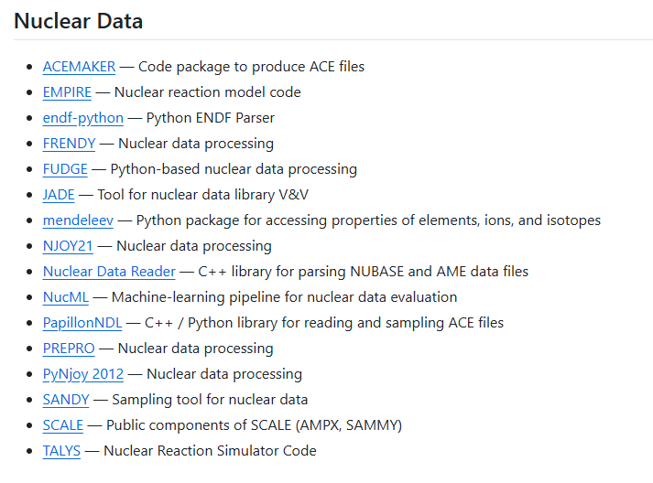
Nuclear Data (open) codes
https://github.com/paulromano/awesome-nuclear

Slide 4
Problems with these tools
Some problems:
Installation
Versioning
Not always open source
Hard to debug and maintain
“Python is slow”
Output is not always consistent
We want to incorporate these tools to improve nuclear data processing and validation.
Make it simple and easy for users to see what is in the nuclear data files, and what has changed.
Notes:
AI generated image

Slide 5
Real life
“Just install ENDFtk”….. 5 hours later
“Just git diff the files”……. 44529--, 56231++
“Just get and run <closed code>”…… I need a license
“Just run NJOY”….. What version and what inputs?
“It works fine on my computer”…. What version, what compiler, what OS, what docker image?....

Slide 6
Possible approaches
Write python wrappers over everything
Additional work and must be maintained
User needs to compile, install and run it locally
Bind Fortran to C to Python
Lots of work
User needs to compile, install and run it locally
Write APIs for service
See item 1, but now remote execution not local
However, requires host (costs)
Web Assembly
Use existing code bases
Run in the browser – client only
import os
os.system(“/opt/bin/njoy < inputfile”)
use iso_c_bindings
#include <pybind11/pybind11.h>
from fastapi import FastAPI
@app.get("/")
async def root():
run_njoy()
button.addEventListener("click",
function() {
Module.ccall(“run_njoy", null, [],[]
});

Slide 7
New approaches - Wasm
Web Assembly (abbreviated Wasm)
WebAssembly is a binary instruction format for a stack-based virtual machine
Fast - encoded in a size- and load-time-efficient binary format
Safe - describes a memory-safe, sandboxed execution environment
Open
Portable
We can run Python, C, C++ and Fortran in the browser directly:
no API calls
All client side
No docker mess

Slide 8
Python
Easy to do if you have wheel available and pure python
Pyodide is simple to use in this case
A bit more difficult if Python package is not pure python…. (beyond scope of talk)
<script src="https://cdn.jsdelivr.net/pyodide/v0.27.5/full/pyodide.js"></script>
<script type="text/javascript">
async function main(){
let pyodide = await loadPyodide();
pyodide.runPython("print(1 + 2)");
}
main();
</script>

Slide 9
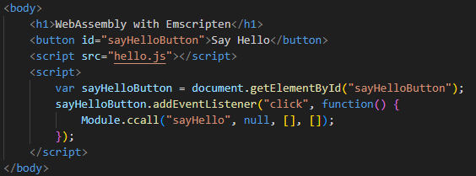
C++
A little harder, but not much, if you have some help
emcc hello.cpp -Os -o hello.js \
-s EXPORTED_FUNCTIONS=_sayHello \
-s EXPORTED_RUNTIME_METHODS=ccall,cwrap

Slide 10
Simple C++ examples
C++ code
.wasm
.html
browser
Emscription compiler
Javascript glue code
Hello world
File system

Slide 11
Fortran
A bit tricky
f2c: ”F2C is just an abomination that harms the Fortran ecosystem. It is best forgotten” (https://fortran-lang.discourse.group/t/f2c-program-how-to-install-how-to-use-any-hints-critique/3572/9). Used by “Pyodide” for compiling packages containing Fortran code but has problems.
Lfortran (https://github.com/lfortran/lfortran): modern open-source (BSD licensed) interactive Fortran compiler built on top of LLVM. Still alpha! Could not compile fizcon or checkr.
Dragonegg (https://dragonegg.llvm.org/): A GCC plugin that replaces GCC's optimizers and code generators with those from the LLVM project.
LLVM Flang: To support web assembly you need a small patch + compile toolchain yourself.
But it can work (with flang)!

Slide 12
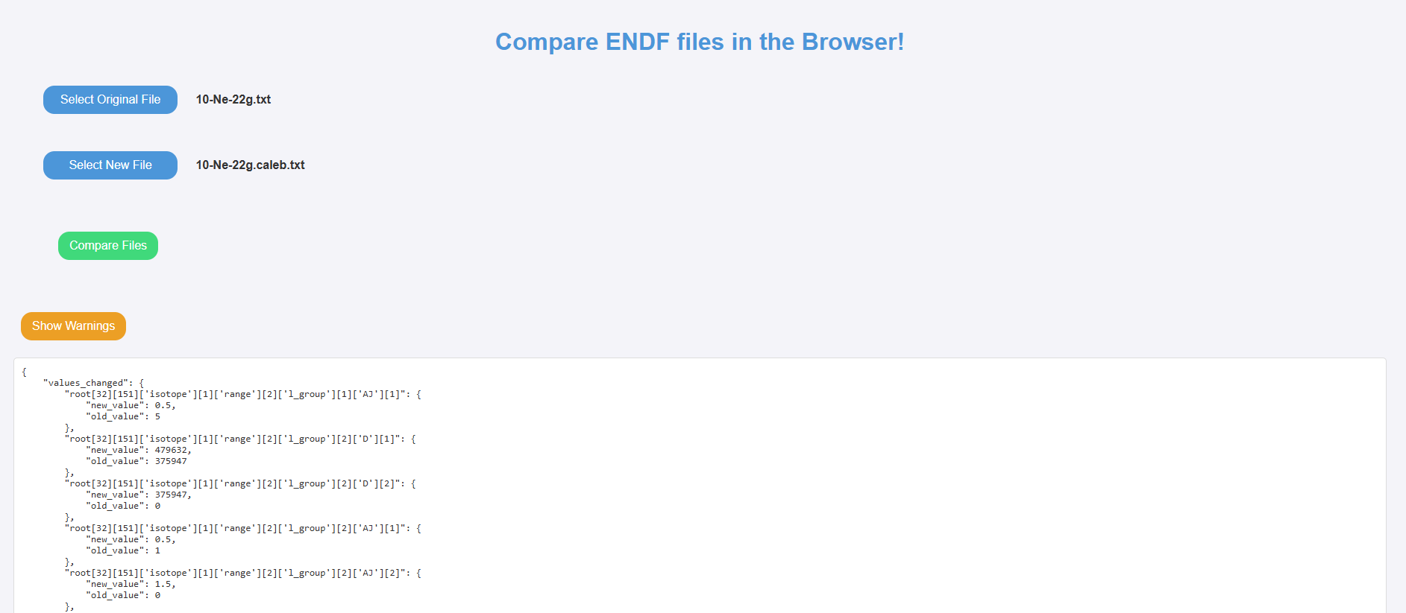
An example
Use case: I want to compare ENDF files easily without installing anything
Solution: WASM to the rescue
JEFF use case
Notes:
Live demo: https://endf-compare-wasm-databank-nds-51acd02ba99e62d10148fd5d7fba7305.io.oecd-nea.org/
Code available: https://github.com/CodeVisionaries/endf-compare-wasm

Slide 13
An example
Use case: I want to compare ENDF files easily without installing anything
Solution: WASM to the rescue
JEFF use case
DEMO
https://endf-compare-wasm-databank-nds-51acd02ba99e62d10148fd5d7fba7305.io.oecd-nea.org/
Notes:
Live demo: https://endf-compare-wasm-databank-nds-51acd02ba99e62d10148fd5d7fba7305.io.oecd-nea.org/
Code available: https://github.com/CodeVisionaries/endf-compare-wasm

Slide 14
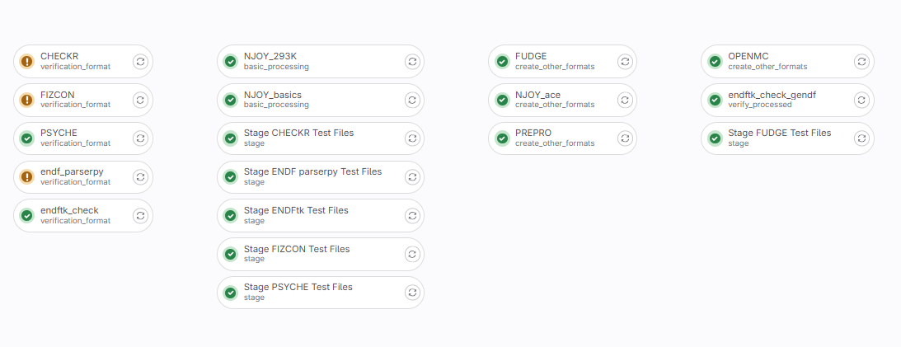
JEFF processing
Processing pipeline using GitLab CI
NJOY, PREPRO, ENDFtk, endf_parserpy, OpenMC, ENDF Utilities
NEA DB has a processing pipeline that runs all of the above to generate processed JEFF files
Wrap everything in Python
System calls
Docker images everywhere
Shane HART, Antonio JIMÉNEZ-CARRASCOSA, Daniela FOLIGNO

Slide 15
What’s possible
WASM is great for simple tools that you want to work in the browser
Fairly straightforward for C++ and (pure) Python packages
OpenMP is possible apparently:
https://github.com/abrown/wasm-openmp-examples
https://github.com/emscripten-core/emscripten/issues/13892
Can utilize workers to avoid blocking main thread
File system support

Slide 16
What doesn’t work so well
Fortran support via Flang (llvm-project) is still not complete and needs work
Fortran wasm is still early days, but optimistic for future
Codes with many dependencies can be challenging
File system not well suited for 40 GB nuclear data libraries
But…
If files are Interplanetary then you might not need to have them locally (see Georg’s talk later)
File:Ipfs-logo-1024-ice-text.png - Wikimedia Commons

Slide 17
Summary
For WASM to work, you just need a browser
No APIs, no server needed
Pure python libraries – very easy
Fortran tools tricky
Exploration of WASM might be beneficial for some nuclear data tools
Provides an alternative to Docker, no installation required
Probably not well suited for Monte Carlo in the browser
But... not limited to just the browser: Wasmtime & https://wasmedge.org/
All examples can be found at: https://git.oecd-nea.org/stainer_t/demo-wasm

Slide 18
References & credits
Python to WASM: Pyodide - https://pyodide.org/en/stable/index.html
C++ to WASM: emscripten - https://emscripten.org/
Fortran: https://gws.phd/posts/fortran_wasm/
Wasmtime
WasmEdge: https://wasmedge.org/
Wasm vs. Docker | Docker
Thanks to NEA DB colleagues and IAEA Georg SCHNABEL & Shin OKUMURA for help

Slide 19
Thank you for your attention
Please contact thomas.stainer@oecd-nea.org if you have any questions or comments regarding this presentation.

