Slide 1
Nuclear data needs for Spherical Tokamaks
M. Rajput, J. Naish, K. Chandrasekhar, G. Kamal

Slide 2
delivering fusion power and transformative superconducting magnet technology
2025

Slide 3
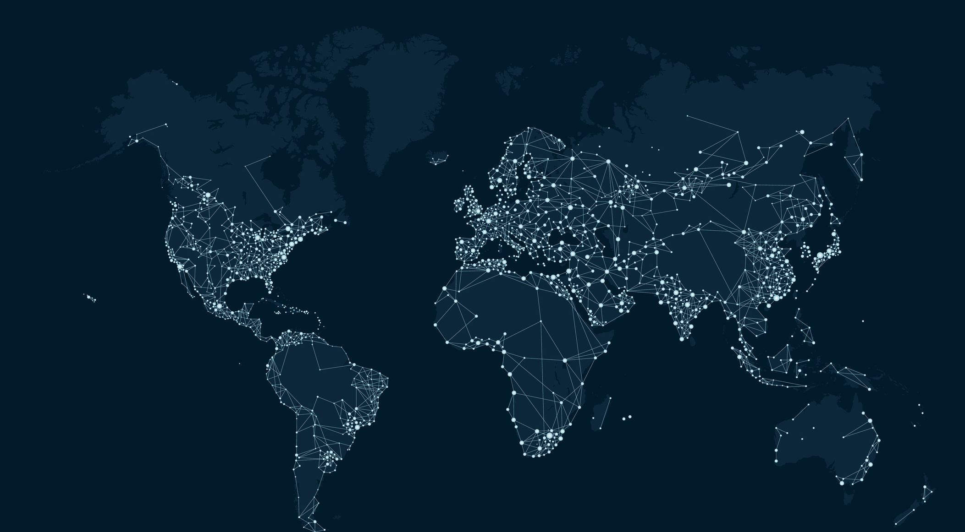
We are Tokamak Energy
The leading global fusion ENERGY company
The leading High temperature superconducting Magnets Company
Princeton, NJ
U.s. subsidiary
Oxford, UK
Global headquarters
Tokyo, JP
Japanese subsidiary
280 people worldwide
$335 million raised
Partnering with:
Notes:
The leading global fusion company means we are building the partnerships with industry and governments worldwide needed to deliver fusion energy – not just R&D but global demonstration and deployment.

Slide 4
our fusion technology
Spherical tokamak with High Temperature Superconducting (HTS) magnets
Spherical tokamak
High efficiency (high bootstrap current)
Stable plasma
Steady state running
Requires 50% less magnet material*
HTS magnets
Quench-safe, robust magnets
Ultra-high magnetic field (20 Tesla +)
Operate at 20K (no liquid cryogens)
250 people
* Compared to a conventional tokamak (CT)

Slide 5
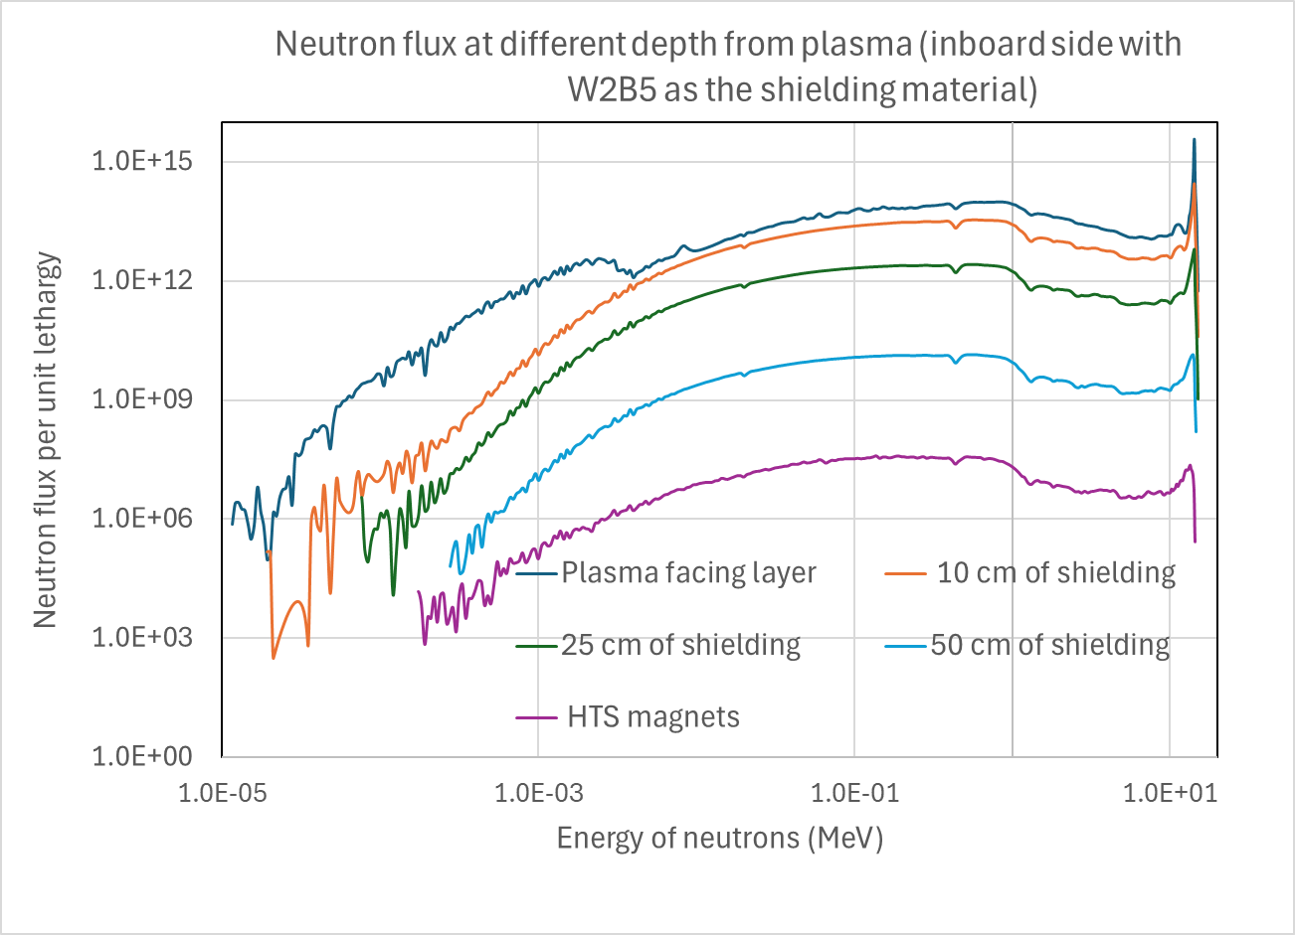
Nuclear cross section data for spherical tokamaks (ST)
Impact on Components:
Components in Spherical Tokamaks (STs) are exposed to neutrons with energies up to 14.1 MeV and cause:
Scattering and absorption reactions
Neutron induced dpa, transmutation and activation
Importance of Nuclear Cross Section Data:
Essential for understanding and simulating interactions across the full energy spectrum of neutrons.
Critical for accurate modelling and simulation of neutron behaviour in STs.
Challenges in Validation:
Limited availability of neutron sources with the required energy range.
Difficulty in validating nuclear cross section databases due to energy constraints.
Fig. Neutron flux in the inboard shielding in ST of 1 GW fusion power with WC as the shield

Slide 6
Workflow for neutron transport simulations in Spherical Tokamaks (ST) Optimisation
Neutron transport simulations and activation analysis are necessary for designing and optimising spherical tokamaks. It directly supports the following aspects:
Performance of shielding
Tritium breeding in breeder blankets
Nuclear and photon heating
Nuclear responses
Potentials of errors in neutronics simulations:
Mathematical model and simplifications
Nuclear data uncertainties
Source description uncertainty
Geometry modelling and simplifications
Human factor
Notes:
Check the grammar….
Shielding in general…

Slide 7
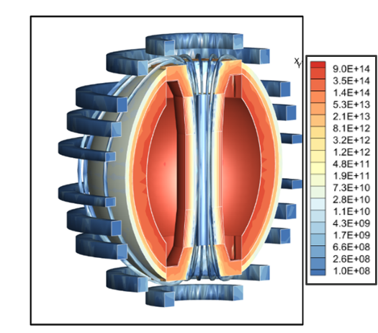
Key parameters for Spherical Tokamaks
The key calculations in the design and optimisation process:
Neutron Flux throughout the ST.
Reaction rates,
Tritium production reactions (Tritium breeding ratio).
Hydrogen and helium production reactions.
Transmutation reaction channels.
Radiation damage and KERMA.
Activation and radioactive waste classifications.
The neutrons will traverse a large number of mean free paths and any discrepancy in cross section data will impact plant and component analysis
Neutron flux (neutron/cm²) map on a generic spherical
tokamak of 1 GW fusion power

Slide 8
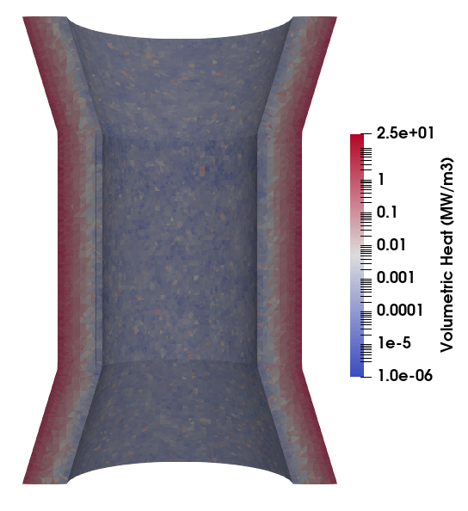
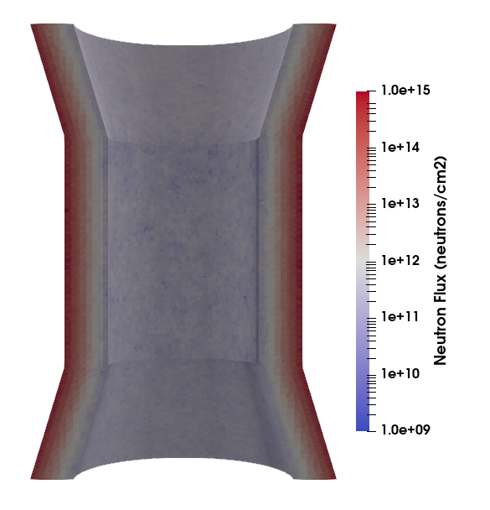
Shielding in spherical tokamaks (ST)
STs have limited spaces between the plasma and HTS magnets, thus heavily impacts the design points of STs.
Efficient shielding is necessary in order to appropriately protect the fusion plant by:
Reducing the radiation damage to the magnets
Reducing the instantaneous heat and steady-state heat.
Tungsten carbides, tungsten borides, boron carbide, and hafnium hydride show good neutron attenuation for both, fast and slow neutrons, thus are being considered as a potential shielding candidate for spherical tokamaks.
Tokamak design parameters are highly sensitive to shielding performance.
Any uncertainty and high variance in nuclear data can significantly impact the predictions of neutron flux on HTS magnets, potentially altering the design and HTS magnet lifetime.
Neutron flux and nuclear heating at the inboard shield in ST of 1 GW
fusion power with WC as the shield material

Slide 9
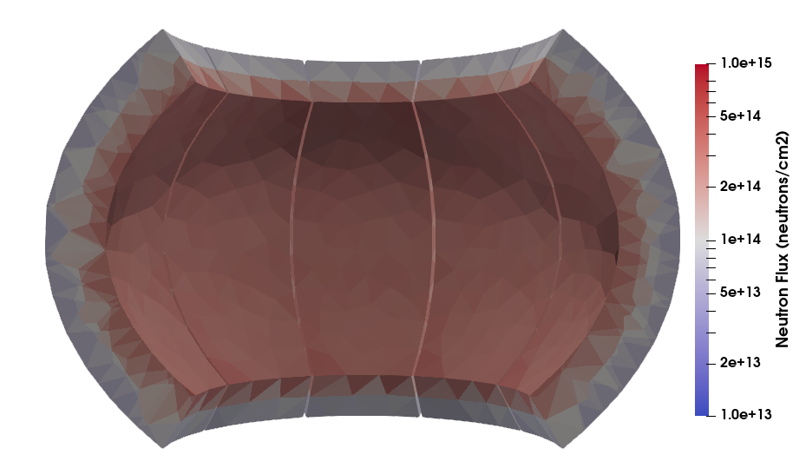
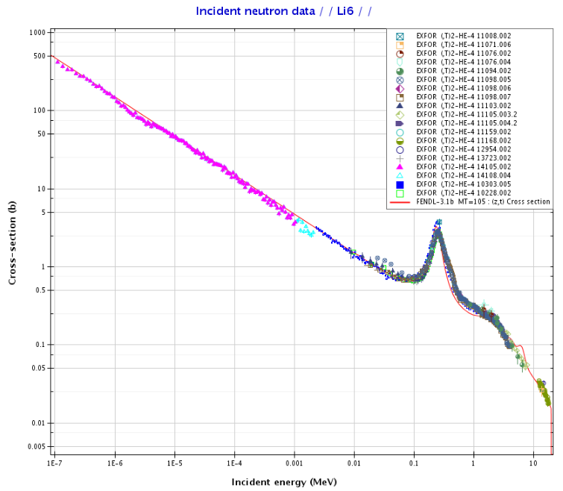
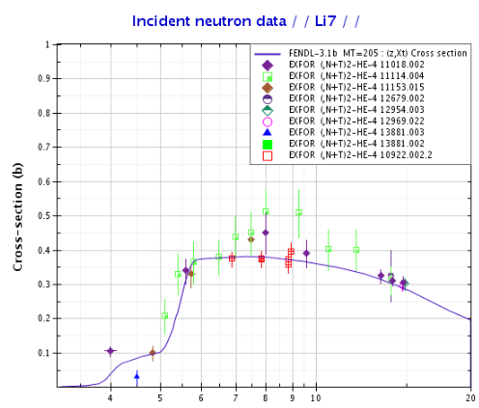
Materials in STs
ST requires maximising the tritium breeding ratio in the outboard region.
Potential breeding solution for the STs: Lithium based materials
Efficient breeding requires the neutron transparent materials such as Vanadium based alloys.
Shields and blankets require structural materials for thermo-physical stability. Fe, Cr, V etc based alloys are potential alloying materials for structural materials.
Due to the large size of the blanket, uncertainty and high variance in the cross sections of structural materials and the tritium production reaction channel (MT205) will impact the Tritium Breeding Ratio and adversely affect the prediction of heat production within the blanket.
Fig. Neutron flux at the outboard blanket in ST of 1 GW fusion power with Liquid Lithium as breeding blanket
Fig. ⁶Li(n,t) and ⁶Li(n,t) reaction cross section data

Slide 10
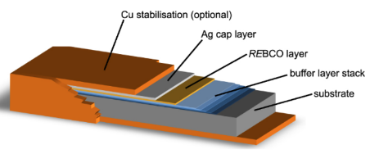
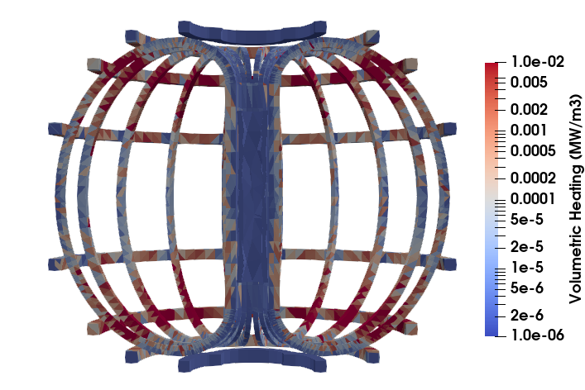
HTS (REBa₂CuO₇) magnets and magnet cage
High temperature superconducting magnets are key to the spherical tokamaks as they provide the required high magnetic field.
Continuous neutron irradiation damages the high temperature superconducting (HTS) tapes and cause the heating of the HTS tape, that will further require additional cooling.
The HTS tape is a composite of REBCO layer (YBa₂CuO₇) sandwiched within the Ag, Cu, buffer and substrate layers.
Important nuclear data for composite HTS materials:
Neutron and photon heating.
dpa cross section.
Gas production and transmutation.
HTS tape* (REBa₂CuO_{7,} where RE is rare earth)
Nuclear heating at the outboard blanket in ST of 1 GW fusion power with Liquid lithium as breeding blanket
*Barth et al. 2015 Supercond. Sci. and Tech., 28 045011, 2015.

Slide 11
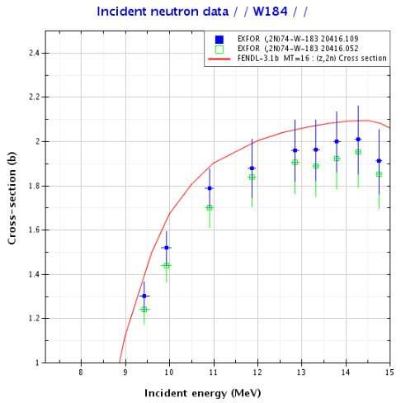
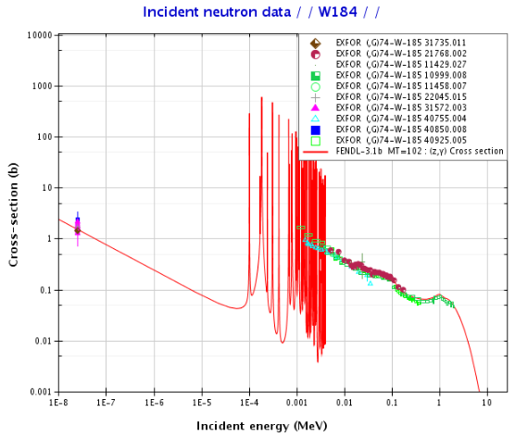
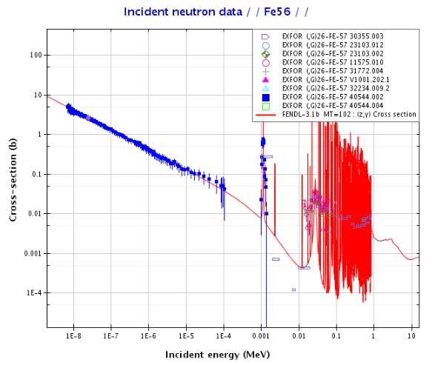
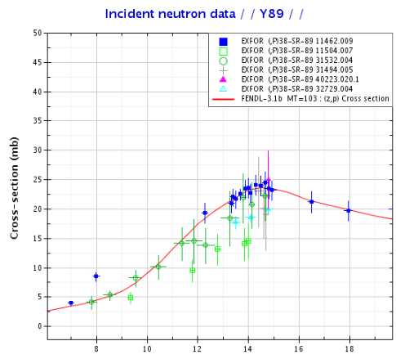
Nuclear data comparison
A substantial amount of nuclear data from FENDL aligns well with experimental data.
Reaction cross sections important for potential ST materials,
Elastic and inelastic scattering cross section.
Gas production, transmutation and (n,2n) reactions.
Capture cross section.
Heating and dpa cross section, etc.
Angular and energy distribution of outgoing particles.

Slide 12
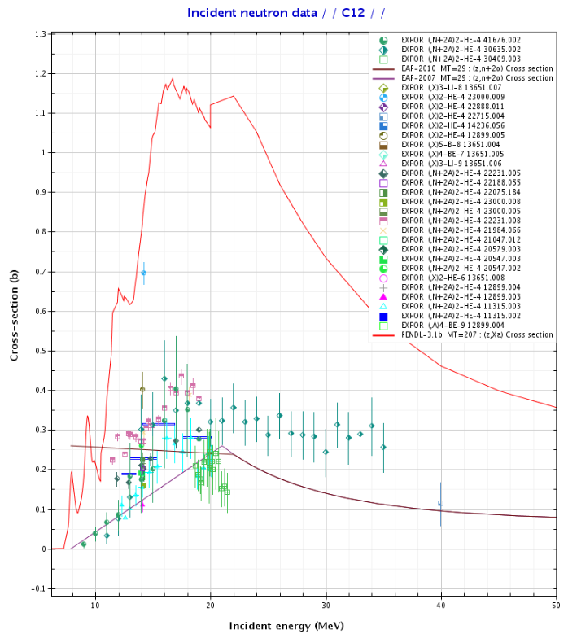
Critical cross section data and their comparison with the experiments
¹²C(n,n’2α)⁴He reaction channel is not properly incorporated in the FENDL library, causing the discrepancy in total helium production*.
EAF 2010, 2007 data library seem to be in slightly better agreement with the experimental data.
This also cause inaccuracies in the gas production and transmutation calculations.
FENDL-3.1, ENDFVIII, and TENDL-19 do not have ¹²C(n,n’2α)⁴He reaction channel, thus helium inventory prediction comes out to be lower than expected.
The accurate differential cross section from ¹²C(n,n’2α)⁴He reaction is also essential for simulating the diamond detectors’ response for fusion neutrons.
*Gilbert, M.R. (2023). Nuclear data for fusion: inventory validation successes and future
needs. JPhys Energy, 5(1), 014001. DOI: 10.1088/2515-7655/abf1c1

Slide 13
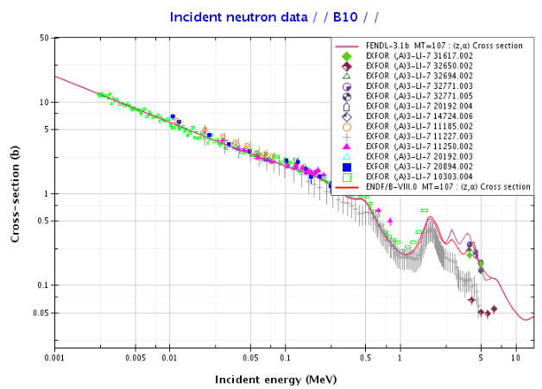
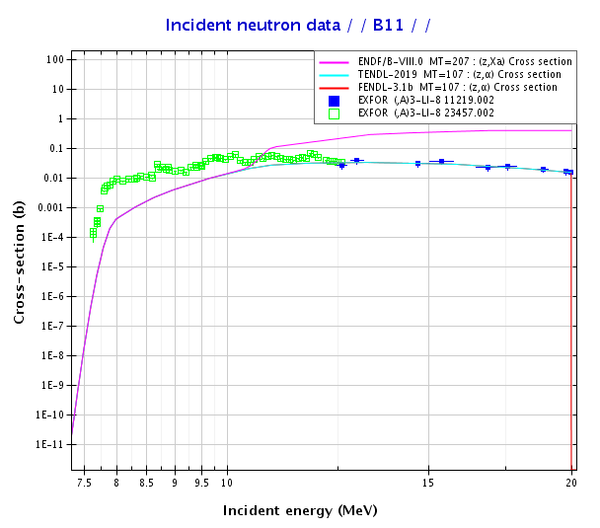
Critical cross section data and their comparison with the experiments
Advanced radiation shielding involve the use of boron.
There are some discrepancies in the ¹⁰B(n,α) in 1 to 10 MeV range. However, the experimental data also shows disagreement with each other.
The FENDL-3.1 underestimate ¹¹B(n,α) reaction cross section data in 7.5 to 12 MeV energy region compared against the experimental data, which will impact the shielding performance of borides-based shields. TENDL-19 and ENDF-VIII show same discrepancy.

Slide 14
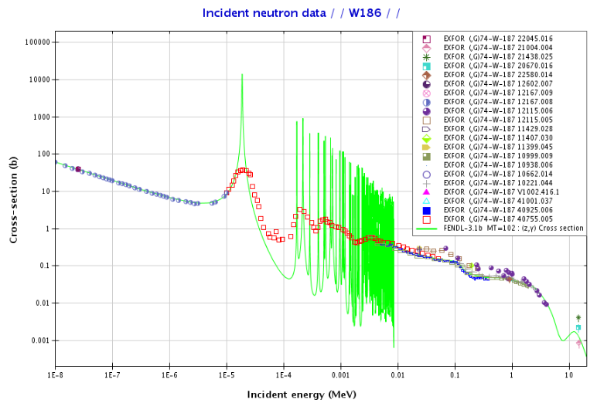
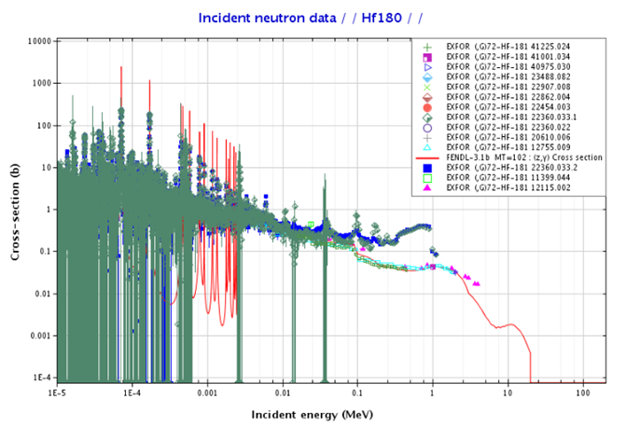
Critical cross section data and their comparison with the experiments
Hafnium based materials are being considered as advanced shield candidates and tungsten is critical to plasma facing components
The resonance peaks in the 186W(n,ϒ) reactions seems to be overpredicting the FENDL-3 XS compared against the experiments.
The discrepancies have also been observed in the ¹⁸⁰Hf(n,ϒ) reaction in 0.1 to 1 MeV range. However, the experimental data also shows disagreement with each other.

Slide 15
Impact of nuclear cross section uncertainty/sensitivity on the Nuclear response calculated with FISPACT-II V5*
As no FENDL library is available for FISPACT, FISPACT calculations have been carried out with the EAF-2010, ENDF-VIII, and TENDL-19.
Gas production with the MCNP have been calculated with the MT203 and MT207 for hydrogen and helium production.
As discussed before, ¹²C(n,n’2α)⁴He reaction channel causes the discrepancy in the helium production in the WC.
MCNP with FENDL-3.1 predicts higher helium production.
EAF library has the ¹²C(n,n’2α)⁴He reaction channels but does not have the dpa cross section.
Helium, Hydrogen and dpa in shielding closer to the plasma
*FISPACT-II: An Advanced Simulation System for Activation, Transmutation and Material Modelling," published in Nuclear Data Sheets 139 (2017), pages 77-137

Slide 16
Impact of different libraries on activation
The activity and dose rate post shut-down play significant role in devising the waste management and maintenance strategies for the reactor components.
Different libraries predict different activity post shutdown, end up resulting different time to low level waste.
Similar discrepancies were also observed in dose rate post shutdown.
Selection of library for the FISPACT:
Should there be a FENDL based library?
ENDF or TENDL?
Activity post-shutdown in WC

Slide 17
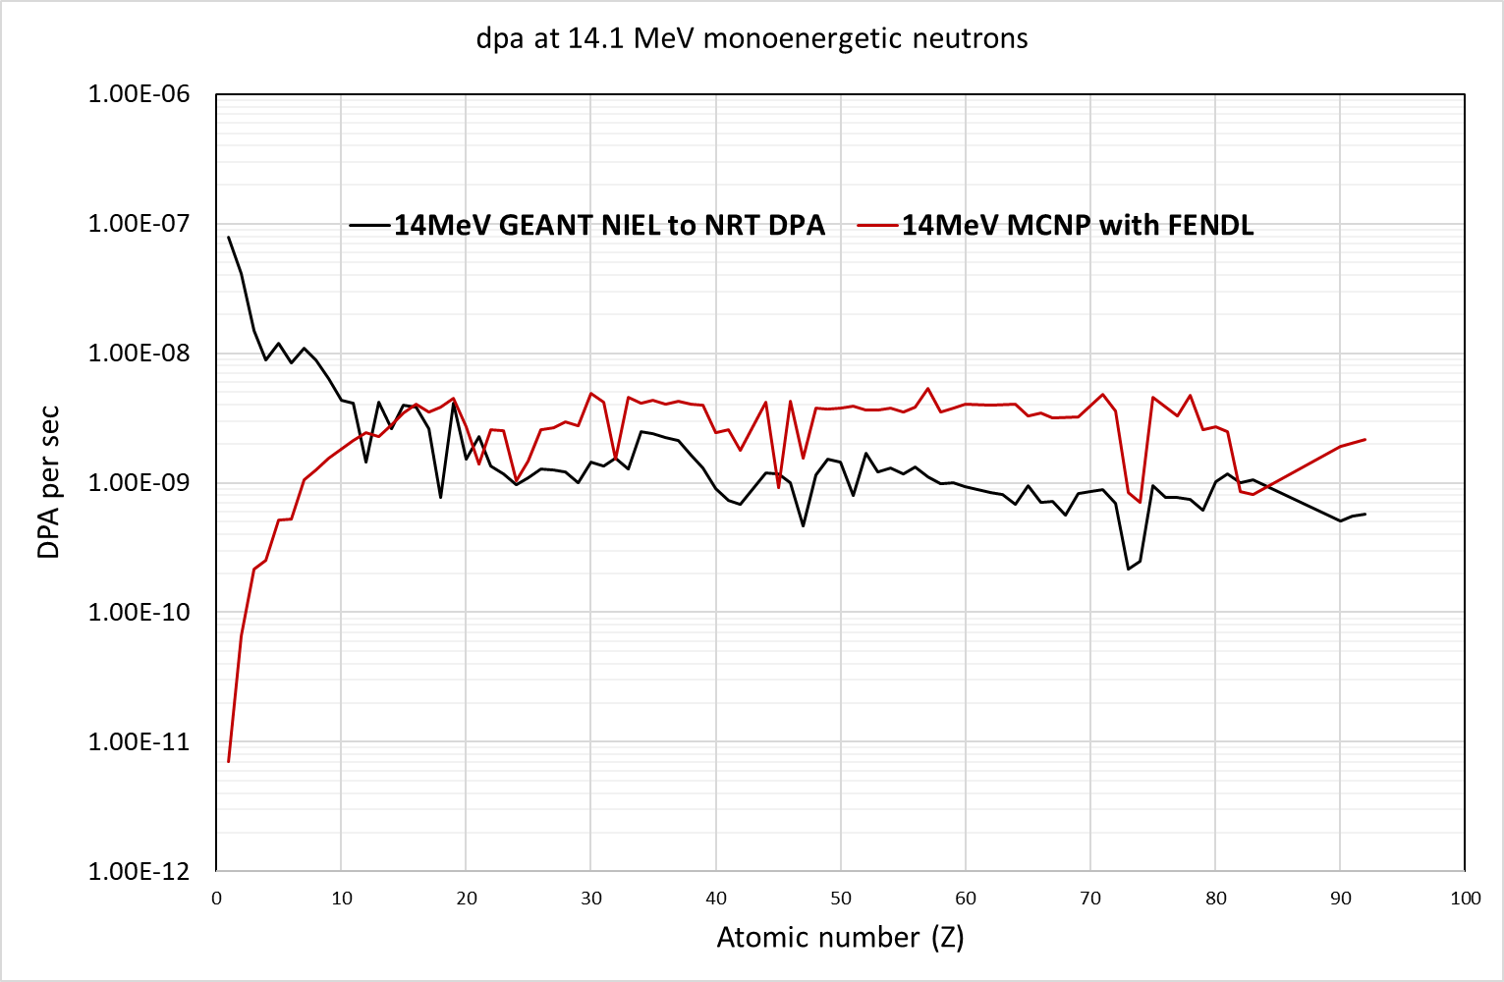
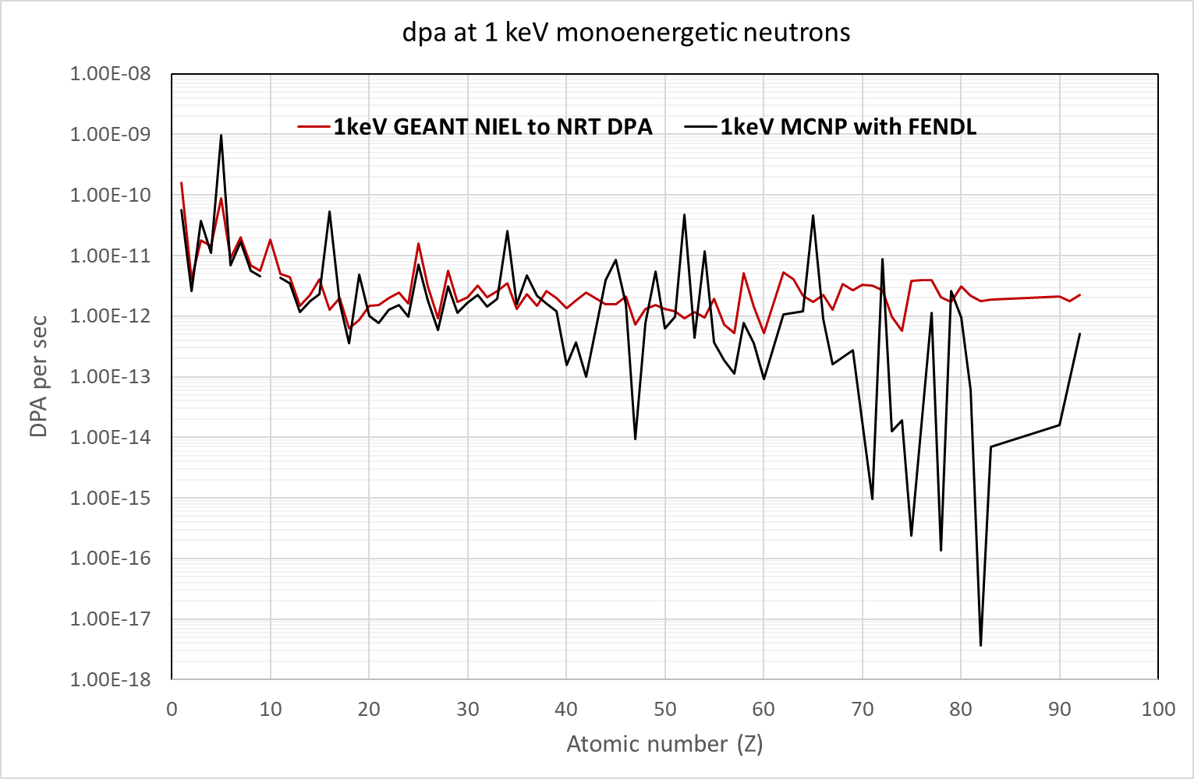
dpa cross section in FENDL-3.1
FENDL implements dpa cross sections based on the damage energy and recoil spectra of all possible reaction channels.
MCNP uses the MT reaction channel 444 from FENDL to predict dpa.
dpa cross sections have been compared with None Inelastic Energy Loss (NIEL) values predicted using Geant4, with the same threshold damage energy.
dpa from MCNP, using FENDL, is larger at higher atomic numbers compared to NIEL to NRT dpa from Geant4.
Both Geant4 and MCNP simulations show a dip in dpa at tungsten.
The low Z region is being investigated to understand the discrepancies in dpa values between MCNP and Geant4.

Slide 18
Summary and discussion
Important materials for spherical tokamak;
Tungsten, Boron, Carbon, Hafnium, Vanadium, Iron, Chromium, etc.
Important parameters for spherical tokamak;
Magnet lifetime, TBR, Neutron shield
Post shutdown assessment; activity, dose rate, and radioactive waste categorisation
Helium producing reaction channels are not precisely included in the carbon cross section database.
Different data libraries predicts different activity post shutdown in case of WC. FENDL doesn’t come with the FISPACT compatible format.
Some important points for consideration:
Impact of NJOY processing on the cross-section data and its impact on the design prediction
dpa cross section data
Possibility of including high energy electron cross section to FENDL to simulate the impact of runaway election in ST domain.

Slide 19
Thank you
Contact us:
Mayank rajput
Mayank.rajput@tokamakenergy.com
www.tokamakenergy.com
Tokamak Energy Ltd 173 Brook Drive Milton Park Oxfordshire OX14 4SD
United Kingdom
© 2025 Tokamak Energy
19

