Slide 1
Ranking
of iron nuclear data performance
for fusion application
using a suite
of benchmark experiments
Alberto Milocco (F4E external expert),
Marco Fabbri, Davide Laghi
IAEA Consultancy Meeting on the Preparation of a Major FENDL Release,
Wien, 13-16 May 2025

Slide 2

Overview
Background
    F4E commitment to nuclear data V&V for ITER structural materials
    SANDA report
    Integral benchmarks databases (CoNDERC, SINBAD, ICSBEP)
Scope
    Nuclear data libraries: FENDL 3.1d & FENDL 3.2c
    Material: Iron
    Experiments: integral
    Metrics: relative % error & chi-squared
    Energy: above 100 KeV
Objective
    Development of a general method for ranking performance of nuclear data libraries
    Contribute further V&V of FENDL 3.2c

Slide 3
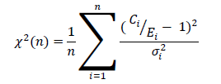
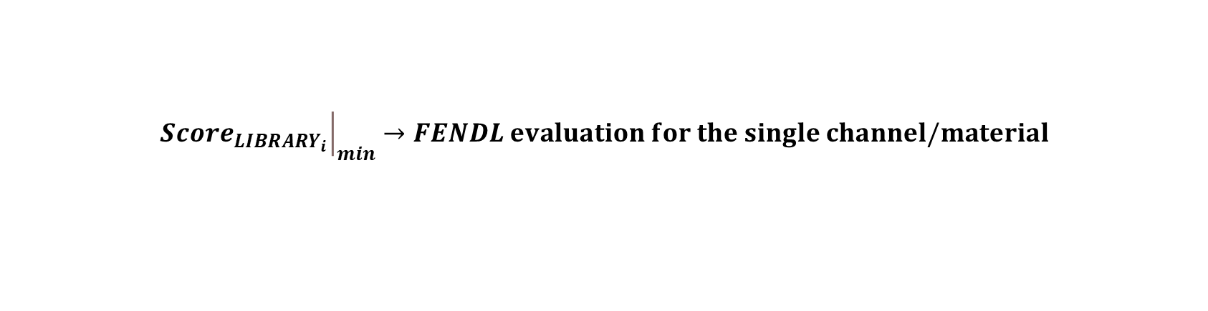
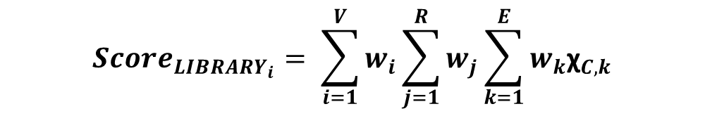
Very preliminary Idea for Validation for FENDL (4/4)
Experiment, w_{V}
Responses, w_{R}
Energy: C/E relative importance, w_{K}
TIARA 40 Mev: 1.0
TIARA 60 Mev: 0.6
ASPIS88
…
Flux: 1.0
Foils: 0.8
Heating: 0.6
…
Very low: 1
Low: 0.8
Middle: 0.6
…
STARTER
$$Score_{LIBRARY_{i}}= \sum_{i=1}^{V}{w_{i}\sum_{j=1}^{R}{w_{j}}}\sum_{k=1}^{E}{w_{k}{\text{χ}}_{C,k}}$$
$${\left.Score_{LIBRARY_{i}}\right|}_{min}→FENDL evaluation for the single channel/material$$
+ Expert JUDGEMENT

Slide 4
Experiments
IPPE-DT: Fe spheres, DT source, SINBAD db
IPPE-CF: Fe spheres, Cf-252 source, ICSBEP db
RCR-SS: stainless steel block, Cf-252 source, ICSBEP db
RCR-FE: Fe sphere, Cf-252 source, ICSBEP db
ISIS-800MEV: Fe/concrete shield, 800 MeV proton spallation source, SINBAD db
ASPIS-88: mild steel shield, U235 fast fission source, CoNDERC/SINBAD db
OKTAVIAN-FE: Fe sphere, DT source, CoNDERC/SINBAD db
Perspective experiments: TIARA, ASPIS-PCA Replica, JANUS-1, ASPIS N/G Water/Steel, …
EXP | IPPE-DT | IPPE-CF | RCR-SS | RCR-FE | ISIS-800MEV | ASPIS-88 | OKT-FE
QA | 🙂 | 🙂 | 🙂 | 🙂 | 😟 | 🙂/ 😐 | 🙂
WE | 1 | 1 | 1 | 1 | 1/3 | 1 | 1

Slide 5
Measurements/1
IPPE-DT: # 5 TOF neutron spectra
IPPE-CF: # 6 PHS neutron & gamma spectra
RCR-SS: #1 n PHS spectrum, #2 activation foil sets,
RCR-FE: #1 PHS neutron spectrum, # 2 activation foils sets, #1 Bonner spheres neutron spectrum
ISIS-800MEV: #1 Bonner spheres neutron spectrum, #2 activation foil sets
ASPIS-88: # 5 sets of activation foils
OKTAVIAN-FE: TOF neutron leakage spectrum from #1 Fe sphere
Label | R1 | R2 | R3 | R4 | R5 | R6 | R7 | R8 | R9
RR | 27Al(n,a) | 197Au(n,g) | 115In(n,n’) | 113In(n,g) | 103Rh(n,n’) | 32S(n,p) | 58Ni(n,p) | 12C(n,n’) | 207Bi(n,nx)
Th. [MeV] | ~4.2 | - | ~0.5 |  |  | 0.9 | 1 |  | ~10

Slide 6
Measurements/2
TOF spectra
WS=1, but sources of experimental uncertainty are:
  source term time distribution
  room return effects
  multiple scattering effects on flight path
Pulse High/proton recoil spectra
WS=1 (provisional), but experimental errors due to:
  unfolding
  neutron/gamma separation
Bonner spheres spectra
WS=1/3 wide energy range, but not much accurate due to high unfolding uncertainy,
Reaction rates:
WS=1 (in general), contributions are distibuted uniformly above threshold for the time being.
* Signals in red font are actually yet mothballed along with metrics evaluations

Slide 7
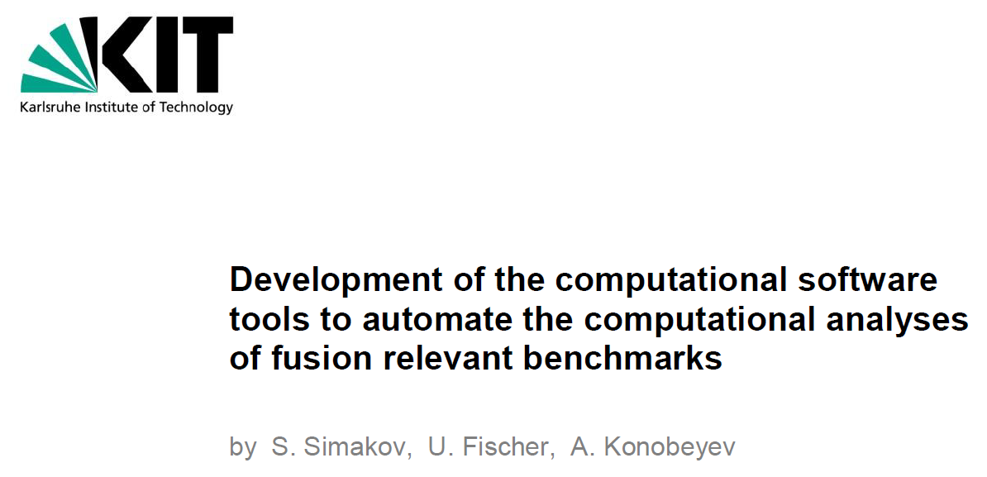
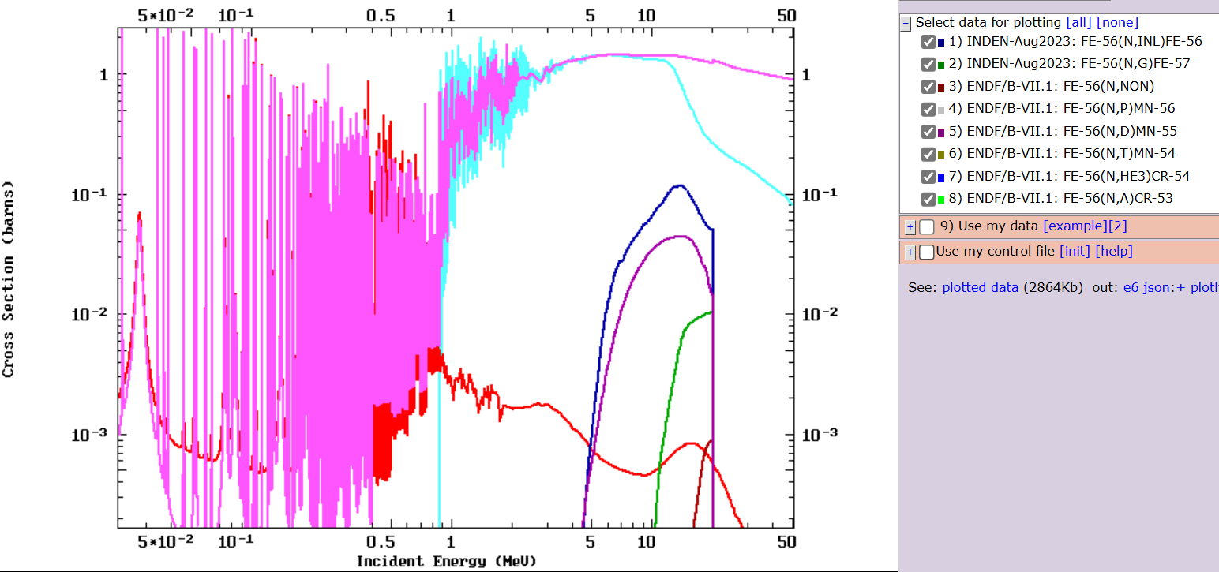
Energy Groups
BIN | E_min [MeV] | E_max [MeV] | W_{E}
E0 | 1000 | - | 0
E1 | 50 | 1000 | 1/3
E2 | 20 | 50 | 2/3
E3 | 10 | 20 | 1
E4 | 7 | 10 | 1
E5 | 4 | 7 | 1
E6 | 3 | 4 | 1
E7 | 2.5 | 3 | 1
E8 | 2 | 2.5 | 1
E9 | 1.5 | 2 | 1
E10 | 1.2 | 1.5 | 1
E11 | 1 | 1.2 | 1
E12 | 0.7 | 1 | 1
E13 | 0.5 | 0.7 | 1
E14 | 0.4 | 0.5 | 1
E15 | 0.2 | 0.4 | 1
E16 | 0.15 | 0.2 | 1
E17 | 0.1 | 0.15 | 1
E18 | 0.06 | 0.1 | 2/3
E19 | 0.03 | 0.06 | 2/3
E20 | 0.01 | 0.03 | 2/3
E22 | 0.001 | 0.01 | 1/3
E23 | 2.5E-8 | 0.001 | 1/3
E24 | - | 2.5E-8 | 0
Fusion application library
Binning in 100 Kev – 1 MeV resonance region
Simakov reference

Slide 8

Key Performance Index (KPI)
KPI1: Mean Weighted Percentage Relative Absolute Deviation (MWP-RAD)
$MWP−RAD$= $\frac{1}{NG∙NE∙NS}\sum_{1}^{NG}{{WG}_{k}∙}\left(\sum_{1}^{NE}{{WE}_{l}∙\left(\sum_{1}^{NS}{{WS}_{lm}∙}{100∙RAD}_{klm}\right)}\right) ; {RAD}_{klm}=$ ${|C}_{klm}/E_{klm}−1|$
KPI2: Mean Weighted Chi-Squared (X2)
$Χ^{2}$= $\frac{1}{NG∙NE∙NS}\sum_{1}^{NG}{{WG}_{k}∙}\left(\sum_{1}^{NE}{{WE}_{l}∙\left(\sum_{1}^{NS}{{WS}_{lm}∙}χ_{klm}^{2}\right)}\right) ; χ_{klm}^{2}=\frac{{\left(C_{klm}/E_{klm}−1\right)}^{2}}{σ_{lkm}^{2}}$
WG: Weight of energy Group
WE: Weight of Experiment
WS: Weight of Signal
$χ_{klm}^{2}$: Chi-square value for signal, experiment and energy bin
$C_{klm}$: Calculated value for signal, experiment and energy group
$E_{klm}$: Experimental value for signal, experiment and energy group
$σ_{klm}$: Experimental error

Slide 9

JADE
JADE developments in current framework:
Pre-processing of MCNP6.3 inputs (only Fe isotopes change, the rest is always Fendl 3.2c and IRDFF)
Suite of new Fe benchmarks soon included for MCNP6.3 simulation
Post-processing (TOF, CHI_SQUARED)

Slide 10
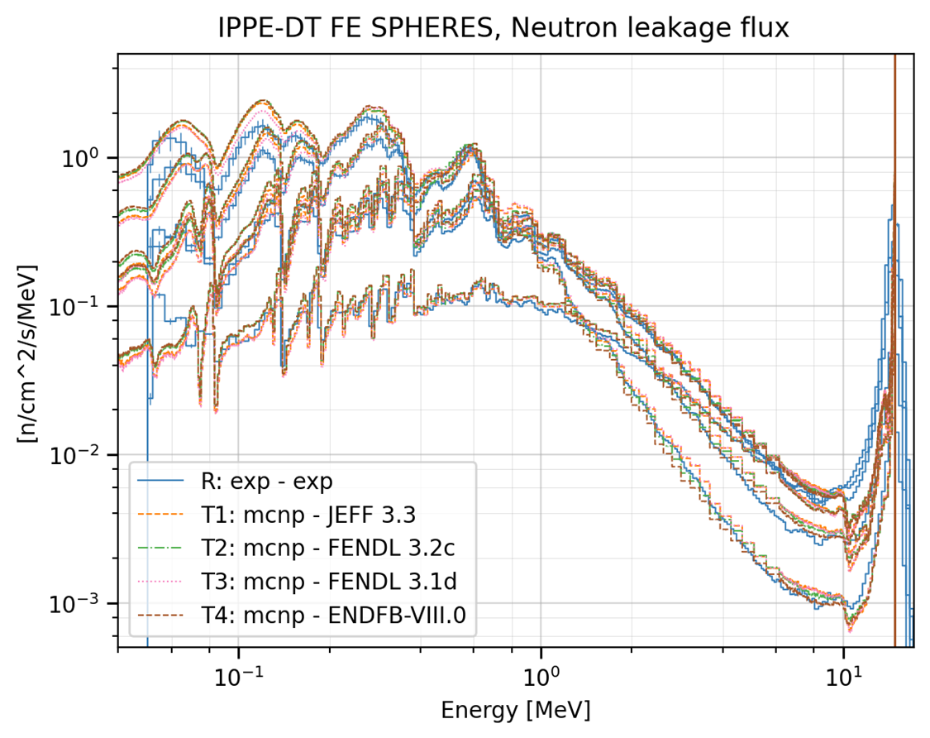
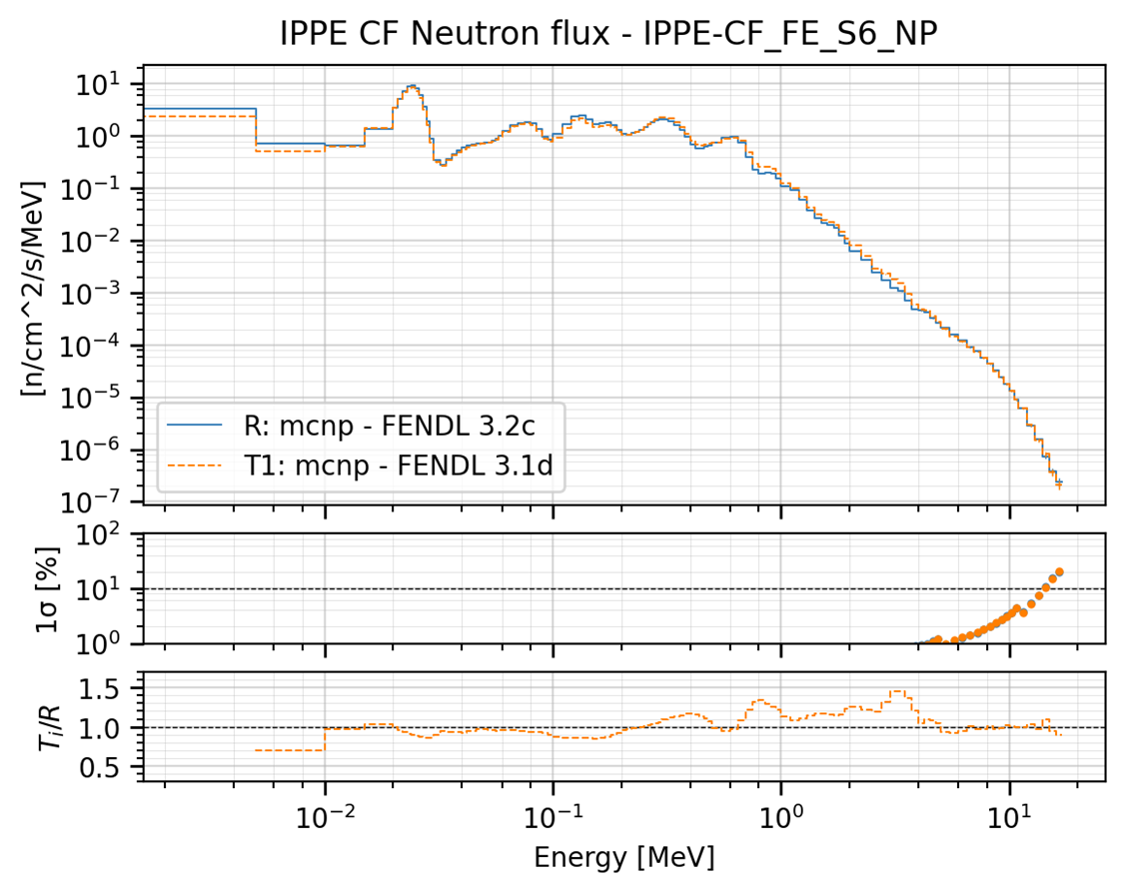
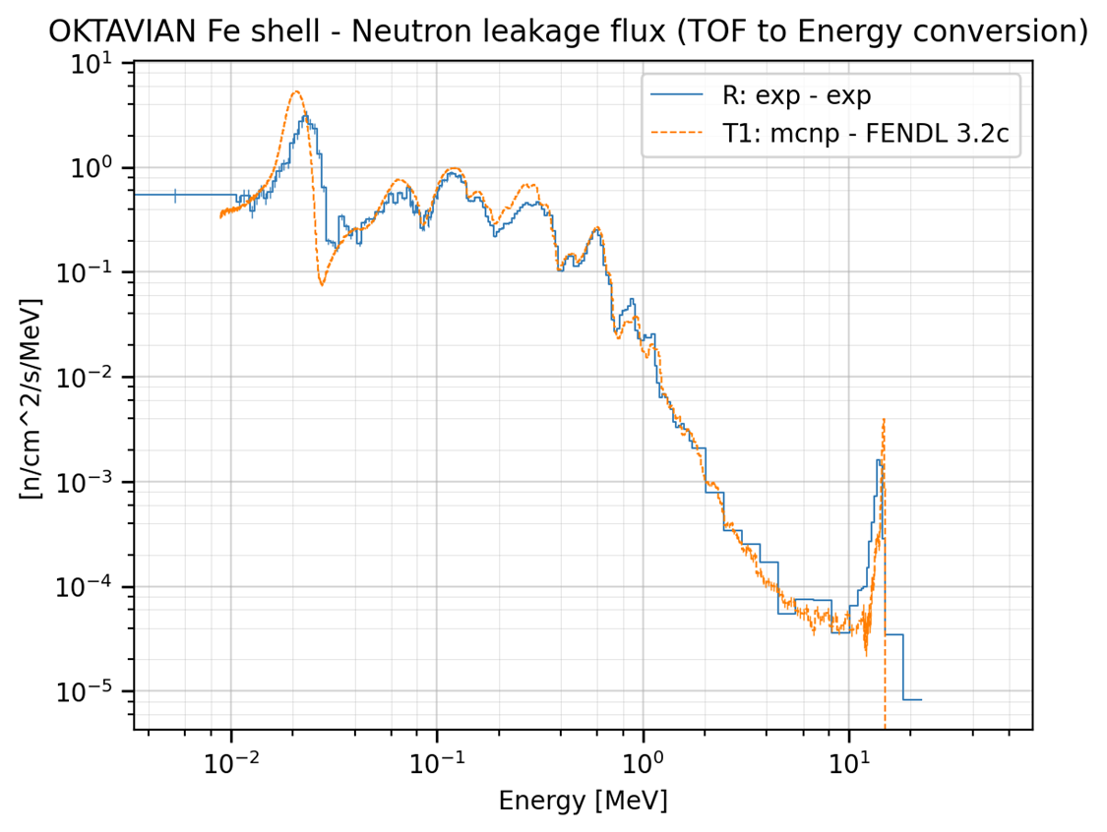
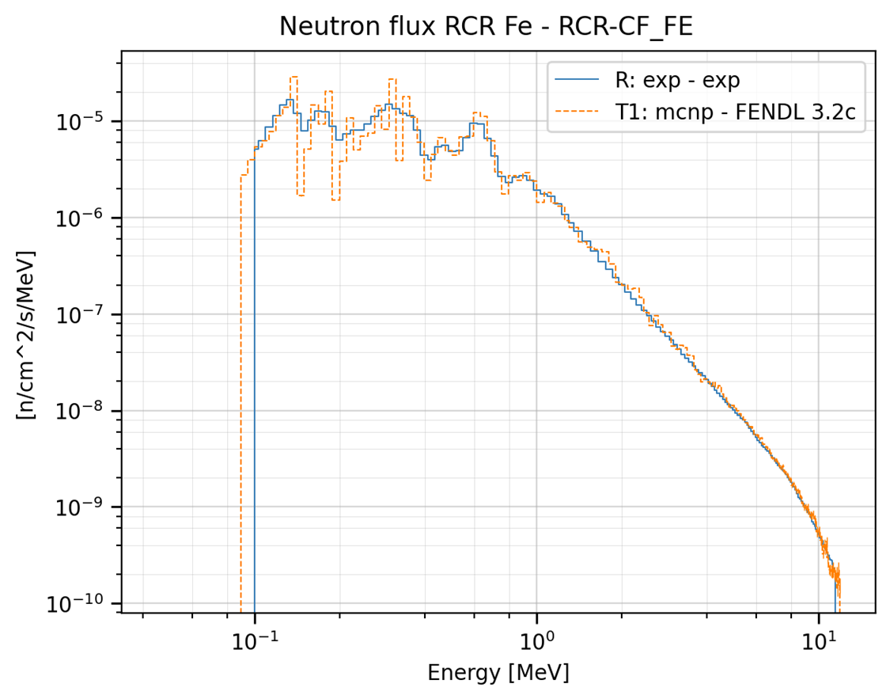
Plots

Slide 11
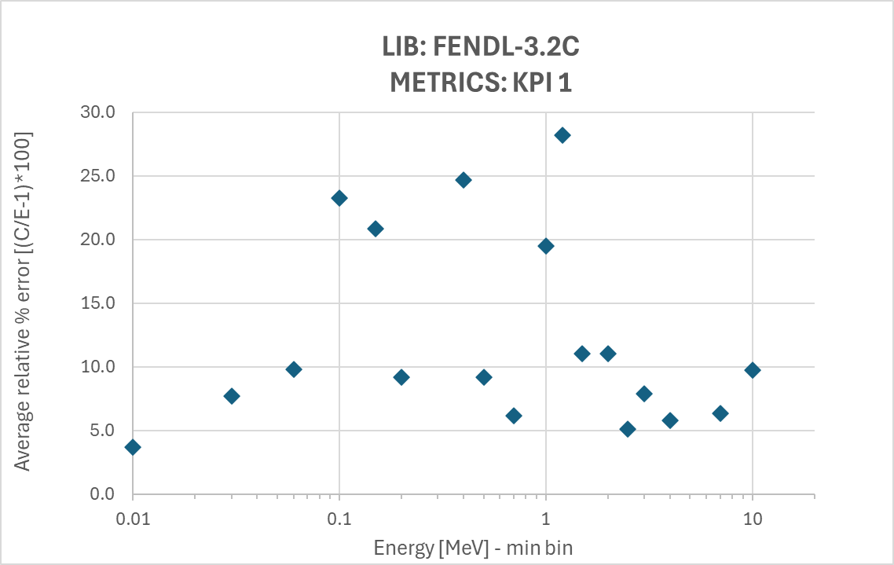
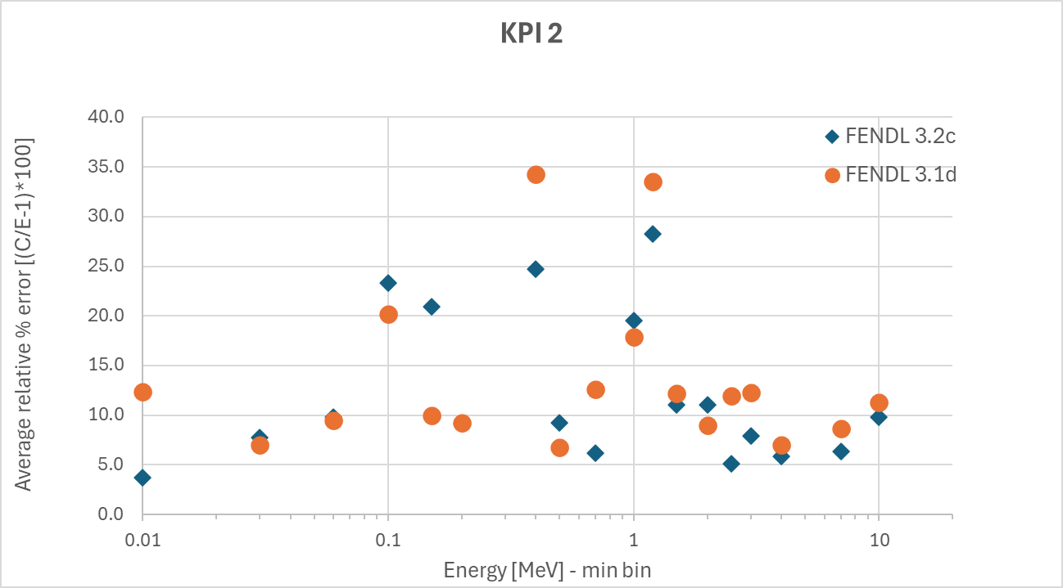
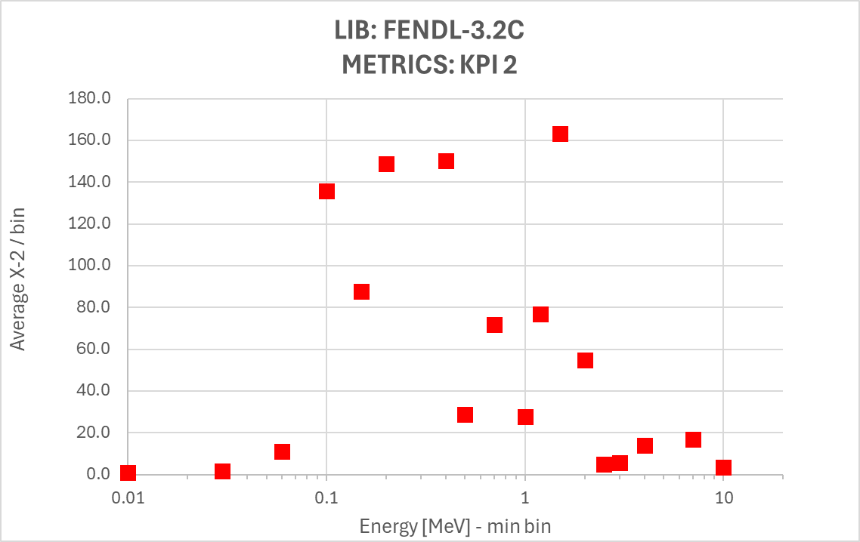
KPIs
General comparison between cross sections from different libraries
Pinpoint issues by energy range
Spot out problems related to specific experiment
Questionable metrics consistency (yet)

Slide 12
Comments
Chi-squared approach may be affected by unrealistic experimental uncertainties
Chi-squares figures for shielding experiments may be different from those for criticality benchmarks
Weights in KPIs are tweaked by expert judgment and take into account quality assessment of the experiment in the overall, modelling uncertainties and application of the library
Weighting individual signals may better disclose computational uncertainties associated with cross sections
Better performance may be due to the use of an experiment in cross sections evaluation/adjustment, but there’s the chance to weight it

Slide 13
Perspective activities
Sensitivity & uncertainty analyses would be the proper drive to establish the measurements weights in the KPIs or associated errors
Correlation between experiments not yet addressed
Normalization and uncertainties associated to KPIs yet to be assessed
More metrics and norm definitions to be tested
KPIs can be authomatic for rapid assessment of the performances of nuclear data libraries
Broadening the scope (e.g. to other materials, energies, signals) may not be straightforward

Slide 14
Conclusions
Simulations of benchmark experiments can be contradictory, hence the need of a general criterium for classification
The number of figures to take in account can be high (~500 in Fe case study), thus further development shall come along with improvements in computational tools (e.g. the JADE)
This activity represents an early attempt to establish a framework for a general assessment of nuclear data performances along with integral benchmarking models

