Slide 1
Overview of FENDL:
Library, processing methods and tools
Presented by: Daniel López Aldama email: dlopezaldama@gmail.com
Contributing authors:
Tim Bohm, Daniel L. Aldama, Georg Schnabel, Marco Fabbri, Saerom Kwon,
Davide Laghi, Andrej Trkov, Alex Valentine, Víctor López, Patrick Sauvan
Consultancy Meeting on the Preparation of a Major FENDL Release
Vienna 13th – 16th May 2025

Slide 2
Outline
Overview of FENDL
Nuclear data management tools developed at the NDS/IAEA within the framework of the FENDL project
Future work towards a major release of FENDL
Consultancy Meeting on the Preparation of a Major FENDL Release
Vienna 13th – 16th May 2025

Slide 3


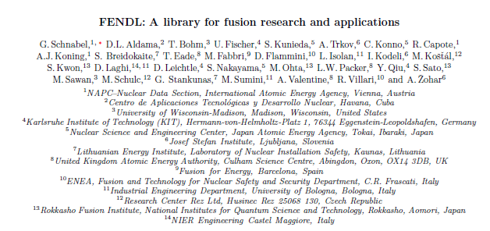
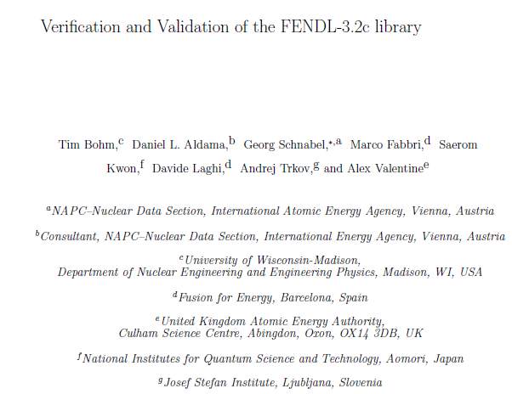
Current status of FENDL
Producing, processing, verifying, validating and documenting FENDL: Team effort
Coordinated by NDS/IAEA during decades
Fusion Science and Technology (ANS)
(Special issue on Nuclear Data for Fusion Applications)
Submitted, under review (FENDL-3.2c)
Nuclear Data Sheets 193 (2024) 1-78
(Big paper based on FENDL-3.2b)

Slide 4
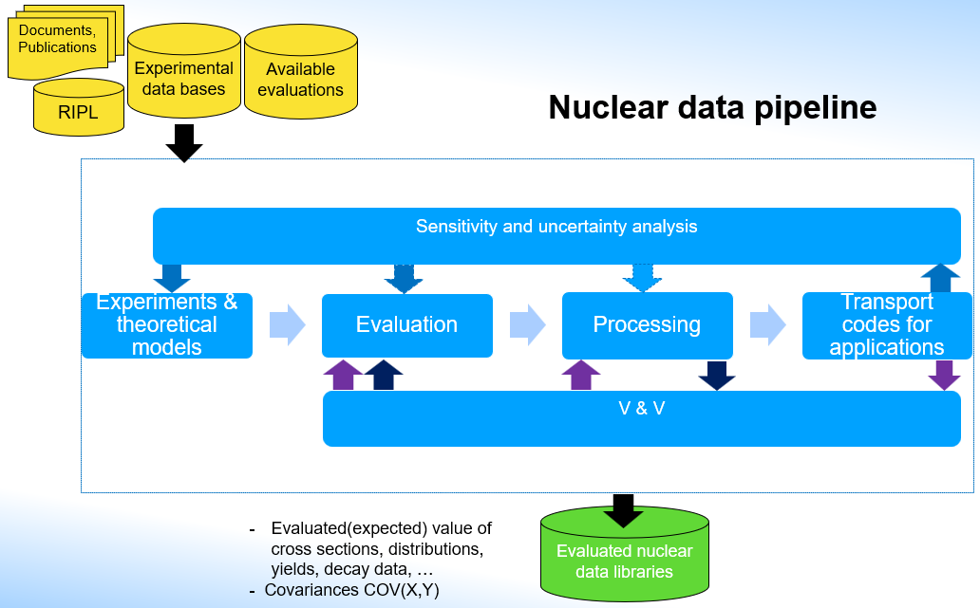
FENDL Project: From evaluators to final user

Slide 5
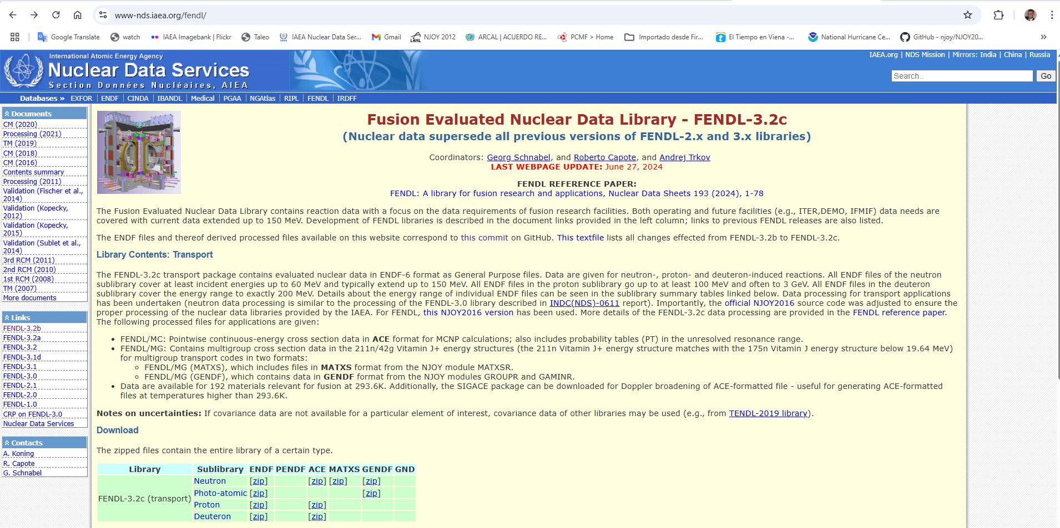
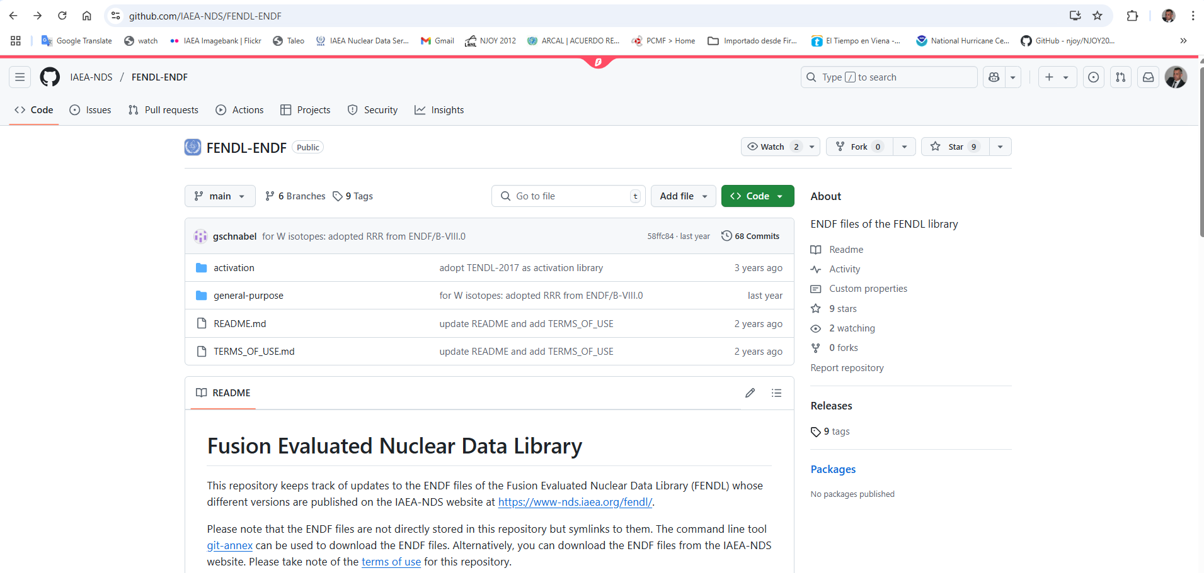
Main updates in evaluations from FENDL-3.2b to FENDL-3.2c
  Web page:
  https://www-nds.iaea.org/fendl/
Incident neutrons
  Tungsten (W) isotopes were taken from ENDF/B-VIII.0 (with extended RRR)
  Correction of the reference frame in MF=6 from LAB (LCT=3) to center-of-mass (LCT=2) for the energy-angle distribution of the recoil nucleus of Mn-55, Th-232, and all tungsten (W) isotopes.
Incident protons
  Li-7 data have been replaced with the revised JENDL-5 evaluation from August 2023. (MT=51,601 => MT=5)
Incident deuterons
  Invalid values (NaN) were removed from sections MF3/MT2 and MF6/MT2 for Ti-50, Ba-132, Gd-157, Er-170, W-182
  GitHub repository:
  https://github.com/IAEA-NDS/FENDL-ENDF

Slide 6
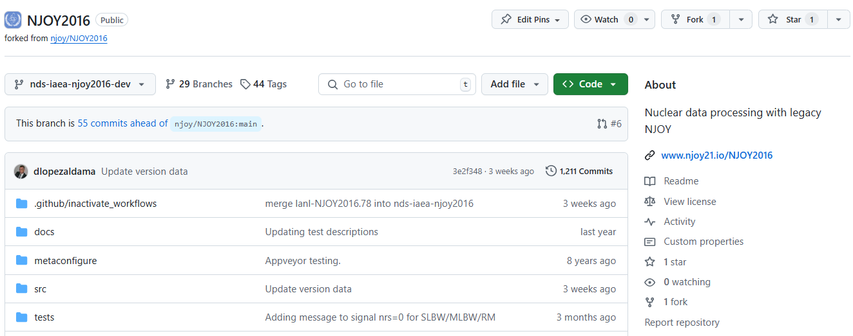
Main updates in processing methods
Processing codes:
  FENDL-3.2b: incident neutrons - NJOY2016.60+IAEA patches
  incident protons - NJOY2016.49+JAEA patches for Japanese files,
  NJOY2016.60+IAEA patches for the rest of files
  incident deuterons - NJOY99.364+JAEA patches for Japanese files
  NJOY2016.60+IAEA patches for the rest of files
  FENDL-3.2c: NJOY2016.74+NDS/IAEA patches for all incident particles (n, p, d)
  https://github.com/IAEA-NDS/NJOY2016/tree/nds-iaea-njoy2016
  https://github.com/IAEA-NDS/NJOY2016/tree/nds-iaea-njoy2016-dev
Last commit contains:
NJOY2016.78+all NDS/IAEA patches

Slide 7
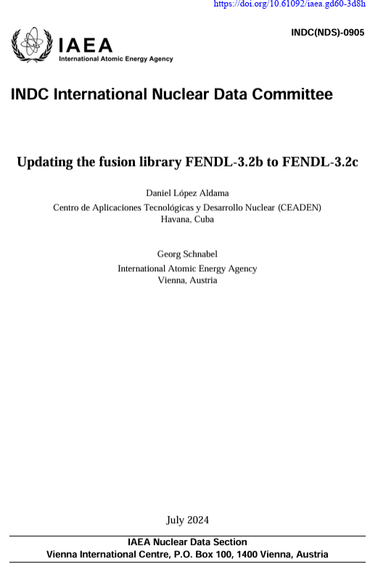
Main processing updates
1. Heating and damage calculation (HEATR)
  Adopted upper kinematic limit for total and partial heating numbers [Kasuaki & Konno]
  Corrected heating calculation for MT=102=(n,γ) [yield issue, reported by Wen Yin et. al., 2021)
  Use of the available energy (Ea) for the damage calculation involving charged-particle emitting reactions [suggested by Chen and Bernand, 2022]
2. Probability tables in the Unresolved Resonance Range (PURR)
  Implemented a simple procedure to handle extremely small samples of the total cross section to avoid negative probability tables. Important for processing La-139, Cd-106, Re-185 and Re-187.
3. Correction of energy-angle distribution smoothing for MF6/LAW=1
(ACER and GROUPR)
4. Major updates for incident protons and deuterons (ACER, RECONR)
  Conversion of MF6/LAW=7(laboratory angle-energy distribution) to ACE/LAW=67 to avoid issues with Monte Carlo codes such as MCNP and PHITS.
  Correction of the reconstruction of the scattering cross section and the corresponding angular distribution for the nuclear+interference formalism
  Other “minor corrections”, such as using the correct values of AWI and AWP for charged particles
  Correction of double counting of redundant cross sections when using RECONR and ACER.
https://doi.org/10.61092/iaea.gd60-3d8h

Slide 8
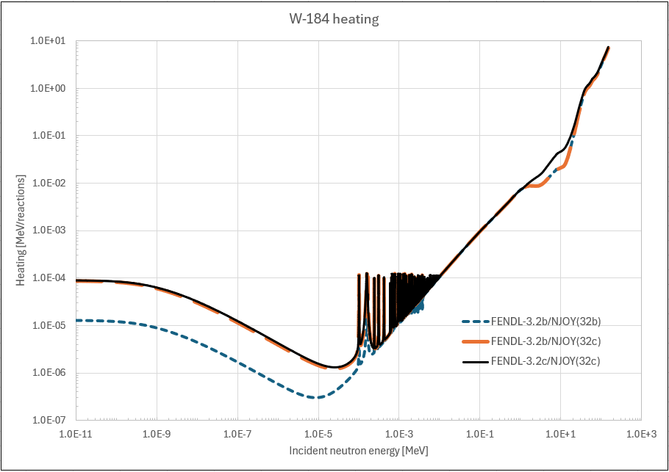
W-184 heating: HEATR + MF6/(LCT=2)

Slide 9
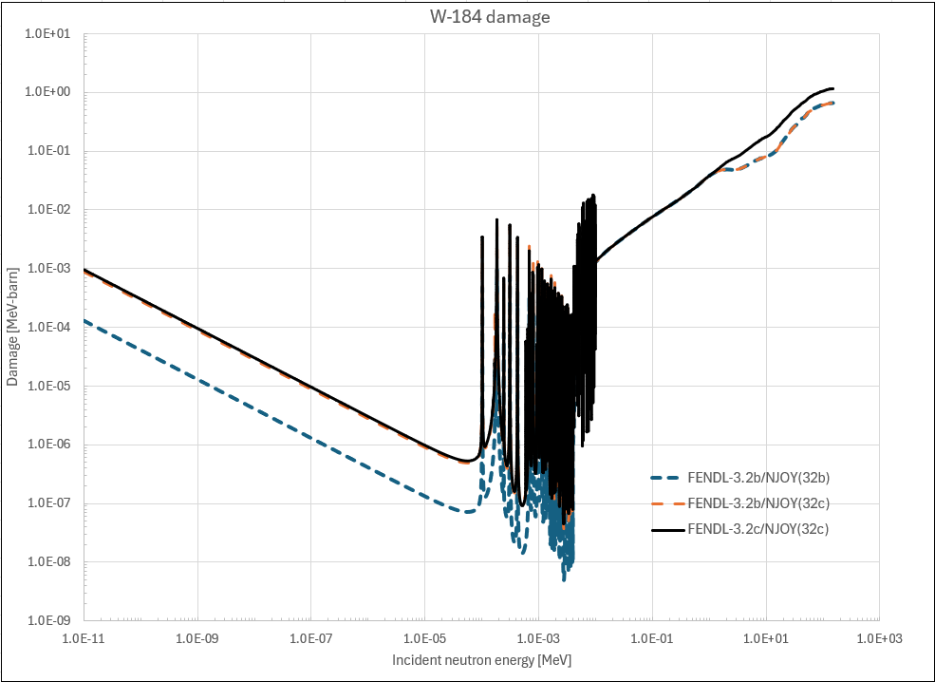
W-184 damage: HEATR + MF6/LCT=2

Slide 10
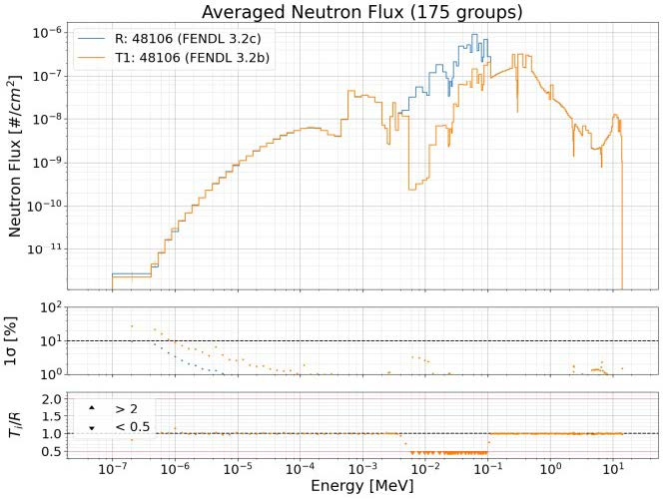

Cd-106: PURR/URR Ptables
FENDL-3.2c
FENDL-3.2b
Marco, Davide, et al.

Slide 11
Fe-58: PURR/URR Ptables
FENDL-3.2c
FENDL-3.2b
Marco, Davide, et al.

Slide 12
Hf-176: PURR/URR Ptables
FENDL-3.2c
FENDL-3.2b
Marco, Davide et. al

Slide 13
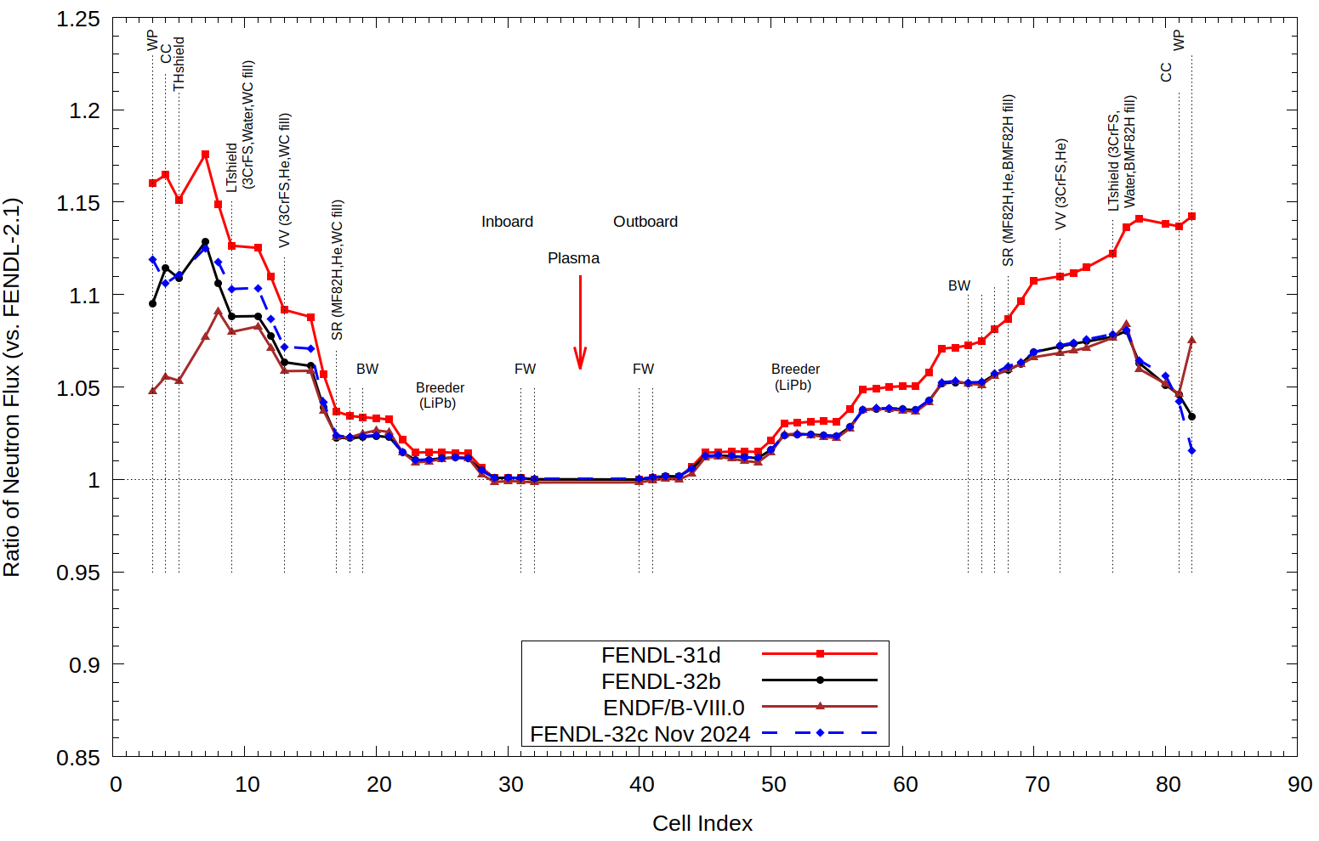
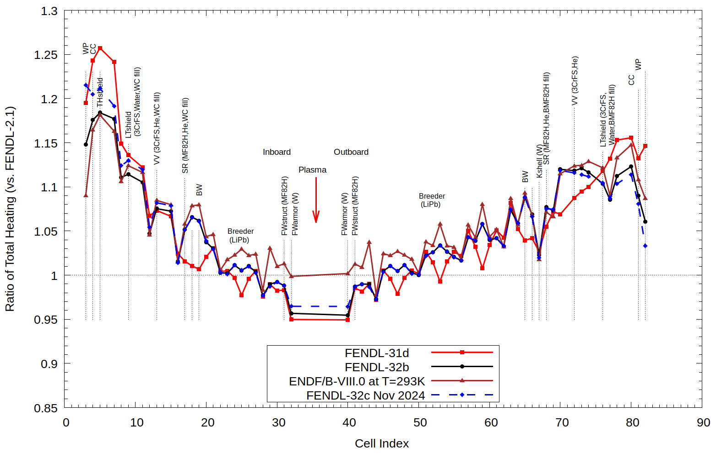
FENDL-3.2c vs FENDL-3.2b for incident neutrons
FNSF 1-D: Flux ratio vs FENDL-2.1
FNSF 1-D: Heating ratio vs FENDL-2.1
FENDL-3.2c
FENDL-3.2b
FENDL-3.2b
FENDL-3.2c
Tim Bohm et. al.
Tim Bohm et. al.
Summary of V & V for incident neutrons:
Computational benchmarks: Sphere Leakage, FNSF 1-D , ITER-1D,
Experimental benchmarks: Oktavian, TIARA, FNG Bulk Blanket, TUD Fe Slab, ASPIS Iron 88, FNS W—BLKT –TOF
No significant differences were observed between the results of FENDL-3.2b and FENDL-3.2c.
The observed differences are consistent with the updates introduced in FENDL-3.2c.

Slide 14
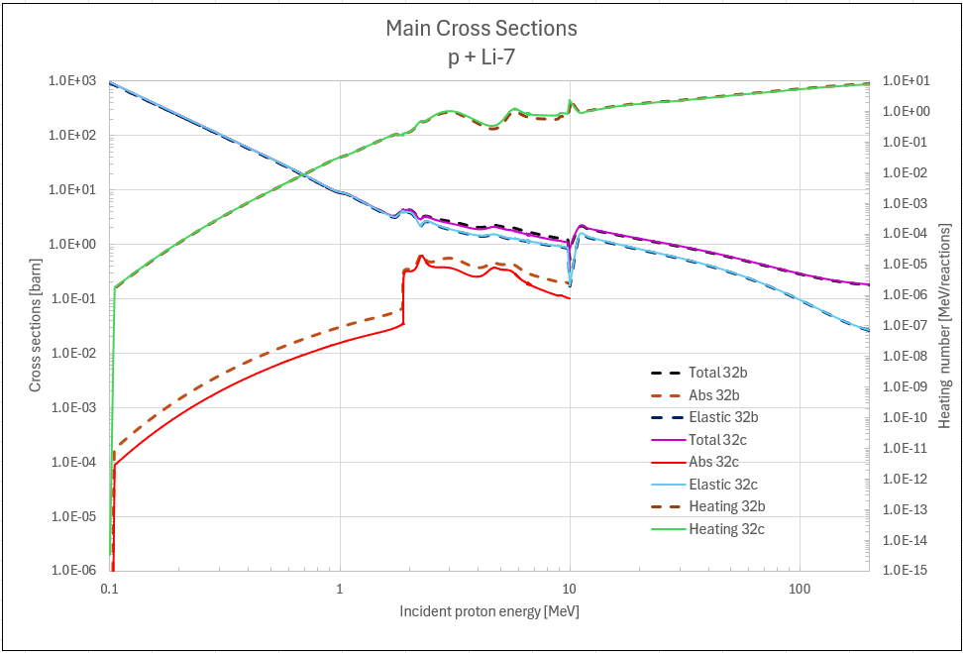
Charged particles: p + Li-7 : RECONR+ACER updates

Slide 15
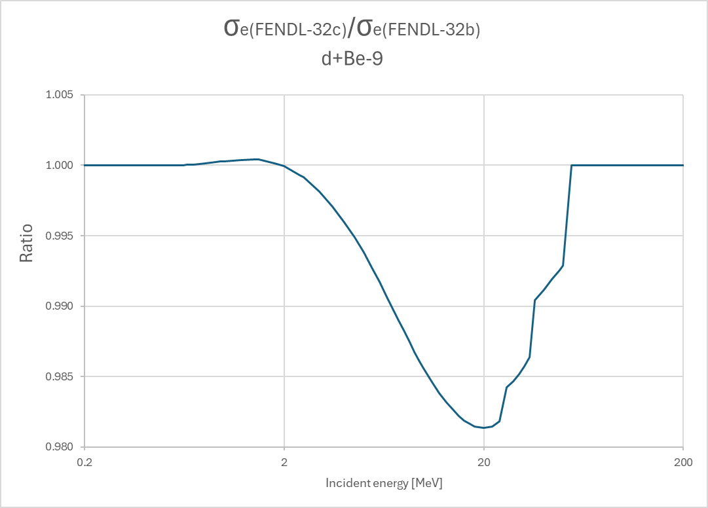
Charged particles: d+Be-9 : RECONR+ACER updates
Ratio=
Elastic scattering ratio max. diff. < 2 % at 20 MeV

Slide 16
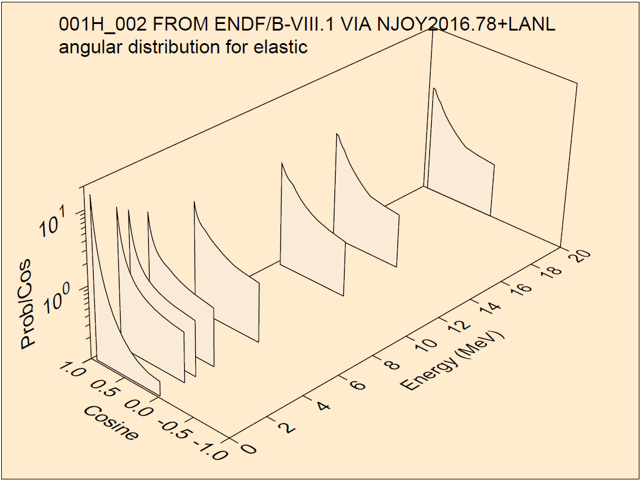
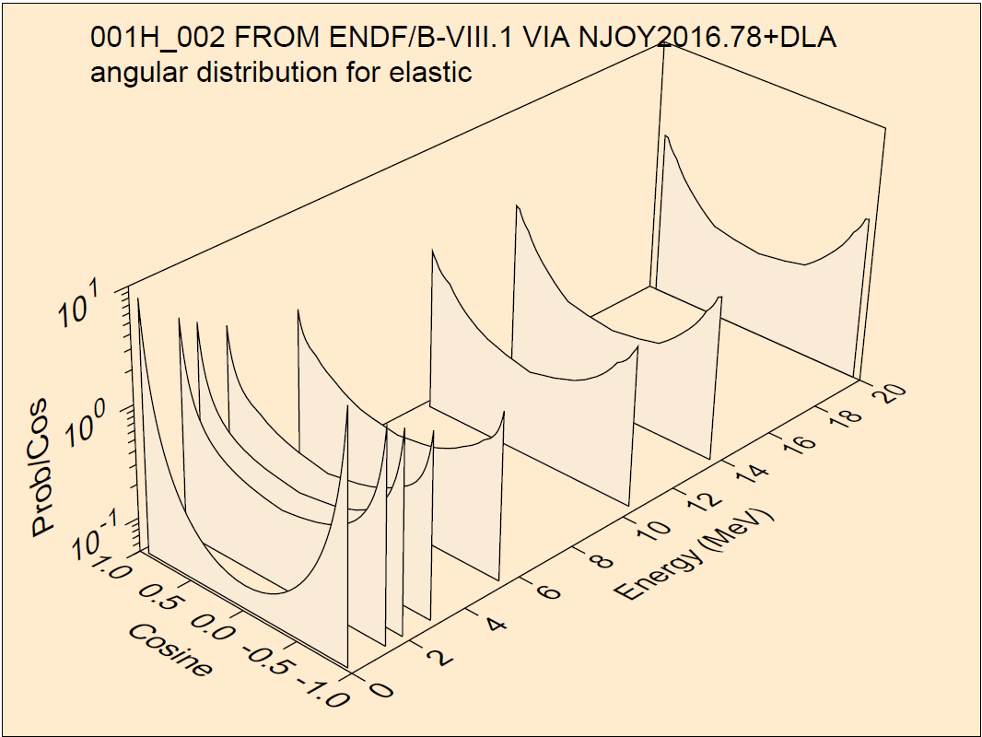
Charged particles: d+d from ENDF/B-VIII.1 (ACER update)
Identical charged-particles using nuclear+interference formalism for the elastic cross-sections

Slide 17
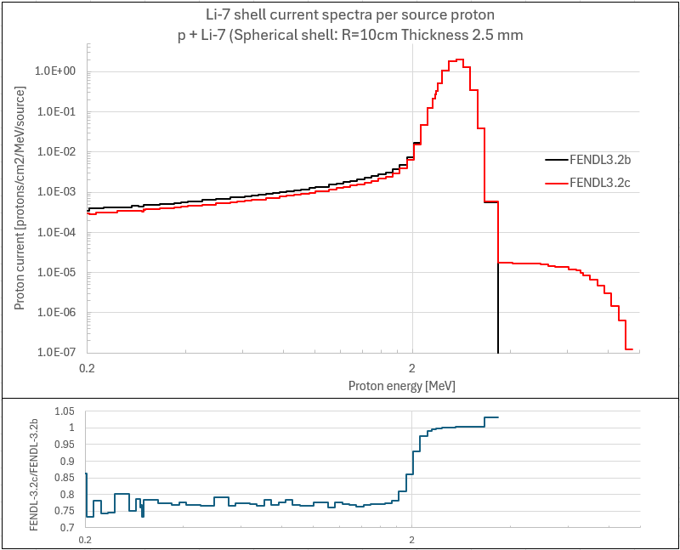
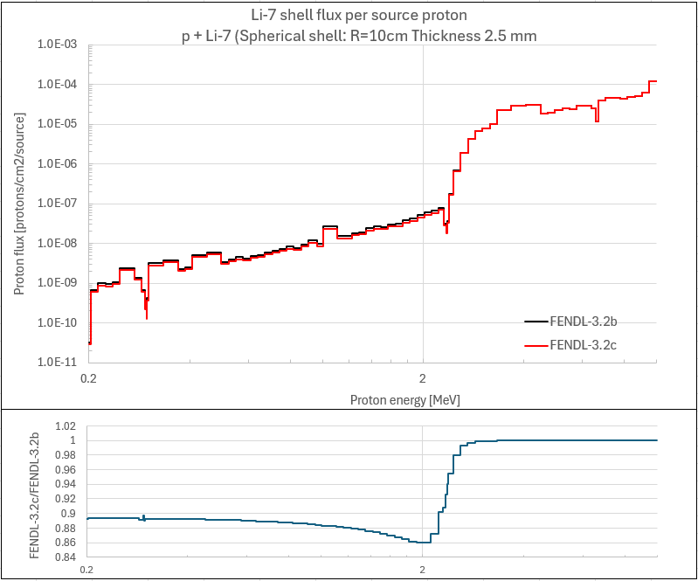
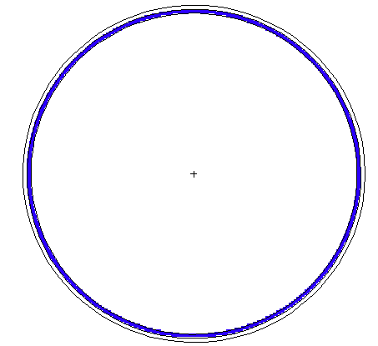
p+Li-7 spherical shell (MCNP-6.2/6.3 issue MT=601,51)
Proton Flux/source
Shell sphere:
Ri=10cm
Thickness=2.5mm
Proton source: 10 MeV
D.L. Aldama & A. Trkov

Slide 18
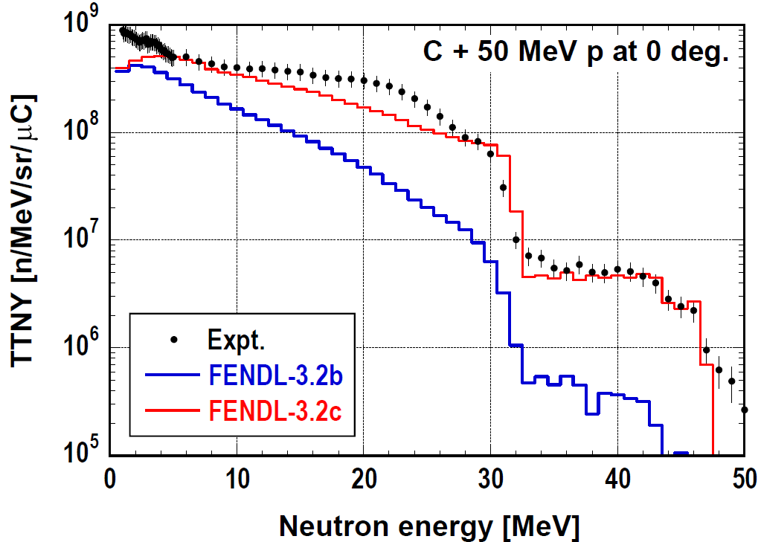
p + C: NJOY2016 updates (LAW61 vs LAW67 MCNP-6.x)
Saerom Kwon & C. Konno

Slide 19
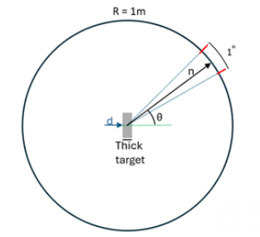
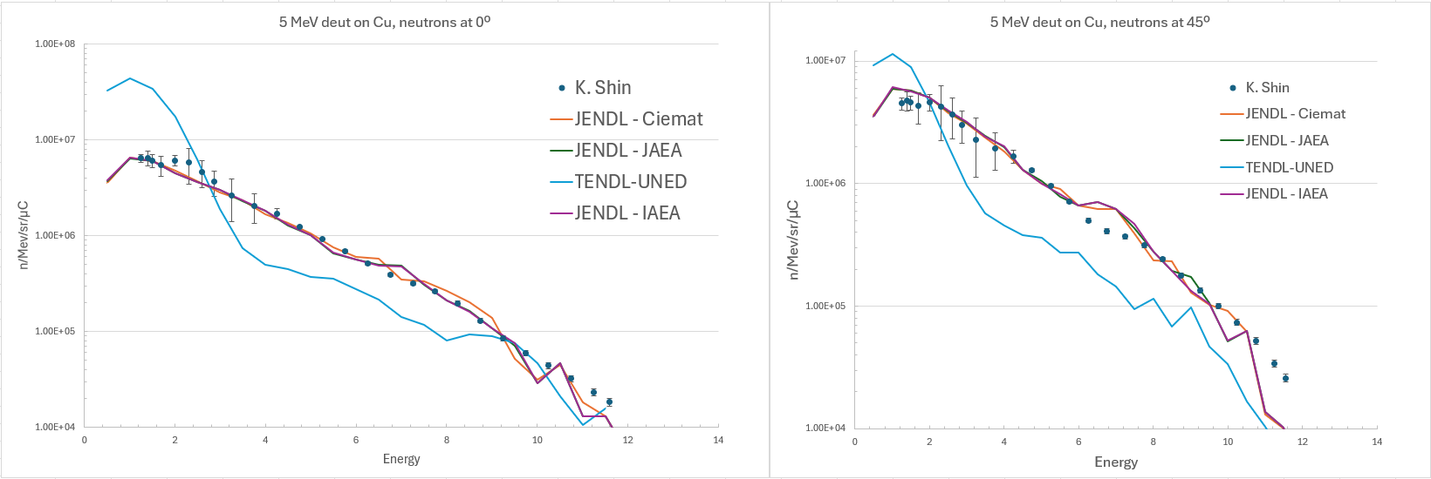
5 MeV deuteron integral test : d + Cu
TENDL-UNED: P. Sauvan et. al. “Implementation of a new energy-angular distribution of particles emitted
by deuteron induced nuclear reaction in transport simulations”, EPJ Web of Conferences 146, 02010 (2017),
ND2016, https://doi.org/10.1051/epjconf/201714602010
Victor López & Patrick Sauvan (UNED)

Slide 20
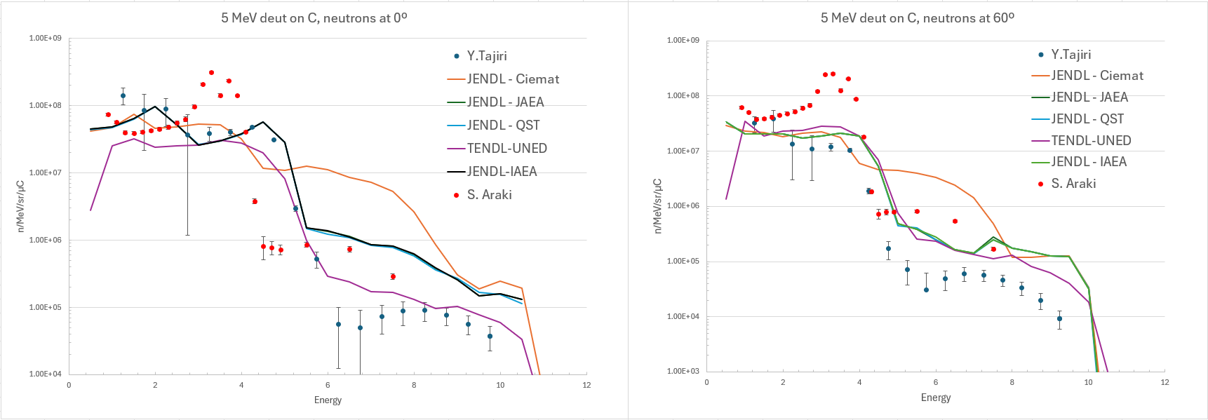
5 MeV deuteron integral test: d + C
TENDL-UNED: P. Sauvan et. al. “Implementation of a new energy-angular distribution of particles emitted
by deuteron induced nuclear reaction in transport simulations”, EPJ Web of Conferences 146, 02010 (2017),
ND2016, https://doi.org/10.1051/epjconf/201714602010
Victor López & Patrick Sauvan (UNED)

Slide 21
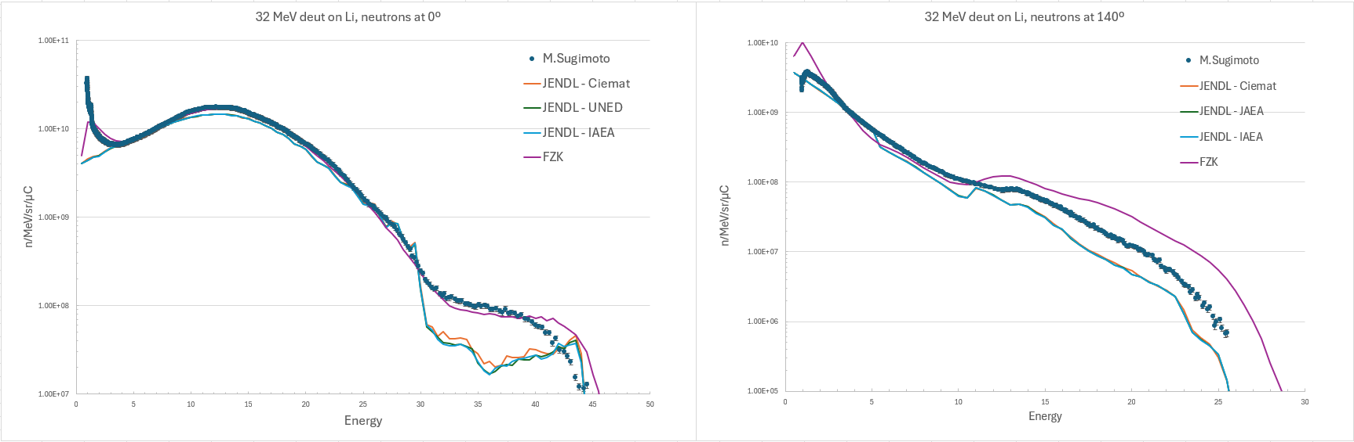
32 MeV deuteron integral test: d + Li
Victor López & Patrick Sauvan (UNED)

Slide 22
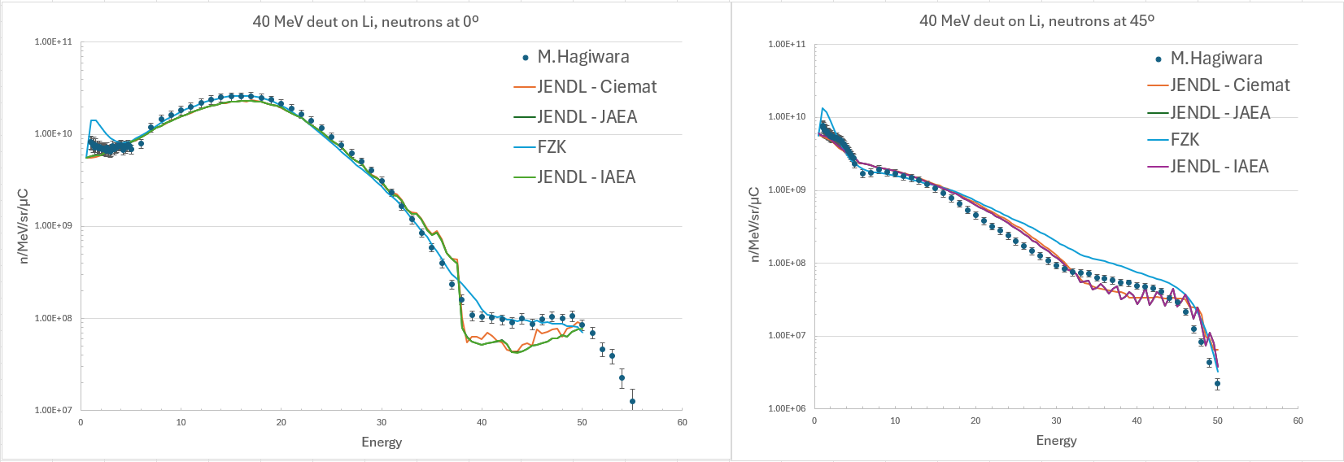
40 MeV deuteron integral test: d + Li
Victor López & Patrick Sauvan (UNED)

Slide 23
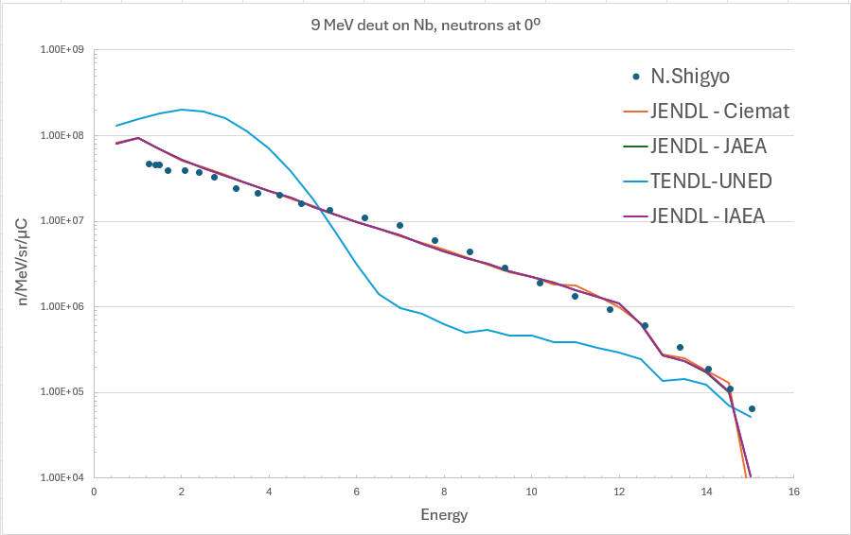
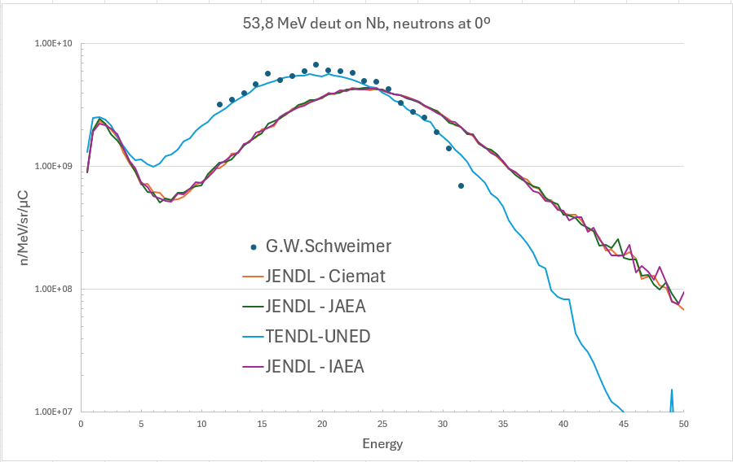
9 & 53.8 MeV deuteron integral test: d + Nb
TENDL-UNED: P. Sauvan et. al. “Implementation of a new energy-angular distribution of particles emitted
by deuteron induced nuclear reaction in transport simulations”, EPJ Web of Conferences 146, 02010 (2017),
ND2016, https://doi.org/10.1051/epjconf/201714602010
Victor López & Patrick Sauvan (UNED)

Slide 24
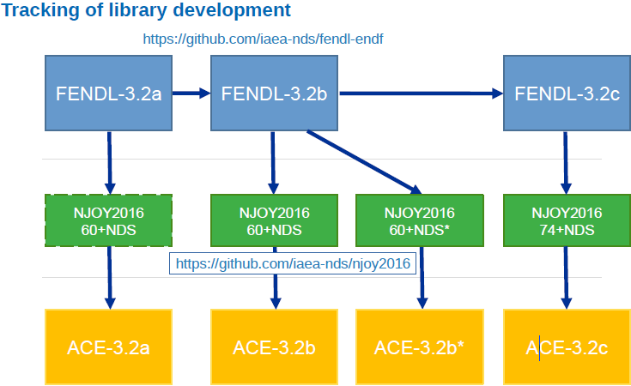
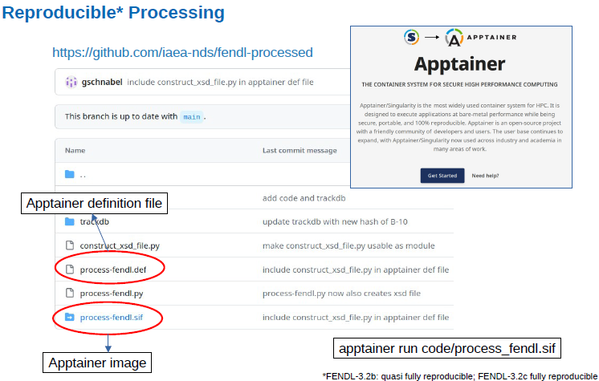
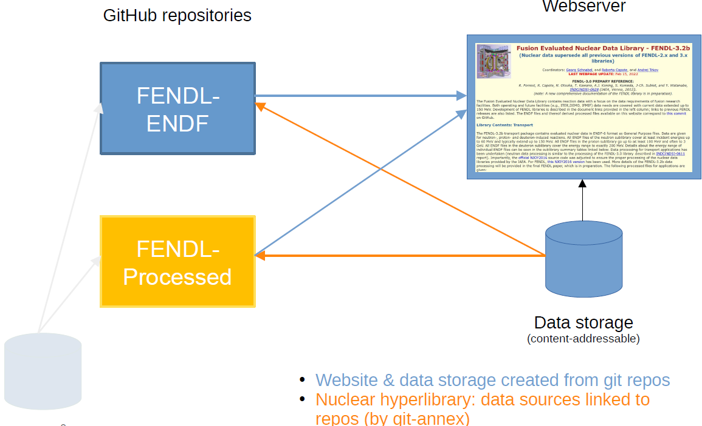
Tools developed at NDS/IAEA in the frame of FENDL
https://github.com/iaea-nds/fendl-processed
github + git-annex + Apptainer
Managed by G. Schnabel, NDS/IAEA

Slide 25
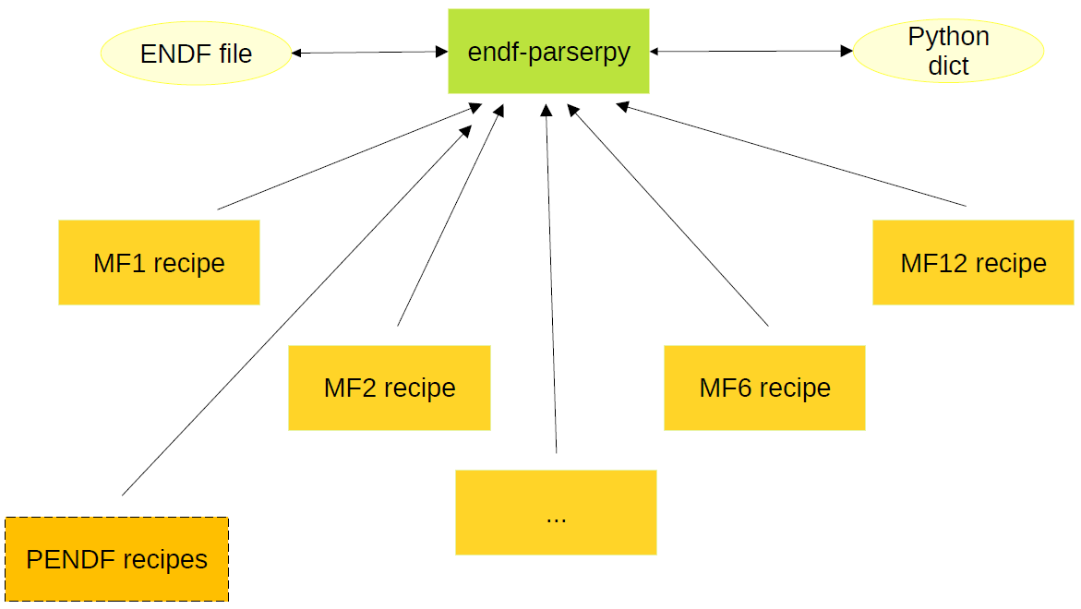
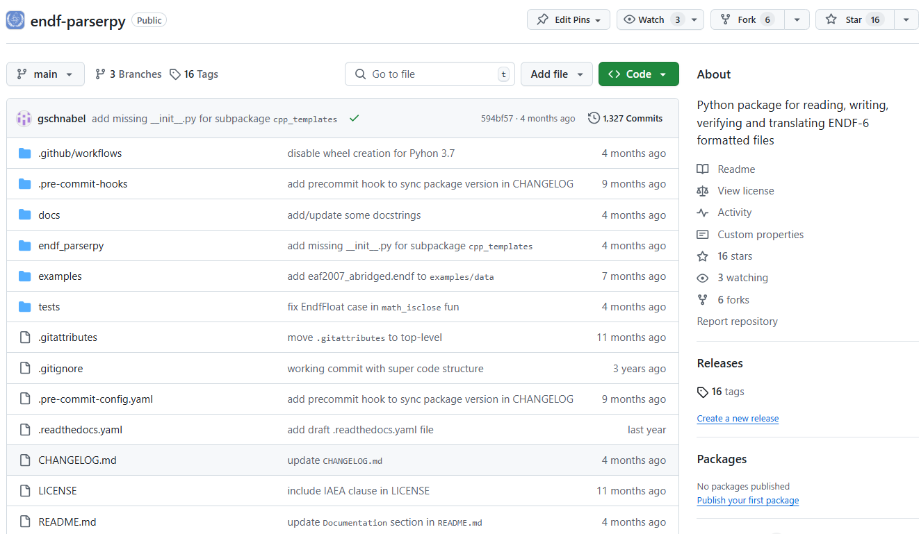
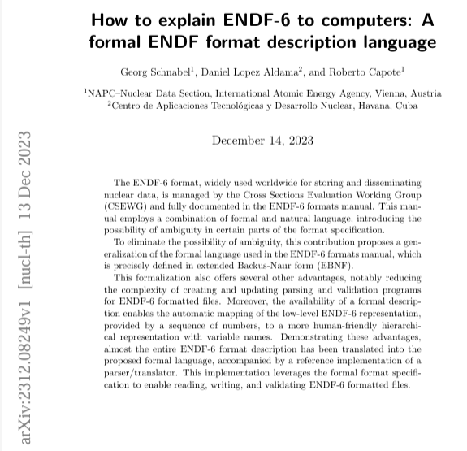
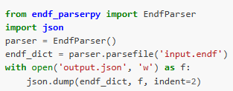
endf-parserpy: Read, write, compare, check, convert ENDF-6 files
https://github.com/IAEA-NDS/endf-parserpy
PENDF
MF
https://arxiv.org/pdf/2312.08249

Slide 26
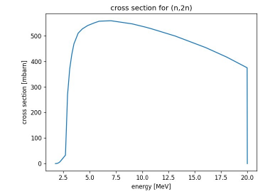
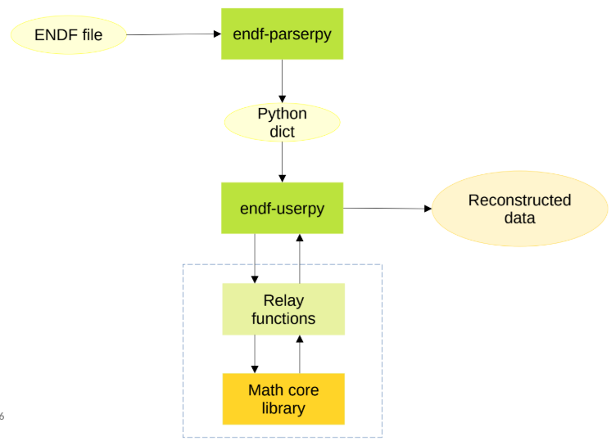
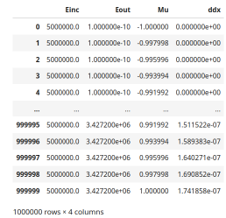
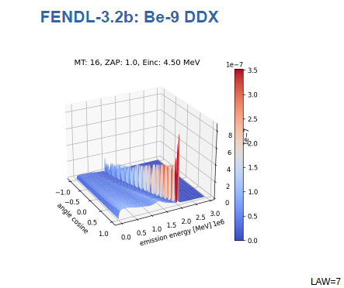
endf-userpy: Interpretation and processing data
ENDF
JSON
NJOY
NJOY
PENDF
Be-9(n,2n)
PREPRO
PREPRO
PENDF
MF support:
MF1
MF2+MF3
MF4
MF5
MF6
MF12
MF13
MF14
MF15
COMPARISON &
EVALUATION TOOLS
EXFOR
DATA
MODEL CODE
DATA
Under development

Slide 27
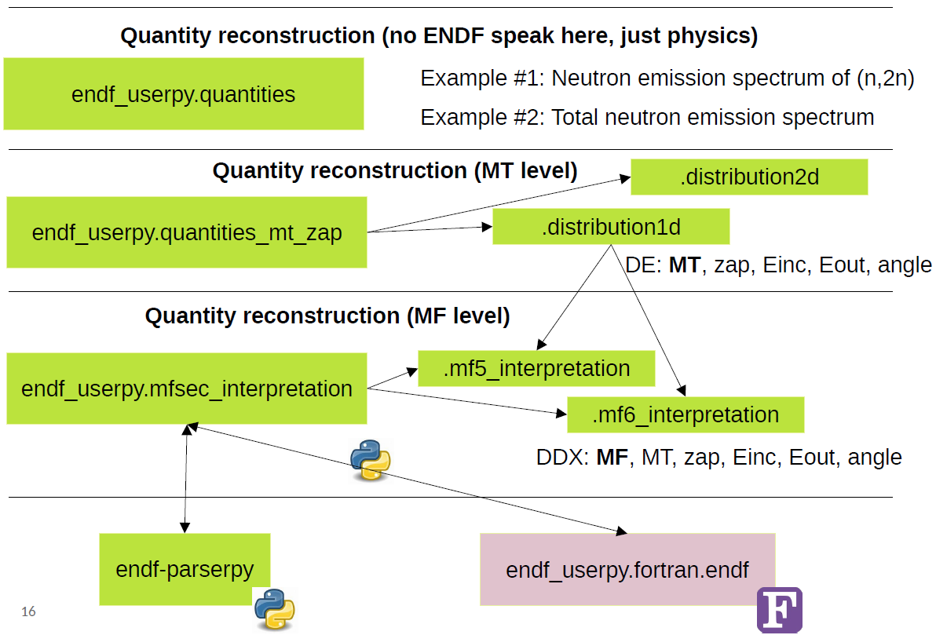
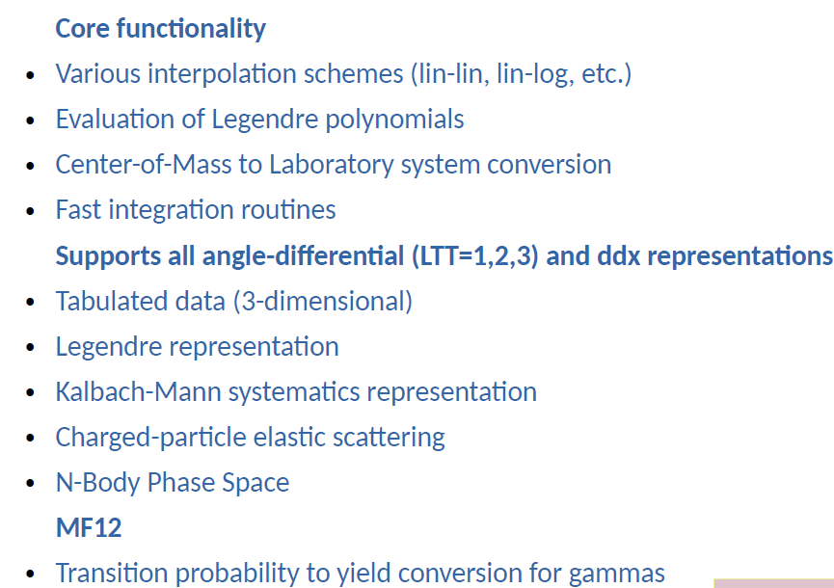
User-oriented multi-layered approach
Higher layer is user-oriented
Data can be obtained at any point of the phase space { E, E’, Ω(μ) }
Phyton
FORTRAN

Slide 28
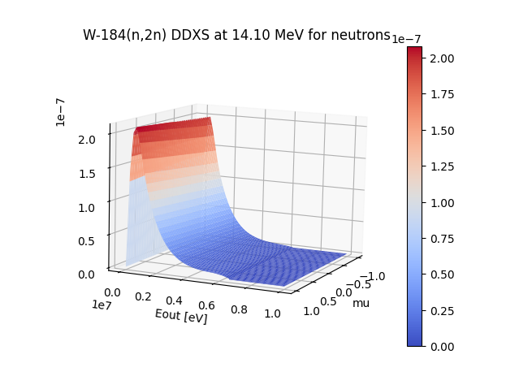
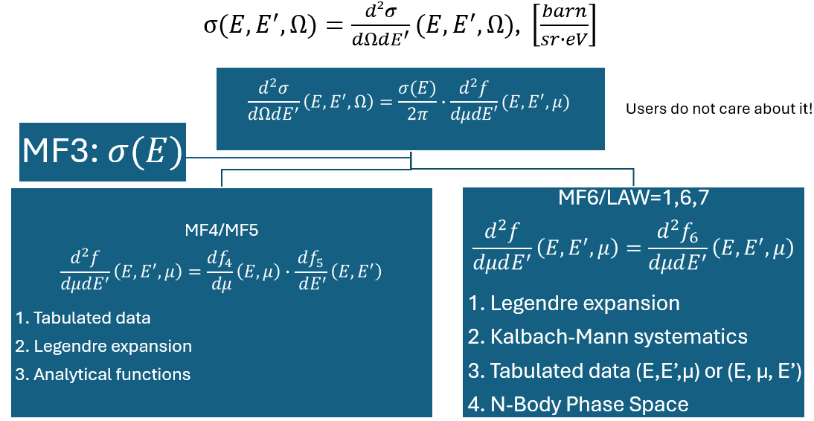

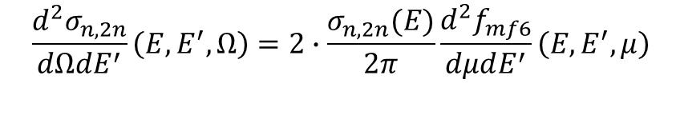
Endf-userpy: W-184(n,2n)
G. Schnabel, D. L. Aldama
$$\frac{d^{2}σ_{n,2n}}{dΩdE^{′}}\left(E,E^{′},Ω\right)=2∙\frac{σ_{n,2n}(E)}{2π}\frac{d^{2}f_{mf6}}{dμdE^{′}}\left(E,E^{′},μ\right)$$
$$for MT=16=\left(n,2n\right), y\left(E\right)=2$$
endf-userpy: ddxs=compute_dist2d_values(endf_dict, mt=16, zap=1, energies=14.1, energies_out, angle_cosines_out)

Slide 29
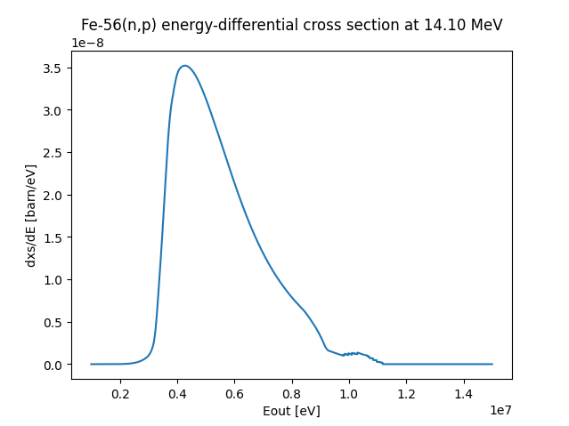
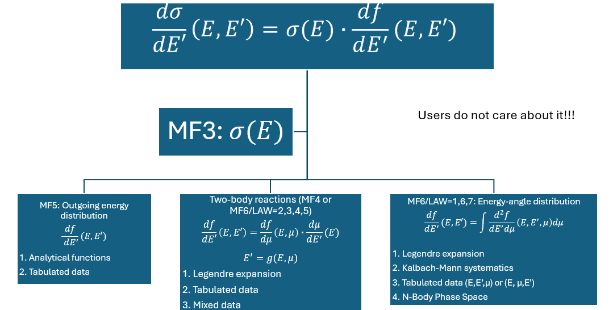
endf-userpy: Fe-56(n,p)
$$for \left(n,p\right), y\left(E\right)=1$$
G. Schnabel, D. L. Aldama
$$\frac{dσ_{n,p}(E,E^{′})}{dE′}=\sum_{mt=600}^{609}{{\left\{σ(E)∙\left[\frac{df_{mf4}}{dμ}\left(E,μ\right)∙\frac{dμ}{dE^{′}}(E)\right]\right\}}_{mt}+{\left\{σ(E)∙\int{\frac{d^{2}f_{mf6}}{dE^{′}dμ}\left(E,E^{′},μ\right)dμ} \right\}}_{mt=649}}$$

Slide 30
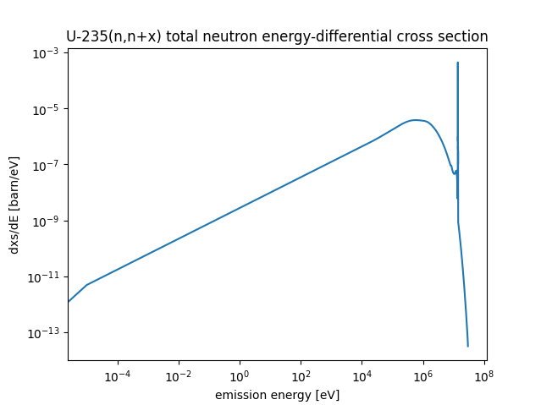
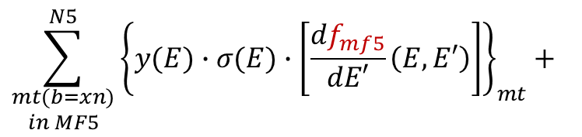
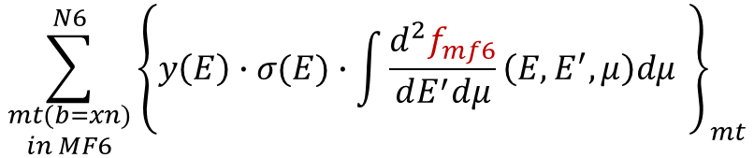

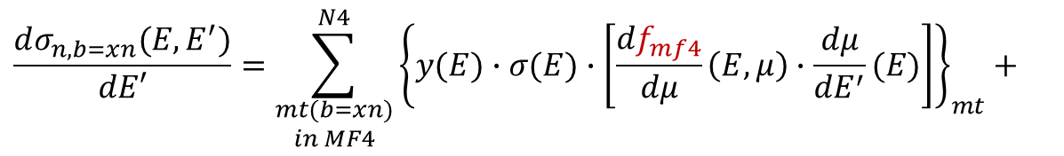


endf-userpy: U-235(n,nx)
$$\frac{dσ_{n,b=xn}(E,E^{′})}{dE′}=\sum_{\begin{aligned}mt(b=xn) \\ in MF4\end{aligned}}^{N4}{{\left\{y(E)∙σ(E)∙\left[\frac{df_{mf4}}{dμ}\left(E,μ\right)∙\frac{dμ}{dE^{′}}(E)\right]\right\}}_{mt}+}$$
Neutron production ddxs
$$\sum_{\begin{aligned}mt(b=xn) \\ in MF5\end{aligned}}^{N5}{{\left\{y(E)∙σ(E)∙\left[\frac{df_{mf5}}{dE′}\left(E,E′\right)\right]\right\}}_{mt}+}$$
$$E_{inc}=14.1 MeV$$
delayed neutrons not included
$$\sum_{\begin{aligned}mt(b=xn) \\ in MF6\end{aligned}}^{N6}{{\left\{y\left(E\right)∙σ(E)∙\int{\frac{d^{2}f_{mf6}}{dE^{′}dμ}\left(E,E^{′},μ\right)dμ} \right\}}_{mt}}$$
$$for MT=2, 51−91=(scattering)⇒ y\left(E\right)=1$$
$$for MT=5=\left(n,x\right) ⇒ y\left(E\right) from MF6$$
$$for MT=16=\left(n,2n\right) ⇒ y\left(E\right)=2$$
$$for MT=17=\left(n,2n\right) ⇒ y\left(E\right)=3$$
$$for MT=18=\left(n,fission\right)⇒y\left(E\right)=ν_{p}\left(E\right) from MF1$$
$delayed neutron⇒y\left(E\right)=ν_{d}\left(E\right) from MF1$
G. Schnabel, D. L. Aldama

Slide 31
Future work towards a major release of FENDL
Assessment of new evaluations
Review of evaluations in recently released and upcoming nuclear data libraries, including:
  INDEN
  ENDF/B-VIII.1
  JENDL-5
  TENDL-20xx
  JEFF-4
Coverage includes all incident particles (n,p,d) and applications in both Monte Carlo and deterministic codes.
2. Activation Data
Review of data relevant to activation applications and codes such as FISPACT-II, ACAB-2008, and others.
3. Uncertainty Quantification
Generation and assessment of covariance data to support uncertainty quantification.
Verification/Correction of NJOY for processing covariance files (e.g. MF40)
4. Thermal scattering laws inclusion (TSL) for moderator materials
5. Verification & Validation (V&V)
Enhancing and automating the V&V process (JADE, …).
Incorporation of new sets of numerical and experimental benchmarks.
6. Tools for Nuclear Data Management
Development and enhancement of software tools for comparison, manipulation, correction, processing,
visualization, and distribution of nuclear data (e.g., endf-parserpy, endf-userpy, etc.).

Slide 32
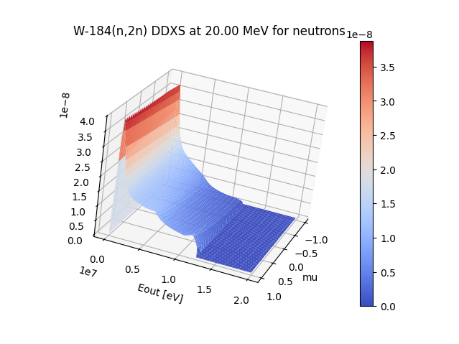
Thank you for your attention
Overview of FENDL:
Library, processing methods and tools
Presented by: Daniel López Aldama
email: dlopezaldama@gmail.com
Contributing authors:
Tim Bohm, Daniel L. Aldama, Georg Schnabel, Marco Fabbri, Saerom Kwon,
Davide Laghi, Andrej Trkov, Alex Valentine, Víctor López, Patrick Sauvan
Consultancy Meeting on the Preparation of a Major FENDL Release
Vienna 13th – 16th May 2025

