Slide 1


JADE v4, a more robust and expandable architecture for neutronics V&V
D. Laghi^{1*}, A. Bittesnich¹, A. Valentine², S.C. Bradnam², M. Fabbri¹, M. Campos¹, M. Di Giacomo¹, A. Milocco¹,
(1) F4E, Josep Pla 2 B3, Barcelona 08019, Spain
(2) UKAEA, Culham Campus, Abingdon, OX14 3DB, United Kingdom
FENDL CM 15/05/2025

Slide 2
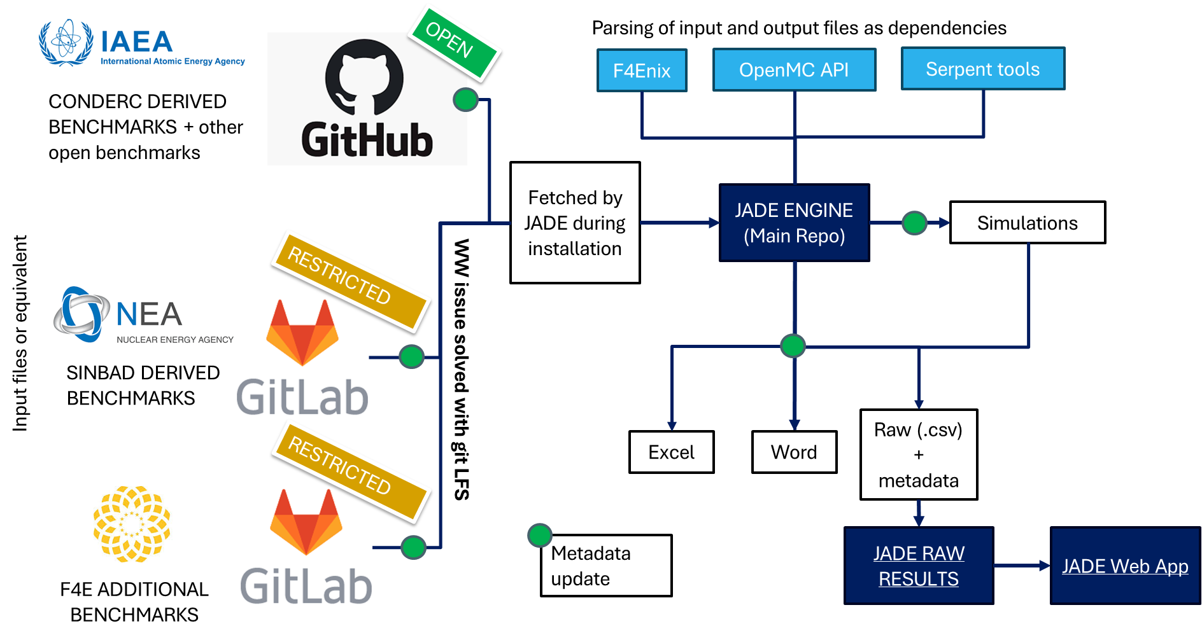
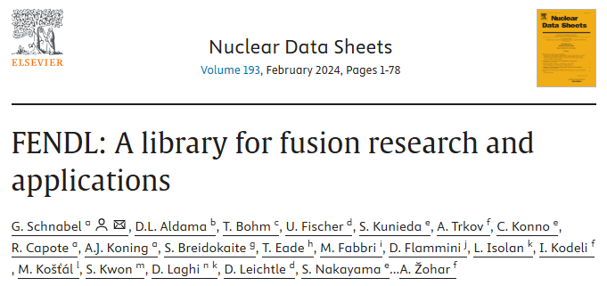



Historical recap
10/2018
U. Fisher highlight the needs for more automated V&V at FENDL CM
01/2021
First JADE major release (v1.0.0)
02/2024
JADE applied with success to FENDL 3.2b V&V campaign (endorsement from IAEA NDS)
11/2024
Creation of the JADE V&V ecosystem with v3.1.0
05/2025
Restoring of all v3 benchmarks + bug corrections with v4.1.0
10/2019
Work on JADE starts as D. Laghi Ph.D. project
11/2022
UKAEA joins the project to port JADE to linux and introduce code2code capabilities
03/2024
v3.0.0 is released. Porting to linux is completed and limited OpenMC capabilities are introduced
04/2025
JADE v4.0.0

Slide 3
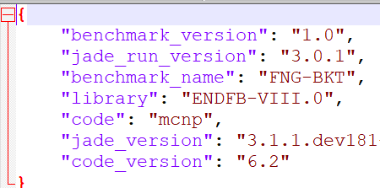
JADE V&V ecosystem
METADATA EXAMPLE
External dependencies
JADE V&V repos
https://github.com/JADE-V-V
https://github.com/IAEA-NDS/open-benchmarks

Slide 4
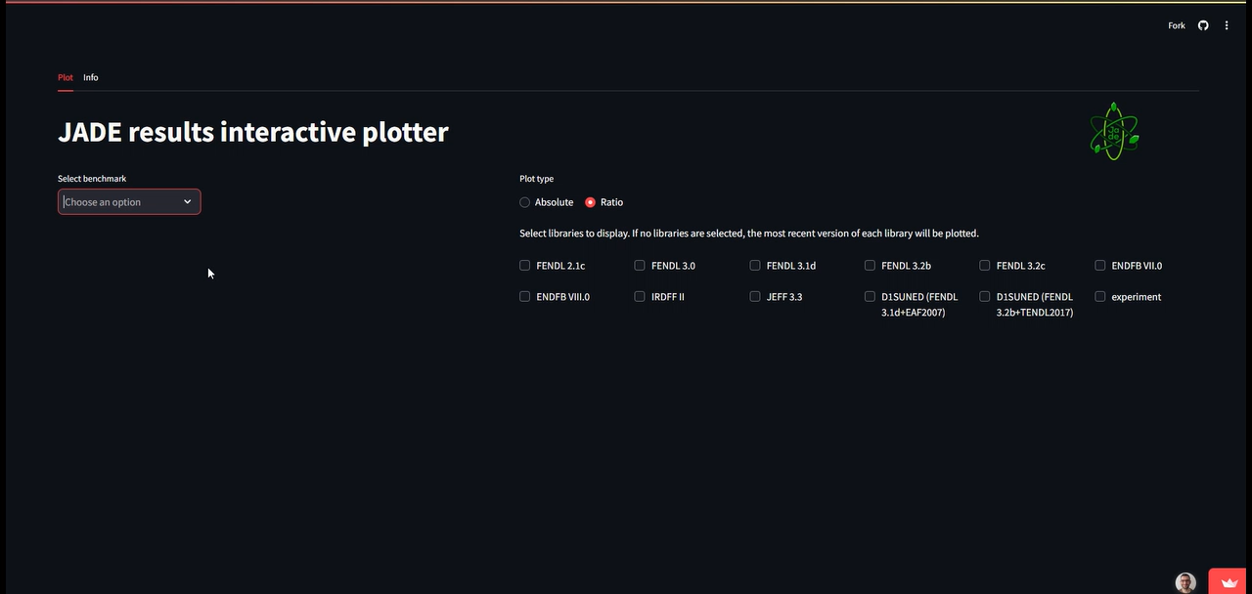
JADE WebApp

Slide 5
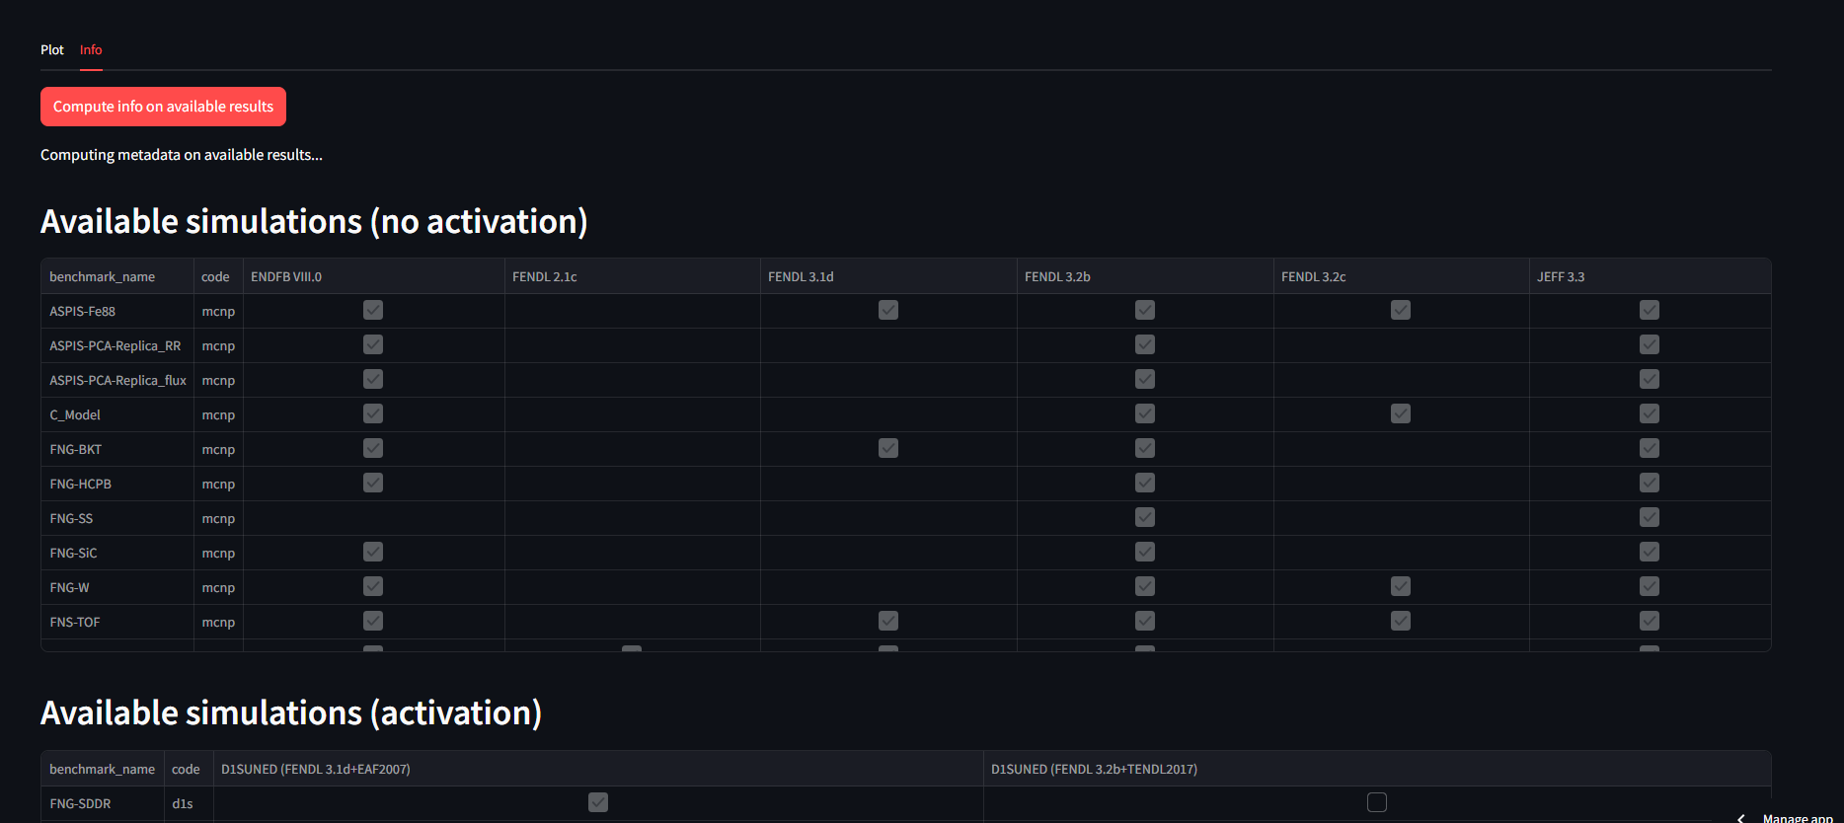
Available response in JADE raw result repository
Numerous experimental results already available on the Web ready to be consulted.

Slide 6
Why the need for a “JADE v4”?
JADE is getting more and more attention from potential users.
Experimental benchmark were still not supported by OpenMC.
Code to Code comparison was not implemented yet and would have required some further changes of the core structure of JADE.
Implementation of new experimental benchmarks (or new features) was becoming too messy due to increasing technical debt.
The core codebase was too complex. It became more and more difficult for new and less experienced developers to onboard the project.

Slide 7
Main achievements of v4.0.0
Re-think JADE to be a code-lib 2 code-lib comparison. Not code2code or lib2lib.
Full implementation of OpenMC (for the available benchmark inputs)
Implement a structure that clearly isolates (by inheritance of specific abstract classes) the extra python code needed to support an additional transport code.
No additional programming for new benchmarks (including experimental). Everything is handled by ad hoc YAML configuration files.
Raw data (csv files) are now a stronger interface. They are the end point of transport code-dependent processing and the starting point of the JADE plotting and excel. This facilitates the integration with 3rd party post-processors like the WebApp.
Software design best practices were applied during refactoring.
The codebase (number of lines) has been reduced to only 1/3 with respect to v3.1.0 one.

Slide 8
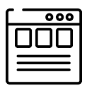






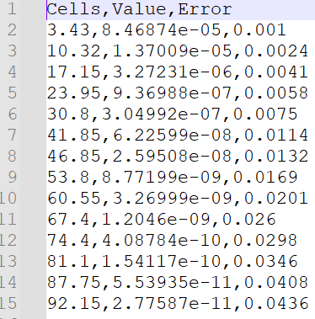


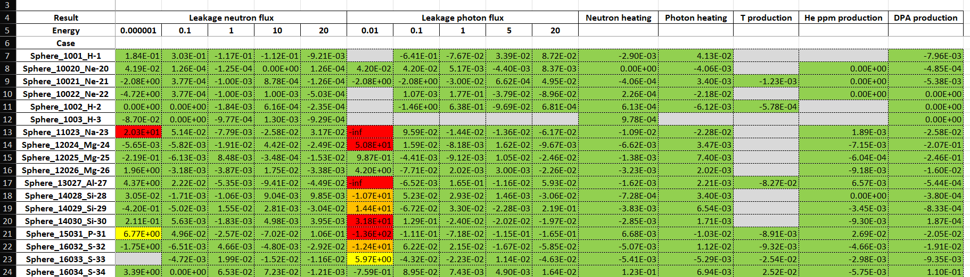

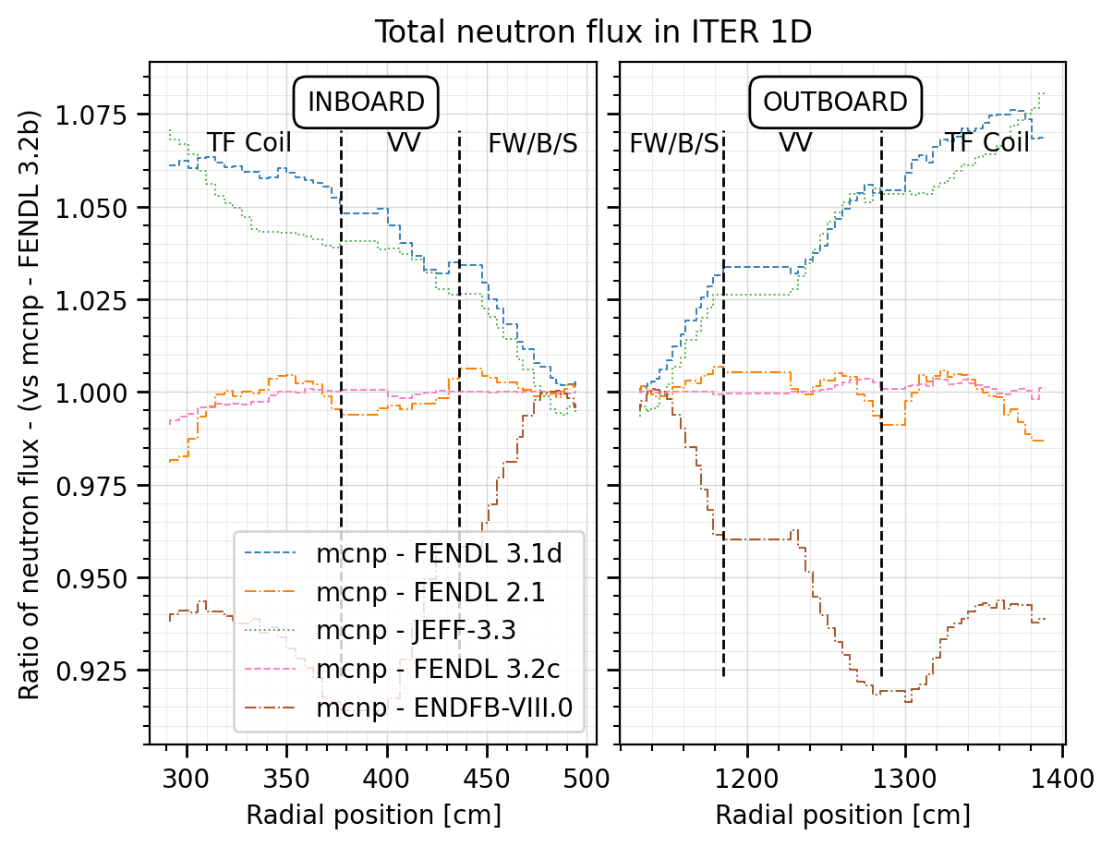

High level structure of JADE Engine
GUI
Run and PP
Benchmarks configuration files
DEVELOPERS
CMD
pip install jadevv
USER
CLUSTER
LOCAL
Environmental
variables

Slide 9


Tallies comparison -> Results comparisons
Simulation output parsing
Tally MODIFIERS:
Scale
To lethargy
Add column
Replace values
…
MODIFIED TALLY
COMB
TALLY RESULT
Tally COMBINATORS:
No actions
Sum
Concatenate
…
MOD1
MOD2
MODn
MODIFIED TALLY
For each tally a standard pandas DataFrame is produced (for all transport codes).
Column headers are tally binnings. Names are standardized.
…
COMB
MODIFIED TALLY
END of transport code dependent processing
RESULT

Slide 10
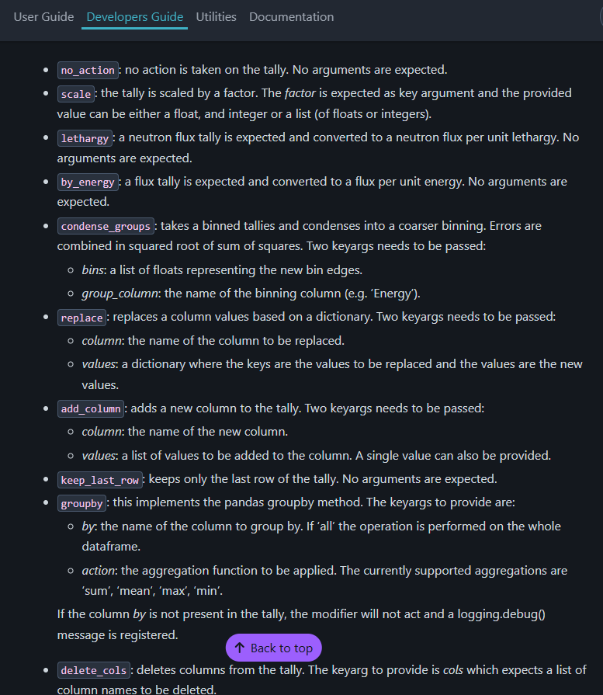
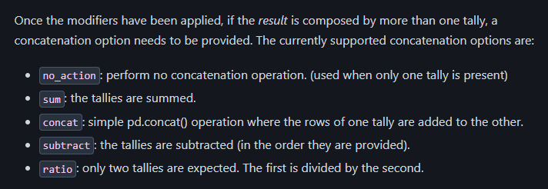
Tally modifiers and concatenators
Examples of TALLY CONCATENATORS
Examples of TALLY MODIFIERS

Slide 11
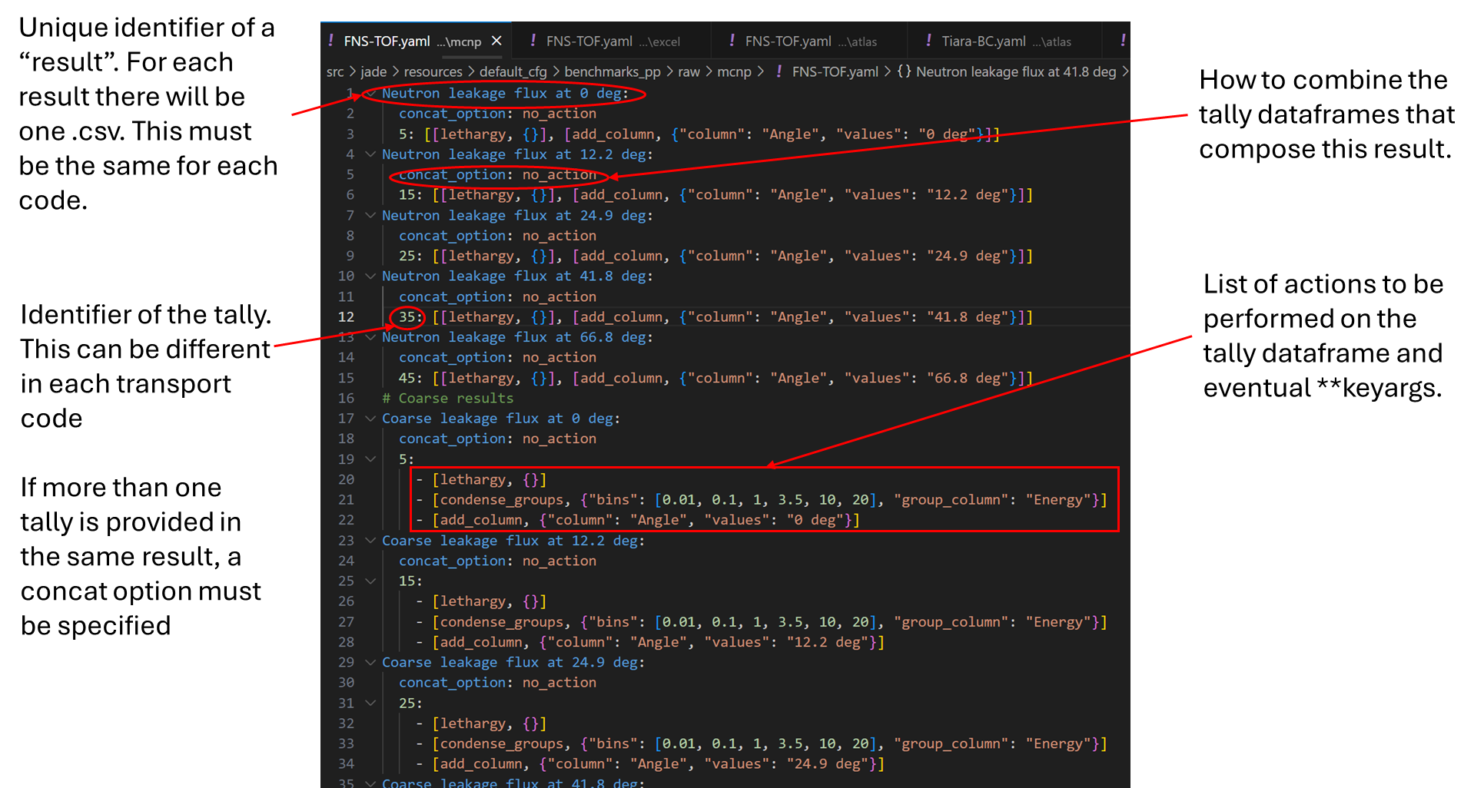


Example of raw results (csv) configuration files
Sphere leakage: MCNP
Sphere leakage: OpenMC

Slide 12
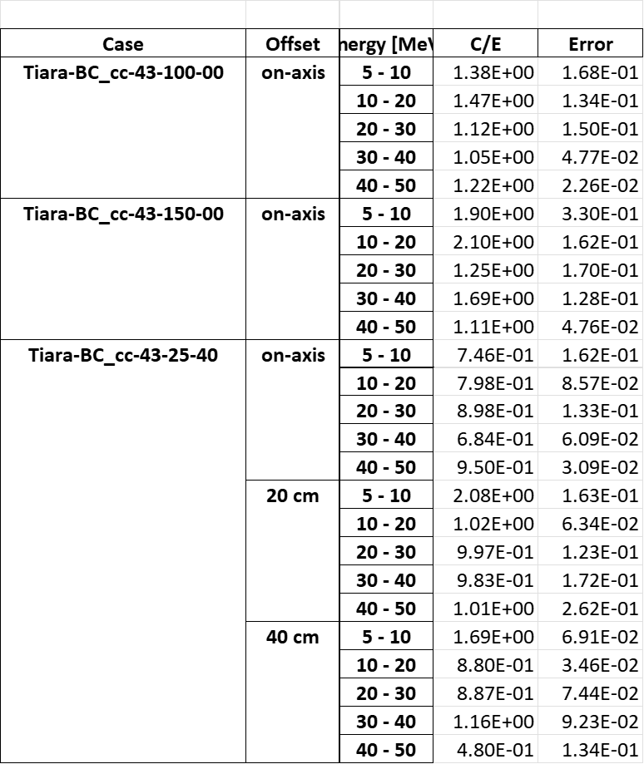
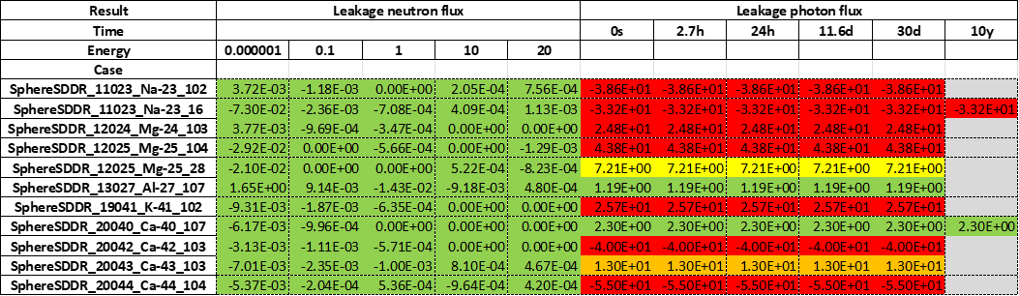
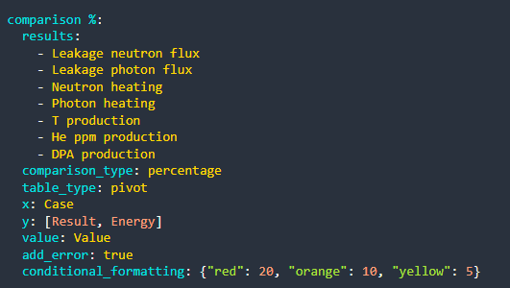
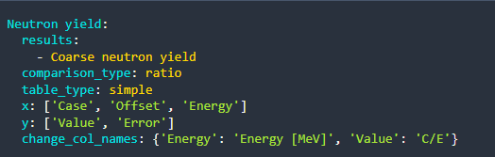
Examples of excel configuration file

Slide 13
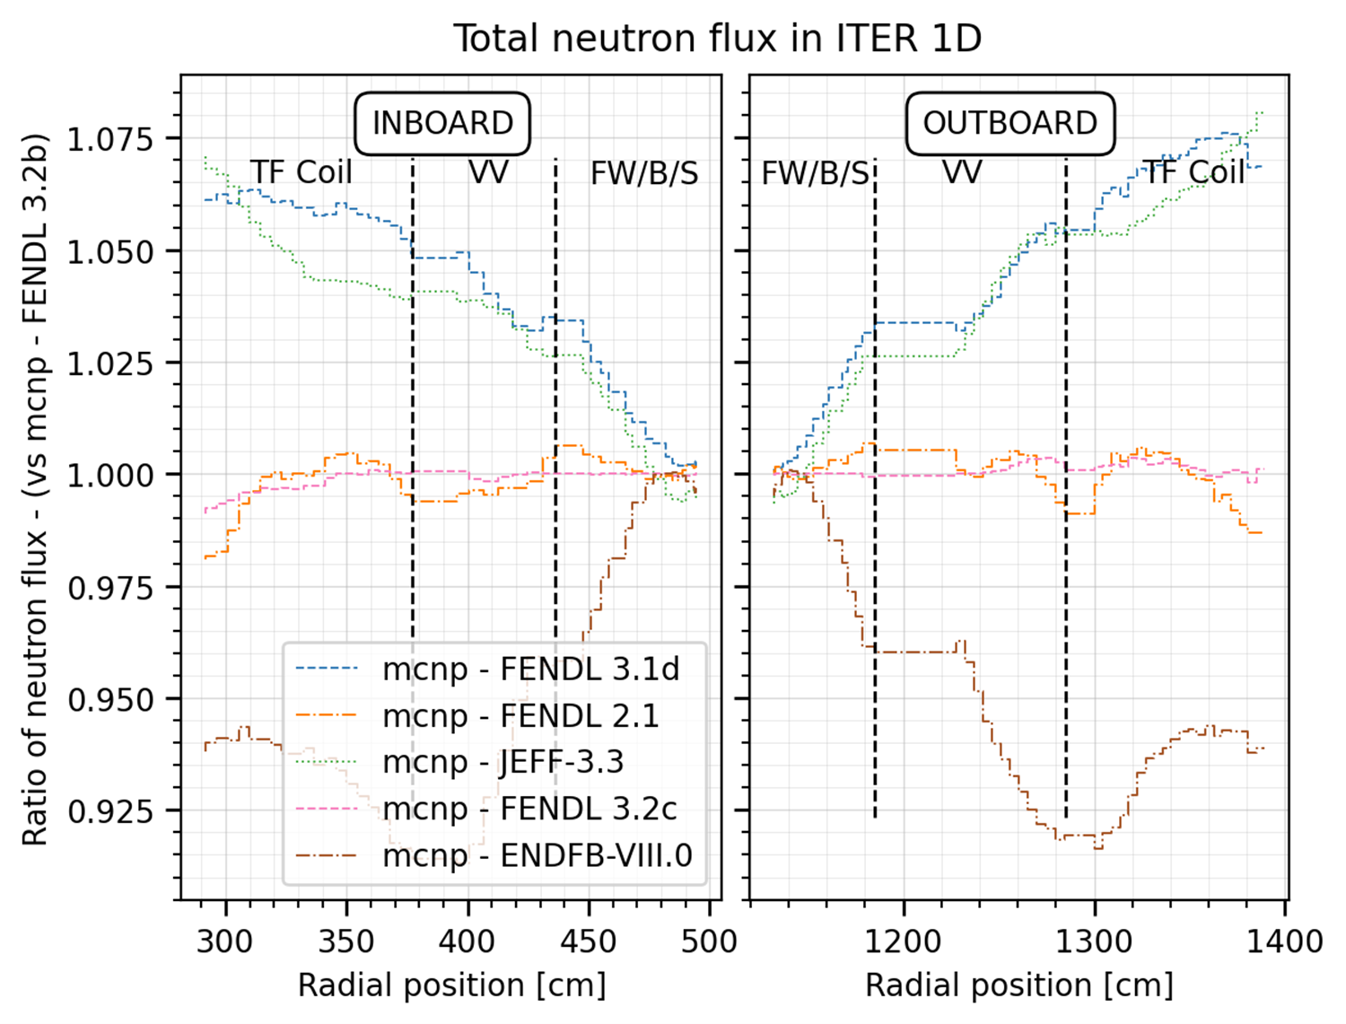
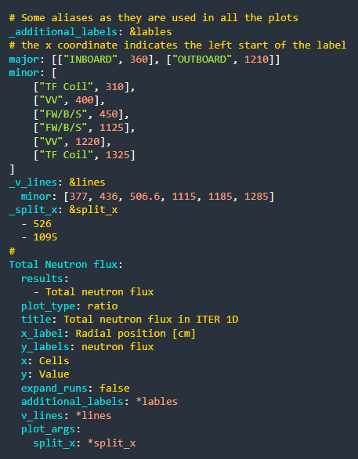
Examples of an atlas configuration file

Slide 14
Benchmark summary
OPEN BENCHMARKS (e.g., Conderc, Community)
CLOSED BENCHMARKS (e.g., SINBAD + ICEBEP+ITER)*
Code | Computational | Experimental | Total
MCNP | 5+1 | 5+11 | 22
OpenMC | 2 | 0+1 | 3
D1SUNED (SDDR) | 2 | 0+1 | 3
For a total of 25 unique benchmarks already included. More are in the pipeline and some from FENDL3.2b paper are still missing.
One benchmark can include more than one setup. For instance, the Oktavian benchmarks includes different experiments conducted with spheres of different materials. If we count each setup as a different benchmark, we reach 88+61 = 149 implementations.

Slide 15
Benchmark summary vs FENDL3.2b paper
Computational exercises
Computational benchmark/exercise | Made by | Implemented in JADE
Leakage Sphere | F4E | Yes
ITER 1-D | F4E | Yes
ITER 3-D | F4E | Yes
FNSF 3-D | UoW | No
FNSF 1-D | UoW | No
ITER-1D HCPB and WCLL TBM (F4E) | F4E | Yes
EU DEMO-3D divertor | Lituanian NA | No
No progress from 2023 as input not yet available.
Can be these already shared? Or better to be inserted in the IAEA open repository? https://github.com/IAEA-NDS/open-benchmarks

Slide 16
Benchmark summary vs FENDL3.2b paper
Experimental benchmark | Made by | Implemented in JADE
Oktavian | F4E | Yes
FNS experiments | JAEA | Partially
TIARA shielding experiments | JAEA | Yes
FNG Cu, WCLL, W-SS-Water shield | ENEA | Cu: No WCLL: No W-SS-Water:No
Research Center Rez 10.7 and 12.7 MeV quasi-monoenergetic neutron source: Dosimetrical reactions | CV Rez | No
Research Center Rez 252Cf(s.f.) source: Ni, Fe, Cu, stainless steel, and Pb leakage spectrum and dosimetrical reactions | CV Rez | No → Partially On-going Fe and SS prepared by A.Milocco (F4E-expert)
LLNL Pulsed Sphere | Neudeker? | No
JET Activation Foils | JSI/UKAEA | No
SINBAD benchmarks: ASPIS Iron 88 PCA REPLICA FNG SiC FNG Tungsten FNG HCPB CIAE Fe | UKAEA | ASPIS Iron 88: Yes PCA REPLICA: Yes FNG SiC: Yes FNG Tungsten: Yes FNG HCPB: Yes CIAE Fe: No
Experimental benchmarks
Further progress made but few input still missing.

Slide 17
Future plans
CONSOLIDATION
Run the entire benchmark suite with FENDL 3.2c (production run) to consolidate the new JADE major version.
Review of all plots by A. Milocco and M. Fabbri to point out improvements on plot quality/types but also on methodologies (e.g. more TOF derivation instead of direct energy binning) and input improvements. Any other volunteer?
Schedule a hackathon to address the major comments that will arise -> v4.2.0
EXPANSION OF FEATURES
Keep implementing new benchmarks
Gradually implement all available benchmarks also in OpenMC
Implementation of CHI SQUARE and other KPIs for nuclear data “evaluation”.

Slide 18
Conclusions
A long-standing effort by F4E has been carried out in the last 6 year to kick-off the JADE V&V tool suite which is now officially recognized by FENDL.
Adding new benchmarks to JADE has never been easier (no coding required).
F4E is willing to continue to coordinate and contribute to this effort in the benefit of all the nuclear data community. Stronger together.
We acknowledge the support of many institutions (e.g., UKAEA, IAEA,…) for their contributions and guidance (e.g., see documentation and papers).
We look forward to the IAEA-NSD support:
  To recollect the benchmarks carried out within the FENDL3.2b V&V published exercise
  To communicate the officiality of FENDL3.2 to ITER by a formal letter
We very welcome the effort of the IAEA-NSD to maintain alive the FENDL community and expert group activity.

Slide 19
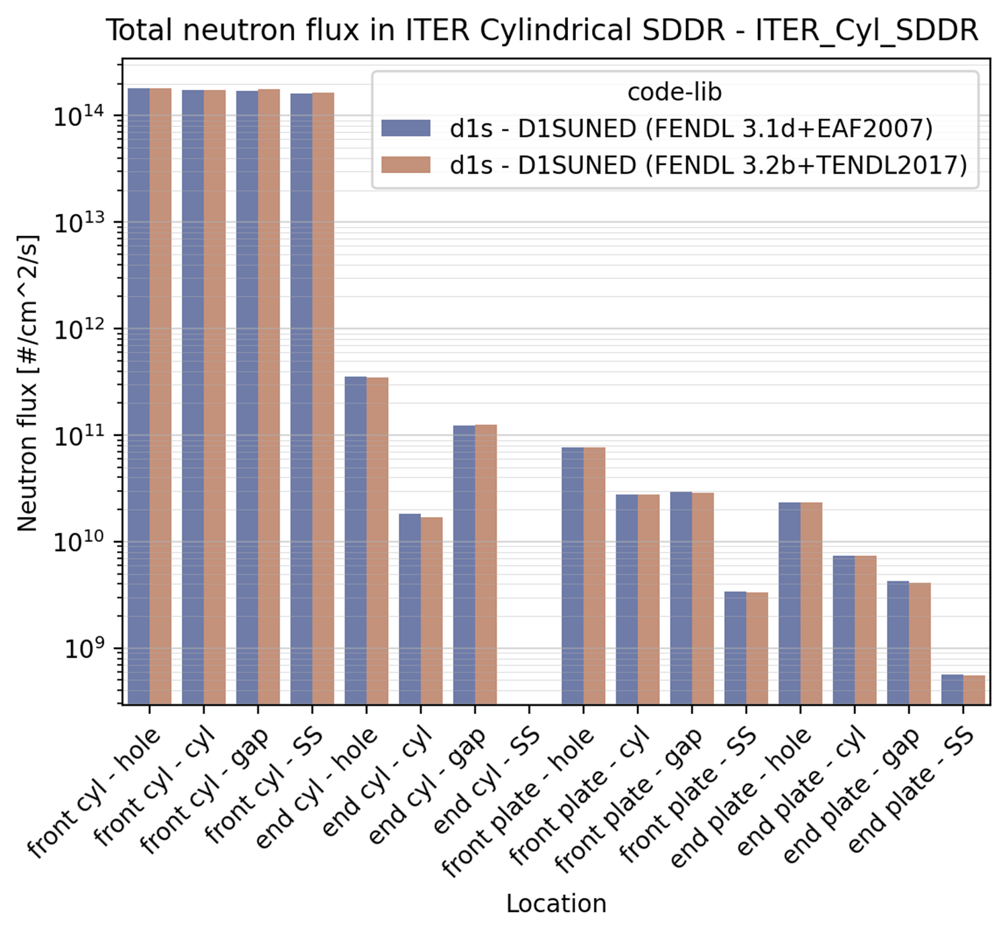
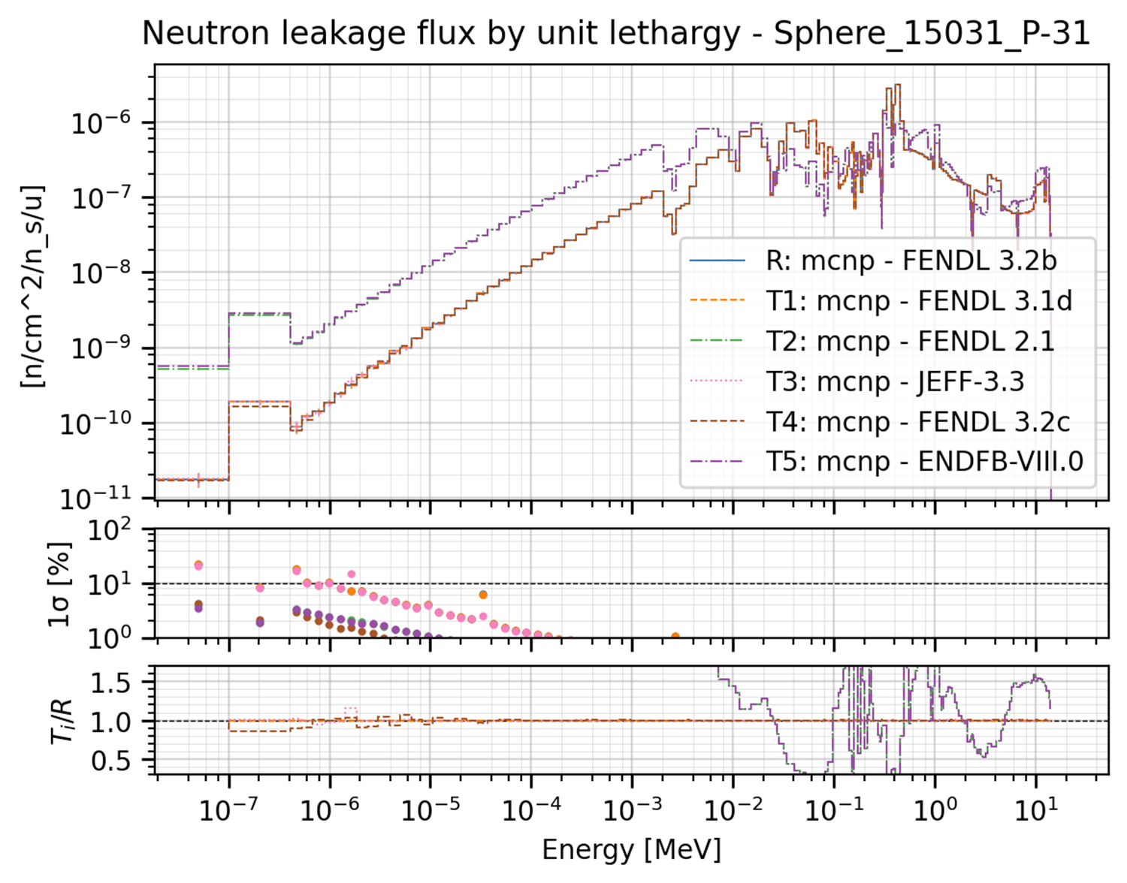
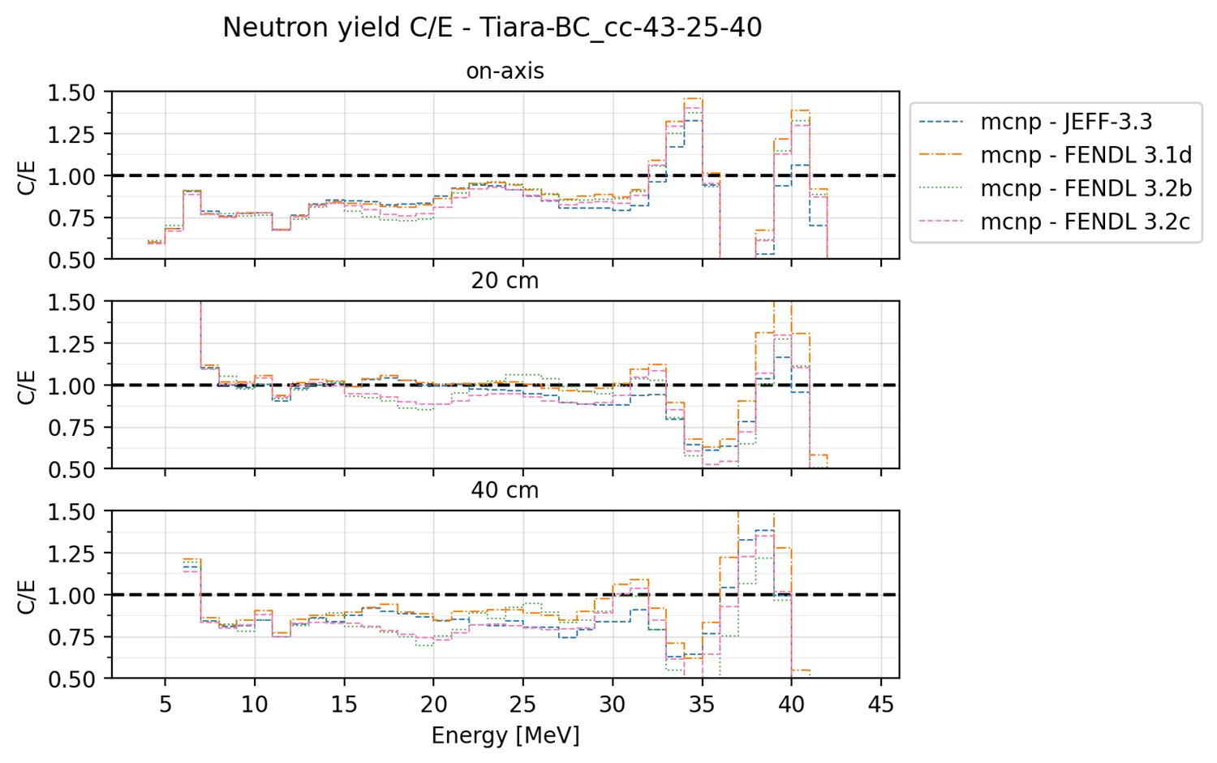
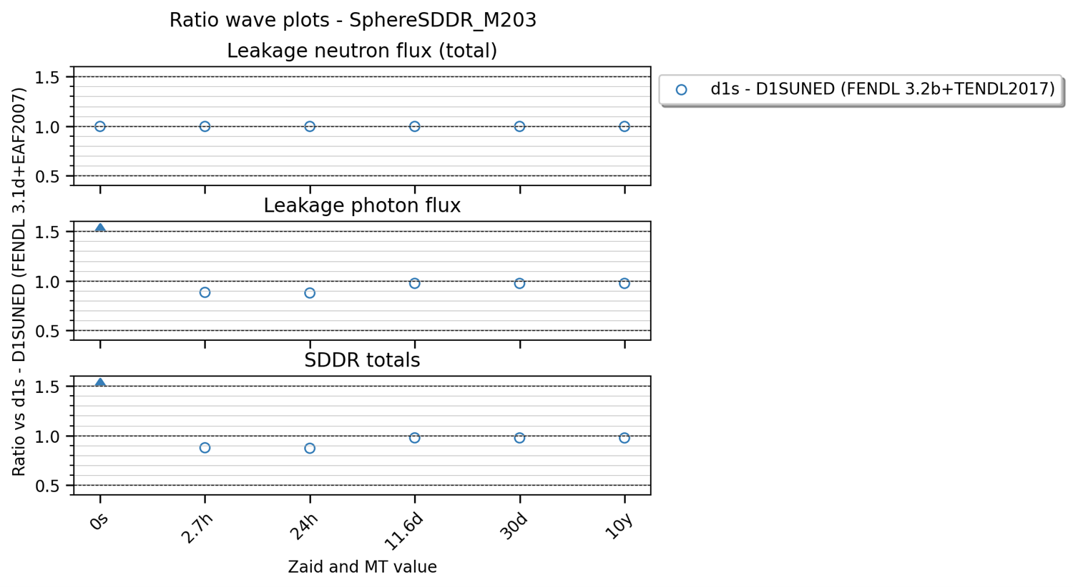
Thanks for you attention

