Slide 1
Rez contribution to fusion research:
Broomstick and Teflon leakage experiments
Michal Kostal
FENDL 2025
Vienna, May 14th 2025

Slide 2
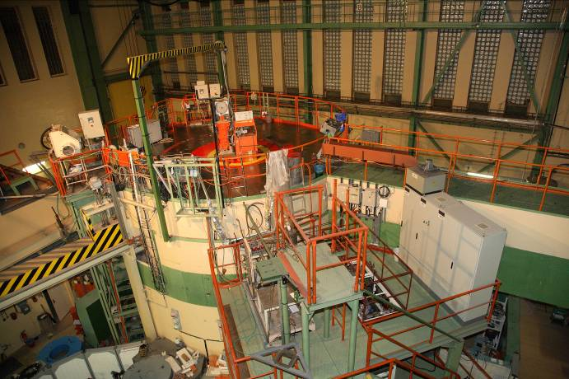
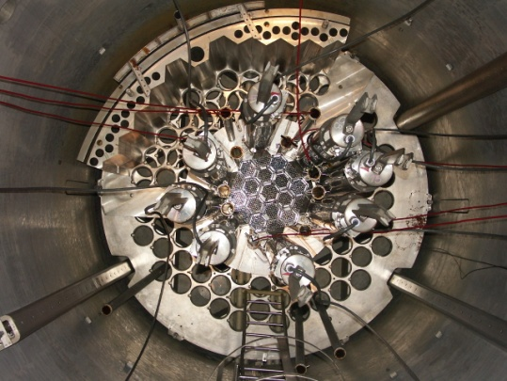
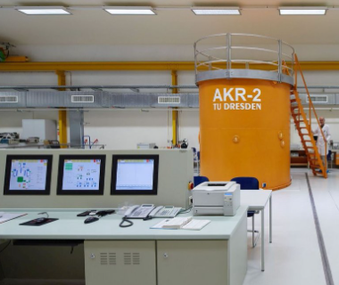
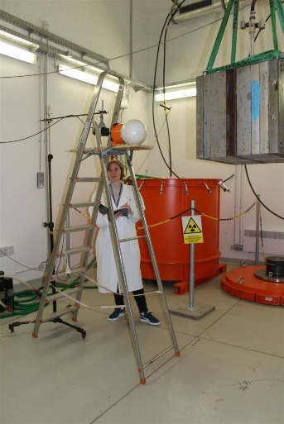
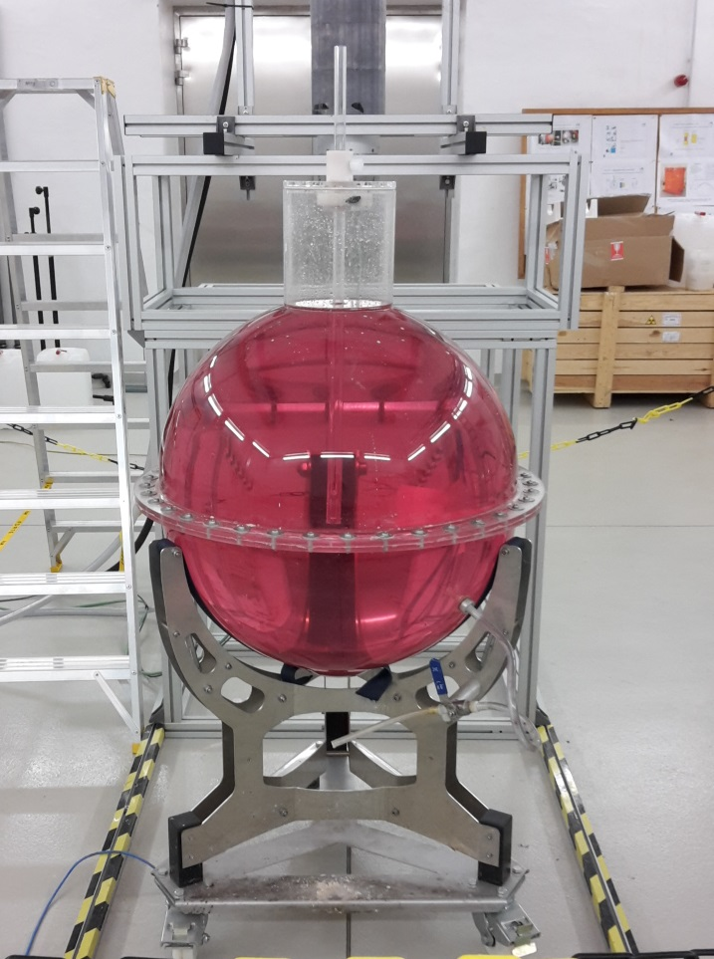
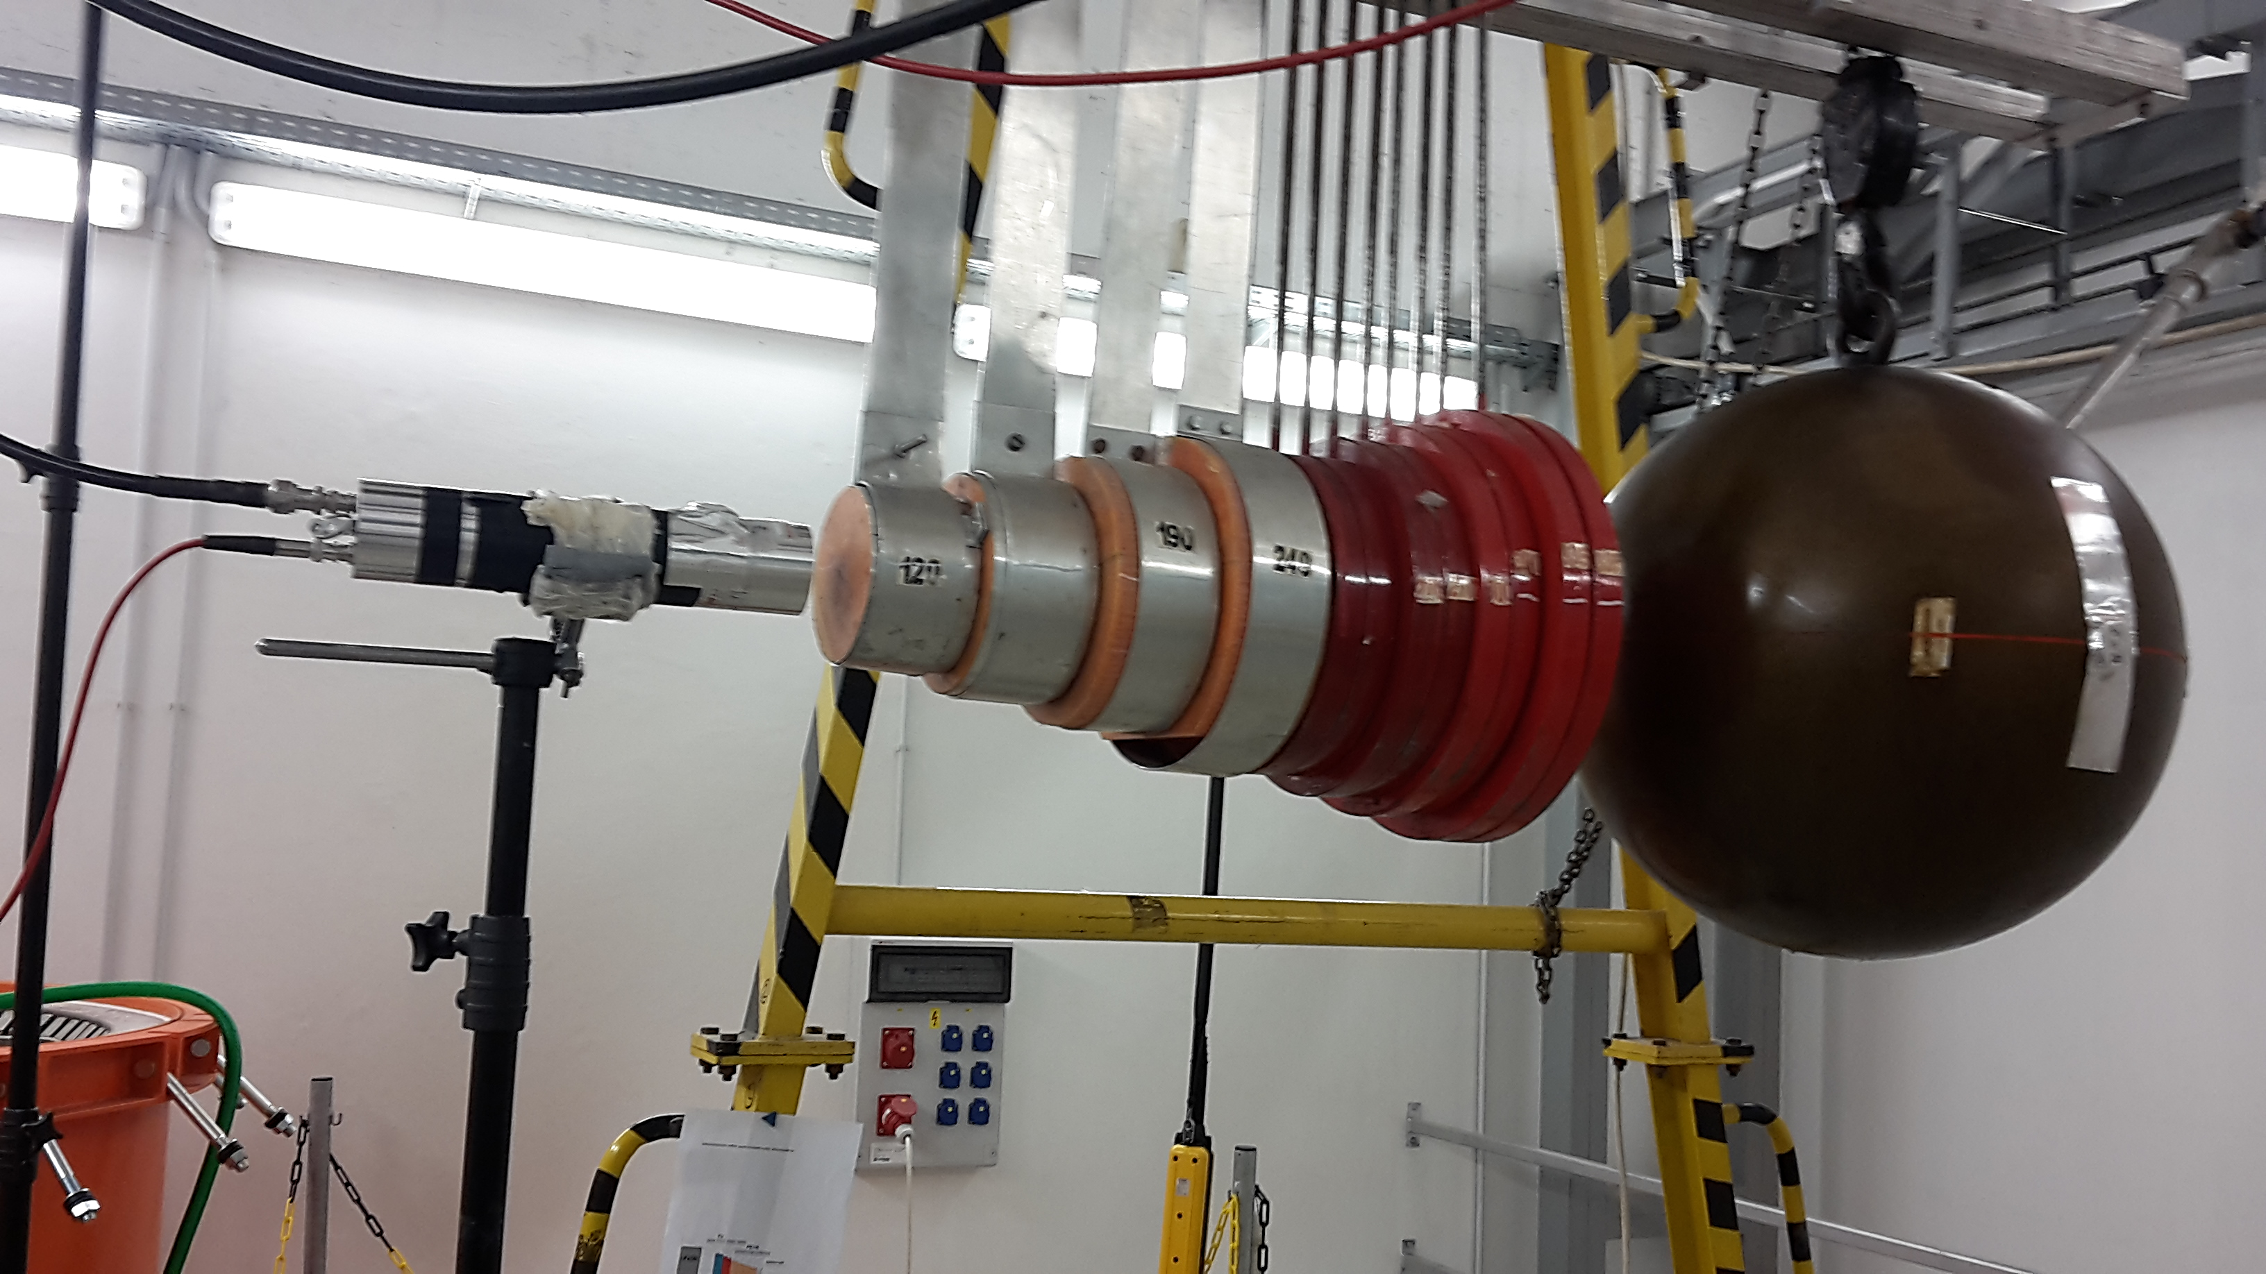


Research infrastructure used by CVR group in experiments
4 research reactors LR-0, LVR-15, VR-1 (university, CTU Prague), AKR-2 (TU Dresden)
²⁵²Cf neutron sources
  Material blocks for neutron leakage measurements:
    spheres (Fe, Ni … and others)
    cubes (CF₂, Al, stainless steel, Cu, graphite … )
  Spherical tank with aqueous solutions for prompt gamma leakage measurements
    NaCl, MnSO₄, FeSO₄, …. , planned CO(NH₂)₂ (ad blue) , and many others
DT generators
Well-described AmBe
XRF analyzers
(and many others)
2

Slide 3
Neutron spectrometry
Well-characterized spectrometer
Validation in PTB
Validation in ²⁵²Cf
Verified in Si filtered spectrum
Radulovic et al., IAEA, INDC(NDS)-0746, 2018

Slide 4
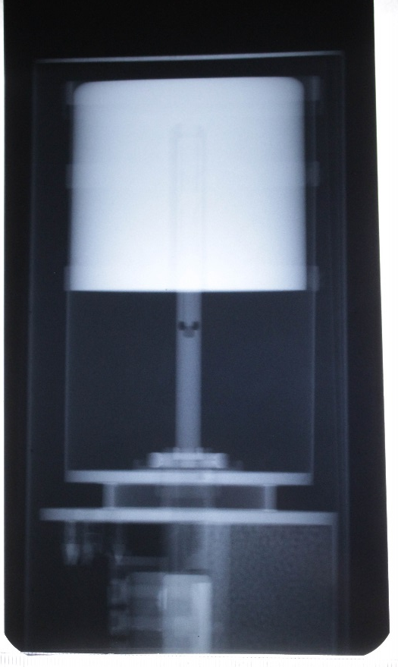
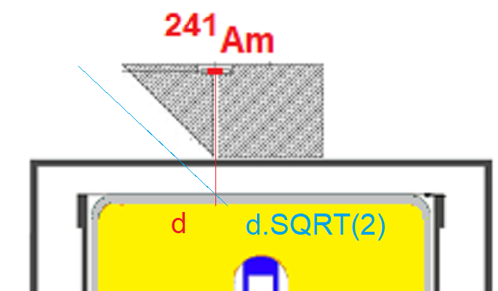
Gamma spectrometry - HPGe
Most important is detector sensitivity
Irradiated pins measurement
  Mathematical model allows arbitrary axial power density profile
Foil measurement
  Mathematical model allows even large samples on detector cap
  Determination of coincidence summing correction
Gamma flux measurement
  Model allows evaluation of gamma flux (only the directionality needed)
Czakoj et al., Rad. Phys. and Chem. 202 (2023) 110542

Slide 5
Uncertainties in gamma spectrometry
Systematic uncertainty
  1.8% End Cap geometry
  1.1% 10cm Above Cap geometry
  0.8% Marinelli beaker geometry
Not only low uncertainties but also arbitrary geometry of irradiated samples can be measured by HPGe with existing model
On Cap
Marinelli beaker (Volume source)
10cm Above Cap

Slide 6
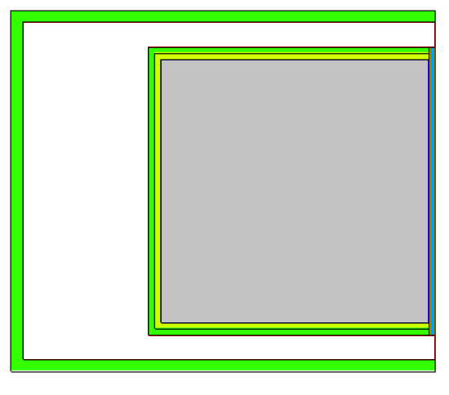
Gamma spectrometry stilbene
Newly developed response matrix
Simulation uses precise probe parameters
  In gamma transport, surrounding materials are essential
Validation in AmBe + ²⁴Na

Slide 7
²⁵²Cf(s.f) TFGS spectrum measurement
First measurement in region 0.1 – 14 MeV
Uncertainties
  7 – 10 % in 1 – 7 MeV
  Below 20 % in 7 – 9 MeV
  Up to 90 % in 14 MeV
Consistent with previous results
  Between Stoddard and Trykov results
Czakoj, T. et al. Measurement of total fission gamma spectrum of 252Cf(s.f.). Eur. Phys. J. A 60, 228 (2024)

Slide 8
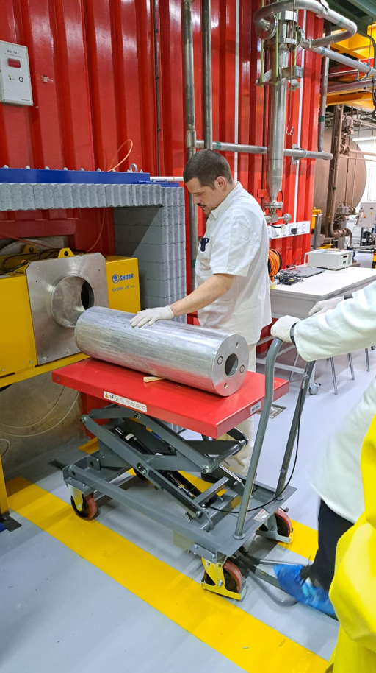
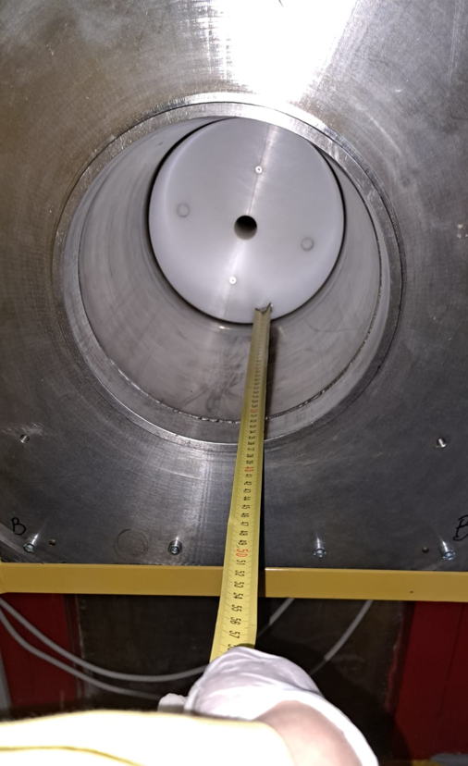
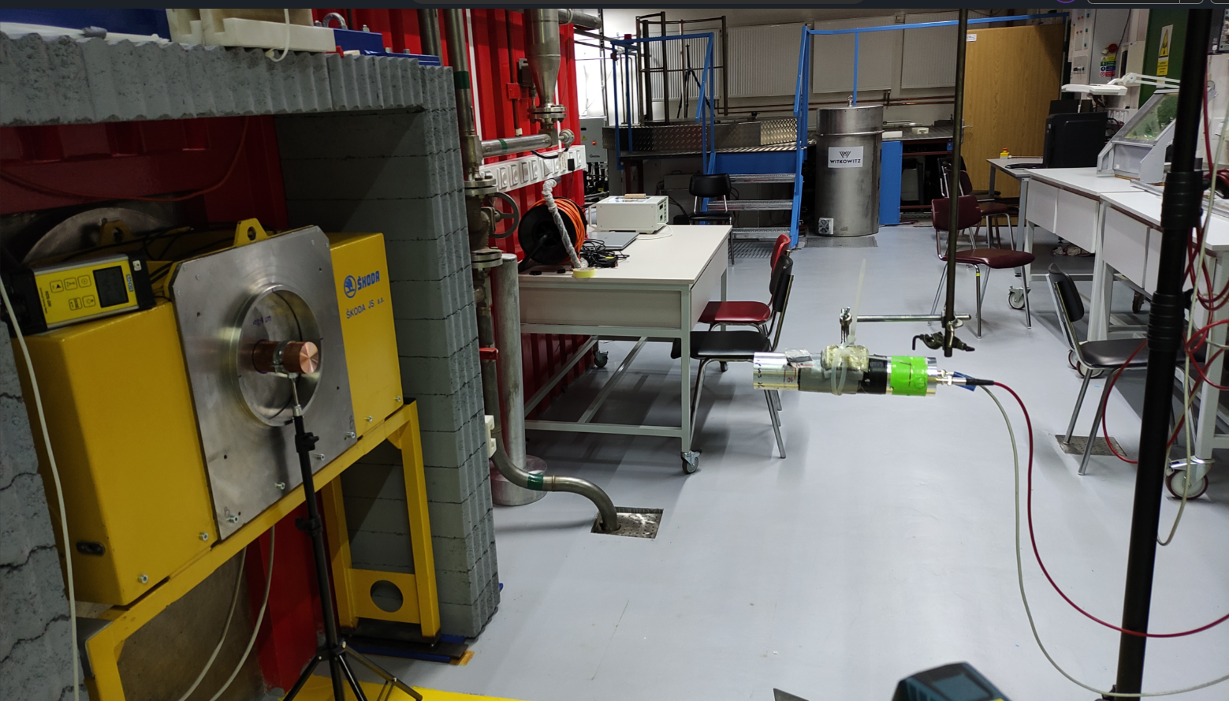
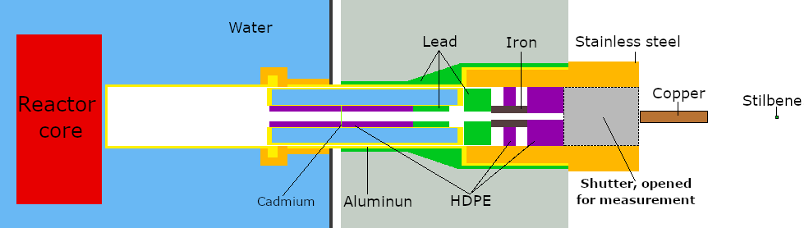
Broomstick experiment
Transport of pinhole beam through broomstick
Integral quantities can usually be measured much more accurately than differential nuclear data, thus are useful to tuning nuclear data evaluations to improve integral performance.
The measured spectra are compared with calculation
The experiment was realized in VR-1 reactor
Kostal et al., Broomstick experiment with copper in VR-1 reactor, Annals of Nuclear Energy, Vol. 211, 2025, p. 110993

Slide 9
Beam characterization
The spectrum in beam is similar to spectrum in channel in previous measurement
Spectra in output and measuring position are identical
    Flux decrease (factor 2.612 ) implies that beam is relatively not divergent
The beam is sharp (1% when moved by 35 mm corresponds to scatter from probe).
Misalignment [mm] | Rel. flux
0 (In axis) | 1.000
5 | 0.965
10 | 0.963
15 | 0.905
20 | 0.533
25 | 0.265
30 | 0.044
35 | 0.011

Slide 10
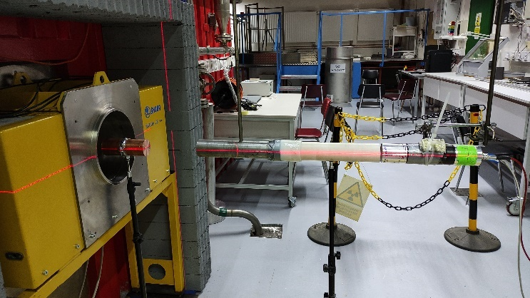
Background determination
Room effect determined using shielding cylinder
  Iron + HDPE
Its magnitude is affected by aperture diameter
For blocks shorter than 20 cm Cu/Cr (attenuation ~ 1000) room effect is negligible

Slide 11
Copper results
Low uncertainty experiment (beam transmission)
  Simple geometry
  Good source description
Discrepancies from simulation (if any) are on account of cross section evaluation
  JEFF-3.3 highly discrepant
  ENDF/B-VIII.1 GOOD (very similar to ENDF/B-VIII.0)
  JENDL-5 problematic
JEFF-3.3
INDEN (used in ENDF/B-VIII.1.)
JENDL-5

Slide 12
Chromium results in new (2025) experiment
Comparison in ENDF/B-VIII.0
Systematic effects
  1 – 1.5 MeV
  1.5 – 4 MeV
Not so bad as 20 cm of chromium is very thick
However, improvement of ENDF/B-VIII.0 is needed for more precise predictions

Slide 13
Comparison with various evaluations
Low uncertainty experiment (beam transmission)
  Simple geometry
  Good source description
Discrepancies from simulation (if any) are on account of cross section evaluation
  JEFF-3.3 highly discrepant
  ENDF/B-VIII.1 GOOD
  JENDL-5 problematic
JEFF-3.3
INDEN (used in ENDF/B-VIII.1.)
JENDL-5

Slide 14
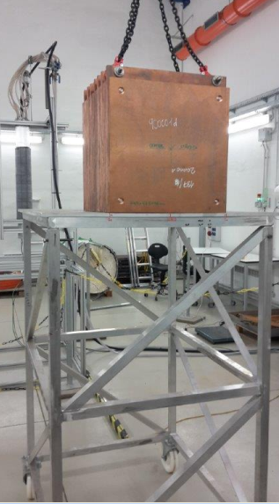
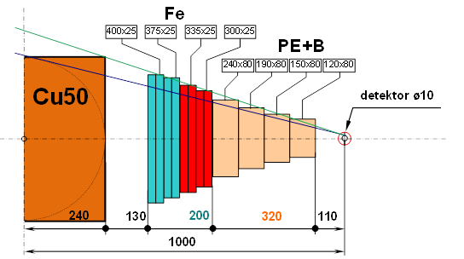
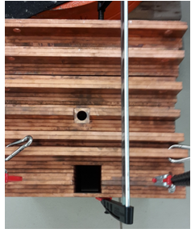
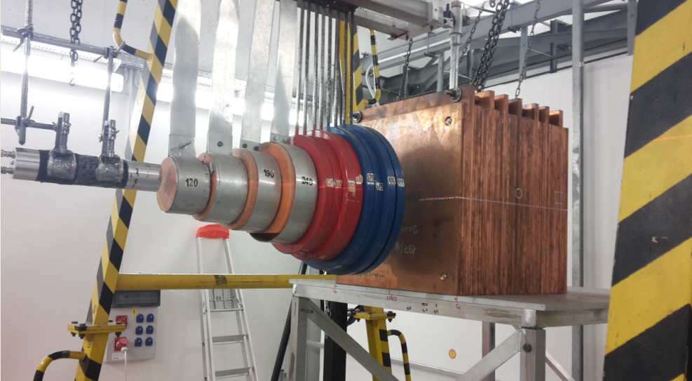
Leakage from copper cube
Copper cube evaluated
(>=99.95% Cu )
Leakage spectrum (1 - 10 MeV )
100 cm from center
Background spectrum (room effect)
Cone 20cm Fe – 32cm PE
Reaction rates of :
¹⁹⁷Au(n,g)¹⁹⁸Au
⁵⁸Ni(n,p)⁵⁸Co
⁹³Nb(n,2n)^{92m}Nb
⁵⁵Mn(n,g)⁵⁶Mn
Support for benchmarks - 2 m above the lab.floor (as usually )
14

Slide 15
Comparison of broomstick and leakage
Obtained results are in good consistence with previously measured neutron leakage from copper block
Broomstick – 15 cm Cu
Cu block 48 x 50 x 50 cm
In broomstick more effective attenuation

Slide 16
Sensitivities
5cm broomstick
Broomstick is excellent accompanying experiment in cross section validation because sensitivities are different from case of leakage from material block
Cu block
20cm broomstick

Slide 17
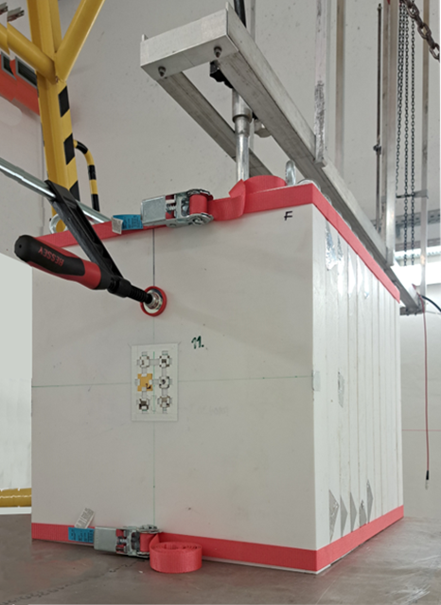
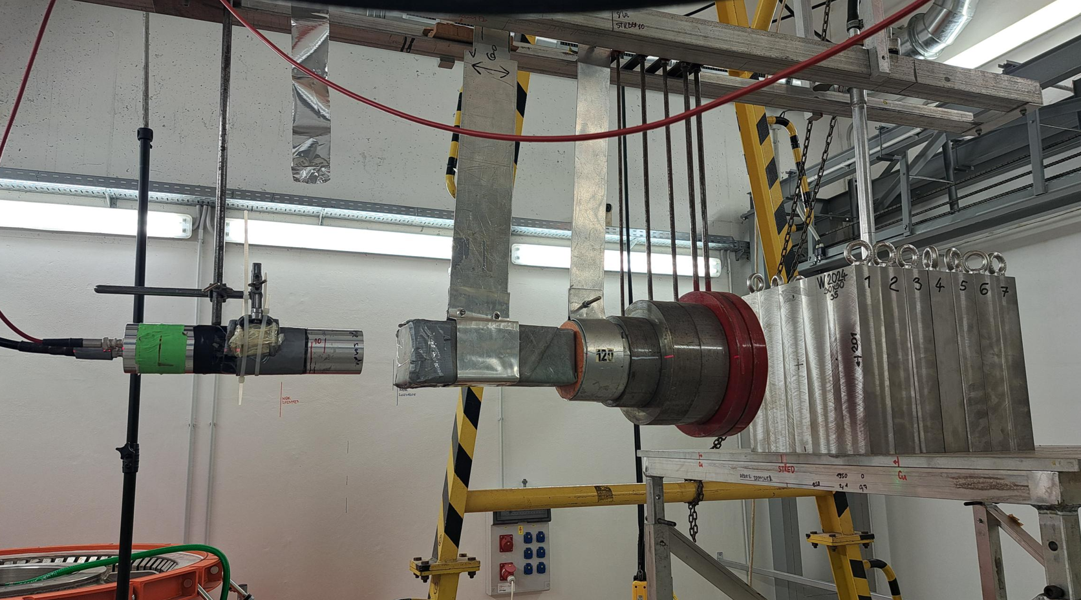
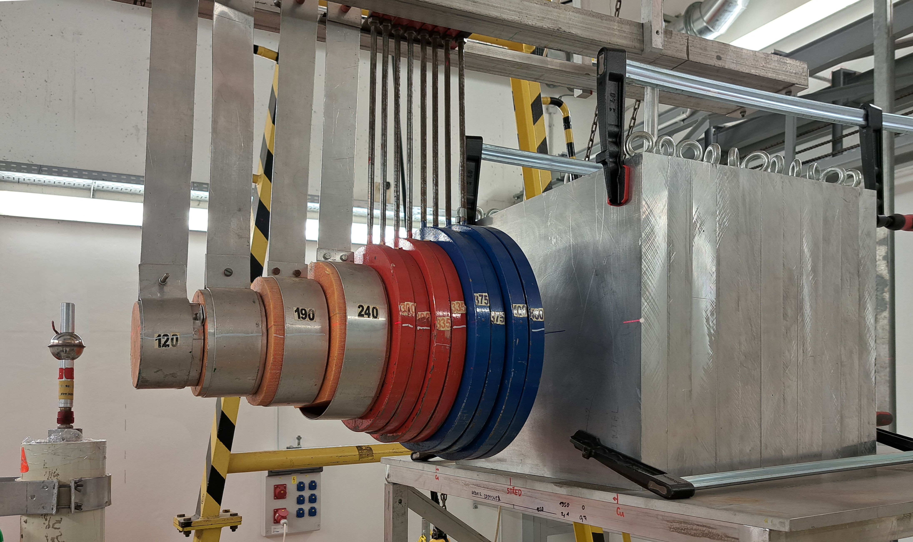
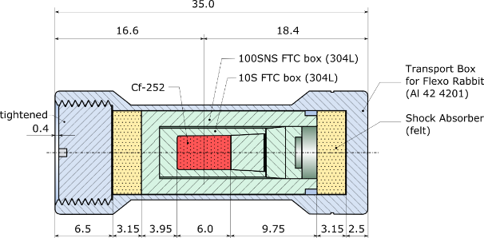
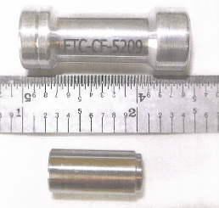
New neutron leakage experiments
PTFE block
60 × 50 × 50 cm
Tungsten 35 x 30 x 30 cm
Aluminium block
55 × 50 × 50 cm
²⁵²Cf in well defined cladding
Cones = 32cm PE + 20cm Fe
Support for benchmarks - 2 m above the lab.floor (as usually)
17

Slide 18
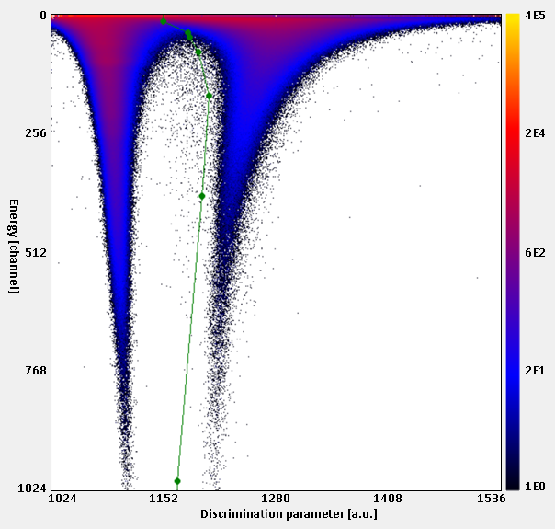
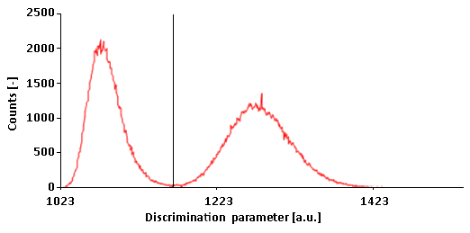
Mmeasurement of Al leakage flux
New approved ICSBEP evaluation
Neutron leakage spectra in 1 m, foils between plates
Stilbene detector 10x10 mm, HPD, In, Ni foils
Not high gamma background (good PSD discrimination)
discrimination in 28 channel ~ 0.86 MeV

Slide 19
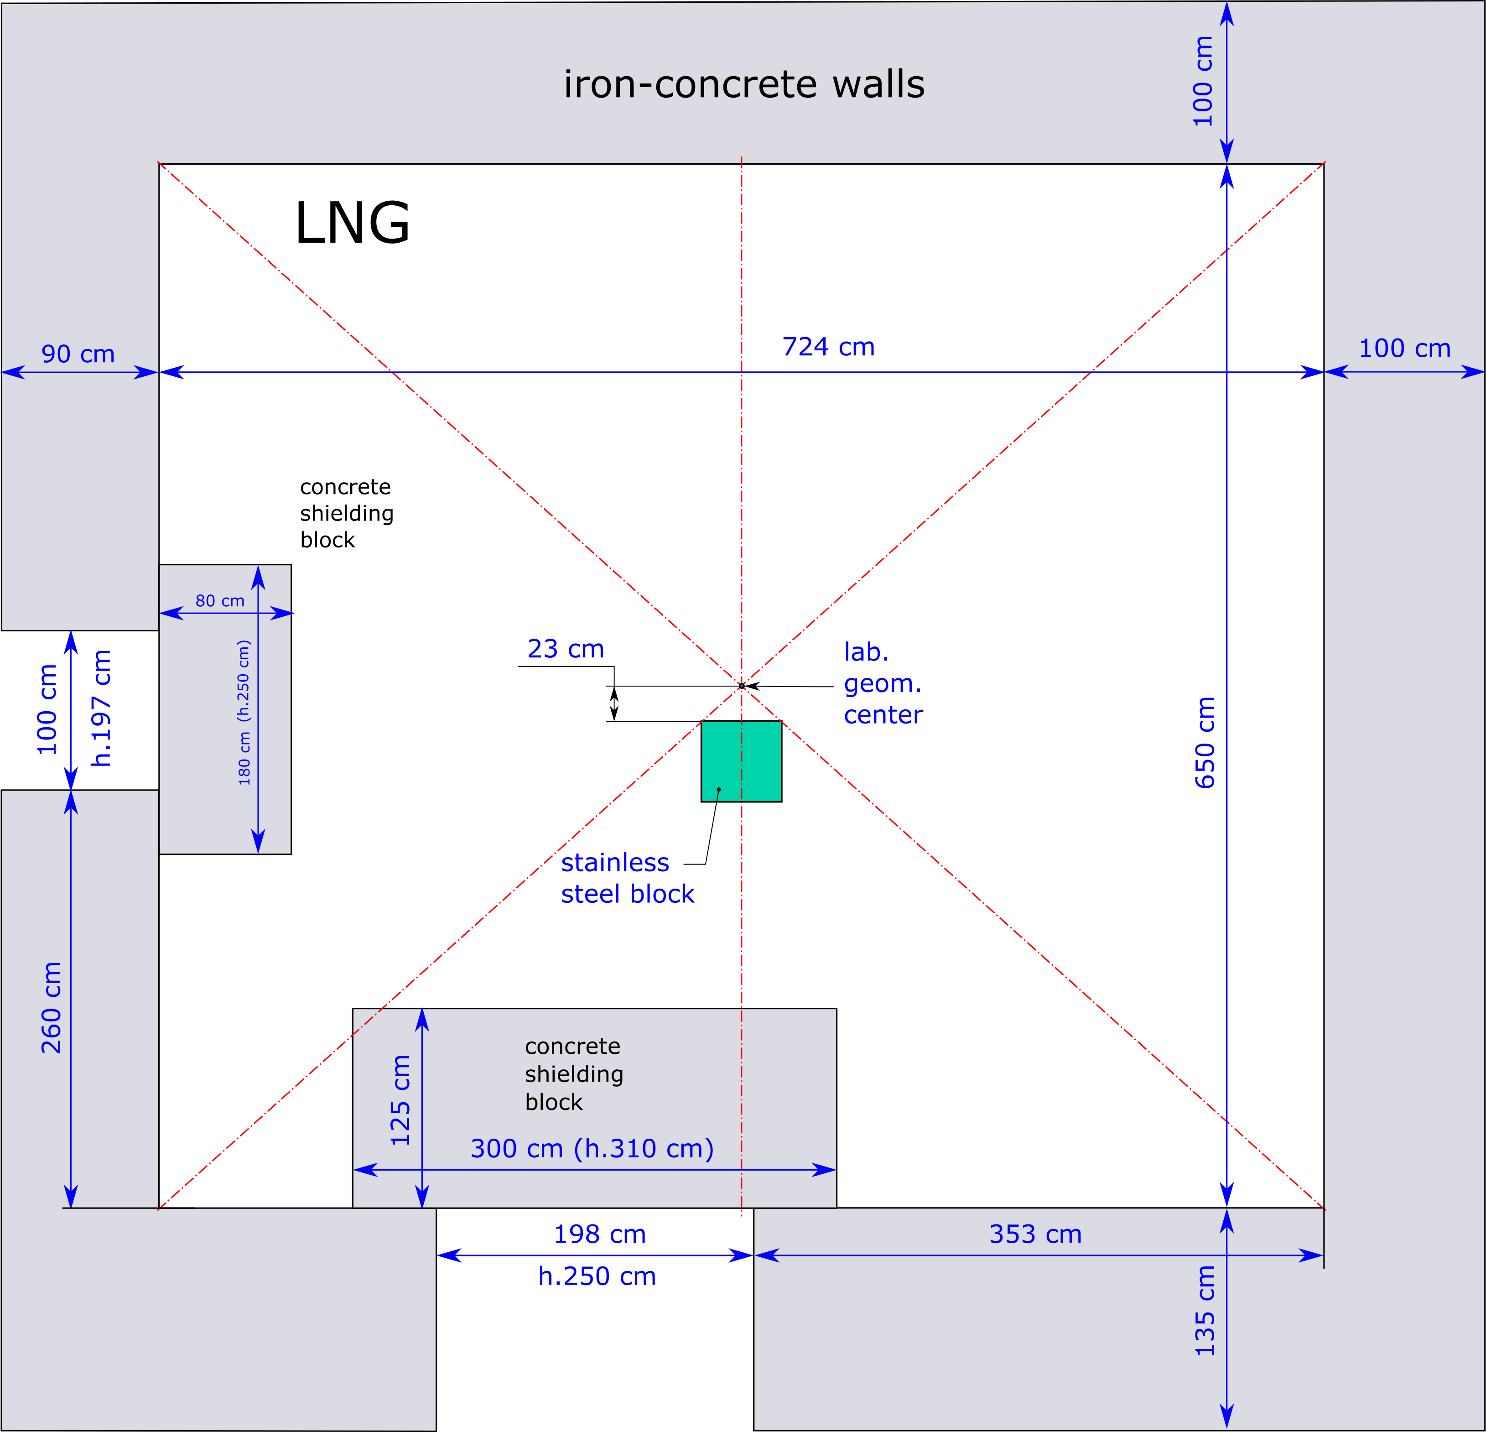
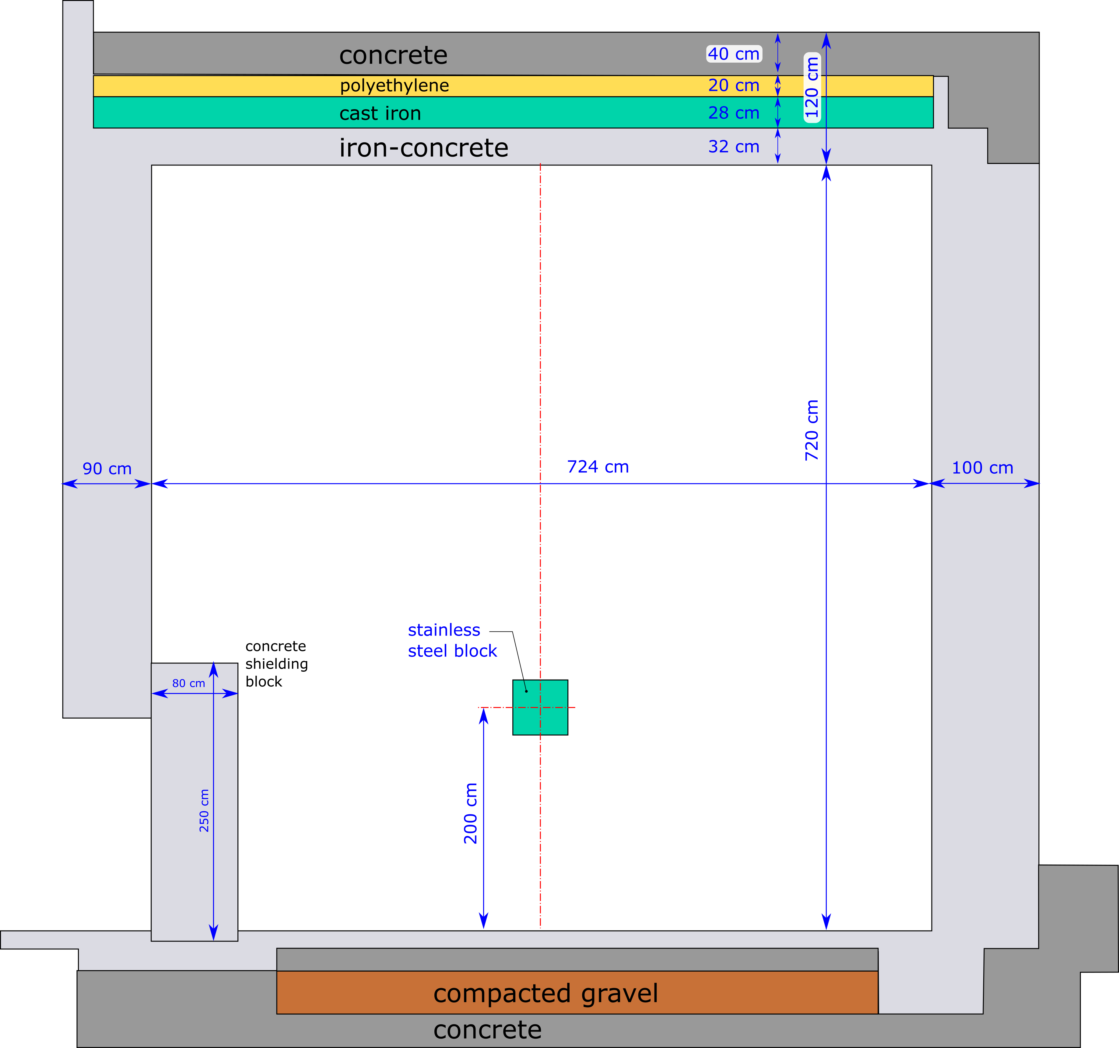
Room effect Al leakage
Experimentally evaluated (it is necessary)
High effect of thermal neutrons (low Al capture)
Room effect evaluation
Vertical view
Horizontal view

Slide 20
Al leakage spectra
Underprediction in lower energies
Relativelly good agreement in 3 – 9 MeV

Slide 21
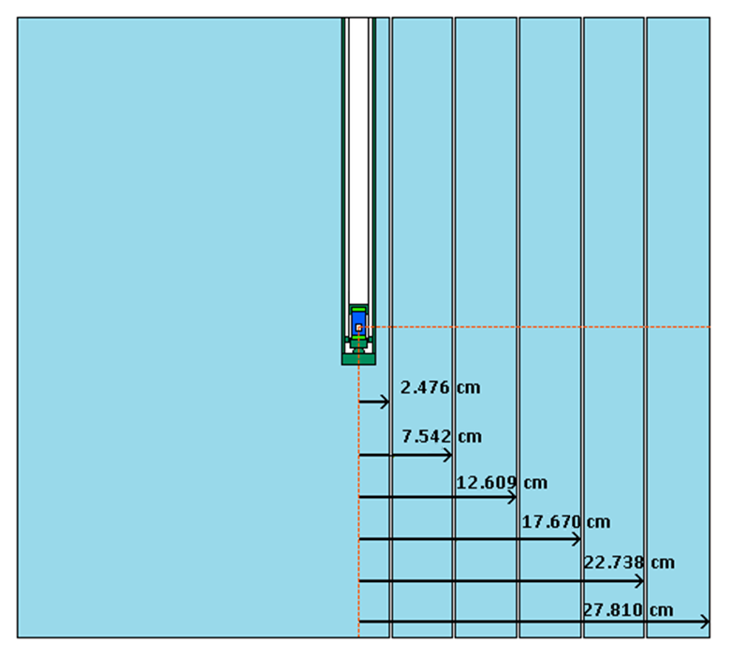
Al leakage – reaction rates
Foils between plates
Nearly all foils are showing underprediction
  ¹¹⁵In(n,n’) shows higher underprediction than ⁵⁸Ni(n,p)
 |  | 115In(n,n') |  |  |  | 58Ni(n,p)
Plate position | Al thickness [cm] | ENDF/B-VIII.0 [%] | JEFF-3.3 [%] | JENDL-5 [%] | Unc. [%] | ENDF/B-VIII.0 [%] | JEFF-3.3 [%] | JENDL-5 [%] | Unc. [%]
6 | 1.18 | -2 | -2 | -2.3 | 3.9 | -9.4 | -9.4 | -9.6 | 12.2
7 | 6.12 | -8.7 | -8.7 | -7.1 | 2.5 | -7.2 | -7.2 | -6.5 | 4.3
8 | 11.06 | -12.2 | -12.2 | -8.2 | 2.5 | -8.7 | -8.4 | -6.6 | 2.9
9 | 16.01 | -12.6 | -12.6 | -6.2 | 2.8 | -11.9 | -11.5 | -10 | 2.6
10 | 20.95 | -18.3 | -18.3 | -10.2 | 2.8 | -8 | -8 | -2.7 | 2.4
11 | 25.91 | -16.9 | -16.9 | -6.8 | 3.5

Slide 22
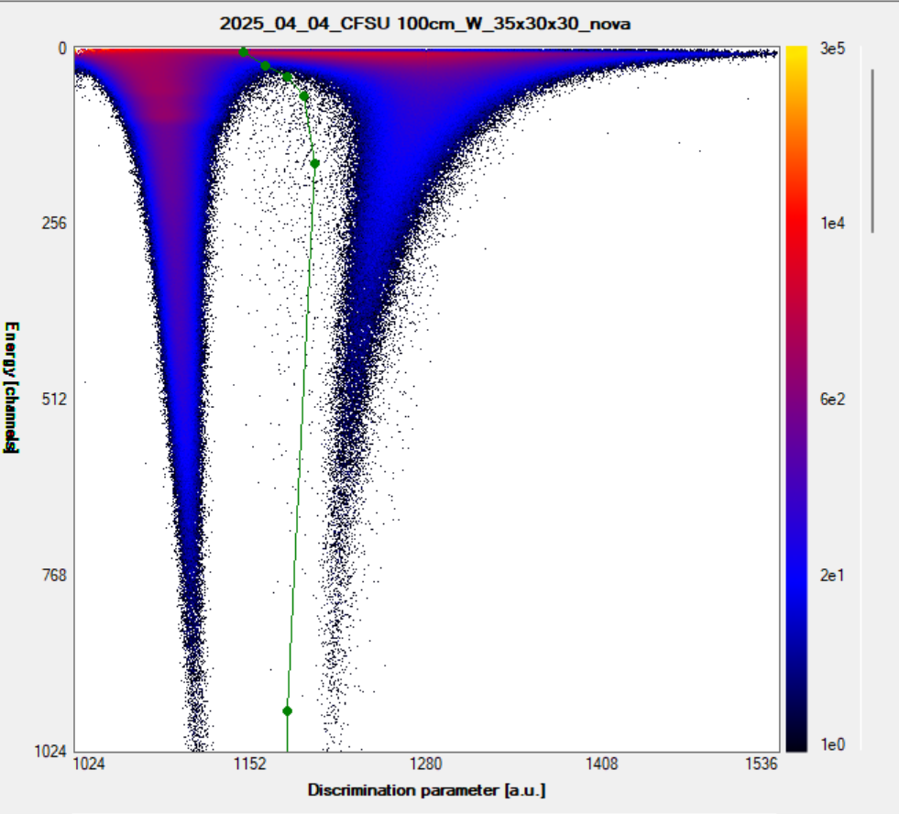
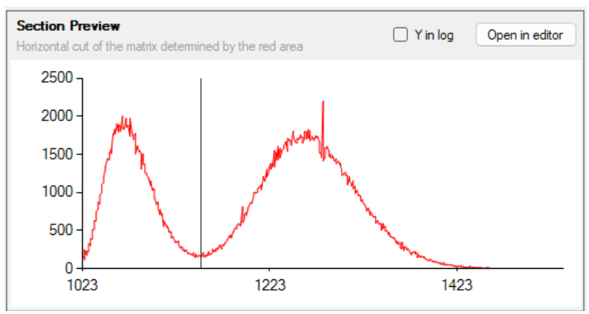
Measurement of W leakage flux
Ongoing experiments (96% W, 3% Ni, 1% Fe )
Neutron leakage spectra in 1 m, In foils between plates
Stilbene detector 10x10 mm, HPD, In foils on block
Not high gamma background (good PSD discrimination)
discrimination in 15 channel ~ 0.6 MeV

Slide 23
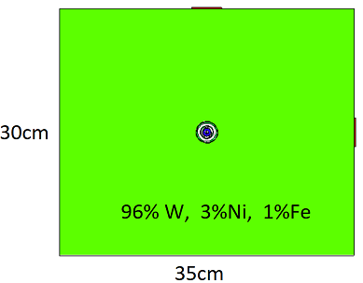
Measurement of W leakage flux
Ongoing experiments (96% W, 3% Ni, 1% Fe )
Neutron leakage spectra in 1 m, In foils between plates
Stilbene detector 10x10 mm in 1m, In foils on block
Not high gamma background (good PSD discrimination)
 | Front part (16.2 cm W) | Side part (13.7cm W)
Experimental RR | 4.76E-30 | 1.01E-29
C/E-1
ENDF/B-VIII | -15.0% | -11.9%
JEFF-3.3 | 10.9% | 9.9%
JENDL-5 | -8.1% | -6.2%
Ongoing experiments – preliminary results

Slide 24
W Broomstick
15cm of W in VR-1 beam
Preliminary experiments
Stilbene detector 10x10 mm
Ongoing experiments – preliminary results

Slide 25
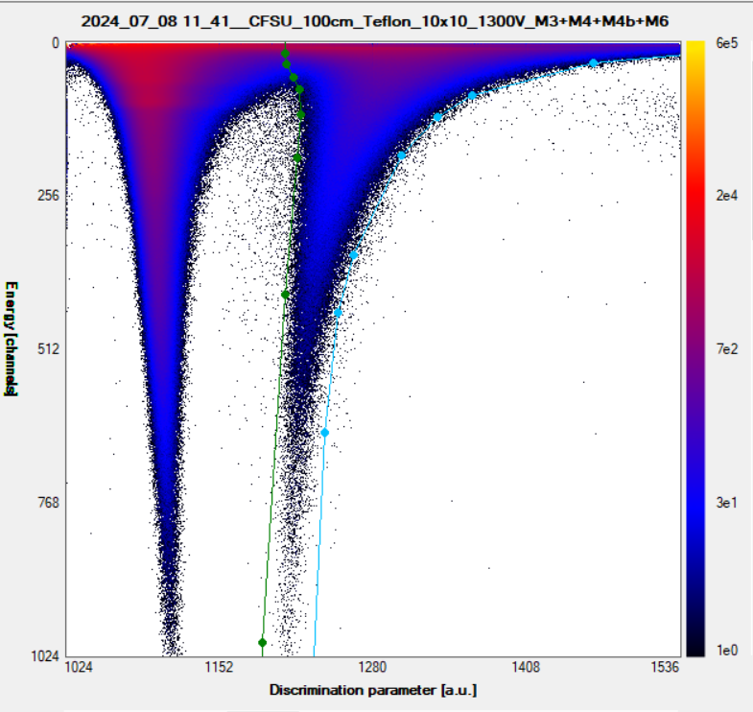
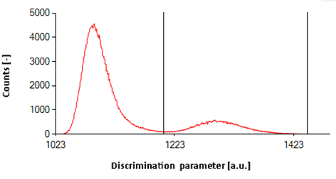
Measurement of PTFE leakage flux
New approved ICSBEP evaluation
Neutron leakage spectra in 1 m, foils between plates
Stilbene detector 10x10 mm, HPD, In, Ni foils
Lowergamma background (good PSD discrimination)
Room effect evaluation
Vertical view
Horizontal view
discrimination in 34 channel ~ 0.99 MeV
Czakoj et al., Comprehensive validation of fluorine cross-sections, Ann. of Nucl. En., Vol. 218, 2025, P.111426

Slide 26
C/E comparison of measured spectra
Best agreement in case of INDEN (ENDF/B-VIII.1.) however still some discrepancies are notable in region below 2 MeV
Czakoj et al., Comprehensive validation of fluorine cross-sections, Ann. of Nucl. En., Vol. 218, 2025, P.111426

Slide 27
Foil results
Indium ¹¹⁵In(n,n’)
Placement on plate No. back side | C₂F₄ thickness [cm] | ENDF/B-VIII.0 | INDEN | JEFF-3.3 | JENDL-5 | u_{r} [%]
6 | 1.40 | 4.4 | 2.0 | 4.4 | 2.2 | 3.9
7 | 6.82 | -4.8 | -4.8 | -4.8 | -7.5 | 3.0
8 | 12.28 | -5.2 | -1.8 | -5.3 | -7.5 | 3.1
9 | 17.68 | -14.4 | -8.1 | -14.5 | -15.9 | 4.4
10 | 23.09 | -24.6 | -16.3 | -24.6 | -25.0 | 7.5
11 | 28.48 | -26.7 | -14.7 | -26.8 | -25.1 | 5.5
Independent monitors of neutron flux
Even high flux monitored 5g Au foil, 2 month activation, 5d measurement => NPA ~ 1200 cts
Nickel ⁵⁸Ni(n,p)
Placement on plate No. back side | C₂F₄ thickness [cm] | ENDF/B-VIII.0 | INDEN | JEFF-3.3 | JENDL-5 | u_{r} [%]
6 | 1.40 | 3.1 | 2.1 | 3.1 | 1.8 | 9.0
7 | 6.82 | -2.0 | -1.7 | -2.1 | -3.3 | 3.4
8 | 12.28 | -5.6 | -2.9 | -5.6 | -5.7 | 2.9
9 | 17.68 | -7.8 | -3.0 | -7.8 | -6.6 | 3.3
10 | 23.09 | -12.3 | -5.5 | -12.3 | -9.6 | 3.2
11 | 28.48 | -9.8 | 0.5 | -9.8 | -4.0 | 3.5
Gold ¹⁹⁷Au(n,2n)
Placement on plate No. back side | C₂F₄ thickness [cm] | ENDF/B-VIII.0 | INDEN | JEFF-3.3 | JENDL-5 | u_{r} [%]
10 | 23.09 | -3.8 | -2.6 | -4.4 | 17.0 | 17.8

Slide 28
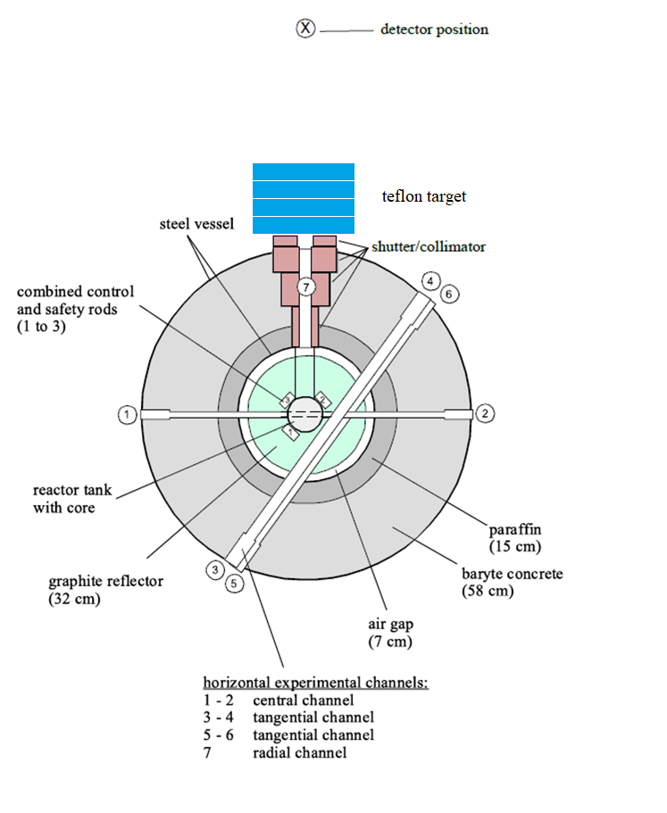
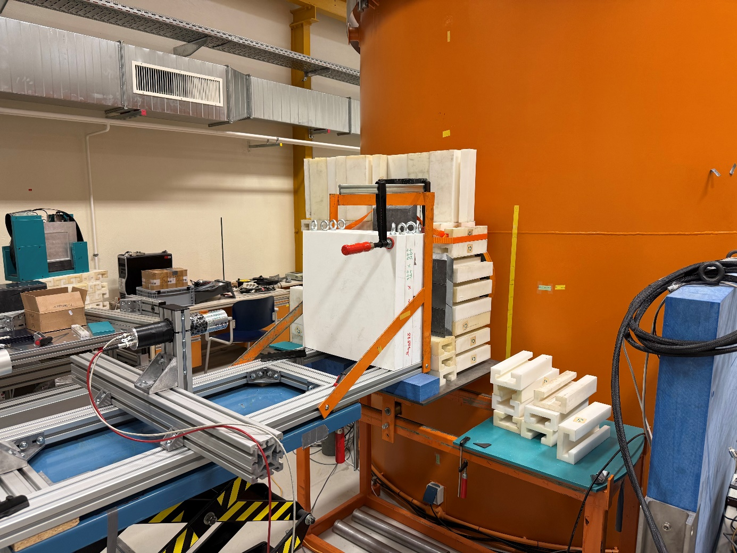
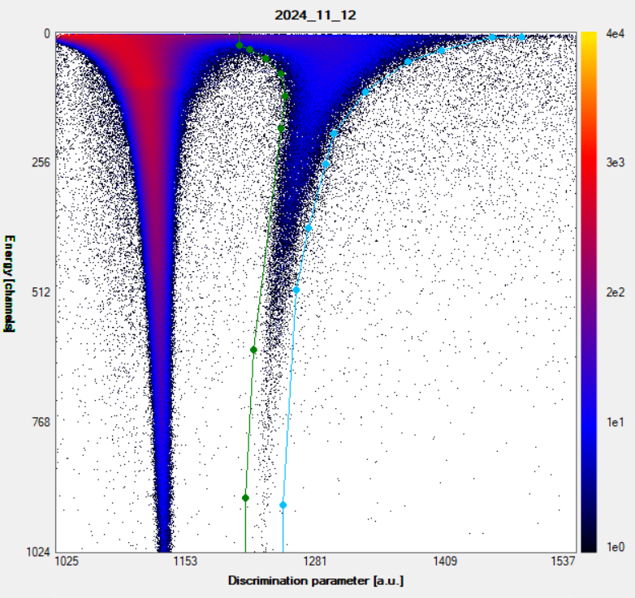
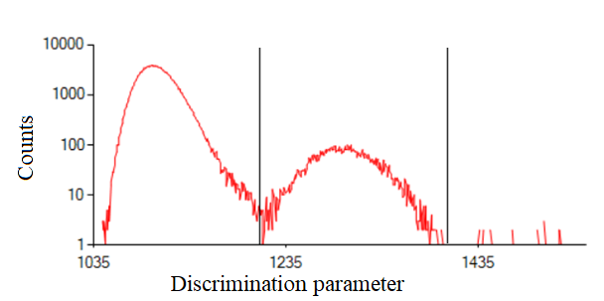
AKR-2 experiment
discrimination in 41 channel ~ 1.1 MeV

Slide 29
AKR-2 spectra
Large beam diameter ~ D=12 cm in this experiment
Due to geometry (holding table) + beam diameter … notable background ..
In this large beam diameter also elastic/inelastic play role . . . (but not so high as in leakage experiments)

Slide 30
C/E of measured spectra
Above 2 MeV good agreement below discrepancies similarly as in californium experiment
Most likely issue in ¹⁹F total cross section below 2 MeV

Slide 31
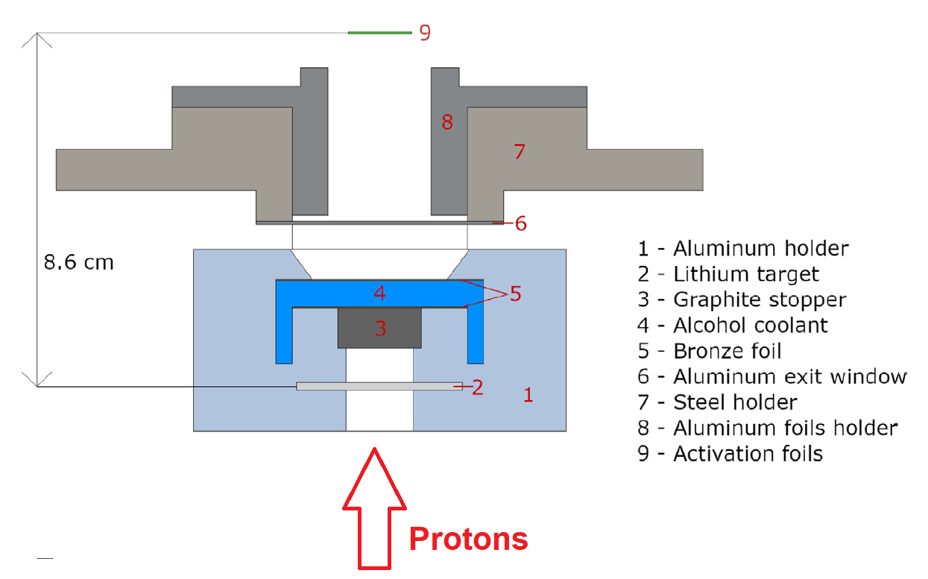
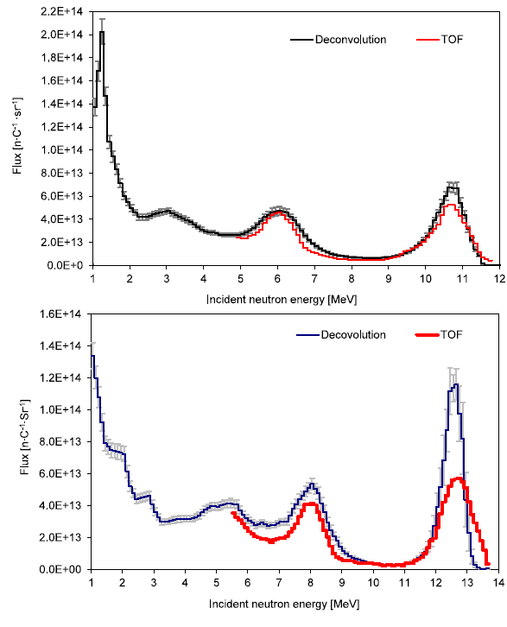
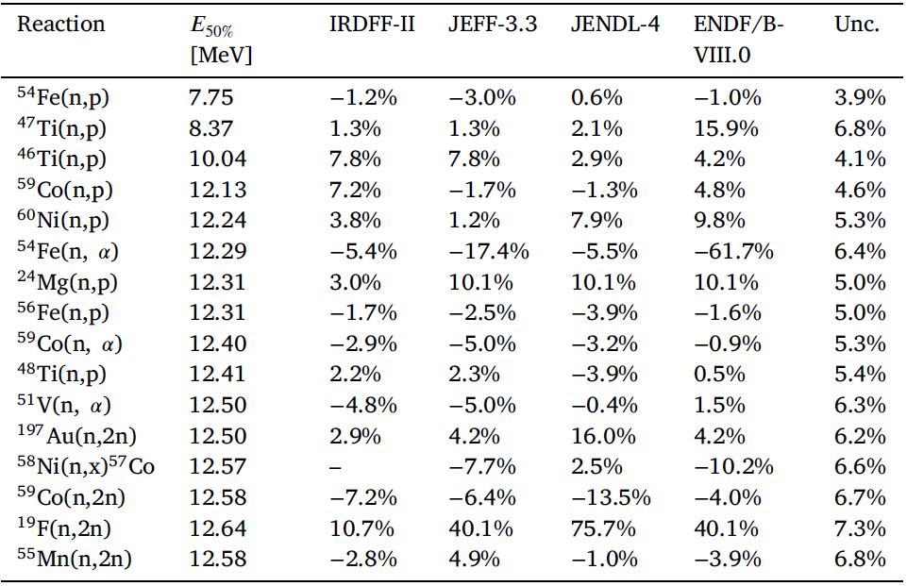
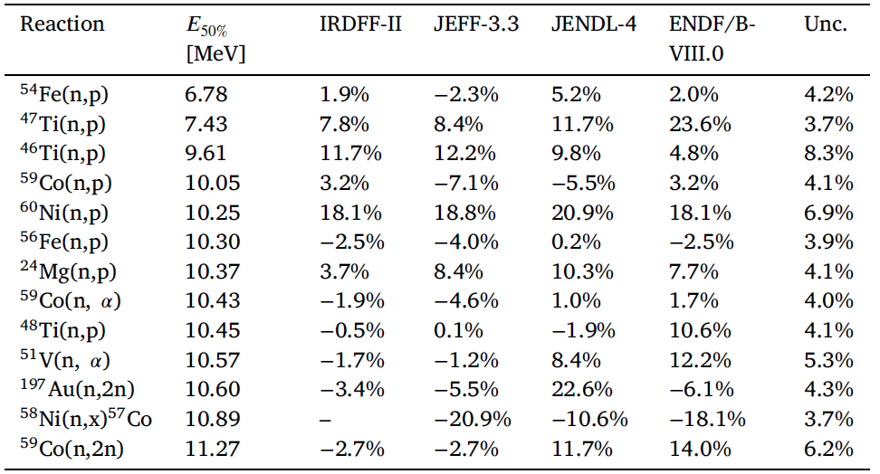
Quasi monoergetic field validation
Formed from ⁷Li(p,n) reaction
Spectra measurement
  Deconvolution
  TOF
Simultaneous activation
⁵⁸Ni(n,x)⁵⁷Co validation in quasi monoenergetic field
E_{protons} | E_{50%} [MeV] | JEFF-3.3 | JENDL-4 | ENDF/B-VIII | Unc.
12.4 MeV | 10.89 | -20.9% | -10.6% | -18.1% | 3.7%
14.4 MeV | 12.57 | -7.7% | 2.5% | -10.2% | 6.6%
Matej et al., Rad. Phys. and Chem., 184 (2021) 109475

Slide 32
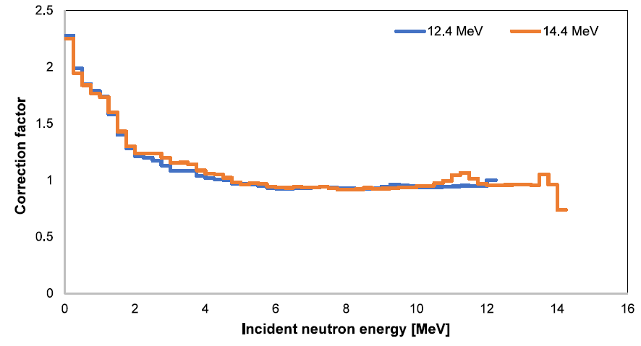
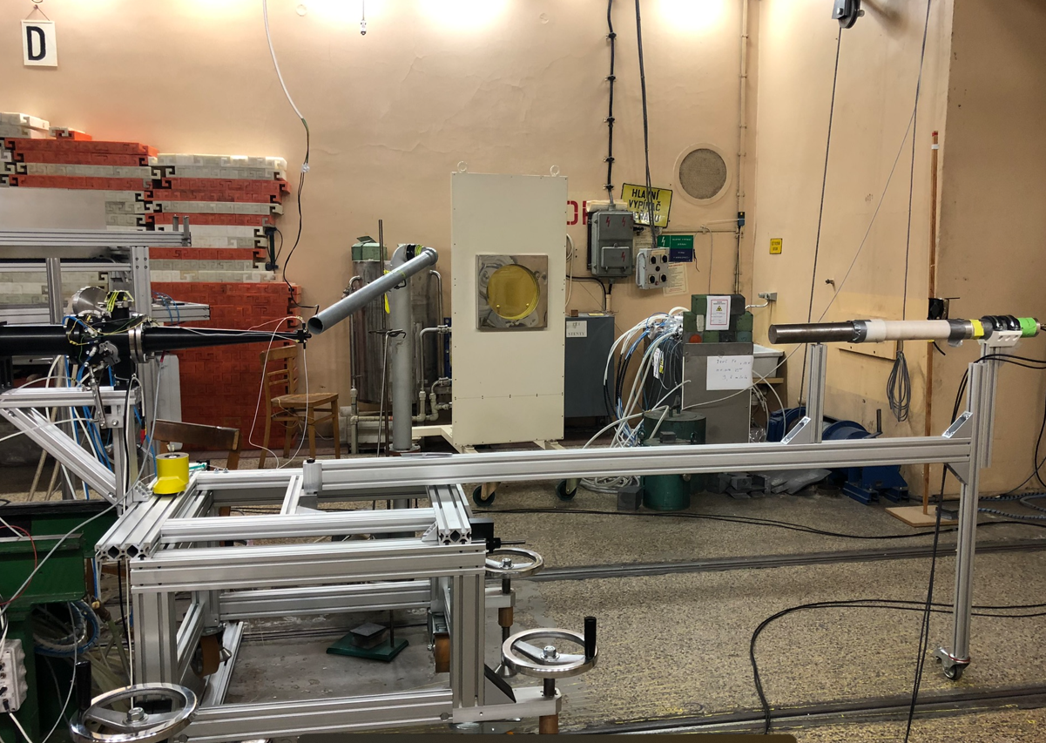
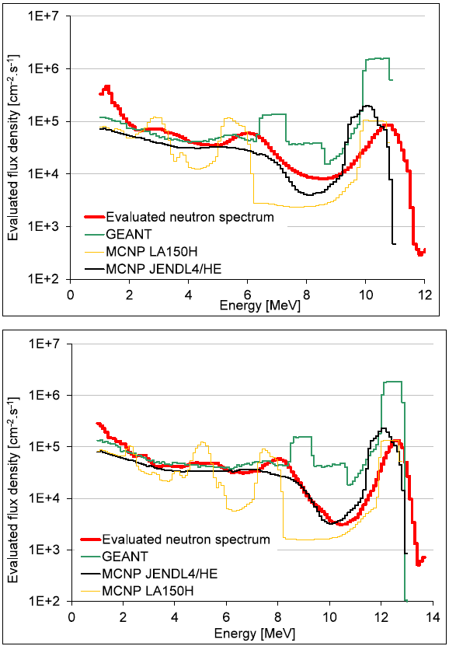
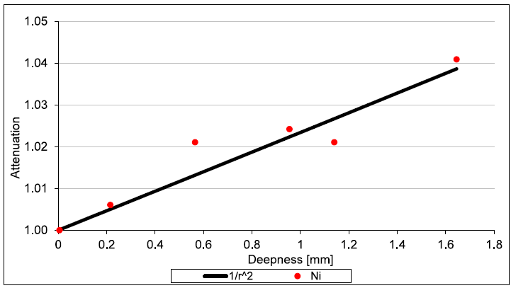
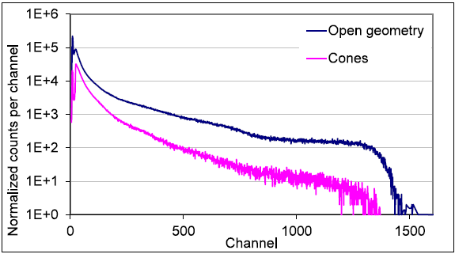
Quasi monoenergetic field
1
Need of experimental characterization
The calculation don’t agree with measured spectra (while TOF and deconvolution)
2
Background effect
Clasical estimation by room effect using cones
3
Material and geometrical correction
It is reflection of fact, that spectra is measured in position diffrerent from foils

Slide 33
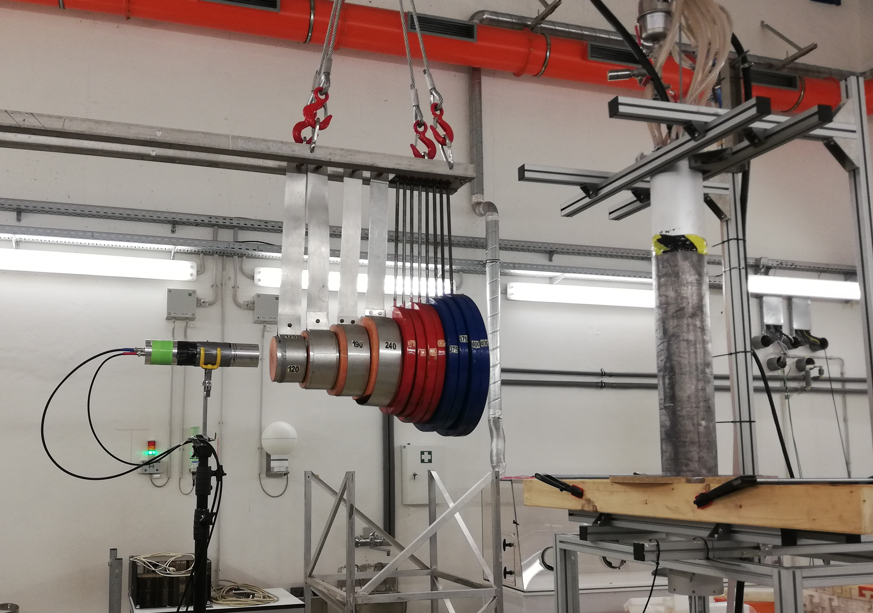
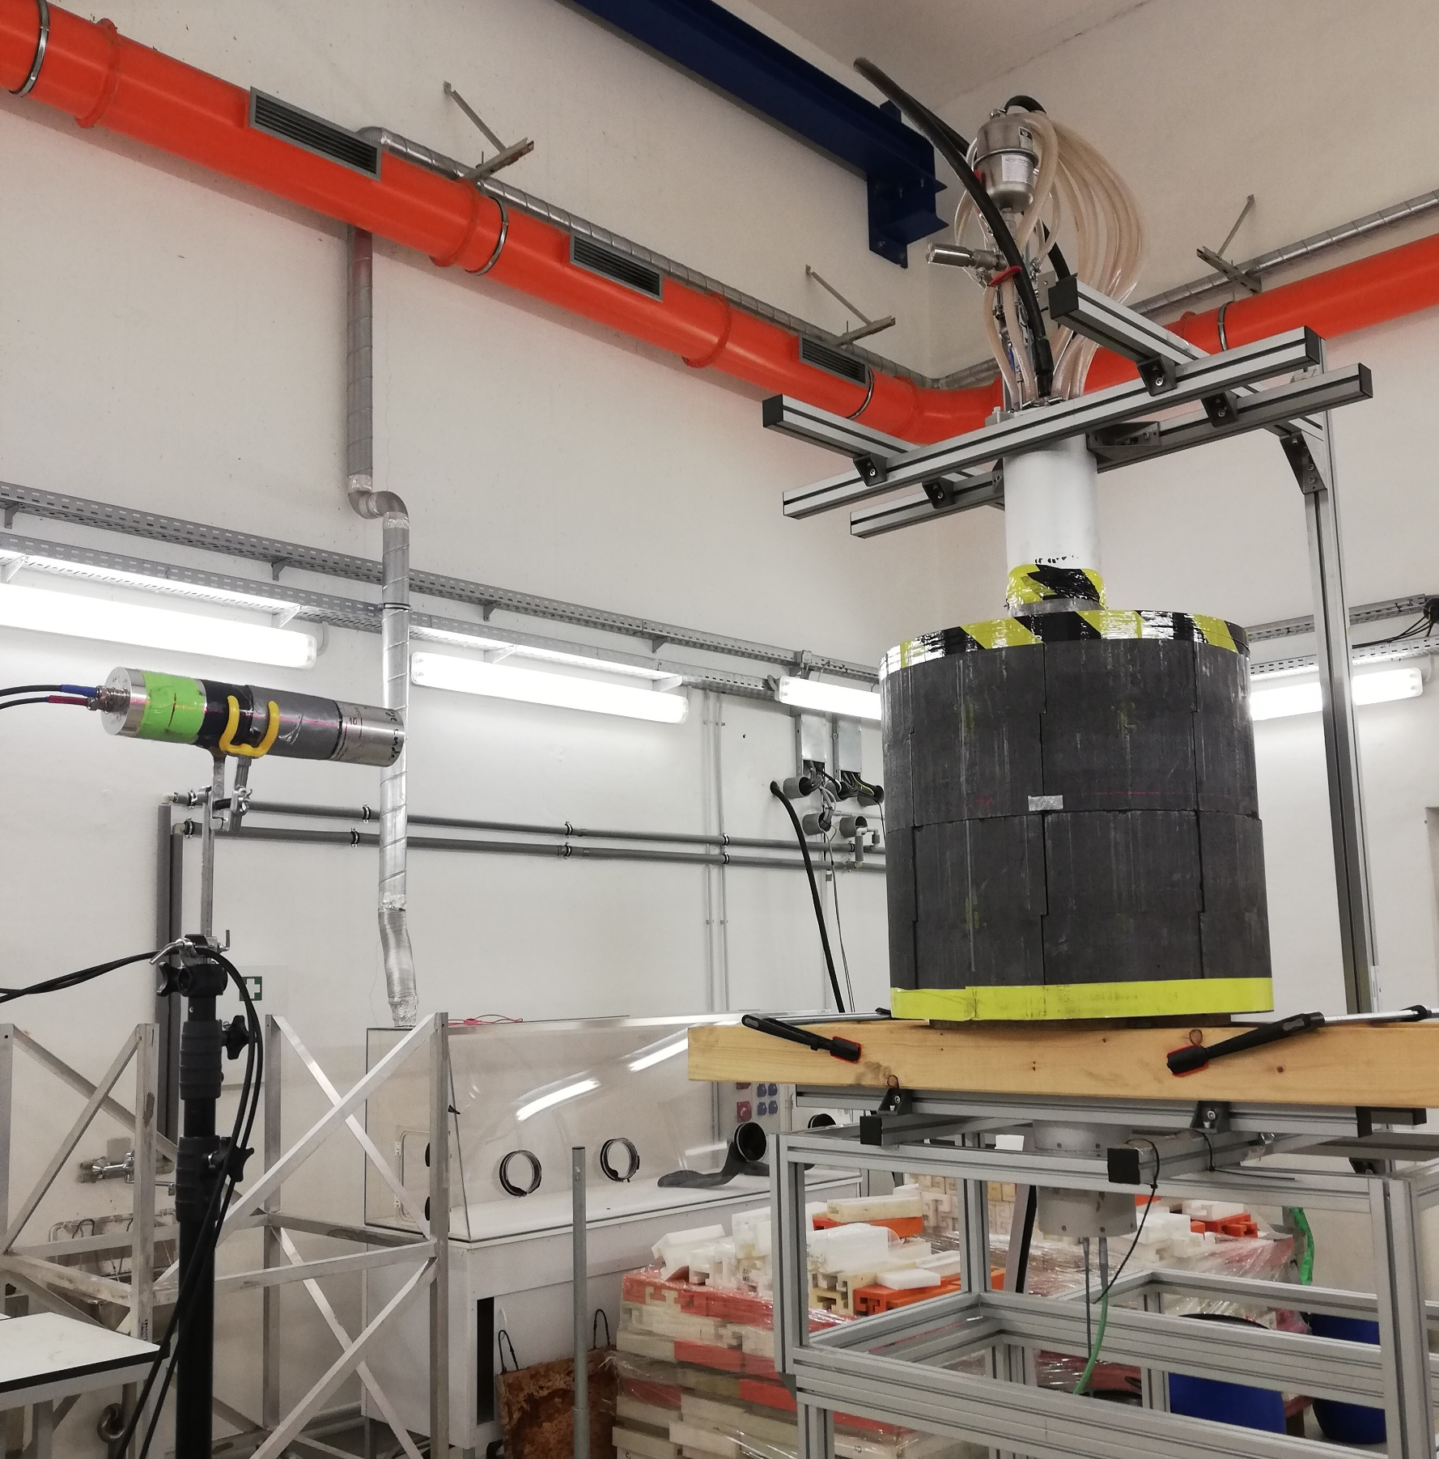
Graphite leakage flux using DT gen
Measurement using DT generator and graphite cylinder
Graphite cylinder 60x60 cm, central cavity 17 cm dia.
Stilbene detector 10x10 mm
Calculation in various libraries in progress
Results and calculations will be published soon

Slide 34
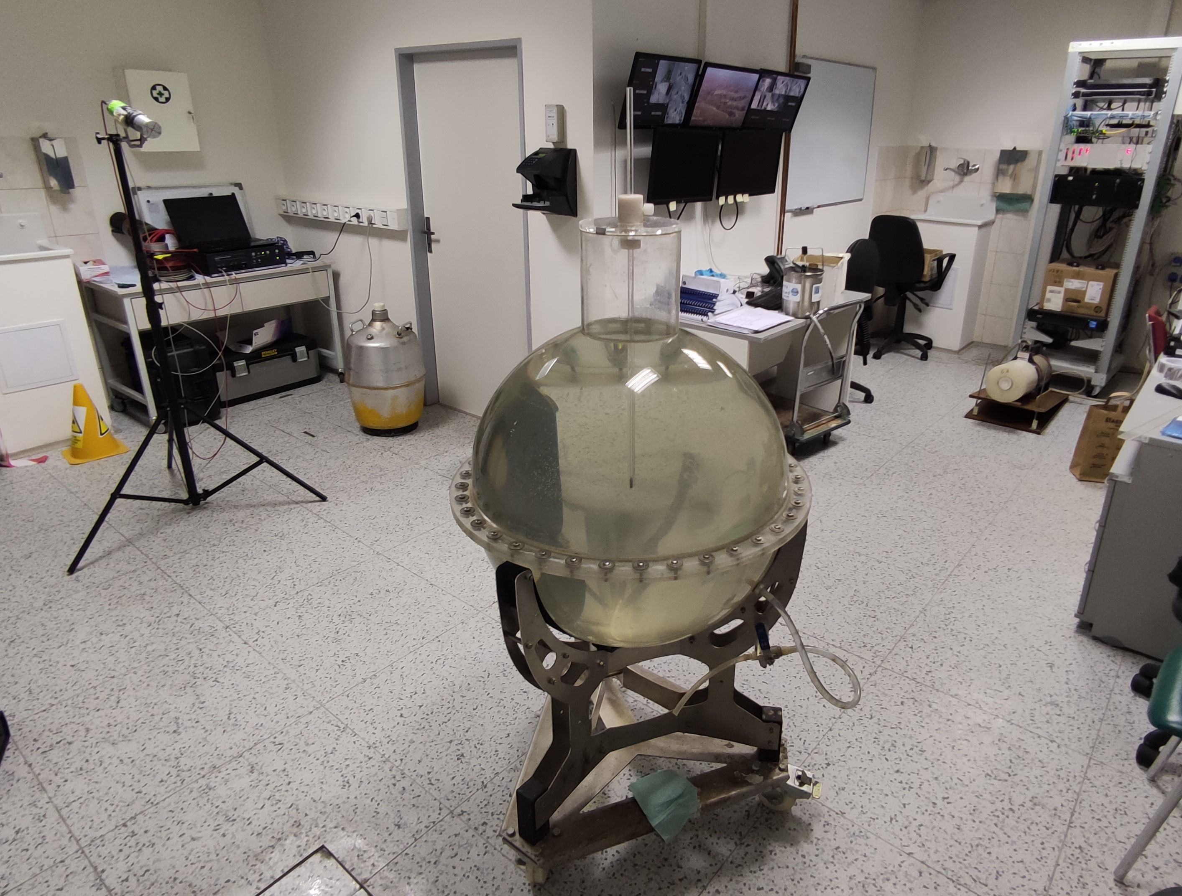
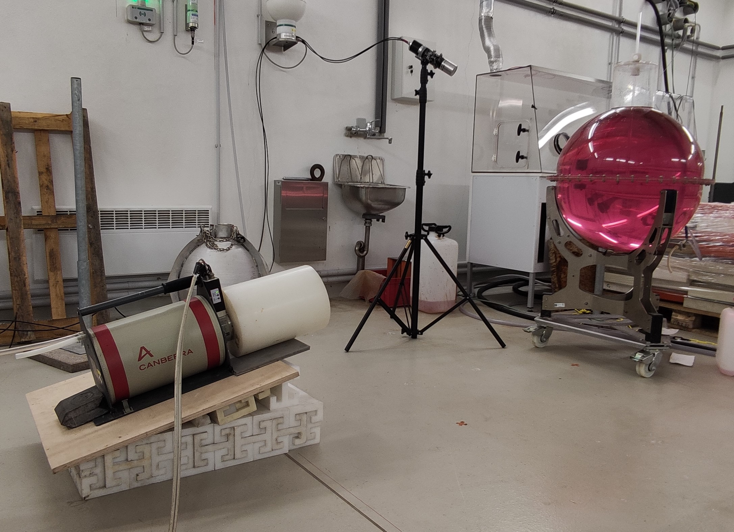

Prompt gamma measurement
  Measurement of leakage gammas with HPGe and stilbene detectors
  Ideal geometry, because Cf inside is standard
  Due to water solvent – good moderation
  SINBAD benchmarking
Energy range | Cl | Fe
0 - 1 eV | 97.738% | 99.404%
1 eV - 0.1 keV | 2.121% | 0.503%
0.1 keV - 10 keV | 0.134% | 0.053%
10 keV - 20 MeV | 0.007% | 0.039%

Slide 35
Gamma spectrum measurement in TRIGA
Not as good resolution as in HPGe, but still valuable results
Gamma spectrum above water
Gamma spectrum measurement of activated water (KATANA)

Slide 36
Gamma in various reactors
High energy gamma as important portion of gamma fields
Above 11 MeV gamma has similar shape with ²³⁵U PFGS
Over 13 MeV experiment is below evaluated PFGS

Slide 37





Epithermal dosimetry
Planned measurements with B₄C (¹⁰B) filters (JSI collaboration), spring 2025
In 2023 preliminary experiment with natural boron capsule (nearly equivalent to JSI one) ~ 2.364 g/cm³ instead of JSI 2.36 g/cm³
 | Poured | Sintered
Density [g/cm³] | 1.197 | 2.36
Thickness [mm] | 7.9 | 4
55Mn(n,g) [s⁻¹] | 3.67E-29 | 3.75E-29
Schulc et al., Appl. Rad. and Isot. 215, (2025), 111586
Kostal et al., Appl. Rad. and Isot. 169 (2021) 109566

Slide 38
Conclusions
Broomstick experiment realized at the VR-1 and it seems excellent tool for total cross section testing
There is a strong potential of AKR-2 for broomstick – discussion about use of C₂Cl₄, Zr in future experiments is planned
The Cf benchmark evaluations of Teflon and Aluminum leakage were approved to ICSBEP
The stilbene gamma spectrometry is promising tool.
The new experiments realized in LR-0 reference field. The new benchmarking is ongoing …

Slide 39
Thank you for attention
Michal Kostal
Michal.Kostal@cvrez.cz

Slide 40

Acknowledgements
The results were obtained using the CICRR infrastructure, financially supported by the Ministry of Education, Youth and Sports - project LM2023041 and by the European Union under grant agreement No 101061142.

