Slide 1
FNG Tungsten Benchmark Analysis using Pointwise and Multigroup FENDL-3.2 Data
I. Kodeli
FENDL Meeting, IAEA, 13-16 May 2025

Slide 2
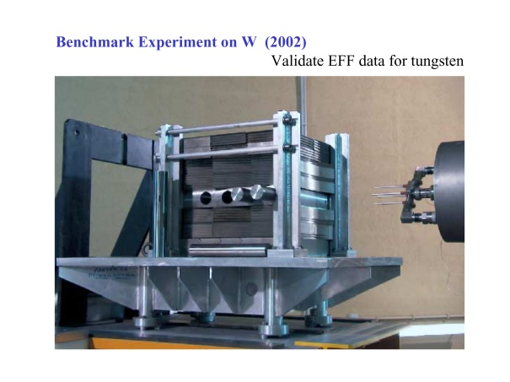
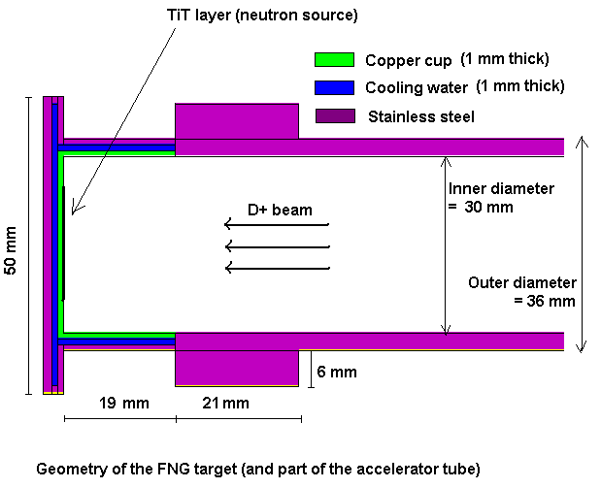
FNG Fusion benchmarks (14 MeV DT source) - FNG-SS Shield (1989) - FNG-ITER Blanket Bulk Shield (1995) - FNG-ITER Neutron Streaming (1997-1998) - FNG-ITER Dose Rate Experiment (2000-2001) - FNG Silicon Carbide (2001) - FNG Tungsten (2002) - FNG HCPB Tritium Breeder Module (2005) - FNG HCLL Tritium Breeder Module (2009) - FNG Cu (2013-2015) - FNG WCLL (2020) - FNG W (2023) - FNG Concrete (late 2025)
EUROfusion experimental programme - Frascati Neutron Generator (FNG)
Objectives:
Validation of JEFF basic nuclear data of relevance for fusion and/or of fusion reactor components for ITER/DEMO. Pre- & post-analysis using S/U, stored in SINBAD for future use
SINBAD Tungsten
- OKTAVIAN Tungsten Sphere
- FNS Tungsten
- FNG Tungsten (2002)
- FNG/TUD Tungsten (spectra)

Slide 3
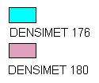
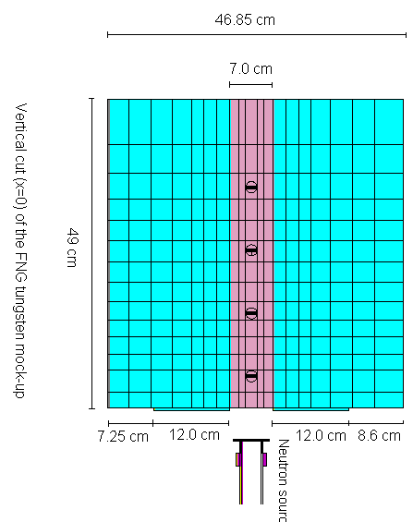
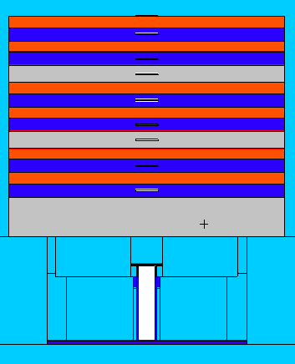
FNG-W 2002 FNG-W 2023
W, SS and H₂O:
48 x 42 x 39.4 cm³
DENSIMET-180: 7 cm, 3 cm, 3 cm
Perspex: 6 x 2 cm
SS-316: 6 x 2.4 cm
Densimet180/176:
42-47 x 46.85 x 49 cm³

Slide 4
FNG-W 2002 FNG-W 2023
Measured reaction rates
Ni-58(n,2n)
Zr90(n,2n)
Nb-93(n,2n)
Al-27(n,α)
Fe56(n,p)
Ni-58(n,p)
In115(n,n’)
Au-197(n,γ)
Mn55(n,γ)
Measured reaction rates
Ni-58(n,2n)
Nb-93(n,2n)
Al-27(n,α)
Ni-58(n,p)
In115(n,n’)
Au-197(n,γ)
W.186(n,γ)
Detector positions (inside SS-316 & W slabs):
D1 – 13.5 cm
D2 - 17.9 cm
D3 - 22.6 cm
D4 – 25.5 cm
D5 – 29.7 cm
D6 - 34.4 cm
D7 - 37.05cm
D8 - 41.5cm
D9 – 44.8 cm
Detector positions:
D1 - 5 cm
D2 - 15 cm
D3 - 25 cm
D4 - 35 cm
Δ ≈ ± 5 - 6%

Slide 5
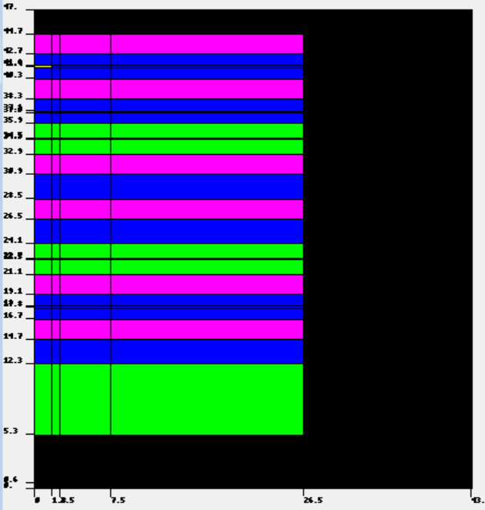
Calculational tools
Computer Codes (Discrete ordinates)
MCNP using ENEA Frascati inputs
DORT (DOORS package) & TWODANT
P₅, S₁₆ approximations, R-Z geometry
First collision source: GRTUNCL (DORT) and built-in analytic option (TWODANT)
XSUN-2023/SUSD3D sensitivity & uncertainty package
Nuclear Data
W-2002: EFF-3.2, FENDL-2 & -2.1, JENDL-3.3, cross-section data (175 energy groups)
W-2023: JEFF-3.3, ENDF/B-VIII.0, FENDL-3.2 (175 energy groups)
Response functions from IRDF-90.2 (2002) & IRDFF (2023)

Slide 6
NJOY Processing Flowchart for Multigroup XS Processing
XSUN2023 Nuclear Data
(NEA-1882)
- up to 440 nuclides
Transport cross sections in Vitamin-J 175- and ECCO 33- energy groups from JEFF-3.3, ENDF/B-VIII.0, FENDL-3.2 (211n/42g)
Covariance matrices processed by NJOY or ANGELO from:
JEFF-3.3 in ECCO 33n & VITAMIN-J 175n structures
ENDF/B-VIII.0 (ECCO 33 & VITAMIN-J 175n)
FENDL-3.2 (211n/42g)
Older nuclear data from ENDF/B-VII.1, JENDL-4.0u, COMMARA-2, SCALE-6.0 and IRDFF for limited number of isotopes
Ongoing:
Extension to other transport codes (DENOVO, THOR)
Nuclear data (JENDL-5.0, ENDF/B-VIII.1, CENDL-3.2, JEFF-4T)

Slide 7
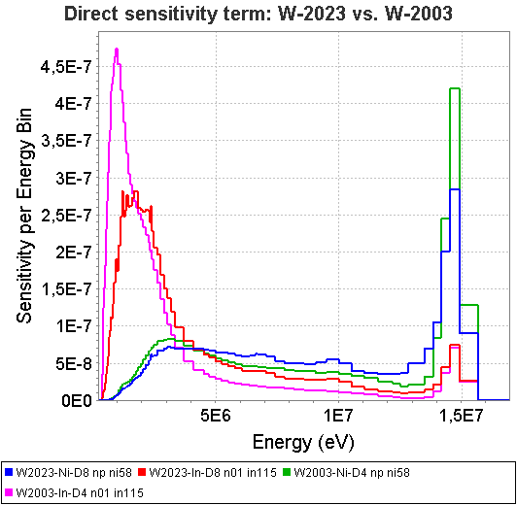
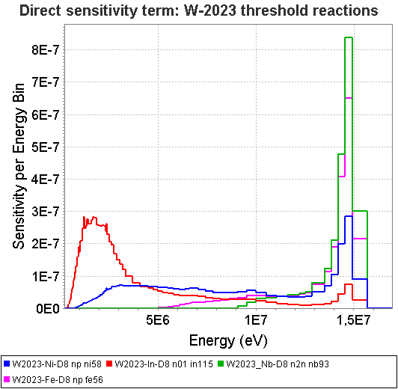
FNG-W 2002 vs. FNG-W 2023

Slide 8
ND sensitivities & uncertainties for: ¹⁸⁶W, ¹⁹⁷Au, ⁵⁵Mn, ⁹³Nb, ²⁷Al, ¹¹⁵In reaction rates at deep position (D8) in the block
Dosimetry reaction(D8) | Uncertainty JEFF-3.3 (%) | Top sensitivities | Top uncertainty
⁹³Nb(n,2n) | 7.71 % | ⁵⁶Fe(n,n’),^{184,182}W(n,2n), ⁵⁶Fe(n,2n),¹⁸⁶W(n,2n),¹H(n,n) | ⁹³Nb(n,2n),C(n,n’),¹⁸⁶W(n,2n), ⁵⁶Fe(n,n’),¹⁸²W(n,n’),⁵⁶Fe(n,np)
²⁷Al(n,α) | 12.02 | ⁵⁶Fe(n,n’),^{184,182}W(n,2n), ⁵⁶Fe(n,2n),¹⁸⁶W(n,2n),¹H(n,n) | ²⁷Al(n,2n),C(n,n’),⁵⁶Fe(n,n’), ¹⁸⁶W(n,2n),⁵⁶Fe(n,np),¹⁸²W(n,n’)
⁵⁶Fe(n,p) | 3.86 | ⁵⁶Fe(n,n’),^{184,182}W(n,2n), ⁵⁶Fe(n,2n),¹⁸⁶W(n,2n),¹H(n,n) | C(n,n’),⁵⁶Fe(n,n’),¹⁸⁶W(n,2n), ⁵⁶Fe(n,np),⁵⁶Fe(n,2n),¹⁸²W(n,n’)
⁵⁸Ni(n,p) | 3.50 | ⁵⁶Fe(n,n’),^{184,182,186}W(n,2n), ¹H(n,n),⁵⁶Fe(n,2n) | ⁵⁸Ni(n,p),C(n,n’),⁵⁶Fe(n,n’),¹⁸⁶W(n,2n), ⁵⁶Fe(n,np), ¹⁸⁴W(n,2n)
¹¹⁵In(n,n’) | 2.53 | ¹H(n,n),⁵⁶Fe(n,n’),^{184,182,186}W(n,2n), ¹⁸⁴W(n,n’) | ¹⁸⁴W(n,n’),⁵⁶Fe(n,n’),C(n,n’), ¹H(n,n),¹⁸⁶W(n,2n), ⁵⁶Fe(n,n)
¹⁹⁷Au(n,γ) | 2.21 | ¹H(n,n),⁵⁶Fe(n,g),⁵⁶Fe(n,n), ⁵⁶Fe(n,n’),C(n,n),¹⁸⁴W(n,2n) | ¹⁸⁴W(n,n’),⁵⁴Fe(n,γ),^{186,182}W(n,n’),¹⁸³W(n,n), ¹⁸³W(n,n’)
¹⁸⁶W(n,γ) | 4.95 | ¹H(n,n),⁵⁶Fe(n,n),⁵⁶Fe(n,g), ⁵⁶Fe(n,n’),C(n,n),¹⁸⁴W(n,2n) | ¹⁸⁶W(n,γ),¹⁸⁴W(n,n’),⁵⁴Fe(n,γ), ^{186,182}W(n,n’),¹⁸³W(n,n)
⁵⁵Mn(n,γ) | 4.20 | ¹H(n,n),⁵⁶Fe(n,g),⁵⁶Fe(n,n), ⁵⁶Fe(n,n’),C(n,n),¹⁸⁴W(n,2n) | ⁵⁵Mn(n,γ),^{54,57,56}Fe(n,γ),^{184,186,182}W(n,n’),¹⁸³W(n,n)
Notes:
8

Slide 9
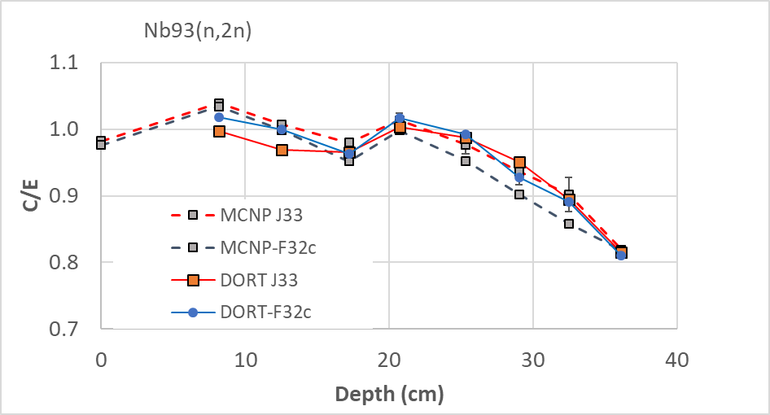
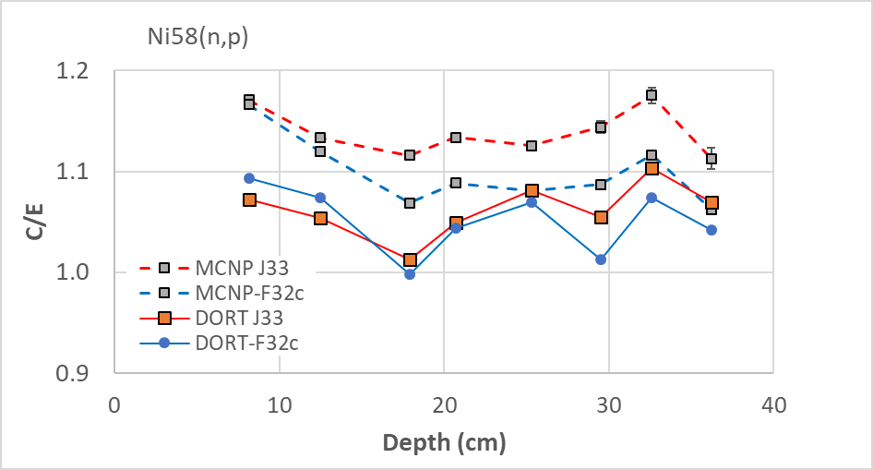
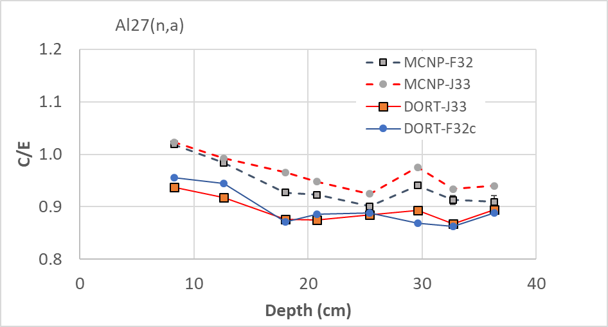
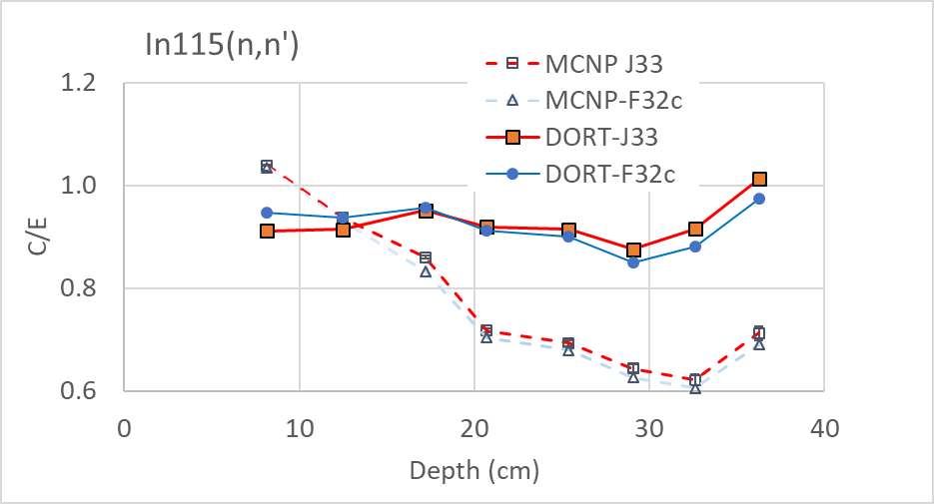
MCNP vs. DORT
MCNP input error – Nb instead of In

Slide 10
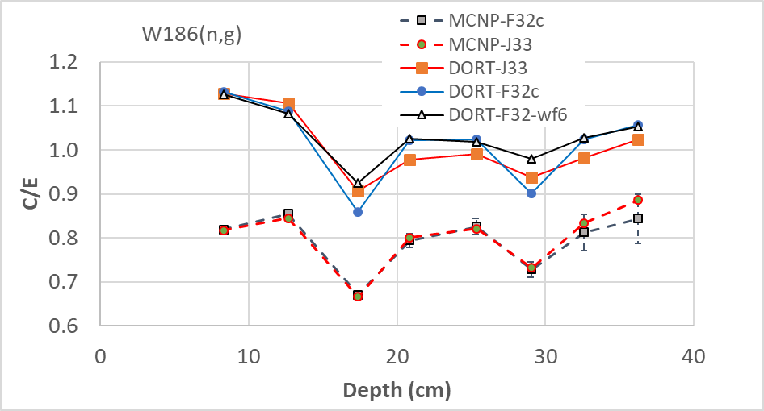
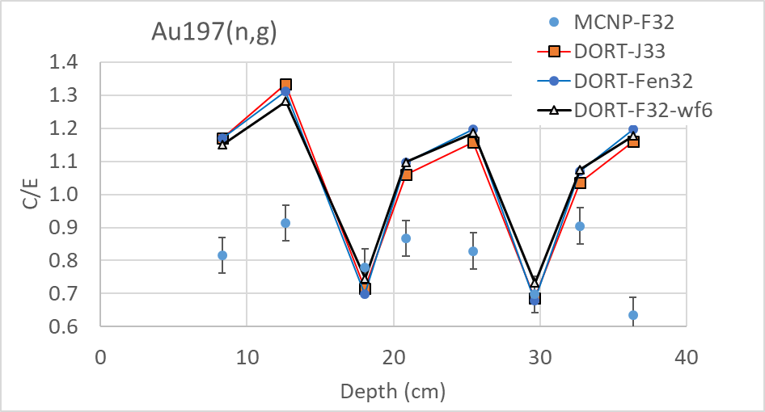
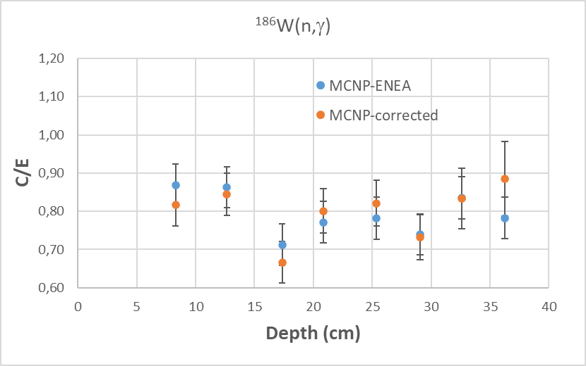
MCNP vs. DORT: VERDI detectors not modelled, approx. W/Au self-shielding
σ₀ =10³ for Au and 1.3.10⁴ for W instead of position dependent ~1.59.10³ and 2.6.10³
Foil density variations (W, Au)

Slide 11
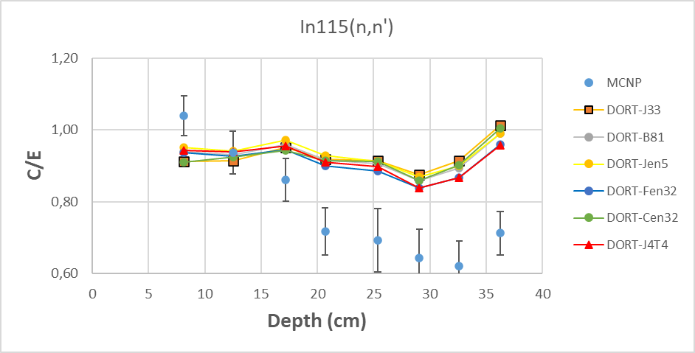
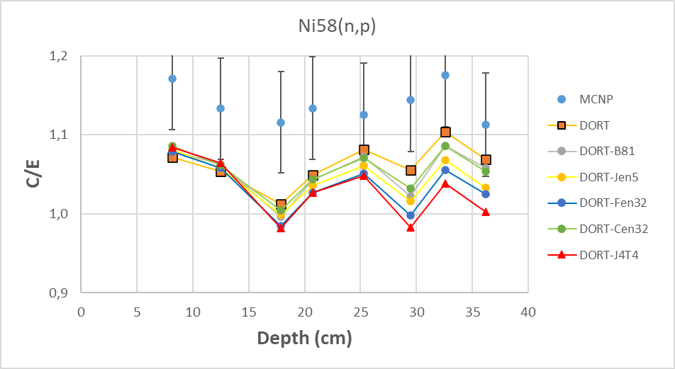
MCNP vs. DORT
JEFF3.3
ENDF/B-VIII.1
JENDL-5.0
FENDL3.2
CENDL-3.2
JEFF4T4

Slide 12
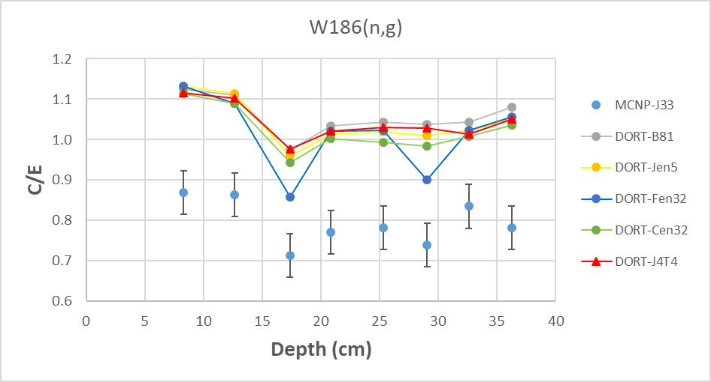
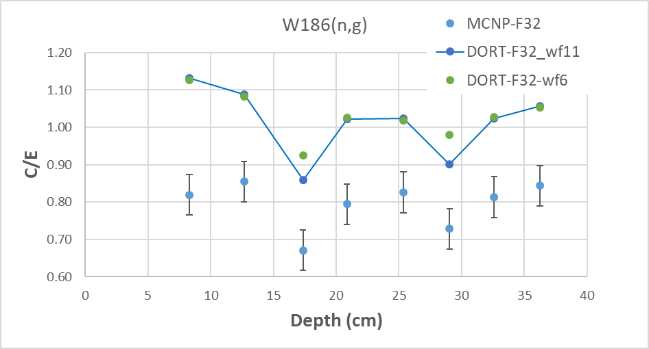
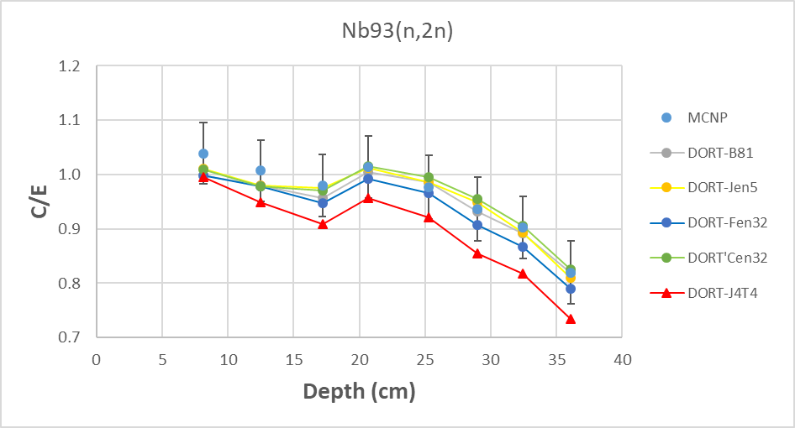
MCNP vs. DORT
JEFF3.3
ENDF/B-VIII.1
JENDL-5.0
FENDL3.2
CENDL-3.2
JEFF4T4

Slide 13
Conclusion
FNG W benchmark studied neutron transport in a shielding composed of layers of tungsten, SS and water;
Activation foils are sensitive to many cross sections: W(n,2n), (n,γ), (n,n⁽‘⁾), ⁵⁶Fe(n,n’), (n,γ), C(n,n’). Due to complex and multiple cross section dependency the benchmark is likely to validate the overall ND performance rather than resolving specific ND problems;
Good C/E agreement. Excellent agreement between MCNP and DORT. DORT/TORT codes & multigroup XS are still useful: S/U analyses, trend analysis, V&V.
Variations in Au and W foil masses observed, which could be due to variations in radii, thickness or/and density; assuming the radii are as certified the variations of density have 2 to ~5% impact on RR.

Slide 14
Table 6: Foils masses (in grams), error on the last digit.
FNG-W 2023: Foil masses & sizes
W/SS/H₂O layers: 48 x 42 x 39.4cm³
DENSIMET-180: 7/3/3 cm
Perspex: 6 x 2 cm
SS-316: 6 x 2.4 cm
Foil dimensions (GOODFELLOW) | Foil dimensions
 | Au | W
D (μm) | 50 | 150
R (mm) | 9 | 9
ρ (g/cm³) | 19.3 | 17.5
Discrepant RR: ¹¹⁵In(n,n’) (-30%) ⁵⁸Ni(n,p) (+15%) ⁶⁰Ni(n,p) (0/-50%)
Position | Measured foils masses (g) |  | Foil density (g/cm³)
 | Au | W | Au | W
1 | 0.2914 | 0.7285 | 22.90 | 19.09
2 | 0.3080 | 0.6325 | 24.21 | 16.57
3 | 0.3134 | 0.7269 | 24.63 | 19.04
4 | 0.2929 | 0.6231 | 23.02 | 16.32
5 | 0.3065 | 0.6298 | 24.09 | 16.50
6 | 0.3115 | 0.6136 | 24.48 | 16.08
7 | 0.3050 | 0.6491 | 23.97 | 17.01
8 | 0.2885 | 0.6070 | 22.67 | 15.90
Up to ~20 higher density for Au than GOODFELLOW values; +-10% for ¹⁸⁶W

Slide 15
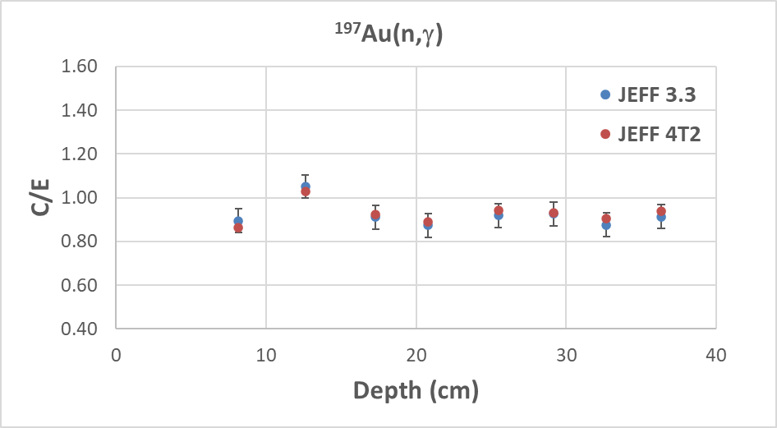
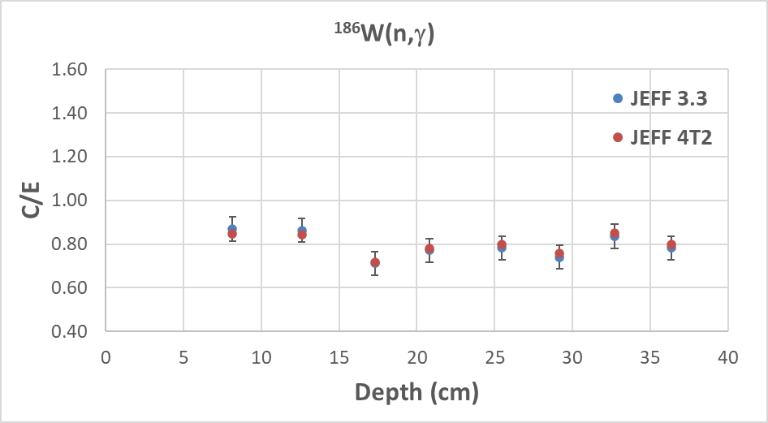
Table 6: Foils masses (in grams), error on the last digit.
FNG-W 2023: Foil masses & sizes
MCNP-6.3 calculation using FENDL-3.2
ENEA results (MCNP)
Position | ¹⁹⁷Au(n,g) |  | ¹⁸⁶W(n,g)
 | C_{m}/C₀ | ΔC_{m}/C₀ | C_{m}/C₀ | ΔC_{m}/C₀
1 | 0.96 | 0.015 | 0.98 | 0.017
2 | 0.94 | 0.012 | 1.02 | 0.015
3 | 0.91 | 0.031 | 1.00 | 0.012
4 | 0.95 | 0.026 | 1.02 | 0.032
5 | 0.96 | 0.030 | 1.02 | 0.036
6 | 0.88 | 0.090 | 1.00 | 0.032
7 | 0.99 | 0.069 | 1.01 | 0.080
8 | 0.93 | 0.095 | 1.03 | 0.114
Up to ~20 higher density for Au than GOODFELLOW values; +-10% for ¹⁸⁶W
Impact on RR due to self-shielding difference: +-2 to 3% for W, around -5% for Au.

