Slide 1
FENDL3.2c: V&V and impact over ITER analysis
M.Fabbri, D.Laghi, M.Campos, A.Bittesnich. M. Di Giacomo (F4E) with many contributions from G.Pedroche, P.Sauvan (UNED)
May^{th} 2025, IAEA HQ

Slide 2
FENDL3.2c V&V and impact over ITER analysis
Outline
FENDL3.2c: the most UpToDate nuclear data library
What FENDL3.2c contains
FENDL transport data (FENDL3.2c)
FENDL activation data (TENDL-2017): generation, V&V and impact
Main takeaways
Some points to consider for FENDL4.0

Slide 3
FENDL3.2c V&V and impact over ITER analysis
Outline
FENDL3.2c: the most UpToDate nuclear data library
What FENDL3.2c contains
FENDL transport data (FENDL3.2c)
FENDL activation data (TENDL-2017): generation, V&V and impact
Main takeaways
Some points to consider for FENDL4.0

Slide 4
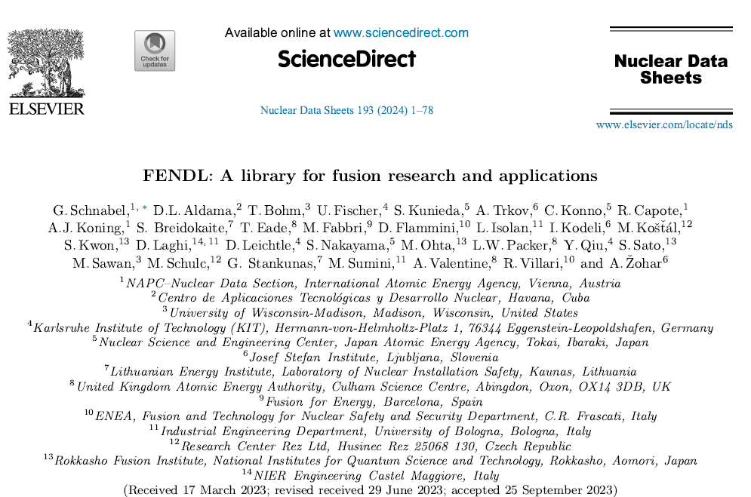
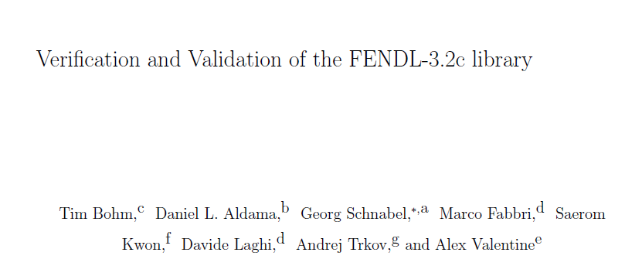
FENDL3.2c: the most UpToDate nuclear data library
The FENDL3.2c is the IAEA recommended nuclear data library for ITER application (others superseded):
Being the most updated, complete and performing evaluations
Having resolved the issued in energy/angle KERMA/DPA cross section
The one with the largest V&V ever with a dedicated peer reviewed publication ( ̴̴80 pages) plus one under review (& one in prepar.).
Strongly relying on configuration-control and automatization using JADE V&V tool driven by F4E & UKAEA.
FENDL3.2b
Under review in FST
FENDL3.2c

Slide 5
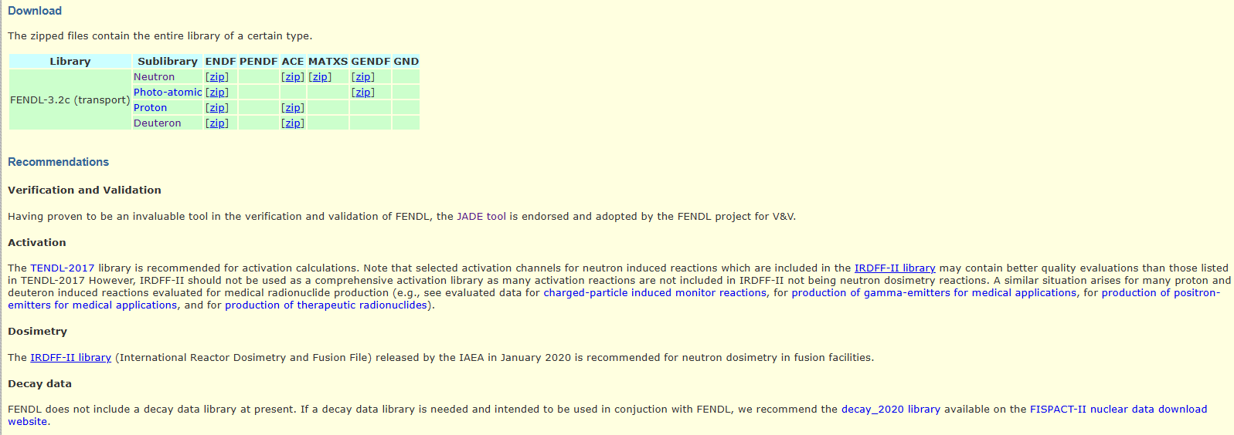
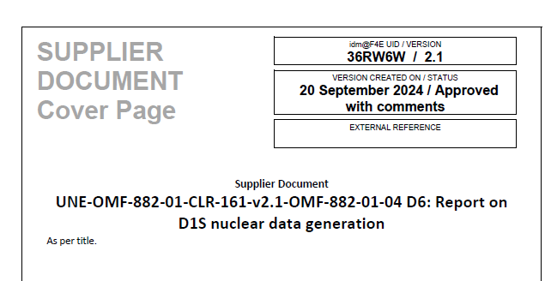
What FENDL3.2c contains?
D1S-ACE library (using FENDL3.2b + TENDL-2017) has been generated and available with F4E-OMF-882-01-04. Joint effort UNED + F4E in the V&V (see annex) & dedicated paper under preparation by G.Pedroche (UNED). Thanks also to S.Villari (ENEA) for the different exchanges.

Slide 6
FENDL3.2c V&V and impact over ITER analysis
Outline
FENDL3.2c: the most UpToDate nuclear data library
What FENDL3.2c contains
FENDL transport data (FENDL3.2c): impact on ITER analysis
FENDL activation data (TENDL-2017): generation, V&V and impact
Main takeaways
Some points to consider for FENDL4.0

Slide 7
Transport library: FENDL3.2c
Extended number of isotopes (180→192) in order mainly to cover all the concrete impurities isotopes
Resolved the issued in energy/angle KERMA/DPA cross section which is addressed in the processing pipeline and confirmed in the computational benchmark. (no need to substitute anymore the faulty FENDL3.1d elements)
Very large number of computational and experimental benchmarks performed to ensure the correctness/improvement of the ACE data. Works of years finally materialized in the V&V of FENDL3.2c.
Complete details reported in the NDS paper whereas hereinafter only a recap of the most relevant ITER benchmark (e.g., material and energy < 20 MeV).
Each single benchmark would request one meeting to be analysed and discussed in detail.
Description of the different set-ups can be found in JADE documentation and/or SINBAD database.
F4E (+EXP A.Milocco) is actively working on a methodology to “resume” the “performance of a library” for a specific application. An initial proposal to be presented later by A.Milocco (to be followed by dedicated paper).
The main change from FENDL3.2b to FENDL3.2c are (focusing only on impinging neutrons):
Correction of the heating number/dpa for W isotopes (change in the NJOY patch)
Update and extended resolved resonance region for W isotopes
Recoil distribution corrected and set at the mass system instead of lab system for Mn-55, W isotopes and Th-232.

Slide 8
Transport library: FENDL3.2c
Experimental benchmark | Comments
Oktavian | Al, Cr, Cu, Mn, Mo, Si, Ti, W and Zr analysed. No substantial differences observed with other FENDL libraries. Results aligned.
FNS experiments | Many assessed set-ups. Minor improvements showed in SS316, Pb and W with FENDL3.2b
FNG Cu, WCLL, W-SS-Water shield | No substantial differences observed with other libraries.
Research Center Rez 252Cf(s.f.) source: Ni, Fe, Cu, stainless steel, and Pb leakage spectrum and dosimetrical reactions | Better FENDL3.2 agreement than other libraries for Ni and SS, similar for Cu and Pb.
LLNL Pulsed Sphere | Similar behavior between FENDL releases and better C/E compared to ENDF-VIII.0 for Fe and Pb.
ASPIS Iron 88 | Better FENDL3.2a Fe agreement than FENDL2.1c.
PCA REPLICA: Fe +W | Better FENDL3.2a agreement than FENDL2.1c.
FNG SiC | Similar behavior between FENDL3.2a and FENDL2.1c.
FNG Tungsten | Slight better FENDL3.2a agreement than FENDL2.1c.
FNG HCPB | Similar behavior between FENDL3.2a and FENDL2.1c.
CIAE Fe | Similar behavior between FENDL3.2a and FENDL2.1c, however slightly worse behavior of the latest release for limited zone of the time domain.
FENDL3.2c has no evident fault as FENDL3.1d and it has a slightly better agreement with Fe, Cu and Pb for the main and high ranked SINBAD experimental data (e.g., ASPIS-88, Rez 252Cf …)

Slide 9
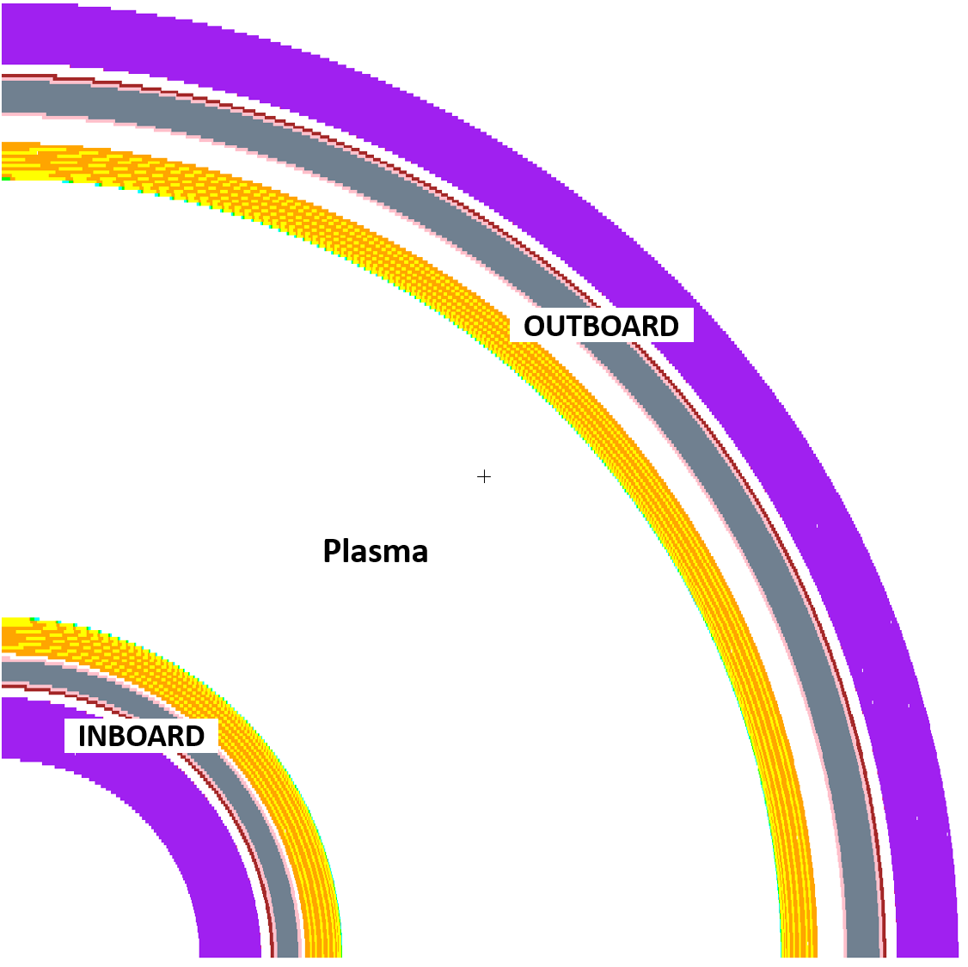
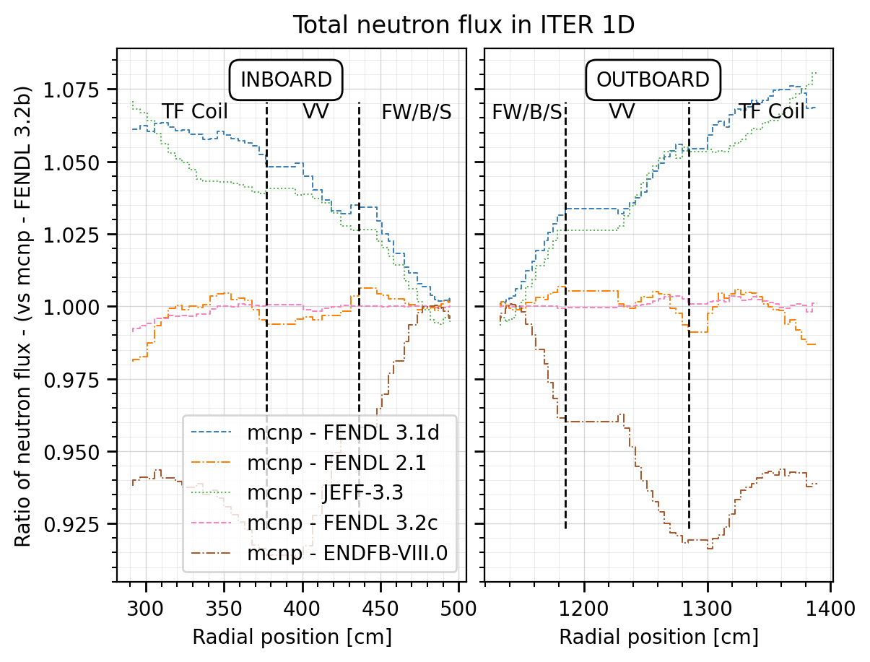
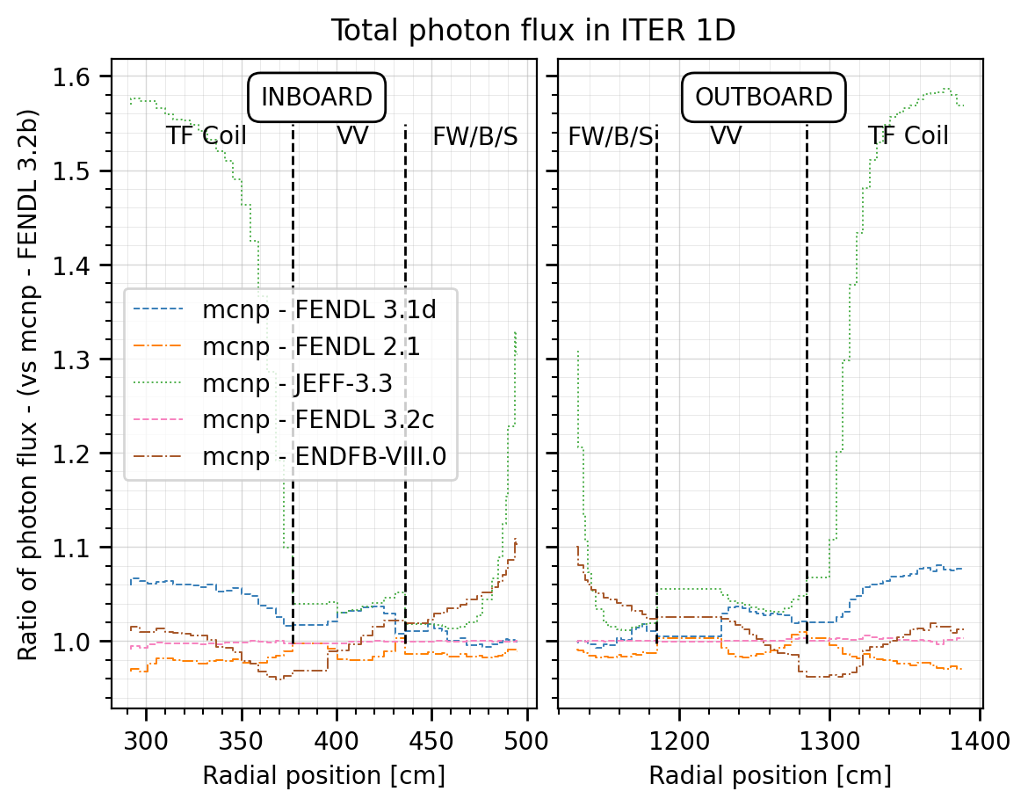
ITER 1D
No substantial differences observed with FENDL2.1c/3.1d, up to -/+5% in deeper regions for ENDF-VIII.0.

Slide 10
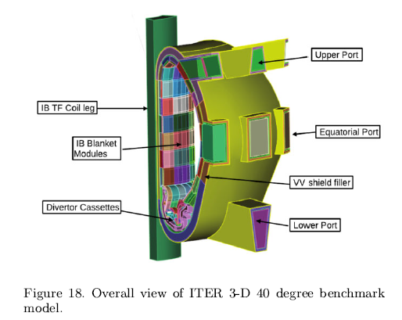
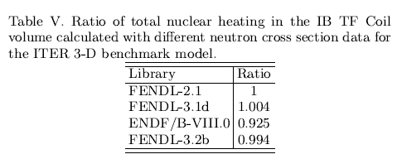
ITER 3D (B-lite with DAG-MC)
Differences observed between libraries aligned with 1D cases. He production increased by about 10%.

Slide 11
FENDL3.2c V&V and impact over ITER analysis
Outline
FENDL3.2c: the most UpToDate nuclear data library
What FENDL3.2c contains
FENDL transport data (FENDL3.2c)
FENDL activation data (TENDL-2017): generation, V&V and impact on ITER analysis
Main takeaways
Some points to consider for FENDL4.0

Slide 12
D1S (Direct 1-step) methodology
Nowadays, ITER shut-down rate calculations are done predominantly by D1S.
Neutron and decay photon simulations are carried out simultaneously in the same Monte Carlo calculation (N-P).
Modified MC radiation transport code and modified cross-section libraries are required to emit decay photons from the neutron interactions (as if they were prompt photons) (i.e., not need for the UKAEA novel D1S under development)
Decay photons have to be weighed by time correction factors, which include information on the irradiation scenario and take into account the radioisotopes build-up and decay.
Significantly faster than R2S.
Low computational resources (N-P calculation).
More accurate in terms of spatial and energy resolution.
✔
Need of modified ACE cross section.
Radioisotopes and pathways need to be known a priori (pre-activation analysis).
Relies on ASSUMPTIONS on the radioactive inventory.
✘

Slide 13
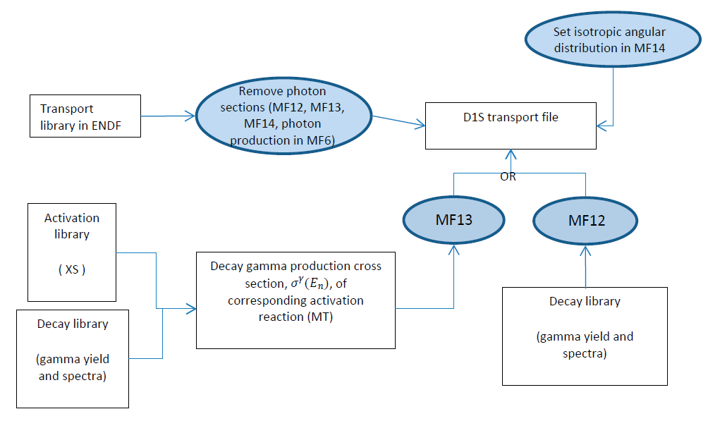
How D1S libraries are constructed? By whom?
Historically ENEA and UNED generated these libraries as they are the only for the time being able to built them, having the later to generate the latest release under a F4E contract:
Ref: https://doi.org/10.1016/j.fusengdes.2021.112646
ACE libraries
ACE XSdir
NJOY-2016 IAEA
FENDL-3.2b
Testing in JADE (mainly)
Computational/Quality
Sphere leakage
XS comparison
Typical reaction
ITER Cylin. Benchmark
ITER Port Cell
ITER Por Interspace
Experimental
FNG-SDDR
JET DT1 SDDR
TENDL-2017
Decay-2020
Decay-2020

Slide 14
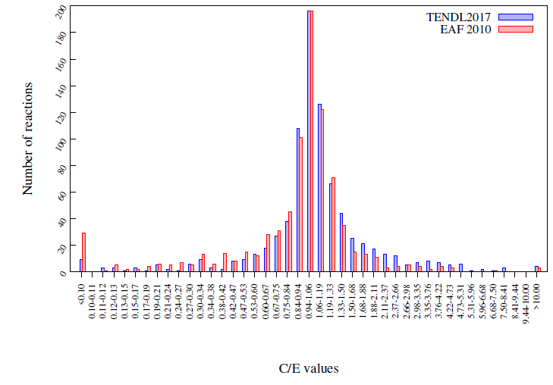
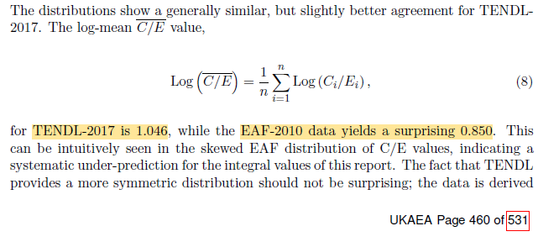
Activation XS: why TENDL-2017?
TENDL-2017 (FENDL-3.2c) performs better in the overall range of isotopes than EAF-2010 (FENDL-3.0A) and more pathways. This is due to some missing pathways in minor reaction/elements.

Slide 15
Impact of TENDL-2017 on ITER analysis
Moreover, several assessment already carried out under F4E umbrella to estimate and forecast the impact:
FISPACT calculations comparing main reaction by N.Taylor (EXP-341-T16 impact of TENDL-17 on ITER-relevant activation reactions (F4E_D_2YNULU v1.1)) for different spectra
XS comparison and sphere leakage test for single channels and ITER typical materials and ITER Cylindrical benchmark by F4E (F4E_D_36RW6W v2.1)
FNG SDDR benchmark and JET SDDR experiment by UNED under OMF-882-01-04 (F4E_D_36RPPC v2.3)
TBM EP#16 and PC#16 by UNED under OMF-882-01-04 (F4E_D_36RW6W v2.1)
Main take aways:
Current D1S-ACE data are based on FENDL3.1c/d+EAF-2010 (generated by F4E-grant) whereas the latest nuclear data package on FENDL3.2c+TENDL-2017 (called hereinafter decay 2020) (generated also by F4E contract)
No major issue have been found in the TENDL-2017
The relative behaviour of the TENDL-2017 vs EAF-2010, depends on the neutron spectra and on the specific reaction channel
The TENDL-2017 computes generally lower results than the one based on EAF-2010 (5-10%)
TENDL-2017 can be improved in several aspects as all the XS libraries. More attention to be given to later TENDL releases and to the main D1S pathways
We have only two SDDR experimental benchmarks: there is clearly an overall underprediction between 20-40%!!! (larger at earlier time) and more SDDR experiments are clearly needed!

Slide 16
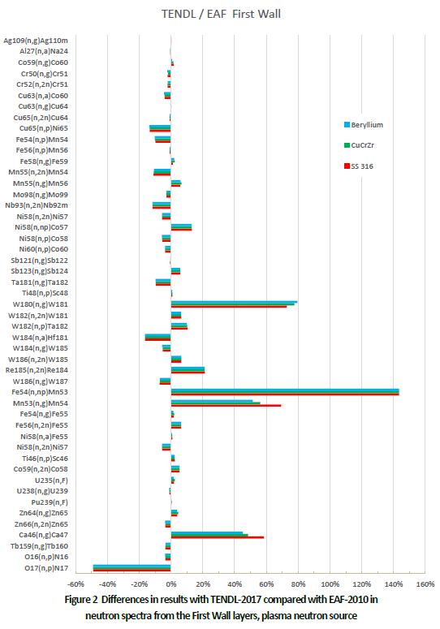
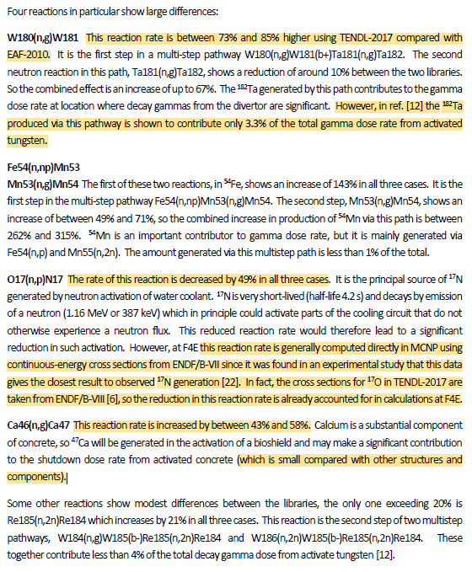
Impact of TENDL-2017
FISPACT calculations

Slide 17
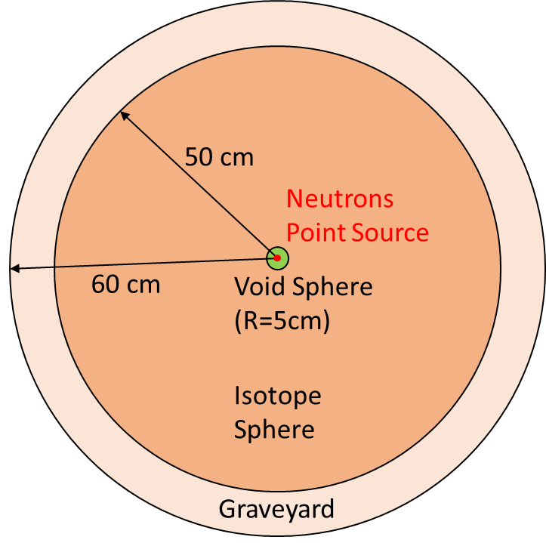
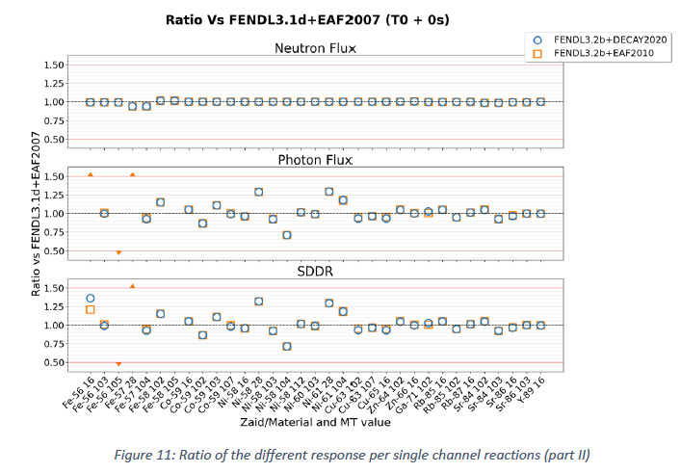
Impact of TENDL-2017
Sphere leakage benchmark: channels
All the single channels have been checked and compared in terms of NF, GF and SDDR.
No significant differences in total neutron flux are recorded. However, there are notable differences in the photon flux and the SDDR for most channels.
SDDR discrepancies outside 0.5-1.5 range analyzed and classified thus understood looking at the XS.
Discrepancies can be attributed to the update of the activation cross section from EAF-2007 to TENDL-2017, rather than the decay gamma library (e.g., EAF-2010, DECAY-2020.
TENDL-2017 widely misses details in the resonance region (RRR) compared to EAF-2007 and manual adjustment as done per EAF one.

Slide 18
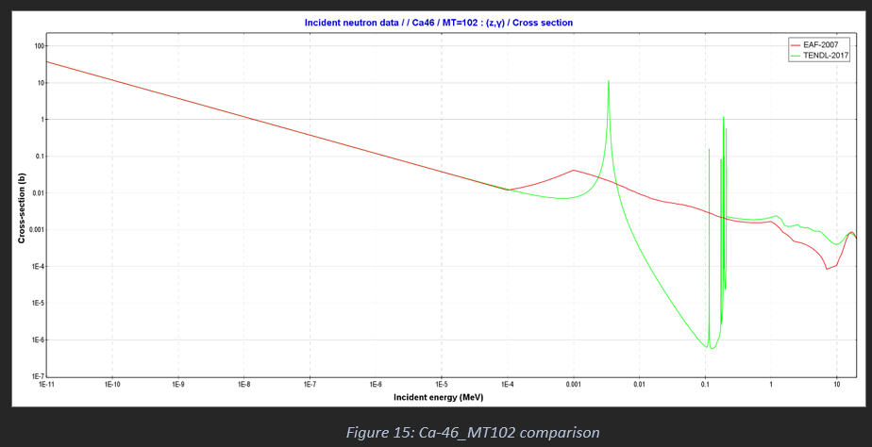
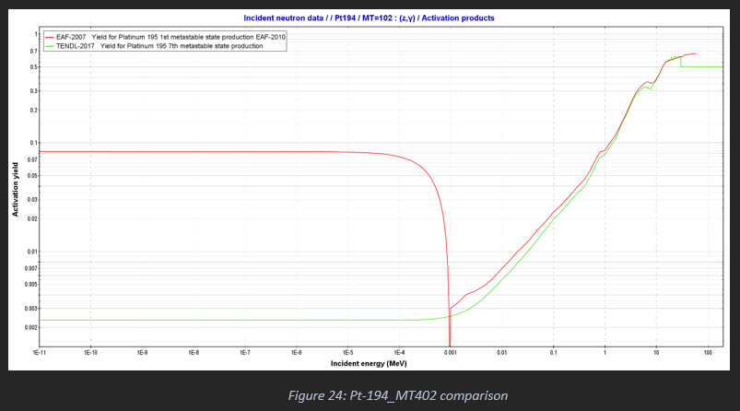
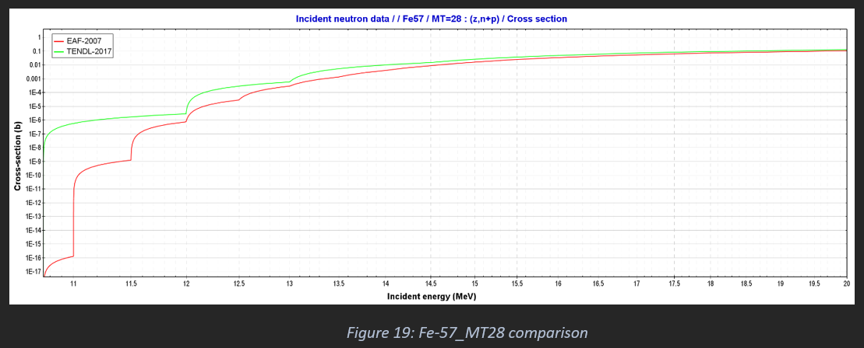
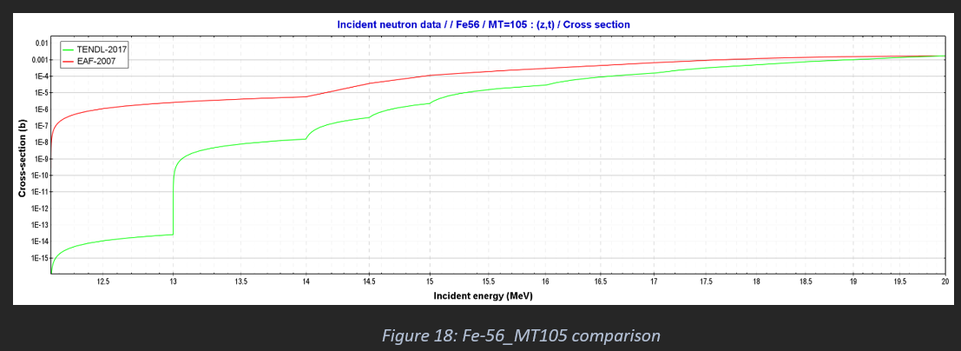
TENDL-2017 vs EAF-2007
We need a selection of activation libraries at least for main D1S pathways (e.g., Co, Mn, Ta, W…)

Slide 19
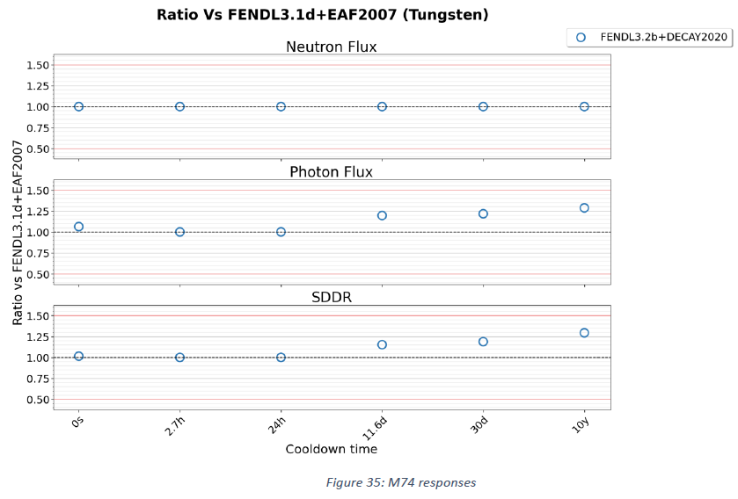
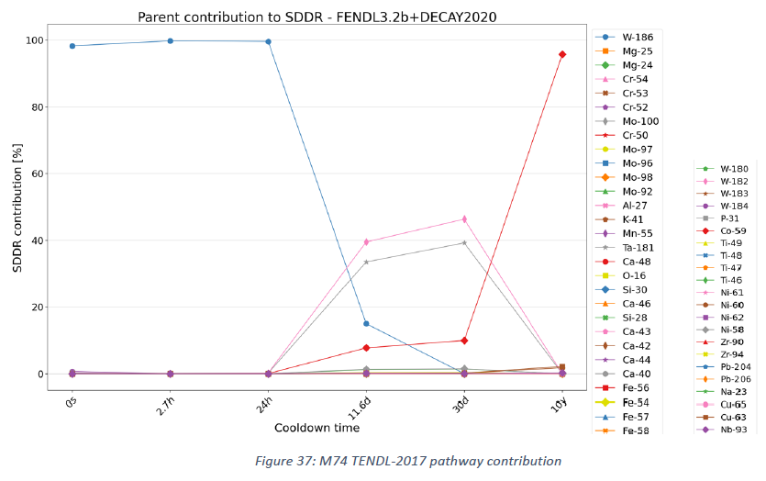
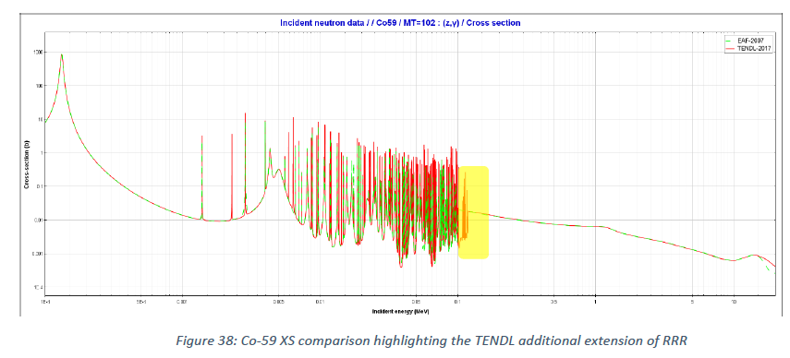
Impact of TENDL-2017
Sphere leakage benchmark: typical materials
FENDL3.2b → 3.2c

Slide 20
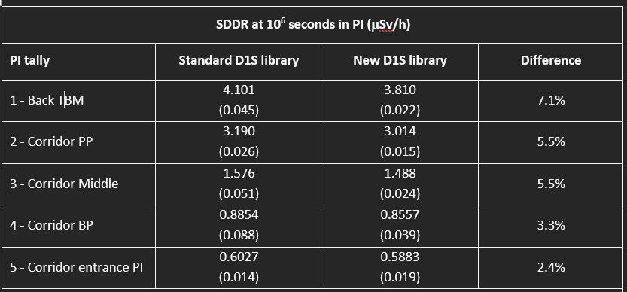
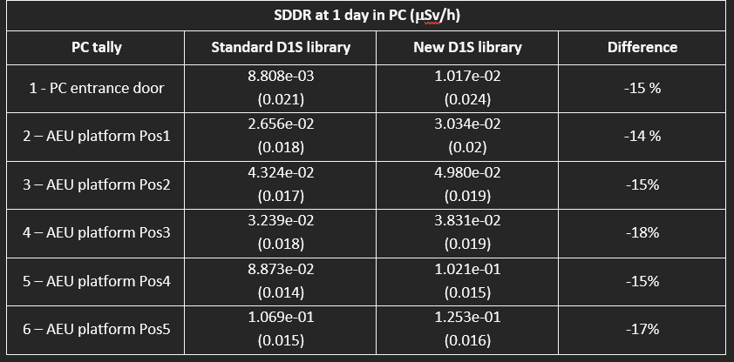
Impact of TENDL-2017
TBM EP#16 and PC#16 at DT1 scenario
The differences between both libraries vary depending on the location (PI or PC) and cooling time.
Results are statistically the same at the PI at all the time.
Whereas at the PC we have an increase by TENDL-2017 of about 10-15% at 1d after shutdown and different behaviour at 1E6s depending on the position -10%/+20%. Different importance of pathways (DT1 vs SA2).

Slide 21
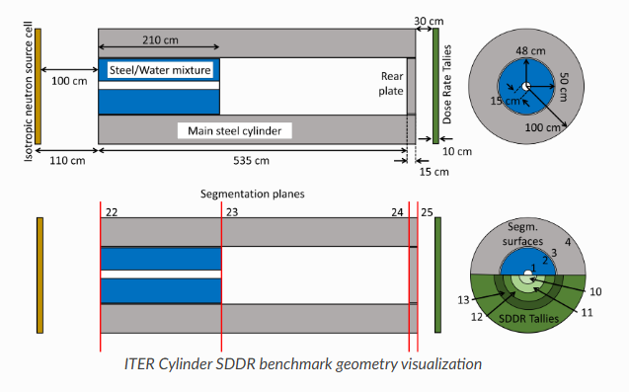
Impact of TENDL-2017
ITER SDDR Cylindrical benchmark
Current D1S-ACE library (blue, FENDL3.1c+EAF-2010) are always slightly higher than the TENDL-2017 based (orange) by 5-10%.

Slide 22
Impact of TENDL-2017
FNG SDDR benchmark
Current D1S-ACE library (prev, FENDL3.1c+EAF-2010) are always slightly higher than the TENDL-2017 based (i.e. negative relative differences)
The absolute relative differences is generally small, around 4-5%.
No major discrepancies on between libraries no incongruences.
Overall underprediction between 20-40%!!! (larger at earlier time)

Slide 23
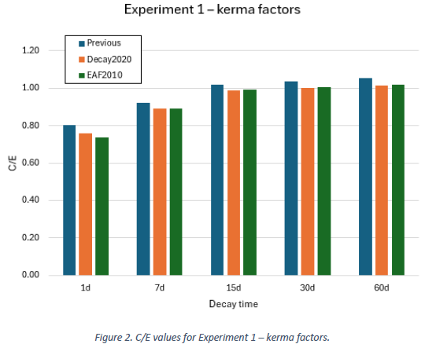
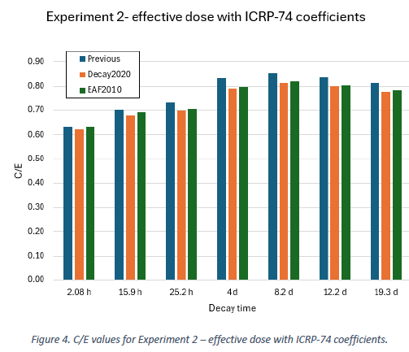
Impact of TENDL-2017
JET DTE1 SDDR experiment
Current D1S-ACE library (blue, FENDL3.1c+EAF-2010) are always slightly higher than the TENDL-2017 based (orange) (i.e. negative relative differences)
The absolute relative differences is generally small, around 1-2%.
No major discrepancies on between libraries no incongruences.
Overall underprediction between 20-40%!!! (larger at earlier time)

Slide 24
FENDL3.2c V&V and impact over ITER analysis
Outline
FENDL3.2c: the most UpToDate nuclear data library
What FENDL3.2c contains
FENDL transport data (FENDL3.2c)
FENDL activation data (TENDL-2017): generation, V&V and impact
Main takeaways
Some points to consider for FENDL4.0

Slide 25
Main takeaways for new FENDL3.2c in ITER
Transport library: from FENDL3.1d to FENDL3.2c
Last week we “approved” the usage of this library in ITER.
Still missing formal letter from IAEA ND leader to subhash.puthaanvetil@iter.org ITER.
Extended number of isotopes (180→192)
Resolved the issued in energy/angle KERMA/DPA cross section
The one with the largest V&V ever with a dedicated peer reviewed publication ( ̴̴80 pages) plus one under review (& one in prepar. for D1S-ACE)
Slight improved agreement with experimental data for Ni, Cu, Fe and W.
Activation library from FENDL3.1d (EAF-2010) to FENDL3.2c (TENDL-2017)
No decision taken yet at ITER as no substantial impact expected
No strong motivation as per transport library apart from the missing pathways we have in current libraries.
We miss experiment of SDDR.
Low C/E!!!
Better overall performance but very similar performance in major pathways.
Much larger coverage of pathways and elements (more pathways in D1S ACE libraries)
TENDL-2017 widely misses details in the resonance region (RRR) compared to EAF-2007 and manual adjustment as done per EAF
Few strange XS spotted once compared to EAF-2010
The TENDL-2017 computes generally lower results than D1S-ACE based on EAF-2010 (5-15%).

Slide 26
Some points to consider for FENDL4.0
Need of further V&V coordination, centralization and proper recording.
New activation library for FENDL? Focus on selection of evaluation/selection on main isotope as per neutron transport.
HDF5 nuclear data missing for FENDL. These are needed for OpenMC calculations.
In ITER application we are still 54 missing isotopes in FENDL (mainly for concrete application). For the time being we are using ENDF-VIII.0 but it would be good to add to FENDL.
As-75, As-74, As-76, As-77, As-78, As-80, As-82, Rb-85, Rb-87, Sr-84, Sr-86, Sr-87, Sr-88, Pd-102, Pd-104, Pd- 105, Pd-106, Pd-108, Pd-110, In-113, In-115, Te-120, Te-122, Te-123, Te-124, Te-125, Te-126, Te-128, Te-130, Pr-141, Nd-142, Nd-143, Nd-144, Nd-145, Nd-146, Nd-148, Nd-150, Eu-151, Eu-153, Tb-159, Dy-156, Dy-158, Dy-160, Dy-161, Dy-162, Dy-163, Dy-164, Yb-168, Yb-170, Yb-171, Yb-172, Yb-173, Yb-174, Yb-176
20 isotopes have zero gamma production (i.e., zero gamma leakage and zero gamma heating). This has been observed also in previous FENDL releases (and also in other libraries like ENDF) so it may not be an issue per se. May you please confirm?
H-3, He-4, Ar-36, Ar-38, Ar-40, Ga-69, Ga-71, Cd-108, Cd-113, Sb-121, Sb-123, Ba-130, Ba-132, Ba-134,
Ba-135, Ba-136, Ba-137, Ba-138, Ce-140, Ce-142

Slide 27
Some points to consider for FENDL4.0
Missing TSL in Be; also others?
New activation library for FENDL? Focus on selection of evaluation/selection on main isotope as per neutron transport.
Work on V&V of Deuterons?
Possibility of workforce from PhD? Any possibility to have them connected to IAEA?
Frequency of FENDL expert consultant meeting: one long in-person, one shorter remote?
FENDL toward a JEFF Gitlab model: generation, ENDF→ACE, testing... Can we ask JEFF to pass it to IAEA?
How to better improve the communication via the expert group (e.g., GitLab/Hub Based, bugs, proposal, collaborations…)
We kindly encourage the FENDL Expert consultant committee to start discussing the “instruction for V&V and acceptance of the FENDL libraries for 4.0”

Slide 28
Open discussion – Q&A

Slide 29
Thank you for your attention
Follow us on:
www.f4e.europa.eu
www.twitter.com/fusionforenergy
www.youtube.com/fusionforenergy
www.linkedin.com/company/fusion-for-energy www.flickr.com/photos/fusionforenergy

Slide 30
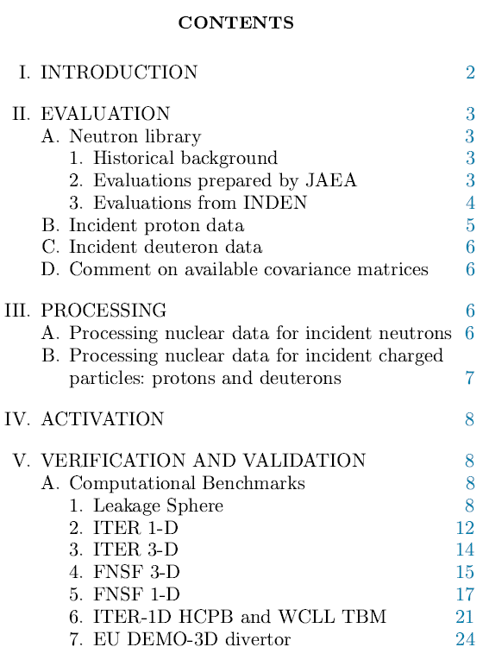
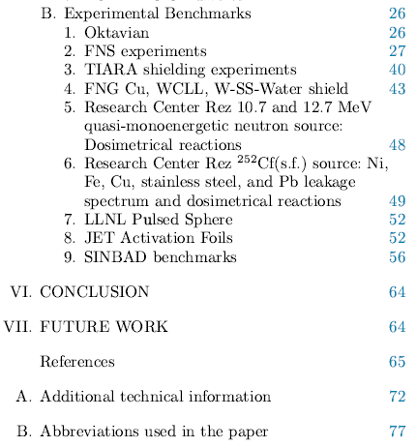
Major paper on FENDL3.2b
FENDL3.2b
the JADE tool is endorsed and adopted by the FENDL project for V&V (former D.Laghi PhD)

Slide 31
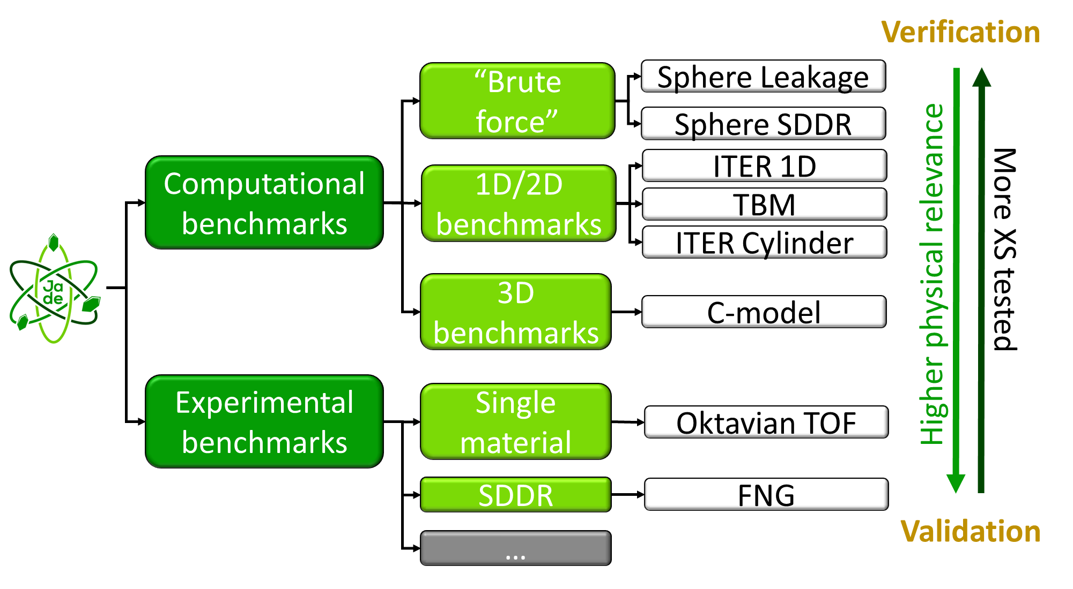
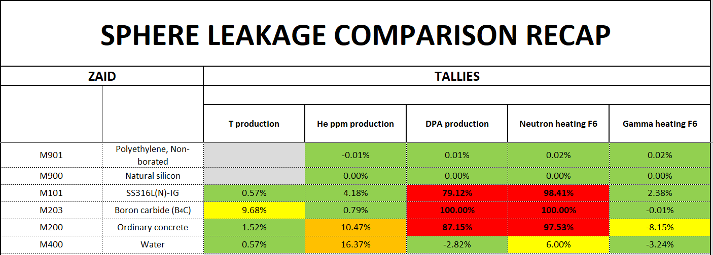
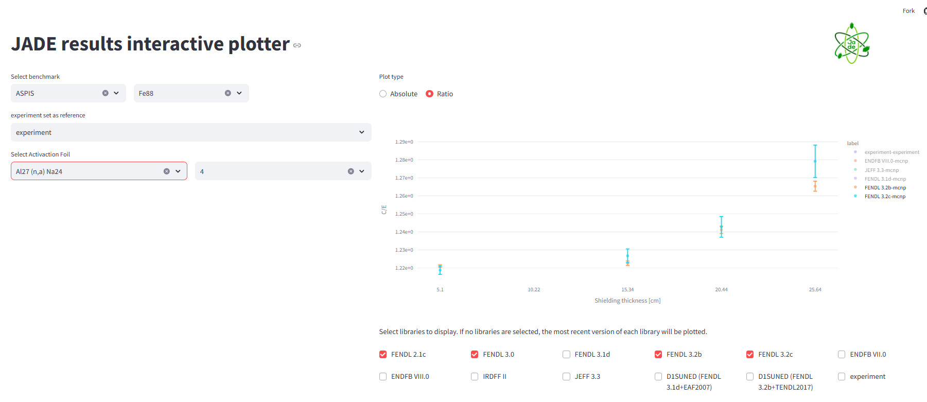
The general process of V&V for FENDL3.2 ACE
Ex.: discrepancy between typical materials
JADE Web App

Slide 32
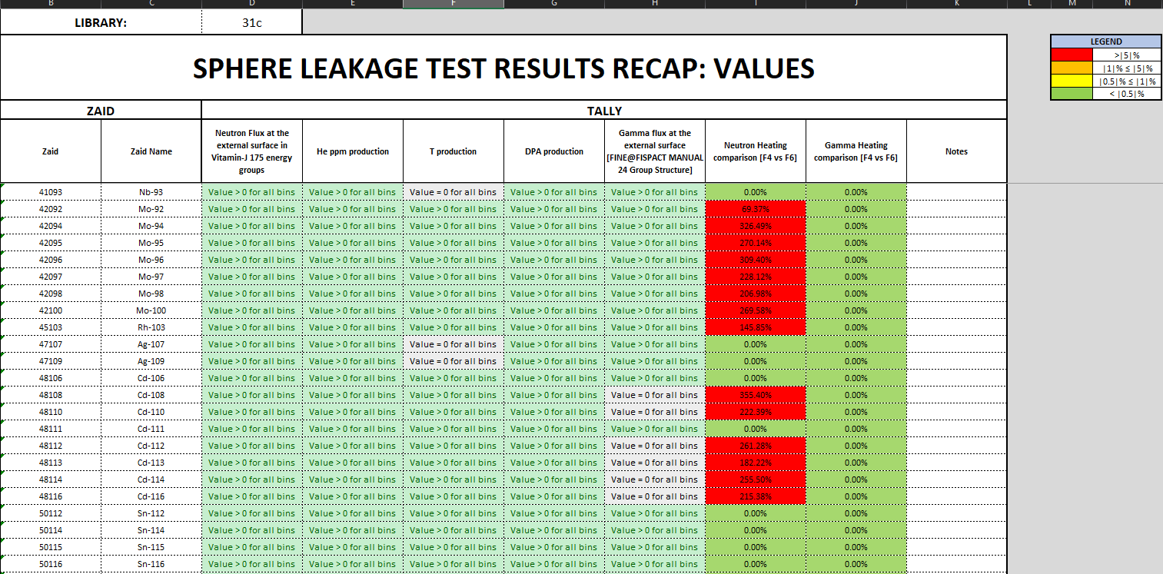
FENDL-3.2 (Beta) testing
Consistency checks results
Tested libraries:
FENDL v2.1
FENDL v3.1d
ENDF VIII.0
FENDL v3.2(Beta)
Paper:
D. Laghi et al., 2021, “Application of JADE V&V capabilities to the new FENDL v3.2 Beta release”, Nuclear Fusion, 61 11. DOI https://doi.org/10.1088/1741-4326/ac121a

Slide 33
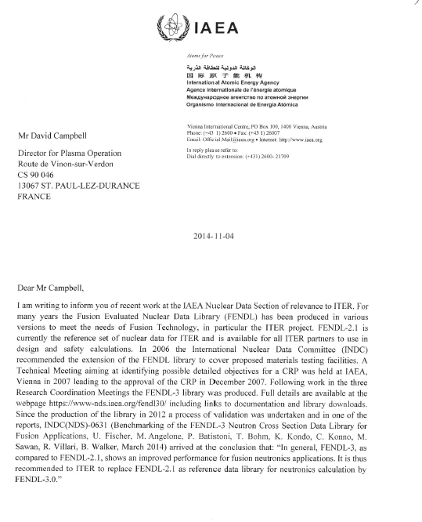
Back-up slide
Delivery of a formal letter from IAEA to ITER for the usage of FENDL3.2c
(Already done in precedence for FENDL3.0 recommendation, 2014)
Letter from IAEA on FENDL 3 (QDJ25M v1.0) (current)

Slide 34
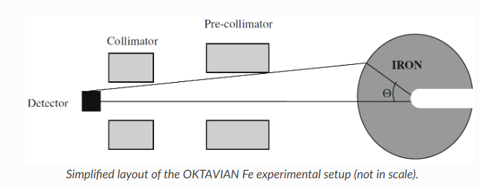
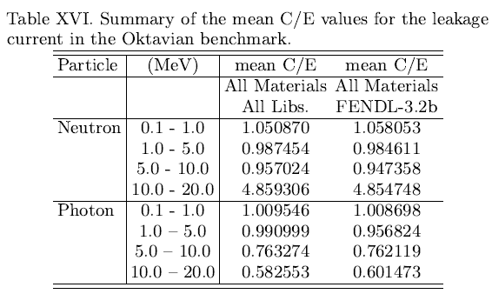
Oktavian experimental benchmark
No substantial differences observed with other libraries. Results aligned.

Slide 35
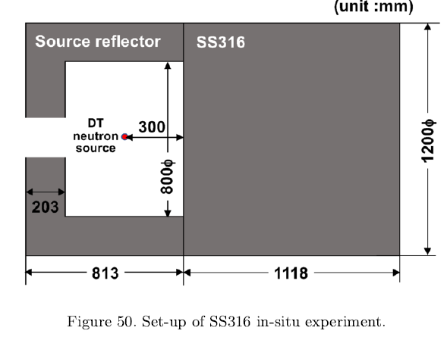
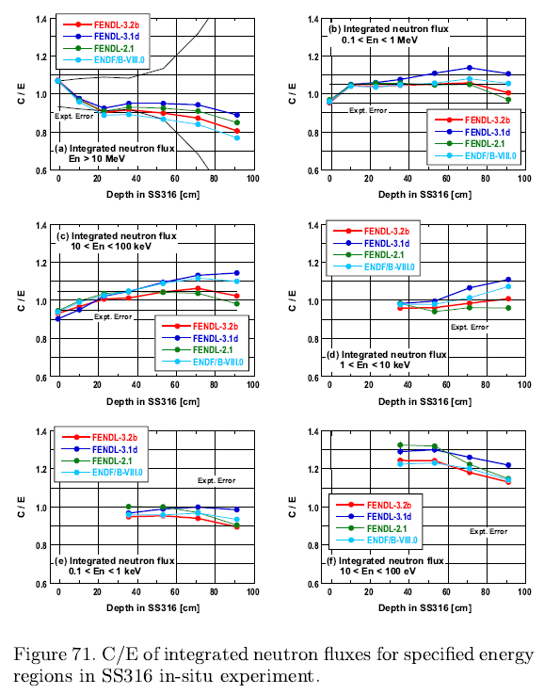
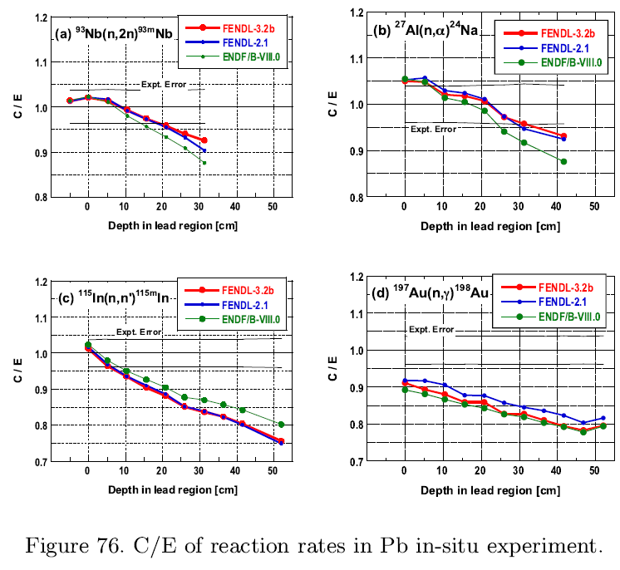
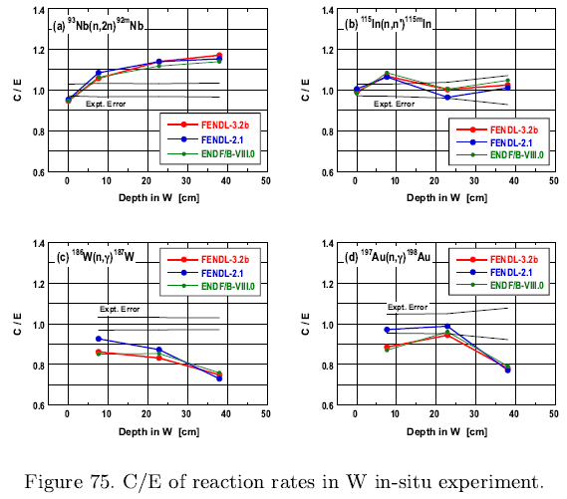
FNS Experiment
Minor improvements showed in SS316, Pb and W with FENDL3.2b

Slide 36
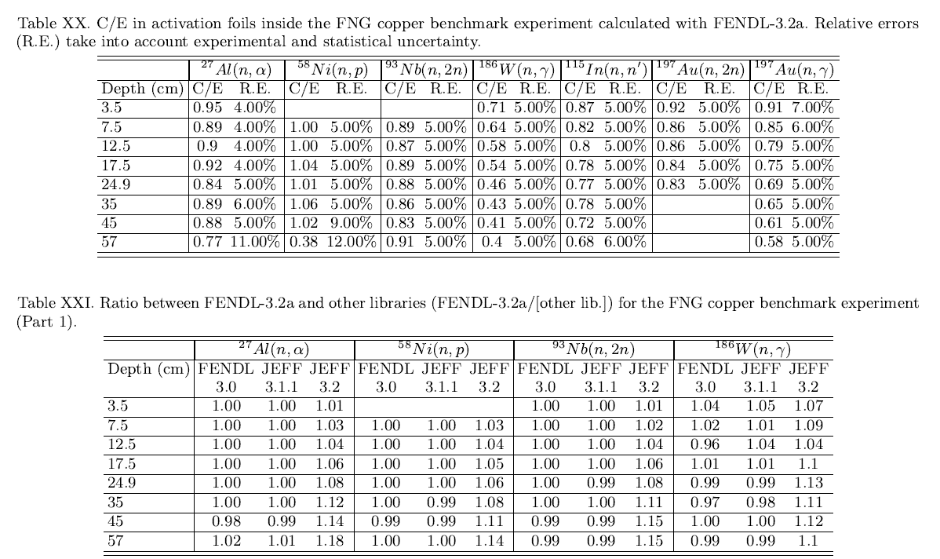
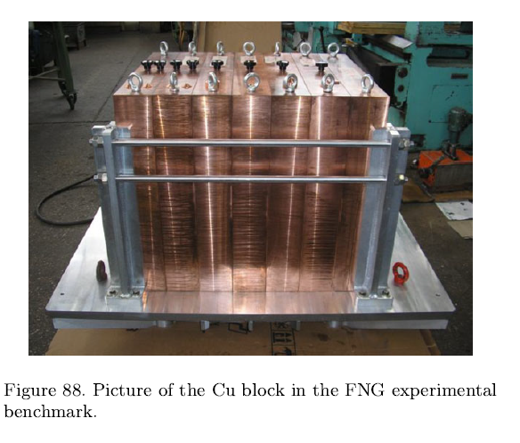
FNG-Copper
No substantial differences observed with other libraries. Results aligned.

Slide 37
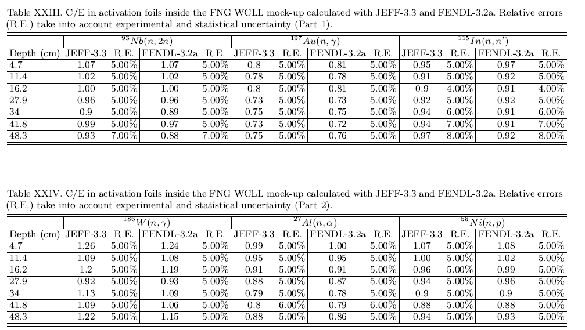
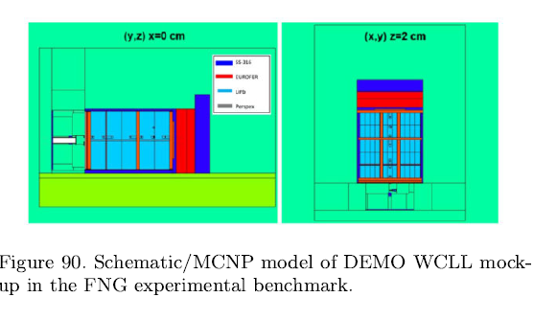
FNG-WCLL
No substantial differences observed with other libraries. Results aligned.

Slide 38
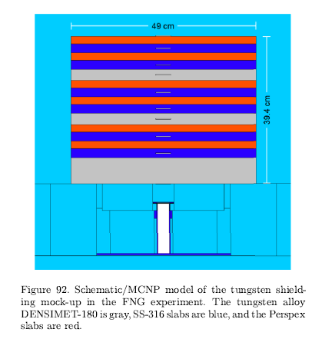
FNG W-SS-Water shield mock-up

Slide 39
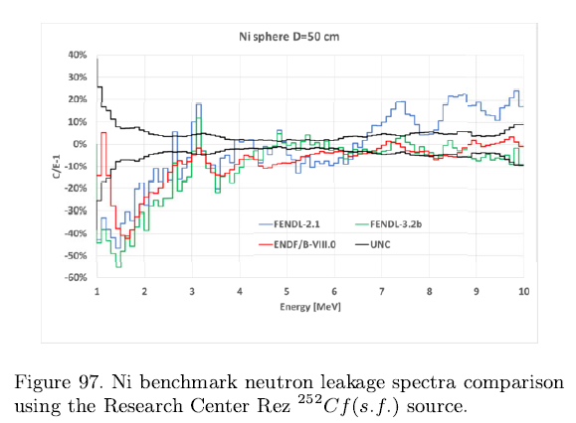
Research Center Rez 252Cf on Ni, Fe, Cu ...
Better FENDL3.2 agreement than other libraries for Ni and SS, similar for Cu and Pb.

Slide 40
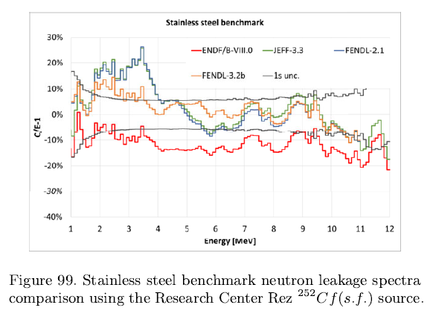
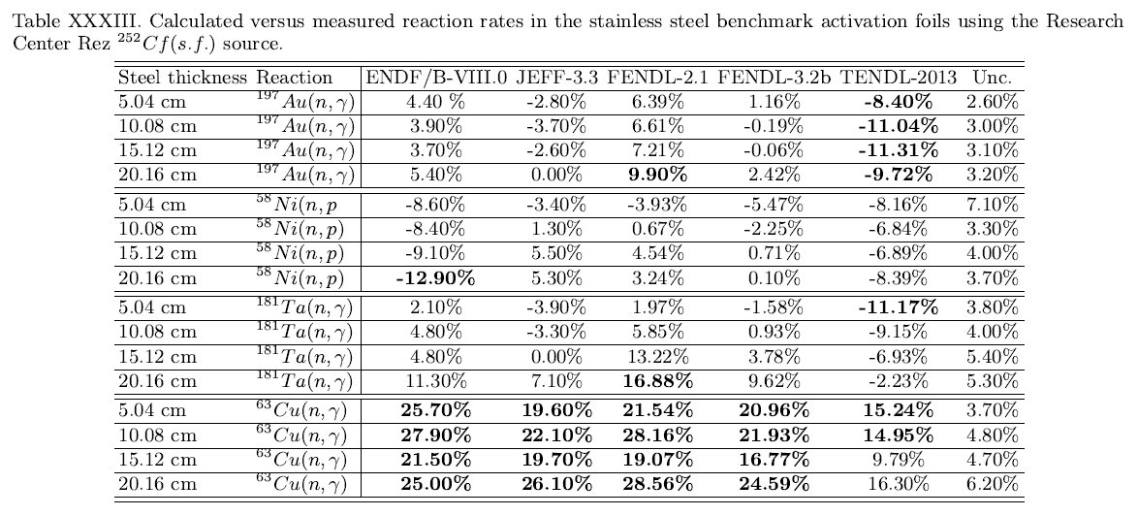
Research Center Rez 252Cf on Ni, Fe, Cu ...
Better FENDL3.2 agreement than other libraries for Ni and SS, similar for Cu and Pb.

Slide 41
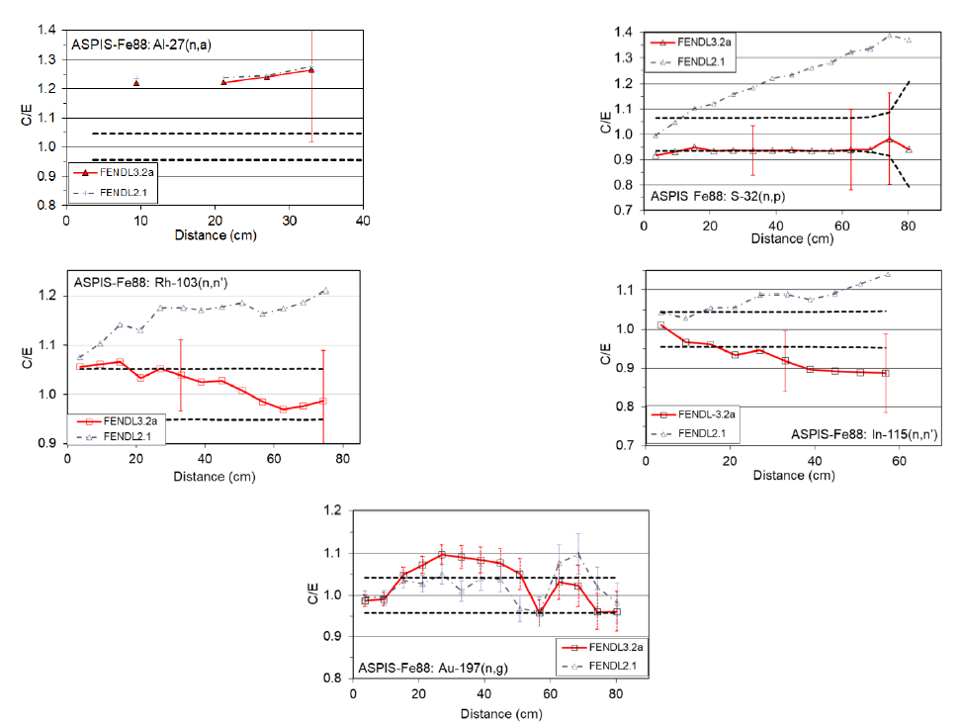
ASPIS-88: Fe
Better FENDL3.2a Fe agreement than FENDL2.1c. Similar behavior also in PCA-replica.

Slide 42
PCA Replica: Fe + Water
Better FENDL3.2a agreement than FENDL2.1c. Case of Fe+Water.

Slide 43
FNG-W
Slight better FENDL3.2a agreement than FENDL2.1c.

Slide 44
FNG-W
Slight better FENDL3.2a agreement than FENDL2.1c.

Slide 45
FNG-HCPB
Similar behavior between FENDL3.2a and FENDL2.1c.

Slide 46
FNG-SiC
Similar behavior between FENDL3.2a and FENDL2.1c.

Slide 47
Iron results not in FENDL paper
TUD* iron slab
TUD* FNG bulk blanket
Position A: Measurement behind the 6 cm thick Perspex layer inside a SS316
Position B: Measurement in a SS316 layer at the total penetration depth
14.1 MeV DT neutron source
*Technische Universitaet Dresden

Slide 48
Neutron spectrum
TUD iron slab
TUD FNG bulk blanket

Slide 49
Photon spectrum
TUD iron slab
TUD FNG bulk blanket

