Slide 1


The Level Density study in the future Chinese Nuclear Reaction Model-UNF
XU Ruirui, Tian Yuan

Slide 2
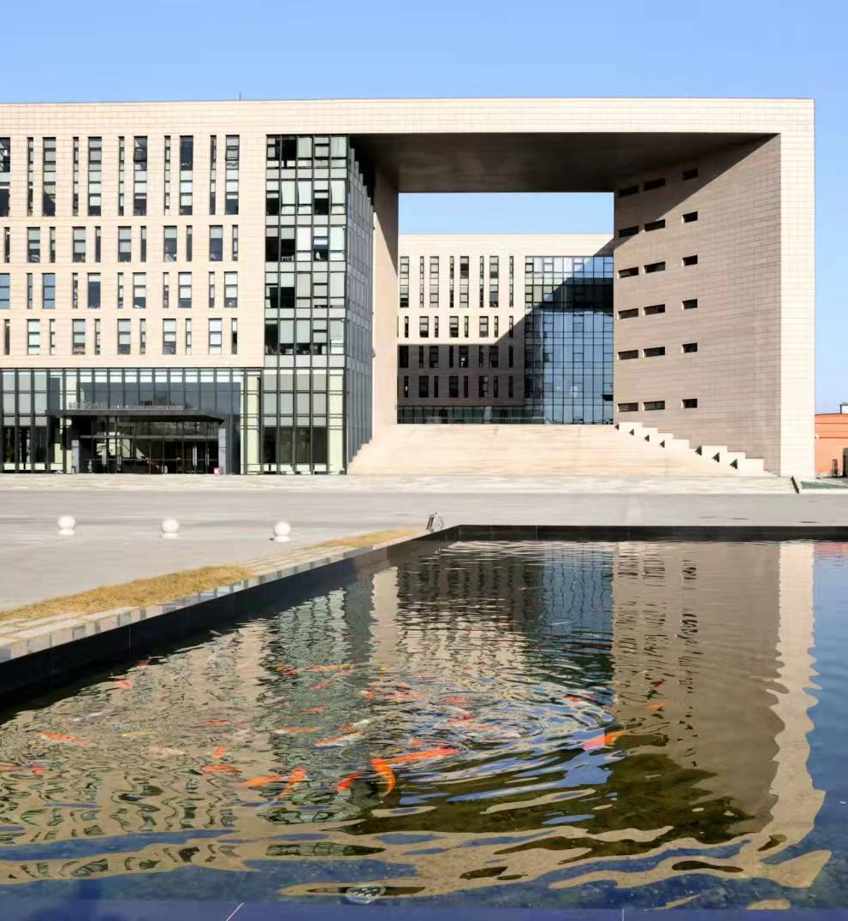
Introduction
Microscopic level density in UNF30
Other method for Level density
Outlook

Slide 3
INTRODUCTION

Slide 4
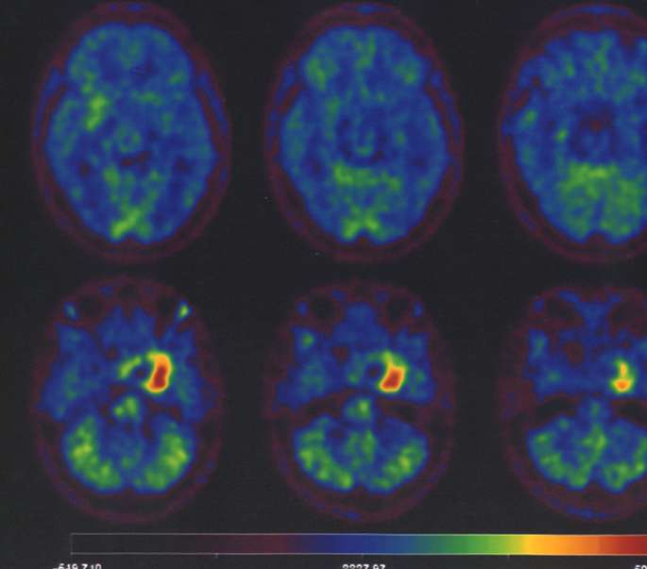
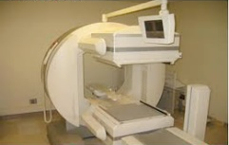
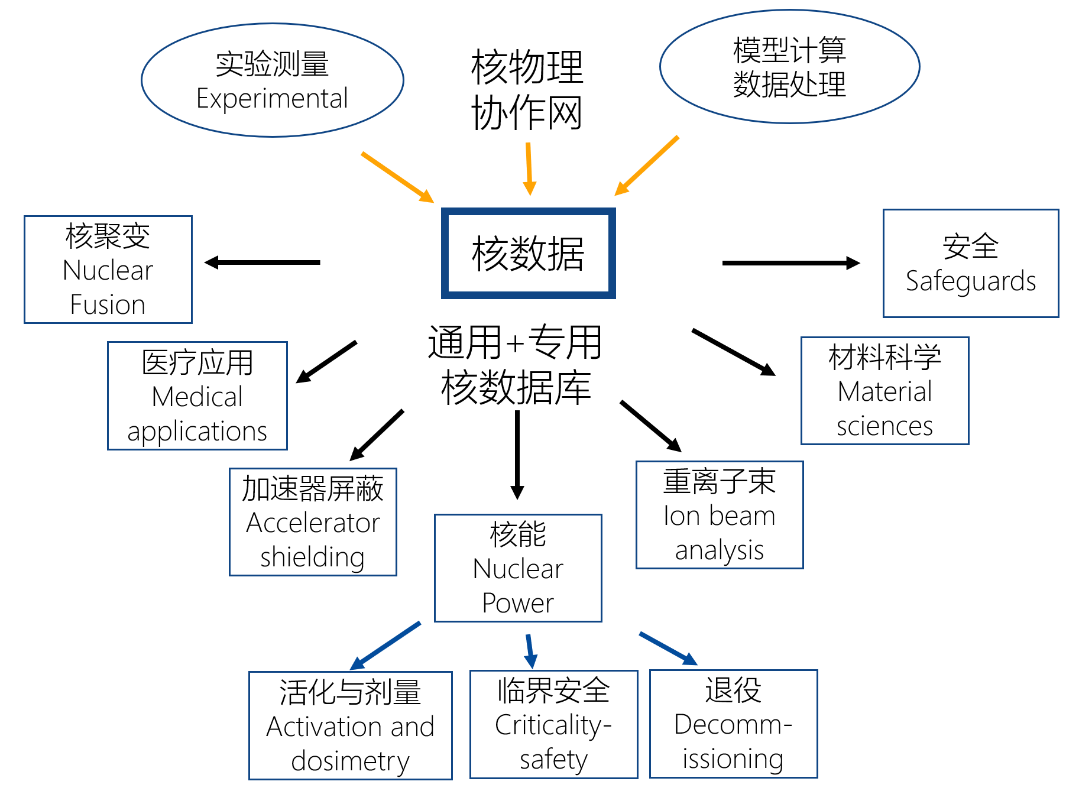
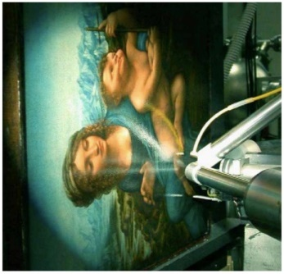

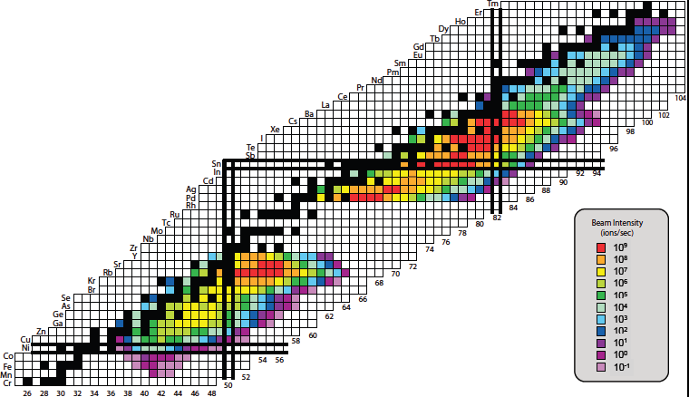
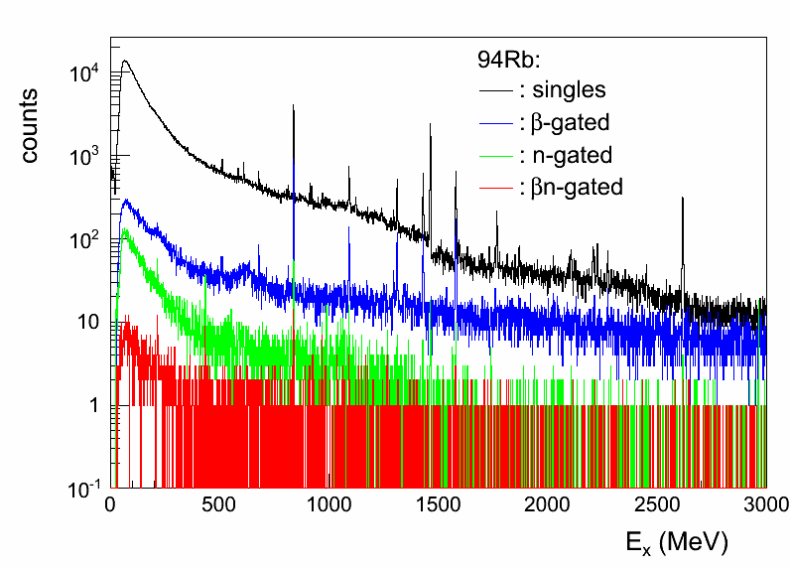
Advancing nuclear technology drives increasing nuclear data demands
Nuclear Physics Collaboration Network
Model Calculation
Nuclear Data
General + Specialized Nuclear Databases

Slide 5
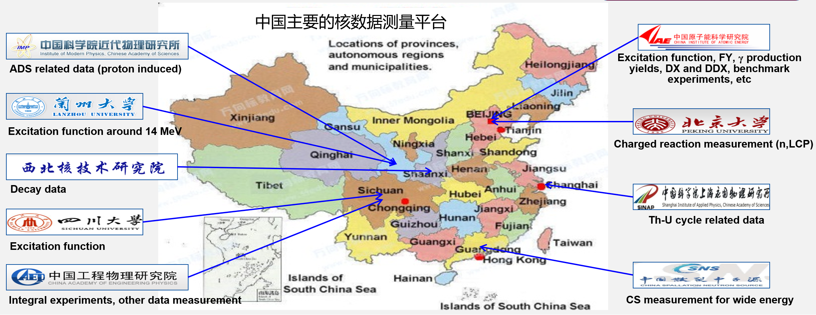
Platform of Chinese Experimental Facilities（partly）

Slide 6
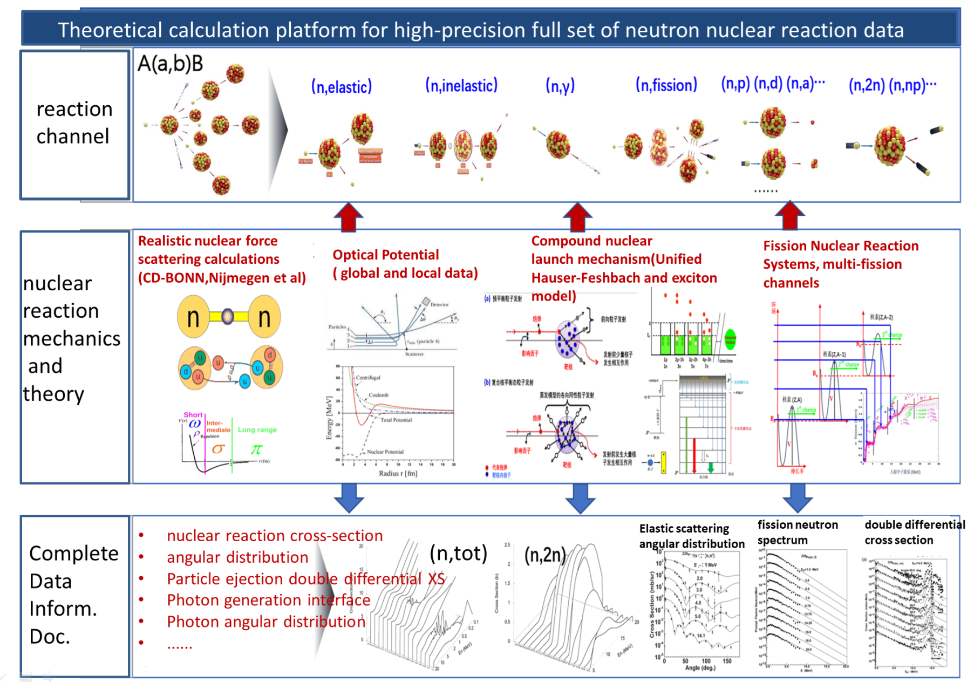
Nuclear Reactions
2. Platform of Chinese Theoretical Model for nuclear reaction
For Nuclear Data — Neutron and Photon beams
Chinese Nuclear Reaction Codes：
1. UNF: UNiFed function
Incident: Neutron, proton, photon
Target: light, medium heavy, actinides
Energy: ~ 20MeV
J.S. Zhang, Nucl. Sci. Eng. 142, 207, 2002
J.S. Zhang, Nucl. Sci. Eng. 114, 55, 1993
2. MEND: Medium Energy Nuclear Data
Incident: neutron, proton, deuteron, triton, alpha, photon
Target: medium heavy, actinides
Energy: ~ 200MeV
C.H. Cai, Nucl. Sci. Eng. 153, 93, 2006
C.H. Cai, Chin. J. Comp. Phys. 20, 279, 2003

Slide 7
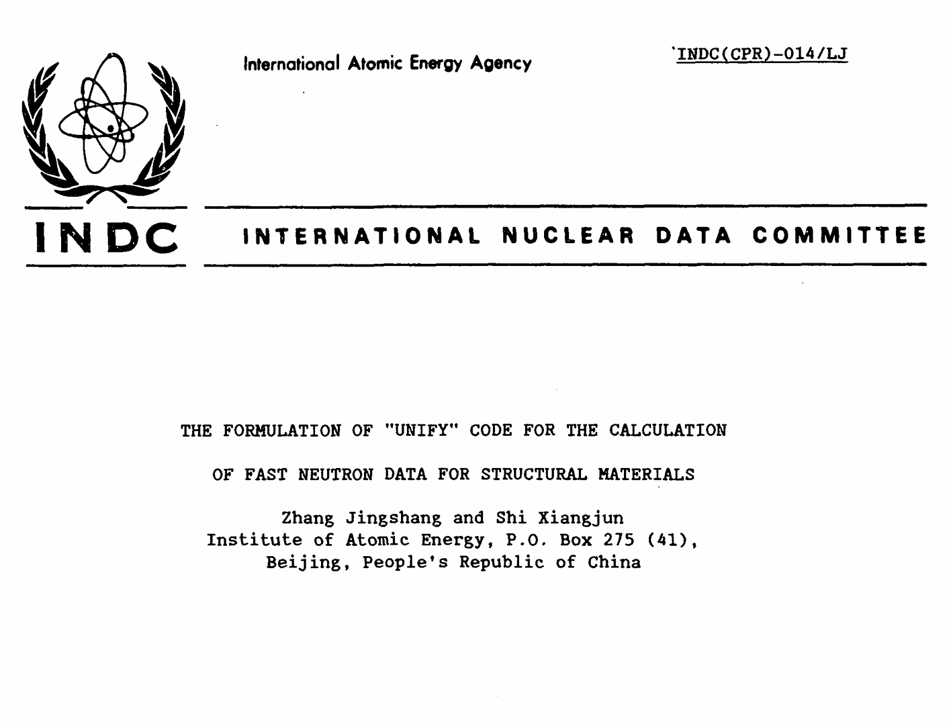
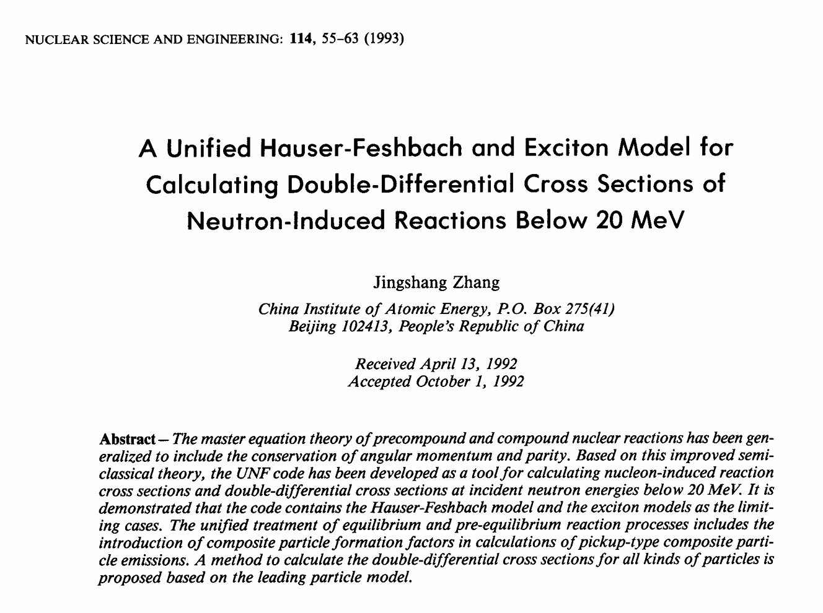
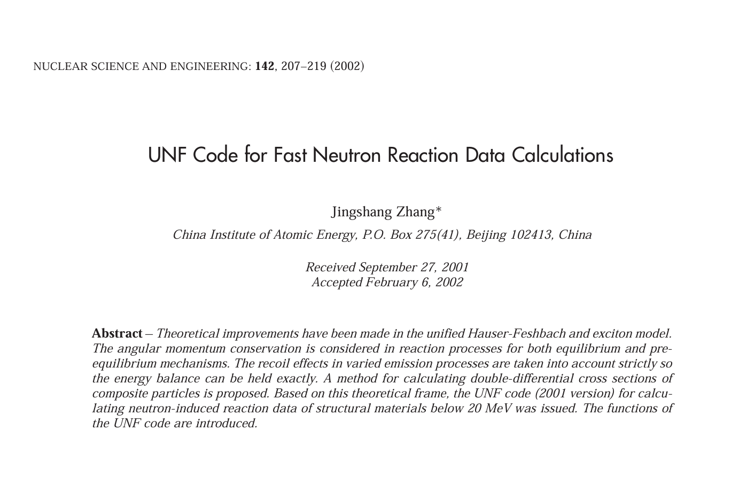
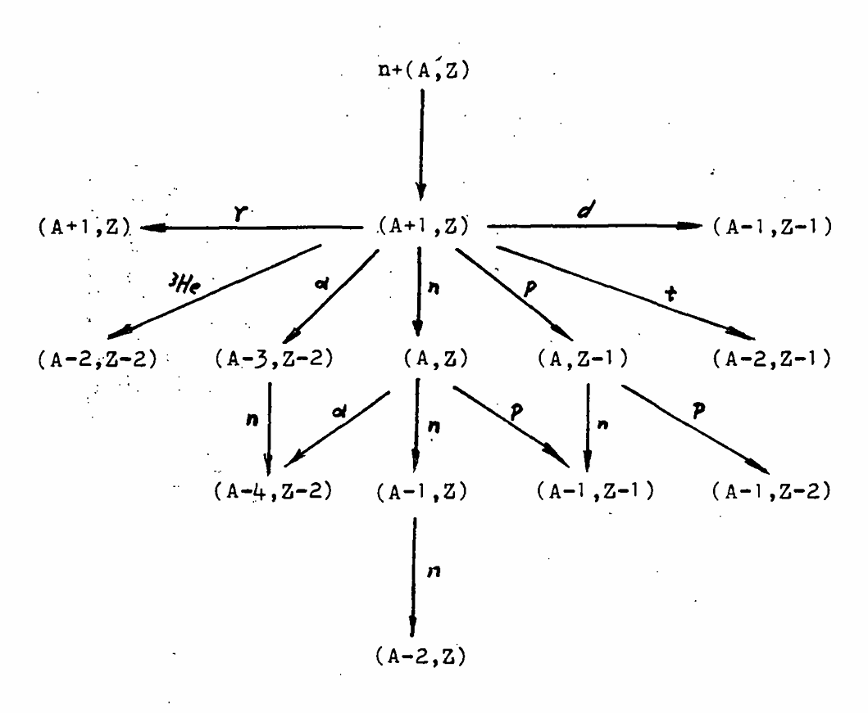
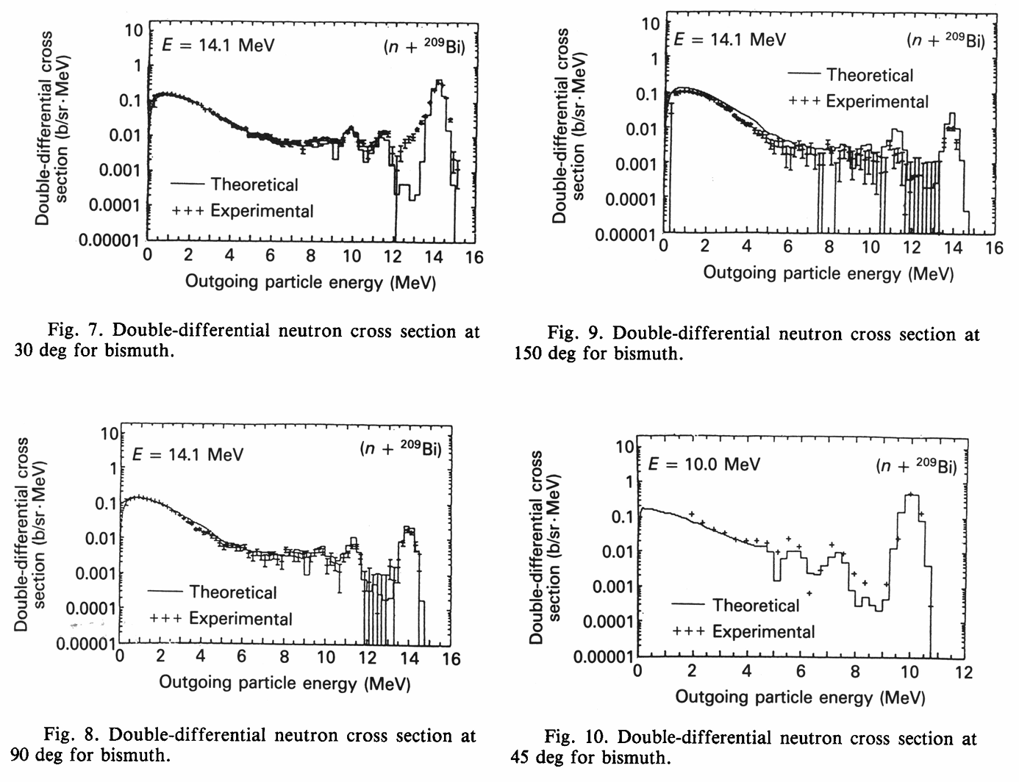
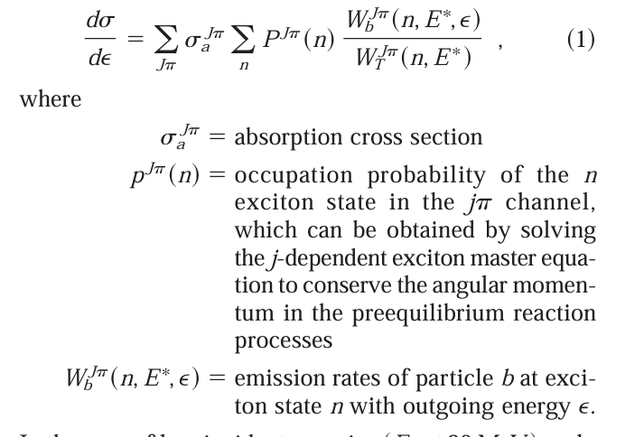
1993
2002
1989

Slide 8
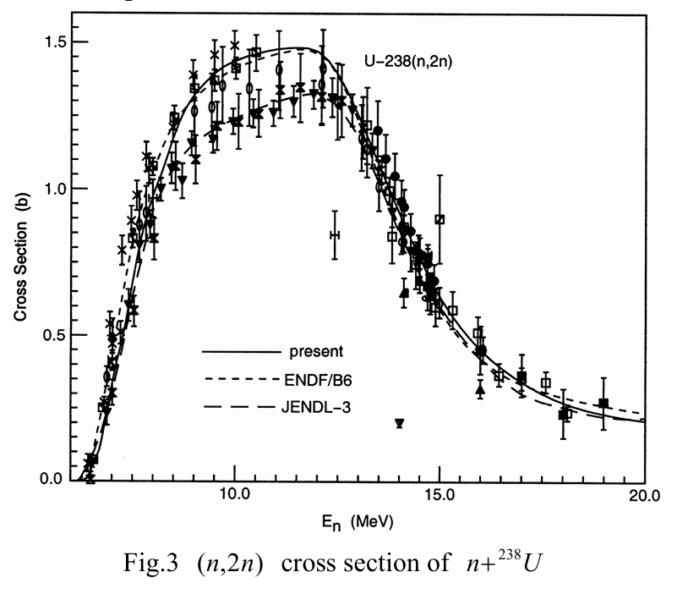
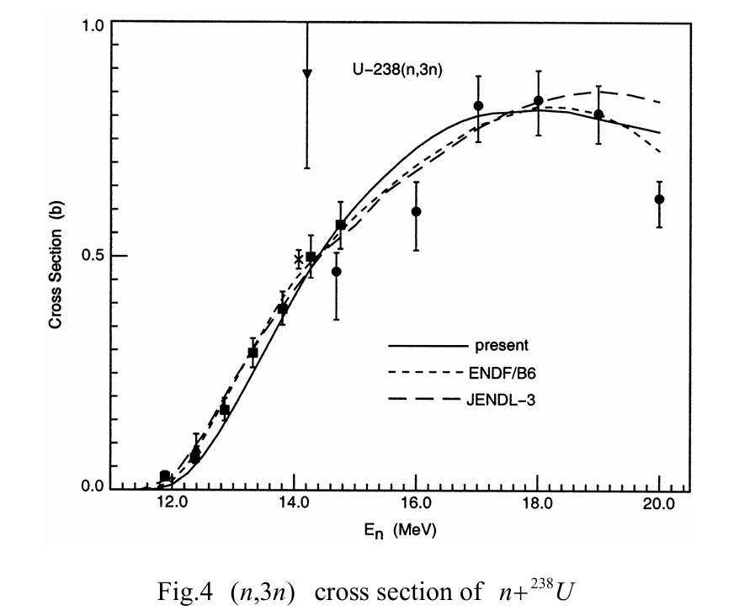
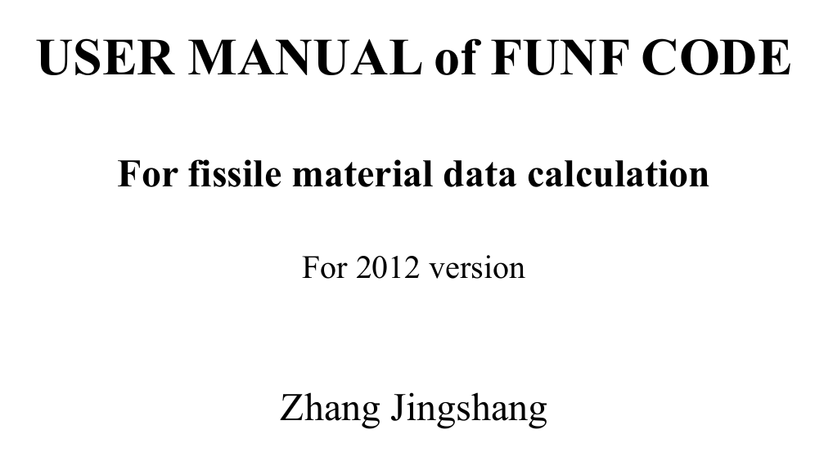
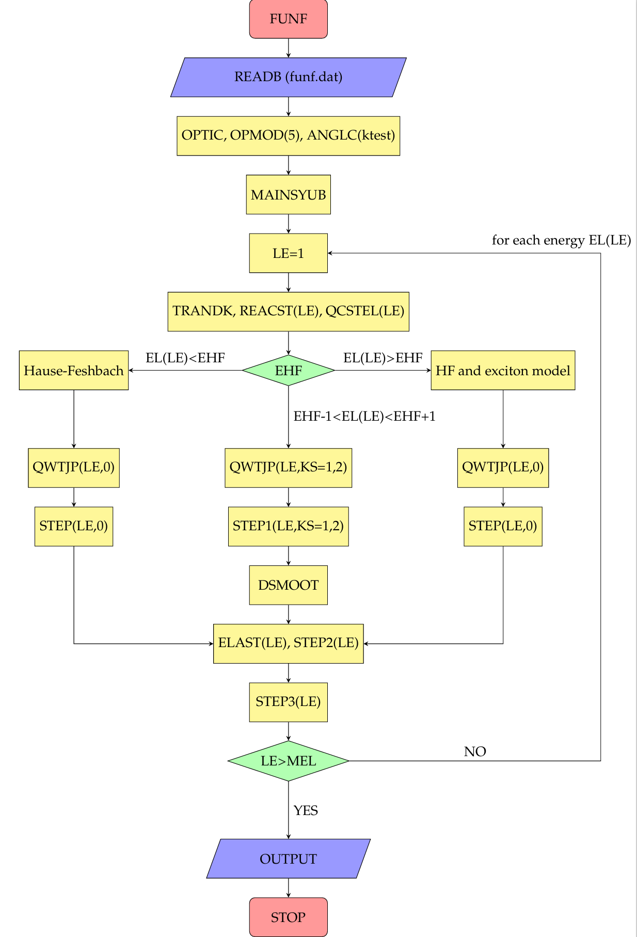
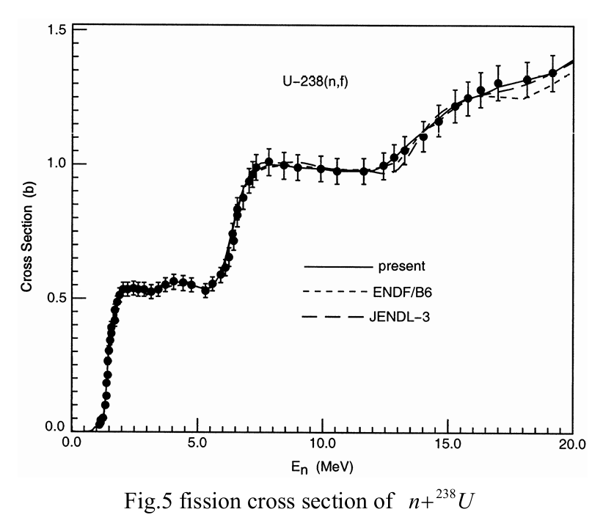
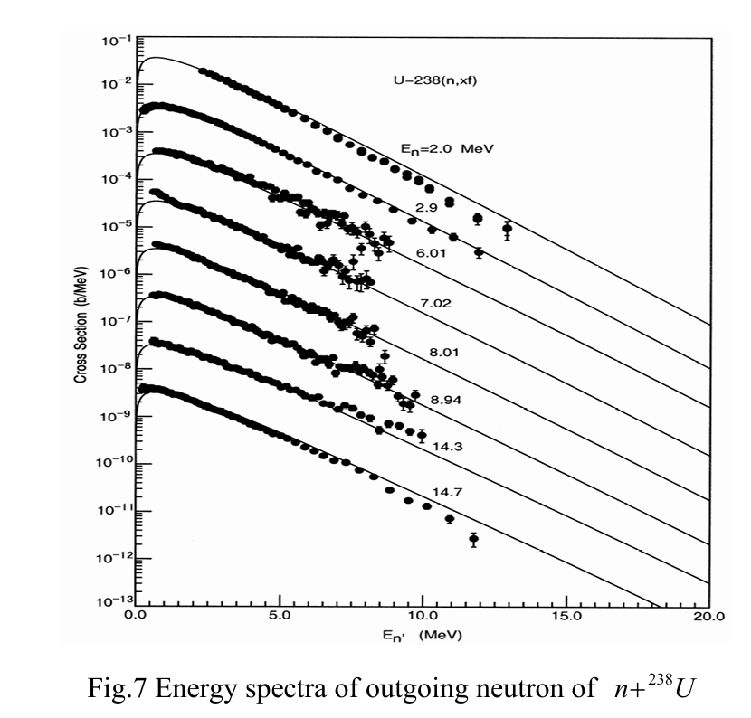
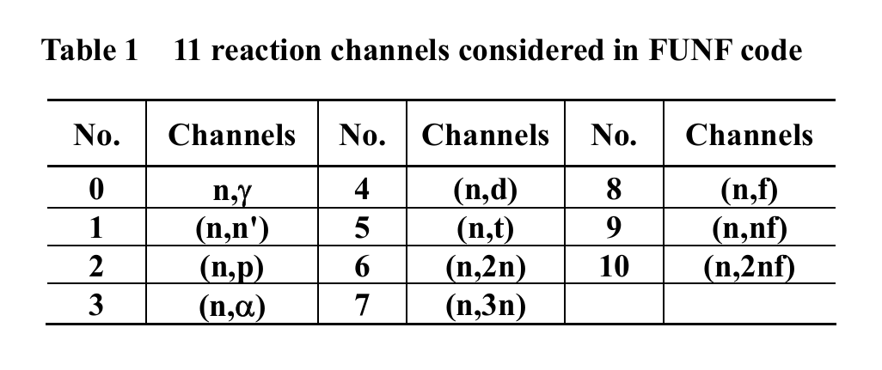
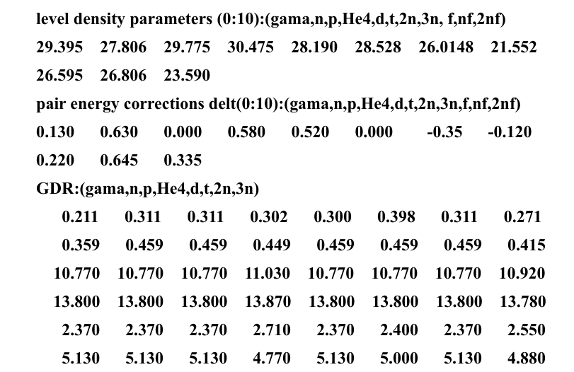
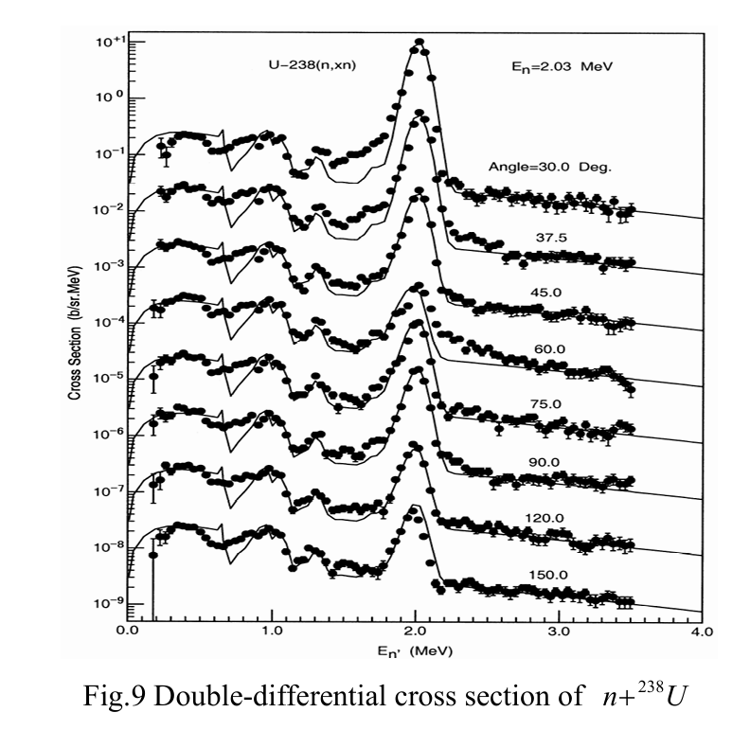
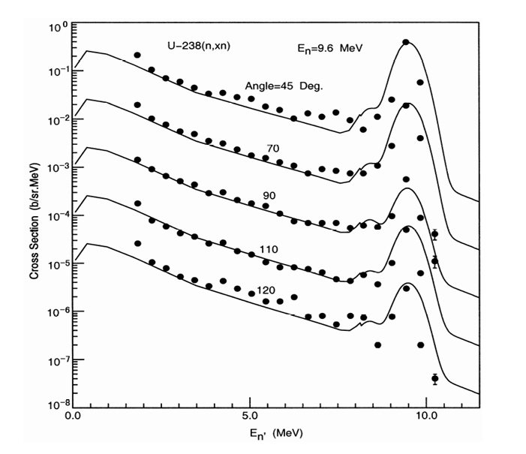
2012

Slide 9
Microscopic Level Density in UNF30

Slide 10
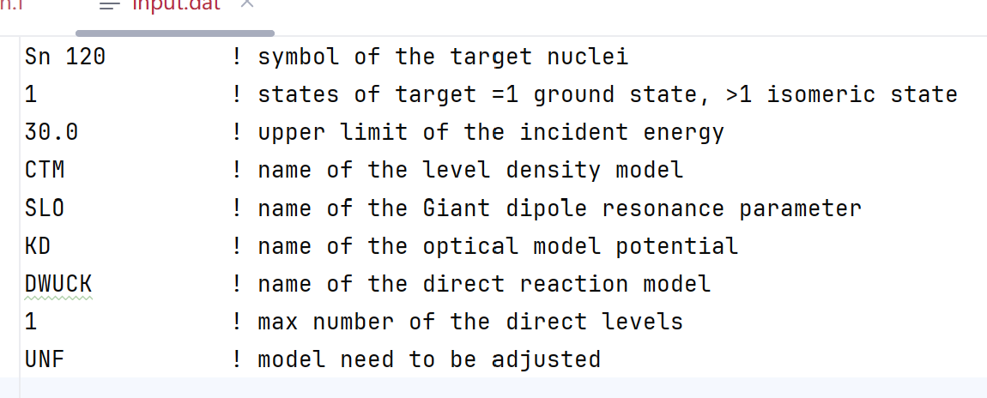
2024
 | UNF | UNF30
Energy range | 20 MeV | 30 MeV
Optical potential model | BG | BG, KD, TPM, CTOM
Direct reaction model | DWUCK | DWUCK, ECIS, (OPTMAN)
Level Density | CTM | GCCI, BSFG, GFL, RHB
Giant dipole resonance | SLO | SLO, MLO, SMLO, RQRPA
Fission reaction | Single humped | Multi-humped, RHB

Slide 11
UNF+MINUIT+MPI
Nuclear Reaction
Model
In CNDC
Optimization Method
Optical potential model
GDR parameters
Mutil-humped fission barriers
Level density

Slide 12
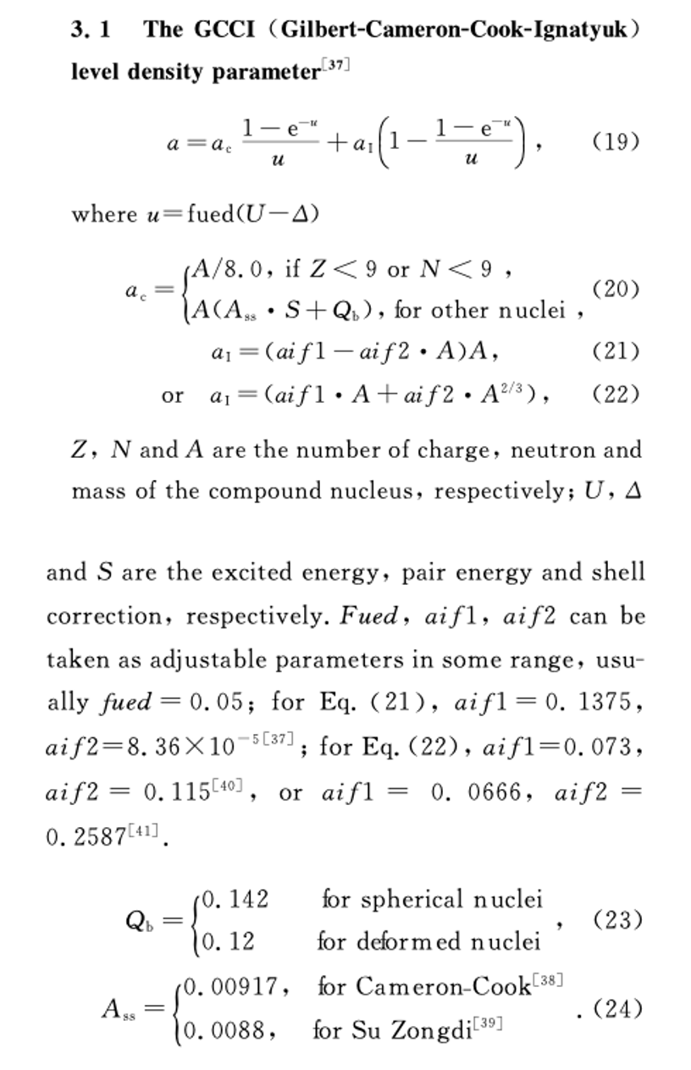
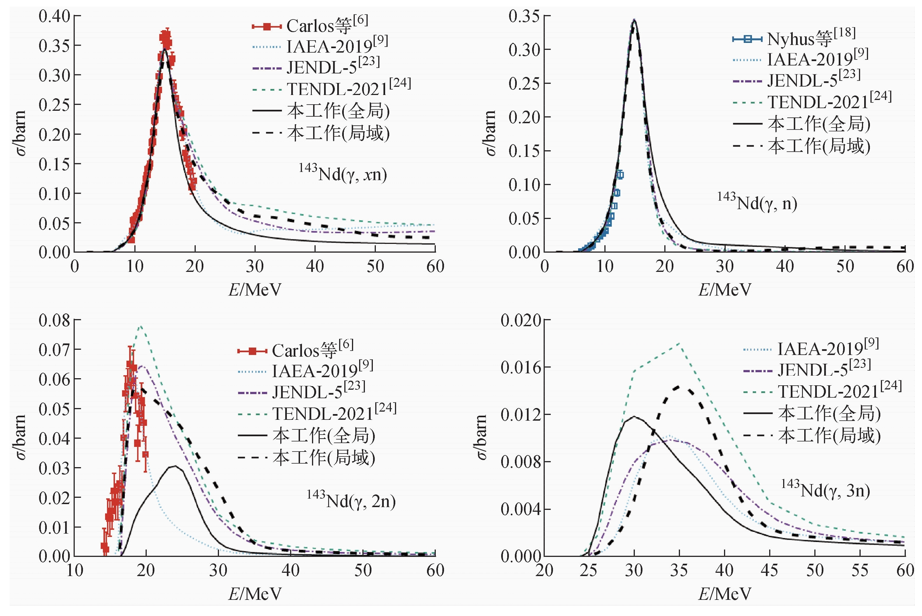

Slide 13
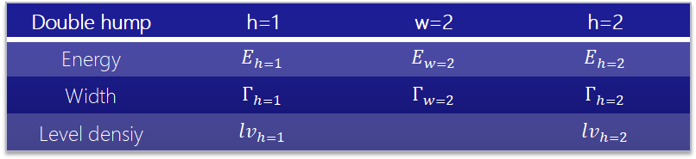
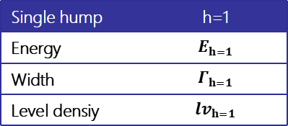
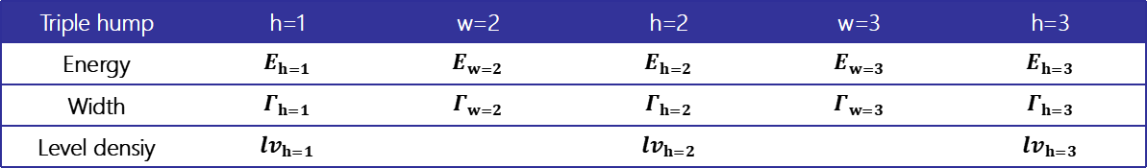
Single hump | h=1
Energy | $$E_{h=1}$$
Width | $$Γ_{h=1}$$
Level densiy | $${lv}_{h=1}$$
Double hump | h=1 | w=2 | h=2
Energy | $$E_{h=1}$$ | $$E_{w=2}$$ | $$E_{h=2}$$
Width | $$Γ_{h=1}$$ | $$Γ_{w=2}$$ | $$Γ_{h=2}$$
Level densiy | $${lv}_{h=1}$$ |  | $${lv}_{h=2}$$
Triple hump | h=1 | w=2 | h=2 | w=3 | h=3
Energy | $$E_{h=1}$$ | $$E_{w=2}$$ | $$E_{h=2}$$ | $$E_{w=3}$$ | $$E_{h=3}$$
Width | $$Γ_{h=1}$$ | $$Γ_{w=2}$$ | $$Γ_{h=2}$$ | $$Γ_{w=3}$$ | $$Γ_{h=3}$$
Level densiy | $${lv}_{h=1}$$ |  | $${lv}_{h=2}$$ |  | $${lv}_{h=3}$$
We need to adjust more than 10 parameters for the fission reaction.
There is no experiment data of the level density at the saddle points.

Slide 14
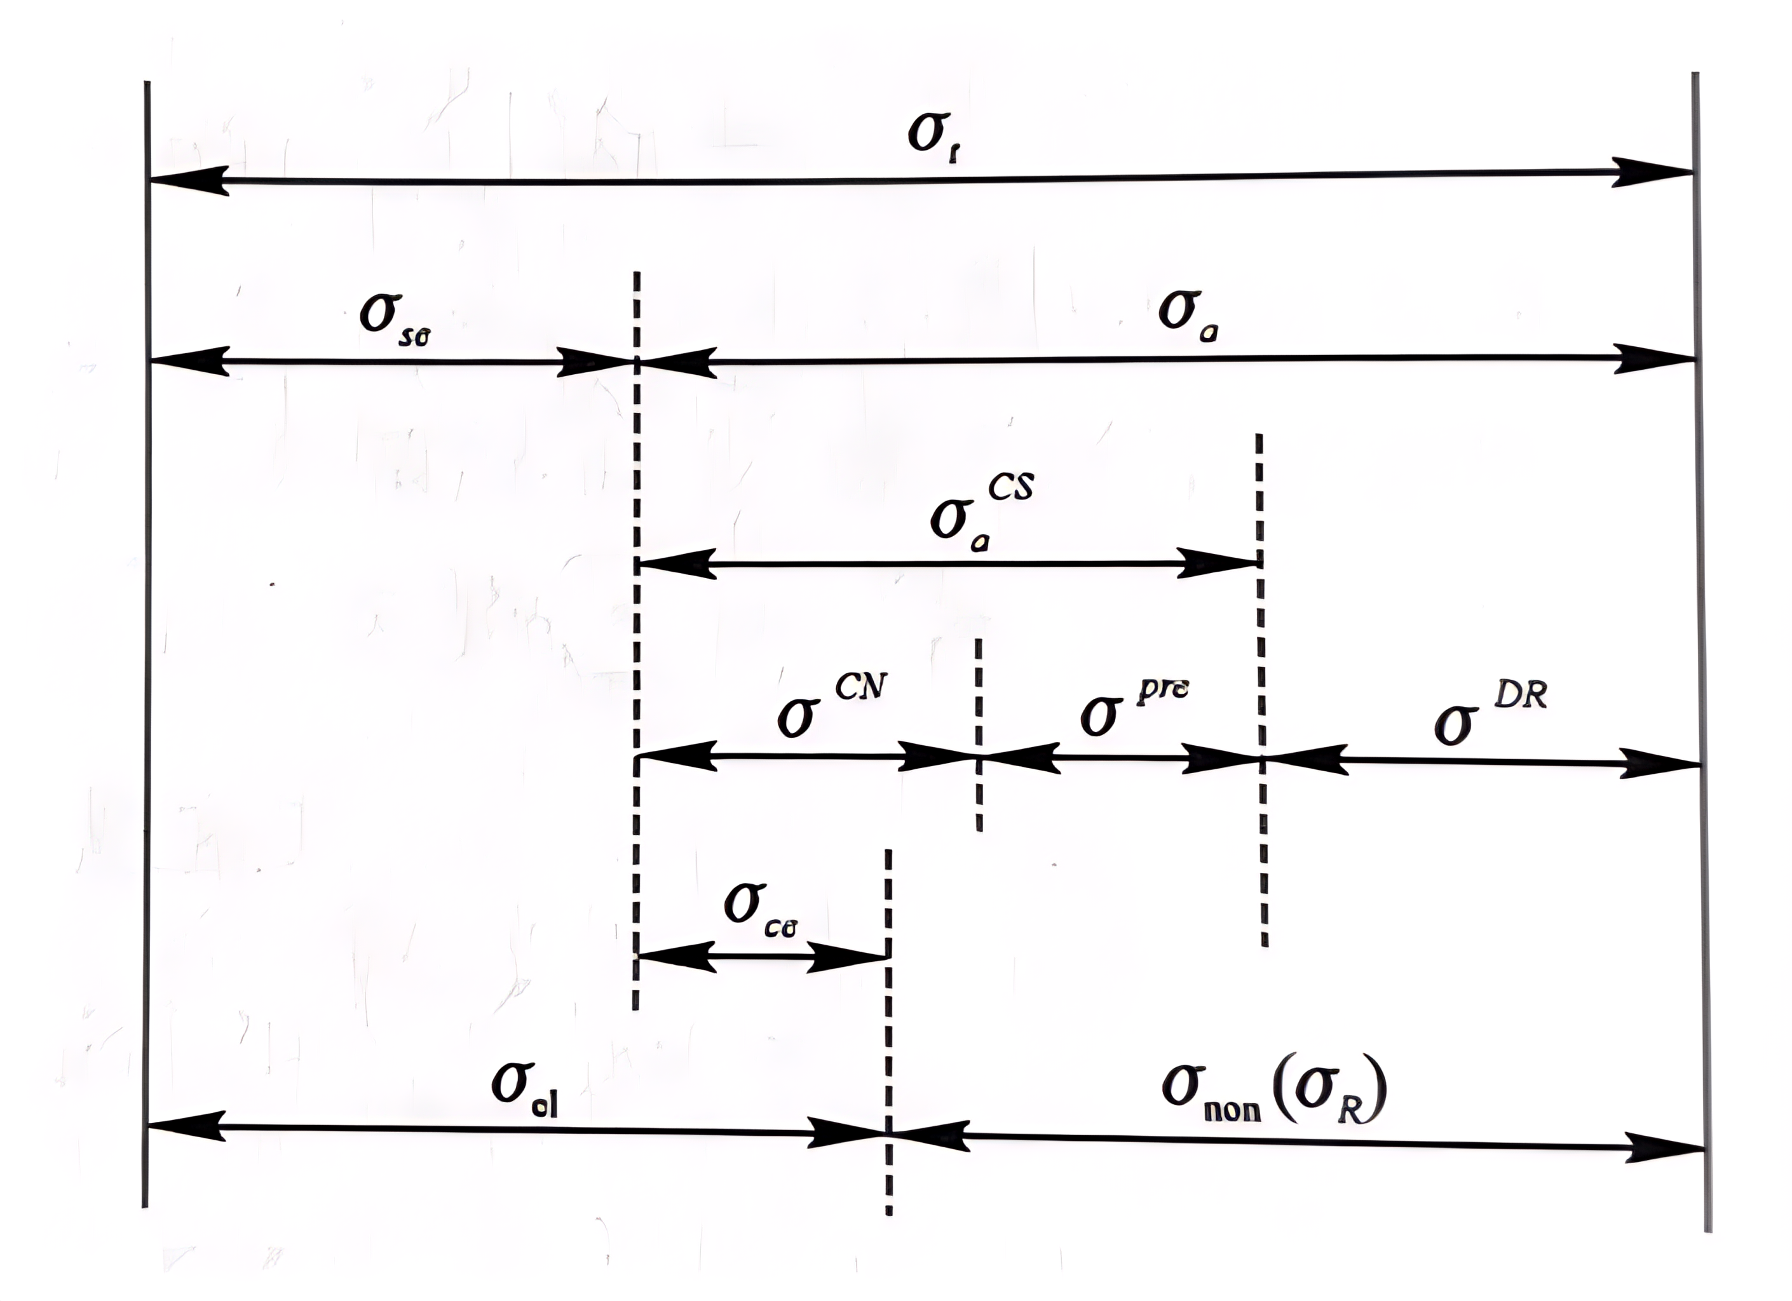
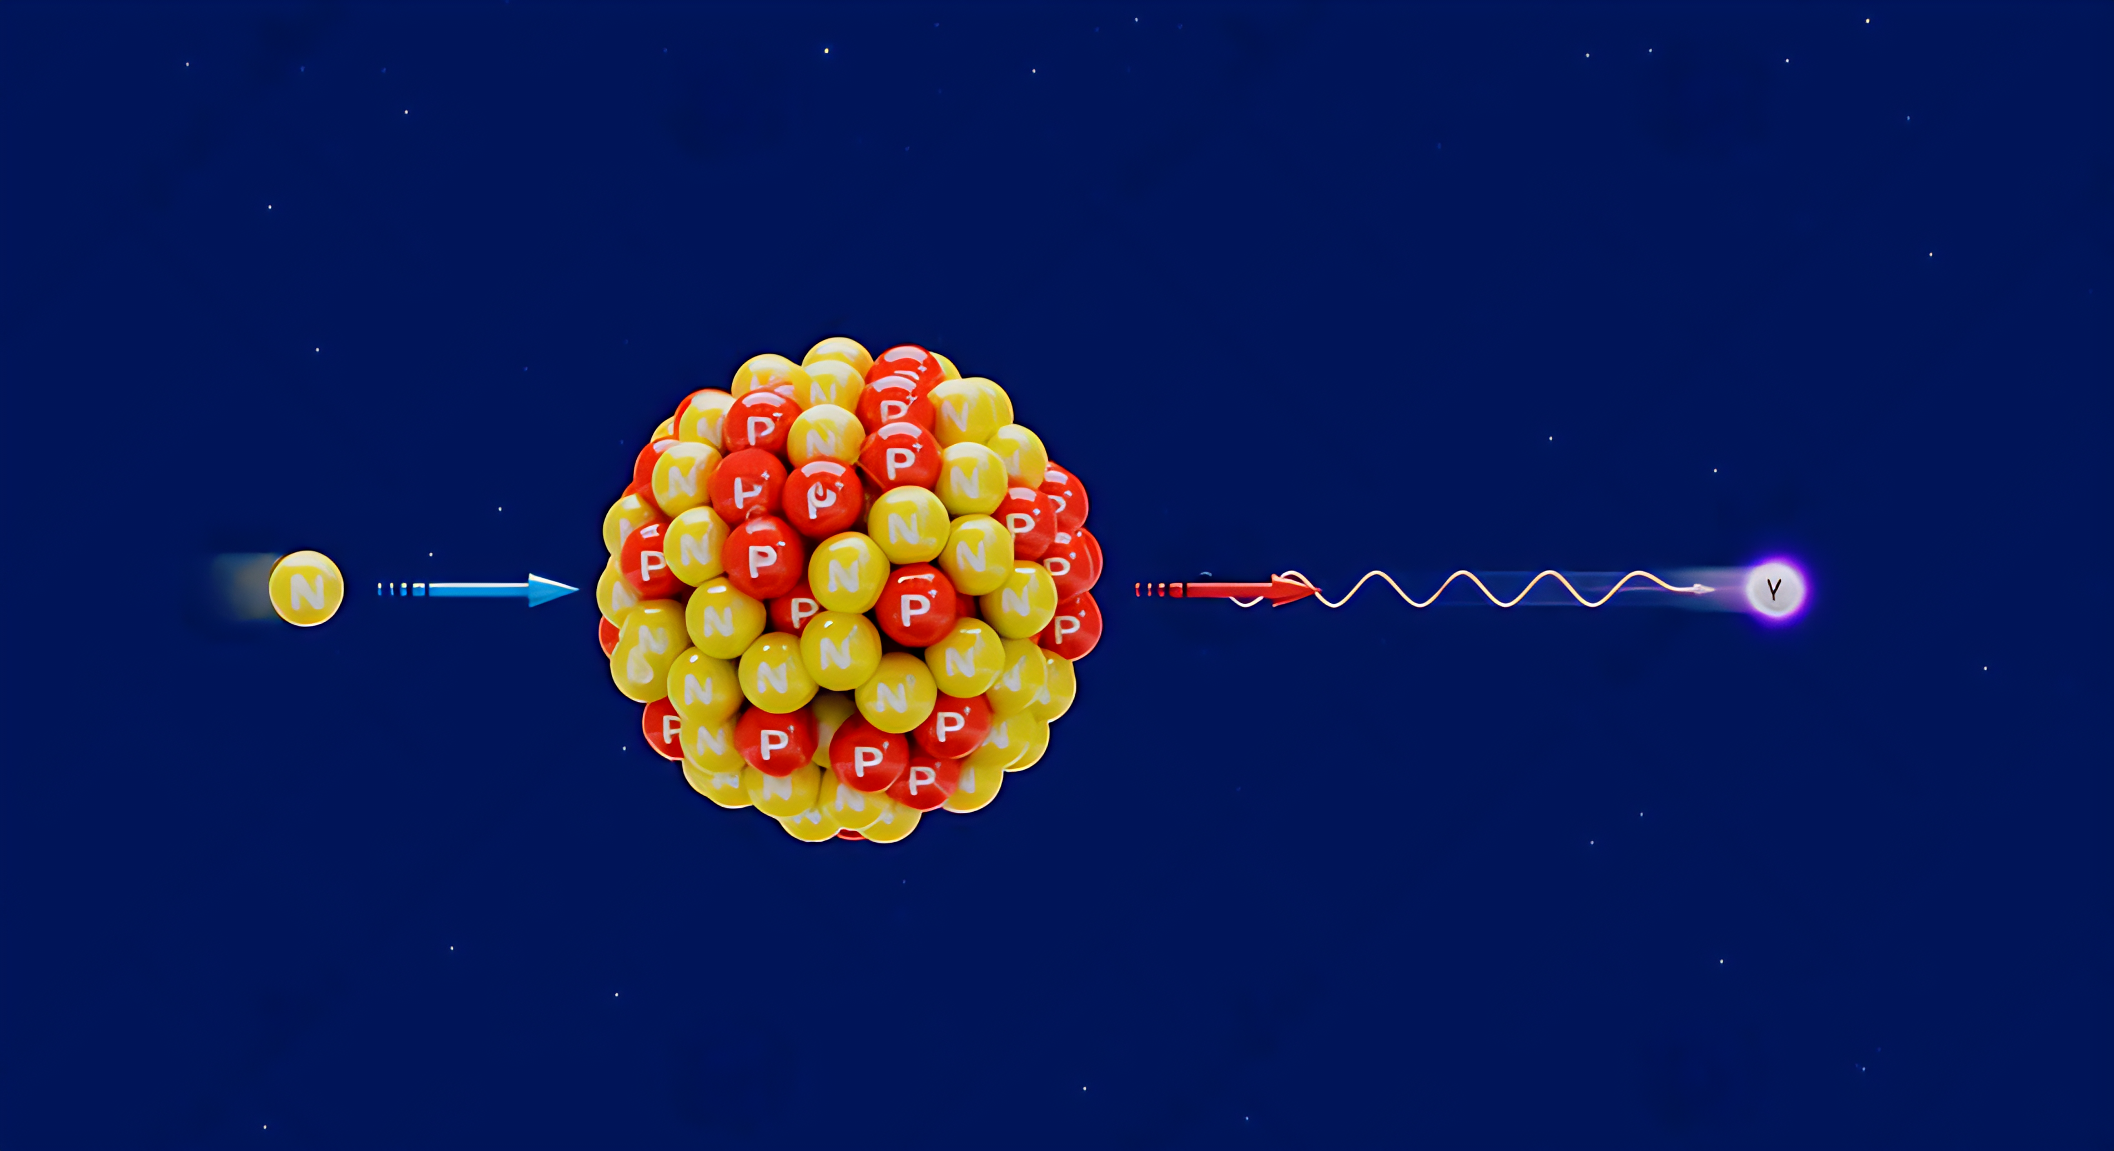
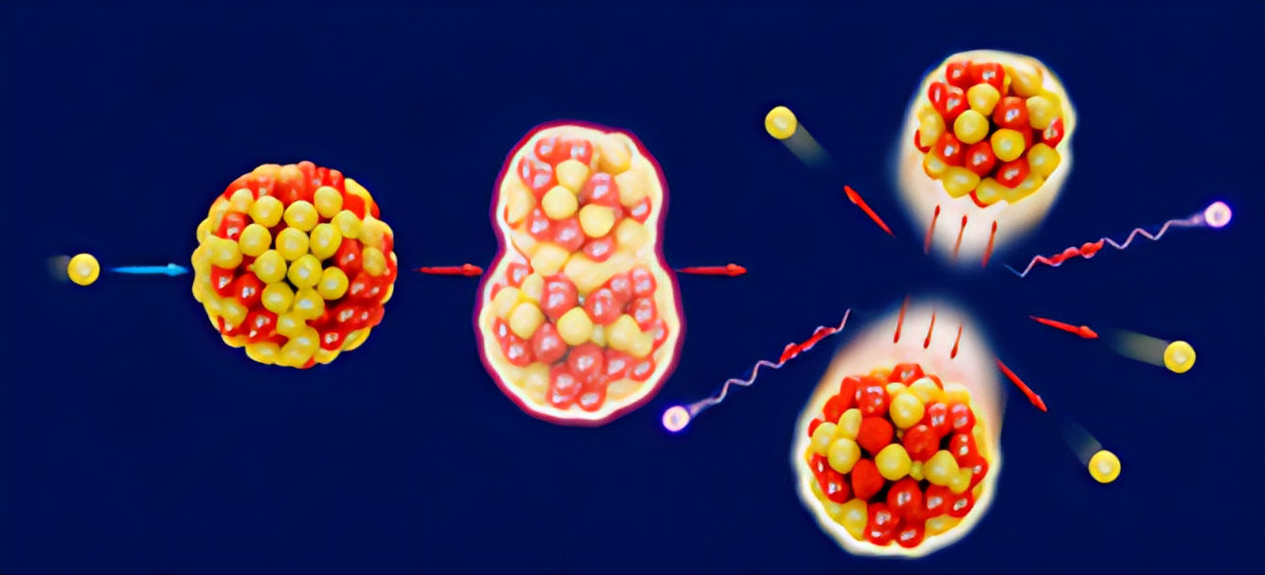
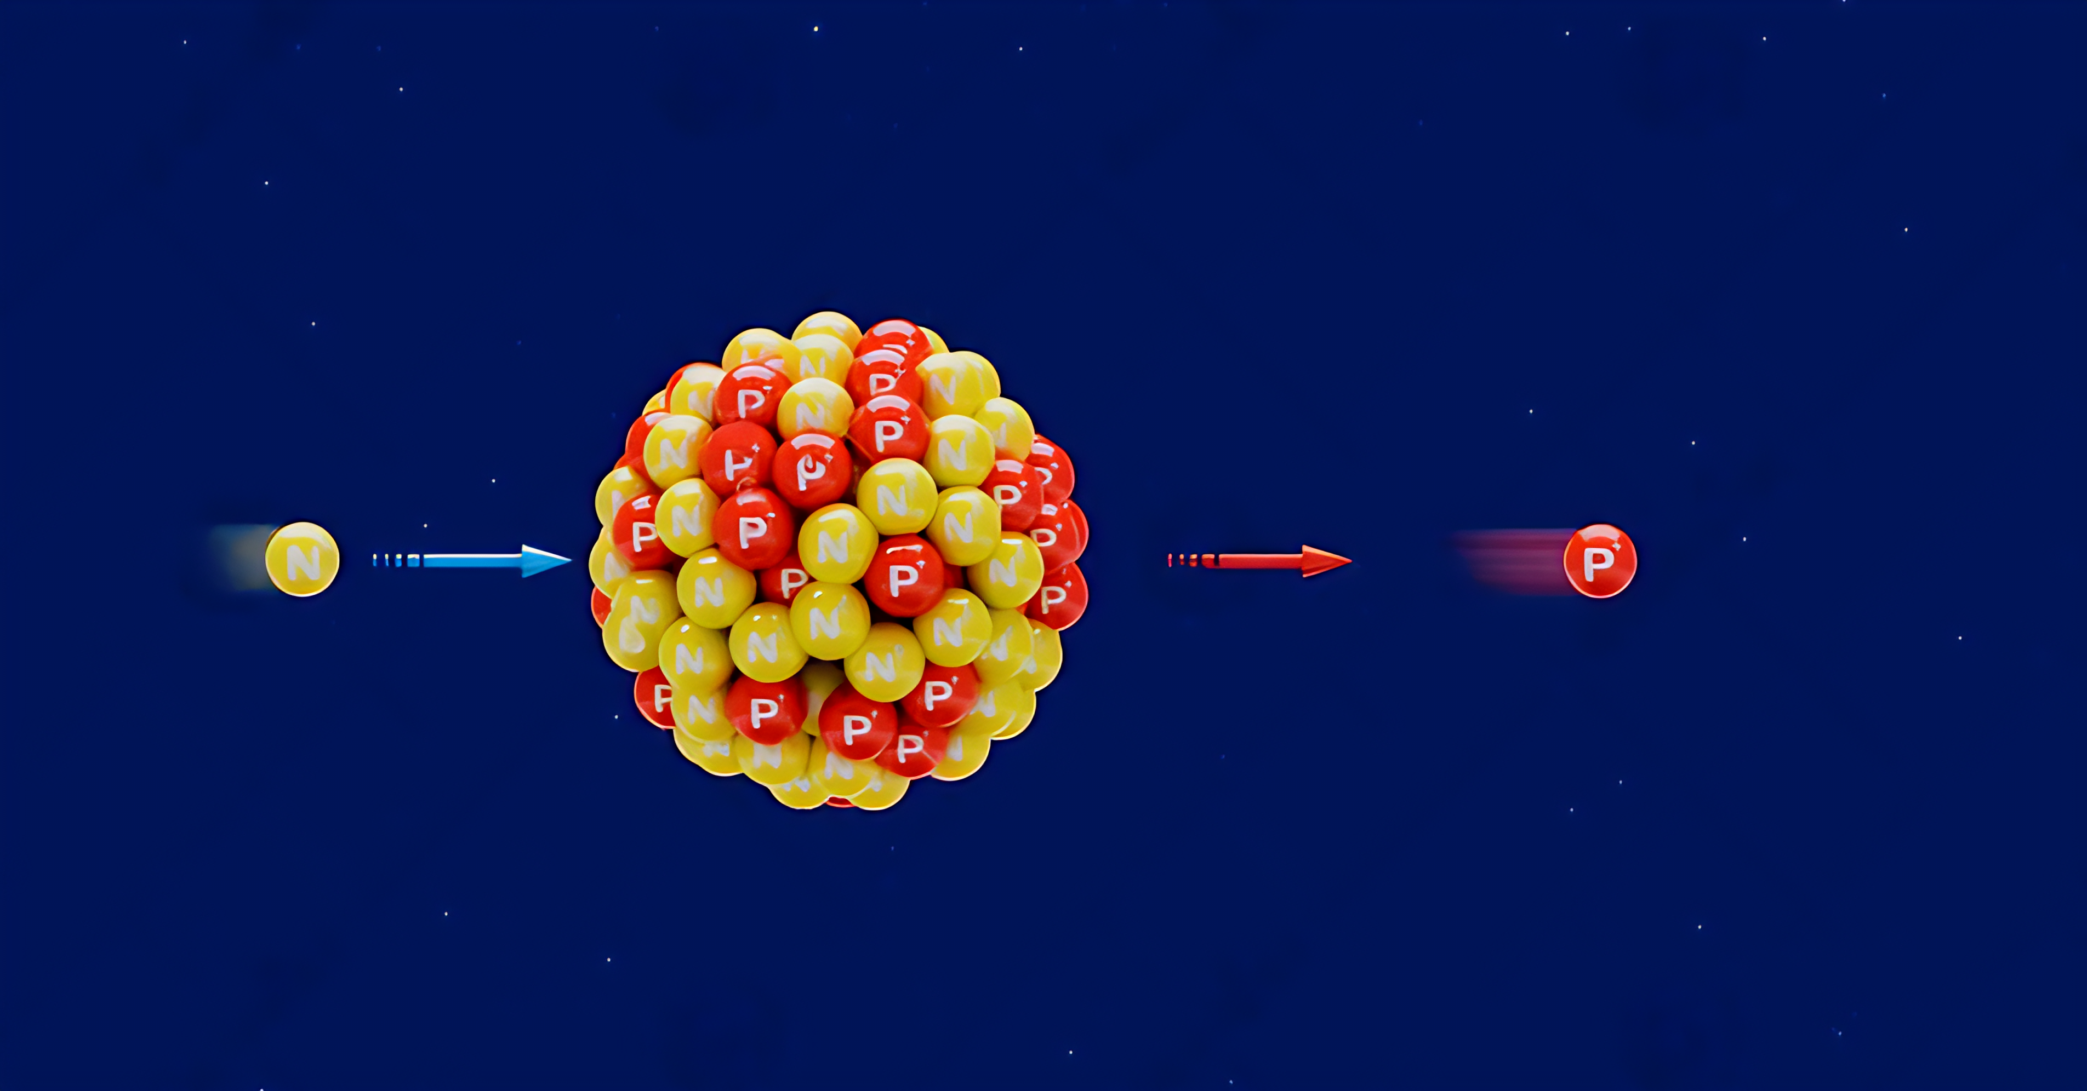
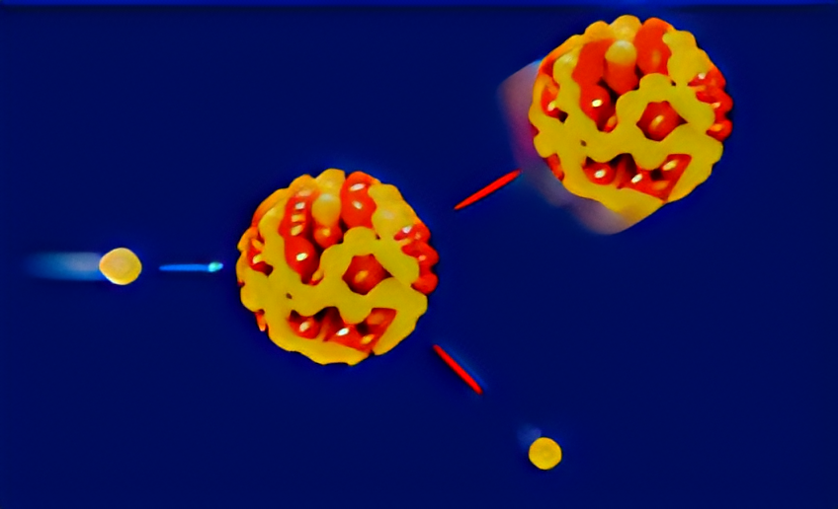
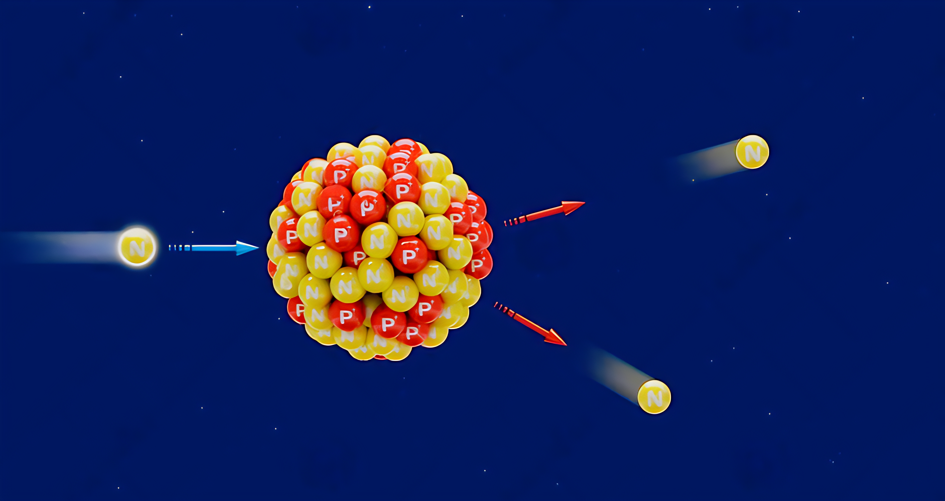
Microscopic Level Density
Radiative Capture Reaction
Photon Strength Function(RQRPA)
Level Density(RHB)
Fission Reaction
Multi-humped Fission Barrier(RHB)
Level Density at saddle points(RHB)
One Particle emission Reaction
unified Hauser-Feshbach and exciton model
Level Density(RHB)
Elastic Reaction
Optical potential model
(CTOM or RHB)
Multi Particle emission Reaction
Hauser-Feshbach
Level Density(RHB)

Slide 15
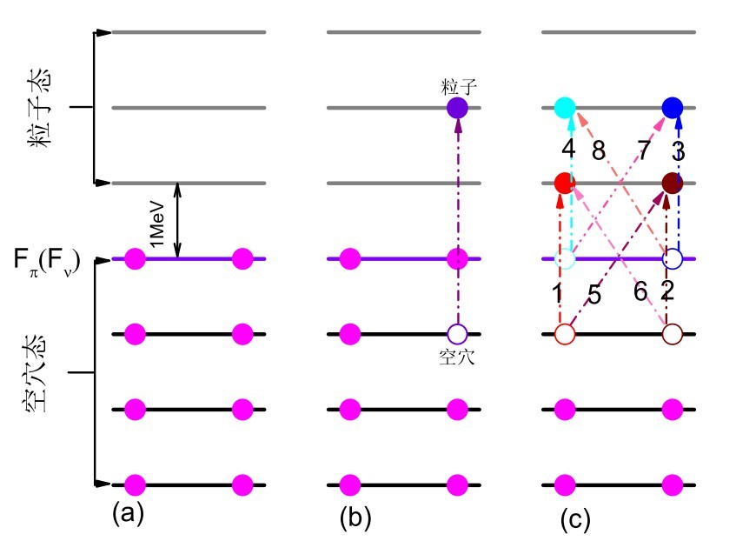

The Micosopic Level Density Based on the CDFT
Single particle level(CDFT)
combinatorial method
Particle-hole state density
rotational and vibrational effects
$ρ_{sph}\left(U,J,P\right)=$ $ω_{i}\left(U,M=J,P\right)−ω_{i}\left(U,M=J+1,P\right)$
Nuclear level density
$ρ_{def}(U,J,P)=1/2[\sum_{K=−J,K≠0}^{J}{ω_{i}\left(U−E_{rot}^{J,K},K,P\right)}]$ $+δ_{(J_{even})}δ_{(P=+)}ω_{i}\left(U−E_{rot}^{J,0},0,P\right)$
$$+δ_{{(J}_{odd})}δ_{(P=−)}ω_{i}\left(U−E_{rot}^{J,0},0,P\right)$$
Collaborate with Jilin University

Slide 16
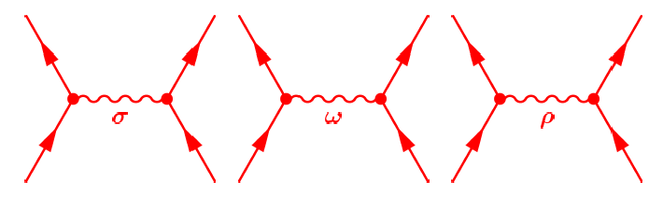
Covariant density functional theory:
g_{σ}
g_{ω}
g_{ρ}
m_{σ}
Taken from Prof. Peter Ring’s talk

Slide 17
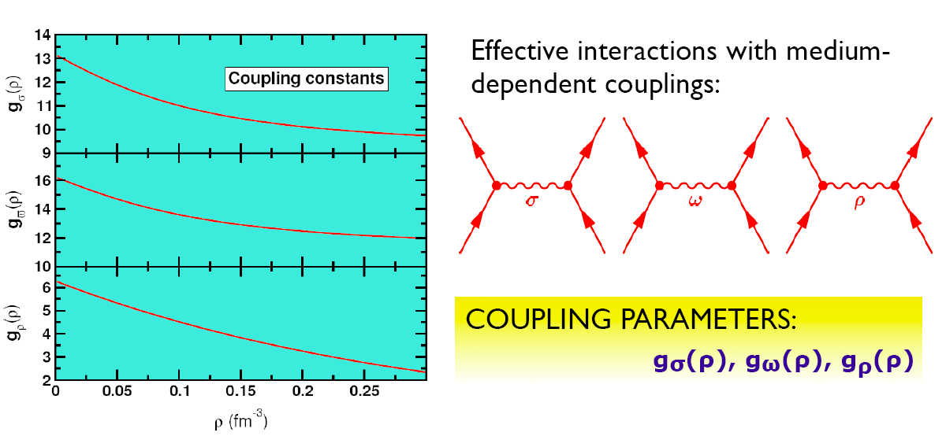
non-linear potential:
NL1,NL3..
Boguta and Bodmer, NPA 431, 3408 (1977)
Density Dependent coupling constants:
Typel, Wolter, NPA 656, 331 (1999)
Niksic, Vretenar, Finelli, P.R., PRC 66, 024306 (2002): DD-ME1
Lalazissis, Niksic, Vretenar, P.R., PRC 78, 034318 (2008):DD-ME2
Point-coupling models with density dependent coupling constants:
Manakos and Mannel, Z.Phys. 330, 223 (1988)
Bürvenich, Madland, Maruhn, Reinhard, PRC 65, 044308 (2002): PC-F1
Niksic, Vretenar, P.R., PRC 78, 034318 (2008): DD-PC1
Zhao, Li, Yao, Meng, J. Meng, archiv 1002.1789 PC-PK1

Slide 18
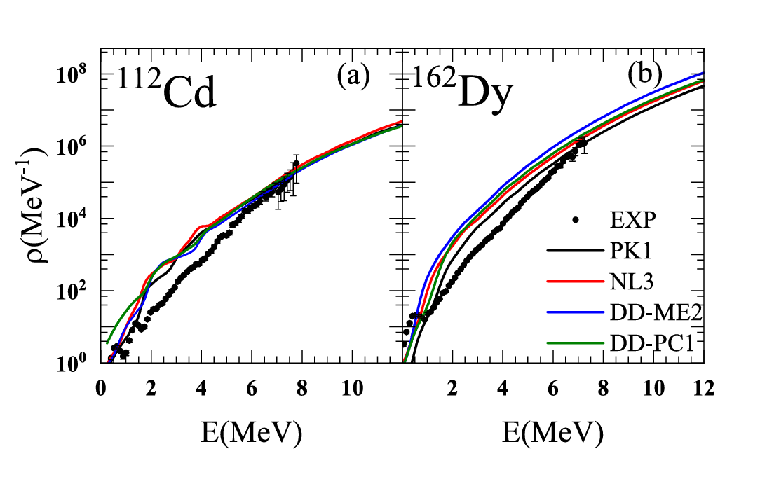
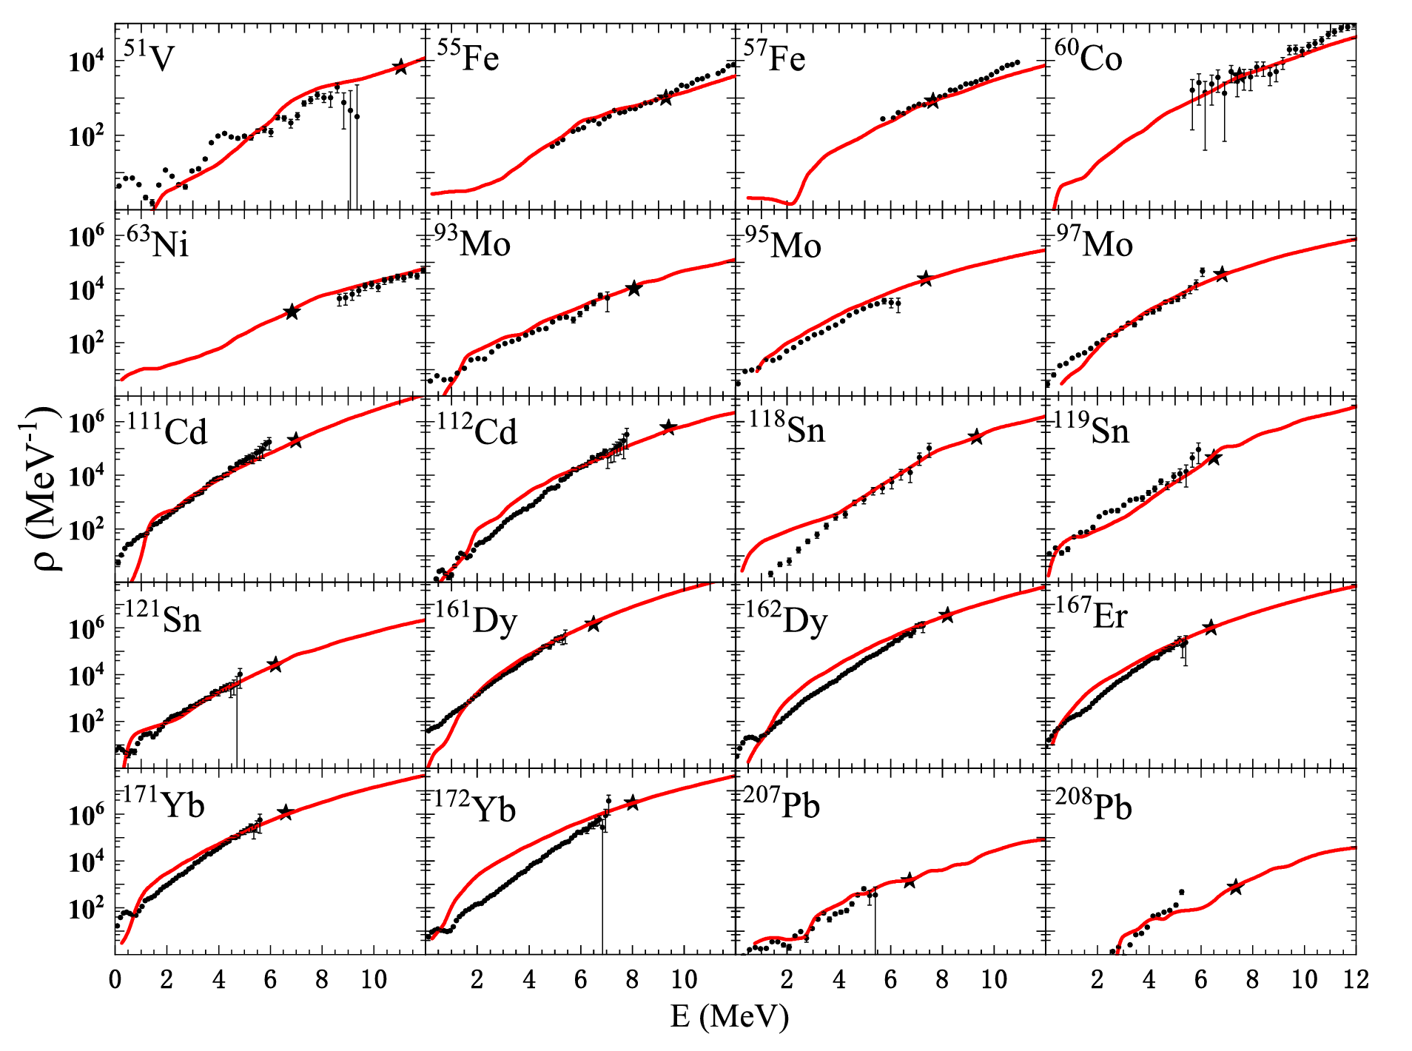
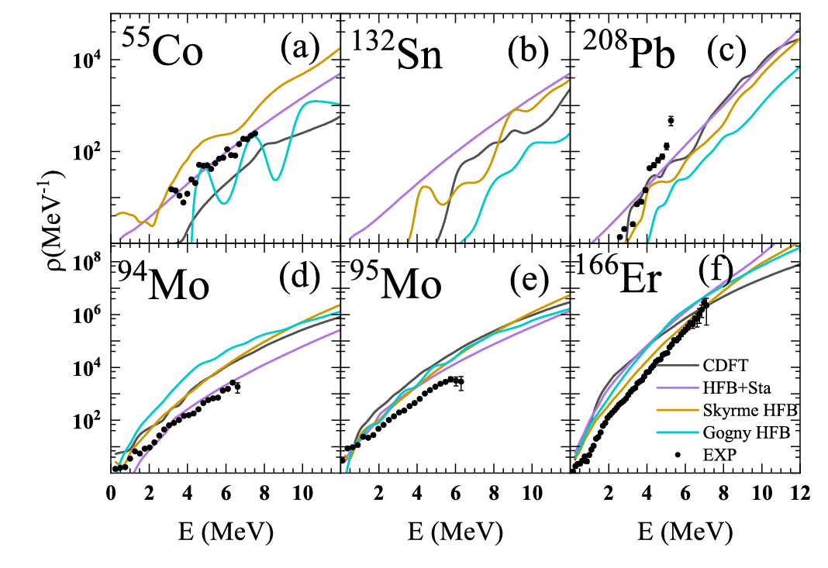
Nuclear Science and Techniques (2023) 34:141

Slide 19
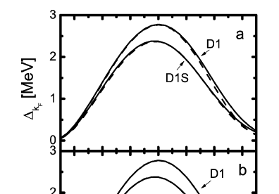
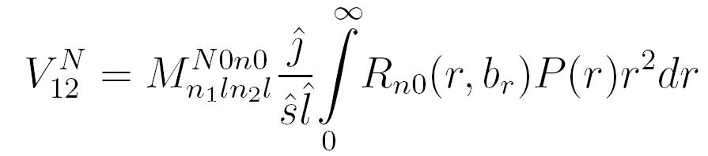
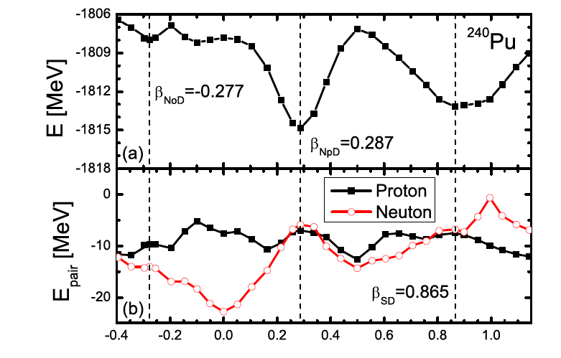
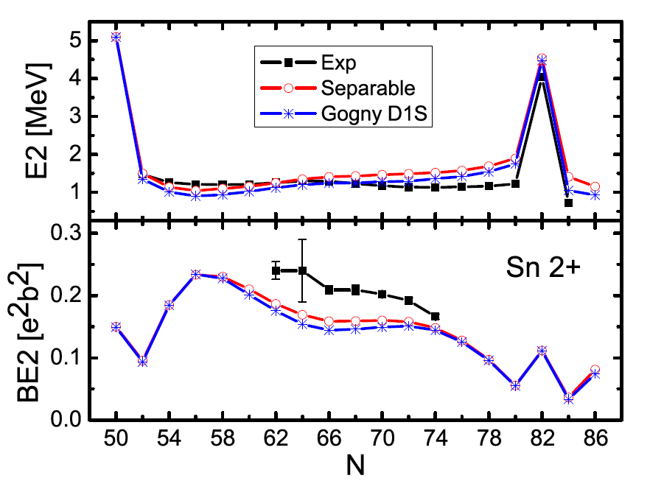
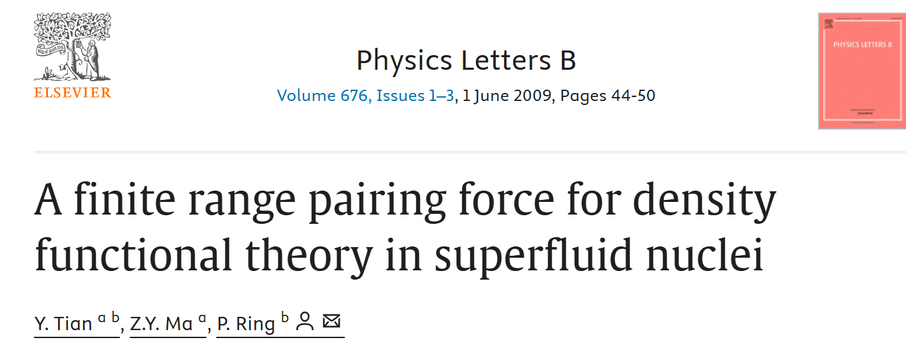
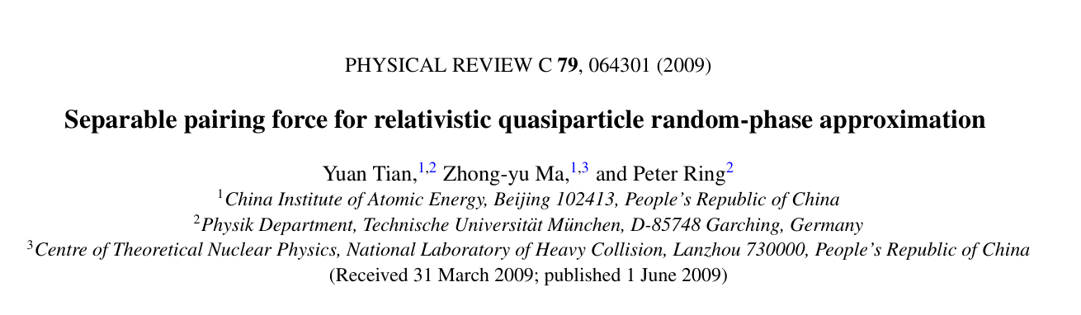
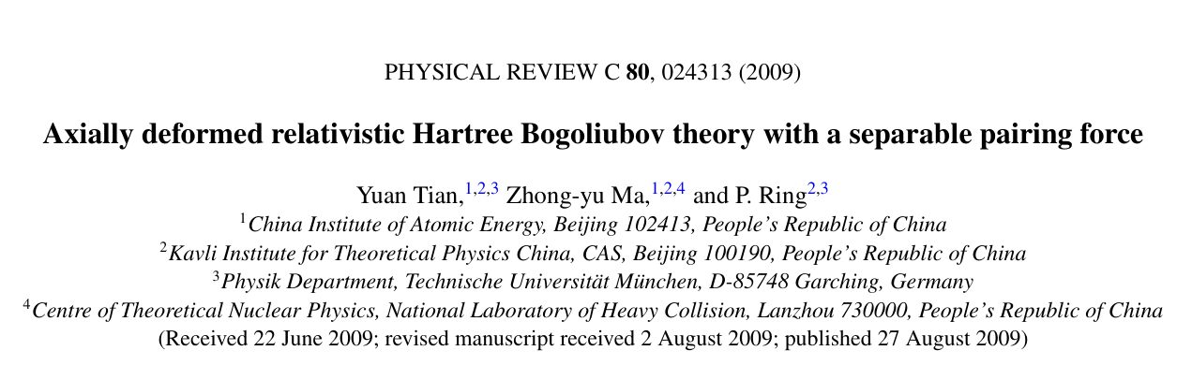
Separable pairing interaction（TMR）

Slide 20
Pairing effect on the Microscopic Level Density
RHB
Pairing correlations are certainly important in the predictions of nuclear properties, which would certainly influence the predictions of nuclear level densities. It is found that the calculation with pairing correlations reproduces the experimental data for nuclear level densities quite well.

Slide 21


Fission Reaction

Slide 22
Other method for Level Density

Slide 23


Using neural network to investigate the level densiy
Applied Radiation and Isotopes 169 (2021) 109583
PHYSICAL REVIEW C 109, 044325 (2024)

Slide 24



Z, A, E
Z, A, β₂, E
Z, A, I, P, E
Z, A, Sn, Sp, E
log ρ/ ρ_{c}
(ρ_{c}=1 MeV⁻¹)
64,32
The training set used in the BNN contains 282 nuclides, including six theoretical NLD models (BSFGM, GCM, GSM, HF-BCS, Gogny-HFB, and Skyrme-HFB), with 11 ≤ Z ≤ 98 , 24 ≤ A ≤ 251 taken from the TALYS 1.95 code, and the experimental 53-nuclide database measured using the Oslo method. Approximately 70000 data points are used for training set.

Slide 25



Training nuclei
Test nuclei
Predict nuclei

Slide 26
OUTLOOK

Slide 27
Note that the following contents contain the all researches in our future plan in 2024-2028
Firstly, CNDC would like to provide the globale phenomenological level density models such as: Constant Temperature + Fermi Gas model and Enhanced Generalised Superfluid model in the real nuclear reaction calculations with Chinese UNF code. Secondly, we are also glad to provide the globale microscopic level density model based on the Relativistic Hartree-Bogoliubov + combinatorial model. The nulcear reaction systems are preliminarily planned as Nb, Sn, U etc. We also would like to incorporate with IAEA, incorporate the recommended energy level density parameters into the UNF programme and systematically compare the calculations.
Yearly Goal: Complete technical upgrades to the UNF program, adding phenomenological NLD models.
Preparation and Preliminary Research: Study existing phenomenological NLD models and design the technical upgrade plan. Design new program architecture to support model integration.
Program Development and Initial Integration: Code and integrate the Constant Temperature + Fermi Gas model. Perform initial testing and begin coding the Enhanced Generalised Superfluid model.
Testing and Validation: Conduct comprehensive numerical simulations to verify model performance. Optimize and adjust model codes based on test results.
Finalization and Documentation: Complete final code optimizations. Write technical documentation and user manuals.
Technical Upgrades to UNF Program: Integration of Constant Temperature + Fermi Gas and Enhanced Generalised Superfluid models with detailed technical documentation.
Optimized Phenomenological NLD Models: Fully integrated and tested models within the UNF program, providing initial global NLD parameters.
Global NLD Parameters for Nd, Sn, U: Comprehensive lists of global NLD parameters for Nd, Sn, and U isotopic chains, supporting nuclear reaction calculations and related research.
Incorporate the recommended energy level density parameters into the UNF programme and systematically compare the calculations.

Slide 28


Thank you for your attention !

Slide 29
Nuclear Physics Collaboration Network
Model Calculation
Nuclear Data
General + Specialized Nuclear Databases

