Slide 1
Level density validation for and with TALYS
Arjan Koning, IAEA
Stephane Goriely, Univ. Brussels

Slide 2
Contents
Some basic level density validation
Optimisation to discrete levels and D0
Indirect level density validation
Impact on TALYS cross section calculations

Slide 3
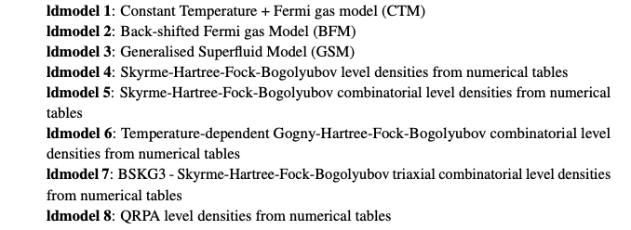
TALYS level density models
Best level density models (averaged over all TALYS applications):
1, 2, 7 and sometimes 5. The big promise is 8!

Slide 4
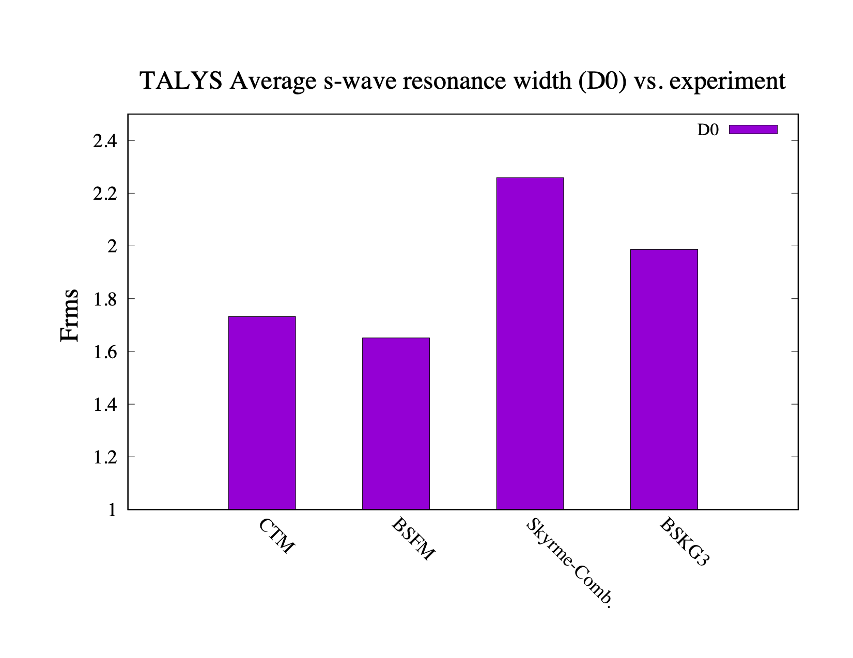
Global level densities
Nuclides with experimental D0 data: 300 (RIPL-3)

Slide 5
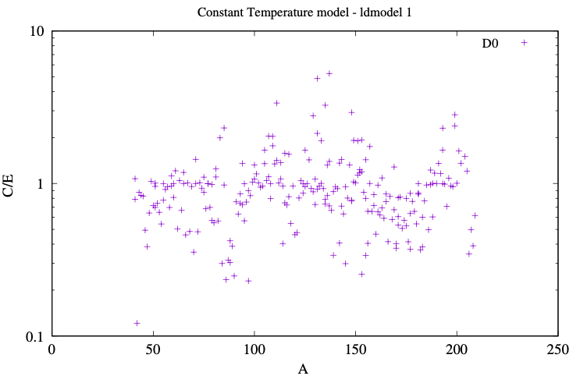
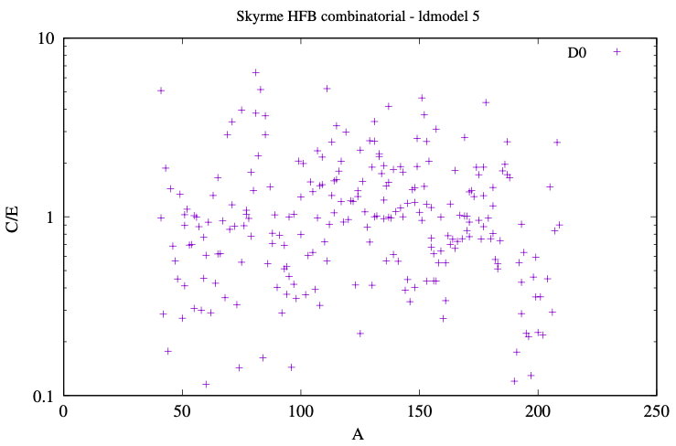
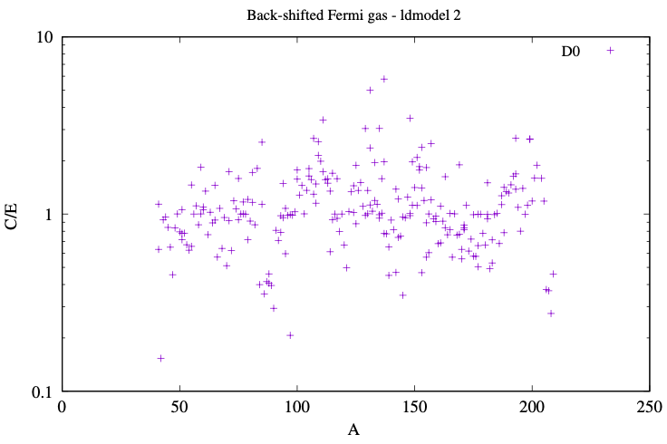
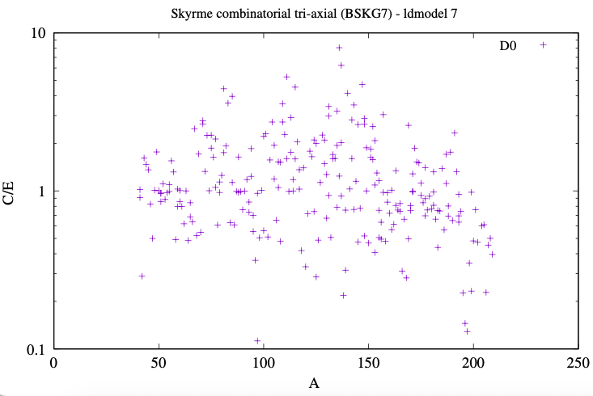
Global level density validation with D0
Frms=1.73
Frms=2.26
Frms=1.67
Frms=2.00
Suspicious for all LD models: e.g. K42, Zr97

Slide 6
Parameter adjustment
Eq. (230) appropriate for
Fermi gas range but not
for constant T range
Should be extended by
adjustment of the spin
distribution (is already in
latest version of TALYS)
Is applicable to both
microscopic and analytic
LD’s
TALYS keywords:
C: ctable(Z,A)
δ: ptable(Z,A)

Slide 7
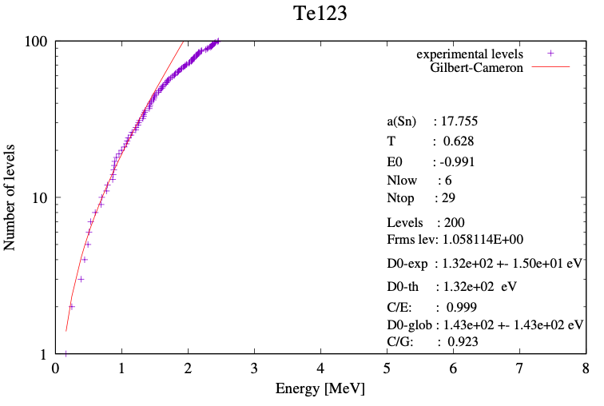
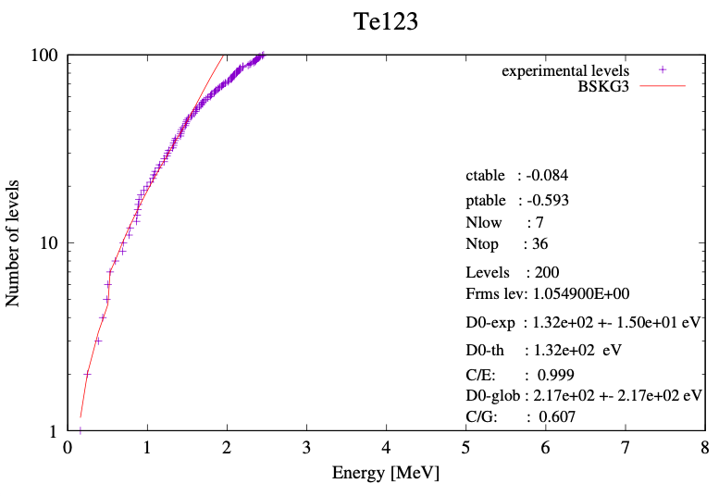
Te-123: Gilbert-Cameron versus BSKG3 - experimental D0
Minimize:
Optimize ctable, ptable,
Nlow (NL) and Ntop (NU)
at the same time

Slide 8
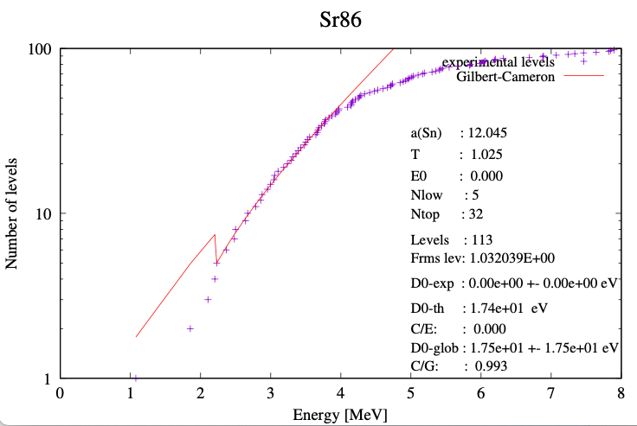
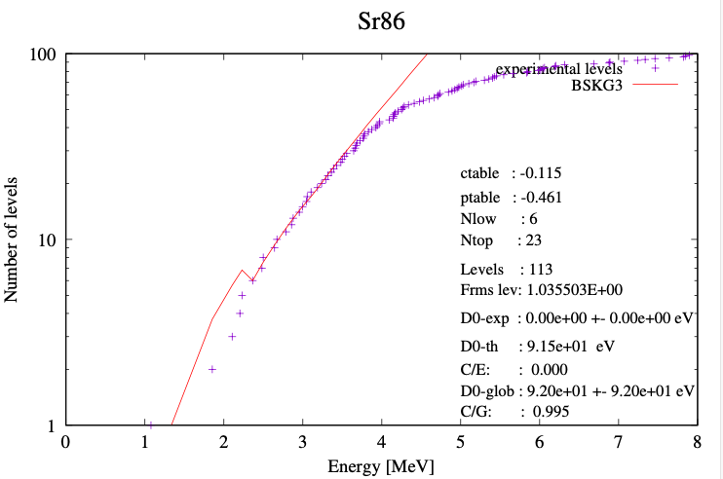
Sr-86: Gilbert-Cameron versus BSKG3 - no experimental D0
Use D0 estimate from global
level density with unc. 100%
to constrain discrete level fit
Note: Many technological important
nuclides have no exp. D0.
For example, Cu64,66 have while
Cu63,65 have not. In those cases,
(n,γ) is better constrained than (n,n’)

Slide 9
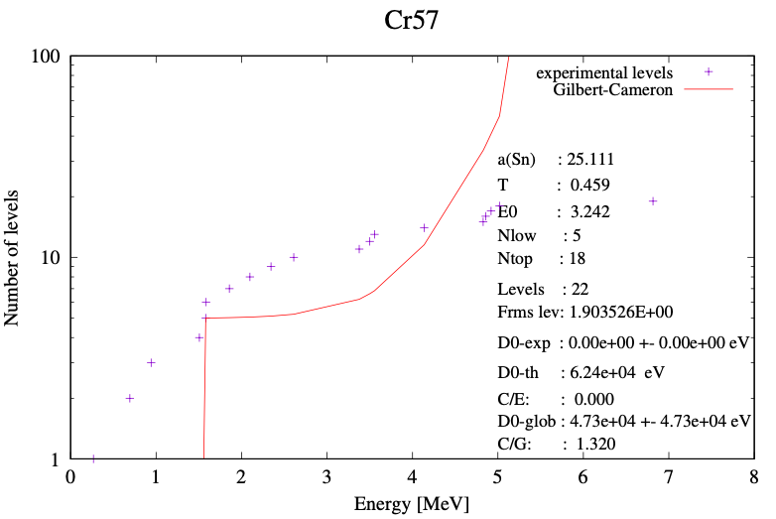
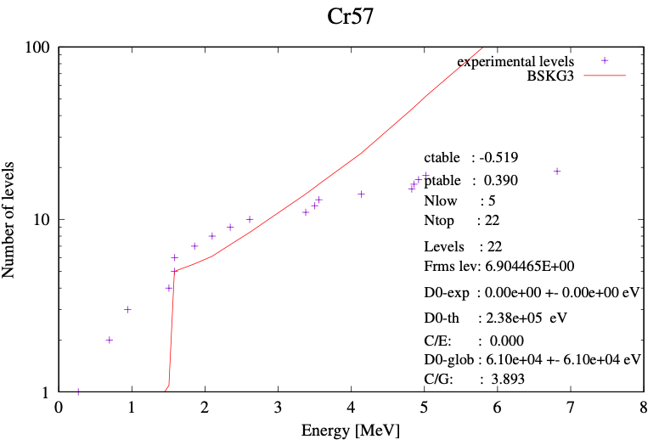
Use clean discrete level database
RIPL discrete level file:
1496 nuclides with > 15 levels
~200 rejected because of huge
deviation from any level density
model (Frms, ctable, ptable)
~1300 nuclides with usable
discrete level scheme up to Ntop

Slide 10
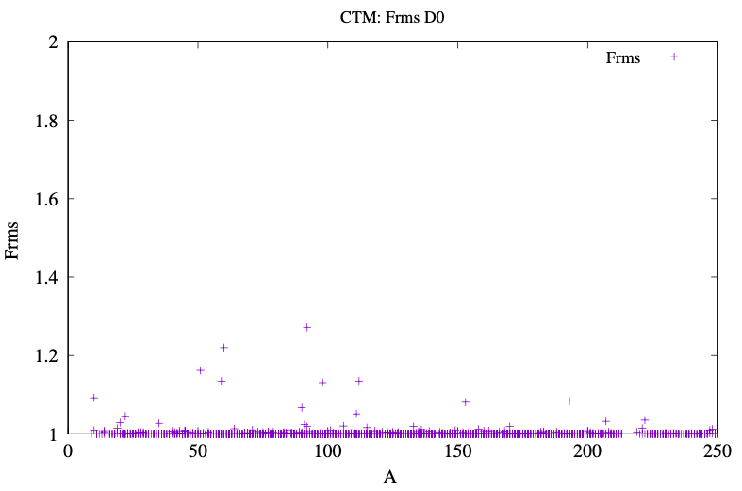
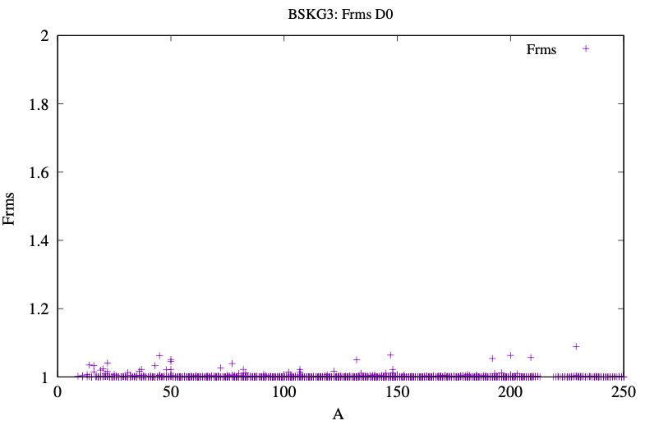
Adjusted level densities- D0
No perfect fit because of simultaneous
adjustment to discrete levels

Slide 11
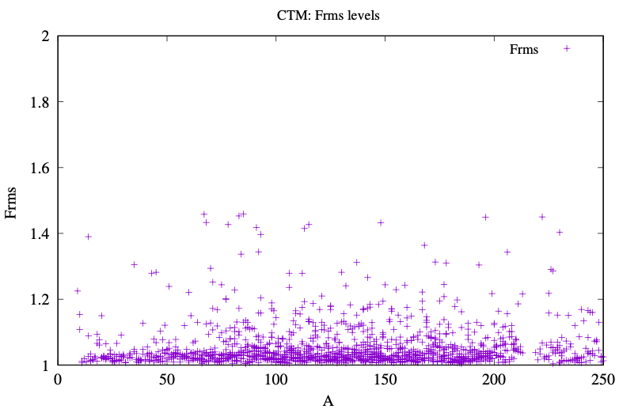
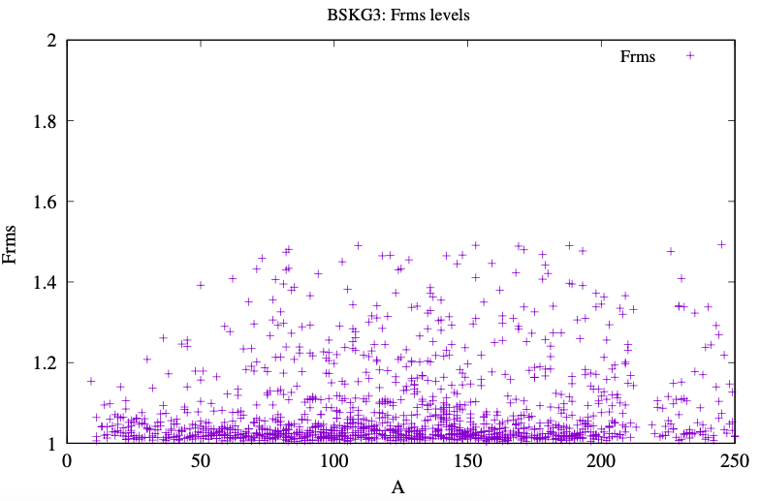
Adjusted level densities
- Discrete levels
Still to do:
Compare global BSKG3 with
global CTM (i.e. global formula
for T and E0)

Slide 12
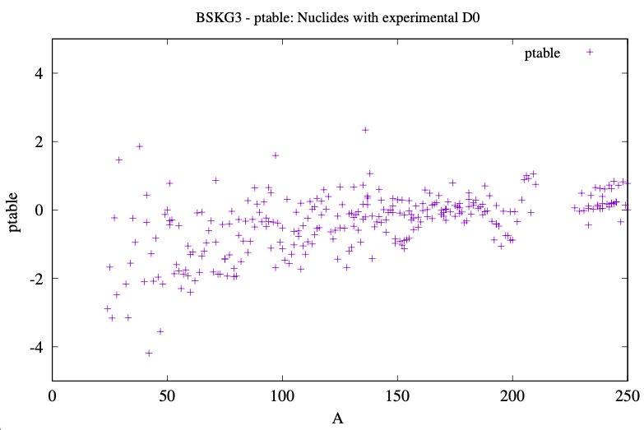
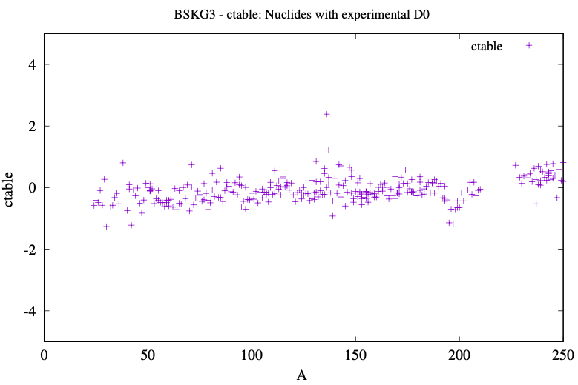
BSKG3 level density parameters adjusted to D0 and discrete levels

Slide 13
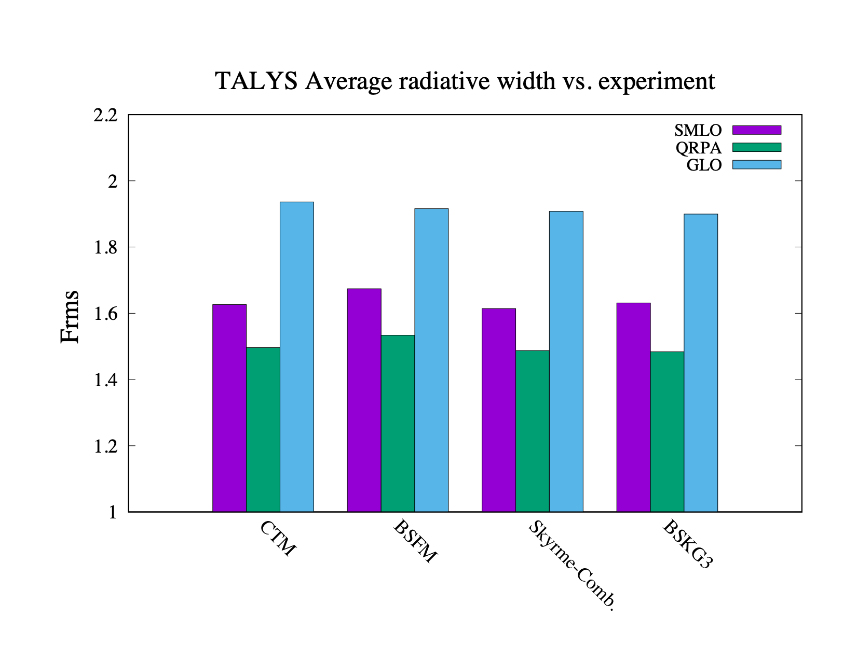
Level densities optimised to discrete levels and D0
Photon strength functions: global model
Nuclides with experimental <Gg> data: 228

Slide 14
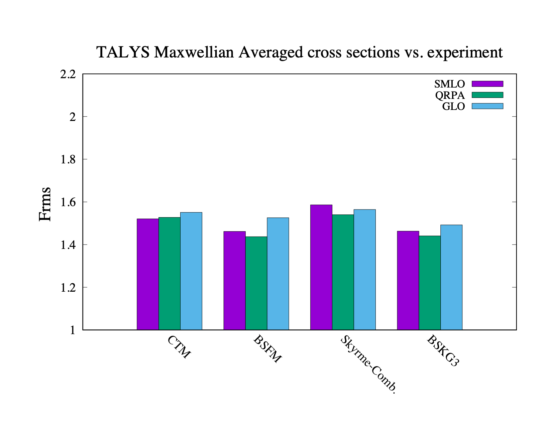
Level densities optimised to discrete levels and D0
Photon strength functions: global model
Nuclides with experimental MACS data: 277

Slide 15
Normalisation of inelastic scattering to high-lying discrete levels
Suppose:
Nlow = 4
Ntop = 20
Ncum starts to exceed exp. discrete levels above Ntop
For inelastic scattering to the first 40 levels:
Weight in HF for level 1 to Ntop : 1
Weight in HF for levels (Ntop + 1) to 40: (Ncum(Eexp (level 40)) - Ntop)/(40 -Ntop)

Slide 16
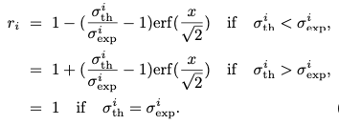
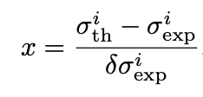
Goodness-of-fit: Frms with experimental uncertainty
Frms = 1.40 means “~40% off”
Erms = 1. means “no model bias”
Instead of
Usual C/E value
we use
C/E value including uncertainties

Slide 17
Parameter optimisation up to 20 MeV
Use TASMAN: Nelder-Mead optimisation
Multi-dimensional parameter landscape not too wild
20 TALYS runs per parameter usually enough
(n,gamma):
PSF: wtable of compound nucleus
(n,n’), (n,2n), (n,p) and (n,np)
rvadjust p, gadjust(0,0), gadjust(0,1), gadjust(1,0)
(n,alpha)
rvadjust a, cstrip a
Isomer versus ground state:
Risomer of the final nuclide
S2adjust of final nuclide

Slide 18
Experimental data
TALYS/TENDL methodology requires all EXFOR to be available instantaneously
Best current option (for AK): EXFORtables - directory structured database
All data normalised to latest standards/monitors
Outlier assignment:
23444 cross section data sets
10969 declared inlier
1975 declared outlier
Still need to put 23444 JSON files on IAEA-github

Slide 19
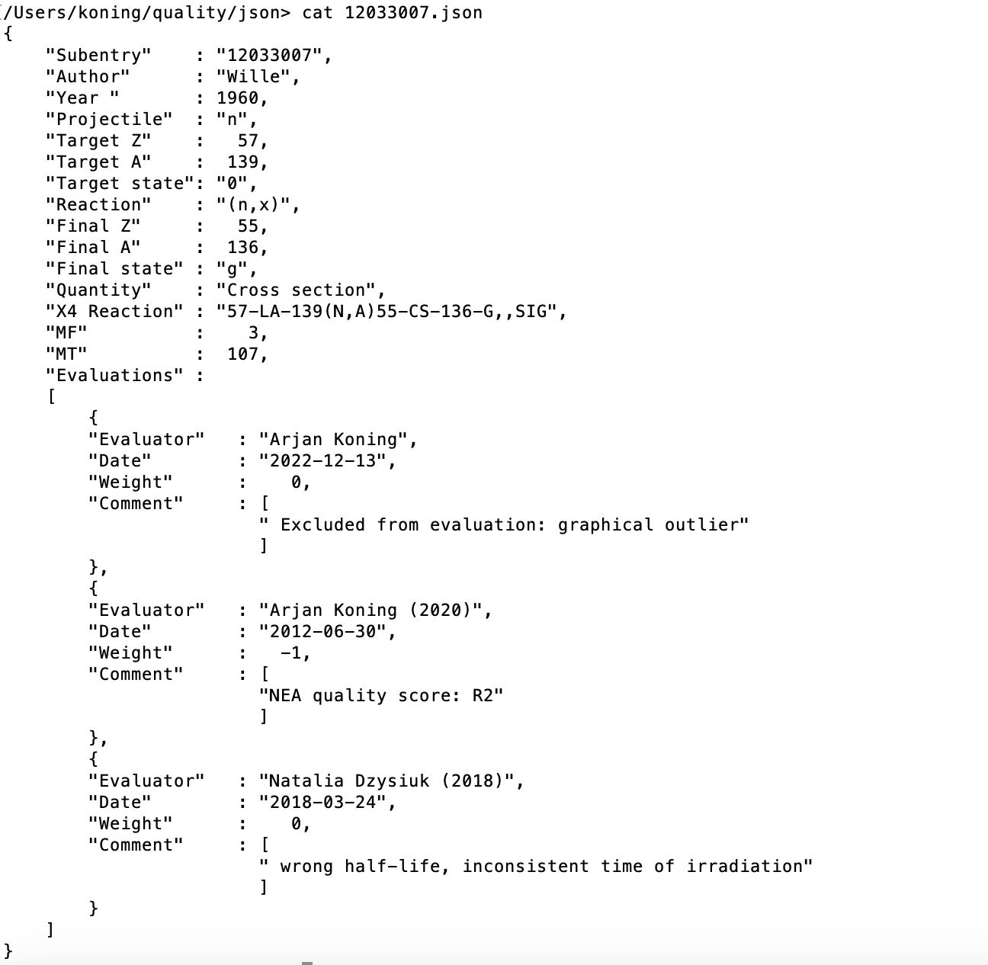

Slide 20
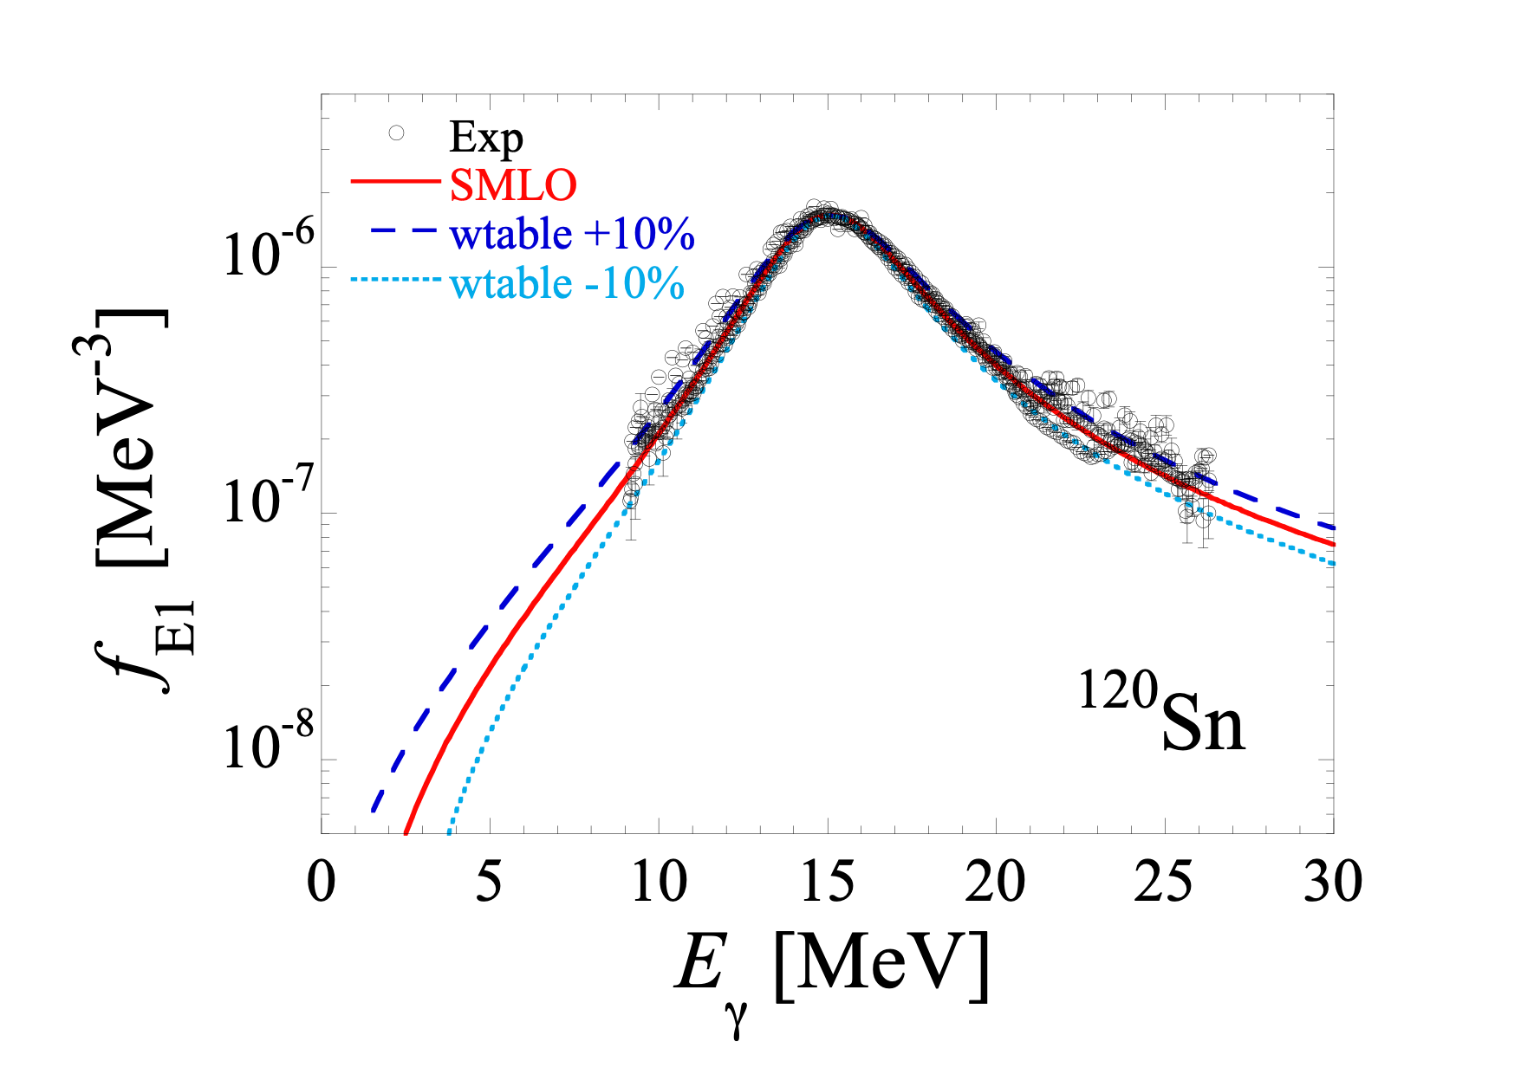
Adjusting (n,γ ) cross sections with PSF width parameter
Sn + Ein: range
important for
(n,γ )

Slide 21
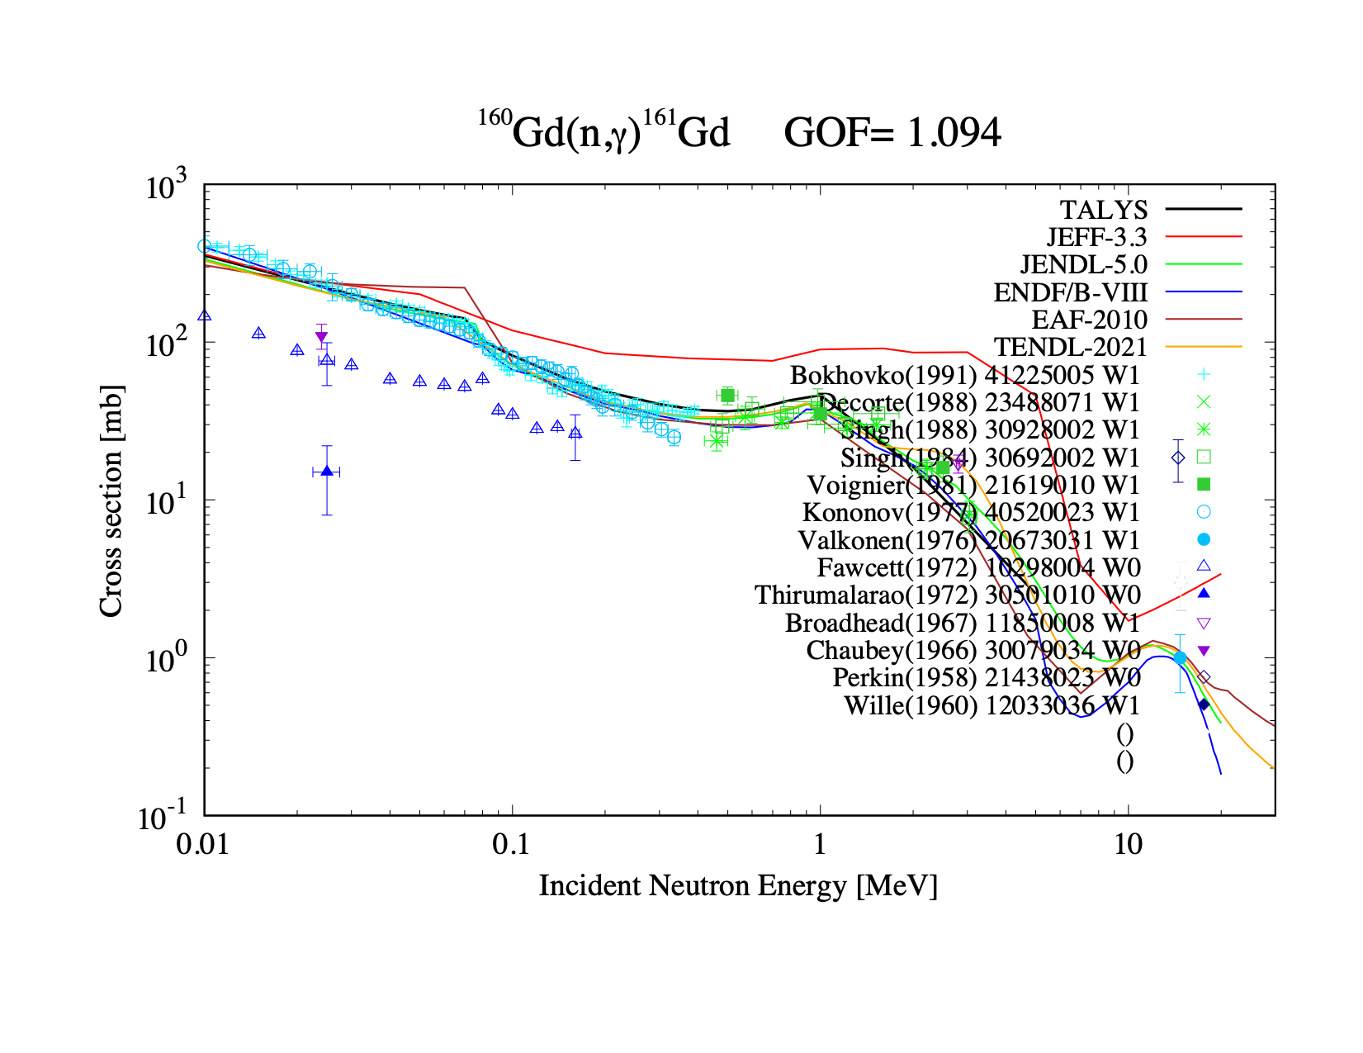
Wtable = 1.08

Slide 22
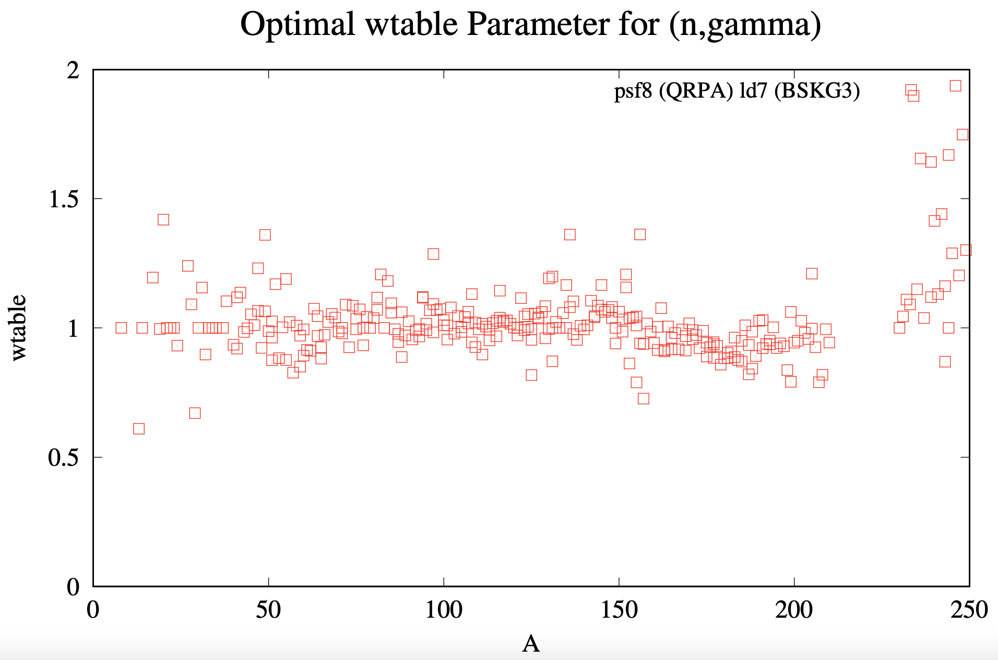
Current optimal combination of level density and photon strength function

Slide 23
Unify all (n,γ) data
EXFOR for cross sections, excluding outliers
Pseudo-data created from perfect TALYS fit to average radiative width Γγ (one point)
Gives a value for wtable, one for each LD model
Use the LD spread of calculated cross sections as uncertainty
Use this to create pseudo-exp. cross sections at 5 and 10 keV
Pseudo-data created from perfect TALYS fit to Maxwellian Averaged Cross Section from Astral/Kadonis database (one point)
Gives a value for wtable, one for each LD model
Use the LD spread of calculated cross sections as uncertainty
Use this to create pseudo-exp. cross sections between 5 and 100 keV
Use pseudo-exp. data in the same fit as normal exp. cross sections
Outlier detection for average radiative width and MACS

Slide 24
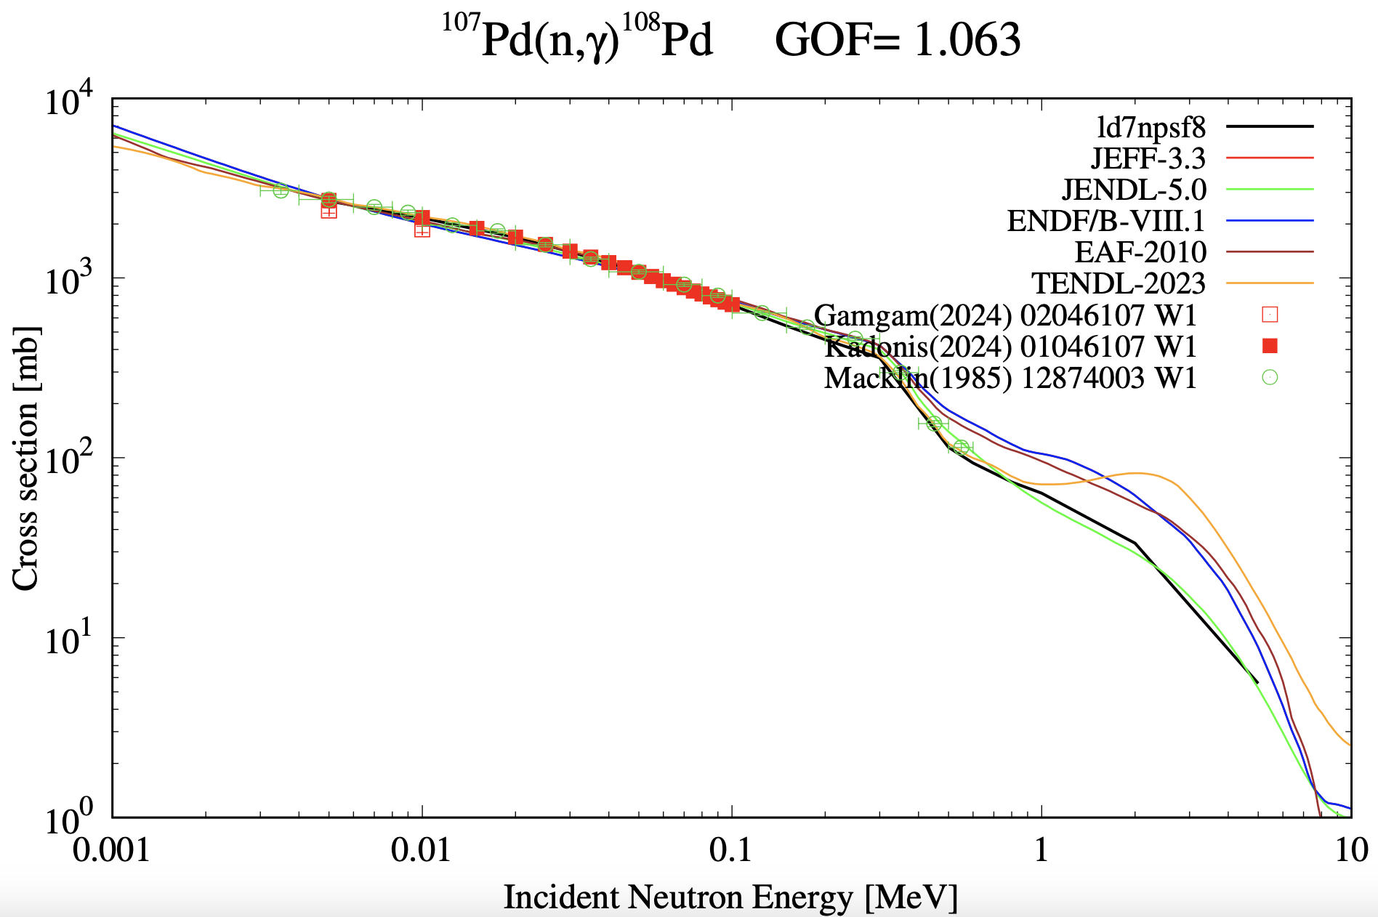
Typical case

Slide 25
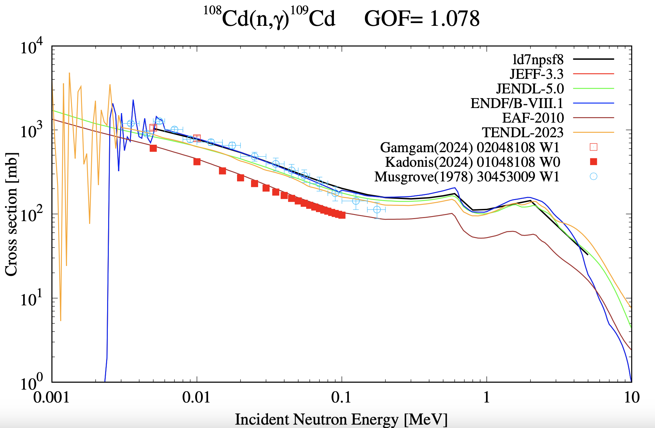
Example: MACS considered an outlier

Slide 26
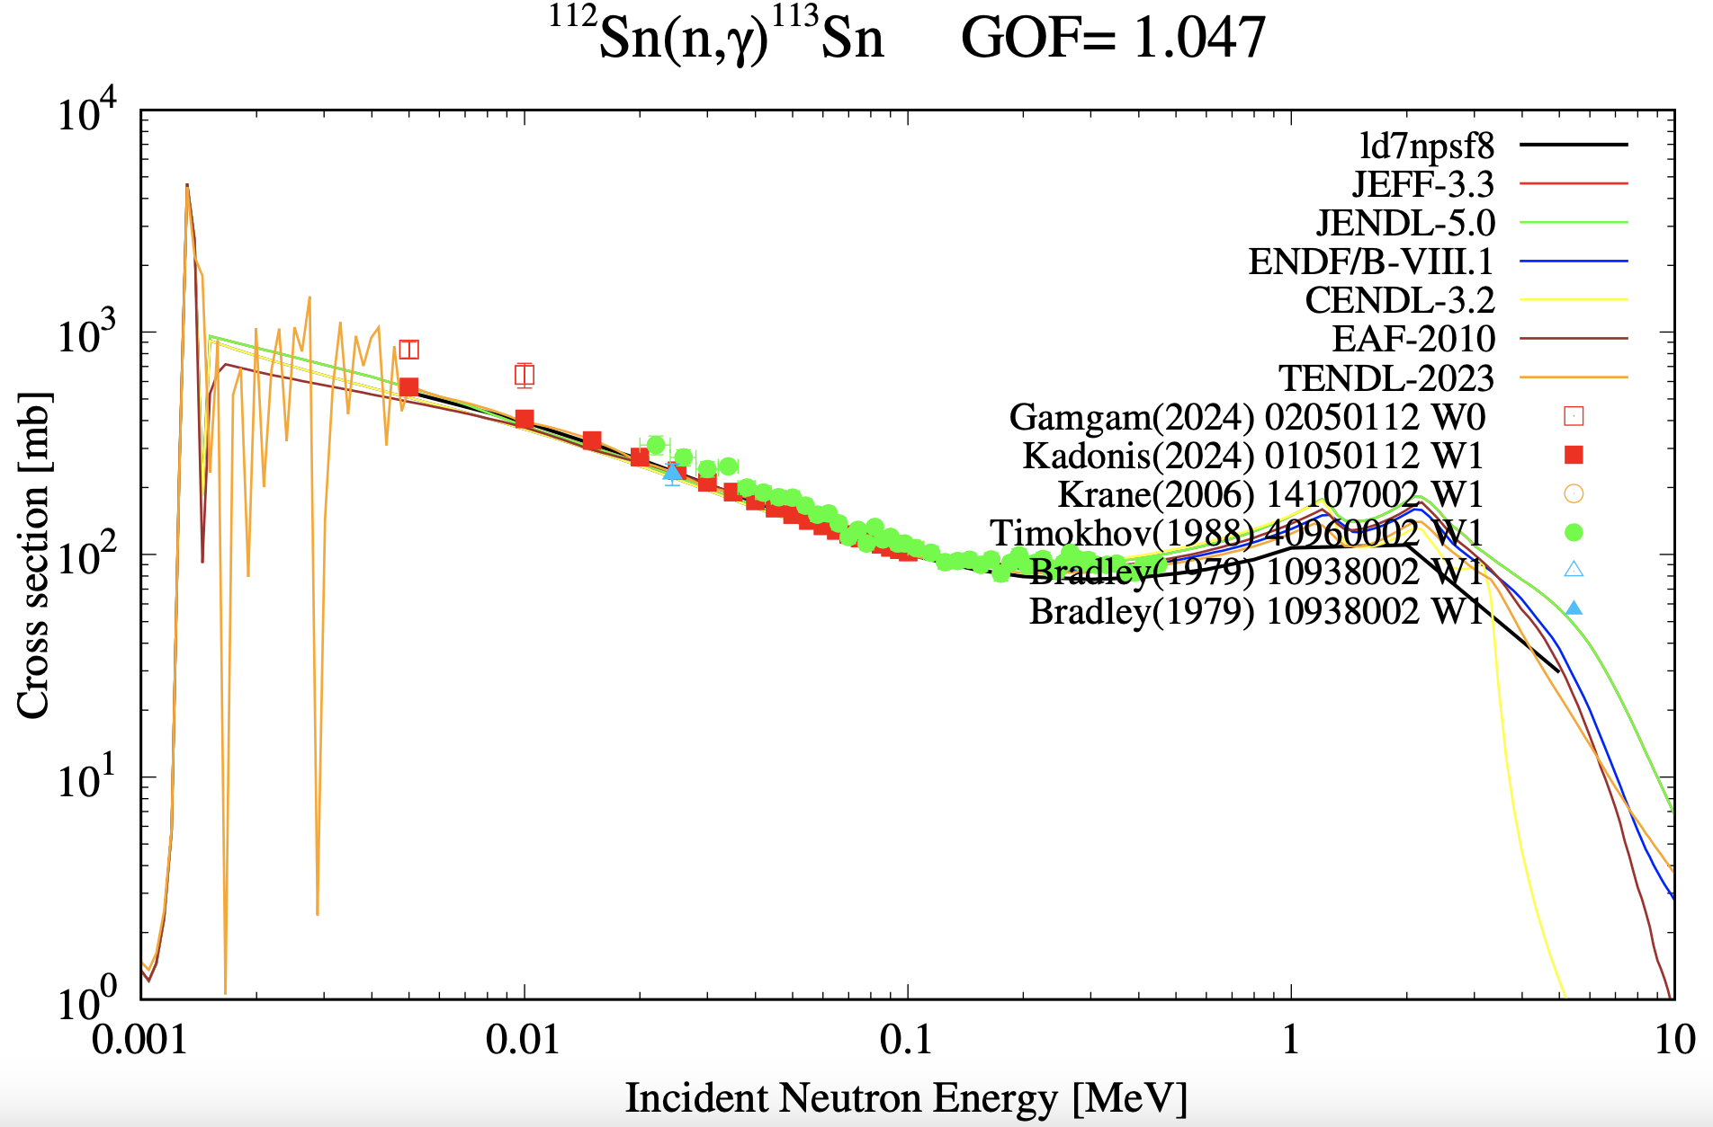
Example: Average radiative width Γγ considered an outlier

Slide 27
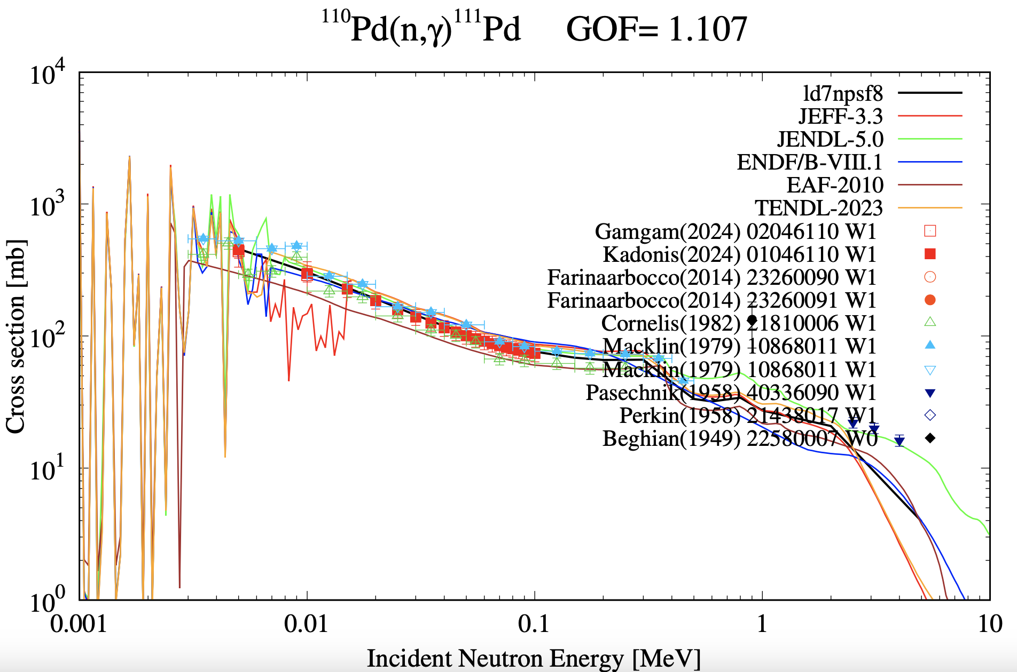
…but usually: (n,γ) cross sections, MACS and Γγ are consistent

Slide 28
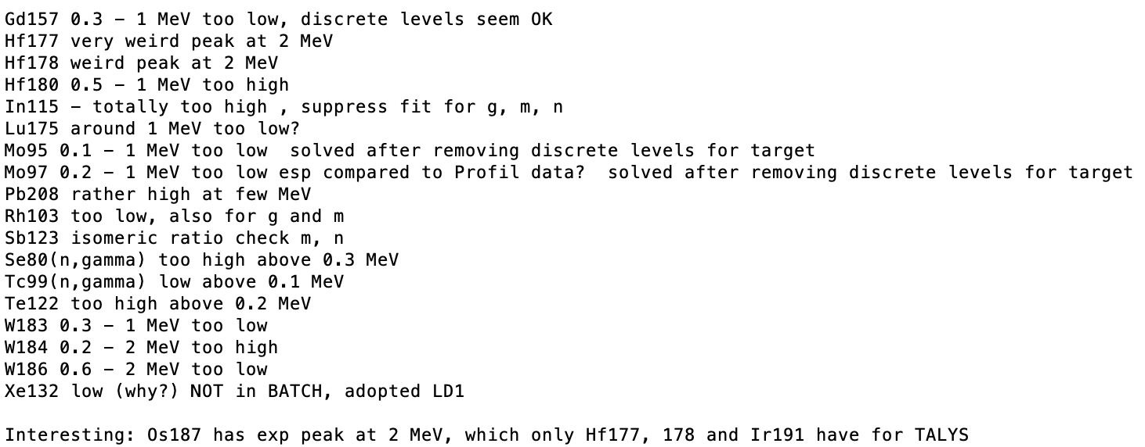
Outliers for TENDL (n,γ) evaluation
8 isotopes with MACS from Astral/Kadonis considered as outlier:
Cr-50, Cu-63,65, Br-81, Cd-106,108, Sm-148,154
36 isotopes with Γγ considered as outlier:
Ca-40,42,44,……Hg-198
My notebook of remaining cases to solve

Slide 29
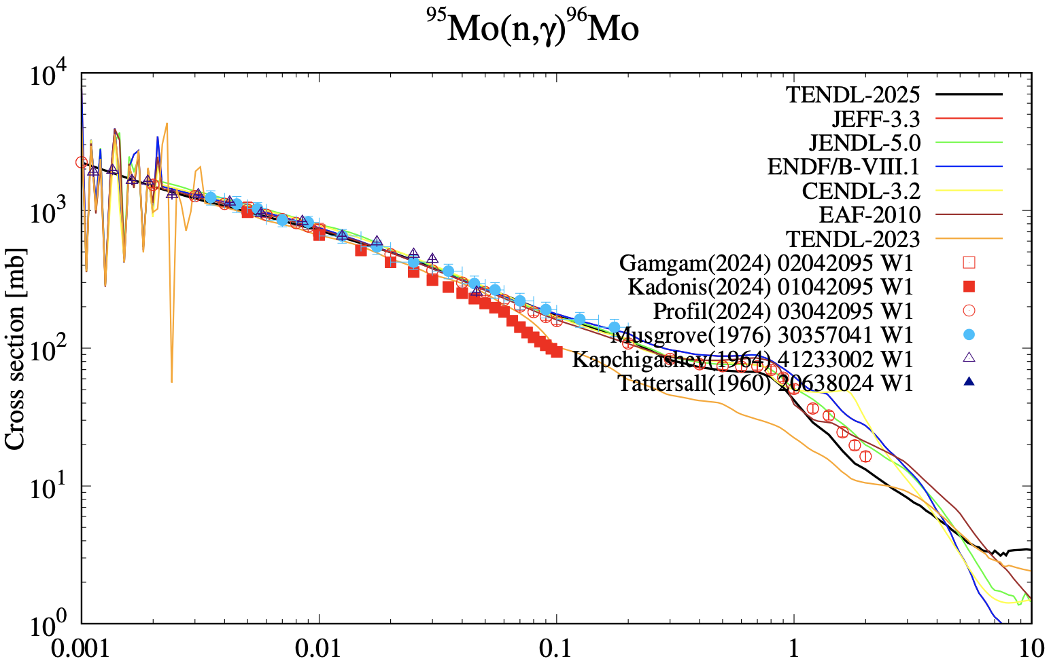
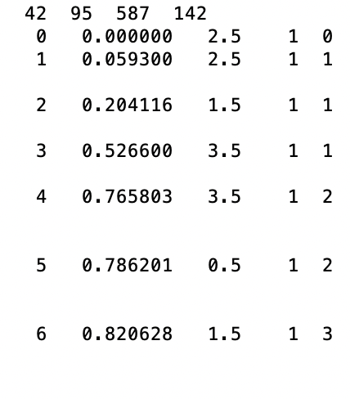
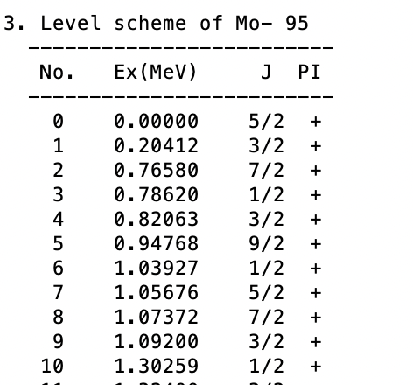
RIPL discrete level scheme important
RIPL-3
JENDL-5
Removing levels has large effect

Slide 30
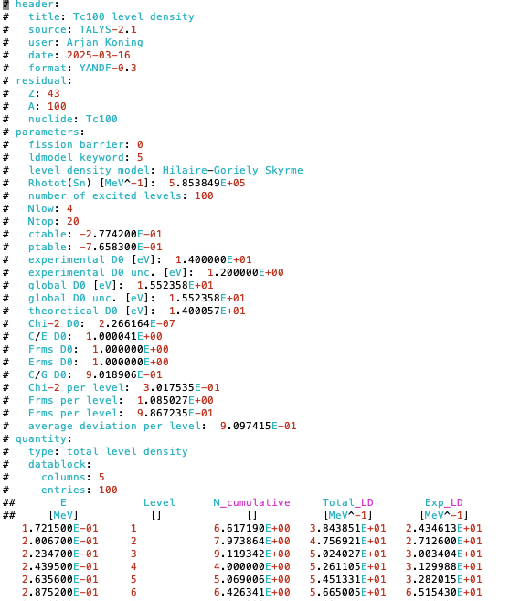
TALYS: YANDF structure for level density tables

Slide 31
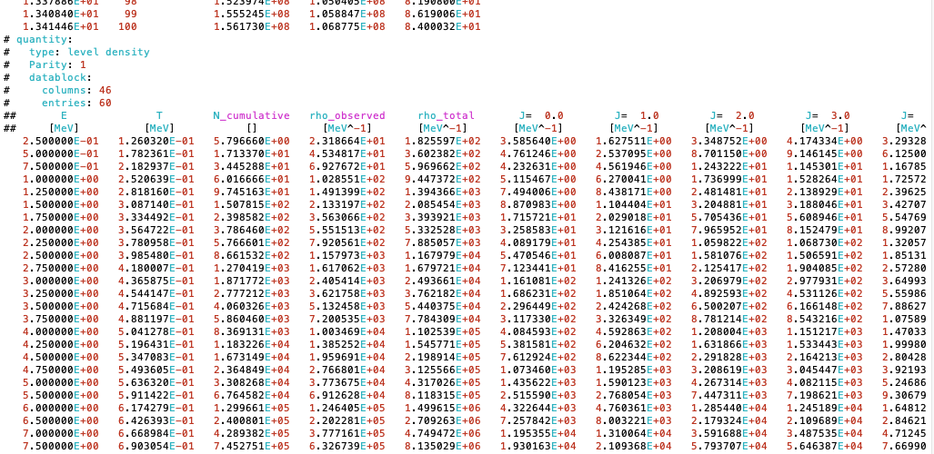
TALYS: YANDF structure for level density tables (continued

Slide 32
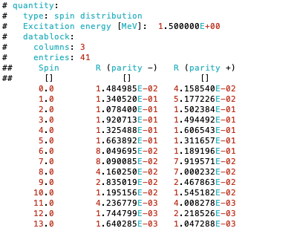
TALYS: YANDF structure for level density tables (continued

Slide 33
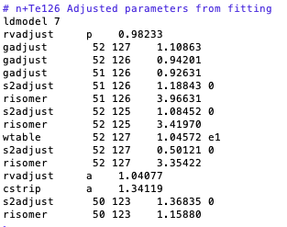
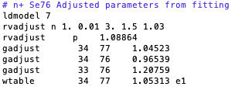
TALYS ‘best’ fits
337 nuclides with ‘best parameter’ files
ldmodel 7 (BSKG3): 239 nuclides
ldmodel 2 (BSFG): 33 nuclides
ldmodel 1 (Gilbert-Cameron): 65 nuclides
Examples:
(n,γ), (n,n’), (n,p), (n,2n), (n,3n)
(n,γ), (n,n’), (n,p), (n,2n), (n,3n), (n,α) + isomers

Slide 34
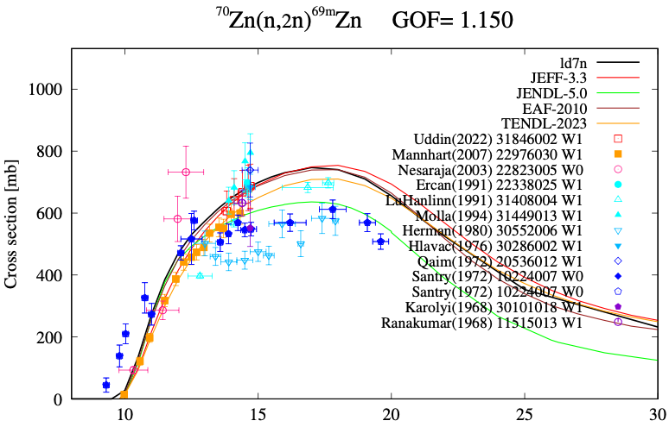
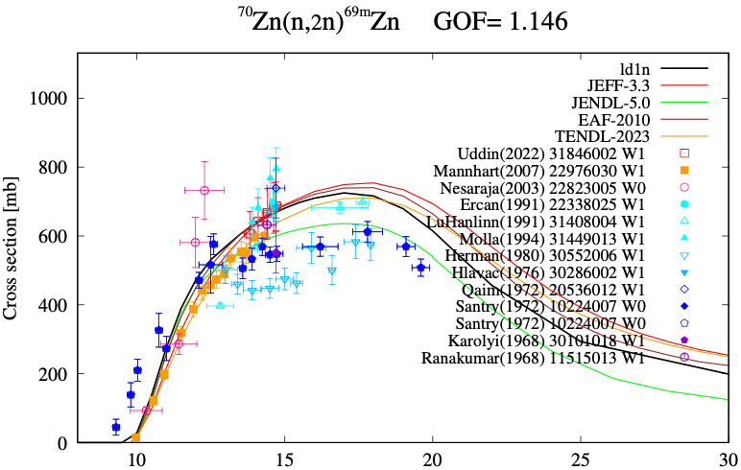
Similar performance of
ld1 (CTM) and ld7 (BSKG3)
To be done: numerical GOF
comparison for all nuclides
and reaction channels until
minimal GOF satisfies the eye
or vice versa

Slide 35
Summary
CTM, BSFG and BSKG3 seem to be of similar quality:
D0 validation
Γγ validation
(n,γ) and MACS validation
All other open channels up to 20 MeV (more compensation from OMP, pre-equilibrium etc models of course)
Validation to D1 still needs to be done
Oslo method not yet included in this scheme.
Currently, no level density parameter adjustment is used in cross section fitting, only the LD model is a parameter. This is too strict.
All LD models give similar fits to discrete levels and D0, after parameter adjustment. It is the spin distribution which makes the big difference in Hauser-Feshbach calculations, leading to different shapes in the excitation functions (good for BSKG3!).
More precise evaluations, i.e. declaring more EXFOR outliers, will give more meaningful results for the quality of level density models.

Slide 36
Thank you!
Notes:
Thank you!

Slide 37
(Towards an evaluation of) compilation of D0, D1, Γγ and MACS evaluations and compilations
Arjan Koning, IAEA
Dimitri Rochman, PSI
Shin Okumura, IAEA

Slide 38
Objective
To do the dirty ground work for experts who are qualified to produce the evaluated value:
Find and/or digitise all available evaluations/compilations
Try to mine all relevant data from EXFOR
Reproduce the value from the major nuclear data libraries for reference
Produce unified formatted databases with clear metadata and data
Do this for all
thermal cross sections:(n,tot), (n,el), (n,γ), (n,f), (n,p), (n,α),
resonance integrals: Ig and If,
strength functions: S0, S1, R,
Average resonance parameters: D0, D1, Γγ,
Maxwellian averaged cross sections: MACS

Slide 39
Example: D0
Sources:
RIPL-2
RIPL-3
Atlas 2016 (Mughabghab)
EXFOR
TARES (Rochman):
D0, D1, Γγ estimated from individual resonances
All individual resonance parameters from major NDL’s and Mughabghab and Sukhoruchkin Atlas
Current rule for D0 (until someone knows better): RIPL-3 > RIPL-2 > Atlas > EXFOR

Slide 40
Computational access to EXFOR
EXFOR
X4toC5
(V. Zerkin)
https://github.com/IAEA-NDS/exforparser
(S. Okumura)
XC5
EXFOR_json
Cross sections
(Average) resonance parameters
MACS
EXFORtables
All data in directory structured organisation

Slide 41
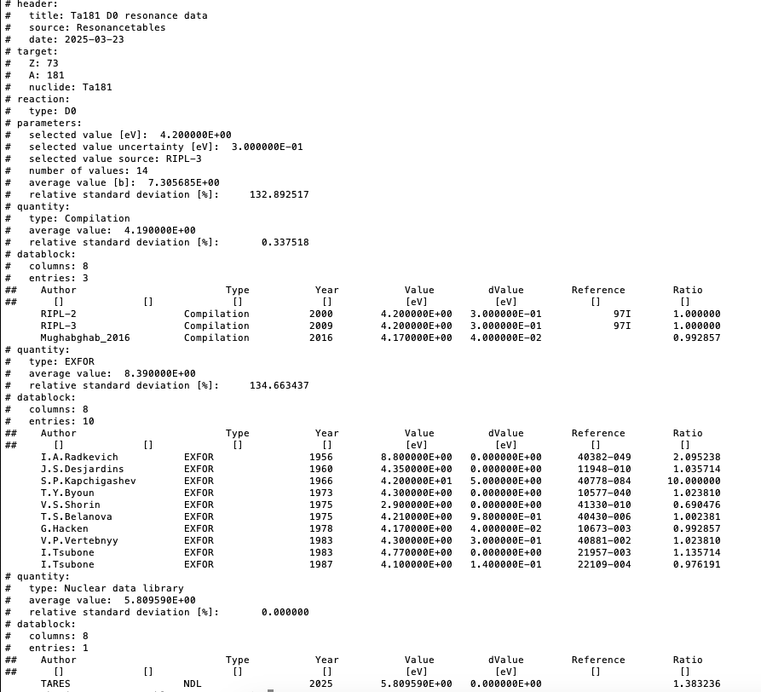
D0: one file per nuclide with all available information
YANDF format

Slide 42
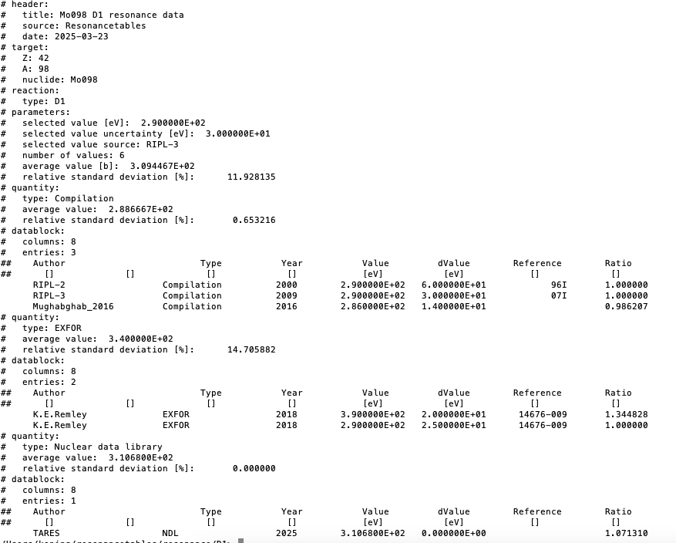
D1: one file per nuclide with all available information

Slide 43
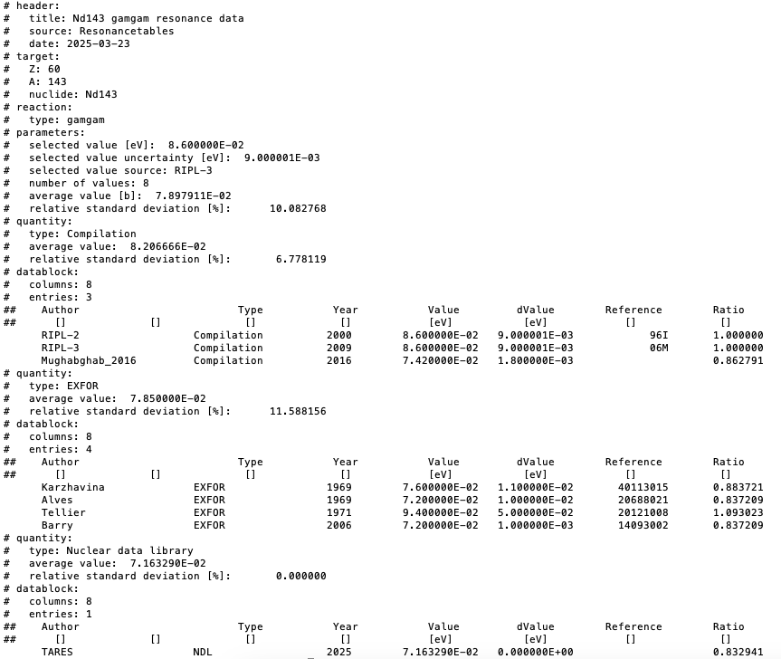
Γγ: one file per nuclide with all available information

Slide 44
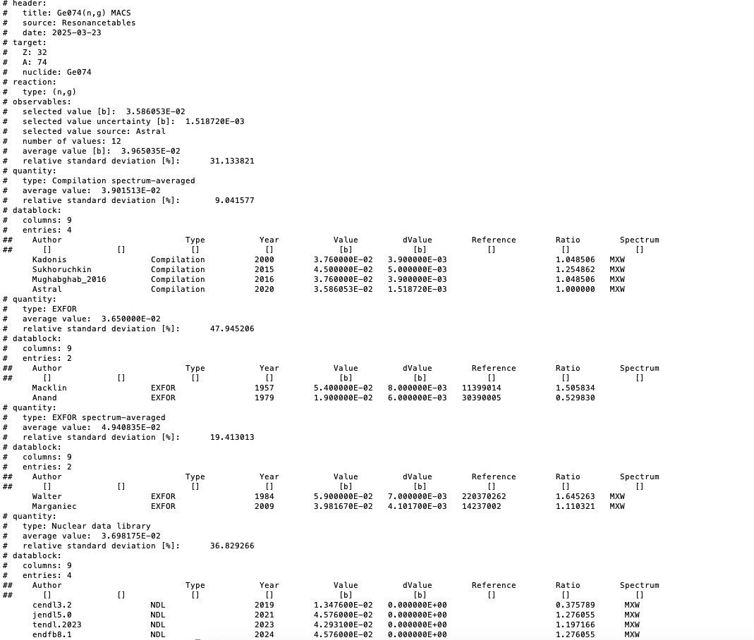
MACS: one file per nuclide with all available information

Slide 45
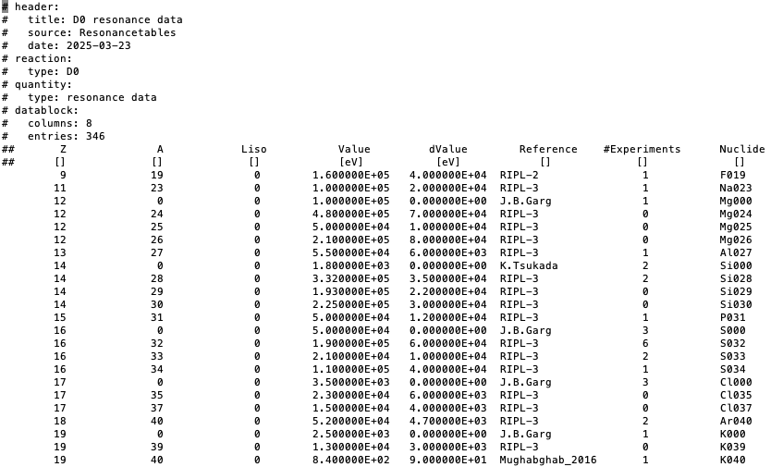
Accumulated results:D0

Slide 46
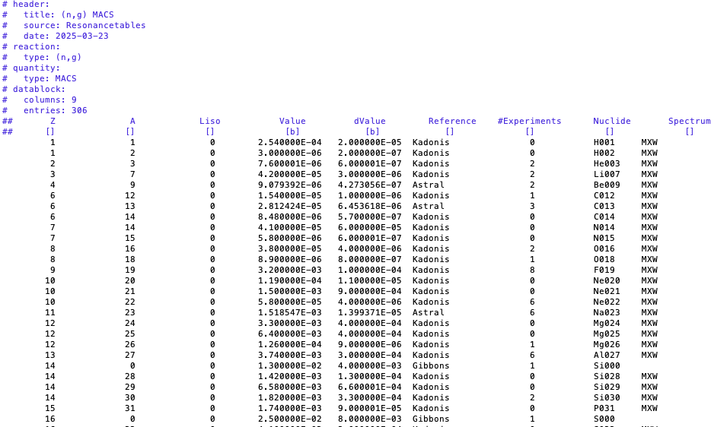
Accumulated results: MACS

Slide 47
Summary
Effort to compile all evaluations and compilations into the same structure. IAEA-NDS has:
All known compilations (we think/hope)
The capability to mine data from EXFOR
The capacity to extract data from nuclear data libraries (for reference)
All individual resonance parameters from NDL’s and Atlases.
Provide the most complete starting point for evaluation.
For recommended values we rely on experts.

Slide 48
Thank you!
Notes:
Thank you!

