Slide 1
Nuclear level density from the Oslo method
1st RCM on Updating and Improving Nuclear Level Densities for Applications
Vetle W. Ingeberg
24.03.2025

Slide 2
Outline
The Oslo Method
Normalization of NLDs
Auxiliary normalization data
Interpolation of NLD to S_{n}
Systematics of normalization data
Data available from the Oslo group
Ongoing projects

Slide 3
The Oslo method
Light ion scattering experiments
p, d, ³He, ⍺ beam
Typical energy 12-30 MeV
Measure particle-𝛾 coincidences
Gamma-ray energies up to neutron separation energy
Si ΔE-E
telescope
p'
≈ 135º
p
NaI(Tl) or LaBr₃(Ce)
Target nucleus

Slide 4
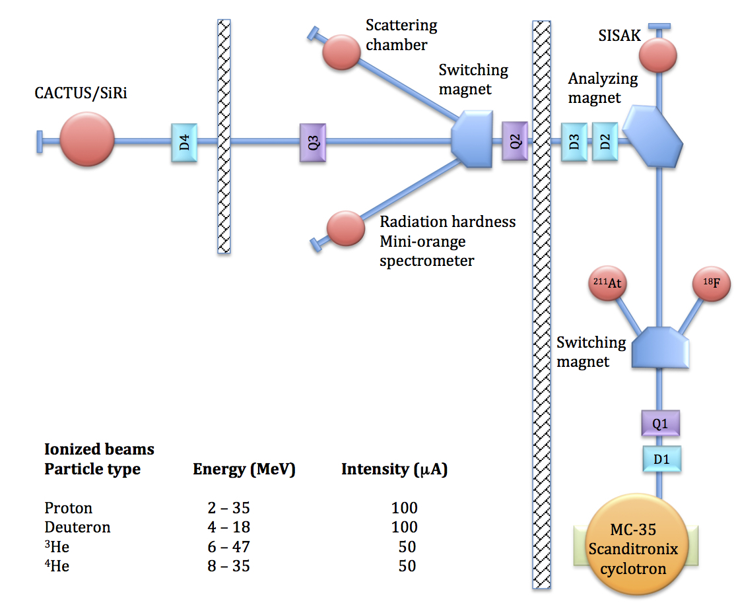
Oslo Cyclotron Laboratory
Scanditronix MC-35 cyclotron
Built in 1978
First beam 1979
Protons
Deutrons
³He
⁴He
He-3 recovery system
CACTUS+SiRi
OSCAR+SiRi

Slide 5
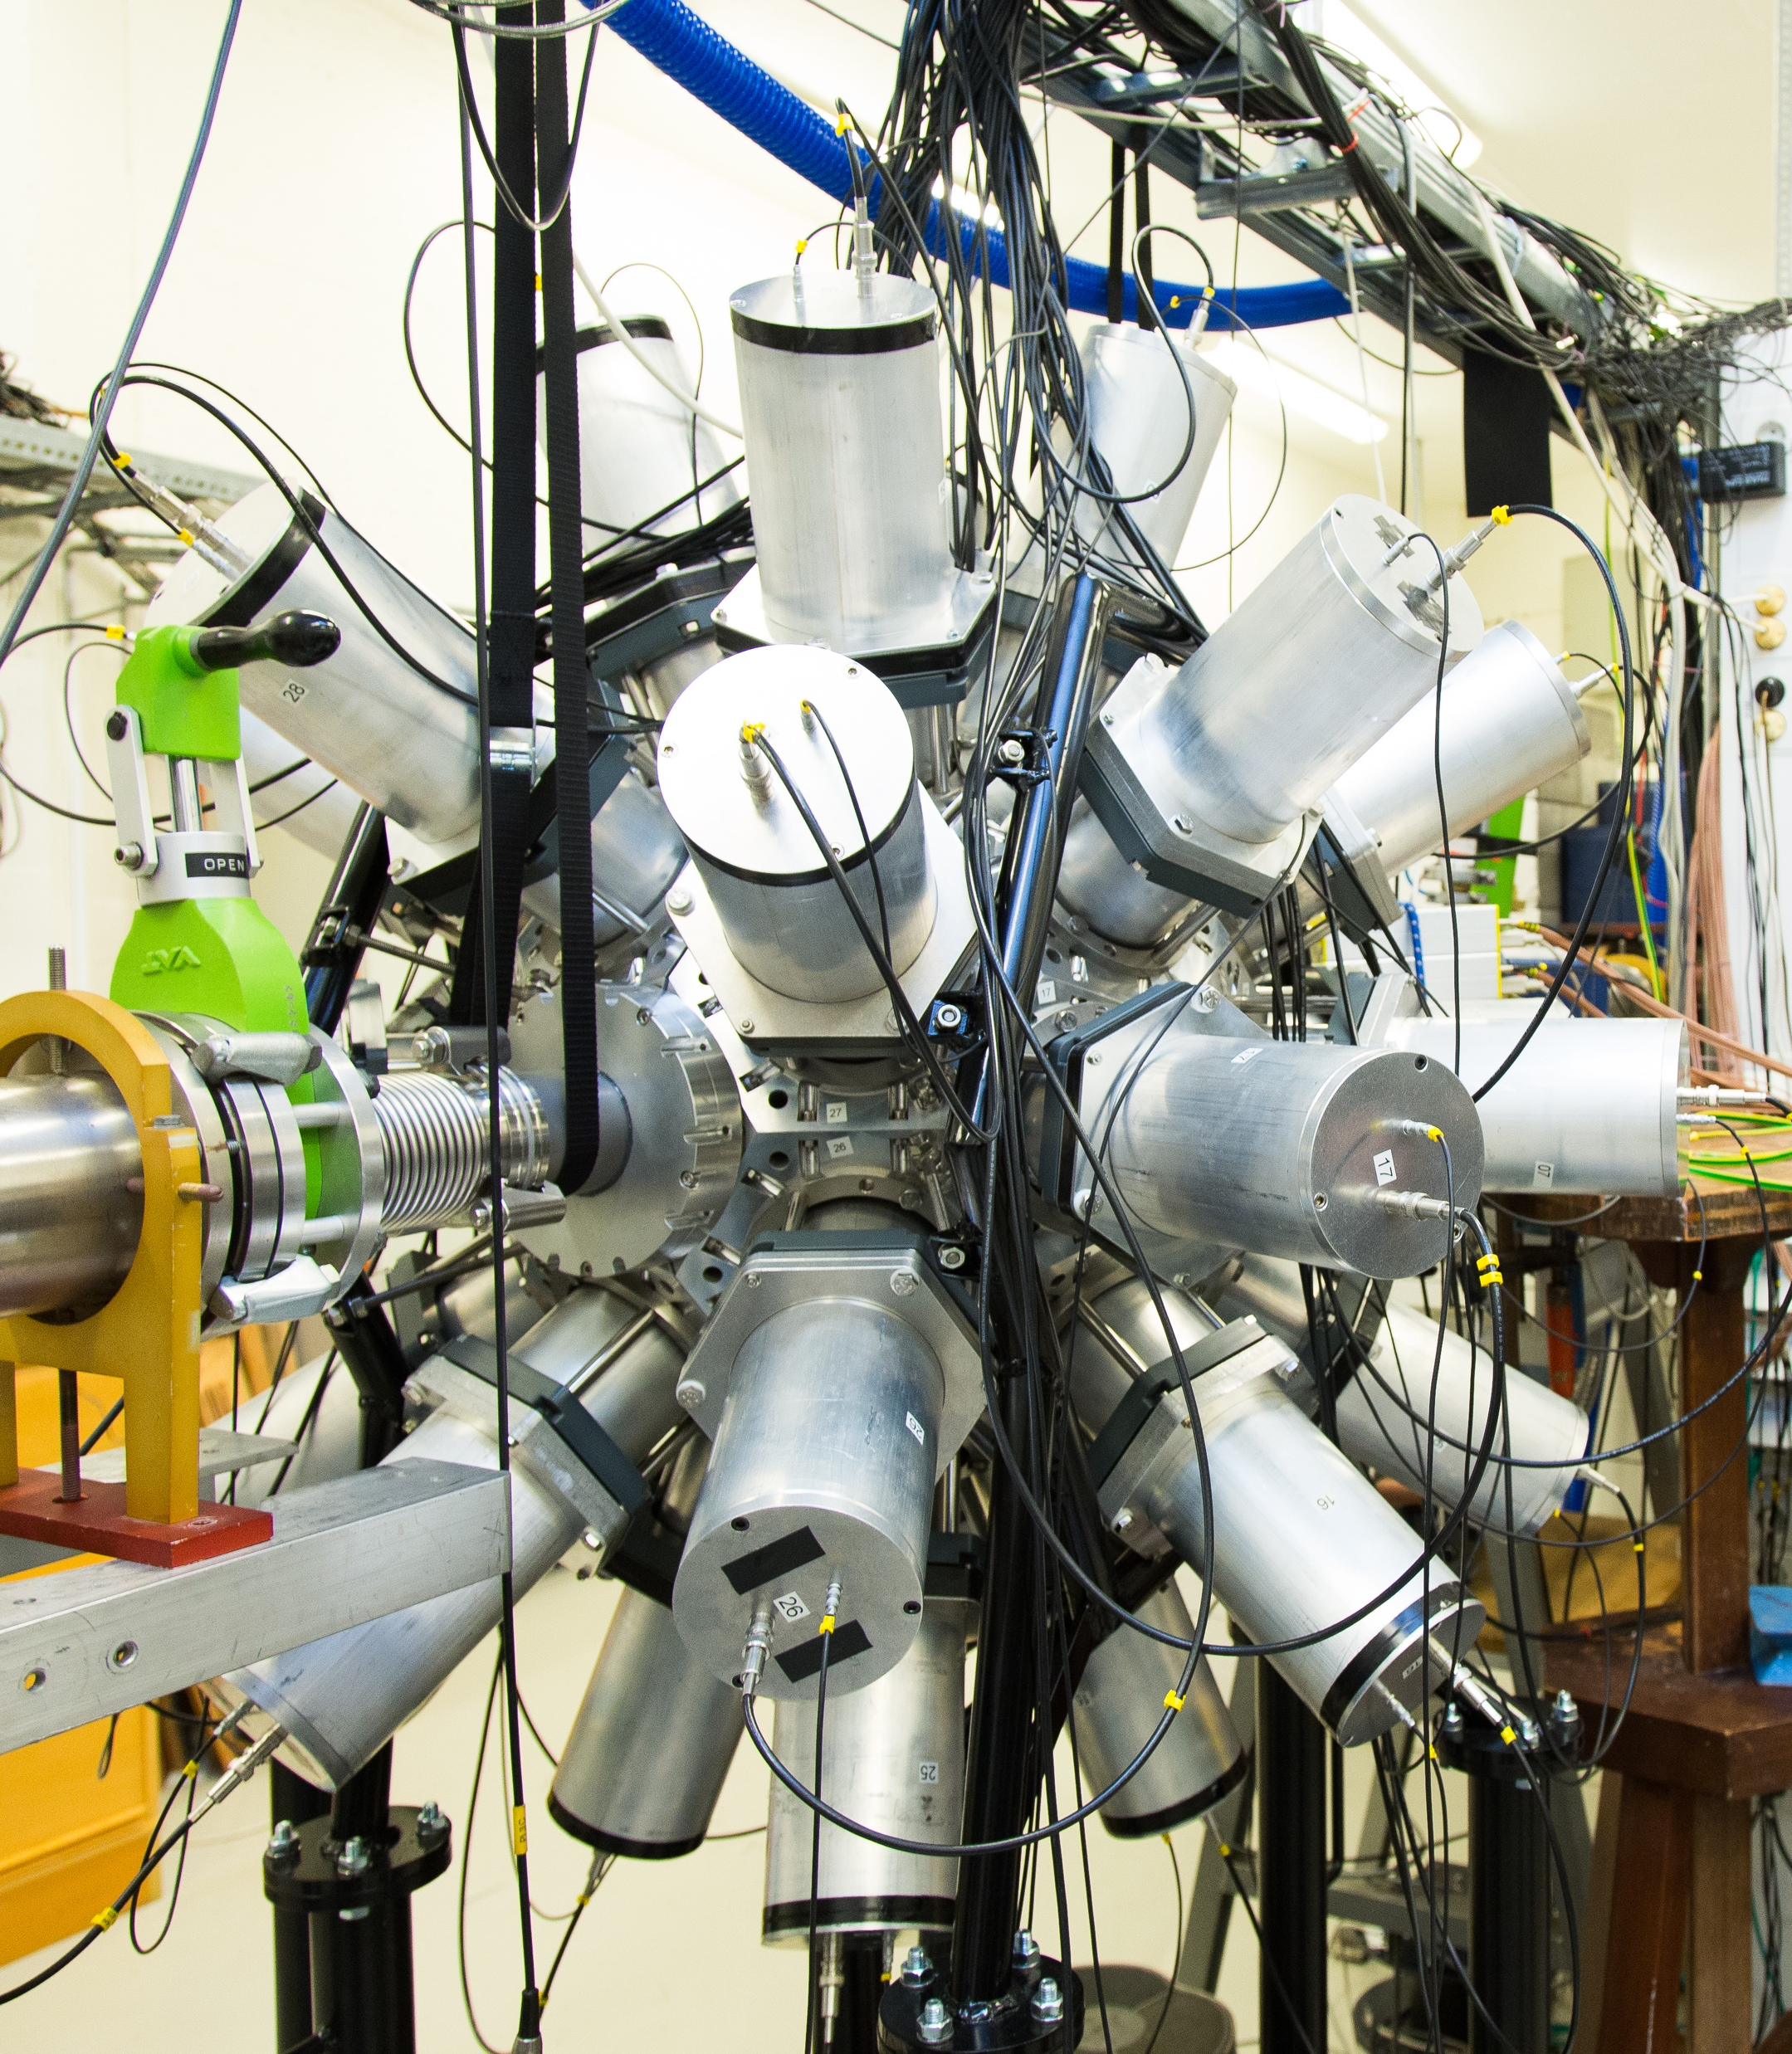
OSCAR Array
Commissioned in 2018
30 Large volume LaBr₃:Ce (3.5x8-inch)
Largest LaBr₃:Ce array in the world
Digital data acquisition (XIA Pixie-16)
Excellent energy resolution
2-2.5% @ 1332 keV
Excellent time resolution
< 1 ns @ 1332 keV
Excellent efficiency (FE)
15% @ 1332 keV

Slide 6
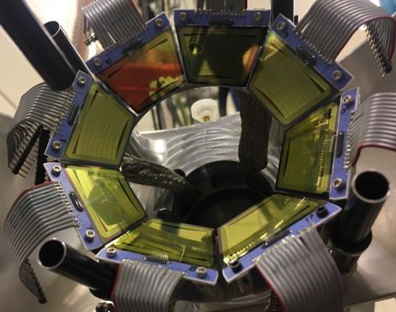
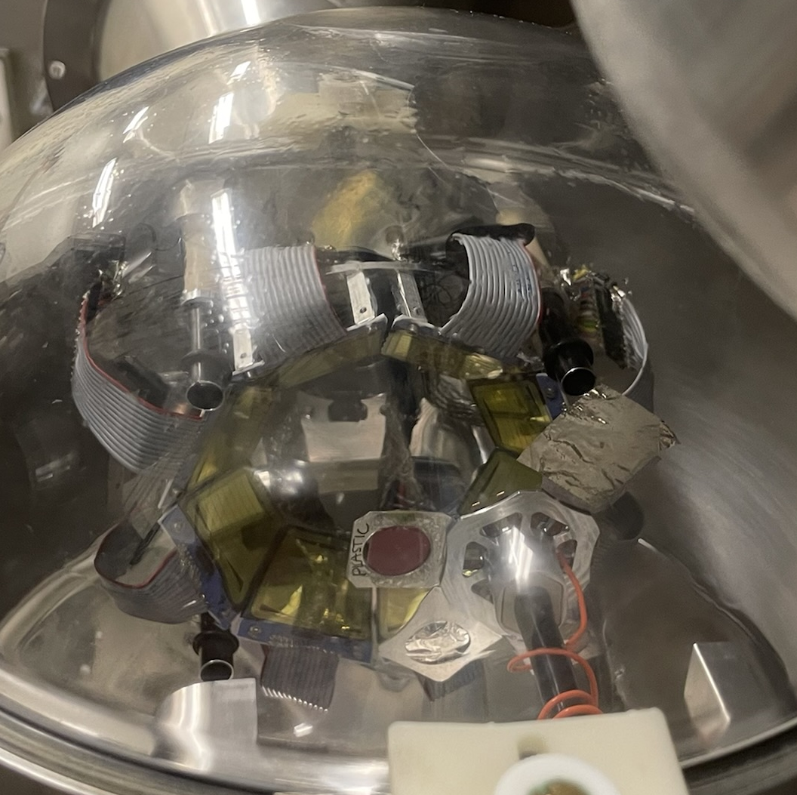
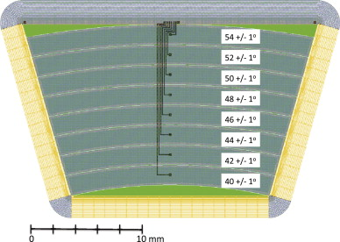
SiRi
Silicon Ring array
Eight trapezoidal particle telescopes
ΔE – E configuration
Front detector: 130 um
Back detector: 1550 um
Eight rings ± 1 degree
Angles:
40-54 degrees (forward config.)
126-140 degrees (back config.)

Slide 7
Fission setup at OCL
Main goal: investigate prompt fission gamma
Secondary goal: NLDs and gSF of nuclei in nuclei heavier than Pb
Expected to be commissioned in fall of 2025

Slide 8
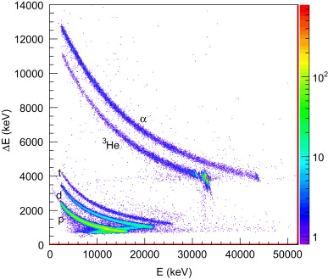
Oslo method experiment
Si ΔE-E
telescope
p'
≈ 135º
p
NaI(Tl) or LaBr₃(Ce)
Target nucleus
V. W. Ingeberg et al., Phys. Rev. C 106, 054315 (2022)
M. Guttormsen et al., Nucl. Instr. Methods A 648,168 (2011)

Slide 9
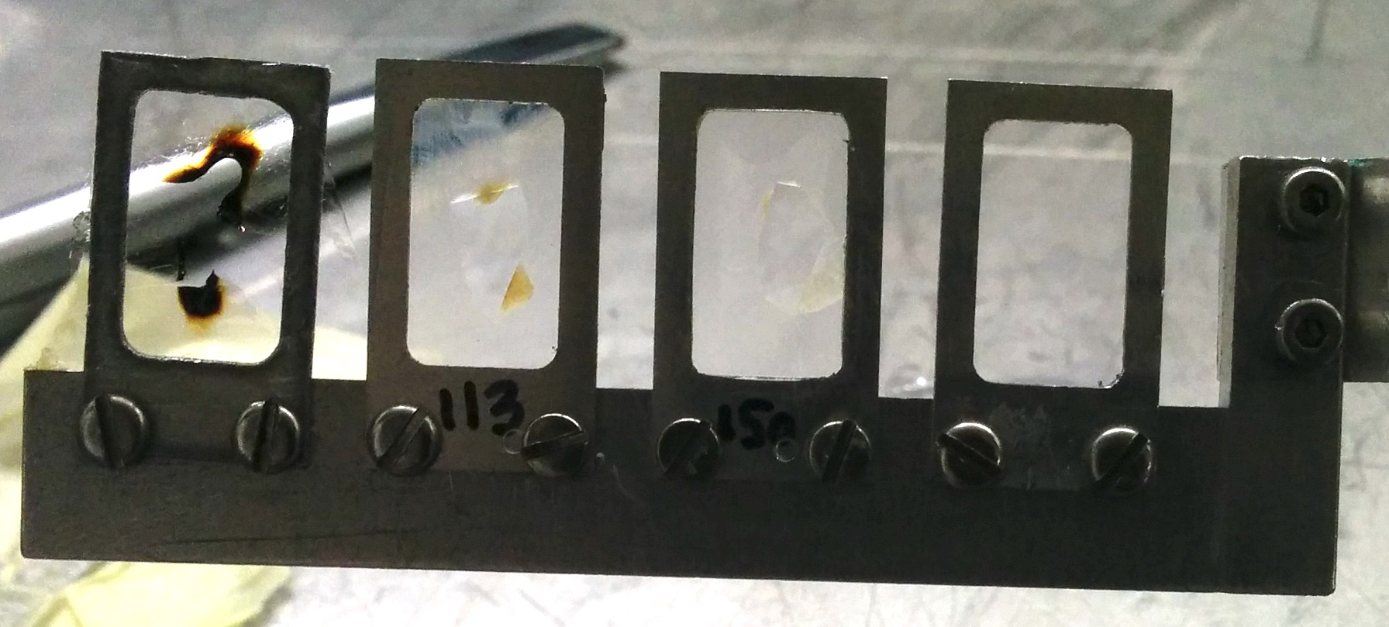
The Oslo method with inverse kinematics
Si ΔE-E
telescope
p'
Si ΔE-E
telescope
p'
≈ 135º
≈ 135º
p
d
Heavy ion
NaI(Tl) or LaBr₃(Ce)
NaI(Tl) or LaBr₃(Ce)
Target nucleus
Deuterated polyethylene targets

Slide 10
β-Oslo method
Implant radioactive nucleus in a total absorption spectrometer
Initial excitation energy determined by sum-𝛾
Can work with low beam current (down to ≈ 1 particle/s)
Requires sufficient efficiency
Needs careful treatment of NLDs due to narrow spin window populated in β-decay
A. C. Larsen et al., Prog. in Part. and Nucl. Phys. 107, 69 (2019)

Slide 11
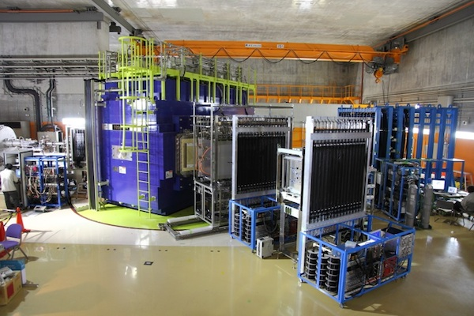
Future experiments: (p, 2p) reaction
Proposal accepted at SAMURAI setup with STRASSE+CATANA
Reaction: ¹¹³In(p,2p)¹¹²Cd
Will be proof-of-principle experiment
Experiment lead by Takashi Nakamura & Yasuhiro Togano

Slide 12

Oslo Method in 4 (simple) steps!
Obtain excitation energy tagged gamma spectra
E.g. light ion scattering, inverse kinematics, etc.
Unfolding method
Correct for detector response for 𝛾-rays
First generation method
Obtain distribution of the first emitted 𝛾 in each cascade
Extract NLD and 𝛾SF
$$P\left(E_{x}, E_{γ}\right)∝2πE_{γ}^{3}f\left(E_{γ}\right)ρ\left(E_{f}=E_{x}−E_{γ}\right)$$
V. W. Ingeberg et al., Phys. Rev. C 106, 054315 (2022)

Slide 13
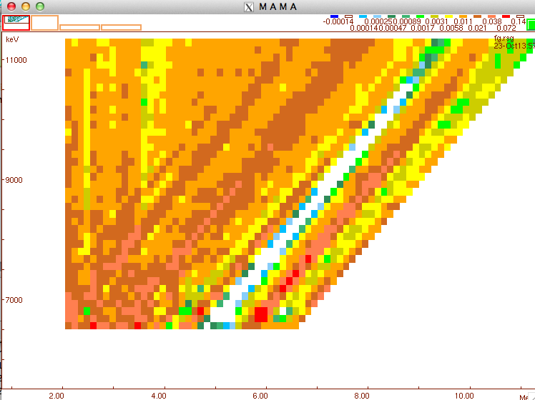
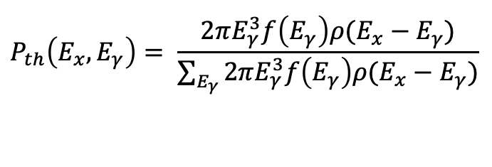
Extraction of NLD and GSF
$$P_{th}\left(E_{x},E_{γ}\right)= \frac{2πE_{γ}^{3}f\left(E_{γ}\right)ρ(E_{x}−E_{γ})}{\sum_{E_{γ}}{2πE_{γ}^{3}f\left(E_{γ}\right)ρ(E_{x}−E_{γ})}}$$
Higher order estimates through a least χ²−minimization:
Each vector element in ρ and f is treated as a free parameter
⁵⁶Fe(p,p’) example:
Data points (“pixels”): 2052
Free parameters: 184
N_{free} << N_{data}
Runs 50 iterations, but converges often at 10-20 iterations (depending on the case)
See: A. Schiller et al., NIM A 447, 498 (2000)

Slide 14


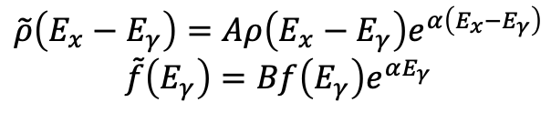
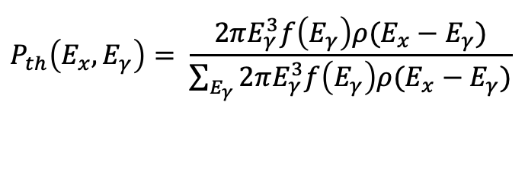
Oslo Method: Normalization
First generation matrix
$$P\left(E_{x}, E_{γ}\right)∝2πE_{γ}^{3}f\left(E_{γ}\right)ρ\left(E_{f}=E_{x}−E_{γ}\right)$$
$$P_{th}\left(E_{x},E_{γ}\right)= \frac{2πE_{γ}^{3}f\left(E_{γ}\right)ρ(E_{x}−E_{γ})}{\sum_{E_{γ}}{2πE_{γ}^{3}f\left(E_{γ}\right)ρ(E_{x}−E_{γ})}}$$
$P_{th}$ symmetric under transformation:
$$\tilde{ρ}\left(E_{x}−E_{γ}\right)=Aρ\left(E_{x}−E_{γ}\right)e^{α\left(E_{x}−E_{γ}\right)}$$
$$\tilde{f}\left(E_{γ}\right)=Bf\left(E_{γ}\right)e^{αE_{γ}}$$
Only relative shape of NLD & GSF!
Need to normalize to auxiliary nuclear data to find physical solution!
V. W. Ingeberg et al., Phys. Rev. C 106, 054315 (2022)

Slide 15
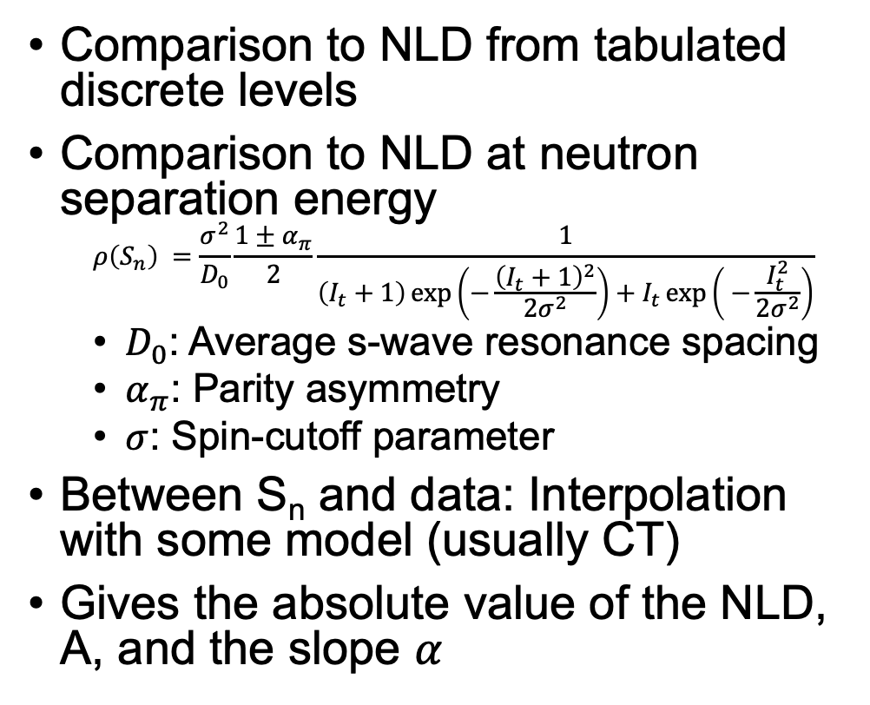
Normalization of NLD
Comparison to NLD from tabulated discrete levels
Comparison to NLD at neutron separation energy
$$ρ\left(S_{n}\right) =\frac{σ^{2}}{D_{0}}\frac{1±α_{π}}{2}\frac{1}{\left(I_{t}+1\right)\exp\left(−\frac{{\left(I_{t}+1\right)}^{2}}{2σ^{2}}\right)+I_{t}\exp\left( −\frac{I_{t}^{2}}{2σ^{2}}\right)}$$
$D_{0}$: Average s-wave resonance spacing
$α_{π}$: Parity asymmetry
$σ$: Spin-cutoff parameter
Between S_{n} and data: Interpolation with some model (usually CT)
Gives the absolute value of the NLD, A, and the slope $α$
⁶³Ni
V. W. Ingeberg et al., Phys Rev. C 106, 054315 (2022)

Slide 16
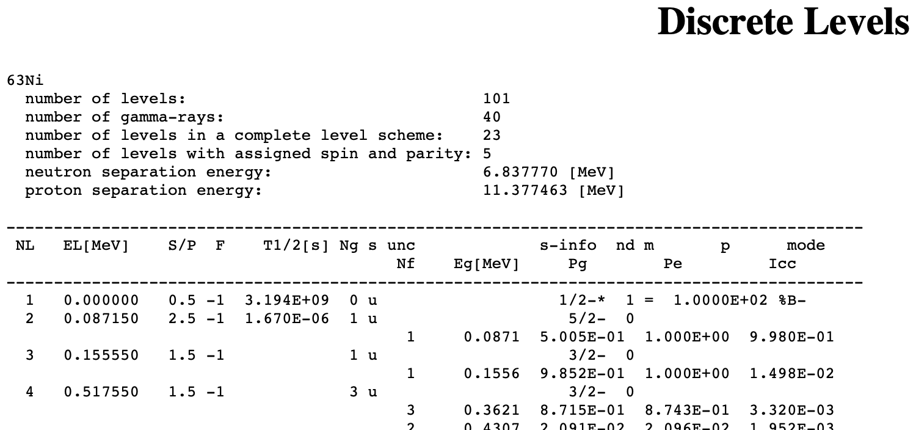
Normalization of NLD - discrete levels
Known tabulated discrete levels
NNDC, RIPL-3, ENSDF, XNSDF, etc.
RIPL-3: Evaluated highest excitation energy with complete level scheme
Possible error sources:
Low energy Yrast states not populated due to high spin
Difference in underlying structure
Incomplete level scheme

Slide 17
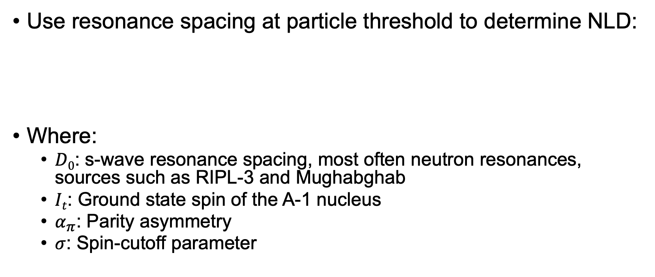
Normalization of NLD – NLD at particle threshold
Use resonance spacing at particle threshold to determine NLD:
Where:
$D0$: s-wave resonance spacing, most often neutron resonances, sources such as RIPL-3 and Mughabghab
$It$: Ground state spin of the A-1 nucleus
$α_{π}$: Parity asymmetry
$σ$: Spin-cutoff parameter

Slide 18
NLD at particle threshold – neutron resonance parameter
Typically taken from Mughabghab or RIPL-1/2/3
Can be large discrepancies between RIPL and Mughabghab
References are typically hard to track down
Example ¹³²Xe(n,ɣ):
RIPL-1/2/3: Ignatyuk, A.V. Contribution to the Second CRP Meeting on RIPL (Vienna, November 1996)
Mughabghab: Unknown, probably Private Comm.

Slide 19
When D₀ doesn’t exist?
A. C. Larsen et al., Phys. Rev. C 87, 014319 (2013)
Estimation from neighboring nuclei
Model estimation
Uncertainties are estimated from best fit
Currently considering more appropriate uncertainty estimation
Bayesian approach
Frequentist: Predictive interval
M. Markova et al., Phys. Rev. C 106, 034322 (2022)

Slide 20
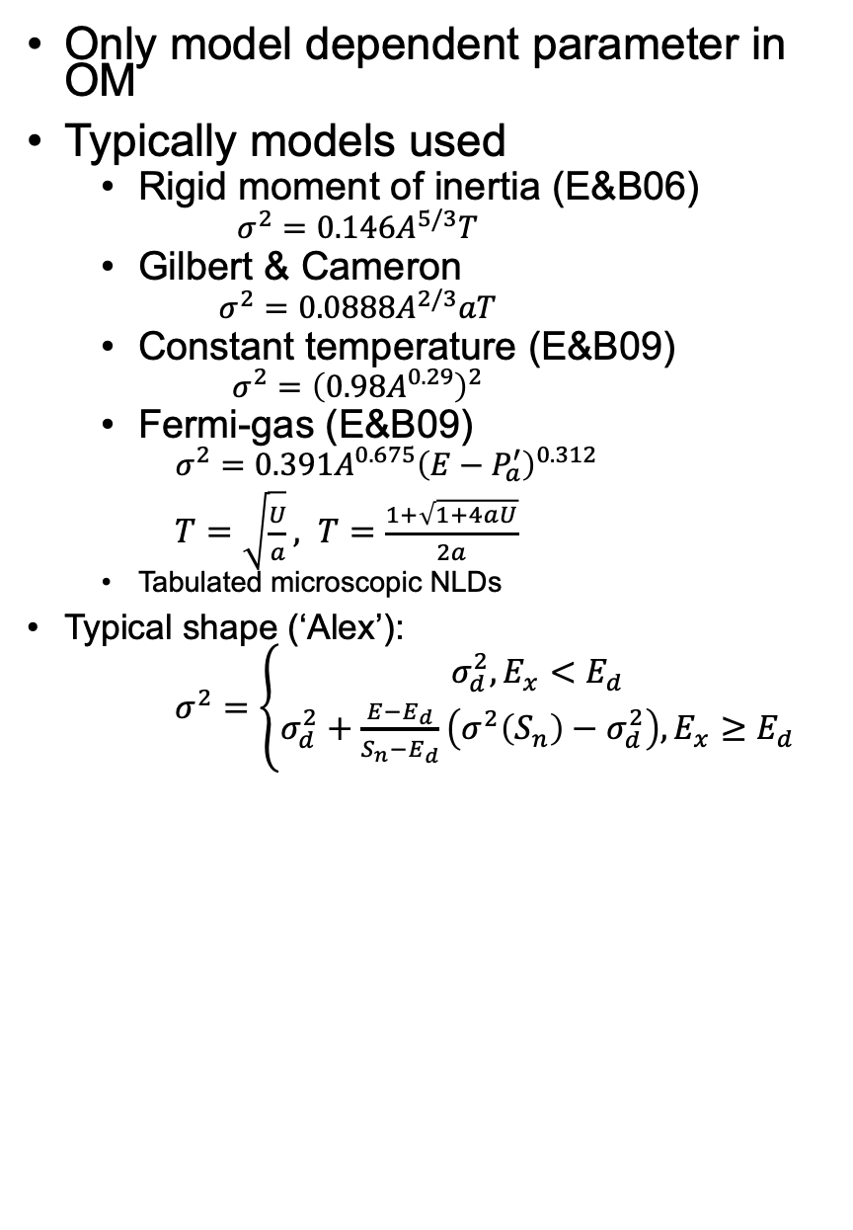
NLD at particle threshold – spin distribution
Only model dependent parameter in OM
Typically models used
Rigid moment of inertia (E&B06)
$$σ^{2}=0.146A^{5/3}T$$
Gilbert & Cameron
$$σ^{2}=0.0888A^{2/3}aT$$
Constant temperature (E&B09)
$$σ^{2}={\left(0.98A^{0.29}\right)}^{2}$$
Fermi-gas (E&B09)
$$σ^{2}=0.391A^{0.675}{\left(E−P_{a}^{′}\right)}^{0.312}$$
$T=\sqrt{\frac{U}{a}}, T=\frac{1+\sqrt{1+4aU}}{2a}$
Tabulated microscopic NLDs
Typical shape (‘Alex’):
$σ^{2}=\left\{\begin{aligned}σ_{d}^{2}, E_{x}<E_{d} \\ σ_{d}^{2}+\frac{E−E_{d}}{S_{n}−E_{d}}\left(σ^{2}\left(S_{n}\right)−σ_{d}^{2}\right), E_{x}≥E_{d}\end{aligned}\right.$

Slide 21
Parity asymmetry
Equiparity often assumed
Seems to be fulfilled in heavier nuclei where more orbitals are accessible
Could have a larger influence on NLDs
GSF often more sensitive
Not much exp. data beyond discrete levels
A. C. Larsen et al., Phys. Rev. C 83, 034315 (2011)

Slide 22
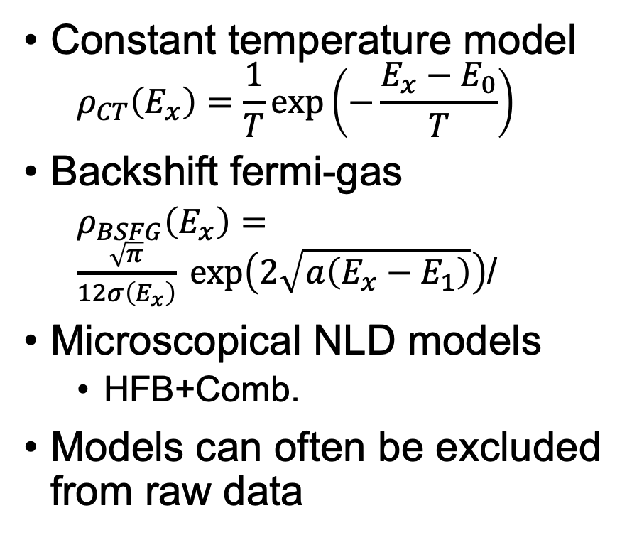
Interpolation function
Constant temperature model
$$ρ_{CT}\left(E_{x}\right)=\frac{1}{T}\exp\left(−\frac{E_{x}−E_{0}}{T}\right)$$
Backshift fermi-gas
$ρ_{BSFG}\left(E_{x}\right)=\frac{\sqrt{π}}{12σ\left(E_{x}\right)}\exp\left(2\sqrt{a\left(E_{x}−E_{1}\right)}\right)$/
Microscopical NLD models
HFB+Comb.
Models can often be excluded from raw data
T. Renstrøm et al., Phys. Rev. C 93, 064302 (2016)

Slide 23
Shape method
Decay to discrete levels
Can obtain the shape of the 𝛾SF
Constrains the slope of OM data
For more details see Mathis’ talk!
M. Wiedeking et al., Phys. Rev. C 104, 014311 (2021)

Slide 24
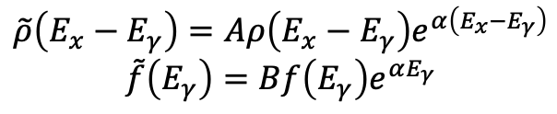
Shape method
Possibility of model independent normalization of NLD
Requires reasonably good resolution in E_{x} and E_{𝛾} (100-300 keV)
For more details see Mathis’ talk!
$$\tilde{ρ}\left(E_{x}−E_{γ}\right)=Aρ\left(E_{x}−E_{γ}\right)e^{α\left(E_{x}−E_{γ}\right)}$$
$$\tilde{f}\left(E_{γ}\right)=Bf\left(E_{γ}\right)e^{αE_{γ}}$$
D. Mücher et al., Phys. Rev. C 107, L011602 (2023)

Slide 25
Reaction dependent systematic errors
Theoretical spin-parity population
Green’s function transfer formalism
(d, p) reaction
Close to Coulomb barrier – reaction resembles a deuteron breakup + neutron absorption
Limited spin window populated
Test with RAINIER (DICEBOX)
F. Zeiser et al., Phys. Rev. C 100, 024305 (2019)

Slide 26
Reaction dependent systematic errors
Nd chain: (p,p) and (d,p)
Limited spin population
Shape method indicates that OM overestimates the slope significantly
For (d,p): 11% of full NLD observed
For (p,p): 22% of full NLD observed
Independently confirmed by measurements of ground state band feeding
M. Guttormsen et al., Phys. Rev. C 106, 034314 (2022)

Slide 27
Reaction Spesific Errors
Initial population determined by side-feeding
M. Guttormsen et al., Phys Rev. C 106, 034314 (2022)

Slide 28
Sources of errors – unfolding method
Assuming a efficiency reduction of ≈ 20%
A.C. Larsen et al., Phys. Rev. C 83, 034315 (2011)

Slide 29
Resolution in inverse kinematics
Direct kinematics, ⁶⁴Ni(p,d)⁶³Ni
V. W. Ingeberg et al., Eur. Phys. J A 56, 68 (2020)
V. W. Ingeberg et al., Phys. Rev. C 111, 015803 (2025)
V. W. Ingeberg et al., Phys. Rev C 106, 054315 (2022)

Slide 30
Normalization without D₀
How in-accurate will the normalization be without D₀?
⁶³Ni: D₀ and evaporation data does not agree
Could say that OM data favors D₀
V. W. Ingeberg et al., Phys. Rev C 106, 054315 (2022)

Slide 31
Nuclear Level Density: Role of deformation
Role of deformation?
Mean-field: Breaks degeneracy – reduces NLD
Vibration: Increases by ≈ 10x
Rotation: Increases by ≈ 100x
Overall increase expected to be ≈ 1000x
Investigated the NLD as a function of deformation in Nd isotopic chain
M. Guttormsen et al., Phys. Lett. B 816, 136206 (2021)

Slide 32
Systematics of NLD in Sn
M. Markova et al., Phys. Rev. C 106, 034322 (2022)
M. Markova et al., Phys. Rev. C 109, 054311 (2022)

Slide 33
KShell calculations
A large number of nuclei were considered in large-scale shell model calculations with KShell – J. Midtbø et al., Phys. Rev. C 98, 064321 (2018)
Most (all?) were all within the same major shell
From ¹⁷O to ⁸⁰Ga
Will give NLD by Ex, J, π
(May be) limited validity due to truncations, limited model space, etc.

Slide 34
Ni isotopes
⁶⁷Ni

Slide 35
Plan for CRP
Determine the relevant metadata required for user to understand the limitations of a dataset
Challenge: No ”standard” way of reporting metadata – for some publications these are not reported
Relevant metadata for quality assessment of data sets
Collect tabulated NLD data and metadata
Need to determine a suitable format
Consider YAML – both human and machine readable
Tabulate theoretical NLD from KShell calculations
Need to determine relevant metadata (input file?)
Consider if these are relevant for the database
Quality assessment of experimental NLD data sets

Slide 36
Oslo method data available (not complete)

