Slide 1

Microscopic investigation on the nuclear level densities of medium and heavy nuclei with shell model
Cenxi YUAN
Sino-French Institute of Nuclear Engineering and Technology (IFCEN), SYSU
2025.03.24@IAEA

Slide 2
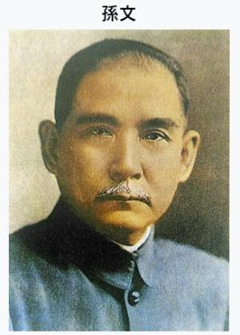

OVERVIEW OF SYSU
Founded in 1924 by Dr. Sun Yat-sen
A leading comprehensive research university in China
Faculty: ~5,000
Students: ~68,000
  SUN Yat-sen
  SUN Wen
  1866.11.12 ~ 1925.3.12
Notes:
Sun Yat-sen University was founded in 1924 by Dr. Sun Yat-sen, a key figure in world history and foundational figure for modern China. We call him “the Forerunner of Chinese Revolution”. With an educational tradition spanning over 100 years, SYSU has become a leading comprehensive research type university in China, regularly ranked among the top 10 universities in the country.

Slide 3
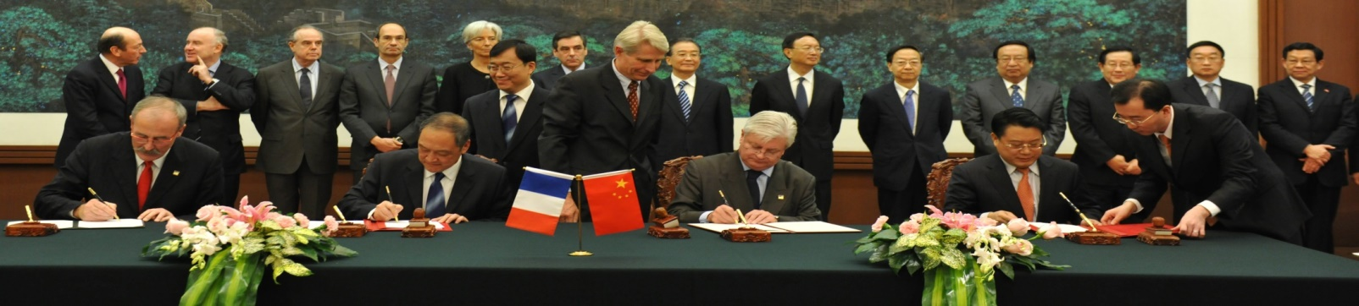







2010 IFCEN established by SYSU and FINUCI*
Strong supports of the two governments
15 years Sino-French collaboration
~70 faculties
Bachelor ~120/Y, Master ~110/Y, Ph.D. ~40/Y
CTI accreditation of 6 years received (2016, 2022)
*Consortium français de formation d'ingénieurs en nucléaire civil
Prime Minister: François Fillon Jiabao Wen

Slide 4
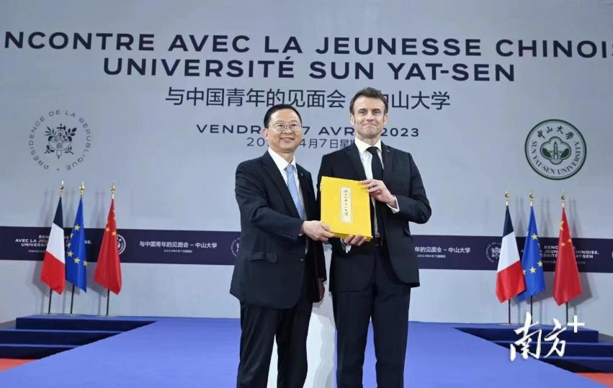
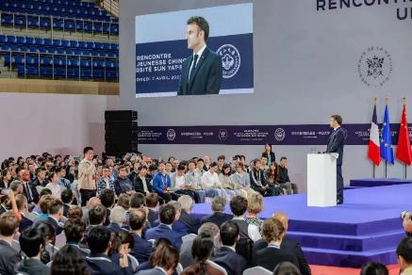
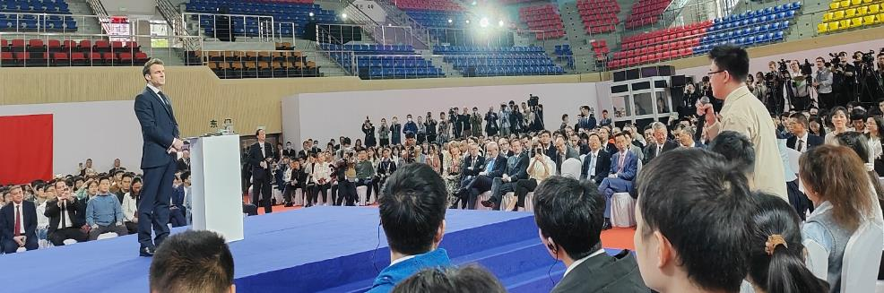
President Macron’s visit to SYSU
on April 7, 2023
Highlighted the IFCEN program as a role model for Sino-French cooperation in higher education and enjoyed quality time with our students

Slide 5
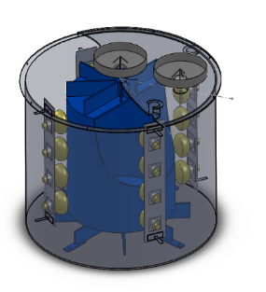
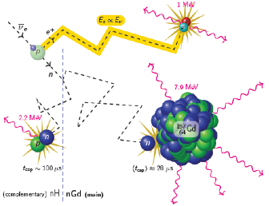
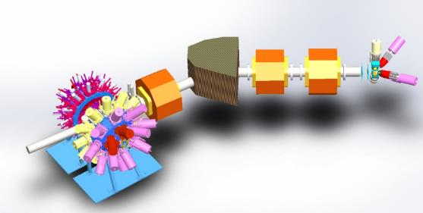
Nuclear Data Science & Application
  Faculty (13): Wei WANG (Dean of IFCEN), Cenxi YUAN (Deputy Dean), Jun SU, Yuehuan WEI, Long ZHU, Yumei ZHANG, Wei HUA, Zhen ZHANG, Bo MEI, Xiao FANG, Chenchen GUO, Shengli CHEN, Guangxin ZHANG
  Researcher (5): Yinu ZHANG, Jun WANG, Tao LI, Wenduo XIAN, Dawei GUAN
  Graduates: ~ 60
  Publication (since 2013): ~ 300
  Beam time (since 2018): ~ 2000 hours
  Research Interest:
    Nuclear Structure and Reaction
    Neutron and Fission
    Neutrino Physics
2m
1.8m

Slide 6
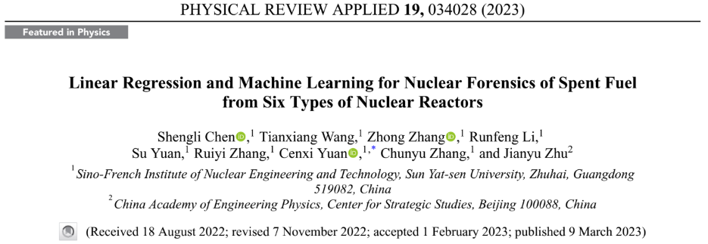
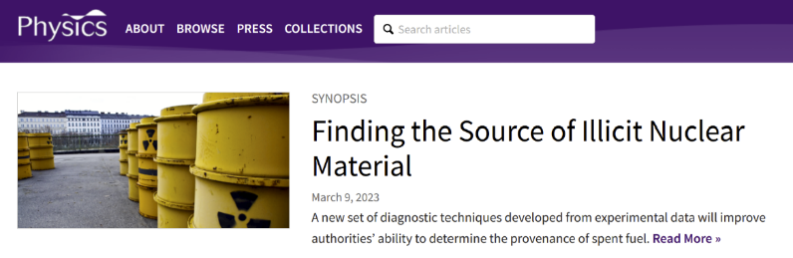
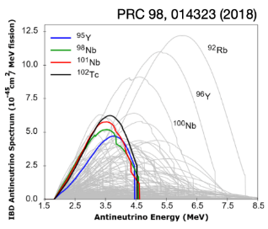
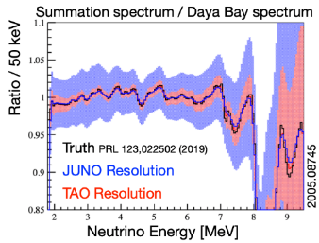
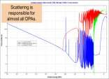
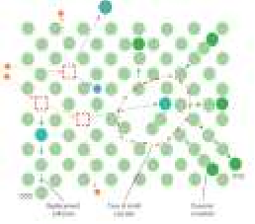
Nuclear Model + Machine Learning Method
Structure and Decay Data
Reactor Neutrino
Neuron
Network
2*Featured Progress in NF-ITWG
Application
Expt. Data
Shell Model
Decay theory
Transport Model
Fission model
Application
Macroscopic Validation
Material Damage
Tensor
Completion
Fission and reaction Data

Slide 7
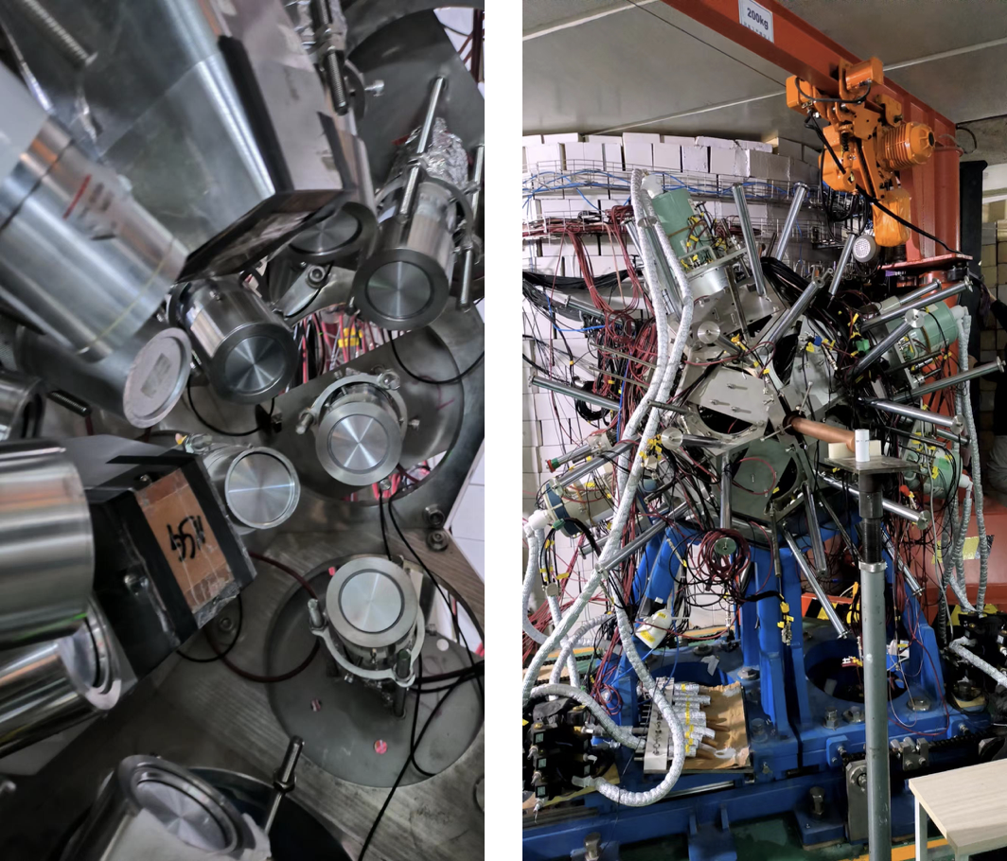
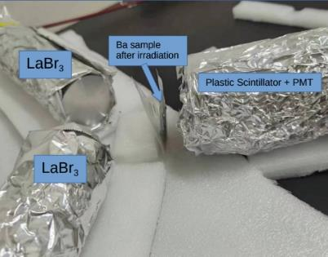
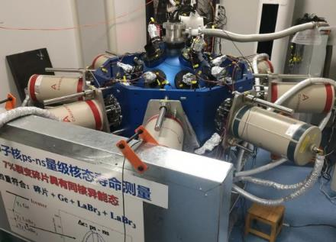
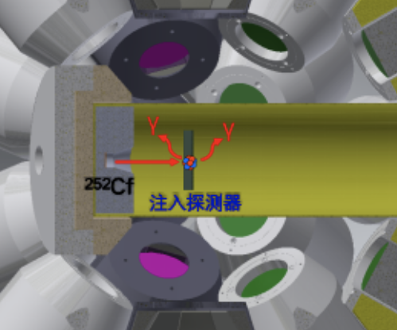
High Precision Measurement for Neutron and fission
Detector
Target
Electronic
LaBr3 detectors 18 set (Saint-Gobain)
Fission Target Room 1 set
PXI Digital Integrated Data Acquisition System 1 set
Structure Data Measurement:
Fission Mechanism and yield
Fission Product and Beta decay
Fast time Gamma-ray and isomers
Structure of nuclei far from stability
LaBr3 + HPGe hybrid array
³⁶Ar+⁶⁴Zn @ Lanzhou
Seniority at A~100
Test Expt. @ CSNS
¹³⁸Ba+n → ¹³⁹Ba → ¹³⁹La
²⁵²Cf @ Lanzhou
Fission Products

Slide 8
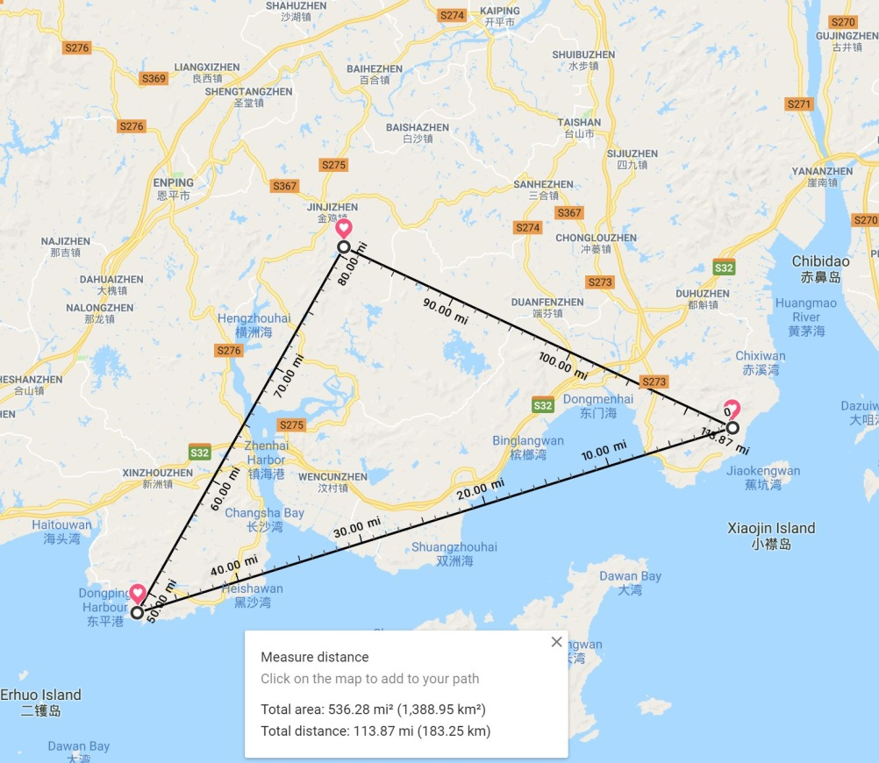
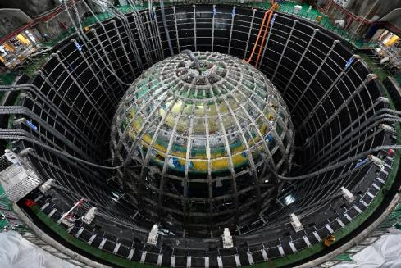
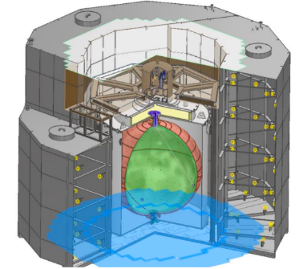
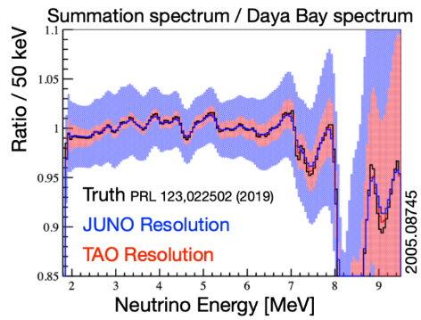
Neutrino Physics
JUNO: Neutrino mass order
JUNO TAO: Neutrino spectrum in reactor
RELICS: Coherent elastic neutrino-nucleus scattering
ALARM: Array of Lattice for Antineutrino Reactor Monitoring
The JUNO Site
Yangjiang Power Plant
Taishan Power Plant

Slide 9
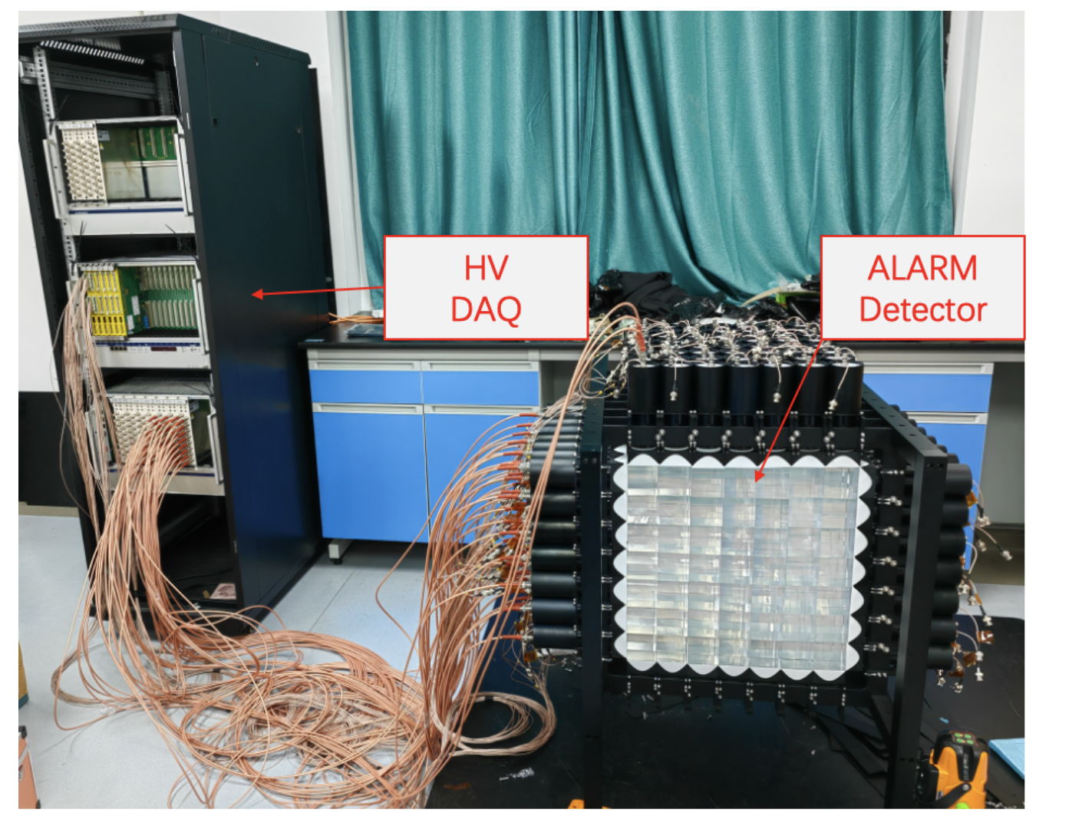
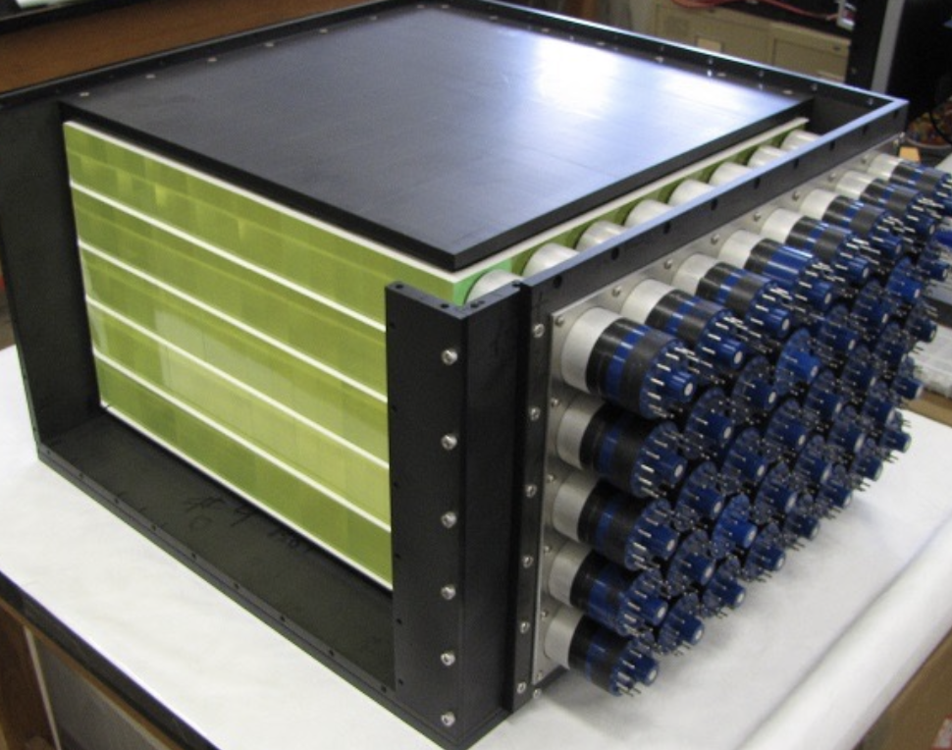
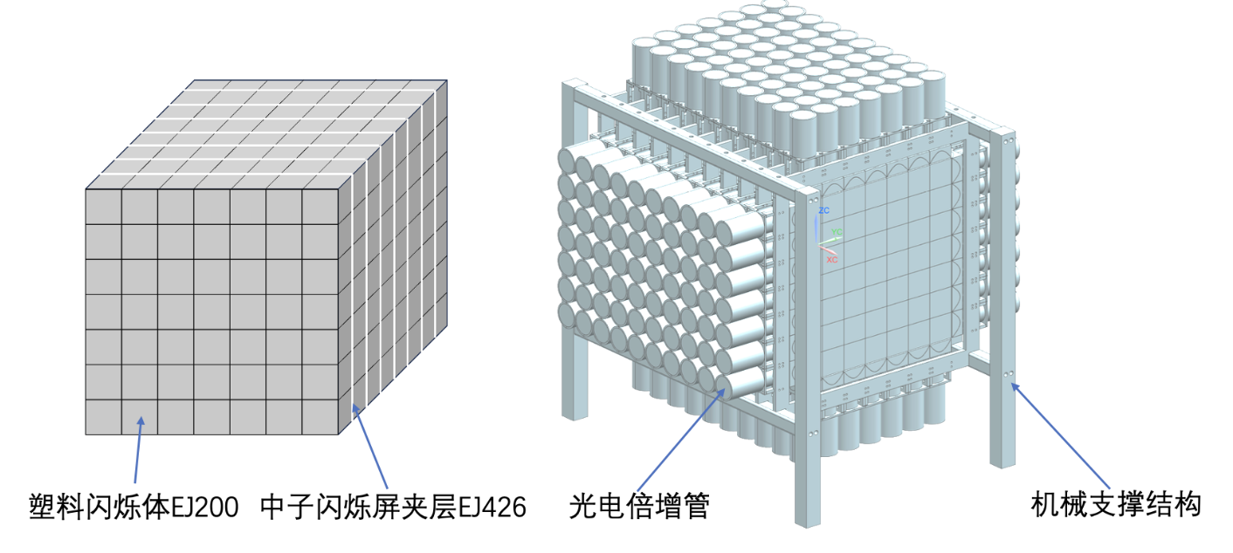
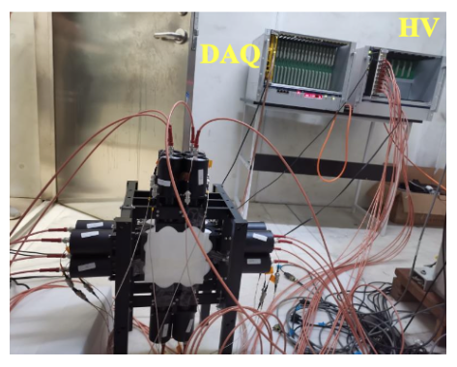
Neutrino Physics
Array of Lattice for Antineutrino Reactor Monitoring: Reactor power monitoring using a simple, compact, and inexpensive detector solution, modular plastic scintillator arrays as neutrino targets and detecting positrons, ⁶Li-doped ZnS scintillators to mark neutron capture events
Seeking International Collaborations
Chandler-like Design
Plastic Scintillator
Neutron Scintillator Interlayer
PMT
Mechanical Support
Test with Am-Be Source

Slide 10
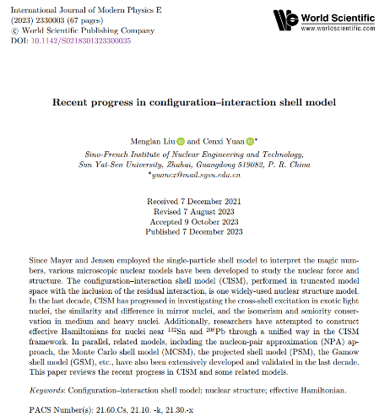
Outline
Introduction to Configuration-Interaction Shell Model (CISM)
CISM with Unified Nuclear Force
CISM for Level Density
Perspective

Slide 11


CISM
Phenomenological Force: deduce force from data, such as BE, level, EM, β
Single Particle Basis
(normally H.O.)
Model Space
Effective Hamiltonian
Wave Functions (configuration mixing)
Solve Schrödinger Equation
(energies, wave functions)
Other Properties:
EM, β, SF…
Three Key Factors of CISM: Model Space, Effective Hamiltonian, Code (Caurier.RMP.05)

Slide 12
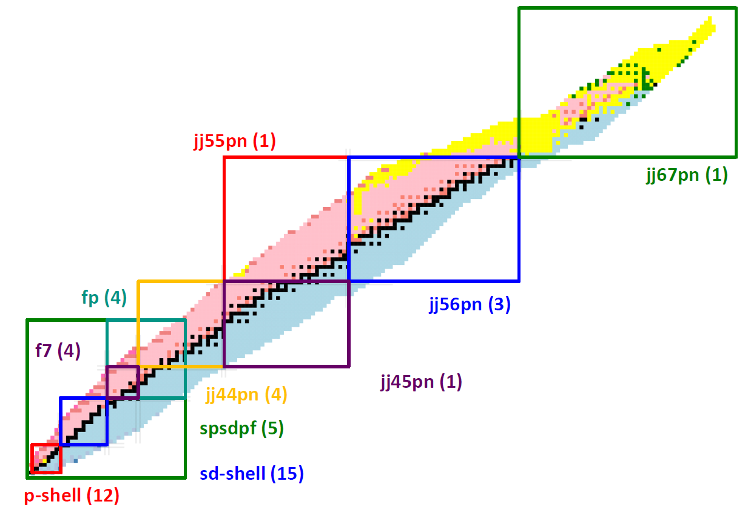
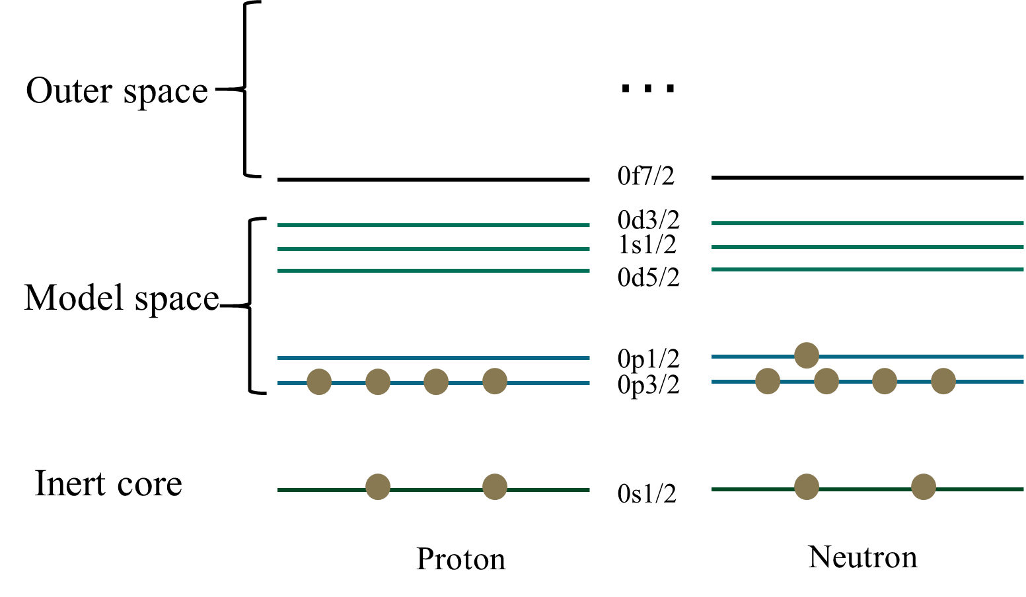
Model Space
Hilbert Space: Core, Model Space (1 or 2 major shells), Outer Space
jj56:
5 proton orbitals between 50 and 82
6 neutron orbitals between 82 and 126
Single: p, sd, pf
Two: psd, sdpf
Three: psdpf
Chart of Nuclides from CISM
Each Model Space (Number of Hamiltonians)
(From B.A. Brown)

Slide 13
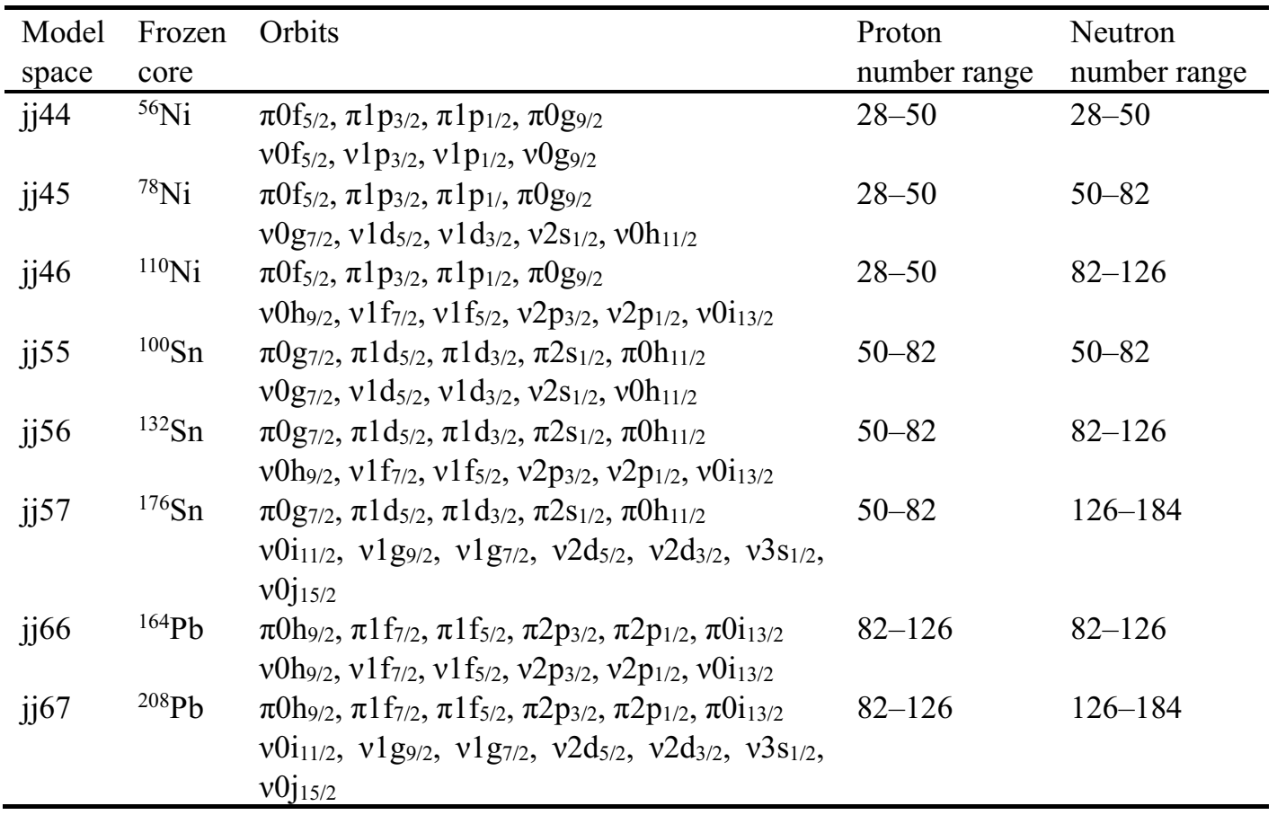
Model Space
Hilbert Space: Core, Model Space (1 or 2 major shells), Outer Space
jj56:
5 proton orbitals between 50 and 82
6 neutron orbitals between 82 and 126
Single: p, sd, pf
Two: psd, sdpf
Three: psdpf
Chart of Nuclides from CISM
Each Model Space (Number of Hamiltonians)
(From B.A. Brown)

Slide 14
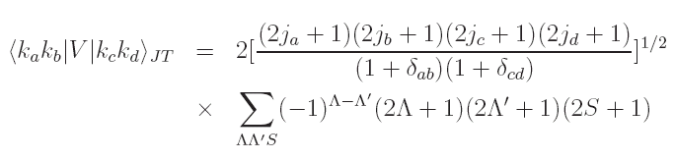
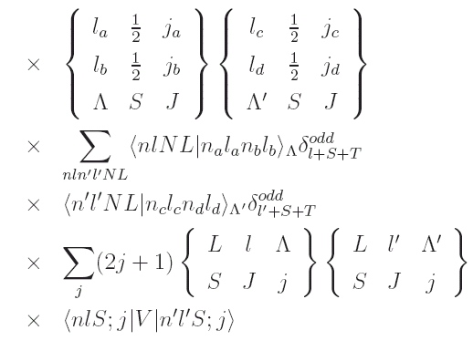

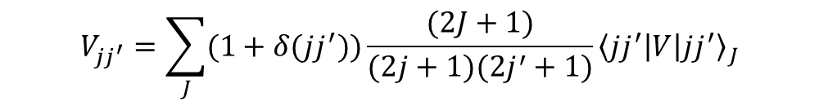
Effective Hamiltonian
V_{MU}+LS (monopole-based universal interaction + spin-orbit force)
$$V_{C}\left(Gauss\right)=\sum_{T=0,1.S=0,1}{f_{T,S}P_{T,S}exp⁡(−{\left(\frac{r}{μ}\right)}^{2}})$$
$$V_{MU}=V_{C}\left(Gauss\right)+V_{T}\left(π+ρ\right)$$
$$\begin{aligned}&V_{MU}+LS=V_{MU}+V_{LS}\left(M3Y\right)\end{aligned}$$
G. Bertsch et al., Nucl. Phys. A 284, 399 (1977).
Monopole interaction:
$$V_{jj^{′}}=\sum_{J}{(1+δ(jj^{′}))}\frac{(2J+1)}{(2j+1)(2j^{′}+1)}{\left\langle jj^{′} | V | jj^{′}\right\rangle }_{J}$$
V_{MU}+LS describe well the monopole properties
Construct effective Hamiltonian for any model space
Verified in many region as effective Hamiltonian or parts of it

Slide 15
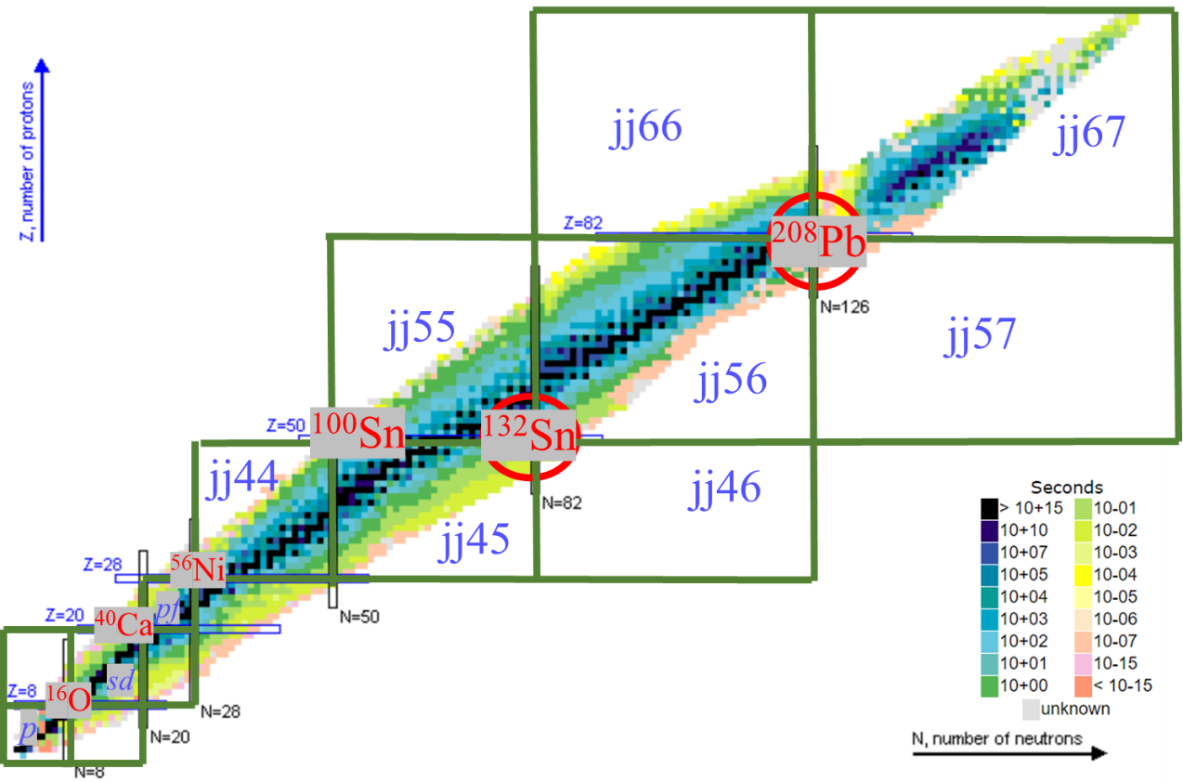
Effective Hamiltonian
V_{MU}+LS as cross-shell part
p-sd (YSOX)
sd-pf (sdpf-mu)
pf-jj44
¹³²Sn jj46
²⁰⁸Pb jj57, jj5_67, jj56_67, jj66
V_{MU}+LS as effective Hamiltonian
¹³²Sn and ²⁰⁸Pb region (red circle)
jj45, jj46, jj55, jj56
jj56, jj57, jj66, jj67

Slide 16
Shell-model code
Oak Ridge Rochester Multi-Shell code (J. B. French et al., 1969)
Glasgow group (R. R. Whitehead et al., 1977)
OXBASH/NUSHELLX (B.A. Brown et al., 1986)
Drexel University shell model code (M. Vallieres et al.. 1988-1997)
ANTOINE : amelioration of the code of the Glasgow group (E. Caurier et al., 1999)
NATHAN (E. Caurier et al.. 1999)
EICODE (J. Toivanen, 2006)
KSHELL (N. Shimizu et al, 2013)
MFDn (P. Maris et al., 2013)
REDSTICK, BIGSTICK (C.W. Johnson et al.)
GSM (2021)
N. Shimizu, arXiv:1310.5431(2013);
N. Shimizu et al., Comput. Phys. Commun. 244, 372 (2019)

Slide 17
Outline
Introduction to Configuration-Interaction Shell Model (CISM)
CISM with Unified Nuclear Force
CISM for Level Density
Perspective

Slide 18

Nice results on BE, level, EM, β
VS
Different H, quality of predicted power
One effective force for all possible nuclei (RMS for BE, level, EM, GT)
Notes:
Background and target

Slide 19
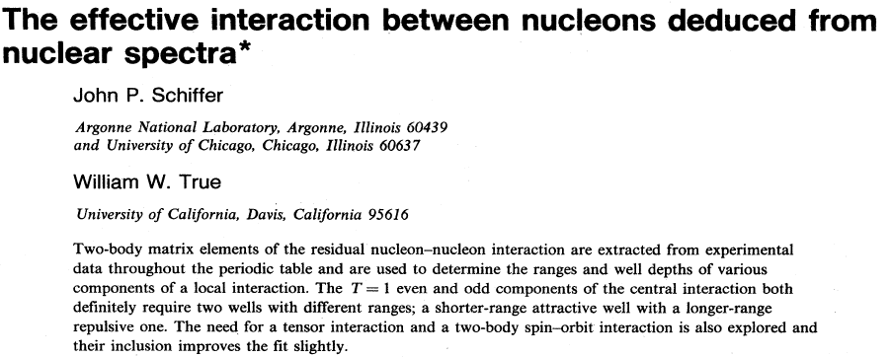



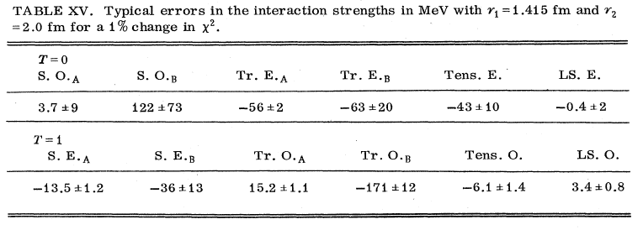
Configuration mixing
V_{MU}+LS(M3Y)
Isospin-Spin
C10 C11 C01 C00
T1 T0 LS1 LS0
Notes:
Introduction of the components/forms of the effective nuclear force

Slide 20
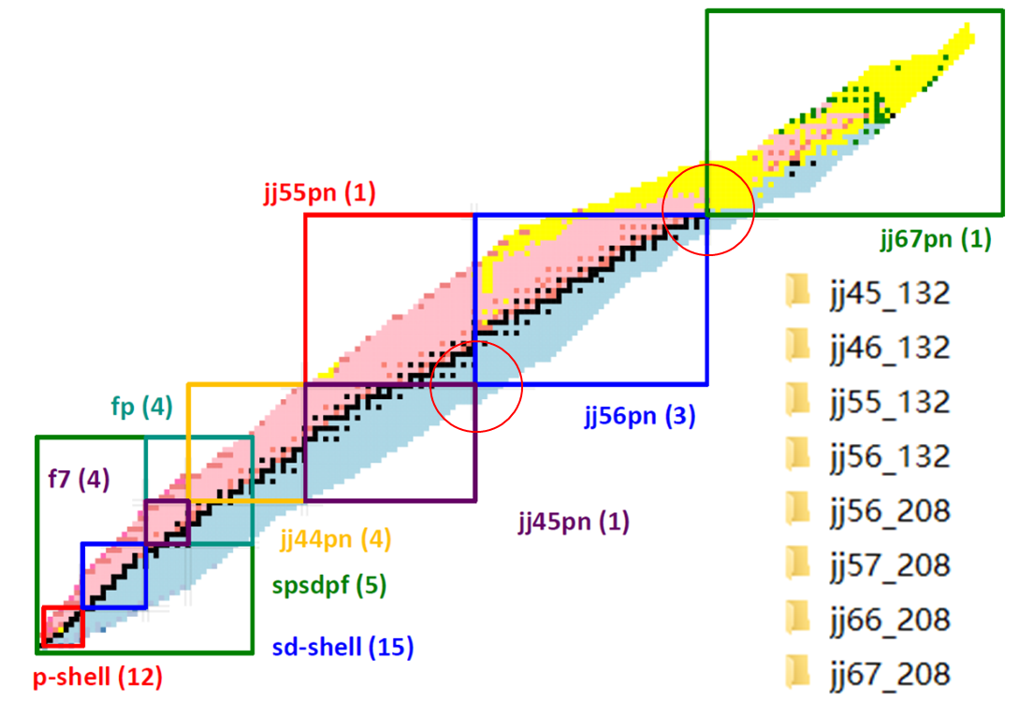
Use one effective nuclear force to deduce Hamiltonians for model spaces around ¹³²Sn and ²⁰⁸Pb.
Focus on the strengths of different force components.
Describe the excitation energies of 725 levels in 136 nuclei .
Overall progress:
No. Nuclei | 136 | 98 | 38 (semi-magic)
No. States | 725 | 505 | 220
RMS (MeV) | 0.139 | 0.138 | 0.141
Mean (MeV) | 0.031 | 0.038 | 0.015
Preliminary
Notes:
The updated results: total

Slide 21
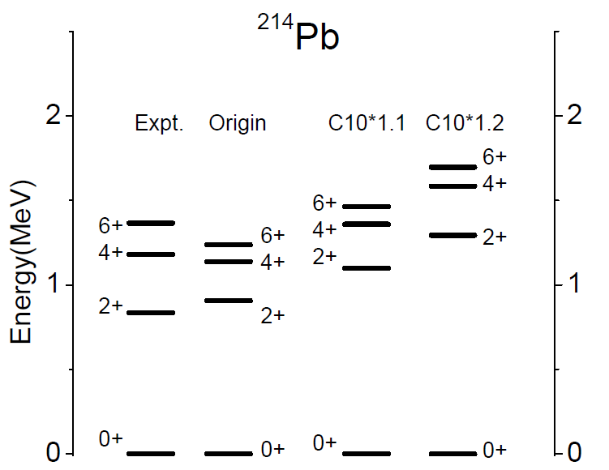
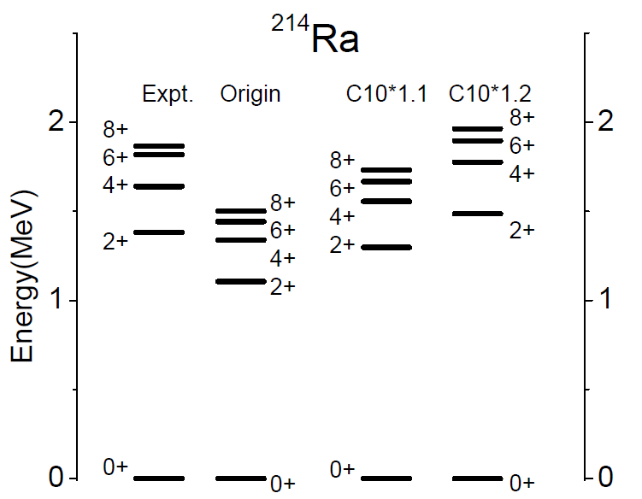
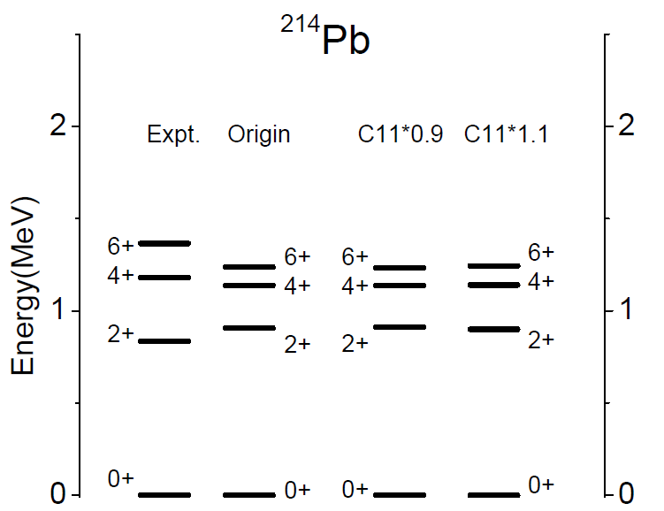
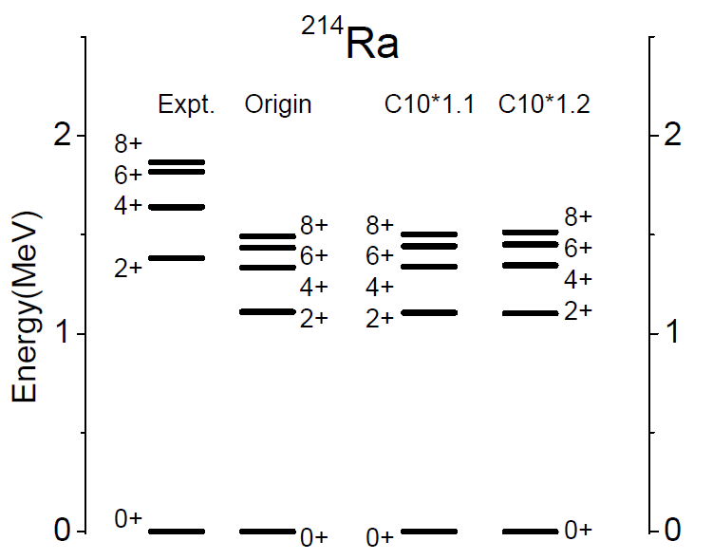
“Mirror” difference?
CXY, TX Du, NPR35.4(2018)537

Slide 22
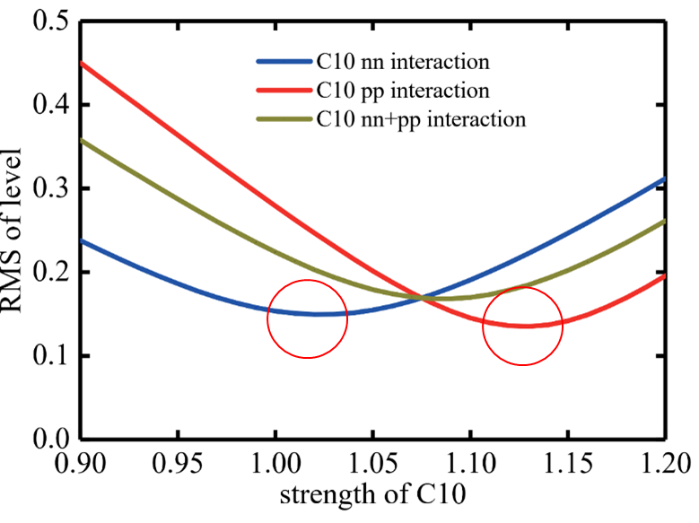
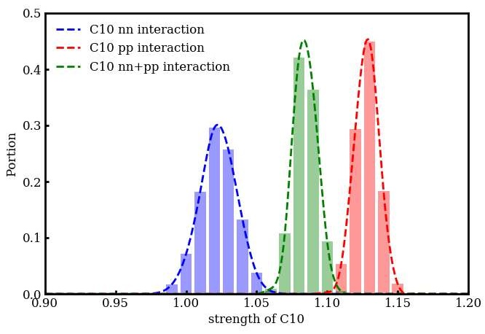
CXY, et al., ND2019 proceedings
EPJ Web of Conf. 239, 04002 (2020)
RMS for nuclei around ²⁰⁸Pb and ¹³²Sn
Uncertainty of strength of C10 from bootstrap method
nn: 101 levels in Pb and Sn isotopes, ²⁰¹⁻²¹⁴Pb, ¹²⁵⁻¹³⁸Sn
pp: 97 levels in N=126 and N=82 isotones, ²⁰⁴Pt-²¹⁴Ra, ¹²⁸Pd-¹³⁹La
Notes:
C10 pp and nn should be enhanced by different percentages

Slide 23
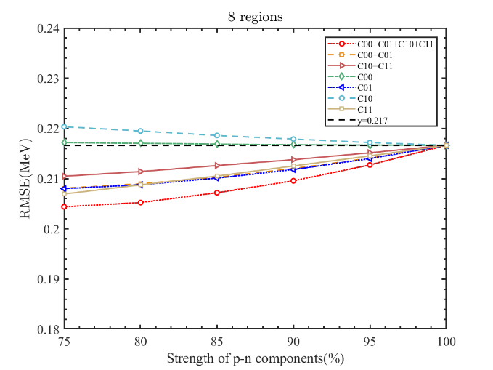
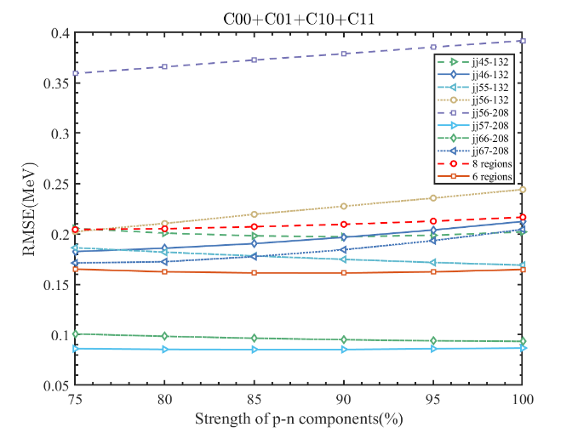
ML Liu Master thesis
RMS for other nuclei
pn: more than 500 levels
RMS slightly sensitive to the pn components
Different tendency for different regions
Notes:
C10 p15 n5, vary pn central forces, from 75% to 100%: no significant improvements

Slide 24
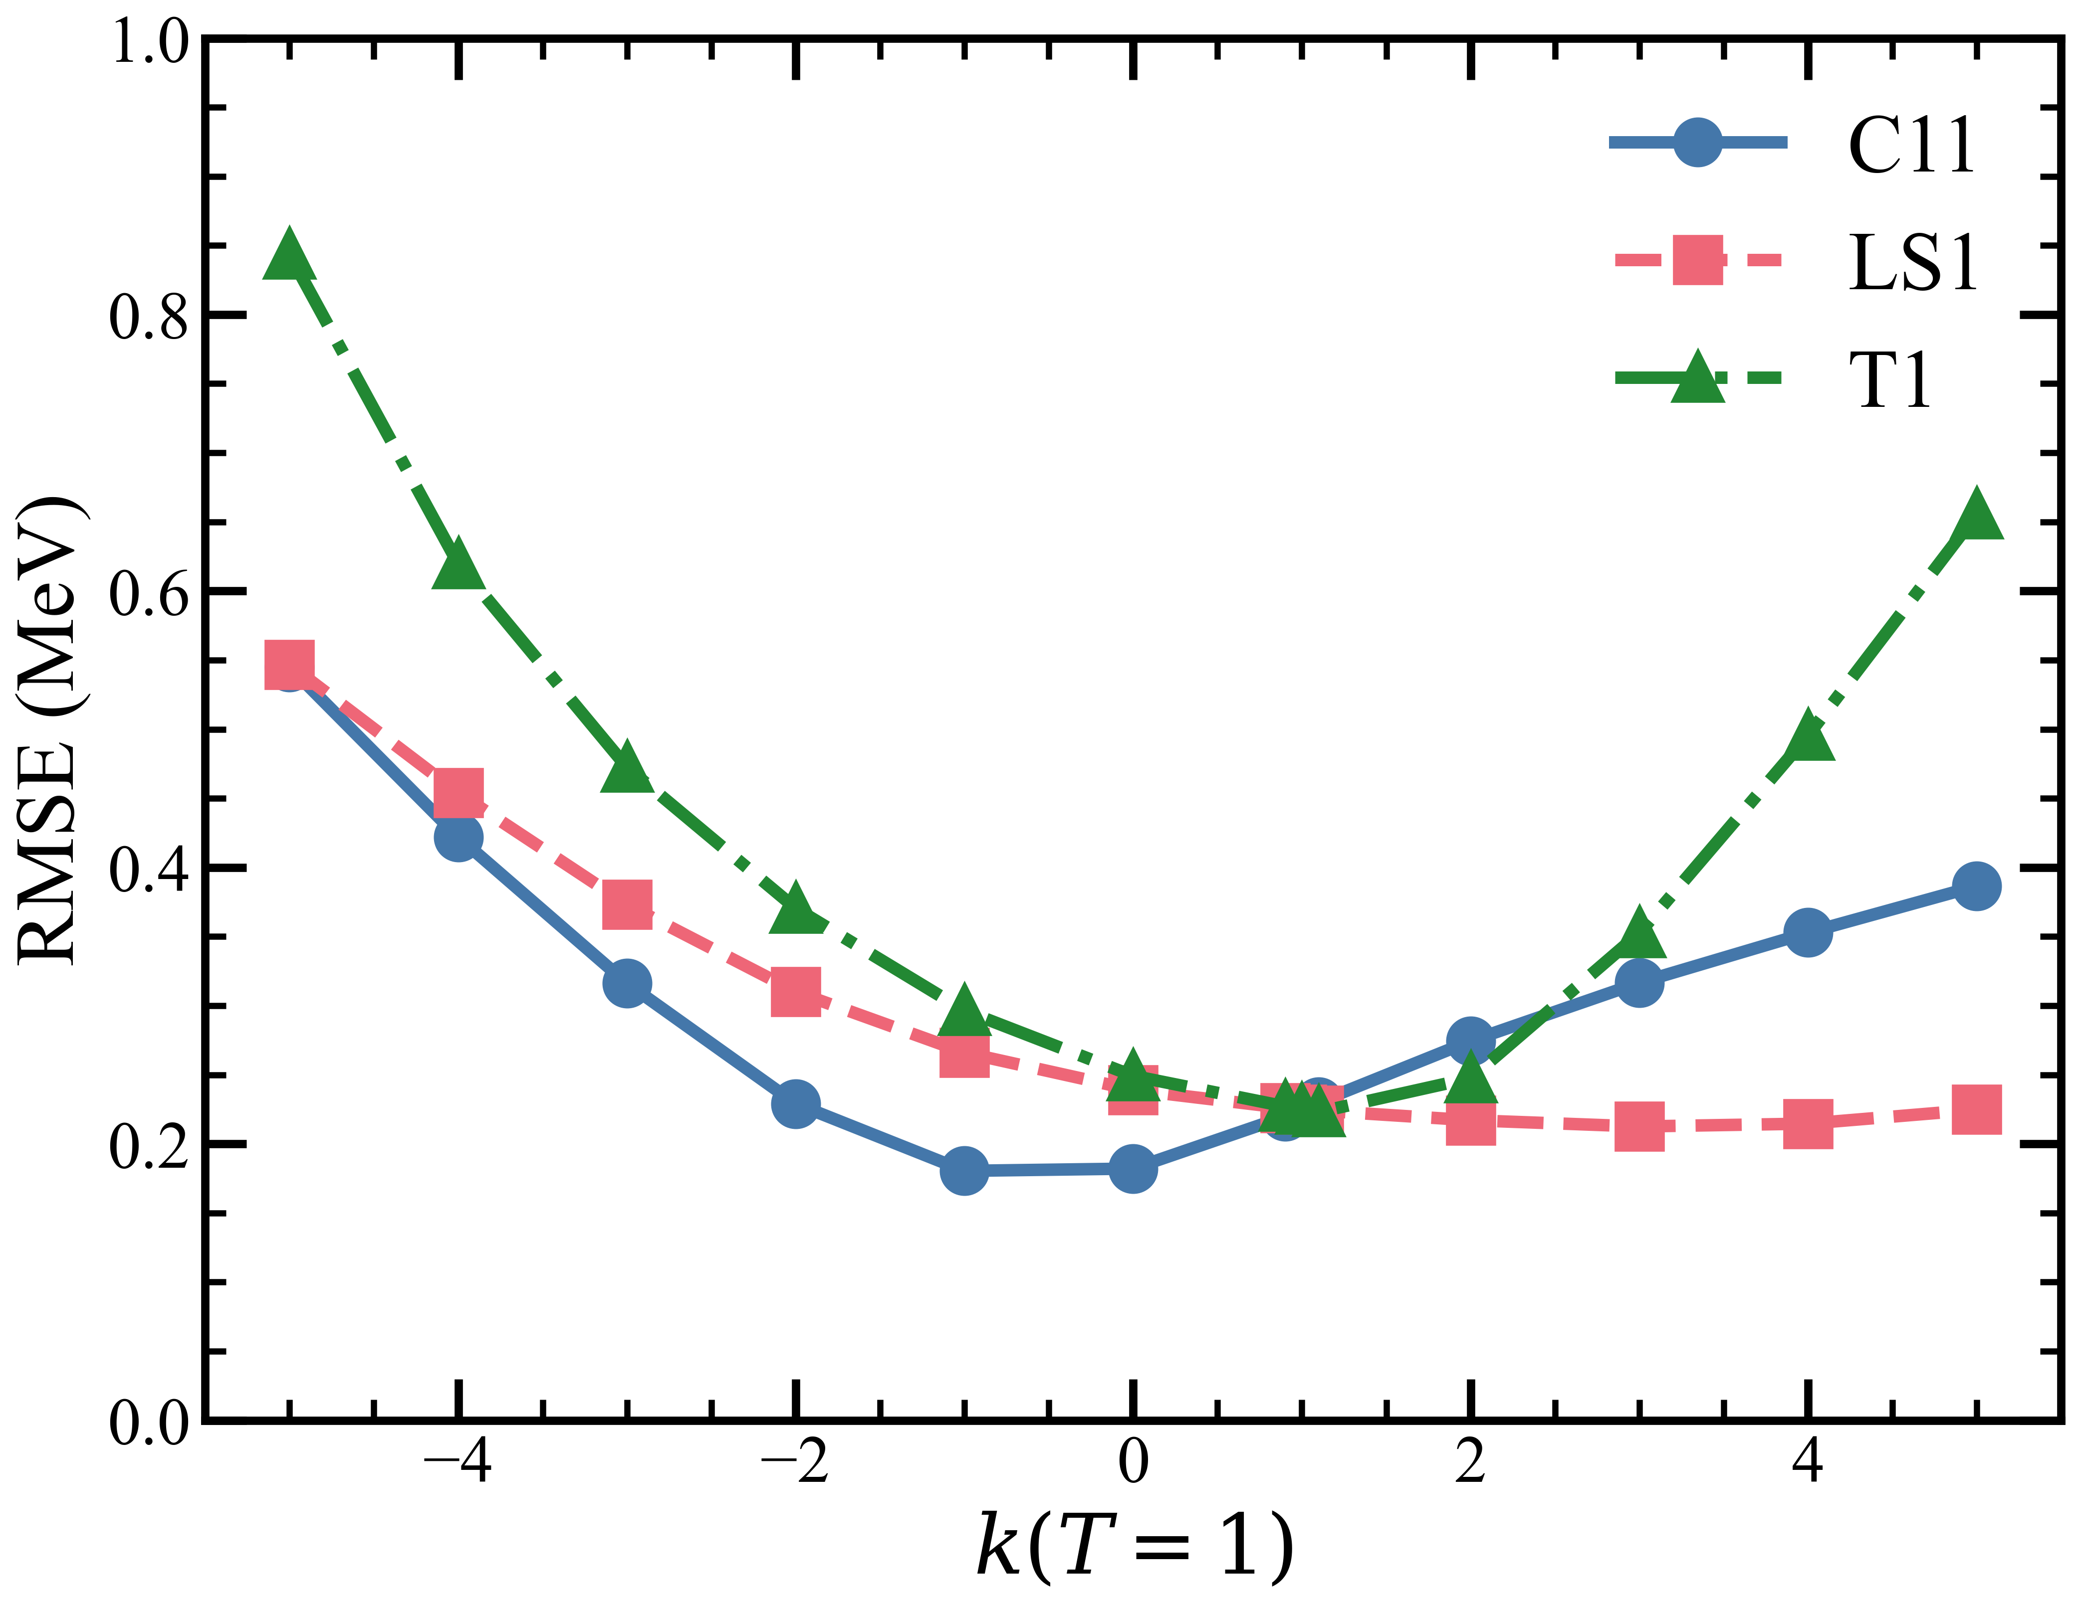
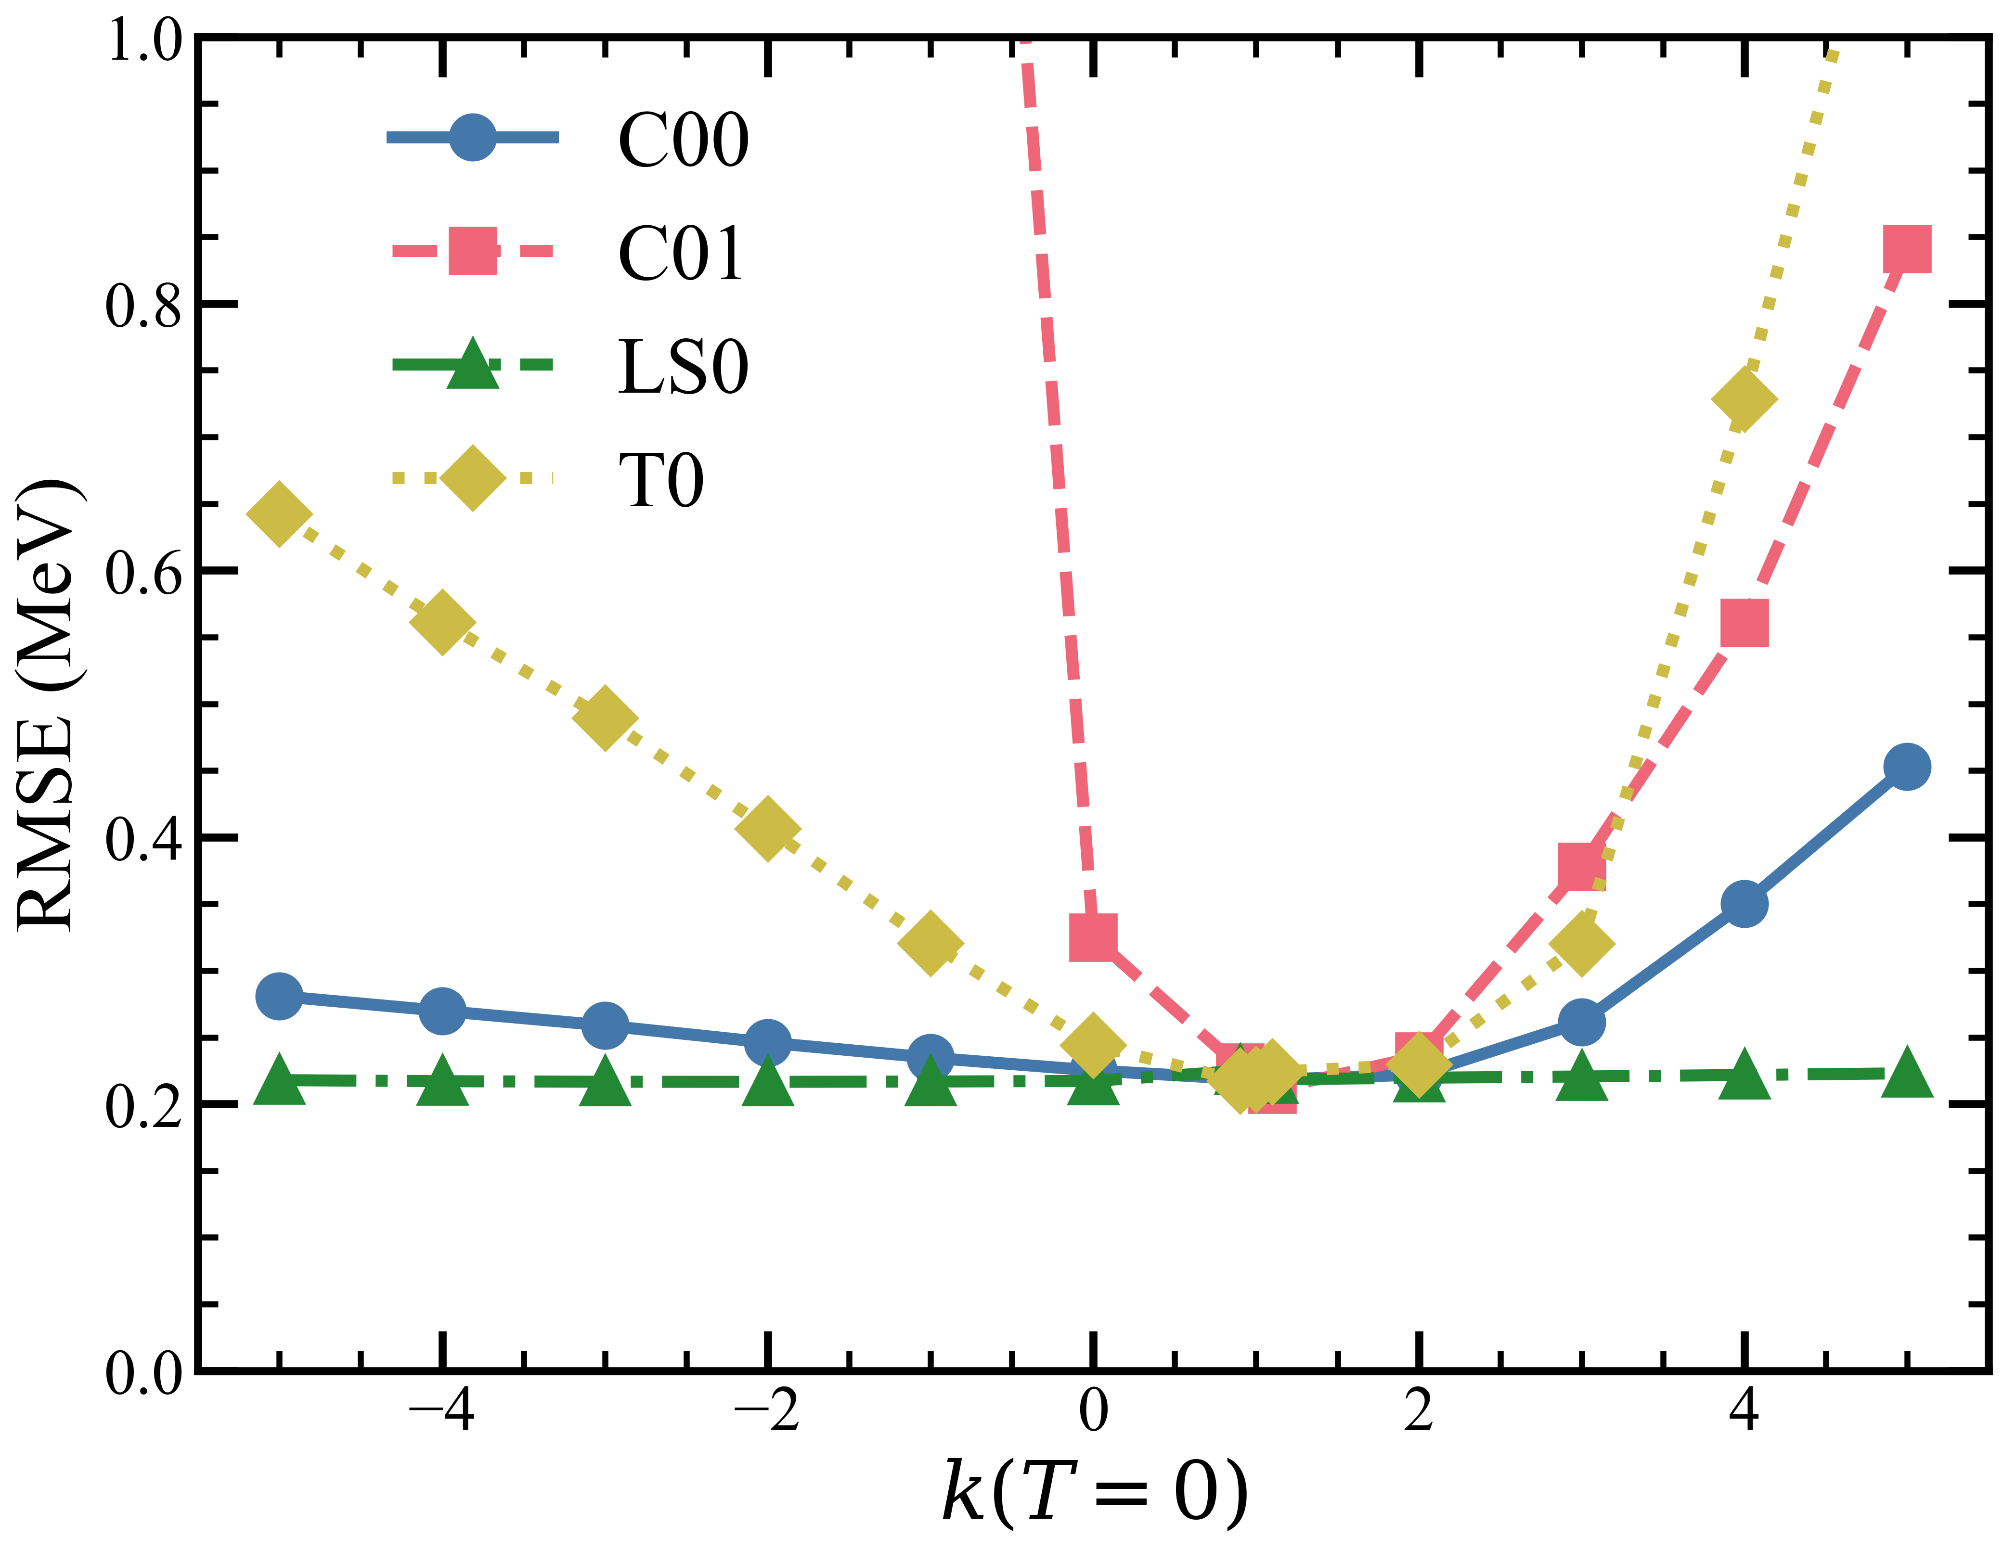
RMS for other nuclei-Excitation energy
Preliminary
T=1: 725 levels T=0: 505 levels
C00, C01,T0 and T1 are relatively well-determined
Spin-orbital forces to be further considered
Notes:
C10 p15 n5, vary other forces, from -500% to +500%: most of nuclear forces are actually well determined.

Slide 25
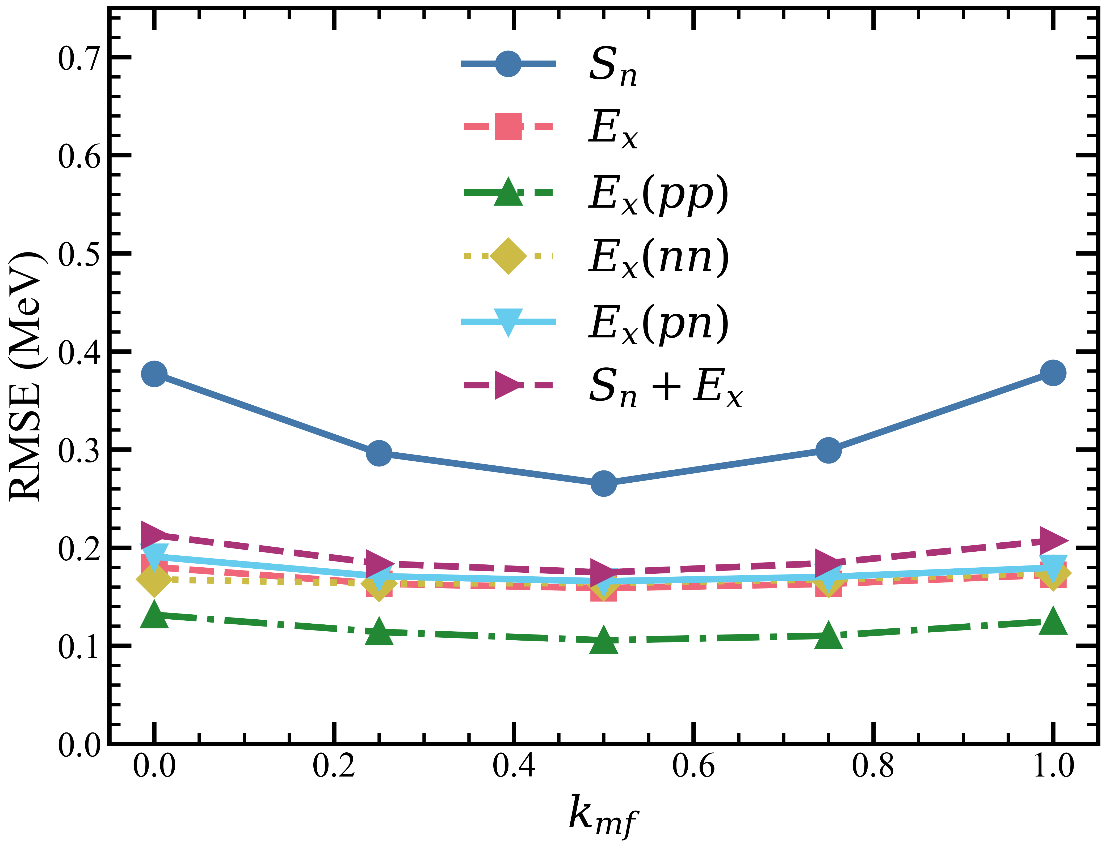
Monopole deduction
Preliminary
< ij | V | ij> (new)= < ij | V | ij> (old) – kmf* Vij(monopole)
monopole deduction or semi-frozen of monopole interaction is suggested.

Slide 26
Outline
Introduction to Configuration-Interaction Shell Model (CISM)
CISM with Unified Nuclear Force
CISM for Level Density
Perspective

Slide 27
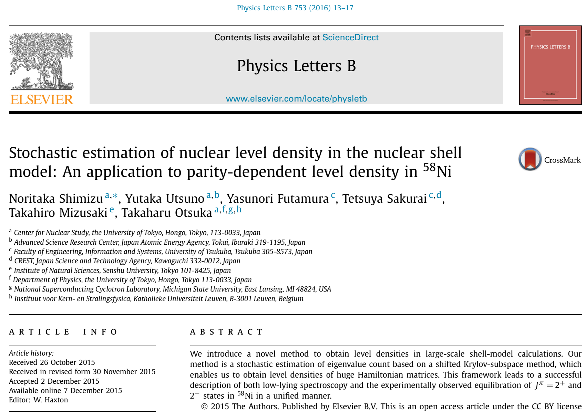
Calculation method

Slide 28


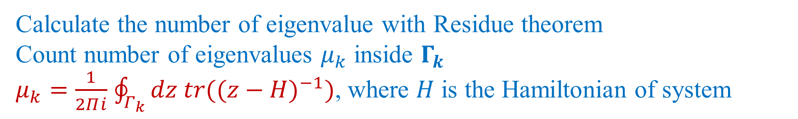






Calculation method
Im(z)
denote the energy level
$$Γ_{k}$$
denote the integral contour
$$E_{0}$$
$$E_{1}$$
$$E_{2}$$
Re(z)
$$E_{k}$$
Intersection of $Γ_{k}$ and real axis
$$Γ_{1}$$
$$Γ_{2}$$
Calculate the number of eigenvalue with Residue theorem
Count number of eigenvalues $μ_{k}$ inside $Γ_{k}$
$μ_{k}=\frac{1}{2Πⅈ}$ $\oint_{Γ_{k}}{dz {tr((z−H)}^{−1})}$, where $H$ is the Hamiltonian of system

Slide 29

Truncation method
Effective single-particle energy (ESPE) gives reference of shell structure, which can be calculated with
$ε_{j}=ε_{j}^{core}+\sum_{j}{V_{jj^{′}}}⟨ψ|{\hat{N}}_{j^{′}}|ψ⟩$
where $ε_{j}^{core}$ is the single-particle energy of$j$ orbit with respect to the core, $⟨ψ|{\hat{N}}_{j^{′}}|ψ⟩$ denotes the occupancy of nucleons in $j^{′}$ orbit and $V_{jj^{′}}$ is the monopole interaction.
By calculating the ESPE we can furtherly obtain the approximate binding energy of single orbit.
$BE=\sum_{j}{⟨}ψ|{\hat{N}}_{j}|ψ⟩$ $ε_{j}^{core}$+$\sum_{jj^{′}}{\frac{V_{jj^{′}}}{2}}⟨ψ|{\hat{N}}_{j^{′}}|ψ⟩⟨ψ|{\hat{N}}_{j}|ψ⟩$

Slide 30


Truncation method
Level Density of Ba and Xe
V_{MU}+LS(M3Y) jj5_56
JB Chen, ML Liu, et al., PRC 107, 054306 (2023)

Slide 31




Structure Properties

Slide 32


NLD

Slide 33


Cumulative Number of Levels

Slide 34


Spin and Parity

Slide 35
Outline
Introduction to Configuration-Interaction Shell Model (CISM)
CISM with Unified Nuclear Force
CISM for Level Density
Perspective

Slide 36
Perspective
  CISM with unified nuclear potential (better for extrapolation) for NLD
  AI based truncation method in CISM
  Systematic study on NLD of fission products (and actinides), including spin and parity distribution
  NLD with cluster information, n, 2n, p, 2p, alpha?

Slide 37



Proton-neutron Interaction Enhances α Formation Factor

Slide 38



First Approach to self conjugate doubly magic ¹⁶⁴Pb?

Slide 39






Difficulty in Four-Fermion Formation
Identification of All Quartet Configurations in Complex Many-Fermion Wave Function
Separating Orbital & Spin Spaces
Separating COM & Relative Motions

Slide 40


Universal Four-Fermion Formation Framework (U4F)
Solving CISM Wave Function
Preliminary
Obtaining Weighting Coefficient of Each Quartet Configuration
By Quartet Amplitude (Four-Fermion Transfer Amplitude)
Separating Orbital and Spin Spaces
Separating Center-of-Mass and Relative Motions
Center-of-Mass Mapping Coefficient
Cai, CXY, Qi, under review

Slide 41

Universal Four-Fermion Formation Framework (U4F)
Preliminary
Reproduce two features: OES and decreasing when approaching to 126

Slide 42
Collaboration
Menglan Liu, Boshuai Cai, Shengli Chen, Guangxin Zhang, Jun Su, Long Zhu, Wei Hua, Bo Mei (SYSU)
Furong Xu, Yanlin Ye, Hui Hua, Zhihuan Li, Jianling Lou, Zaihong Yang, Xiaofei Yang (PKU)
Chong Qi (KTH), Takaharu Otsuka (Todai), Noritaka Shimizu (Tsukuba), Toshio Suzuki (Nihon U)
Zhong Liu, Yuhu Zhang, Meng Wang, Zaiguo Gan, Xinxing Xu, Huabin Yang, Zhiyuan Zhang, Shitao Wang, Xing Xu, Yuanming Xing, Jiajian Liu, Jianguo Li (IMP)
Chengjian Lin, Huiming Jia, Xiaoguang Wu (CIAE), Phil Walker, Zsolt Podolyak (Surrey), Jenny Lee (HKU) Gaolong Zhang, Danyang Pang, Hiroshi Watanabe (Beihang), He Wang (RIKEN)
Many others …

Slide 43


Thanks for your Time!
Welcome to SYSU and IFCEN!
Collaborations and Applications Welcome!
Contact: Cenxi YUAN, yuancx@mail.sysu.edu.cn

