Slide 1
³He (n,p)T -The Forgotten Standard
Allan D. Carlson
NIST Associate
Under Contract with BNL
Presented at
The IAEA Technical Meeting on Neutron Data Standards
January 27-31, 2025

Slide 2
History
ENDF/B-I did not have standards. Individual laboratories had relatively poor “standards.” The cooperation for defining standards that should be used at all or most laboratories did not exist
ENDF/B-II was the start for defining standards but the quality was a concern.
With ENDF/B-III, standards were much improved. It was then that the first ENDF/B standards evaluation for the ³He(n,p) cross section was produced. The evaluation was produced in 1968 in a very simple way and accepted by the CSEWG Standards Subcommittee for acceptance in the ENDF/B-III file in 1971.
The thermal cross section was derived from total cross section measurements by Als-Nielsen and Dietrich up to 11 eV. At the time of that evaluation, no experimental measurements of that cross section were available below 1.7 keV. So, below 1 keV, the Als-Nielsen and Dietrich results were used assuming the cross section is 1/v.
Up to the highest energy for this standard to be used, 50 keV, results using reciprocity from T(p,n)³He measurements by Macklin and Gibbons were used .

Slide 3
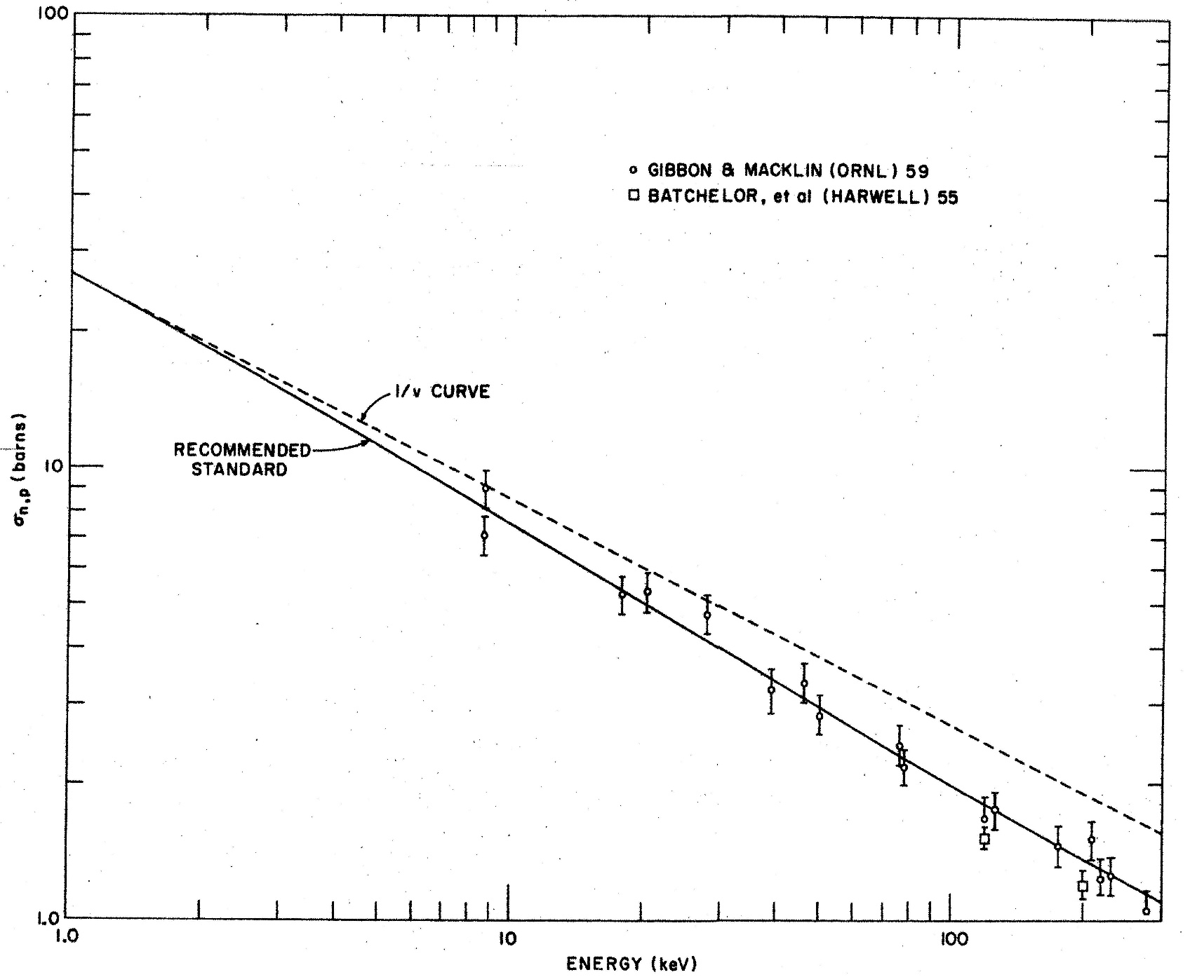
The ENDF/B-III Evaluation of the ³He(n,p)T Cross Section

Slide 4
More ³He(n,p)
It was stated the uncertainty at thermal is about 1%. From thermal to 10 keV it was estimated to be about 3%. However it was stated the uncertainty increases rapidly above 10 keV.
For the ENDF/B-IV and ENDF/B-V standards evaluations, new evaluations were not done for the ³He(n,p) cross section so the ENDF/B-III evaluation was used.
Measurements are available now above 50 keV but there are concerns about the accuracy and consistency of the various experiments So the accuracy was judged to be about 10%, not standards accuracy

Slide 5
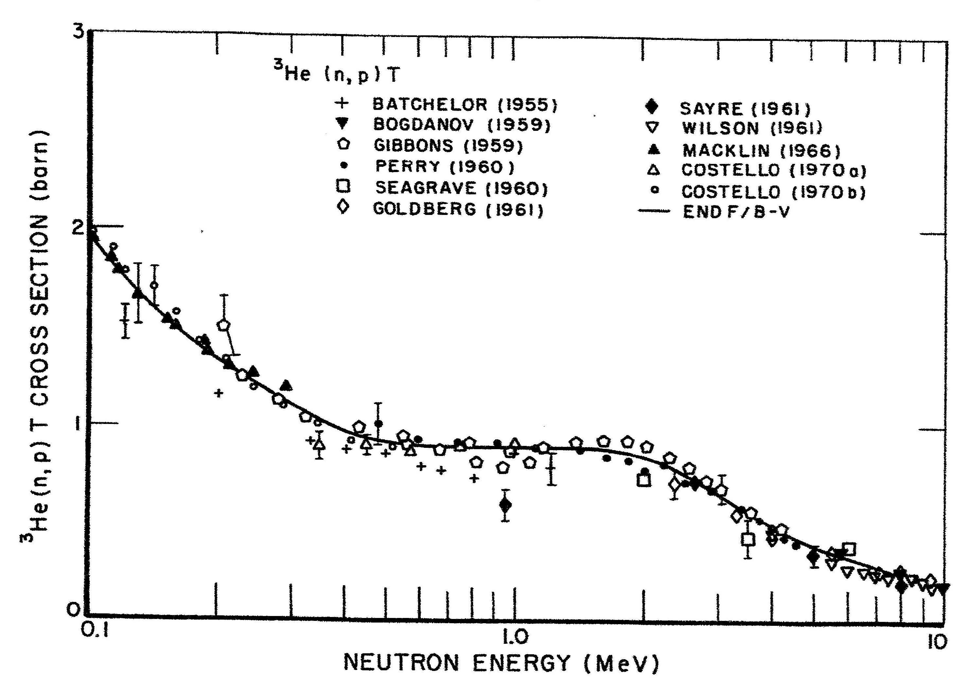
Higher Energy Measurements of the ³He(n,p) Cross Section

Slide 6
The ENDF/B-VI ³He(n,p) Evaluation
Hale did an R-matrix evaluation for ENDF/B-VI using all possible 2-body reactions.
He felt the evaluation was still limited to 50 keV maximum. The uncertainty estimates are, below 0.1 keV, 0.3%; 01. to 1 keV, 0.7%; 1 to 10 keV, 2% and 10 to 50 keV, 5%.

Slide 7
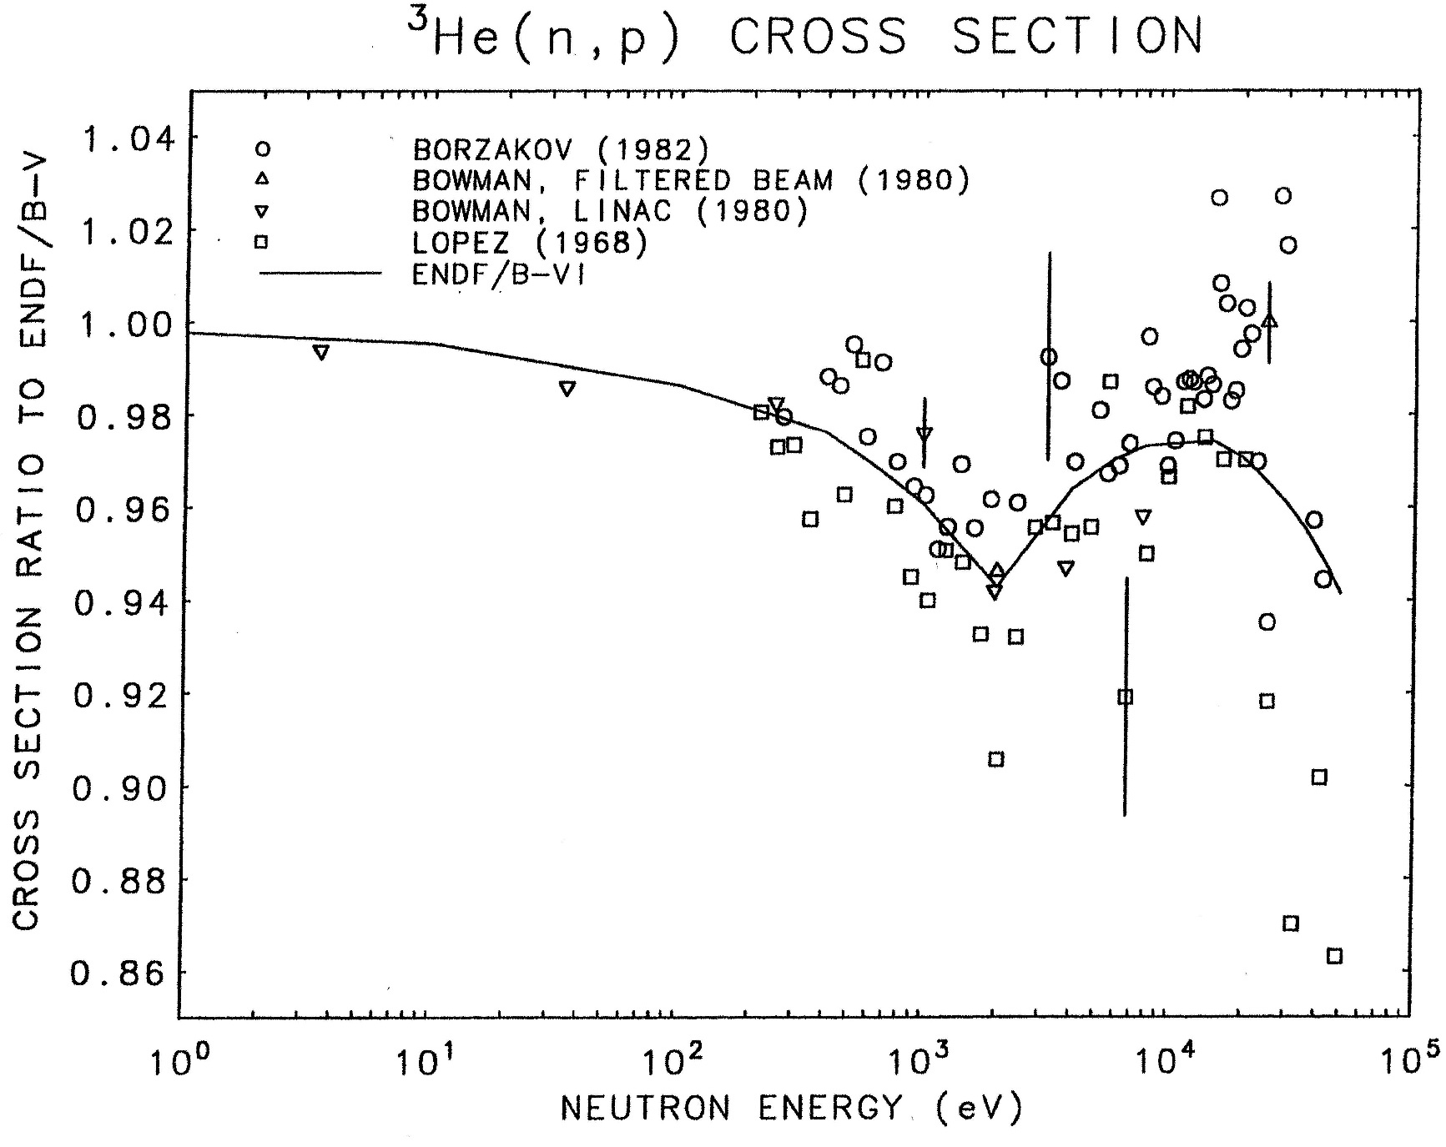
ENDF/B-VI ³He(n,p) Evaluation compared to the ENDF/B-V Evaluation and Measurements

Slide 8
Conclusion
This evaluation was never accepted outside the ENDF community.
Discussion (in the 1980s) with members of the European community indicated no interest in supporting an effort concerning this cross section. I supported it because of history and I was the USA representative.
No recent measurements have been made using this standard.
It has not been involved in our evaluation process since so few measurements have been made relative to other standards.
It should be noted that the work on this cross section was done with ³He gas counters. At that time the time response was generally not a problem. Today, in many cases, they are far too slow for many types of measurements.
There was an effort at NIST to develop a gas scintillator. Then the timing could be significantly improved. However, the detector was too large and inconvenient to use.
What should be done?

