Slide 1



Nuclear data evaluation pipeline for structural materials - treating model defects and inconsistent data
Henrik Sjöstrand
Erik Andersson Sunden
Mattias Ellert
Alf Göök
Uppsala University

Slide 2
Nuclear data evaluation pipeline for structural materials - treating model defects and inconsistent data
Henrik Sjöstrand (VR)

Slide 4
Background
The goal of this project is to develop a pipeline for nuclear data evaluation, that implements (and further develops) methodology to treat model defects and inconsistent experimental data that has originated in research activities at UU. In addition, the pipeline should
automatize as much as possible the steps involved in an evaluation
create fully reproducible ND evaluations
provide an intuitive framework for ND evaluation

Slide 5
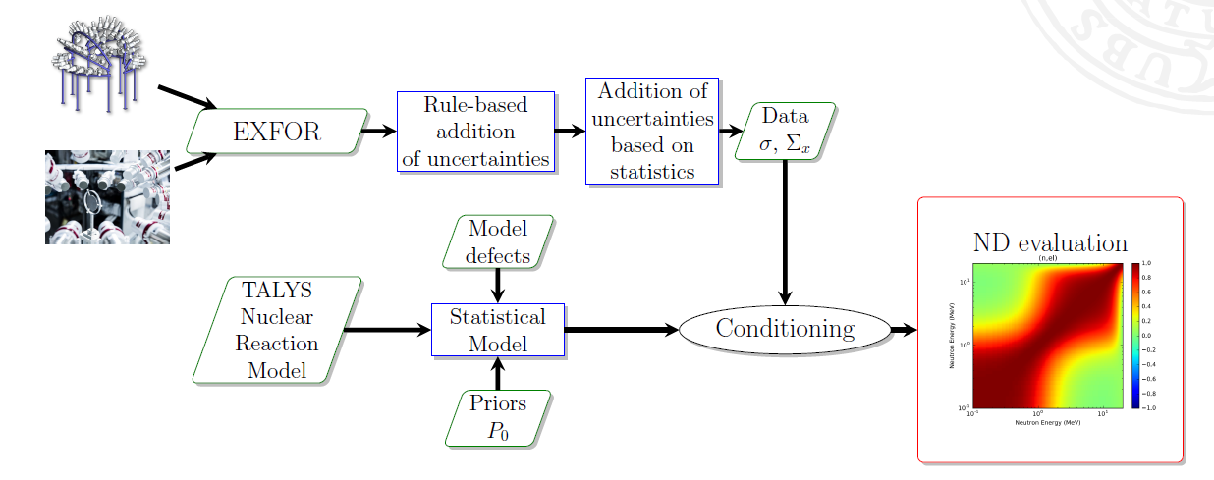
NEPU - Nuclear data Evaluation pipeline of Uppsala
LM
Fine Structure treatment
A.Göök, E. Andersson-Sundén, J. Hansson, and H. Sjöstrand, “A Nuclear Data Evaluation Pipeline for the Fast Neutron Energy Range – using heteroscedastic Gaussian processes to treat model defects,” EPJ Web of Conf., vol. 294, p. 04005, 2024, doi: 10.1051/epjconf/202429404005.
https://github.com/UU-nuclear
G. Schnabel, H. Sjöstrand, J. Hansson, D. Rochman, A. Koning, and R. Capote, “Conception and Software Implementation of a Nuclear Data Evaluation Pipeline,” Nuclear Data Sheets, vol. 173, pp. 239–284, Mar. 2021, doi: 10.1016/j.nds.2021.04.007.

Slide 6
Containerization
To facilitate reproducibility the pipeline is containerized.
A container is a standard unit of software that packages up code and all its dependencies so an application runs quickly and reliably from one computing environment to another – bypassing complex installation procedures.
This allows the evaluation to be archived and distributed for others to replicate, no matter what version of Linux they are running.
We use the container platform Apptainer, created specifically to run on high-performance computing (HPC) clusters.

Slide 7
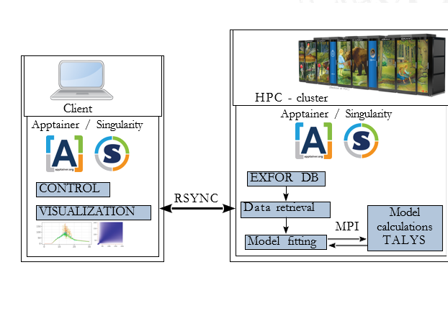
High Performance Computing
Pipeline can run entirely on HPC cluster
MPI wrapper for Talys
large scale parallelization
Currently running on UPPMAXª
A full evaluation, including the generation of random files, can be performed in a few hours
Greatly facilitates the testing and validation of ideas and methods

Slide 8
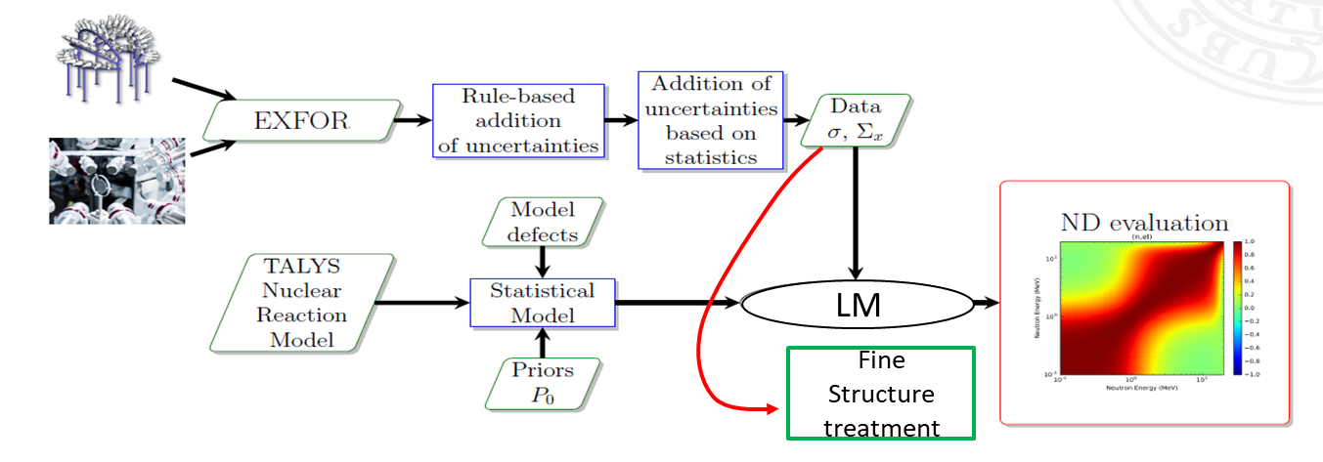
Workflow in the Pipeline
Data is retrieved from EXFOR → Mapped to TALYS predictions
Rule-based correction of uncertainties in data
Correction of uncertainties based on statistics
Talys parameter sensitivity evaluation
Setup of GP for energy dependence of parameters
Parameter optimization using the LM algorithm
Setup of GP in the observable domain
Re-optimization using the LM algorithm
Calculation of MVN approximation of the posterior pdf
Generation of random files
Addition of fine structures (under development)
Creation of ENDF
(Integral adjustment )
Notes:
is divided into a number of steps, each represented by an R-script.

Slide 9
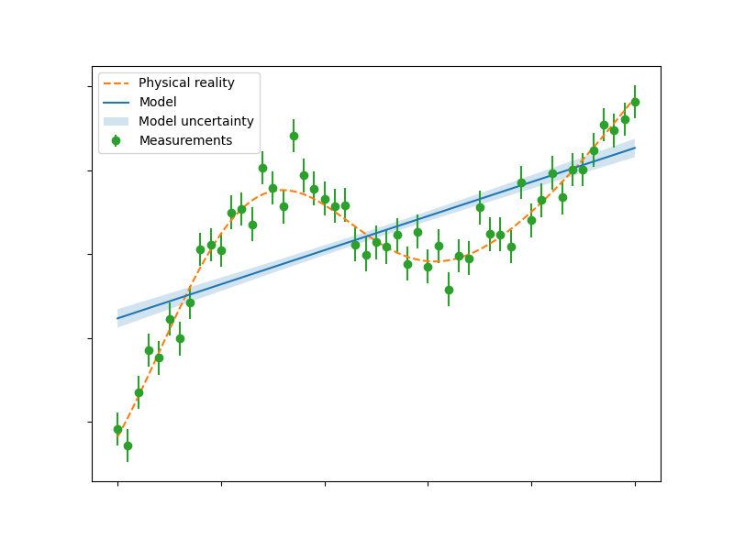
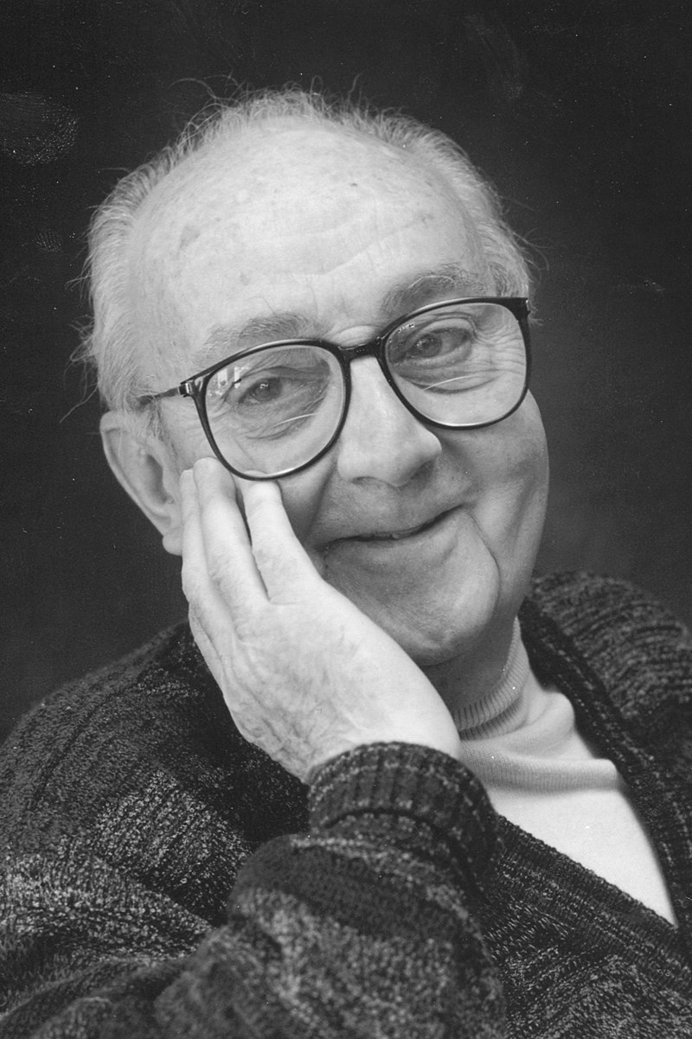
Model Defects
A model that cannot reproduce the underlying truth, no matter its parameters, can have sever consequences
•
•
Evaluation become biased towards the model.^{1,2}
Uncertainties will be underestimated – often severely.^{1,2}
→ Model defects must be addressed.
”All models are wrong, some are useful.” – G.E. Box, 1976
P. Helgesson, Ph.D. thesis, Uppsala University (2018)
G. Schnabel, Ph.D. thesis, TU Wien (2015)

Slide 10
Workflow in the Pipeline
is divided into a number of steps, each represented by an R-script.
Data is retrieved from EXFOR → Mapped to TALYS predictions
Rule-based correction of uncertainties in data
Correction of uncertainties based on statistics
Talys parameter sensitivity evaluation
Setup of GP for energy dependence of parameters
Parameter optimization using the LM algorithm
Setup of GP in the observable domain
Re-optimization using the LM algorithm
Calculation of MVN approximation of the posterior pdf
Generation of random files

Slide 11
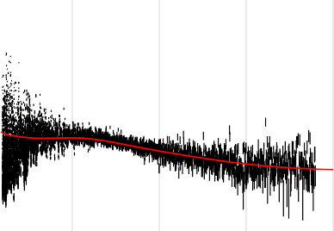
Treatment of Random Uncertainties
TALYS models the average cross-section, while experiments observe (unresolved) resonance structure. Therefore, the variance of the data around the mean
cross-section is much larger than their reported random (statistical) uncertainties.
⁵⁶Fe(n,tot)
0.4
7.5
exp. data
TALYS fit
cross section (barn)
0.3
5.0
0.2
density
2.5
0.1
0.0
0.0
0
5
10
energy (MeV)
15
20 −10 −5 0 5 10
normalized residual
Not treating this model defect can lead to biased TALYS fit, with underestimated uncertainties.

Slide 12
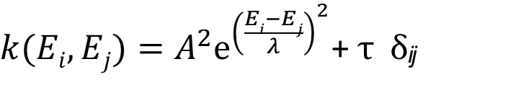
Treatment of Random Uncertainties
Estimate the distribution of data around a smooth energy-averaged cross-section.
The smooth cross-section should be influenced by the model as little as possible.
Assuming that the distribution is Normal, a Gaussian Process (GP) seems like a good candidate.
A GP models data by estimating the correlation between close-lying points with a covariance function, e.g.
The hyper-parameter λ controls the length-scale (smoothness)
The random error in the data is modeled by the nugget parameter τ
$k(Ei,Ej)=A^{2}ⅇ^{{\left(\frac{Ei−Ej}{λ}\right)}^{2}}$+ τ δ_{ij}

Slide 13
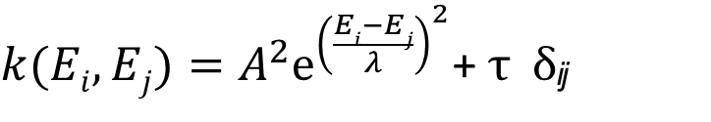
Treatment of Random Uncertainties
To determine the distribution of data around a smooth mean function, we model it using a heteroscedastic GP ³.
The heteroscedastic GP introduces latent variance variables, placed under a GP to allow a smoothly varying nugget parameter – variance of data around the mean
$k(Ei,Ej)=A^{2}ⅇ^{{\left(\frac{Ei−Ej}{λ}\right)}^{2}}$+ τ δ_{ij}
τ ²δ_{ij} → δ(x₁), δ(x₂), ..., δ(x_{n} ), δ(x ) ∼ GP
³https://CRAN.R-project.org/package=hetGP

Slide 14
Treatment of Random Uncertainties

Slide 15

Treatment of Random Uncertainties
In practice...
To separate random and systematic uncertainties, we apply the procedure experiment by experiment.
•
Experiments for which to apply the procedure are selected based on the energy resolution in the experiment.
The length scale is determined from a Marginal Likelihood Optimization on default TALYS predictions.
•
Hyper-parameters for the heteroscedastic GP are optimized with the lengthscale λ fixed – simultaneous inference of mean xs and the variance of the data

Slide 16
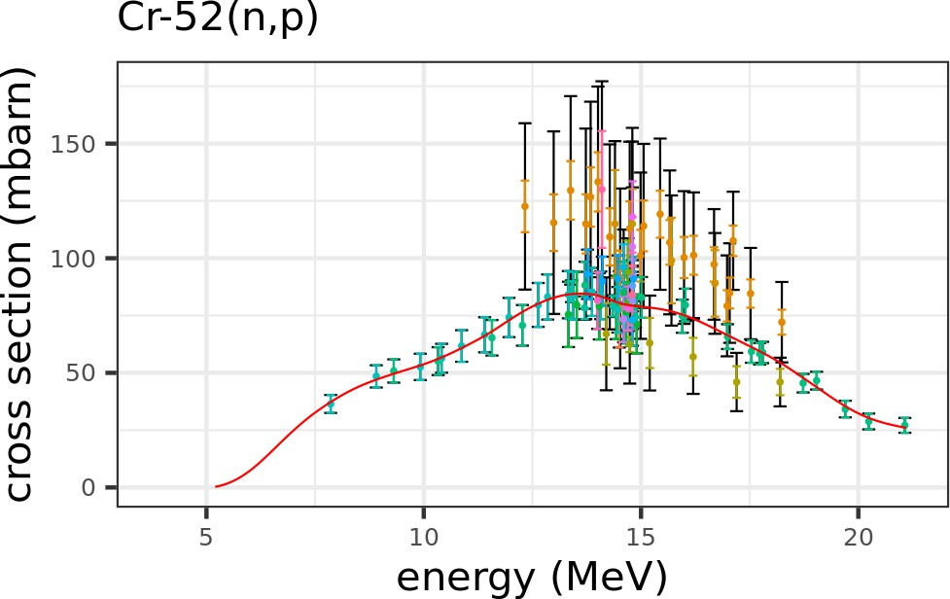
Correction of Systematic Uncertainties
Outliers are assigned inflated normalization uncertainty.
inflated total unc.
posterior mean of linear spline
The presence of unrecognized uncertainties can be identified if data-sets are inconsistent with each other.

Slide 17
Workflow in the Pipeline
is divided into a number of steps, each represented by an R-script.
Data is retrieved from EXFOR → Mapped to TALYS predictions
Rule-based correction of uncertainties in data
Correction of uncertainties based on statistics
Talys parameter sensitivity evaluation
Setup of GP for energy dependence of parameters
Parameter optimization using the LM algorithm
Setup of GP in the observable domain
Re-optimization using the LM algorithm
Calculation of MVN approximation of the posterior pdf
Generation of random files

Slide 18
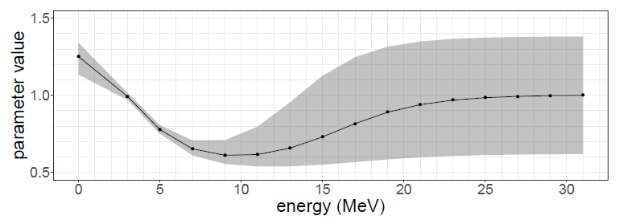

New flexible covariance function in GP- parameter domain.
Energy-dependent parameters^{1,2} around ‘global’ parameters β
The energy dependence modeled with GP
$$y_{j}=f\left(E_{j};{β}+δ(E_{j})\right)+ε;{ } δ_{i}(E)∼GP$$
Smooth variation of parameter values with energy
Consistent physics description at each energy
TALYS conserves the sum-rules
In the presence of model defects, parameter uncertainty is mainly constrained were there is data
[1] P. Helgesson and H. Sjöstrand, “Treating model defects by fitting smoothly varying model parameters: Energy dependence in nuclear data evaluation,” Annals of Nuclear Energy, vol. 120, pp. 35–47, Oct. 2018, doi: 10.1016/j.anucene.2018.05.026.
[2] G. Schnabel, H. Sjöstrand, J. Hansson, D. Rochman, A. Koning, and R. Capote, “Conception and software implementation of a nuclear data evaluation pipeline,” Nuclear Data Sheets, vol. 173, pp. 239–284, 2021.
Notes:
Normal: Model in the model space, Model defect in the observable space.

Slide 19
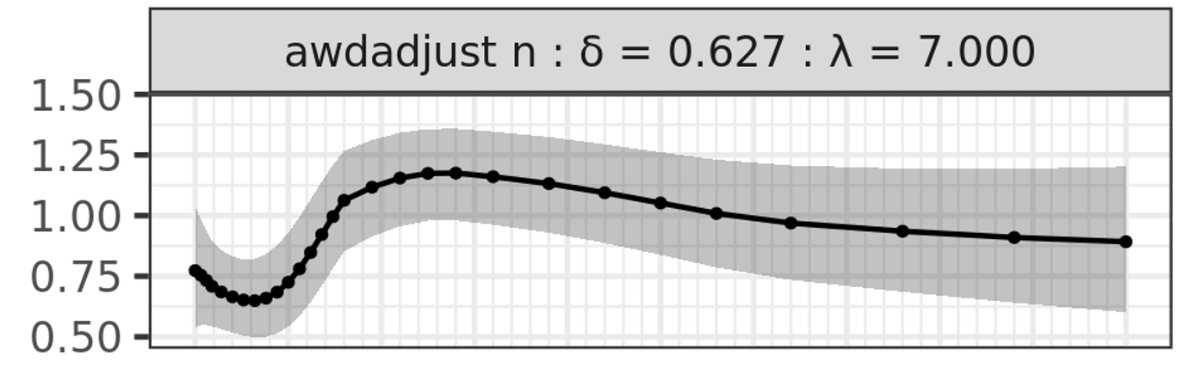
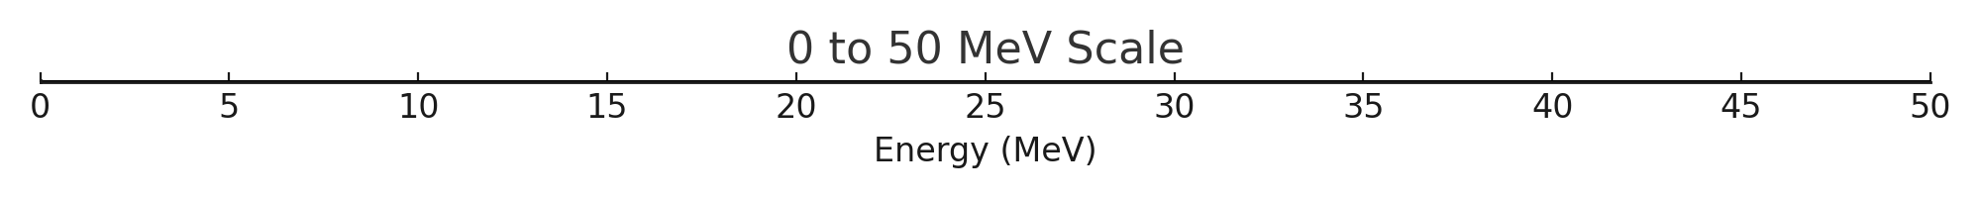
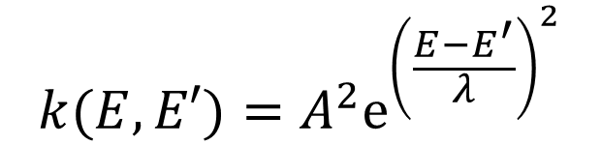

Flexible covariance function in GP- parameter domain.
$$k(E,E′)=A^{2}ⅇ^{{\left(\frac{E−E^{′}}{λ}\right)}^{2}}$$
$$A$$
E represents user-defined energy grid points. Users can define how rapid variations are allowed in different energy regions
Expert knowledge still necessary!

Slide 20
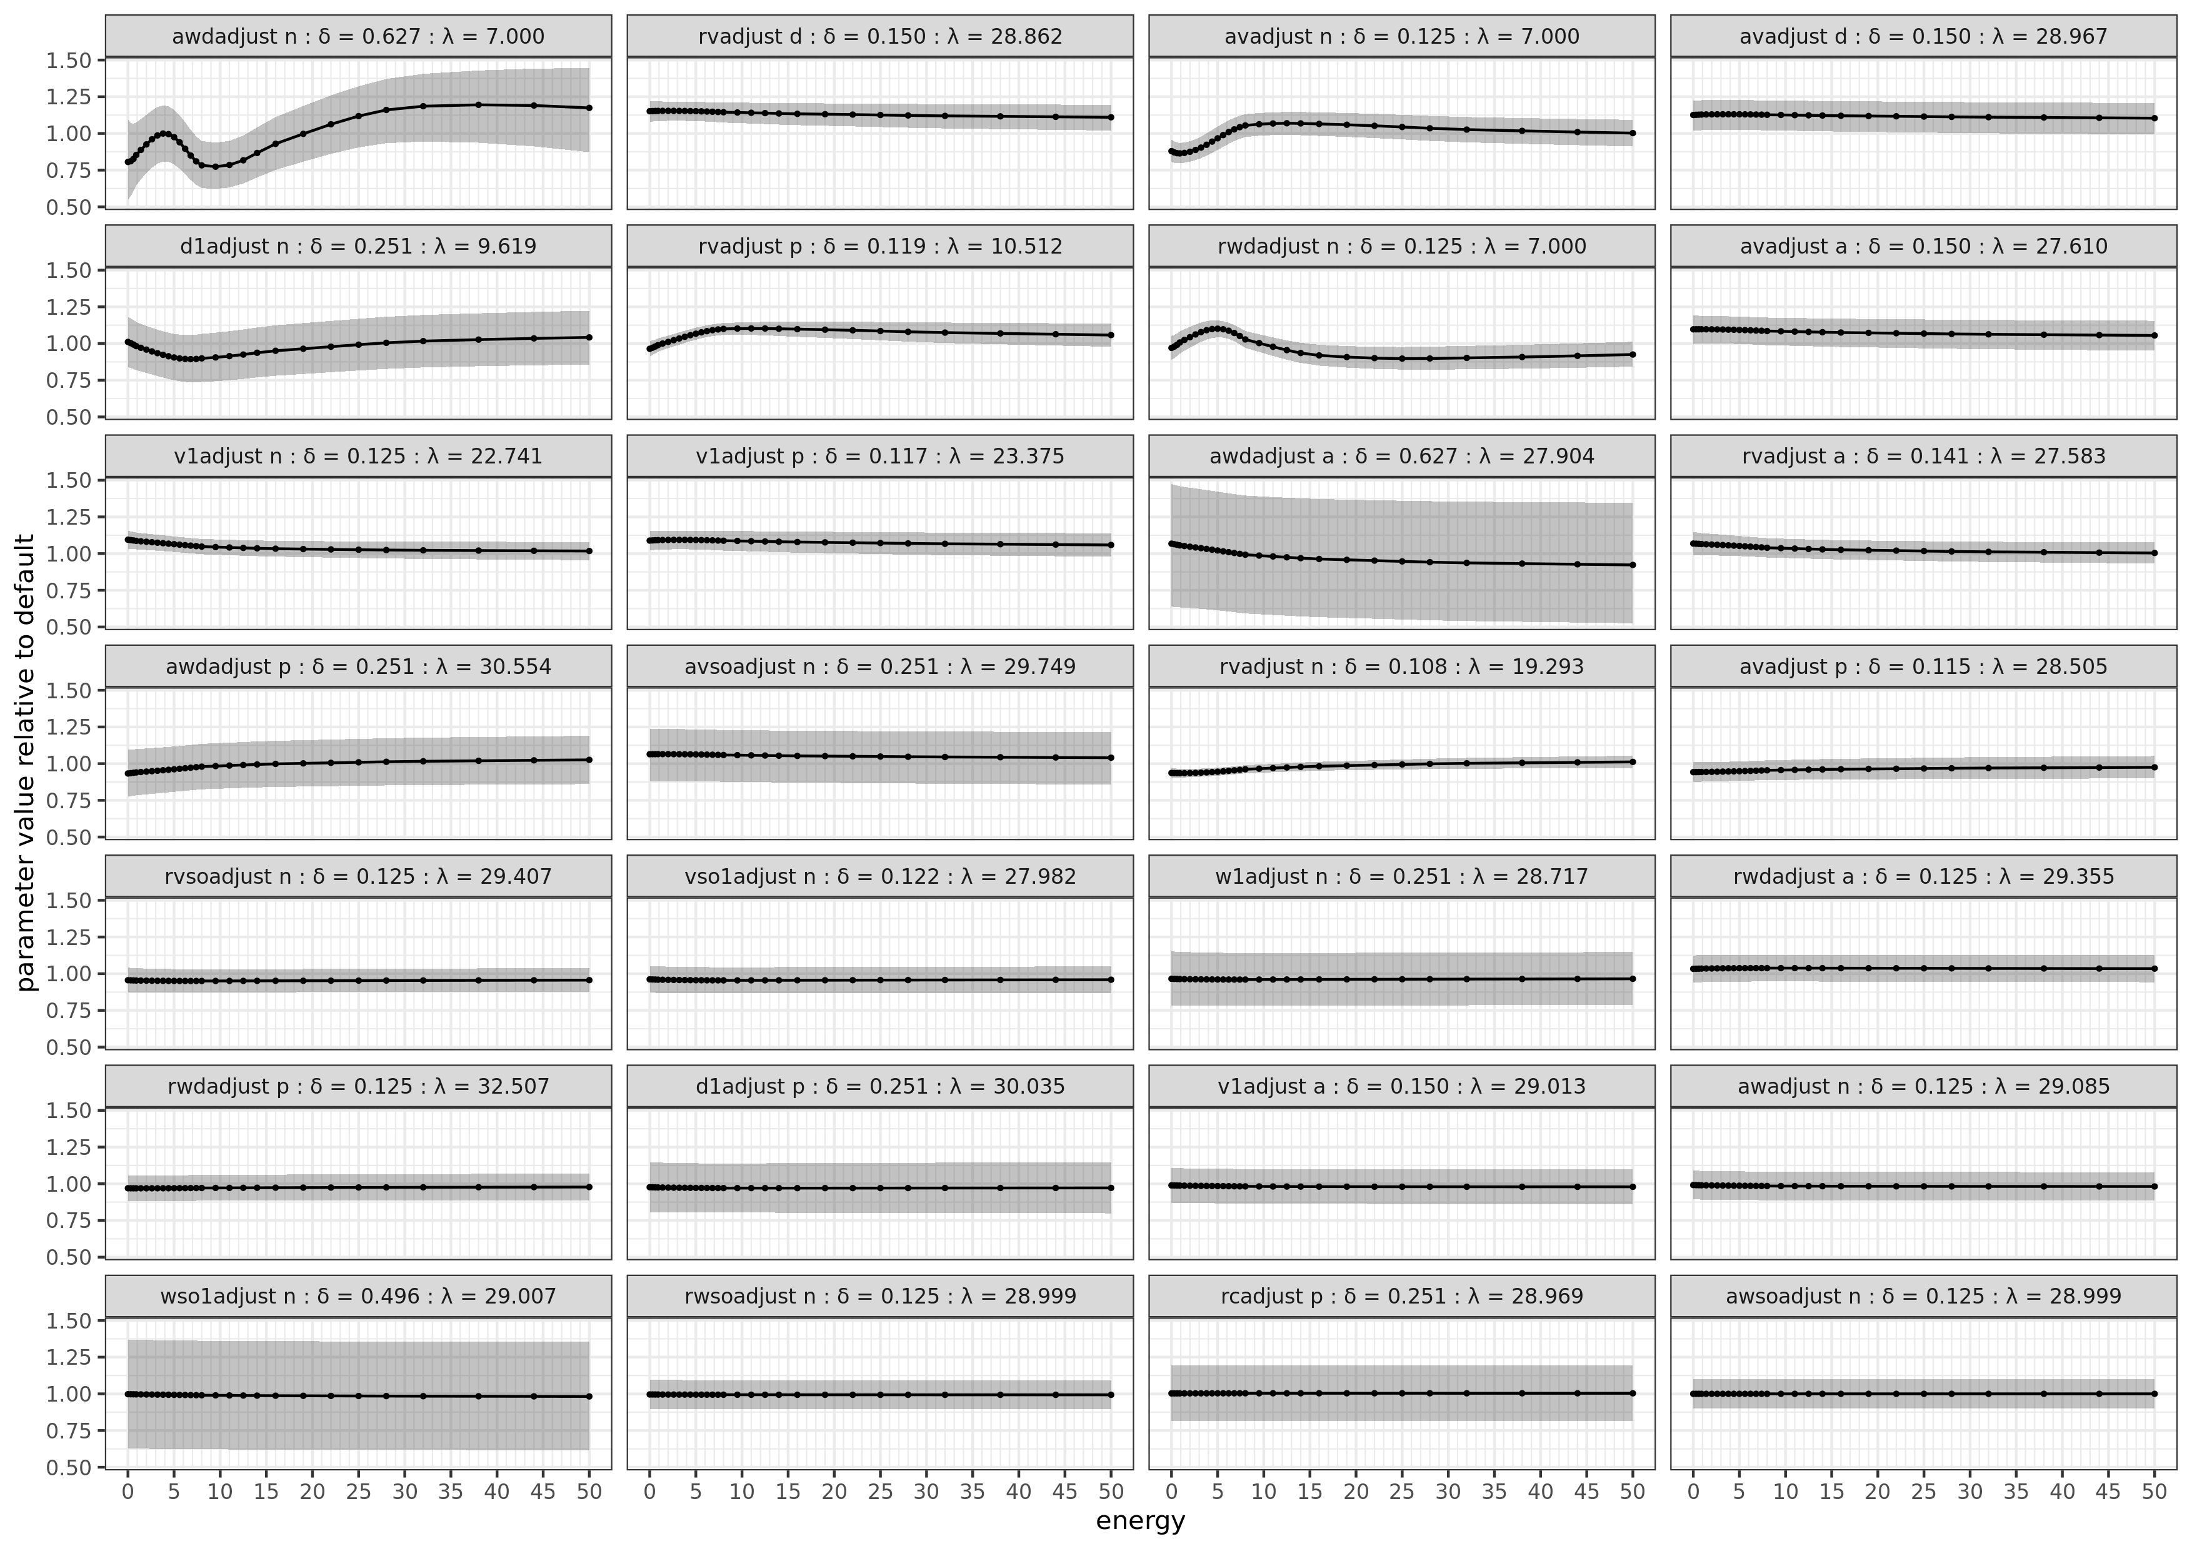
Fe56 parameters

Slide 21
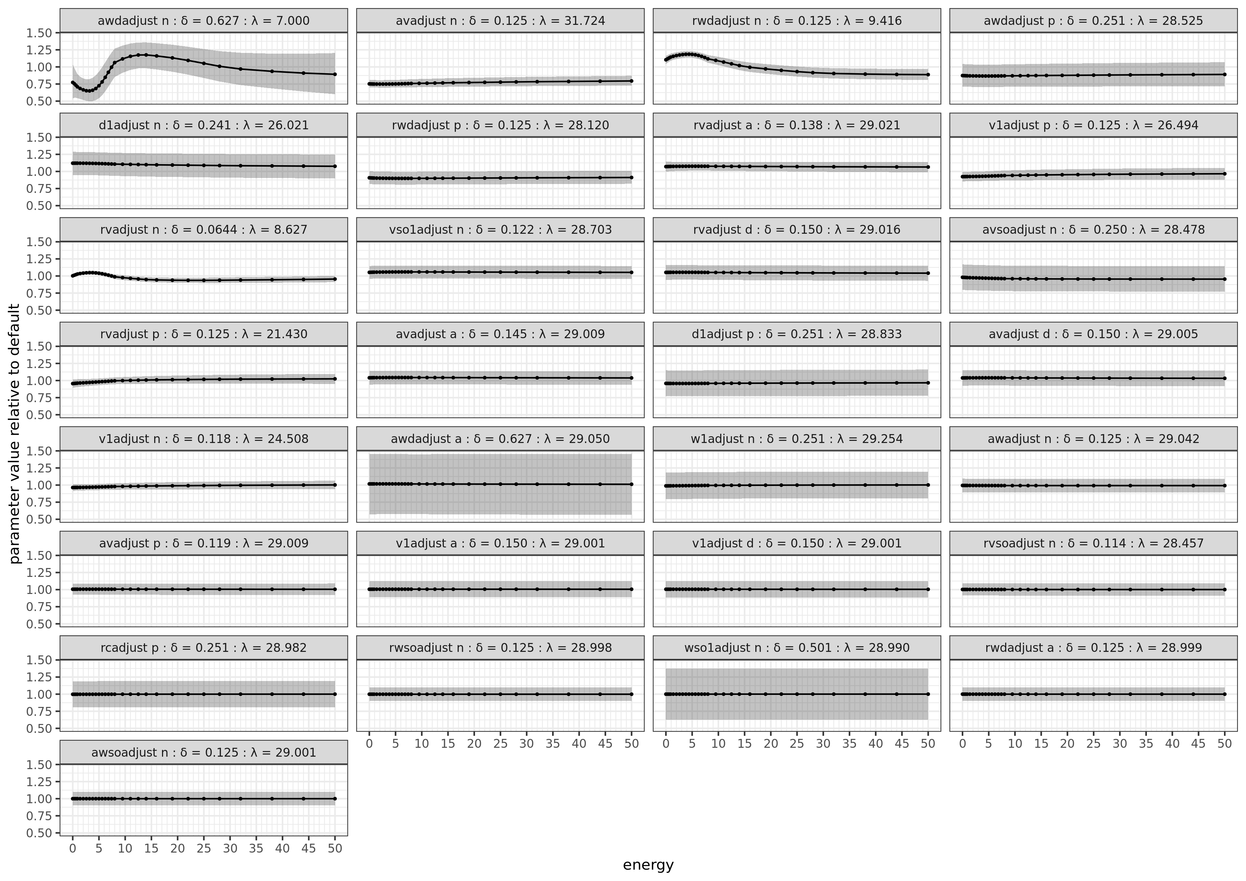
Cr52 parameters

Slide 22
Workflow in the Pipeline
is divided into a number of steps, each represented by an R-script.
Data is retrieved from EXFOR → Mapped to TALYS predictions
Rule-based correction of uncertainties in data
Correction of uncertainties based on statistics
Talys parameter sensitivity evaluation
Setup of GP for energy dependence of parameters
Parameter optimization using the LM algorithm
Setup of GP in the observable domain
Re-optimization using the LM algorithm
Calculation of MVN approximation of the posterior pdf
Generation of random files

Slide 23
GP in the cross-section domain
An advantage of the parameter GP is the conservation of the physics
The freedom may not be large enough to describe all model defects
ε_{m} - describes the residual deviation between experiments and model
ε_{m} - is not added to the final result (to not mess with the physics)
he covariance structure of the GP is retained when fitting the model
$$y_{j}=f\left(E_{j};{β}+δ(E_{j})\right)+ε+εm;{ }εm∼GP$$

Slide 24
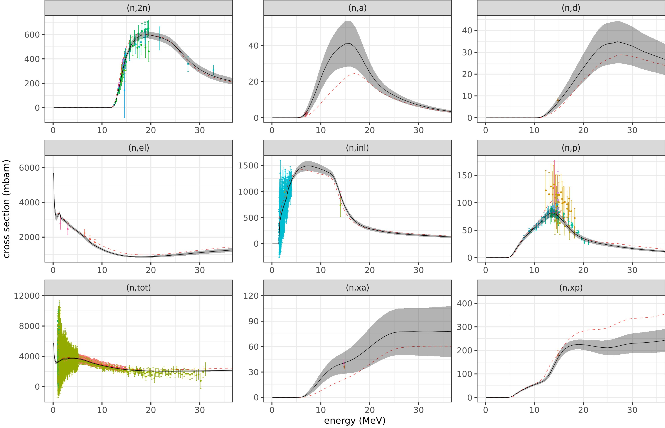
Results – all fitted channels Cr52

Slide 25
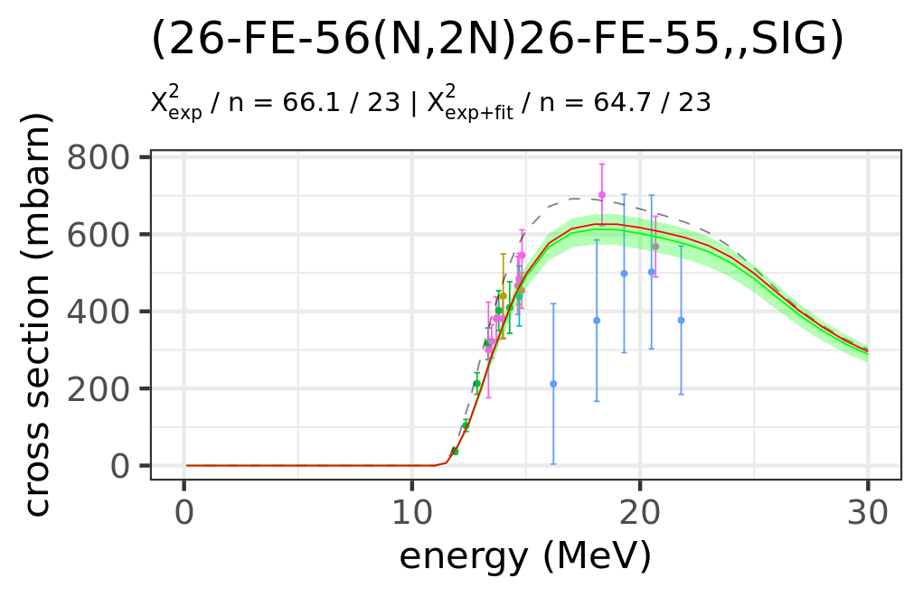
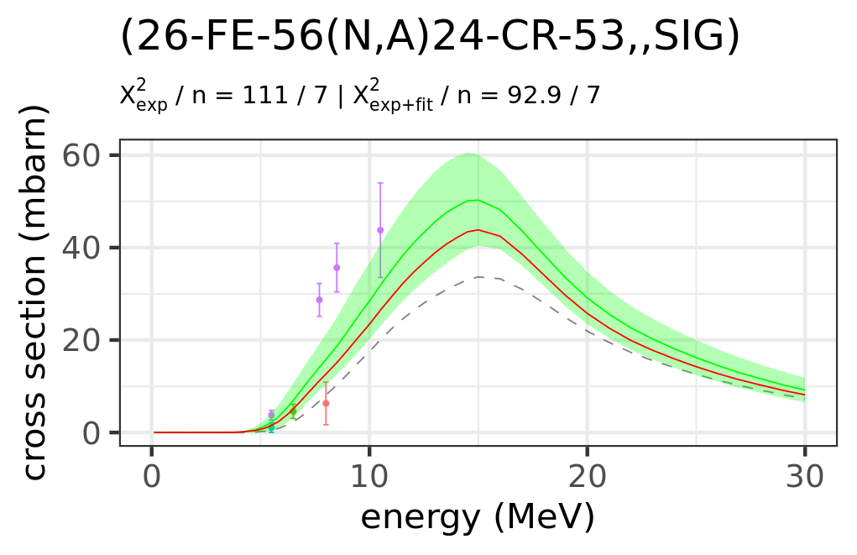
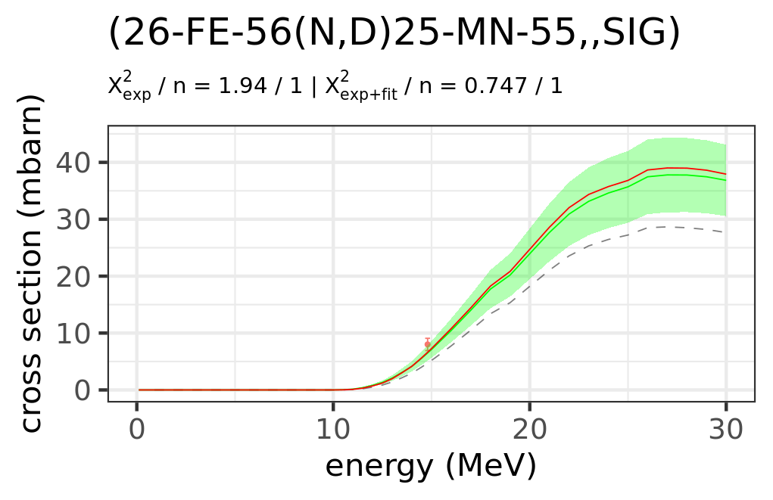
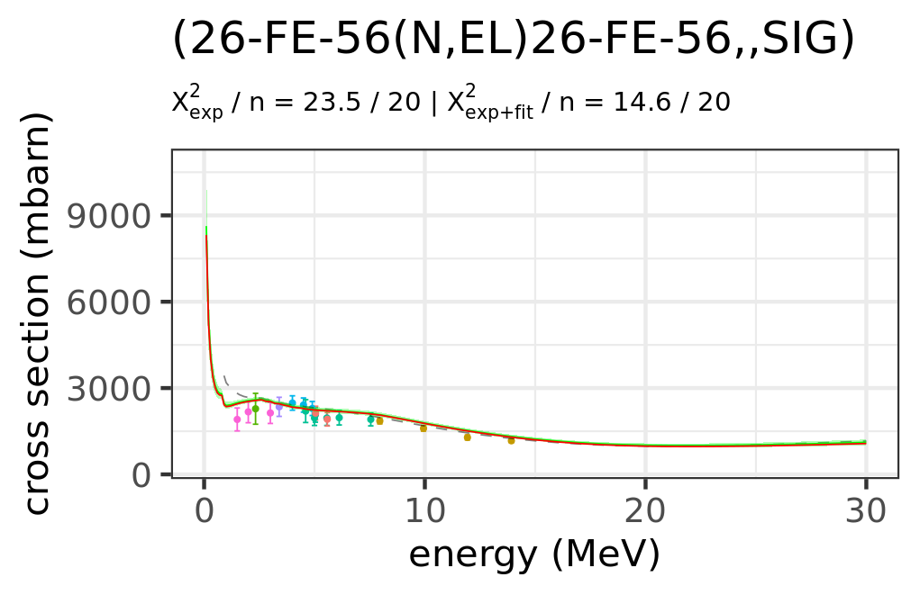
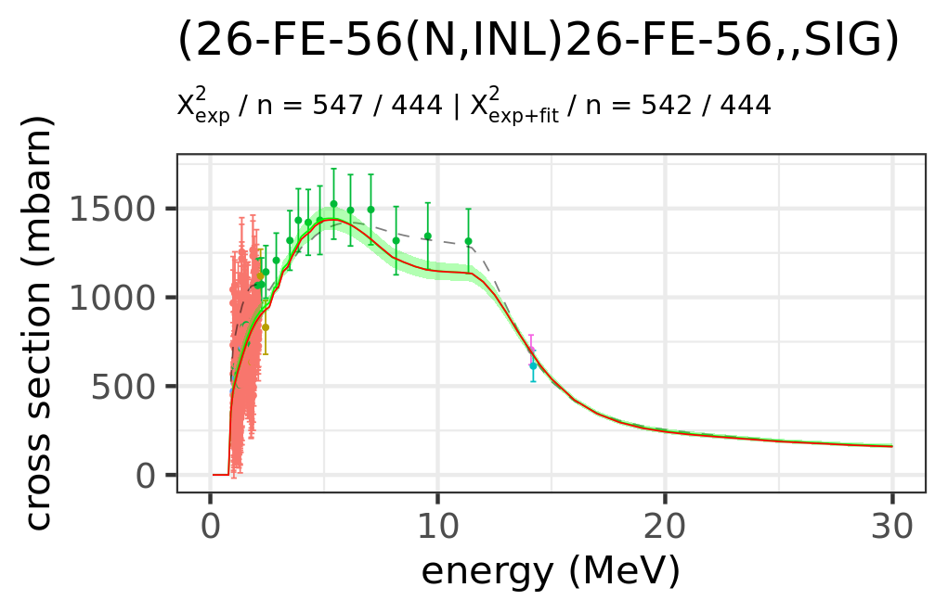
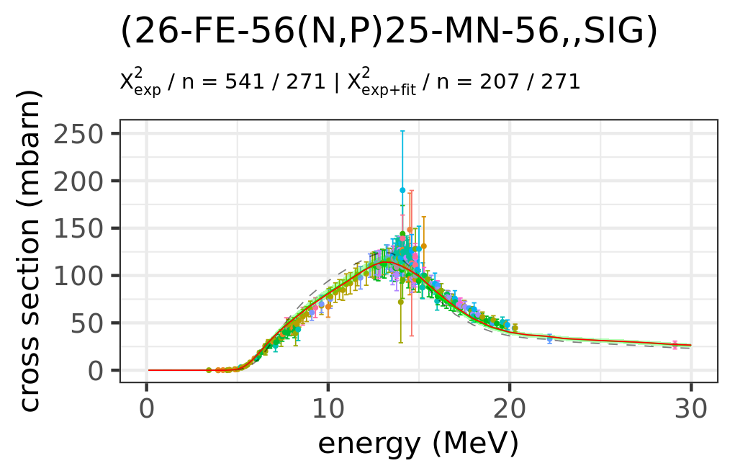
Results Fe56

Slide 26
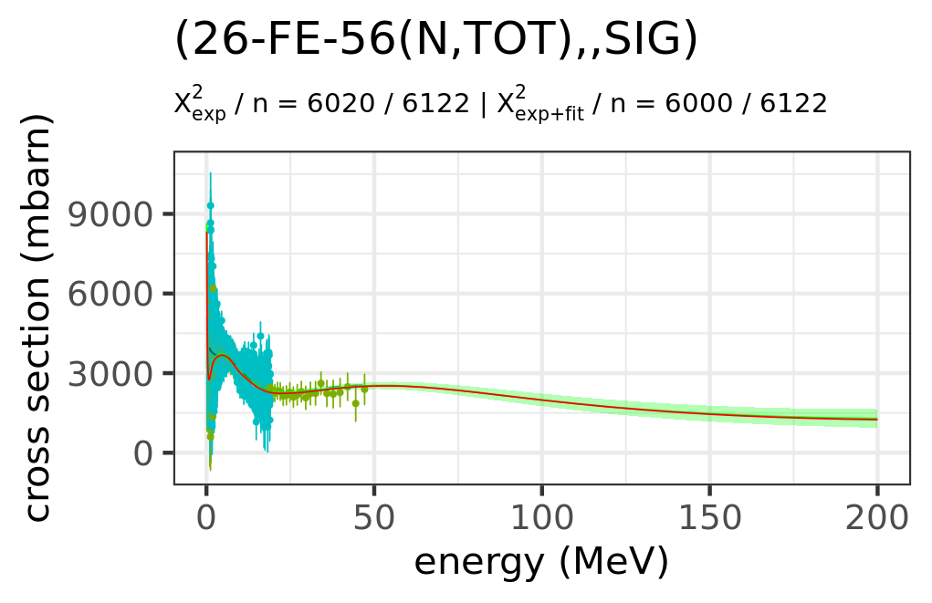
200 MeV (n,tot)

Slide 27
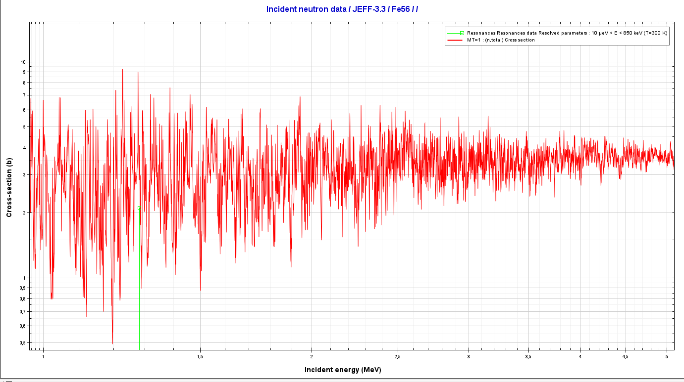
Fine-structure
Energy-dependent Talys parameters cannot reproduce rapid variation in low energy region
(1-10 MeV).
Notes:
What we promised to work on for 2023

Slide 28



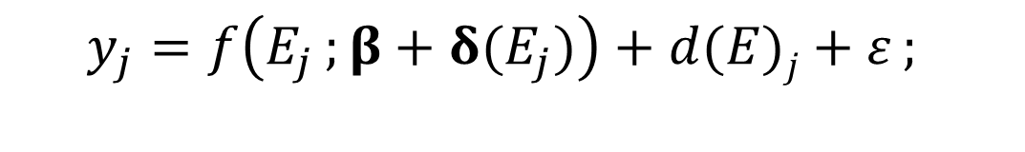
New discrepancy model
tot
$$y_{j}=f\left(E_{j};{β}+δ(E_{j})\right)+d(E)j+ε;{ }$$
elastic
non-elastic
$$ⅆ_{j,ch}\sim GP(E)$$
n,n’_{tot}
$$d_{sum}=Σ_{ch}d_{ch}$$
n,2n
n,a
n,xp
n,d
n,n’₁
n,n’₂
n,n’₃
n,n’₄
n,n’_{k}
…
With a discrepancy function, you can choose which channels to include!
Notes:
Energy dependent Talys parameters cannot reproduce rapid variation in low energy region (1-5 MeV).
Treating model defects with GP in the observable domain while ensuring physical consistency require complex covariance functions.
Construct simple discrepancy model with purpose of ensuring physical consistency,
Only model parameters(d_{ch}) for exclusive channels
Apply GP in the parameter domain of this simple “model” ,d_{j}(E).
Add model to TALYS result
Almost like a GP in the observable domain

Slide 29
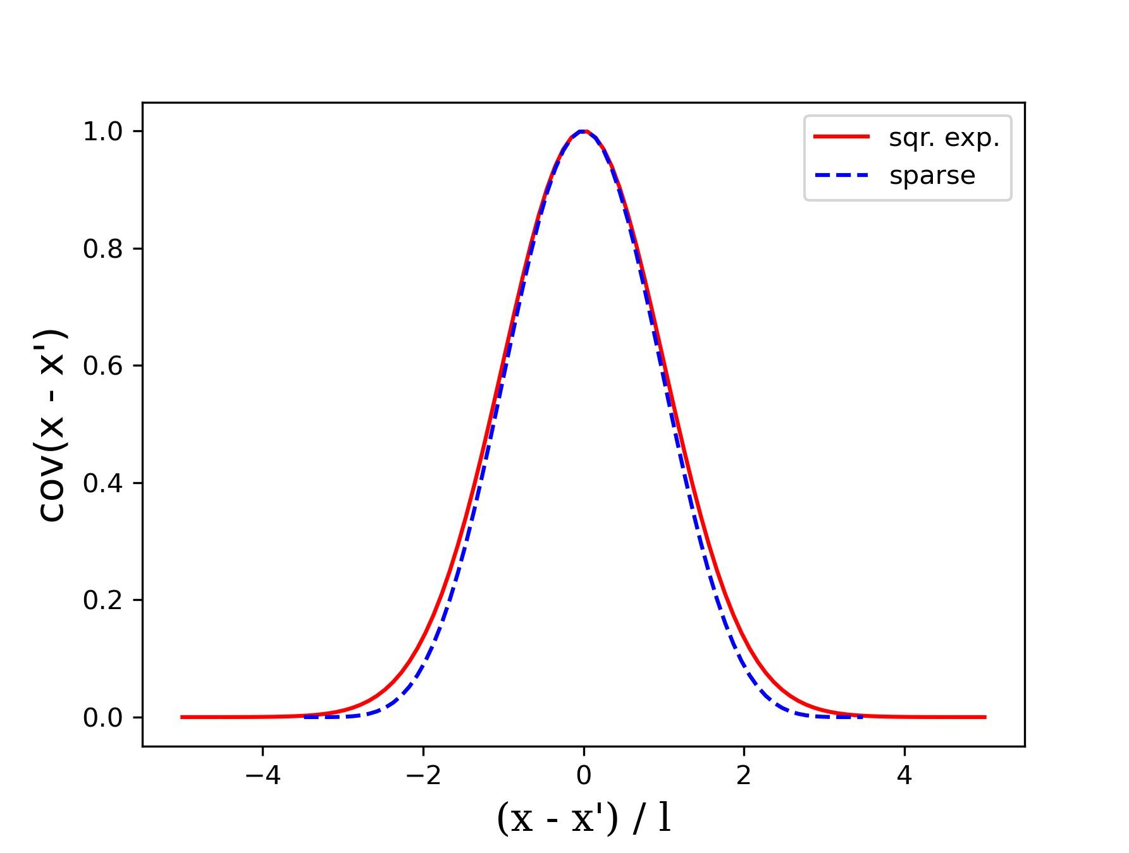
Sparse - GP
GP-regression on large data sets is slow O(N3).
Speed-up is needed.
Solution: Sparse covariance functionª
Truncation → very sparse covariance matrices
less than 1% non-zero elements.
note the vanishing covariance at large values of x − x′.
ªA. Melkumyan and F. Ramos, A Sparse Covariance Function for Exact Gaussian Process Inference in Large Datasets in: IJCAI 2009, 1936-1942
Notes:
This correlation function has large benefits for the present application,
typical length scales needed to reproduce the resonance fluctuations are in the order of a few keV, while
the full data set spans several MeV
When using the
GP only to describe the residual of a model for the energy averaged cross-section the correlation on
the longer energy scale is expected to already be accounted for. The use of the truncated correlation function is thereby motivated.

Slide 30


Energy behaviour
By using a relative prior covariance (using the TALYS predictions,T) → cross-section channel that is expected to be small will also have a smaller expected model defect.
Traditional GP formulation relies on a covariance structure with constant hyper-parameters. I.e., constant amplitude and length scale.
However: Resonances: higher energy → higher level density → smoother cross-sections.
Solution: Heteroscedastic -GPª with a variation in the amplitude. A = (A(E1), . . . , A(En)).
A is given a sparse energy grid
This vector is also set under a GP prior.
$$ⅆ_{j,ch}\sim GP(E)$$
$$k={T^{2}A}^{2}C\left(E, E^{′};λ \right)$$
ªM. Binois and R. B. Gramacy, “hetGP: Heteroskedastic Gaussian Process Modeling and Sequential Design in R,” Journal of Statistical Software, vol. 98, pp. 1–44, July 2021.

Slide 31
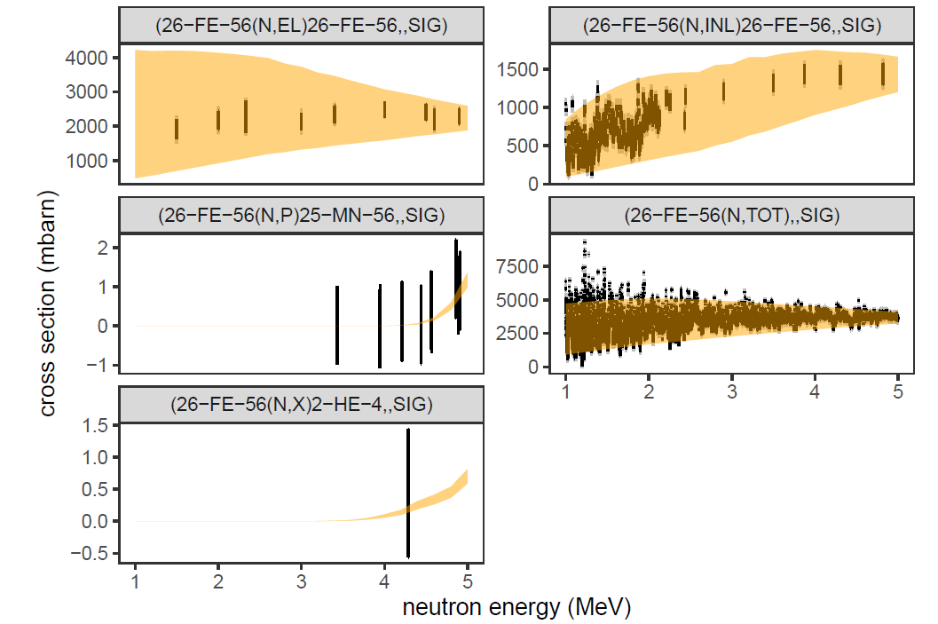
Hyper parameter optimzation
A ~GP, with a zero mean and k_{A}
k_{A} is found through marginal likelihood optimization using L-BFGS-B with numerically computed gradients.
MeV

Slide 32
Energy binning
Since the fluctuations are taken from experimental data, the discrepancy functions energy grid is directly from the experimental data. The data set with the narrowest binning was chosen for this purpose (EXFOR ,22316003)

Slide 33
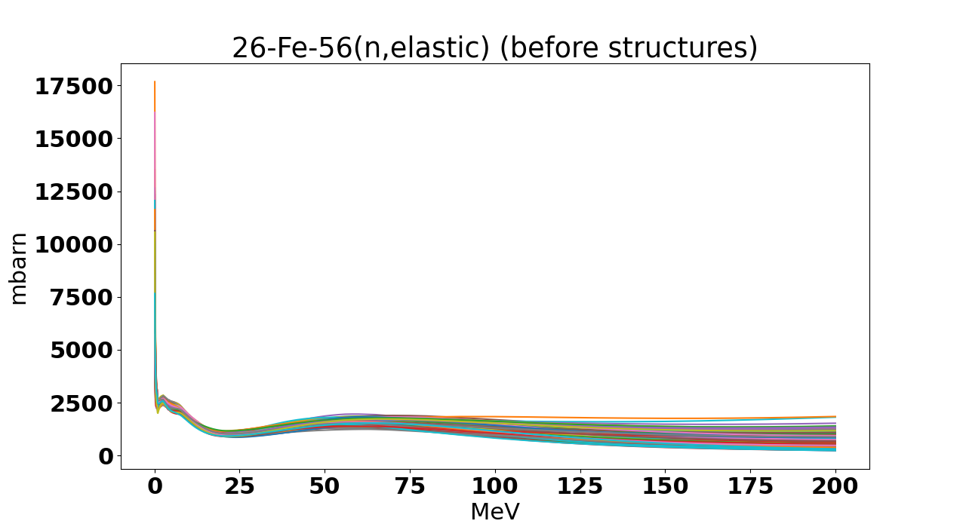
26-Fe-56 (n,elastic) – no structure

Slide 34
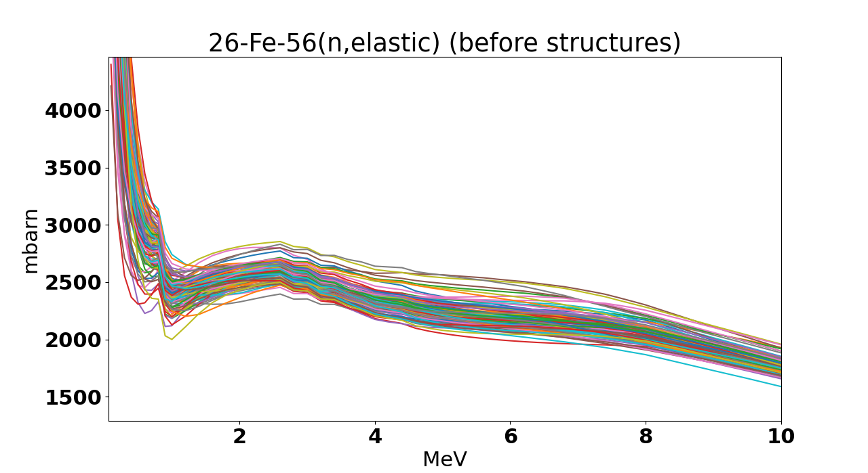

Slide 35
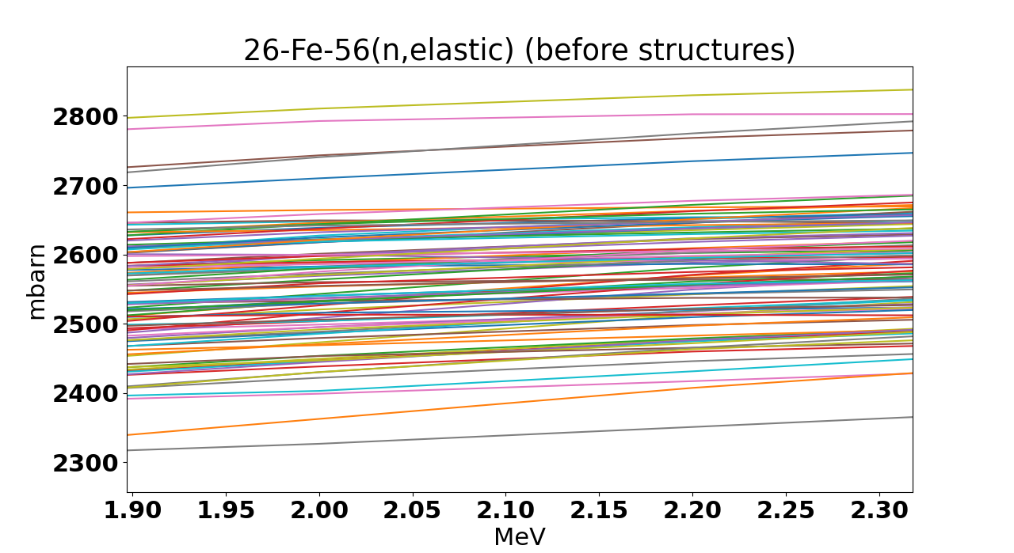

Slide 36
Integrating with TALYS
From TALYS
a large set of random files are created
each with its unique set of model parameters.
From the structure treatment,
discrepancy random files are created.
one structure per TALYS random file (elastic and inelastic)
Plan
Each discrepancy random files are added to the TALYS random files
interpolation of the TALYS cross-sections onto the energy grid of the structure files.
TALYS files provide long range systematic uncertainties, whereas structure provides short-range uncertainties and adaption to data.
This will allow for integration with the rest of TENDL –T6 infrastructure (TASMAN TEFAL) (to be done).

Slide 37
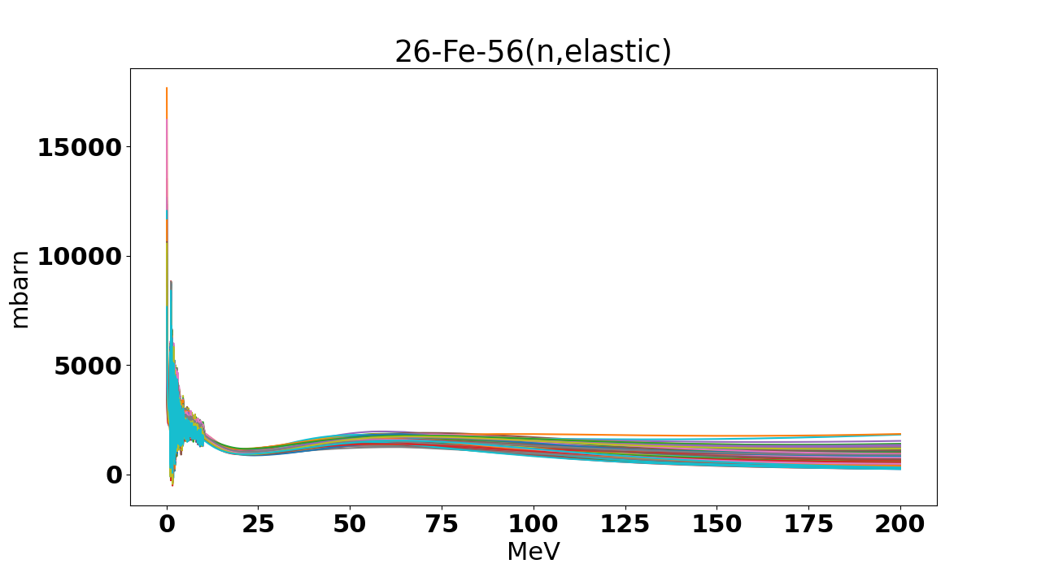

Slide 38
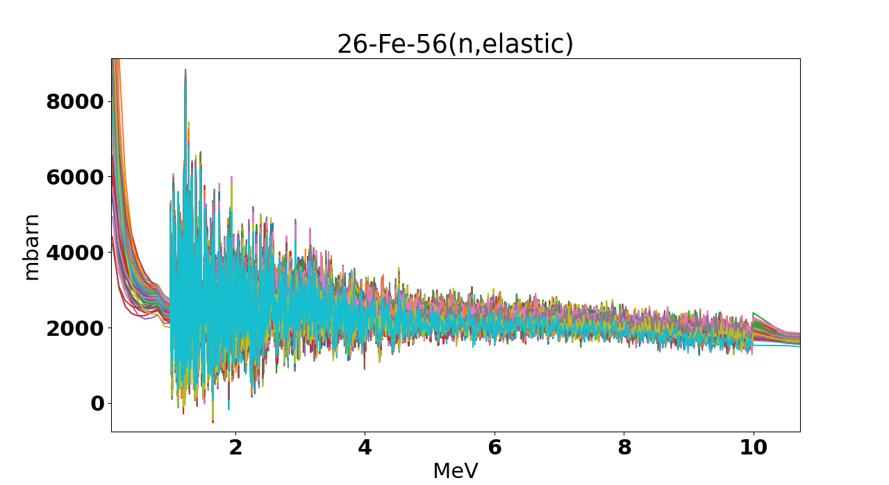

Slide 39
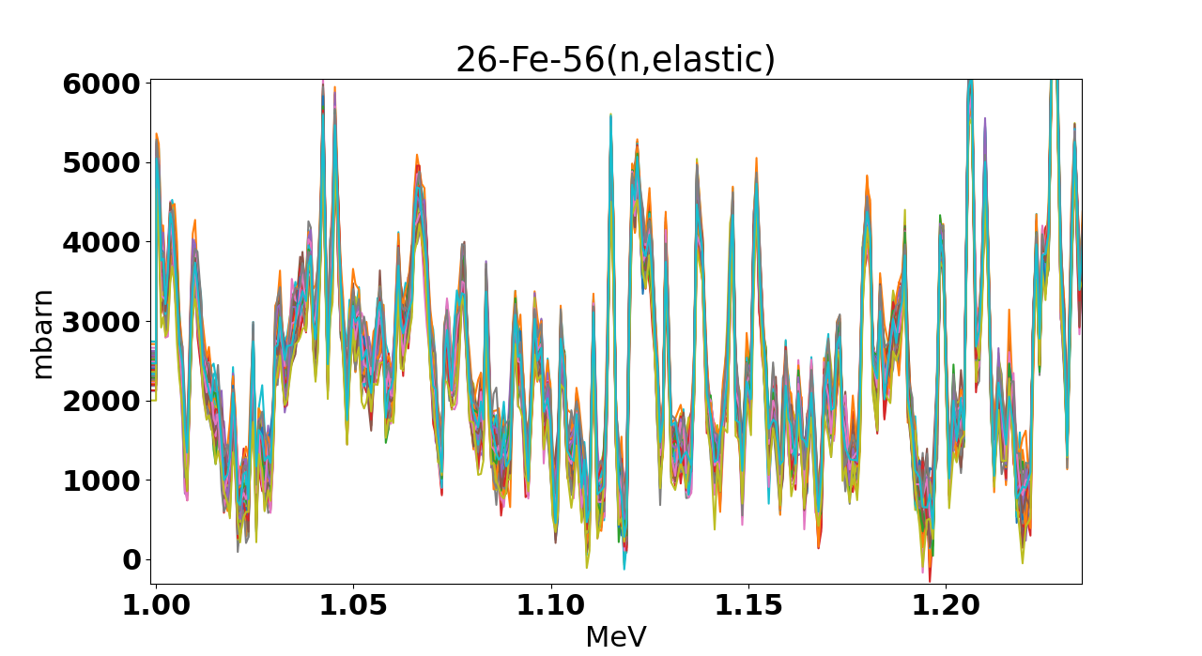

Slide 40
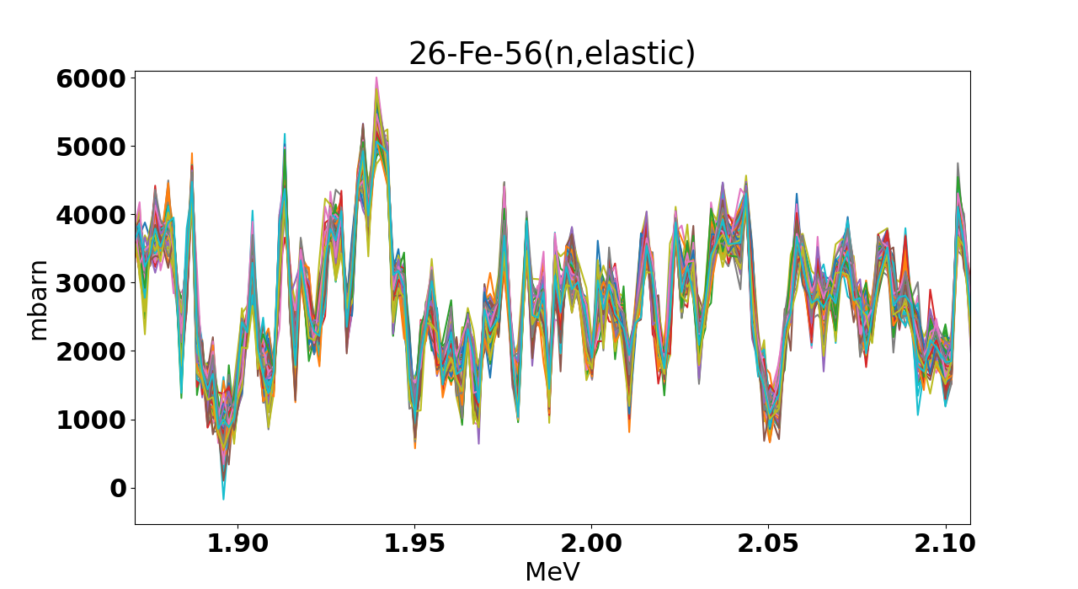

Slide 41
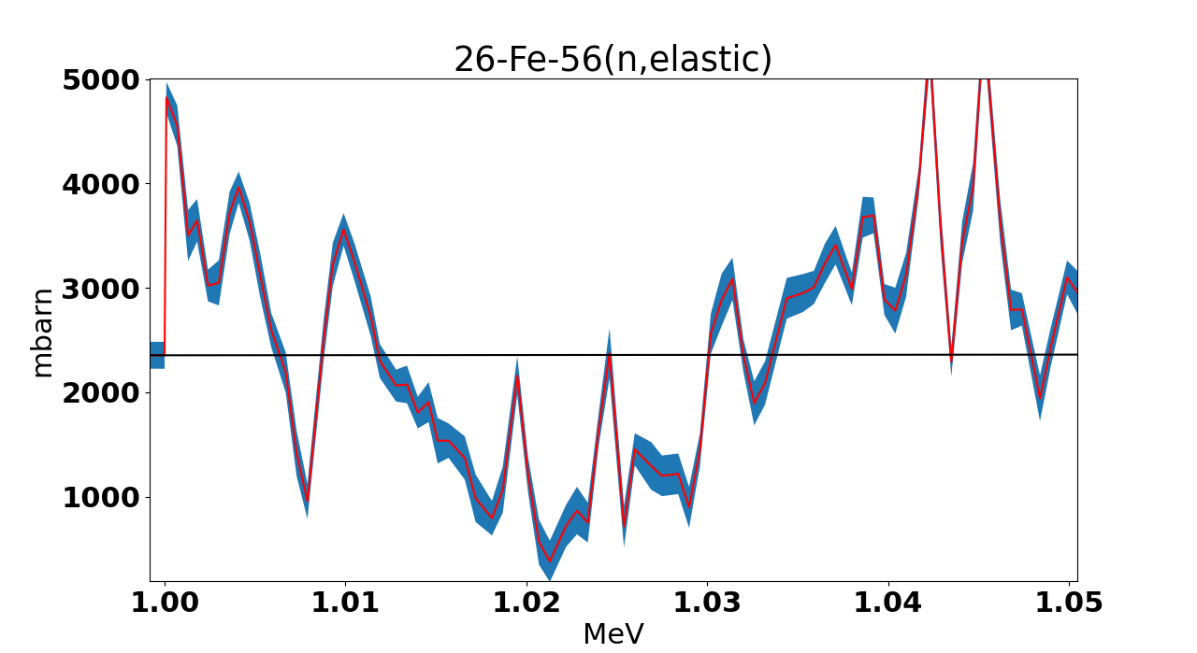

Slide 42
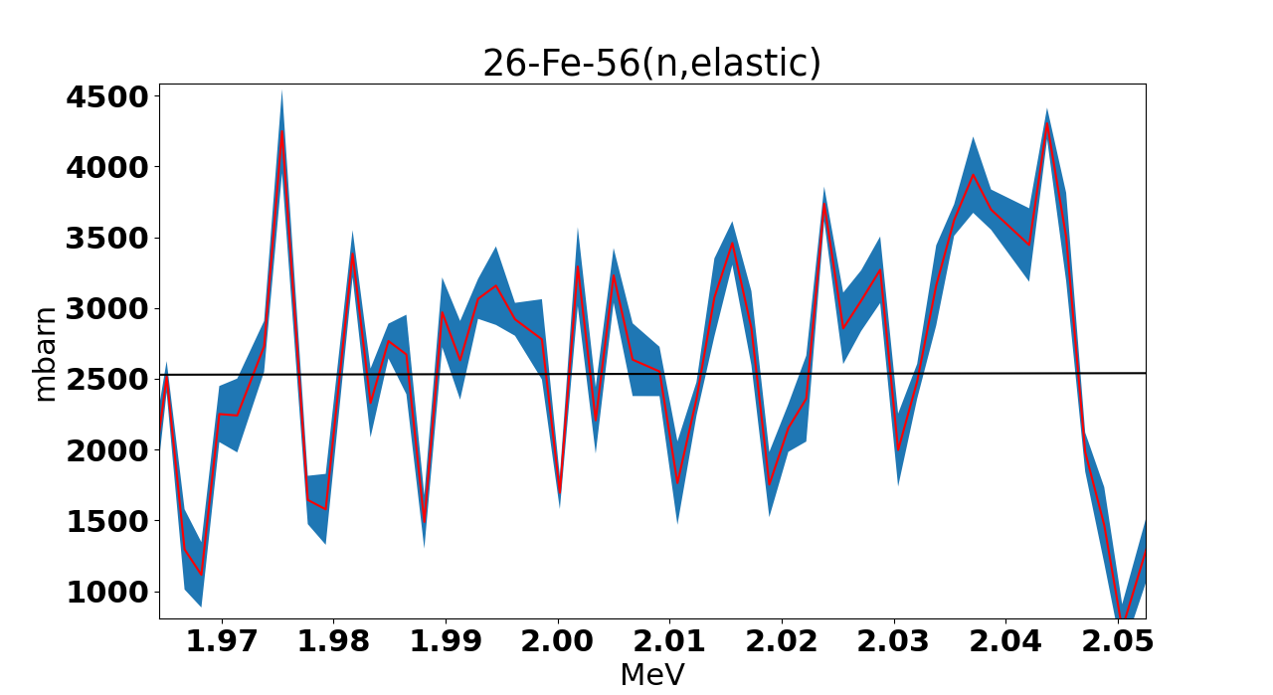

Slide 43
Integrating with TALYS
Plan
Each discrepancy random files are added to the TALYS random files
interpolation of the TALYS cross-sections onto the energy grid of the structure files.
or
Run TALYS with the energy grid of the structure files

Slide 44
On future activities
Generalization of the pipeline
New isotopes
For fusion – Tungsten?
For Aprende - Zr (https://aprende-project.eu/)

Slide 45
Summary & Conclusion
We are developing the Nuclear data Evaluation pipeline of Uppsala (NEPU)
Based on TALYS code system
Implements automatic procedure for
Treatment of inconsistent experimental data
treatment of resonance structure based on heteroscedastic GP
Treatment of model defects
Treatment of fine-structure
designed for fully reproducible ND evaluations
Application of the pipeline to Cr52 and Fe56 has been presented.

Slide 46

Questions

Slide 48
Cross-validation – results
•
•
Overall good performance.
Indicates that the automated procedures perform well.
A slight tendency to overestimate uncertainties is noted.
DATASET | ndf | _{χ}2 | χ²/ndf
1 | 1731 | 1735.56 | 1.00
2 | 1731 | 1732.94 | 1.00
3 | 1729 | 1755.52 | 1.02
4 | 1730 | 1498.83 | 0.87
5 | 1730 | 1659.85 | 0.96
sum | 8651 | 8378.70 | 0.97±0.02
1.0
χ² / ndf
0.5
0.0
1
2
3
DATASET
4
5

Slide 49
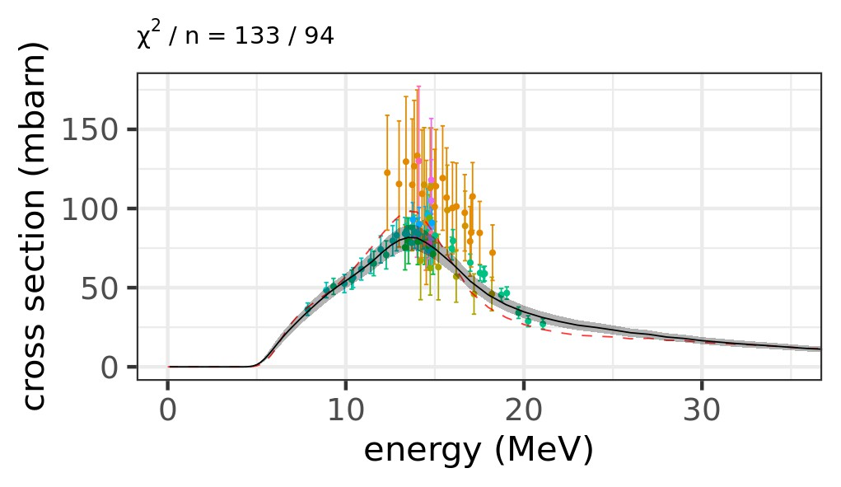
Cross-validation – results per channel
1.5
⁵²Cr(n,p)
χ² / ndf
1.0
0.5
0.0
(n,2n)
(n,inl)
(n,p)
(n,tot)
•
Only channels with > 5 data points included here.

Slide 50
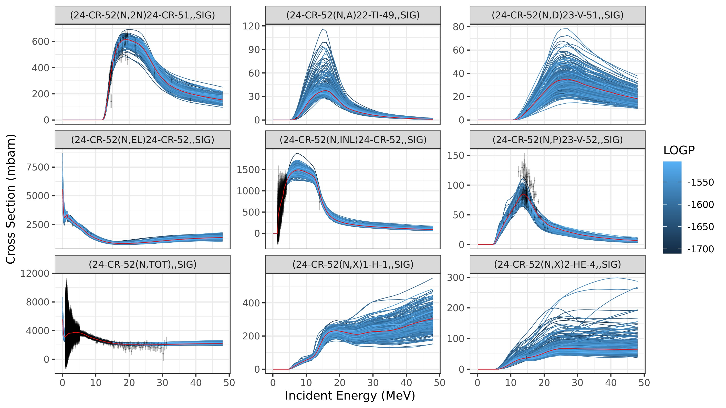
Cross section samples

