Slide 1
Validation studies of the tungsten isotopes for the JEFF-4 Library
Andrej Trkov on behalf of the INDEN network
Jožef Stefan Institute, Jamova cesta 39, 1000, Ljubljana, Slovenia

Slide 2
Summary of new/modified evaluations
U-235, U-238: new evaluations provided by Gilles Noguere for JEFF-4t5
Th-232: The following changes were introduced:
Elastic angular distributions up to 1.5 MeV taken from JENDL-5.0 (EMPIRE problem)
Subthreshold fission cross section up to 0.7 MeV taken from JENDL-5.0 (fix)
Capture cross section in the energy range 50 – 500 keV taken from JENDL-5.0
U-233: Starting from “u233jeff4t3.endf”, replace capture by JENDL-5.0 in the energy range 600 eV - 20 MeV (driven by CEA PROFIL experiment)
U-233 (still to do):
Merge resonance parameters up to 2.5 keV
Use nubar from ENDF/B-VIII.1, renormalize to thermal value (thermal to 50 keV)
Tungsten isotopes: fine-tuning of capture cross sections
W-182 JENDL-5.0 (112-170 keV), JEFF-3.3 (0.5-15 MeV)
W-183 JEFF-3.3 (255-600 keV)
W-184 JENDL-5.0 (10 keV-20MeV)

Slide 3
Objective
Validate ENDF/B-VIII.1 (label “e81a”) and JEFF-4t4 (label “jeff4t4”)
Test the impact of refined tungsten isotope evaluations (label “f4t3U358ThAl3Wg”)

Slide 4
Tungsten Benchmarks
No. ICSBEP Label Short name Common name Comment
-----------------------------------------------------------------------------
1 IEU-MET-FAST-013 imf013 ZPR-9/1 Tungsten
2 IEU-MET-FAST-014 imf014-002 ZPR-9/2 Tungsten
3 IEU-MET-FAST-014 imf014-003 ZPR-9/3 Tungsten
4 HEU-MET-FAST-060 hmf060-004 ZPR-9/4 Tungsten ; Al
5 HEU-MET-FAST-067 hmf067-005 ZPR-9/5 Tungsten ; Al ; Graphite
6 HEU-MET-FAST-067 hmf067-006 ZPR-9/6 Tungsten ; Al ; Graphite
7 HEU-MET-FAST-070 hmf070-007 ZPR-9/7 Tungsten ; Al
8 HEU-MET-FAST-070 hmf070-008 ZPR-9/8 Tungsten ; Al ; Be
9 HEU-MET-FAST-070 hmf070-009 ZPR-9/9 Tungsten ; Al ;
10 HEU-MET-FAST-003 hmf003-008 Topsy-W_1.9in LANL Tungsten
11 HEU-MET-FAST-003 hmf003-009 Topsy-W_2.9in LANL Tungsten
12 HEU-MET-FAST-003 hmf003-010 Topsy-W_4.5in LANL Tungsten
13 HEU-MET-FAST-003 hmf003-011 Topsy-W_6.5in LANL Tungsten
14 HEU-MET-FAST-049 hmf049-001 KFBN2-1cm Tungsten
15 HEU-MET-FAST-049 hmf049-002 KFBN2-3cm Tungsten
16 HEU-MET-FAST-049 hmf049-003 KFBN2-8cm Tungsten
17 HEU-MET-FAST-050 hmf050 KFBN2-f1 Tungsten
18 HEU-MET-FAST-052 hmf052 KFBN2-f2 Tungsten ; Be ; U238
19 HEU-MET-MIXED-017 hmm017 KFBN2-f3 Tungsten ; PE
20 HEU-MET-FAST-084 hmf084-14 Comet-W_1.0in Tungsten
21 HEU-MET-FAST-084 hmf084-25 Comet-W_0.5in Tungsten
22 HEU-MET-FAST-085 hmf085-006 Comet-W_2.0in Tungsten
23 PU-MET-FAST-005 pmf005 Planet-Pu/W1.8in LANL Tungsten
24 U233-MET-FAST-004 umf004-001 Planet-U3/W_1in LANL Tungsten
25 U233-MET-FAST-004 umf004-002 Planet-U3/W_2in LANL Tungsten
-----------------------------------------------------------------------------

Slide 5
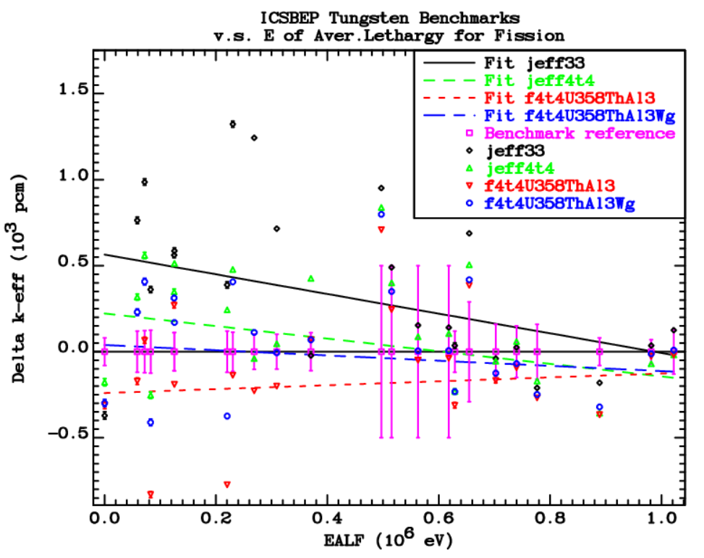

Slide 6
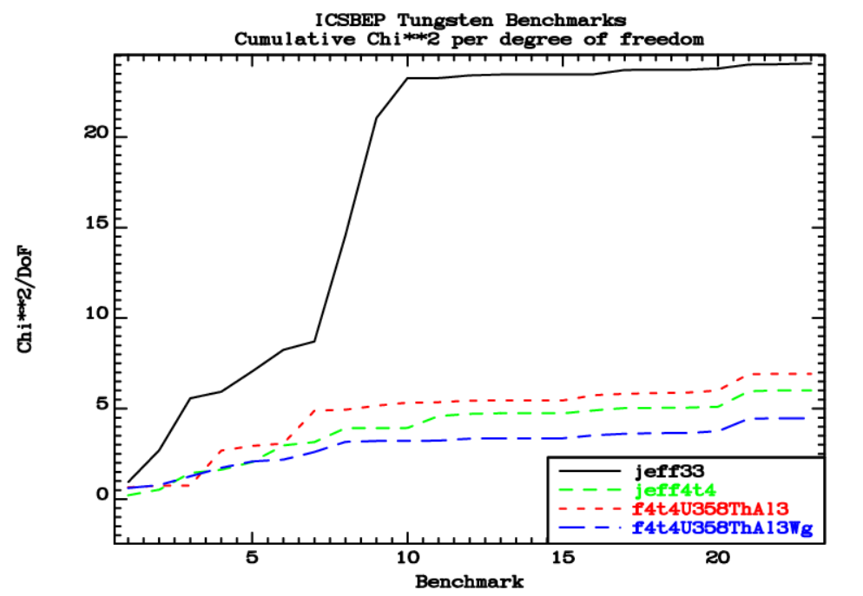

Slide 7
Conclusions
Improving tungsten evaluations proved more tricky than initially anticipated
Cross section curves for capture were refined considering (new) experimental data
In combination with other improvements in the JEFF-4t5 candidate evaluations, considerable improvement in performance of the tungsten evaluations was observed
Improvements in tungsten for the ENDF/B-VIII.1 library are not so clear-cut

