Slide 1
Updates on neutron-induced reaction cross section measurements on structural materials
M. Diakaki¹, G. Gkatis^{1,2}, A. Karakaxi^{1,2}, A. Mengoni^{3,4},
G. Noguere², C. Paradela⁵, E. Pirovano⁶, A. Plompen⁵,
P. Schillebeckx
¹ Department of Physics, National Technical University of Athens, 15780 Athens, Greece
² CEA/DES/IRESNE/DER/SPRC/LEPh, Cadarache, 13108 Saint Paul Lez Durance, France
³ European Organisation for Nuclear Research (CERN), Switzerland
⁴ ENEA Bologna / INFN, Sezione di Bologna, Italy
⁵ European Commission, Joint Research Centre, 2440 Geel, Belgium
⁶ Physikalisch-Technische Bundesanstalt, 38116 Braunschweig, Germany
INDEN meeting on Structural Materials, 16-20 December 2024, IAEA

Slide 2
OUTLINE
Neutron scattering measurements at the ELISA setup (GELINA facility) with enriched Fe samples (⁵⁴Fe, ⁵⁶Fe)
Transmission measurements with natural Fe samples.
I will not show new results on direct capture (the same from last year)
Near future perspectives
The ⁵⁴Fe, ⁵⁶Fe is the PhD thesis of Georgios Gkatis (CEA Cadarache-NTUA).
A new PhD student is starting soon on the continuation with the Cu isotopes.

Slide 3
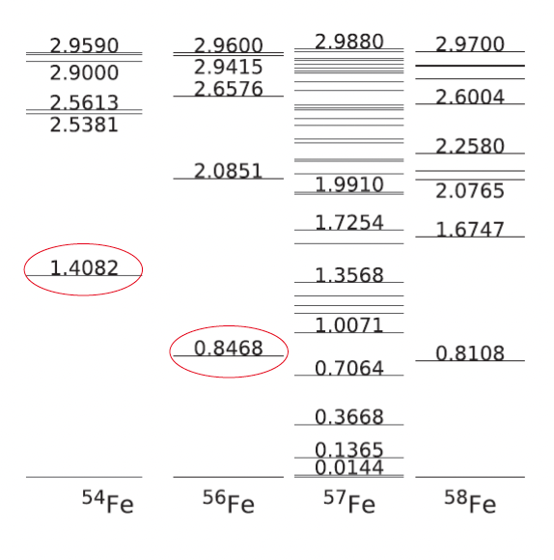
Experimental campaign at GELINA
Neutron induced scattering (elastic/inelastic) on Iron isotopes at GELINA with highly enriched targets: ⁵⁶Fe, ⁵⁴Fe
Transmission measurements using natural Fe samples of different thicknesses

Slide 4
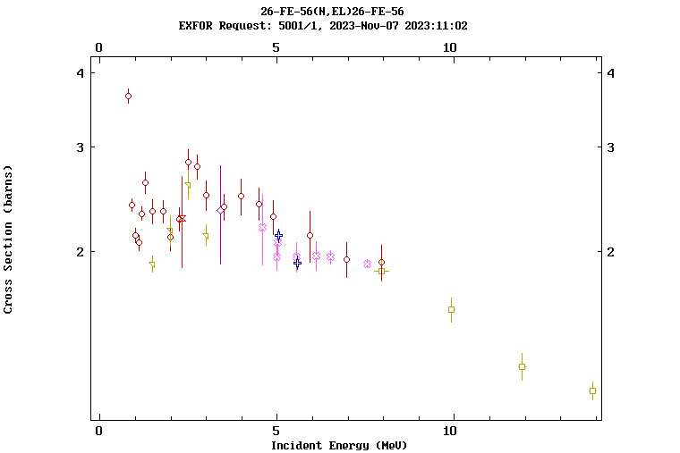
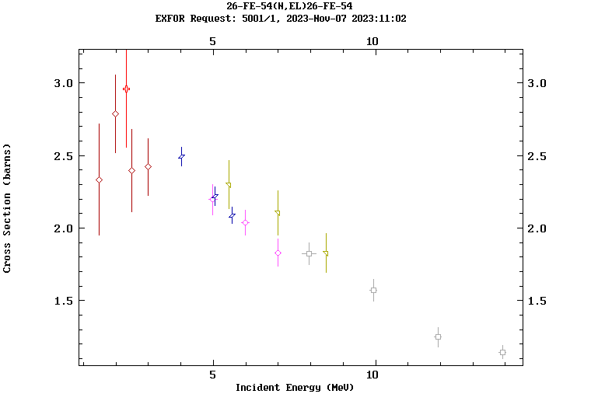
Neutron scattering on ⁵⁴Fe and ⁵⁶Fe with the ELISA setup (JRC-Geel)
E_{n} ~ 1-6 MeV:
No theoretical model able to reproduce the fluctuating behavior present in medium-mass nuclei
Neutron scattering dominant BUT difficult to measure => Cross section data very limited and scarce even for very important isotopes (double differential and angle integrated)
EXFOR data on Fe(n,el)
⁵⁶Fe
⁵⁴Fe
=> Evaluated (n,el) data often obtained by subtracting total and competing reaction cross sections
Notes:
2 proton based kai 2 deuteron based per angle.

Slide 5
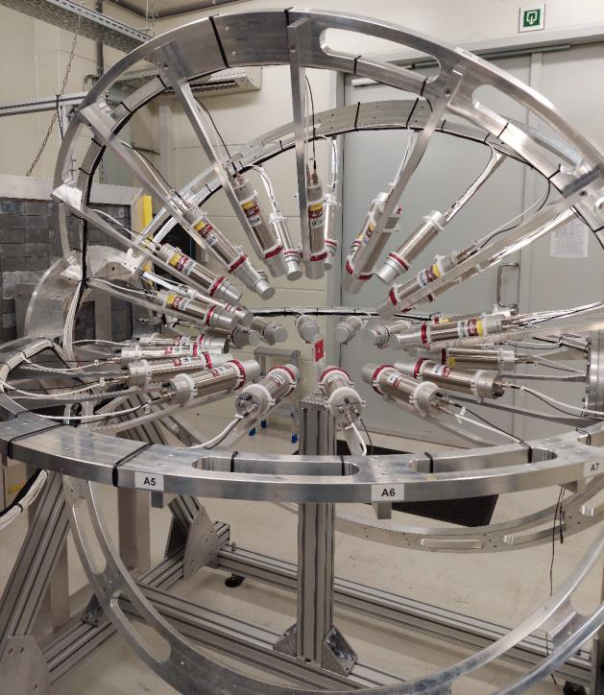
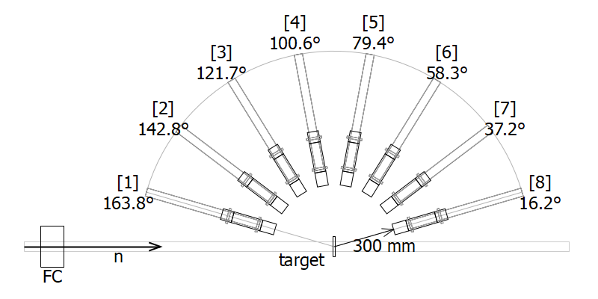
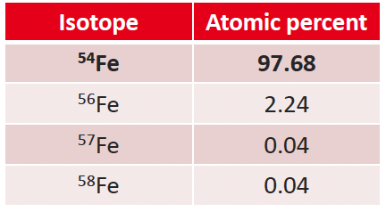
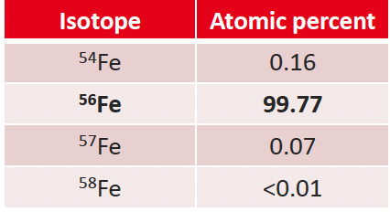
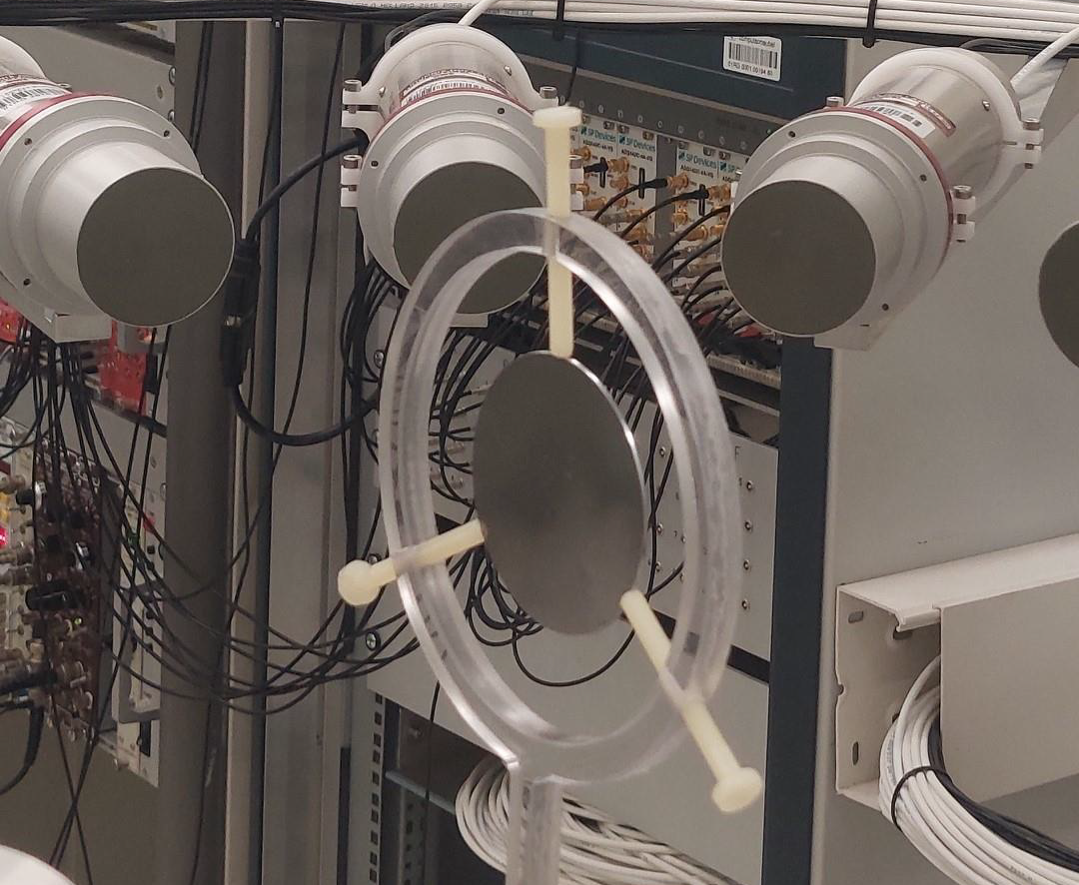
Neutron scattering on ⁵⁴Fe and ⁵⁶Fe with the ELISA setup (JRC-Geel)
ELISA setup (Elastic and Inelastic Scattering Array)*:
High-resolution neutron scattering double differential cross section data E_{n} ~1-8 MeV
32 liquid organic scintillators at 8 scattering angles : detection of scattered neutrons
4 detectors per angle for redundancy/ cross checks (2 types of detectors per angle : EJ301, EJ315).
Fission chamber (1.37m from the sample) : measurement of the neutron flux
The setup is placed at a 30 m distance from the GELINA neutron source (FP1_30m).
Already used for (n,el) on natural Iron [2] -> this experiment lacked statistics.
Highly enriched targets:
⁵⁴Fe
⁵⁶Fe
^{*[1]}M. Nyman et al., EPJ Web of Conferences 239, 17003 (2020)
^{[2]}E. Pirovano et al., Phys. Rev. C 99, 024601 (2019)
Notes:
Two types of measurements were performed. One
with the sample in place (sample-in) that lasted almost
360 hours, and a second one without the sample (sampleout)
that lasted for almost 330 hours. The sampleout
measurement was carried out in order to establish
the background contribution from in-beam neutrons that
scattered once or multiple times in the air and surrounding
materials and then got detected by one of the scintillators.

Slide 6
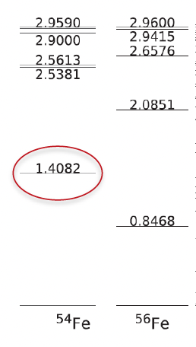
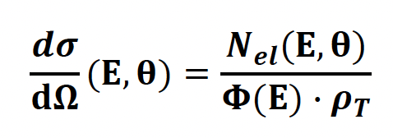
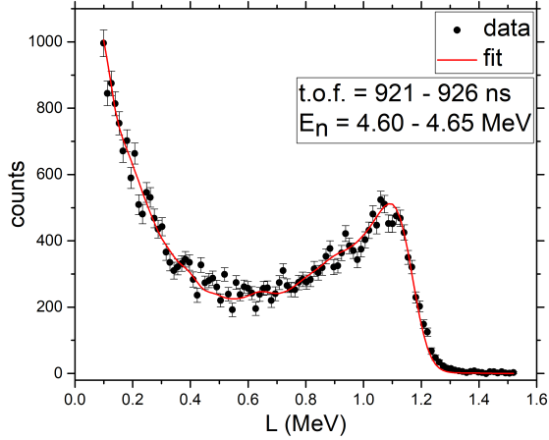
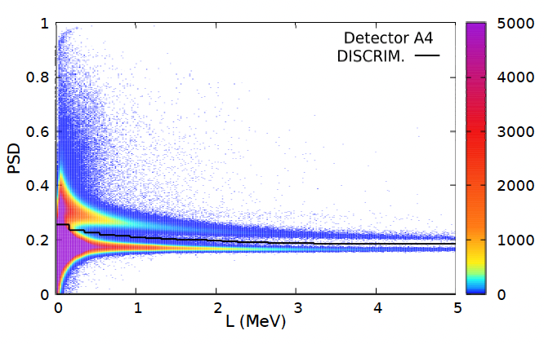
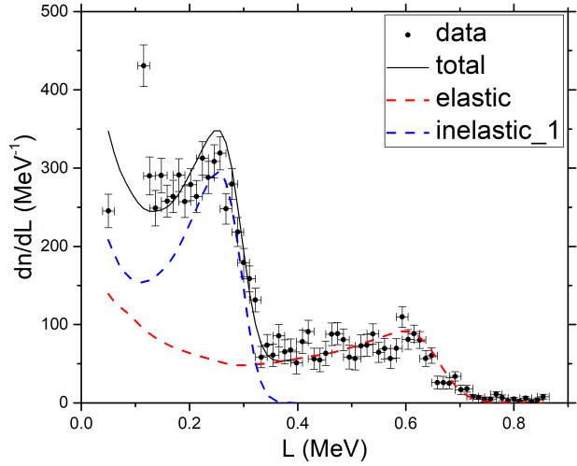
Neutron scattering on ⁵⁴Fe and ⁵⁶Fe with the ELISA setup (JRC-Geel)
1) Detector characterization :
a) Resolution function: γ-ray sources / b) Response function: ^{nat}C(n,el)
2) Photon / neutron separation via Pulse Shape Analysis (charge integration method)
3) Background subtraction (sample-out measurement)
4) Elastic–Inelastic separation
5) Multiple scattering correction (Monte Carlo simulations)
6) Cross section calculation:
1) ¹²C(n,el)
4)
2)
inelastic
neutrons
elastic
photons
Notes:
Carbon was chosen for its high inelastic
threshold of 4.81 MeV,

Slide 7
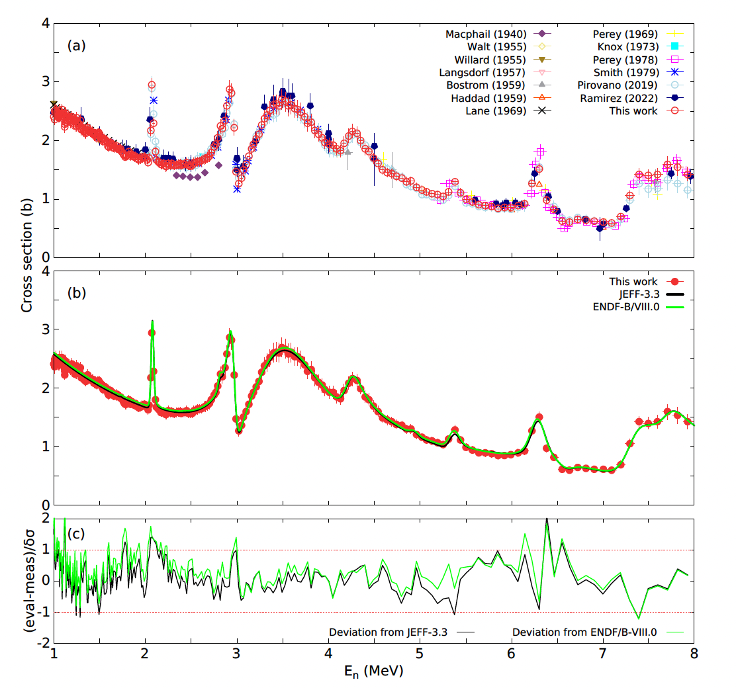
Neutron scattering on ⁵⁴Fe and ⁵⁶Fe with the ELISA setup (JRC-Geel)
Validation of the analysis
Extraction of the ^{nat}C(n,n) cross section
Cross section known with <1% uncertainty up to 4.8MeV
Very good agreement between this work and JEFF-3.3, ENDF VIII.0 + EXP. DATA
G. Gkatis et al., Physical Review C, 110(3), 034609, (2024):
(Angular distributions : 1 - 8 MeV)

Slide 8
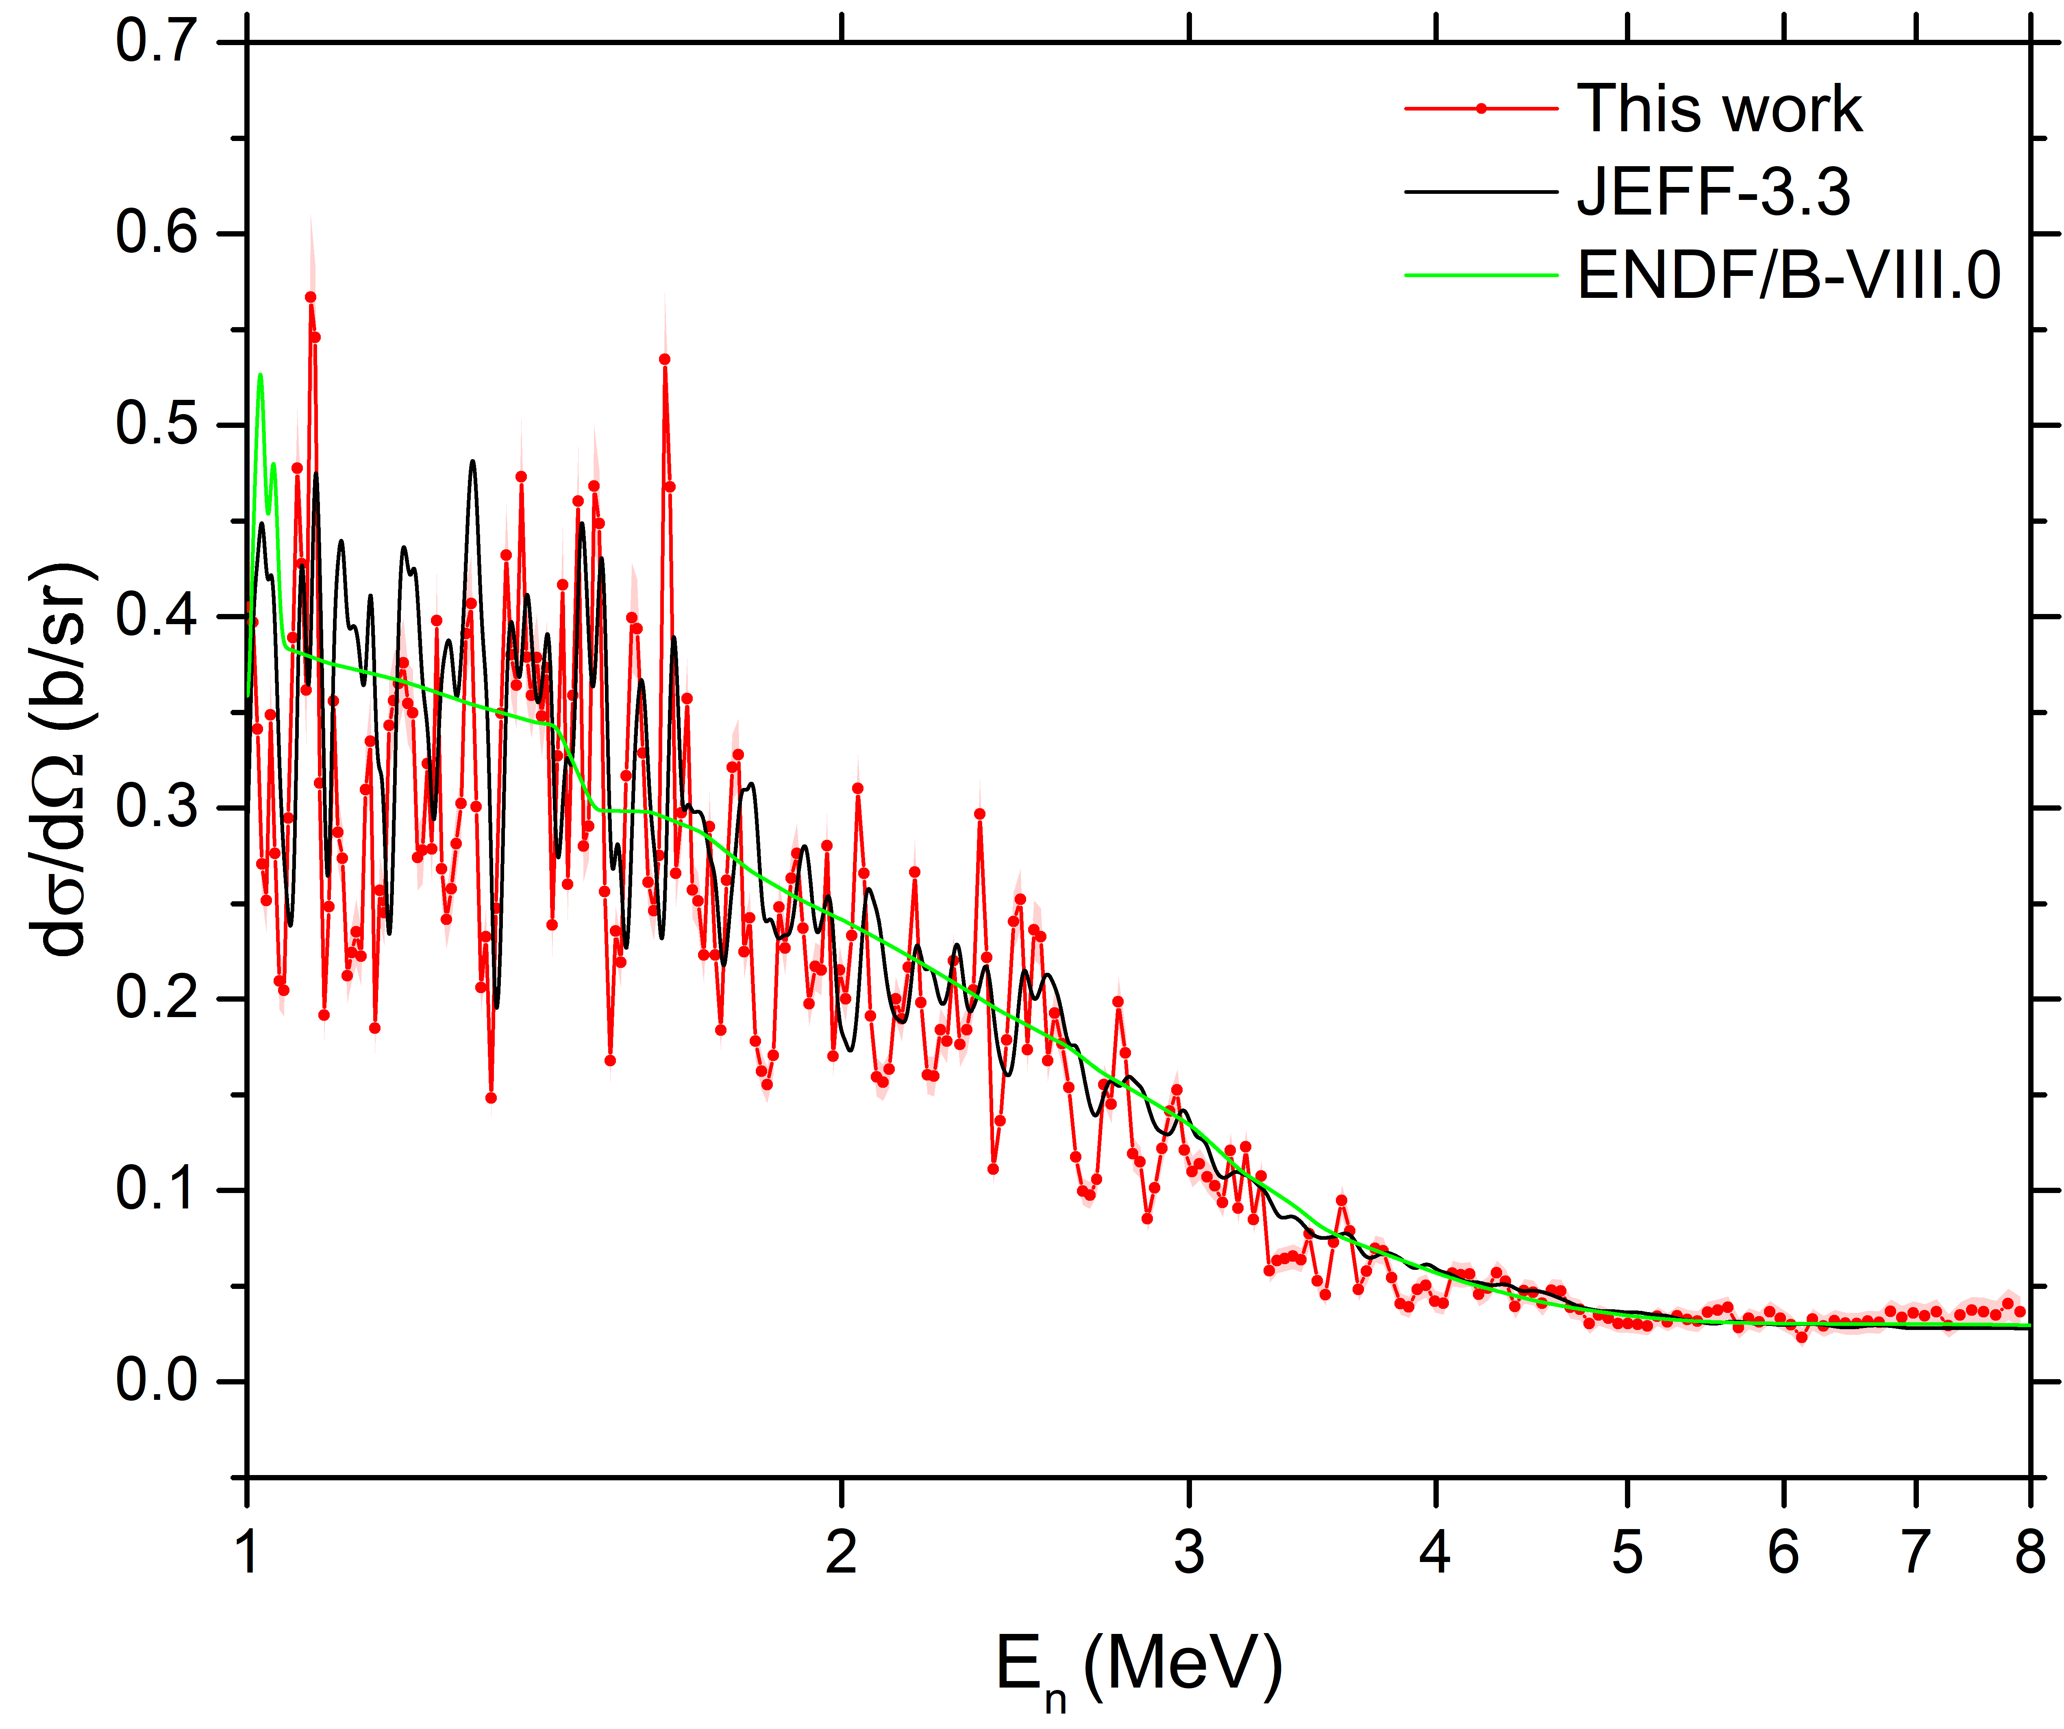
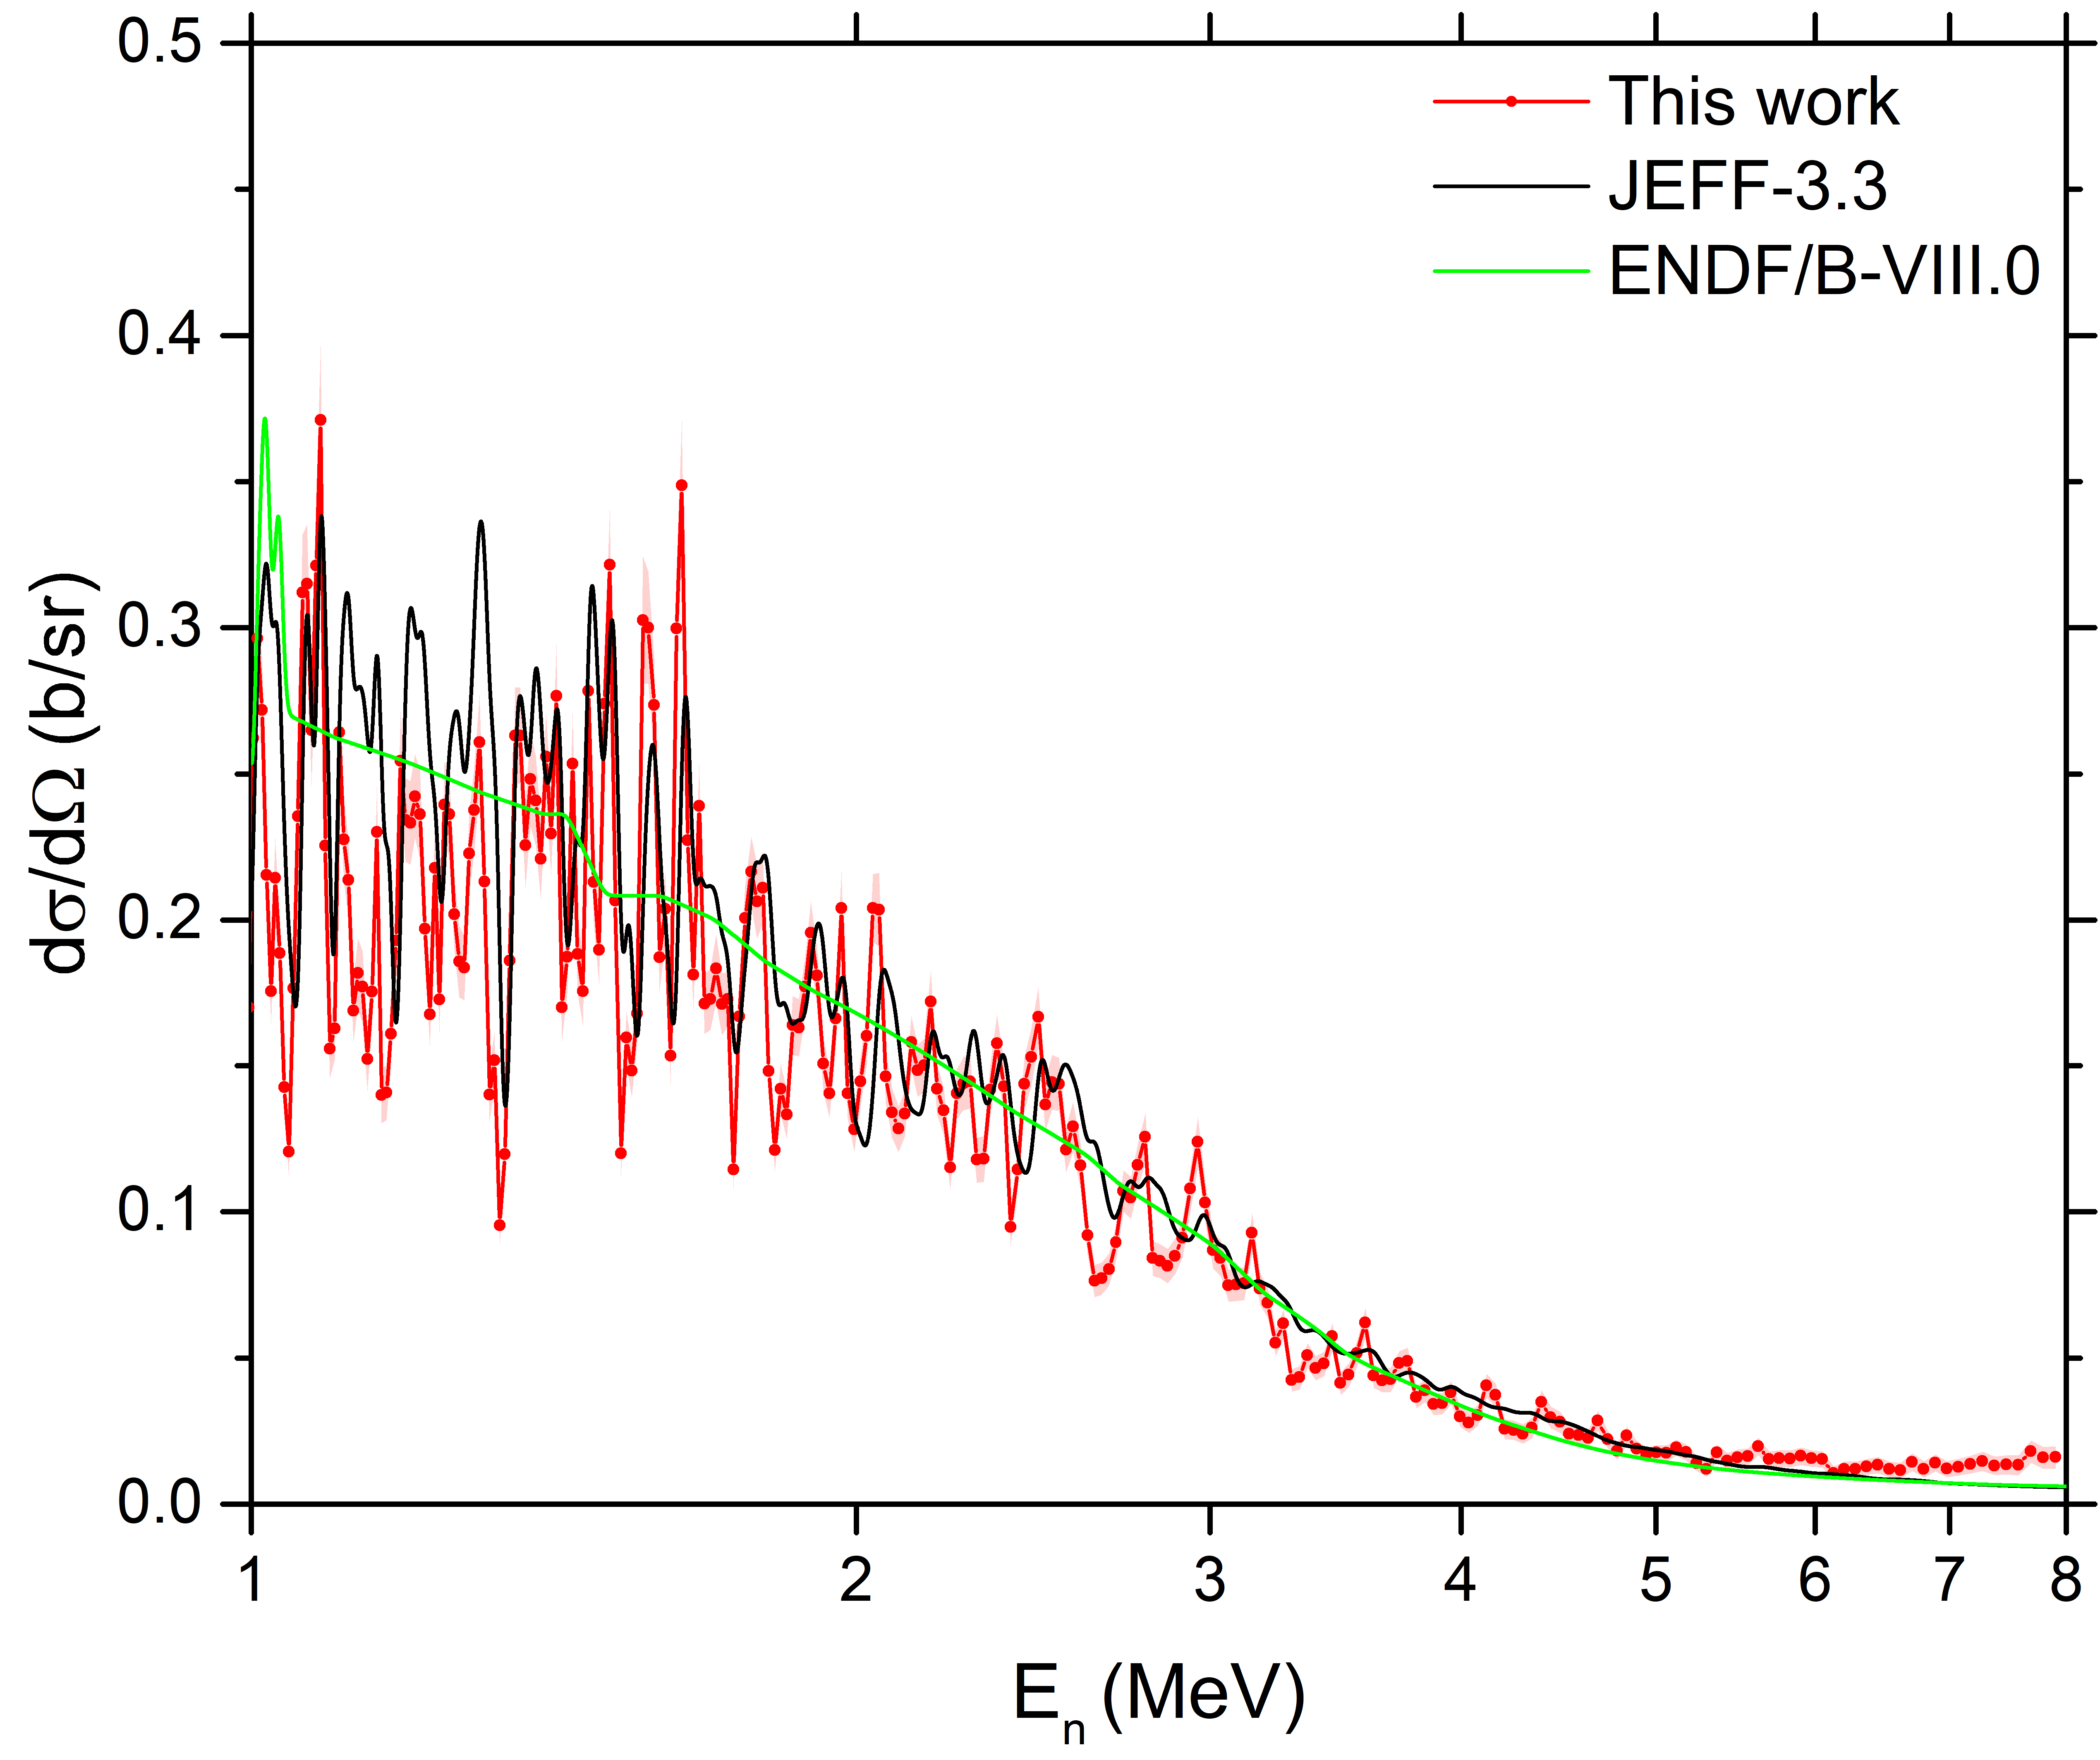
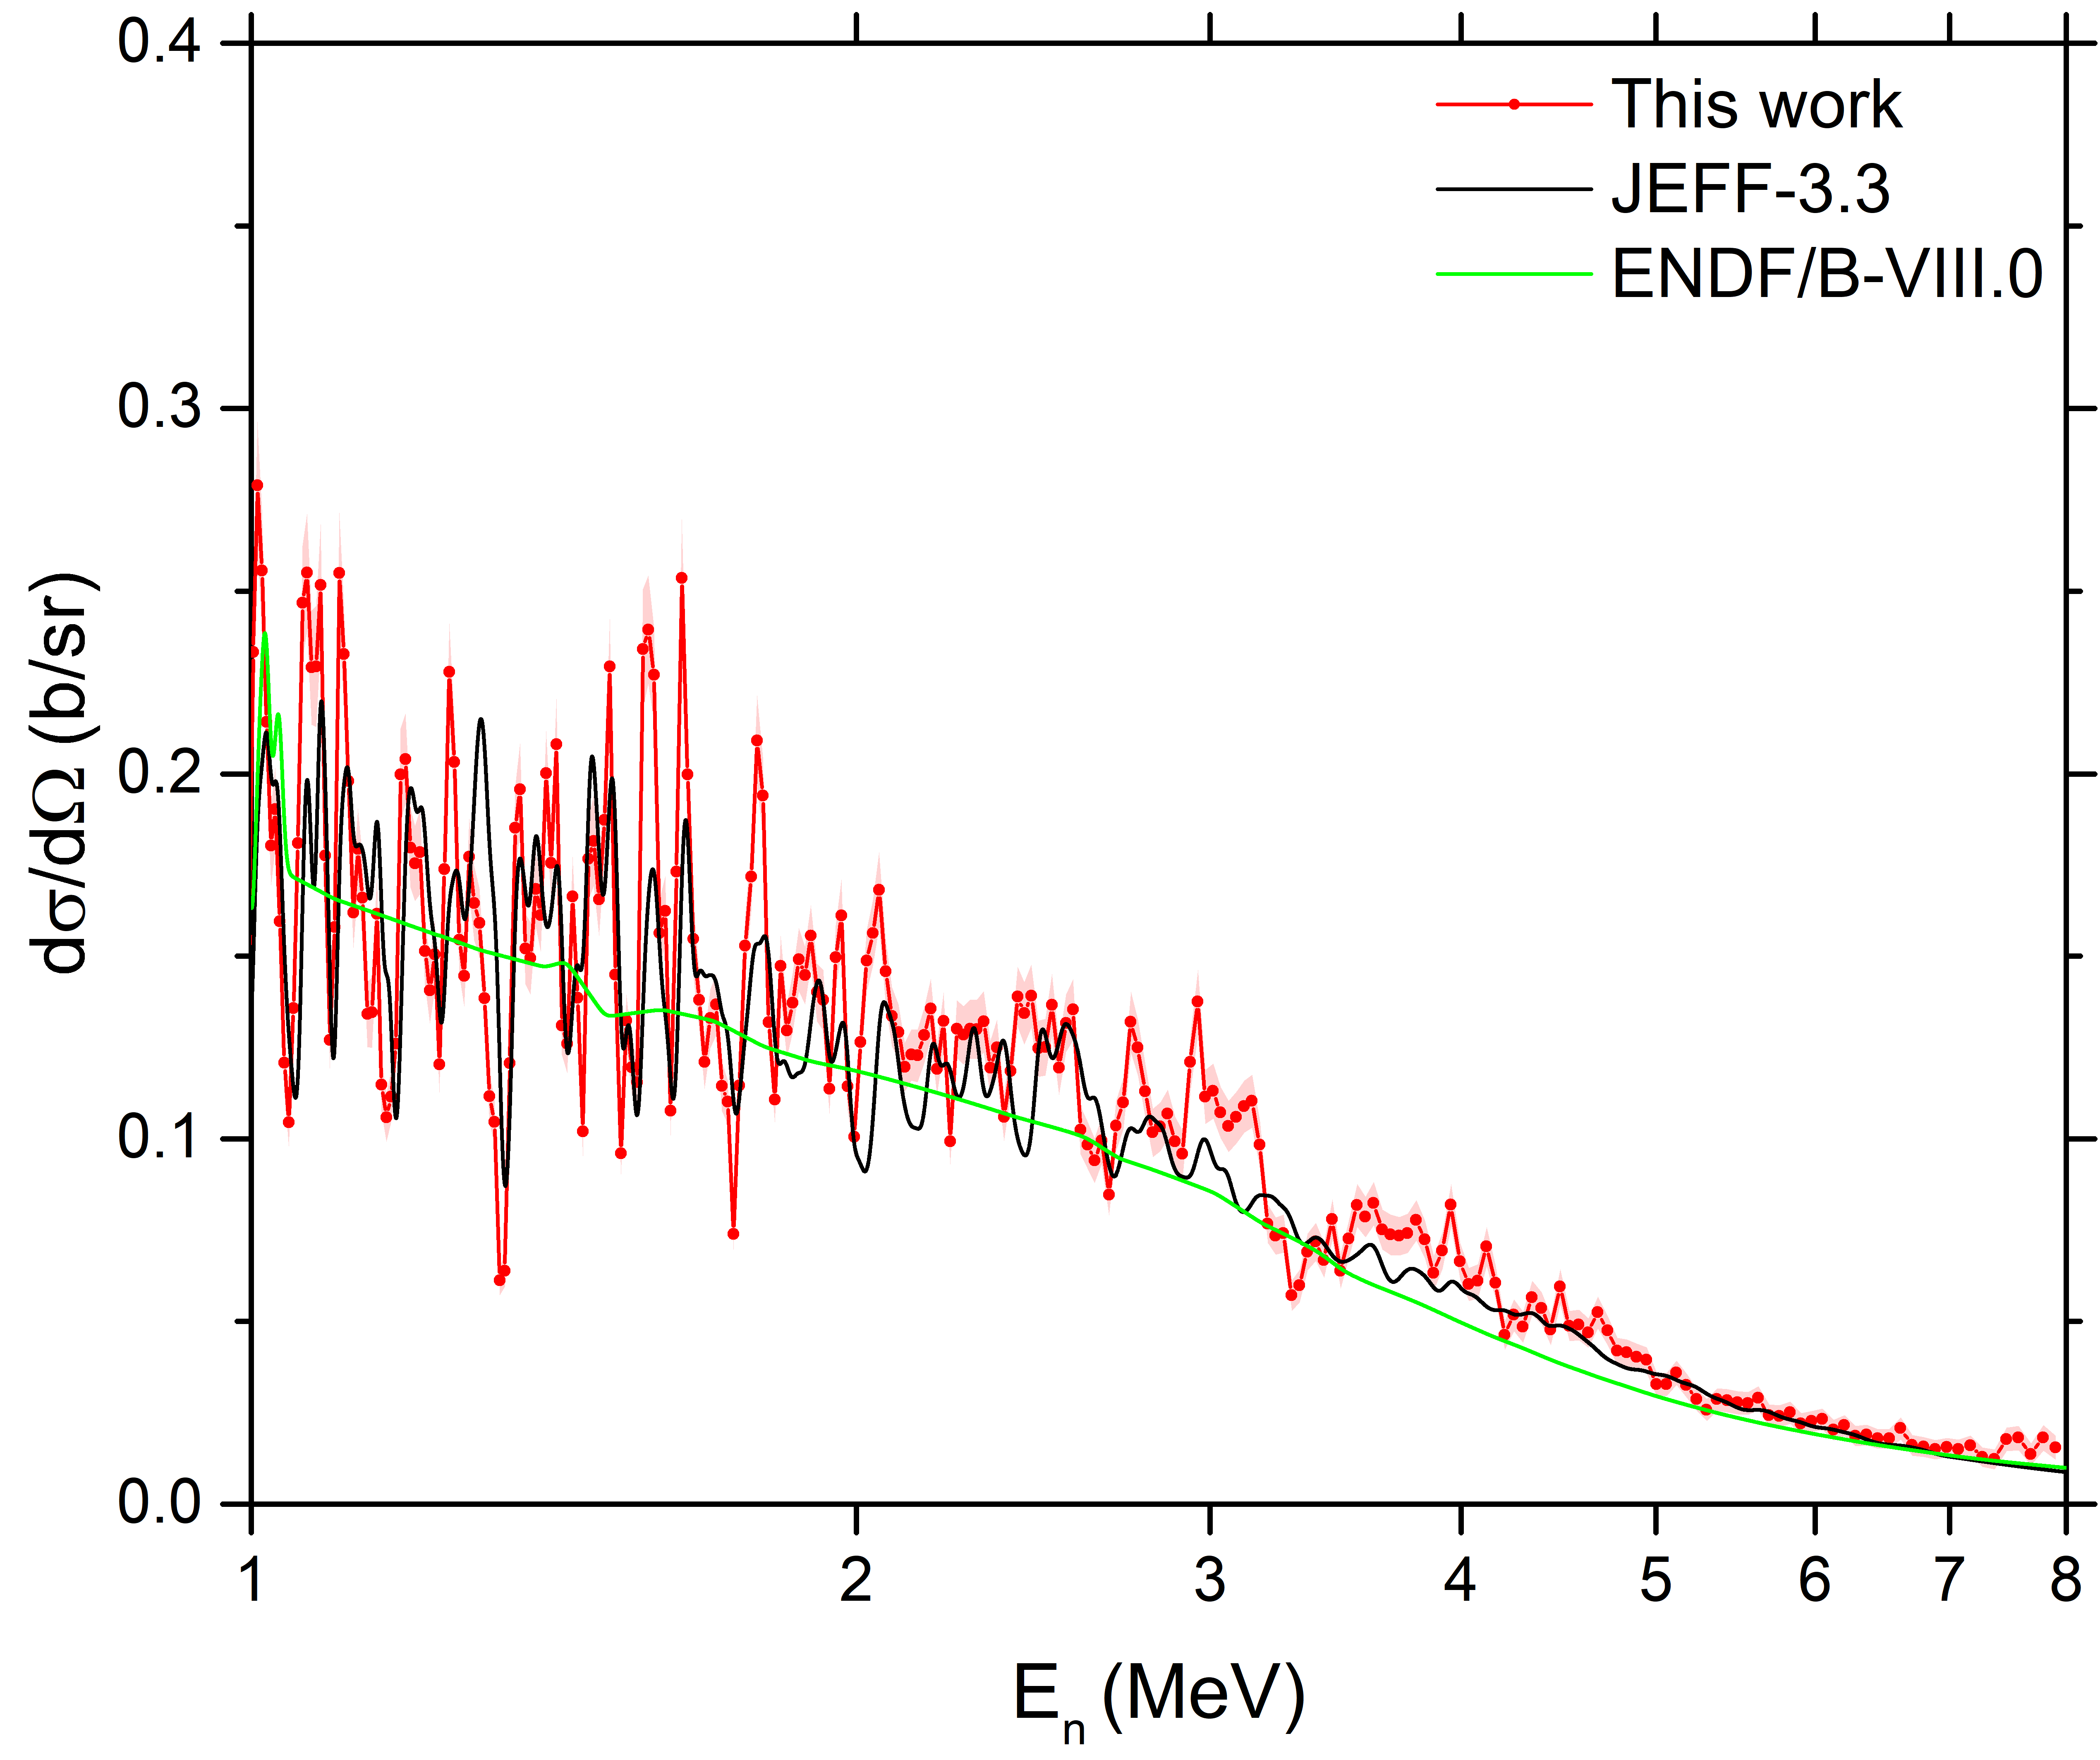
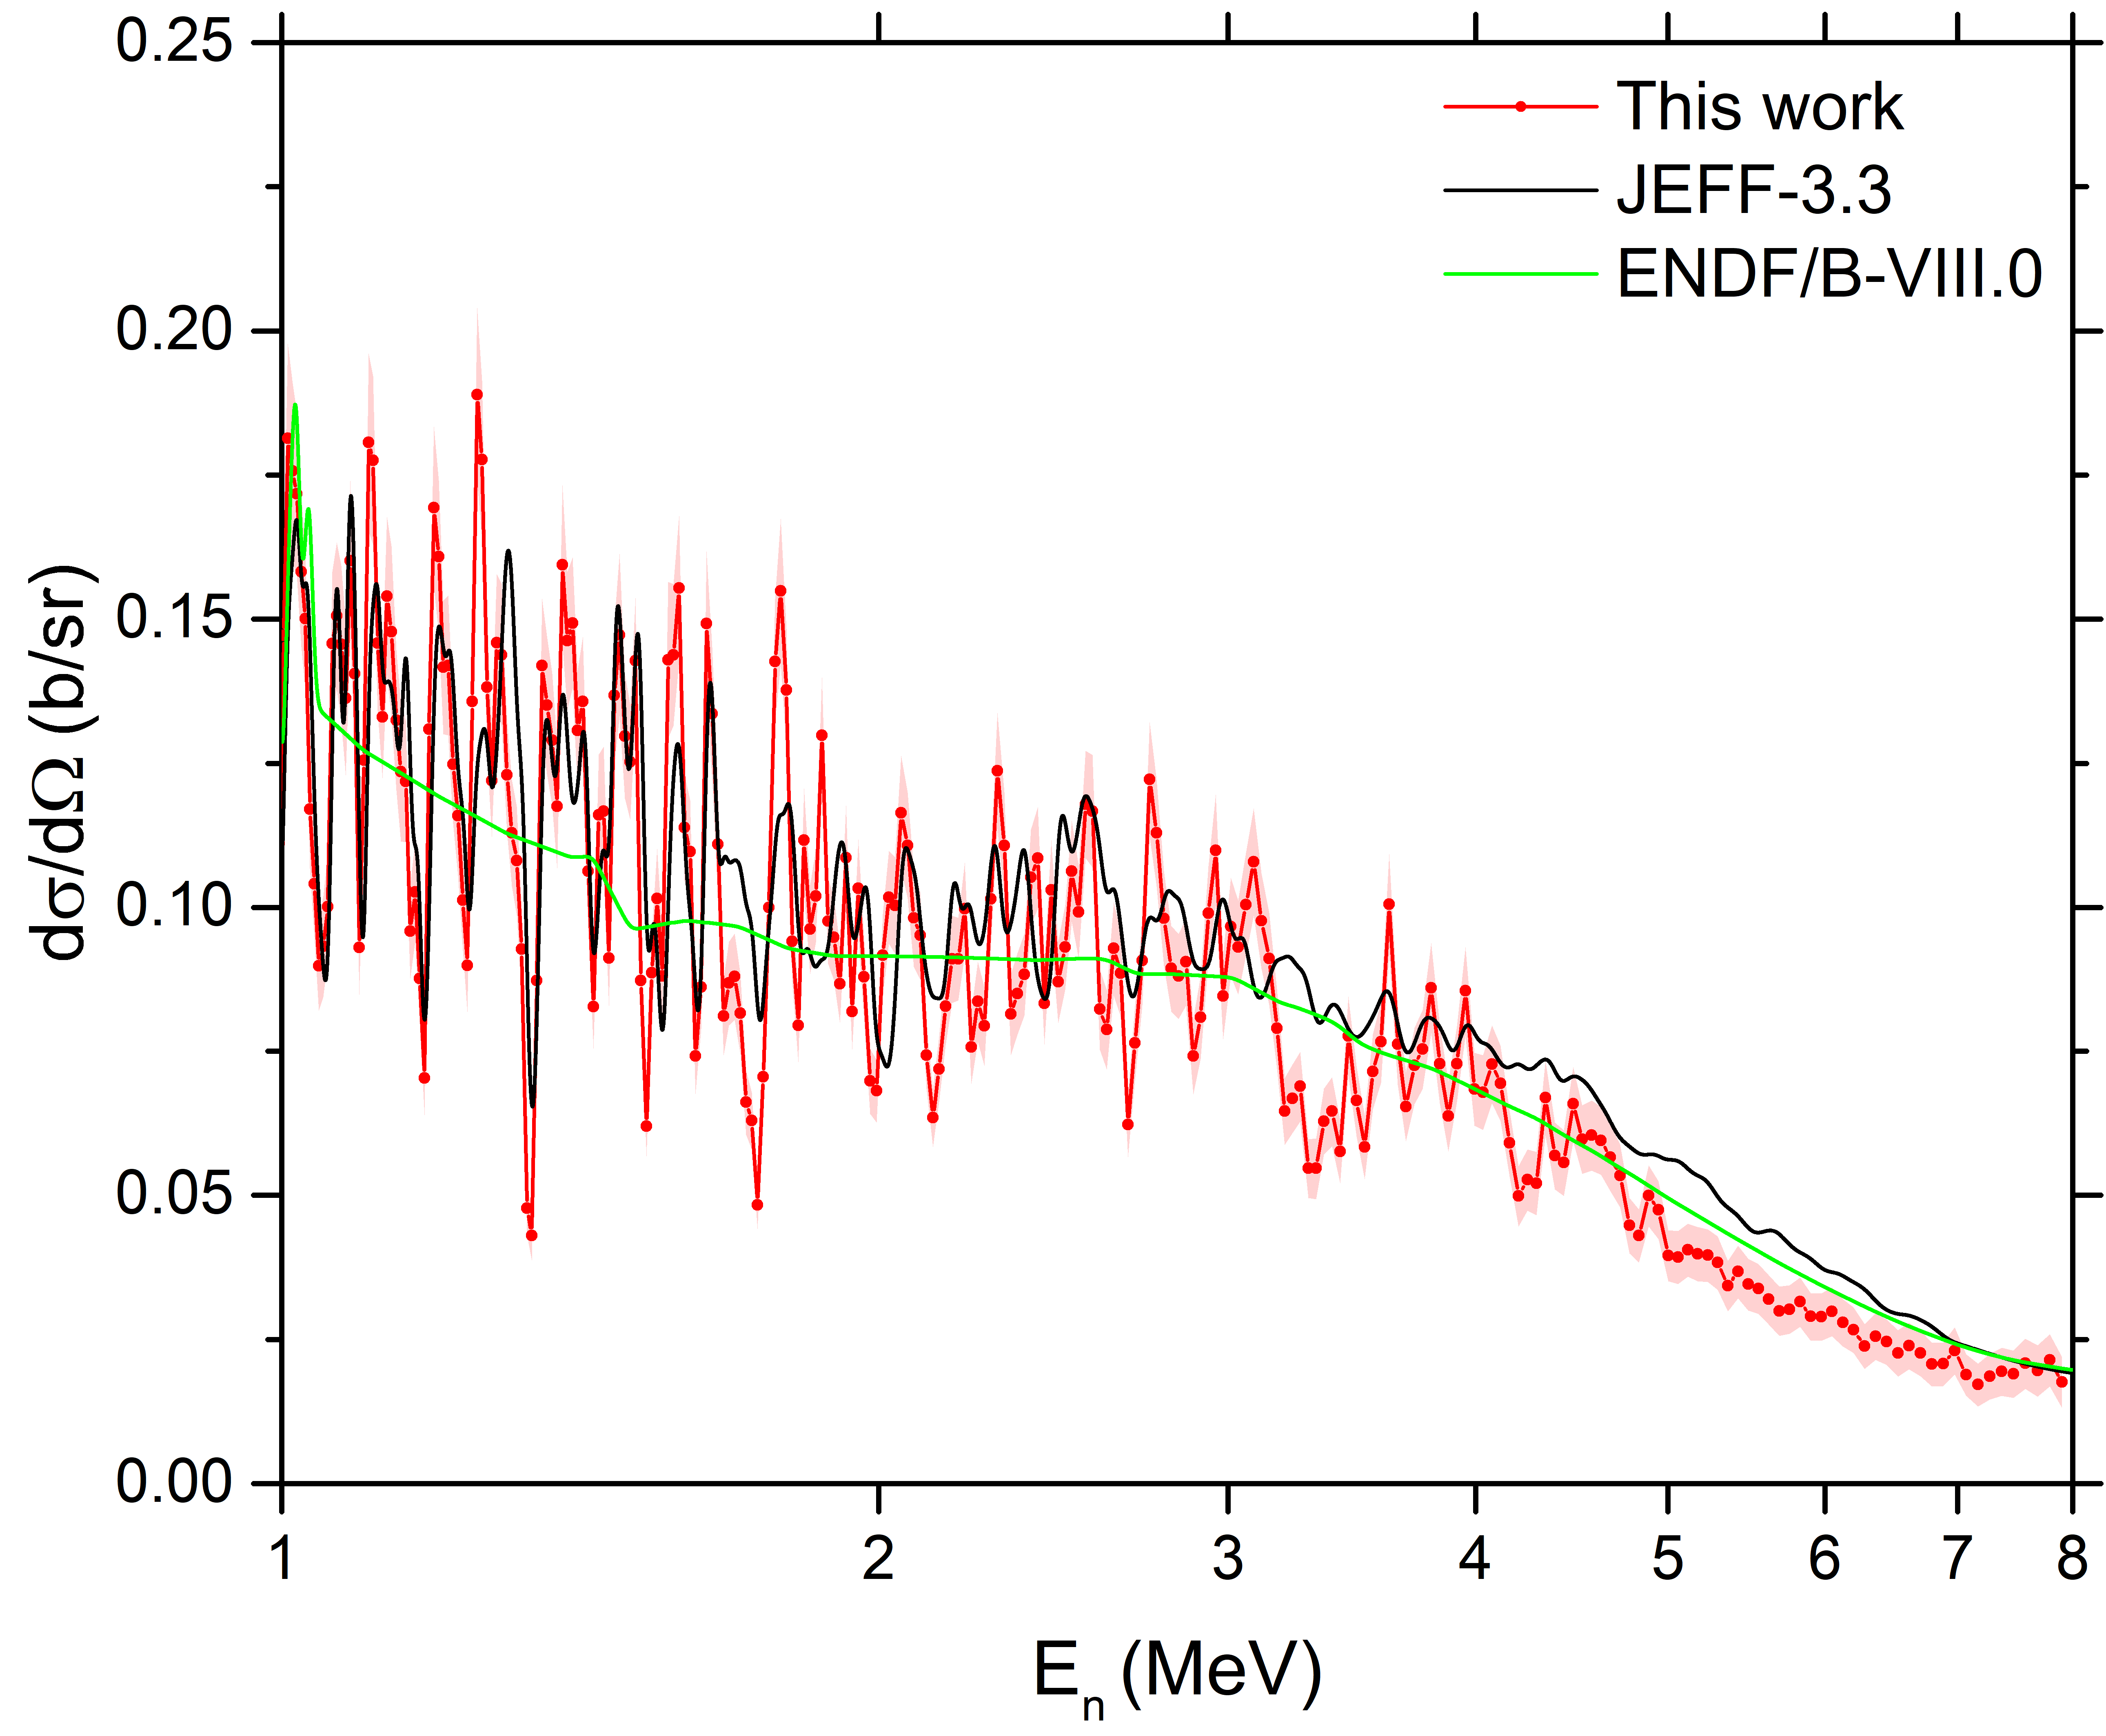
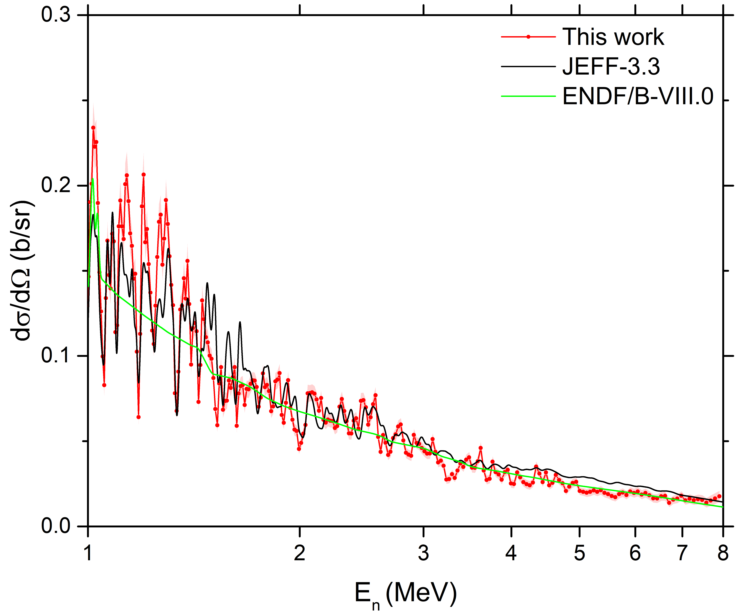
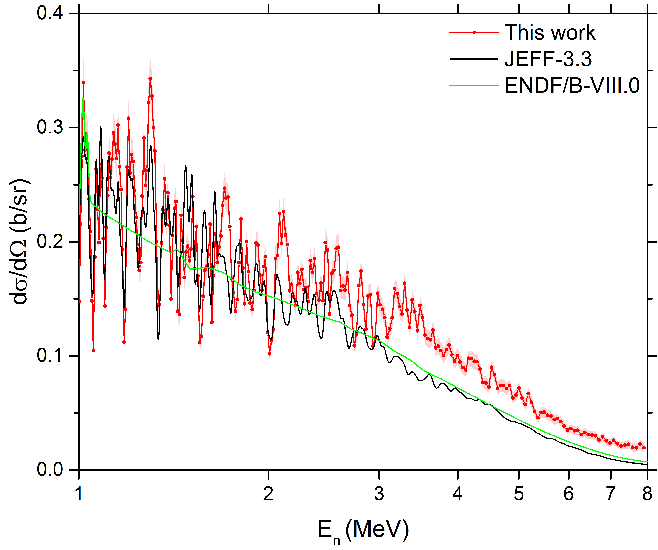
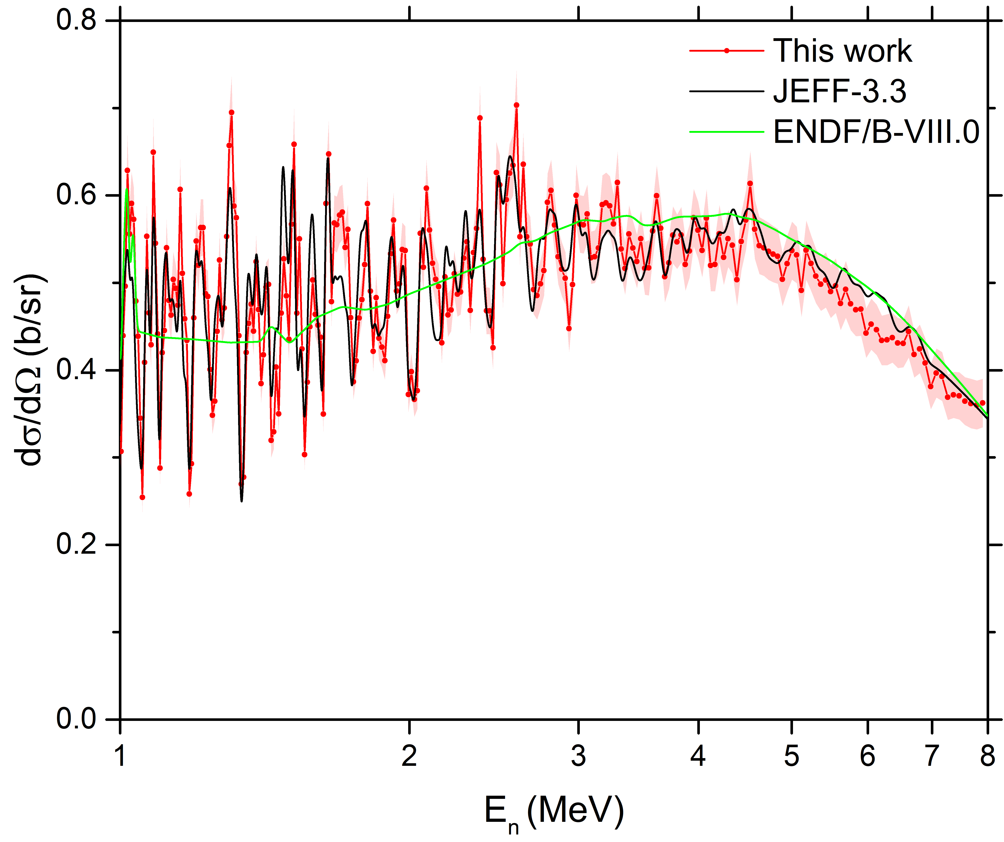
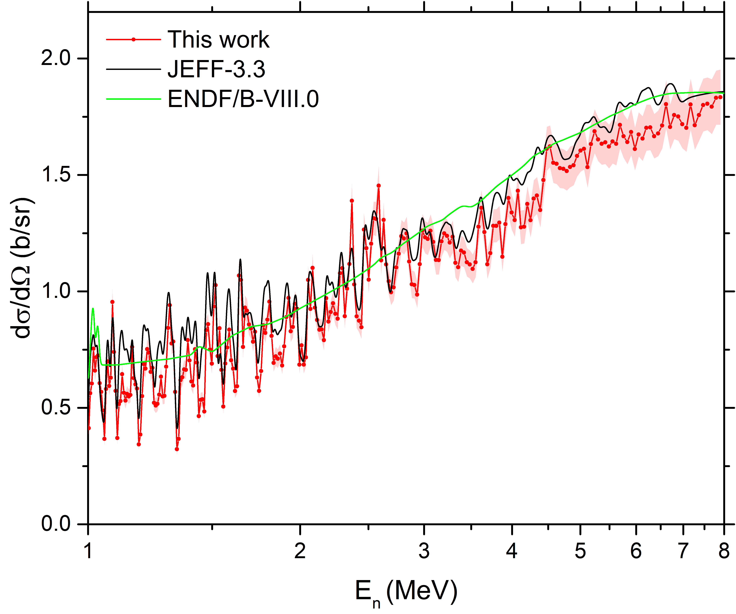
Neutron scattering on ⁵⁴Fe : ⁵⁴Fe(n,n) Differential cross sections vs Energy
θ_{LAB} = 163.8º
θ_{LAB} = 142.8º
θ_{LAB} = 121.7º
θ_{LAB} = 100.6º
θ_{LAB} = 79.4º
θ_{LAB} = 58.3º
θ_{LAB} = 37.2º
θ_{LAB} = 16.2º
G. Gkatis et al., Phys. Rev. C 109, 034612 (2024)
Similar at 56Fe, natFe, not seen at ¹²C !!!
Notes:
Uncertainties 5-25%

Slide 9
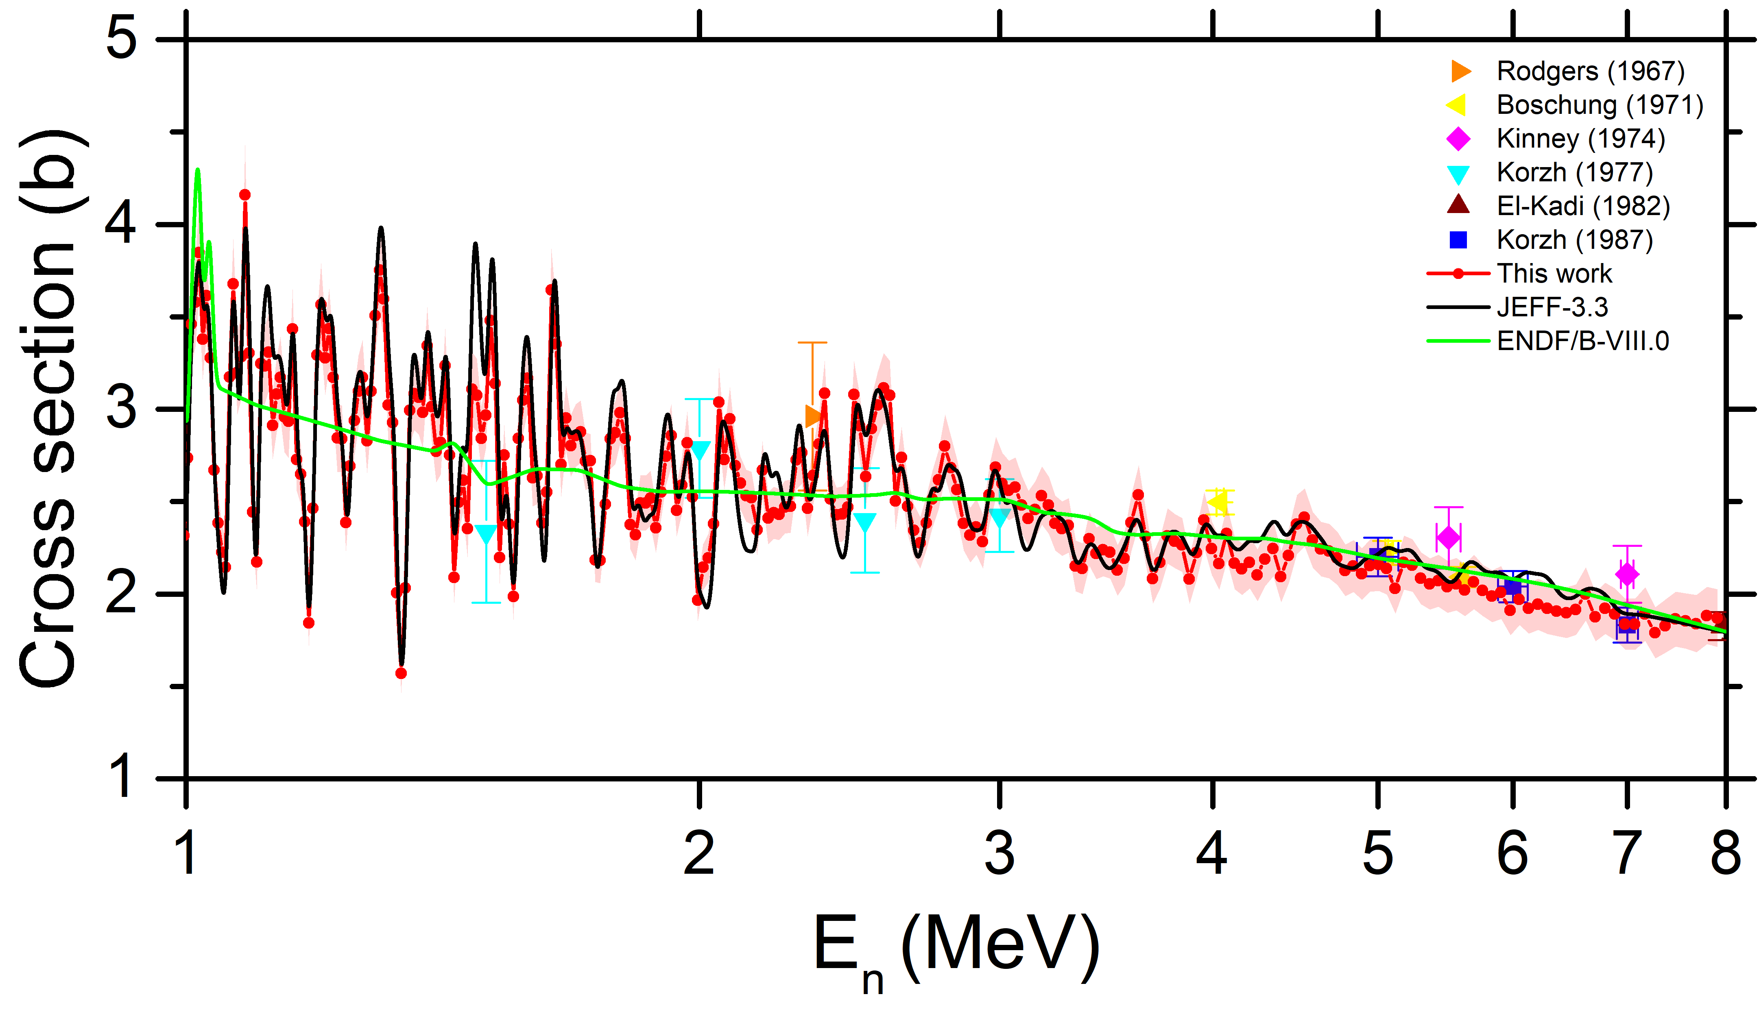
Neutron scattering on ⁵⁴Fe : ⁵⁴Fe(n,n) angle integrated cross section
=ENDF-VIII.1=INDEN
Fluctuations can / should be included in the new evaluations
G. Gkatis et al., Phys. Rev. C 109, 034612 (2024)
Notes:
Uncertainties 5-8%

Slide 10
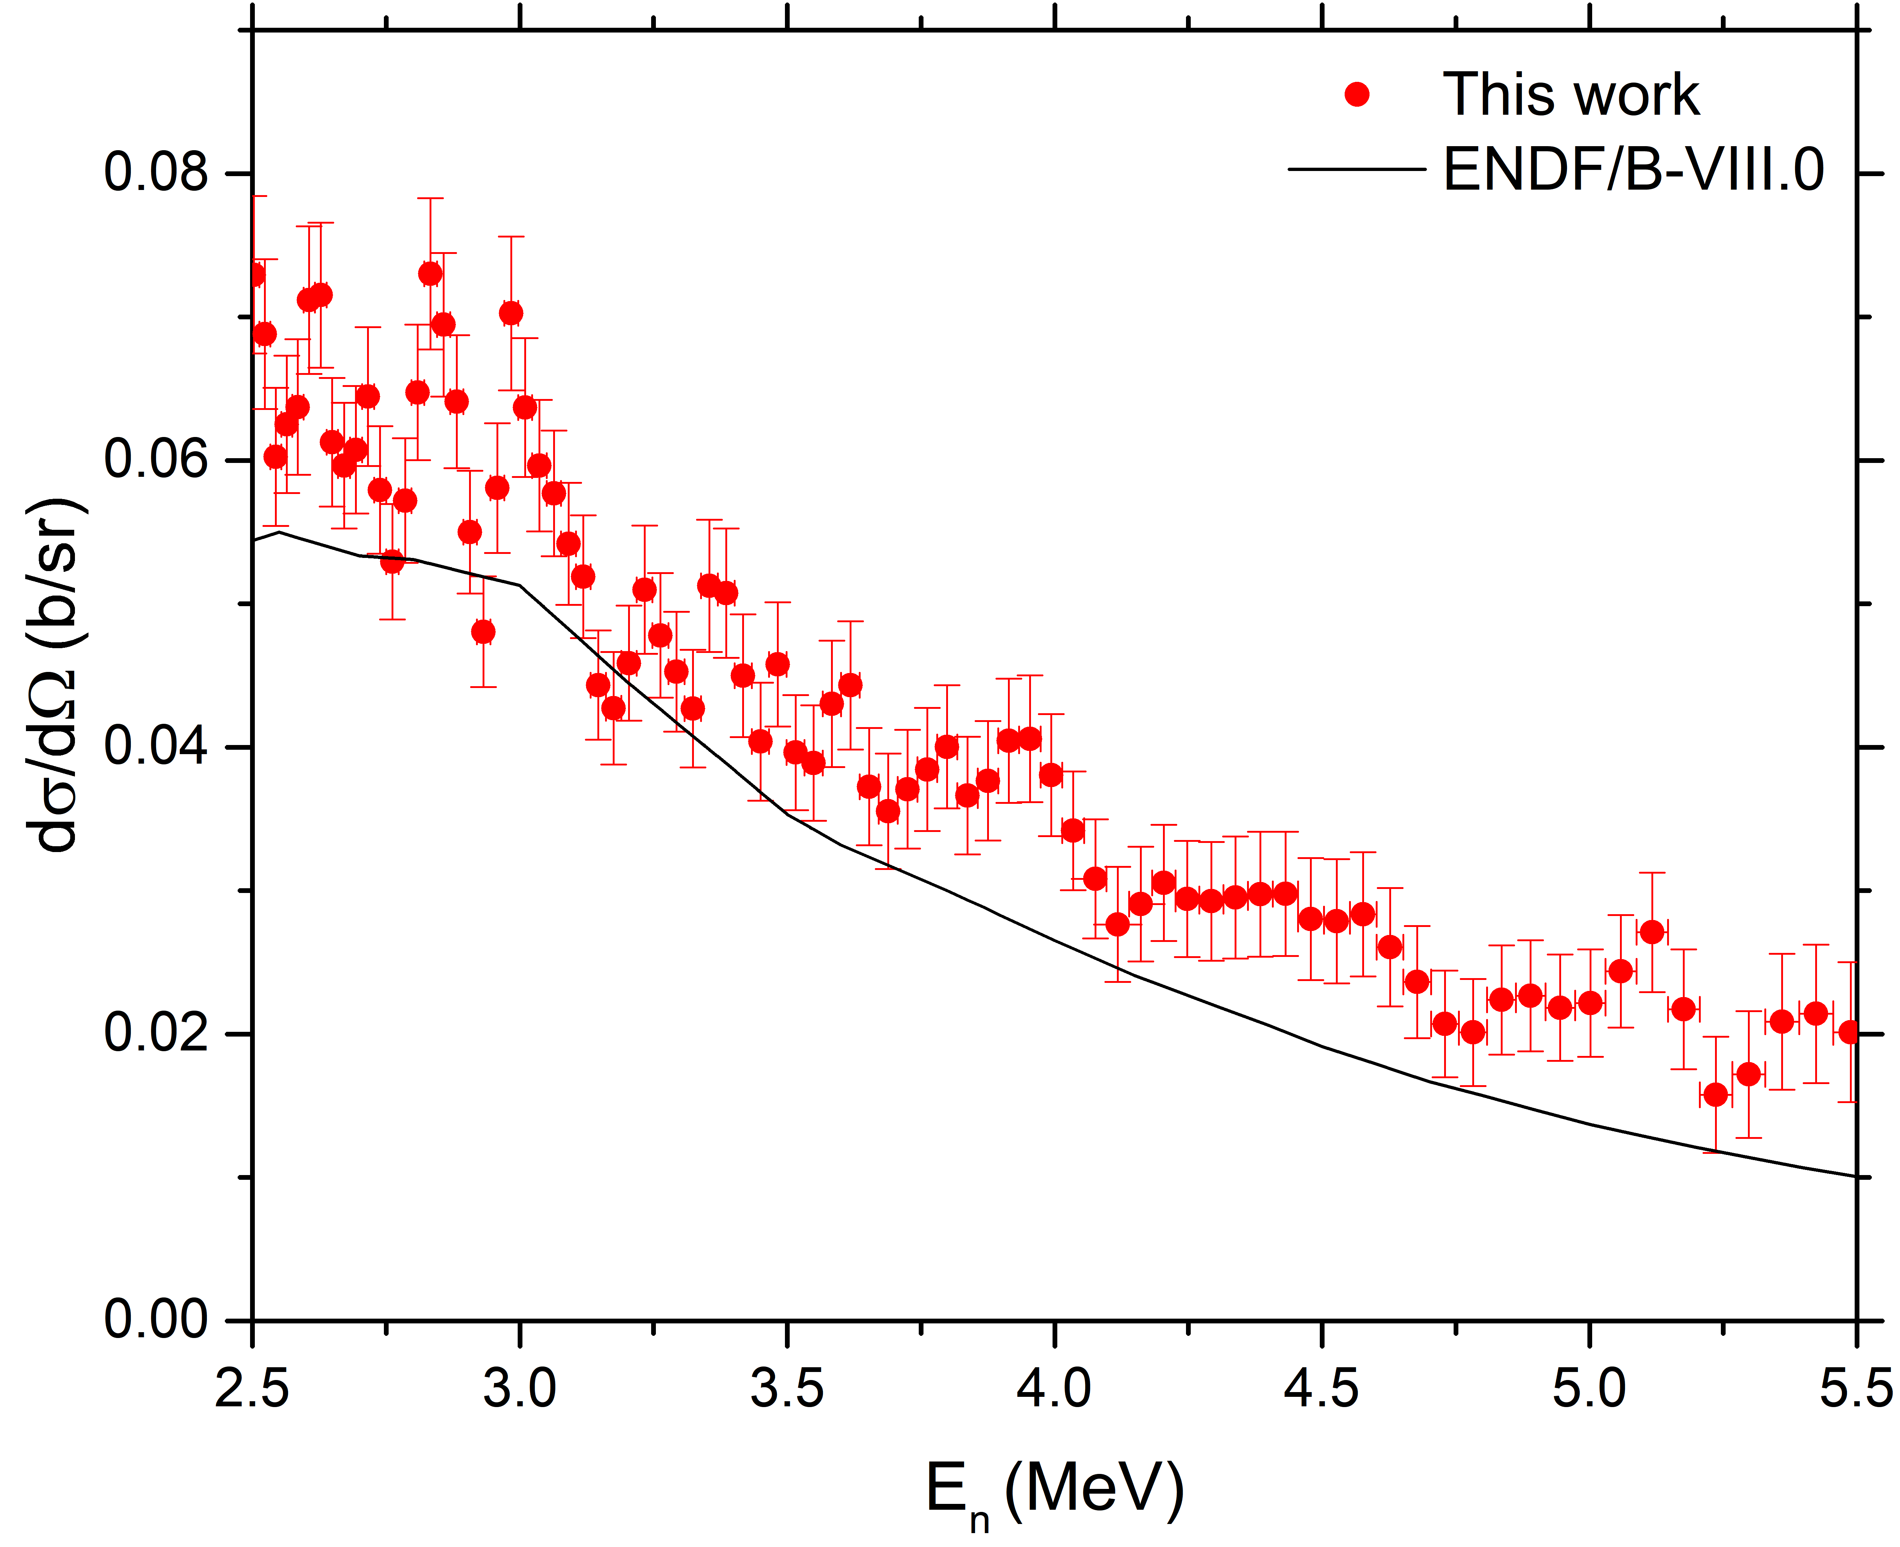
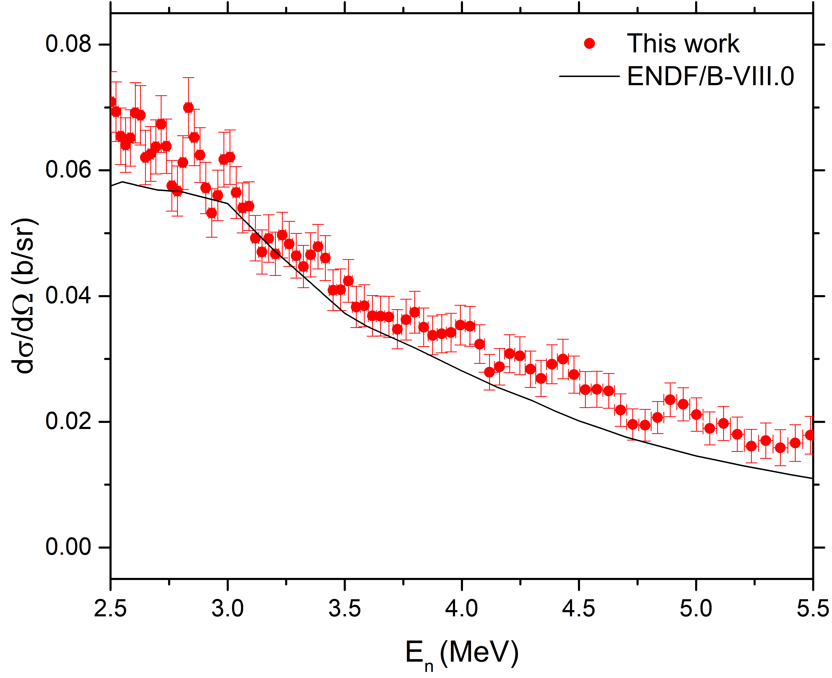
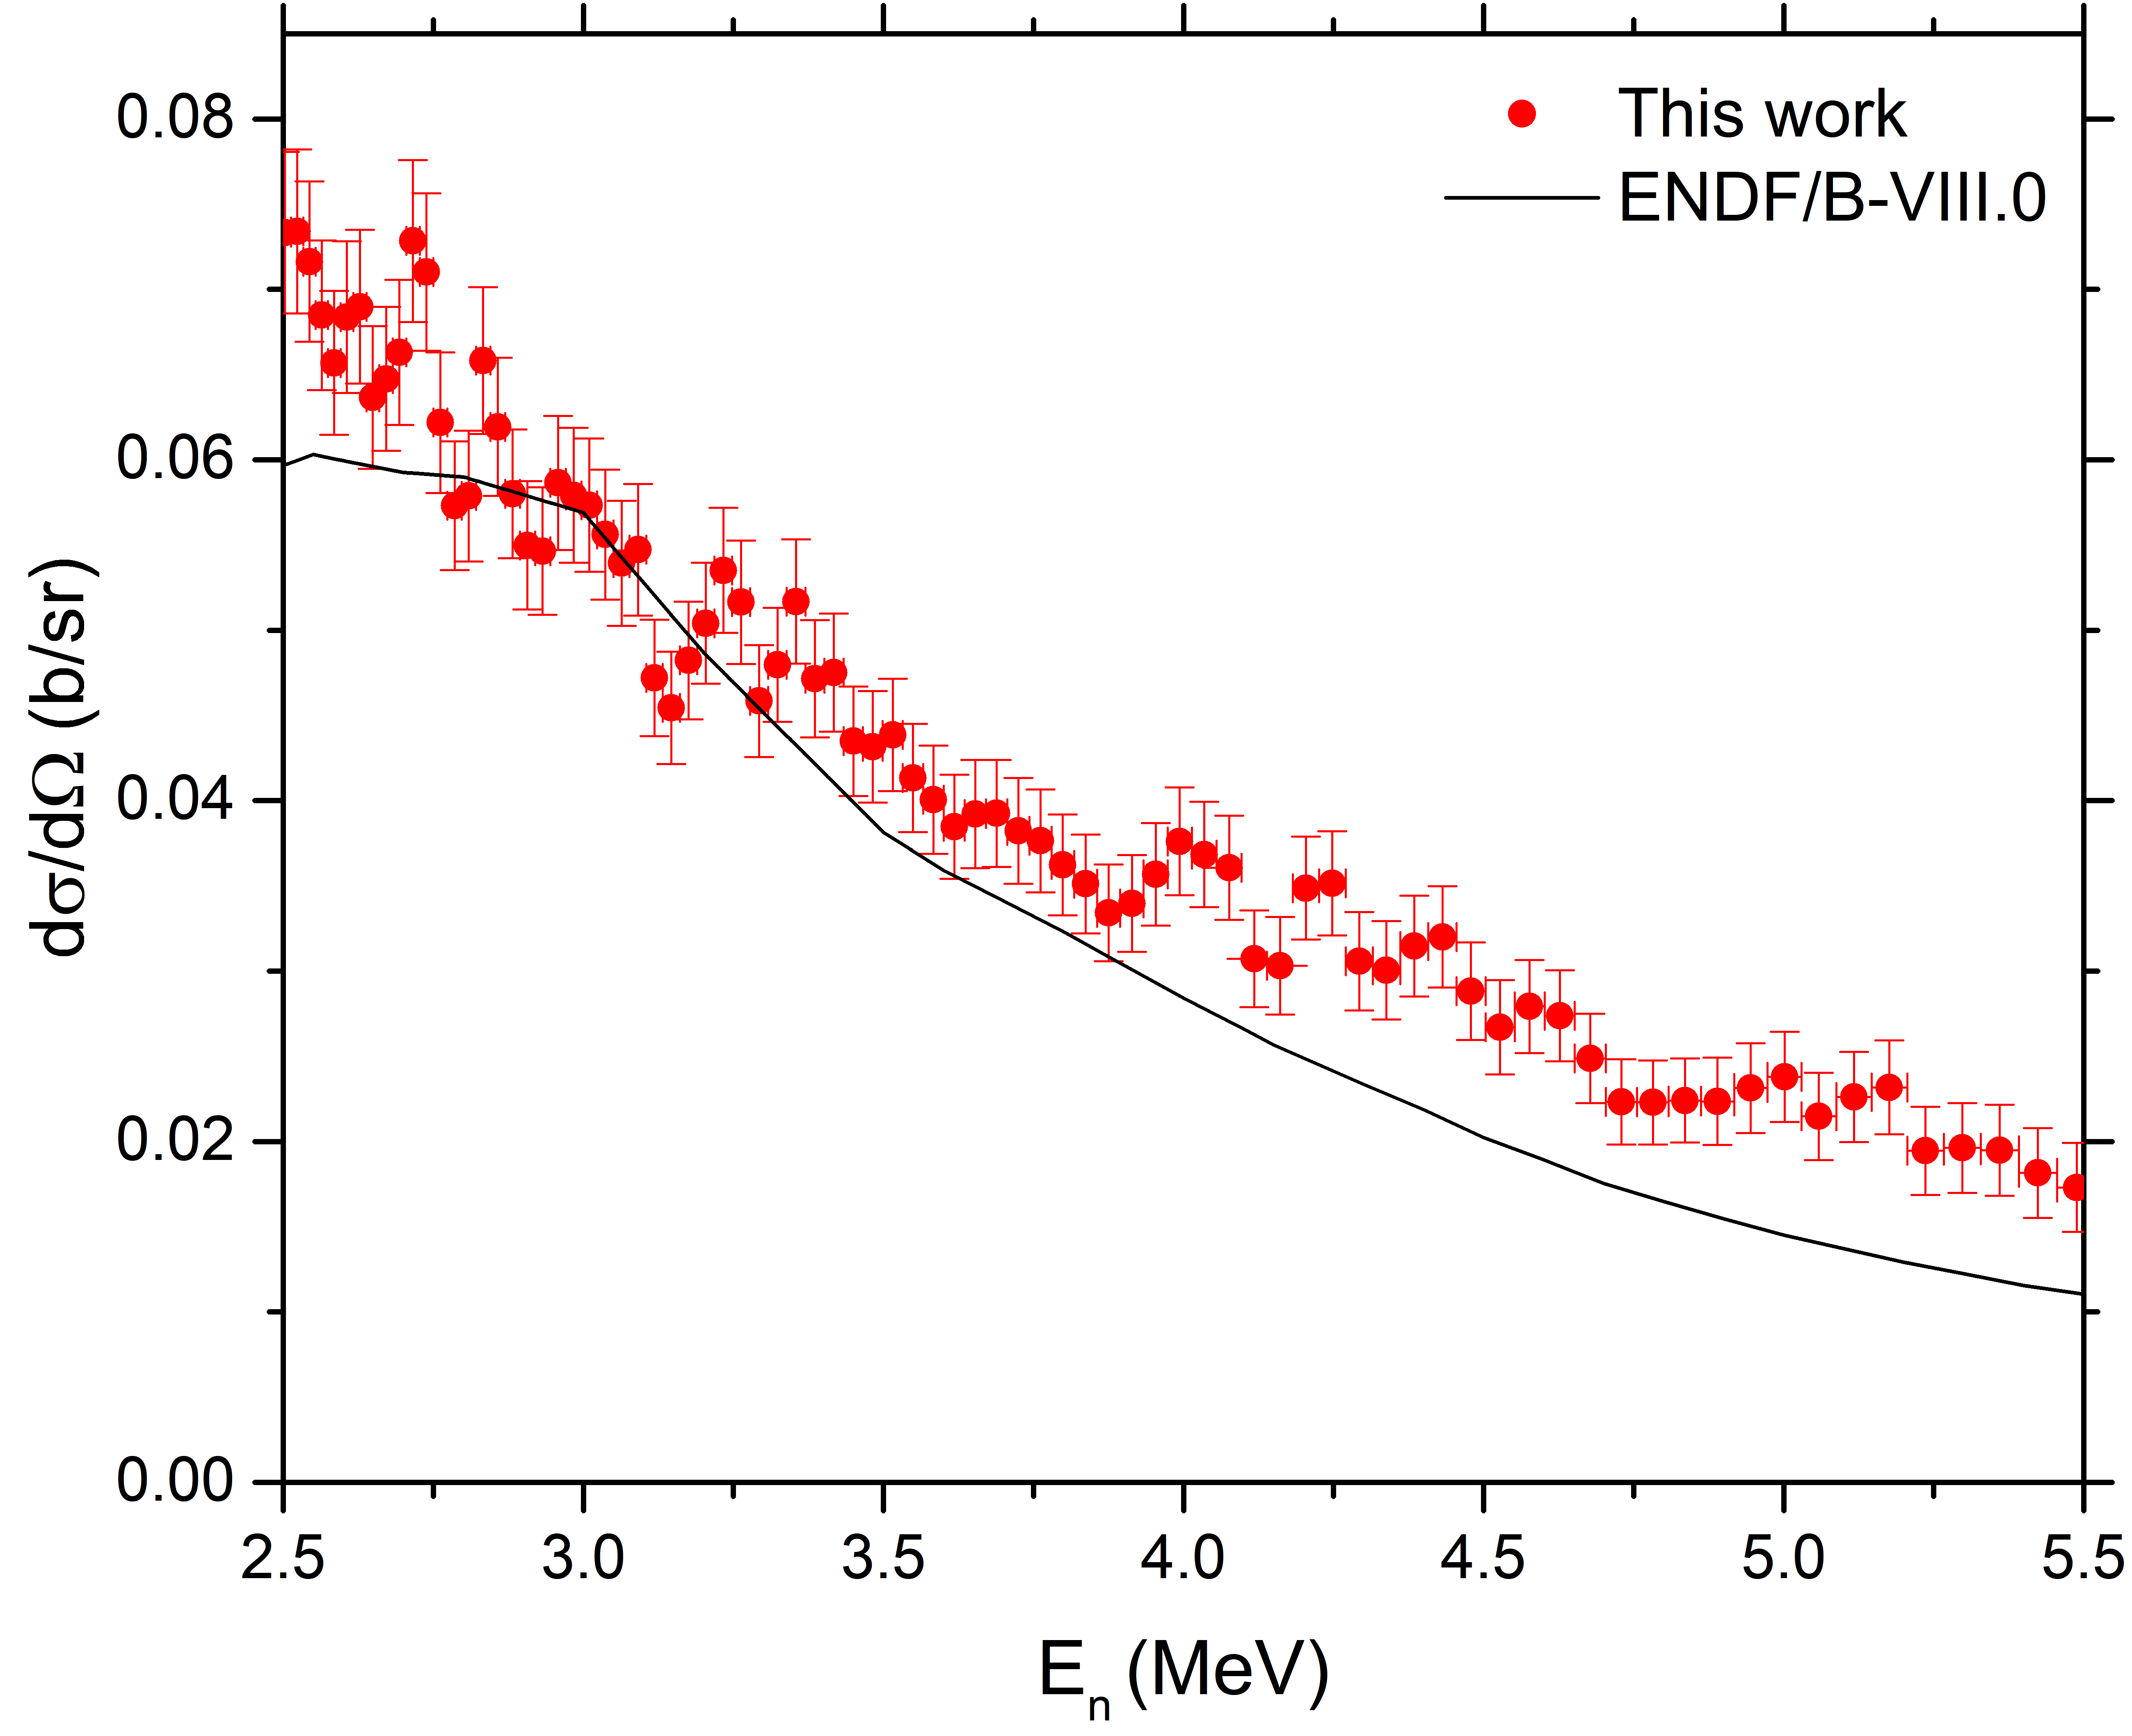
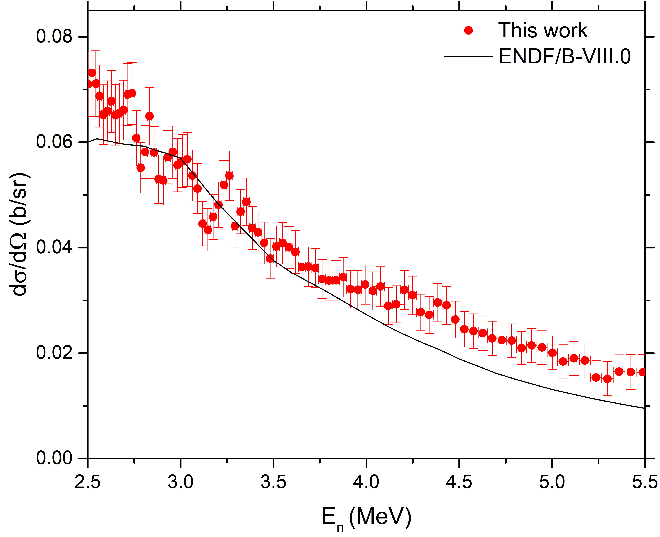
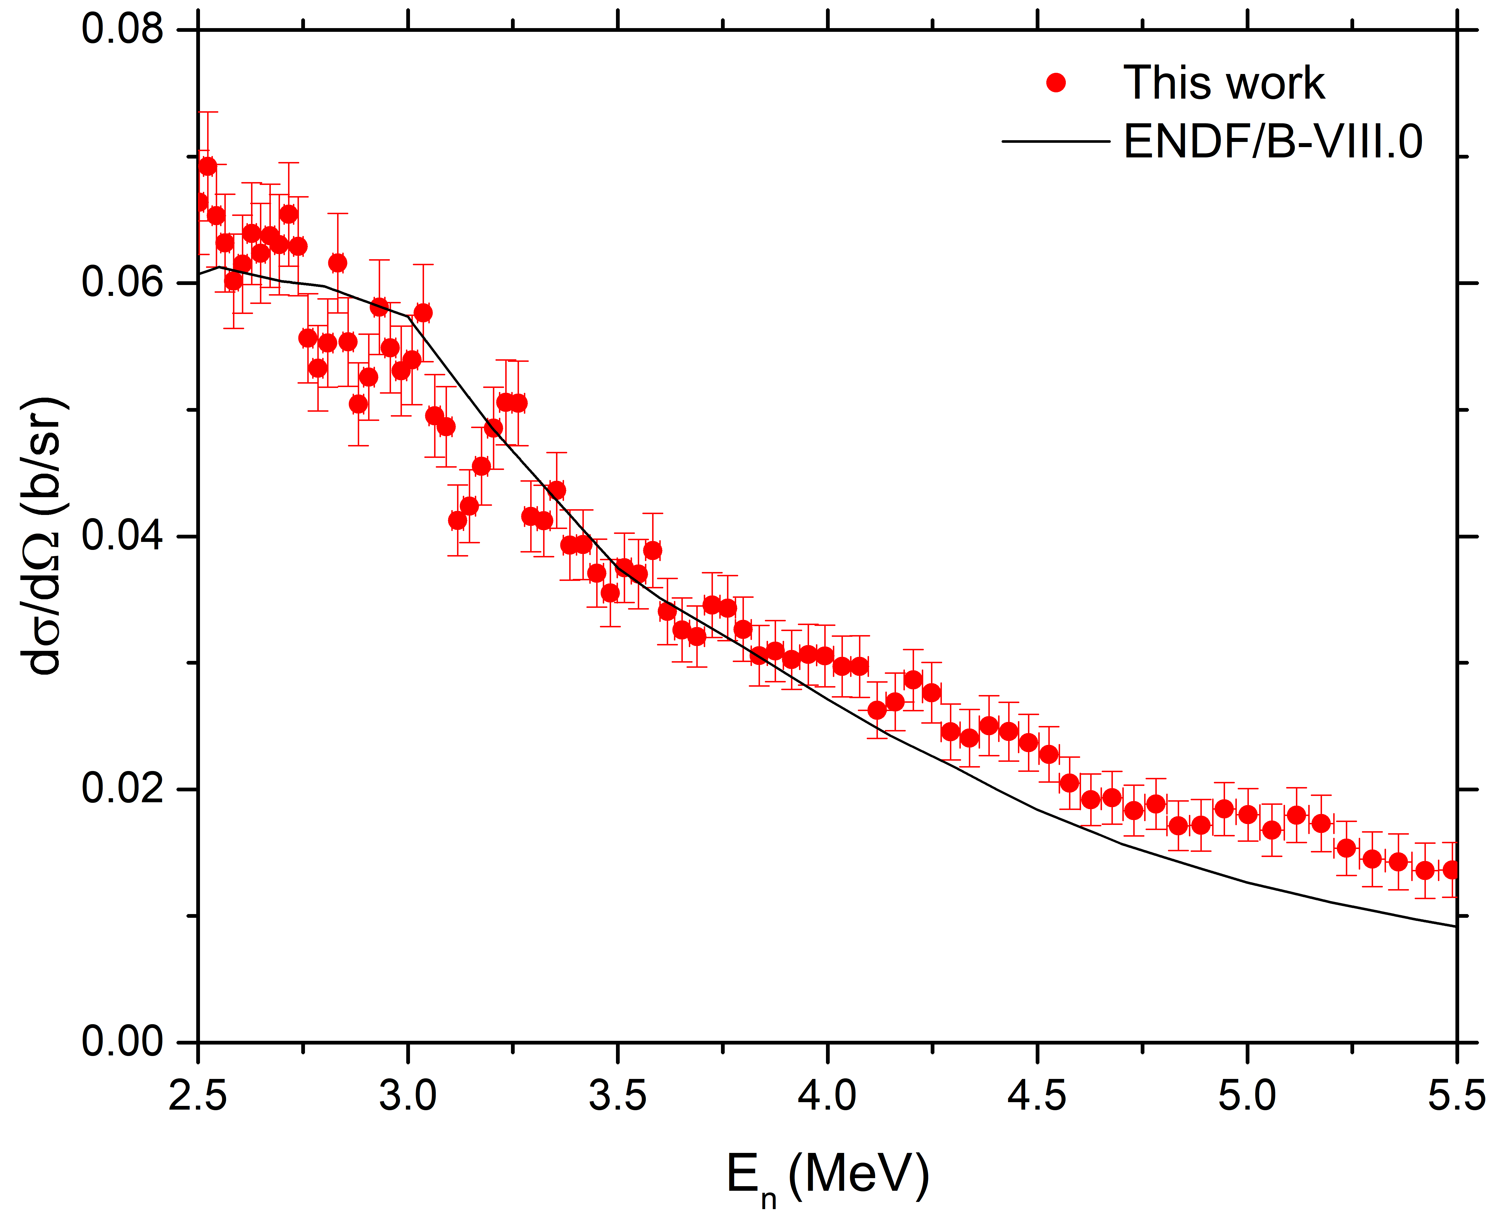
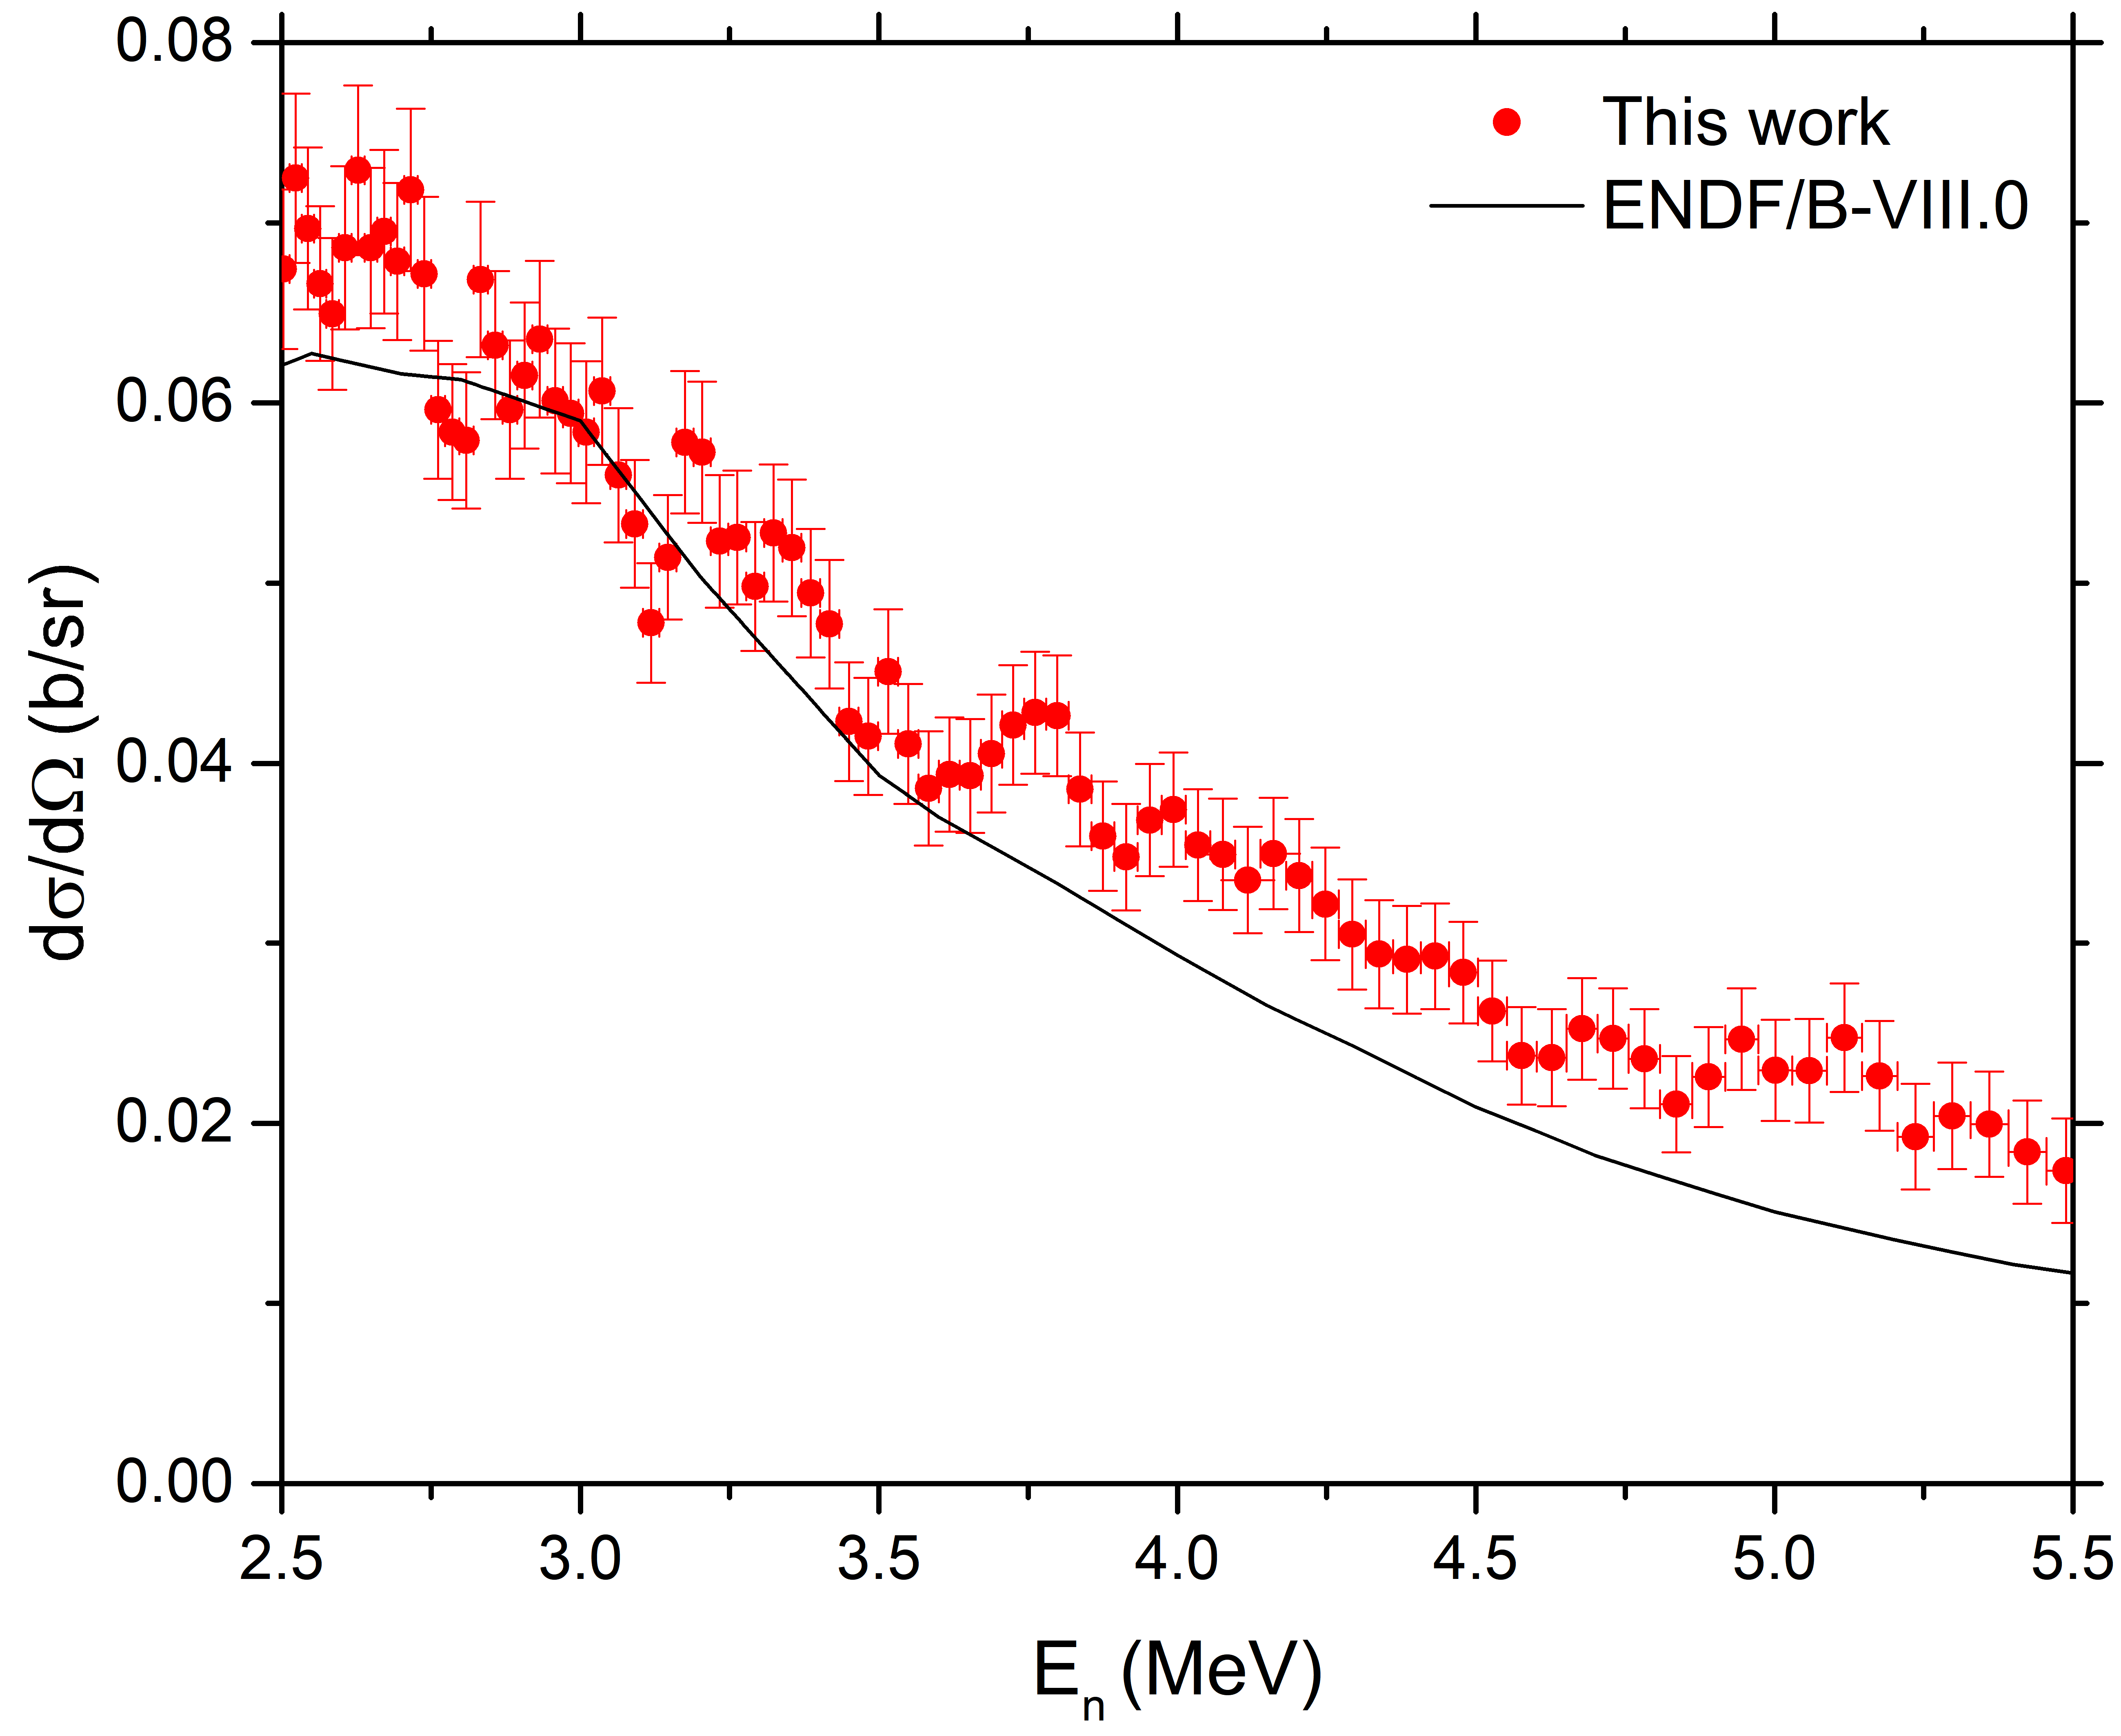
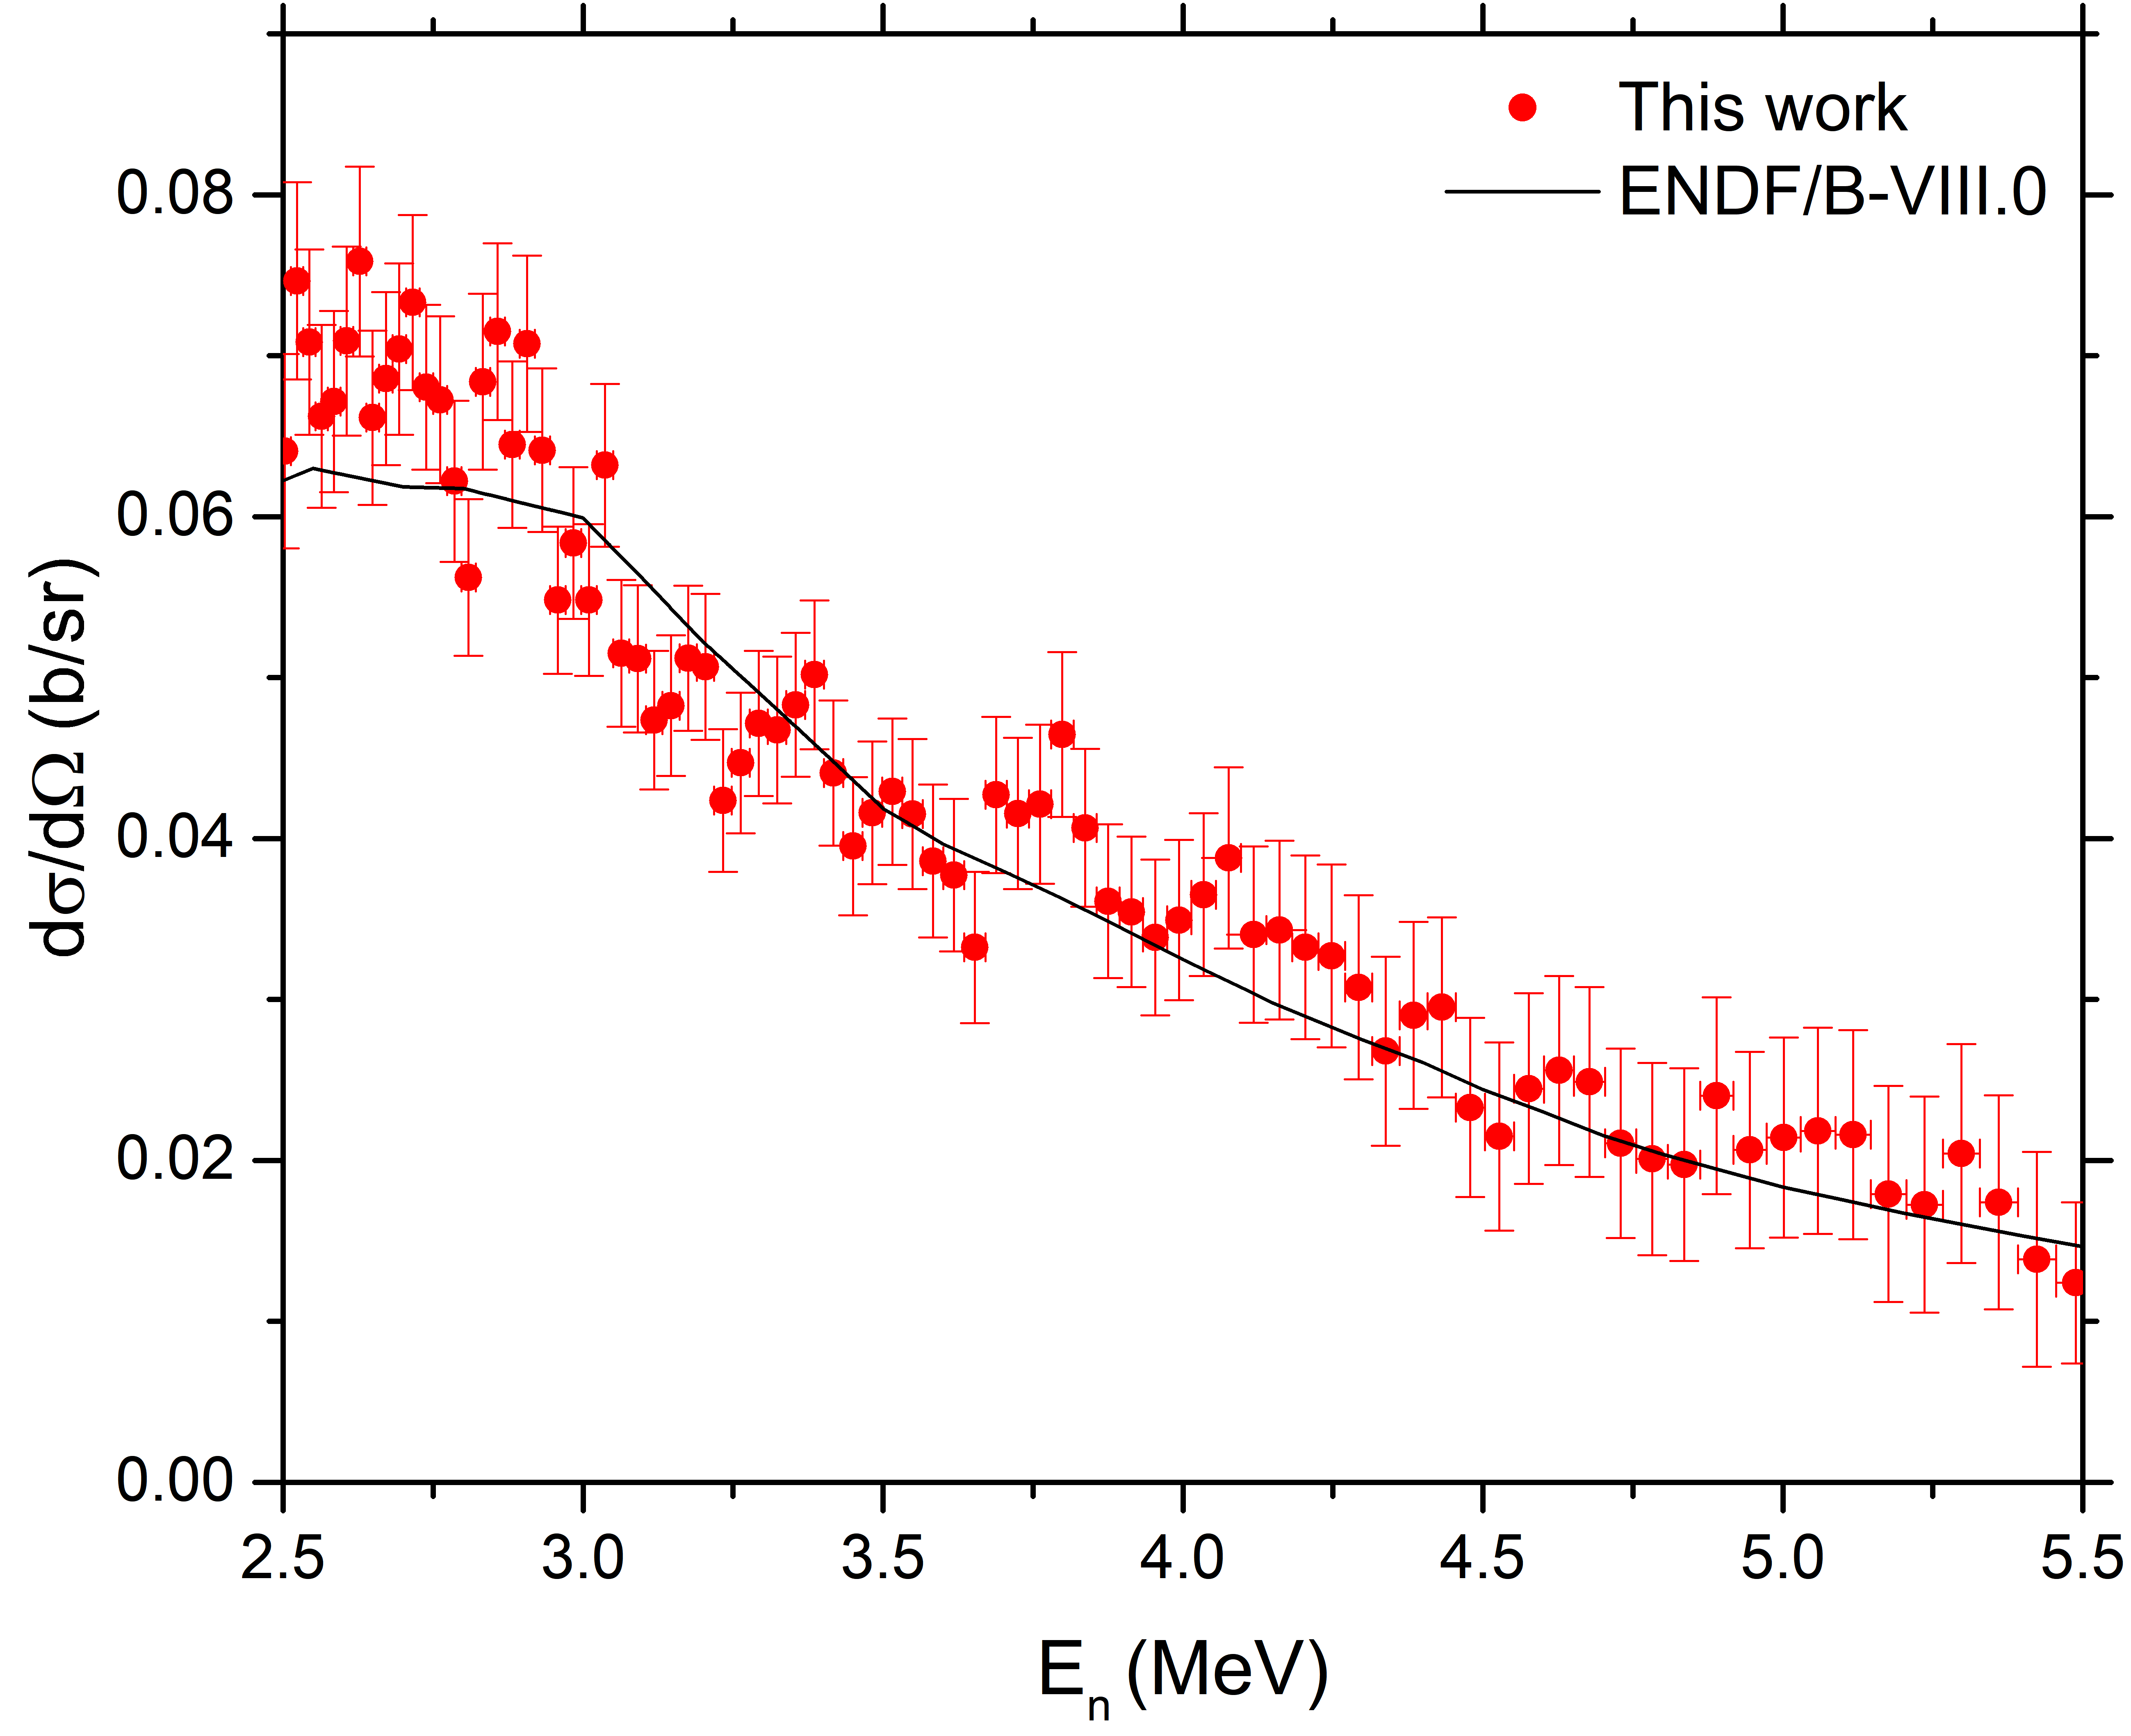
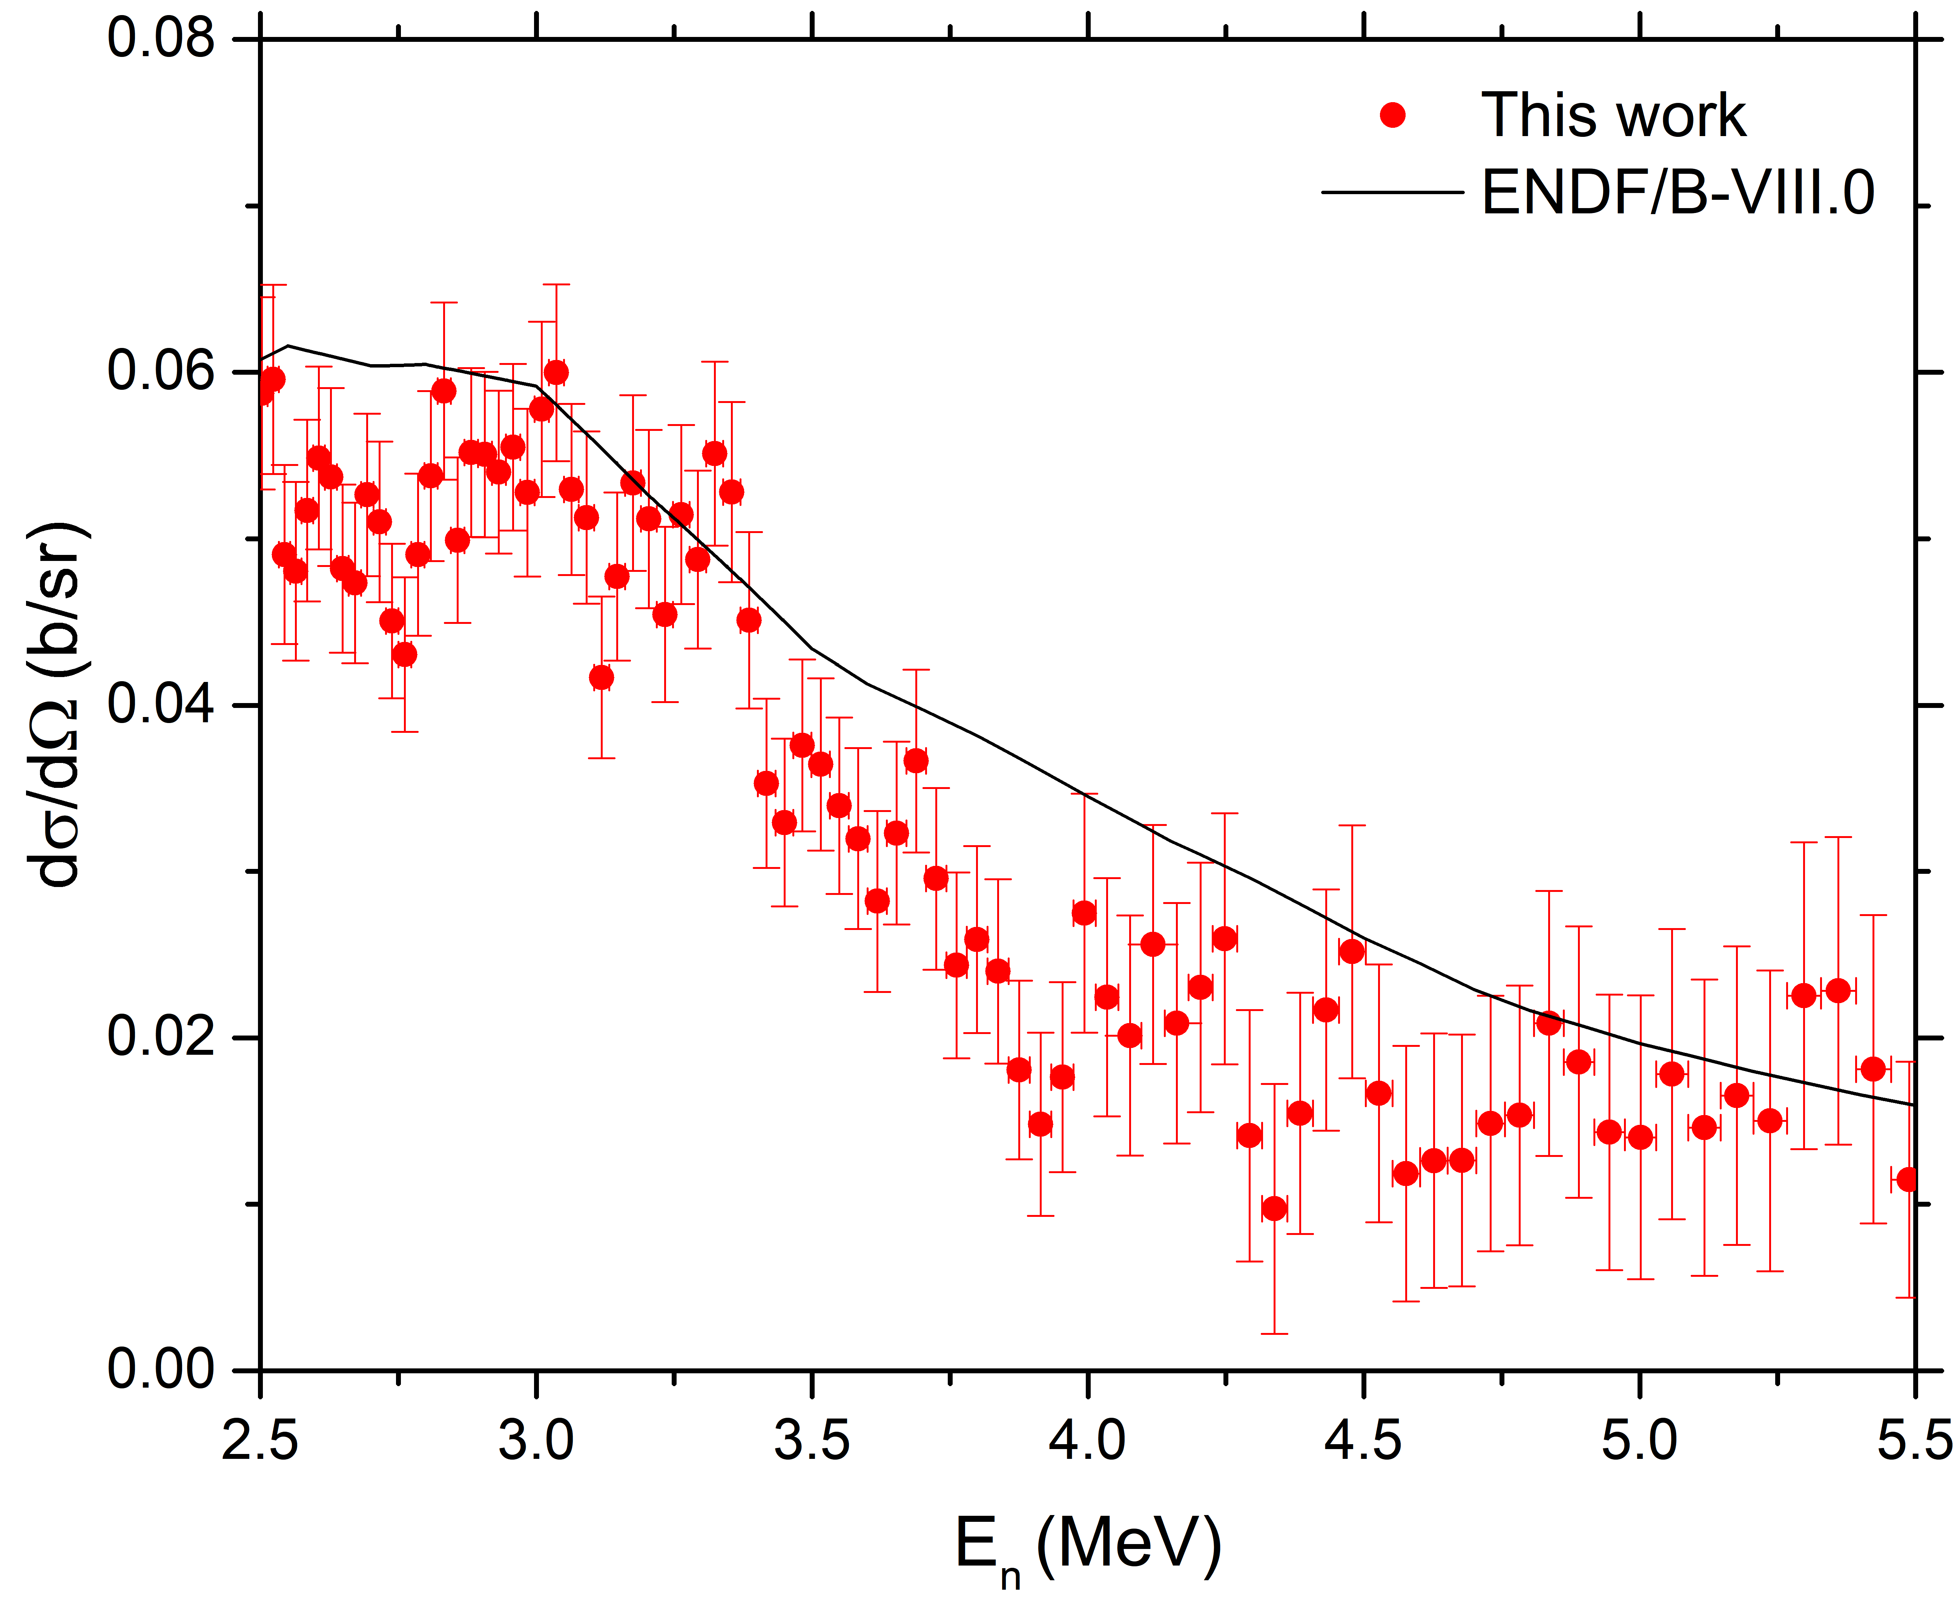
Neutron scattering on ⁵⁴Fe : ⁵⁴Fe(n, n₁’) Differential cross sections vs Energy
θ_{LAB} = 163.8º
θ_{LAB} = 142.8º
θ_{LAB} = 121.7º
θ_{LAB} = 100.6º
θ_{LAB} = 16.2º
θ_{LAB} = 79.4º
θ_{LAB} = 58.3º
θ_{LAB} = 37.2º
G. Gkatis et al., Phys. Rev. C 109, 034612 (2024)

Slide 11
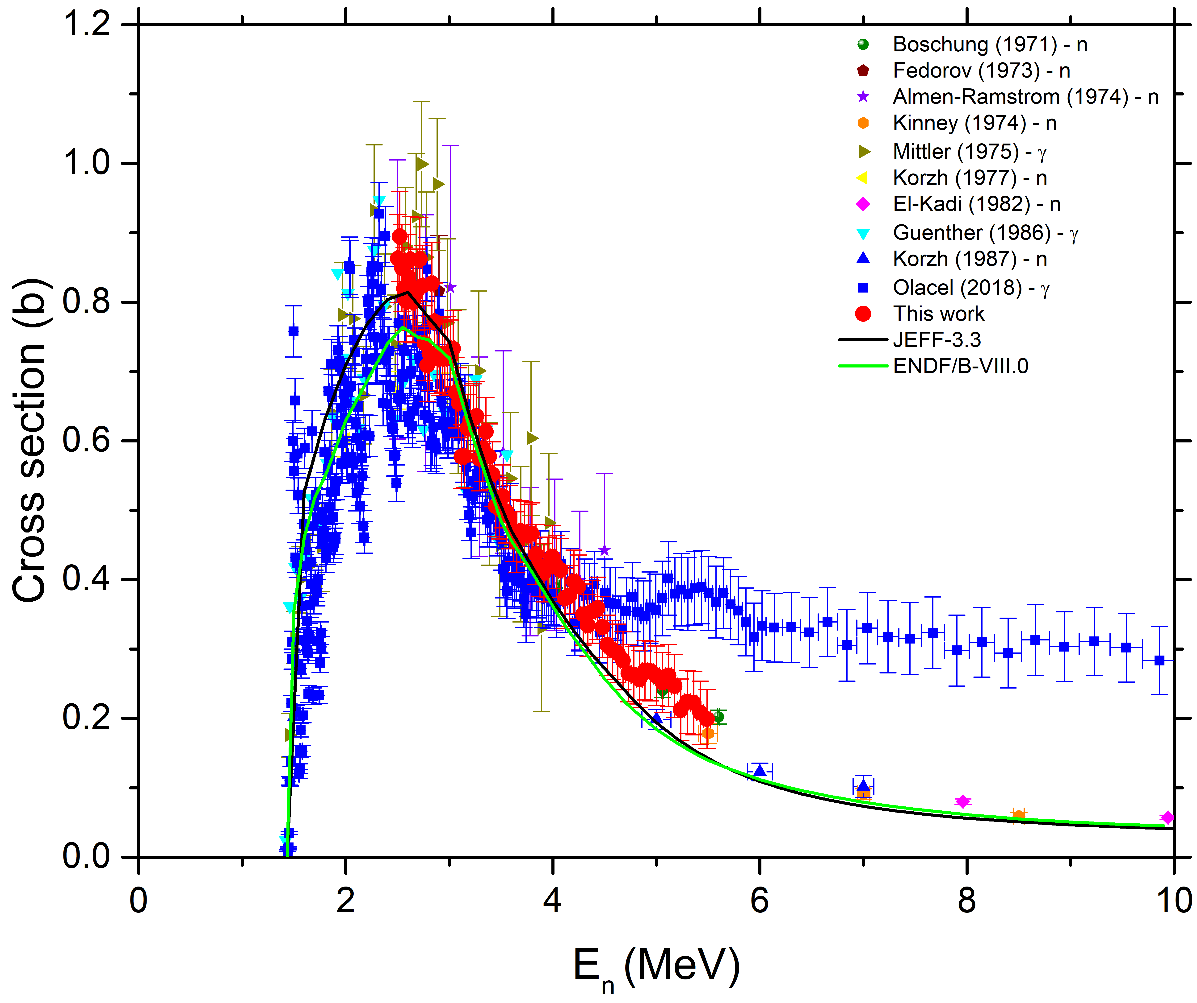
Neutron scattering on ⁵⁴Fe : ⁵⁴Fe(n, n₁’) angle integrated cross section
During evaluation
both techniques based on
γ –ray and neutron detection
should be considered.
Different systematic uncertainties/
Complementary.
G. Gkatis et al., Phys. Rev. C 109, 034612 (2024)
All Data submitted to EXFOR since March 2024
Notes:
UNCERTAINTY : 6% and 20%.

Slide 12
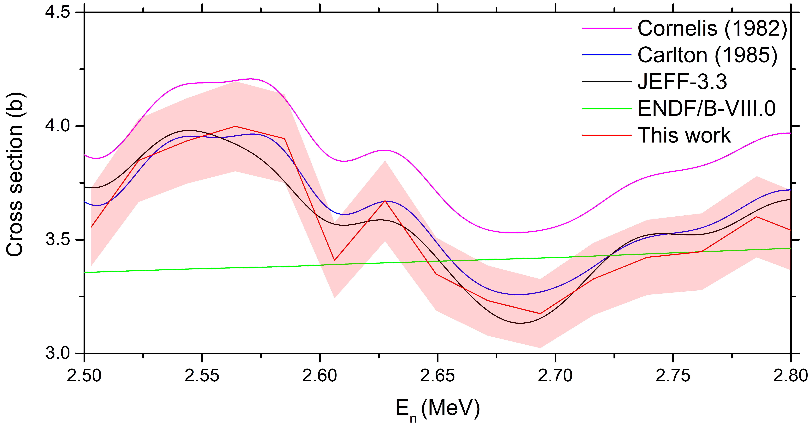
Neutron scattering on ⁵⁴Fe : Extraction of the ⁵⁴Fe(n,tot)
=σ(⁵⁴Fe(n,n))+ σ( ⁵⁴Fe(n, n₁’))
Notes:
Cornelis :NORMALISATION ISSUES?

Slide 13
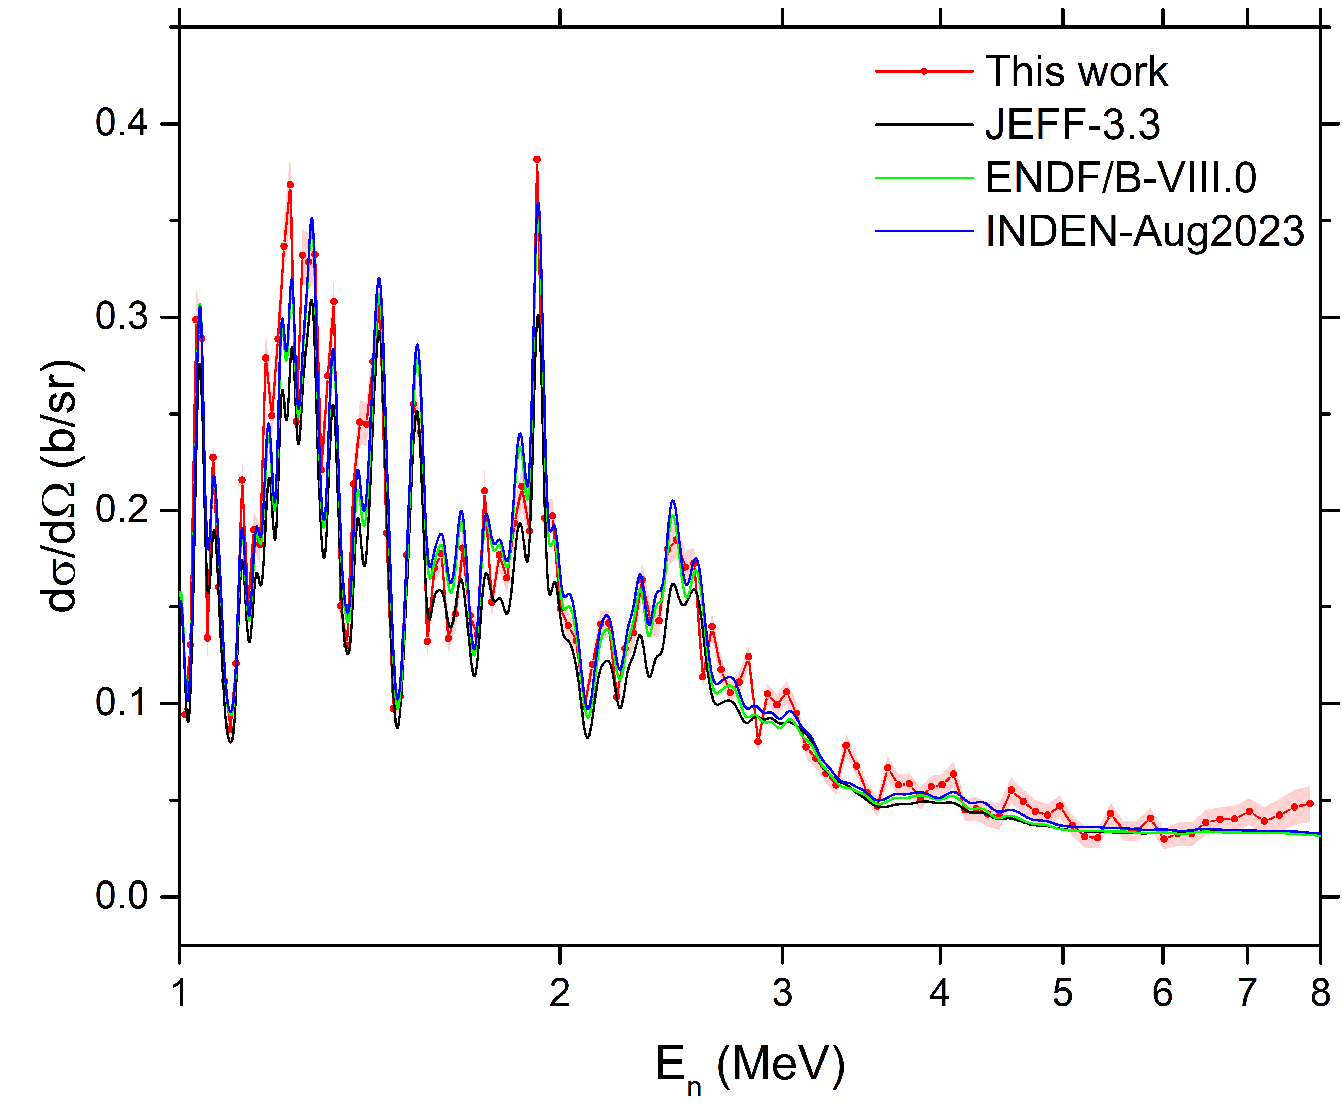
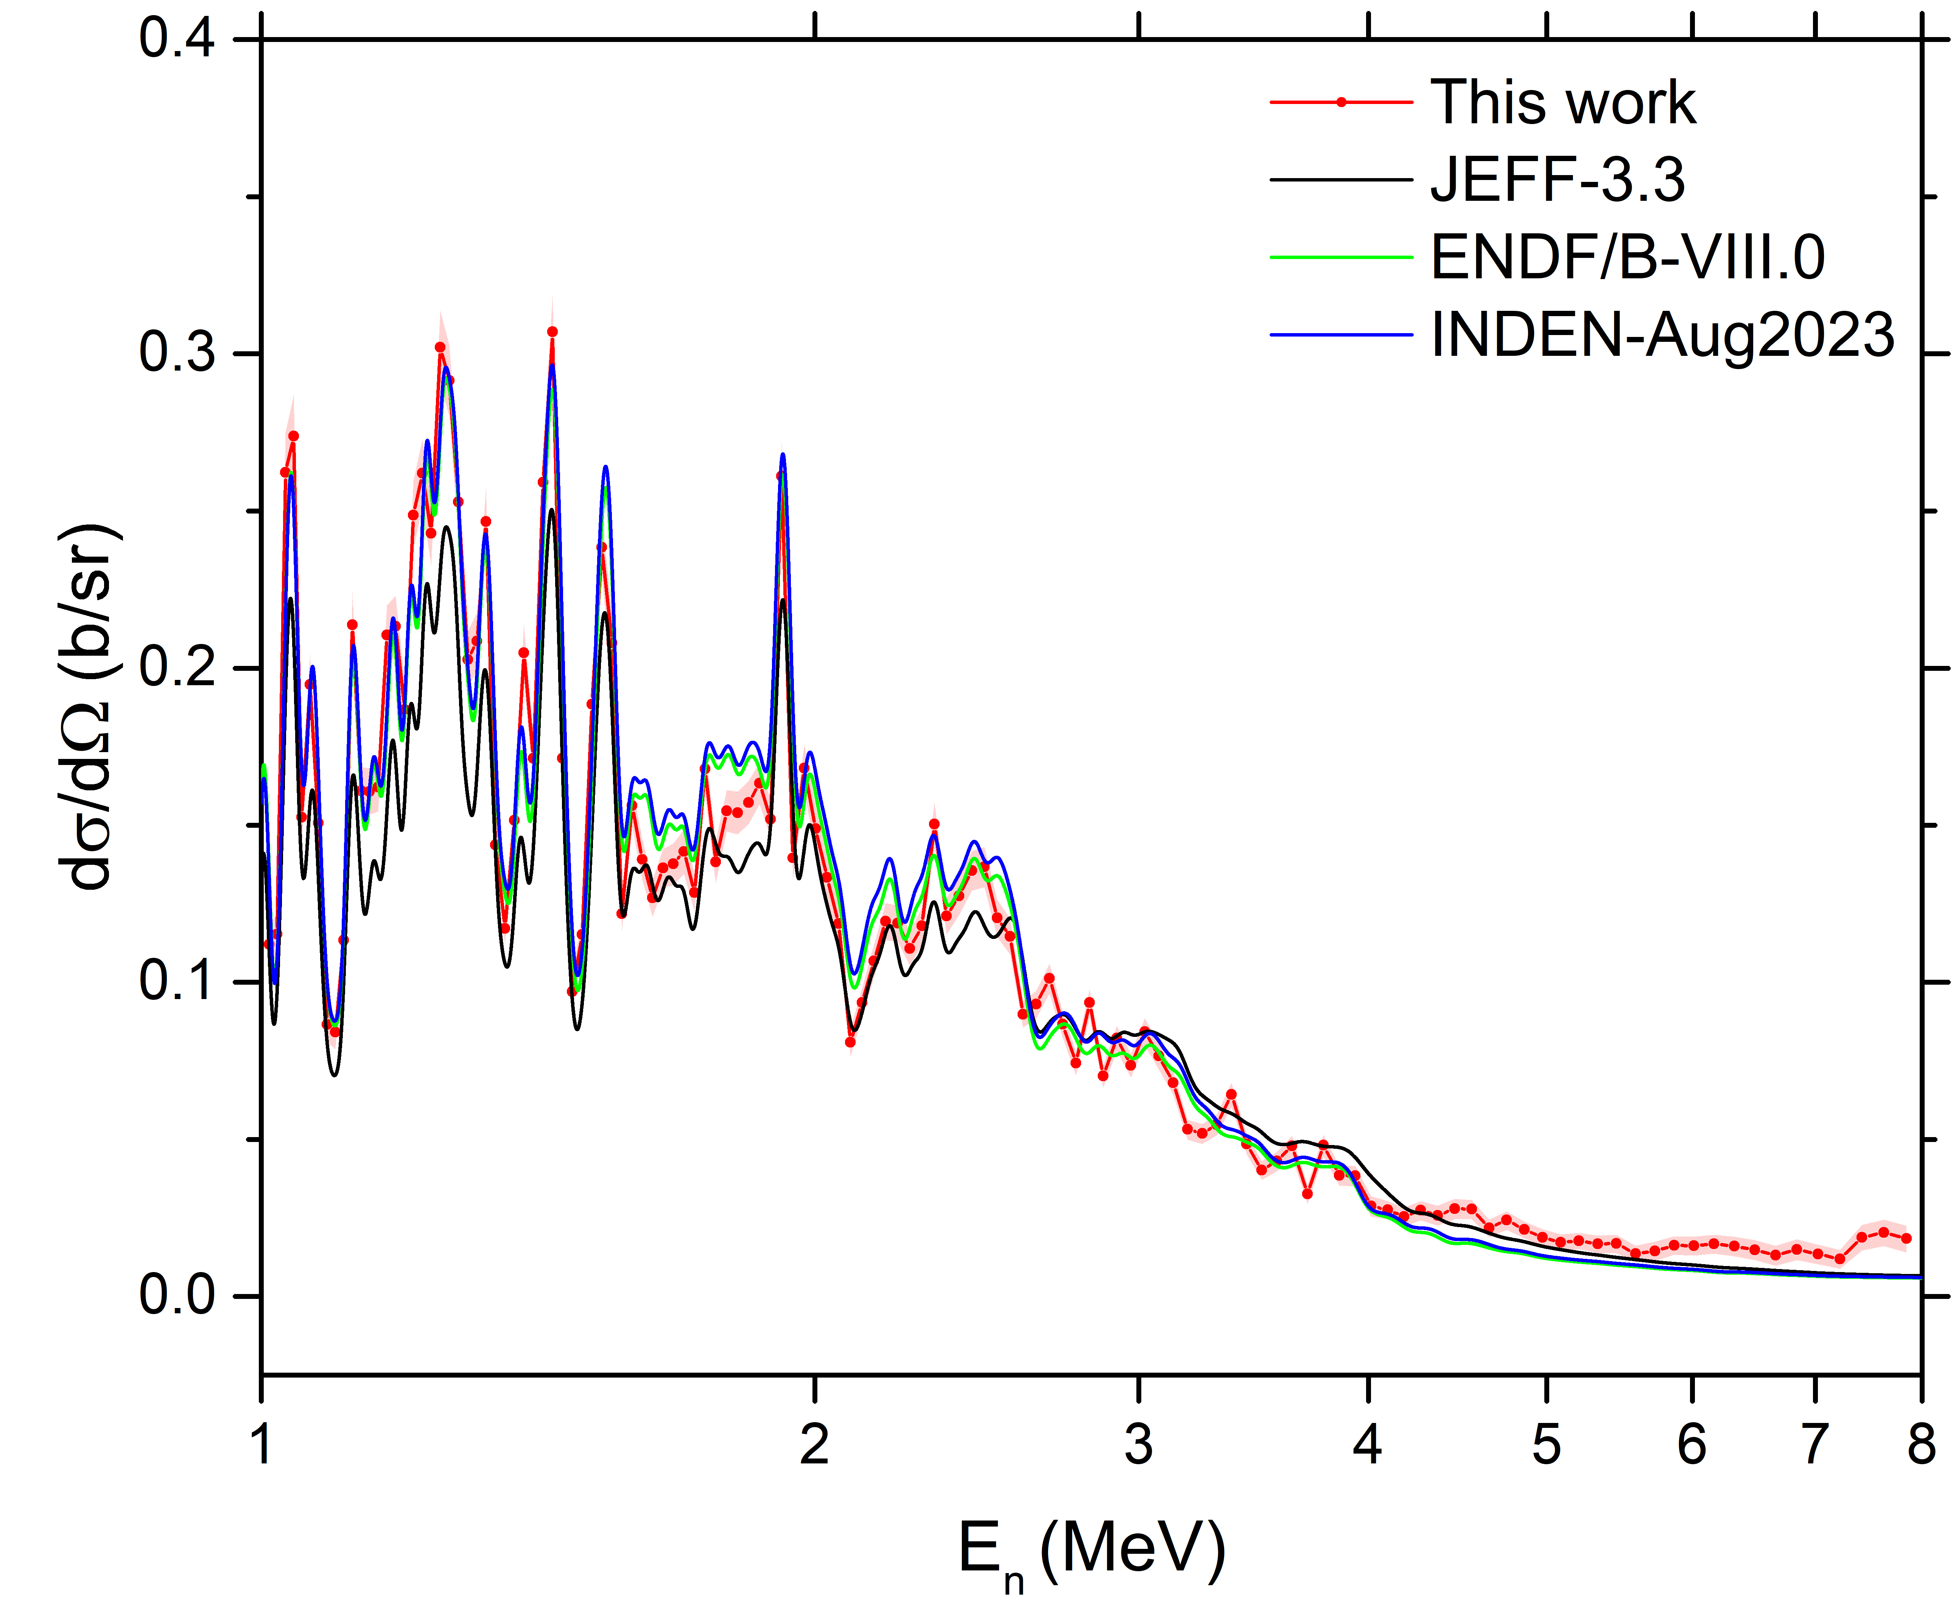
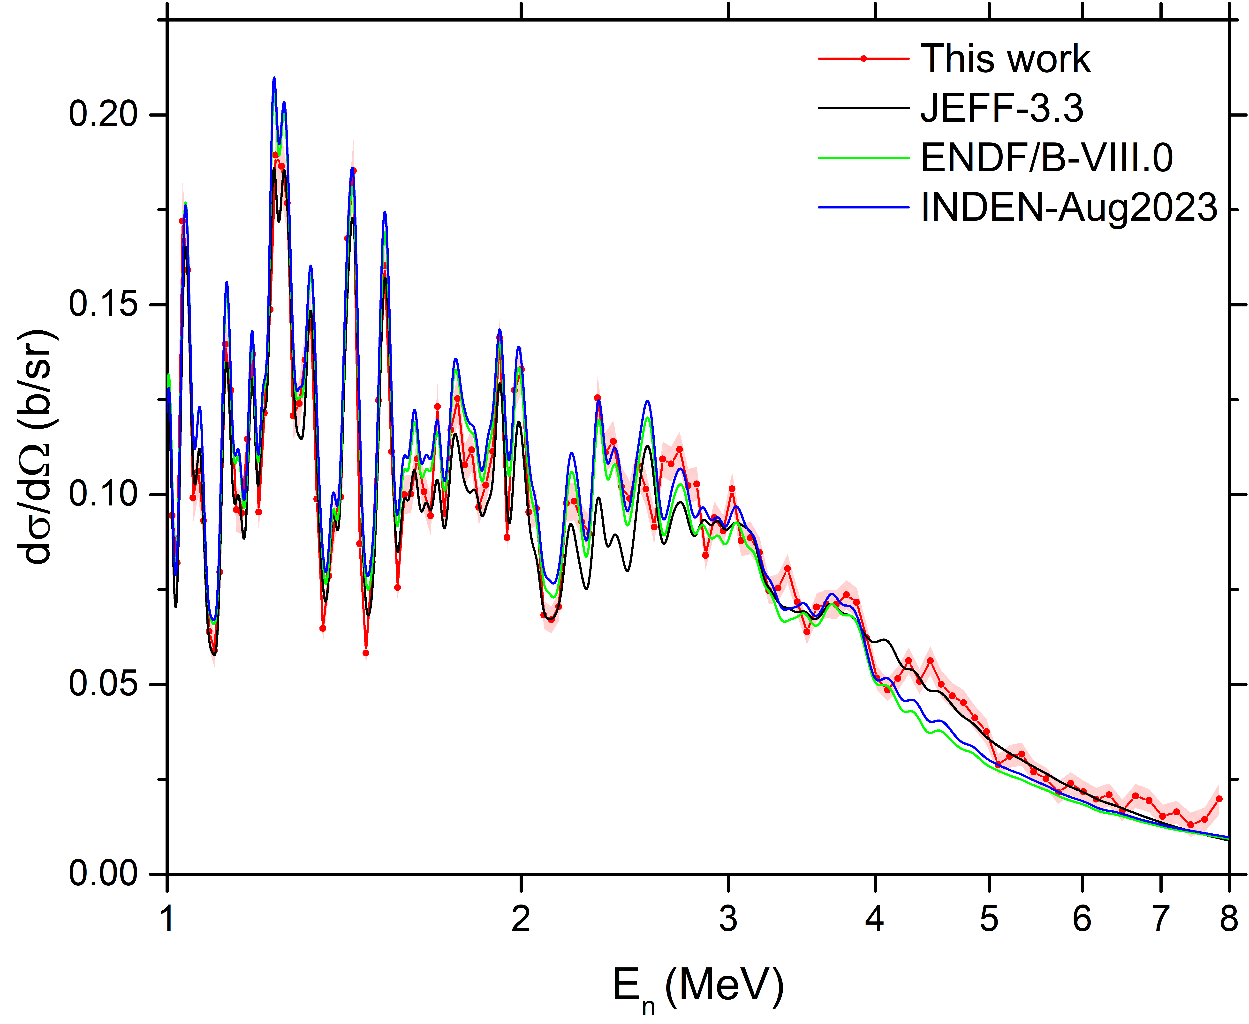
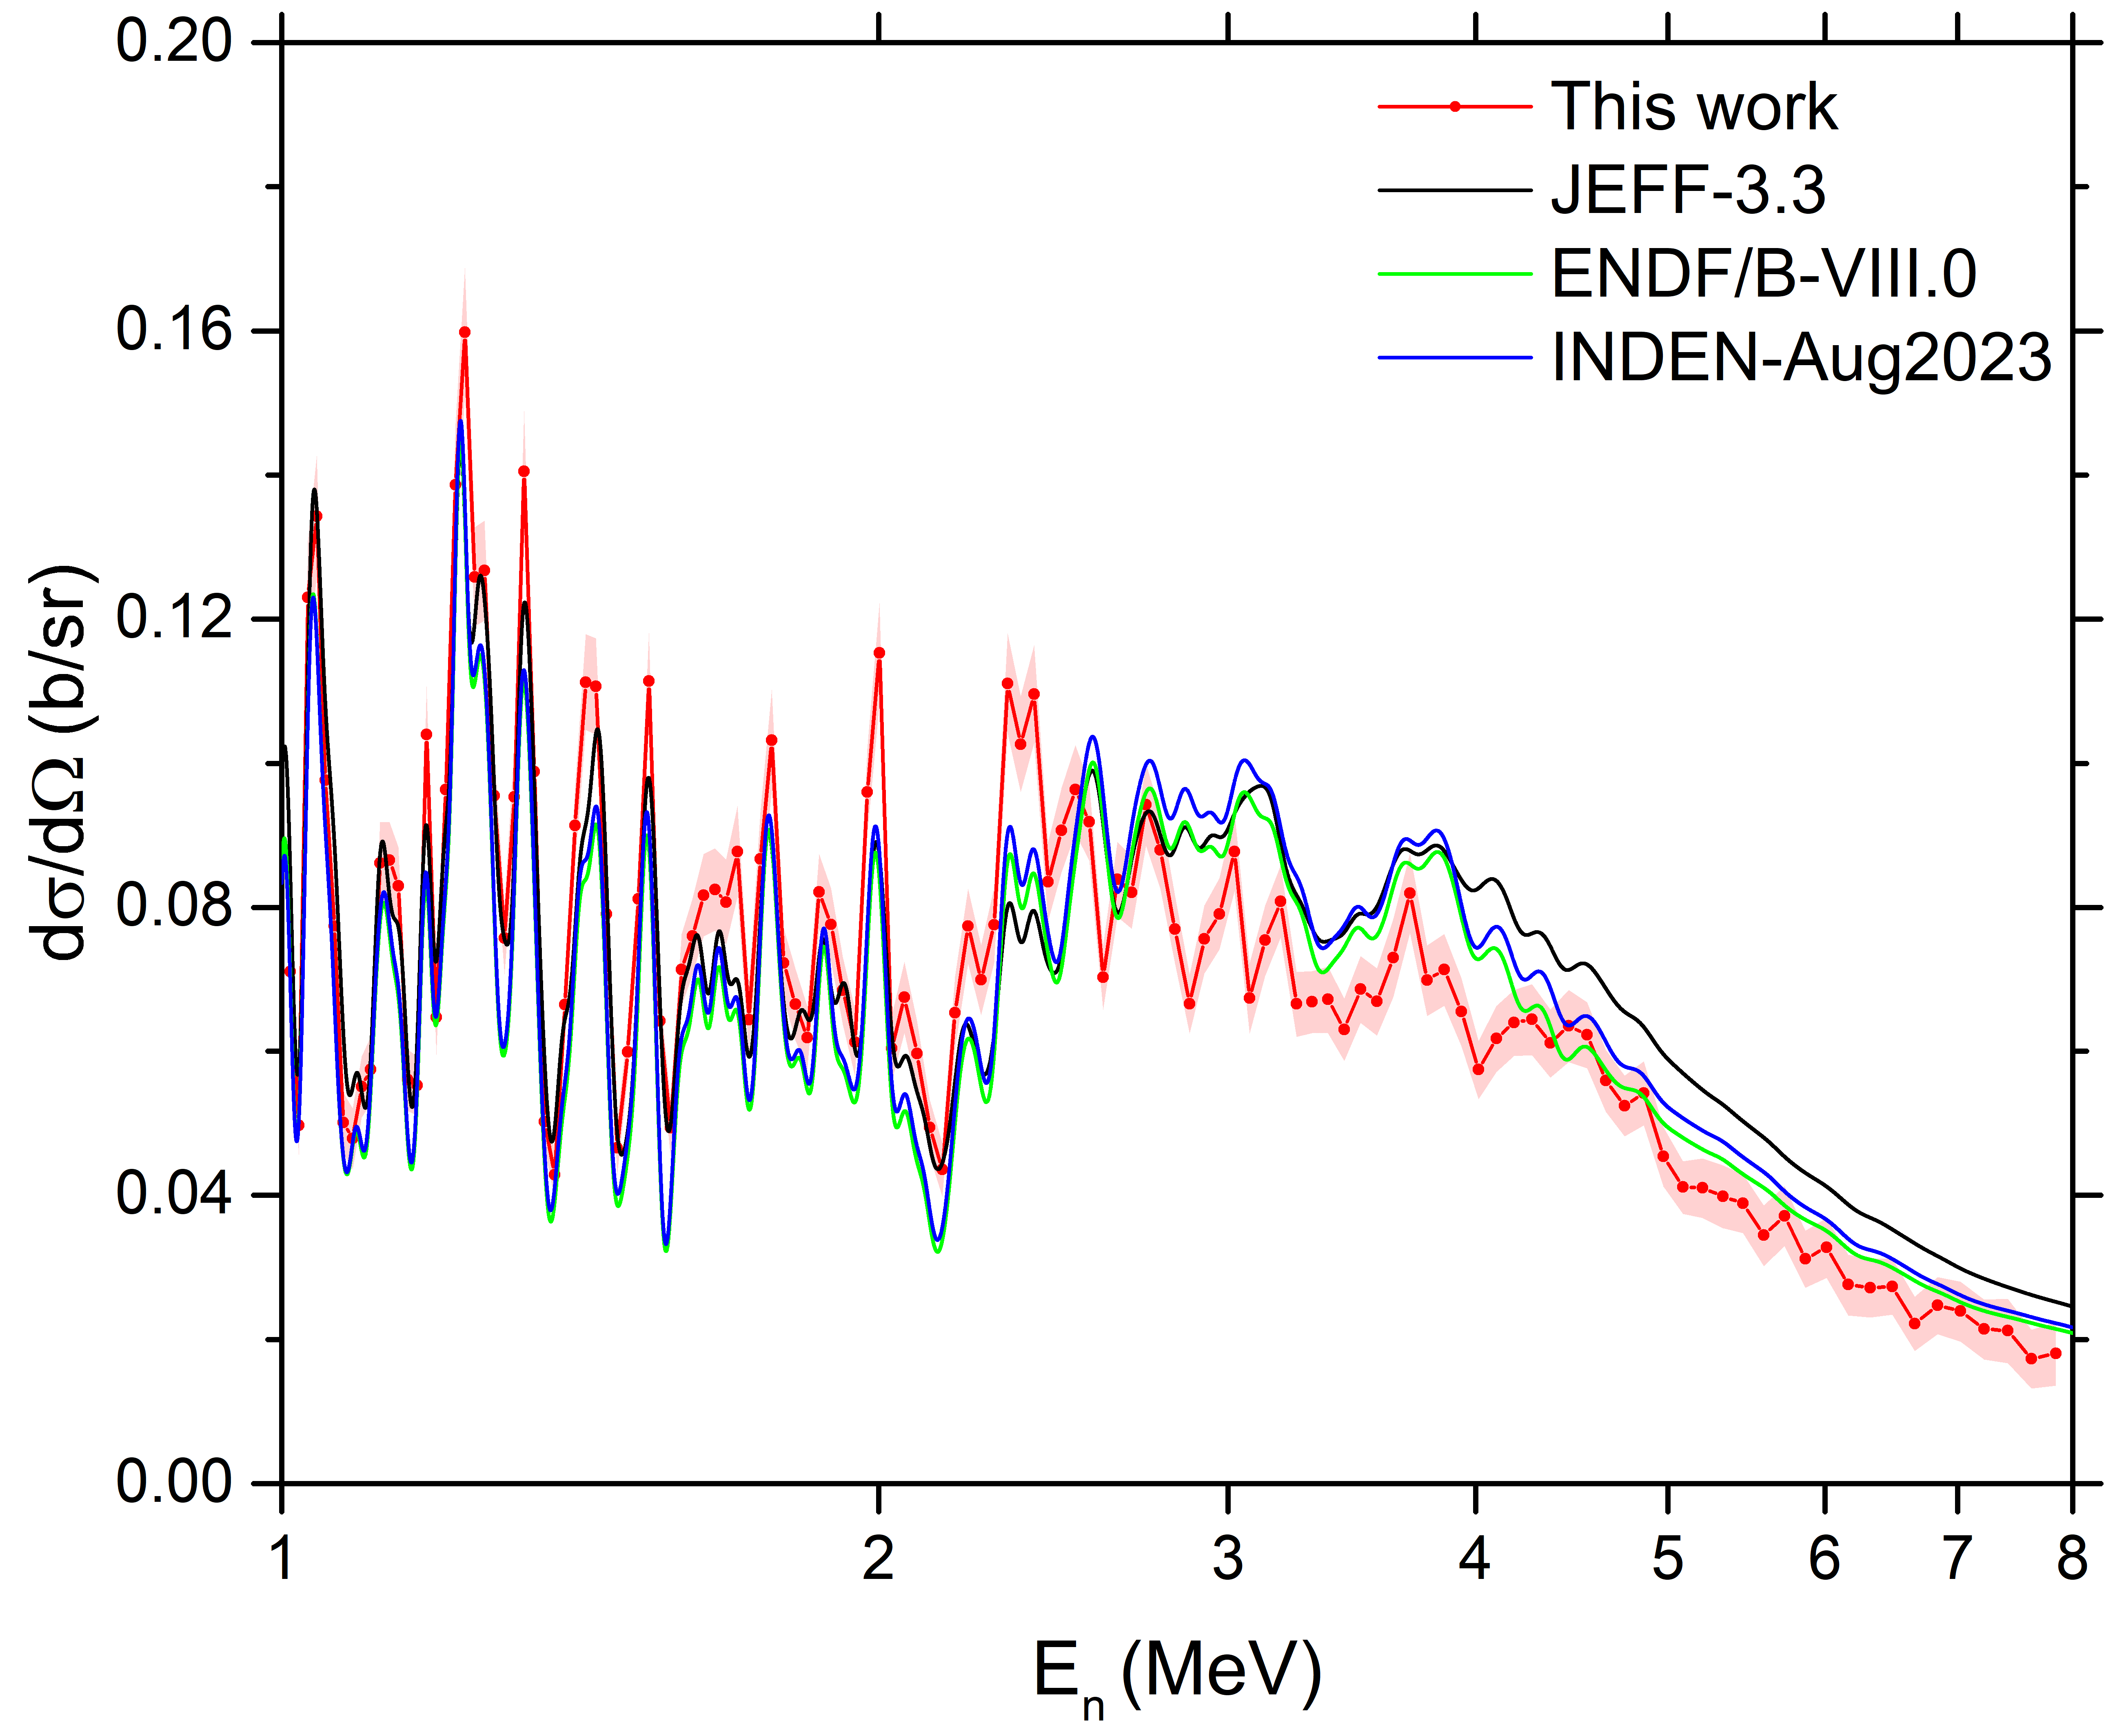
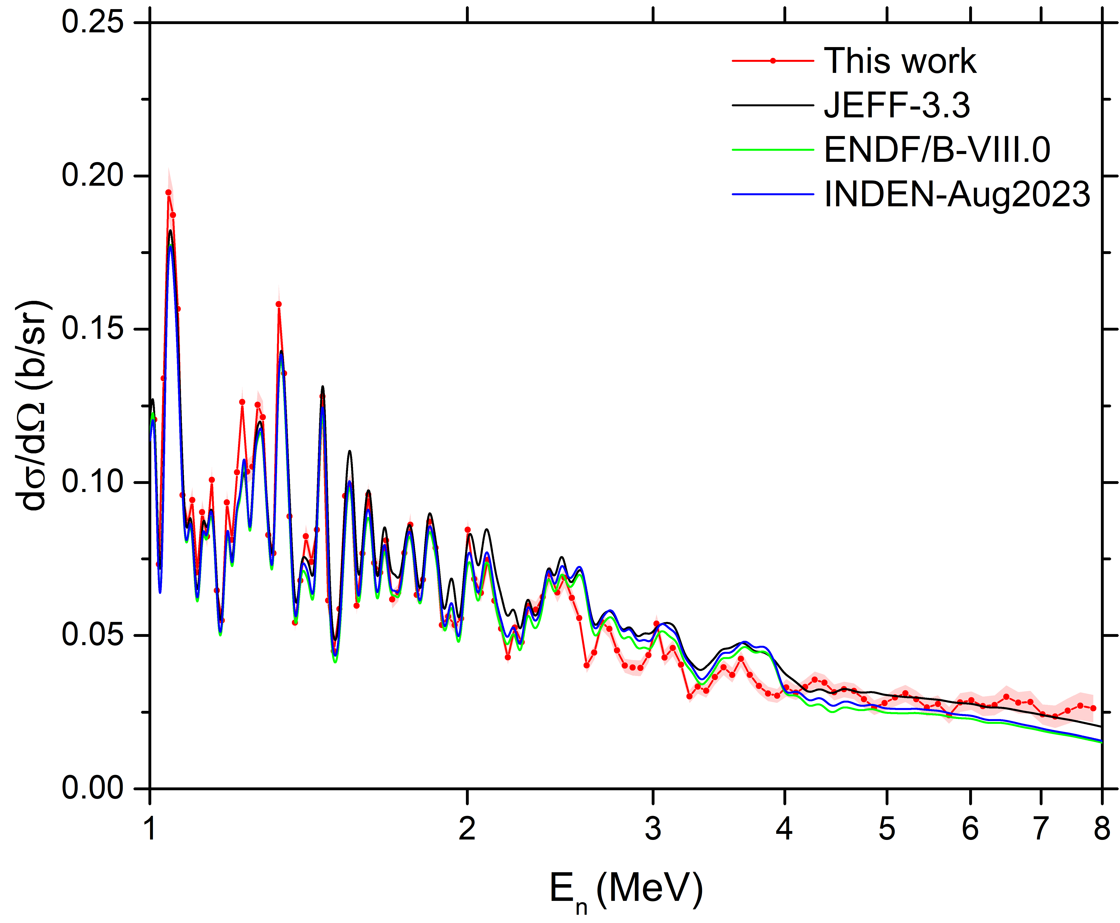
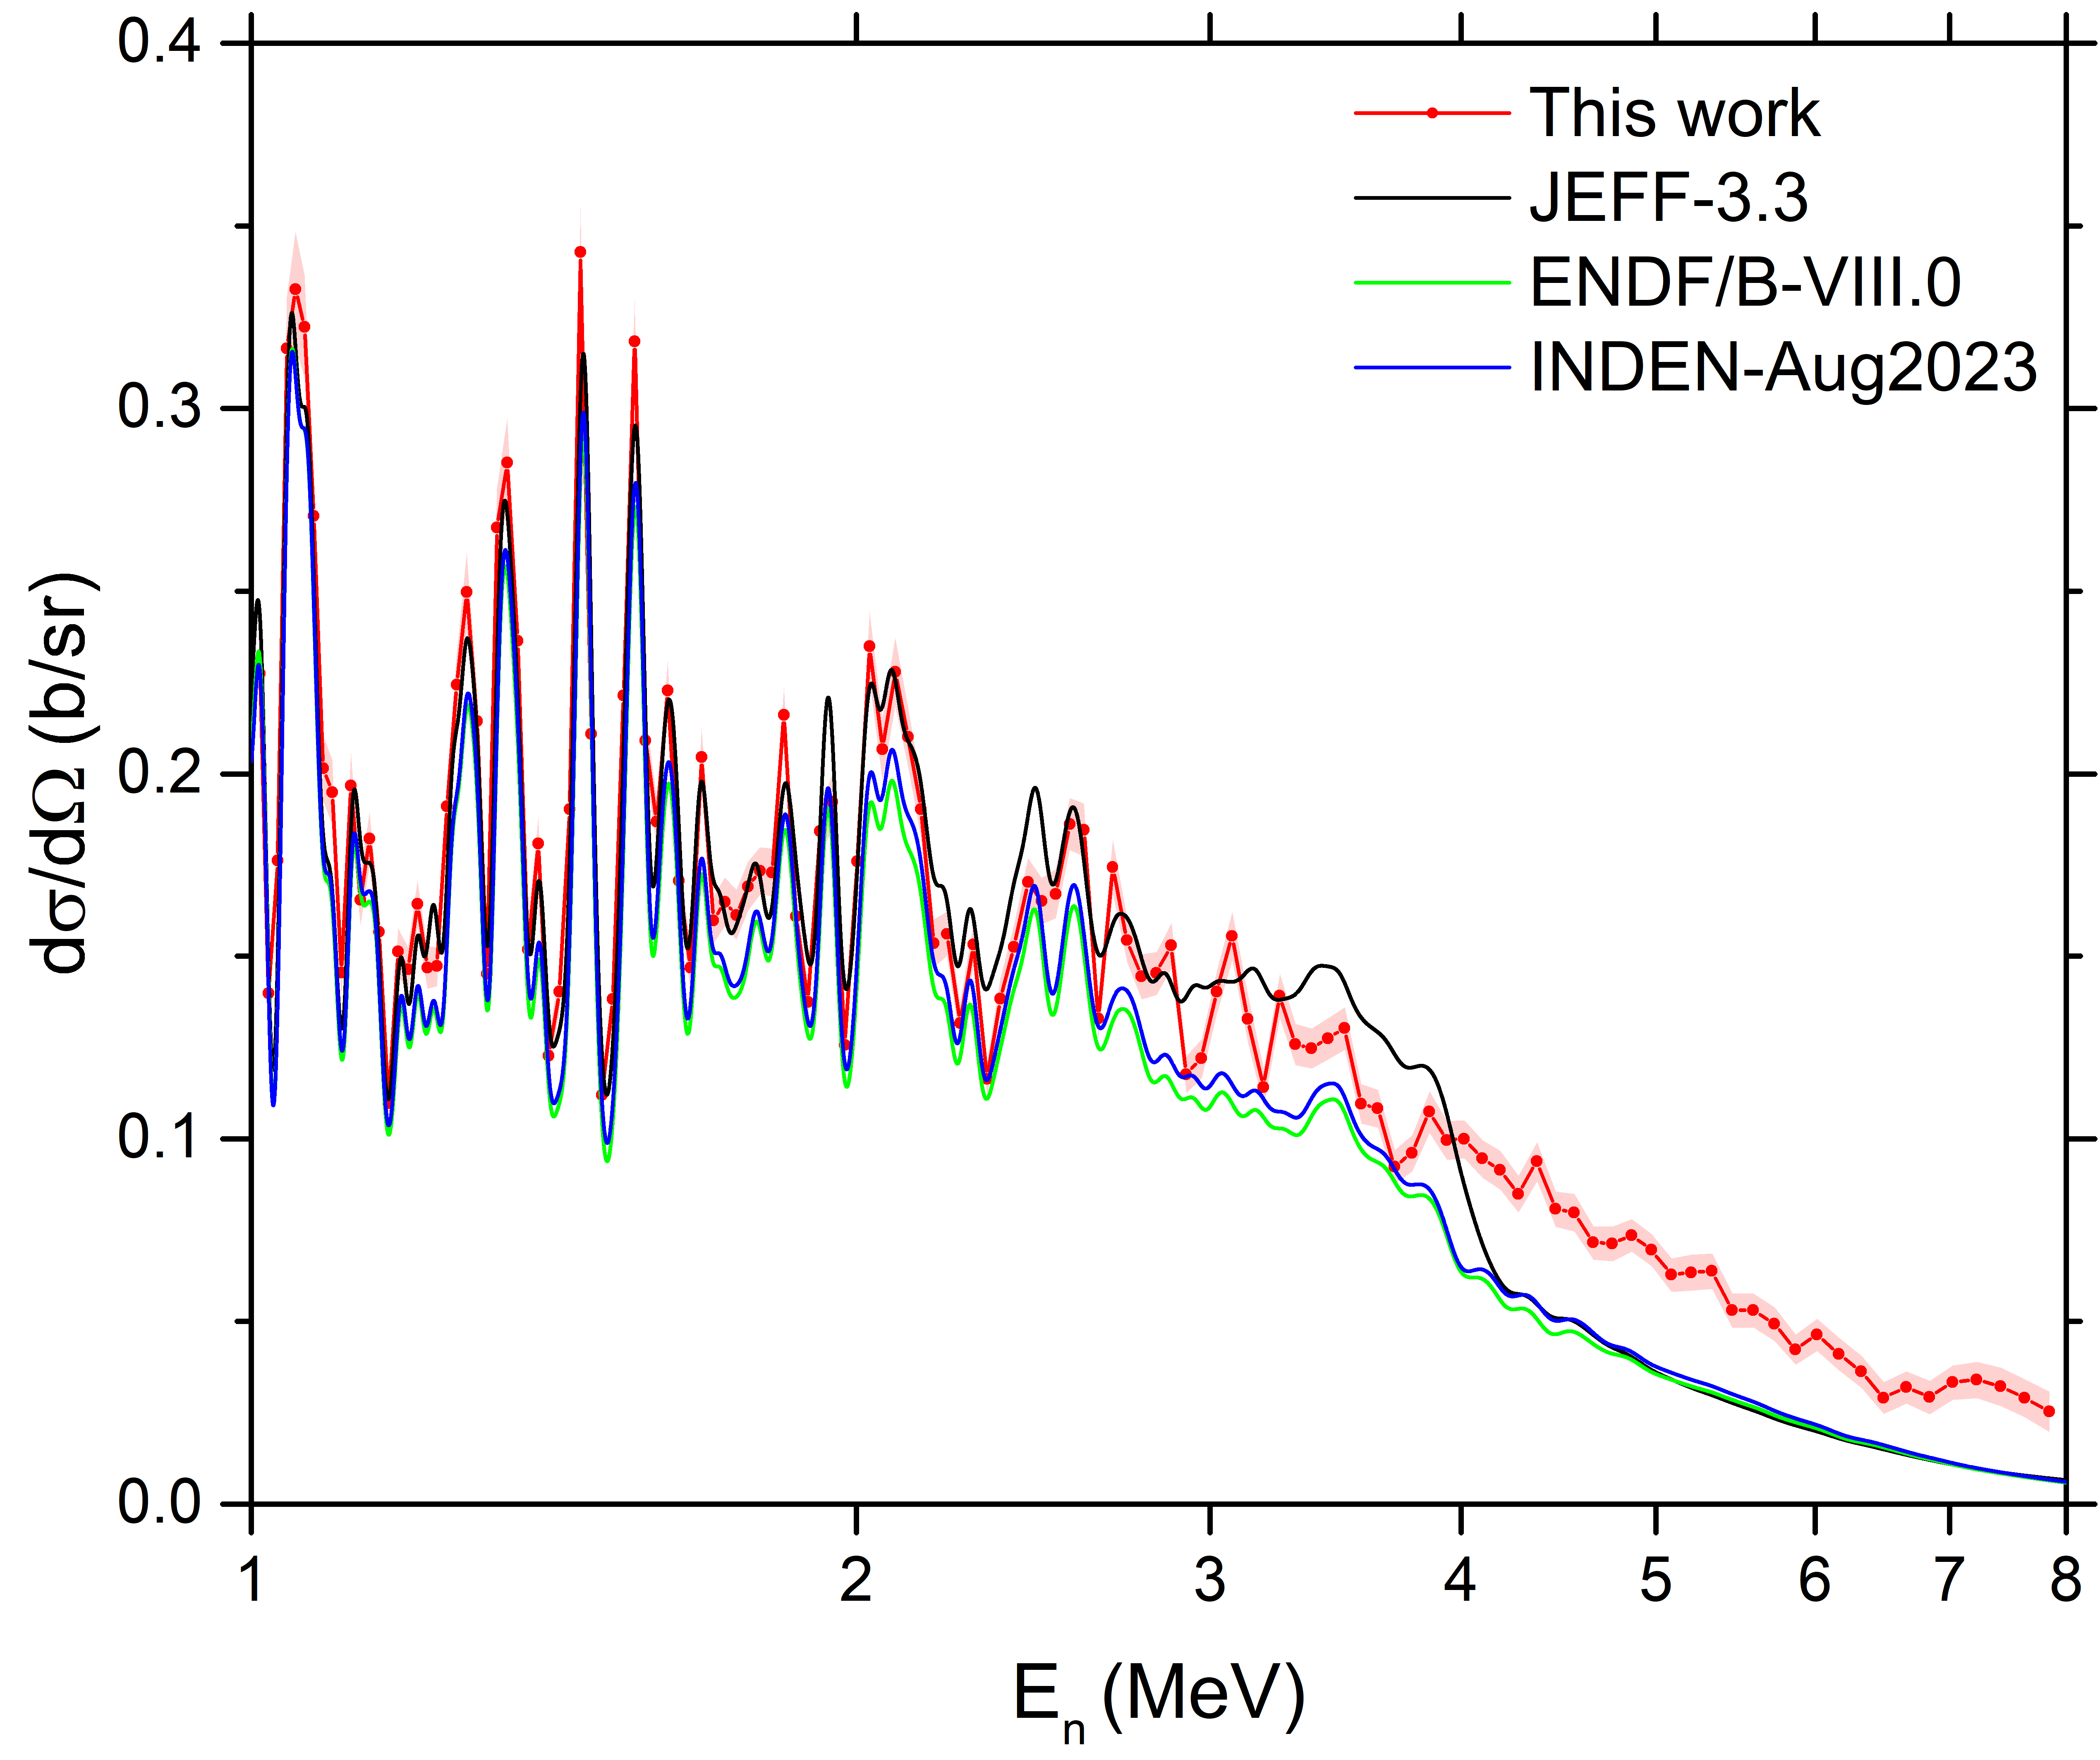
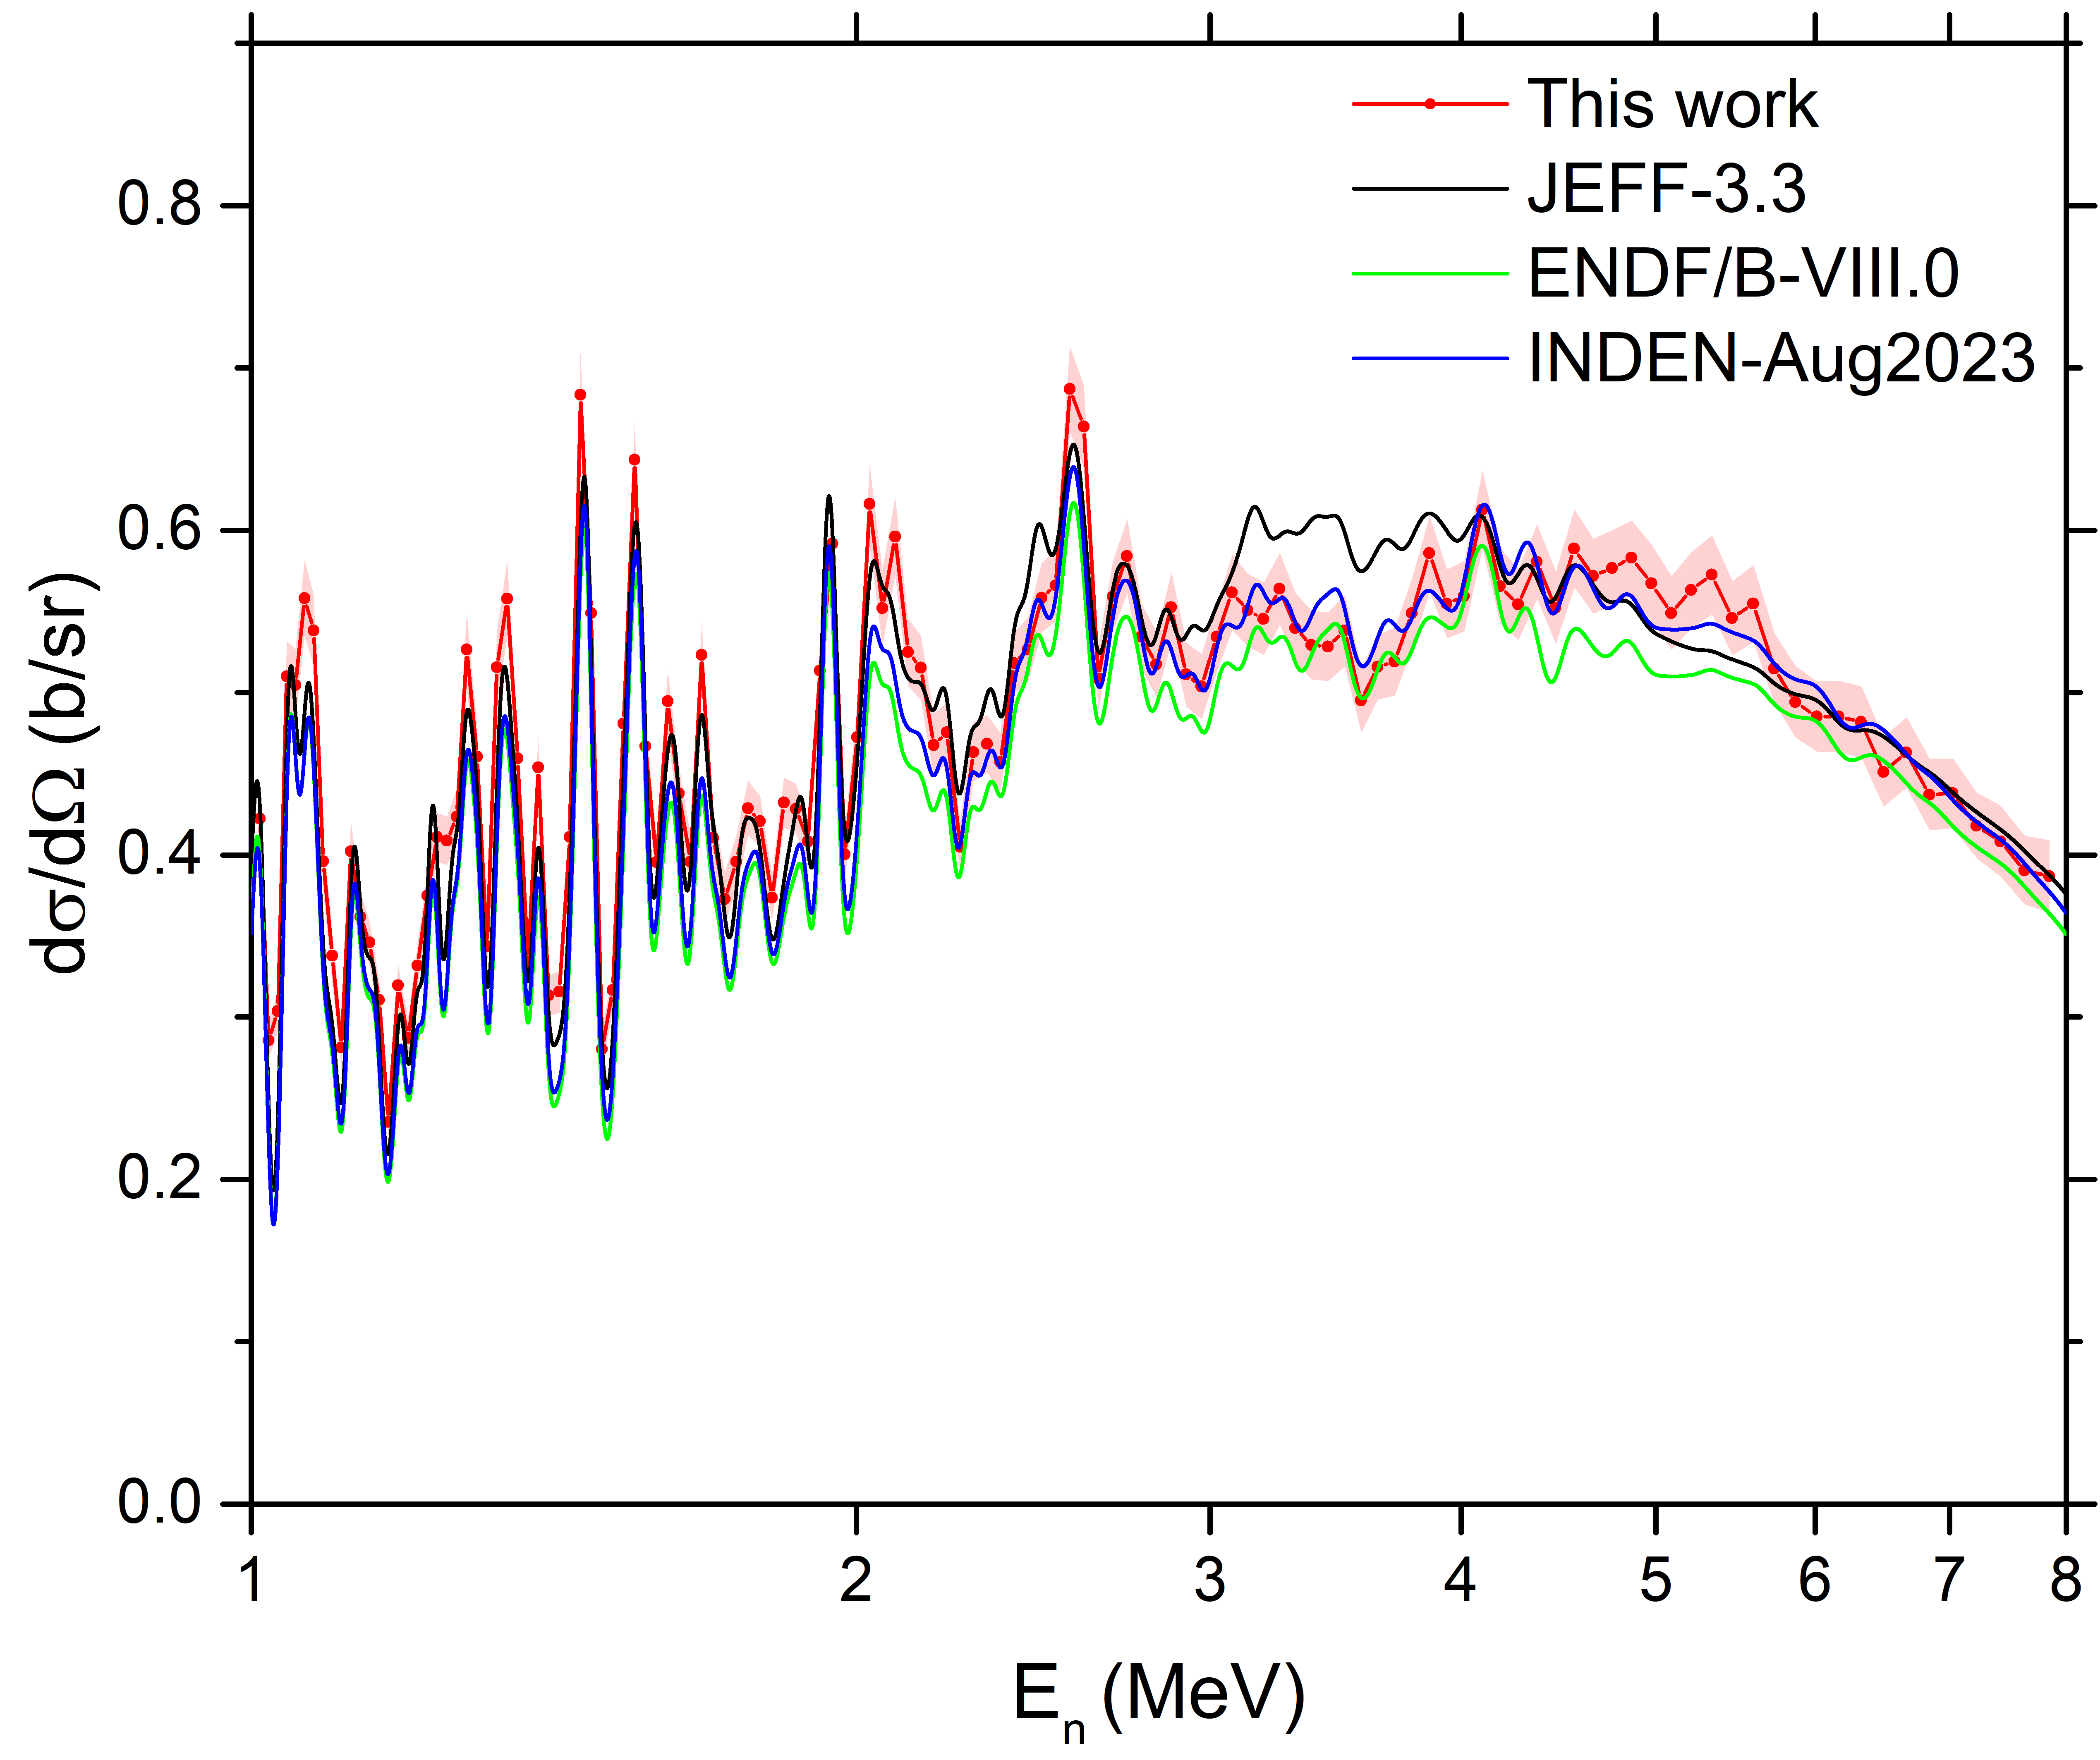
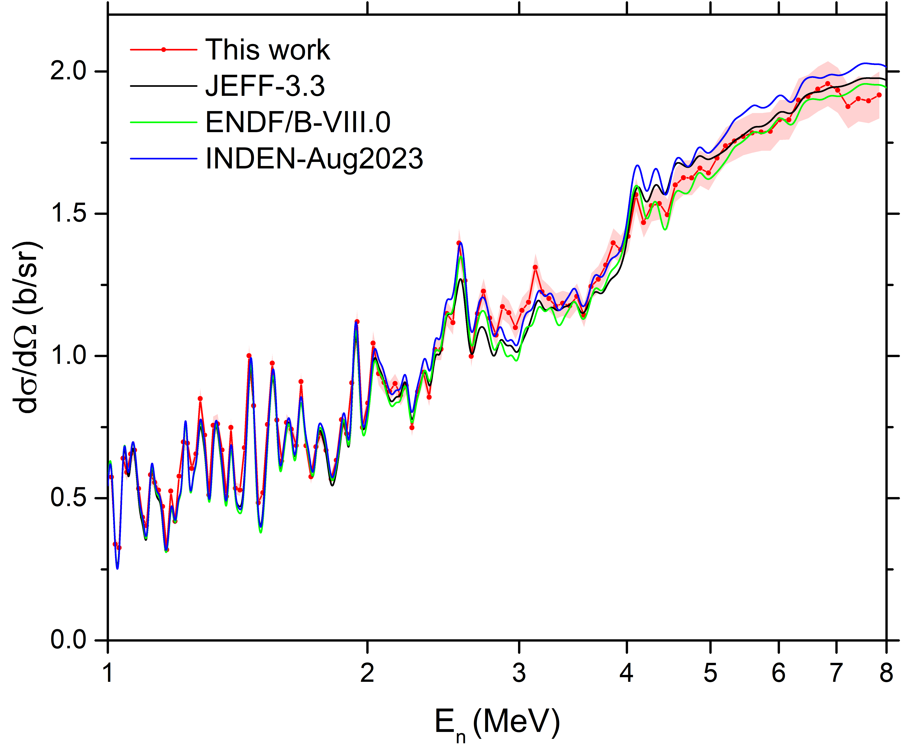
Neutron scattering on ⁵⁶Fe : ⁵⁶Fe(n,n) Differential cross sections vs Energy
θ_{LAB} = 163.8º
θ_{LAB} = 142.8º
θ_{LAB} = 121.7º
θ_{LAB} = 100.6º
θ_{LAB} = 79.4º
θ_{LAB} = 58.3º
θ_{LAB} = 37.2º
θ_{LAB} = 16.2º

Slide 14
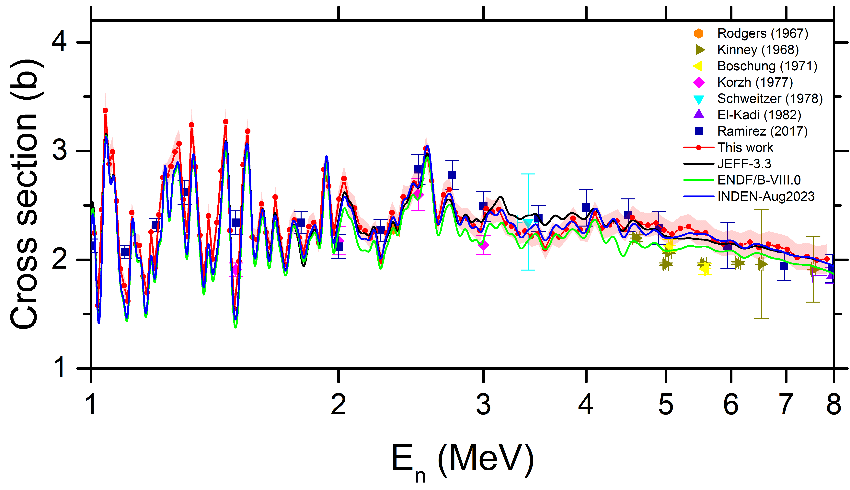
Neutron scattering on ⁵⁶Fe : ⁵⁶Fe(n,n) angle integrated cross section
Good agreement with INDEN 2023
Notes:
3-6%

Slide 15
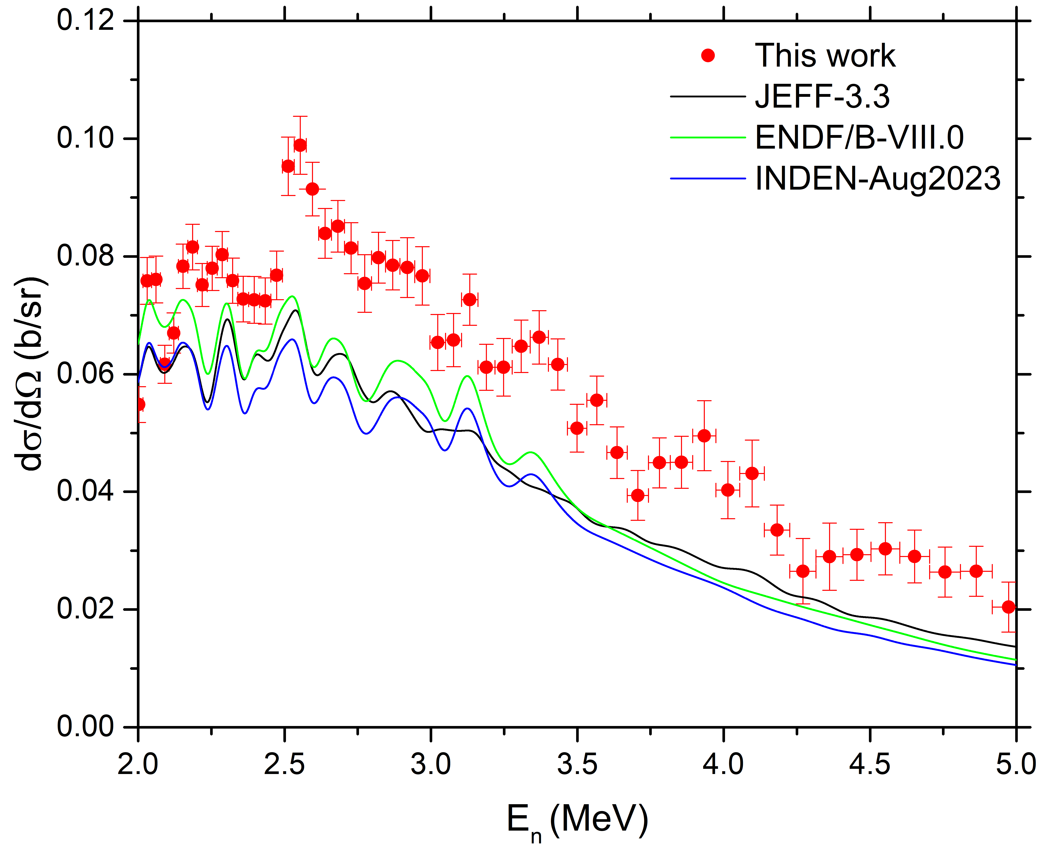
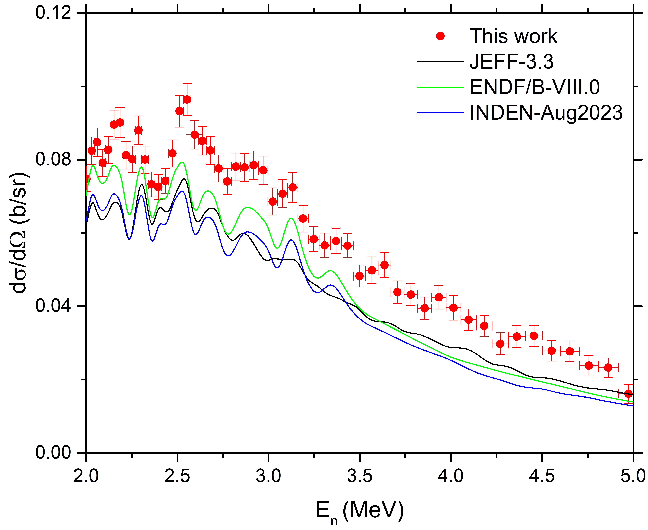
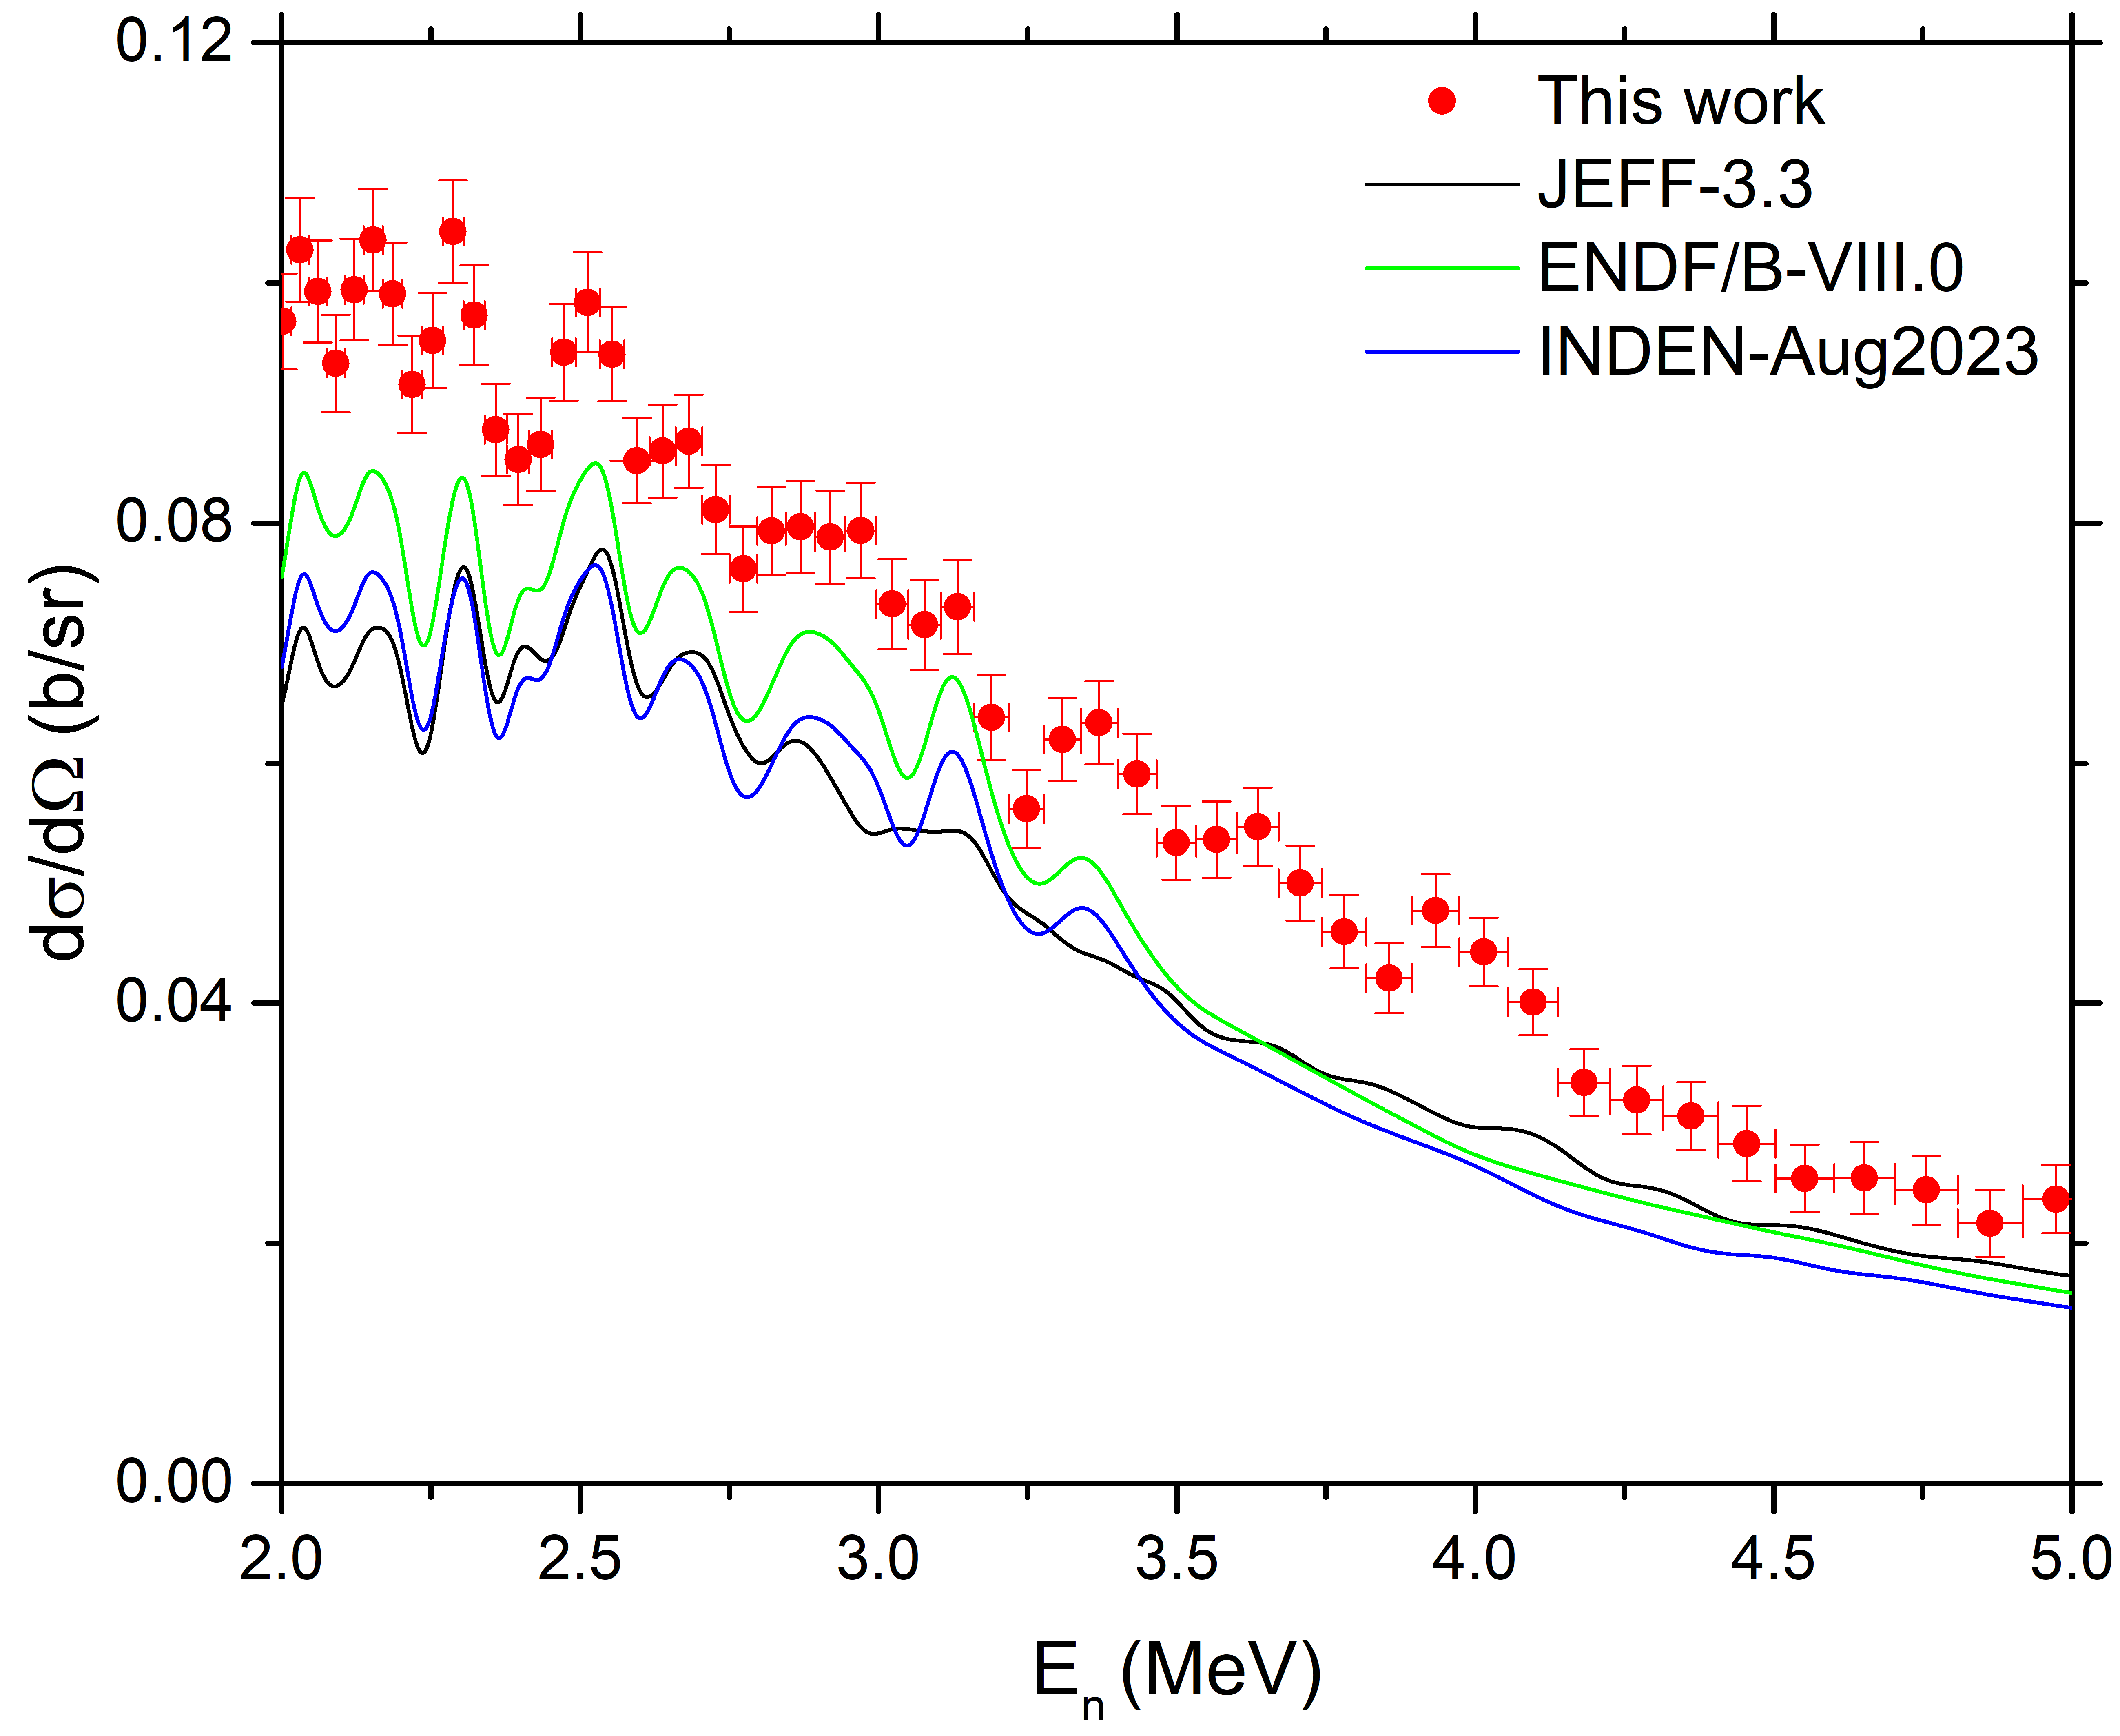
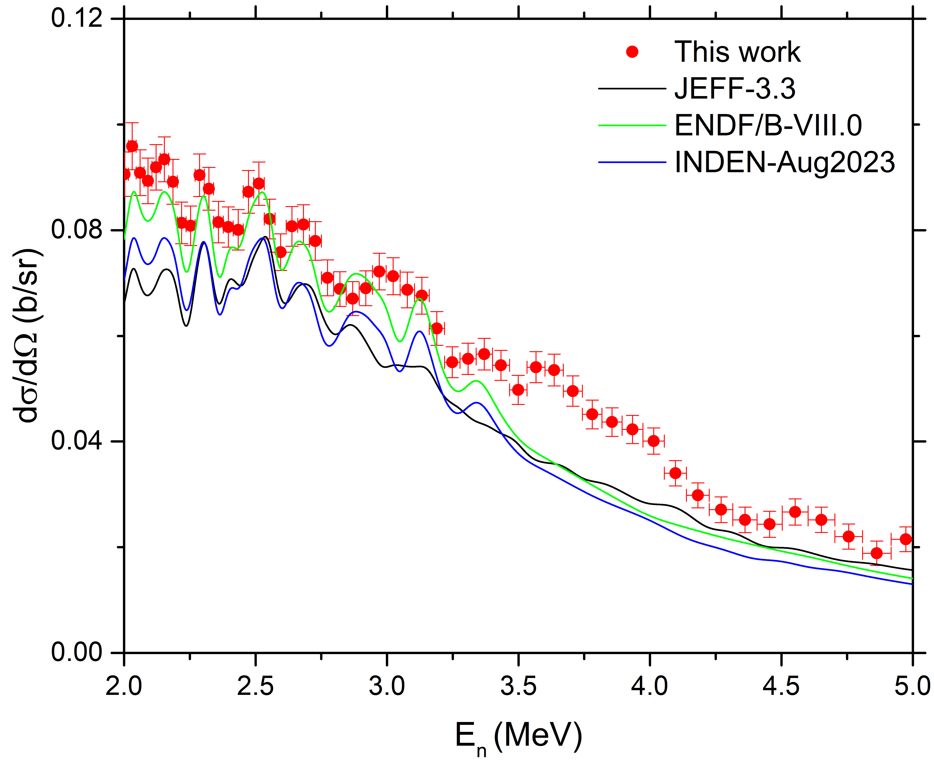
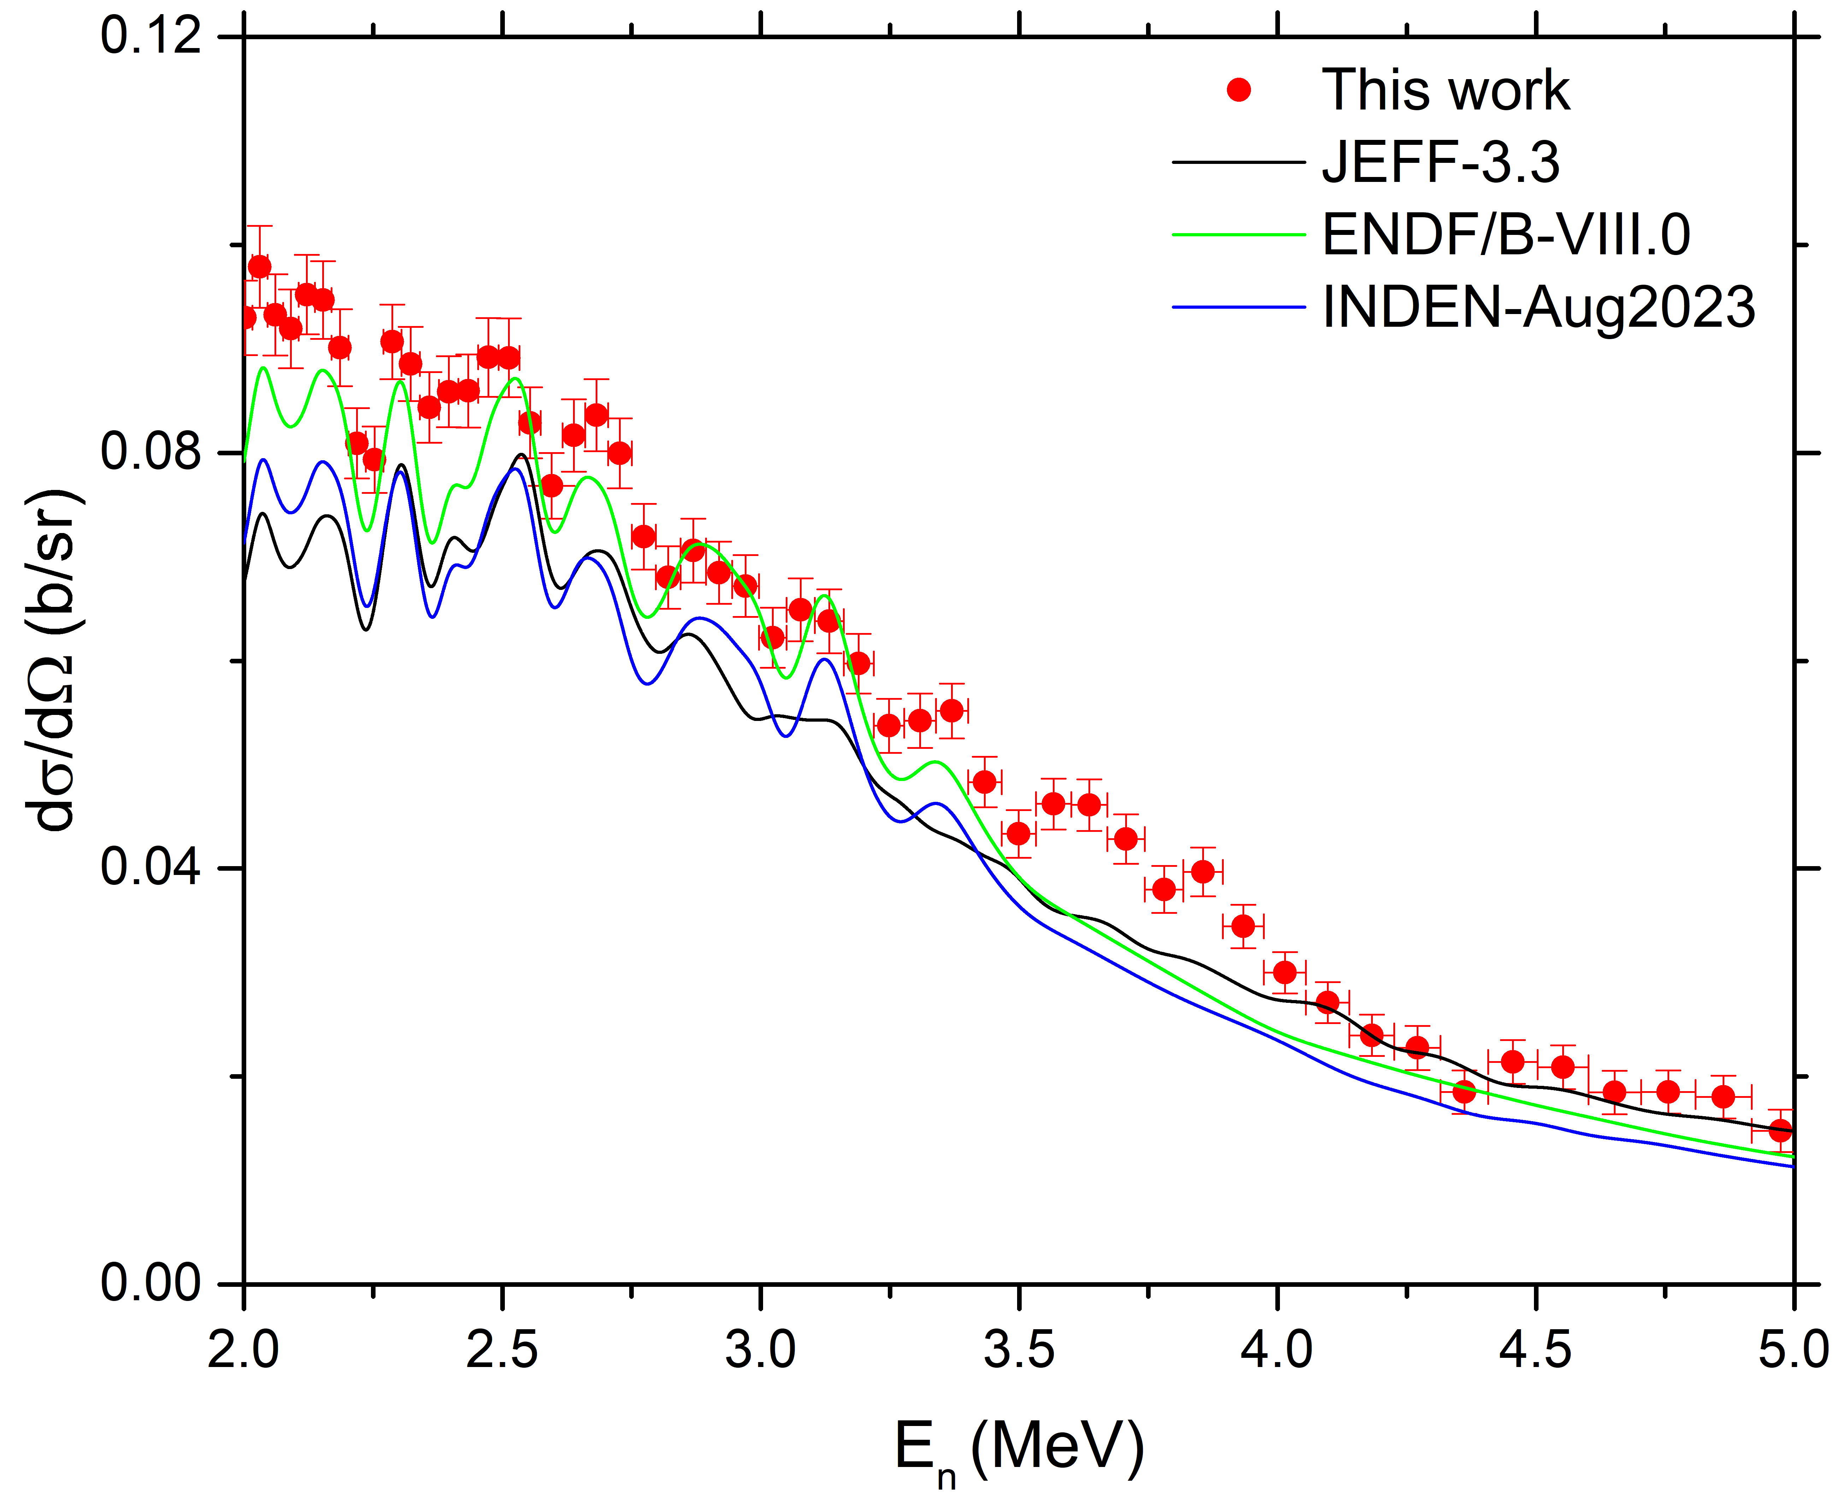
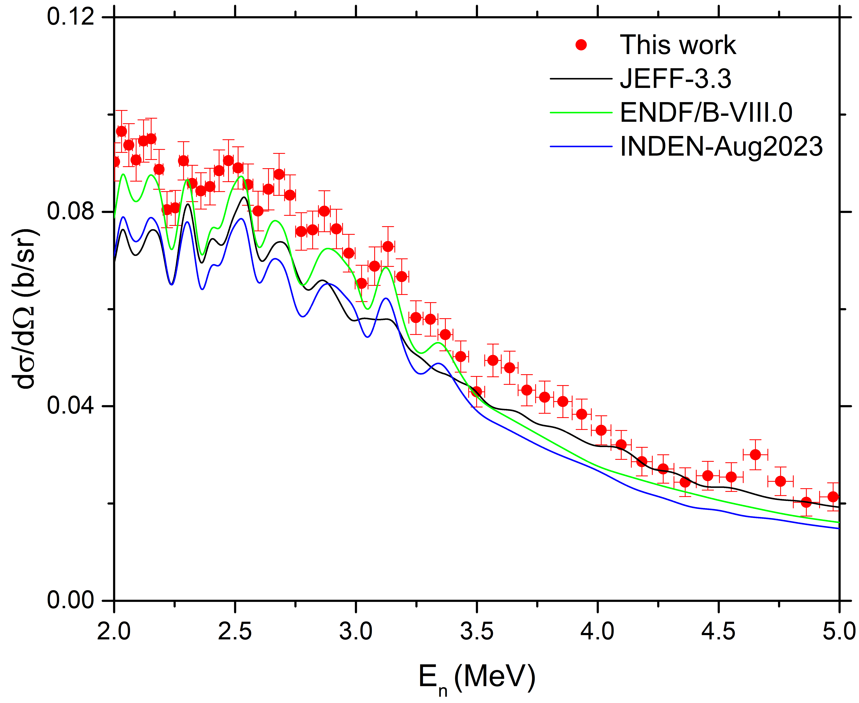
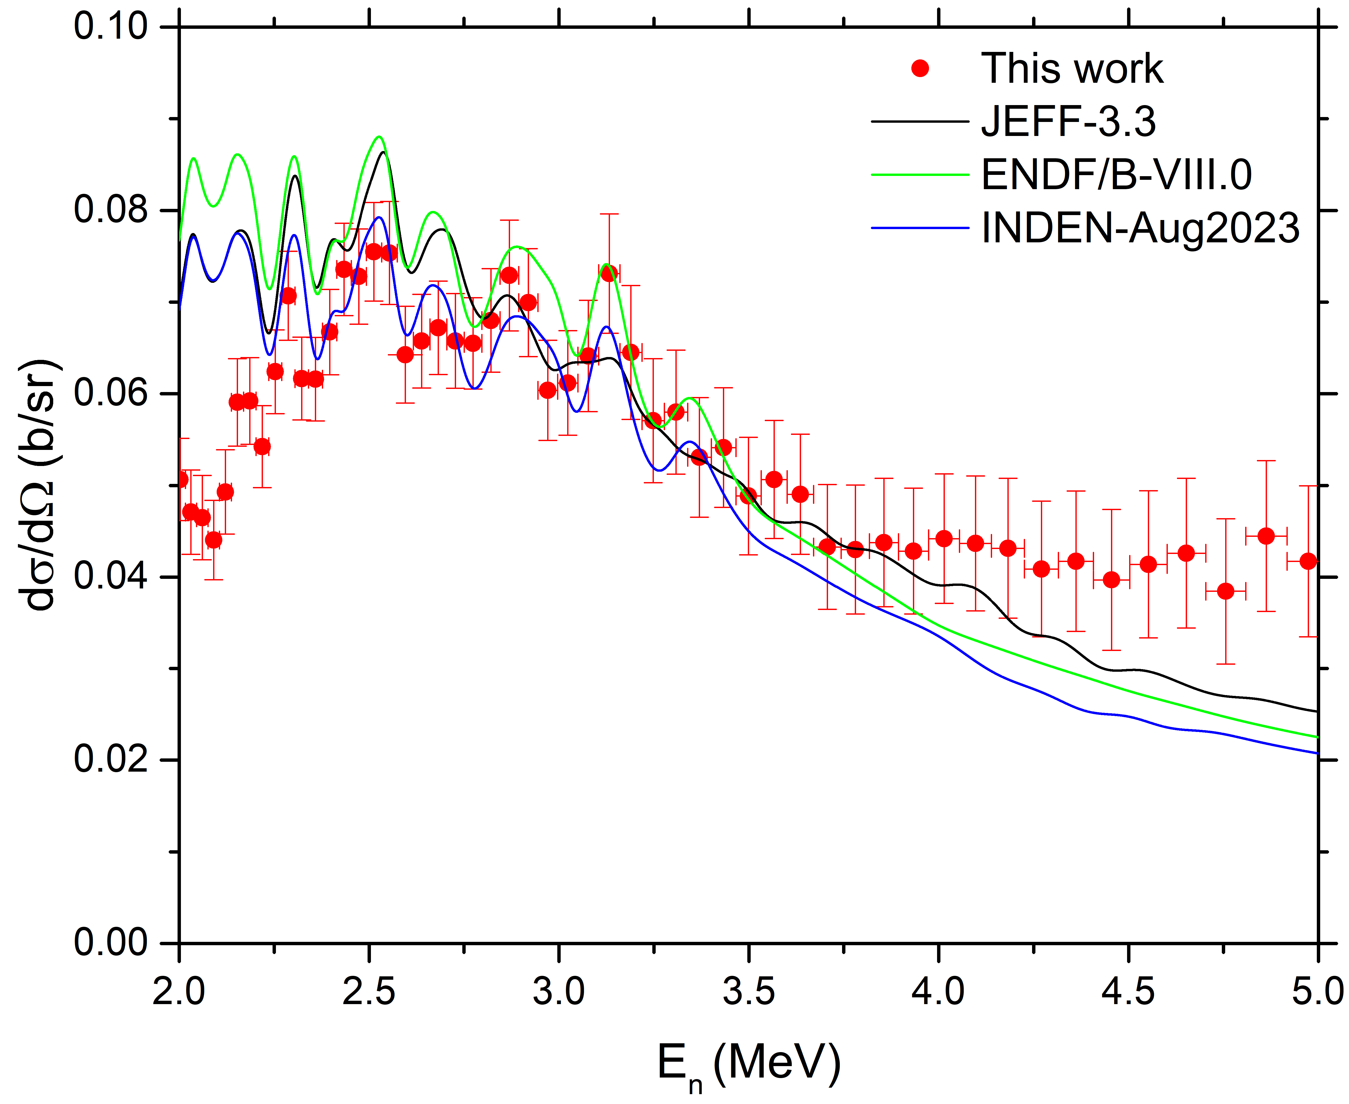
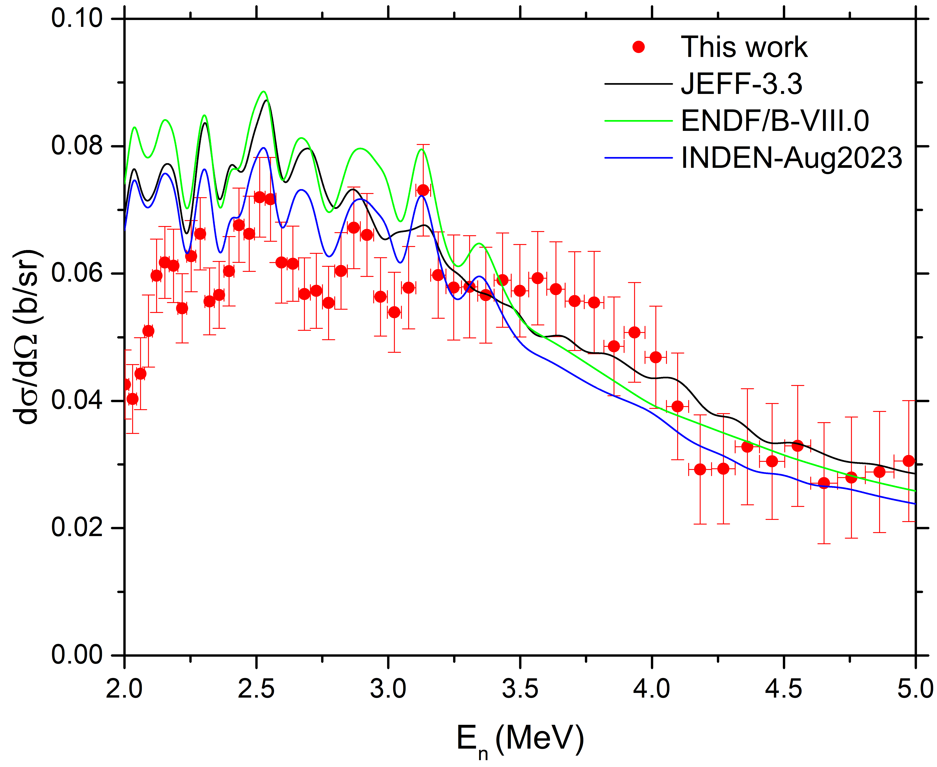
Neutron scattering on ⁵⁶Fe : ⁵⁶Fe(n, n₁’) Differential cross sections vs Energy
θ_{LAB} = 163.8º
θ_{LAB} = 142.8º
θ_{LAB} = 121.7º
θ_{LAB} = 100.6º
θ_{LAB} = 79.4º
θ_{LAB} = 58.3º
θ_{LAB} = 37.2º
θ_{LAB} = 16.2º
Threshold: 845 keV
More significant discrepancies with evaluations ~ systematically higher
Uncertainties at low neutron energies currently under analysis.

Slide 16
Neutron scattering on ⁵⁶Fe : ⁵⁶Fe(n, n₁’): angle integrated cross section
Data agree very well
Notes:
Beyer : nELBE

Slide 17
Neutron scattering on ⁵⁶Fe : Extraction of the ⁵⁶Fe(n,tot)
=σ(⁵⁶Fe(n,n))+ σ( ⁵⁶Fe(n, n₁’))+ σ( ⁵⁶Fe(n, γ))
(n,tot) from INDEN/ENDF/JEFF :
BASED ON JEFF 3.2
(Vonach - Tagesen +
superimposed
Berthold high-resolution
data on natural sample
(+contribution from minor
isotopes)
Normalisation???
Maybe could be increased ??
First point not to take into account because (n,n₁’)
not extracted at this point

Slide 18
What’s next on scattering at ELISA (GELINA)
Effort to expand the measurement capabilities to En < 1 MeV (ELISA setup upgrade with Li-glass detectors) - ongoing
Study of gamma emitting reactions with the Liquid scintillators’ response.
^{63,65}Cu campaign : - severe lack of experimental data.
- ELISA setup ideal for (n,n) and (n,n₁’) on Cu isotopes
⁶³Cu
⁶⁵Cu

Slide 19
Transmission measurements at GELINA (JRC-Geel)
Transmission: fraction of the neutron beam traversing a sample without any interaction: $T_{exp}=\frac{C_{in}}{C_{out}}∝e^{−nσ_{tot}}$
$σ_{tot}$: total cross section
$n$: areal number density
Shown at INDEN-2019: Very thick samples probing into the
Total cross section minima
Useful:
Very thick target
(Harvey-1975)
⁵⁶Fe
Total cross section minimum at 24.5keV :
=> Total cross section $≈$ Capture
Maybe s-wave direct capture component with transmission on very thick sample??
New transmission measurements planned and partially performed at GELINA on natFe samples
Notes:
In this type of measurement the:
Incoming neutron fluence rate cancels
Detection efficiency cancels

Slide 20
Transmission measurements at GELINA (JRC-Geel)
^{nat}Fe samples: 3 metallic discs bought:
Li-glass detector used.
Sample at ~24 m flight path, detector at ~50 m.
Moderated neutron beam used (with ¹⁰B and Pb
filters)
ID | Thickness (mm) | Mass (mg)
1 | 1.194 | 667
2 | 4.486 | 2506.4
3 | 4.488 | 2504
No. 1 (1.2 cm) and no. 2 (4.5 cm) measured (summer 2023.)
Combination of no. 2 and no. 3 (=> 9 cm) PENDING:
to be measured as soon as GELINA is back to normal => probe into cross section minima with better statistics (similar to nELBE).

Slide 21
Transmission calculation
$$T_{exp}(t_{m})=N_{T}\frac{C_{in}(t_{m})−k_{T}B_{in}(t_{m})}{C_{out}(t_{m})−k_{T}B_{out}(t_{m})}$$
$C_{in},C_{out}$: counts of the sample-in and the sample-out measurement
$B_{in}, B_{out}$: background contributions
$N_{T}$: normalization factor to account for the losses due to dead time in the detector and electronics chain
$k_{T}$: correlated uncertainty component for systematic effects due to the background model
$t_{m}$: time-of-flight ($T_{0}$-start signal / $T_{s}$-stop signal / $t_{0}$-time offset)
$$t_{m}=\left(T_{s}−T_{0}\right)+t_{0}$$
sample
detector
sample

Slide 22
Transmission results
The background contribution needs to be considered in a consistent way, with the black filters technique (Na –Co –W).
𝐵(t)= 𝑏𝑜 + 𝑏₁𝑒^{−λ1𝑡} + 𝑏₂𝑒^{−λ2𝑡} + 𝑏₃𝑒^{−λ3(𝑡+𝑡0)}
Data up to 100keV.
First REFIT calculation with
adjustment of the resonant parameters of JEFF 3.3.
Will follow:
-9 cm thick sample measurement
-Proper Resonance analysis of all datasets

Slide 23
Conclusions and future perspectives
Direct Capture Calculations:
DC calculations with the pdix code completed.
DC calculations to be continued with CONRAD
Direct capture important (confirmed by independent teams/codes)
Neutron Scattering Measurements at GELINA:
^{54,56}Fe(n,el/inl) reactions measured high resolution for the forst time with enriched targets (finalisation of ⁵⁶Fe ongoing)
New experimental campaign on Neutron Scattering Measurements on ^{63,65}Cu with enriched samples (OR ⁶⁵Cu and ^{nat}Cu) will be perfomed (APRENDE) at the ELISA setup, in the context of a new PhD thesis (CEA / NTUA).
Improvement of the ELISA setup (with the local staff at JRC-Geel).
Evaluations could (should?) take into account the elastic channel when measured with high accuracy.
Evaluations could (should?) take into account the measurements of (n,n₁’)both with γ- and n-detection
Transmission Measurements at GELINA:
Natural Fe samples of two thicknesses already measured at GELINA, analysis nearly finished.
Natural Copper samples of different thicknesses already measured at GELINA (flight path : 50 m, analysis ongoing (Master thesis Anna Karakaxi)
A “thick” natural Fe sample (~9 cm) will also be measured once GELINA is functional again.
Thank you!

Slide 24
Extra slides

Slide 25
Results of the ⁵⁶Fe(n,n₁’) - EXFOR
E_{n} = 2.25 MeV
E_{n} = 2. 5 MeV
E_{n} = 2. 75 MeV
E_{n} = 3 MeV
E_{n} = 3.25 MeV
E_{n} = 4 MeV
E_{n} = 4.65 MeV
E_{n} = 5 MeV
Notes:
Pirovano large statistical uncertainties compared to current data.

Slide 26
54Fe results zoomed

Slide 27
Results of the ⁵⁶Fe(n,n) - EXFOR
E_{n} = 1.3 MeV
E_{n} = 2. 33 MeV
E_{n} = 3 MeV
E_{n} = 3.4 MeV
E_{n} = 4.55 MeV
E_{n} = 5 MeV
E_{n} = 6 MeV
E_{n} = 7 MeV
Notes:
eLASTIC SCATTERING ENDF VIII.1 :
REFITTED KINNEY DATA + COMPARISON WITH PEREY ENRICHED IN THE OVERLAPPING DATA
>4 MeV: EMPIRE CALCULATIONS

Slide 28
63Cu,65Cu

Slide 29
DRC with CONRAD

