Slide 1
International Nuclear Data
Evaluation Network (INDEN)
Challenges and potential improvements:
^{54,56}Fe, ^{50,53}Cr and F-19
Roberto Capote
Deputy Section Head, NDDU head
INDEN-SM meeting, December 2024, IAEA HQ, Vienna, Austria

Slide 2

































International Nuclear Data
Evaluation Network (INDEN)
https://www-nds.iaea.org/INDEN

Slide 3
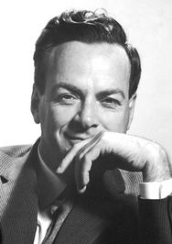
Outlook
Fe-54,56: New elastic/inelastic data by
Gkatis et al (EC JRC Geel)
Cr-50,53: New capture data by
Maroto et al (CNA Sevilla, Spain)
Ta-181: Capture data and integral performance
F-19: Quasidiff. RPI data (G. Siemers et al)
“It doesn't matter how beautiful your theory is,
it doesn't matter how smart you are.
If it doesn't agree with experiment, it's wrong.”
Richard Philips Feynman, Nobel Prize in Physics 1965

Slide 4
Iron updates

Slide 5
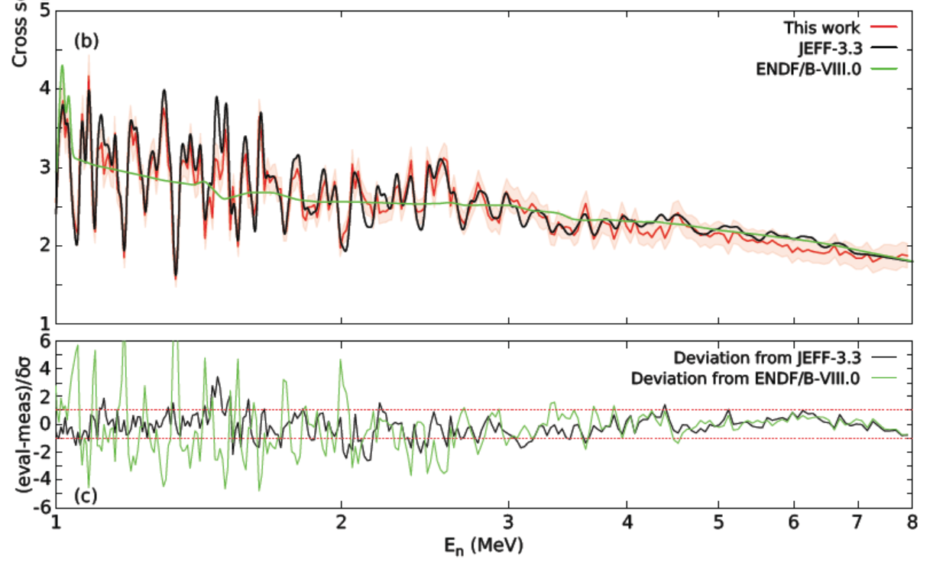
Fe-54 elastic cross sections
G. Gkatis PhD, Aix-Marseille Université, 10 June 2024 (unpub)

Slide 6
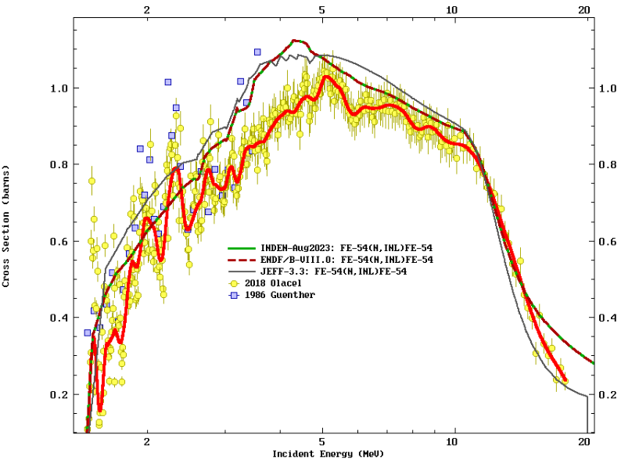
Fe-54 inelastic cross sections

Slide 7
Chromium updates

Slide 8
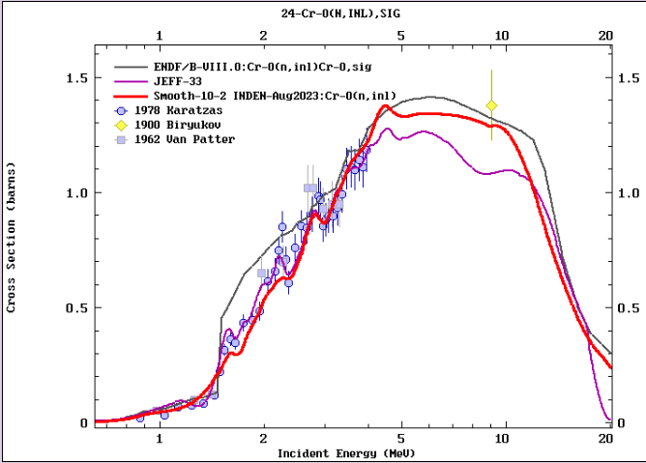

Slide 9
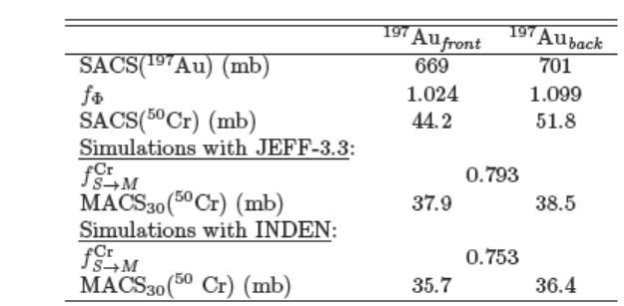
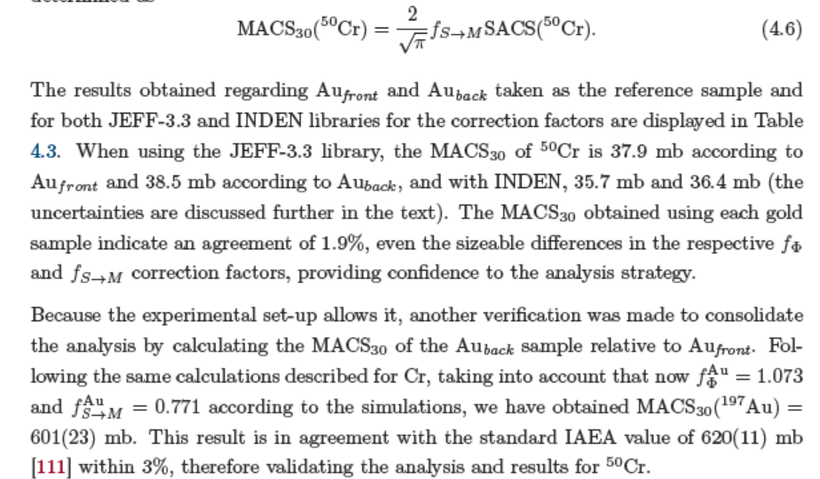
Cr-50(n,g)
MACS
(NEA HPRL)
MACS₃₀(¹⁹⁷Au)=601(23)mb
STD=620(11) mb
MACS₃₀(⁵⁰Cr)=37.1(20)mb
JEFF-3.3:
MACS₃₀(⁵⁰Cr)=37.8 mb
INDEN:
MACS₃₀(⁵⁰Cr)=44.3 mb
P. Maroto PhD, Univ. Sevilla, Spain, Sept 2024 (unpub)

Slide 10
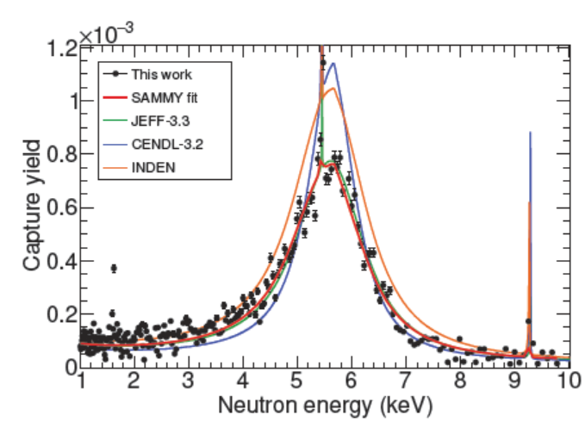
⁵⁰Cr(n,g) (NEA HPRL) ToF thin (n,g) yield
MACS₃₀(⁵⁰Cr)=37.1(20)mb
JEFF-3.3:
MACS₃₀(⁵⁰Cr)=37.8 mb
INDEN:
MACS₃₀(⁵⁰Cr)=44.3 mb

Slide 11
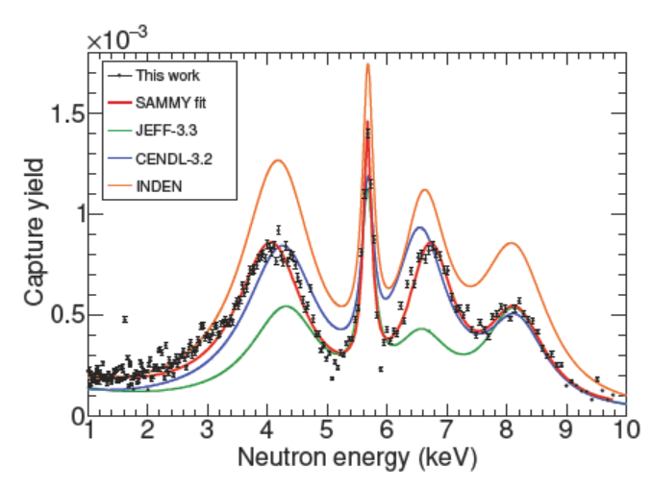
⁵³Cr(n,g) (NEA HPRL) ToF thin (n,g) yield
INDEN too high
CENDL-3.2 closest
JEFF-3.3 too low

Slide 12
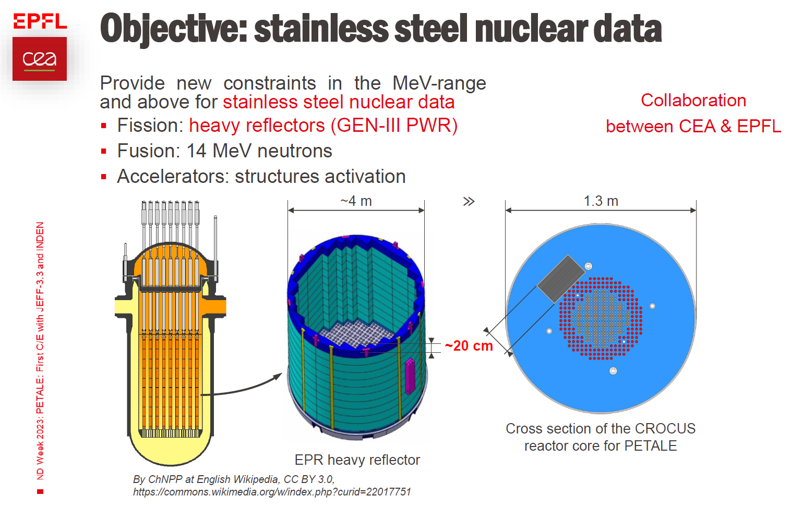
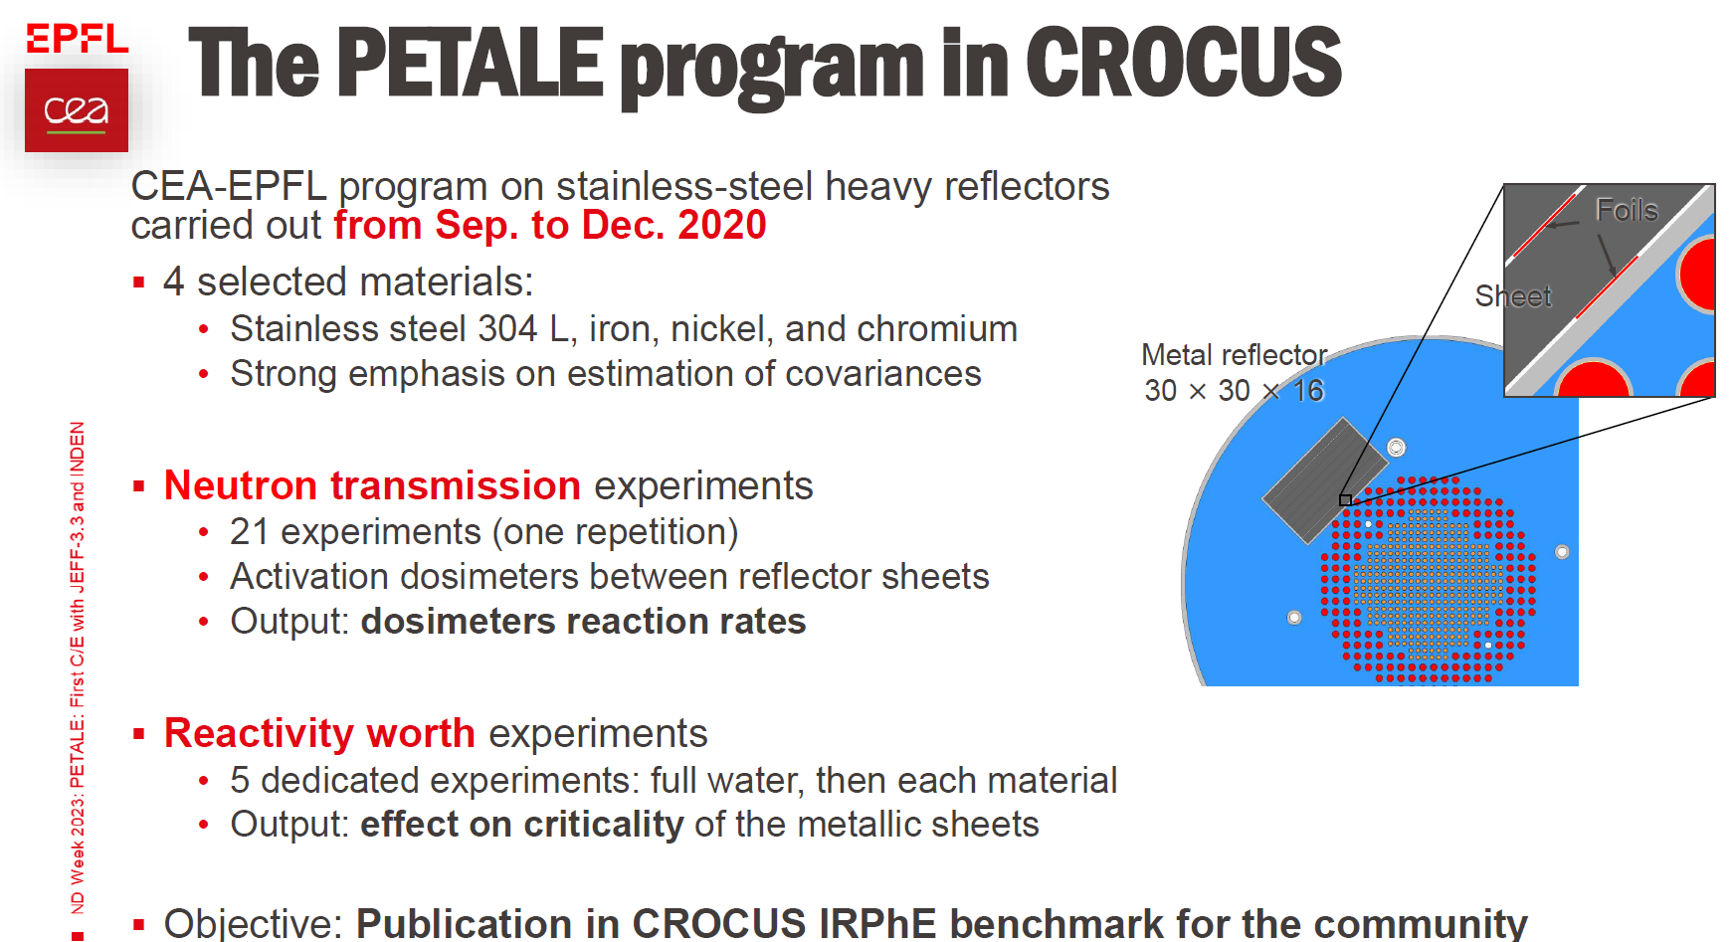
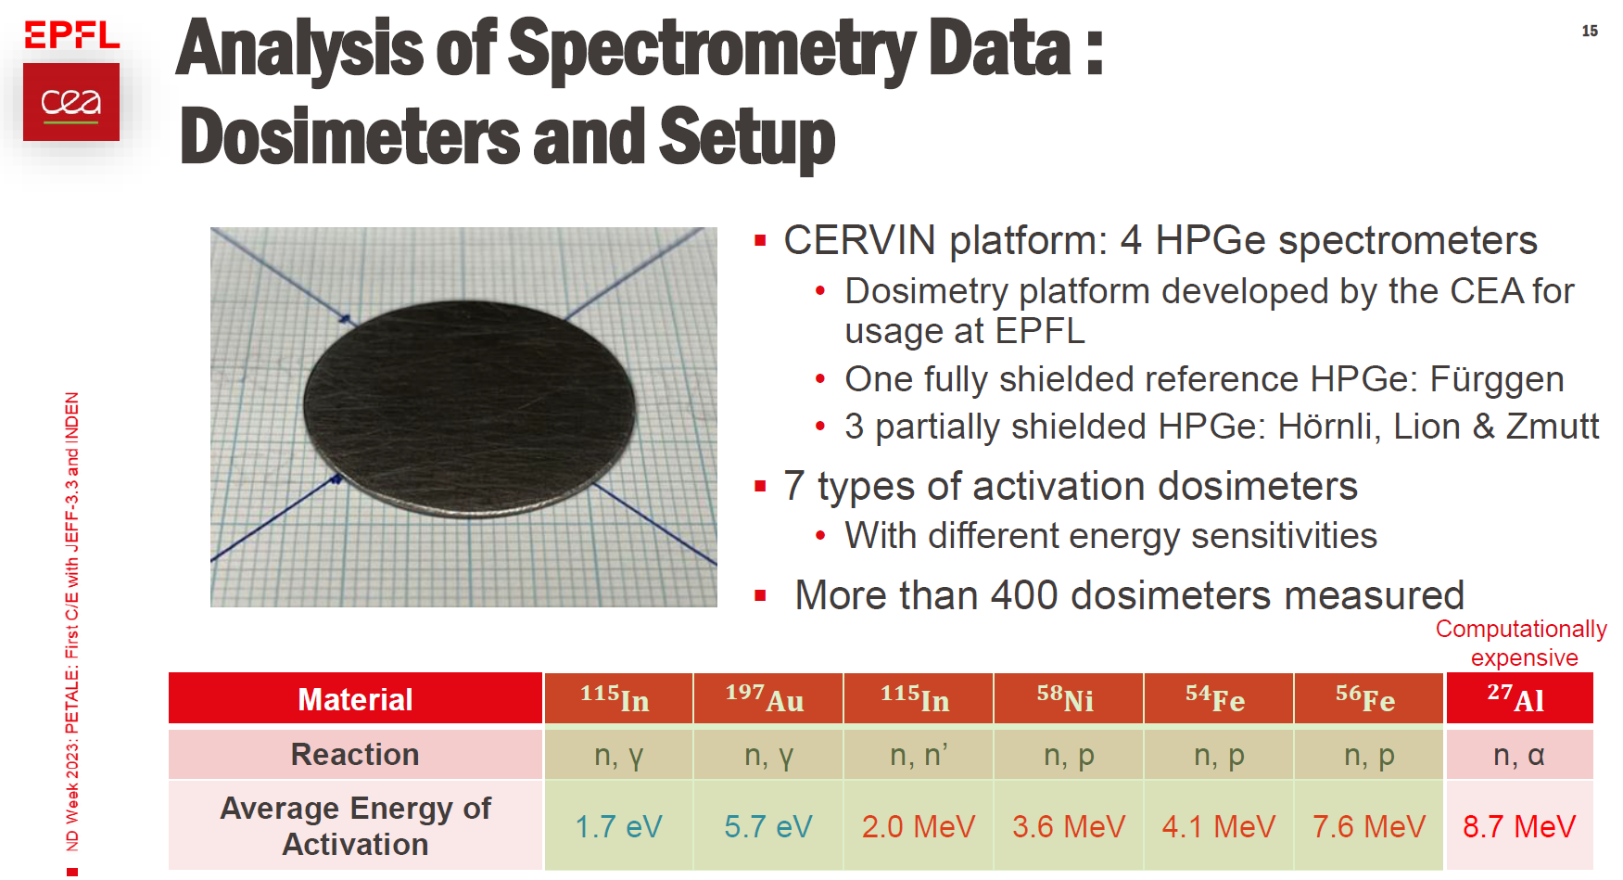
jefdoc-2269: T. Ligonnet et al (2023)
T. Ligonnet et al, presented at JEFF meeting. November 2023, jefdoc-2269

Slide 13
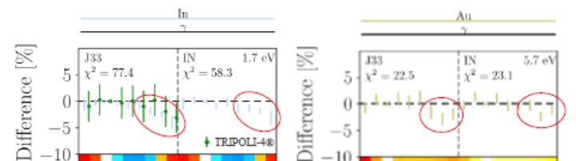
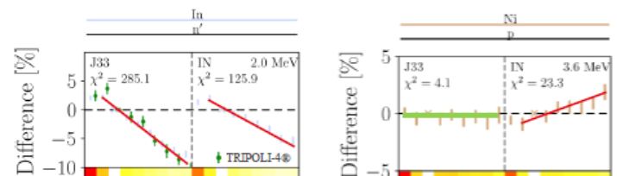
PETALE: Cr reflector (preliminary)
“Near thermal” range: Au-197(n,g) In-115(n,g)
fast range: In-115(n,n’) fast range: Ni-58(n,p)
T. Ligonnet et al, presented at JEFF meeting. November 2023, jefdoc-2269

Slide 14
SUMMARY
Fe-54,56: Gkatis data & inelastic to be considered
Cr-50,53: RRR reevaluation (Maroto & PETALE)
Covariances for Cu (to be adopted from JEFF-3.3?)
Covariances for Fe (to be adopted from JEFF-3.3?)
Covariances for Cr to be adopted from B8.1
Covariances for F-19 to be adopted from B8.1

Slide 15
Thank you!
Notes:
Thank you!

