Slide 1
Interest on high quality evaluation of Zr isotopes for LWRs
David BERNARD
SPRC/LEPh
IAEA/INDEN/CM-STRUCT/December 2024

Slide 2
Main uncertainties on radial power map
For a fully homogenous UO₂+H₂O core (fundamental mode, flux = 1st eigen-vector, keff = 1st eigen-value)
R
Sensitivity to ²³⁸U(n,n’),
Spoiler alert : main sensitivity component.
Sensitivity of radial power maps to nuclear data are null (whatever the radius is except maybe for R=4m)

Slide 3

Main uncertainties on radial power map
For heterogeneous cores (alternating different enrichment/burnup from an assembly to another one for instance), the neutron flux is a linear combination of 1^{rst} (fundamental mode) and others (harmonics).
Nuclear data perturbation (sensitivities) can excite natural harmonics of the neutron flux.
As in quantum mechanics, the perturbation theory gives us the sensitivity coefficients of radial power maps (periph versus center) to nuclear data.
with
Depending on the Eigen Value Separation :
= 400 for very large cores…but it depends on the heterogeneity of the core

Slide 4
Main uncertainties on radial power map
Toy model : the startup tests (fresh UO₂, Hot “Zero” Power) of the CHOOZ-N4 PWR (205 assemblies).

Slide 5
Main uncertainties on radial power map
with
As the sensitivity is proportional to XS, we have to be careful with sensitivities calculated with deterministic codes (aggregating elastic and inelastic XS for instance). Limitation to P0 (sometimes P1) Legendre polynomials…
Sqrt(S x MF33 x S⁺) gives the a priori uncertainty of about 8-10% depending on used MF33, and depending on the core loading and size.
Main components are ²³⁸U(n_{2-5MeV},n’), p(n_{th},p), p(n_{500keV-1MeV},n)….and ^{i}Zr
The control rod worth uncertainty (depending on the position in the core) is ∼2 times the radial radial power map uncertainty.

Slide 6
^{9i}Zr components of uncertainties of radial power map by deterministic perturbation theory
⁹⁰Zr/Thermal and resonant Capture → about 0.20%
⁹⁰Zr/Fast elastic scattering → about 0.22%
⁹⁰Zr/P0-Inelastic scattering → about 0.16%
⁹⁰Zr/Total uncertainty → 0.30%
⁹⁰⁺⁹¹⁺⁹²Zr/Total uncertainty → about 0.66%
And x2 for control rod worth → 1.3% (still depending on core loading and size)
Why inelastic scattering ? Because of neutron slowing down (same reason for ²³⁸U(n,n’_{cont})). Low energy discrete inelastic reaction do “not slow” down fission neutrons. They stay roughly at the same nrj (can be considered as elastic scattering from a neutronic point of view), and…
Mean free path of neutron is higher at 500keV-1.3 MeV than fast or at lower nrj!
These neutrons do not contribute to the radial flux stiffness.

Slide 7
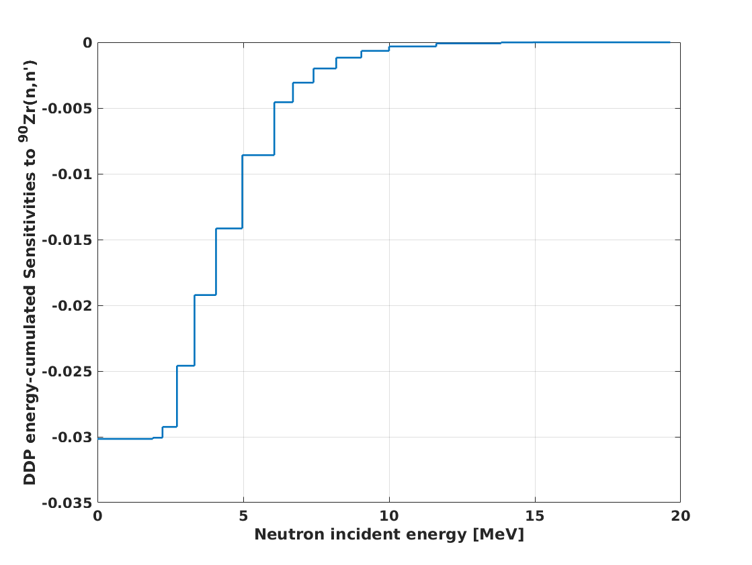
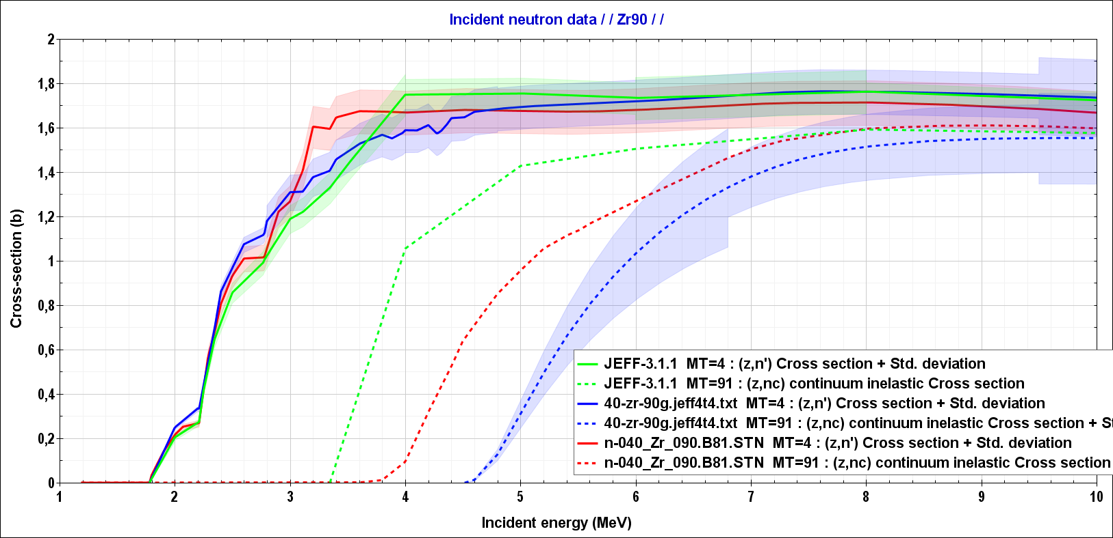
Sensitivity of radial power map to total ⁹⁰Zr(n,n’)
∼80% of the sensitivity
btw 3 MeV and 8 MeV
with JEFF-3.1.1 !!!
Direct TRIPOLI-4®/JEFF-3.1.1 Monte Carlo calculations give the same sensitivity values for the SUM of discrete inelastic and for the continuum inelastic xs:
S(Radial –Center to Periph- Power Maps / nn’_{i & c}) = -0.028(0.004)%/%
Is it the same if using other libraries (i.e. different continuum thresholds) ? I don’t know…
BTW, it is mandatory to use consistent covariances !

Slide 8
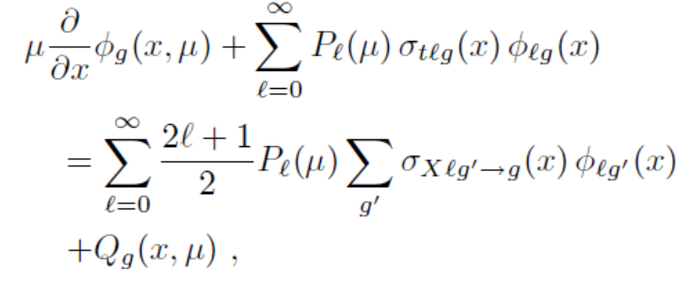
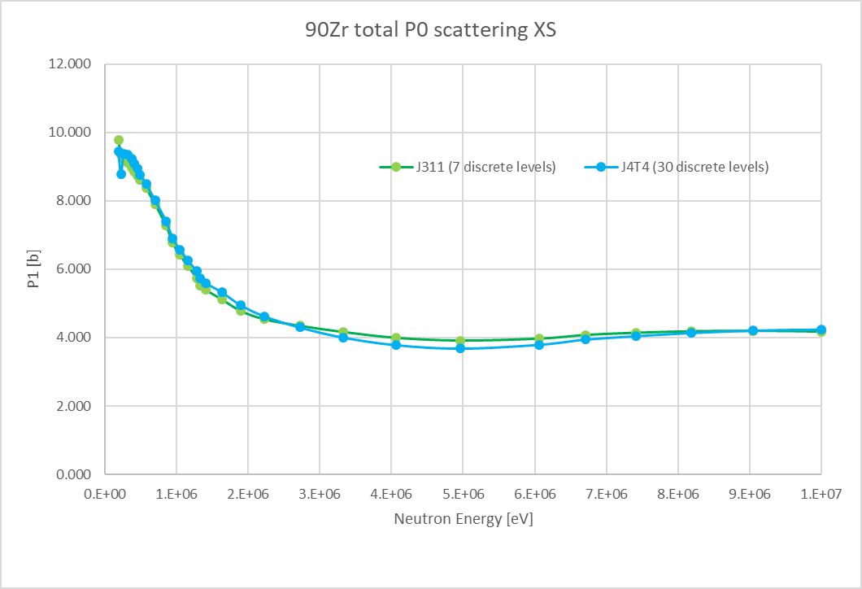
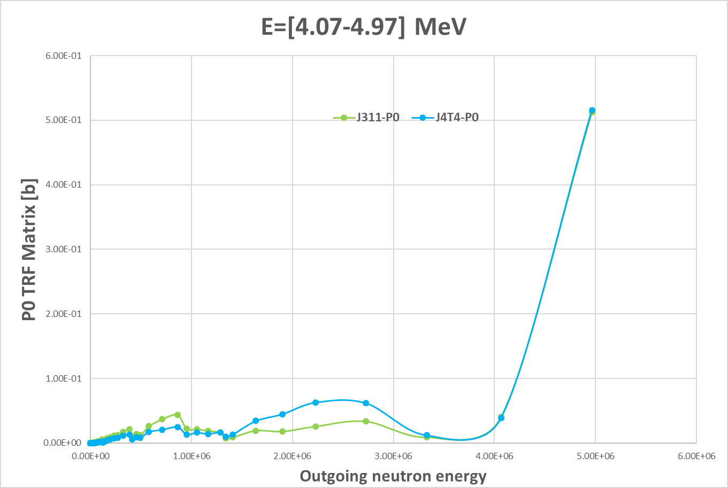
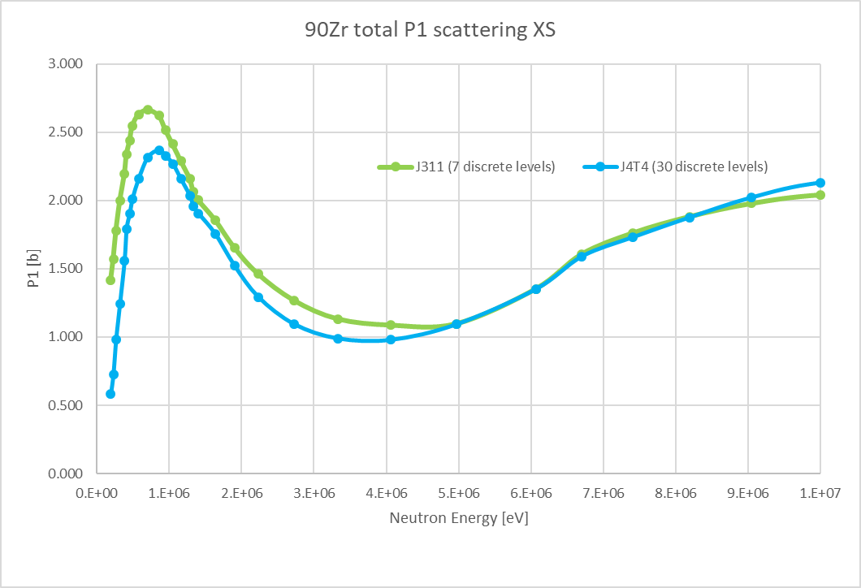
Do sensitivities “sensitive” to the number of discrete inelastic levels ?
JEFF-3.1.1 (7 discrete levels, E_{cont}=3.5MeV)
JEFF-4T4 (30 discrete levels, E_{cont}=4.5MeV)
NJOY/GROUPR solves the transport equation:
To extract P0 and P1 XS + Trf matrices
Proof
Not so clear to me... 7 discrete levels seem “enough” for neutronic calculations for total scattering including elastic and inelastic
E*
E*

Slide 9
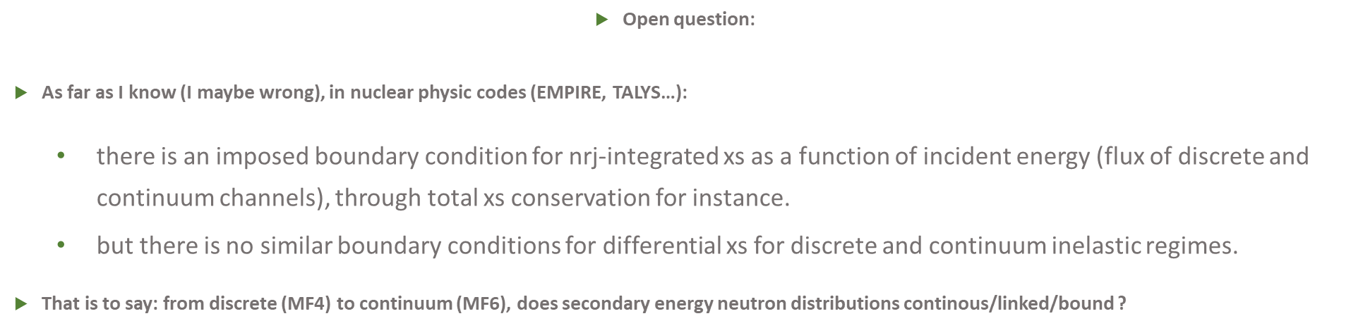
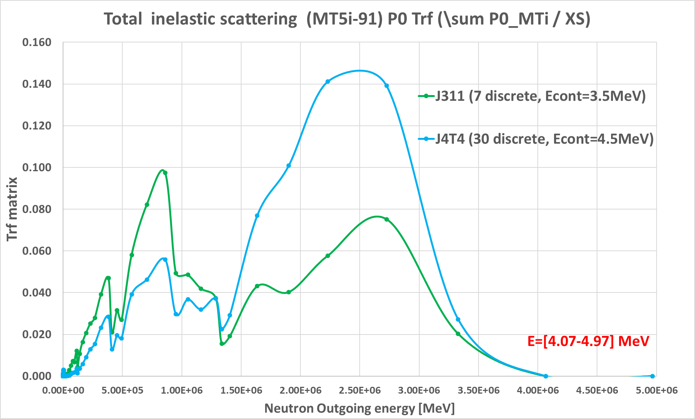
My 2021 question…my 2024 answer ☺
I think that I have my answer to my 2021 question : is there “continuity” between MF4 and MF6 depending on how many discrete levels in inelastic ?
P0&P1 XS is mandatory to deterministic codes and, to me, a “good” way to condense MF4+MF6 information.
E’ continuity is not ensure…
As I understand (neutron migration area), J311 and JEFF-4T4 sensitivities could be different. Core level uncertainties aswell….
Continuum inelastic regime
Discrete inelastic regime

Slide 10
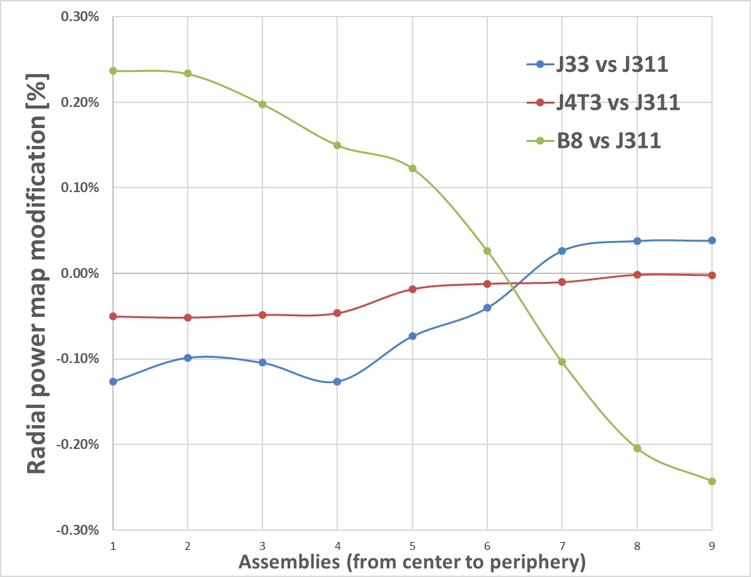
Uncertainty of radial power map to total ⁹⁰Zr(n,n’)
Reminder : JEFF-3.1.1 sensitivities + COMAC files → about ±0.30% for total XS
Let’s try a ND dispersion analyses : JEFF-3.1.1 (7 discrete levels), JEFF-3.3 (20 discrete levels), JEFF-4T3 (16 discrete levels), ENDF/B-VIII.0 (9 discrete levels)
4 libraries 1σ → ±0.28%
Different neutron harmonics excitations
Deterministic propagation of uncertainty seems then valid !

Slide 11



Conclusions
^{i}Zr+n nuclear data (scattering+capture) contribute slightly (compare to ²³⁸U(n,n’) for instance) to radial power map and control rod worth uncertainties : resp. 0.7% and 1.4%.
From ND point of view, a maximum of discrete levels has to be described but few of them seems enough for neutronic calculations (I’am not so sure → to be consolidate) : elastic is higher than inelastic.
But, everything depends really on the reactor size and on the fuel loading.
On going work → NEA/WPEC/SG53
→ EU/APRENDE
(reduction of JRC gamma production xs data)

