Slide 1
Towards Advanced Wall Modeling
Using Machine Learning and
Its Integration with Neutral Transport Simulations
Wall model
S. Saito Yamagata Univ., Japan
H. Nakamura NIFS, Japan
K. Sawada Shinshu Univ, Japan
K. Hoshino Keio Univ., Japan
Y. Homma QST, Japan
S. Yamoto QST, Japan
Neutral transport code
Fluid model
(SONIC code)

Slide 2
Contents
Background
Molecular dynamics simulation of hydrogen recycling on tungsten wall
Integration with fluid codes and neutral transport simulation
Machine learning approaches for the wall model
Future work: towards advanced wall modeling

Slide 3
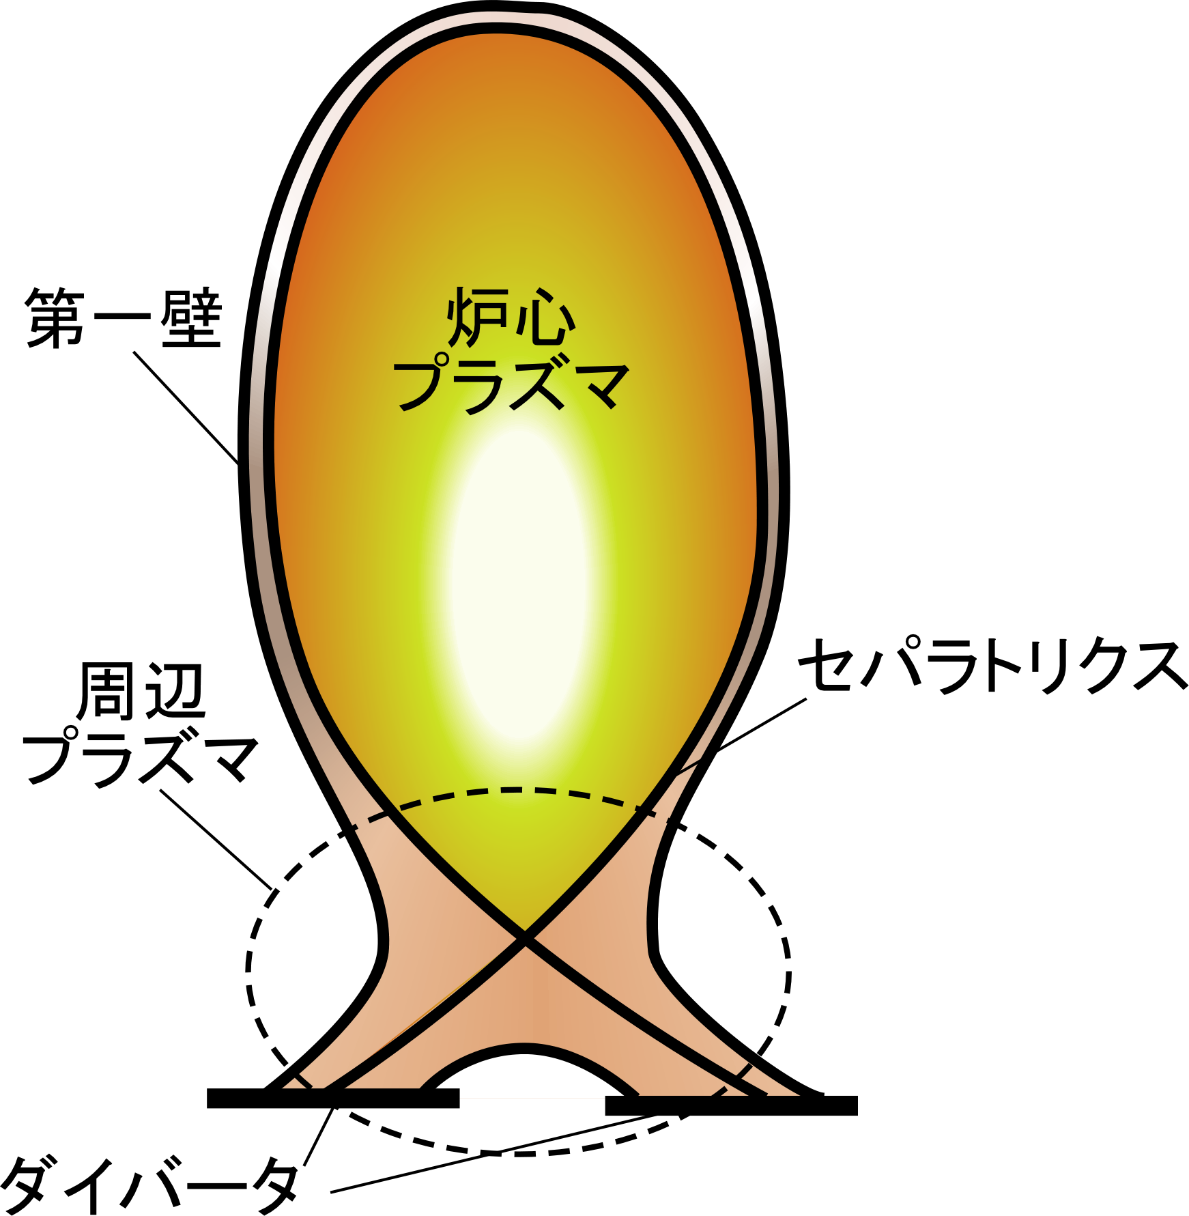
Hydrogen recycling and plasma-material interaction
Core plasma
Neutral transport
collision, ionization
dissociation, recombination
First wall
Core
plasma
Recycled
hydrogen
Incident
hydrogen
Edge plasma
atom
molecule
Edge
plasma
Separatrix
H
H₂
H
Hydrogen recycling on the wall
Divertor

Slide 4
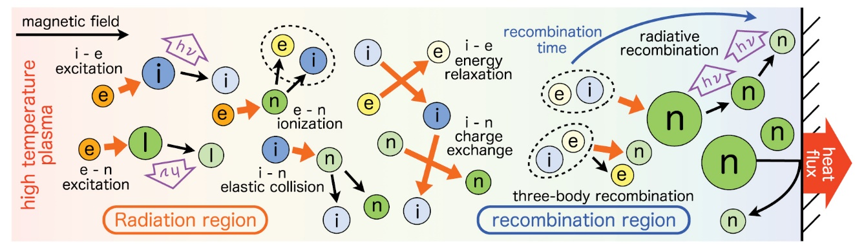
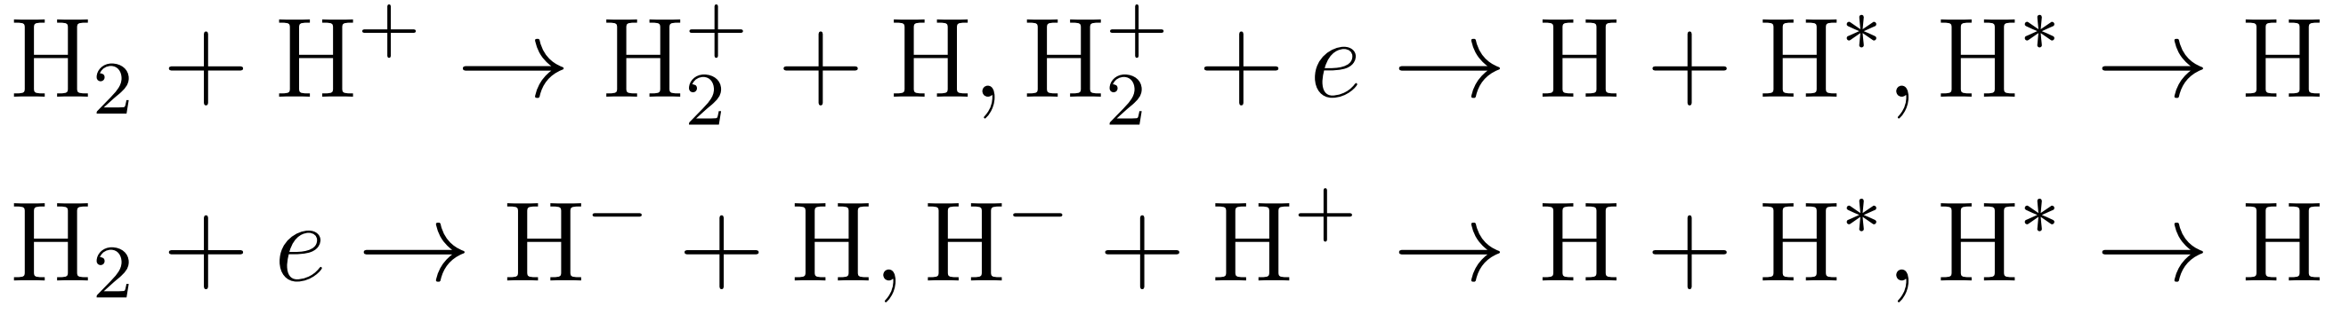
Background：Importance of detached plasma and hydrogen molecular processes
Figure 13 from Y. Hayashi et al 2016 Nucl. Fusion 56 126006 doi:10.1088/0029-5515/56/12/126006
Transport of neutrals (hydrogen atoms / molecules)
by Neutral transport code + Collisional radiative model
Hydrogen recycling model
by MD
Detached plasma
Key technology to reduce heat load on the wall
(prevent walls from melting)
Neutral gas (hydrogen, nitrogen, neon, etc.) is
injected into the divertor region to neutralize
the plasma.
Molecular Assisted Recombination: MAR
Charge exchange recombination (CX) :
Dissociative recombination (DA):
Vibrational states v

Slide 5
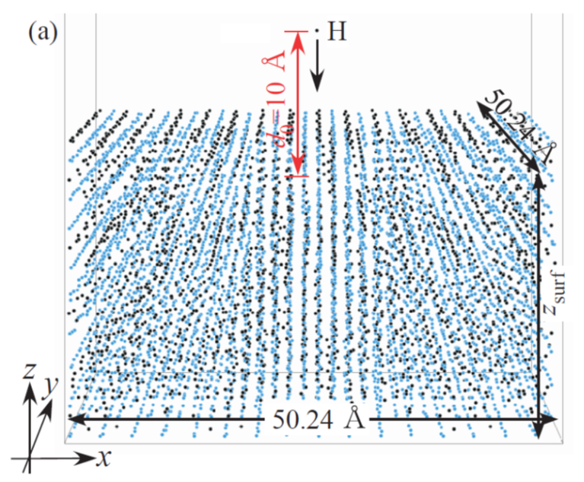
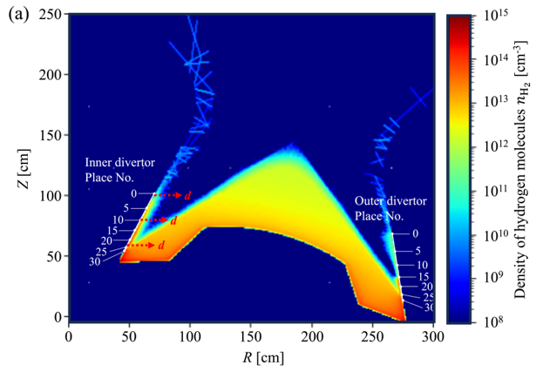
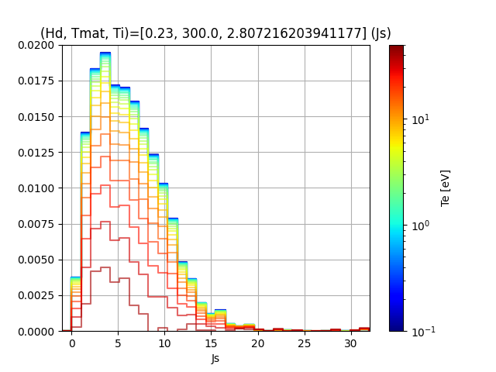
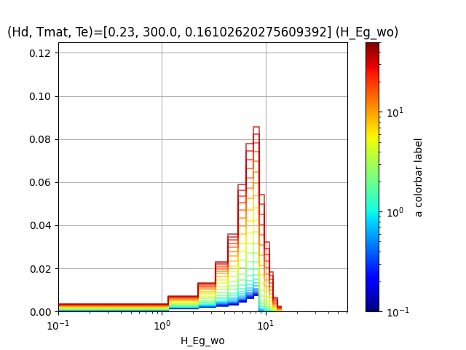
Overview of our wall model
① MD simulation
Evaluation of rovibrational states
of emitted hydrogen molecules
Context and Motivation
H
W
We would like to calculate neutral transport in the edge plasma under the dynamically changing interaction between the plasma and the wall.
By using machine learning, we can dynamically generate the distribution of released hydrogen (especially the rovibrational states of hydrogen molecules) from the plasma parameters near the wall.
S. Saito, et al., Contrib. Plasma Phys. e201900152 (2020).
S. Saito, et al., Jpn. J. Appl. Phys. 60, SAAB08 (2021).
② Training ML model
Training data
Input
H/W
Mater. temp.
Ion temp.
Elec. temp.
Fully connected network
Output
Spatial distribution of hydrogen molecule’s density in the edge plasma of JA-DEMO
（Neutral transport simulation）
Output: emission distribution of hydrogen (translational energy, rovibrational states)
Prediction
Distribution of Rotational states of released hydrogen molecules
③
Prediction
of release distribution
H/W=0.23 T=300K T_{i}=2.81eV
0.0200
50
0.0175
0.0150
10
0.0125
Electron temperature T_{e} [eV]
Number of Emissions / Number of Samples
We would like to use
machine learning (ML) model
0.0100
1
0.0075
0.0050
0.0025
0.1
0.0000
0
5
10
15
20
25
30
S. Saito, et al., Nucl. Fusion 64 126067 (2024).
Rotational states
Notes:
・炉壁から放出された水素分子の振動・回転準位をMDで計算する。
・得た振動・回転準位をもとにNT計算を実施し、周辺プラズマ周辺の振動回転準位のポピューレションの分布を計算
・分光計測との比較も検討

Slide 6
Contents
Background
Molecular dynamics simulation of hydrogen recycling on tungsten wall
Integration with fluid codes and neutral transport simulation
Machine learning approaches for the wall model
Future work: towards advanced wall modeling

Slide 7
Hydrogen Recycling Model on Tungsten Materials （MD）
Tungsten (W)
Hydrogen (H)
Target material ：Hydrogen contained
bcc tungsten
Boundary condition：Periodic in x and y
Material temperature：300 K
Interaction：EAM potential [1]
Incident atom：Hydrogen atom
Number of Incidents：One
Thermostat： Langevin
Incident energy： 0.1-100 eV
H/W：0.2
[1] Li-Fang Wang, Xiaolin Shu, Guang-Hong Lu, and Fei Gao: J. Phys. Condens. Matter 29 (2017) 435401.

Slide 8
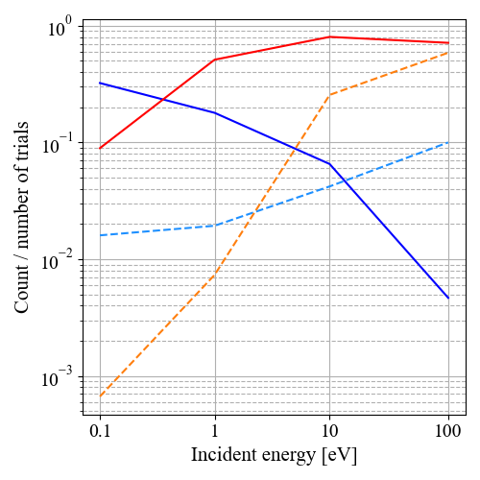

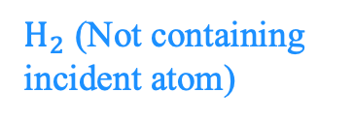
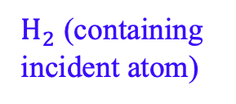
Incident energy dependence of hydrogen emission
S. Saito, et al., “Emission of high rovibrational hydrogen molecules under detached plasma conditions by recycling on the tungsten wall”, Nuclear Fusion 64 126067 (2024).
H (Incident atom)
H (Incident atom)
$H_{2}$ (containing incident atom)
$H_{2}$ (Not containing incident atom)
$H_{2}$ (Not containing incident atom)
H (in the material)
H (in the material)
When the incident energy is low, many molecules containing incident hydrogen are emitted.
→ There is a possibility that a large amount of hydrogen molecules are released
under detached condition.

Slide 9
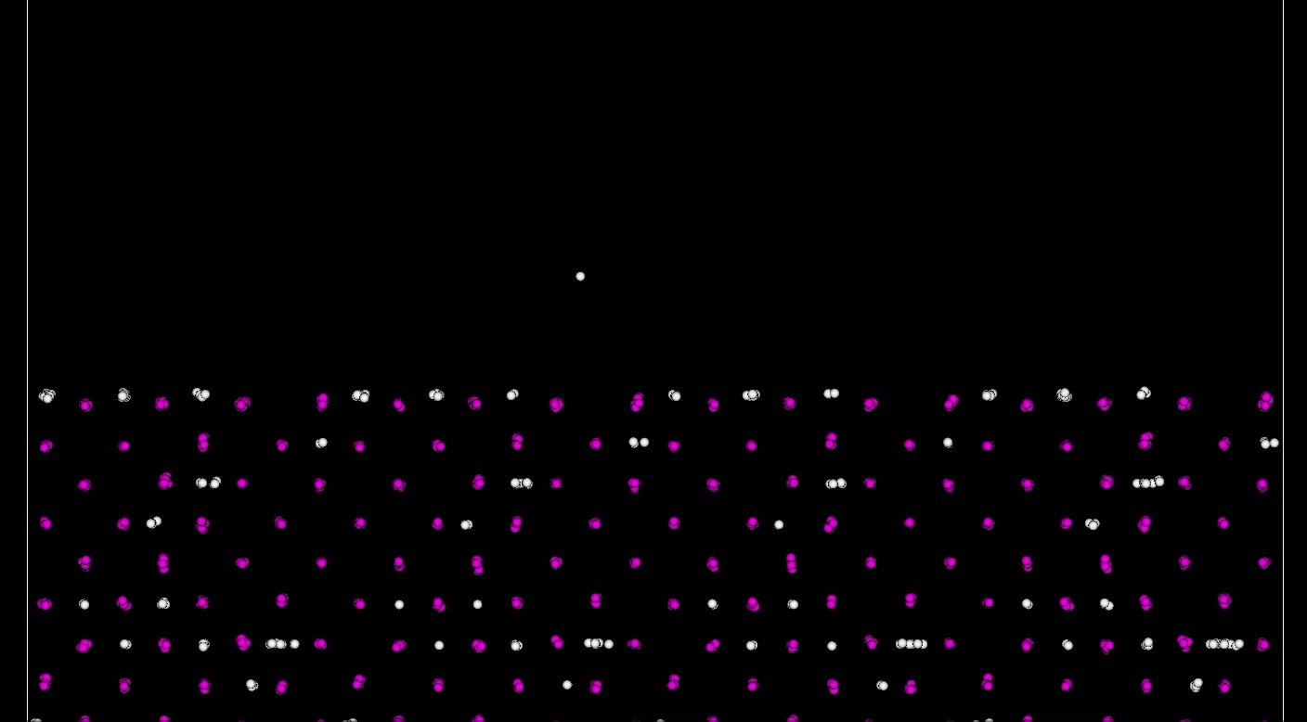
Trajectory analysis of H₂ generation on the surface in low incident energy case
E_{in} = 0.1 eV, H/W=0.2
S. Saito et al., Jpn. J. Appl. Phys. 60, SAAB08 (2021)
Tungsten atom
Hydrogen atom
Tungsten atom
When the incident energy is low, most of the incident hydrogen atom
forms molecules on the surface.

Slide 10
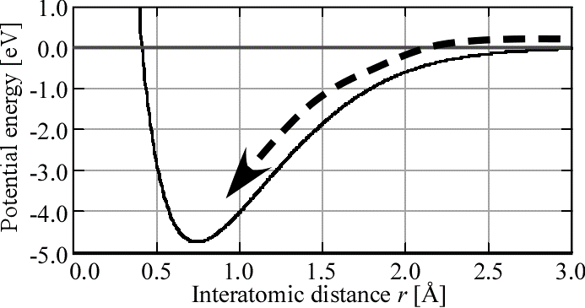
Energy acquisition mechanism of hydrogen molecules
Incident hydrogen atoms acquire surface binding energy (~1.5 eV) when they are trapped on the surface.
When forming a molecule on the surface, the molecule acquires the binding energy (~4.5 eV) between two hydrogen atoms.
After forming a molecule on the surface, the molecule receive a repulsive force from tungsten wall and the molecule is accelerated (less than 1.0 eV?) in the vertical direction.
→ Possibility of forming molecules with high rovibrational states
Interaction energy between two hydrogen atoms
r = 0.733Å
Interaction energy between a hydrogen molecule and tungsten wall

Slide 11
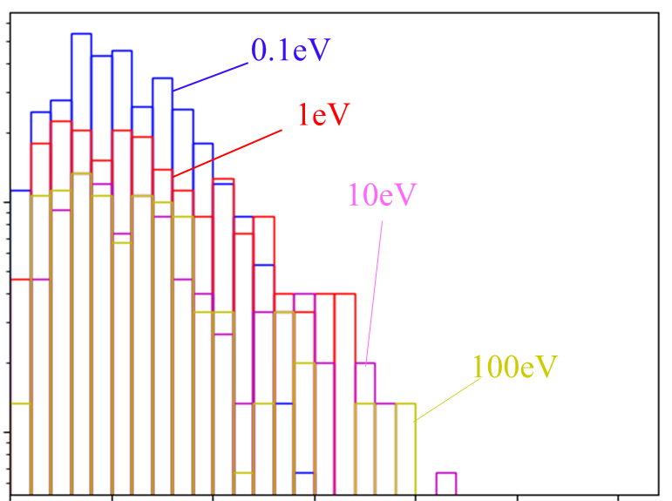
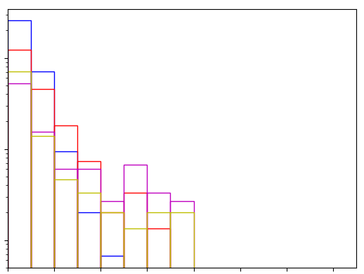
Incident energy dependence of distribution of rovibrational states of released hydrogen molecules
0.0600
0.3000
E_{in}=0.1eV
E_{in}=0.1eV
E_{in}=1eV
0.1000
E_{in}=1eV
0.0100
E_{in}=10eV
Count / Number of Trials
Count / Number of Trials
E_{in}=10eV
0.0100
E_{in}=100eV
E_{in}=100eV
0.0010
0.0010
0.0005
0.0005
0
5
10
15
20
25
30
0
2
4
6
8
10
12
14
Rotational state J
Vibrational state v
Even if the incident energy is low, molecules with relatively high rovibrational states are formed.

Slide 12
Contents
Background
Molecular dynamics simulation of hydrogen recycling on tungsten wall
Integration with fluid codes and neutral transport simulation
Machine learning approaches for the wall model
Future work: towards advanced wall modeling

Slide 13

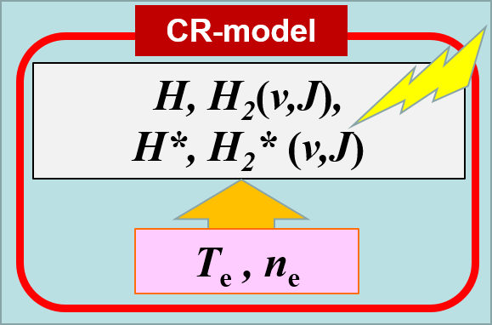
Combining NT-CR code, MD, and SONIC code
Figure 13 from Y. Hayashi, et. al. 2016 Nucl. Fusion 56 126006 doi:10.1088/0029-5515/56/12/126006
Initial value
H,
H₂ (v,J)
Divertor
MD sim.
T_{e}, n_{e} (SONIC code)

Slide 14
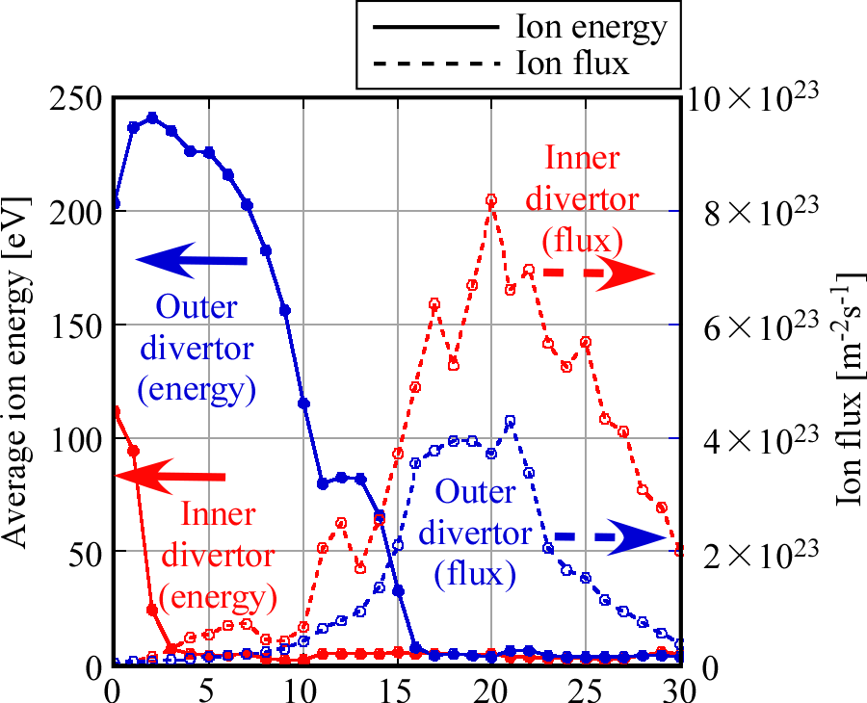
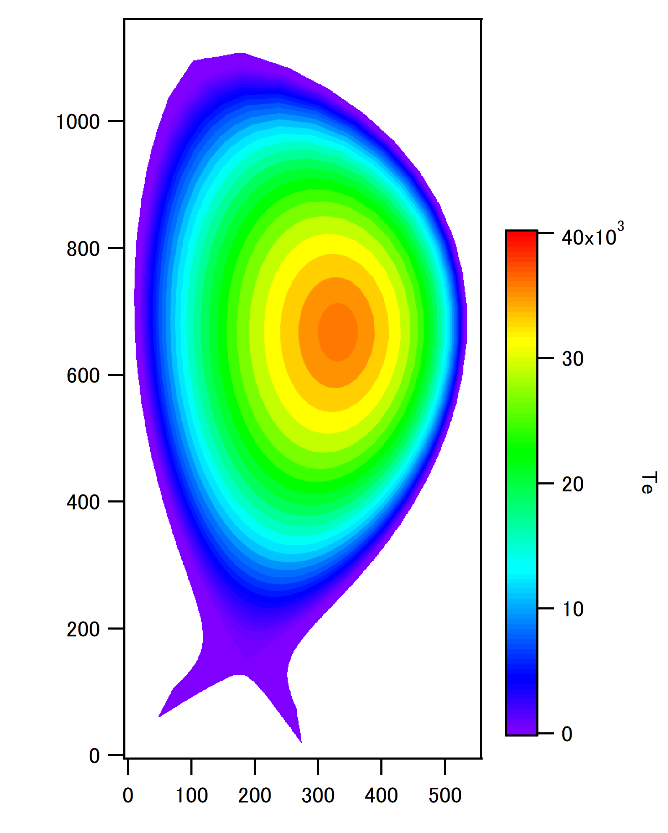
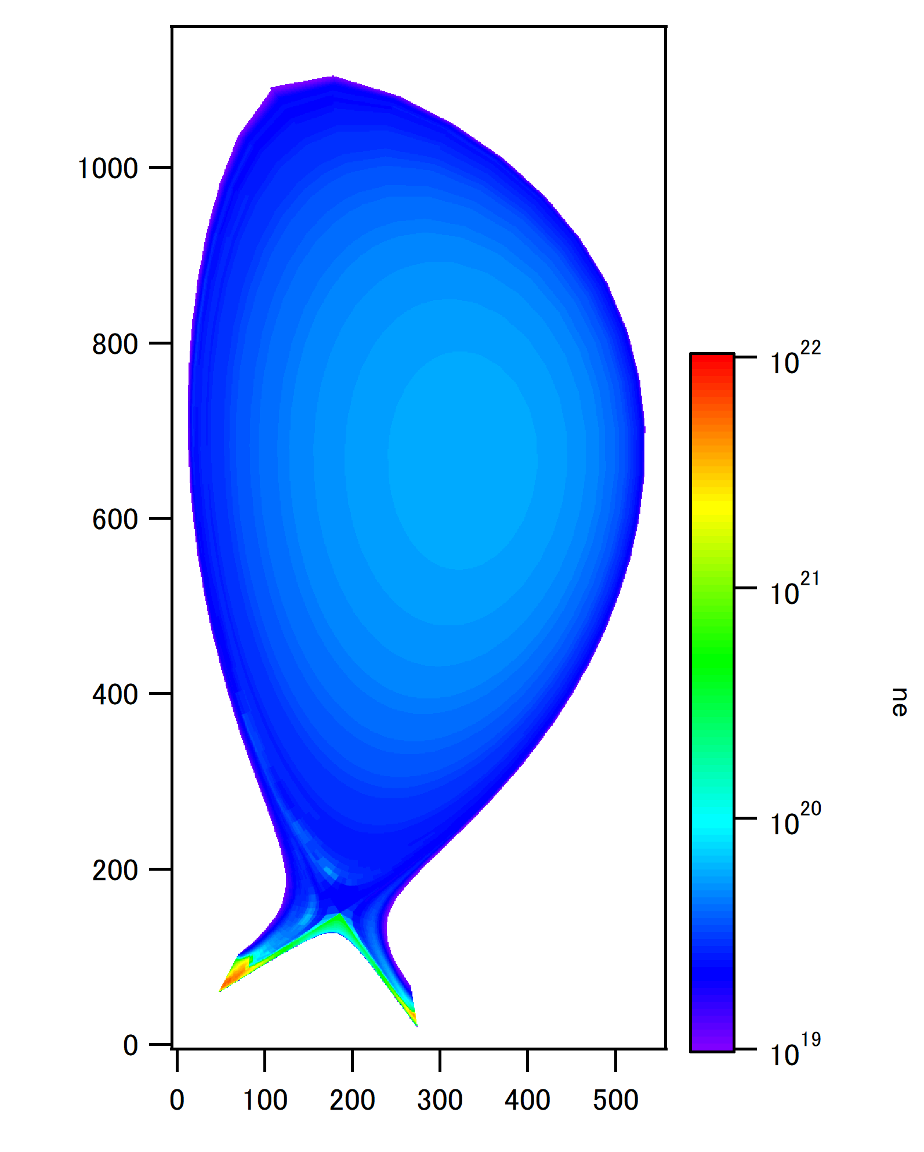
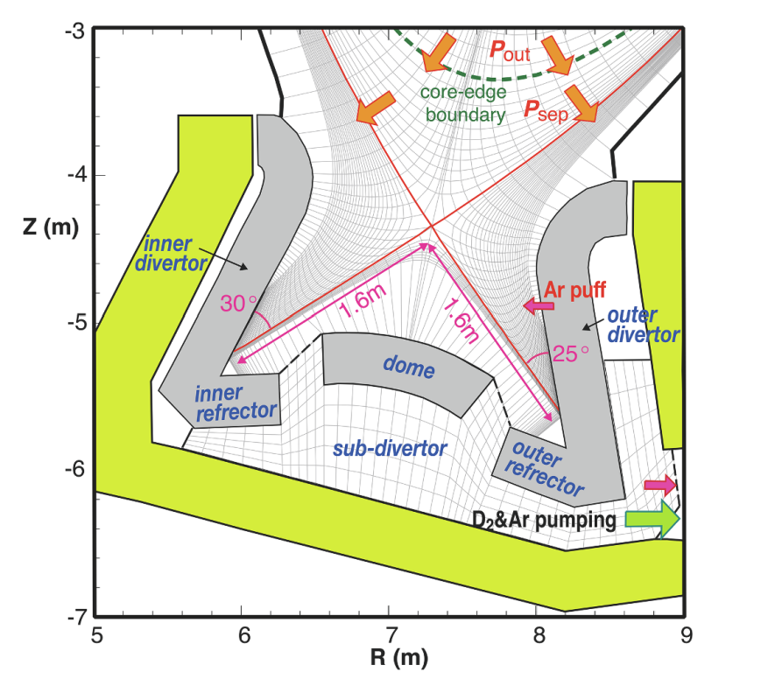
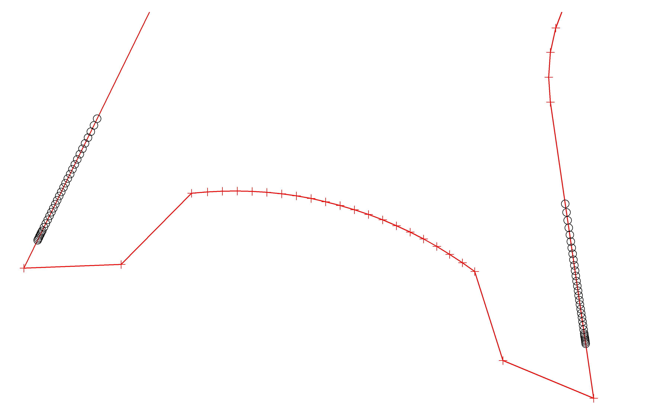
Neutral transport simulation with SONIC + MD for JA-DEMO
Emission distribution of
rovibrational states (v, J ) by MD sim.
NT simulation
with CR model
T_{e} & n_{e} by SONIC
T_{e}
n_{e}
Place No.
Place No.
Inner divertor
N. Asakura, K. Hoshino, Y. Homma, Y. Sakamoto, Joint Special Design Team for Fusion DEMO, “Simulation studies of divertor detachment and critical power exhaust parameters for Japanese DEMO design”, Nuclear Materials and Energy 26 (2021) 100864.
0
Outer divertor
5
10
15
0
25
20
5
30
10
15
25
20
30

Slide 15
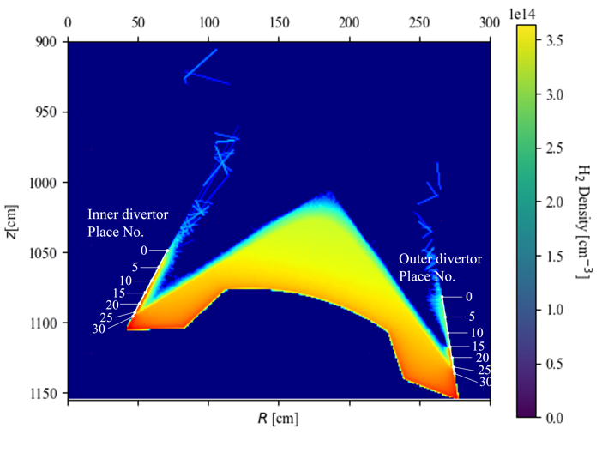
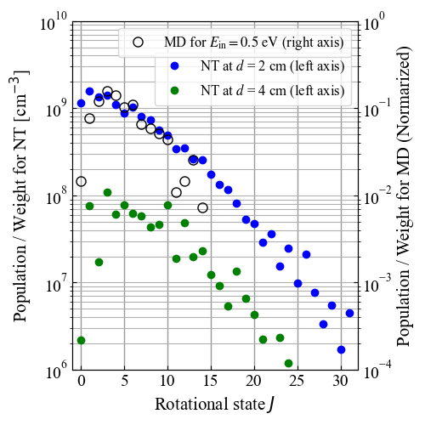
Spatial distribution of H₂ near divertor
S. Saito, et al., Nucl. Fusion 64 126067 (2024).
d
S. Saito, et al., Nucl. Fusion 64 126067 (2024).
The data suggest that the molecules with rotational states higher than J=15 are produced by the collisions with electrons, H⁺ ions, or neutral H atoms near the divertor, even though the absence of those higher-level molecules in the emission distribution.

Slide 16
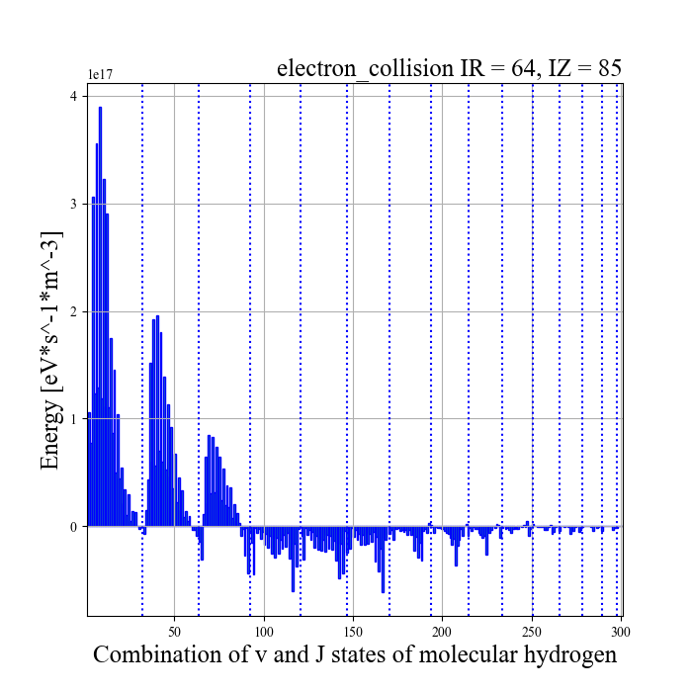
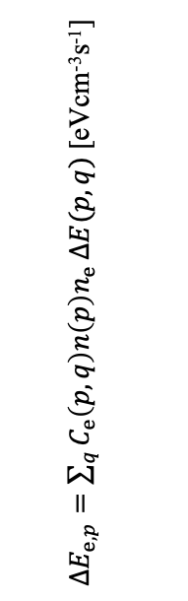
Rovibrational state dependence of absorbed energy
by collision with electrons
Absorbed energy by collision with electrons
${ΔE}_{e, p}=\sum_{q}{C_{e}\left(p,q\right)n\left(p\right)n_{e}}ΔE(p,q)$ [eVcm⁻³s⁻¹]
J :
0〜31
0〜30
〜28
〜27
〜25
23
22
20
18
16
14
12
10
7
2
v :
0
1
2
3
4
5
6
7
8
9
10
12
14
Rovibrational states before collision

Slide 17
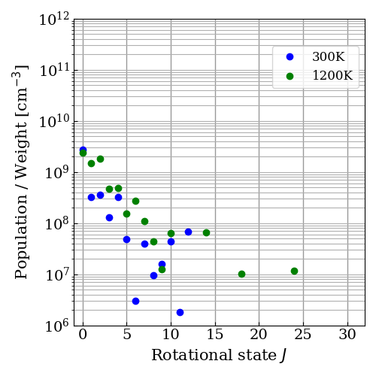
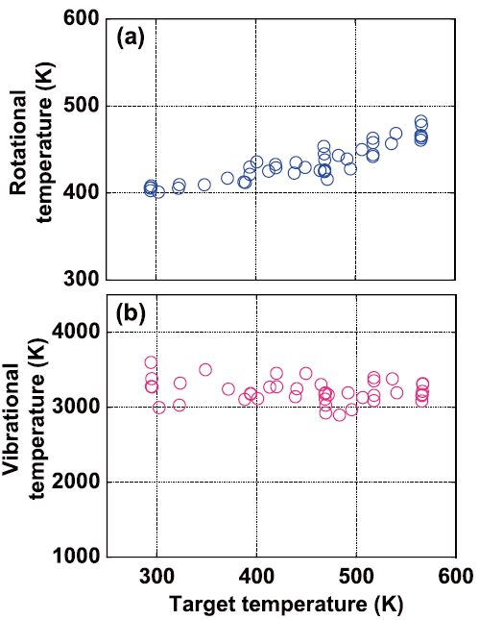
Dependence of rotational states distribution of plasma near wall on wall temperature
Simulation results using wall model + neutral transport for JA-DEMO
Actual rotational temperature by spectroscopic measurement in GAMMA10
2 cm from the inner divertor at No. 0
Wall temperature (K)
A. Terakado, et al., Plasma Fusion Res. 13, 3402096 (2018).

Slide 18
Contents
Background
Molecular dynamics simulation of hydrogen recycling on tungsten wall
Integration with fluid codes and neutral transport simulation
Machine learning approaches for the wall model
  Prediction model for emission distribution
  Deep learning assisted kMC-MD hybrid simulation
Future work: towards advanced wall modeling

Slide 19
Application of Machine Learning (ML)
to Hydrogen Recycling Model
Conventional method (Full MD)
Output: Information of emitted particle
Input-A:
Irradiation condition
Hydrogen recycling model
（MD code）
Emission species (atoms/molecules)
Emission angle
Transrational energy
Rovibrational states
Incident species
Incident angle
Incident energy
Results
Limited results
for hydrogen emission
H
Atom
H
Incident atom
H₂
Reference
Molecule
Wall
Retained hydrogen
atoms/molecules
Neutral transport code
Input-B：
Material condition
Temperature
Density
Crystalline structure
Proposed Method (Predicted by ML)
Hydrogen recycling model
（MD code）
Applicable to
a wide range
of conditions
Results
Training
Training data
Machine Learning
model
Call
Neutral transport code
Notes:
Our calculation scheme successfully revealed the physics in the edge plasma.
However, when we would like to extend our calculation scheme to the wide rage of condition, we encounter a difficulty.
This figure shows the schematic diagram of the hydrogen recycling model.
We have two kind of input parameters and output parameters.
Input-A is the irradiation condition such as …
Input-B is the material condition such as …
We obtain the output such as … corresponding to the input parameters.
However, because of the computation time, it is difficult to calculate the all input conditions by MD simulation.
Therefore, in the case of conventional method which is calculated by only MD, we could only apply the limited input parmaters.
Then, we propose a method assisted by machine learning.
In this scheme, first, we obtain the training data by MD code.
Then, we train the deep learning model from the training data.
The deep learning model can apply to wide ragen of conditions even though we only obtained the training data for limited conditions.

Slide 20
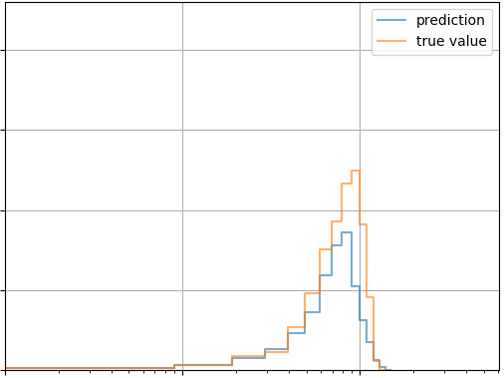
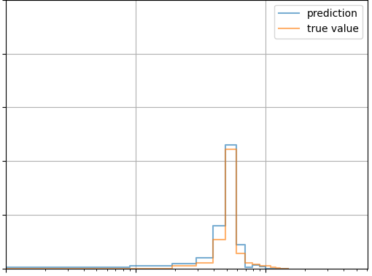
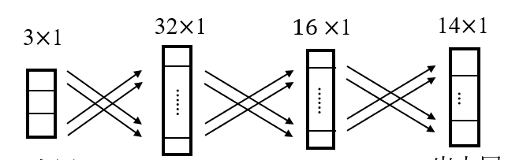
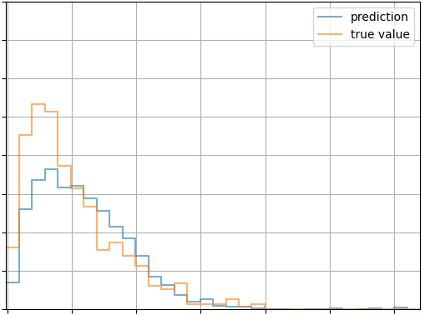
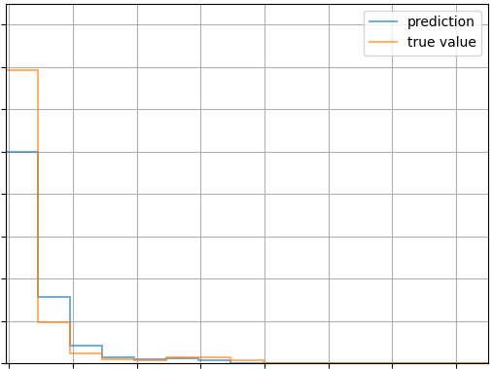
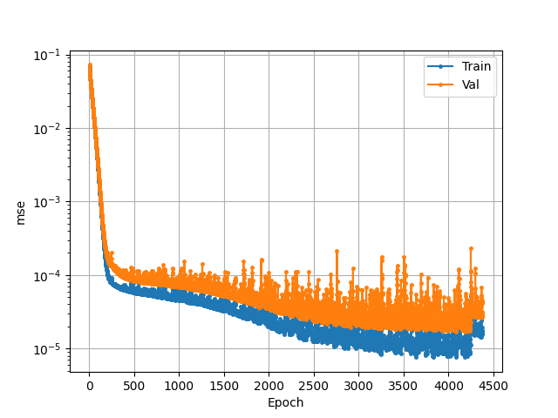
Prediction results of release distribution
S. Saito, et al., ”Machine learning-based hydrogen recycling model for predicting rovibrational distributions of released molecular hydrogen on tungsten materials via molecular dynamics simulations”, Nuclear Materials and Energy. 43 101942 (2025).
Translational energy of H atoms
Translational energy of H₂ molecules
Network models for prediction of translational energy of H aotms
H/W=0.23 T=800K E_{in}=50eV
0.25
H/W=0.23 T=800K E_{in}=50eV
0.20
0.20
0.15
0.15
Num of Emissions / Num of Samples
H
Num of Emissions / Num of Samples
H
0.10
0.10
H
0.05
0.05
Input
Output
0.00
0.00
10⁻¹
10⁰
10¹
10⁻¹
10⁰
10¹
Translational energy [eV]
Translational energy [eV]
Rotational states of H₂ molecules
Vibrational states of H₂ molecules
Evolution of Loss function (MSE)
0.040
H/W=0.23 T=800K E_{in}=50eV
0.16
H/W=0.23 T=800K E_{in}=50eV
10⁻¹
0.035
0.14
0.030
0.12
10⁻²
0.025
0.10
(((
H
H
)))
H
H
Loss
0.020
10⁻³
Num of Emissions / Num of Samples
0.08
Num of Emissions / Num of Samples
0.015
0.06
10⁻⁴
0.010
0.04
0.005
0.02
10⁻⁵
0.000
0.00
0
2
4
6
8
10
12
14
0
2000
4000
4500
0
5
10
15
20
25
30
500
1000
1500
2500
3000
3500
Rotational states
Vibrational states
Epoch

Slide 21
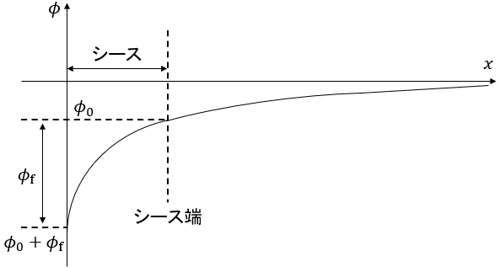
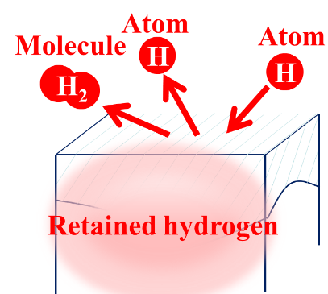
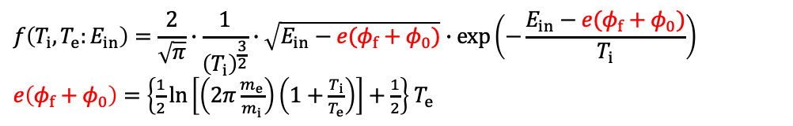


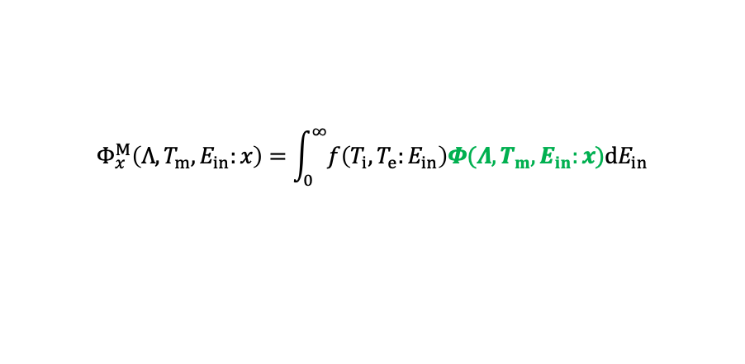

Consideration of incident energy distribution (Shifted-Maxwellian)
Distribution of incident energy $E_{in}$ considering acceleration
by sheath （Shifted-Maxwellian）
sheath
$$f\left(T_{i},T_{e}:E_{in}\right)=\frac{2}{\sqrt{π}}∙\frac{1}{{\left(T_{i}\right)}^{\frac{3}{2}}}∙\sqrt{E_{in}−e(φ_{f}+φ_{0})}∙exp⁡\left(−\frac{E_{in}−e(φ_{f}+φ_{0})}{T_{i}}\right)$$
$e\left(φ_{f}+φ_{0}\right)=\left\{\frac{1}{2}\ln\left[\left(2π\frac{m_{e}}{m_{i}}\right)\left(1+\frac{T_{i}}{T_{e}}\right)\right]+\frac{1}{2}\right\}$ $T_{e}$
$T_{i}$, $T_{e}$: Ion/Electron temperature,$m_{i}$, $m_{e}$: Ion/Electron mass
sheath edge
Integrate the output distribution of the machine learning model
according to the distribution 𝑓 of the incident energy $E_{in}$
$$Φ_{x}^{M}\left(Λ,T_{m},E_{in}:x\right)=\int_{0}^{∞}{f\left(T_{i},T_{e}:E_{in}\right)Φ(Λ,T_{m},E_{in}:x)\text{d}E_{in}}$$
Machine learning model for the distribution of x
$x$: Translational energy $E$ / Rotational state J / Vibrational state $v$
$Λ$: H/W
$T_{m}$: Material temperature

Slide 22
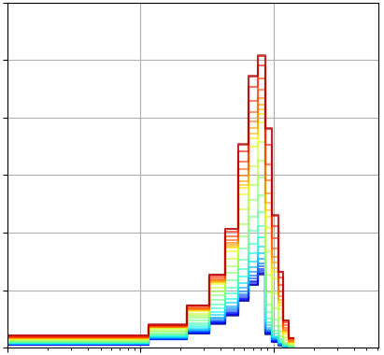
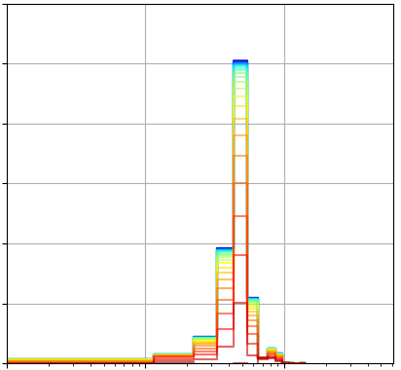
Translational energy distribution of recycled atoms and molecules
considering Maxwell distribution
atoms
molecules
H/W=0.23 T=300K T_{i}=2.81eV
H/W=0.23 T=300K T_{i}=2.81eV
0.12
0.12
0.10
0.10
0.08
0.08
0.1
1
10
50
Number of Emissions / Number of Samples
Number of Emissions / Number of Samples
Electron temperature T_{e} [eV]
0.06
0.06
0.04
0.04
0.02
0.02
0.00
0.00
10⁻¹
10⁰
10¹
10⁻¹
10⁰
10¹
Translational energy [eV]
Translational energy [eV]
The higher the electron temperature and the deeper the sheath, the greater the amount of atoms emitted.
The lower the electron temperature and the shallower the sheath, the greater the amount of molecular emission.

Slide 23
Contents
Background
Molecular dynamics simulation of hydrogen recycling on tungsten wall
Integration with fluid codes and neutral transport simulation
Machine learning approaches for the wall model
  Prediction model for emission distribution
  Deep learning assisted kMC-MD hybrid simulation
Future work: towards advanced wall modeling

Slide 24
Attempt at a Deep Learning Assisted kMC-MD Hybrid Method
Objective: Simulation of hydrogen atom accumulation due to continuous injection
Injection
H
~ 1 ps
Diffusion
~ 0.1 μs
H
~ 1 ps
Injection
W surface
W surface
W surface
H
H
H
H
H
H
H
H
H
H
H
H
H
H
time
non-equilibrium
equilibrium
non-equilibrium
Comparison of methods
Hybrid simulation method
Molecular dynamics (MD)
kinetic Monte Carlo (kMC)
Injection: MD
Diffusion: kMC
 | Comp. Cost | Sim. in Non-Eq. States
MD | × | ○
kMC | ○ | ×
H
W surface
W surface
H
H
H
H
H
H
H
H
H

Slide 25
Purpose and method
Hybrid method has the problem that it needs considerable computation cost for the calculation of the migration barrier and trapping site required for kMC calculation.
injection
(MD)
diffusion (kMC)
injection (MD)
diffusion (kMC)
H
H
H
H
H
H
H
H
H
H
H
H
H
W
H
W
H
H
W
H
H
W
Predicting the following three values by deep learning models :
      3D potential energy distribution
      Migration barrier
      Minimum potential point (trapping site)
Today’s topic
Under development
Notes:
Therefore, in this study, we propose a method that adds a deep learning process between the injection and diffusion phases to enable fast computation by predicting potential minima and migration barriers.
Specifically, we will develop a model that uses deep learning to predict three key elements: 3D potential energy distribution, Migration barrier, and Minimum potential point.
In this study, I developed a deep learning model to predict the 3D potential energy distribution, and the migration barrier was determined using the Nudged Elastic Band method.

Slide 26
Network model (Generator)

Slide 27
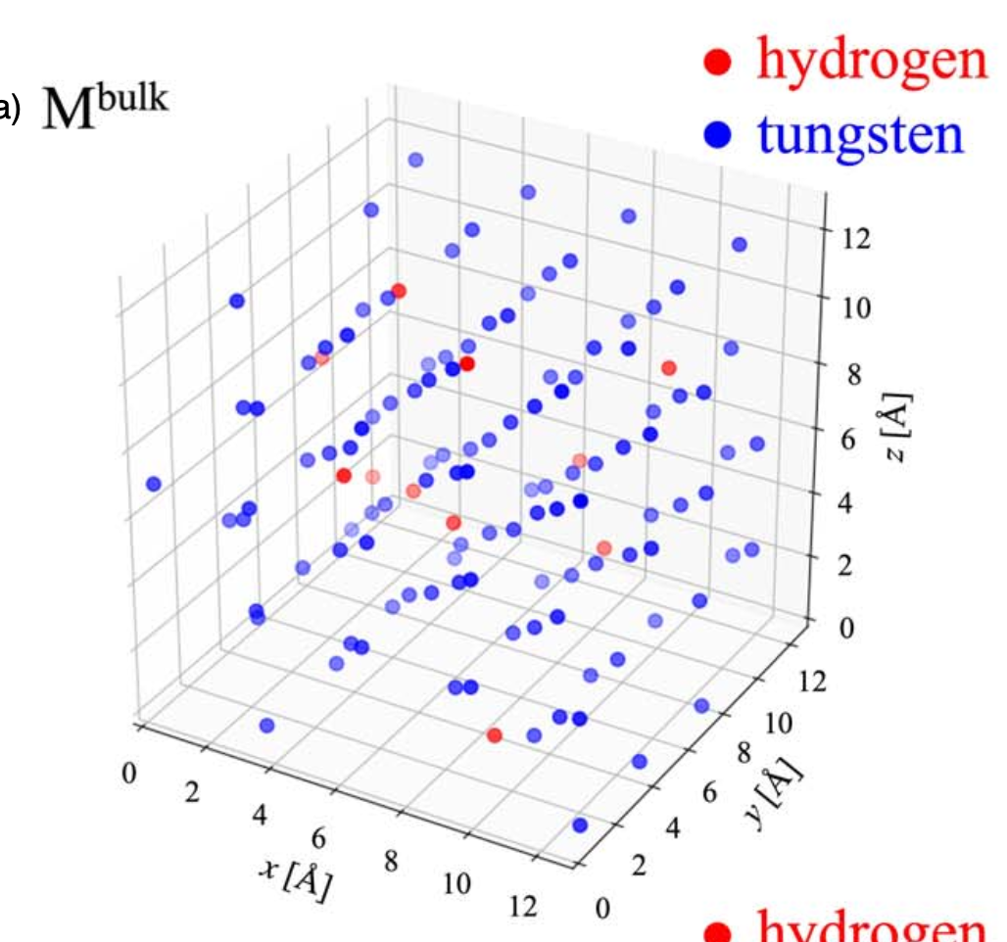
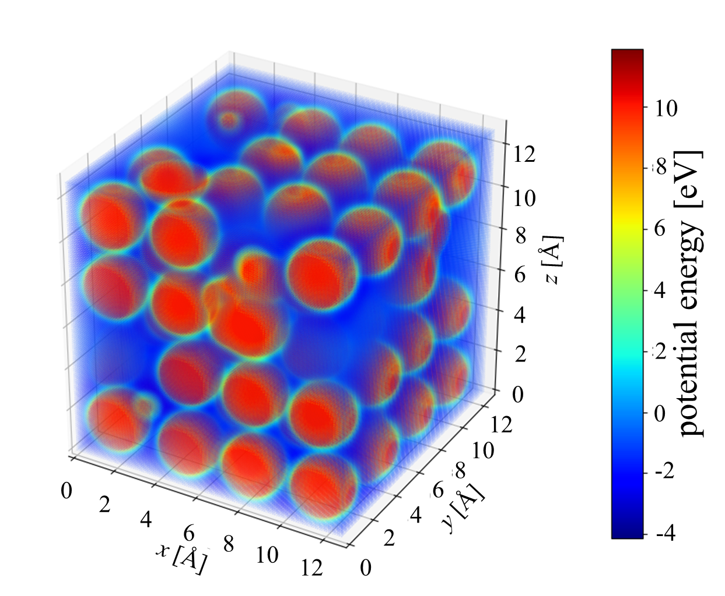
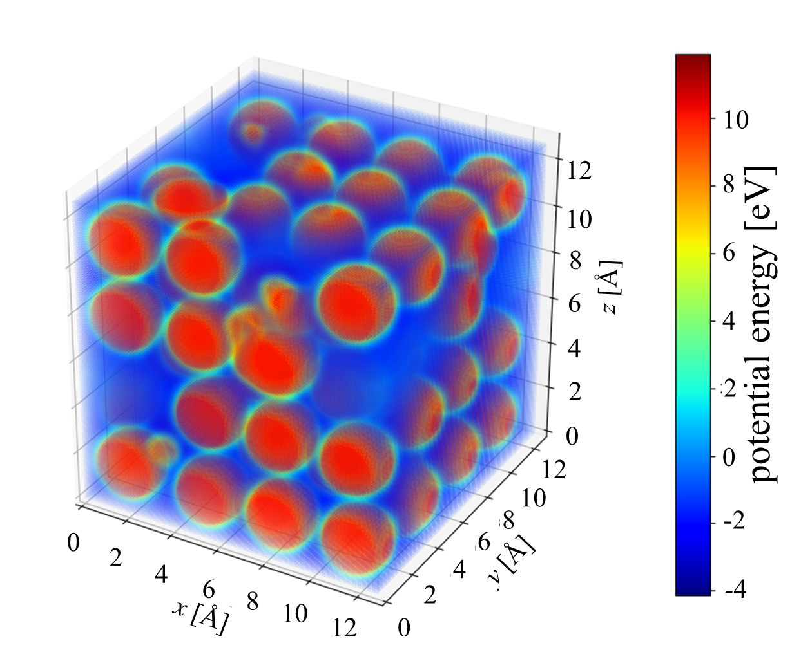
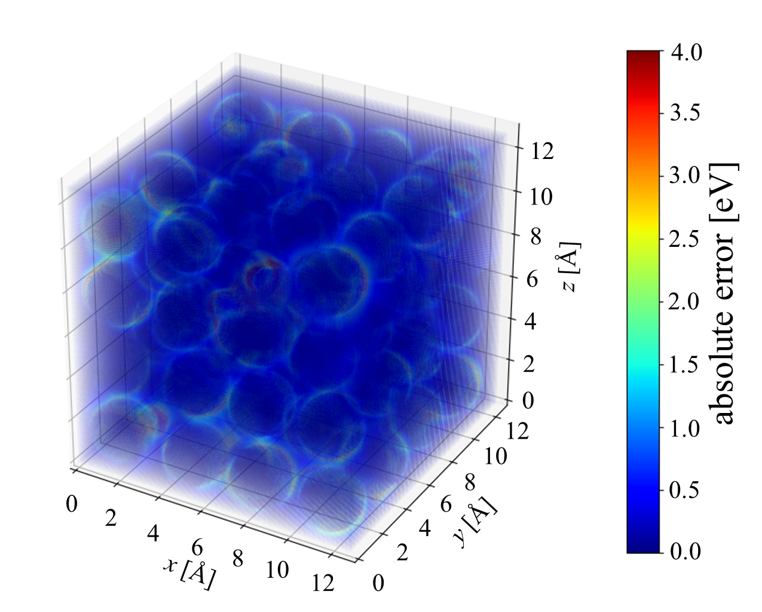
Results of prediction of 3D potential energy distribution
Input
EAM potential
4 hours
by 1 CPU(1 core)
DL model
0.2 second by
1 CPU(1 core) + 1 GPU
Ture values
Predicted values
Absolute error
The accuracy is good based on the comparison between the true and predicted values
S. Saito, et al., “Deep learning model for predicting the spatial distribution of binding energy from atomic configurations”, Japanese Journal of Applied Physics, 63, (2024).
Notes:
Here, about result of predicting test data.
The left figure is the label data, the center figure is the prediction data, and the right figure is the error.
The error is the absolute difference between the label data and prediction data, and it is plotted with a maximum value set to 4.
The accuracy is generally good based on the comparison between the Ture and Predict.
However, the absolute error indicates that predicting the contours of the particles is challenging.

Slide 28
Contents
Background
Molecular dynamics simulation of hydrogen recycling on tungsten wall
Integration with fluid codes and neutral transport simulation
Machine learning approaches for the wall model
  Prediction model for emission distribution
  Deep learning assisted kMC-MD hybrid simulation
Future work: towards advanced wall modeling

Slide 29
Future work: towards advanced wall modeling
Wall model
Deep learning Assisted
MD-kMC Method
for calculation of density

Slide 30
Summary
Hydrogen recycling on tungsten walls was investigated using MD simulations.
Emission distributions of rovibrational states of recycled hydrogen were predicted using machine learning techniques.
The developed wall model was integrated with the SONIC code and neutral transport simulations.
Future plan: We will develop a deep learning-assisted kMC–MD hybrid method to generate training data for machine learning models that predict particle density. The model will provide input for emission distribution predictions and enable to solve the dynamical interaction between plasma and wall.

Slide 32
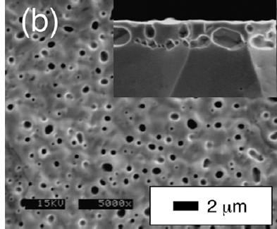
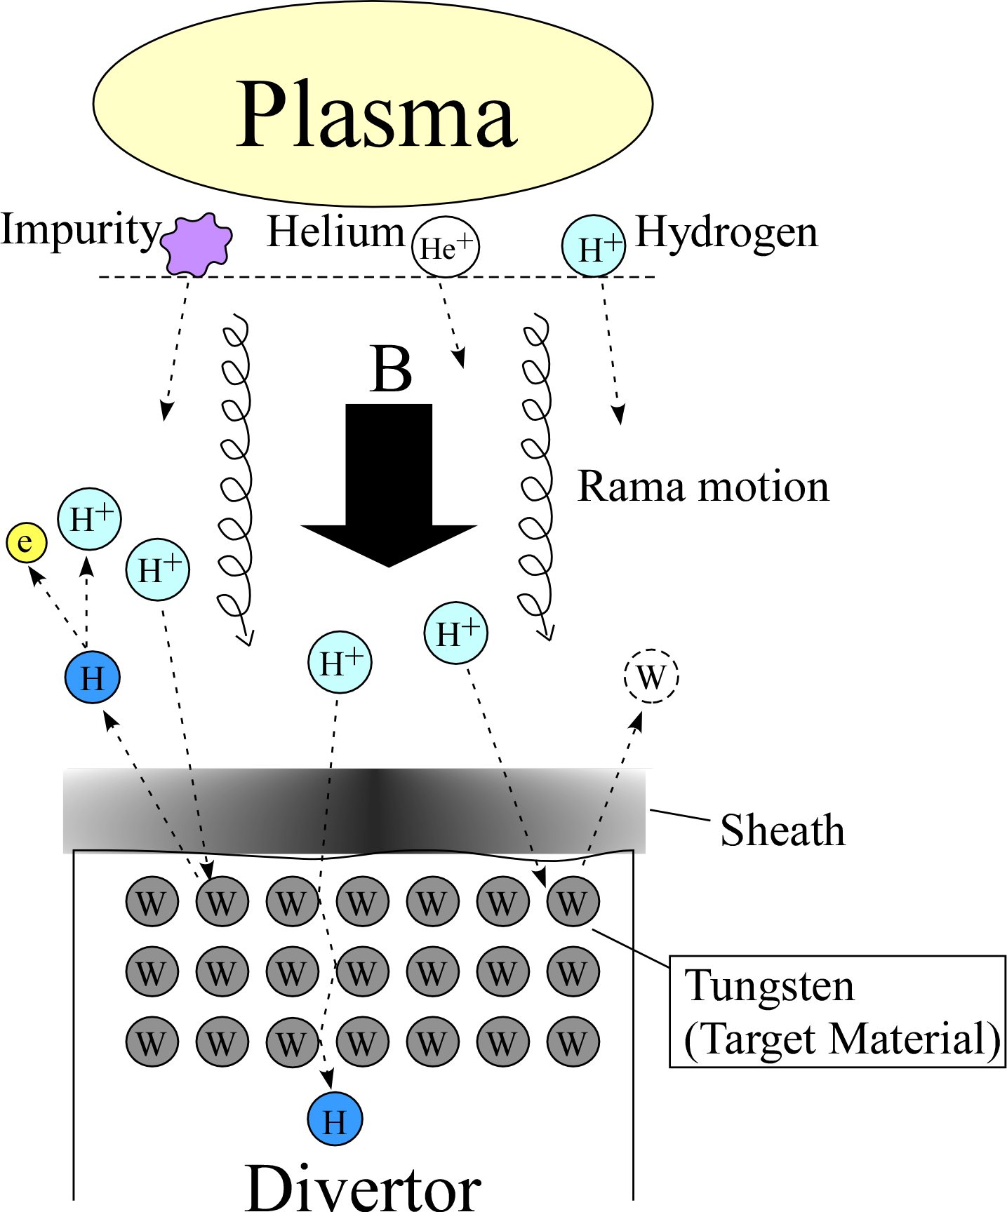
Radiation damage to walls
(helium bubbles)
Helium bubbles
N. Ohno, et. al., J. Nucl. Mater. 363 (2007) 1153
retention
Accumulate of the Plasma particles in the material
sputtering
He⁺
He⁺
Emission of material atoms by collisions with plasma particles
Helium bubbles
Changes in the material surface structure
(generation of helium bubbles)
He⁺

Slide 33
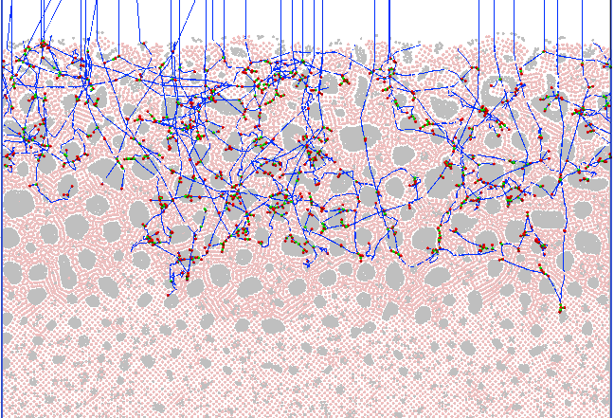
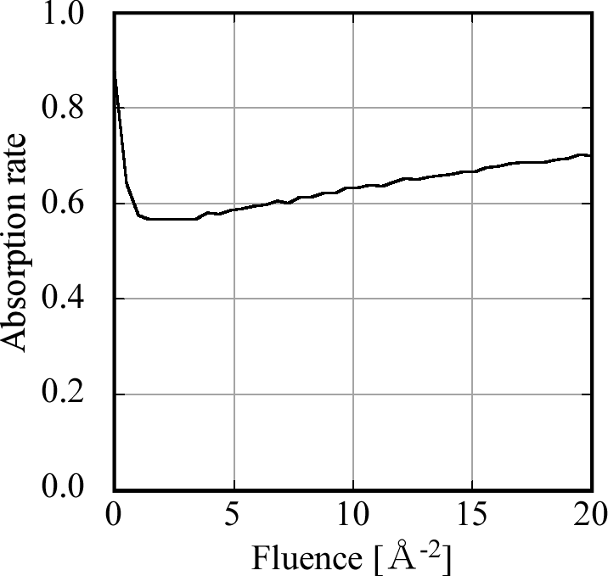
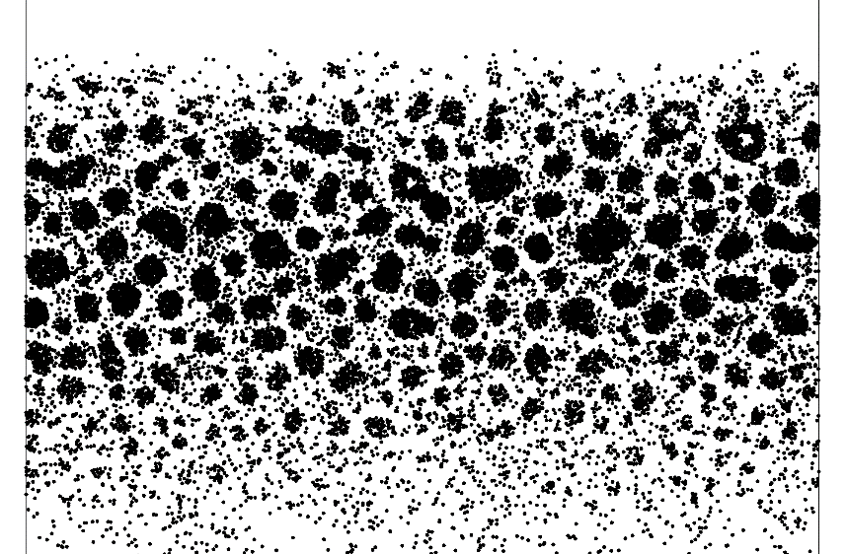
Time evolution of absorption rate by helium irradiation
E_{in}=1 keV
Trajectories of incident helium atoms
Fluence [×10²⁰ He/m²]
S. Saito, et al., JJAP. 55 (2016) 01AH07
Plot of stopping positions
of incident helium atoms
S. Saito, et al., proc. JSST2017 (2017)
S. Saito, et al., JJAP. 56 (2017) 01AF04

Slide 34
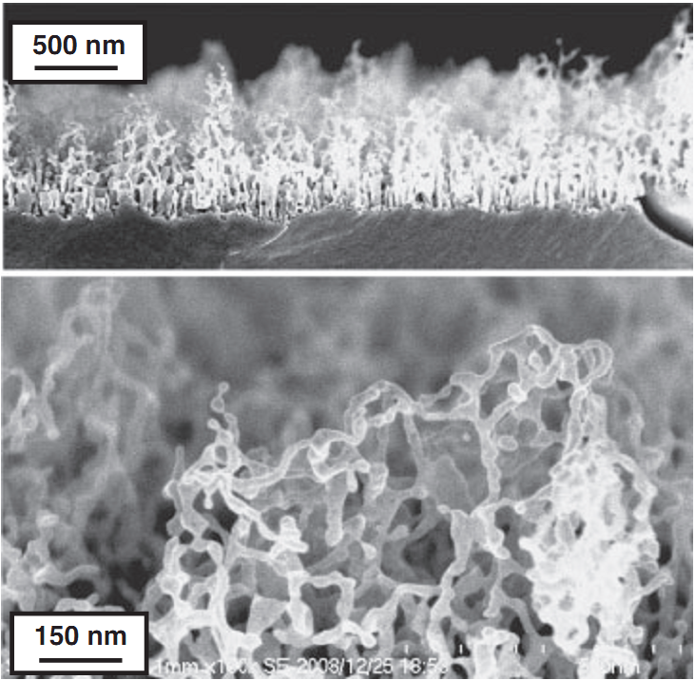
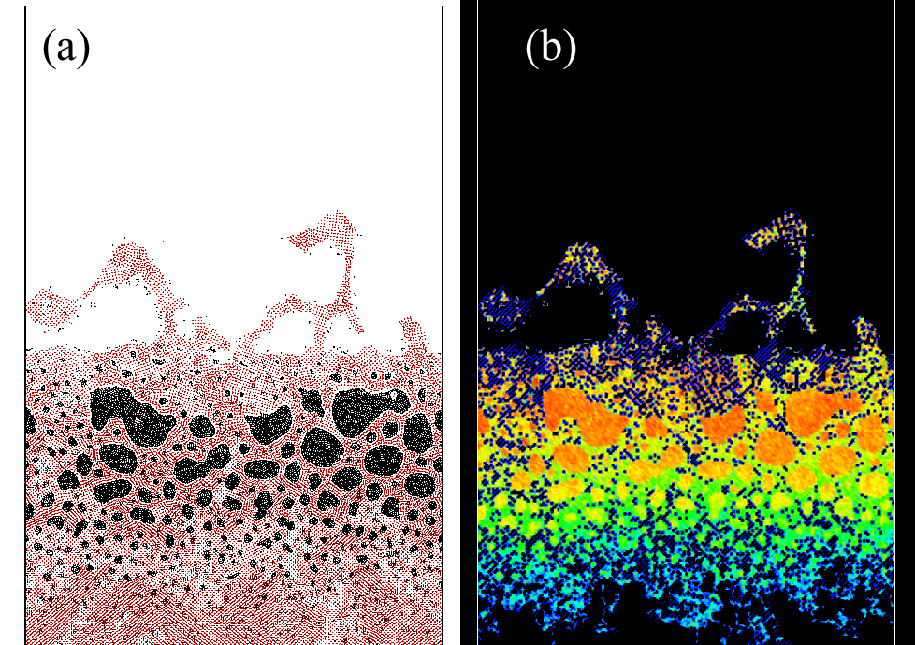
Energy absorption on the fuzz structured surface
Fuzz structure of tungsten surface
formed by helium plasma exposure.
S. Kajita, et al., JJAP. 50 (2011) 08JG01
S. Saito, et al., JJAP. 55 (2016) 01AH07
S. Saito, et al., proc. JSST2017 (2017).
S. Saito, et al., JJAP. 56 (2017) 01AF04

Slide 35
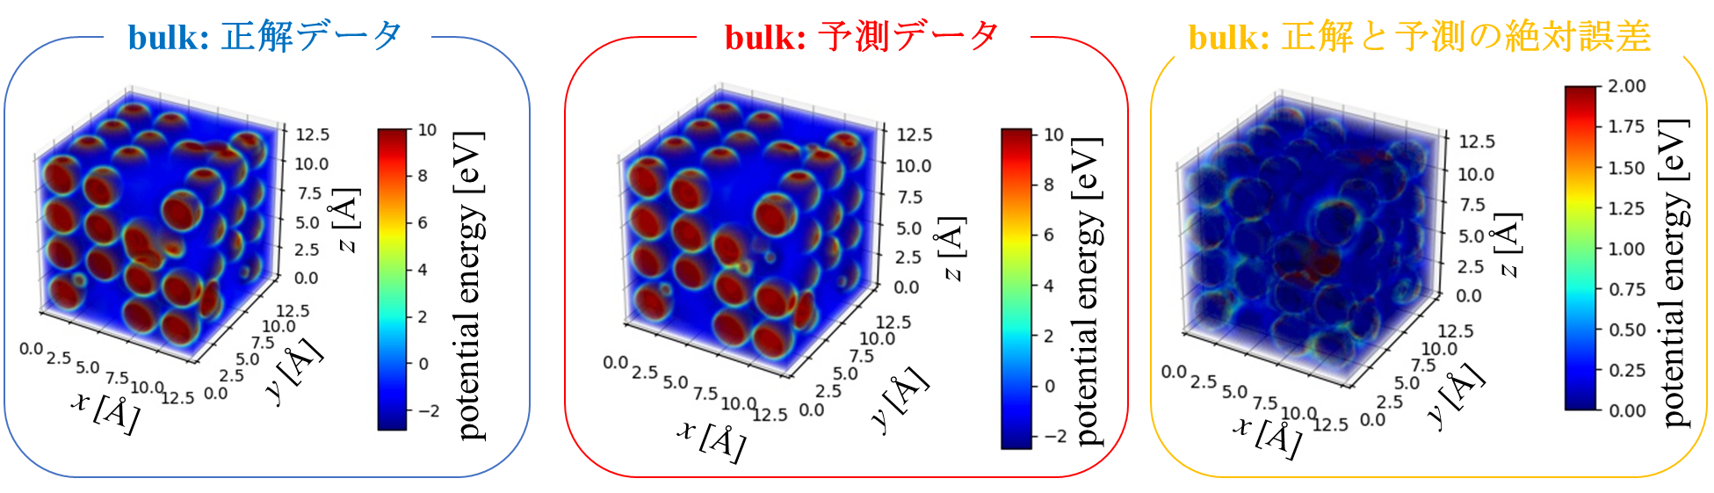


Results of prediction of 3D potential energy distribution
bulk: true data
bulk: prediction
bulk: absolute error
surface: true data
surface: prediction
surface: absolute error
surface: 正解と予測の絶対誤差
random: true data
random: prediction
random: absolute error
random: 正解と予測の絶対誤差
S. Saito, et al., Jpn. J. Appl. Phys. 63 9SP03 (2024).

Slide 36

Wall model
automatic generation
system for ML mode
Deep learning Assisted
MD-kMC Method
For calculation of density
Heat conduction sim.
using FEM
$n_{e}, T_{e}$: Electron density and temperature of edge plasma
$T_{e}^{sh}, T_{i}^{sh}, Γ_{P}^{sh }$: Electron temperature, ion temperature, and flux to the wall at the sheath edge
$Δn, Δπ,Δε$: Increments in density, momentum, and energy of ions resulting from neutral transport
$T_{m}$: Wall temperature
$θ_{B}$: Incident angle of magnetic field lines to the wall
$ρ_{D}, ρ_{T}, ρ_{He}$: Deuterium, tritium, and helium densities in the wall
$f_{x}^{v, J, E}$: The distribution of rovibrational states, and translational energy of released molecule 𝑥
$f_{x}^{E}$: The distribution of translational energy of released atom 𝑥

Slide 37


cf. pix2pix
Example: Converting grayscale image to a color image
Generative adversarial network (GAN) for 2D image to 2D image conversion
pix2pix
Phillip Isola, Jun-Yan Zhu, Tinghui Zhou, Alexei A. Efros,
Image-to-Image Translation with Conditional Adversarial Networks
https://arxiv.org/pdf/1611.07004.pdf
Overview of GAN
input image
GAN
GAN consists of two networks: a generator and a discriminator.
Generator
Output the desired image from the input image.
Discriminator
Judge whether the image is generated or real one.
Generator
Discriminator
output image

Slide 38


Usage of deep learning in kMC
Expansion of pix2pix from 2D to 3D
2D image
255 | 255 | 0 | 0 | 0
255 | 255 | 0 | 0 | 0
255 | 255 | 100 | 100 | 100
255 | 255 | 100 | 100 | 100
3D image
Pixels (arranged in 2D array)
Pixel value represents the intensity of the pixel.
Voxels (arranged in 3D array)
Voxel value ​​represents the potential energies.

Slide 39

Structure discriminator

Slide 40


Generation of training data by MD simulation
Simulation Condition
・Target material: bcc tungsten containing hydrogen
・Boundary condition: Periodic boundary condition (x and y directions)
・Atomic interaction: EAM potential
・Heat bath: Langevin thermostat
・Incoming atom: Hydrogen atom
・Number of incident atoms: 1 atom
・Simulation time: 1ps
H
W
Training Data
・H/W ($Λ$): 0.1, 0.23
・Material temperature ($T_{m}$): 300, 600, 1000 [K]
・Incident energy ($E_{in}$): 0.1, 1, 10, 100 [eV]
2(H/W)×3(temperature)×4(incident energy) = 24 patterns
Test Data
・H/W ($Λ$): 0.23
・Material temperature ($T_{m}$): 400, 800 [K]
・Incident energy ($E_{in}$): 5, 50 [eV]
2(temperature)×2(incident energy) = 4 patterns

Slide 41





Machine Learning Model
Example: $Λ$=0.23,
$T_{m}$=1000K, $E_{in}$=0.1eV
1distribution
0.10
1000 samples
0.08
1000 samples
1distribution
0.06
1500 samples
random selection
Num of Emissions / Num of Samples
1000 samples
1distribution
0.04
1000 samples
1distribution
0.02
0.00
1000 samples
1distribution
0
5
10
15
20
25
30
Training Data
2(H/W)×3(temperature)×4(incident energy) = 24 patterns
→ 24×5(random selections) = 120 training data
回転準位
Training Data
Input
H/W($Λ$)
Output
Fully Connected Network
Distributions of translational energy of emitted H atoms
Distributions of translational energy of emitted H₂ molecules
Distributions of rotational states of emitted H₂ molecules
Distributions of vibrational states of emitted H₂ molecules
Material Temperature ($T_{m}$)
Incident Energy ($E_{in}$)

Slide 42


Direct prediction model for emission distribution
considering Maxwellian distribution
Emission distribution for monochromatic incident energy
Input: $Λ$, $T_{m}$, $E_{in}$
Emission distribution
considering Maxwellian distribution
Input: $Λ$, $T_{m}$, $T_{i}$, $T_{e}$
Integration with Maxwellian distribution
Prediction by machine learning
Emission distribution
considering Maxwellian distribution
Input
合計: 11664
$$Λ$$
$$T_{m}$$
$$T_{i}$$
$$T_{e}$$
80%
20%
Fully Connected Network
Training Data | Test Data
9331 | 2333
Emission distribution
considering Maxwellian distribution

Slide 43








Result of prediction
Transrational energy of H
Transrational energy of H₂
Atom translational energy distribution prediction model
0.12
0.12
0.10
H/W=0.10 T=300K
T_{i}=0.42eV T_{e}=48.94 eV
H/W=0.23 T=900K
T_{i}=0.85eV T_{e}=11.72 eV
32$×$1
14$×$1
0.10
4$×$1
0.08
0.08
0.06
H
0.06
Num of Emissions / Num of Samples
Num of Emissions / Num of Samples
H
0.04
H
0.04
0.02
0.02
入力
出力
0.00
10⁻¹
10⁰
10¹
0.00
10⁻¹
10⁰
10¹
Translational energy [eV]
Translational energy [eV]
Atom translational energy distribution Prediction model loss function (MSE)
Rotational state of H₂
Vibrational state of H₂
0.030
H/W=0.23 T=400K
T_{i}=2.21eV T_{e}=1.74 eV
0.14
0.025
0.12
H/W=0.23 T=400K
T_{i}=2.21eV T_{e}=1.74 eV
10⁻³
0.020
0.10
0.015
H
H
0.08
(((
H
)))
10⁻⁴
Num of Emissions / Num of Samples
Num of Emissions / Num of Samples
H
Loss
0.010
0.06
10⁻⁵
0.04
0.005
0.02
10⁻⁶
0.000
0
5
10
15
20
25
30
0.00
0
2
4
6
8
10
12
14
16
Rotational state J
Vibrational state v
0
50
100
150
200
250
300
350
400
Epoch

Slide 44








Energy absorption due to excitation of rovibrational states
$${ΔE}_{e}=\sum_{p,q}{C_{e}\left(T_{e}:p,q\right)n\left(p\right)n_{e}}ΔE(p,q)$$
$C_{∗}$ : Excitation rate coefficient due to collision with *
$p$: Vibration/rotation level before collision
$q$: Vibration/rotation level after collision
$${ΔE}_{H+}=\sum_{p,q}{C_{H+}\left(T_{e}:p,q\right)n\left(p\right)n_{e}}ΔE(p,q)$$
$ΔE\left(p,q\right)≡E\left(q\right)−E\left(p\right)$ ,
$E\left(p\right)$: Energy eigenvalue at rovibrational state 𝑝
$${ΔE}_{H}=\sum_{p,q}{C_{H}\left(T_{e}:p,q\right)n\left(p\right)n_{H}}ΔE(p,q)$$
$n\left(p\right)$: Hydrogen molecule density at vibrational/rotational level 𝑝
Notes:
1eVを１つのプラズマに注入すると約10000度になる。しかし温度はマクスウェル・ボルツマン分布にし
エネルギー固有値とは
ポピュレーションいくつだ？1.0*10＾14eV
10000eVほど奪われている
めっちゃ奪われていない？
より長い時間を計算したらどうなるの？

Slide 45









$${ΔE}_{e}=\sum_{p,q}{C_{e}\left(T_{e}:p,q\right)n\left(p\right)n_{e}}ΔE(p,q)$$
$p$: Vibration/rotation level
before collision
$q$: Vibration/rotation level
after collision
$ΔE\left(p,q\right)≡E\left(q\right)−E\left(p\right)$ ,
$E\left(p\right)$: Energy eigenvalue at
rovibrational state 𝑝
$n\left(p\right)$: Hydrogen molecule density
at vibrational/rotational level 𝑝
$C_{e}$ : Excitation rate coefficient
due to collision with electron

Slide 46
Calculation of vibrational state v and rotational state J of H₂ molecule
1. Calculate rotational state J from total angular momentum L of hydrogen molecule in center-of-mass coordinate system obtained from MD
$$J=\frac{1}{2}\left(\sqrt{1+4{\left(\frac{L}{ℏ}\right)}^{2}}−1\right)$$
$$L^{2}=ℏ^{2}J\left(J+1\right)$$
2. Calculate the total energy E in center-of-mass coordinate
$$\frac{1}{2}μ{\left(\frac{dR}{dt}\right)}^{2}+U\left(R\right)+\frac{1}{2μ}{\left(\frac{L}{R}\right)}^{2}=E$$
Classical
system:
$R$：Internuclear distance
μ：Reduced mass
$U\left(R\right)$： Potential function
3. Find the v closest to the values ​​of J and E from the table of J, v and E pairs obtained by solving the Schrodinger equation in center-of-mass coordinate system.
Quantum
system:
$$−\frac{ℏ^{2}}{2μ}\frac{d^{2}ψ_{v}}{{dR}^{2}}+U\left(R\right)ψ_{v}+\frac{ℏ^{2}}{2μ}\frac{J\left(J+1\right)}{R^{2}}ψ_{v}=Eψ_{v}$$
Notes:
Of cores, no theoretical method to obtain quantum values from classical values.
However, as one possibility, we translate the classical values obtained by MD to the quantum values by these procedure.
round ~ to the nearest whole number

Slide 47


