Slide 1
Nanoindentation and Defect Behavior in Irradiated FCC NiFe Alloys: Experimental Insights and Atomistic Modeling
Francisco Javier Dominguez-Gutierrez, Edyta Wyszkowska, Gordana Markovic, Cyprian Mieszczynski, Anna Kosinska, Lukasz Kurpaska

Slide 2
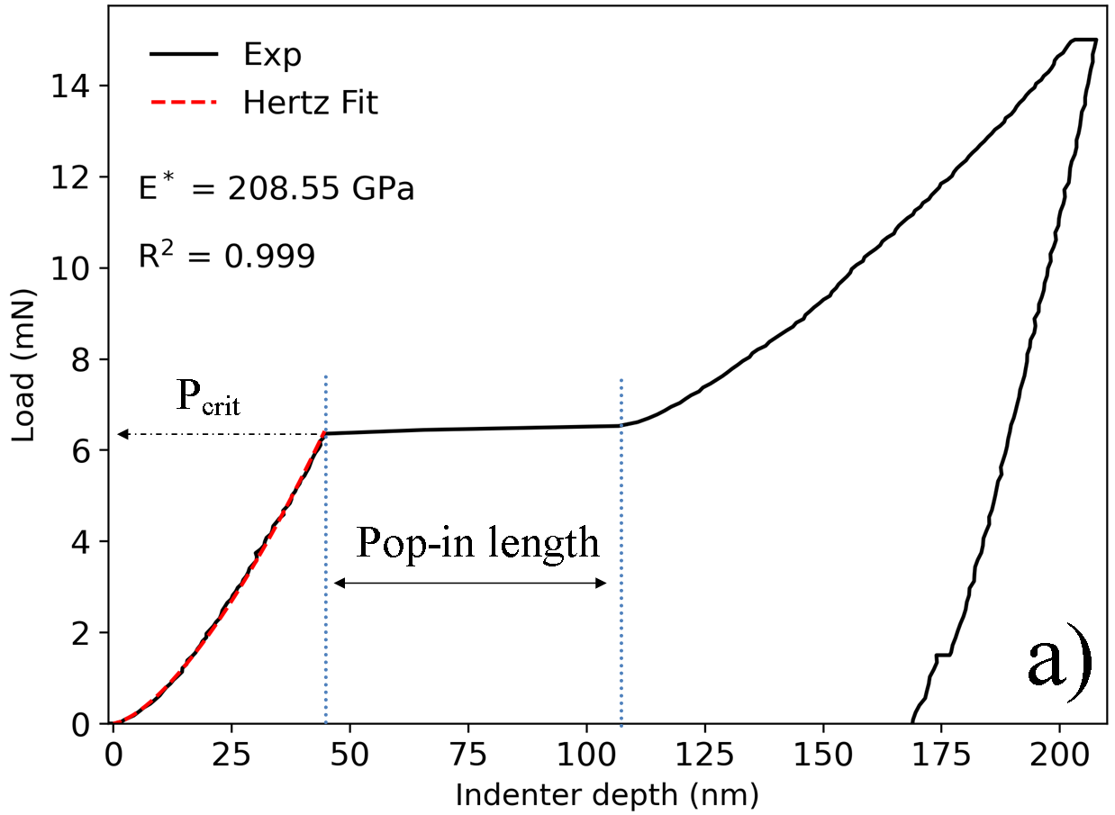
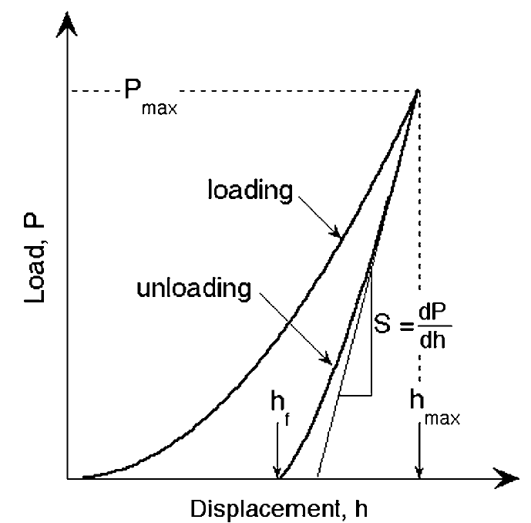
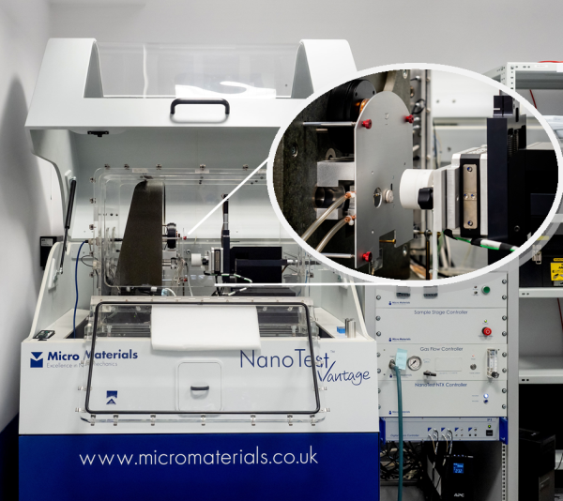
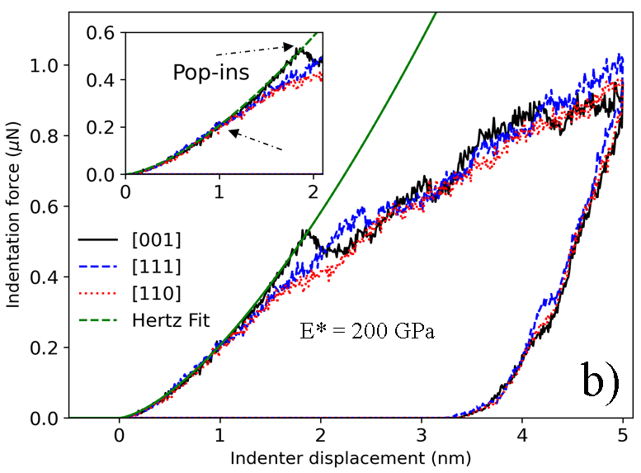
Basics of nanoindentation tests
To measure the elastic modulus and hardness of the material from load-displacement curves.
Oliver-Pharr method
Pure Fe
W. C. Olvier and G. M. Pharr. J. Mater. Res. 19, 1 (2004).
K. Mulewska et al. NIM-B 539, 55 (2023) K. Mulewska et al. J. Nuclear Materials 586, 154690 (2023)
L. Kurpaska et al. Materials & Design 217, 110639 (2022)

Slide 3
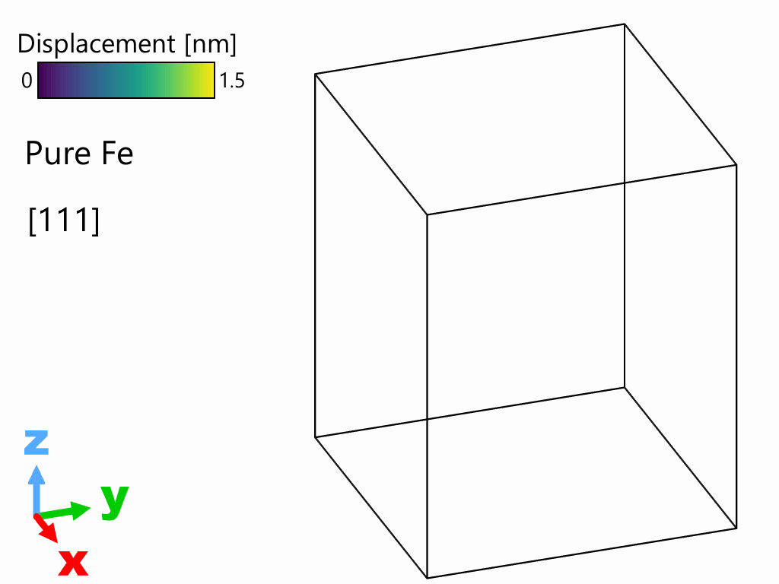
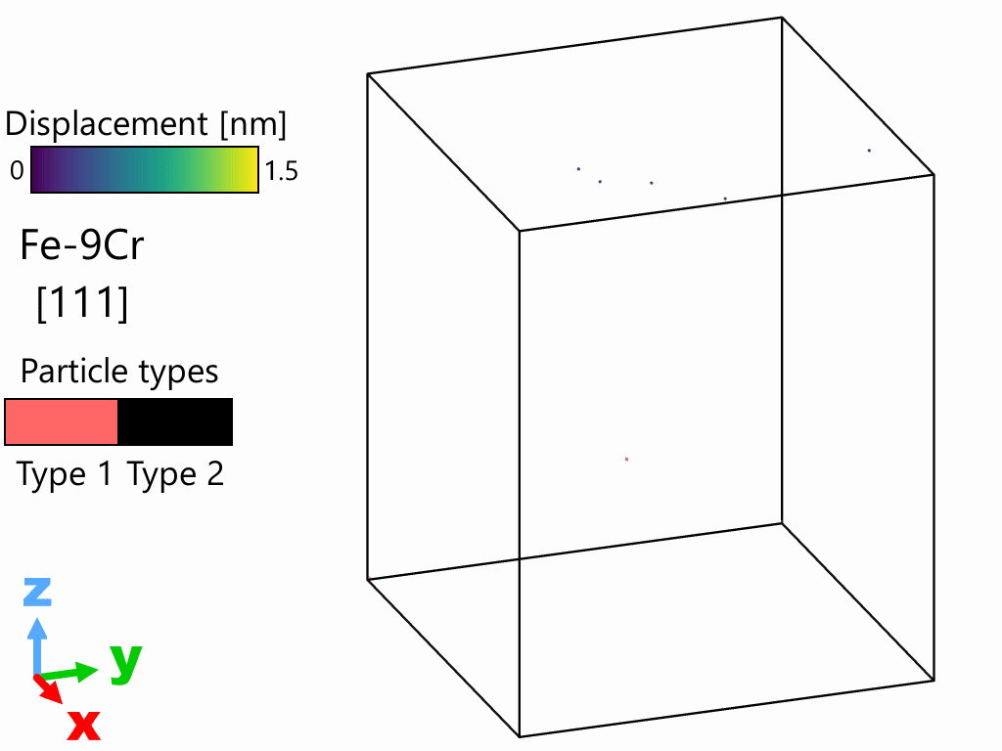
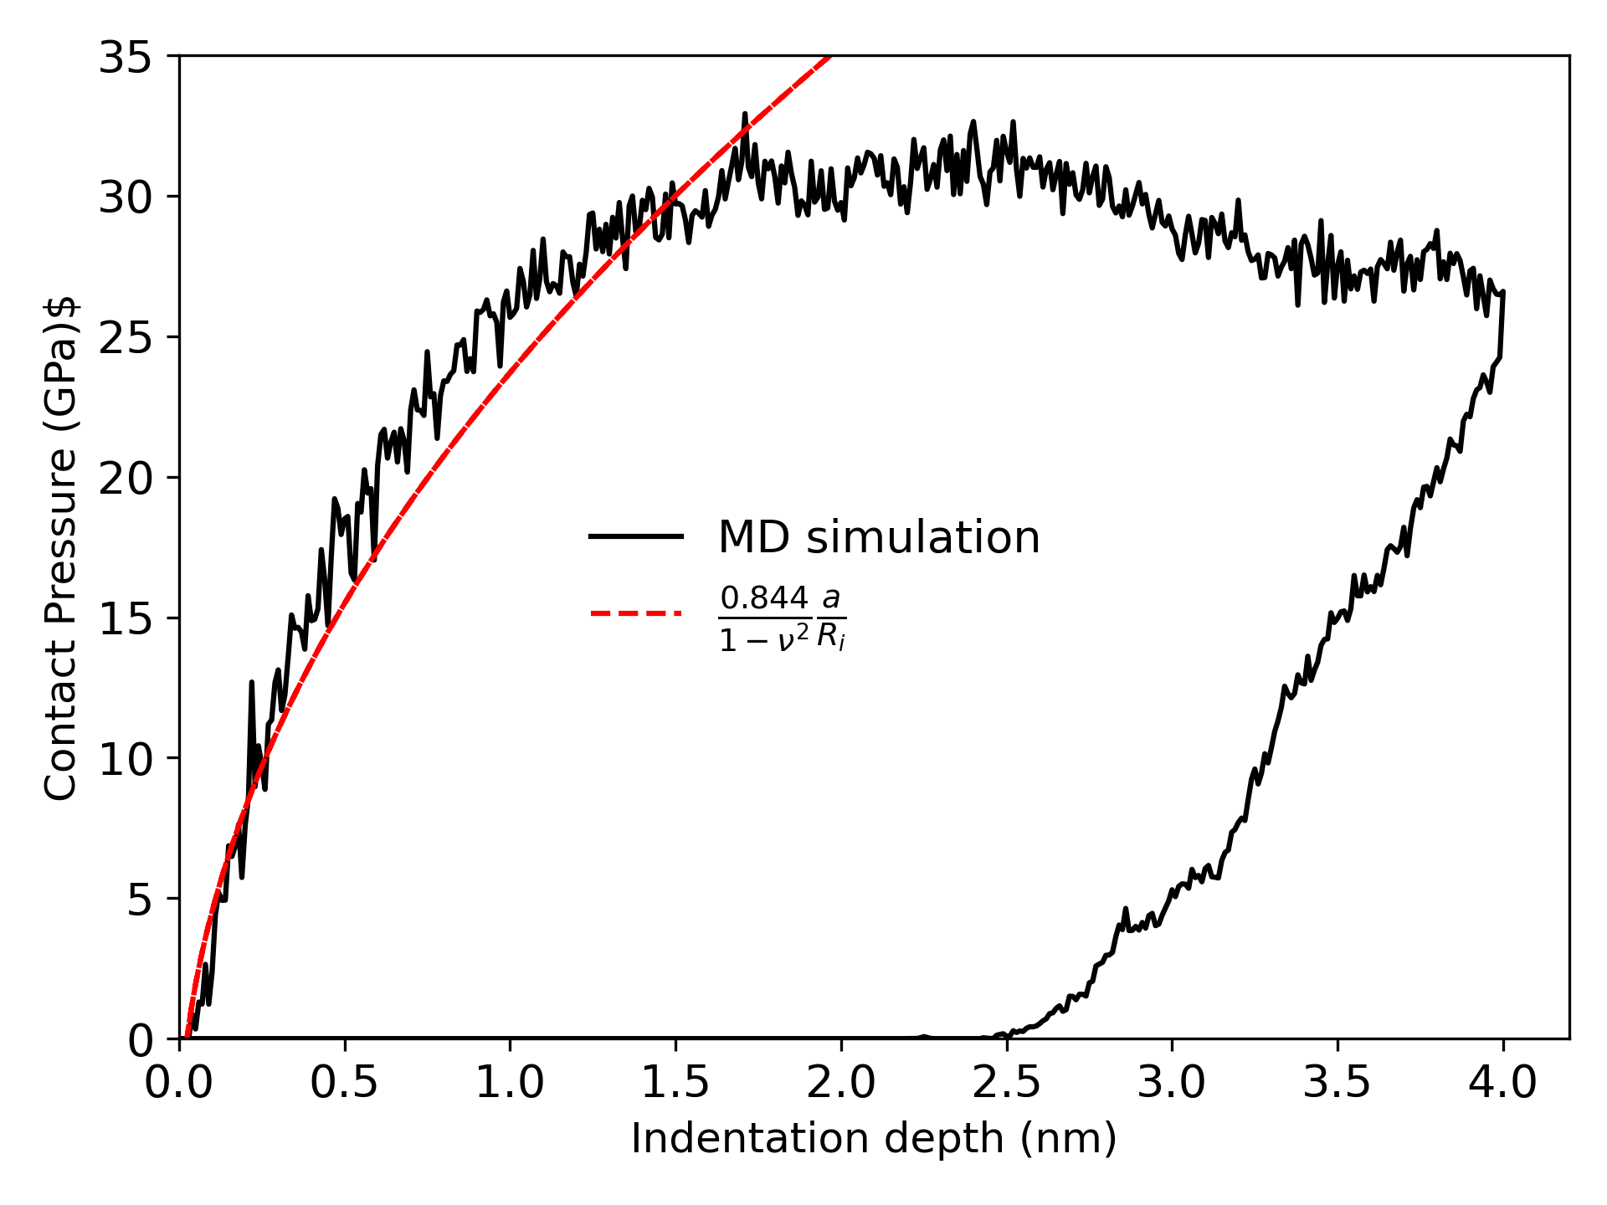
Nanoindentation test of pure BCC Fe and FeCr₉
Basics of nanoindentation tests: MD Modeling
Large scale MD simulation for rT nanoindentation of pristine single-element Fe matrix. Simulations cell are define by ~25 million atoms: 57x56x70nm³ size.
Pile-ups and slip traces
Edge dislocations
Dislocation loop
F. J. Dominguez-Gutierrez, S. Papanikolaou et al. Materials Science & Engineering A 826 ,141912 (2021)
L Kurpaska, F. J. Dominguez-Gutierrez,Y. Zhang et al. Materials & Design 217, 110639 (2022).
A. Naghdi, F. Pellegrini, F. J. Dominguez Gutierrez et al. Acta Materialia 277, 120200 (2024).

Slide 4
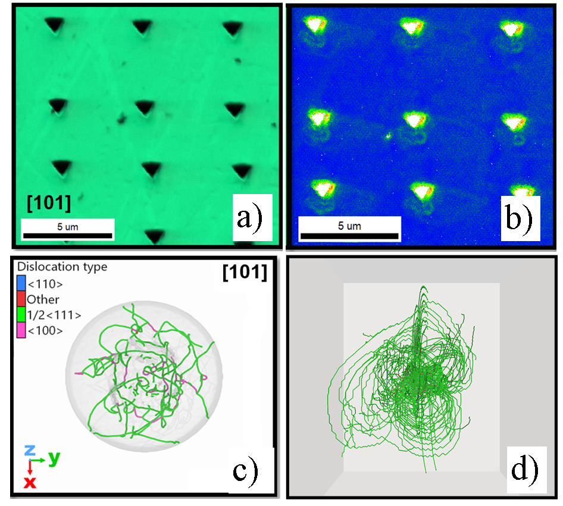
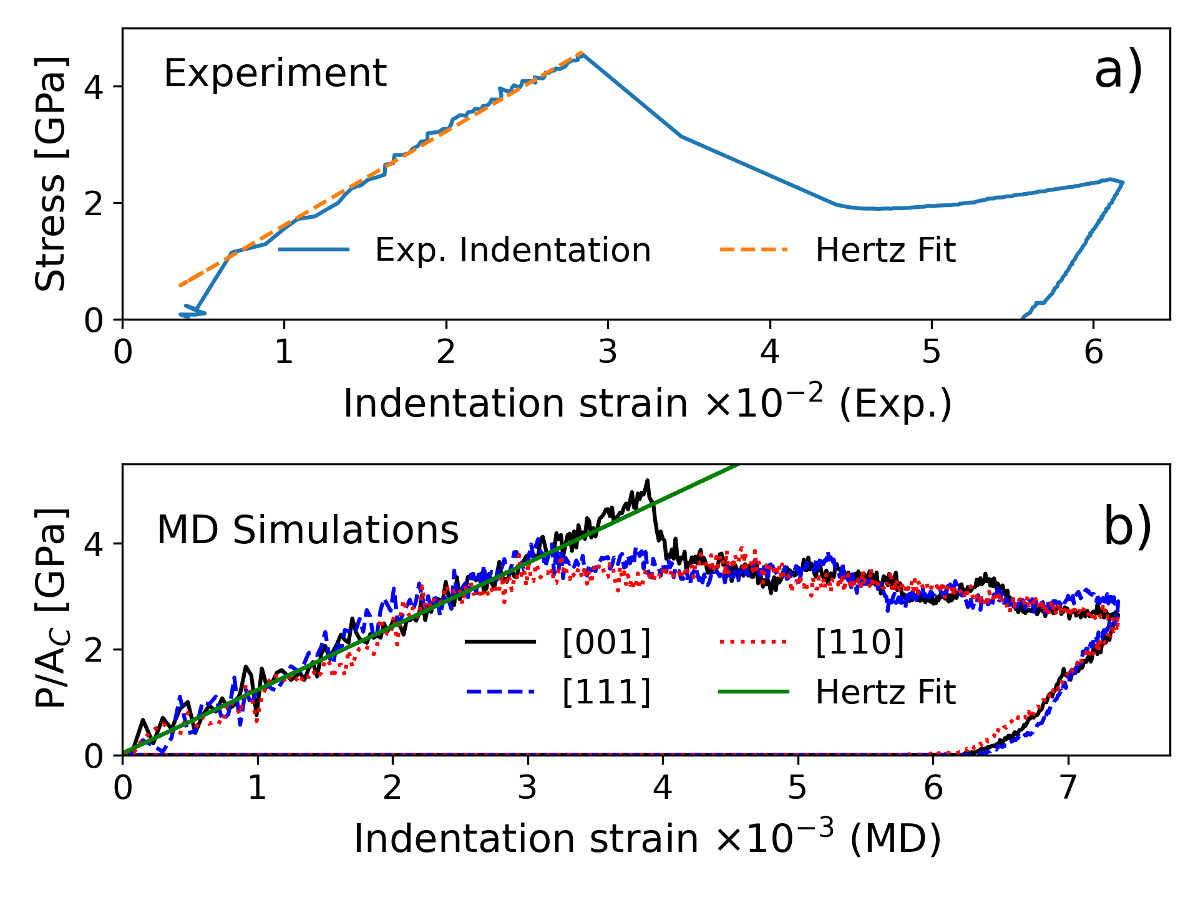
Nanoindentation test: Towards multiscale modeling
Pure Fe
GNDs visualization by EBSD images, and MD, and DDD simulations
K. Mulewska et al. NIM-B 539, 55 (2023) K. Mulewska et al. J. Nuclear Materials 586, 154690 (2023)

Slide 5
Nanoindentation test: Towards multiscale modeling
EMIIDNA
Dr Tymofii Khvan - NCBJ

Slide 6
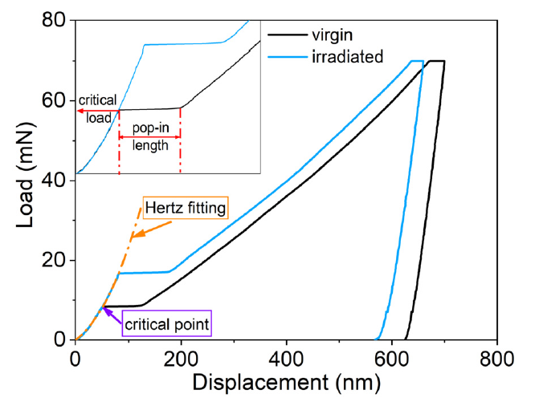
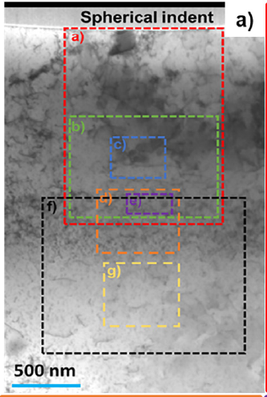
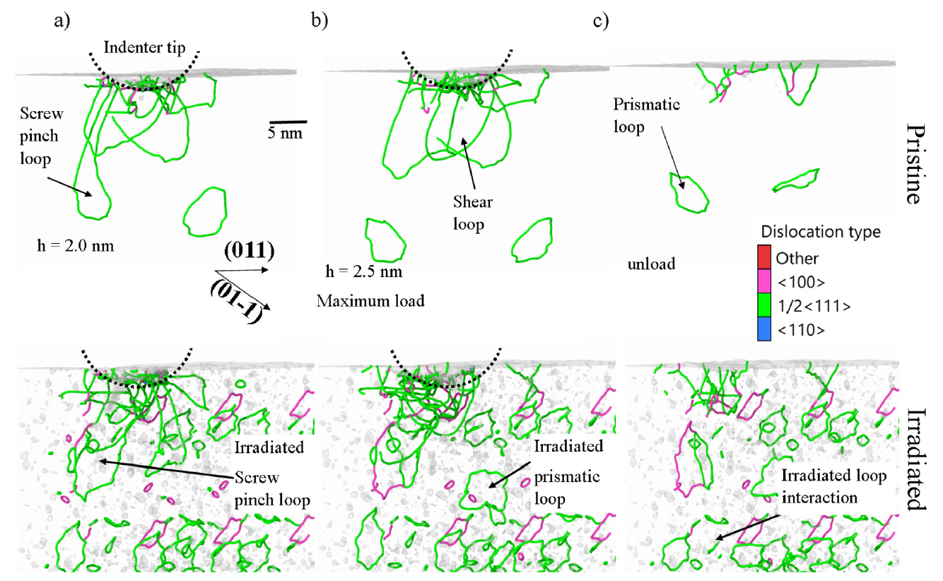
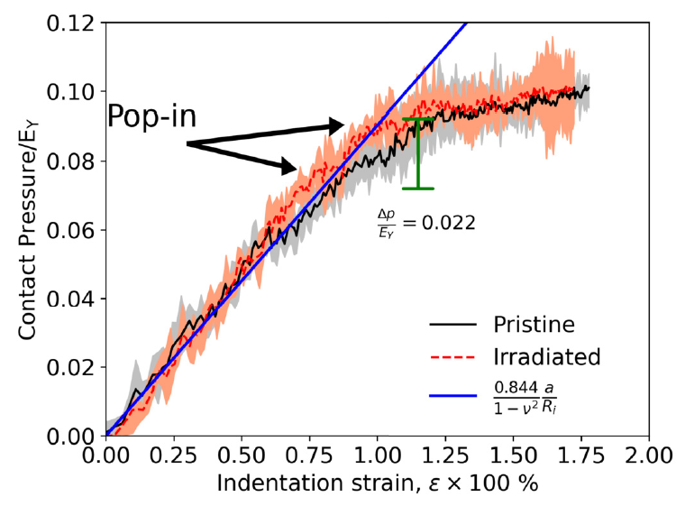
Nanoindentation test of self-irradiated BCC Fe
EMIIDNA
K. Mulewska, F. J. Dominguez-Gutierrez et al. J. Nucl. Materials 586, 154690 (2023)

Slide 7
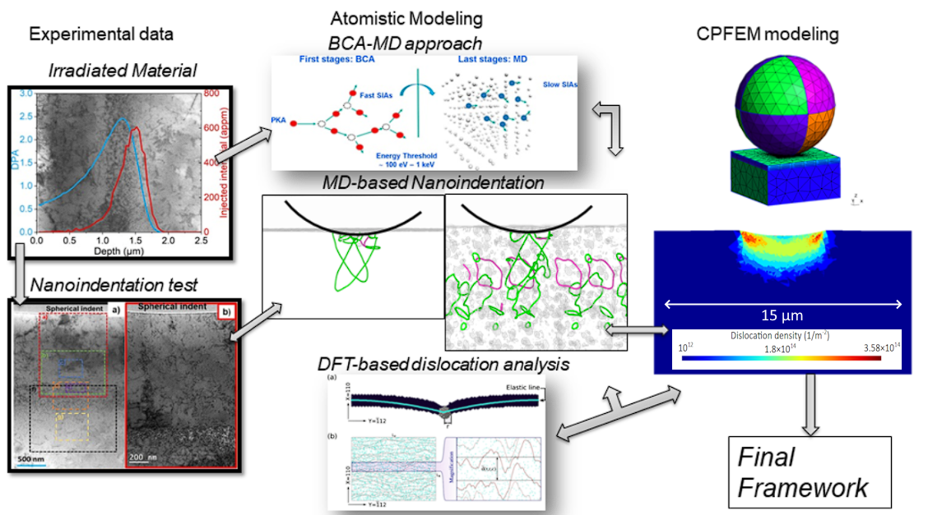
EMIIDNA
Summary:
An experimentally guided multiscale modeling approach is developed to study irradiation-induced defect formation and its impact on FeCr alloys' mechanical behavior under ion implantation. It integrates BCA-MD, MD, CPFEM, and DFT with nanoindentation, SEM/TEM imaging, and ML-based defect characterization.
RL 2: Advanced materials developing and manufacturing
RL 5: Advanced materials modeling and characterisation

Slide 8
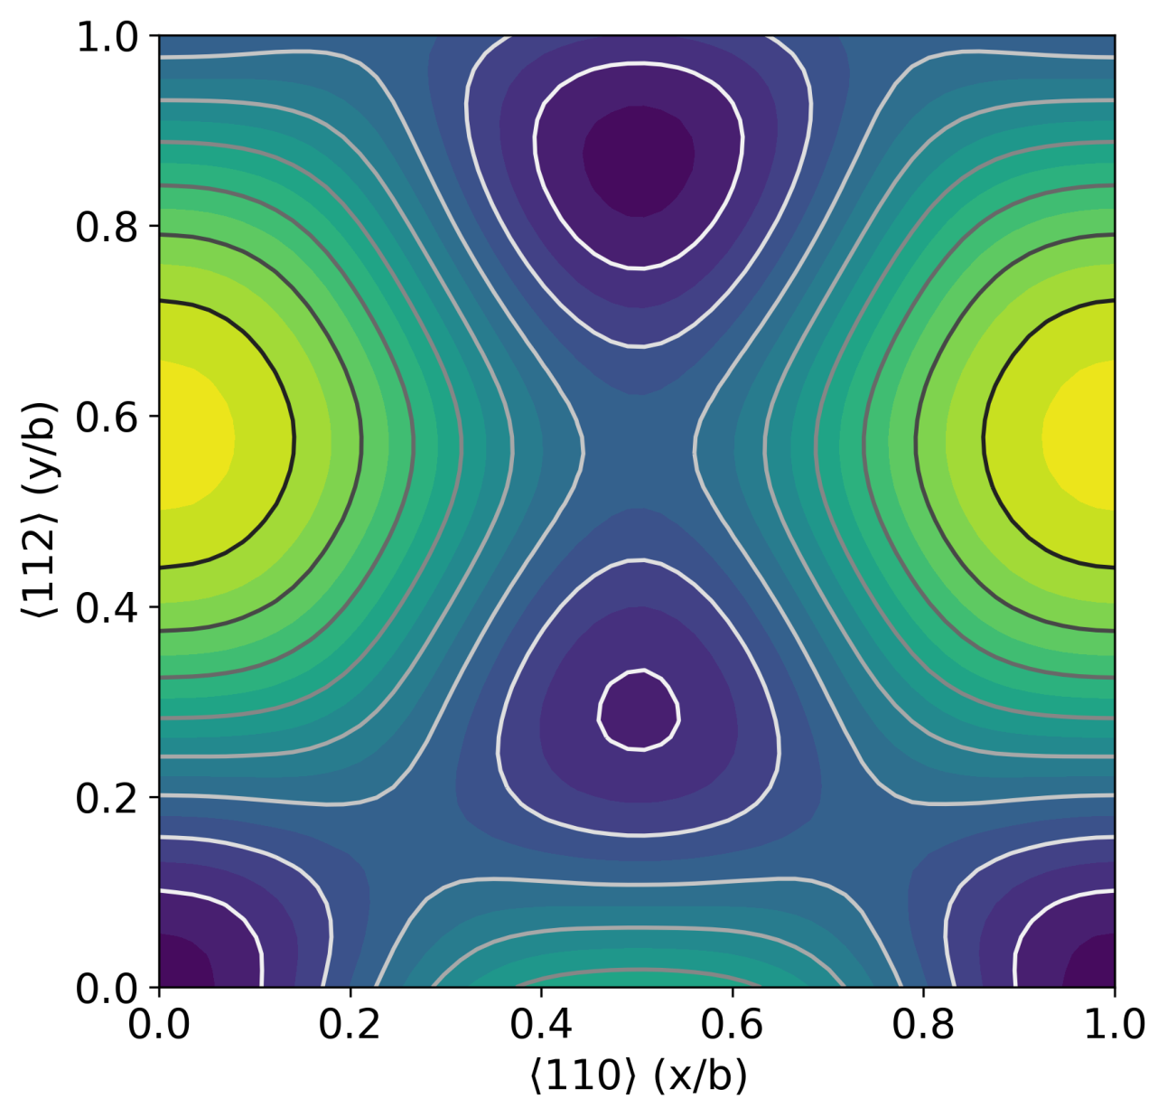
Technical Aspects: What do we need to perform Large scale MD simulation for nanoindentation?
Atomistic modelling, as close as possible to experiments
Interatomic potentials: - Surface information for pile-ups formation - Enough information for Stacking fault energies - Excellent modeling of elastic to plastic deformation transition
HPC facilities - due to the size of the cell with a minimum of 5 Million atoms (contact area) - interatomic potentials are now sophisticated and need long wall time - a minimum of 120 processors to run a MD simulation for EAM potentials
Advanced tools to analyze the MD results - Ovito with DXA sometimes miscount defects in the samples - Need of several frames to track the formation of defects - Quantification of dislocation densities and defects - Extracting images of the indented surface for comparison with SEM images

Slide 9
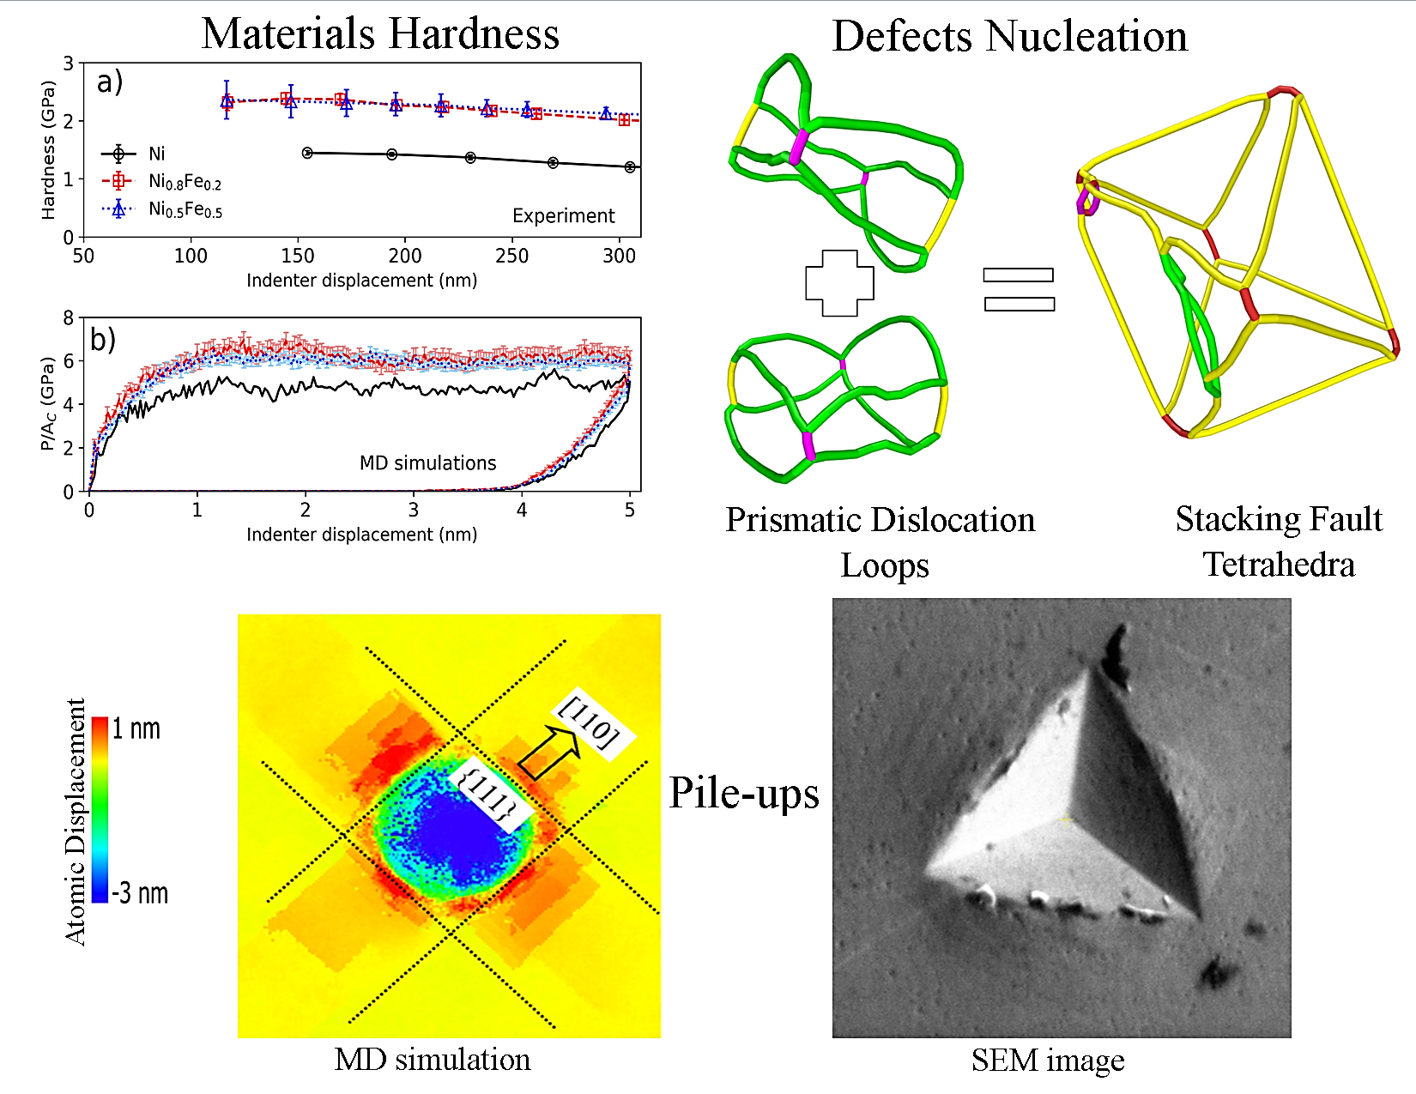
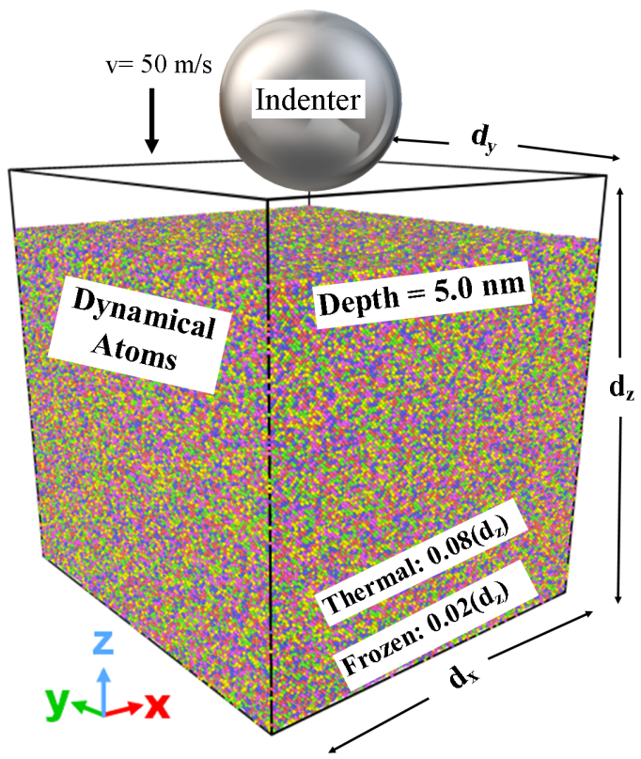
Single phase concentrated solid solution alloys: Ni and NiFe alloys
In collaboration with: NCBJ
L. Kurpaska
K. Mulewska
A. Kosinska (SEM)
R. Alvarez-Donado
I. Jozwik
W. Chrominski
J. Jagielski
In collaboration with US
Y. Zhang
H. Bei
W. J. Weber
Samples:
Pure Ni, Ni₈₀Fe₂₀, and Ni₅₀Fe₅₀
[100] crystal orientation
300 K temperature
The agreement between experiments and modeling reveals that the nucleation of stacking fault tetrahedra (SFT) is a key factor contributing to the hardening of materials.
PDL = Prismatic Dislocation Loop
SFT = Stacking fault Tetrahedron
L. Kurpaska, F. J. Dominguez-Gutierrez, Y. Zhang et al. Materials & Design 217, 110639 (2022).

Slide 10
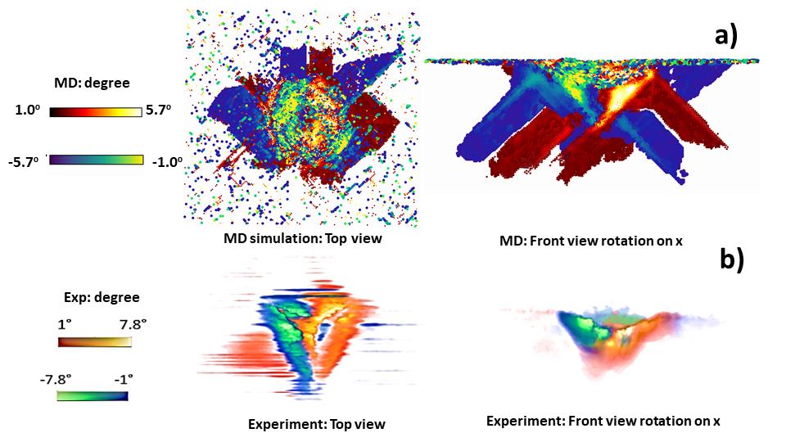
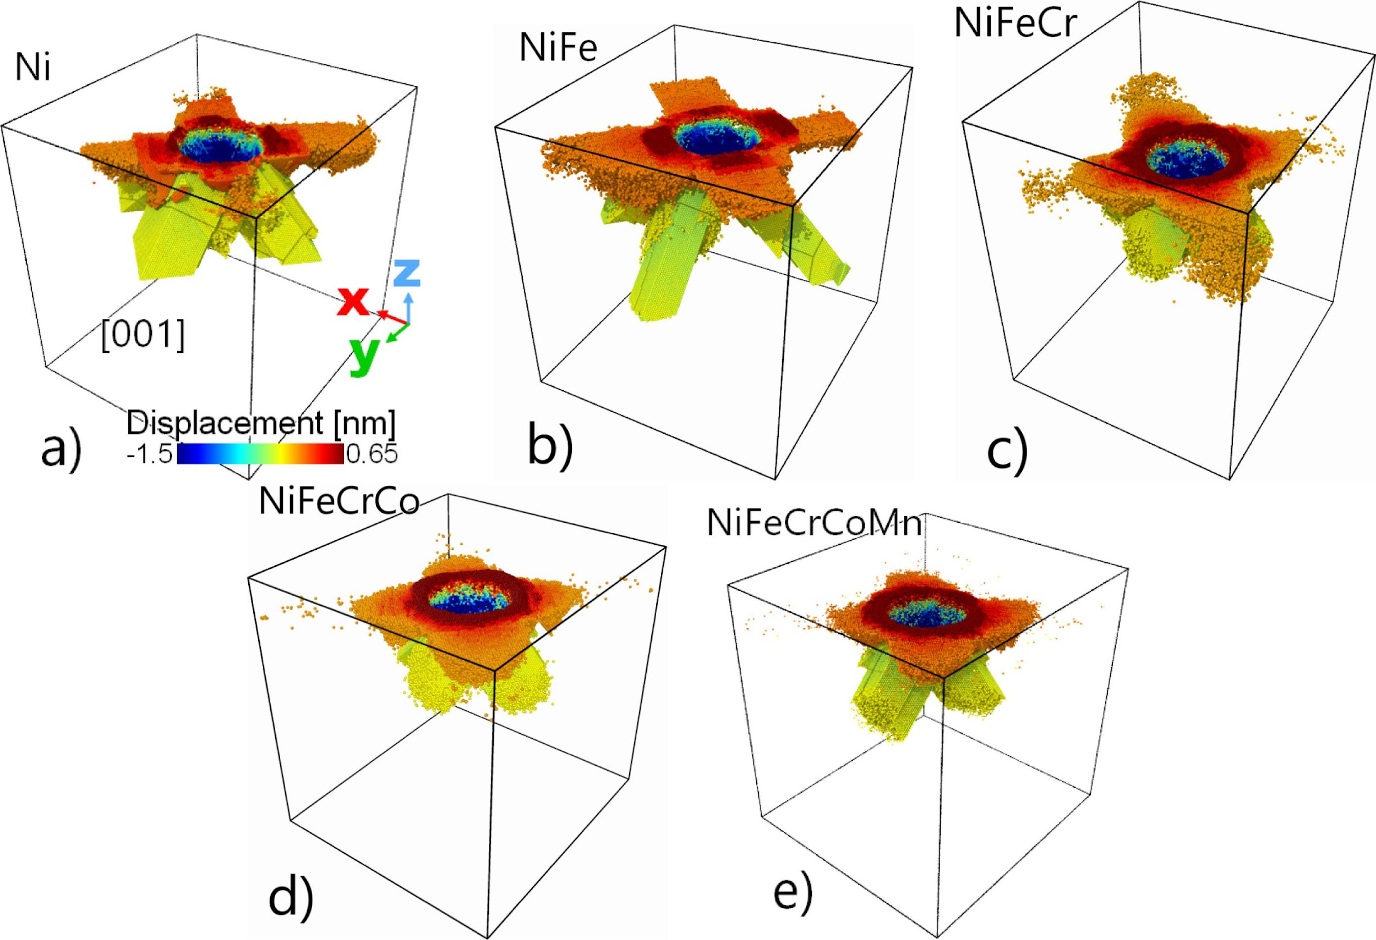
Problem-Solving and Decision-Making: room temperature Nanoindentation
Single phase concentrated solid solution alloys: FCC cantor alloy
3D-EBSD reconstruction of Cantor Alloy for the grain reference orientation deviation (GROD) angles and MD simulations
Formation of pile-ups and slip traces observed in indented samples varies across different alloys, often accompanied by halo formation attributed to their intricate chemical compositions.
M. A. Stróżyk, F. J. Dominguez-Gutierrez et al. under review in Ultramicroscopy (2025)
K. Frydrych, F. J. Dominguez-Gutierrez et al. Mechanics of Materials 181, 104644 (2023).

Slide 11
E. Wyszkowska et al. Under review in Nanoscale (2025) A Aligayev, ML Dos Reis, A Chartier et al.Plasma Physics and Controlled Fusion 67, 055020 (2025).

Slide 12
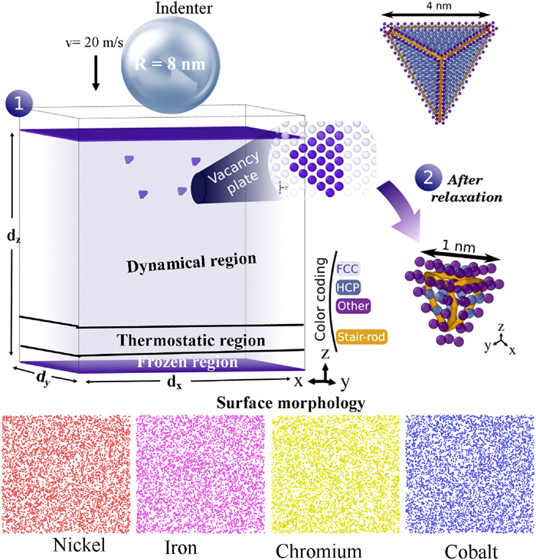
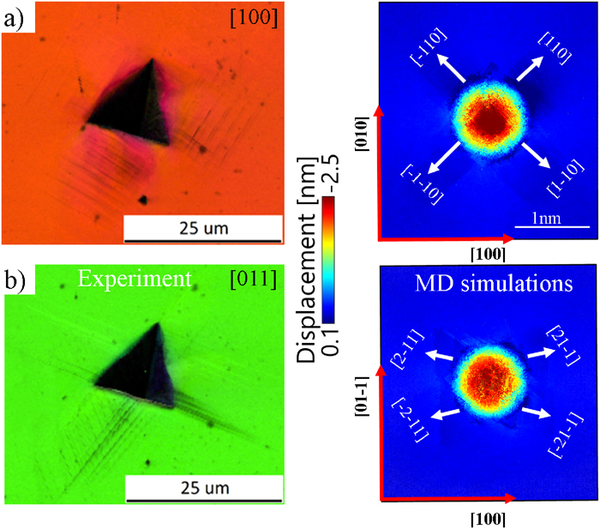
Stacking faults effects on nanomechanical response of NiFeCrCo alloy
F. J. Dominguez-Gutierrez et al. J. Appl. Phys. 135, 185101 (2024)
A.Naghdi, F. J. Dominguez-Gutierrez et al. Phys. Rev. Lett 132, 116101 (2024).

Slide 13
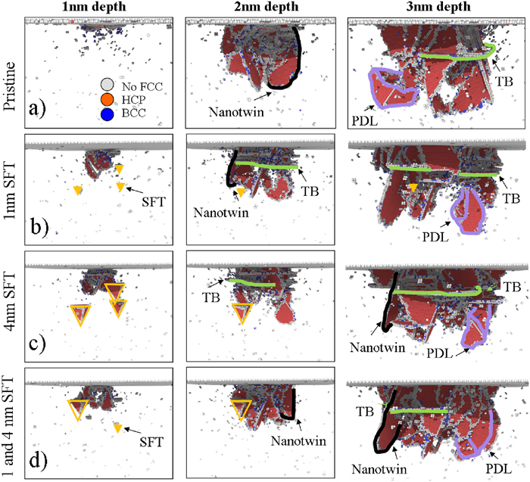
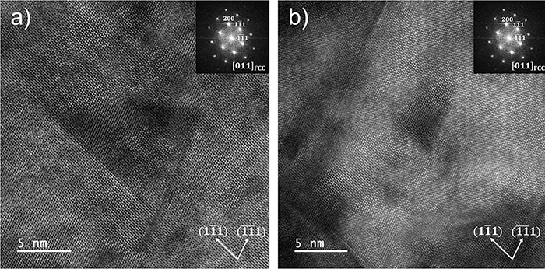
Stacking faults effects on nanomechanical response of NiFeCrCo alloy
F. J. Dominguez-Gutierrez et al. J. Appl. Phys. 135, 185101 (2024)
A. Ustrzycka, F.J. Dominguez-Gutierrez et al. Int. J. of Plasticity 182, 104118 (2024)

Slide 14
Concluding Remarks
Nanomechanical tests can be modeled by several interatomic potentials, but dislocation dynamics depends on the approach used showing the need of MD simulations to be as close as possible to experiments.
Increasing the number of elements in the FCC Ni-based alloy slows down the evolution of dislocations
Team work makes the dream work!
Collaborations: javier.dominguez@ncbj.gov.pl
55 million atoms for WTa alloy with tailored MLIP, rT nanoindentation. (4-J team) J. Očenášek, J. Byggmastar, J. Alcala, J. Dominguez. Submitted to Acta Materialia (2025)

