Slide 1
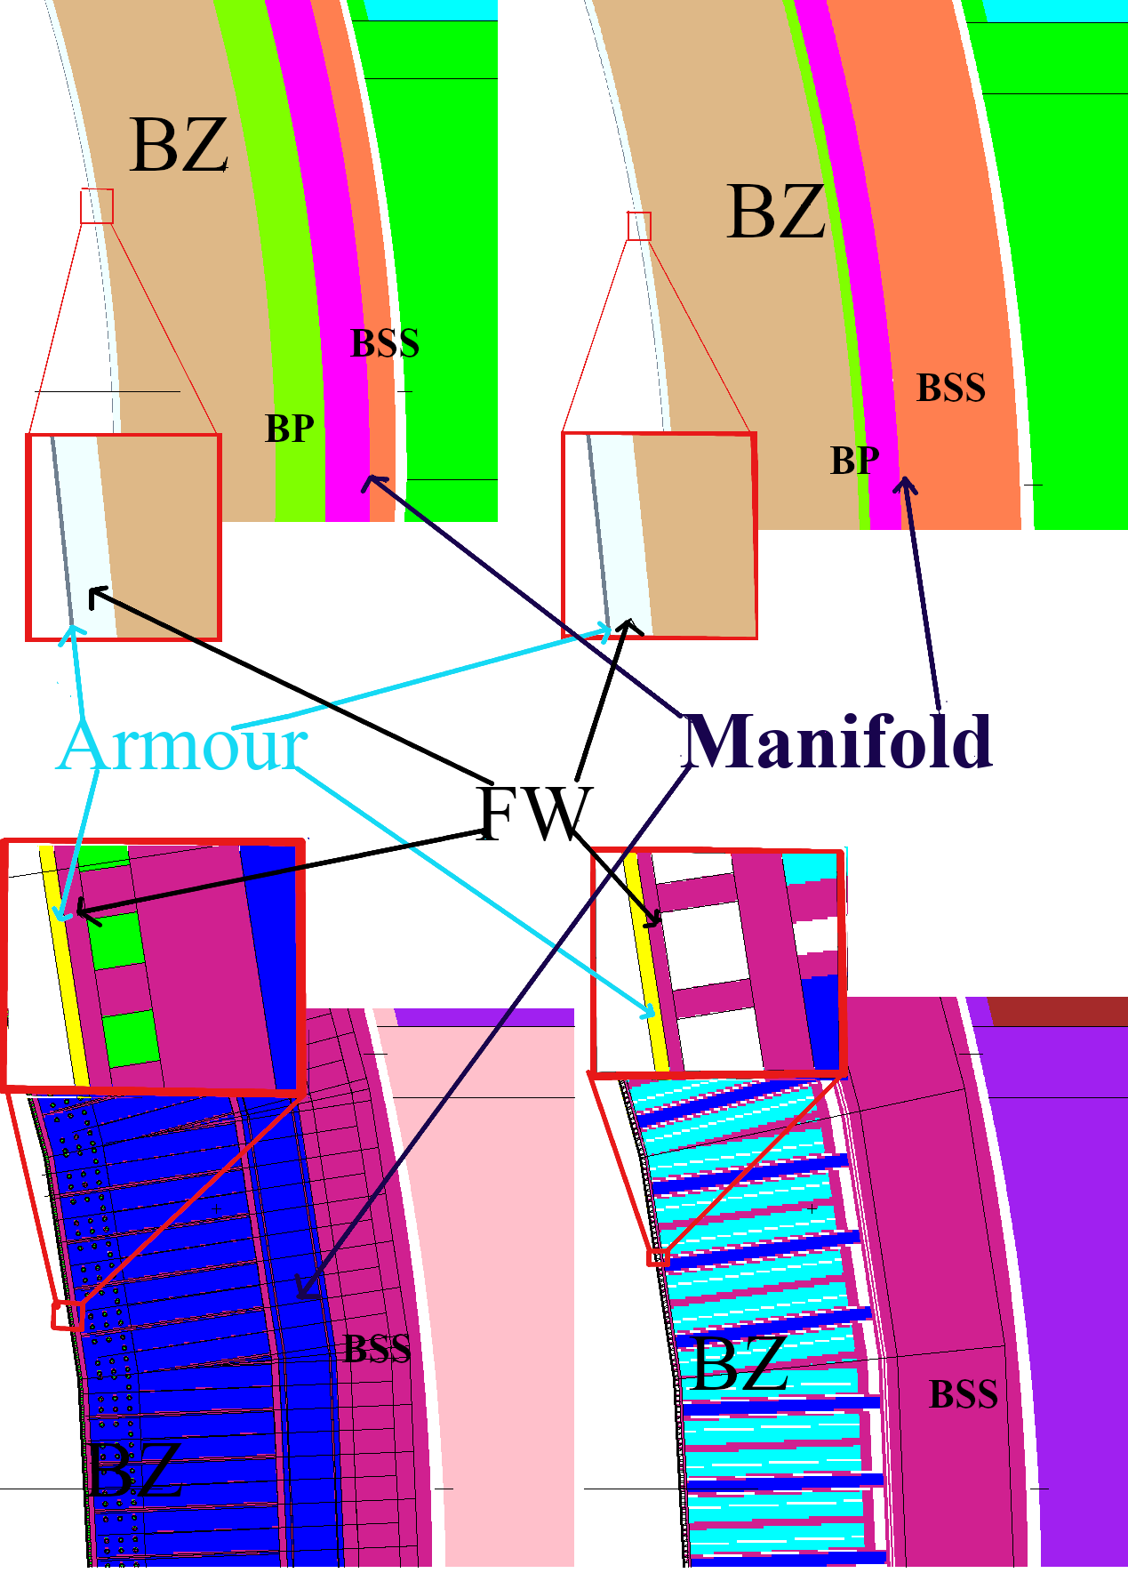
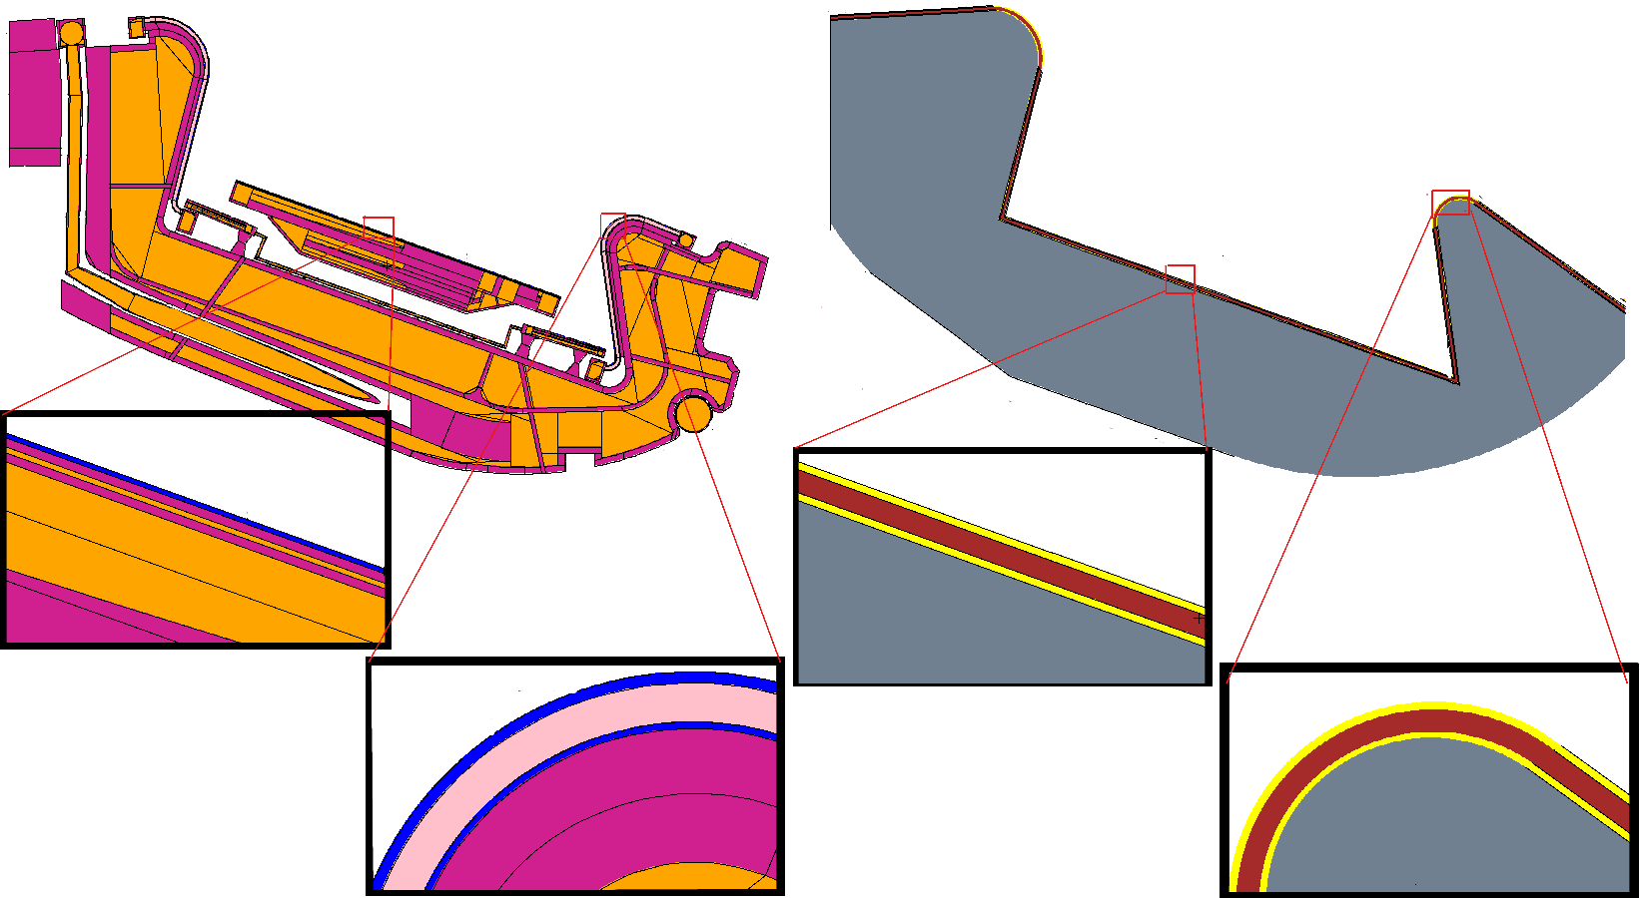
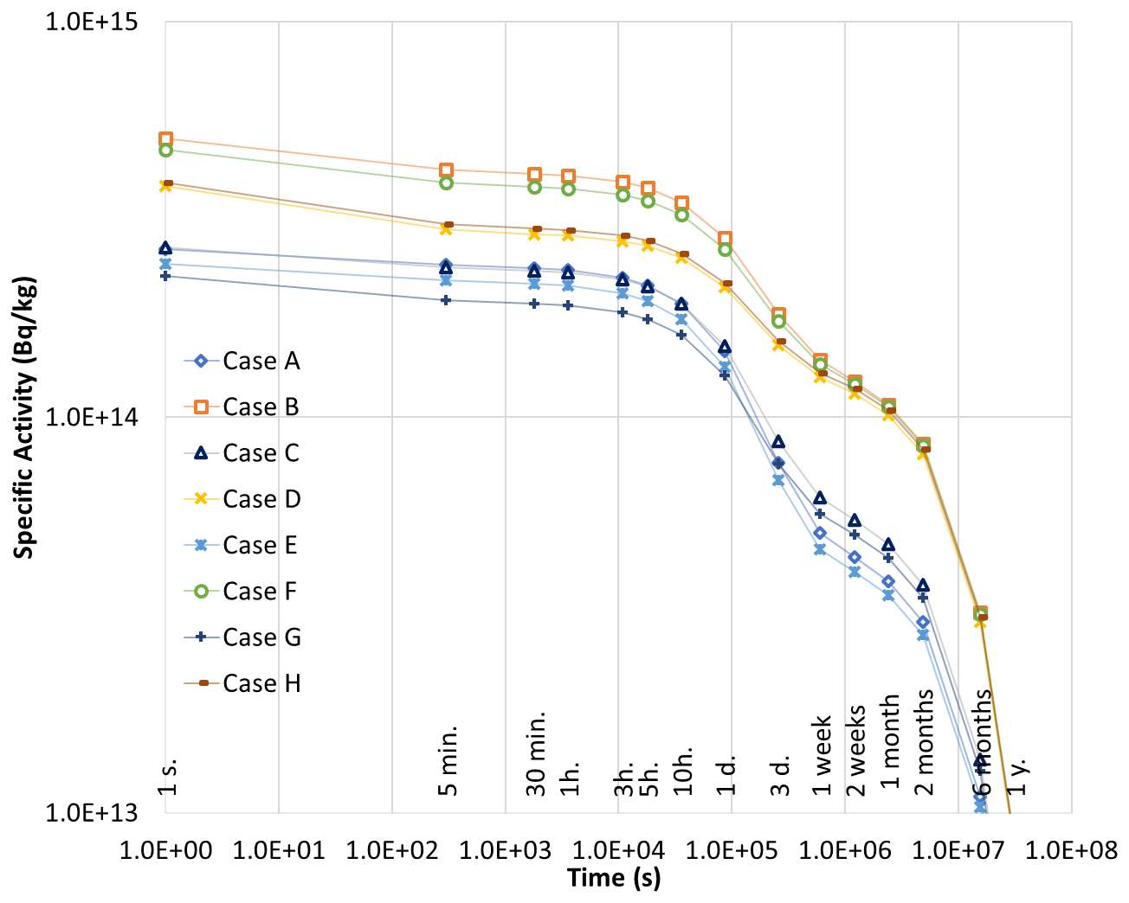
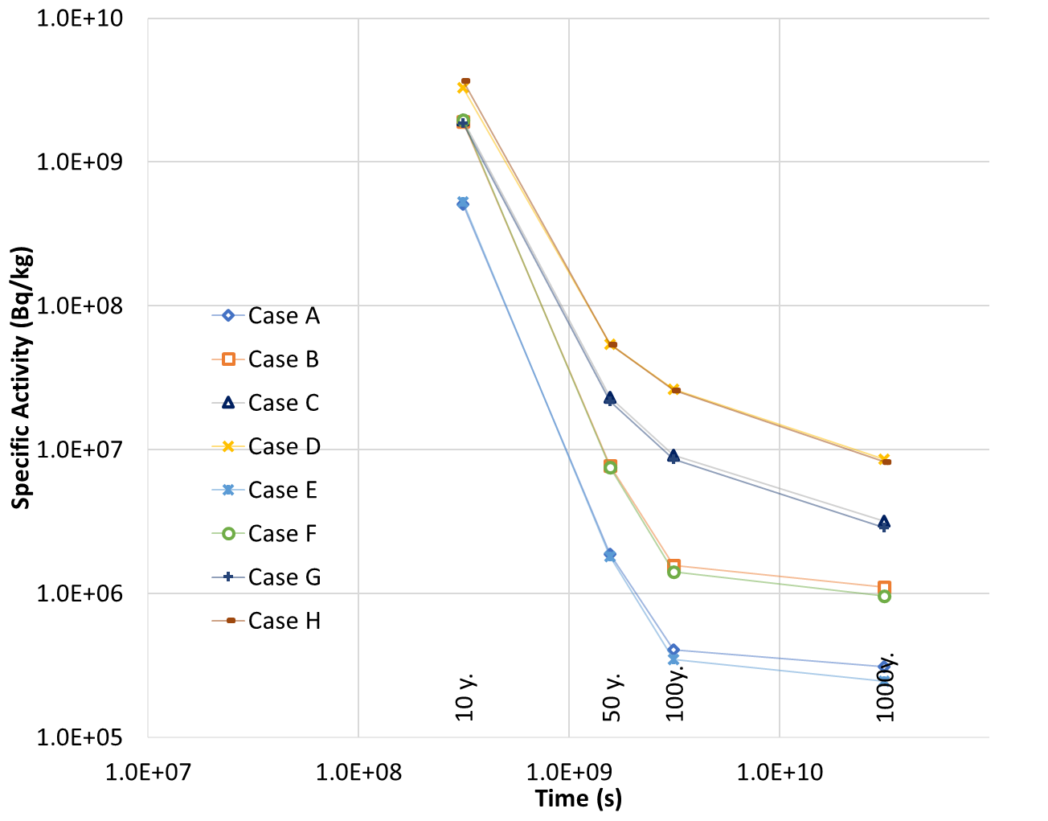
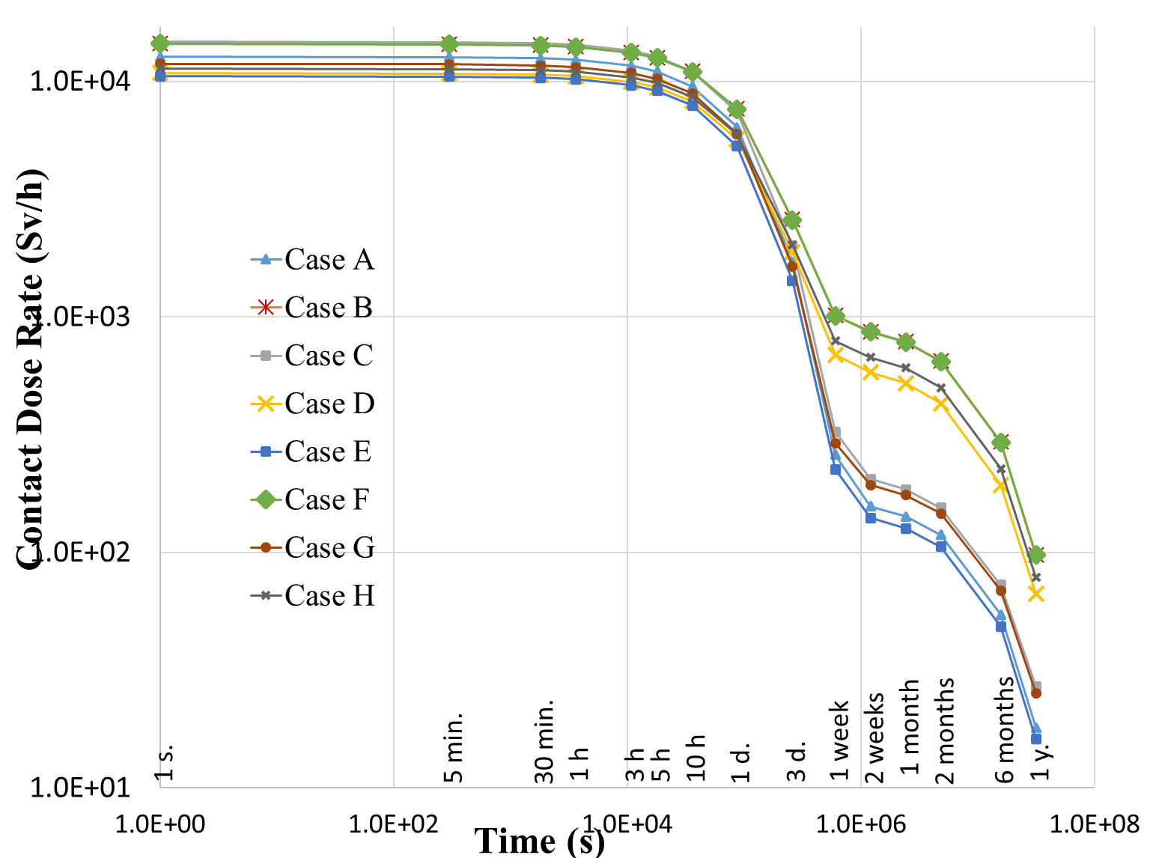
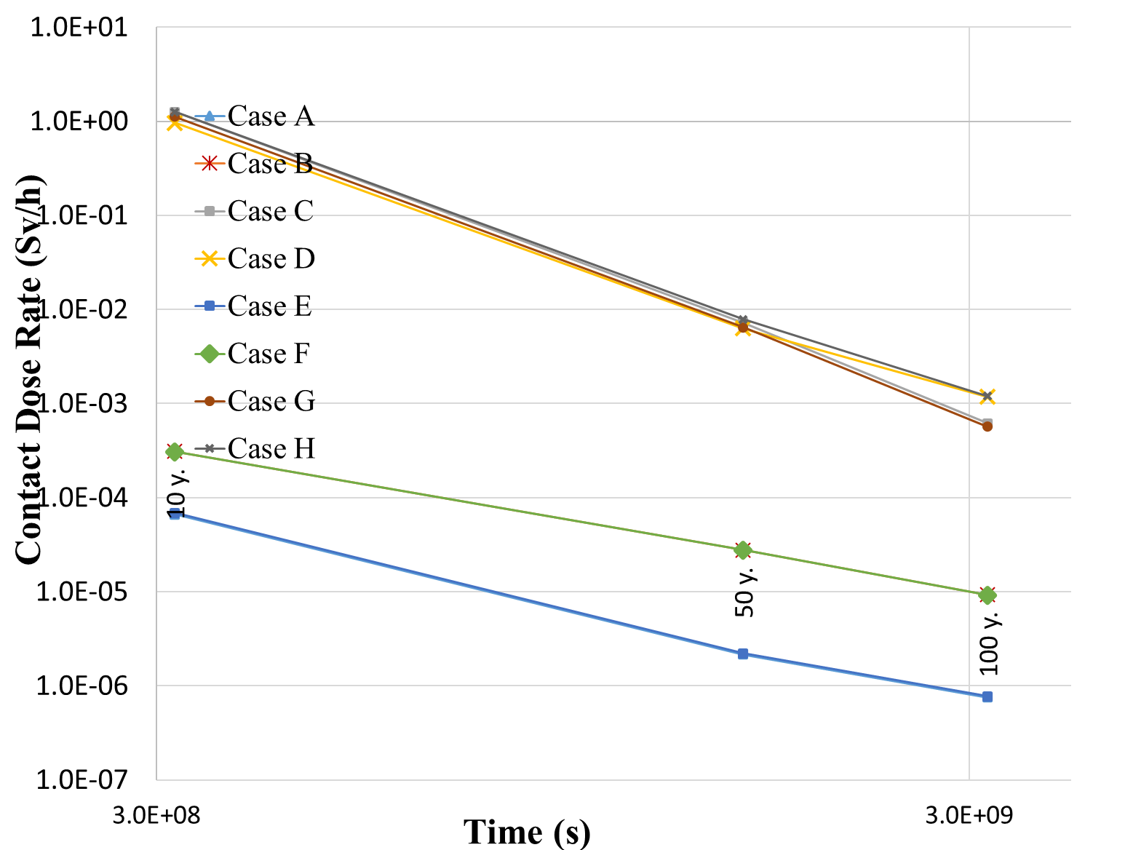
Neutron Activation Analysis of Tungsten in Divertor and Breeding Blanket Armor for EU DEMO
Simona Breidokaitė
Gediminas Stankūnas
Lithuanian Energy Institute, Laboratory Of Nuclear Installation Safety
simona.breidokaite@lei.lt
ID: 7
METHODOLOGY
WCLL
Pure Tungsten
Divertor – Case A (1730kg)
Breeding blanket – Case B (1752kg)
Tungsten alloy
Divertor - Case C (550kg)
Breeding blanket – Case D (1745kg)
HCPB
Pure Tungsten
Divertor – Case E (1730kg)
Breeding blanket – Case F(1752kg)
Tungsten alloy
Divertor – Case G (550kg)
Breeding blanket– Case H (1745kg)
Calculated neutron fluxes, based on the 1998 MW fusion plasma source, were normalized with 7.094×10²⁰ n s⁻¹.
After 10⁹ particle histories, the average statistical error for all calculations is lower than 10% in the divertor.
Specific activity and contact dose rates were estimated using FISPACT-II with the TENDL-2017 nuclear data library.
Specific activities and contact dose rates were averaged by mass contribution;
Dose rate calculations were performed using the MCNP6 code with FENDL 3.2 nuclear data library, while conversion factors were taken from ICRP-74
Figure 1. MCNP model of semi - heterogeneous (left) and homogenized (right) divertor model.
Figure 2 MCNP model of heterogenized and heterogenized WCLL (left) and HCPB (right) breeding blanket models.
ACKNOWLEDGEMENTS
RESULTS
Table 1. Dominance radionuclides:
Table 2. Average, minimum and maximum dose rates in all cases (µSv/h)
 | Activity
 | 1s. | 1y. | 10y. | 50y | 100y.
Pure | ¹⁸⁷W | ¹⁸¹W/¹⁸⁵W | ¹⁷⁹Ta | ³H | ¹⁸⁶Re/^{186m}Re
Alloy | ¹⁸⁷W | ¹⁸¹W/¹⁸⁵W | ¹⁷⁹Ta/⁶⁰Co | ^{93m}Nb/⁶⁰Co | ⁹¹Nb
 | Contact dose rate
Pure | ¹⁸⁷W | ¹⁸²Ta | ¹⁷⁹Ta | ^{178n}Hf | ^{178n}Hf
Alloy | ¹⁸⁷W | ¹⁸²Ta | ⁶⁰Co | ⁶⁰Co | ^{108m}Ag
 | Case A | Case B | Case C | Case D | Case E | Case F | Case G | Case H
average | 2.59E+18 | 8.48E+17 | 3.88E+17 | 3.18E+18 | 2.24E+18 | 3.24E+17 | 3.06E+17 | 2.37E+18
max | 3.60E+18 | 2.17E+18 | 9.56E+17 | 6.34E+18 | 3.08E+18 | 6.78E+17 | 7.53E+17 | 4.79E+18
min | 2.61E+18 | 9.72E+16 | 2.10E+15 | 1.85E+17 | 1.13E+18 | 7.91E+16 | 1.77E+15 | 1.30E+17
Figure 3. The averaged specific activity in all evaluated cases
Averaged MCNP dose calculations showed that when tungsten alloy is used for the divertor cells, WCLL results are higher by approximately 1.25 times than HCPB and 1.34 times when used for BB armour. When pure tungsten is used, WCLL model values are higher 1.16 and 2.16 times.
In the comparison of the same component but different material, Pure tungsten values are higher almost 7 times in divertor cells and 3 times lower in breeding blanket armour cells.
Figure 4. The average contact dose rate in all evaluated cases
Material Effect: Pure vs. Alloy
WCLL Divertor:
1 Day Post-Shutdown: ~3% difference
Later Trend: Increases from 13% to 90%
HCPB Divertor:
Initial difference: 9%, rising to ~100%
Exceptions at 1 & 3 days: 7%
Breeding Blanket Armor Analysis
Post-shutdown difference:
HCPB: ~31%
WCLL: ~43%
After 2 Weeks:
HCPB: ↓ to 5%
WCLL: ↓ to 10%
Later Activity due to alloy impurities: ➤ The difference rises again to up 100%
BB Model Effect: HCPB vs. WCLL
Divertor (Pure):
After shutdown: 8%
1–100 years: ↓ to 4% ↑ to 20%
Divertor (Alloy):
After shutdown: 16%
1–1000 years: ↓ to 6%, ↑ to 11%
Armor Components (Pure):
Immediate: 7%
1 week–1 year: ↓ from 3% to 0.02%
End of period: ↑ to 12%
Armor Components (Alloy):
Average: 3%
Peak at 10 years: 12%
Material Effect: Pure vs. Alloy
Divertor Cells:
Up to 1 Week Post-Shutdown: ➤ Alloy shows ~15% higher contact dose rate
Later Period: ➤ Alloy shows ~27% higher and ↑ to 200%
Breeding Blanket Armors
Initially: ➤ Pure tungsten shows ~25% higher dose rate
Later Period: ➤ Increase reaches ~27%
Due to Impurities in Alloy Composition: ➤ Contact dose rate difference increase up to 200%
BB Model Effect: HCPB vs. WCLL
Divertor (Pure Tungsten):
After shutdown: 18%
10 years: ↓ to 4%,
Divertor (Tungsten Alloy):
After shutdown: 21%
1 month: ↓ to 6%,
10 years: ↑ to 11%,
Armor Components (Pure):
Average: 0.3%
Armor Components (Alloy):
Immediate: 5%
1 week–10 year: ↑ from 13% to 26%
End of period: ↑ to 2%

