Slide 1
Novel methods to derive nuclear reactors antineutrino spectra
Andrea Mattera¹, Elizabeth McCutchan¹, Alejandro Sonzogni²
1: National Nuclear Data Center
2: Nuclear Science & Technology Department, sonzogni@bnl.gov

Slide 2
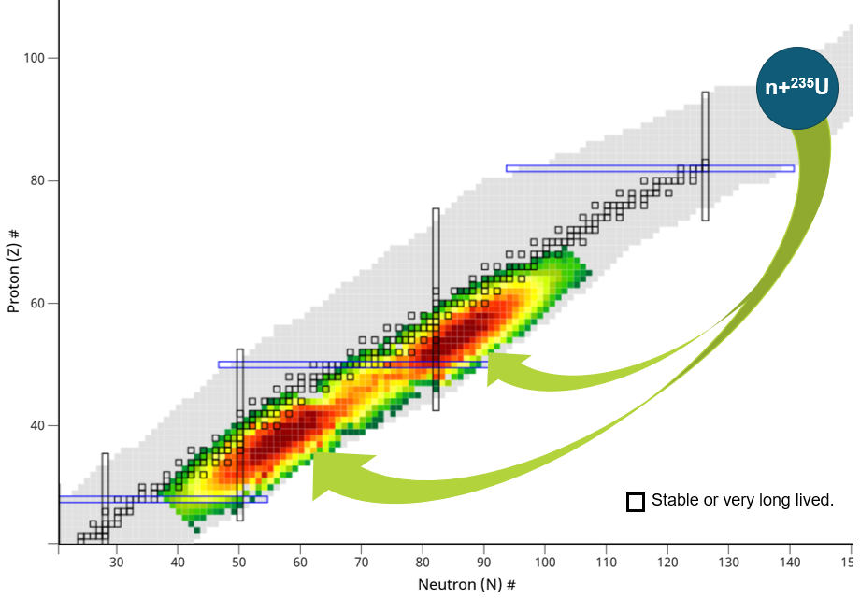
How are antineutrinos produced in a nuclear reactor?
Electron antineutrinos are produced by neutron rich fission products during beta-minus decay.
The fission products population follows a set of linearly coupled differential equations:
dN_{k}/dt = F x I_{k} – λ_{k} N_{k} + Σ λ_{j} P_{jk} N_{j}
F: fission rate,
I: probability of produced directly by fission,
λ: decay constant,
P: decay probability j to k
If steady state, dN_{k}/dt = 0, then N_{k} / F= C_{k} / λ_{k}
C: cumulative yield,
Then:
S(E) = Σ C_{k} S_{k}(E)
Summation method:
Calculate S_{k}(E) using decay databases and use C_{k} from fission databases.
Conversion method:
Measure electron spectrum and fit as many ‘average’ branches as you can.
6 electron antineutrinos are produced per fission = 200 MeV = 3.2x10⁻¹¹ J.
1 GW_{th} reactor = 3.1x10¹⁹ fissions/second = 1.8x10²⁰ antineutrinos/second

Slide 3
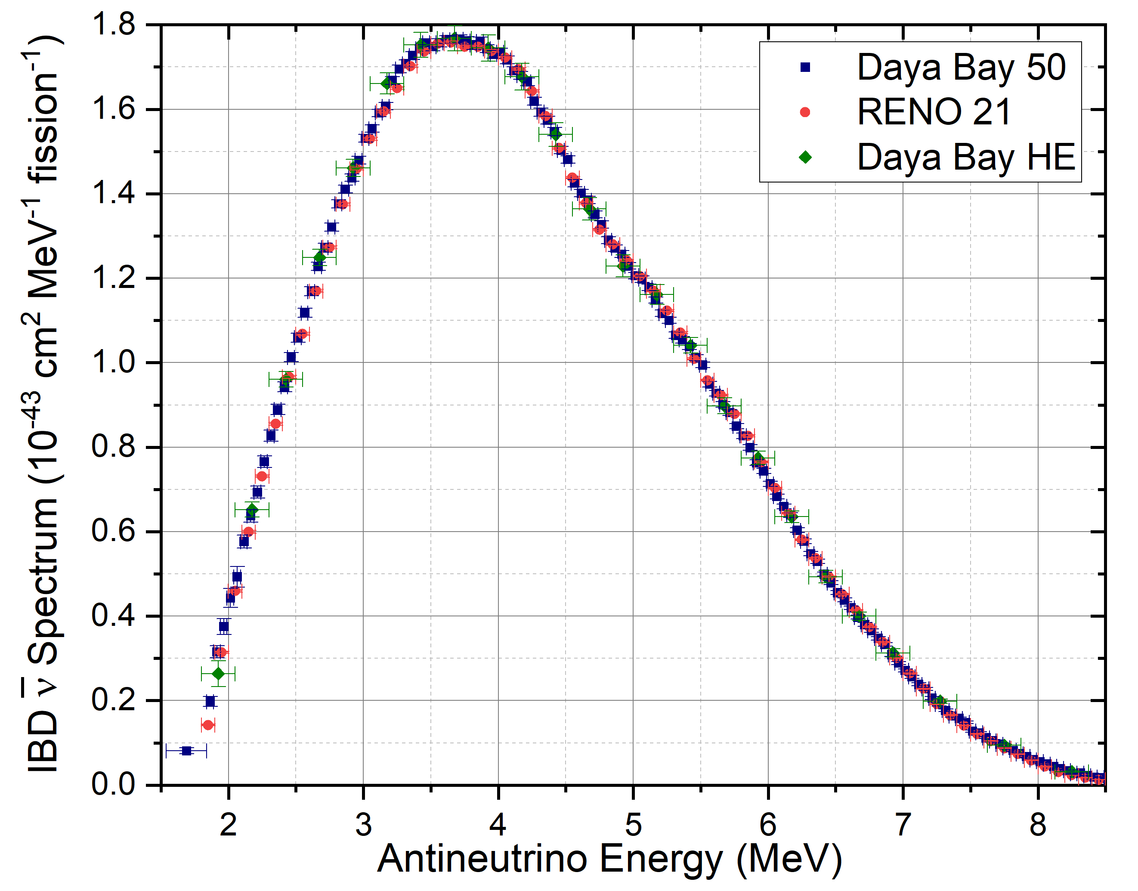
Three fantastic near detectors IBD spectra
Daya Bay 50
Chin. Phys. C 45, 073001 (2021)
RENO 21
PRD 104, L111301 (2021)
Daya Bay HE
PRL 129, 041801 (2022)
Using these spectra, we developed an inverse problem method; that is, assuming negligible effects from:
(i) hypothetical sterile neutrinos,
(ii) antineutrino energy calibrations,
(iii) allowed shape assumptions,
obtained reference ^{235,238}U and ^{239,241}Pu electron and antineutrino spectra.

Slide 4
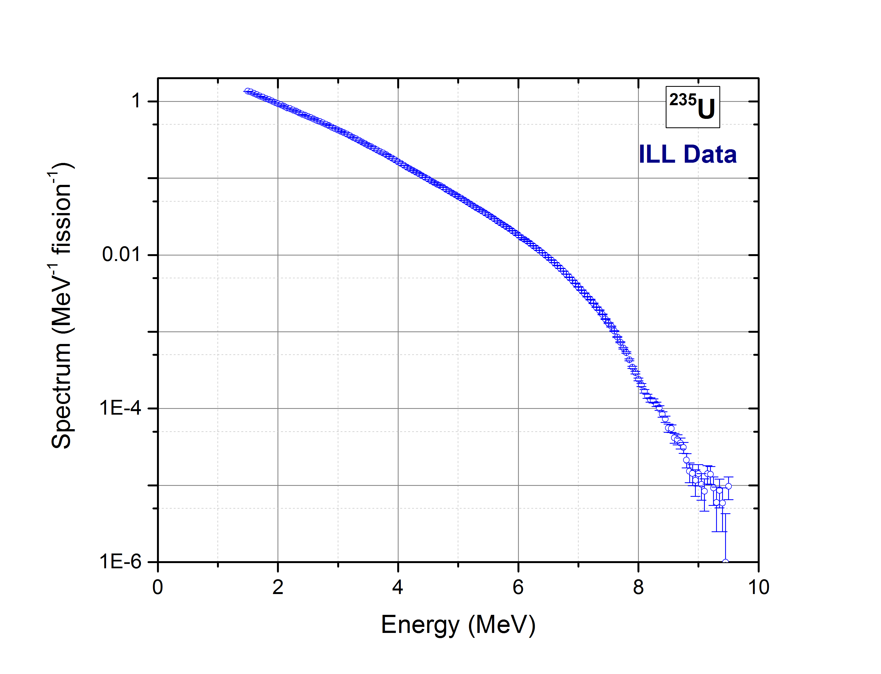
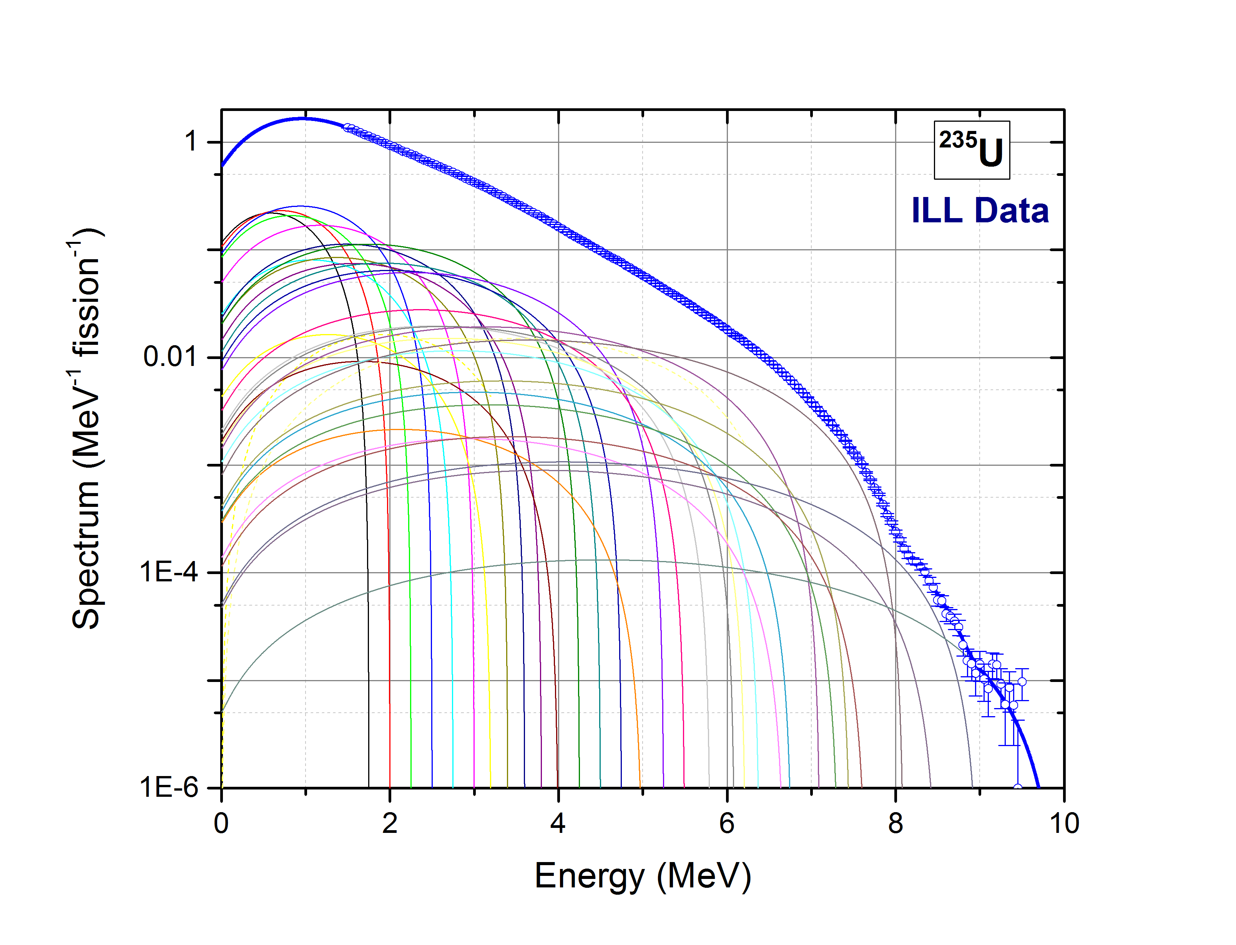
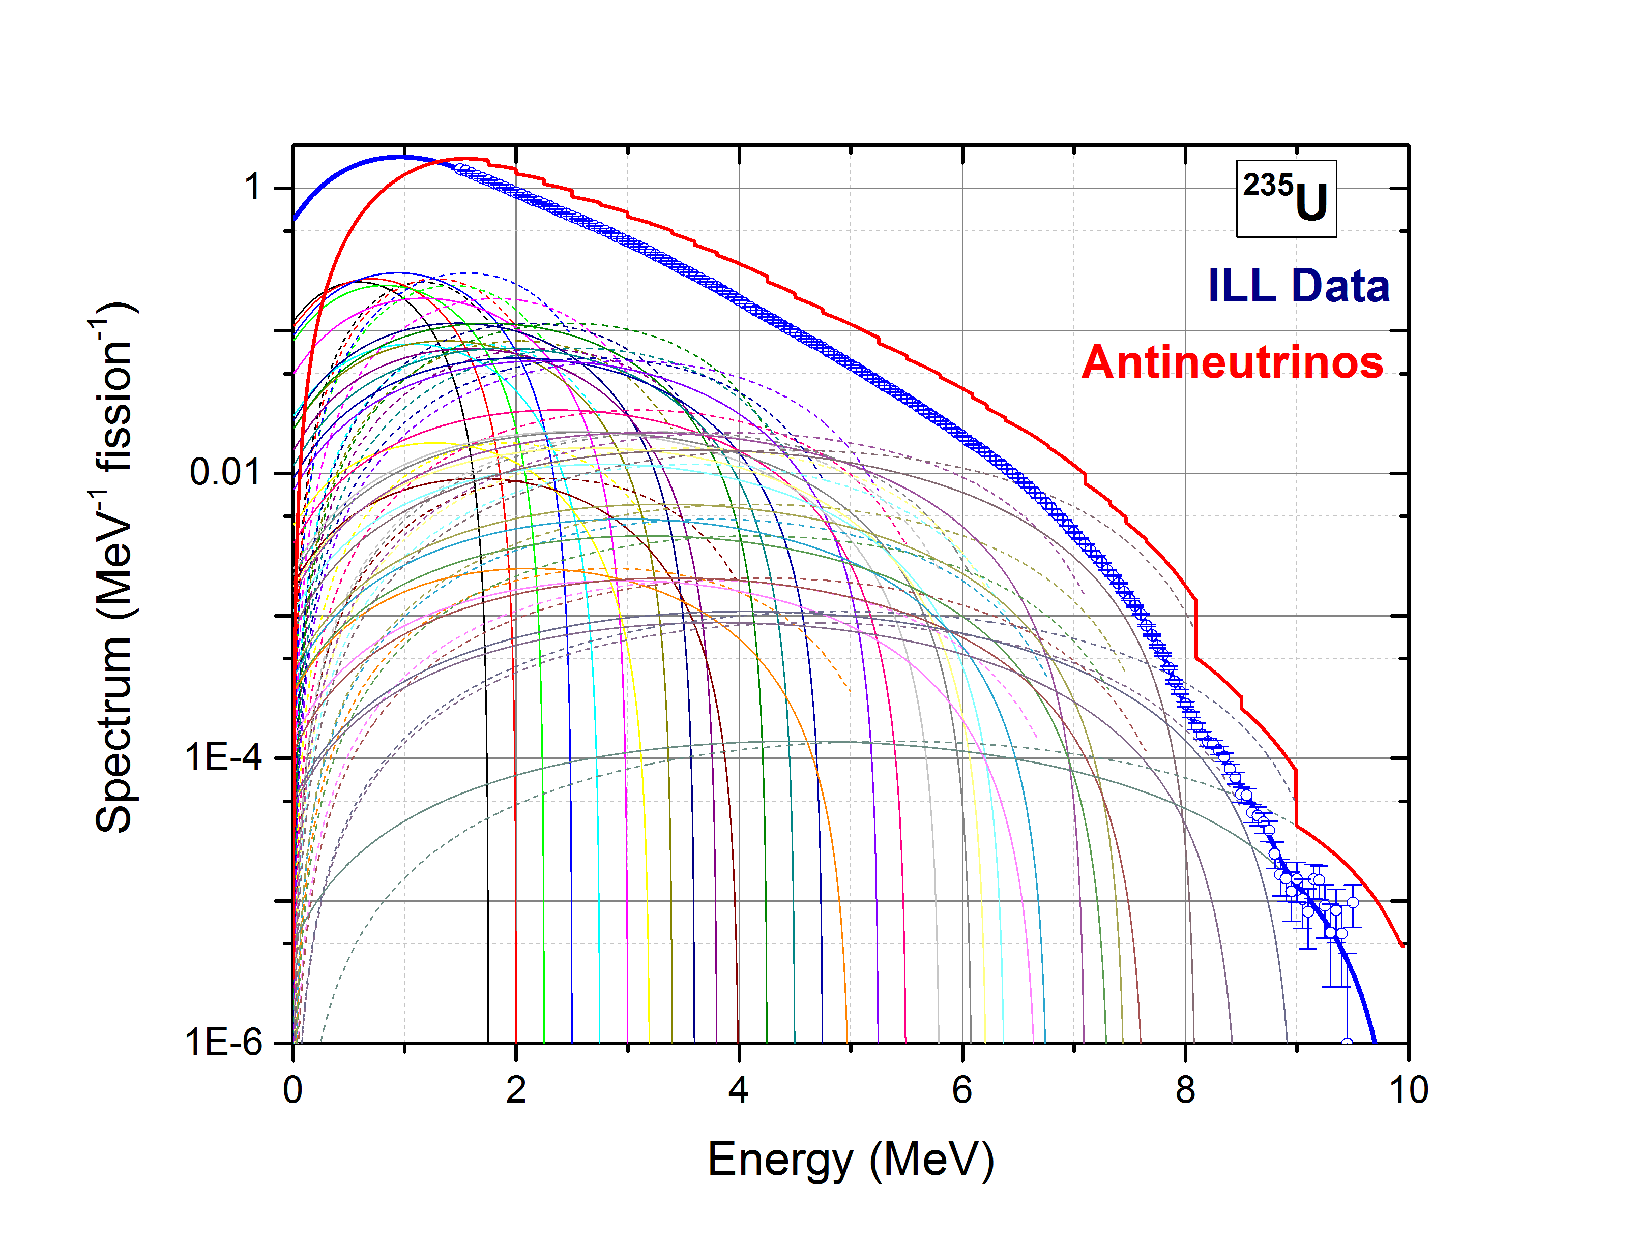
Conversion Method
Electron Spectrum measured at ILL, K. Schreckenbach et al., Phys. Lett. 160B, 325 (1985).
Best current estimates:
²³⁵U and ^{239,241}Pu antineutrino spectra, from P. Huber, conversion fit to ILL electron data.
PRC 84, 024617 (2011).
²³⁸U antineutrino spectra from summation calculation,
Th. Mueller et al.,
PRC 83, 054615 (2011).

Slide 5
Understanding the origin of the anomaly

Slide 6
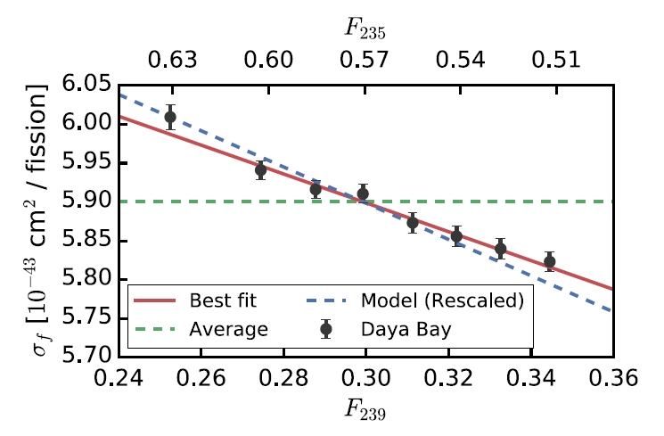
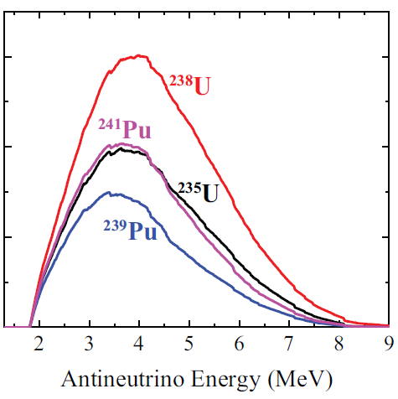
Evolution of the Reactor Antineutrino Flux and Spectrum at Daya Bay
F.P. An et al., PRL 118, 251801 (2017)
σ = F₂₃₅ x σ₂₃₅ + F₂₃₉ x σ₂₃₉ + F₂₃₈ x σ₂₃₈ + F₂₄₁ x σ₂₄₁
Nucleus | Daya Bay IBD Yield (10⁻⁴³ cm² fission⁻¹) | Huber IBD Yield (10⁻⁴³ cm² fission⁻¹)
²³⁵U | 6.17 +- 0.17 | 6.69 +- 0.15
²³⁹Pu | 4.27 +- 0.26 | 4.36 +- 0.11

Slide 7
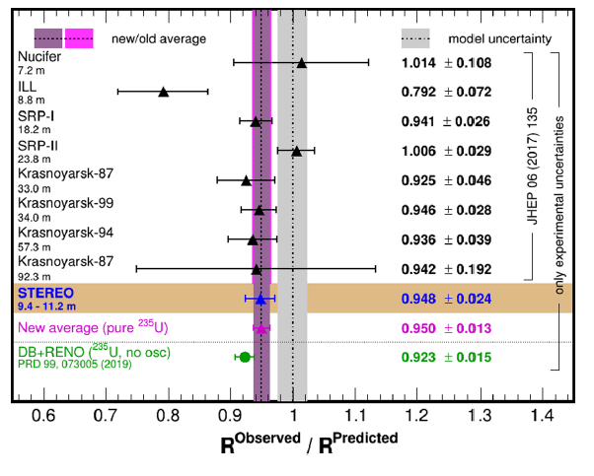
Confirmation from STEREO
Accurate Measurement of the Electron Antineutrino Yield of ²³⁵U Fissions from the STEREO Experiment with 119 Days of Reactor-On Data
H. Almazán et al., PRL 125, 201801 (2020)
ILL reactor, 93.5% ²³⁵U enrichment.
F₂₃₅=99.3%
Detector at 9.4 m from the core
Confirms Daya Bay and RENO results

Slide 8
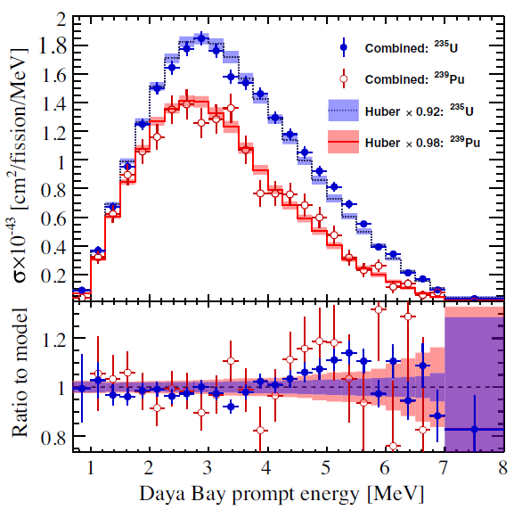
Joint Determination of Reactor Antineutrino Spectra from ²³⁵U and ²³⁹Pu Fission by Daya Bay and PROSPECT
F.P. An et al., PRL 128, 081801 (2022)
PROSPECT, short baseline experiment at ORNL with a Highly-Enriched Uranium reactor (HFIR)
Using fuel evolution, spectrum as function of F₂₃₉, as well as the PROSPECT ²³⁵U spectrum, the individual ²³⁵U and ²³⁹Pu IBD spectra were deduced.
The ²³⁹Pu IBD spectrum agrees fairly well with Huber’s (-2%).
The ²³⁵U IBD spectrum multiplied by a factor of 0.92 shows good agreement with Huber’s.

Slide 9
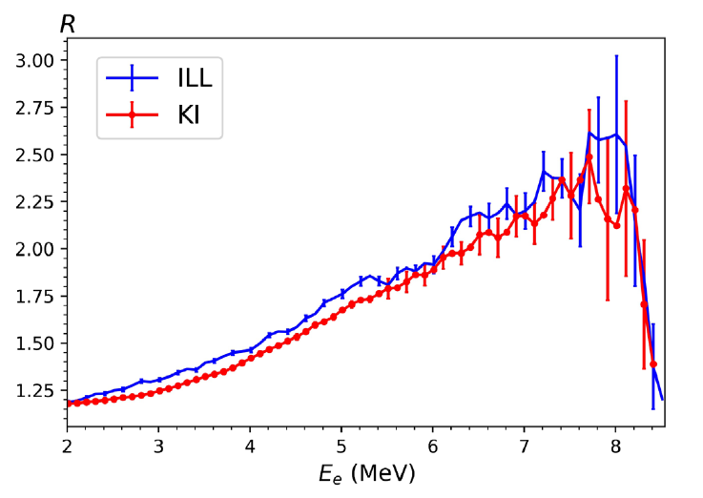
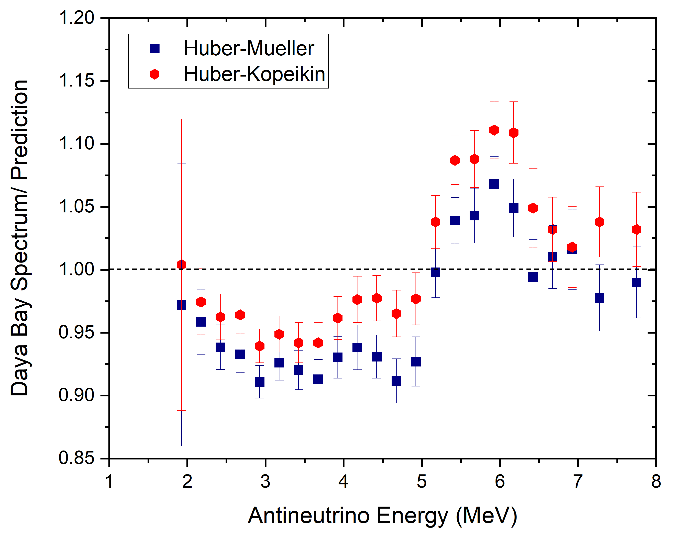
Kopeikin et al., 2021
Phys. Rev. D 104, L071301 (2021).
Measurement of ²³⁵U / ²³⁹Pu electron spectra ratio R₅₉ using scintillators outside reactor core.
φ=7 x 10⁶ n s⁻¹ cm⁻²
Ratio of ²³⁵U to ²³⁹Pu electron spectra is about 5% lower than ILL values.
Assuming that ILL ²³⁹Pu and ²⁴¹Pu spectra are correct, renormalize ²³⁵U Huber and ²³⁸U Haag spectra using this ratio.
Deficit improves, but still present. Bump gets more visible.
Why is the ²³⁵U ILL spectrum normalization not correct? After all it seems to be the best of the 3 ILL datasets.

Slide 10
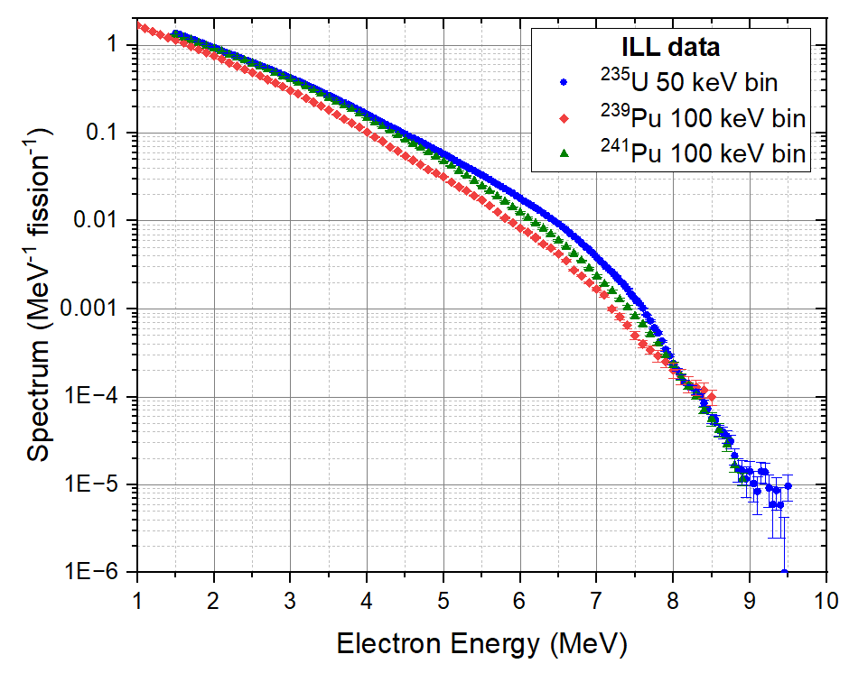
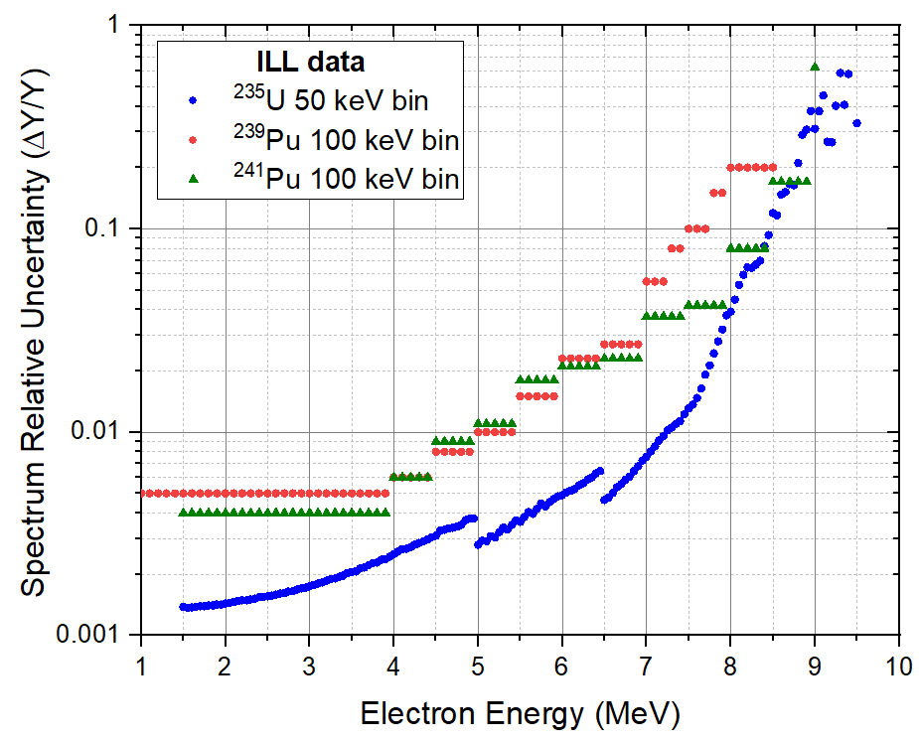
ILL Electron Data
The ²³⁵U electron spectrum is the most extensively measured and with the smallest uncertainties.

Slide 11
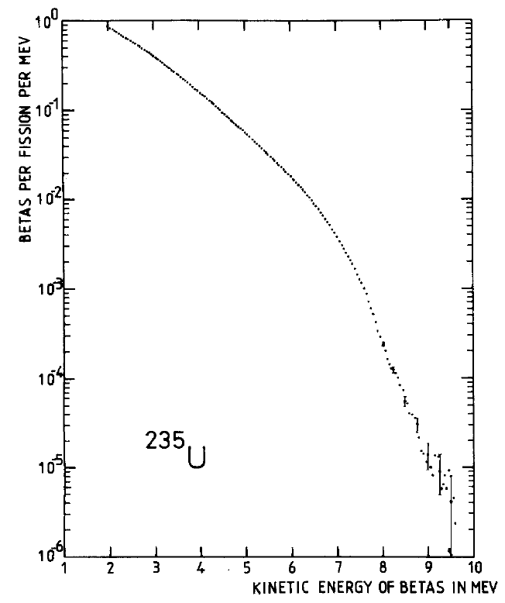
Electron spectra measurements at ILL
ILL Reactor
Φ ~ 10¹⁴ neutrons/cm² s
Detectors to count e-
²³⁵U, ^{239,241}Pu foils
0.1 - 1 mg/cm²
e-
Magnets to determine E_{e-}
Not so well known cross section
To normalize spectrum, we must know:
Foil thickness
Fission cross section
Neutron flux
Detection efficiency
Well known cross sections
Use ¹¹³Cd, ¹¹⁵In, ¹⁹⁷Au, and ²⁰⁷Pb K conversion electrons following neutron capture, with well known cross sections, electron energies, and electron K conversion coefficients.

Slide 12
²⁰⁷Pb neutron capture cross section
Value used by ILL to normalize ²³⁵U spectrum: 712 ± 10 mb, best value available in 1981, 1985.
source: 1981 S.F. Mughabghab evaluation, based on an indirect measurement published in a 1963 conference proceeding.
Value from 2018 S.F. Mughabghab evaluation: 647 ± 9 mb
Sources:
610 ± 30 mb, Blackmon et al., PRC 65, 045801 (2002).
649 ± 14 mb, Schillebeeckx et al., EPJA 49, 143 (2013).
Ratio of cross sections: 647 / 712 = 0.908.
Larger cross section --> Lower neutron flux --> Larger electron spectrum.
For more details, see Phys. Rev. C 108, 024617 (2023).

Slide 13
ORNL delayed gamma and electron data
During our library clean-up, we found three very valuable reports with delayed electron and gamma spectrum following the thermal fission of ²³⁵U and ^{239,241}Pu.
Only one report available online, which can’t be searched by content.

Slide 14
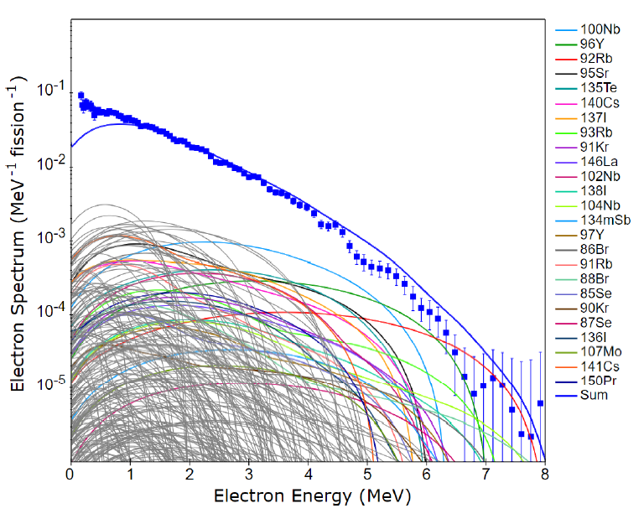
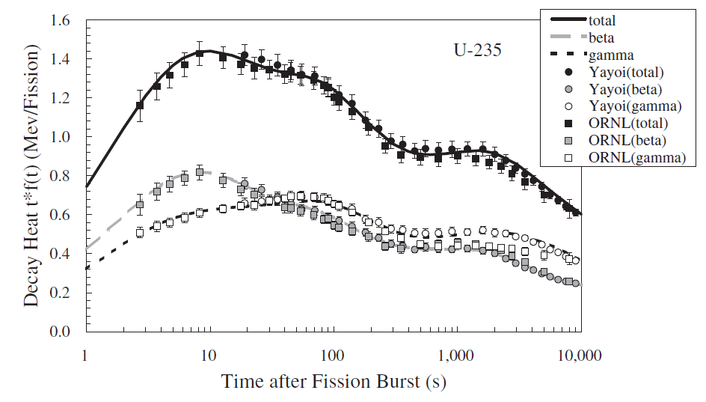
Decay Heat
Ionizing radiation energy released by the fission products, per unit time as function of time.
Divided in two components, gammas and betas.
Only the decay heat values, published in refereed journals, were available.
The electron spectra data, decay heat is proportional to the spectrum energy average, were not.
N. Hagura, T. Yoshida, T. Tachibana, Journal of Nuclear Science and Technology, 43:5, 497 (2012)

Slide 15
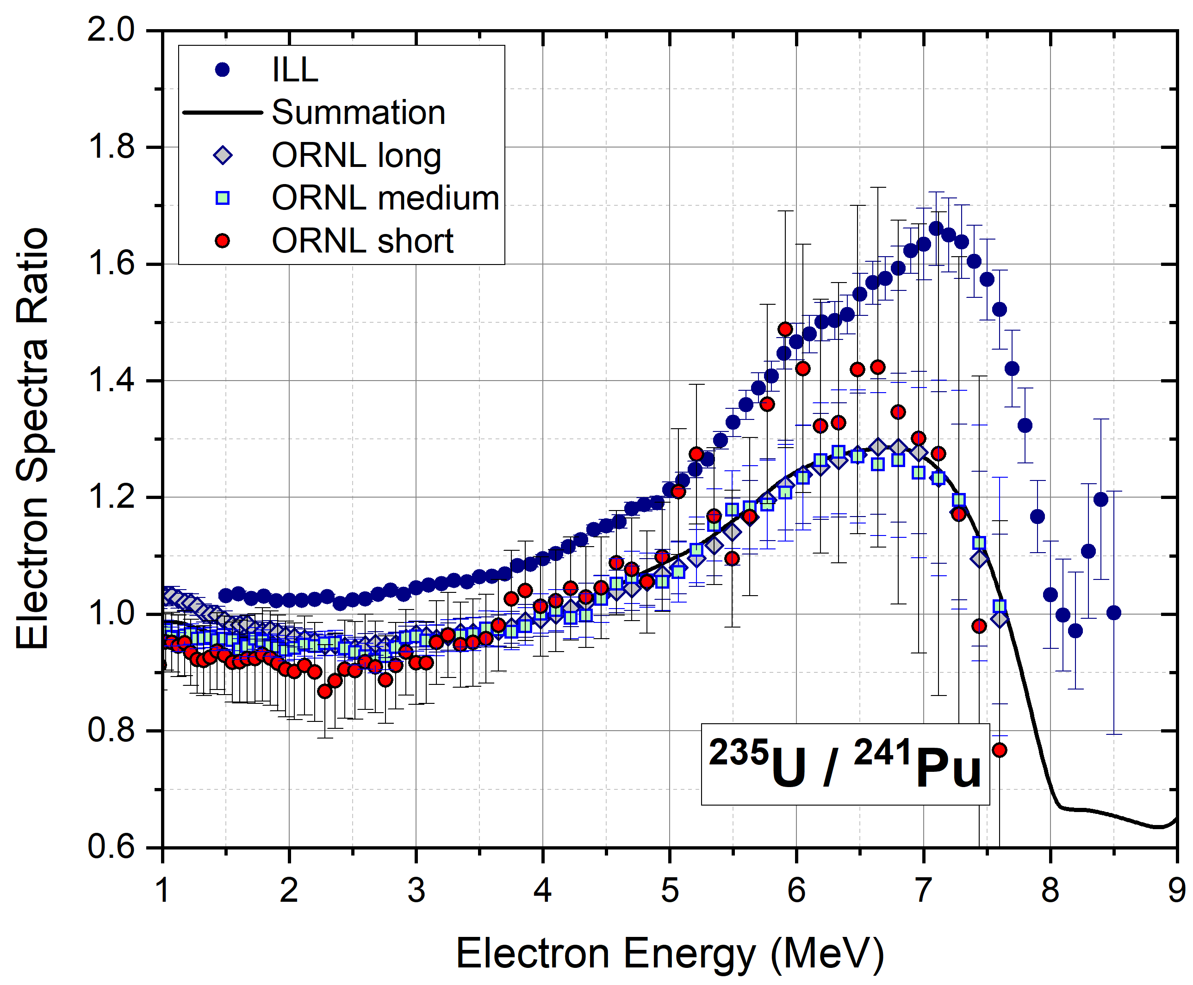
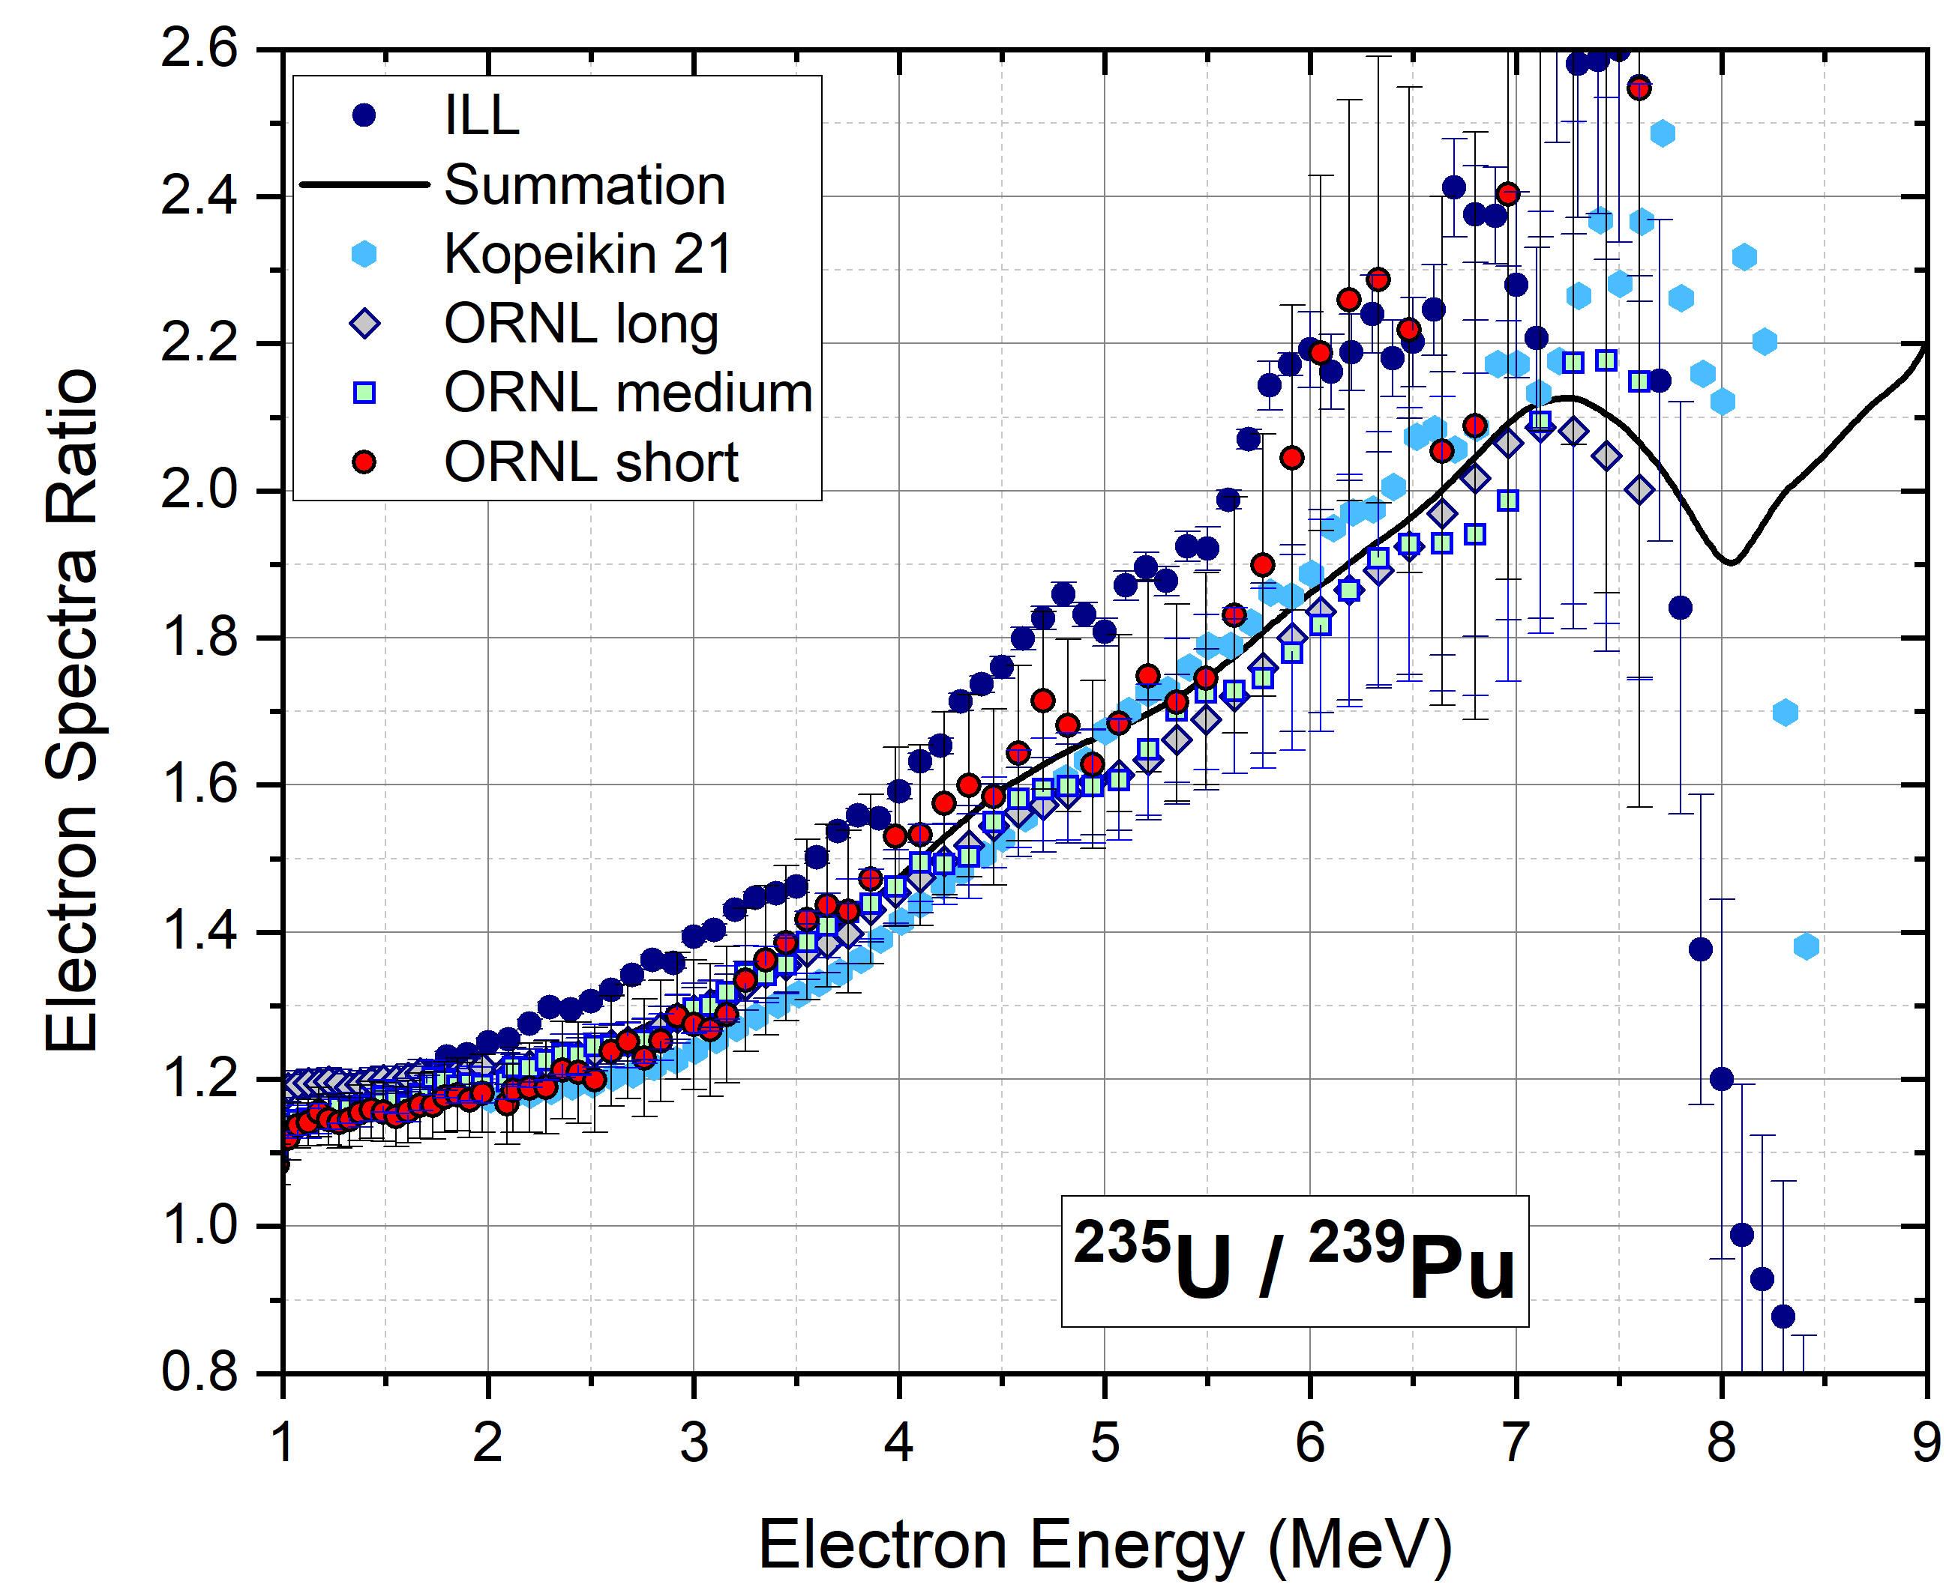
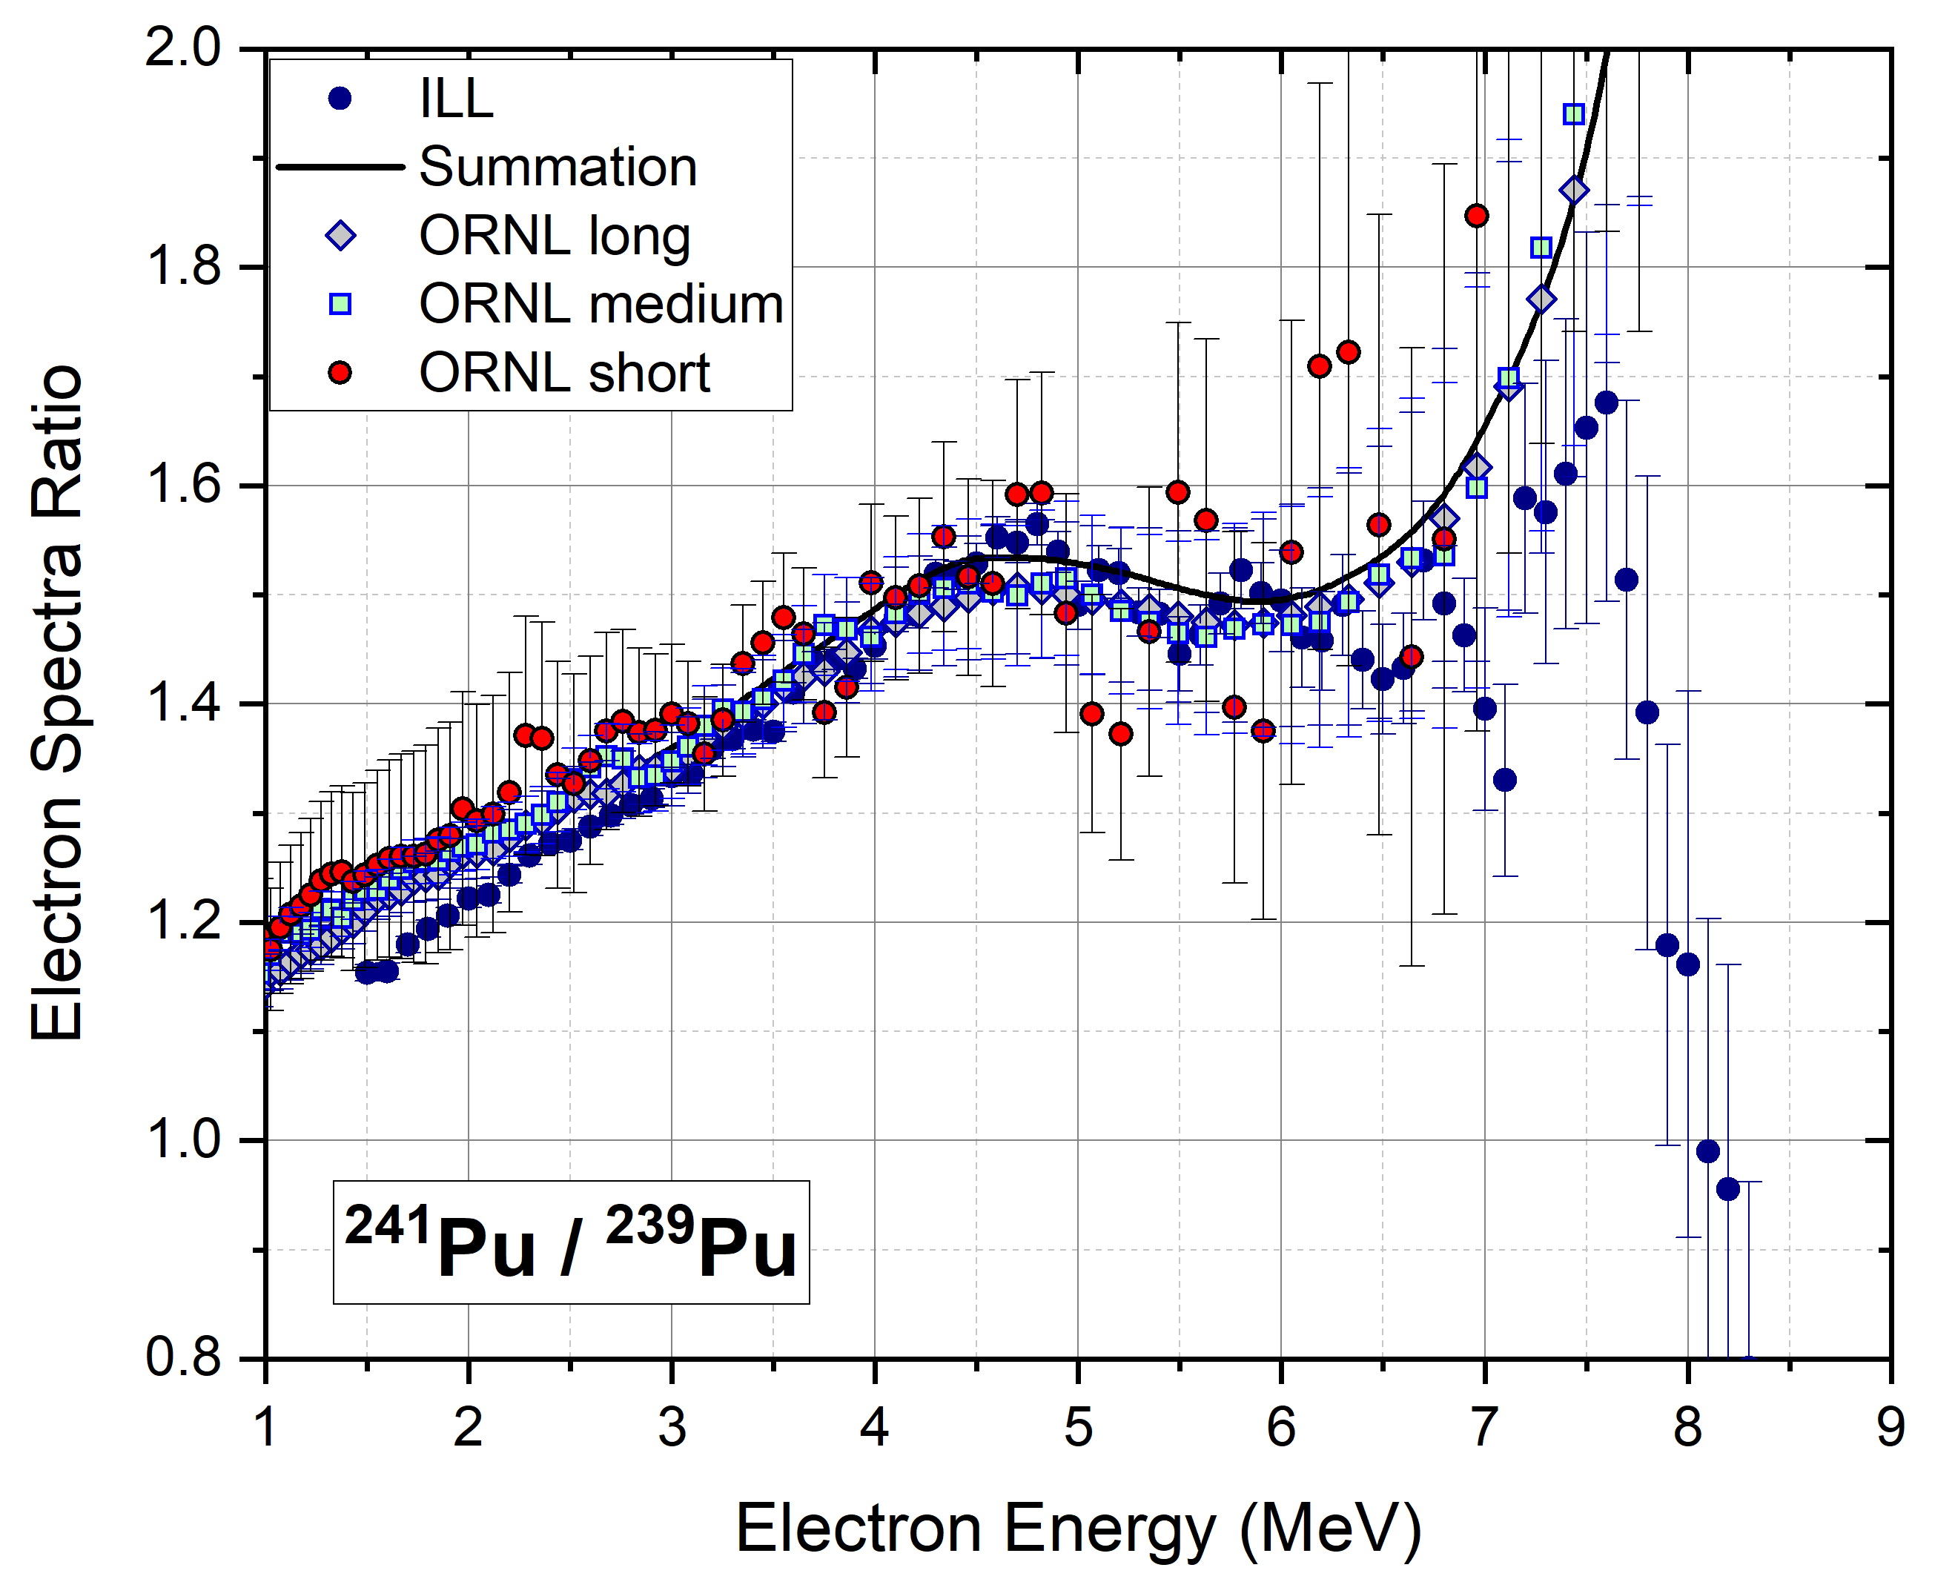
Electron Spectra Ratios
With the assistance of ENDF/B-VIII.1β decay data and JEFF-3.3 fission yields, we are able to obtain ratios of electron spectra in equilibrium.
R₅₉ agrees better with Kopeikin et al.
R₅₁ also illustrates issues with ²³⁵U normalization.
Behavior of ILL R₅₉ and R₁₉ at high energies disagree with summation, possibly indicating issues in the ²³⁹Pu target.
PRC 108, 024617 (2023).

Slide 16
Selfie with Franz Von Feilitzsch, following my Neutrino 2024 talk in Milan, Italy.
Franz told me that the ILL electron data was lost during the move from Grenoble to Munich. No room to store those tapes.
It would cost ~$30M to perform these experiments again…

Slide 17
Fun with Conversion! (preliminary results)

Slide 18
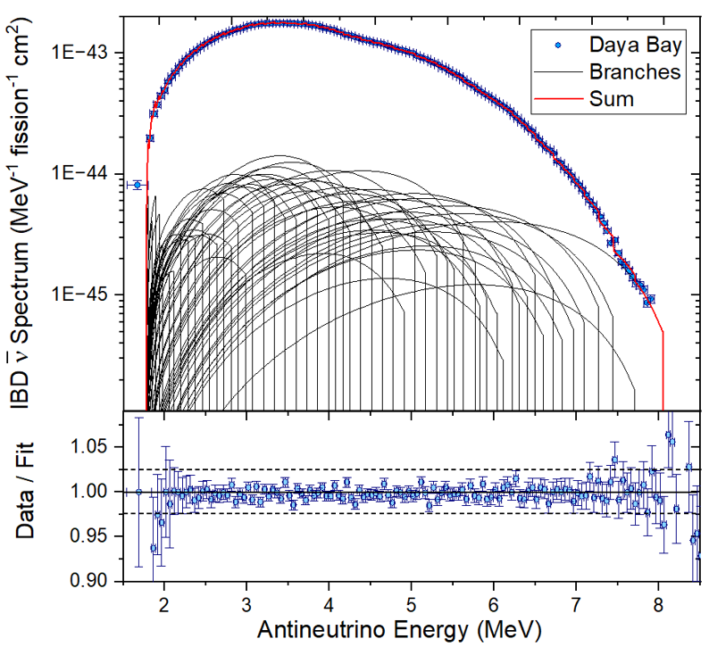
Searching for a possible explanation for ‘the bump’
We start by performing a ‘reverse conversion’ fit to the Daya Bay data, which features the smallest binning, 50 keV, for all but the lowest energy point.
From this fit we can deduce the corresponding electron spectrum, which can also be written as
Dominant term, ~80% of the spectrum
We will use measured and calculated R_{5i}=S₅/S_{i} values to obtain

Slide 19
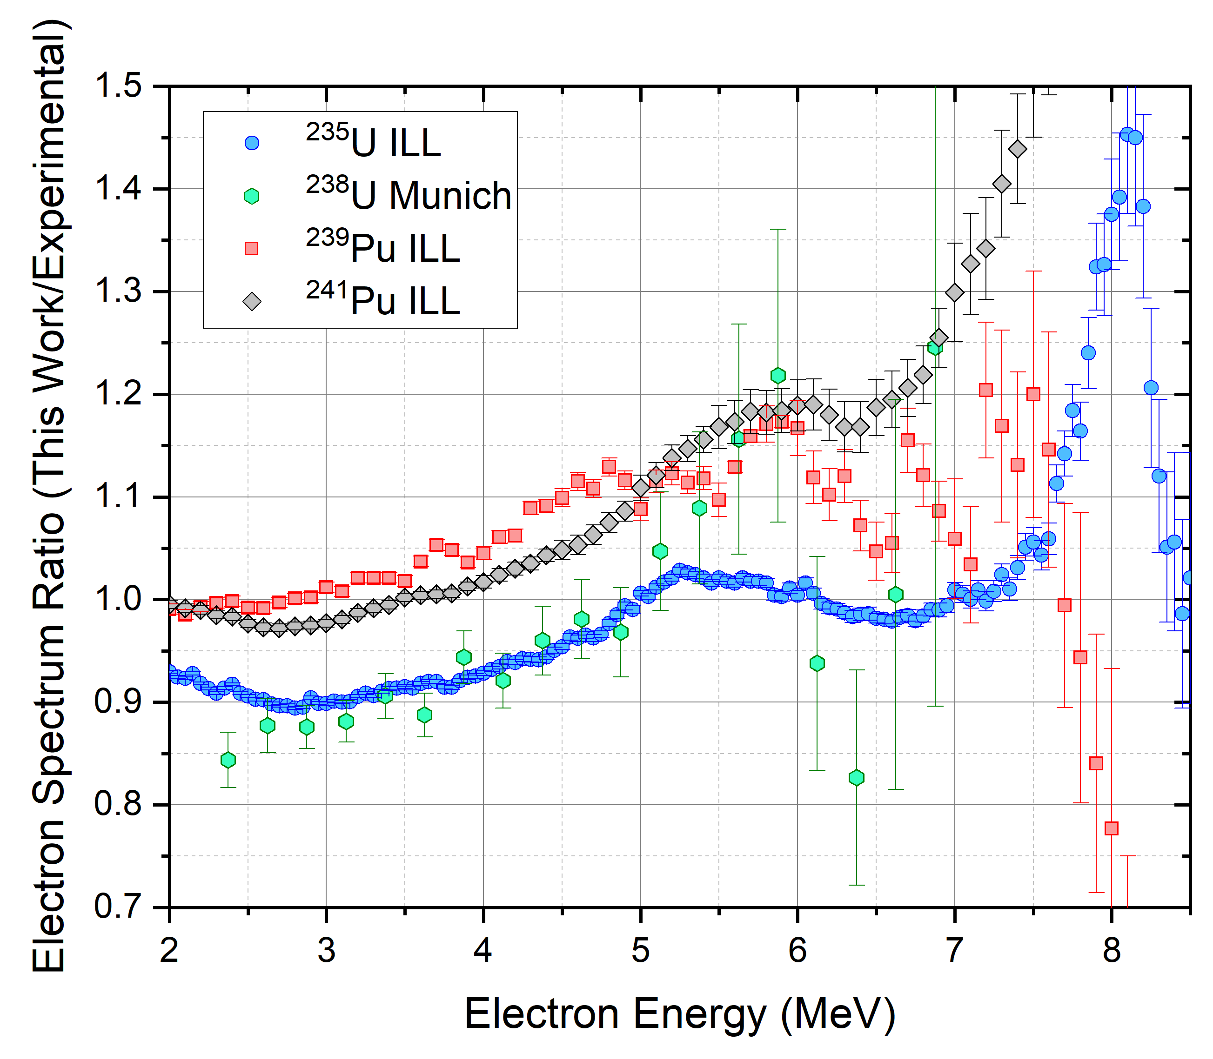
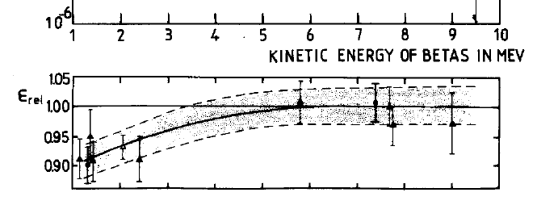
Searching for a possible explanation for ‘the bump’
The ratio of the deduced electron spectra to the ones measured at ILL & Munich is not constant. ILL spectra values get smaller in the 3 to 5 MeV range.
Perhaps BILL’s efficiency is 10% smaller than assumed in that energy interval?
Which doesn’t agree with the efficiency curve used at ILL:

Slide 20
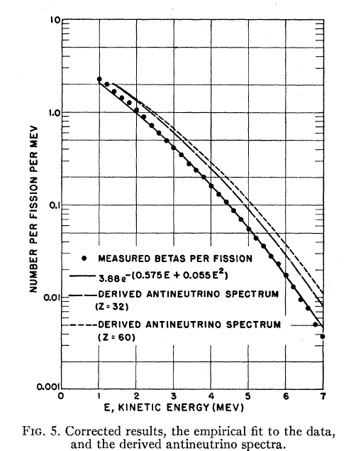
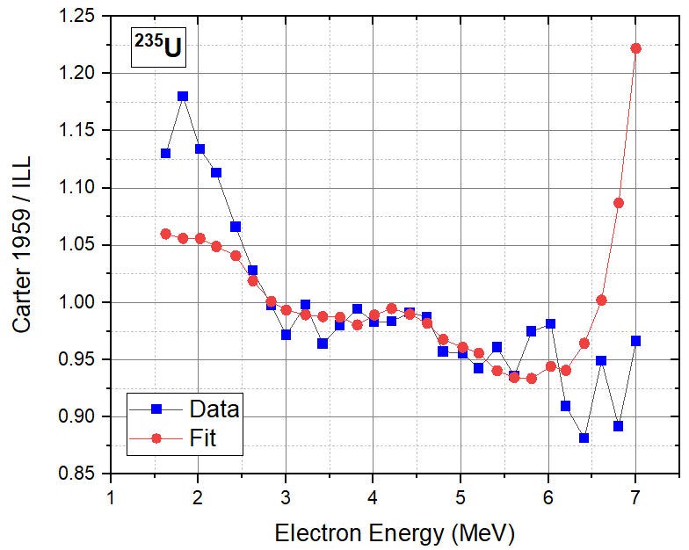
The comparison with the Carter data shows the opposite effect!

Slide 21
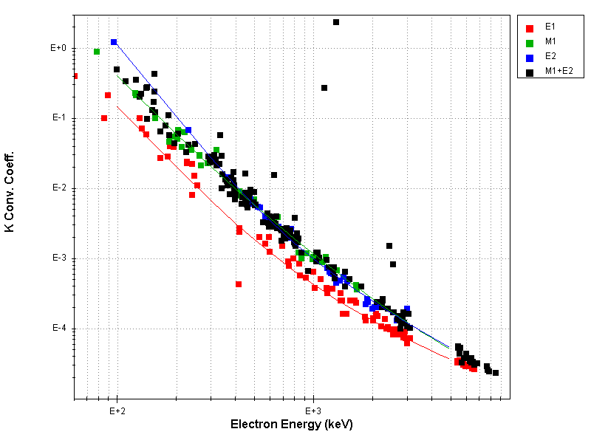
Following suggestions during the Aachen meeting, we reviewed 70+ articles featuring data taken with BILL
Most of them are conversion coefficients measurements to determine gamma multipolarities in neutron capture experiments.
Only the ¹¹³Cd(n,g) experiment has data up to 8 MeV, A. Mheemeed et al, NPA 412, 113 (1984).
There is a gap in the critical 3-5 MeV interval.
Also, the scatter in the data wouldn’t reveal a 10% efficiency drop.
The only possible way forward is to remeasure the ²³⁵U and ²³⁹Pu electron spectra with high precision, including robust normalization and efficiency procedures

Slide 22
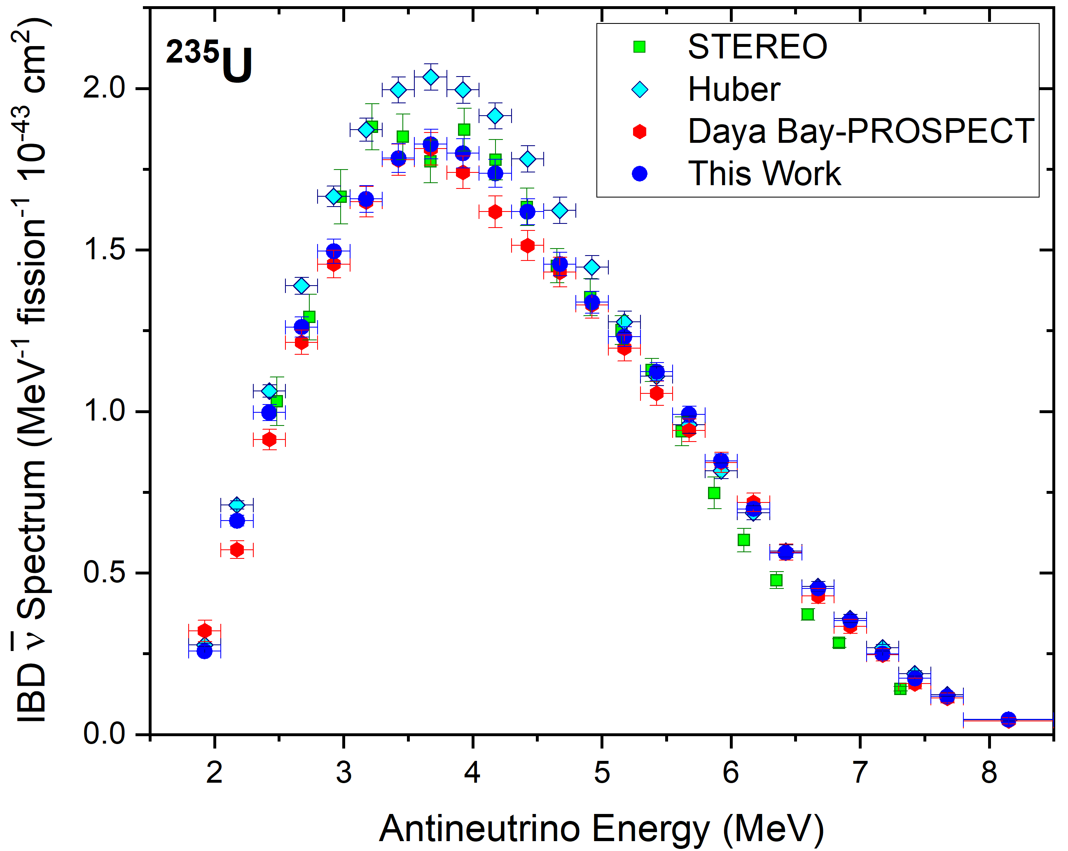
Derived reference antineutrino spectra
We can renormalize the ILL spectra, perform a regular conversion fit, and obtain the corresponding antineutrino spectra.
Our derived ²³⁵U spectrum agrees well with STEREO and Daya Bay – PROSPECT.
As expected, considerably lower than Huber’s at the top.
Our σ₅ is ~7% lower than Huber’s and ~3% higher than DBP.

Slide 23
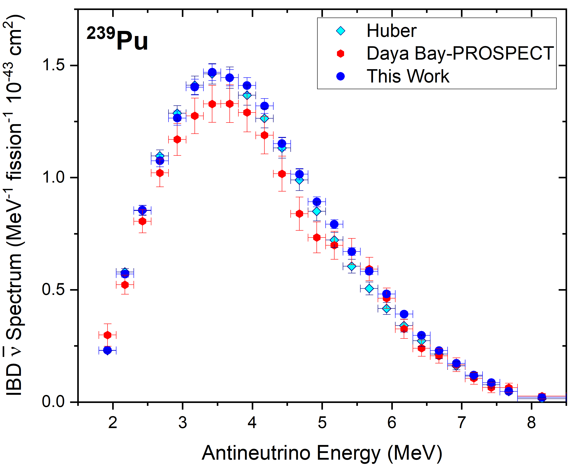
Derived reference antineutrino spectra
Our derived ²³⁹Pu spectrum shows a good agreement with Huber’s, but it is higher in the bump region, up to 15%.
Unexpectedly, we get an overall higher spectrum than DBP.
Our σ₉ is ~3% higher than Huber’s and ~8% higher than DBP.
Our S₉ doesn’t exhibit the shoulder that the DBP one has at around 5 MeV due to the smooth nature of the DB50 and Kopeikin’s curves.

Slide 24
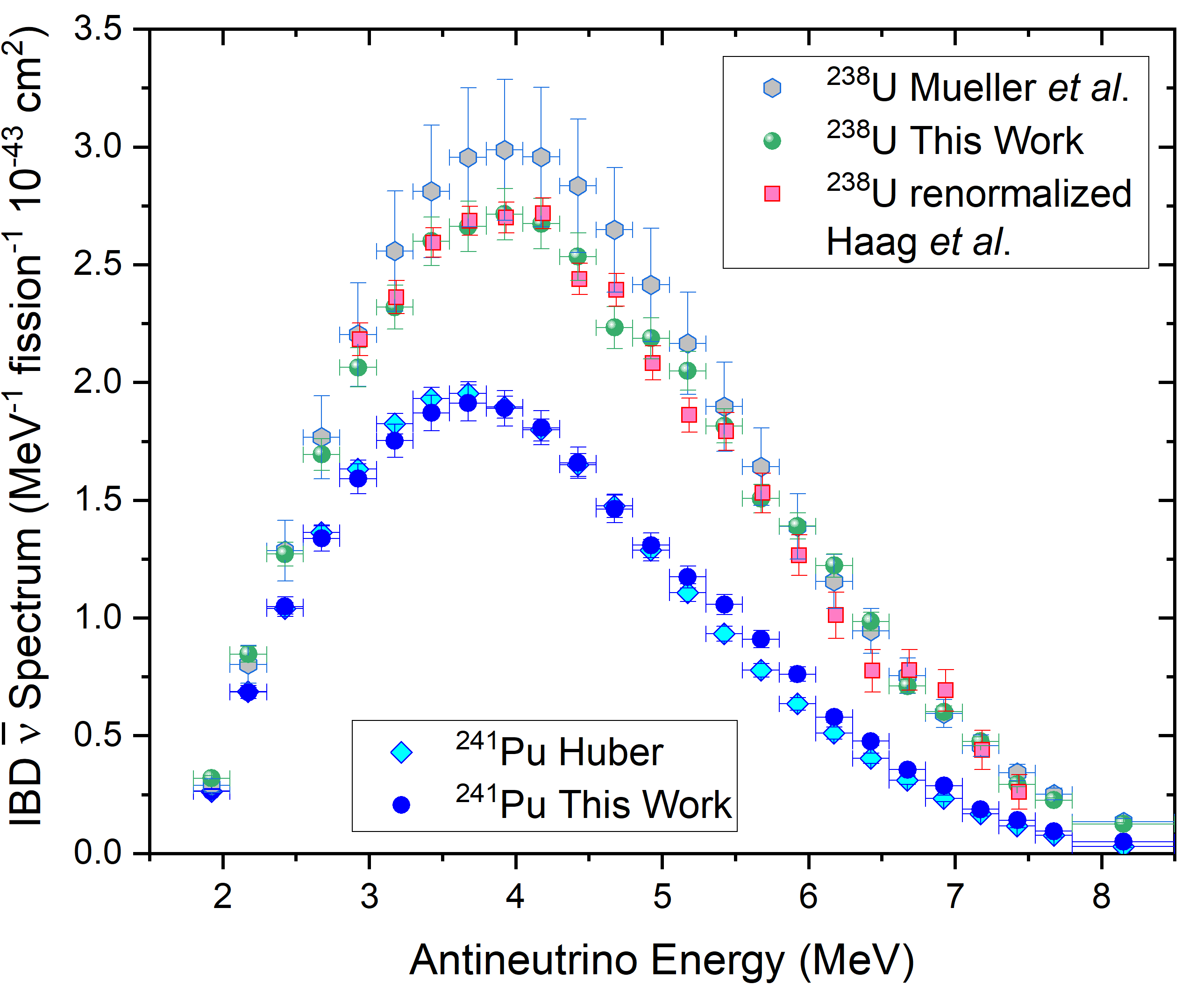
Derived reference antineutrino spectra
Our derived ²⁴¹Pu spectrum shows a good agreement with Huber’s, but it is a bit lower at the top and higher in the bump region, reflecting additionally the use of a summation R₅₁.
Our σ₁ is ~2% higher than Huber’s.
Our S₈ is ~10% lower than Mueller’s, perhaps due to updated nuclear data – Perisse’s shows the same trend.
Haag’s ²³⁸U electron spectrum was re-normalized and the antineutrino spectrum was calculated in the same way.

Slide 25
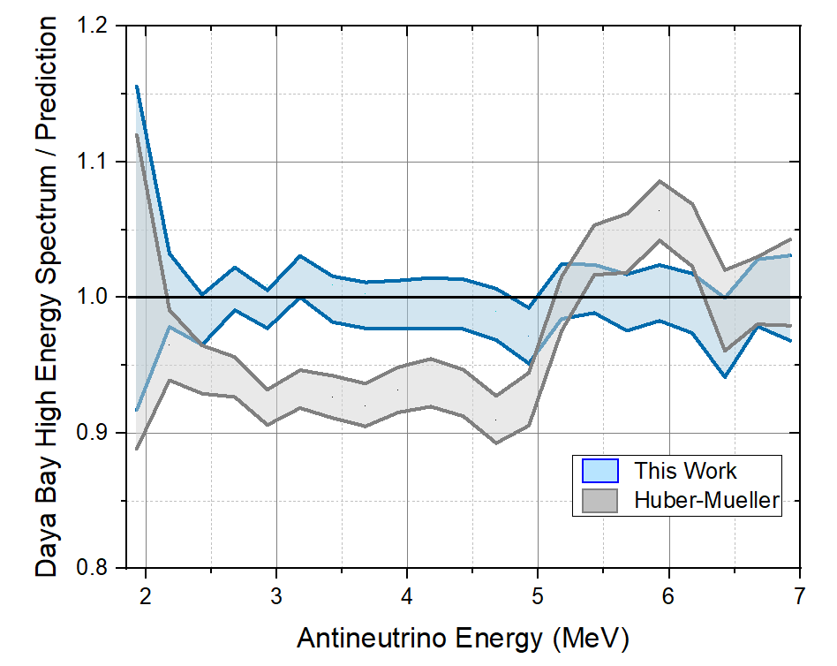
Consistency – comparison with Daya Bay High Energy data
Despite two successive conversion fits, our derived antineutrino spectra are consistent with the Daya Bay HE data, ratio ~ 1.
Our double conversion method was also benchmarked with a toy model employing summation spectra.
Note, only Daya Bay HE uncertainties are shown in the ratio.

Slide 26
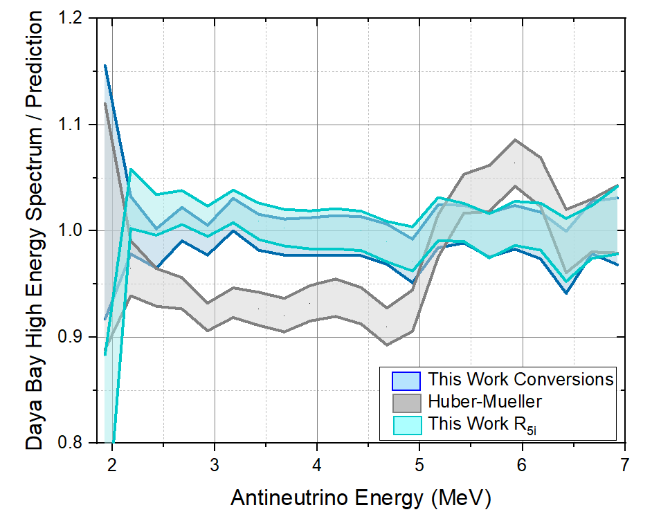
Consistency
We could also derive the ^{235,238}U and ^{239,241}Pu antineutrino spectra from a reactor spectra and summation R_{5i} values:
This method is numerically far simpler, and we obtain similar values to the double conversion method ones.
It is however less reliable since we are using summation R₅₉ values.

Slide 27
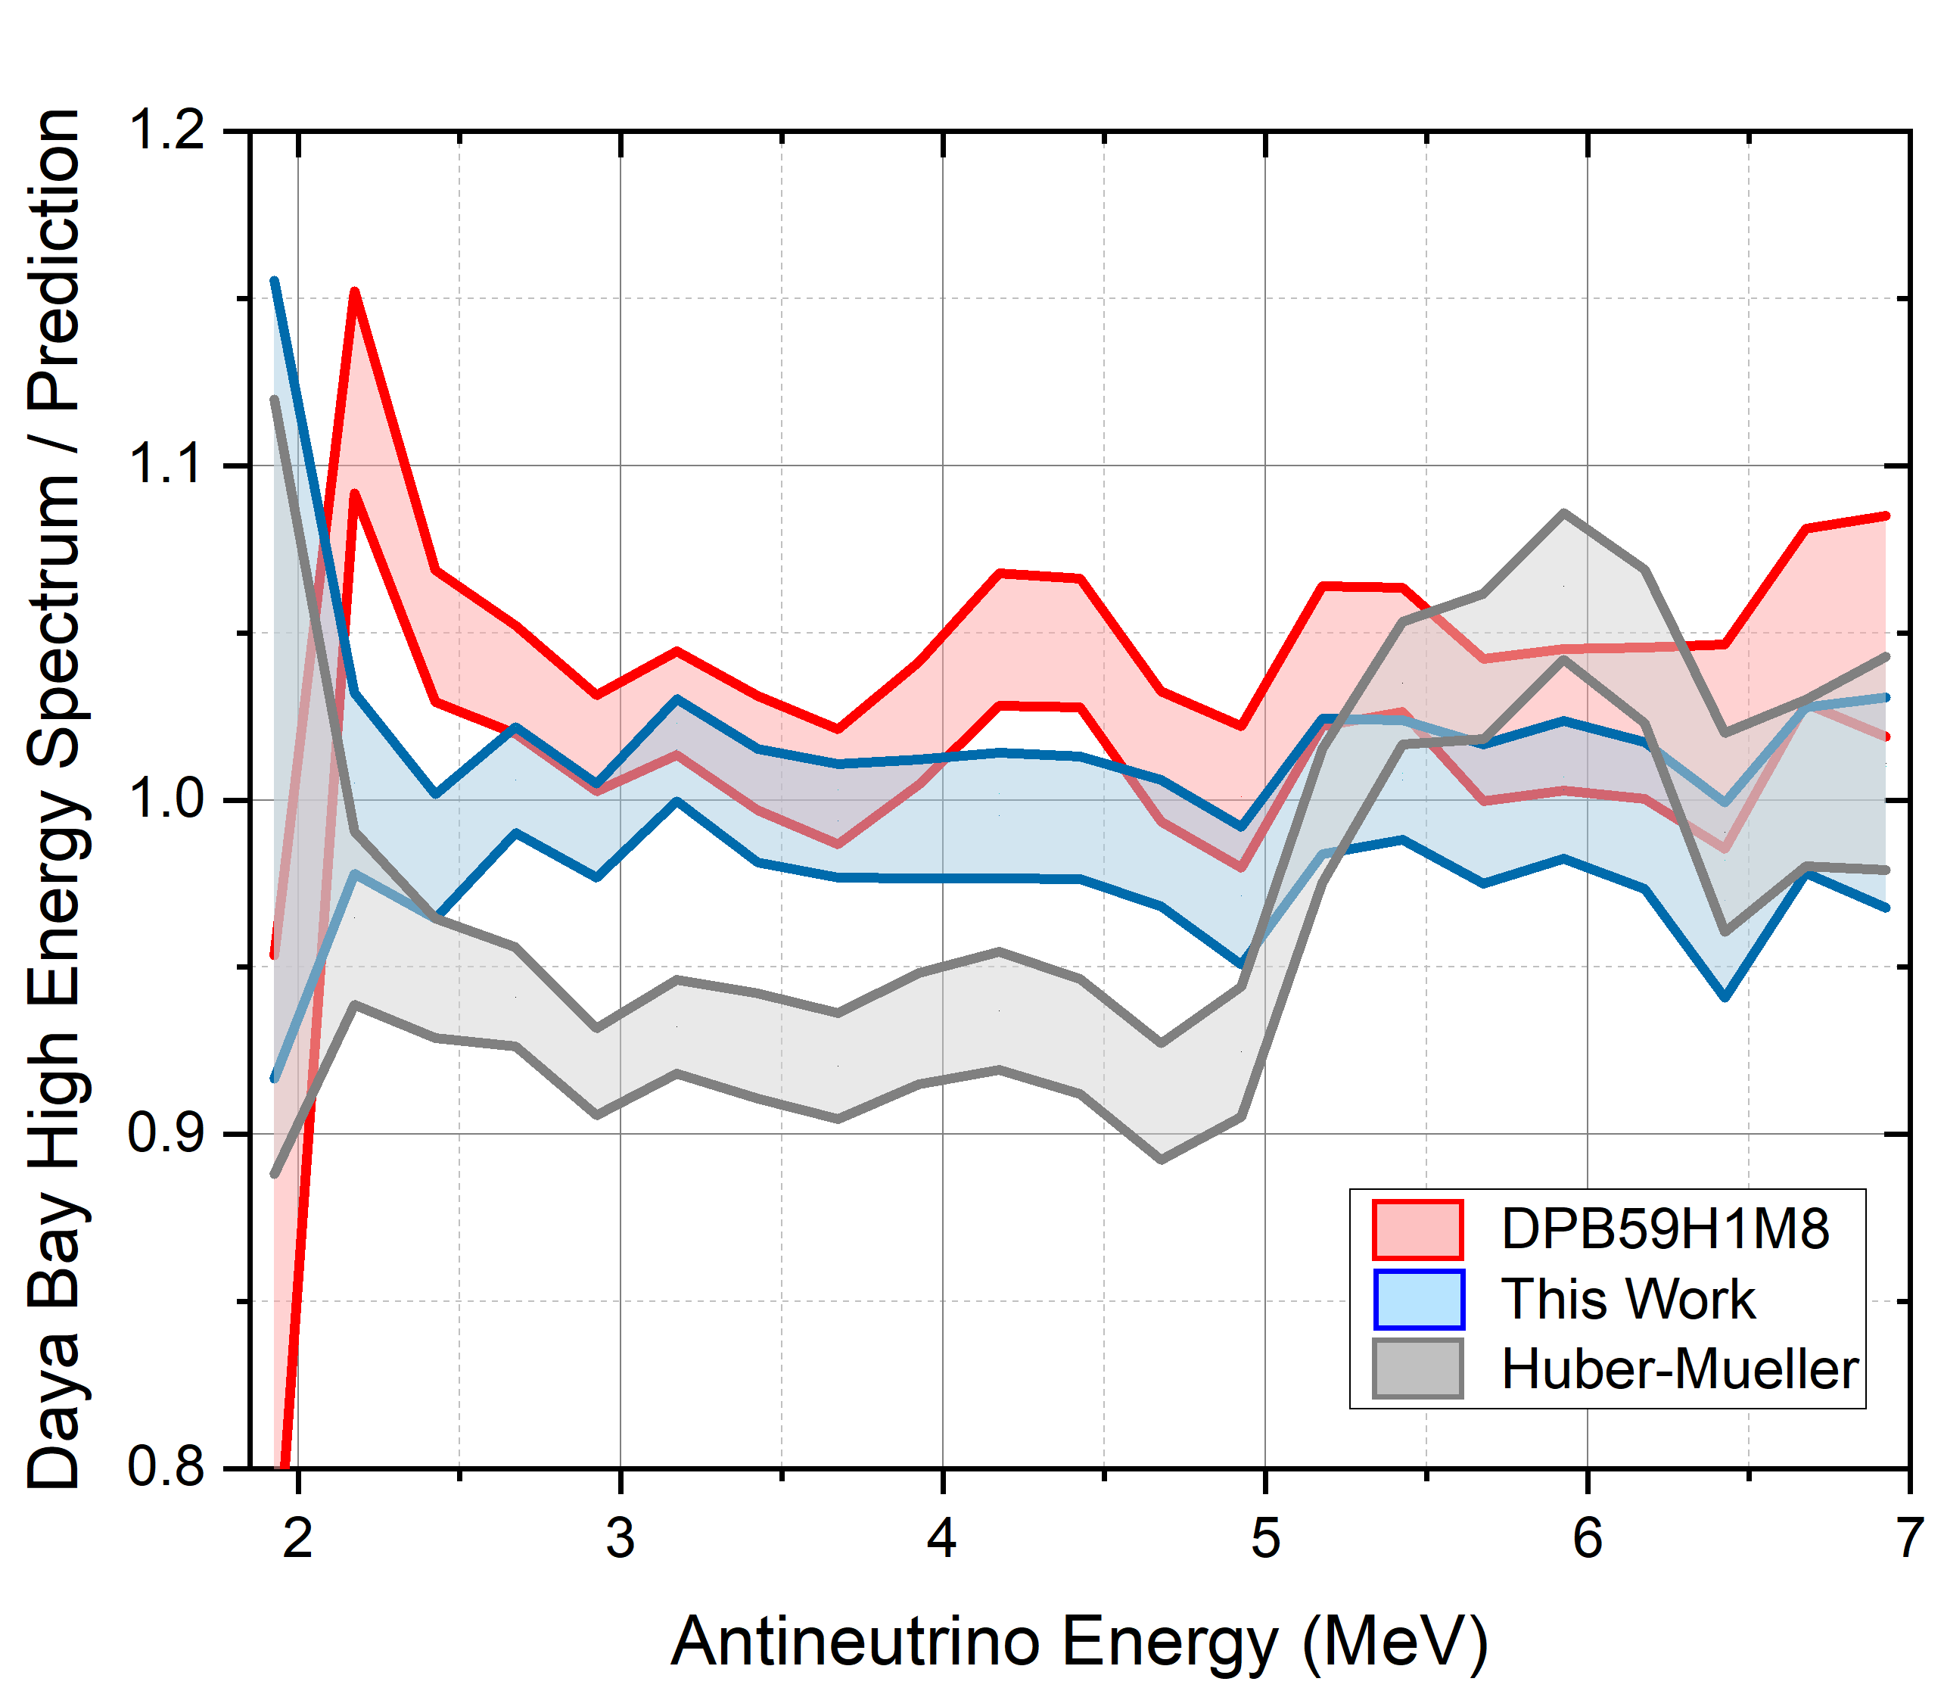
Consistency – comparison with Daya Bay High Energy data
The DBP59H1M8 reactor model consists of Daya Bay – PROSPECT ²³⁵U and ²³⁹Pu antineutrino spectrum, plus Huber’s ²⁴¹Pu and Mueller’s ²³⁸U spectra.
Excluding mistakes in our calculations, the DBP59H1M8 model doesn’t seem to reproduce the DBHE spectrum, despite their shared provenance.
The DBP ²³⁹Pu lower than Huber’s seems to be a problem.
Has anyone else seen or checked this??

Slide 28
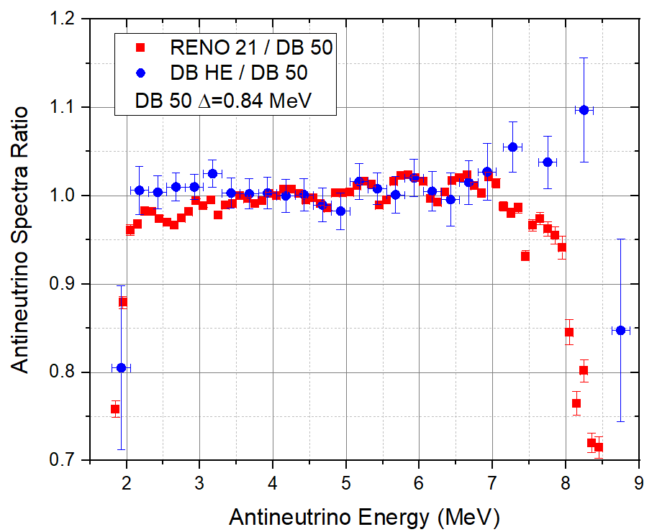
A few issues we encountered…
The Daya Bay 50 spectrum, given in prompt energy value, was shifted by 0.84 MeV to match the Daya Bay HE spectrum, not the stated 0.78 MeV.
On closer examination, the Daya Bay HE spectrum doesn’t agree super well with the RENO 21 one.
Therefore, the reference antineutrino spectra deduced from the DB50 spectrum will not satisfactorily account for the RENO 21 spectrum.

Slide 29
New paradigm for antineutrino spectrum
Currently, we parametrize the antineutrino spectrum using a polynomial fit:
S(E) = exp (a₀ + a₁E + a₂E² + a₃E³ + a₄E⁴ + a₅E⁵ )
It creates a very smooth spectrum, which we think is an unnecessary artifact.
To gauge this problem, we will study the Daya Bay 50 keV IBD data
First, we divide by the IBD cross section.
Second, we perform a polynomial fit to the logarithm of the antineutrino spectrum.
We then multiply the parametrized spectrum by the IBD cross section and compared to the original data.

Slide 30
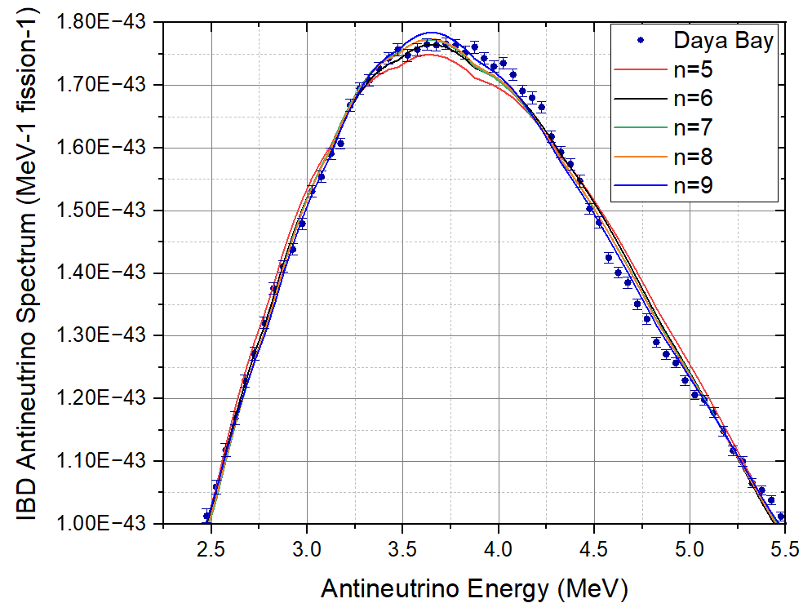
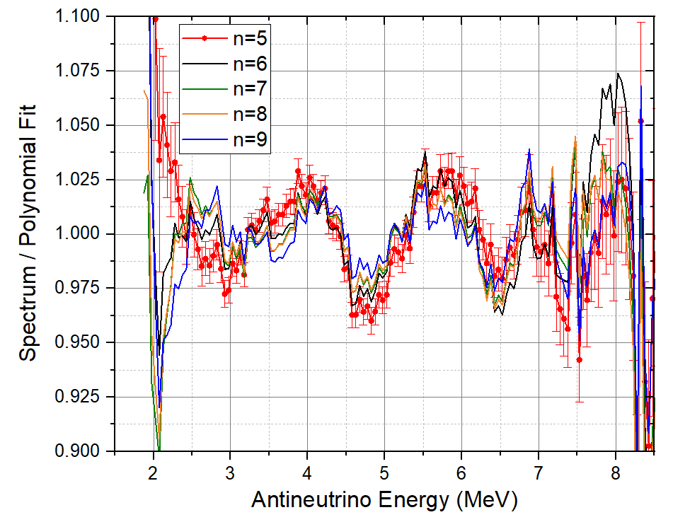
New paradigm for antineutrino spectrum
Daya Bay 50 keV IBD data – spectra uncertainties only shown for n=5.
Fit performed using Origin software with W = 1/(ΔS)²

Slide 31
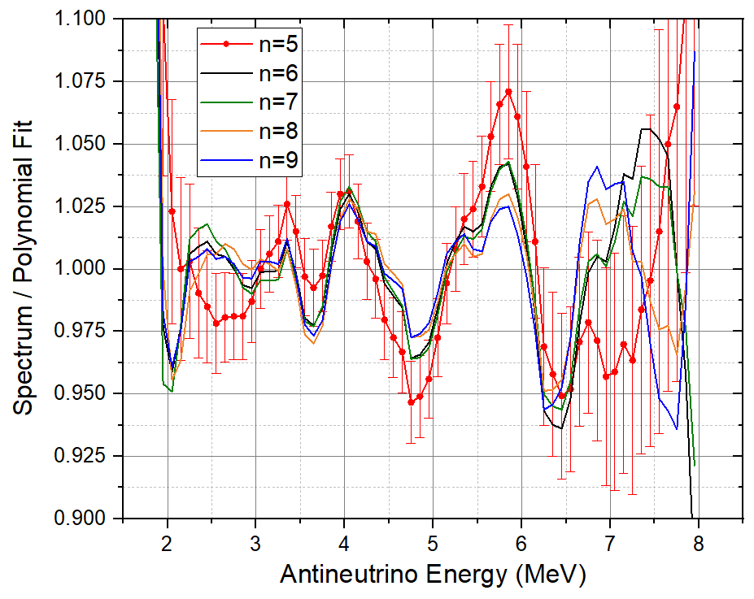
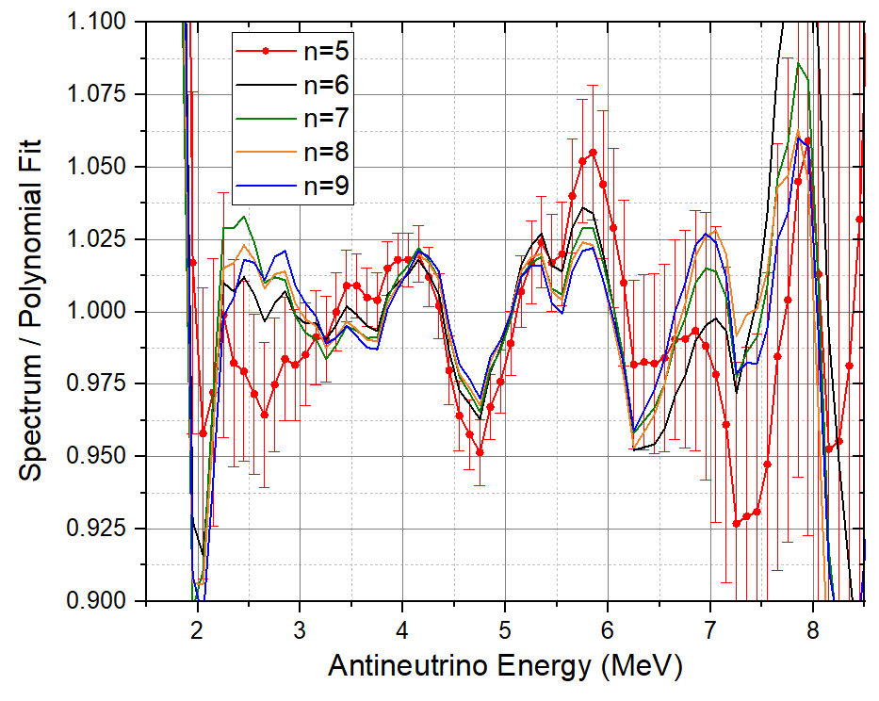
New paradigm for antineutrino spectrum
Similar features observed for NEOS and RENO data

Slide 32
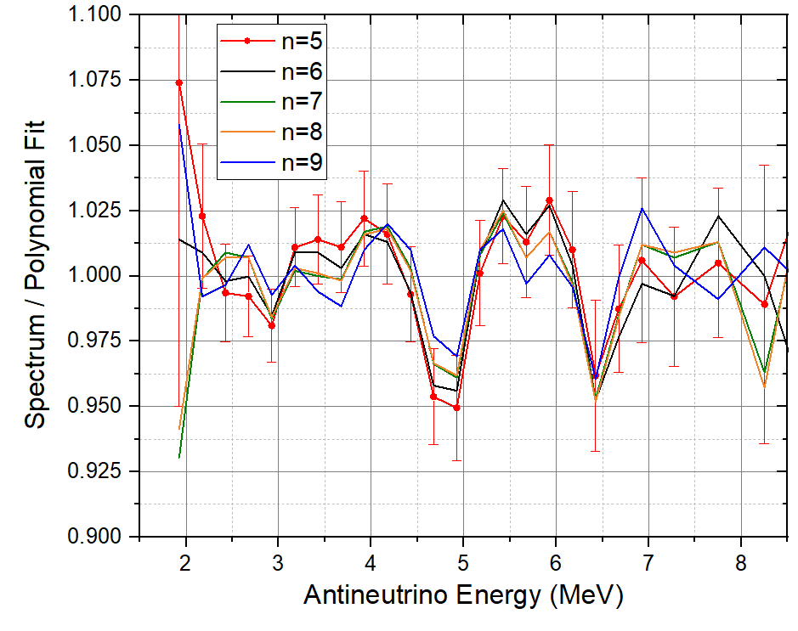
New paradigm for antineutrino spectrum
And for Daya Bay High Energy data
Fit also checked with Python and JAVA libraries
Solution:
Point-wise function, spectrum given every 10 keV
Straightforward for Summation
We need to think how to do it for future Conversion analysis.

Slide 33
Summary and Outlook

Slide 34
Conclusions
Understanding the magnitude and features of reactor antineutrino spectra measured in the last 15 years has been a fascinating and rewarding intellectual adventure.
We think that the source of the RAA is the use of a higher ²⁰⁷Pb(n,γ) cross section to normalize the ILL ²³⁵U electron spectrum.
We really need to re-measure the ^{235,238}U and ^{239,241}Pu electron spectra with (i) high resolution, (ii) high signal to noise ratio, (iii) well characterized efficiency, and (iv) very robust normalization procedure.
The Daya Bay 50 dataset is a treasure trove, but we need to use a 0.84 MeV shift, not the 0.78 MeV shift stated. Can we check that?
Would love to see a joint Daya Bay – RENO analysis that will produce the definite IBD antineutrino standard for future generations, and following an inversion procedure, obtain reference ^{235,238}U and ^{239,241}Pu electron and antineutrino spectra.
Help! Perhaps I am an idiot, and I’m making mistakes in my calculations, but I found the Daya Bay – PROSPECT ²³⁹Pu antineutrino spectrum to be too low. Why should it be smaller than Huber’s?

Slide 35
Acknowledgements
Work sponsored in part by the U.S. Department of Energy, Office of Science, Office of Nuclear Physics under Contract No. DE-AC02-98CH10886

Slide 36
Backup Slides

Slide 37
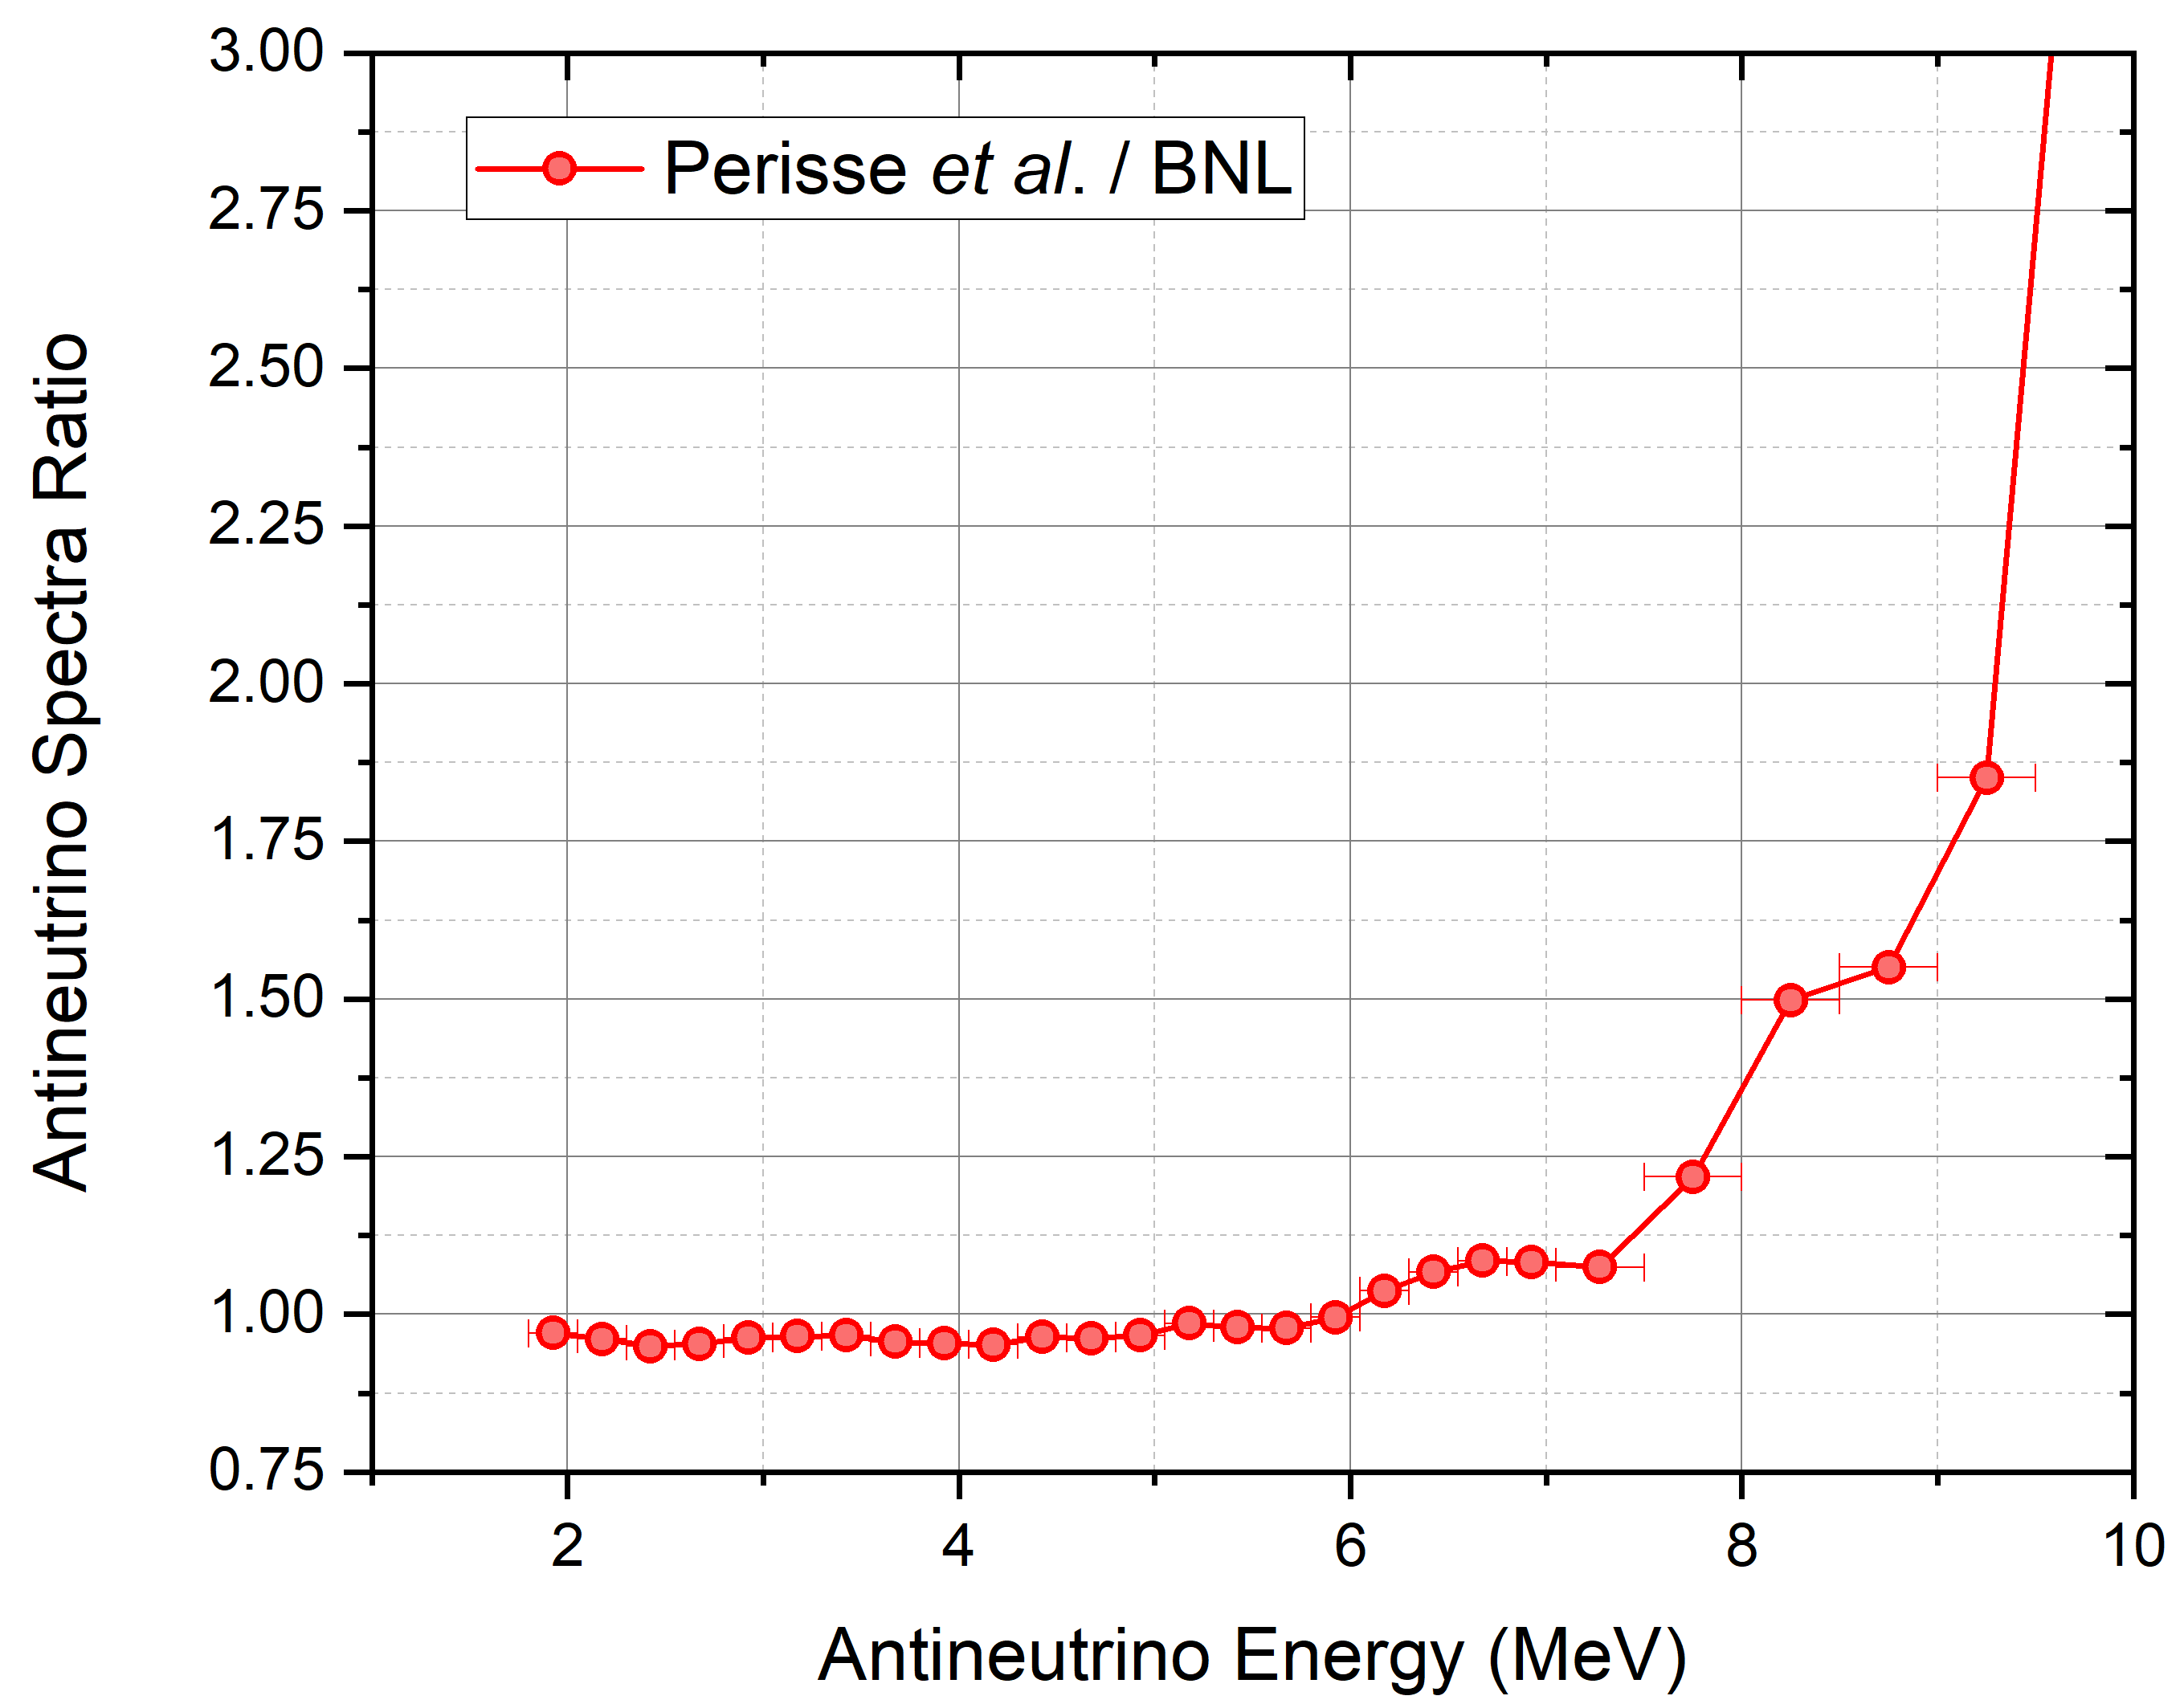
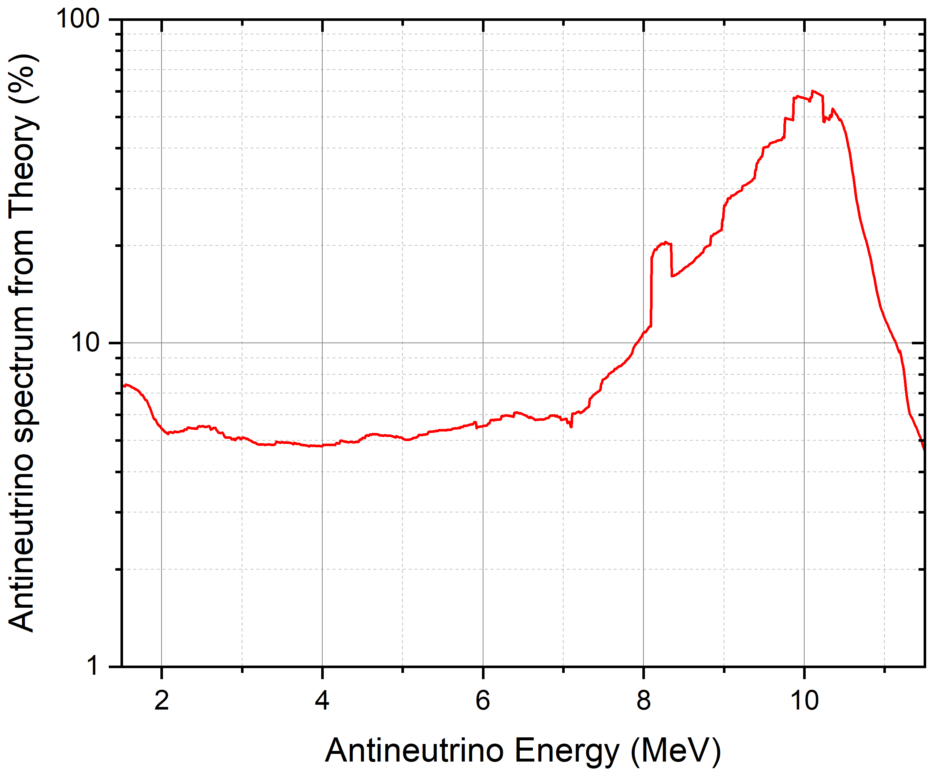
Main reason for the difference between Perisse et al. and BNL??
After all, we are most likely using the same experimental beta intensities & fission yields data
5%-70% of the antineutrino spectrum for the Daya Bay fission fractions comes theoretical calculations due to unknown or incomplete decay schemes. That may explain the difference between the two summation sets.

Slide 38
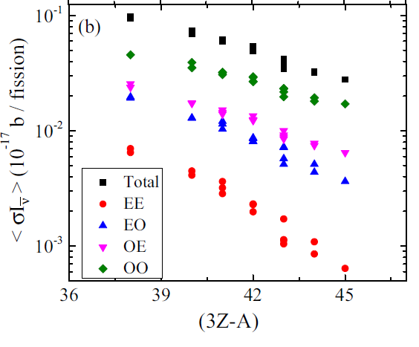
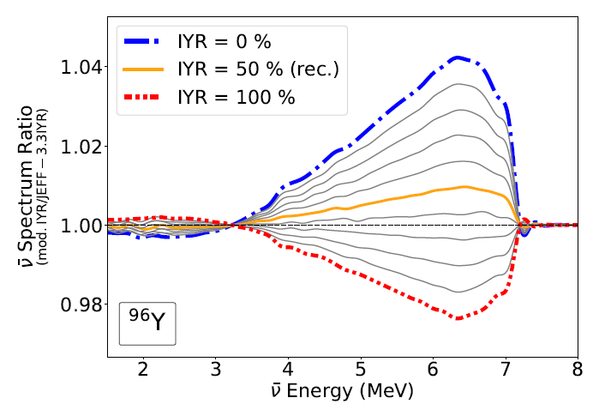
In addition to poorly known or incomplete decay schemes…
Most of the IBD antineutrinos are produced by odd-Z, odd-N nuclides, due to their larger Qβ-.
These nuclides typically have two long-lived levels, a low-spin and a high-spin one. The low spin will produce many more IBD antineutrinos.
⁹⁶Y is the most representative case, with an isomeric ratio of 50% from ²³²Th(p,fission). The thermal neutron one is likely smaller, and impacts our understanding of the ‘bump’ origin (A. Mattera to be published).

Slide 39
Neutron flux at the ILL reactor
Absolute spectra were obtained from:
N_{e}: number of detected electrons, f from fission, st from the calibration foil,
α: K internal conversion coefficient,
σ_{st}(n,γ): neutron capture cross section, σ(n,f): neutron fission cross section,
n: Number of nuclides in the foils.
²³⁵U: conversion electrons from ¹¹⁵In and ²⁰⁷Pb
²³⁹Pu: ¹¹⁵In and ¹⁹⁷Au
²⁴¹Pu: ¹¹³Cd, ¹¹⁵In, and ²⁰⁷Pb.
We reviewed all the data documented in the ILL articles and found one problem case.
ILL references:
W. Mampe et al., NIM 154, 127 (1978).
F. von Feilitzsch, A. A. Hahn, and K. Schreckenbach, Phys. Lett. B 118, 162 (1982).
K. Schreckenbach et al., Phys. Lett. B 160, 325 (1985).
A. A. Hahn et al., Phys. Lett. B 218, 365 (1989).

