Slide 1
Introduction to the Nuclear Data Section
Paraskevi (Vivian) Dimitriou
Nuclear Data Section
Division of Physical and Chemical Sciences
International Atomic Energy Agency

Slide 2

International Atomic Energy Agency
Founded in 1957: world centre for cooperation in the nuclear field
Promotes the safe, secure and peaceful use of nuclear technologies
Total of 179 Member States
Over 2500 personnel

Slide 3
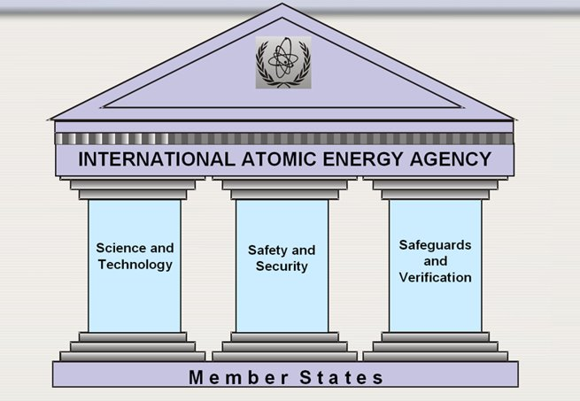
safe, secure and peaceful application of nuclear technologies
Division of Physical and Chemical Sciences
Nuclear Data
Physics
Radioisotope Production and Industrial Applications
Isotope Hydrology

Slide 4
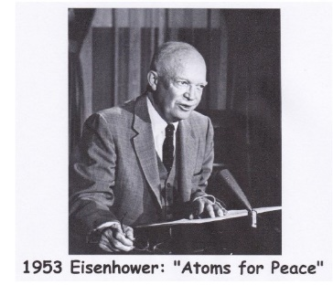
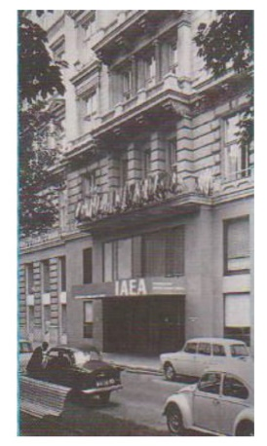
How did it all start?
Eisenhower’s historical speech “Atoms for Peace” on 8 December 1953
First International Conference on Peaceful Uses of Atomic Energy, Geneva, 1955
IAEA is founded in 1957
UK, USSR and US discuss making nuclear data public at Geneva conferences 1955, 1958
Carl Westcott was hired in 1963 to oversee the Nuclear Data Program at the Agency
Nuclear Data Section is created in 1965 - International Nuclear Data Committee advises on promoting research and exchange of data among member states

Slide 5
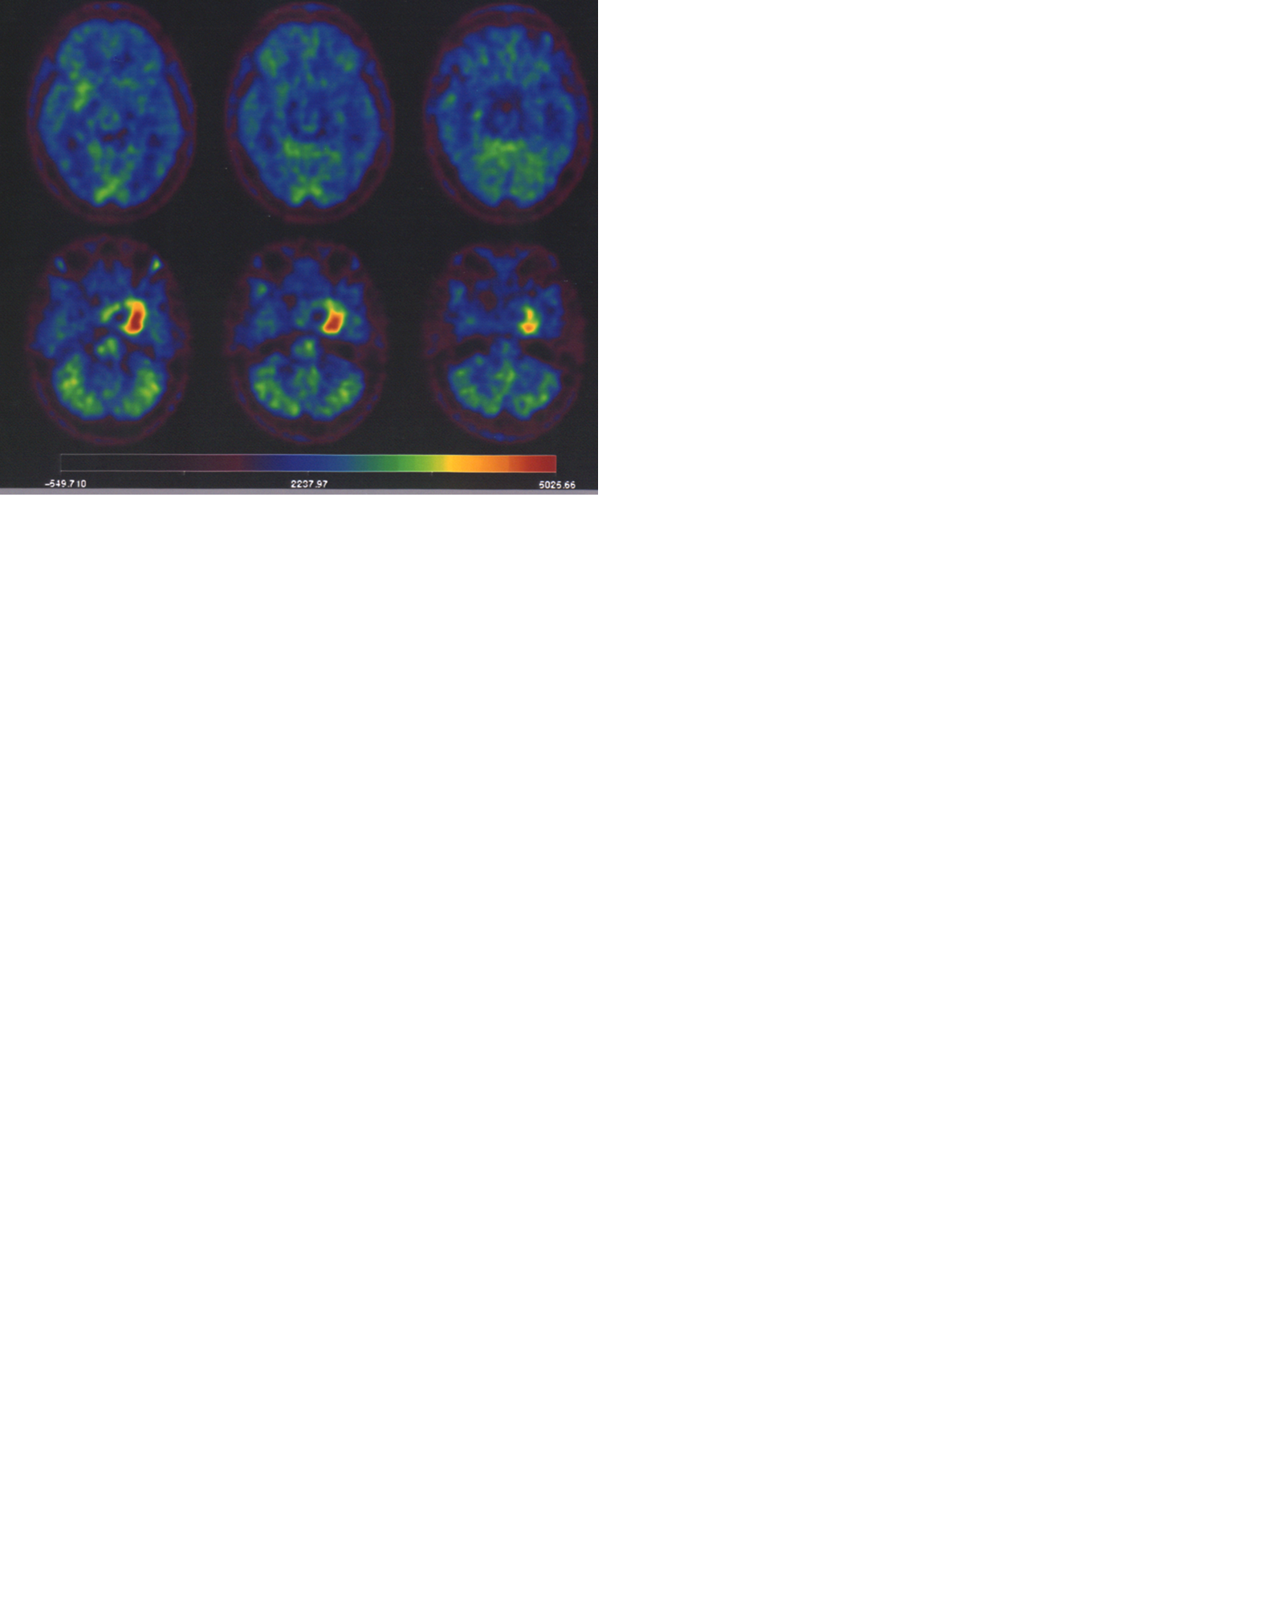
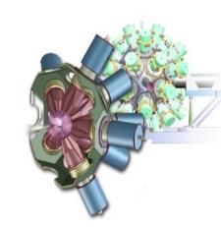
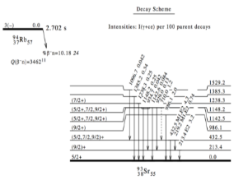
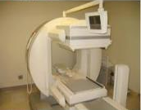
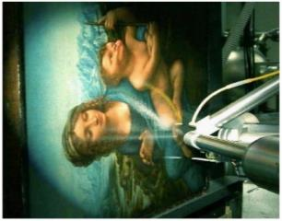
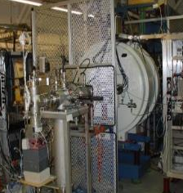
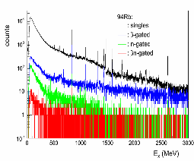

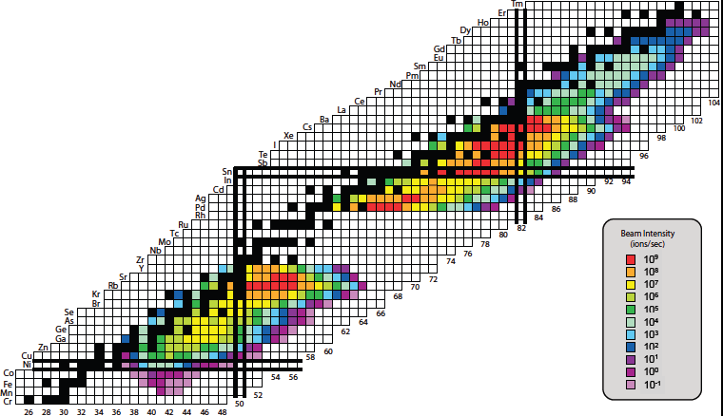

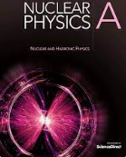
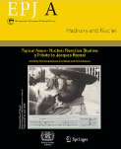
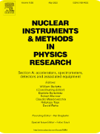
Nuclear physics research: experiment + theory
Compilation
Evaluation
Dissemination
Verification/
Validation
JYFLTRAP Penning trap
Applications:
organised
complete
recommended
traceable
easily retrievable
Nuclear Data

Slide 6
Training
Meetings
Coordinated Research Projects
Nuclear Reactions – ΕΧFOR→ NRDC
Nuclear Structure and Decay – ENSDF → NSDD
Nuclear Reactions Evaluation – ENDF/B, JEFF, → INDEN
Beta-delayed neutrons
Photonuclear data and Photon Strength Functions
Fission Yields
Nuclear Level Densities - new
(alpha,n) reactions for basic and applied research
Nuclear data needs for Reactor Antineutrino Spectra
Nuclear data needs for medical applications
Thermal capture and gamma emission
Neutron capture reactions on short-lived nuclei - new
Joint IAEA-ICTP workshops on Nuclear Structure and Decay Data
IAEA Workshops on EXFOR Compilation
Joint IAEA-ICTP Workshop on Nuclear Reaction Data
IAEA Workshop on EMPIRE code/Talys code
International Networks

Slide 7



Networks
1975
1974
2018
Nuclear Reaction Data Centers
Nuclear Structure and Decay Data evaluators
International Nuclear Data Evaluation Network
Experimental Nuclear Reaction Data
Recommended Nuclear Structure and Decay Data
Recommended Nuclear Reaction Data
EXFOR
ENSDF
ENDF

Slide 8

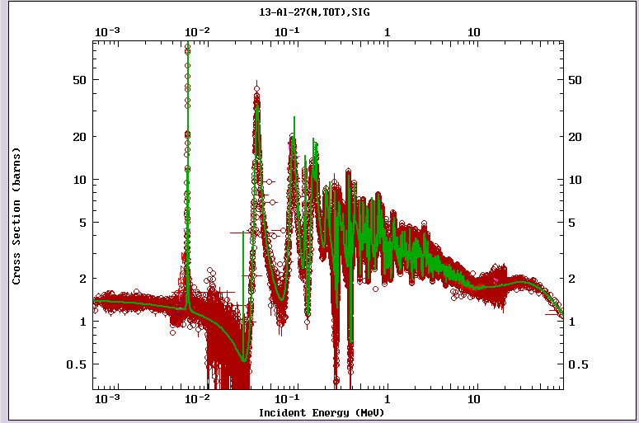
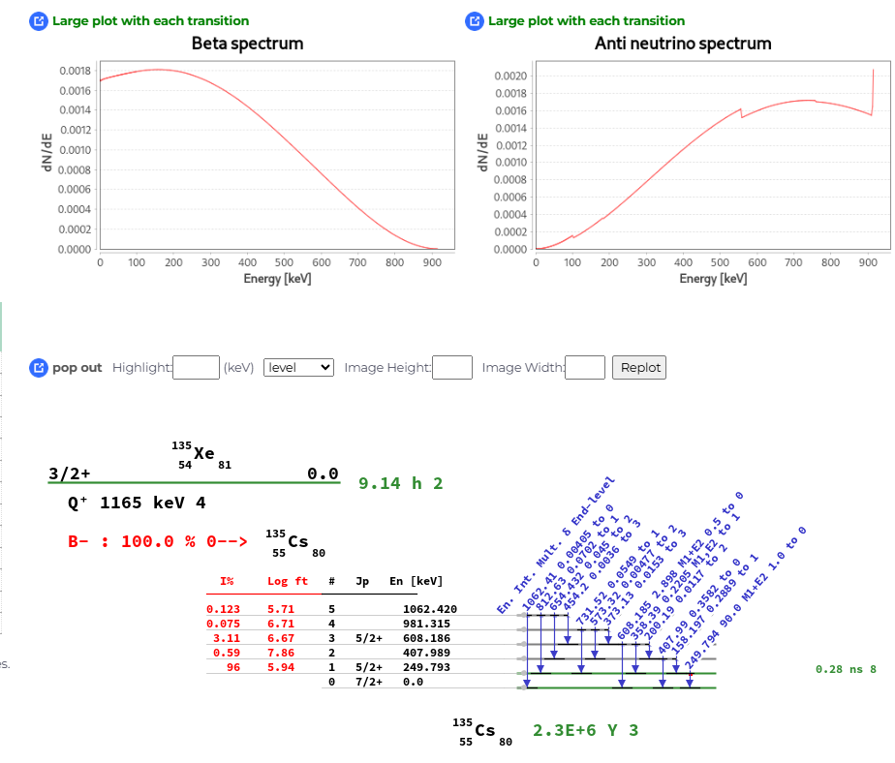
EXFOR & Live Chart (ENSDF)

Slide 9

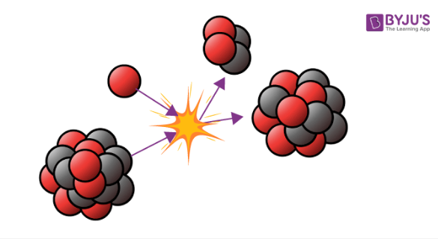




Databases and Web Applications
Application | Content
Live Chart of Nuclides/Isotope Browser Mobile App | Recommended nuclear structure and decay data (ENSDF), graphical interface, Pyhton API, mobile app
Atomic Mass Data (AME & Nubase) | Basic nuclear properties (masses, spins, parities, half-lives, isomers, decay modes)
Nuclear Electromagnetic Moments | Compiled and evaluated experimental nuclear magnetic and electric quadrupole moments
EXFOR | Experimental nuclear reaction database
Neutron Standards | Neutron cross-section standards
Photonuclear Data Library | Recommended photonuclear reaction data
ENDF | Interface to evaluated nuclear reaction data: ENDF/B, JEFF, JENDL, CENDL, ROSFOND
Neutron Activation Analysis | Neutron activation and Prompt-Gamma Activation Analysis (PGAA) database and Evaluated Gamma Activation File (EGAF) for non-destructive analytical methods
Ion Beam Nuclear Data Library (IBANL) | Experimental charged-induced cross sections for ion beam analytical methods
Electronic Stopping Power of Ions in Matter | Compilation of stopping power experiments
International Reactor Dosimetry and Fusion File (IRDFF) | Reaction cross sections, fission yields and decay data for dosimetry applications
Beta-Delayed Neutron Emission Database | Experimental beta-decay half-lives, beta-delayed neutron emission probabilities, and emission spectra
Compilation of Nuclear Data Experiments for Radiation Characterisation (CoNDERC) | Decay Heat, incident particle spectra used world-wide, origen Input for shielding calculation, thermal resonane data
Medical Radioisotopes Production Portal | Therapeutic Radionuclides, Gamma Emitters, Positron Emitters
Medical Isotope Browser | Medical radioisotopes production simulator
International Database of Reference Gamma Spectra (IDB) | In collaboration with IAEA-SG
IAEA Handbook of Nuclear Data for Safeguards | A set of recommended nuclear data for safeguard (decay data, thermal neutron capture cross section, resonance integrals, fission product yield ..etc)

Slide 10


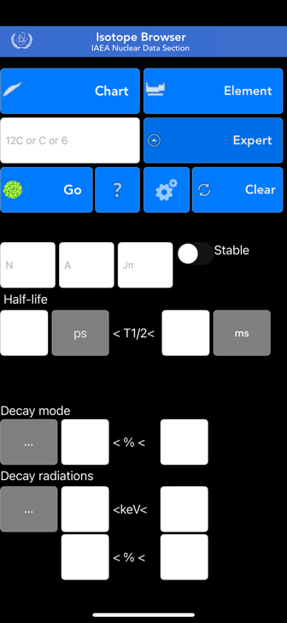
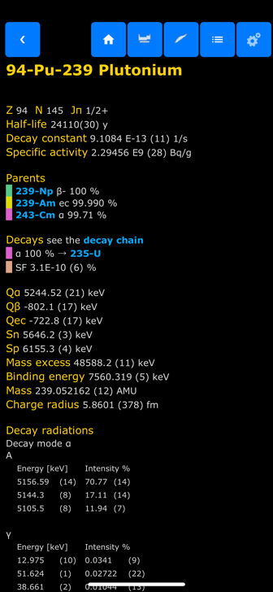
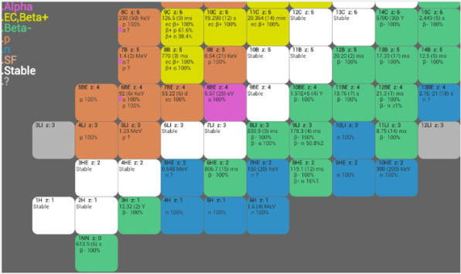
Isotope Browser – for Mobile Devices
App for Mobile Devices
  Properties of over 4,000 isotopes
  No internet connection needed
  ~180,000 downloads, 4.8 ⭐️
  11 languages (Arabic, Chinese, English, French, Spanish, Russian, Japanese, Slovenian, Italian, Trad. Chinese, German)
  Regularly updated with new features and data
Available for both
- Android
- Apple

Slide 11
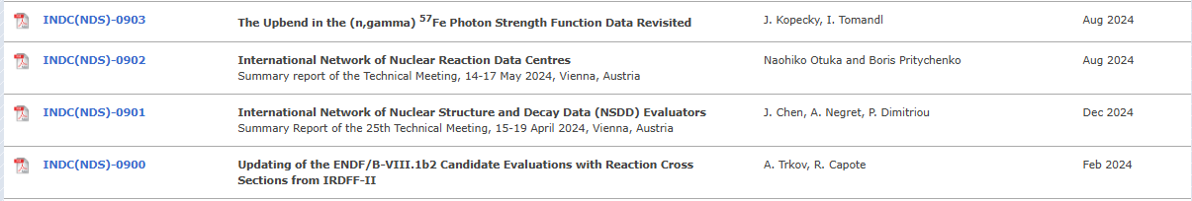
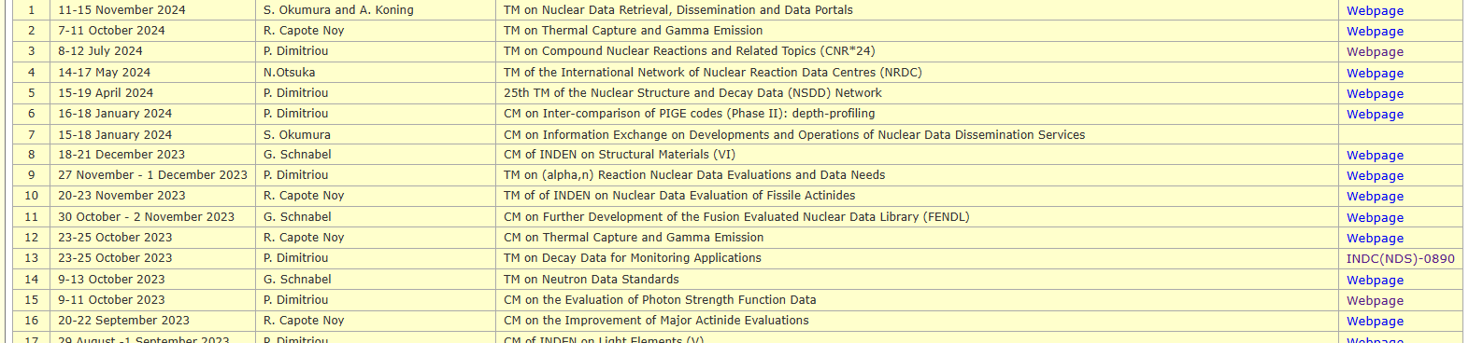
Meetings - Reports

Slide 12
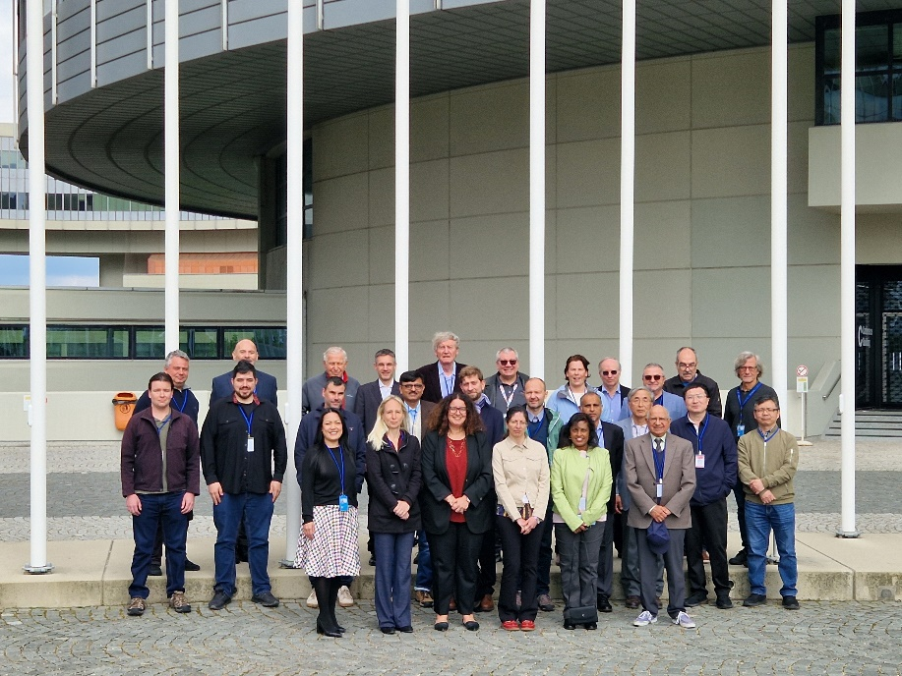
Nuclear Structure and Decay Data (NSDD)
50th Anniversary
15 – 19 April 2024, IAEA, Vienna
24 in-person participants from 13 countries; 19 remote plus 3 IAEA staff
Meeting report: INDC(NDS)-0901
Meeting website: https://conferences.iaea.org/event/387/
Retrospective
How it all began, 1970’s – 2016, Jagdish Tuli
From the viewpoint of the NDS Section Head, Alan Nichols
The last two decades, Vivian Dimitriou
In turbulent times, Pavel Oblozinsky

Slide 13


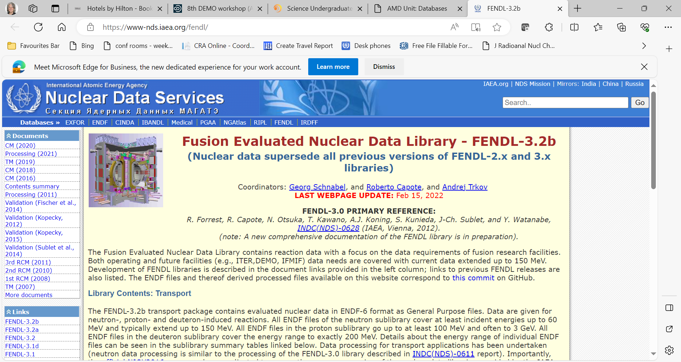




NDS Fusion Databases and Networks
Atomic and Molecular Databases and Networks
FENDL Fusion Evaluated Nuclear Data Library
AMBDAS
ALADDIN
CollisionDB
CascadesDB
DefectDB
Data Centres Network
Code Centres Network
Global Network for the Atomic and Molecular Physics of Plasmas
https://nds.iaea.org/fendl/
https://amdis.iaea.org/
c/o: A. Koning
Notes:
Atomic and Molecular Data Unit maintains several databases of fundamental data relevant to fusion energy research, including AMBDAS (a bibliographic database) and the new CollisionDB database of plasma collisional processes with over 120,000 entries. CascadesDB and DefectDB hold simulations of neutron-induced primary radiation damage in a variety of materials including iron and tungsten.
There are 3 networks important for assuring the extent and quality of shown here on this slide.
The nuclear data section in its development unit also provides access to and curates data for nuclear Fusion reaction data for neutron, proton, and deuteron reactions typically up to energies of 150 MeV in its Fusion evaluated nuclear data library, FENDL.
Not shown here but there is also another IRDFF-II library of data important to neutron dosimetry for fusion facilities.

Slide 14
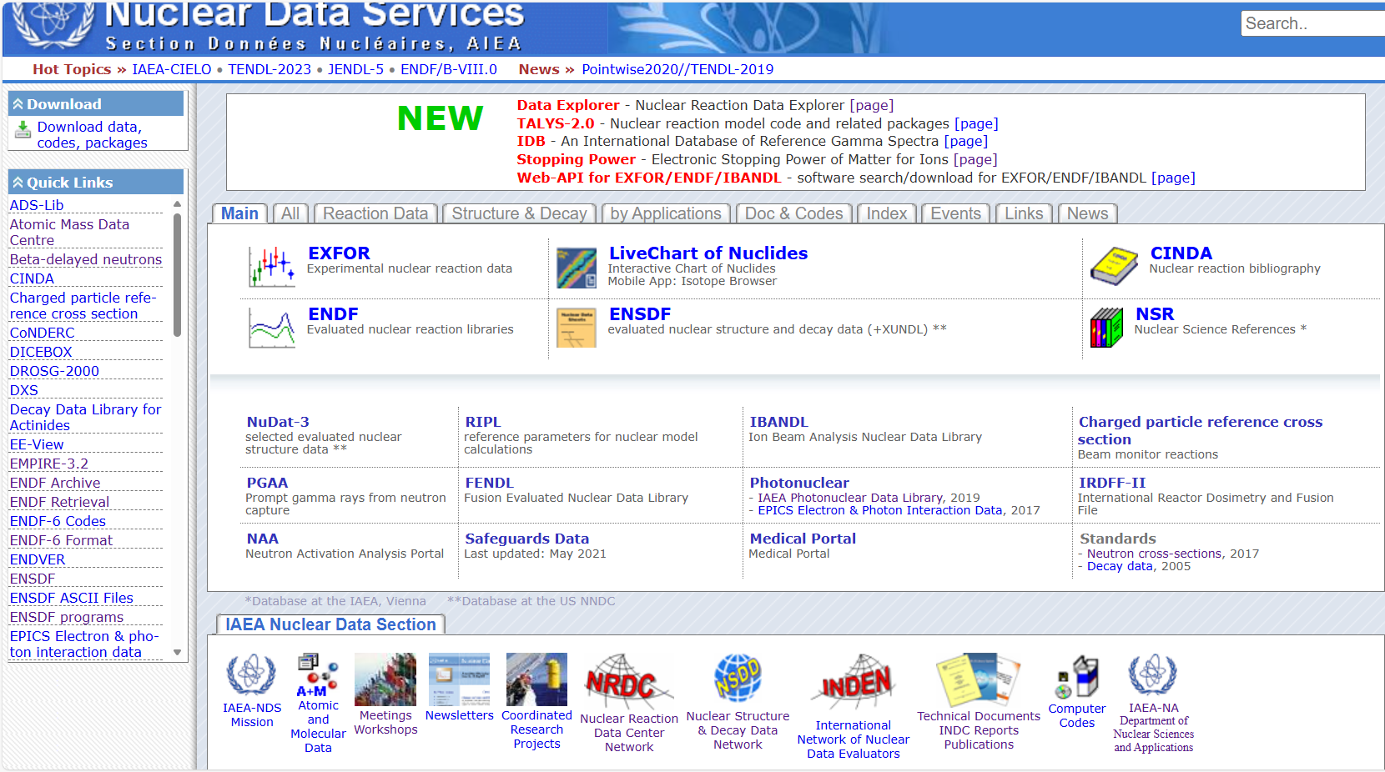
nds.iaea.org

Slide 15
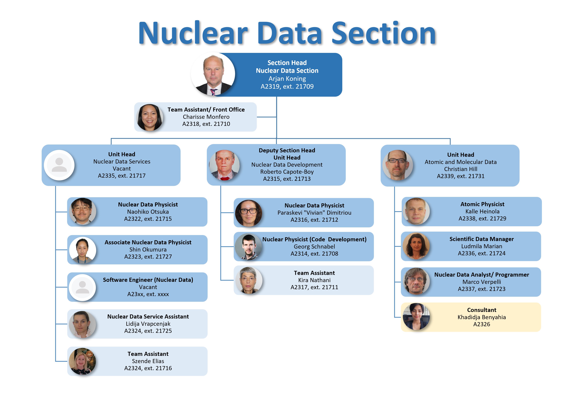
Alejandra Martinez

Slide 16
Thank you!

