Slide 1
From Total Neutron Cross Sections to Nuclear Charge Radii
Tables and systematics
I. Angeli
IEAEA, Vienna
27 – 30, January, 2025

Slide 2
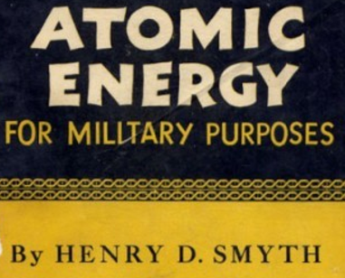
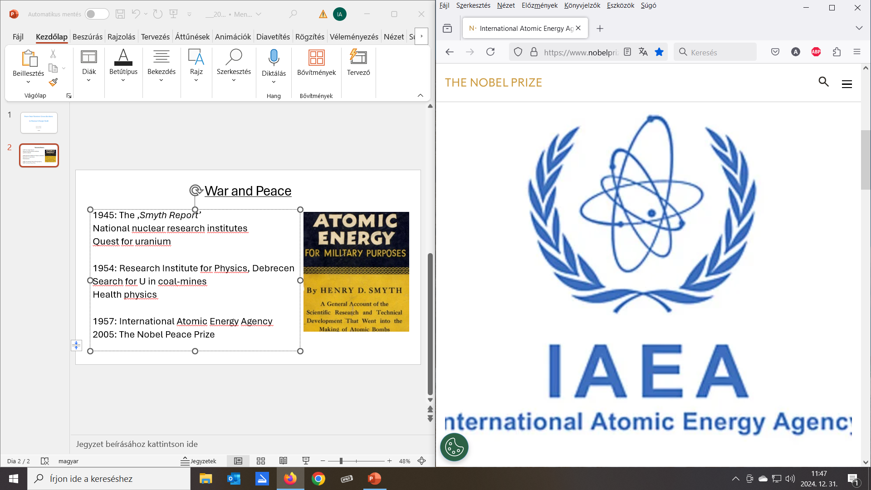
War and Peace
1945: The ‚Smyth Report’
National nuclear research institutes
Quest for uranium
1954: Research Institute for Physics, Debrecen
Basic research
Search for U in coal-mines
Health physics
1957: International Atomic Energy Agency
Peaceful purposes of nuclear energy

Slide 3
Total neutron cross sections
1965: J. Csikai: Neutron physics group, E_{n} ∼ 14 MeV cross sections.
Reactions by activation method. σ_{T} by transmission method.
1967: → Institute of Experimental Physics, University of Debrecen
IAEA(NDS): Research Contract, neutron generator.
Thank you Joe Schmidt! Thank you Joe Dolnićar!
1968: σ_{T}(¹²C) < σ_{T}(⁹Be) ! (Nucl. Phys., A119, 525) Z, N = 6, … magic?
1969: Correlation of matter radii with binding energy (Phys.Lett. B29, 36)
Black nucleus formula: σ_{BN} = 2π(R_{m}+λ)² → R_{m}

Slide 4
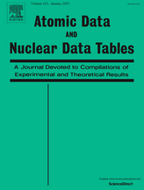
1971: Visit to Ioffe Institute: 1 week: total neutron cross sections;
3 weeks: K_{α} Isotope Shifts → δ <r²>_{ch} + other e⁻ methods!
1974: Atomic Data and Nuclear Data Tables, 14, special issue 5 – 6:
p.: 479: DeJager, et al.: Electron scattering …
p.: 509: Engfer, et al.: Muonic atoms …
p.: 605: Boehm, et al.: K_{α} Isotope Shifts …
p.: 613: Heilig, et al.: Optical Isotope Shifts …
What is the physics behind these data?

Slide 5
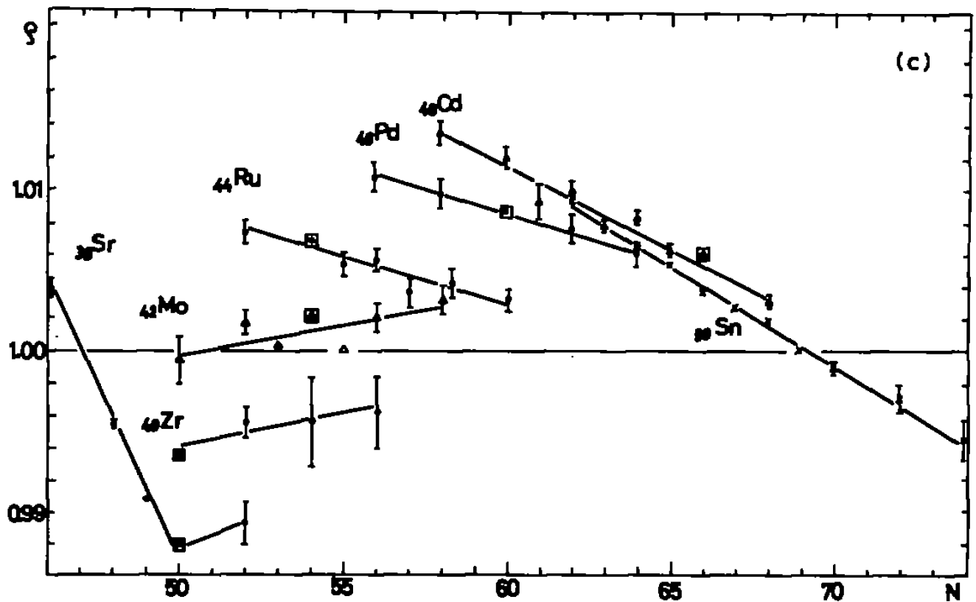
ρ = R /[(r₀ + r₁/A^{2/3} + r₂/A^{4/3}).A^{1/3}] liquid drop + surface thickness (Elton)
N = 50:
Shell effect!

Slide 6
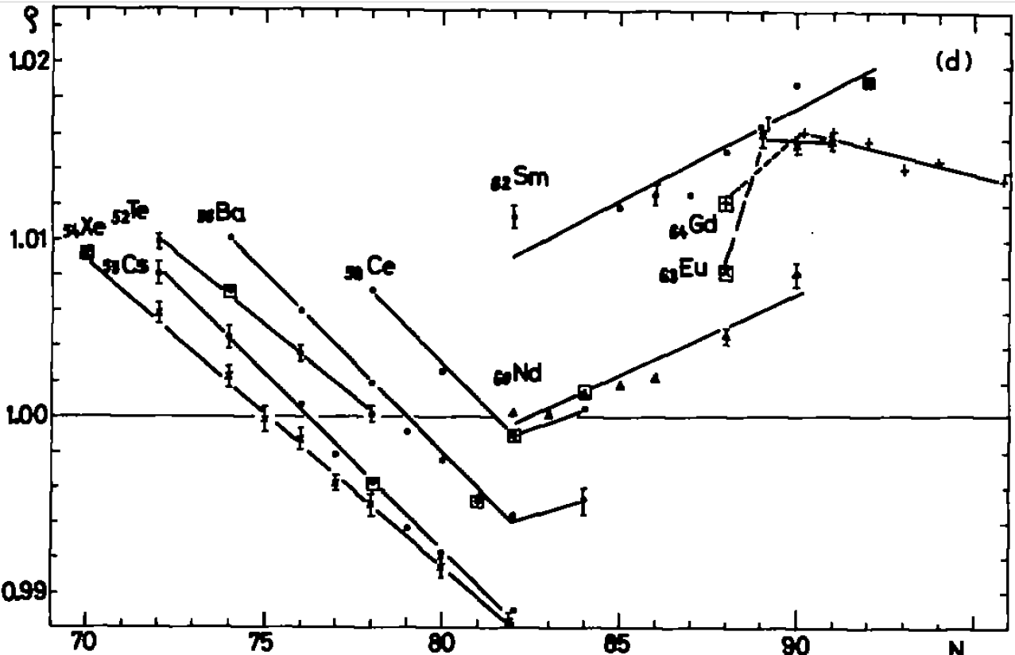
N = 82:
Shell effect!
N ∼ 90:
Deformation
effect!
a_{Z}: slope of the lines for the element. A_{Z}: Average mass number

Slide 7
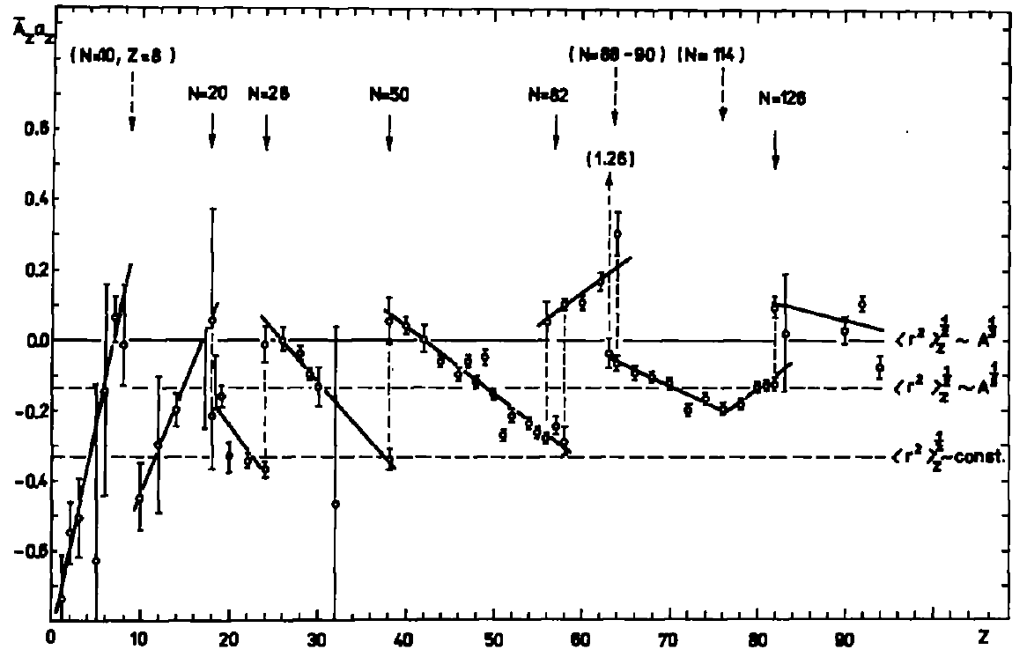
a_{Z}: slope of the lines for the element. A_{Z}: Average mass number

Slide 8
1977: (Nucl. Phys. A288, 480) :
Isotopic series: shell effects, deformation effects,
odd-even effects ∼ 6×10⁻⁴.
Data?
1978: (ATOMKI Közlemények = Reports, 20, 1)
Isotonic, isobaric and iso-symmetric series: effects
+ Appendix: rms charge data table!

Slide 9
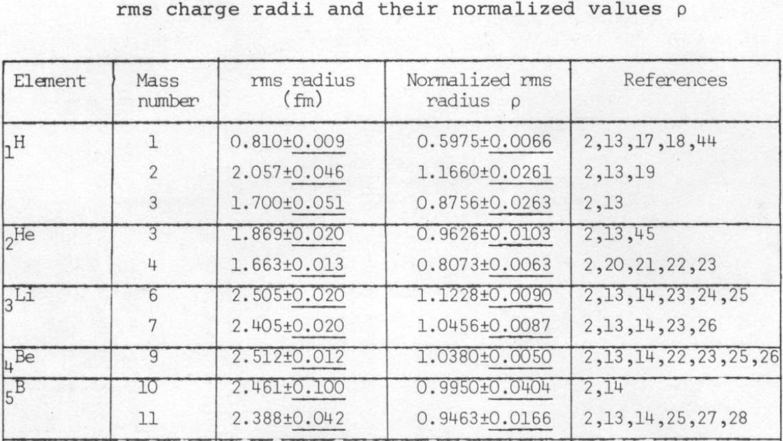
Table I. (1978)

Slide 10
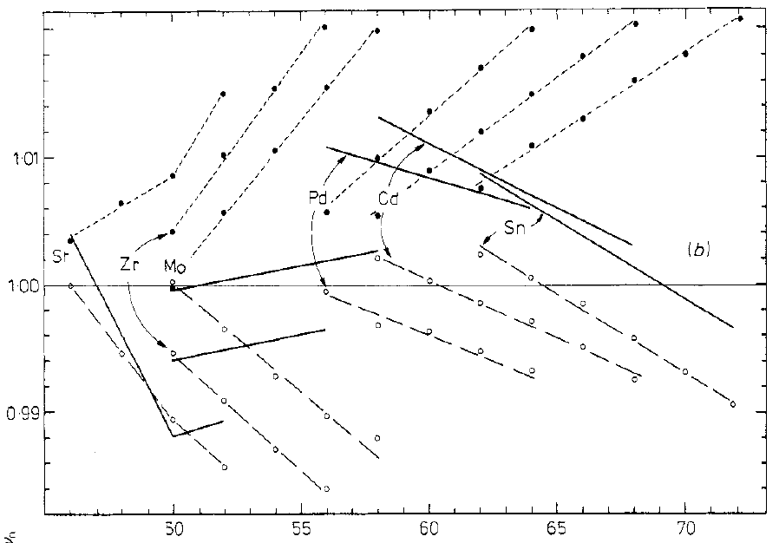
Comparison to theory: normalized rms radii (ρ)
(1980: Journ. Phys. G6, 303)
Lombard, et al., Orsay
Full lines: ∼ experiment.
Open circles: charge calc.
Full circles: neutron calc.

Slide 11
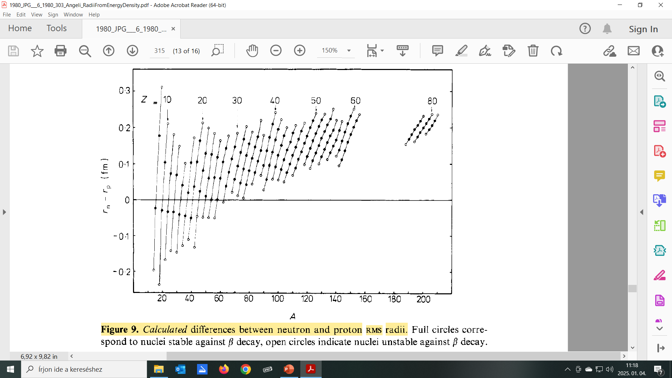
Neutron skins calculated
.

Slide 12
1987: At. Data Nucl. Data T. 36, 495: DeVries: Electron scattering
At. Data Nucl. Data T. 37, 455: Aufmuth: Optical Isotope Shifts
Data sources!

Slide 13
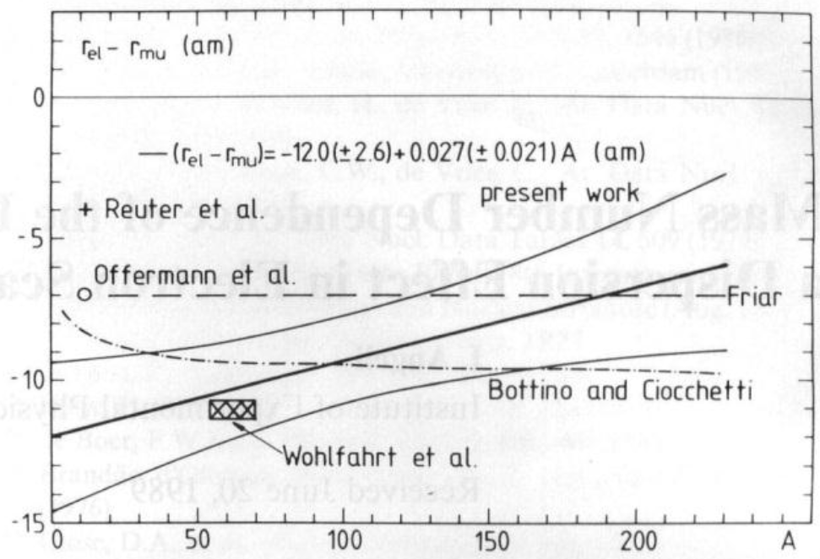
1989: Do r_{el} and r_{mu} measure the same quantity?
Difference (r_{el} – r_{mu}):
85 nuclei, mean: -9.3(1.5) am.
R(A) ≈ -12 + 0.03×A fm.
Negative, decreasing with A
(Zeitschrift für Physik, A334, 377)

Slide 14
1991: Evaluation procedure for nuclear rms charge radii
(Acta Phys. Hung. 69, 233)
Search for discrepant data: „outliers”.
Different data screening and averaging procedures tested.
How to form a weighted mean and its uncertainty for a data group?
Conclusion: - „Final results are less sensitive to the
actual procedure of evaluation than to
the selection of input data.”
(Cohen, Taylor).

Slide 15
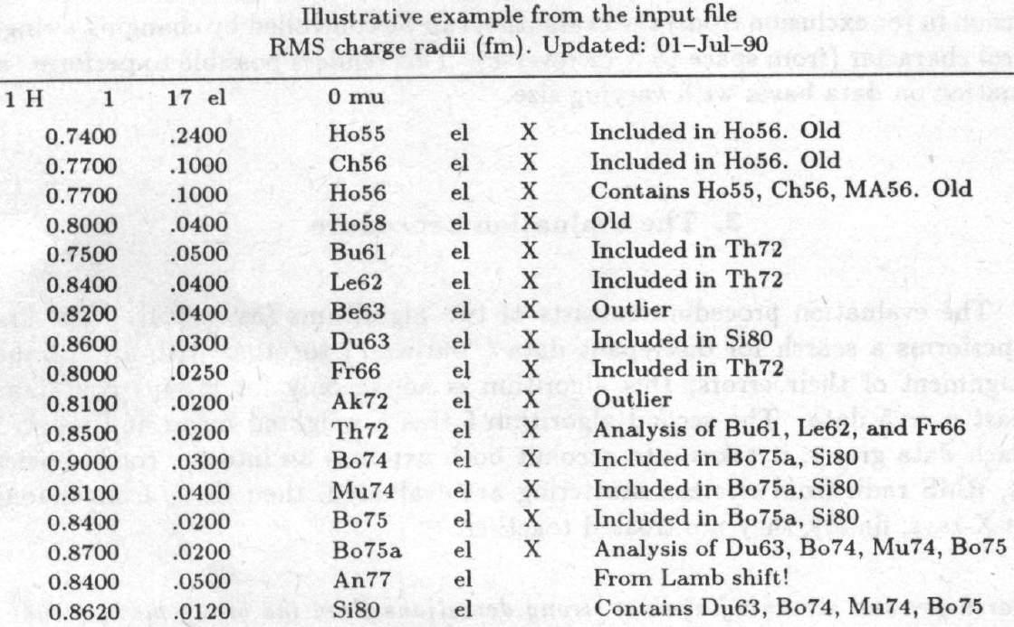

Slide 16
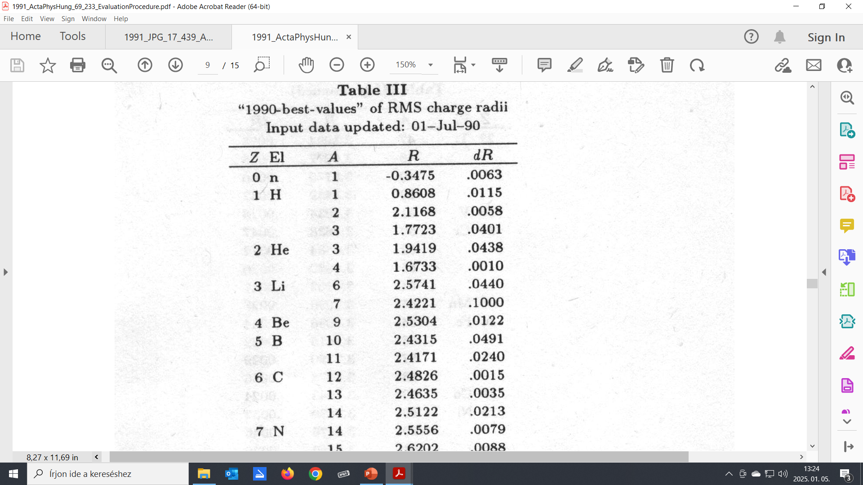
Table II. 1991
(Acta Phys. Hung. 69, 233)

Slide 17
1994: At. Data Nucl. Data Tables, 56, 133: Nadjakov: Systematics …
1995: At. Data Nucl. Data Tables, 60, 177: Fricke: Tables …
1995: Retirement
IAEA(NDS) Research Contract
Thank you Hans Lemmel!

Slide 18
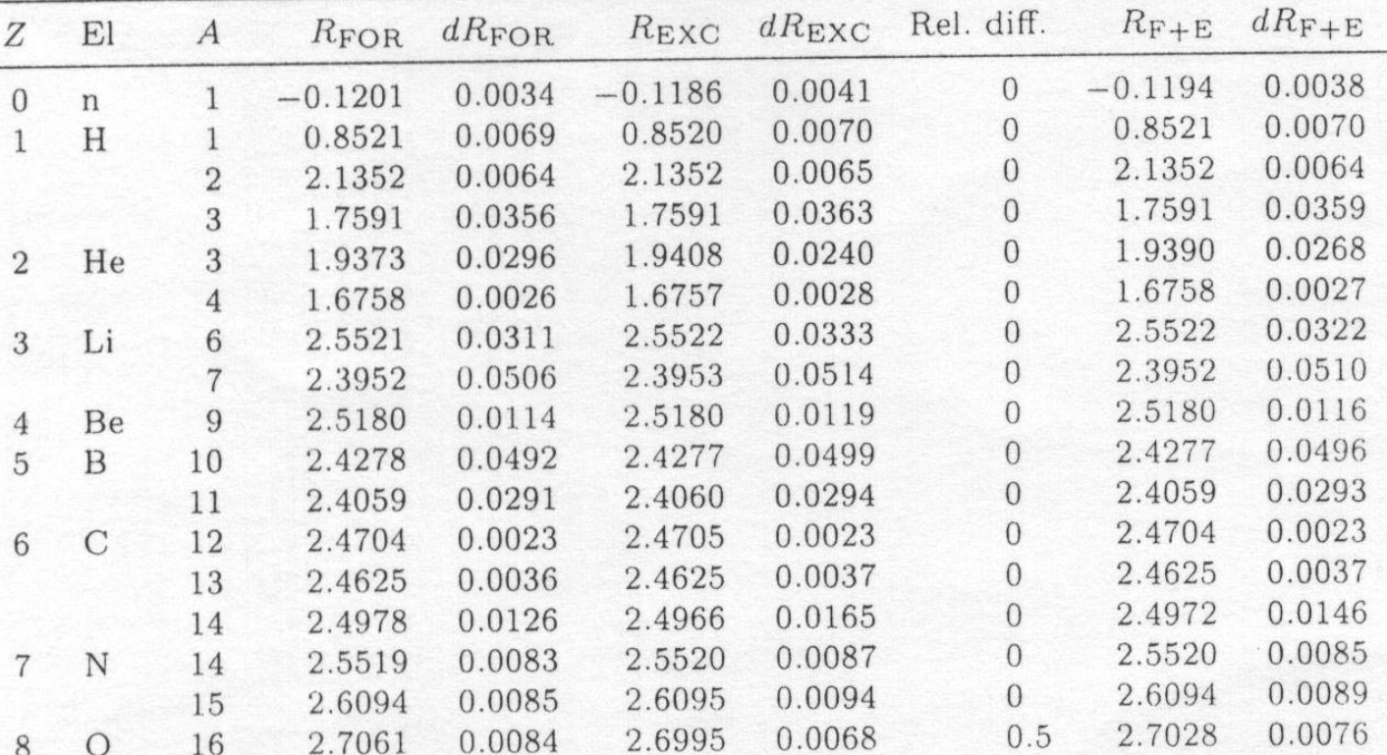
1998: Table III. (Acta Phys. Hung. New Series, 8, 23)
Comparison. Refined method (FORTRAN). Simple method (EXCEL)
|R_{FOR} – R_{EXC}|
⎯⎯⎯⎯⎯
dR_{F+E}
91% within
± ½ combined
error

Slide 19
1999: Table IV. (IAEANDS_indc-hun-0033)
Similar to III. but:
Data search updated to May 1999.
Contains full input data tables, and background materials.
Presented also in electronic files.
Chapter with easy-to-use formulae added.

Slide 20
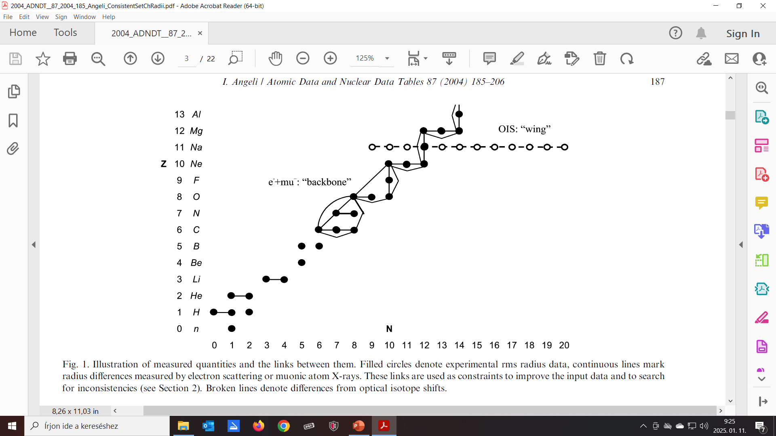
Table V. 2004: Consistent set of nuclear rms charge radii (Atomic Data and Nuclear Data Tables, 87, 185)
Measured differences used for constraint by least squares;
Redundancy improves accuracy:
Output errors are less than input!
The least precise value benefits
most of the constraint.

Slide 21
.

Slide 22
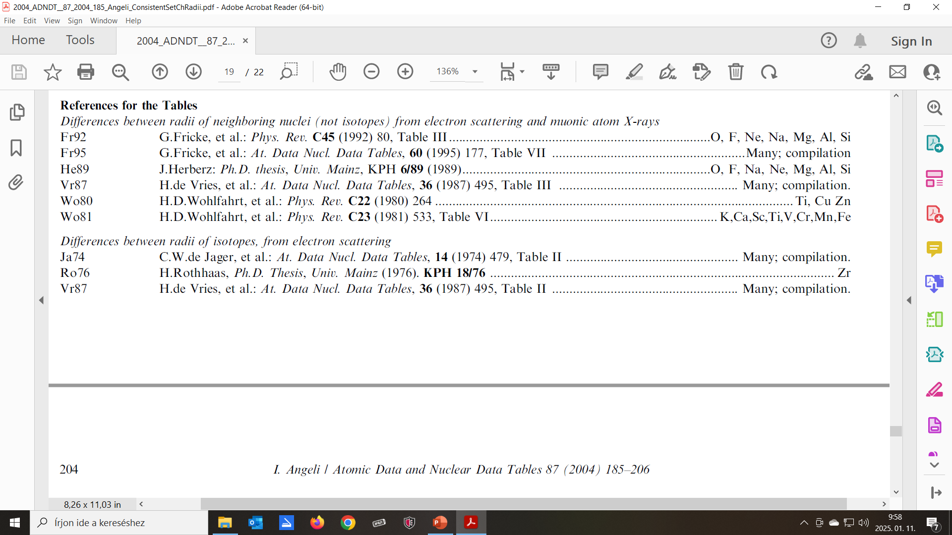
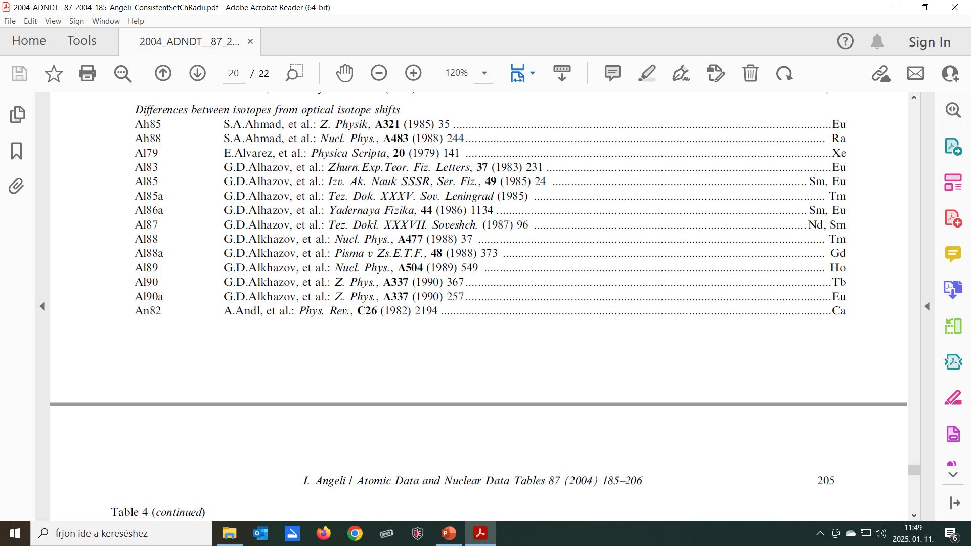

Slide 23
2005: Nobel Peace Prize!
International Atomic Energy Agency
and
Mohamed ElBaradei
Congratulations!

Slide 24
2007: Moments of the 2p-Fermi charge distribution
(Acta Phys. Deb., 41, 59)
Moments <r^{m}> and isotopic differences δ<r^{m}> for m = 1 to 10
Diffusity a assumed to be constant.
δ<r^{m}> for even m are given in terms of δ<r²>
Useful parameter: β = π.a/c introduced

Slide 25
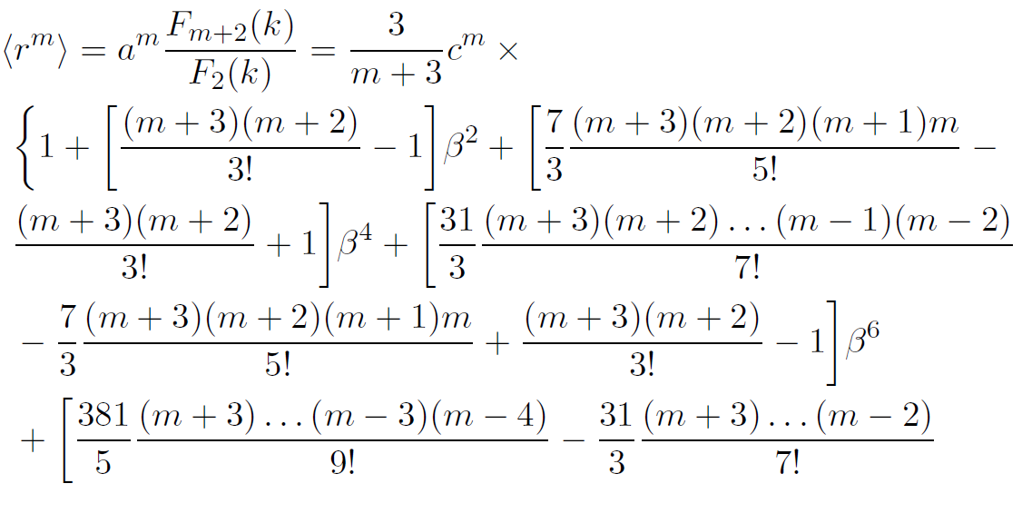
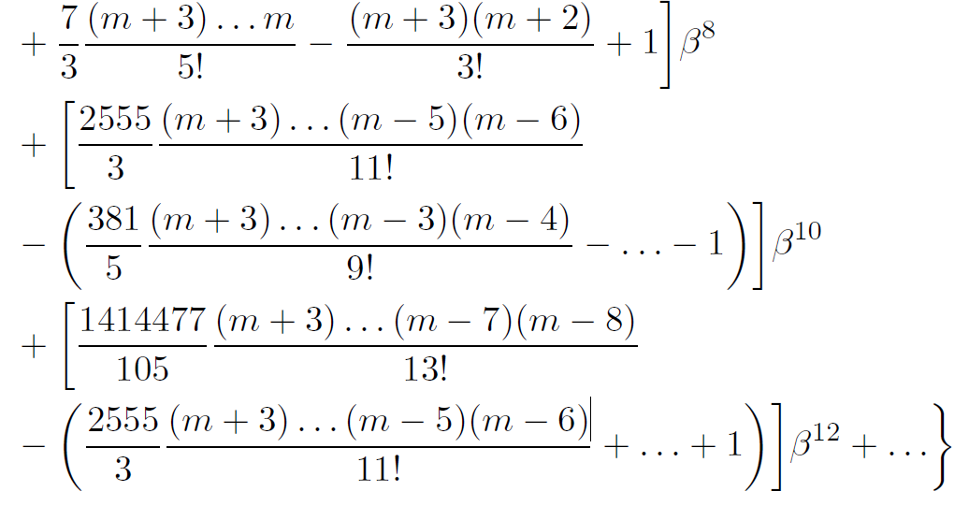
<r^{m}>

Slide 26
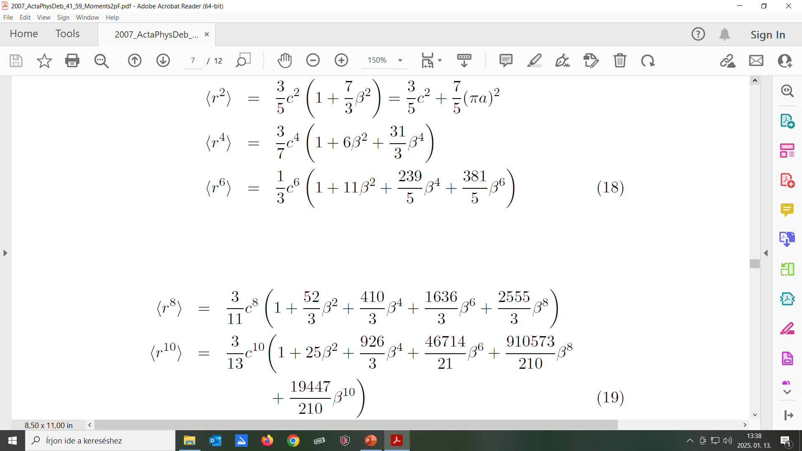
Even m

Slide 27
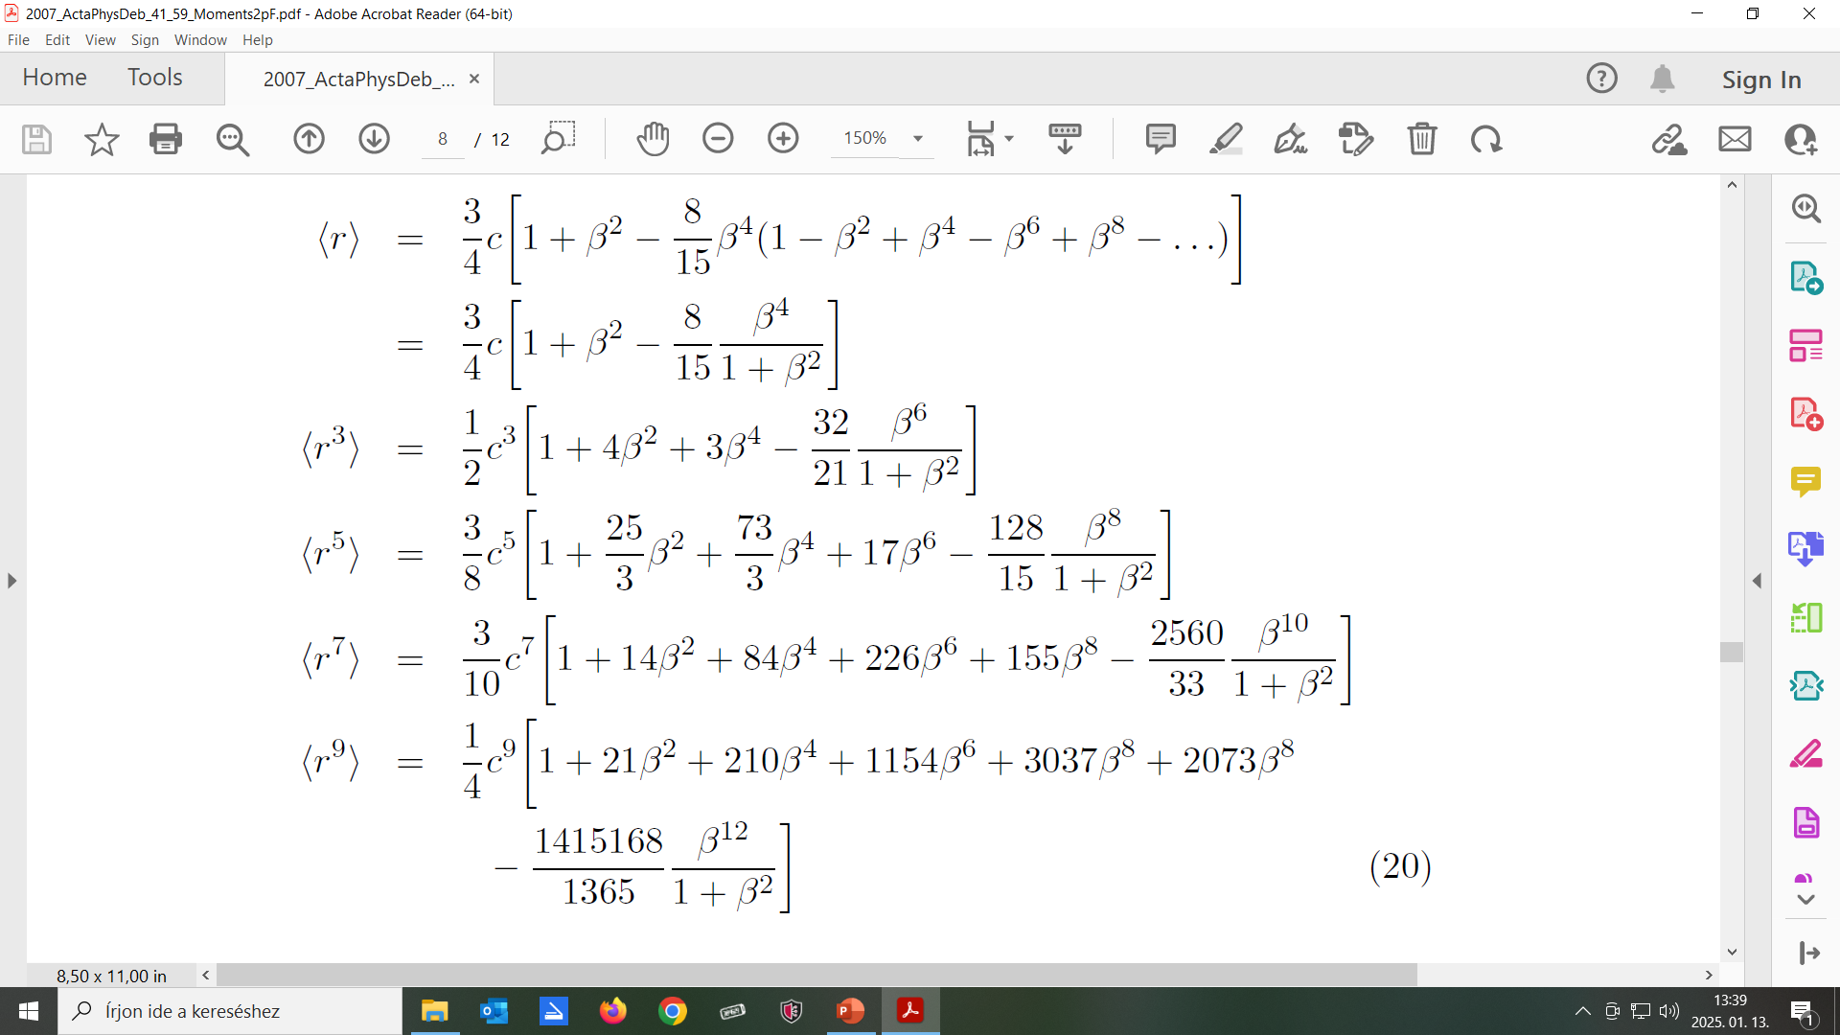
Odd m

Slide 28
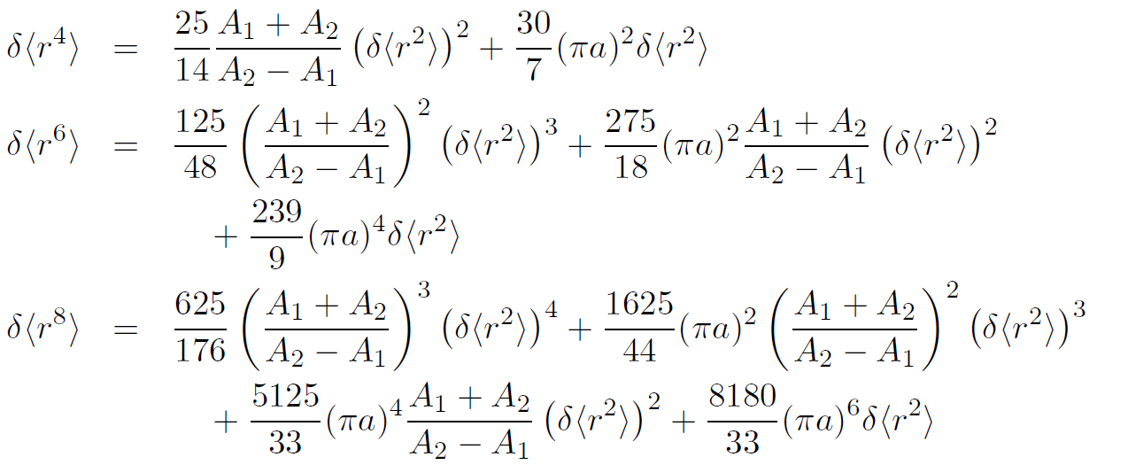
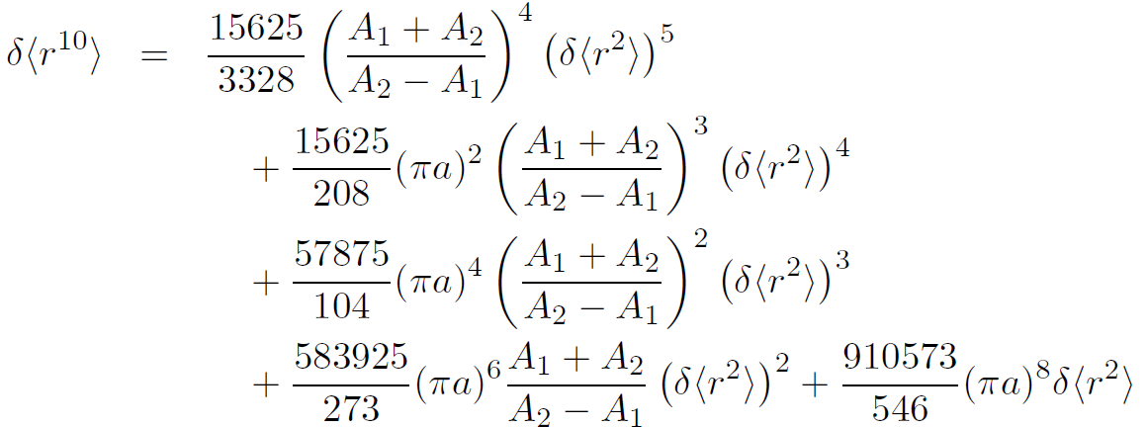
δ<r^{m}>
In
δ<r²>

Slide 29
2010: Calculation of Fermi parameters from charge moments
(Acta Phys. Deb. 44, 6)
Fricke: ADNDT, 60, (1995) 177. Table IX:
Experimental moments: <r²>^{1/2}, <r⁴>^{1/4}, <r⁶>^{1/6} for 20 nuclei.
Fermi parameters c and a calculated for 20 nuclei.
Uncertainty estimated.
Method and program described.

Slide 30
Table VI. 2013: Table of experimental nuclear ground state charge radii (Atomic Data and Nuclear Data Tables, 99, 69)
Atomic Data and Nuclear Data Tables, 56 (1994) 133: Nadjakov, et al. [12]
Updated by K. Marinova
Atomic Data and Nuclear Data Tables, 87 (2004) 185: Angeli. [13]
Updated by I. Angeli
Combined: R = R_{av} = 0.5×(R[12] + R[13]) Not independent!
ΔR_{tot} = max (ΔR[12], ΔR[13], 0.5×|R[12] – R[13]|)
4% differ more than 1×ΔR_{tot} underlined in Table1.

Slide 31
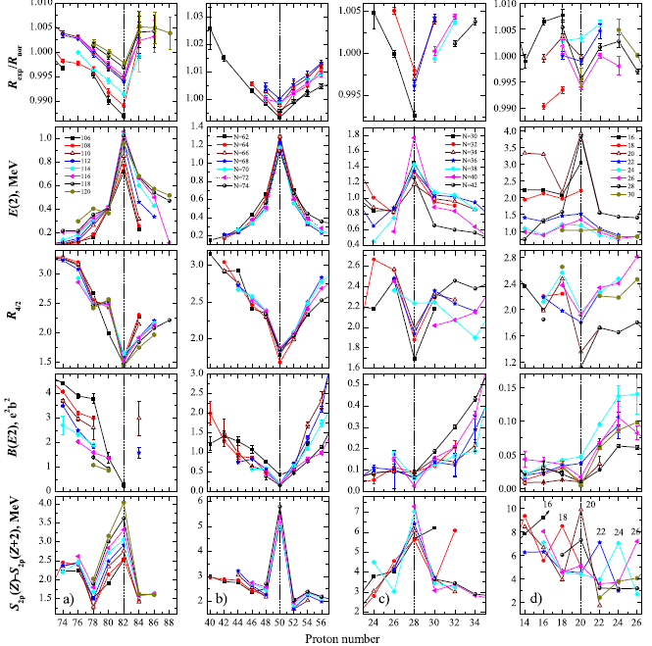
2015: Correlaton of charge radii with other nuclear observables
(J. Phys. G42, 055108)
Isotonic series:
R_{exp}/R_{nor}, R_{nor}∼ A^{1/2} (ADNDT 2004)
E₁(2+)
R_{4/2} = E₁(4⁺)/E₁(2⁺)
B(E2)↑
S_{2p}(Z) – S_{2p}(Z+2)

Slide 32

Thank you, Krassimira!

Slide 33
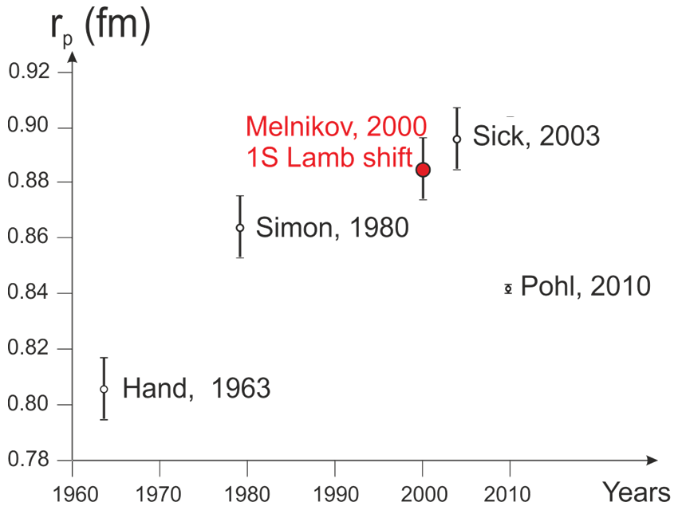
2021:The quest for the proton charge radius
[p.31. in: Gribov-90 Memorial Volume, World Scientific]
(arXiv: 2103.17101v1 [physics.hist-ph] 29 Mar 2021)
1963, Hand: Evaluation
1980, Simon: Electron scatt.
2000, Melnikov: 1S Lamb shift
2010: Pohl: Muonic H Lamb shift
„Proton radius puzzle!”

Slide 34
Present and future
1) Personal: not able to continue!
→ Endre TAKÁCS
2) Problems
3) Future: neutron radii?

Slide 35
Problems

Slide 36
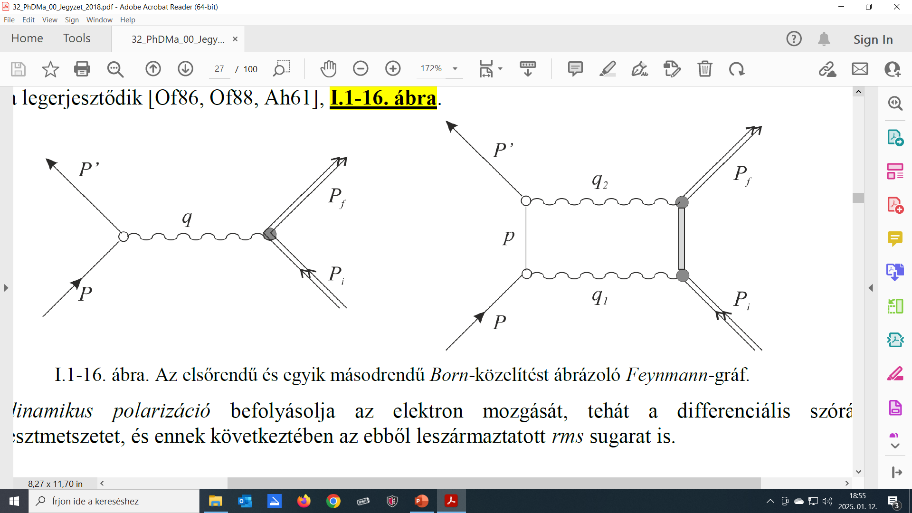
Dispersion correction?

Slide 37
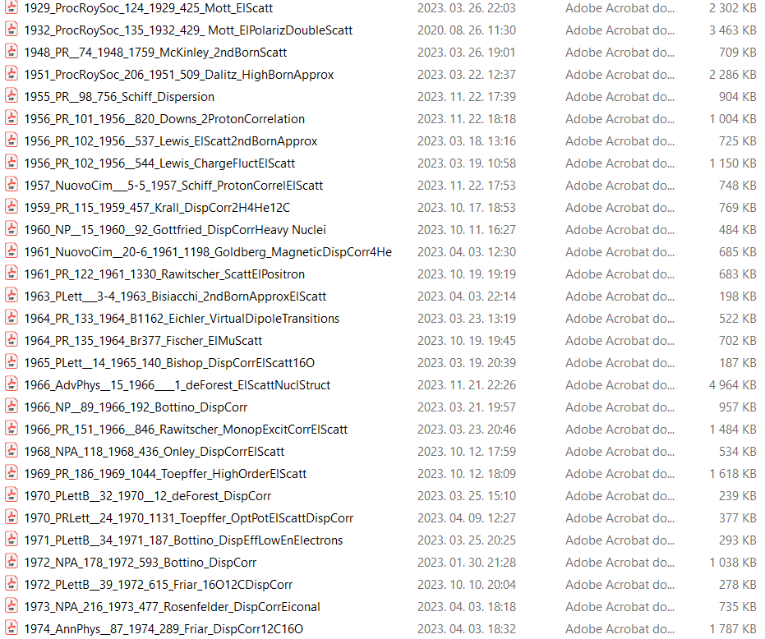
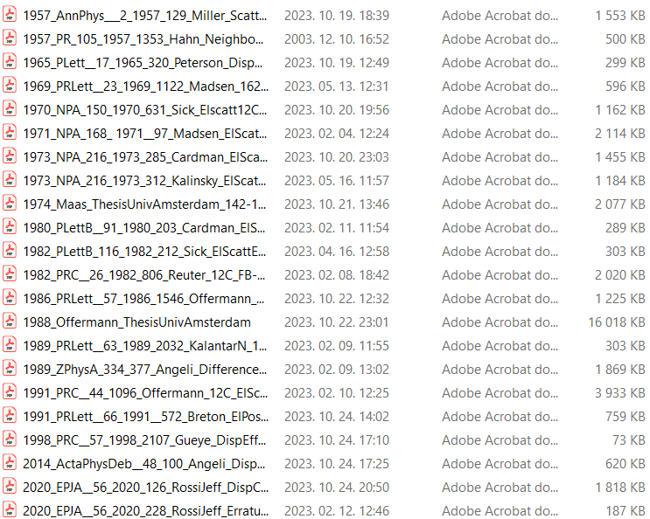
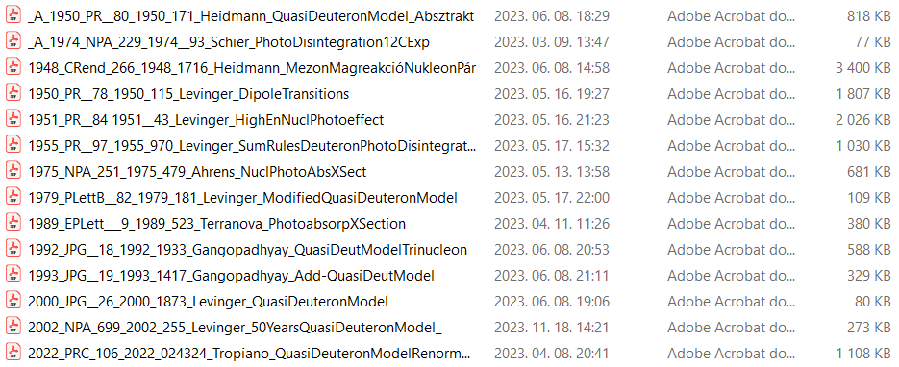
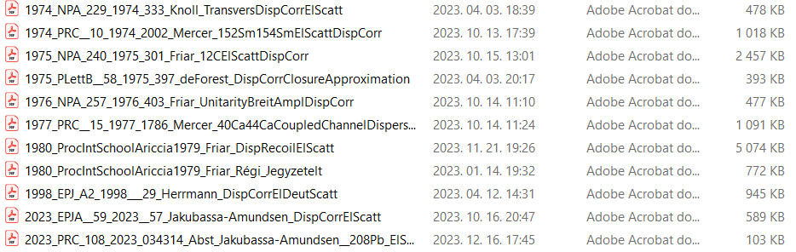

Slide 38
Theory ≈ 40 papers
1954, Lewis: Thesis, Univ. Michigan (unpublished)
1955, Schiff: PhysRev. 98 (1955) 756.
„Small but not negligible…”
1959, Krall: PhysRev. 115 (1959) 457.
„The change in R₀ deduced from experiment
when dispersive effects are included:
²H: -0.01 fm. ⁴He: -0.08 fm. ¹²C: -0.05 fm.”
1966, Bottino: NuclPhys. 89 (1966) 192.
„Dispersion effects of the order of 1/Z are found
at the diffraction minima of the form factors …”

Slide 39
1971, Bottino: PhysLett. 34B (1971) 187.
„The experimental determination of <r²> by means of a purely static model yields an overestimate.
The corrections in percentage:
²H: -1.5 %, ¹²C: -1.0 %.”
1972, Bottino: NuclPhys. A178 (1972) 593.
„The static interpretation leads to an underestimate of the radii.
Dispersive effects decrease roughly as 1/A.”
²H: 1.3 %, ⁴He: 0.7 %, ¹²C: 0.6 %, ⁴⁰Ca: 0.5 %.

Slide 40
1975, DeForest: PhysLett. 58B (1975) 397.
„Dispersion corrections are presently the greatest theoretical obstacle to precision analysis of elastic electron scattering data.”
„These effects depend on the complete
dynamical structure of the nucleus and
are not well understood at the present time.”

Slide 41
1980: Friar:Proc.Int.School, Ariccia, (1979) 143.
  „Two of the least understood and more
complicated subjects in the field of
electron scattering are the topics of
dispersion and recoil corrections.”
„Different formulations of the dispersion effect
make comparison of calculated results very difficult.”

Slide 42
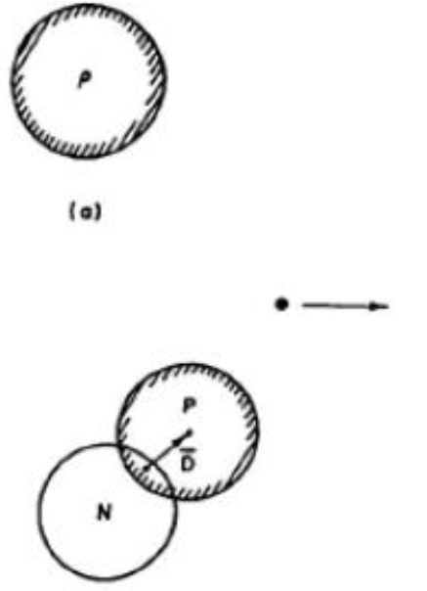
„A static nucleus presents the same shape
at each instance of time.”
„The behavior of an actual nucleus
is determined by the
induced dipole moment D, and the
characteristic frequencies of oscillations by D.”
[See papers on: „Quasi-deuteron model”]

Slide 43
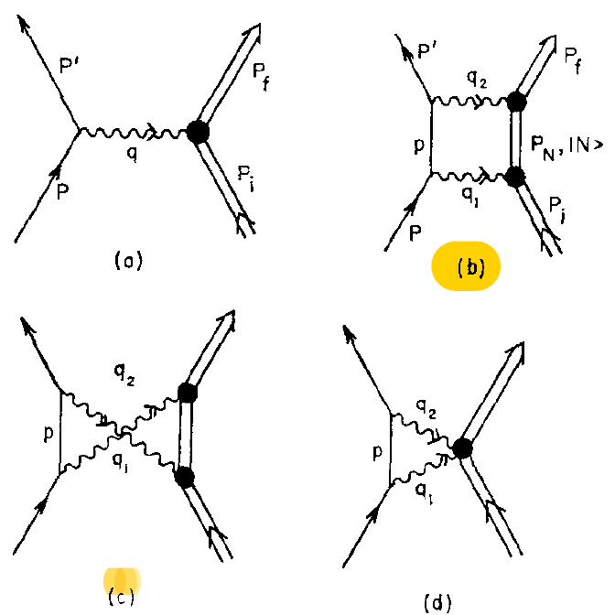
Dispersion effects are attractive and react on the electron
These 1b and 1c contributions are just the dispersion corrections to elastic scattering.

Slide 44
The fitted rms radius is then given in terms of
the „real” radius <r²>^{1/2} by the approximate relationship:
<r²>^{1/2}_{eff} ≈ <r²>^{1/2} + Δr
For ¹⁶O with approximations, an upper bound on the dispersion effect:
Δr = -7.10⁻³ fm.
For ¹²C where exact numerical calculations have been performed:
Δr = -(2-3).10⁻³ fm.”

Slide 45
Experiment ≈ 30 papers
1969, Madsen: PhysRev. 17 (1969) 1122.
ANOMALOUS ELECTRON SCATTERING FROM Nd¹⁴²
„Dispersion corrections should be applied to our data.”
1970, Sick: NuclPhys. A150 (1970) 631.
„The presence of dispersion effects appears to be necessary
to explain the cross sections of ¹²C and ¹⁶O
in the sharp first diffraction minimum.”

Slide 46
1982, Reuter: PhysRev. C26 (1982) 806.
Theoretical results differ, - even in the sign of the effect!
Applying a crude estimate for dispersion corrections,
increases the rms radius of ¹²C by 4 am.

Slide 47
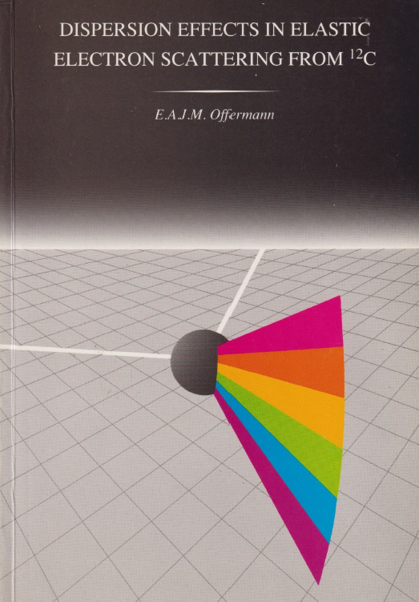
1988, Offermann: Thesis,
University of Amsterdam (1988).
„DISPERSION EFFECTS IN
ELASTIC ELECTRON SCATTERING
FROM ¹²C”
The dispersion corrections
increase the ¹²C rms radius with: +0.007 (+0.007/-0.011) fm.

Slide 48
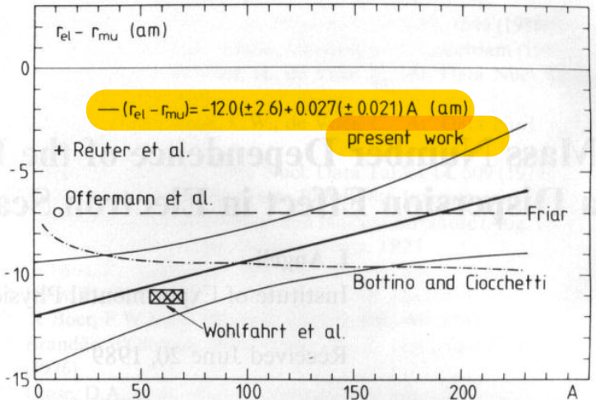
1989: Mass Number Dependence of the Difference (r_{el} – r_{mu}).
A Dispersion Effect in Electron scattering? (Zeitschrift für Physik, 334, 377)
„The weighted average of (r_{el} – r_{mu}) differences for 85 nuclides:
-9.3 (1.5) am.”
Average:
-9.3 (±1.5) am

Slide 49
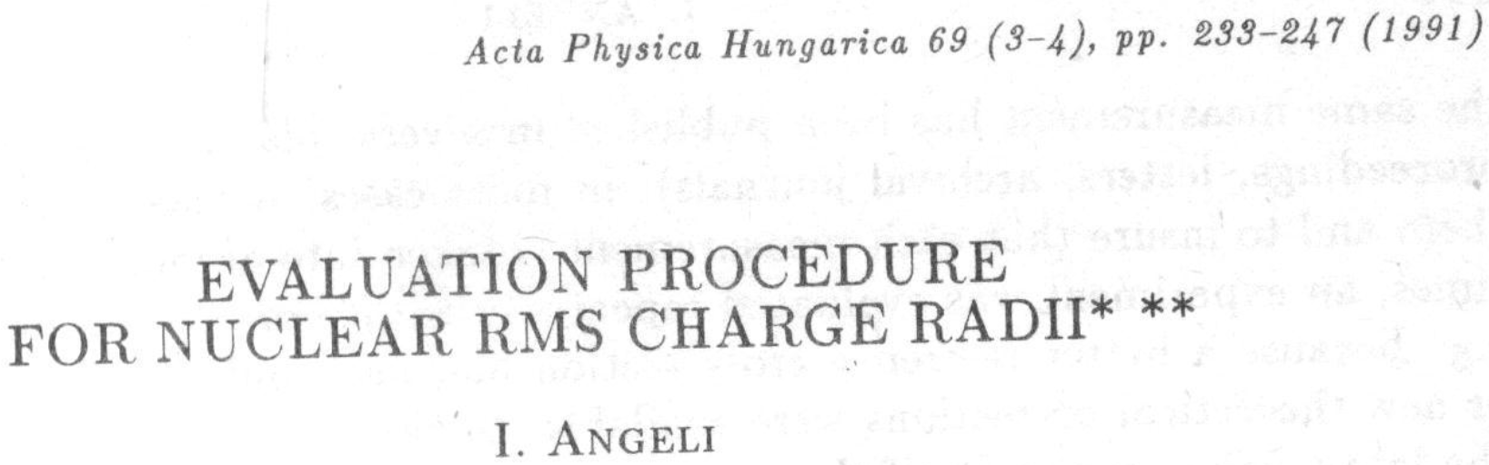
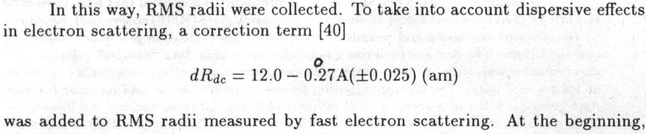

Slide 50
1998: Herrmann: EurPhysJ. A2 (1998) 29.
„For the deuteron charge radius our dispersion corrections lead to
a decrease of
²H: -0.003 fm.”
„In [Bottino 1972] the sign of the correction to the rms-radius
seems to be wrong.”
The true rms-radius is smaller than the one obtained
by analyzing the scattering data in a static framework.”

Slide 51
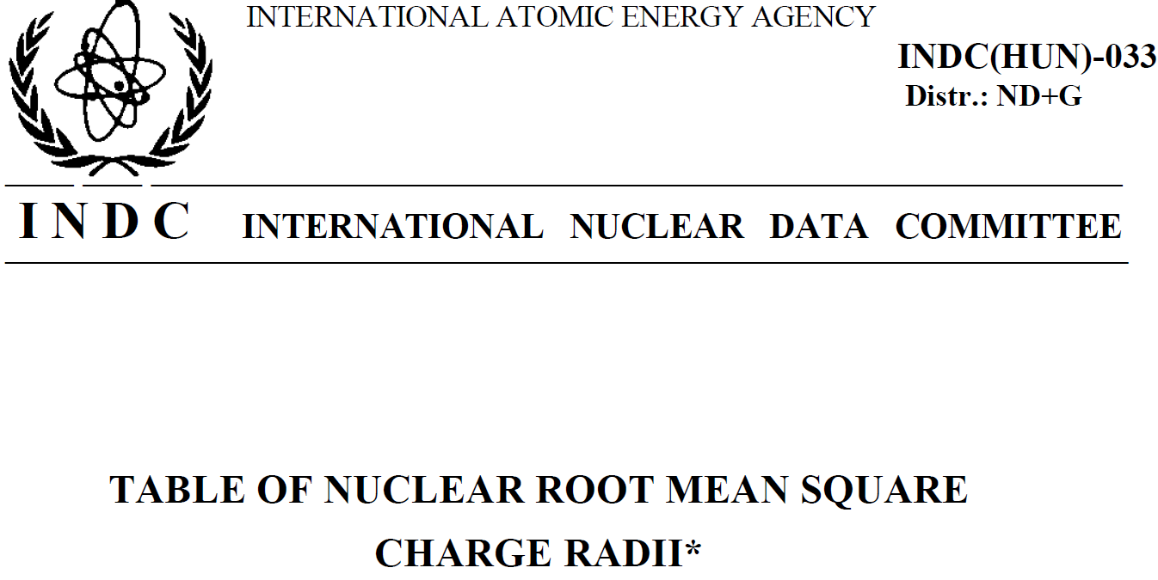
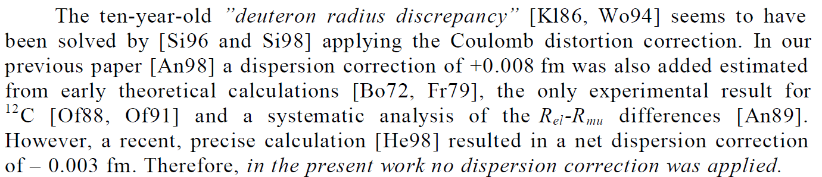

Slide 52
Normalizations to proton

Slide 53
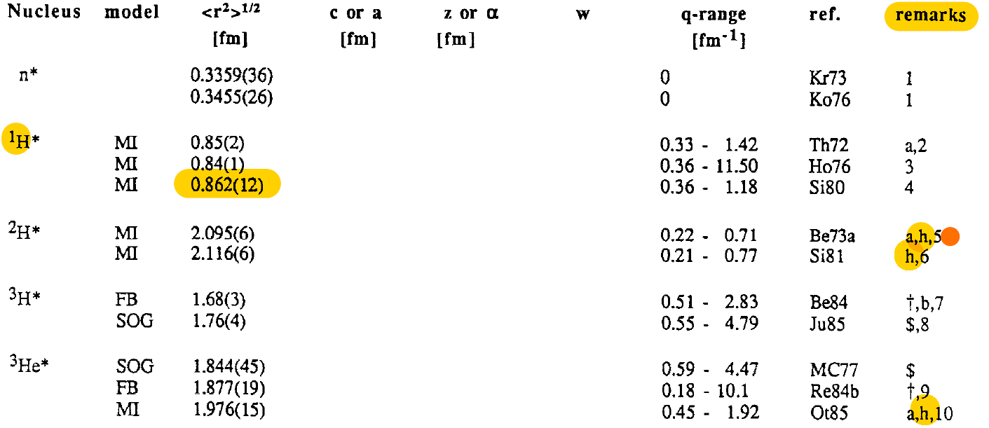
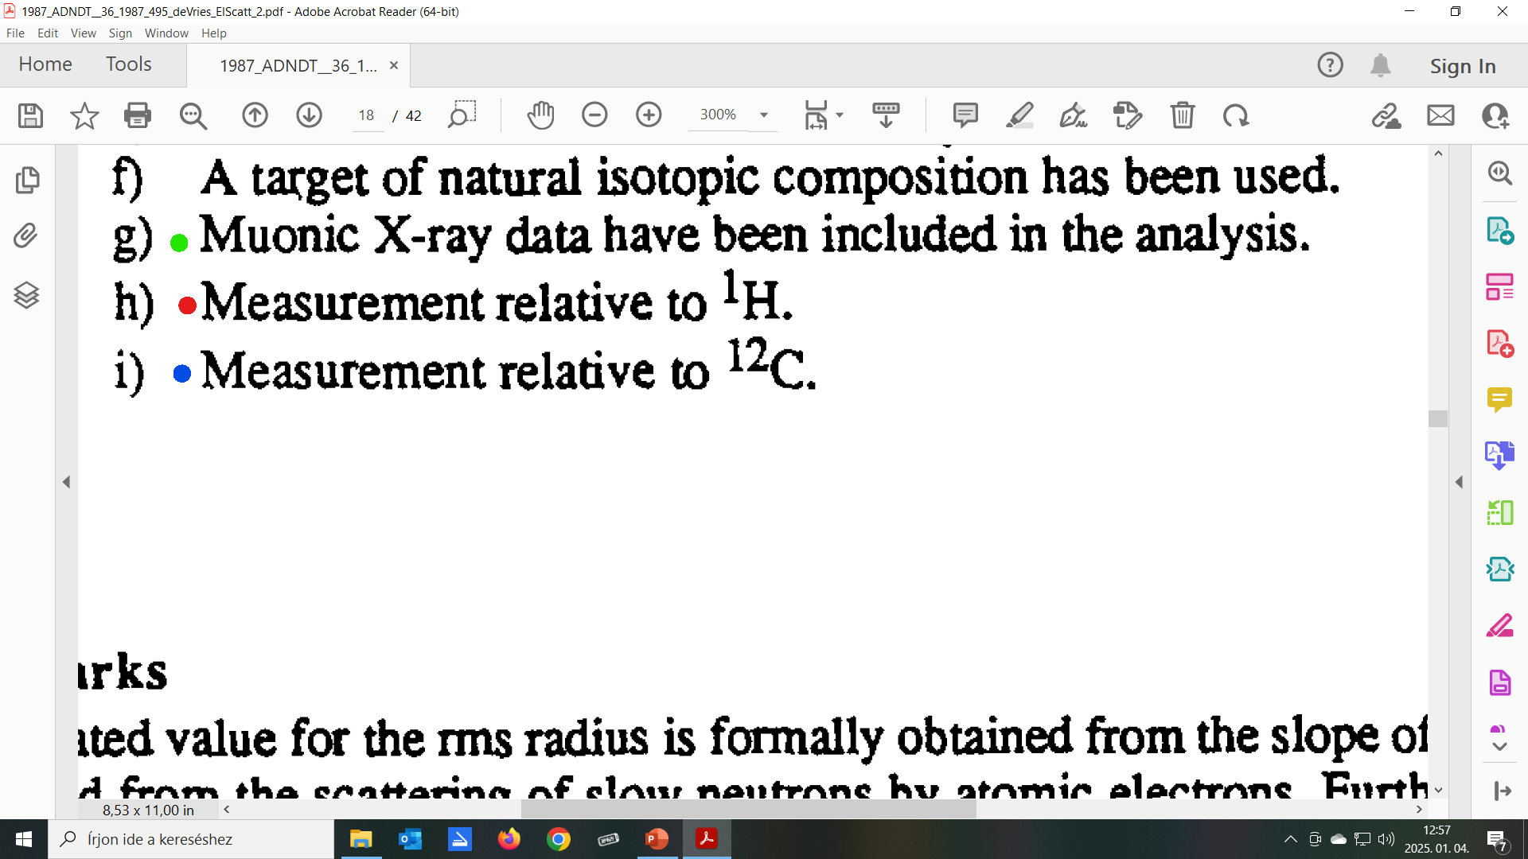
1987: At. Data Nucl. Data Tables, 36, 495. deVries: Electron scattering
h in 53 remarks!

Slide 54
1963, Hand: Cross section evaluation
<r²>^{1/2} = 0.805 (11) fm.
1980, Simon: Electron scattering
<r²>^{1/2} = 0.862 (12) fm.
2000, Melnikov: 1S Lamb shift
<r²>^{1/2} = 0.883 (14) fm.
2010: Pohl: Muonic H Lamb shift
<r²>^{1/2} = 0.84184 (67) fm.
„Proton radius puzzle!”

Slide 55
What to do?
Renormalize the original data? If they exist? Who?
Nature, 575, (2019) 174: Xiong, … Electron scattering!
r_{p} = 0.831 (7)_{stat} (12)_{syst} fm.
Estimate common systematic error? How?
Other ideas? ….

Slide 56
The proton radius in charge radii
To the attention of authors and referees!

Slide 57
$r_{c}^{2} r_{p}^{2}$+ <r²>_{p} … Friar, Negele: Adv. Nucl. Phys. 8, (1975) 219.
The second term depends on time!
1963: <r²>^{1/2} = 0.805 (11)
1980: <r²>^{1/2} = 0.862 (12) fm.
Nucl. Phys. A624 (1997) 349: $r_{c}^{2} r_{p}^{2}$+ 0.64 fm²
2000: <r²>^{1/2} = 0.883 (14) fm.
2010: <r²>^{1/2} = 0.84184 (67) fm.
Braz. Journ.Phys. 54 (2024) 105: $r_{c}^{2} r_{p}^{2}$+ 0.64 (without unit!)
Phys. Rev. C109 (2024) 054323: $r_{c}^{2} r_{p}^{2}$+ (0.8 fm)²

Slide 58
Future?

Slide 59

Weak and strong

Slide 60
Nucleus = protons + neutrons
Electric charge = 1 = 0
Weak charge ≈ 0 ≈ 1
Beta-decay, Fermi → „weak interaction”!
Electrons have electric and weak charges.
→ neutron-distribution determination!

Slide 61
Two simultaneous interactions.
How to separate them?
The weak interaction scatters
electrons of different polarization differently!
The electromagnetic interaction does not
make difference to polarization.
→ Scattering of polarized electrons!

Slide 62
Laser beam of circular polarization →
→ GaAs semiconductor crystal, photo-effect
→ electrons take over the (linear) polarization!
Scattering → „right” (R) electron beam,
scattering ← „left” (L) electron beam.

Slide 63
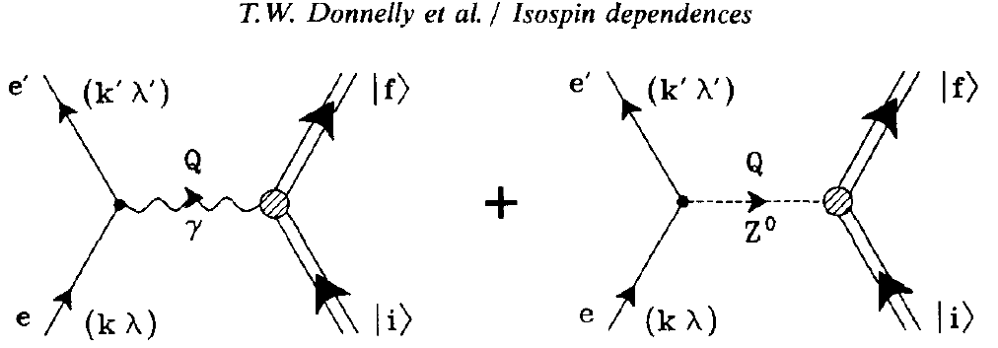
Simultaneous elektromagnetic and
weak interactions with sattering amplitudes
a_{E} a_{WR} a_{WL}

Slide 64
The cross sections are:
$σ_{R}={\left(a_{E}+a_{WR}\right)}^{2}=a_{E}^{2}+2$ $a_{E}a_{WR}+a_{WR}^{2}$
$σ_{L}={\left(a_{E}+a_{WL}\right)}^{2}=a_{E}^{2}+2$ $a_{E}a_{WL}+a_{WL}^{2}$
$σ_{R}$- $σ_{L}$≈ 2 $a_{E}×$($a_{WR}$- $a_{WL})$
Interference - through a_{E} - renders observation possible!

Slide 65
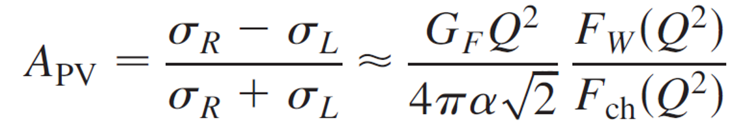
„Parity Violating Asymmetry”
contains the weak (≈ neutron) form factor F_{W}(q)
G_{F} Fermi-constant,
Q momentum transfer,
F_{ch}(q) known.
Cross section ratio eliminates systematic errors!

Slide 66
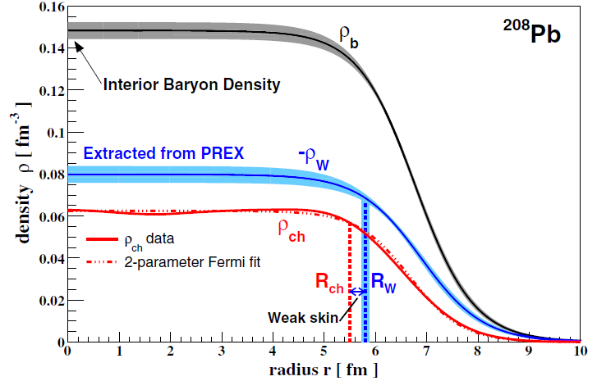
Phys.Rev.Lett. 126 (2021) 172502: Adhikari, et al. …
Jefferson Laboratory.
„Weak ← --------------------------
density”
≈
neutron-
density
A_{PV} → R_{n}– R_{p} „neutron skin” ≈ 0.28 (± 0.07) fm.

Slide 67
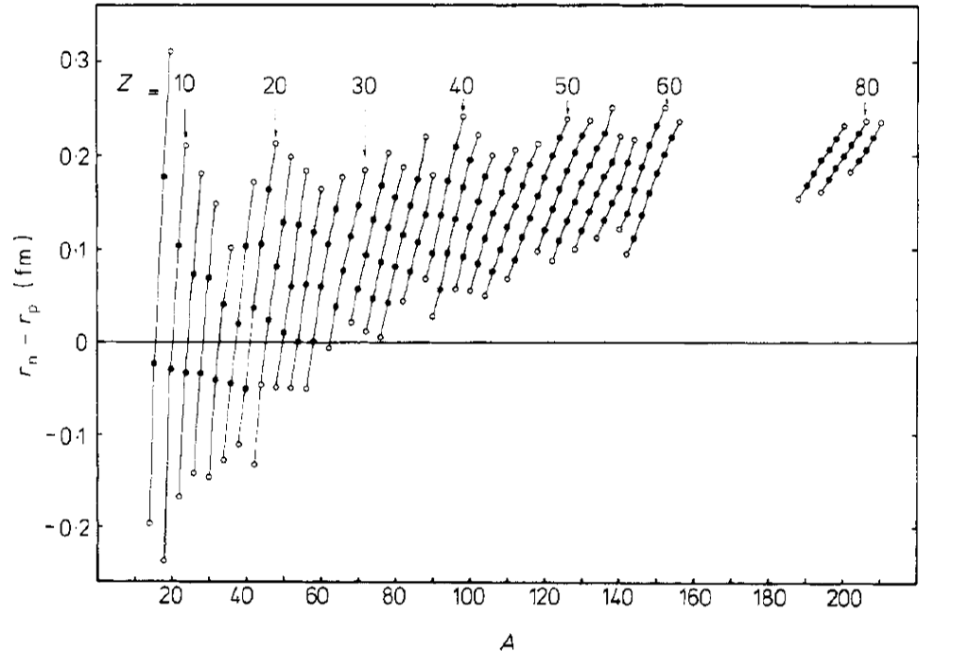
J.Phys. G6 (1980) 303.

Slide 68
Sic itur ad astra!
For ²⁰⁸Pb, from asymmetry
→ R_{n} – R_{p} „neutron-skin” ≈ 0.28 fm.
→ S symmetry energy, → L ∼ $\frac{∂S}{∂ρ}$
---------------------------------------------------------------------------------------------------------------------------------------------------------------------------------------------------------------------
→ R_{NS} radius of neutron star!
„Giant nucleus” held together by gravitation.
10% protons

Slide 69
Reading
Experiments:
Phys. Rev. Letters, 108 (2016) 112502.: Abrahamyan, …
Phys. Rev. Letters, 126 (2021) 172502.: Adhikari, …
Review, short:
Nuclear Physics News, 34 (2024) 34.: Mammei, …
Reviews, detailed:
Frontiers in Physics, 11/1 (2016) 111301.: Souder, …
Annual Rev. Nucl. Part. Phys. 74 (2024) 321.: Mammei, …

Slide 70
Thank you for your attention!

